Slide 1
It’s Not Just About Sports; It’s about the Facts
Title IX Investigations
Training for School Title IX Investigators
Dr. LaMonica Hillman, Assistant Superintendent - Support Services
Dr. Cecil Clark – Chief Human Resources Officer
Dr. Aronica Gloster, Coordinator – Health Services/ System Title IX Coordinator
January 18, 2022 10AM – 12:00PM TEAMS

Slide 2
RCSS Vision and Mission Statements
Vision Statement
The Richmond County School system will provide an equitable education for all students to prepare them for life beyond the classroom.
Mission Statement
Building a globally competitive school system that educates the whole child through teaching, learning, collaboration, and innovation.

Slide 3
RCSS Strategy Map
Increase
post high school readiness
Improve content mastery
Improve early literacy and numeracy skills
Establish and monitor achievement and instructional expectations
Student Achievement and Success
Improve relationships between home and school
Initiate and develop collaborative partnerships
Improve communication
Parent, Family, and Community Engagement
Improve efficiency of recruitment strategies
Enhance professional learning for all employees
Improve employee retention
High Performing Workforce
Improve wellness for all
Improve positive relationships for all stakeholders
Ensure a positive learning and working environment
Culture and Climate
Regularly review and monitor policies and procedures for effectiveness
Increase service productivity and responsiveness
Improve the safety and orderliness of environments
Ensure fiscal responsibility and accountability
Operational and Organizational Effectiveness
Notes:
Based on the vision, mission, and beliefs, the RCSS stakeholders created the strategy map. This is our map for improvement from 2020-2025. Please review the strategy map from the bottom to the top as all parts lead to student achievement and success for our students. You may want to circle or place a star next to the performance objectives related to this presentation.

Slide 4
Learning Outcomes
Participants will be able to
Understand the general history of Title IX
Recognize and evaluate sexual harassment
Understand the grievance process and your role as investigator
Identify conflicts of interest
Utilize techniques for effective interviewing
Understand requirements of investigative report and how to summarize relevant evidence
Locate and use RCSS forms for documenting processes
Notes:
At the end of this session, it is our hope that you will be able to:
Understand the general history of Title IX
Recognize and evaluate sexual harassment
Understand the grievance process and your role as investigator
Identify conflicts of interest
Use a framework to assess relevancy
Identify and weigh evidence
Understand Requirements of investigative report and how to summarize relevant evidence
Locate and use Forms

Slide 5
Title IX Overview & Updates

Slide 6
Title IX of the Education Amendments Act, 1972
20 U.S.C. § 1681 & 34 C.F.R. Part 106 (1972)
Title IX protects people from discrimination based on sex in education programs or activities that receive Federal financial assistance. Title IX specifically states that:
“No person in the United States shall, on the basis of sex, be excluded from participation in, be denied the benefits of, or be subjected to discrimination under any educational program or activity receiving Federal financial assistance.”
Notes:
Title IX of the Education Amendments Act – were originally written in 1972 and released in 1975.
It protects people from discrimination based on sex in education programs that receive federal financial assistance. Specifically it states:
“No person in the United State shall, on the basis of sex, be excluded from participation in, be denied the benefits of, or be subjected to discrimination under any educational program or activity receiving Federal financial assistance.”
Congress passed Title IX in response to the marked educational inequalities women faced prior to the 1970s. Before Title IX, women were often excluded from or had only limited access to educational programs. Efforts were initially focused on equity in sports programs.
7 Elite colleges and universities set quotas for the admission of women or prohibited them from attending altogether; those that accepted applications from women often required higher test scores and grades for their admission.
Once admitted to schools, women had less access to scholarships; were excluded from “male” programs, such as medicine; and faced more restrictive rules, such as early curfews, than their male peers.
Discrimination extended beyond students; women faculty were more frequently denied tenure than their male counterparts, required to take pregnancy and maternity leaves, or prohibited from entering faculty clubs. In part as a result of these inequalities, only 8 percent of women age 19 and older were college graduates in 1970, compared with 14 percent of men.Recent changes have

Slide 7
Title IX of the Education Amendments Act, 1972
20 U.S.C. § 1681 & 34 C.F.R. Part 106 (1972)
1972: Title IX signed into law
1975: Regulations first issued by Department of Health, Education and Welfare to address sex discrimination in athletics. Did not address sexual harassment as a form of discrimination.
1997 – 2017:
Department of Education addressed the topic through series of guidance documents (“Dear Colleague Letters”)
Important Supreme Court Cases that impact handling of sexual harassment.
2018: The Department published proposed regulations to address the topic.
2020: The new regulations are the first time the Department has addressed sexual harassment as a form of sex discrimination via regulations.
Notes:
Title IX of the Education Amendments Act – were originally written in 1972 and released in 1975.
It protects people from discrimination based on sex in education programs that receive federal financial assistance. Specifically it states:
“No person in the United State shall, on the basis of sex, be excluded from participation in, be denied the benefits of, or be subjected to discrimination under any educational program or activity receiving Federal financial assistance.”
Congress passed Title IX in response to the marked educational inequalities women faced prior to the 1970s. Before Title IX, women were often excluded from or had only limited access to educational programs. Efforts were initially focused on equity in sports programs.
7 Elite colleges and universities set quotas for the admission of women or prohibited them from attending altogether; those that accepted applications from women often required higher test scores and grades for their admission.
Once admitted to schools, women had less access to scholarships; were excluded from “male” programs, such as medicine; and faced more restrictive rules, such as early curfews, than their male peers.
Discrimination extended beyond students; women faculty were more frequently denied tenure than their male counterparts, required to take pregnancy and maternity leaves, or prohibited from entering faculty clubs. In part as a result of these inequalities, only 8 percent of women age 19 and older were college graduates in 1970, compared with 14 percent of men.Recent changes have

Slide 8
Typical Title IX – Related Concerns
Discrimination
Program Equity
Recruitment, Admissions and Access
Pregnancy
Athletics
Employment, Recruitment & Hiring
Extra-curricular activities
Access to Course Offerings
Salaries and Benefits
Financial Assistance
Facilities
Funding
Sex, Gender, Gender Identity
Harassment
Stalking
Domestic Violence
Dating Violence
Sexual Assault
Sexual Violence
Sexual Exploitation
Sexual Intimidation
Sexual Misconduct
Bullying and Cyberbullying
Retaliation
Source: ATIXA
Notes:
This slide shows the breadth of Typical Title IX Concerns. They are divided into two areas – discrimination and harassment.
Discrimination & Harassment
The new regulations deal with harassment – as a form of discrimination.

Slide 9
RCSS Board Policy GAAA - Nondiscrimination Policy
Equal Opportunity Employment
It is the policy of the Richmond County Board of Education not to discriminate on the basis of sex, age, race, disability, religion or national origin in the educational programs and activities of or admissions to facilities operated by the Board or in the employment practices of the Richmond County Education Agency. The Board shall comply with all aspects of Title IX of the Education Amendments of 1972; Title VI and VII of the Civil Rights Act of 1964 and 1991; Section 504 of the Rehabilitation Act of 1973 as subsequently amended; Age Discrimination in Employment Act, 29 USCA 630 and the Equal Pay Act and the American with Disability Act (42 USC 12101).
To ensure compliance with the policy, the Superintendent of Schools shall:
Designate staff members to: a. Coordinate efforts of the system to comply with this policy
b. Develop and ensure the maintenance of a filing system to keep all records required under this policy.
c. Investigate any complaints of violations of this policy.
d. Develop and administer a grievance procedure for employees and students.
Provide for the publication of this policy to all students in educational facilities operated by the Richmond County Education Agency, parents of said students, employees of the Richmond County Education Agency, employment agencies and professional associations; such publication to include the name, office address and telephone number of the complaint administrators designated pursuant to this policy.
Notes:
RCSS has two policies that relate to non discrimination:
Policy GAAA – Equal Opportunity Employment
Don’t discriminate on basis of sex (including gender identity) age, race, disability religion or national origin
Applies to education programs and activities
Applies to admissions to facilities operated by the Board
Applies to employment practices
Related legislation – Title IX, Title VI and VII of the Civil Rights Acts of 1964 and 199t, section 504, Age Discrimination in Employement Act and Equal Pay Act and American with Disability Act.
Superintendent will
Coordinate efforts to comply
Keep records
Investigate complaints
Administer a grievance procedure for employees & students
Provide for publication of policy to all students, parents, employees, employment agencies and professional associations

Slide 10
RCSS Board Policy GAEB:
Sexual Harassment of Employees
It is the policy of this school system to prohibit any act of harassment of students or employees by other students or employees based upon race, color, sex, national origin, religion, age or disability at all times and during all occasions while at school, in the workplace or at any school event or activity. Harassment may include, but is not limited to, conduct or speech which entails unwelcome sexual advances, requests for sexual favors, taunts, threats, comments of a vulgar or demeaning nature, demands or physical contact which creates a hostile environment for a student or employee. There may be other speech or conduct which employees or students experience as inappropriate or illegal harassment which should also be reported; harassment can take many forms and it is not possible to itemize every aspect of the harassment forbidden by this policy.
Any student, employee, applicant for employment, parent or other individual who believes he or she has been subjected to harassment or discrimination by other students or employees of the school system as prohibited by this policy should promptly report the same to the principal of their school or to the appropriate coordinator designated in policy GAAA/JAA, who will implement the Board's discriminatory complaints procedures as specified in that policy. Students may also report harassment or discrimination to their school counselor or any administrator. Students and employees will not be subjected to retaliation for reporting such harassment or discrimination. If at any point in the investigation of reported sexual harassment of a student, the coordinator or designee determines that the reported harassment should more properly be termed abuse, the reported incident or situation shall be referred pursuant to the established protocol for child abuse investigation.
Notes:
The Other Policy is Policy GAEB – Sexual Harassment of Employees
Prohibits harassment of students or employees
By students or employees
Based on race, color, sex, national origin, religion, age, or disability (protected classes)
Harassment can include – conduct or speech entailing unwelcome sexual advances, requests for sexual favors, taunts, threats, vulgar comments, physical contact that creates hostile environment – and others acts
Report to principal or appropriate coordinator designated by policy
No retaliation for reporting
If it is abuse, it should be reported to proper authorities (DFACS)

Slide 11
Board Policy GAEB: Sexual Harassment of Employees
It is the duty of all employees to promptly report harassment forbidden by this policy. All supervisors will instruct their subordinates as to the content of this policy and, through appropriate staff development, enlighten employees as to the varied forms or expression of prohibited harassment. The principals of all schools shall ensure that students and parents are informed through student handbooks and verbally that such harassment is strictly forbidden, how it is to be reported and the consequences for violating this policy.
Alleged violations of this policy will be investigated, and when it is determined that a violation has occurred, prompt appropriate disciplinary action will be taken against persons found to have violated this policy. These actions include sanctions authorized by law, Board policy, and the Code of Student Conduct and Discipline.
When a student has found to have violated this policy and engaged in an act or acts of harassment, appropriate progressive disciplinary and rehabilitative actions will be taken in an effort to resolve the problem and eliminate the possibility of its recurrence. These actions may include, but are not limited to:
Notes:
ALL employees must promptly report
Supervisors must tell of this policy
Principals must put in handbooks and verbally that harassment is forbidden
Violations will be investigated
Appropriate discipline actions as well as rehabilitative actions taken and outlined

Slide 12
Board Policy GAEB: Sexual Harassment of Employees
Student counseling;
Family counseling;
Specialized training;
Referral to outside agencies;
Detention;
In-School and Out-of-School Suspension, including Long-Term Suspension;
Class or School Transfer;
Revocation of Out of Zone School Assignments or Exceptions;
Expulsion.
When an employee is found to have violated this policy and engaged in an act or acts of harassment, the Superintendent may recommend all or any combination of the following discipline, as appropriate, in order to address and remedy instances of harassment:
Conference;
Letter of Direction;
Reassignment;
Letter of Reprimand;
Suspension; or
Termination.
Notes:
This slide lists positive supportive measures and consequences

Slide 13
Board Policy GAEB: Sexual Harassment of Employees
Notwithstanding the above progressive and varied discipline options, the Local Board notes that certain words or terms which are of a particularly egregious and inflammatory nature will not be tolerated. Harassment of an egregious or inflammatory nature which is particularly insulting or demeaning to a particular race, gender, sexual orientation or identity, religion, age or disability (e.g., the “N” word) may result in the Superintendent’s recommendation of termination, and in no less than ten (10) days suspension and sensitivity training.
Furthermore, when an employee is found to have violated this policy and engaged in an act or acts of egregious and inflammatory harassment toward a student or students, the Superintendent shall recommend that the Board terminate the employment of such employee.
All substantiated allegations of harassment committed by certified personnel shall be reported, as required by law, to the Professional Practices Section of the Professional Standards Commission.
Due process rights shall be afforded to all affected employees, as appropriate. Nothing herein is to designed to create rights where not otherwise provided by law.
Notes:
Superintendent can recommend termination or 10 days suspension with sensitivity training when using particular insults
Substantiated violations – reported to Professional Standards Commission
Due process will be afforded to all effected employees.

Slide 14
Notes:
So why should we care about Sexual Harassment. This short video describes the impacts of sexual harassment and what it looks like in schools. Some of these examples may sound familiar. It is produced by an advocacy group but describes common instances of harassment.

Slide 15
Why Title IX is Important – Potential Impact of Sexual Misconduct
Shame,
Humiliation,
Stress,
Anxiety,
Depression,
Loss of sleep
Impaired learning/poor work performance
Absenteeism/turnover
Culture of discrimination
Culture of discrimination
Civil liability (monetary damages, attorney fees)
Negative media attention and public outcry
OCR Resolution Agreement
Loss of federal funds
Notes:
Just as we know that ACEs (adverse childhood experiences) have long-term effects, so too are the impacts of sexual misconduct on individuals, schools and communities. Some of those impacts are shown here.

Slide 16
Office for Civil Rights (OCR) and Title IX
Office for Civil Rights (OCR) The U.S. Department of Education’s Office for Civil Rights (OCR) enforces, among other statutes, Title IX.
New Department regulations became effective on August 14, 2020. These changes required us to amend the RCSS procedures for responding to complaints of sexual harassment and sexual violence.
Evidence of “deliberate indifference” is what can get schools and systems into serious trouble.
Notes:
The Office of Civil Rights – enforces Title IX. They work to ensure that schools are providing safe environments, conducive to learning and free of discrimination.
They work to ensure that school systems/distrcts properly respond to complaints of sexual harassment and sexual violence.
They look to make sure that school personnel don’t demonstrate “deliberate indifference.”

Slide 17
Office for Civil Rights (OCR) and Title IX
• OCR standard indicates that upon receipt of notice, school/district must take immediate and appropriate steps to investigate what occurred and take prompt and effective action to end the harassment, remedy the effects, and prevent the recurrence.
• OCR administratively enforces Title IX by:
– Conducting investigations from complaints filed with the U.S. Dept. of Education.
– Engaging in voluntary compliance investigations.
Notes:
• OCR standard indicates that upon receipt of notice, school/district must take immediate and appropriate steps to investigate what occurred and take prompt and effective action to end the harassment, remedy the effects, and prevent the recurrence.
• OCR administratively enforces Title IX by:
– Conducting investigations from complaints filed with the U.S. Dept. of Education.
– Engaging in voluntary compliance investigations (will go into districts to see if we are compliant – maybe chosen randomly)

Slide 18
Title IX of the Education Amendments Act, 1972
Updates
Announced May 6, 2020; Effective 8/20/2020
Goal of Updates: Predictable, Consistent and Reliable means of securing non-discrimination
Robust protections for all of those involved in Title IX cases
Creates framework for how schools must respond to complaints
Grievance process – fair and transparent
School can’t be discriminatory in responses (must apply to all regardless of sex)
Maintenance of records for 7 years
Transparency of Training: Title IX training materials must be available for the public to review.
Notes:
There have been significant changes with the 2020 regulations:
1. Goal of Updates: Predictable, Consistent and Reliable means of securing non-discrimination
Had been “dear colleague letters” during President Obama’s administration
Now federal law – during President Trump’s administration
Unsure how President Biden will proceed
Robust protections for all of those involved in Title IX cases
Previously more “victim- centered”
Now more respondent “centered” – with focus on due process
Creates framework for how schools must respond to complaints
Grievance process – fair and transparent
School can’t be discriminatory in responses (must apply to all regardless of sex)
Maintenance of records for 7 years
Title IX training materials must be available for the public to review.  Our department will upload all Title IX trainings onto the District website.  School websites should include a link to the District’s nondiscrimination webpage, where training materials will be stored.

Slide 19
School Requirements – Title IX
Annual Training
Employees
Students
Parents (make information available)
Poster
Display in visible places
Updated with school-specific TIX Coordinator information
Handbook Statement
Include statement on non-discrimination and Title IX
Personnel
Designated School Title IX Coordinator
Will maintain all files related to Title IX cases
Website
RCSS Title IX Website
School sites – link to RCSS Site
Reporting Requirements:
Report to the System’s Title IX Coordinator, as well as any additional designated individuals (school site administrators and school Title IX Coordinator), any known claims of potential sexual harassment.
Notes:
There are requirements for schools:
Annual Training
Employees
Students
Parents (make information available)
Poster
Display in visible places
Updated with school-specific TIX Coordinator information
Handbook Statement
Include statement on non-discrimination and Title IX
Personnel
Designated School Title IX Coordinator
Will maintain all files related to Title IX cases
Website
RCSS Title IX Website
School sites – link to RCSS Site
Reporting Requirements:
Report to the System’s Title IX Coordinator, as well as any additional designated individuals (school site administrators and school Title IX Coordinator), any known claims of potential sexual harassment.

Slide 20
New Roles
System Title IX Coordinator:
ensures fidelity and compliance
facilitates investigation process
arrange for appeals process
ensures training
School Title IX Coordinator (School-level):
Ensures training of students, employees on Title IX
Receives reports and complaints
First point of contact
Implements supportive measures and decisions
Keeps records pertaining to Title IX complaints
Title IX Investigator (System-level):
Investigates alleged misconduct
Can be the Title IX Coordinator
Decision-Maker & Appellate Decision-Maker (System-level):
Makes a decision based on the Title IX Investigator’s investigative report
Cannot be the Title IX Coordinator or Title IX Investigator
Informal Resolution Facilitator:
Must be trained
Facilitates process between complainant and respondent
Can be School Title IX Coordinator
Notes:
System Title IX Coordinator:
ensures fidelity and compliance
facilitates investigation process
arrange for appeals process
ensures training
School Title IX Coordinator (School-level)
Ensures training of students, employees on Title IX
Receives reports and complaints
First point of contact
Implements supportive measures and decisions
Keeps records pertaining to Title IX complaints
Title IX Investigator (System-level)
Investigates alleged misconduct
Can be the Title IX Coordinator
Decision-Maker & Appellate Decision-Maker (System-level)
Makes a decision based on the Title IX Investigator’s investigative report
Cannot be the Title IX Coordinator or Title IX Investigator
Informal Resolution Facilitator:
Must be trained
Facilitates process between complainant and respondent

Slide 21
School Title IX Coordinator – Role & Responsibilities
Ensure training of school employees and students on Title IX guidelines
Facilitate the provision of Safety/Supportive Measures for both the complainant and the respondent.
Process formal complaints and send them to the Investigator.
Manage the case file including all forms, letters, evidence provided, and other documents.
Ensure that the case file is maintained in secured storage in administration for a period of seven years.
Collaborate and communicate with other essential personnel in the duties of this role.
Notes:
This slide emphasizes role of school title IX Coordinators.

Slide 22
RCSS Title IX Personnel
Title IX System Coordinator
Dr. Aronica Gloster, Student Services
Complaints Against Employees
Dr. Cecil Clark,
Chief HR Officer
System Investigators
Mrs. Kourtney Bell
Mr. Gregg Riddle
Officer Henry Jackson
Decision-Maker
Mr. Matthew Priester,
Deputy Superintendent
Appellate Decision-Maker
Dr. Kenneth Bradshaw,
Superintendent
Athletics Complaints
Mr. Scott McClintock, Athletics
Complaints Against Students
Dr. Aronica Gloster,
Student Services
Dr. Kenneth Bradshaw,
Superintendent
Notes:
Complaints from the school will be received by Title IX System Coordinator who will work with the specific parties listed below.

Slide 23
RCSS Title IX Terms
Complainant – means an individual who is alleged to be the victim of conduct that could constitute sexual harassment, or on whose behalf the Title IX Coordinator has filed a formal complaint.
Respondent – means an individual who has been reported to be the perpetrator of conduct that could constitute sexual harassment
Advisor -- a friend, a family member, an attorney, a neighbor, or other individual of the party's choosing who may support complainant or respondent. Can review documents, attend meetings but not actively participate in interviews. Advisors cannot interrupt or disrupt the process.
Actual Notice/Knowledge -- means notice of sexual harassment or allegations of sexual harassment to a recipient’s Title IX Coordinator or any k-12 school employee
Deliberate Indifference – response is unreasonable given what is known
Notes:
These are a few terms that are important in the process with which you need to be familiar.
Complainant – means an individual who is alleged to be the victim of conduct that could constitute sexual harassment, or on whose behalf the Title IX Coordinator has filed a formal complaint.
Respondent – means an individual who has been reported to be the perpetrator of conduct that could constitute sexual harassment
Advisor -- a friend, a family member, an attorney, a neighbor, or other individual of the party's choosing who may support complainant or respondent. Can review documents, attend meetings but not actively participate in interviews.
Actual Notice -- means notice of sexual harassment or allegations of sexual harassment to a recipient’s Title IX Coordinator or any official who has authority to institute corrective measures on behalf of the School System. (Any employee who is aware)
Deliberate Indifference – response is unreasonable given what is known

Slide 24
Title IX & Sexual Harassment

Slide 25
Title IX Elements
Title IX
Discrimination
Sex/Gender Discrimination
Program Equity
Sexual Harassment
Quid Pro Quo
Unwelcome Conduct
Sexual Assault, Dating Violence, Domestic Violence or Stalking
Notes:
This diagram reminds us of the divisions of responsibility covered by Title IX. We are focusing on Sexual Harassment. There is a new definition of sexual harassment from this legislation.

Slide 26
Sexual Harassment
Sexual harassment means conduct on the basis of sex that satisfies one or more of the following:
Quid Pro Quo: An employee of the School System conditioning the provision of an aid, benefit, or service of the recipient on an individual’s participation in unwelcome sexual conduct;
(2) Unwelcome conduct determined by a reasonable person to be so severe, pervasive, and objectively offensive that it effectively denies a person equal access to the School System’s education programs or activities; or
(3) “Sexual assault” as defined in 20 U.S.C. § 1092(f)(6)(A)(v), “dating violence” as defined in 34 U.S.C. § 12291(a)(10), “domestic violence” as defined in 34 U.S.C. § 12291(a)(8), or “stalking” as defined in 34 U.S.C. § 12291(a)(30).
All of these types of sexual harassment jeopardize the equal access to education that Title IX is designed to protect
Notes:
Sexual harassment means conduct on the basis of sex that satisfies one or more of the following:
Quid Pro Quo: An employee of the School System conditioning the provision of an aid, benefit, or service of the recipient on an individual’s participation in unwelcome sexual conduct;
(2) Unwelcome conduct determined by a reasonable person to be so severe, pervasive, and objectively offensive that it effectively denies a person equal access to the School System’s education programs or activities; or
(3) “Sexual assault” as defined in 20 U.S.C. § 1092(f)(6)(A)(v), “dating violence” as defined in 34 U.S.C. § 12291(a)(10), “domestic violence” as defined in 34 U.S.C. § 12291(a)(8), or “stalking” as defined in 34 U.S.C. § 12291(a)(30).
All of these types of sexual harassment jeopardize the equal access to education that Title IX is designed to protect

Slide 27
Quid Pro Quo
• “Quid pro quo” means “something for something”
Applies only employee to student
• Sexual demands are made the condition of educational benefits or access to educational opportunities regarding the individual
• Not evaluated for severity, offensiveness, pervasiveness, or denial of equal educational access – existence is enough
Notes:
• “Quid pro quo” means “something for something”
Applies only employee to student
• Sexual demands are made the condition of educational benefits or access to educational opportunities regarding the individual
• Not evaluated for severity, offensiveness, pervasiveness, or denial of equal educational access – existence is enough

Slide 28
Unwelcome Conduct – Circumstances to Consider
Totality of the circumstances to consider:
frequency (persistence or pervasiveness),
nature (offensiveness),
severity of the conduct.
Whether the conduct was physically threatening.
Whether the conduct was humiliating.
The relationship between the alleged harasser and the subject or subjects of the harassment.
The age of the alleged harasser and the subject or subjects of the harassment.
The size of the school, location of the incident(s), and context in which conduct occurred.
Notes:
Unwelcome conduct determined by a reasonable person to be so severe, pervasive, and objectively offensive that it effectively denies a person equal access to the School System’s education programs or activities; or

Slide 29
Unwelcome Conduct – Circumstances to Consider
Sample indicators of a student experiencing unwelcome conduct :
skipping class to avoid a harasser,
a decline in a student’s grade point average, or having difficulty concentrating in class
a third grader who starts bed-wetting or crying at night due to sexual harassment,
high school wrestler who quits the team but carries on with other school activities following sexual harassment.
A complainant does not need to have “already suffered loss of education before being able to report sexual harassment
• Complainants do not need to have “dropped out of school, failed a class, had a panic attack, or otherwise reached a ‘breaking point’”
• School officials turning away a complainant by deciding the complainant was “not traumatized enough” would be impermissible = deliberate indifference!
Notes:
Here are things that might be indicators of a student experiencing unwelcome conduct; can make it less subjective to decide.
However, a student doesn’t need to have reached a “breaking point” to have experienced unwelcome conduct.

Slide 30
Sexual Assault/ Dating Violence
(3) “Sexual assault” as defined in 20 U.S.C. § 1092(f)(6)(A)(v), “dating violence” as defined in 34 U.S.C. § 12291(a)(10), “domestic violence” as defined in 34 U.S.C. § 12291(a)(8), or “stalking” as defined in 34 U.S.C. § 12291(a)(30).
Based on Clery Act and Violence Against Women Act – higher education
Includes rape, sodomy, forcible fondling, stalking
Notes:
The Third area of

Slide 31
Title VII vs Title IX
Title VII – Employees Only
Title VII prohibits acts of sexual harassment when such harassment becomes a “term or condition” of employment, when rejection of the harassment could be used as the basis for an employment decision or when such conduct creates an intimidating “hostile” work environment.
The types of sexual harassment prohibited by Title VII are grouped into two categories:
quid pro quo sexual harassment, when the harassment is directly linked to the grant or denial of an employee’s economic benefits, and
hostile environment harassment, when the harassment creates a difficult working environment for an employee.
Title IX
Sexual harassment means conduct on the basis of sex that satisfies one or more of the following:
Quid Pro Quo: An employee of the School System conditioning the provision of an aid, benefit, or service of the recipient on an individual’s participation in unwelcome sexual conduct;
(2) Unwelcome conduct determined by a reasonable person to be so severe, pervasive, and objectively offensive that it effectively denies a person equal access to the School System’s education programs or activities; or
(3) “Sexual assault” as defined in 20 U.S.C. § 1092(f)(6)(A)(v), “dating violence” as defined in 34 U.S.C. § 12291(a)(10), “domestic violence” as defined in 34 U.S.C. § 12291(a)(8), or “stalking” as defined in 34 U.S.C. § 12291(a)(30).
All of these types of sexual harassment jeopardize the equal access to education that Title IX is designed to protect
Notes:
The Third area of

Slide 32
Title IX Jurisdiction
Where did it occur?
•Schools must respond when sexual harassment occurs within the scope of a school’s “education program or activity” and in the US. The school system must have had substantial control over the alleged perpetrator (i.e. respondent).
This should be a consideration in the initial interview with complainant and also if the formal complaint is filed.
• Includes locations, events, or circumstances over which the school exercises substantial control over both the respondent and the context in which the sexual harassment occurred, whether such programs or activities occur on-campus or off-campus.
• For example:
At school
Extracurricular activities
Field trips
School bus
Distance education
School Gyms
A formal complaint filed for an allegation outside of the Title IX jurisdiction must be dismissed.
• A school may address sexual harassment affecting its students or employees that falls outside Title IX’s jurisdiction in any manner the school chooses, including providing supportive measures and/or pursuing discipline

Slide 33
School Responsibilities for Responding
to Sexual Harassment
For K-12 schools, once any school/district employee has actual notice of sexual harassment/sexual misconduct, the school must:
Take immediate and appropriate steps to investigate what occurred – The obligation to investigate is absolute, even if just an Initial Assessment is completed
Take prompt and effective action to:
Investigate the allegation
Stop the harassment
Prevent the recurrence
Remedy the effects
These responsibilities must be met regardless to whether the Complainant makes a formal complaint or asks the school to take action.
Notes:
For K-12 schools, once any school/district employee has actual notice of sexual harassment/sexual misconduct, the school must:
Take immediate and appropriate steps to investigate what occurred – The obligation to investigate is absolute, even if just an Initial Assessment is completed
Take prompt and effective action to:
Investigate the allegation
Stop the harassment
Prevent the recurrence
Remedy the effects
These responsibilities must be met regardless to whether the Complainant makes a formal complaint or asks the school to take action.

Slide 34
Check Your Understanding -- Poll
Notes:
Let’s see if we can identify potential instances of sexual harassment based on the definitions.

Slide 35
School Response to Allegations &
Grievance Procedures

Slide 36
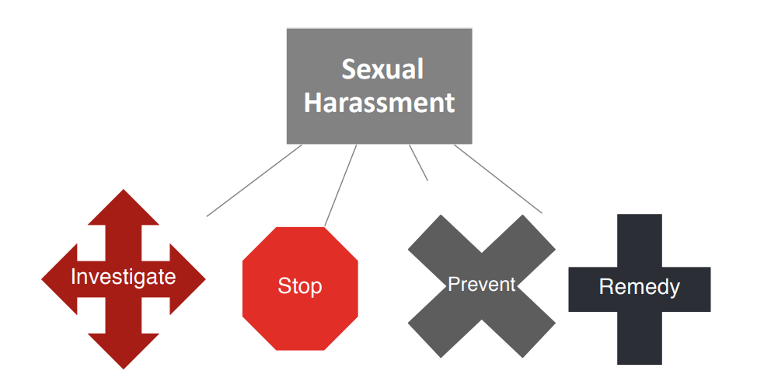
School Responsibilities for Responding
to Sexual Harassment
Notes:
Whenever there is an allegation of sexual harassment, the schools must investigate (either informal (small i) or big I formal investigation
Stop the harassment
Prevent Sexual Harrasment
Remedy the impacts of the harassment - means such measures must be designed to restore or preserve equal access to the School System’s education program or activity. Such remedies may include services for supportive measures, as defined below. However, remedies need not be nondisciplinary or non-punitive and need not avoid burdening the respondent.

Slide 37
Actual Notice
What is Actual Notice? When do you have it? Who can receive it?
Actual notice occurs when an individual notifies the Title IX coordinator or other responsible employee. A responsible employee:
Has the authority to take action to redress the harassment; or
Has the duty to report harassment or other types of misconduct to appropriate officials; or is
Someone a student could reasonably believe has this authority or responsibility;
Individual complains to school police or security official.
Staff member witnesses harassment
Rumors, gossip, social media, etc. can be notice
This means that ALL EMPLOYEES are responsible and must report any allegations of sexual harassment. Not doing so is being “deliberately indifferent.”
Once actual notice exists, the duty to investigate is absolute.
Small “i” preliminary inquiry.
Big “I” comprehensive investigation (Formal Complaint.)
Notes:
Everything kicks off when school employees have Actual Notice! Let‘s talk about when actual notice occurs and the responsibility that goes with it.
Actual notice occurs when an individual notifies the Title IX coordinator or other responsible employee. A responsible employee:
Has the authority to take action to redress the harassment; or
Has the duty to report harassment or other types of misconduct to appropriate officials; or is
Someone a student could reasonably believe has this authority or responsibility;
Individual complains to school police or security official.
Staff member witnesses harassment
Rumors, gossip, social media, etc. can be notice
This means that ALL EMPLOYEES are responsible and must report any allegations of sexual harassment. Not doing so is being “deliberately indifferent.”
Once actual notice exists, the duty to investigate is absolute.

Slide 38
Actual Notice Summary
Actual notice triggers the obligation to offer supportive measures, explain grievance process
Formal complaint triggers the obligation to investigate
Parent/guardian has “right” to make report or complaint for students in K-12.

Slide 39
Common Supportive Measures
Referral to counseling, medical and/or other health services
Referral to the Employee Assistance Program
Mutual restrictions on contact between the parties
Altering work arrangements for employees
Safety planning
Providing school safety escorts
Transportation accommodations
Implementing contact limitations (no contact orders) between the parties; mutual restrictions on contact between the parties
Academic support, extensions of deadlines, or other modifications of work or class schedule
Trespass or Be on the Lookout (BOLO) orders
Increased security and monitoring of certain areas of school
Other similar measures
Notes:
This slide lists examples of common supportive measures.
Referral to counseling, medical and/or other health services
Referral to the Employee Assistance Program
Mutual restrictions on contact between the parties
Altering work arrangements for employees
Safety planning
Providing school safety escorts
Transportation accommodations
Implementing contact limitations (no contact orders) between the parties; mutual restrictions on contact between the parties
Academic support, extensions of deadlines, or other modifications of work or class schedule
Trespass or Be on the Lookout (BOLO) orders
Increased security and monitoring of certain areas of school
Other similar measures

Slide 40
Process Overview
Report
School & System TIXC receive report
School TIXC contacts complainant, provides supportive measures, conducts small “I” investigation, evaluates concern for Title IX “fit,” and explains options to complainant.
Complaint
Complainant files formal complaint
System TIXC receives formal complaint and reviews
Resolution
Investigative report sent to Decision-Maker who determines findings
Informal Resolution can be used any time prior to determination
Investigators are contacted to conduct big “I” investigation
Notes:
This slide outlines the general process for handling Title IX concerns

Slide 41
Grievance Process Overview
Notification of formal complaint
Investigation
Evidence Review (10 days)
Investigation report complete
Review of investigation report (10 days before determination)
Opportunity to ask questions
Written Determination
Appeal
Final Determination
Notes:
This slide outlines the general process for handling Title IX concerns

Slide 42
Balancing Needs in the Grievance Process
Due Process
Trauma-Informed Practices
Investigations must be:
Thorough
Reliable
Impartial
Notes:
This slide outlines the general process for handling Title IX concerns

Slide 43
Conducting Interviews & Gathering Evidence

Slide 44
Conducting Fair and Impartial Investigations
Investigator is self-aware
Conflicts of interest
Biases
Each party is shown compassion and respect; Understands how trauma may impact interviews
Investigators recognize the difference between rumors and facts
Investigator keeps and open mind until all evidence is obtained
Investigator ensures that all witnesses suggested and evidence offered by the parties is carefully considered
Investigator is trained and prepared
Each party is fully heard
Investigator considers the evidence and only the evidence
Notes:
Everything kicks off when school employees have Actual Notice! Let‘s talk about when actual notice occurs and the responsibility that goes with it.
Actual notice occurs when an individual notifies the Title IX coordinator or other responsible employee. A responsible employee:
Has the authority to take action to redress the harassment; or
Has the duty to report harassment or other types of misconduct to appropriate officials; or is
Someone a student could reasonably believe has this authority or responsibility;
Individual complains to school police or security official.
Staff member witnesses harassment
Rumors, gossip, social media, etc. can be notice
This means that ALL EMPLOYEES are responsible and must report any allegations of sexual harassment. Not doing so is being “deliberately indifferent.”
Once actual notice exists, the duty to investigate is absolute.

Slide 45
Conflict of Interest & Bias
Watch for conflicts of interest or bias throughout the process
A conflict of interest occurs when personal or private interests may compromise one's judgment, decisions, or actions
A bias is a tendency, inclination, or prejudice toward/against someone
Often based on stereotypes, rather than actual knowledge of an individual or a particular circumstance
Frequently based on a person's gender, race, or sexual orientation
Pre-judgement
Relationships/Friendships
Self-Reflect. Consult. Remove yourself from the process and reach out for assistance.

Slide 46
Insert video: How to deal with unconscious bias?

Slide 47
Planning the Investigation
Co-investigators are encouraged
Rapport building
Helpful when one is ill or having bad day
Sharing of responsibilities
Notetaker can be included, but needs to be listed as notetaker, not investigator
Investigation should be prompt
Review the information received from the TIXC
Policy alleged to be violated
Determine who needs to be interviewed
Notes:
Everything kicks off when school employees have Actual Notice! Let‘s talk about when actual notice occurs and the responsibility that goes with it.
Actual notice occurs when an individual notifies the Title IX coordinator or other responsible employee. A responsible employee:
Has the authority to take action to redress the harassment; or
Has the duty to report harassment or other types of misconduct to appropriate officials; or is
Someone a student could reasonably believe has this authority or responsibility;
Individual complains to school police or security official.
Staff member witnesses harassment
Rumors, gossip, social media, etc. can be notice
This means that ALL EMPLOYEES are responsible and must report any allegations of sexual harassment. Not doing so is being “deliberately indifferent.”
Once actual notice exists, the duty to investigate is absolute.

Slide 48
Planning the Investigation
Set a schedule for interviewing the parties
Order of persons to be interviewed
Anticipate about 30 minutes more than needed
Plan an hour to capture key statements, document
Dates and times
Place
In person, virtual, phone?
Notify parties of interview
Must have advanced notification (form available)
If there are delays, please notate and we must notify
Share the general process
Notes:
Everything kicks off when school employees have Actual Notice! Let‘s talk about when actual notice occurs and the responsibility that goes with it.
Actual notice occurs when an individual notifies the Title IX coordinator or other responsible employee. A responsible employee:
Has the authority to take action to redress the harassment; or
Has the duty to report harassment or other types of misconduct to appropriate officials; or is
Someone a student could reasonably believe has this authority or responsibility;
Individual complains to school police or security official.
Staff member witnesses harassment
Rumors, gossip, social media, etc. can be notice
This means that ALL EMPLOYEES are responsible and must report any allegations of sexual harassment. Not doing so is being “deliberately indifferent.”
Once actual notice exists, the duty to investigate is absolute.

Slide 49
Planning the Investigation, con’t.
Complainant Considerations
May be reluctant due to possible retaliation – remind of policy
Remind of supportive measures
Talk with complainant (and parent/guardian) about next steps
Be understanding of impacts of trauma – events out of chronological order, fact may be jumbled; don’t assume deceit
Respondent Considerations
No presumption of responsibility
May be simultaneously involved in criminal investigations
Share next steps with respondent and parents/guardians
At all times, be aware of bias and conflicts of interest and respond appropriately.
Notes:
Everything kicks off when school employees have Actual Notice! Let‘s talk about when actual notice occurs and the responsibility that goes with it.
Actual notice occurs when an individual notifies the Title IX coordinator or other responsible employee. A responsible employee:
Has the authority to take action to redress the harassment; or
Has the duty to report harassment or other types of misconduct to appropriate officials; or is
Someone a student could reasonably believe has this authority or responsibility;
Individual complains to school police or security official.
Staff member witnesses harassment
Rumors, gossip, social media, etc. can be notice
This means that ALL EMPLOYEES are responsible and must report any allegations of sexual harassment. Not doing so is being “deliberately indifferent.”
Once actual notice exists, the duty to investigate is absolute.

Slide 50
Planning the Investigation, con’t.
Witnesses
Identified by parties (complainant and respondent)
Can ask for suggested order
There will be various types
Eye witnesses
Character witnesses
Hearsay issues – usually not as reliable as eye witness, but can be considered
Can use witness statement forms
Notes:
Everything kicks off when school employees have Actual Notice! Let‘s talk about when actual notice occurs and the responsibility that goes with it.
Actual notice occurs when an individual notifies the Title IX coordinator or other responsible employee. A responsible employee:
Has the authority to take action to redress the harassment; or
Has the duty to report harassment or other types of misconduct to appropriate officials; or is
Someone a student could reasonably believe has this authority or responsibility;
Individual complains to school police or security official.
Staff member witnesses harassment
Rumors, gossip, social media, etc. can be notice
This means that ALL EMPLOYEES are responsible and must report any allegations of sexual harassment. Not doing so is being “deliberately indifferent.”
Once actual notice exists, the duty to investigate is absolute.

Slide 51
Planning the Investigation, con’t.
Suggested default order for interviews
Complainant
Complainant’s witnesses
Neutral witnesses
Respondent’s witnesses
Respondent
Any additional witnesses identified by Respondent
Round 2
Round 3.
*Every case is different
Notes:
Everything kicks off when school employees have Actual Notice! Let‘s talk about when actual notice occurs and the responsibility that goes with it.
Actual notice occurs when an individual notifies the Title IX coordinator or other responsible employee. A responsible employee:
Has the authority to take action to redress the harassment; or
Has the duty to report harassment or other types of misconduct to appropriate officials; or is
Someone a student could reasonably believe has this authority or responsibility;
Individual complains to school police or security official.
Staff member witnesses harassment
Rumors, gossip, social media, etc. can be notice
This means that ALL EMPLOYEES are responsible and must report any allegations of sexual harassment. Not doing so is being “deliberately indifferent.”
Once actual notice exists, the duty to investigate is absolute.

Slide 52
Evidence
Evidence
Direct – first person
Other types of evidence:
7-10 days is a reasonable time to hold off for law enforcement to collect evidence if involved
If we get info from law enforcement, should be all or nothing to prevent bias
Respondent may be prohibited from participating
Inform them process is moving forward and they have rights
Submit witnesses
Review investigation report
Don’t share pornographic images!
Preponderance of the evidence standard will be used in determination (more likely than not)
Notes:
Everything kicks off when school employees have Actual Notice! Let‘s talk about when actual notice occurs and the responsibility that goes with it.
Actual notice occurs when an individual notifies the Title IX coordinator or other responsible employee. A responsible employee:
Has the authority to take action to redress the harassment; or
Has the duty to report harassment or other types of misconduct to appropriate officials; or is
Someone a student could reasonably believe has this authority or responsibility;
Individual complains to school police or security official.
Staff member witnesses harassment
Rumors, gossip, social media, etc. can be notice
This means that ALL EMPLOYEES are responsible and must report any allegations of sexual harassment. Not doing so is being “deliberately indifferent.”
Once actual notice exists, the duty to investigate is absolute.

Slide 53
Evidence – What’s Useful and Allowed?
Evidence is generally considered relevant if it has value in proving or disproving a fact at issue
Under the Title IX regulations, evidence of the Complainant’s sexual behavior or predisposition is explicitly and categorically not relevant except for two limited exceptions:
– Offered to prove that someone other than the Respondent committed the conduct alleged, or
– Concerns specific incidents of the Complainant’s sexual behavior with respect to the Respondent and is offered to prove consent
Notes:
Everything kicks off when school employees have Actual Notice! Let‘s talk about when actual notice occurs and the responsibility that goes with it.
Actual notice occurs when an individual notifies the Title IX coordinator or other responsible employee. A responsible employee:
Has the authority to take action to redress the harassment; or
Has the duty to report harassment or other types of misconduct to appropriate officials; or is
Someone a student could reasonably believe has this authority or responsibility;
Individual complains to school police or security official.
Staff member witnesses harassment
Rumors, gossip, social media, etc. can be notice
This means that ALL EMPLOYEES are responsible and must report any allegations of sexual harassment. Not doing so is being “deliberately indifferent.”
Once actual notice exists, the duty to investigate is absolute.

Slide 54
Interview Skills / Questioning
No one right way to do it
Choose a non-threatning place and create a comfortable atmosphere
Face-to-face recommended
Neutral, quiet, private setting
Start with developing rapport
Thank them for being here
Developmentally appropriate welcoming language
Explain your role and process
Not here to prosecute or defend, just gathering information
Interview, not interrogation
Advisors may not ask questions or respond
They can present any evidence, as long as relevant
Acknowledge it may be uncomfortable
Review confidentiality and protection from any retaliation
Set tone that you are open to whatever they share; not going to shock you
Provide policy and procedures
Observe
Are they uncomfortable, distracted?
Do you need to take a break? Make it your fault if needed
Be professional
Forms:
Investigative report
Notes:
Actual notice is initiated when there is a report of an allegation of sexual harassment. The reports can come from
Report Sources:
Student
Parent/guardian can make report/complaint for student
Employee
Member of the public
Anonymous person
There are various ways of receiving a report :
Types of Report:
Verbal
Written
Rumor or observation
Students must be warned about the consequences of providing false information, but not in a manner designed to discourage honest reports.

Slide 55
Interview Skills / Questioning
Be professional
Relaxed conversation
Let them et the pace
Lower your voice/tenor
Be empathetic
Nod head
Short comments – help me understand,….what I’m perceiving is …”
Good eye contact – listen with eyes and ears
Avoid writing while part is talking, if possible
Forms:
Investigative report
Notes:
Actual notice is initiated when there is a report of an allegation of sexual harassment. The reports can come from
Report Sources:
Student
Parent/guardian can make report/complaint for student
Employee
Member of the public
Anonymous person
There are various ways of receiving a report :
Types of Report:
Verbal
Written
Rumor or observation
Students must be warned about the consequences of providing false information, but not in a manner designed to discourage honest reports.

Slide 56
Interview Skills / Questioning
Have questions prepared, but be flexible
Can Start with the 5Ws
Open-ended
May work through timeline of events
Repeat questions as needed
Closing question
Is there anything I haven’t asked about?
Anything you’d like to add?
Let them know they can provide information later
Let them know you may come back for clarification
Videos/ recordings are allowed by regulations, but must be transcribed and then allow parties to verify accuracy = lengthens the process
Interviews from other agencies can be used as evidence, but don’t eliminate responsibility for investigation
Investigate as though you’ll be investigated –
Document (electronic and paper)
.
Forms:
Investigative report
Notes:
Actual notice is initiated when there is a report of an allegation of sexual harassment. The reports can come from
Report Sources:
Student
Parent/guardian can make report/complaint for student
Employee
Member of the public
Anonymous person
There are various ways of receiving a report :
Types of Report:
Verbal
Written
Rumor or observation
Students must be warned about the consequences of providing false information, but not in a manner designed to discourage honest reports.

Slide 57
Interview Skills / Questioning
Use funnel approach – start broad then narrow down
Investigator is a dripping hose that encourages interviewee to be a fire hose
We’re here to talk about a situation that happened on ….. Tell me what you know
Tell me more about that…..Thank you for that……what happened next?
Let them roll if they’re on a roll
Don’t label behavior (I’m investigating a sexual assault – rather, there’s been an allegation of inappropriate conduct
.
Forms:
Investigative report
Notes:
Actual notice is initiated when there is a report of an allegation of sexual harassment. The reports can come from
Report Sources:
Student
Parent/guardian can make report/complaint for student
Employee
Member of the public
Anonymous person
There are various ways of receiving a report :
Types of Report:
Verbal
Written
Rumor or observation
Students must be warned about the consequences of providing false information, but not in a manner designed to discourage honest reports.

Slide 58
Interview Skills / Questioning
Use funnel approach – start broad then narrow down
Investigator is a dripping hose that encourages interviewee to be a fire hose
We’re here to talk about a situation that happened on ….. Tell me what you know
Tell me more about that…..Thank you for that……what happened next?
Let them roll if they’re on a roll
Don’t label behavior (I’m investigating a sexual assault – rather, there’s been an allegation of inappropriate conduct
.
Forms:
Investigative report
Notes:
Actual notice is initiated when there is a report of an allegation of sexual harassment. The reports can come from
Report Sources:
Student
Parent/guardian can make report/complaint for student
Employee
Member of the public
Anonymous person
There are various ways of receiving a report :
Types of Report:
Verbal
Written
Rumor or observation
Students must be warned about the consequences of providing false information, but not in a manner designed to discourage honest reports.

Slide 59
Grievance Process – Retaliation
To avoid retaliation concerns, regulations require institutions to keep the identity of parties and witnesses confidential (exceptions: FERPA, state law, or hearing concerns)
Retaliation complaints may be made through grievance process
May not retaliate because participation or refusal to participate in an investigation, proceeding, or hearing
RCSS Code of Conduct and Board Policy prohibit retaliation

Slide 60
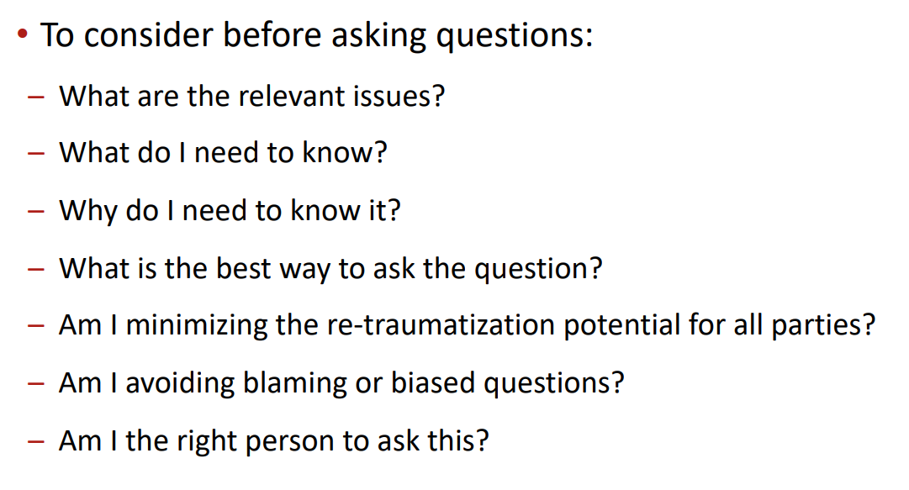

Slide 62
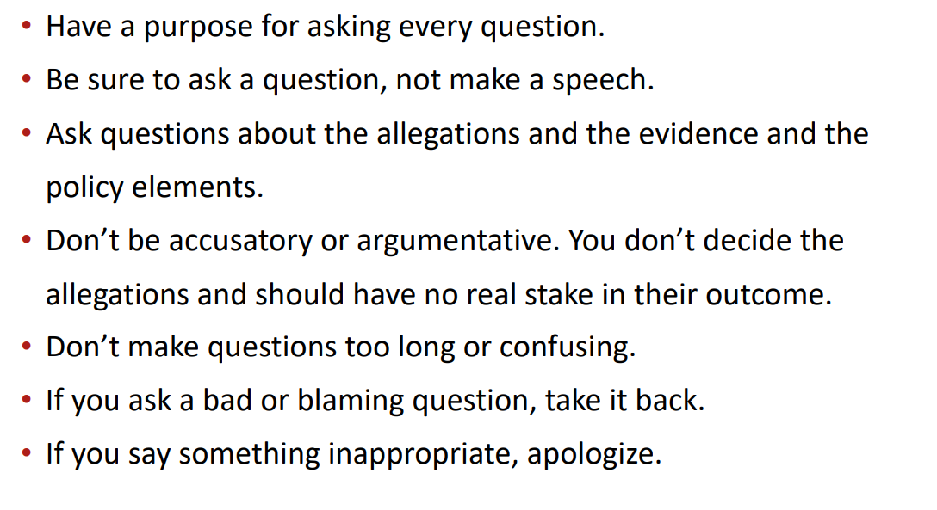

Slide 63
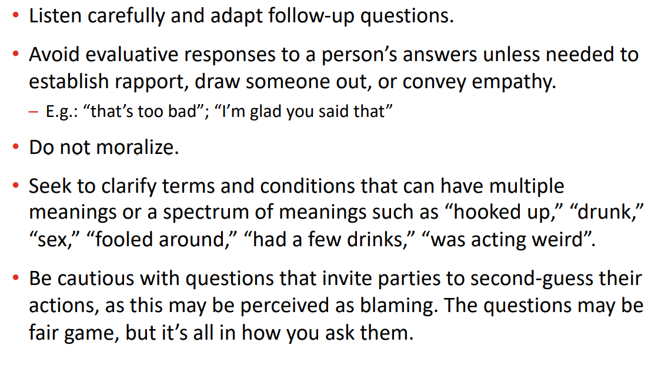

Slide 64
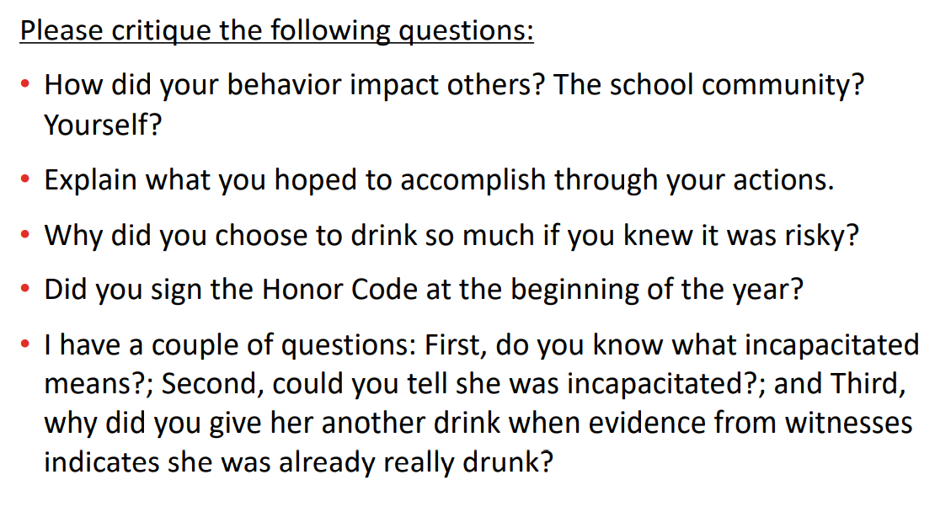

Slide 66
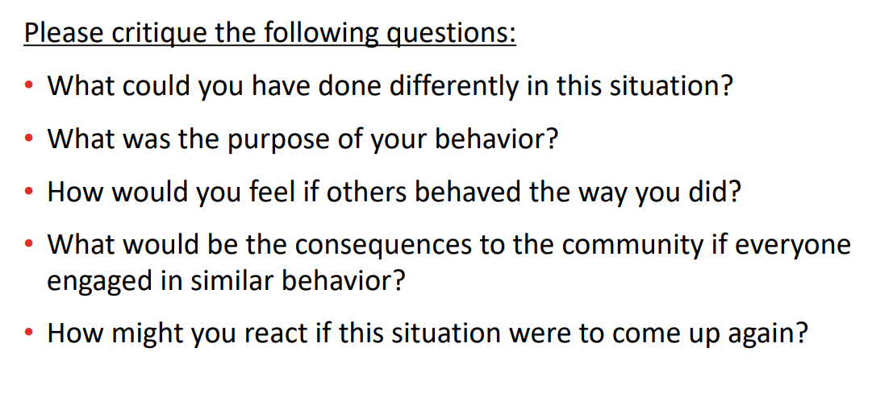

Slide 67
Interview Skills / Questioning
Here are 16 sample investigation interview questions to ask the complainant:
What happened?
What was the date, time and duration of the incident or behavior?
How many times did this happen?
Where did it happen?
How did it happen?
Did anyone else see it happen? Who? What did they say? What did they do?
Was there physical contact? Describe it. Demonstrate it.
What did you do in response to the incident or behavior?
What did you say in response to the incident or behavior?
How did the subject of the allegation react to your response?
Did you report this to anyone in management? To whom? When? What they say and/or do?
Did you tell anyone about the incident or behavior? Who? What did they say and/or do?
Do you know whether the subject of the allegation has been involved in any other incidents?
Do you know why the incident or behavior occurred?
Do you know anyone else who can shed light on this incident?
Is there anything else you want to tell me that I haven’t asked you?
Source: 44 Investigation Interview Questions for the Complainant, Subject and Witnesses (i-sight.com)
.
Notes:
Actual notice is initiated when there is a report of an allegation of sexual harassment. The reports can come from
Report Sources:
Student
Parent/guardian can make report/complaint for student
Employee
Member of the public
Anonymous person
There are various ways of receiving a report :
Types of Report:
Verbal
Written
Rumor or observation
Students must be warned about the consequences of providing false information, but not in a manner designed to discourage honest reports.

Slide 68
Interview Skills / Questioning
These 14 sample investigation interview questions can help get witnesses to talk:
What did you witness?
What was the date, time and duration of the incident or behavior you witnessed?
Where did it happen?
Who was involved?
What did each person do and say?
Did anyone else see it happen? Who?
What did you do after witnessing the incident or behavior?
Did you say anything to the parties involved in response to what you witnessed?
How did the complainant and the subject of the allegation react to your response?
Did you report this to anyone in management? To whom? When? What they say and/or do?
Did you tell anyone about the incident or behavior? Who?
Do you know why the incident or behavior occurred?
Do you know anyone else who can shed light on this incident?
Is there anything else you want to tell me that I haven’t asked you?
Source: 44 Investigation Interview Questions for the Complainant, Subject and Witnesses (i-sight.com)
.
Notes:
Actual notice is initiated when there is a report of an allegation of sexual harassment. The reports can come from
Report Sources:
Student
Parent/guardian can make report/complaint for student
Employee
Member of the public
Anonymous person
There are various ways of receiving a report :
Types of Report:
Verbal
Written
Rumor or observation
Students must be warned about the consequences of providing false information, but not in a manner designed to discourage honest reports.

Slide 69
Interview Skills / Questioning
Sample Questions to Ask the Subject of the Complaint:
Here’s what to ask the subject of the complaint:
What happened?
If the subject denies that the incident occurred, ask:
Is there any reason anyone would invent or lie about the incident?
Where were you when the alleged incident occurred?
Do you have any witnesses who can corroborate your whereabouts at the time of the incident?
If the subject doesn’t deny that the incident occurred, ask:
When and where did this happen?
What were the circumstances leading up to the incident?
Who else was involved?
What is your connection to the complainant?
Are you aware of any other complaints by this person?
Recount the dialogue that occurred in order of what was said.
What did the complainant do or say?
Is there any evidence to support your account of what happened?
Is there anyone else we should talk to who had knowledge of the incident or the circumstances surrounding it?
Have you talked to anyone about the incident? Who? What did you tell them?
Source: 44 Investigation Interview Questions for the Complainant, Subject and Witnesses (i-sight.com)
.
Notes:
Actual notice is initiated when there is a report of an allegation of sexual harassment. The reports can come from
Report Sources:
Student
Parent/guardian can make report/complaint for student
Employee
Member of the public
Anonymous person
There are various ways of receiving a report :
Types of Report:
Verbal
Written
Rumor or observation
Students must be warned about the consequences of providing false information, but not in a manner designed to discourage honest reports.

Slide 70
Interview Skills / Questioning
Dishonesty
Eliminate need by telling them before hand what you know (“People have reported you being at the party; I’ve seen video…”}
In a non-accusatory way, explain how statements don’t “make sense”
Allow opportunity for individual to restate
Try to gauge why they are lying
If they continue to lie, confront and explain repercussions for lying in an investigation
Calmly return to the questions
Sometimes people who do bad things mean them for a good reason……
.
Notes:
Actual notice is initiated when there is a report of an allegation of sexual harassment. The reports can come from
Report Sources:
Student
Parent/guardian can make report/complaint for student
Employee
Member of the public
Anonymous person
There are various ways of receiving a report :
Types of Report:
Verbal
Written
Rumor or observation
Students must be warned about the consequences of providing false information, but not in a manner designed to discourage honest reports.

Slide 71
Interview Skills / Questioning
Resistant and Quiet Witnesses
Gauge their resistance/ try to address their motivation
Answer questions about process
Back up when needed
Be honest about any possible disclosure
Explain expectation of their school and rationale for duty to participate
If they open up, be responsive
If appropriate appeal to their humanity
.
Notes:
Actual notice is initiated when there is a report of an allegation of sexual harassment. The reports can come from
Report Sources:
Student
Parent/guardian can make report/complaint for student
Employee
Member of the public
Anonymous person
There are various ways of receiving a report :
Types of Report:
Verbal
Written
Rumor or observation
Students must be warned about the consequences of providing false information, but not in a manner designed to discourage honest reports.

Slide 72
Investigative Report

Slide 73
Formal Complaint & Investigation Steps
1. Receive Notice/Complaint
2. TIXC coordinator conducts initial assessment and jurisdiction determination. (meet with complainant)
3. Complainant decides whether or not to file formal complaint. TIXC decides whether to investigate based on initial assessment
a. TIXC also offers informal resolution option
4. Notice of Investigation to Parties/Notice of Formal Allegation (“Charge”)
5. Formal comprehensive investigation conducted by System Investigators
• Witness interviews.
• Evidence gathering.
7. Draft investigation report.
8. Meet with System Title IX Coordinator (or legal counsel) to review draft report and evidence.
9. Provide all evidence directly related to the allegations to parties and their advisors for inspection and review with 10 days for response.
10. Complete final investigation report.
• Synthesize and analyze relevant evidence.
• Send final report to parties for review and written response at least 10 days prior to making a determination of responsibility.
Notes:
Should a complainant decide to pursue a formal complaint, there are several steps that ensue. They are listed on this slide.
Receive Notice/Complaint
2. TIXC coordinator conducts initial assessment and jurisdiction determination. (meet with complainant)
3. Complainant decides whether or not to file formal complaint. TIXC decides whether to investigate based on initial assessment
a. TIXC also offers informal resolution option
4. Notice of Investigation to Parties/Notice of Formal Allegation (“Charge”)
5. Formal comprehensive investigation conducted by System Investigators
• Witness interviews.
• Evidence gathering.
7. Draft investigation report.
8. Meet with System Title IX Coordinator (or legal counsel) to review draft report and evidence.
9. Provide all evidence directly related to the allegations to parties and their advisors for inspection and review with 10 days for response.
10. Complete final investigation report.
• Synthesize and analyze relevant evidence.
• Send final report to parties for review and written response at least 10 days prior to making a determination of responsibility.

Slide 74
Investigative Report
Use the provided form
System Title IX Coordinator and Legal Counsel will review before releasing
Can redact, but provide a key (witness 1 – john brown)
Understand tthat report will be reviewed by both parties
Information deemed irrelevant – note in appendix/ end of report
.
Forms:
Investigative report
Notes:
Actual notice is initiated when there is a report of an allegation of sexual harassment. The reports can come from
Report Sources:
Student
Parent/guardian can make report/complaint for student
Employee
Member of the public
Anonymous person
There are various ways of receiving a report :
Types of Report:
Verbal
Written
Rumor or observation
Students must be warned about the consequences of providing false information, but not in a manner designed to discourage honest reports.

Slide 75
Grievance Process - Decision-Making
Investigator will notify Decision Maker (Mr. Priester)
of evidence/ provide investigative report
Decision Maker will objectively evaluate and draw conclusions
Independent, free of bias, conflict of interest
Will be trained
Burden of Proof
School has burden of proof to show met by a preponderance of the evidence
Greater than 50% chance claim is true

Slide 76
Grievance Process - Decision-Making
Written decision report will be provided in a report
Identifies the school policy violated
Provides a description of the procedural steps taken by the school on the way to getting to that point;
Includes a findings of fact section;
Includes a section that draws conclusions after applying the facts to the portion of the school’s policy that applies;
Includes statement and rationale for the ultimate determination of responsibly;
Includes any disciplinary action the school will impose, and whether the school will provide remedies to the complainant;
Includes a statement and rationale for any remedies for the complainant, addressing how those remedies will restore or preserve equal access;
Includes a statement that the parties have right to appeal the initial determination regarding responsibility, permissible bases for appeal and procedures.
*School Title IX Coordinator is responsible for ensuring remedies in the decision are implemented.

Slide 77
Grievance Process –Decision & Appeal
• Appeal bases: (must impact the hearing)
• procedural irregularity
• new evidence
• conflict of interest or bias
• erroneous relevancy determinations
• Must be equitable to both parties
• Notice must be given to both parties when appeal filed
• Decision-maker for the appeal ≠ initial decision-maker on the formal complaint, the investigator, or the Title IX Coordinator
• Both parties must have a chance to submit a written statement and must both receive the issuing written decision

Slide 78
RCSS Title IX Complaint Process
RCSS Title IX Complaint Process
Notes:
Once there is a formal complaint, RCSS does have a Complaint Process specific to allegations of sexual harassment.

Slide 79
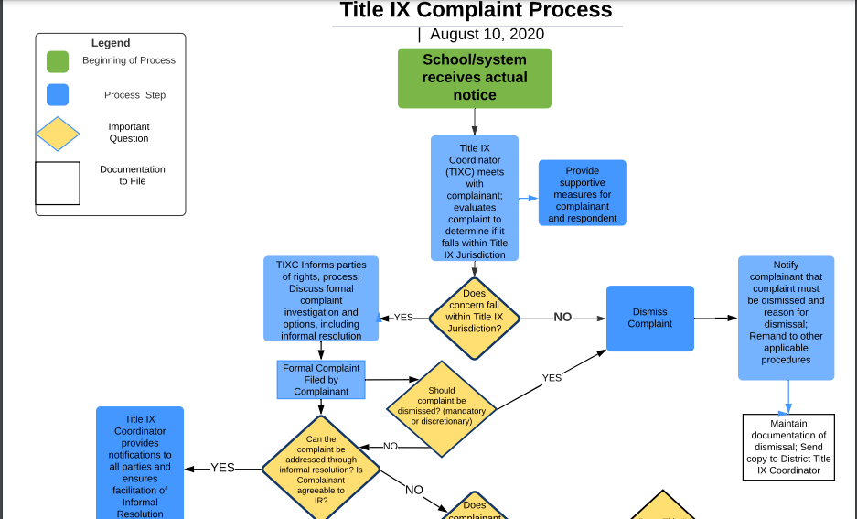

Slide 80
Recordkeeping, Special Considerations, Prevention & Resources

Slide 81
Recordkeeping & Forms
Record keeping
All Title IX records should be maintained locally for 7 years
All statements
Evidence
Communication
Logs
Decisions
Reports
Informal Resolution
Appeals
Everything related to an allegation
All Title IX training materials
Copies of documents will also be maintained at Board Office.
Where to Access Forms: Title IX Shared Folder for Schools

Slide 82
Recordkeeping & Forms
Keep a log of questions asked or not asked
Put in with Investigative report
Witness list
Flowchart (showing relationship of witnesses)
Other notes:
Drips Document
Future pointers – what came out, other witnesses, new evidence, future questions

Slide 83
Special Situations & Considerations
a. DFACS reports – continue to make immediate reports; must be made within 24 hours
Intentional contact with another’s private area
Intentional nudity/exposure of private area to another person
Alleged misconduct is unique to student’s age and suggests abuse
b. Criminal Behavior – must still be reported to school safety and law enforcement
Notify Principal,
Notify SRO
Notify DFACS, as appropriate
Meet with parents to ensure safety measures
Document findings
Must conduct a parallel Title IX investigation – under consultation with Board Attorney
c. Digital Students
d. Transgender Students – may have complaints under Title IX; refer to Mr. Fletcher’s guidance – compassion, empathy, due process
e. Confidentiality

Slide 84
Prevention
Prevention Efforts
Positive School Climate
Foster culture of support and acceptance
Supports positive relationships
Encourages respect
Prohibit bullying
Sex Abuse Prevention and Awareness Training
Annual meetings at the beginning of the year
GCN training (ethics)
Posters
Information to parents

Slide 85
Next Steps
Review the RCSS policies and procedures for Sexual Harassment
Review the RCSS Training for Coordinators
Review the RCSS Training for Investigators
Access and familiarize yourself with the forms.
Create a place for keeping Title IX Records

Slide 86
RCBOE Resources
RCBOE Title IX Website:
https://www.rcboe.org/Page/62245
Richmond County School System Non-Discrimination Policy
Non-Discrimination Policy
Richmond County School System Bullying Policy
Bullying Policy
Georgia Department of Education - Equity
https://www.gadoe.org/External-Affairs-and-Policy/Policy/Pages/Equity.aspx
US Department of Education
Office of Civil Rights - Title IX and Sex Discrimination
https://www2.ed.gov/about/offices/list/ocr/docs/tix_dis.html
US Department of Education
Office of Civil Rights - Athletics
https://www2.ed.gov/about/offices/list/ocr/docs/tix_dis.html
US Department of Education
Title IX Site
https://sites.ed.gov/titleix/
System Contact:
Dr. Aronica Gloster
Director of Student Services & RCSS Title IX Coordinator
glostar@boe.Richmond.k12.ga.us
(706)826-1000 x 5501

