Slide 1
Number Sense Drills
Oct 12 Collab
Mr. Werth

Slide 2
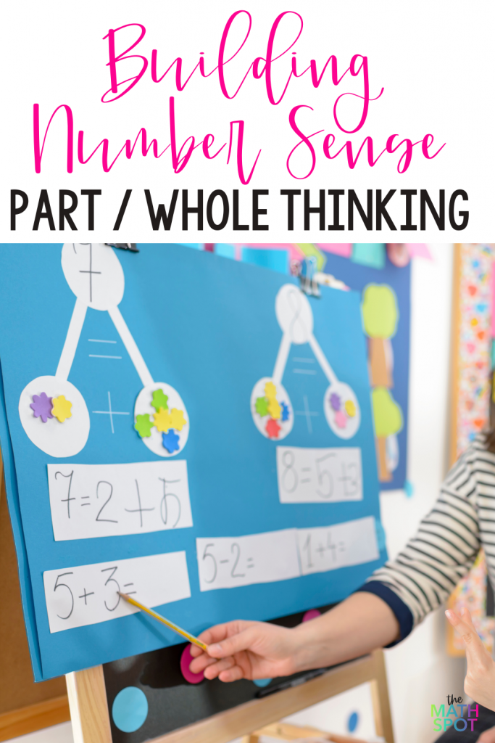
Step 1
Begin by taking a poster paper or your board and writing a
mathetmatical /number based equation or concept

Slide 3
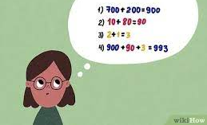
Step 2
Have students silently and independently answer the questions in their heads.
Students should not be writing; focus on mental math

Slide 4
Step 3
Establish an answering system
Students should keep hands close to their chest so as not to alert other students and dissuade them from continuing to think
Closed fist = I am thinking about it
Thumbs up = I have the answer
Thumbs up with one finger out =
I can explain my answer

Slide 5
Important Notes
These should be done daily, perhaps either as a bellringer, a transition strategy, or an exit ticket.
Have the teacher remain at the front of the classroom and choose three students at the end. Begin with ones who you know did not get the question right, and have them come up and write out their solution and explain to the class.
Progress through to students who did it correctly until you get to the correct answer
Do a strain of 3 problems at the front of the room that progress in difficulty
Utilize the green number sense book
There are also resources in Canvas

