Slide 1
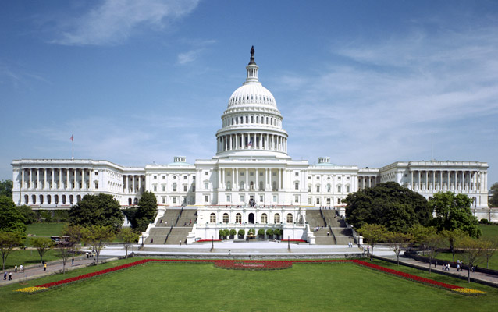
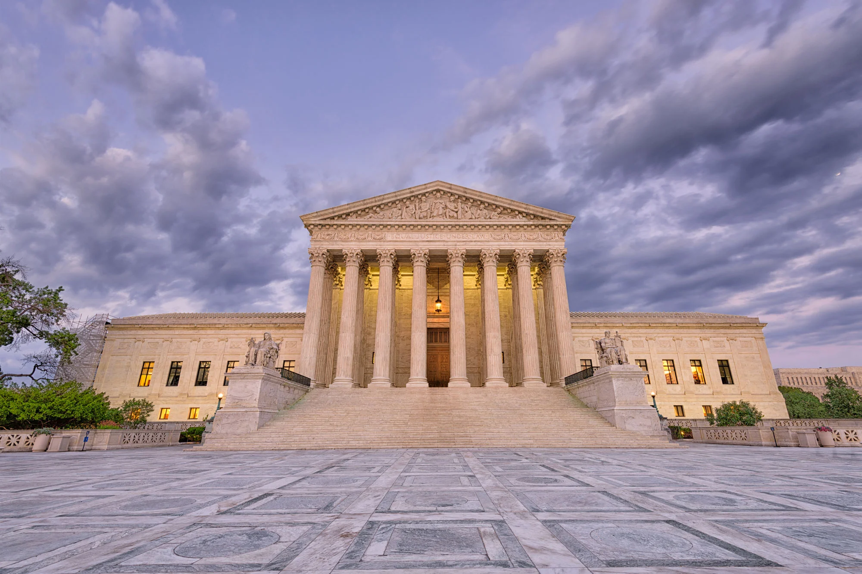
Bell ringer
The Three Branches of Government
Which Branch of Government performs which function? Use the branches as a word bank to fill in the blank for the questions below.
Legislative Branch
Executive Branch
Judicial Branch
The _______________ Branch enforces the law.
The _______________ Branch interprets the law
The ________________ Branch makes the law.

Slide 2
THE THREE BRANCHES OF U.S. GOVERNMENT
Coach B.O. Streetman,
Instructor

Slide 3
ENGAGEMENT

Slide 4
GEORGIA STANDARDS OF EXCELLENCE
SSCG4: Demonstrate knowledge of the organization and powers of the national government.

Slide 5
I CAN STATEMENTS
1. I can demonstrate knowledge of the organization of powers of the United States’ national government.

Slide 6
SUCCESS CRITERIA
We will know that we are successful when we can demonstrate knowledge of the organization of powers of the United States’ national government.

Slide 7
WHAT IS THE PURPOSE OF THE U.S. CONSTITUTION?
Since its creation, the primary function of the U.S. federal government has been CREATING and ENFORCING laws to GUARANTEE order and consistency within our society.
Mini-Activity: Please paraphrase the prior statement
_________________________________________________________________________________________________________________________________

Slide 8
EXPLORE EXPLAIN AND ELABORATE

Slide 9
GEORGIA STANDARDS OF EXCELLENCE
SSCG4: Demonstrate knowledge of the organization and powers of the national government.

Slide 10
I CAN STATEMENTS
1. I can demonstrate knowledge of the organization of powers of the United States’ national government.

Slide 11
SUCCESS CRITERIA
We will know that we are successful when we can demonstrate knowledge of the organization of powers of the United States’ national government.

Slide 12
The fears of the framers of the constitution
At the end of the day, the “Founding Fathers” were human. When they were pondering the how their new government should look in 1787, they wanted an efficient government, but they did not want a régime that looked liked the British style of rule they recently fought an eight year war to escape.

Slide 13
The fears of the framers of the constitution…continued
In substance, they did not want the power of the new government to be dominated by one individual or a just a select few.
So, they decided to separate lawmaking powers, enforcement of law and interpretation of laws into three separate branches in their new Constitution.
Also, each new branch would exercise certain checks and balances on each other to prevent one branch from becoming more powerful than the other.

Slide 14
THREE BRANCHES OF GOVERNMENT VIDEO

Slide 15
The Legislative Branch Article I

Slide 16
The U.S. Congress
Bicameral: Legislative body that has two houses.
U.S. Senate
100 members
Each state has 2 members regardless of the state’s population
Six years terms
U.S. House of Representatives
435 members
Number of members per state is determined by the state population
Reapportioned after each census
Two year terms
Sen. Raphael Warnock (D-GA)

Slide 17
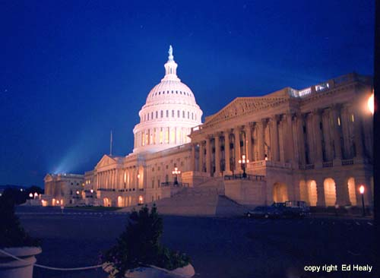
Congressional Duties
Make the Laws
Be representatives of their constituents- individual citizens or voter represented by a politician within an electoral district, state, community, or organization.

Slide 18
Powers of Congress – Article 1
Raise and collect taxes
Borrow money
Regulate commerce
Set laws for Naturalization and Bankruptcy
Coin Money
Punish counterfeiting
Post office
Copyrights and patents
Set up courts
Declare war
Establish the military and National guard
Make rules and allot funds for the military and National guard
Punish pirates
Run Washington D.C. and all federal property
Elastic clause- implied power

Slide 19
U.S. congress MINI-ASSESSENT
Directions: Please use the previous slides and notes to answer the questions below:
1. Define the term bicameral.
2. Which chamber of Congress has two members each, regardless of the each state’s population?
3. Which chamber of Congress’ membership is determined by the state’s population?
4. What are the two primary duties of the U.S. Congress? (Define constituents)
5. Examine the slide entitled Powers of Congress. Select a minimum of two powers and research describe them.

Slide 20
The U.S. HOUSE OF REPRESENTATIVES

Slide 21
House of Representatives
Term: 2 years
Qualifications
25 years old
7 years as a U.S. citizen
Resident of represented state
Rep. Rick Allen (R-GA)
(GA’s 12th Congressional District

Slide 22
House of Representatives
Number of representatives: 435
Speaker of the House – Mike Johnson (R-LA)
3rd in line of succession to the U.S. Presidency
Decides the committees each member will serve on
Decides the order in which bills will be heard

Slide 23
House of Representatives
Special Powers of the House of Representatives
All money (appropriations) bills start here
Select the President in an Electoral College tie
Write the article of impeachment against high ranking officials

Slide 24
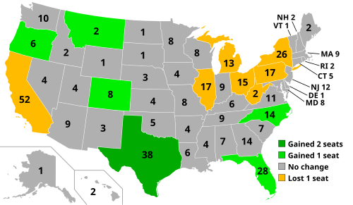
House of Representatives
State population determines the amount of members allotted from each state. This number is subject to change every ten years after the U.S. Census is conducted.

Slide 25
U.S. HOUSE OF REPRESENTATIVES MINI-ASSESSENT
Directions: Please use the previous slides and notes to answer the questions below:
1. List the Constitutional requirements for members of the U.S. House of Representatives.
2. Identify the Representative for Georgia’s 12th House District.
3. Who is the current Speaker of the U.S. House of Representatives and list two powers allotted to his office.
4. List at least one special power granted to the U.S. House of Representatives.
5. According to the map, which two U.S. States have the most members of the U.S. House of Representatives. Please explain why this is the case.

Slide 26
The U.S. SENATE

Slide 27
THE U.S. Senate
Term of office: 6 years
Qualifications:
30 years old
9 years a citizen of the U.S.
Resident of the represented state
Sen. Jon Ossoff (D-GA)

