Slide 1
Energy USE AND PRACTICES
Notes:
Introduce yourself and thank them for their time. Tell them you will be brief.

Slide 2
Richmond County School System
Inventory
5,651,613 square feet of air conditioned & lit space
56 schools
3 support facilities
129 acres under roof
Notes:
This is the quantity of space that we light, air condition and heat

Slide 3
Richmond County School System
FY 2016 Expenditures
Natural Gas $ 301,089
Water $ 698,917
Electricity $ 5,920,757
Total Utilities $ 6,920,763
Notes:
Divided by 191 school/admin days = $29,301 per day

Slide 4
New Energy Use Policy
Notes:
Since we are spending so much on utilities, we thought we would institute a new energy use policy this winter. This was our pilot at Warren Road Elementary headed by Dr. Ryals. She is demonstrating that you can get plenty of work done when it’s 55 in your office as long as you have a pair of gloves, coat, scarf and hot beverage. Hats are also recommended to help keep in body heat.

Slide 5
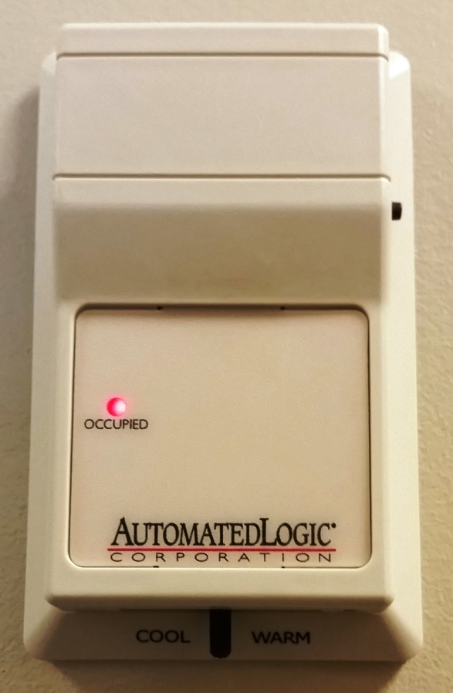
Controlling the Climate in Your Room
Notes:
You have control in your space. Talk about timed local override and slide adjustment.

Slide 6
What you can do to help
“Buffet” Service
Take what you need
Use what you take
Eliminate waste
Notes:
Do you generally turn the water off when you’re done washing you hands? Why would you leave the light on when you walk out of the room?

Slide 7
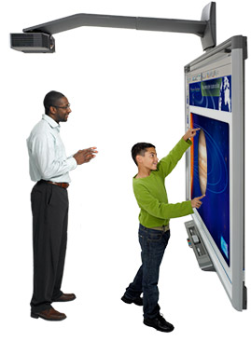
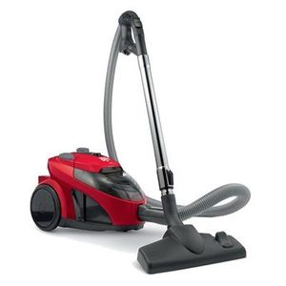
Harvesting the Low-Hanging Fruit
Turn off Promethean Boards
=380 Watts=
Notes:
A Promethean board uses 380 watts; about the same as a canister vacuum cleaner. Would you leave a vacuum cleaner running when you weren’t using it?

Slide 8
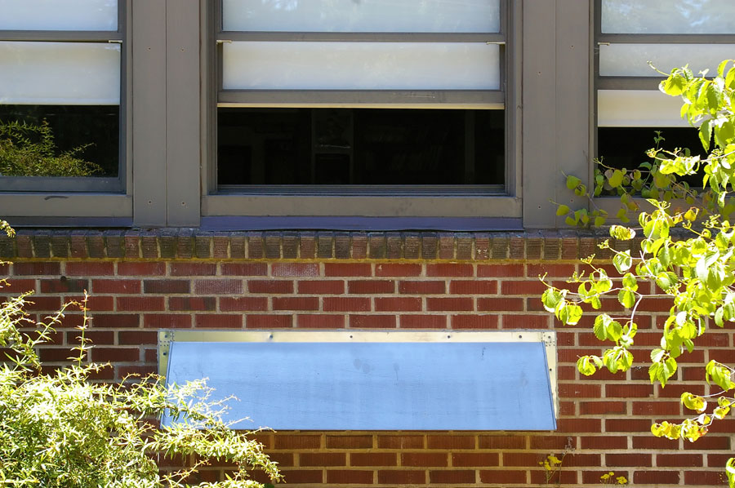
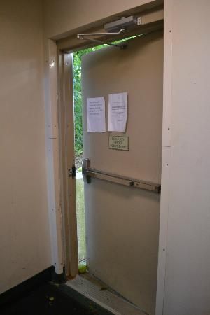
Harvesting the Low-Hanging Fruit
Close Windows and Doors
Windows 5 X Infiltration
Doors 15 X Infiltration
Notes:
All buildings leak air. We want them to in a limited way. Building leakage is called infiltration. An open window increases a typical classroom’s infiltration by a factor of 5. An partially open exterior door increases a classroom’s designed infiltration by a factor of 10.

Slide 9
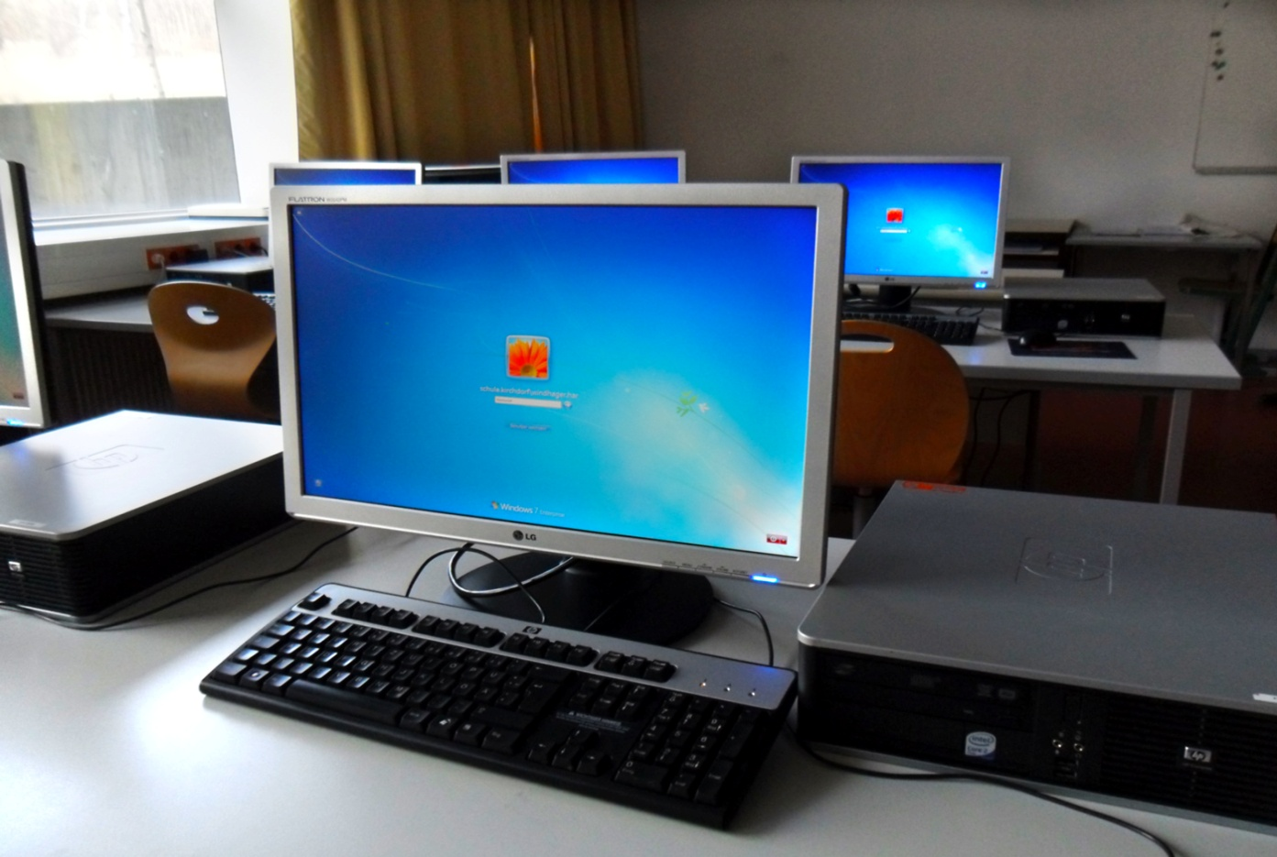
Harvesting the Low-Hanging Fruit
Turn off Idle Computers
Monitor 60 Watts
CPU 250 Watts
Notes:
A typical desktop computer monitor and speaker uses 310 watts. Most classrooms have 5 computers. That’s 1,550 watts or the equivalent of a hair dryer blowing all the time those computers are on. Please encourage students to turn off monitors when they walk away from a computer and put CPUs to sleep and when they won’t be in use for a while.

Slide 10
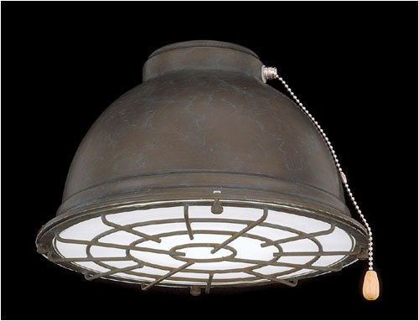
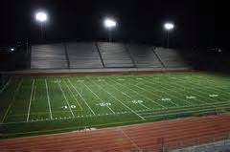
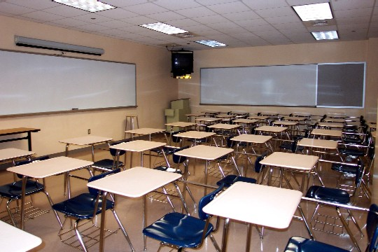
Harvesting the Low-Hanging Fruit
Turn Off Lights
Gym Lights 400 – 1,000 Watts
Stadiums $200 - $250 per hour
Notes:
A typical classroom with 12-2’x4’ ceiling fixtures uses 1,536 watts or about $460 per year.
Our middle school gyms average 6,600 watts or $2,000 annually. Middle and high schools are more.
Lighting a football stadium costs between $200 and $250 per hour.

Slide 11
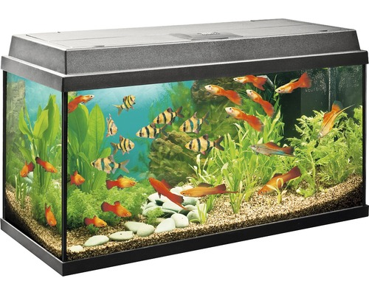
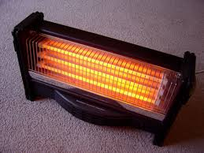
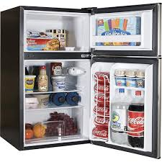
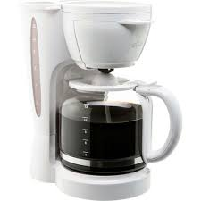
Harvesting the Low-Hanging Fruit
Remove personal appliances

Slide 12
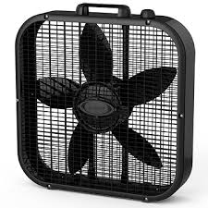
Keeping Comfortable
Fans
are
Accepted

Slide 13
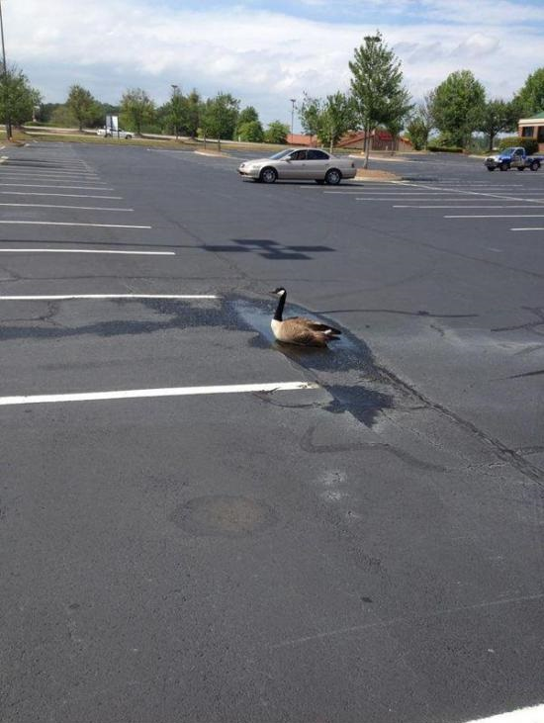
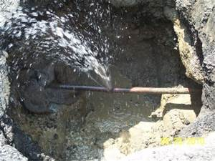
Report Maintenance Issues
Notes:
The puddle in the middle of the dry parking lot in this instance was actually an underground leak that cost the owner thousands of dollars in lost water.

Slide 14
Report Maintenance Issues

Slide 15
Give Yourself a Raise
Computers & Monitors
Lights
Air & Heat
Promethean Boards

