Slide 1
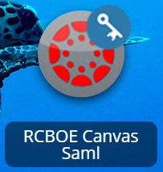
 | How do I login to Canvas?
Where do I go to login to Canvas?
> GO TO LAUNCHPAD
> LOGIN
> CHOOSE THE CANVAS ICON
What are my username and password?
USERNAME: YOUR RICHMOND COUNTY EMAIL ADDRESS EX: king.martinl@student.rck12.net
PASSWORD: THE SAME AS YOUR RICHMOND COUNTY PASSWORD
What if my username and password don't work?
LET YOUR TEACHER KNOW

Slide 2
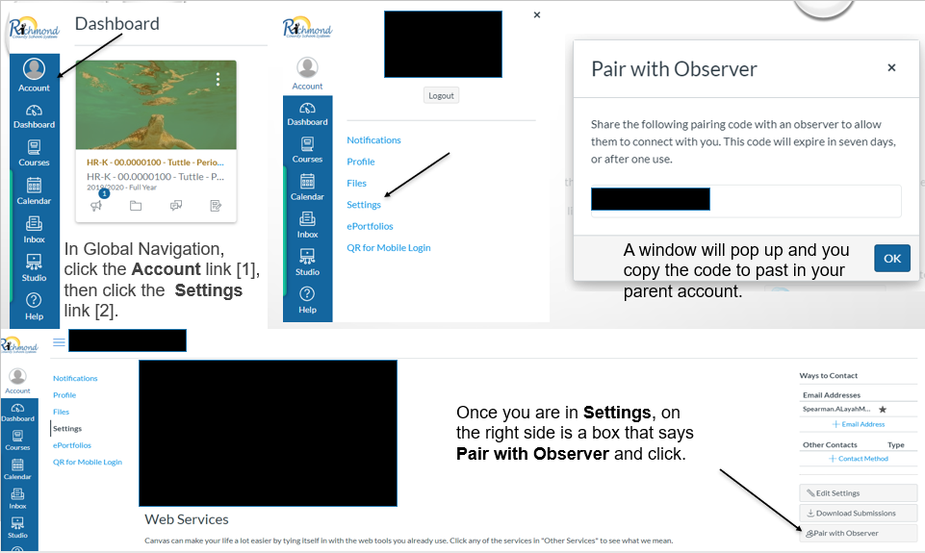

Slide 3
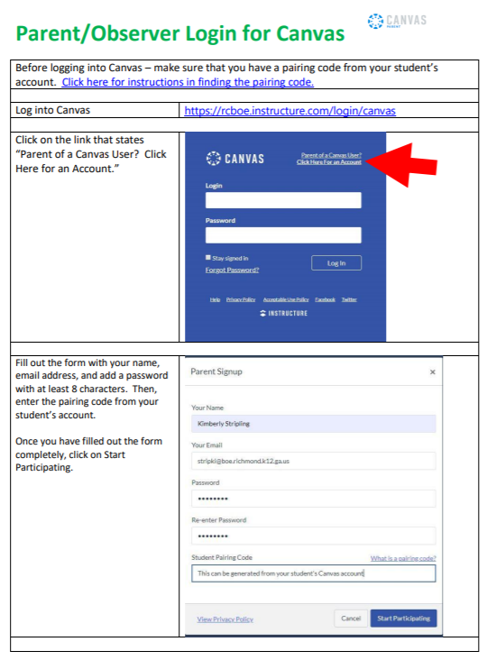

Slide 4
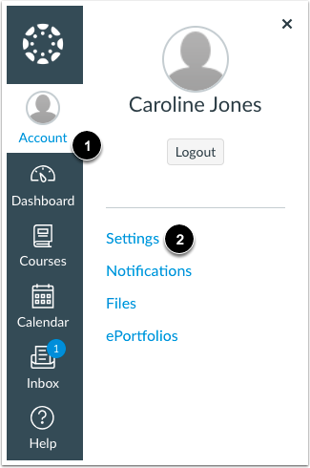
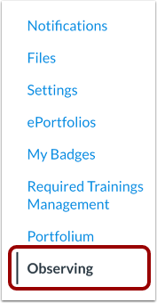
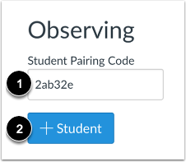
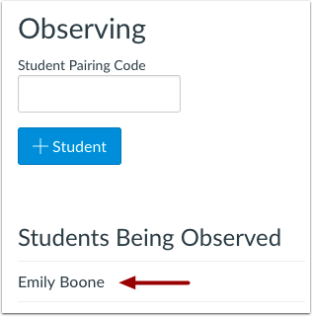
Type the pairing code in the Student Pairing Code field [1] and click the Add Student button [2].
In User Navigation, click the
Observing link.
View the
paired student.
In Global Navigation, click the
Account link [1], then click the
Settings link [2].

Slide 5
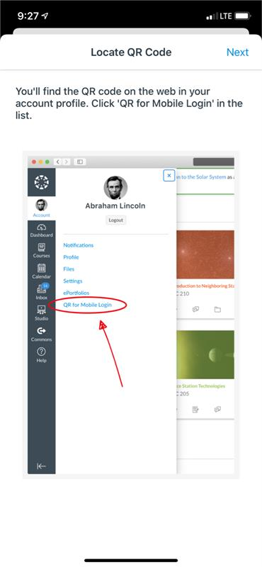
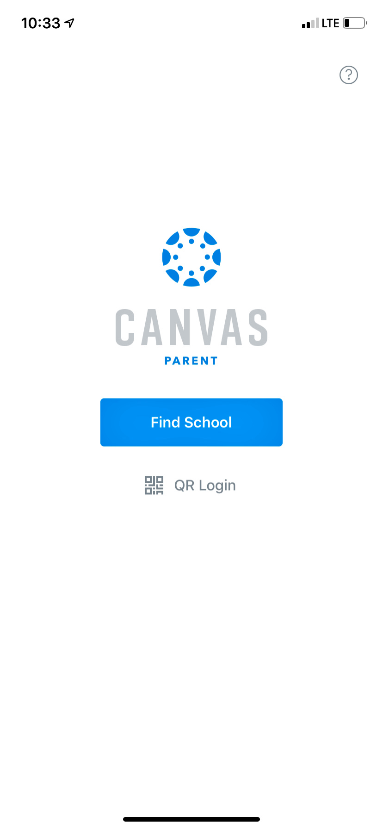
Pairing Parent Online Account with Parent App on Phone
computer
phone

