Slide 1
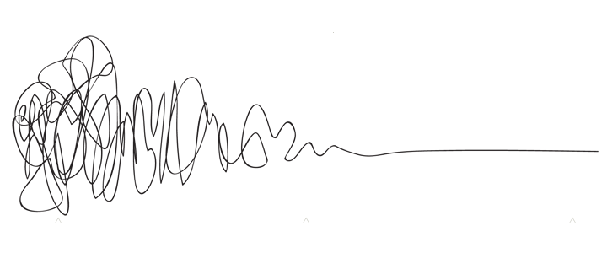
Advanced Mathematical Decision Making
with Ms. Lake
Overview
Advanced Mathematical Decision Making (AMDM) is designed to follow the completion of Advanced Algebra (or the equivalent). The course will give students further experiences with statistical information and summaries, methods of designing and conducting statistical studies, an opportunity to analyze various voting processes, modeling of data, basic financial decisions, and use network models for making informed decisions. Instruction and assessment should include the appropriate use of manipulatives and technology. Topics should be represented in multiple ways, such as concrete/pictorial, verbal/written, numeric/data-based, graphical, and symbolic. Concepts should be introduced and used, where appropriate, in the context of realistic phenomena.
Contact
Email:lakees@richmond.k12.ga.us Remind code: @lakealg23
Materials
Spiral Notebook
Calculator
Pencil
Grades
- Weekly Notebook
- Classwork
- Quizzes & Mini-Assessments
Tests & Unit Projects
Minor Grades- 60%
Major Grades-40%
Responsibilities & Expectations
Be on time and prepared
Keep track of your notebook for this class! Don’t lose it! Show all of your work and do your practice problems in the notebook.
Always be respectful and positive towards others, their work, and their ideas. Listen to others to help LEARN about their point of view, even if you don’t always agree with them.
Become comfortable with taking risks, pushing ourselves, and trying work outside of our comfort zone.
Communication, honesty, and transparency from everybody.
Take responsibility for our own learning (ask for help; participate in discussions; show our work and follow through with trying even when we’re unsure; take our practice work seriously).
If you want to retake an assessment then you must first complete a learning plan
Work needs to be done by the due date. Late work may be turned in up to two weeks after the due date. After two weeks work will not be accepted.
Students may keep their cellphones unless they become a distraction. If a student has to be told more than once to put away their phone, they will be asked to store it in cell jail and parents will be notified.
Student should follow the school behavior and dress code policies. Dress code issues will be sent to Mrs. Crawford, behavior issues will be dealt with in class and with parents depending on the severity.
Units
Using the Power of Mathematical Reasoning to Make Decisions
Using probability to Make Decisions
Using Statistical Studies to Make Decisions
Using Mathematical Models to Make Decisions
Using Vectors and Matrices to Make Decisions
Using Network Models to Make Decisions
Culminating Capstone Unit
“You are going to be solving problems in your future that haven’t even been thought of yet. You don’t only need to know how to find the answer to already-known problems; you need to learn the skills that will help you tackle the unthinkable problems of the future.”
What if I need help?
After school tutoring will be available on Tuesdays until 4:15. Your ride must be on time or else you will not be allowed to stay again.
Resources for each standard will be made available on Canvas
FEV tutor will be available for extra help

