Slide 1
Musical Deductions
Tech I-IV
Exercises in Emotional Responses

Slide 2
Track 1
Title: Ice Dance
By: Danny Elfman
https://www.youtube.com/watch?v=VMfs1rlw4tc
Emotions/Feeling/Mood created by music:

Slide 3
Track 2
Title: The Throne Room
By: John Williams
https://www.youtube.com/watch?v=248ggPoK158
Emotions/Feeling/Mood created by music:

Slide 4
Track 3
Title: One Day
By: Hans Zimmer
https://www.youtube.com/watch?v=cScVoZWVDLQ
Emotions/Feeling/Mood created by music:

Slide 5
Track 4
Title: The Mission Theme
By: Ennio Morricone
https://www.youtube.com/watch?v=oag1Dfa1e_E
Emotions/Feeling/Mood created by music:

Slide 6
Track 5
Title: One Last Wish
By: James Horner
https://www.youtube.com/watch?v=4duBXGPjYJM
Emotions/Feeling/Mood created by music:

Slide 7
Track 6
Title: First Blood
By: Jerry Goldsmith
https://www.youtube.com/watch?v=OFiSvI6WRi8
Emotions/Feeling/Mood created by music:

Slide 8
Track 7
Title: We had Today
By: Rachel Portman
https://www.youtube.com/watch?v=XwtbKaHvIMk
Emotions/Feeling/Mood created by music:

Slide 9
Track 8
Title: Fireworks
By: Lesley Barber
https://www.youtube.com/watch?v=e1LigboYmDE
Emotions/Feeling/Mood created by music:

Slide 10
Track 9
Title: The Fellowship
By: Howard Shore
https://www.youtube.com/watch?v=7CXGG3_prGA
Emotions/Feeling/Mood created by music:

Slide 11
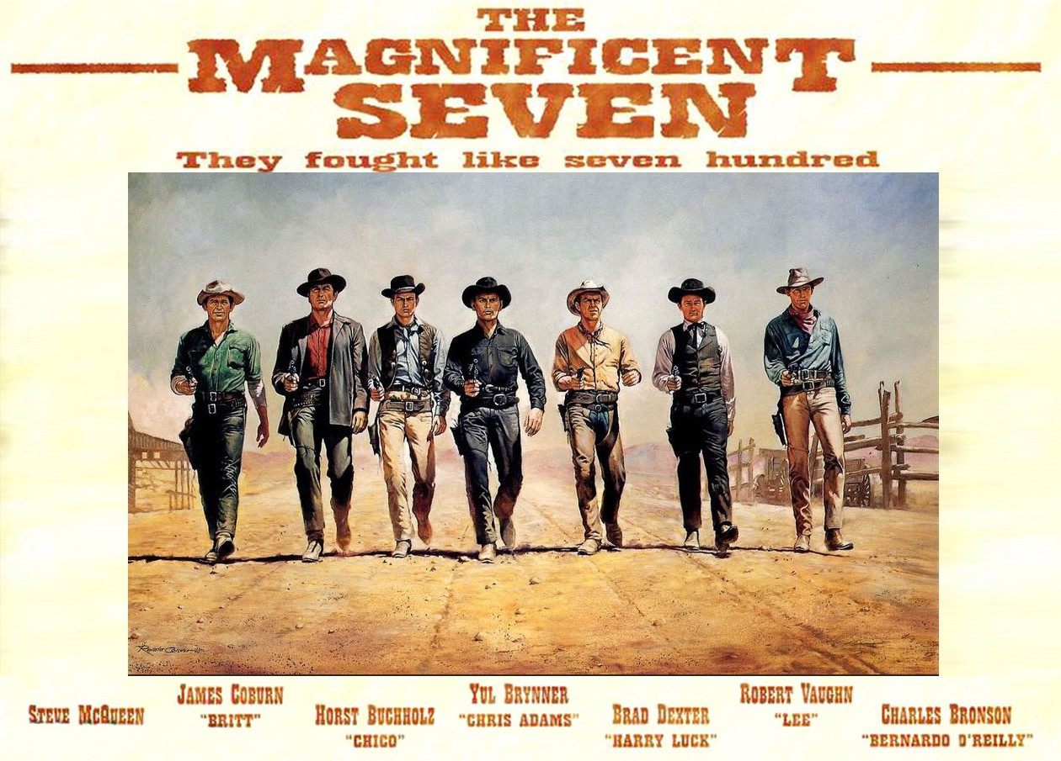
Track 10
Title: The Magnificent Seven
By: Elmer Bernstein
https://www.youtube.com/watch?v=8XDB7GMnbUQ
Emotions/Feeling/Mood created by music:

Slide 12
Track 11
Title: To Kill A Mocking Bird Main title
By: Elmer Burnstein
https://www.youtube.com/watch?v=_t98LWNwUhI
Emotions/Feeling/Mood created by music:

Slide 13
Track 12
Title: Race of Truth
By: Epic Score
https://www.youtube.com/watch?v=7qgFxpMkgHo
Emotions/Feeling/Mood created by music:

Slide 14
Track 13
Title: New Frontiers
By: Ross Bugden
https://www.youtube.com/watch?v=4NGZQqPpDMw
Emotions/Feeling/Mood created by music:

Slide 15
Track 14
Title: Finding Neverland
By: Jan A. P. Kacmarek
https://www.youtube.com/watch?v=xFoP8QKal_g
Emotions/Feeling/Mood created by music:

Slide 16
Track 15
Title: Jaws Theme
By: John Williams
https://www.youtube.com/watch?v=ZDcrMScGaj8
Emotions/Feeling/Mood created by music:

Slide 17
Track 16
Title: Skyfall
By: Adele and producer Paul Epworth and features orchestration by J. A. C. Redford.
https://www.youtube.com/watch?v=DeumyOzKqgI
Emotions/Feeling/Mood created by music:

Slide 18
Track 17
Title: Beauty and the Beast - Transformation
By: Alan Menken
https://www.youtube.com/watch?v=tH9RTuaUL8k
Emotions/Feeling/Mood created by music:

Slide 19
Track 18
Title: Psycho Theme
By: Bernard Herrmann
https://www.youtube.com/watch?v=qMTrVgpDwPk
Emotions/Feeling/Mood created by music:

Slide 20
Track 19
Title: Concerning Hobbits
By: Howard Shore
https://www.youtube.com/watch?v=CL_3mlOPnGI
Emotions/Feeling/Mood created by music:

Slide 21
Track 20
Title: Hedwig’s Theme
By: John Williams
https://www.youtube.com/watch?v=wtHra9tFISY
Emotions/Feeling/Mood created by music:

Slide 22
Track 21
Title: La La Land Epilogue
By: Justin Hurwitz
https://www.youtube.com/watch?v=HSg3tBzAVFk
Emotions/Feeling/Mood created by music:

Slide 23
Track 22
Title: Sherlock Theme
By: Michael Price and David Arnold
https://www.youtube.com/watch?v=pFy94O0RLOg&list=PL9n0ervSoSibGft5wUcSwG14uAVpp5s6r&index=1
Emotions/Feeling/Mood created by music:

Slide 24
Track 23
Title: Blade Runner Theme
By: Vangelis
https://www.youtube.com/watch?v=JAwo7DPUFUM
Emotions/Feeling/Mood created by music:

Slide 25
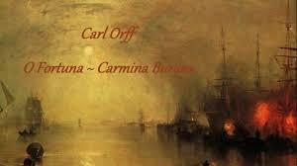
Track 24
Title: O Fortuna – Carmina Burana
By: Carl Orff
https://www.youtube.com/watch?v=GXFSK0ogeg4
Emotions/Feeling/Mood created by music:

