Slide 1
Read and analyze documents H and I and answer the following questions…..
How does President Jefferson Davis of the CSA and President Lincoln present their beliefs concerning southern secession?
In your opinion, which is more believable? Why?

Slide 2
FACTS ABOUT THE CIVIL WAR
Most tragic moment in American history----the struggle for the heart and soul of America.
Equality of all men in question
Both sides fighting to preserve their traditions
Brother vs brother---family vs family
1 out of 4 soldiers would die in this conflict
10,000 battles in the Civil War
War has been called the War for Southern Independence and the War Against Northern Aggression.

Slide 3
FACTS ABOUT THE CIVIL WAR
War would destroy 1 America and build another.
Almost as many died in this war as all wars combined before and since.
It is America’s bloodiest war.
1 out of 7 Civil War soldiers injured would die in field hospitals, whereas, in the Vietnam War, 1 out of 270 injured soldiers would die in MASH units.
First war of the Industrial Revolution---new weapons would cause massive destruction against outdated military tactics.

Slide 4
FACTS ABOUT THE CIVIL WAR
50,000 books, hundreds of songs and poems written during the Civil War
Schools, parks and streets named after heroes of the Civil War
Confederate Flag controversial in our society today.
Preserved the Union and democracy
Slavery abolished, African Americans become citizens with the right to vote, but the equality of all men continues to be a struggle in our country today.

Slide 5
FACTS ABOUT THE CIVIL WAR
DIFFERENT VIEWS ON THE WAR
Slavery war to blame
Agricultural vs. industrial societies
Sectionalism
War was good
State’s rights vs. National Government
Preserve the Union and democracy

Slide 6
Notes 1
THE CIVIL WAR
1861 to 1865
Confederate States of America----CSA
Jefferson Davis---President
Confederate Constitution
Firing on Fort Sumter, April 12, 1861
Lincoln needed border states
South fires first shot
Suspends Constitution
NORTH VS. SOUTH
Advantages
Strategy
Military leaders
Border states were slave states but remained loyal to the North…Lincoln needed them….. Maryland, Delaware, Kentucky and Missouri……..

Slide 7
Notes 2
4. THE WAR YEARS: 1861 TO 1863-----Turning points
Battle Fronts
Western Theater------------------------Eastern theater
Summary: USA is defeating the CSA because of General Grant
1861 to 1863
Summary: CSA is defeating the USA because of General Lee
Lincoln’s “first steps” to abolish slavery
Emancipation Proclamation--Jan. 1863
freed slaves in states still in rebellion
Kept Great Britain out the war
Freed slaves can fight for the Union army
Union troops: “freedom fighters”

Slide 8
Notes 3
Key Union victories in July 1863
Vicksburg
Gettysburg
Pickett’s Charge
Lincoln’s Gettysburg Address

Slide 9
Flags: North/South
NORTH VS SOUTH
BLUE/USA
United States of America or Union
President Abraham Lincoln
Capital: Washington, D.C.
Feds-----Federal
Yanks-----Yankees
Bluebellies
Blue coats
GRAY/CSA
Confederate States of America
President Jefferson Davis
Capital: Richmond, VA
Rebs------Rebels---”Johnny Rebs”
Secessh-------Seccession
Graycoats
Yellow bellies

Slide 10
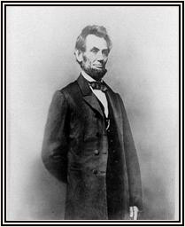
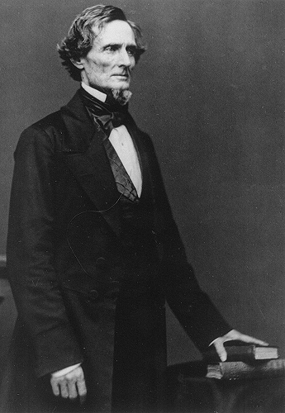
Lincoln/Davis
LINCOLN VS DAVIS
vs
Born in Kentucky
Self-educated
Congressmen from Illinois
Abolitionist
First Presidential candidate for the Republican Party
Minority president
Born in Kentucky
Served as Secretary of War
Senator from Mississippi
Slaveowner
Served as Secretary of State
First and only President of the CSA

Slide 11
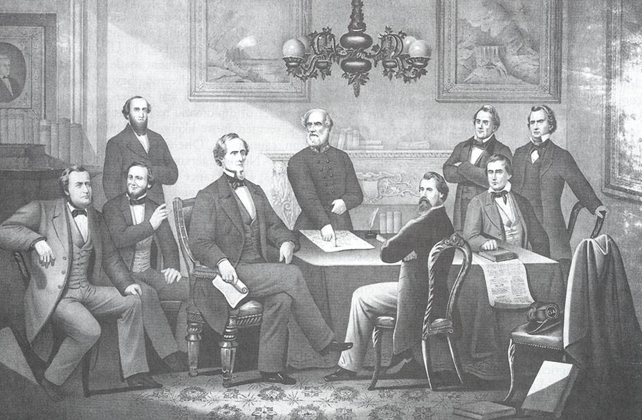
Rebel Cabinet
CONFEDERATE CABINET

Slide 12
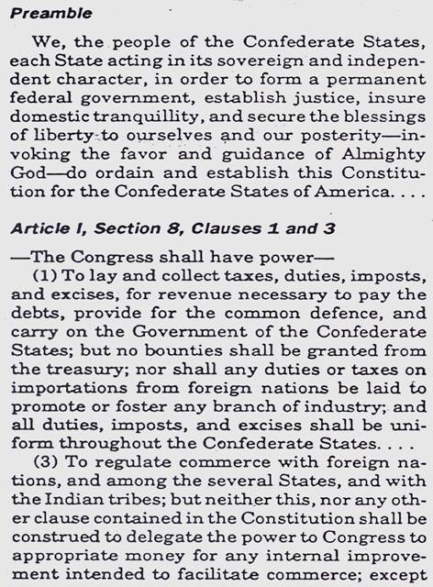
CSA Constitution
CONFEDERATE CONSTITUTION
When the Confederate States of America was formed, its founders wrote a constitution similar to the United States Constitution. Its differences, however, indicate how the South Wanted to change their structure of government.

Slide 13
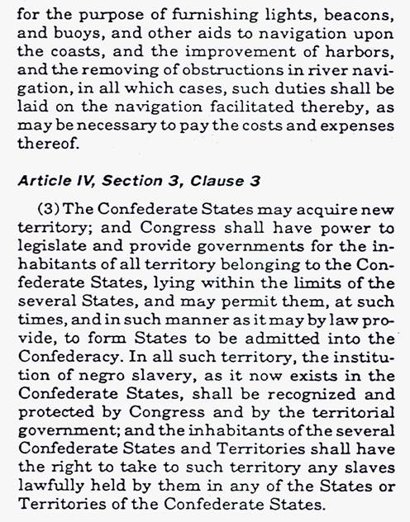
CSA Constitution
CONFEDERATE CONSTITUTION
MAIN DIFFERENCES:
State’s rights
Tariffs are equal throughout the CSA
Slavery is legal and is allowed to expand!

Slide 14
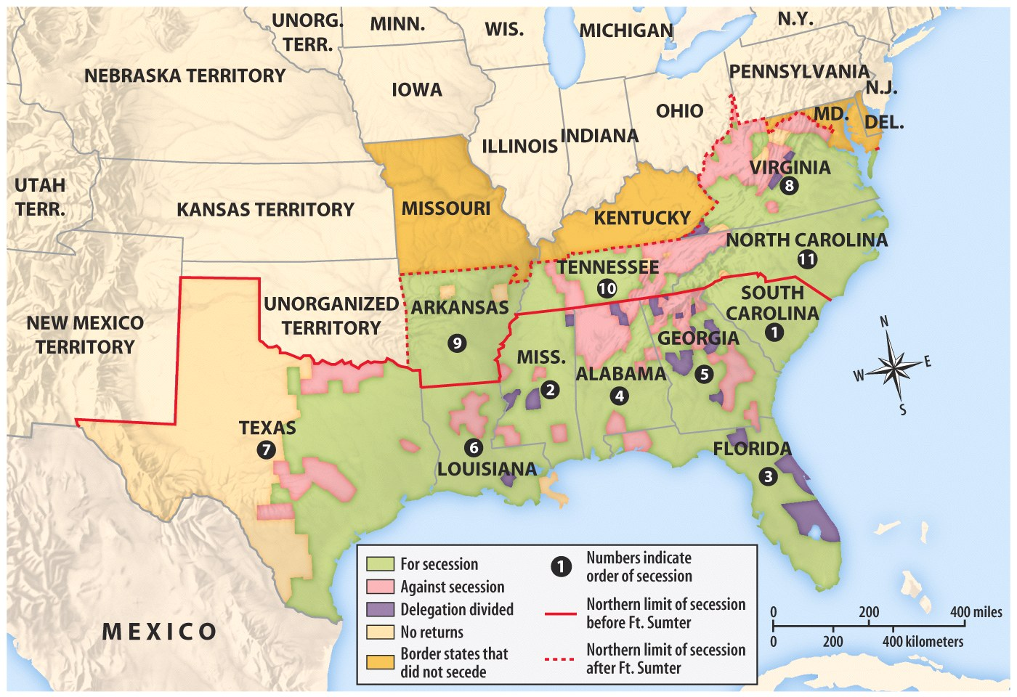

Slide 15
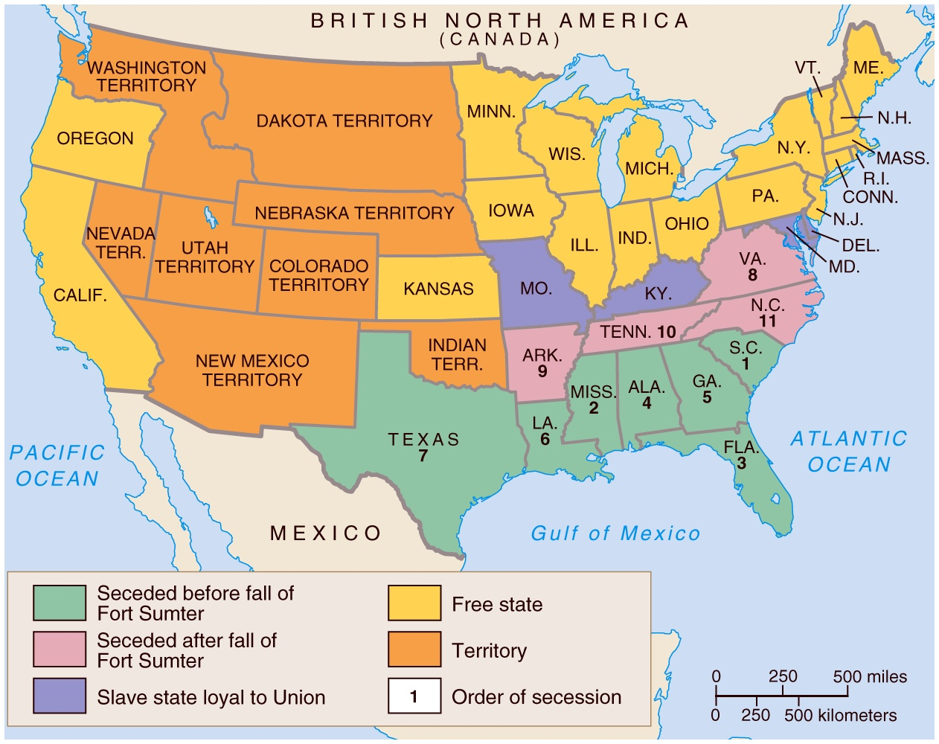
Secession

Slide 16
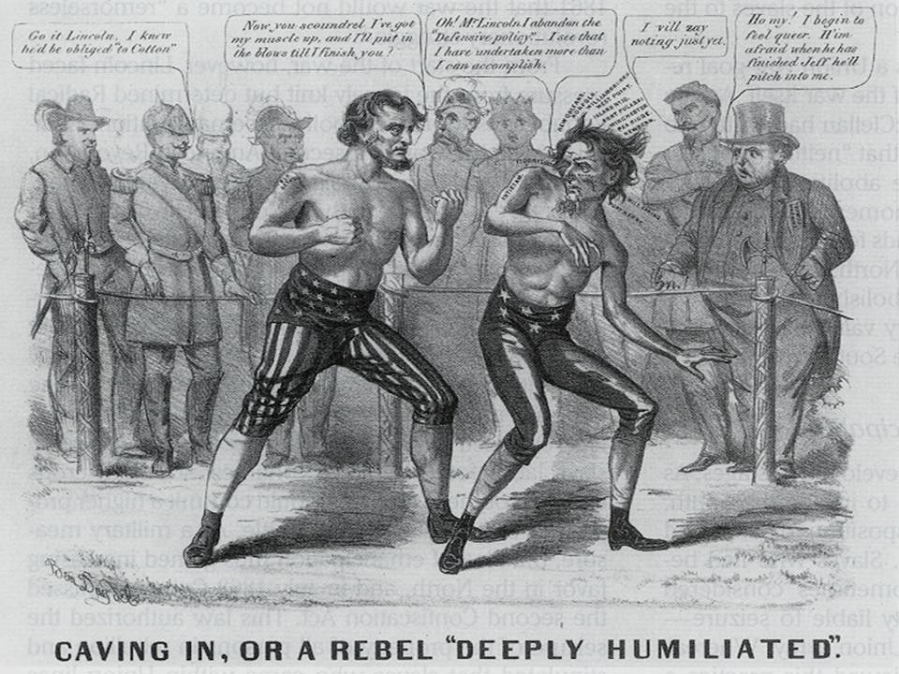
Cartoon: Lincoln vs Davis

Slide 17
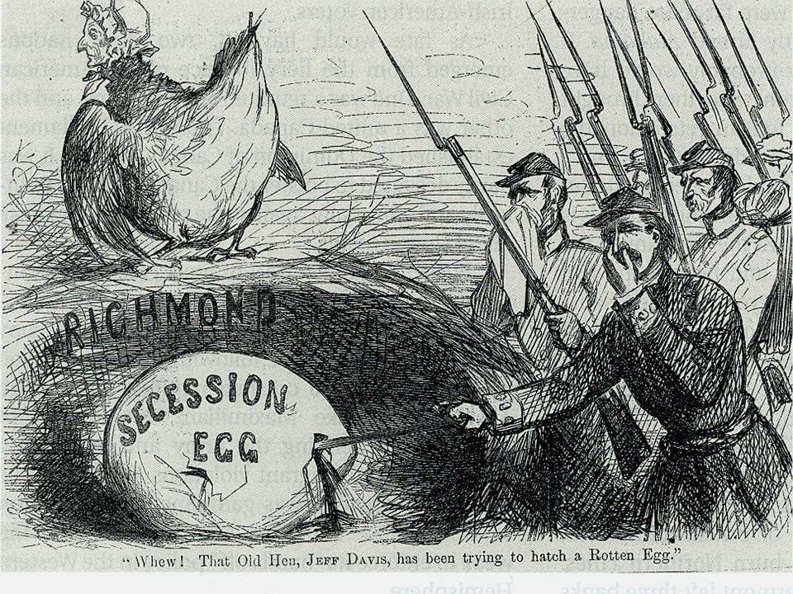
Cartoon: North thought of secession

Slide 18
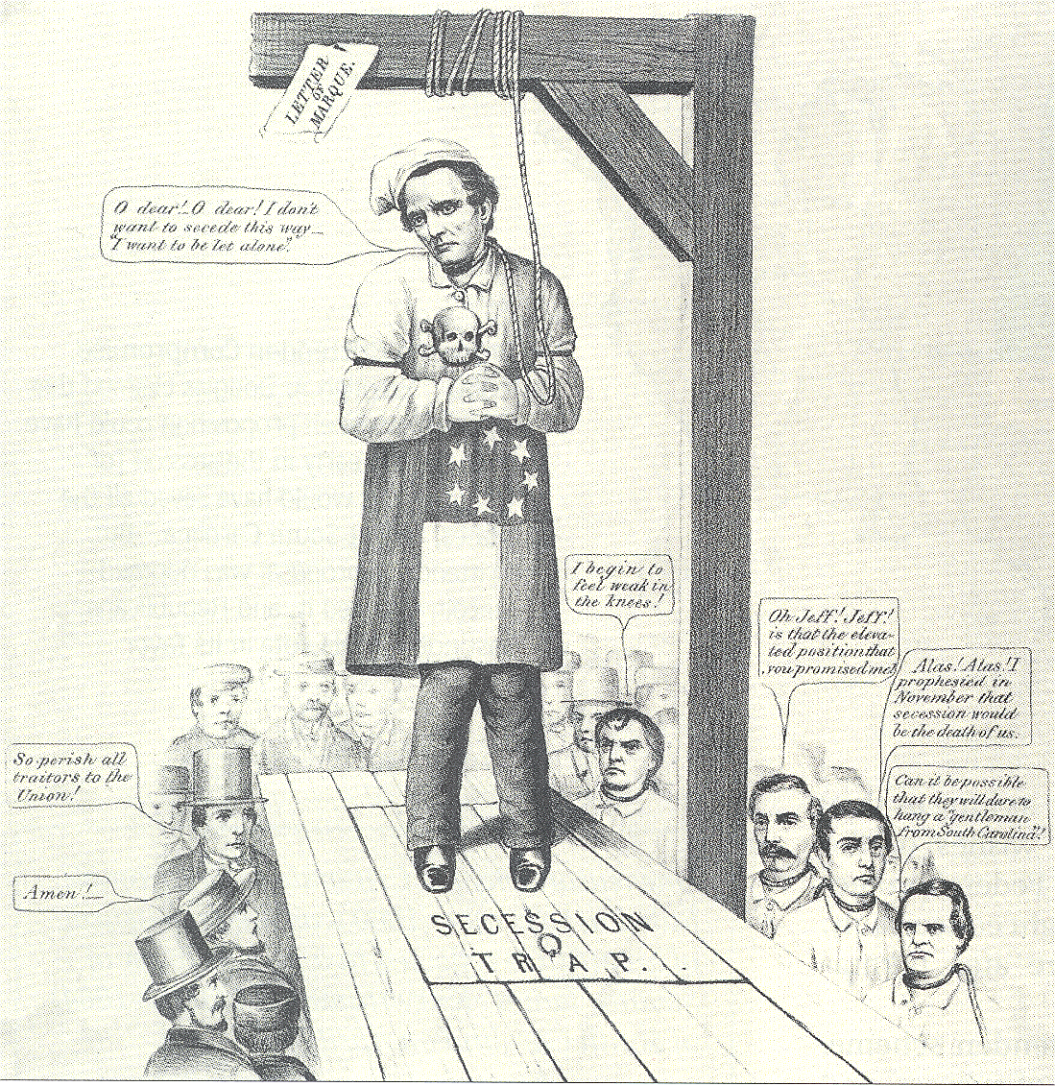
Cartoon: Davis hanging himself

Slide 19
Alexander H. Stephens (1812-1883), destined the next year to become vice president of the new Confederacy, wrote privately in 1860 of the Southern Democrats who seceded from the Charleston convention:
“The seceders intended from the beginning to rule or ruin; and when they find they cannot rule, they will then ruin. They have about enough power for this purpose; not much more; and I doubt not but they will use it. Envy, hate, jealousy, spite…..will make devils of men. The secession movement was instigated by nothing but bad passions.”

Slide 20
Lincoln wrote to the antislavery editor Horace Greeley in August 1862, even as he was about to announce the Emancipation Proclamation:
“If I could save the Union without freeing any slave, I would do it; and if I could save it by freeing all the slaves, I would do it; and if I could do it by freeing some and leaving others alone, I would also do that.”

Slide 21
Jefferson Davis On the War
"I tried all in my power to avert this war. I saw it coming, for twelve years I worked night and day to prevent it, but I could not. The North was mad and blind; it would not let us govern ourselves, and so the war came, and now it must go on till the last man of
this generation falls in his tracks, and his children seize the musket and fight our battle, unless you acknowledge our right to self government. We are not fighting for slavery. We are fighting for Independence, and that, or extermination".........

Slide 22
Regarding the Civil War, the London Times (November 7, 1861) editorialized
“The contest is really for empire on the side of the North and for independence on that of the South, and in this respect we recognize an exact analogy between the North and the Government of King George III, and the South the Thirteen Revolted Provinces.”

Slide 23
Abraham Lincoln (1809-1865), Kentucky born like Jefferson Davis, was aware of Kentucky’s crucial importance. In September 1861 he remarked,
“I think to lose Kentucky is nearly the same as to lose the whole game. Kentucky gone, we cannot hold Missouri, not, I think, Maryland. These all against us, and the job on our hands in too large for us. We would as well consent to separation at once, including the surrender of this capital, Washington, D.C.

Slide 24
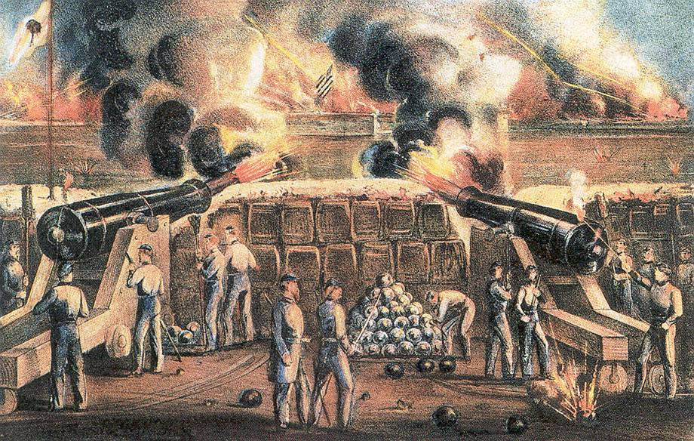
Picture: Fort Sumter 1
SOUTH FIRES ON FORT SUMTER

Slide 25
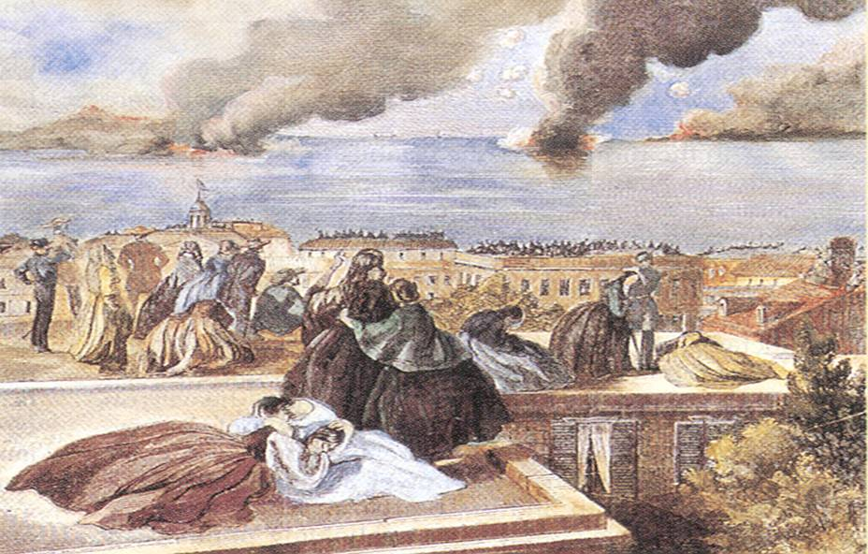
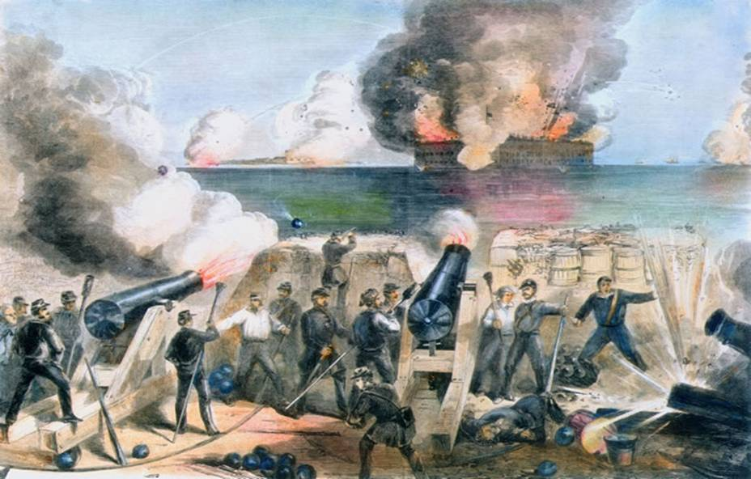
Fort Sumter 2
SOUTH FIRES ON FORT SUMTER

Slide 26
Lincoln and Liberty
LINCOLN AND LIBERTY TOO
Hurrah for the choice of the nation….Our chieftain so brave and so true. We’ll go for the great reformation…For Lincoln and liberty too.
We’ll go for the son of Kentucky…The hero of hoosierdom through…The pride of the suckers so lucky…For Lincoln and liberty too.
Then up with the banner so glorious…The star-spangled red, white and blue…We’ll fight ‘til our banner’s victorious…For Lincoln and liberty too…
Come all you true friends of the nation…Attend to humanity’s call…Come aid in the slaves’ liberation…And roll on the liberty ball.
And roll on the liberty ball…And roll on the liberty ball… Come aid in the slaves’ liberation. And roll on the liberty ball….
We’ll finish the temple of freedom…And make it capacious within…That all who seek shelter may find it…Whatever the hue of their skin…
Whatever the hue of their skin…That all who seek shelter may find it…Whatever the hue of their skin…
Success to the old-fashioned doctrine…That men are created all free…And down with the power of the despot…Wherever his stronghold may be
Wherever his stronghold may be….Wherever his stronghold may be…And down with the power of the despot…Wherever his stronghold may be

Slide 27
Dixie
DIXIE LAND
I wish I was in the land of cotton, old times there are not forgotten, Look
away, look away, look away, Dixie land. In Dixie land where I was born in,
early on a frosty mornin',Look away, look away, look away, Dixie land.
Chorus:
Then I wish I was in Dixie, hooray! Hooray! In Dixie land I'll take my stand, to live and die in Dixie, Away, away, away down south in Dixie, Away, away, away down south in Dixie.
Southrons, hear your country call you! Up, lest worse than death befall you! To arms! To arms! To arms, in Dixie! Lo! All the beacon-fires are lighted, Let all hearts be now united! To arms ! To arms! To arms, in Dixie!
Chorus:
Advance the flag of Dixie Hurrah! Hurrah! For Dixie's land we take our stand, And live or die for Dixie! To Arms! To Arms! And conquer peace for Dixie...To Arms! To Arms And conquer peace for Dixie
Chorus:
Hear the Northern thunders mutter! Northern flags in South winds flutter! To arms ! To arms! To arms, in Dixie! Send them back your fierce defiance! Stamp upon the accursed alliance! To arms ! To arms! To arms, in Dixie!

Slide 28
Dixie
DIXIE LAND
Chorus:
Advance the flag of Dixie Hurrah! Hurrah! For Dixie's land we take our stand, And live or die for Dixie! To Arms! To Arms! And conquer peace for Dixie To Arms! To Arms And conquer peace for Dixie
Chorus: Fear no danger! Shun no labor! Lift up rifle, pike and saber! To arms ! To arms! To arms, in Dixie! Shoulder pressing close to shoulder, Let the odds make each heart bolder! To arms ! To arms! To arms, in Dixie!
Chorus: Swear upon our country's altar. Never to submit or to falter, To arms ! To arms! To arms, in Dixie! Till the spoilers are defeated, Till the Lord's work is completed! To arms ! To arms! To arms, in Dixie!
Chorus:

Slide 29
Chart: North/South
NORTH AND SOUTH COMPARED
Based on %

Slide 30
NORTH VS SOUTH
22 states
23,000,000 population
Industrial economy
Majority of transportation
Lincoln, a military novice.
Asks Robert E. Lee to command Union troops and declines
Belief war is about slavery and preserving the Union.
11 states
10,000,000
includes 4 million slaves
Agricultural economy
Exports, not food
Limited manufacturing and railroad lines.
Davis, military experience.
Better military leaders
Belief war is about states rights, independence and preserving their war of life.
“The North’s major advantage would be its economy and the South’s main disadvantage was its economy”

Slide 31
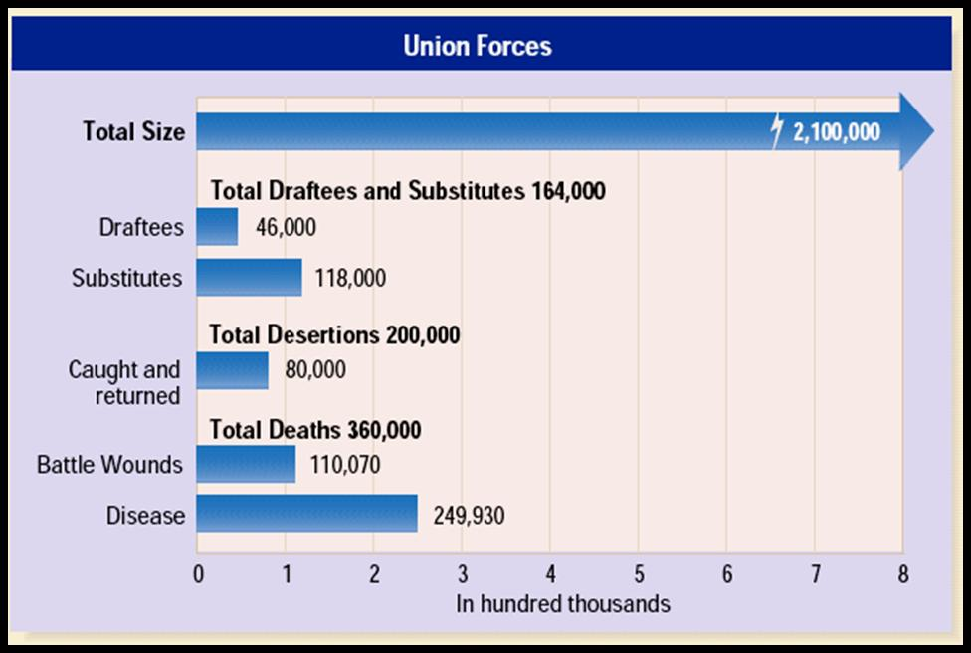
NORTH

Slide 32
SOUTH

Slide 33
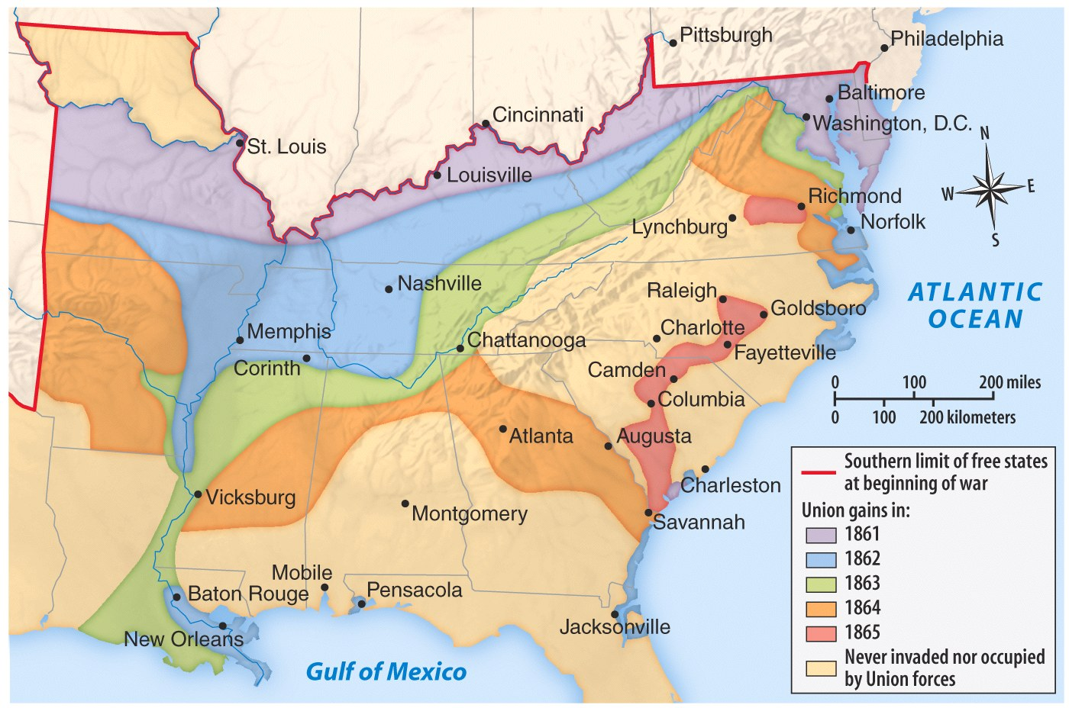
Eastern Theater
Western Theater

Slide 34
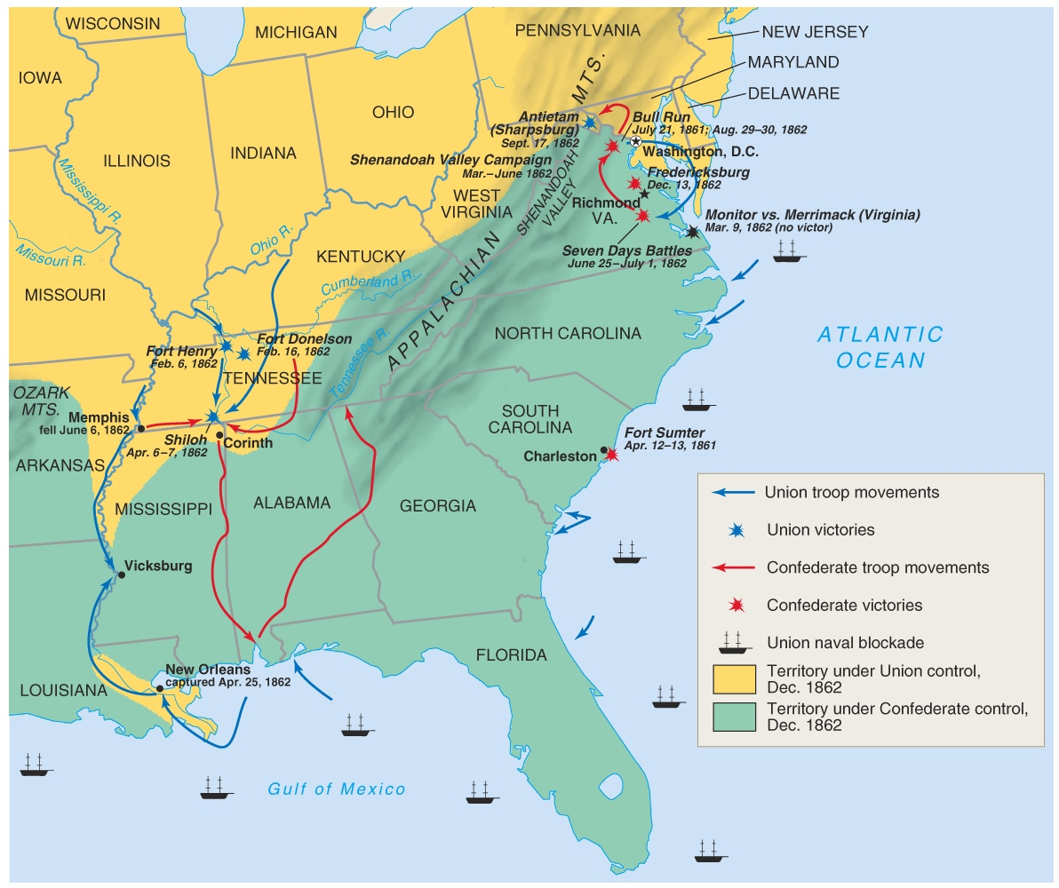
Theater/Battles 1862

Slide 35
Secession
VA. 8
West Virginia secedes from Virginia in 1863 and sides with USA.
Border states/slaves states remain loyal to the Union

Slide 36
LINCOLN'S "NECESSARY" ACTIONS
Suspended “civil liberties” or parts of the Constitution
writ of habeas corpus: Protects from unfair arrest and trial by jury.
Occupation of Baltimore: Controlled by military---- “martial law”
Arrested over 15,000 civilians: Without “probable cause”---suspicious “Rebel” sympathizers.
Closed “rebel” newspapers: Violated 1st amendment rights of “free speech and press”.
First Income Tax
Greenbacks
1st paper money

Slide 37
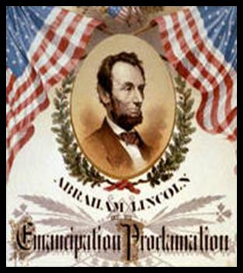
EMANCIPATION PROCLAMATION
Abolitionists pressured Lincoln to free the slaves.
After the Battle of Antietam, he announced that the slaves would be freed.
Became effective on Jan. 1, 1863, in those states still in rebellion.
Emancipation Proclamation did not end slavery in US
Lincoln’s “first” step towards ending slavery.
“Final step” 13th Amendment to the Constitution on Dec. 1865 would legally and constitutionally abolish slavery.

Slide 38
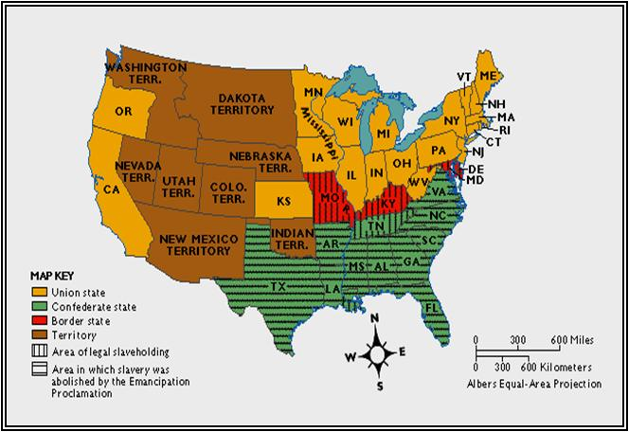
EMANCIPATION PROCLAMATION
Freed all slaves in states in rebellion against the US
Did not apply to slaves in border states fighting for US
No affect on southern areas already under US control.
War was NOW fought to end slavery.
US soldiers were “Freedom Fighters”

Slide 39
EMANCIPATION PROCLAMATION
Kept Great Britain from siding with the South
and becoming an ally.
War was now a war to
abolish slavery
destroy the South
preserve the Union

Slide 40
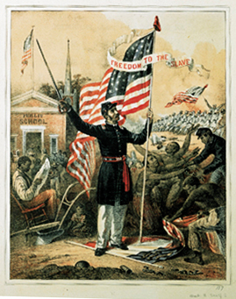
EMANCIPATION PROCLAMATION
Freedom to the Slave, 1863
Picture celebrated the Emancipation Proclamation in 1863.
While it placed a white Union soldier in the center:
It also portrayed the important role of African American troops and emphasized the importance of education and literacy.

Slide 41
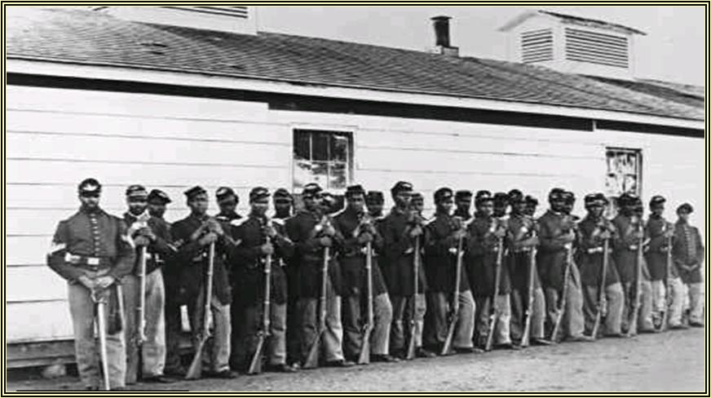
BLACK TROOPS
Black troops
Over 200,000 freed slaves fought for the US…..
Famous 54th Black Regiment of Massachusetts which was organized by Frederick Douglass…..

Slide 42
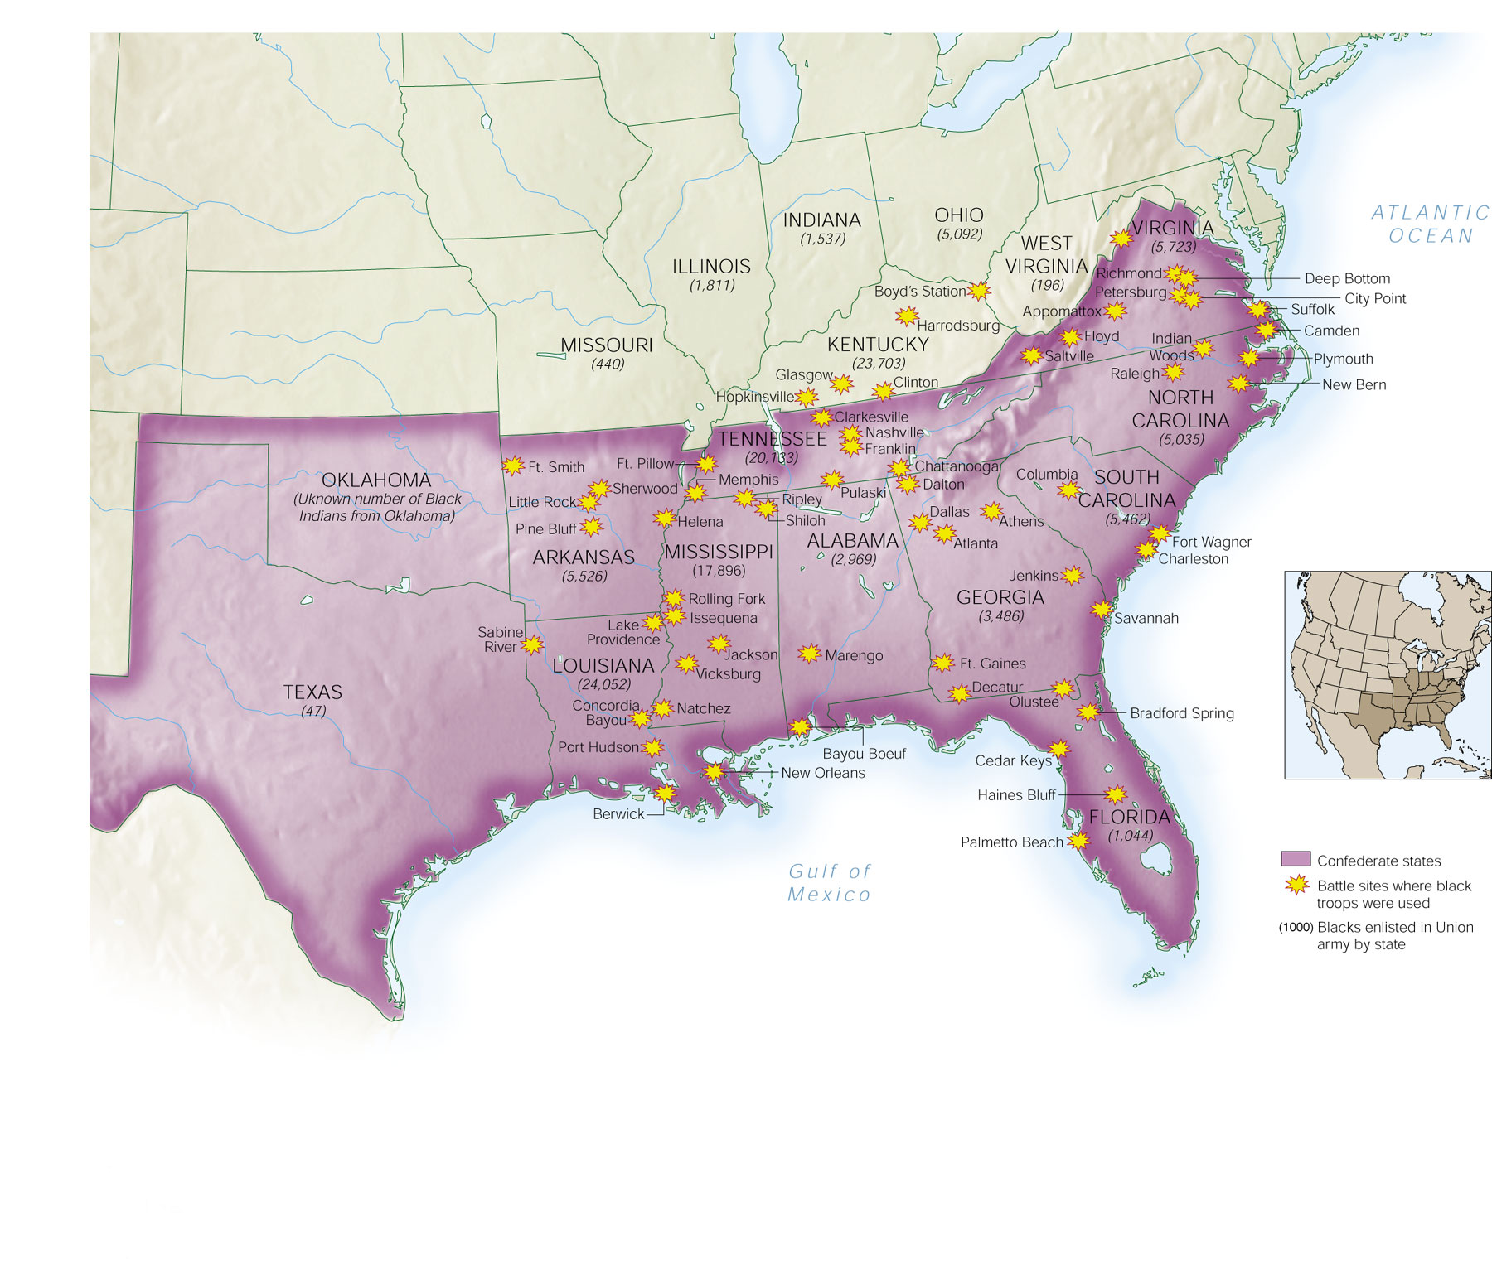
African Americans in Civil War

Slide 43
The President’s
Abraham Lincoln
Jefferson Davis

Slide 44
The General’s
Ulysses S. Grant
Robert E. Lee

Slide 45
The General’s Main Men
William T. Sherman
Stonewall Jackson

Slide 46
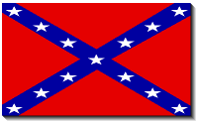
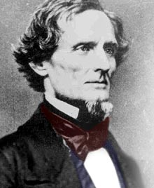
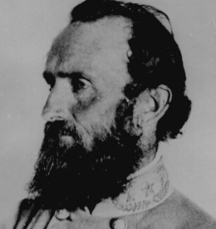
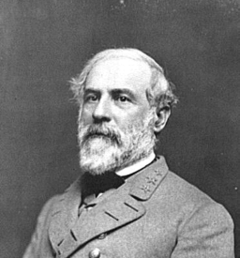
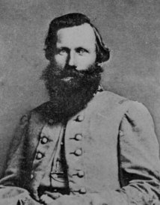
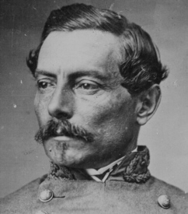
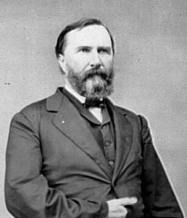
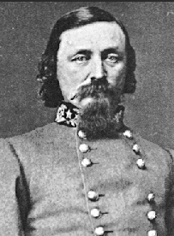
South Leaders
Jefferson Davis
Stonewall Jackson
Robert E. Lee
Jeb Stuart
James Longstreet
George Pickett
Pierre T. Beauregard

Slide 47
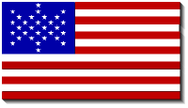
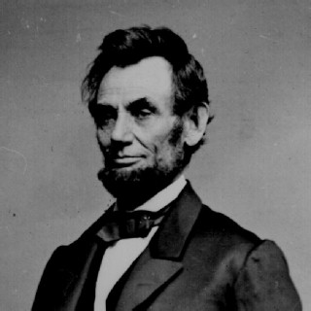
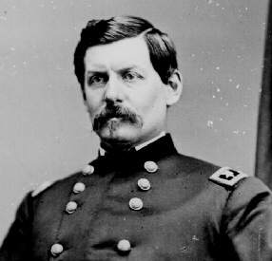
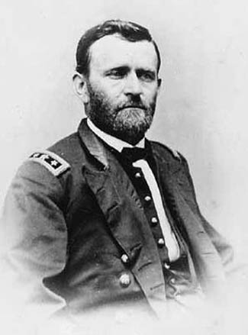
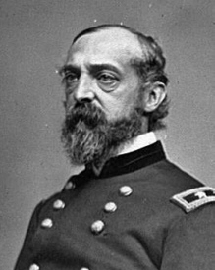
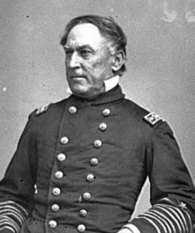
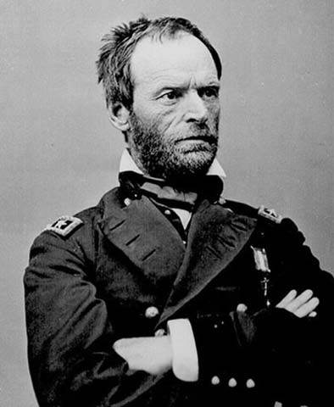
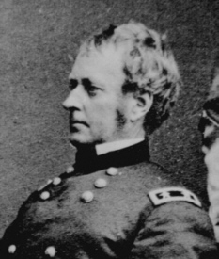
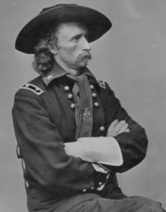
South Leaders
Abe Lincoln
George McClellan
Ulysses Grant
George Meade
David Farragaut
William T. Sherman
Joseph Hooker
George A. Custer

Slide 48
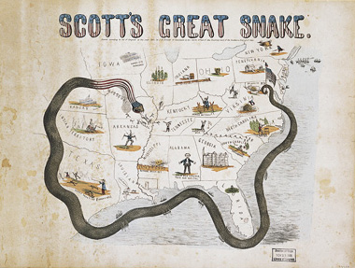
UNON STRATEGY
Aggressive offensive to crush the rebellion.
War of attrition: South has less manpower…
Gen Winfield Scott’s Anaconda Plan
Control river systems: Ohio and Mississippi
Blockade and seizure of ports
War goal: Preserve Union and later abolish slavery
Capture Richmond
Don’t allow Confederacy to rest.
Napoleonic tactics at first----later “trench warfare”

Slide 49
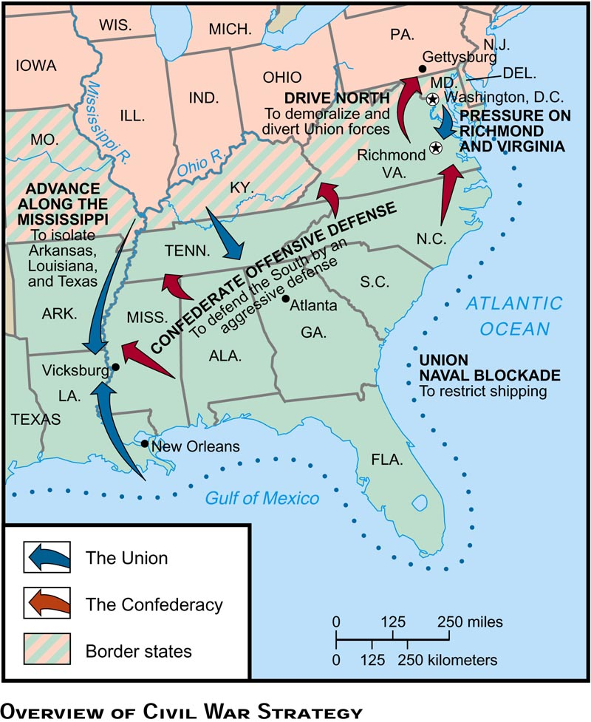
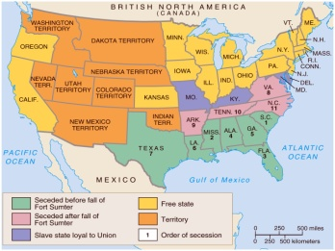
Strategy

Slide 50
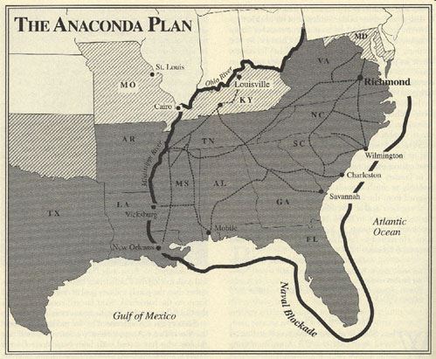

Slide 51
CONFEDERATE STRATEGY
Defend and delay until Union gives up.
Quick victories to demoralize Union
Alliance with Great Britain
Capture Washington, D.C.
Defend Richmond
Sought decisive battle that would convince the Union it wasn’t worth it
Use better military leadership to your advantage and outsmart Union generals.

Slide 52
Theater/Battles 1862

Slide 53
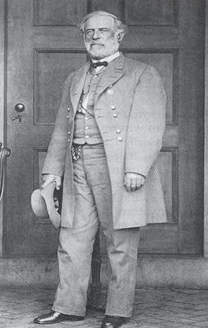
KEY BATTLES IN THE EAST
Union Strategy
Capture Richmond, Virginia
Union Leaders
Several different leaders: Winfield Scott, George McClellan, John Pope, Ambrose Burnside, Joe Hooker, George Meade, Ulysses Grant
Union Army
Army of the Potomoc
Confederate Strategy
Capture Washington, D.C.
Confederate Leader
General Robert E. Lee
Confederate Army
Army of Virginia
CSA General Robert E. Lee

Slide 54
Battles in East 1
KEY BATTLES IN THE EAST
DATE BATTLE VICTOR RESULT
July 1861 Bull Run South Union retreats to Wash. D.C.
Manasses
June 1862 7 Days South Lee stops McClellan from taking Richmond
August 1862 Bull Run South Lee stops John Pope from taking Richmond
*Sept. 1862 Antietam Draw McCellan stops Lee from taking Washington, D.C. Lincoln issues Emancipation Proclamation
*Turning Point battle

Slide 55
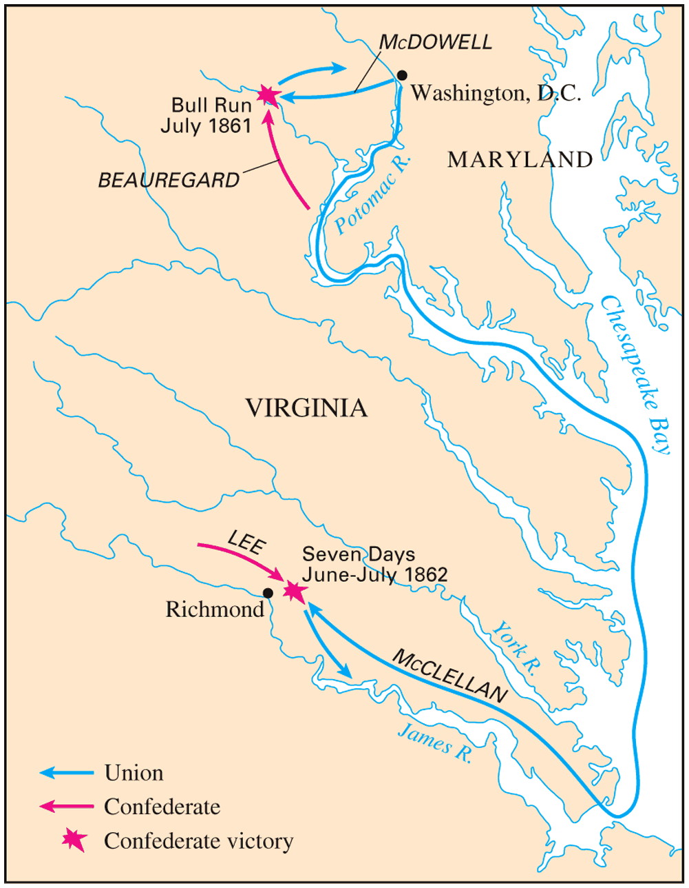
Battle of Bull Run (1st Manassas), July, 1861
Lincoln sent 30,000 inexperienced soldiers to fight at Bull Run.

Slide 56
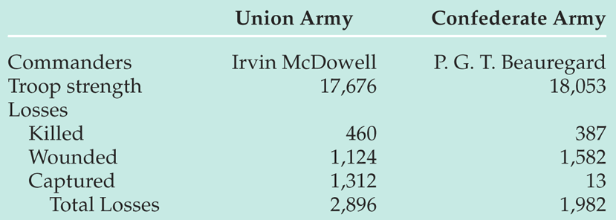
Battle of Bull Run (1st Manassas), July, 1861
Northern troops were pushed back to D.C.
South won this battle but “lost the war”.
WHY? Failed to capture Washington, D.C.
Would never be so close to Washington, D.C.

Slide 57
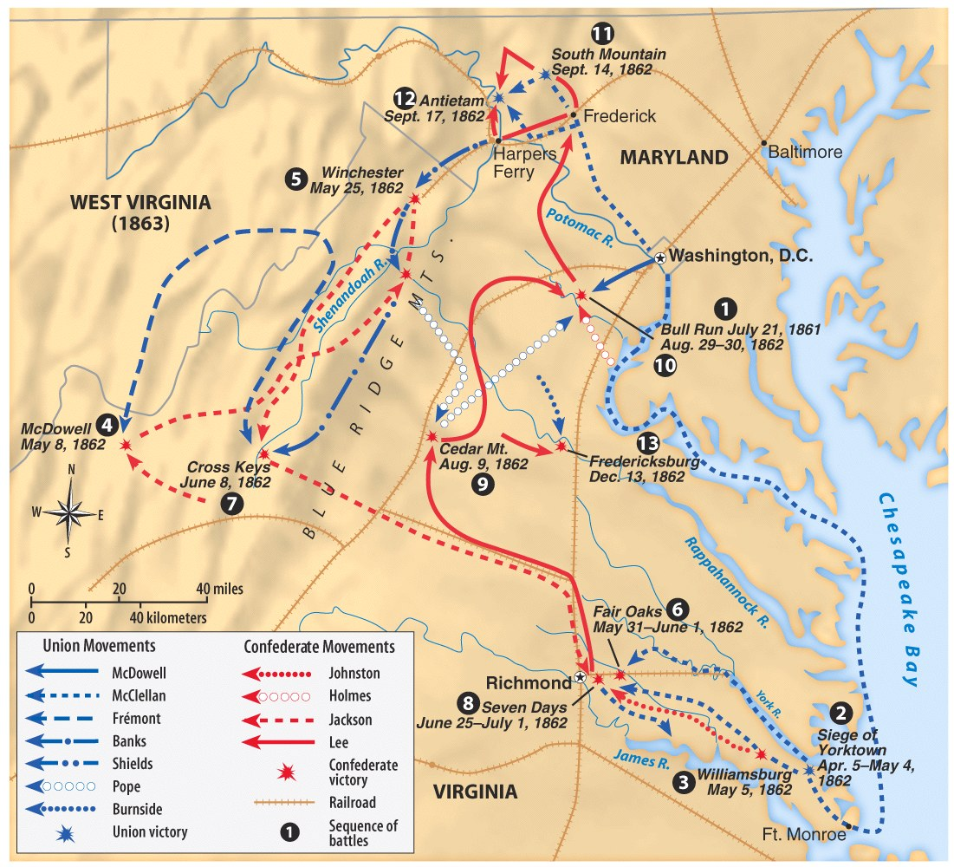

Slide 58
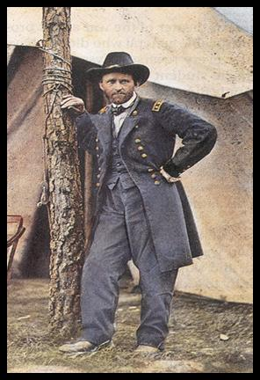
KEY BATTLES IN THE WEST
Union Strategy
Control river systems and split the Confederacy in half and isolate the 3 sections.
Union Leaders: General Ulysses S. Grant
Union Army: Army of the West
Confederate Strategy
Fight a defensive war and drive Union out of South
Confederate Leader: Several different generals
Confederate Army: Army of Tennessee
USA General Ulysses S. Grant

Slide 59
Battles in West 1
KEY BATTLES IN THE WEST
DATE BATTLE VICTOR RESULT
Feb. 1862 Fort Donelson Union Controlled the Ohio River
March 1862 Fort Henry Union Controlled Cumberland River
April 1862 Shiloh Union Controlled Tennessee River
April 1862 New Orleans Union Controlled mouth of Mississippi
July 1863 Vicksburg Union Controlled Mississippi River * split Confederacy in half
*Turning Point Battle

Slide 60
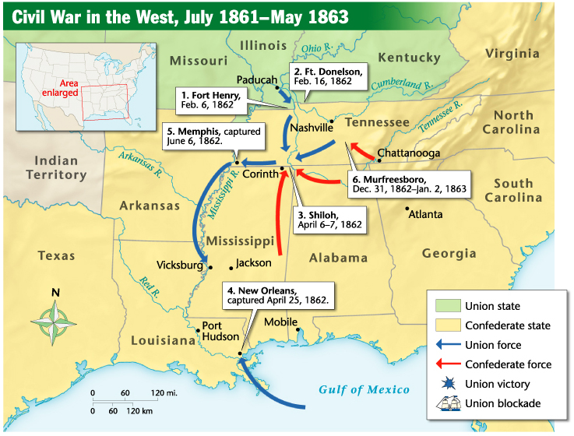
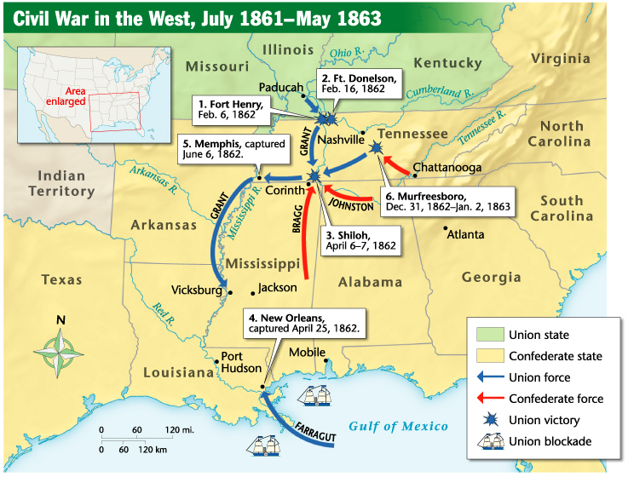

Slide 61
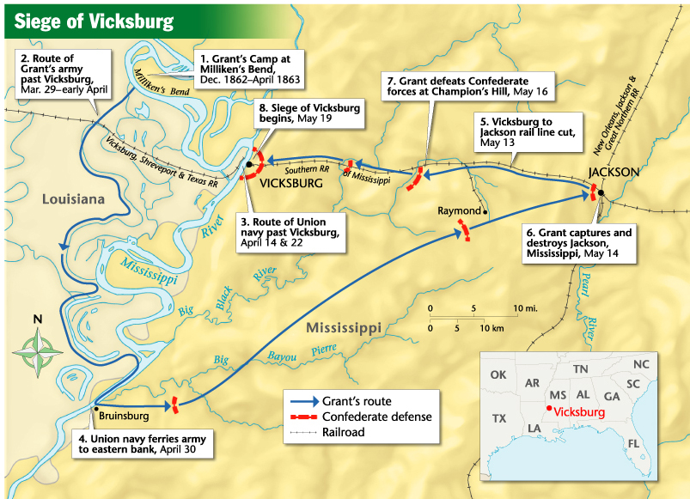
Vicksburg/Gettysburg
VICKSBURG
Grant captures Vicksburg, splits the CSA in half.
USA controls the Mississippi River.

Slide 62
VICKSBURG
On July 4, 1863
30,000 Confederate troops defending Vicksburg surrendered their arms.
Grant captured 260 cannons, 60,000 stand-of-arms, and more than 2 million rounds of ammunition.
Former slaves celebrated Independence Day for the first time.
4 days later, the Mississippi River was in the hands of the Union army
Effectively cutting the Confederacy in two.

Slide 63
Battles in East 1
KEY BATTLES IN THE EAST
DATE BATTLE VICTOR RESULT
July 1861 Bull Run South Union retreats to Wash. D.C.
Manasses
June 1862 7 Days South Lee stops McClellan from taking Richmond
August 1862 Bull Run South Lee stops John Pope from taking Richmond
*Sept. 1862 Antietam Draw McCellan stops Lee from taking Washington, D.C. Lincoln issues Emancipation Proclamation
*Turning Point battle

Slide 64
Theater/Battles 1862

Slide 65
Battles in East 2
KEY BATTLES IN THE EAST
DATE BATTLE VICTOR RESULT
Dec. 1862 Fredericksburg South Lee stops Burnside from taking Richmond
Jan. 1863 Chancellorsville South Lee stops Joe Hooker from taking Richmond
*July 1863 Gettysburg North George Meade stops Lee from moving into Washington, D.C.
*Turning point battle

Slide 66
GETTYSBURG

Slide 67
Vicksburg/Gettysburg
GETTYSBURG
General Lee invades the North.
The “High Tide of the Confederacy”. South’s last chance to capture Washington, D.C.

Slide 68
PICKETT'S CHARGE
General George Pickett
General Lee orders a frontal assault on Union lines to break through, surround and destroy the North.

Slide 69
Gettysburg Casualties
The defeat of Lee at Gettysburg would be the last time Lee would invade the North and try to take Washington, D.C.
Lee’s retreat at Gettysburg on July 3rd and Grant’s defeat of the South at Vicksburg on July 4th would lead to the eventual surrender of the South by 1865.

Slide 70
Gettysburg Address
GETTYSBURG ADDRESS
On November 19, 1863, some 15,000 people gathered at Gettysburg to honor the Union soldiers who had died there just four months before.
President Lincoln delivered a two-minute speech which became known as the Gettysburg Address.
He reminded people that the Civil War was being fought to preserve a country that upheld the principles of freedom, equality, and self-government.
The Gettysburg Address has become one of the best-loved and most-quoted speeches in the English language.
It expresses grief at the terrible cost of war and the importance of preserving the Union.

Slide 71
Gettysburg Address
GETTYSBURG ADDRESS
Four score and seven years ago, our fathers brought forth upon this continent a new nation: conceived in liberty, and dedicated to the proposition that all men are created equal……Now we are engaged in a great civil war. . .testing whether that nation, or any nation so conceived and so dedicated. . . can long endure. We are met on a great battlefield of that war…..

Slide 72
Gettysburg Address
GETTYSBURG ADDRESS
We have come to dedicate a portion of that field as a final resting place for those who here gave their lives that that nation might live. It is altogether fitting and proper that we should do this…But, in a larger sense, we cannot dedicate. . . we cannot consecrate. . we cannot hallow this ground. The brave men, living and dead, who struggled here have consecrated it, far above our poor power to add or detract.

Slide 73
Gettysburg Address
GETTYSBURG ADDRESS
The world will little note, nor long remember, what we say here, but it can never forget what they did here. It is for us the living, rather, to be dedicated here to the unfinished work which they who fought here have thus far so nobly advanced. It is rather for us to be here dedicated to the great task remaining before us. . .

Slide 74
Gettysburg Address
GETTYSBURG ADDRESS
That from these honored dead we take increased devotion to that cause for which they gave the last full measure of devotion. That we here highly resolve that these dead shall not have died in vain. That this nation, under God, shall have a new birth of freedom and that government of the people, by the people, for the people, shall not perish from the earth.

Slide 75
MILITARY PREPAREDNESS
Professional development of officers.
1802 West Point is formed
55 of 60 largest battles, both sides were commanded by West Pointers.
Artillery and Infantry schools opened.
Professional staff begins in earnest
Greater independence for military leaders.
Politicians focus on strategy and are less involved in operational and tactical decisions.
Mexican War
Many leaders on both sides gain valuable experience.
First great post-Industrial Revolution war.

Slide 76
Inventions/ Innovations
Telegraph
Davis uses to gather forces for Shiloh.
Fredericksburg sees first extensive use on the battlefield.
Railway
Greatly changes logistics and strategic maneuver.
North had good system; South had acceptable quantity, but no standardized track width.

Slide 77
WEAPONS
Outdated muskets replaced with rifle
greatly changes tactics.
more accurate, faster loading, fire more rounds than muskets
Minié ball (more destructive bullet)
Cold Harbor: 2k dead in 20 minutes, another 5k wounded.
Calvary used for reconnaissance
Scouting and skirmishes
Artillery
invention of shells, devices that exploded in the air.
fired canisters, special shells filled with bullets.
Grenades
land mines are used
Ironclads
replaces wooden ships
Trench warfare replaces Napoleonic tactics

