Slide 1
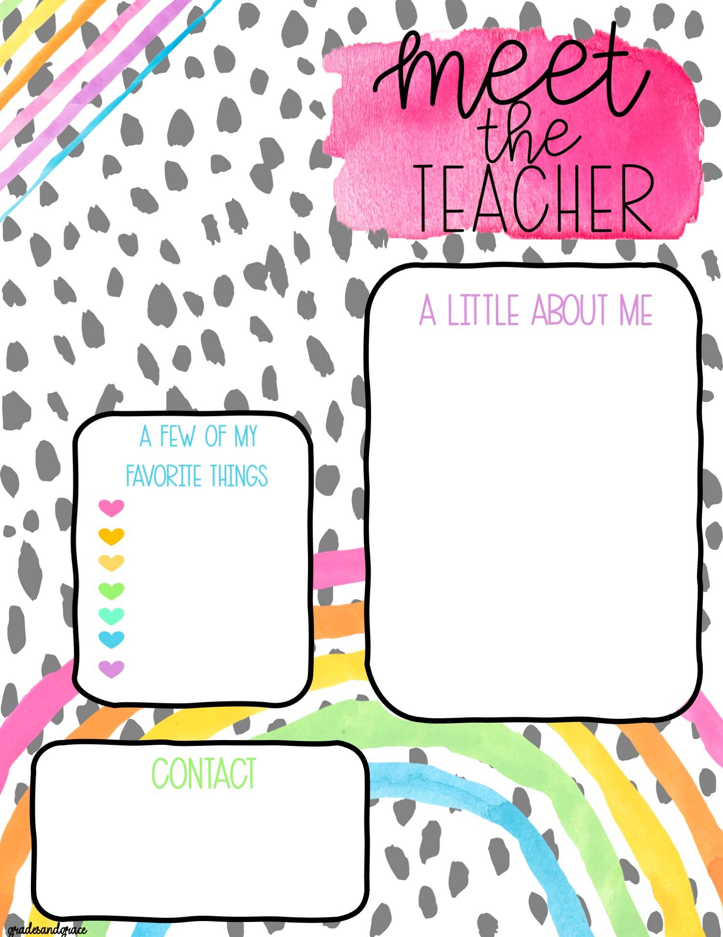
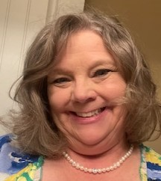
Ms. T. W. Hooks
Hi! My name is Tammie W. Hooks. I am so excited to be working with my students and their families this year.
This will be my 22nd year of teaching. My 4th year teaching General Education and 19 years previously as a Special Education Teacher..
I received my degree in Special Education from Augusta State University. I also received my certification for General Education and ESOL (English as a 2nd Language).
I am a native of this area: raised and educated here. I have an adult son named Christopher and a dog named Luke.
When I am not at school, I enjoy playing Trivia with my friends, nature walks with my dog, and reading for pleasure. I like many genres of music and movies. I enjoy learning about Biology and all the creepy, crawly, weird things in nature. I can’t wait to share my personal fossil and rock collections.
Movies-action/drama
Candy: Reese’s Peanut
Butter Cups
Family, friends
and my dog,
Animals: dogs, horses
Touring old towns
Drinks: Sweet Tea &
Pepsi
Colors: pink, purple,
black, teal
Email: hooksta@boe.Richmond.k12.ga.us
School: Blythe Elementary School
290 Church Street
Blythe, Georgia 30805
School Web page: http://blythe.rcboe.org/
Telephone: 706-592-4090
Fax: 706-592-3708
Notes:
Reminder:
2023-2024
This is a powerpoint with text boxes for insertion

Slide 2
Mission & Vision Statements
Mission: Building a globally competitive school system that
educates the whole child through teaching, learning,
collaboration, and innovation.
Vision: The Richmond County School System will provide an equitable
education for all students to prepare them for life beyond the
classroom.
Blythe Elementary Mission and Vision
Mission: At Blythe Elementary, we are building a globally competitive school system that educates the whole child through teaching, learning, collaboration, and innovation.
Vision: At Blythe Elementary, we are providing an equitable education for all students to prepare them for life beyond the classroom.

Slide 3
Ms. Hooks Class Supply List- Third Grade
2024-2025
5- 1 Subject Spiral Notebooks- (blue, yellow, green, black, and orange
( My class is color coded for subjects.)
1- Red two-subject notebook OR 2 red 1-subject notebooks
1- Purple Plastic Folder (prongs and pockets)
1- pair of blunt tip student scissors (no junior or adult scissors)
6- glue sticks
1- pack of wide ruled notebook paper
1- boxes of Crayola Crayons (12 pack) (no color changing or fancy colors)
(No markers or colored pencils)
2- packs #2 pencils (Ticonderoga brand is the best and stay sharper longer.)
No personal pencil sharpeners.
1- pencil pouch with zipper (NO boxes)
1-bookbag
1- headphones (required)
AND
1- pair of earbuds (required)
(Additional pairs of earbuds or headphones may be purchased through
school if students’ listening devices do not work or are lost for $10 each.)
2-medium/fine point permanent black markers
4- dry erase markers (student’s color choice) (Expo markers last the longest.)
1- quart zip clear bags (girls);
1-gallon zip clear bags (boys)
4-pink erasers (no cap erasers)
1-roll of clear tape
1- red ink pen
3- yellow highlighters
Extra Donations for class:
1- tissues
1- shareable disinfecting wipes.
Notes: *Students may need glue, crayons, and pencils after Christmas if they use all their supplies before then. ** Students also need to have supplies at home to do their homework (pencils, paper, scissors, glue, crayons)

Slide 4
Our Classroom Specifics- page 1 of 3
Volunteering in the school: All persons wishing to volunteer at the school, for functions, or field-trips must complete a certification class. Volunteer training is offered at various times and days throughout the school year. Please contact the office if you wish to volunteer.
Classroom Visitors: Please make arrangements with the office and myself before visiting our classroom. Students appreciate knowing when a visitor is coming. There are protocols for visiting the school/classrooms . I would appreciate visits limited to a 15-minute time frame. This will ensure all students will be comfortable and be able to continue their focus on tasks.
Celebrations: I welcome celebrations for students’ special events or birthdays. However, please make arrangements with me ahead of time. We will only do food items during lunch. I only allow healthy-nutritious snacks, food, and drinks. I do not allow cakes, cupcakes, cookies, ice cream, balloons, etc. Any items brought to school must be commercially prepared and individually wrapped according to school policy. Healthy foods can include nuts, gummy-bears, graham crackers, fruit, cheese, sugar-free items, juice, Kool-aide, (no sodas), etc. Feel free to choose what you would like to send and have fun doing this. I can find other suggestions if needed. If this is a surprise, please let me know! The children love to be surprised!
Lunches
All students receive a free lunch and breakfast. Students may also bring a lunch. If a lunch is brought to school please make sure to follow these guidelines:
No glass containers
No items that need to be warmed. Students do not have access to microwaves.
No sodas or high sugar drinks (juice, water, sports drinks [no caffeine] are great).
No candy or large bags of chips/Takis. A small individual size bag is fine.
Students are NOT allowed to share any food from home. Many students have food allergies,
so please remind your student to not share food brought from home.
Homework/Practice: Please know that we are a one-to-one technology school and students will have access to a personal laptop at school. We will be using Canvas for daily instruction, assignments, and Asynchronous Learning Days (Learning at Home). Laptops will not be sent home daily, unless needed for an assignment.
Students will have a homework folder . This will go home as needed with important correspondence or assignments/project information. Students will receive regular homework. I will post a message on the Class Story in Class Do Jo to let you know it’s coming home.
Fluency Folders
All students at Blythe Elementary School will have a Fluency Folder (purple/blue) to complete each night. Parents are expected to listen to their student read and/or complete the questions that follow it nightly. Parents’ initials each night verify this homework is completed. Failure to initial results in your student not receiving credit for the homework assignment. Any changes in this will be posted on our Class Story.

Slide 5
Our Classroom Specifics- page 2 of 3
Dress Code
Please see the Richmond County Student Code of Conduct for specific dress code information. Just a few quick reminders:
1. NO leggings/jeggings- if your student comes to school in leggings and their top does not come to the middle of their thighs, you will be asked to bring them a change of clothes. No short tops with these type of bottoms.
2. Athletic shoes are required for days we have PE and outdoor activities. Crocs must have the strap attached and worn around the heel (Sports Mode ☺) at all times. No slides or slipper type shoes or flip-flops.
3.No hats may be worn in the building. This includes the hat that is attached to a pull-over/hoodie type jacket. Hats are allowed when a special fundraiser is going on. These fundraiser hats are not the attached hat/hoodie on a jacket.
4. Tank tops or tops with spaghetti straps are not allowed to be worn. If it is part of a dress outfit, a jacket must be worn. Students’ tops should not show any back or stomach and fit appropriately on the shoulders. Shorts/skirts, dresses must be within 2 inches of a student’s knees. Mid-thigh lengths are not the appropriate length
5. Please label jackets, sweaters, hats, and bookbags with your student’s name. We end up with many unidentified clothing items every week.
Technology
Students will be issued a laptop, power block with attached cord, and the second power cord. Students are expected to take care of the items. Students are charged for lost or damaged technology devices and parts. Any fines will need to be paid as soon as possible. Insurance for devices can be purchased. Please see the flyer and instructions in the Registration Packet for more information. Students will NOT take laptops home unless an Asynchronous Day is planned (Learn at Home) or it is needed for a homework assignment. At a later time, students might be able to bring them home on a regular basis. If you do not wish your student to take laptops home, please make sure you check the appropriate box on the Loan Agreement. Phones and tablets should remain at home. Richmond County has updated their cell phone policy (July 2024). More information will be sent when available. The school is not responsible for personal devices.
Restrooms
We have the luxury of having a bathroom next to our room on the hall. Students will be allowed to go during homeroom, before dismissal, and other scheduled times. If a mess is made, the student will be asked to clean it up for the next person. Please talk with your child about appropriate use of a bathroom and use of materials. We have trouble with too much toilet paper being used, flushed at one time, and seats/floors not being left dry. We all love a clean bathroom to use.

Slide 6
Our Classroom Specifics- page 3 of 3
Communications
Our school uses Class Dojo for communication and important notifications. I will also have a class page on Class Dojo where I post important information for students and parents as well as links to valuable information. Please check our Class Story daily in order to stay updated and not miss important events. I will use this app to communicate with connected members via the messaging option. Class Do Jo has the capacity to translate into another language for you if needed. Please make sure you have downloaded the Class Do Jo app. Students have individual logins for themselves and parents.
Parent Conferences
Conferences are required for the first semester and at other points in the year. I will be using MicroSoft Teams. I have found this is more convenient for parents to meet. However, face-to-face is also an option if scheduled. I will send out a link for signing up using “Sign Up Genius.” Parent conferences are available at other times as well, just let me know. MS Teams can be accessed through the link that will be emailed to you or through the app. The program works better if the app is downloaded, but is not required.
MTSS (RTI) Intervention Meetings
Students in the MTSS (RTI) process or who are referred to the team for intervention will meet regularly to discuss data and progress. These may be done virtually through Teams or in person.
Absences
If your student is out of school, please send me a message in Class Do Jo and let me know and the reason. I will make note of it. However, an official note either from a doctor/dentist or a written note is required for ALL absences. Please see the county attendance policy for more details.
Dismissal
Our school will begin dismissal at 3:10 pm. All car rider students must have a tag displayed on the dashboard in the required place. No students will be released in a car rider line without displaying this tag. If a tag is not displayed accordingly or lost/misplaced, the person picking up the student must go to the office to pick up their student(s).

Slide 7
Infinite Campus Parent Portal page 1 of 3
Parent Portal Account Overview
Parent Portal allows you to register your child for school and update your contact information, as well as review your child's schedule, attendance and report card. Parents and guardians can share one account or each have their own account.
Access Parent Portal
Parent Portal (see below for web address) is available to authorized parents and guardians of Richmond County School System students
https://campus.rcss-k12.org/campus/portal/richmond.jsp
Unable to access your Parent Portal account?
1. Click Forgot Password/Username
2. Follow the instructions in the email you receive to update your username or
password
If you didn't receive an email, contact the Data Clerk/Registrar at your child's school to access your account
Look Up Your Activation Key
An Activation Key is required when creating a new Parent Portal account. If you have already created a Parent Portal account, you will not need to complete this step again.
If you have issues entering your child's Social Security Number, contact the Data Clerk/Registrar at your child's school.
To look up your Parent Portal Activation Key
Visit Parent Portal Activation Key (see below for web address)
https://campus.rcssk12.org/campus/K12_Custom/cParent/index.jsp?appName=richmond
Enter the last 4 digits of your student's Social Security Number
Click Submit
Print, copy or write down the alpha-numeric code following GUID
Create a New Account
Follow the steps below and complete all pages to create a Parent Portal Account.

Slide 8
Infinite Campus Parent Portal Page 2 of 3
Follow the steps below and complete all pages to create a Parent Portal Account. Look up for your Parent Portal Activation Key
Visit Parent Portal Activation Key (see below for web address)
https://campus.rcssk12.org/campus/K12_Custom/cParent/index.jsp?appName=richmond
Enter the last 4 digits of your student's Social Security Number
Click Submit
Print, copy or write down the alpha-numeric code following GUID
Click Manually Enter Activation Key
Input or paste the Activation Key into the field on the New User screen
Click Submit
2. Complete the fields on the Campus Parent Account screen
Input a username
Input and confirm a password
Click Submit
3. You have successfully created your account.
Or download the instructions (see below for web address)
https://www.rcboe.org/cms/lib/GA01903614/Centricity/Domain/9409/Parent%20Portal%20Registration%20Instructions.pdf
If you have multiple children attending Richmond County Schools and do not see all of your children listed after you create an account, please contact the school of the missing child.
l

Slide 9
Infinite Campus Parent Portal Page 3 of 3
Update Your Contact Information
1. Visit Parent Portal.
2. Click Campus Parent.
3. Input your username and password. Click Log In.
Click Forgot Password? or Forgot Username? If you are having trouble logging in.
4. Scroll down on the left and click More.
5. Click Address Information in the middle of the screen.
Input your current phone number and click Update.
Input your primary (mailing) address and click Update.
Web address to update Contact information:
https://www.rcboe.org/cms/lib/GA01903614/Centricity/Domain/9409/Update%20Your%20Parent%20Portal%20Contact%20Information.pdf

