Slide 1
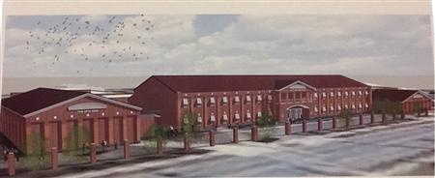
Lucy C. Laney High School School Council Meeting
March 19, 2025

Slide 2
Review Roles
Time Keeper
Norms Monitor
Recorders

Slide 3
Meeting Norms
Begin and end on time
Keep an open mind
Respect everyone’s opinions
Stay on task

Slide 4
December 18, 2024

Slide 5
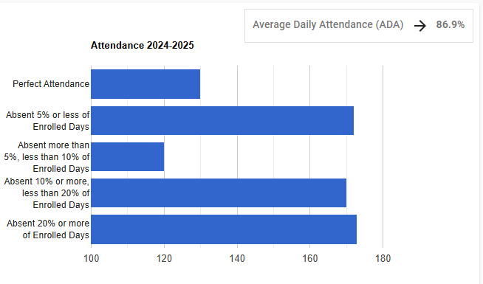
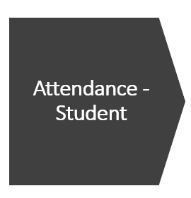
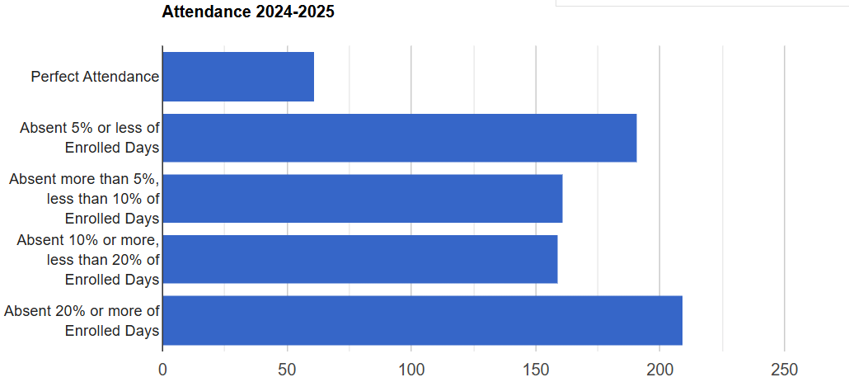
Attendance
Perfect Attendance:
-69 or dec. 53%
Absent 5% or less:
+19 or inc. 11%
Absent more 5% , less 10%:
+41 or inc. 34%
Absent more 10% , less 20%:
-59 or dec 6.4%
Absent more 20%:
+36 or inc. 20.8%
130
172
120
170
173
61
191
161
159
209

Slide 6
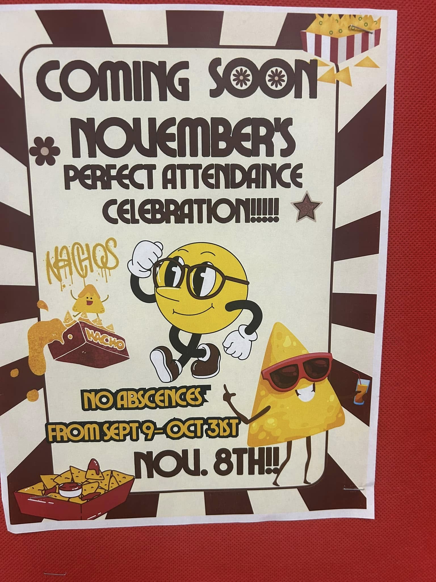
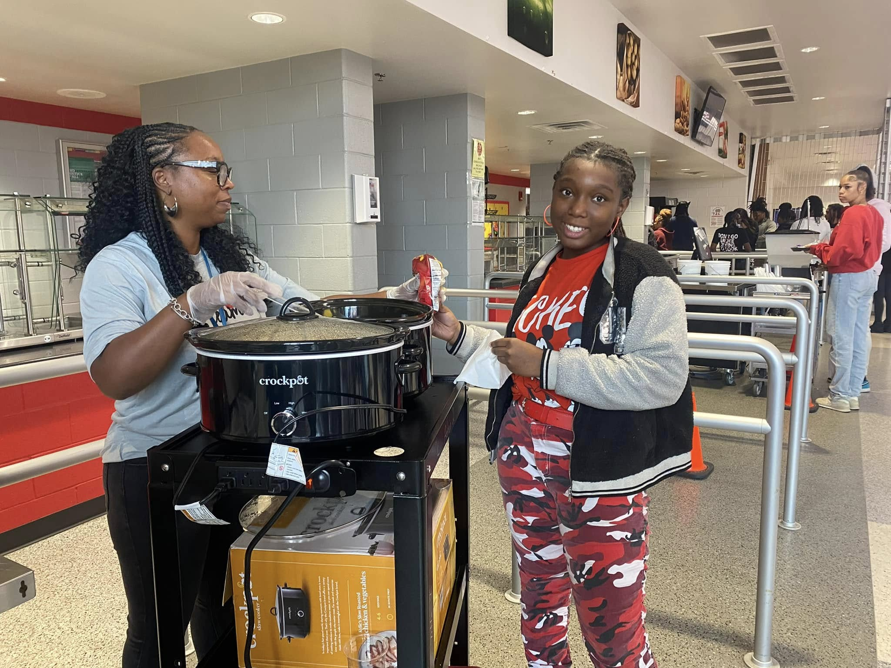
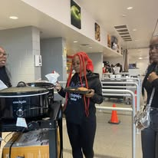
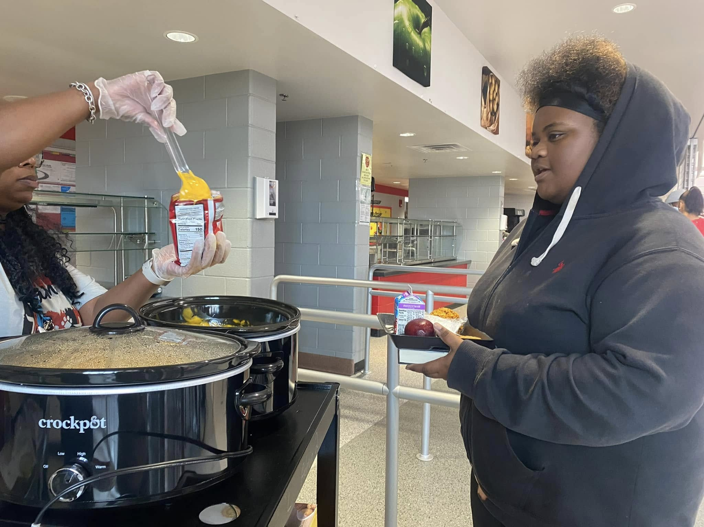
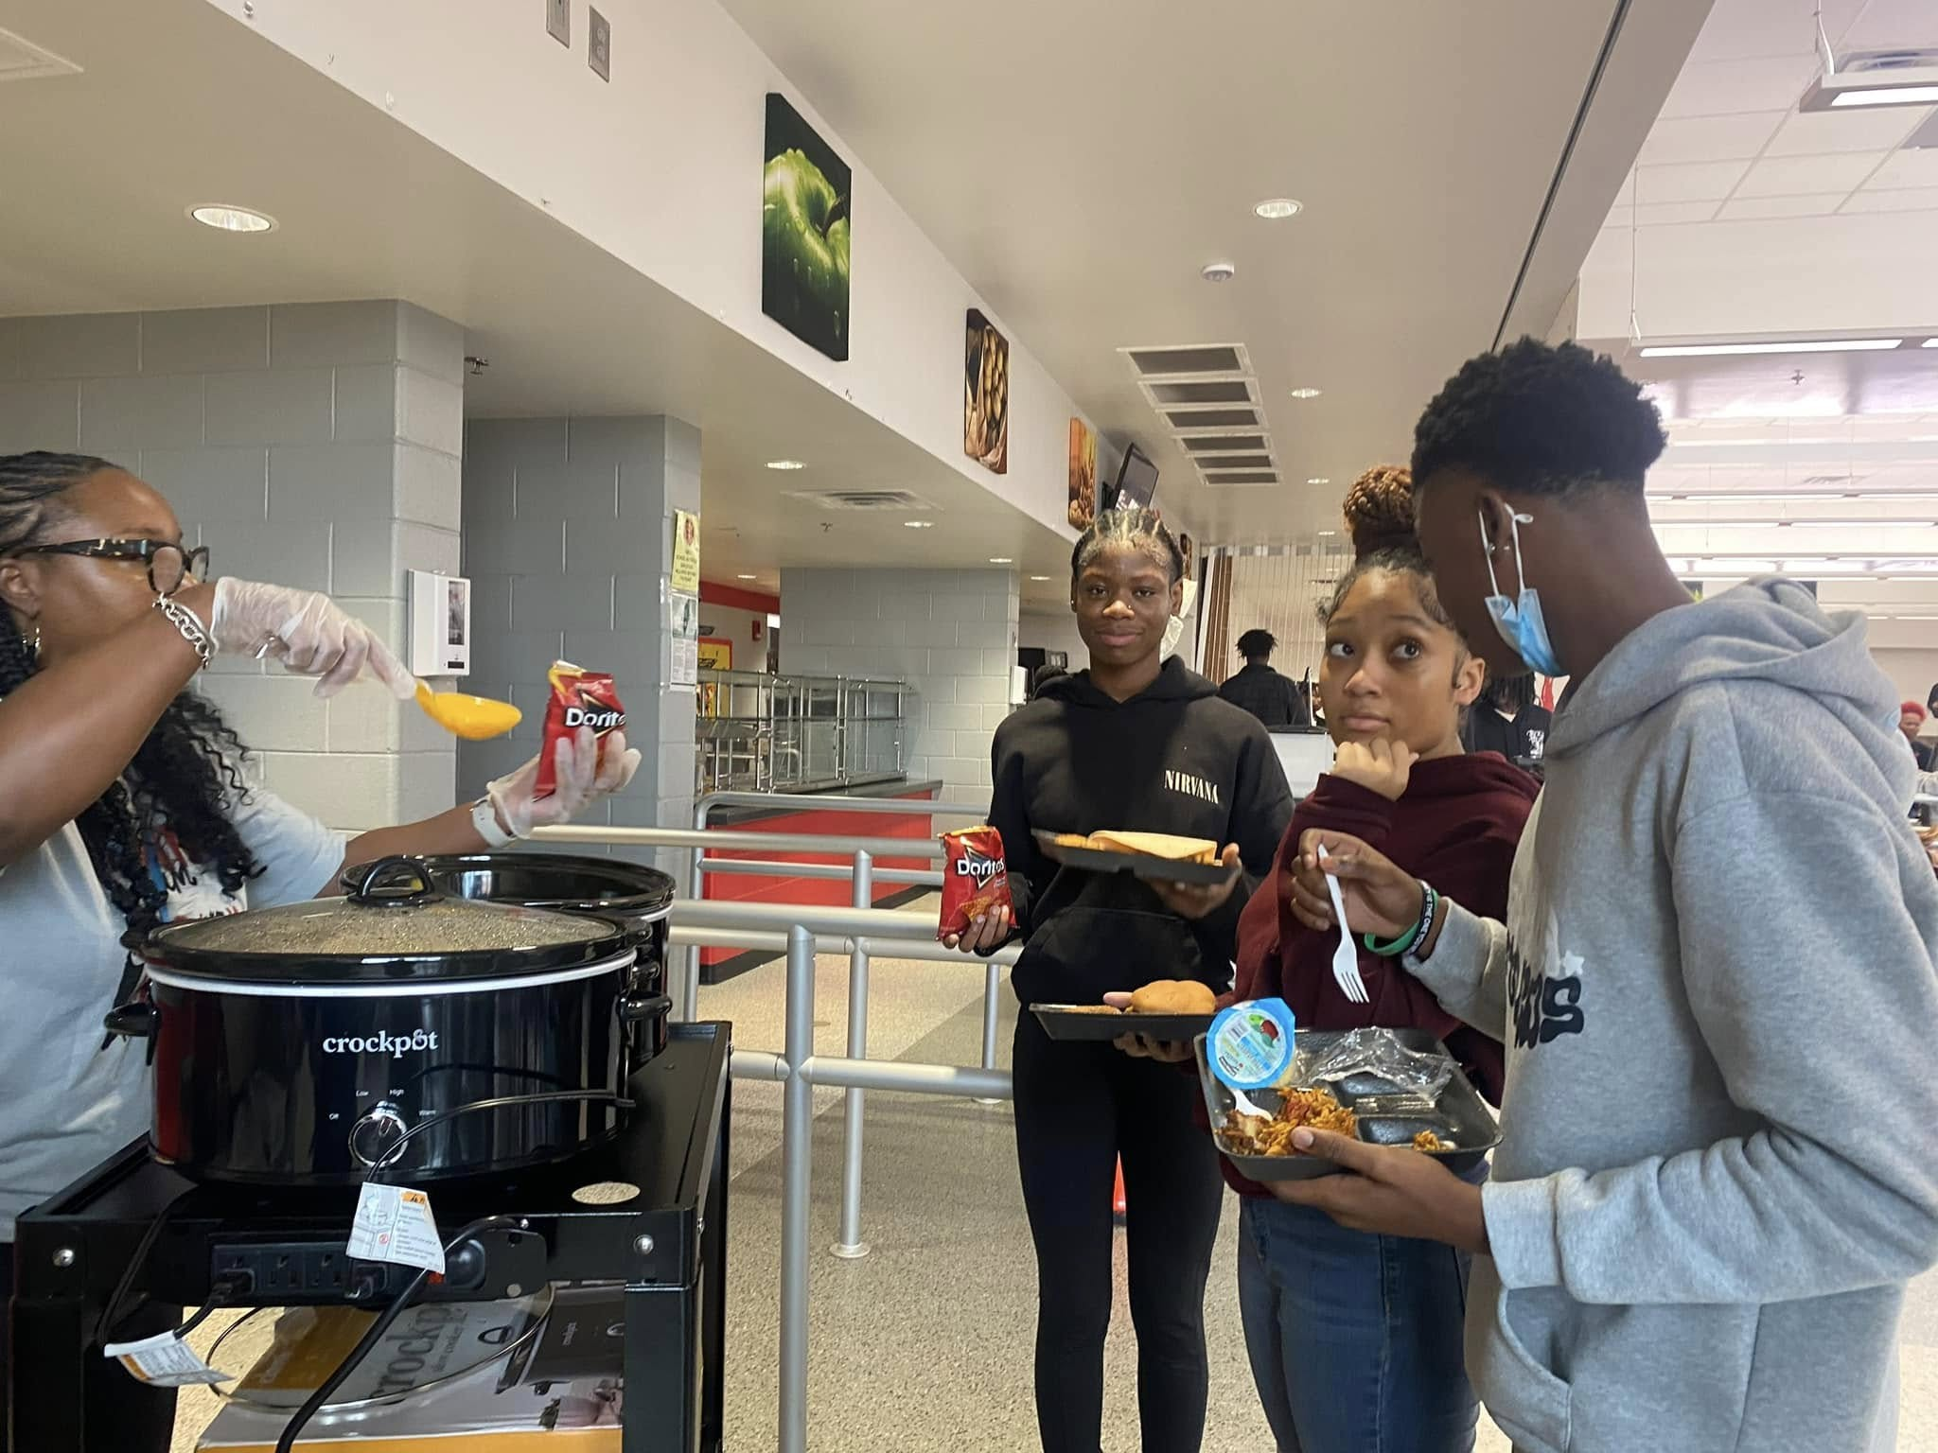
Attendance
 | # of Letters | # Letters | Difference
5 Day Attendance Letters | 142 | 259 | +117
 | Count | Count | Difference
Attendance Meetings (2nd & 4th Tuesdays) | 4 | 6 | +2
 | Count
Attendance Celebrations | 3

Slide 7
Attendance
Attendance Reason | Total (days) | Total (days) | Diff.
Doctor’s Appointment | 297.09 | 601.13 | 304.04
Excused | 142.79 | 268.24 | 125.45
Excused Parent | 165.83 | 360.88 | 195.05
Excused Legal | 9.14 | 17.37 | 8.23
Suspension | 278.01 | 464.09 | 186.08
Family Emergency | 3.97 | 9.60 | 5.63
Total Excused | 896.83 | 1721.31 | 824.48
Total Unexcused | 3660.32 | 6765.86 | 3105.54
Tardies | # of Students as of 10/28/24 | # of Students as of 12/20/24
0 | 133
5 - 10 | 228 | 302
11 - 15 | 74 | 110
16 - 20 | 23 | 54
21 - 25 | 8 | 22
26 - 30 | 3 | 12
31 - 35 | 1 | 6
36 - 39 | 0 | 3
40 | 0 | 2

Slide 8
Discipline
Month | Referral Count
August | 84
September | 143
October | 108
November | 111
December | 52
Totals | 498
Discipline | # of Students
In School Suspension | 197
Out of Suspension | 108
Notes:
This slide should include major and minor referrals.
Include SWD suspensions, both in and out of school.

Slide 9
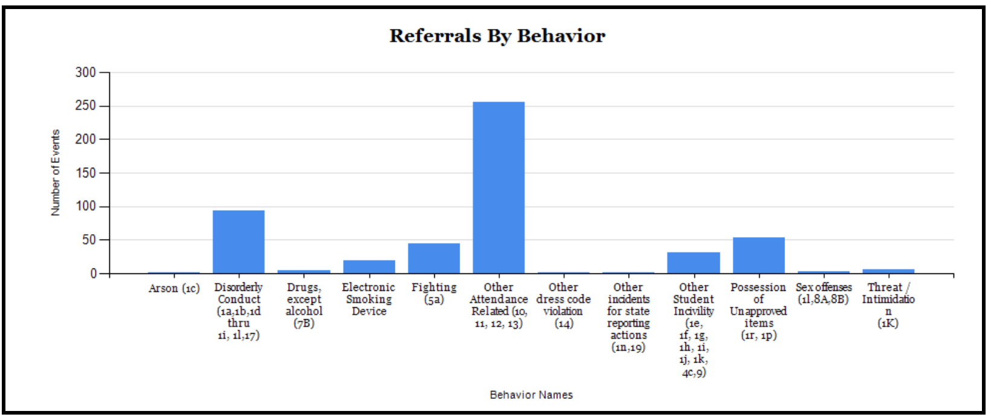
Discipline
Total Referrals: 306 (45 Day)
Total Referrals: 498 (90 Day)
252
145
91
56
53
36
42
21
25
29
2
4
11
2
1
18
2
5
2
2
2
3
M

Slide 10
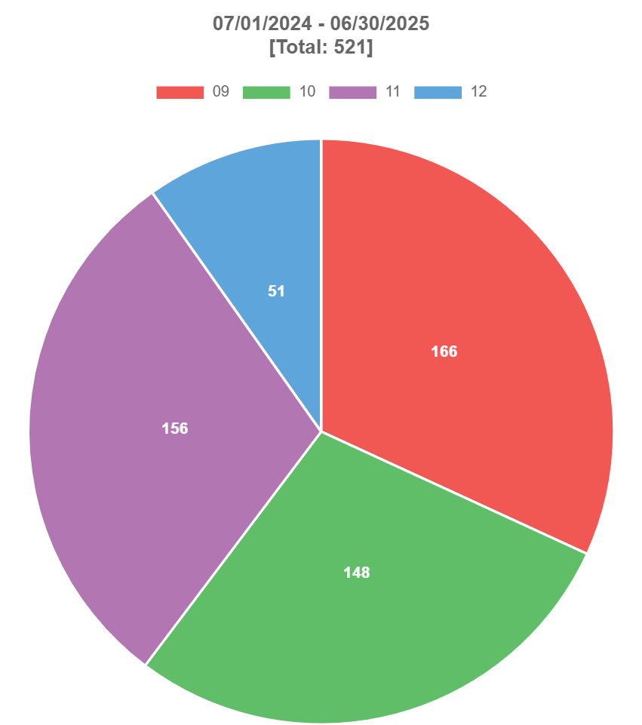
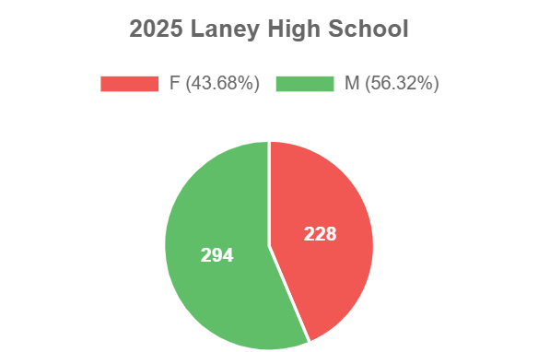
Discipline
Total Referrals: 498
56
154
149
218
280
139
Notes:
This slide should include major and minor referrals.
Include SWD suspensions, both in and out of school.

Slide 11
Literacy Initiative and/or Reading Campaign
L.I.T. @ Laney (monthly literacy time)
1 School 1 Book: Chaos Theory by Nic Stone
PINES Book Mobile (4th Thursdays)
Library collab with Maxwell Branch (2nd Thursdays) (JROTC)
August Circulation: 174 *Patrons: 264 *Classes:16
September Circulation: 482 *Patrons: 422 *Classes: 19
October Circulation: 149 *Patrons: 283 *Classes: 19
November Circulation: 258 *Patrons: 351 *Classes: 23
December Circulation: 152 *Patrons: 507 *Classes: 11
Lunch Bunch, Classes for citations and plagiarism, updated Manga and Lower Level
Circulations have surpassed last year’s and I have reset my goal to a lofty 2500 books this year! (WOW)

Slide 12
Book Club “TOME Society”
Will have 1 inducted into
Tau Omicron Mu Epsilon Honor Society this year
780 Copies Purchased (1 per student and staff member)

Slide 13
Bookmobile
Maxwell Branch Visit
Lessons in
Media Center
1 Book Pick-Up Day

Slide 14
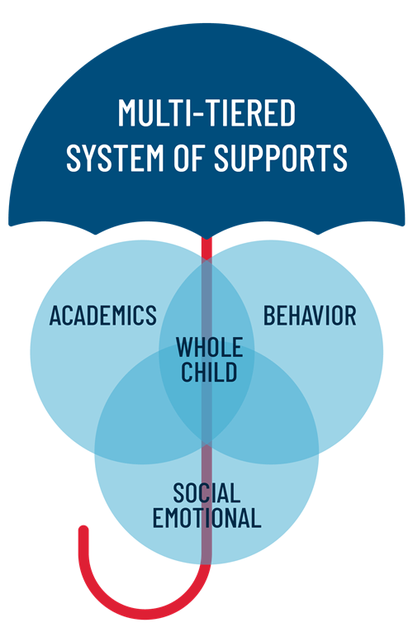
MTSS – Multi-Tiered Systems of Support
45 Day | Math | Reading | Behavior
Tier 2 | 26 | 17 | 1
Tier 3 | 8 | 6 | 0
90 Day | Math | Reading | Behavior
Tier 2 | 25 | 14 | 1
Tier 3 | 5 | 5 | 0
2 Students moved from Tier 3 for Math to Tier 2
1 Student moved from Tier 2 for Math to Tier 1
3 Students moved from Tier 2 for Reading to Tier 1
1 Student moved schools that was Tier 3 for Math and Reading

Slide 15
Cohort Data
Cohort | On Track | At Risk | Valid Withdrawals | Drop Outs | Total | Graduation Rate
2025 | 103 | 59 | 45 | 45 | 252 | 49.76
2026 | 83 | 88 | 43 | 15 | 229 | 44.62
2027 | 100 | 91 | 29 | 14 | 234 | 48.78
2028 | 86 | 105 | 8 | 5 | 204 | 43.88
Note: 54 At Risk 2025 Cohort students should graduate by the end of Summer 2025 (75.8%)

Slide 16
NWEA MAP (HS)
Notes:
How are you using it?

Slide 17
NWEA MAP (HS)
Notes:
How are you using it?

Slide 18
Professional Learning Implementation
Conducted two professional learning sessions:
1.) Navigating the Instructional Framework (Closing) (Dec. 2): aimed at exploring effective instructional strategies for concluding a lesson.
2.) Magic School AI (Jan. 9): examined innovative ways to incorporate artificial intelligence tools into our teaching methods.
Evaluation of Professional Learning Effectiveness:
Comprehensive monitoring approach
1.) Conducting classroom observations, where we assess the implementation of strategies discussed during the sessions.
2.) Review and analyze student performance data to identify trends and areas for improvement.
3.) Regular conferencing with teachers provides valuable insights into their experiences and challenges, allowing us to support their professional growth effectively.

Slide 19
Cross Functional Data Analysis
What action steps have you taken based on the data from the cross functional team visits?
Common Theme: time management/preparedness, rigor, engagement level, teacher-centered instruction, checking for student understanding
Debriefed with the Leadership Team & Staff
Provided differentiated professional learning on common themes
Adjusted focus to coaching cycles based on the needs of the teachers
Solicited support from the Teaching & Learning Department to support areas of growth
Monthly Collaborative Planning Sessions (EOC Courses Only)

Slide 20
SAT & ACT
SAT # testers – 2; 8; 6
ACT# testers- 1; 8
Plan of Action:
Students not in class –
Extended learning program
Senior early release practice in Media Ctr 1 or 2 days per week
Mock Assessment
Work on deficiencies using
Khan Academy
SAT Prep Books
Ensure sign up day for when student is interested in taking
SAT & ACT Registration Day
SAT & ACT Deadline Reminders
SAT & ACT Mock Assessment
SAT Evidence-Based Reading
School | 2022-2023 | 2023-2024 | Change | 2024-2025 | Change
Laney High School | 456 | 469 | 13 | 492 | +23
SAT Math |  |  |  | 2;8;6
School | 2022-2023 | 2023-2024 | Change | 2024-2025 | Change
Laney High School | 415 | 444 | 29 | 434 | -10
All seniors not in SAT/Tools class, but one student - took SAT Twice- Avg. EBR 570; Avg. Math 450 increased both areas and was above avg in each area on each test
ACT Composite
School | 2022-2023 | 2023-2024 | Change | 2024-2025 | Change
Laney High School | 16.2 | 15.8 | -0.4 | 12.3 | -3.5

Slide 21
GMAS/EOC
Algebra C & C Biology
Change in Dev & Above Algebra C &C | Change in Dev & Above Biology
Made Desmos calculator part of daily rituals
Created anchor charts & reference sheets
Facilitating learning with Learning Plans for rigor
Collaboration of resources
Math Academy
Incorporating stations
ST Math Full Year
IXL Full Year
***Challenges
Lesson delivery
Giving students struggle
Station planning from data
Teacher absences
Biology
Sticking close to pacing guide –Week behind
Prepared for collaboration with resources and feedback
Pre/Post unit assessment
Hands on labs
Progress Learning
Learning Cycle for differentiated stations
***Challenges
Student retention
Rigor
Assessment uses
9 | 9
Algebra Plan –
Daily TITD
weekly ST Math & IXL lessons
Reward top students ST Math & IXL
Station Posters
Ensure all students take Pre & Post test and Diagnostic/formatives
Define
Active data wall
Biology Plan-
Labs
Vocabulary weekly- Quiz Wednesday
Weekly Question Bank (Edulastic, Albert, Progress learning)
Science Academy
Albert IO assessments
Interactive games use data in real time to correct misconceptions
Stay close to Pacing Guide

Slide 22
American Lit. US History
GMAS/EOC
Change in Dev & Above Am Lit
Change in Dev & Above US History
American Lit. & Composition
Incorporating TITD grammar activities
Incorporating Albert IO –TITD exposure to
rigor
Citing textual evidence lessons in Media Ctr.
Pre/Post district assessments
Do Now’s with test format & question types
Stations: grammar, writing, reading comprehension, remediation
IXL interventions
Progress Learning
***Challenges
Citing Textual Evidence consistency
Collaborative learning
Prep planning for stations/instructional delivery
Assessment uses
Analyzing date consistently
US History
Team teaching
Consultant
Pre/Post district assessments
Progress Learning
***Challenges
Utilizing high impact strategies
(Lecture heavy)
Semester Exam predictor low
Stations
6 | 9
American Lit Plan –
Data analysis/stations
Interactive data walls
Utilize Pre/Post Data, NWEA MAP, formatives to drive instruction/delivery
Incorporate more collaborative group learning
US History Plan –
Data analysis/stations
Consultant 2-3 times a week
Smaller classes for targeted remediation

Slide 23
Initiative 1: Increase the percentage of students performing at or above the developing level on the Georgia Milestones Assessment in all content areas by 6 percentage points, raising the school overall average from 37% to 43% by the end of the 24-25 SY.
Action Steps | How have these action steps impacted student achievement?
Action Step 1: Implement Laney Academy for teachers in order to improve content and pedagogical knowledge. Action Step 2: Implement common assessments aligned to the rigor of the standards. Action Step 3: Utilize a consultant in all subject areas in order to provide best practices and support to teachers and students. | Have implemented (3) Laney Academy Sessions thus far this school year. Common Assessments are scheduled to be administered the Week of January 27th. Core Common Assessments are created utilizing Albert.io in order to create more rigorous-based assessments based on standards. Semester Final Exam utilized Albert.io Elective Courses Common Assessments are teacher-created. Secured a Social Studies Consultant Implement Laney Extended Learning Academy (Tues, Wed, Thurs)

Slide 24
Initiative 2: Increase the percentage of students reading on grade level from 35% to 45%, as measured by the NWEA MAP Benchmark Assessment, by the end of the 24-25 SY.
Action Steps | How have these action steps impacted student achievement?
Action Step 1: Implement school-wide literacy strategies within all classrooms. Action Step 2: Implement Laney Academy for teachers in order to improve content and pedagogical knowledge. Action Step 3: Implement L.I.T. w/ Laney (reading campaign) school-wide. | Introduced the following literacy strategies so far this school year: Anticipation Guide Quick Writes See, Think, Wonder Think, Pair, Share Teachers are required to include a literacy strategy within their weekly lesson plans. Have implemented (3) Laney Academy Sessions thus far this school year. Implemented (3) L.I.T. w/ Laney Sessions All students and staff are engaged in reading throughout the building utilizing the 1 School 1 Book Initiative Implement Laney Extended Learning Academy (Tues, Wed, Thurs)

Slide 25
Initiative 3: Decrease the number of disciplinary referrals by 26%, reducing them from 542 to 400, by the end of the 24-25 SY.
Action Steps | How have these action steps impacted student achievement?
Action Step 1: Implement PBIS with fidelity. Action Step 2: Recognize students for attendance, academic achievement, and extra-curricular activities. Action Step 3: Implement a student advisory committee. | PBIS Framework posted throughout the school. Behavior Expectations communicated daily over the intercom. Implemented a Laney High School Admin Consequence Chart Held (3) Attendance Celebration & (1) Academic Celebration Academic Pep Rally: Friday, January 31st (23) Students are on the student advisory committee. 9th Grade = 4; 10th Grade = 4; 11th Grade = 12; 12th Grade = 3 Held (3) meetings with student advisory committee.

Slide 26
Initiative 4: Increase the 4-year Cohort Graduation Rate of 73.54% in 2024 to a 76.54% 4-year Cohort Graduation Rate in 2025.
Action Steps | How have these action steps impacted student achievement?
Action Step 1: Review “On Track” & “At Risk” students’ status monthly for Seniors and “At Risk” students’ status for Juniors. Action Step 2: Review Withdrawals each month with the guidance secretary and registrar to ensure proper documentation for record’s request have been received, uploaded in Infinite Campus, and printed for the Valid Withdrawal Binder. Action Step 3: Review and Investigate current students flagged under “Drop Out” on the USHA data dashboard. | Assigned staff to monitor and track students that are “At Risk” Meet monthly to discuss the progress of “At Risk” students Senior Counselor and MTSS Facilitator monitor the progress of “On Track” students. MTSS Facilitator working on “Drop Out” list in order to locate students. Review withdrawal forms to ensure the receiving school is listed on the withdrawal form as well as the parent/guardian’s email address. Developed Withdrawal Book for tracking purposes. Updated Withdrawal Guidelines for tracking purpose.

Slide 29
Next Steps…
Incorporate instructional opportunities to inform the parent/guardians of instructional expectations.
Continue to build lasting relationships with parent/guardians in an effort to bridge the gap between home and school.
Broaden our community partnership in effort to have a greater impact on our students as well as the community.
Next School Council Meeting: TBD

Slide 30
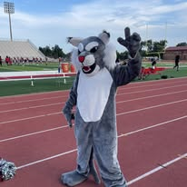
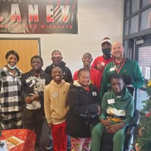
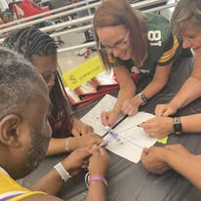
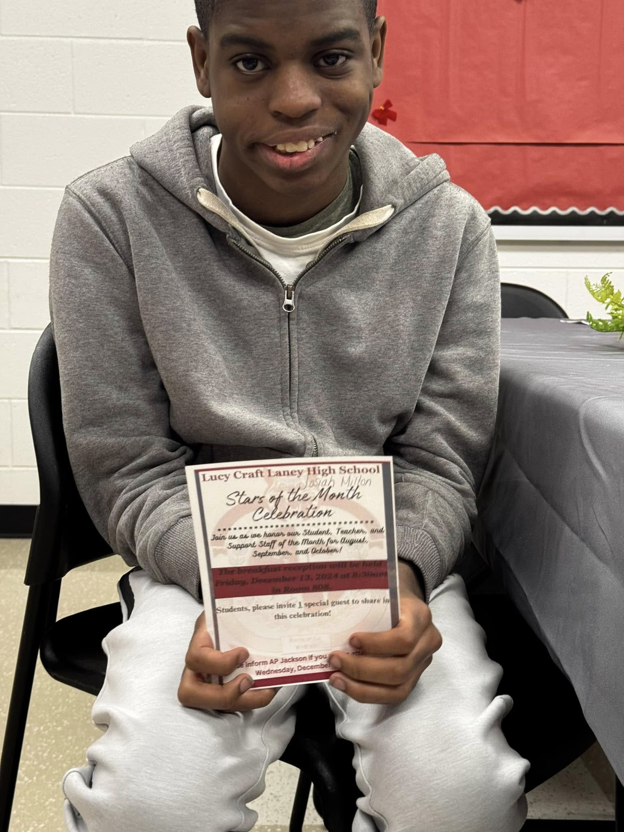
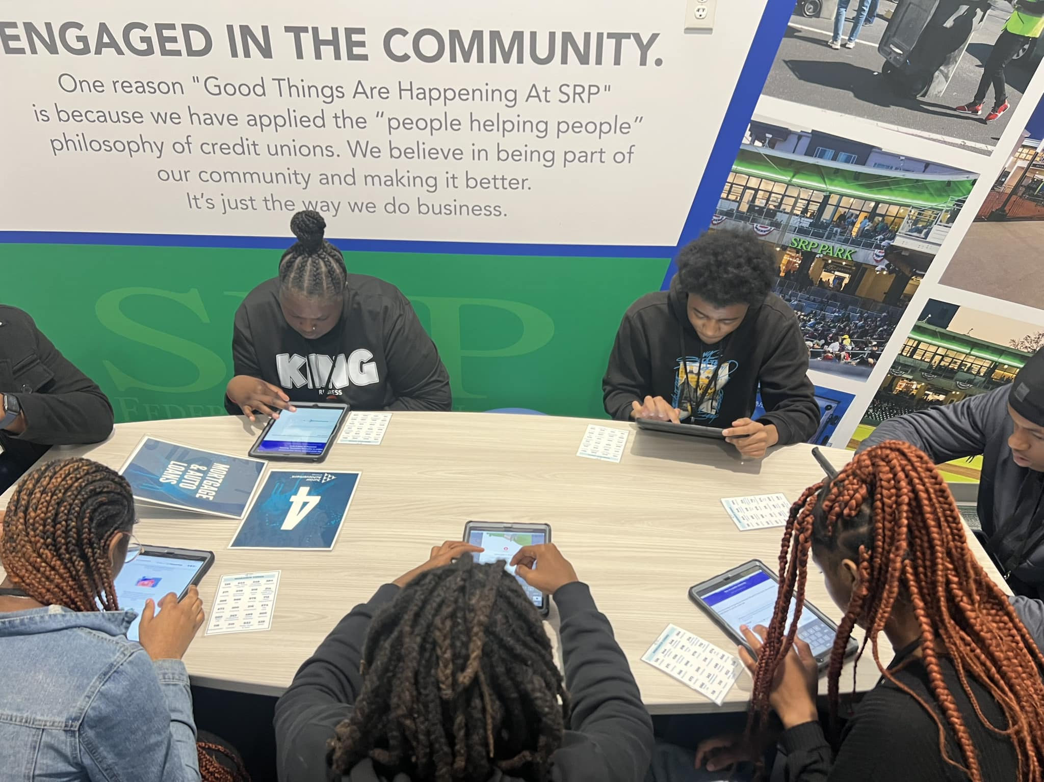
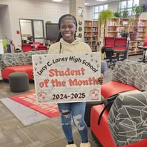
#OneTeamAndWinning
M

