Slide 1
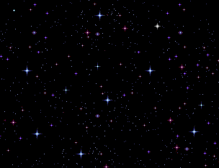
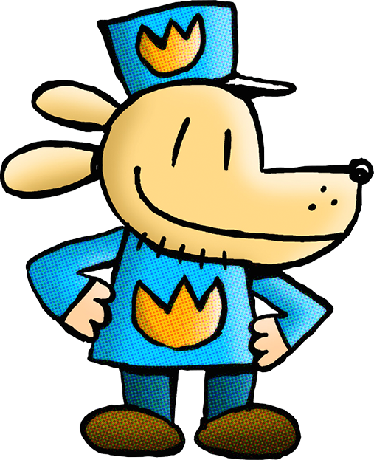
Created by Veronica Menjivar-Alfa
Notes:
Click on the book you’d like to hear for a read aloud.

