Slide 1
TITLE IX REGULATIONS: Mastering Regulation Whiplash Like a Diva

Slide 2
RCSS Vision and Mission
Vision Statement
The Richmond County School system will provide an equitable education for all students to prepare them for life beyond the classroom.
Mission Statement
Building a globally competitive school system that educates the whole child through teaching, learning, collaboration, and innovation.

Slide 3
No chain of fools here!
A

Slide 4
Today's Playlist
Title IX Definitions and Timeline
RCSS Policies
Chart of Changes
Enduring Essentials
Reoccurring Issues: A Closer Look
Scenarios
Title IX Processes

Slide 5
Title IX Federal Law
This Photo by Unknown Author is licensed under CC BY-SA

Slide 6
WHY? Why Do We Care About Title IX?
Why Do We Care?

Slide 7
WHY?
Why Does this Matter?
Why Do We Care?

Slide 8
WHY? Why Does this Matter?
Why Do We Care?

Slide 9
WHY? Why Does this Matter?
Why Do We Care?

Slide 12
WHY? Why Does this Matter?
Why Do We Care?

Slide 13
WHY? Why Does this Matter?
Why Do We Care?

Slide 14
Why Do We Care?

Slide 15
What is the Status of the Title IX Regulations?
2020?
2024?
2020 again?
Why Do We Care?

Slide 16
The Legal Pendulum
1972
The Law - Title IX is signed into law.
1975
Discrimination in Athletics - Regulations first issued by Department of Health, Education and Welfare to address discrimination in athletics. Did not address sexual harassment.
1997
Dear Colleague Letters - From 1997-2017 the Department of Education addressed the topic through a series of guidance documents - "Dear Colleague Letters
1999
Davis v. Monroe County Board of Education – Supreme court ruled that schools can be held liable for student-on-student harassment under Title IX if the harassment is severe, pervasive, and objectively offensive.
2020
The new regulations are the first time the Department has addressed sexual harassment as a form of sex discrimination via regulations.
2024
The U.S. Department of Education releases final Title IX regulations -LGBTQ+ students and a broader definition of sexual harassment.
2024
Several injunctions filed by states.
9 Jan. 2025
A federal judge in Kentucky struck down changes made to Title IX by the Biden administration ruling that the new regulations violate the Constitution.
31 Jan. 2025
USDE announced that it will enforce the Trump Administration’s 2020 Title IX Rule
Today
STAY TUNED

Slide 17
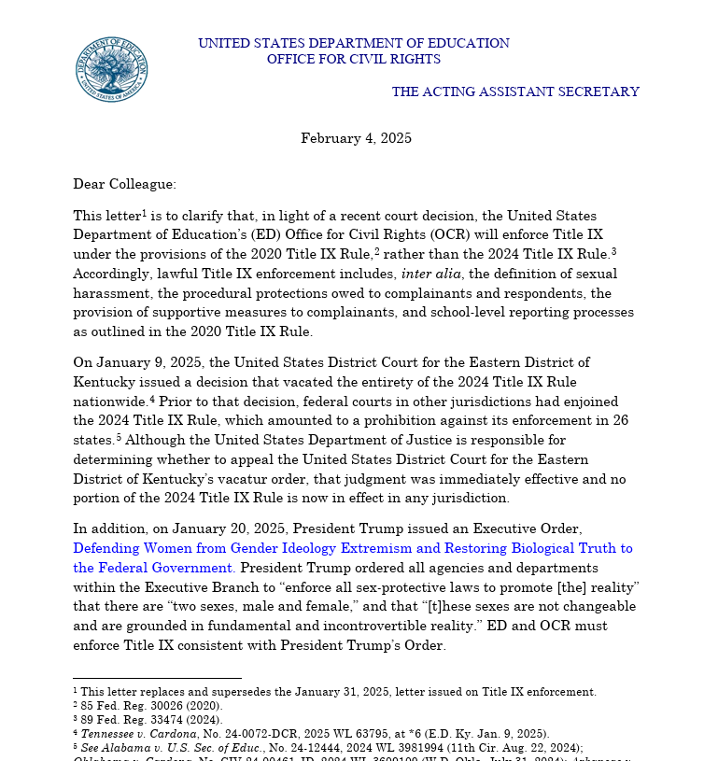

Slide 19
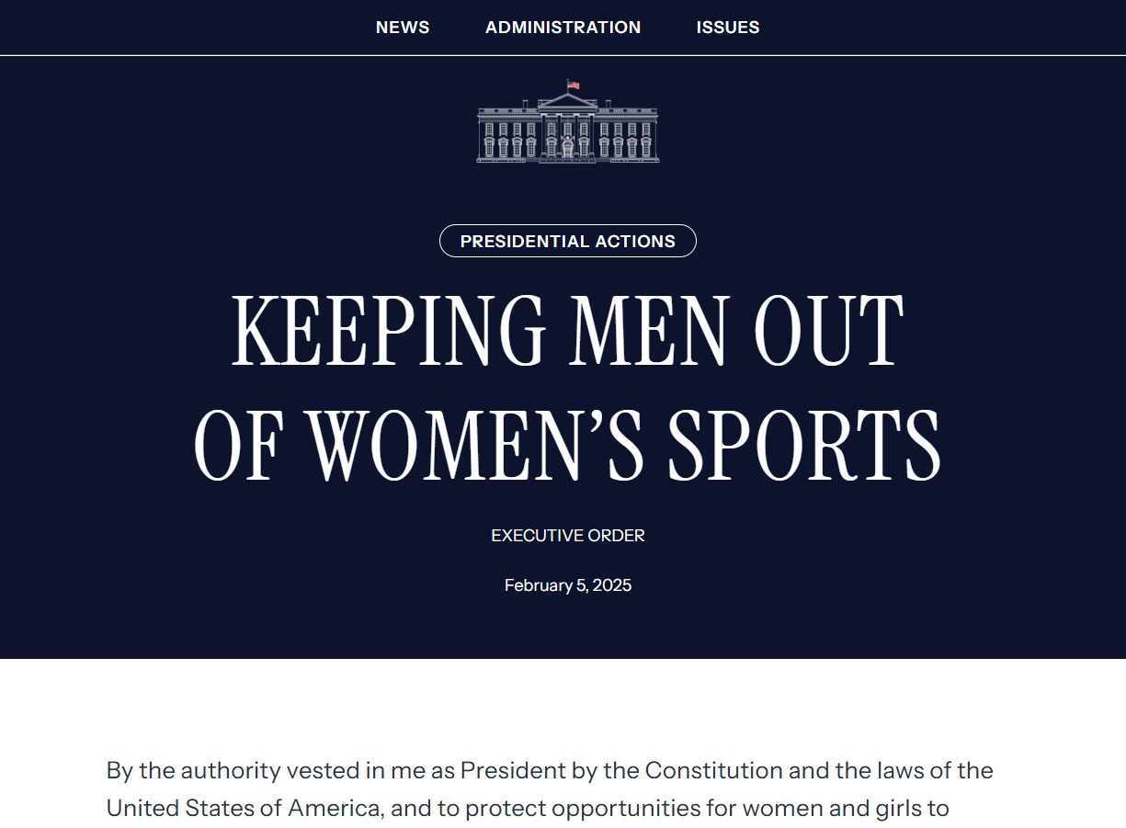

Slide 20
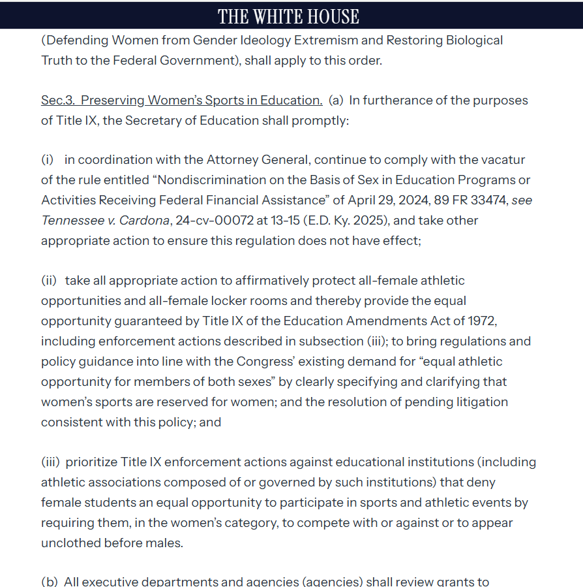

Slide 22
Let's THINK... What Else Do We Need to Consider?
Title IX
2020 Regulations
Executive Orders
Georgia High School Association

Slide 25
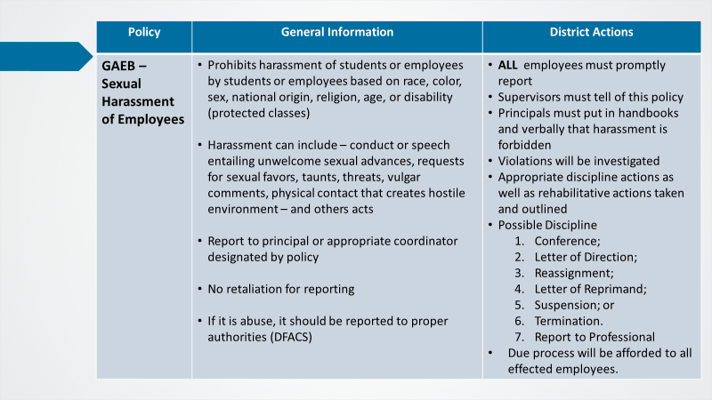

Slide 29
DO RIGHT WOMAN, DO RIGHT MAN Definitions and Elements of Title IX
Jurisdiction
Sexual Harassment
Actual Knowledge
Response

Slide 30
Jurisdiction: Is this in the House that Jack Built?

Slide 31
Jurisdiction
The Title IX statute applies to persons in the United States with respect to education programs or activities that receive Federal financial assistance.
Under the Final Rule, schools must respond when sexual harassment occurs in the school’s education program or activity, against a person in the United States.

Slide 32
Jurisdiction Part 2

Slide 33
Jurisdiction
The Title IX statute and existing regulations contain broad definitions of a school’s “program or activity.”
Education program or activity includes locations, events, or circumstances over which the school exercised substantial control over both the respondent and the context in which the sexual harassment occurred.

Slide 34
Jurisdiction
Also includes any building owned or controlled by a student organization that is officially recognized by a postsecondary institution (such as a fraternity or sorority house).

Slide 35
Jurisdiction
Title IX applies to all of a school’s education programs or activities, whether such programs or activities occur on-campus or off-campus.
A school may address sexual harassment affecting its students or employees that falls outside Title IX’s jurisdiction in any manner the school chooses, including providing supportive measures or pursuing discipline.

Slide 36
Jurisdiction
At the time of filing a formal complaint, a complainant must be participating in or attempting to participate in the education program or activity of the school with which the formal complaint is filed.

Slide 37
Scope: Sexual Harassment

Slide 39
Scope: Sexual Harassment

Slide 41
Actual Knowledge Davis v. Monroe

Slide 42
Notice and Actual Knowledge
The 2020 Regulations require a K-12 school to respond whenever ANY EMPLOYEE has notice of sexual harassment, including allegations of sexual harassment.

Slide 43
Notice and Actual Knowledge
The 2020 Regulations require a K-12 school to respond whenever ANY EMPLOYEE has notice of sexual harassment, including allegations of sexual harassment.

Slide 46
Response Obligations

Slide 47
Mandatory Response Obligations
Schools must respond promptly to Title IX sexual harassment allegations in a manner that is not deliberately indifferent.

Slide 48
Mandatory Response Obligations
Manner that is NOT deliberately indifferent means a response that is not clearly unreasonable in light of the known circumstances.

Slide 49
Mandatory Response Obligations-- Schools Must:
Offer supportive measures to the alleged victim ("Complainant")
Promptly contact the complainant confidentially to discuss supportive measures and explain process for filing formal complaint.

Slide 50
Mandatory Response Obligations-- Schools Must:
Follow a grievance process that complies with 2020 Regulations before the imposition of any disciplinary sanctions or other actions that are not supportive measures against a Respondent.

Slide 51
Mandatory Response Obligations-- Schools Must:
Investigate sexual harassment allegations contained in any formal complaint.

Slide 52
Mandatory Response Obligations-- Schools Must:
If the allegations do not meet the definition of sexual harassment, or if there is no jurisdiction, the school must dismiss for purposes of Title IX.
School may address allegations in any manner appropriate under code of conduct.

Slide 53
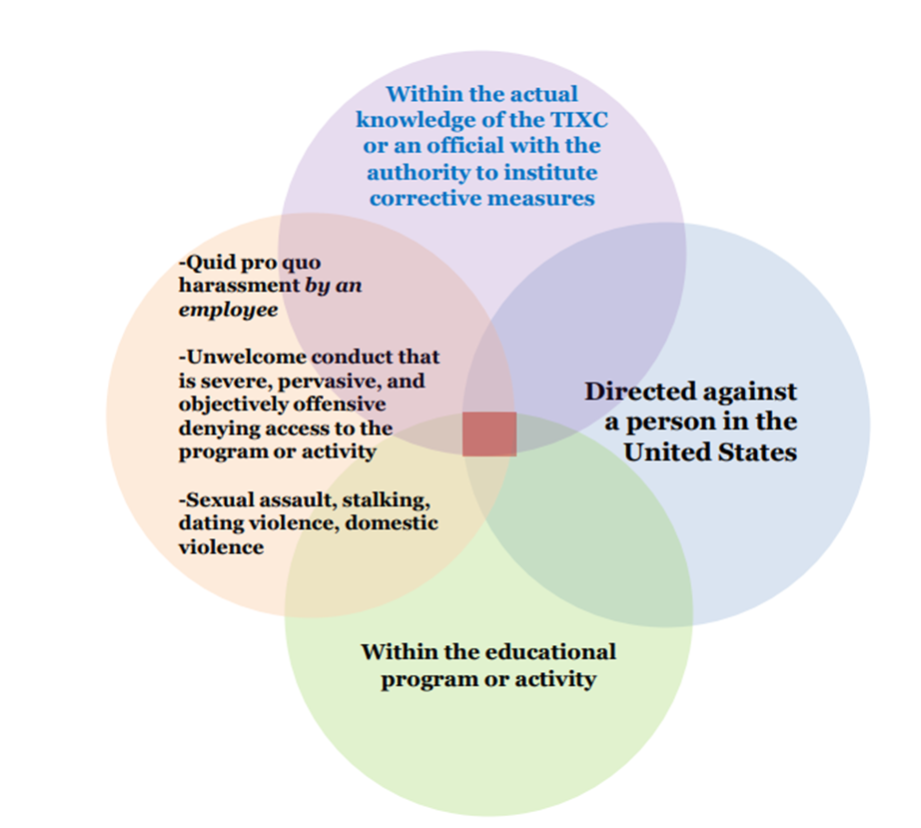
Formal Grievance Process Obligations Arise
The Complainant is participating in, or attempting to participate in, your programs or activities at the time of the formal complaint
Formal Complaint from Complainant or TIXC

Slide 54
Sex = IX

Slide 55
Whiplash on the Freeway of Love
2020 vs. 2024 Regulations

Slide 56
Chart of Changes

Slide 57
What’s the Bottom Line?
Obligation
Jurisdiction
Actual Knowledge
Informal Resolutions
Pregnancy
These Are Ever
Changing Times
A Rose is
Still A Rose

Slide 58
Trump Rule (2020)
Schools must address sexual harassment if it is so severe, pervasive, and objectively offensive that it effectively denies a person equal access to a school program or activity.
Objectively- a reasonable person would also agree that it was offensive.
Biden Rule (2024)
Schools must address sex-based harassment if it is so severe or pervasive that it denies or limits a person’s ability to participate in a school program or activity
(Grant, 2025)

Slide 61
Biden Rule (2024)
Regardless of where an underlying incident occurs (e.g., off campus, outside the U.S.), school must address any resulting hostile environment that arises:
In a school program or digital platform In an official student group’s building Under the school’s substantial control
Trump Rule (2020)
Schools must address sexual harassment that occurs off-campus and inside the U.S. if it occurs:
In a school program or digital platform
In an official student group’s building
Under the school’s substantial control
JURISDICTION
(Grant, 2025)

Slide 62
Biden Rule (2024)
Schools must address a complaint of sex-based harassment (or other sex discrimination) if the complainant was participating or trying to participate in school at the time of the incident.
JURISDICTON
Trump Rule (2020)
Schools must address a complaint of sexual harassment only if the complainant is participating in or attempting to participate in the educational program or activity at the time of the filing of the complaint.
(Nondiscrimination on the Basis of Sex in Education Programs or Activities Receiving Federal Financial Assistance, 2020)

Slide 63
Biden Rule (2024) All K-12 employees must report possible sex-based harassment (or other sex discrimination) to the Title IX Coordinator.
Trump Rule (2020)
All K-12 schools must respond to alleged sexual harassment if any employee has actual knowledge of it.
OBLIGATION

Slide 64
Actual Knowledge
Actual knowledge means notice of sexual harassment or allegations of sexual harassment to a recipient's Title IX Coordinator or any official of the recipient who has authority to institute corrective measures on behalf of the recipient, or to any employee of an elementary and secondary school.
This standard is not met when the only official of the recipient with actual knowledge is the respondent.

Slide 65
Informal Resolution
2020
Trump 2020 Regulations: Informal resolution was permitted only after a formal complaint of sexual harassment was filed, primarily for student-on-student cases.
2024
Biden 2024 Regulations: Informal resolution could be offered upon receiving any complaint or information about potential sex discrimination, without the necessity of a formal complaint.

Slide 66
Why Informal Resolution?
Faster Resolution – Informal resolution processes are often quicker than formal investigations, which can take weeks or months to complete. This allows students, parents, and staff to move forward without prolonged uncertainty.
Less Adversarial Process – Unlike a formal investigation, which can feel legalistic and confrontational, informal resolution focuses on dialogue and finding mutually acceptable solutions. This can help maintain positive relationships within the school community.
Increased Student and Parent Control – Parties involved in an informal resolution process typically have more say in the outcome, rather than leaving the decision entirely up to administrators or hearing officers.
Confidentiality – Informal resolutions can provide more privacy than formal proceedings, reducing the risk of public scrutiny or reputational harm for the involved students.
Educational and Restorative Approach – Schools can use informal resolution to implement educational interventions, counseling, mediation, or restorative justice practices that address harm without resorting to punitive measures.
Reduced Stress and Trauma – A formal Title IX investigation can be stressful for all involved, especially in sensitive cases. Flexibility in Outcomes – Informal resolutions allow schools to craft creative and individualized solutions that meet the needs of the parties involved, such as safety agreements, no-contact agreements, training, or behavioral interventions.
Encourages Communication and Understanding – A well-facilitated informal resolution process can promote mutual understanding and prevent future conflicts by addressing the underlying issues in a constructive manner.

Slide 67
Pregnancy: Leave of Absence
Trump Rule (2020)
Schools must allow a voluntary leave of absence for pregnancy or related conditions for as long as a student’s healthcare provider deems medically necessary.
Upon return, the student must be reinstated to their prior status.
Biden Rule (2024)
Schools must allow a voluntary leave of absence for pregnancy or related conditions for at least as long as a student’s healthcare provider deems medically necessary.
Upon return, the student must be reinstated to their prior academic status and, where practicable, prior extracurricular status.

Slide 68
Pregnancy: Accommodations
Trump Rule (2020)
Schools must offer services and benefits to students who are pregnant or have a related condition if they are offered to other temporarily disabled students.
Biden Rule (2024)
Schools must consult with a student who is pregnant or has a related condition to offer individualized and voluntary “reasonable modifications” unless this would “fundamentally alter” the school’s program or activity.

Slide 69
Chart of Changes: Pregnancy Participation
Trump Rule (2020)
A pregnant student can participate in an alternate program if it is voluntary, and the program is comparable to those offered to their peers.
A school cannot require a student who is pregnant or has a related condition to get a doctor’s approval to participate in a school program or activity unless it is required of students with other physical or emotional conditions.

Slide 70
Enduring Understandings
It Isn't, It Wasn't, It
Ain't Never Gonna Be
It Is, It Was, It is
Always Going to Be
Non-Discrimination Mandate: Both sets of regulations maintain the core principle that discrimination based on sex is prohibited in any education program or activity receiving federal financial assistance. Title IX Coordinator: The requirement for schools to designate a Title IX Coordinator to oversee compliance with Title IX regulations remained unchanged. Grievance Procedures: Both the 2020 and 2024 regulations require schools to have grievance procedures in place for handling complaints of sex discrimination. Retaliation Prohibition: Both sets of regulations prohibit retaliation against individuals who exercise their rights under Title IX.

Slide 71
Reoccurring Issues: A Closer Look

Slide 72
Fondling
The FBI’s Uniform Crime Reporting (UCR) Program defines fondling as:
"The touching of the private body parts of another person for the purpose of sexual gratification, without the consent of the victim, including instances where the victim is incapable of giving consent because of their age or temporary or permanent mental incapacity."
Key Elements of the UCR Definition of Fondling Touching – Physical contact with private body parts (e.g., breasts, genitals, buttocks).
Sexual Gratification – The act must be for sexual purposes rather than accidental or incidental contact.
Without Consent –If the victim does not or cannot consent, it is classified as fondling. This includes situations where the victim is unconscious, underage, or mentally incapacitated (temporarily or permanently).

Slide 73
Title IX – Determination & Processes

Slide 74
Part I
Determination & Process Decision
See the handouts.

Slide 75
Sample Verification
Don’t forget to check the boxes!

Slide 76
Part II
Informal Resolution
*both parties must consent
See the handouts.

Slide 77
Part III
Formal Investigation & Decision
*at least a 40-Day process
See the handouts.

Slide 78
Scenarios

Slide 79
Scenario 1
Situation: The math teacher request that a student stays after class. The math teacher tells the student that they will receive an "A" in the class if they go on a date with them.
Does the school have jurisdiction?
If proven, is this an example of sexual harassment?
If so, what type of harassment is witnessed here?

Slide 80
Scenario 2
Situation: A male student repeatedly follows a female student across campus and inside the school building, sends her daily sexually explicit texts, and makes crude comments in class. She has begun skipping class and avoiding certain areas of campus.
Does the school have jurisdiction?
If proven, is this an example of sexual harassment?
If so, what type of harassment is witnessed here?

Slide 81
Scenario 3
Situation: A student participating in the after-school program (housed in the school cafeteria) grabs another student's buttocks without consent. The victim is upset but continues attending classes.
Does the school have jurisdiction?
If proven, is this an example of sexual harassment?
If so, what type of harassment is witnessed here?

Slide 82
Scenario 4
Situation: A student frequently tells inappropriate jokes in class that make some students uncomfortable, but they are not directly targeting anyone.
Does the school have jurisdiction?
If proven, is this an example of sexual harassment?
If so, what type of harassment is witnessed here?

Slide 83
Scenario 5
Situation: A student is sexually assaulted by another student in the band hall bathroom. They report the assault to the school custodian.
Does the school have jurisdiction?
If proven, is this an example of sexual harassment?
If so, what type of harassment is witnessed here?

Slide 84
References
National Women’s Law Center. (2025, February 11). Biden’s New Title IX Rule: Fact Sheet and Chart - National Women's Law Center. https://nwlc.org/resource/bidens-new-title-ix-rule-fact-sheet-and-chart/
National Women’s Law Center. (2025, February 11). Biden’s New Title IX Rule: Fact Sheet and Chart - National Women's Law Center. https://nwlc.org/resource/bidens-new-title-ix-rule-fact-sheet-and-chart/
NIBRS Offense Definitions. (2012). Uniform Crime Reporting (UCR) Program National Incident-Based Reporting System (NIBRS). https://ucr.fbi.gov/nibrs/2012/resources/nibrs-offense-definitions
Grant, B.J. (2025, February 22). Title IX Update: A Return to the 2020 Regulations & Key Clarifications from OCR. McGrath Training. https://www.mcgrathtraining.com/post/title-ix-update-a-return-to-the-2020-regulations-key-clarifications-from-ocr
National Women’s Law Center. (2025, February 11). Biden’s New Title IX Rule: Fact Sheet and Chart - National Women's Law Center. https://nwlc.org/resource/bidens-new-title-ix-rule-fact-sheet-and-chart/
NIBRS Offense Definitions. (2012). Uniform Crime Reporting (UCR) Program National Incident-Based Reporting System (NIBRS). https://ucr.fbi.gov/nibrs/2012/resources/nibrs-offense-definitions
Student Services / Non-Discrimination, Harassment and Title IX. (n.d.). https://www.rcboe.org/Page/62245

Slide 85
Questions? Say a Little Prayer for Us...

