Slide 1
Thank you!
You can download 2 different options for guided notes:
Thank you so much for purchasing this product for your classroom! I very much appreciate your support and business. Please, however, do not post this resource to any webpage, blog, Weebly page or Youtube.
Interactive Foldable & Guided Outline Notes:
https://www.dropbox.com/s/201xlwlr5q9dy04/Revolution%20Battles%20Notes.docx?dl=0
Note: For the graphic organizer, I combine Washington’s Crossing with the Battle of Trenton so that 6 tabs work for the graphic organizer.
Flipped Classroom Video:
https://youtu.be/ecBIa32TzKs
Google Slides Version:
https://docs.google.com/presentation/d/1dBGr3Fm-IO2ovekwEKvsmhjf9lQnAtjRHOffpV8cc6A/copy
© Students of History - http://www.teacherspayteachers.com/Store/Students-Of-History

Slide 2
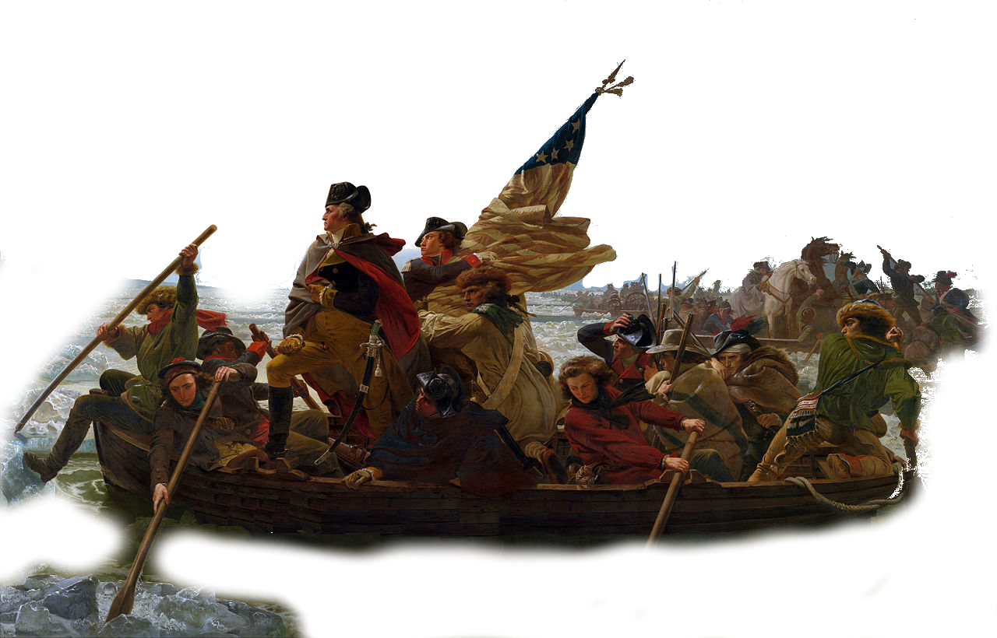
© Students of History - http://www.teacherspayteachers.com/Store/Students-Of-History
Notes:
© Students of History - http://www.teacherspayteachers.com/Store/Students-Of-History

Slide 3
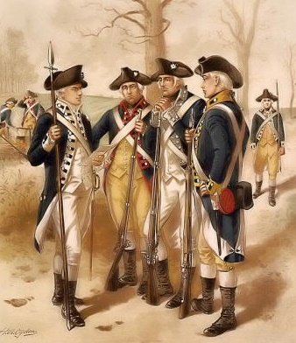
Strong leader in George Washington
Familiar with the land
Guerrilla warfare tactics
French alliance

Slide 4
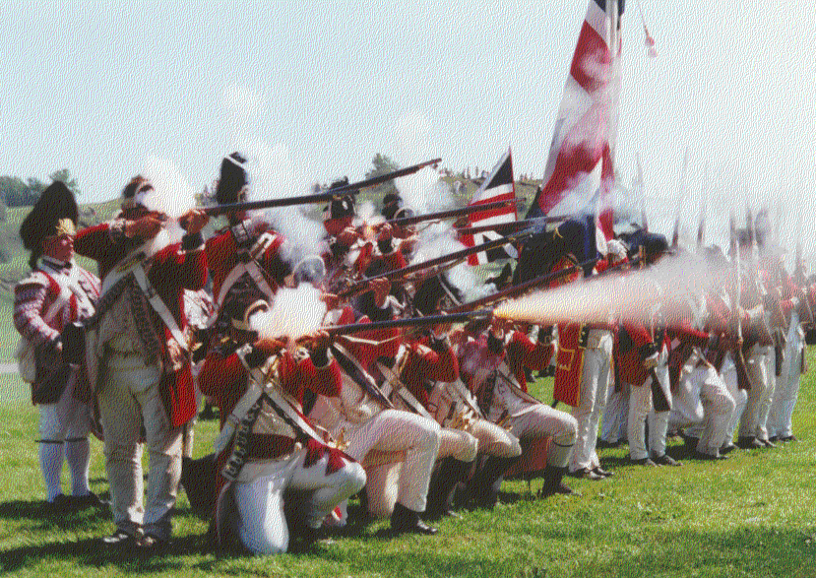
Well-trained soldiers
World’s most powerful navy
Lots of $$$ compared to the colonies

Slide 5
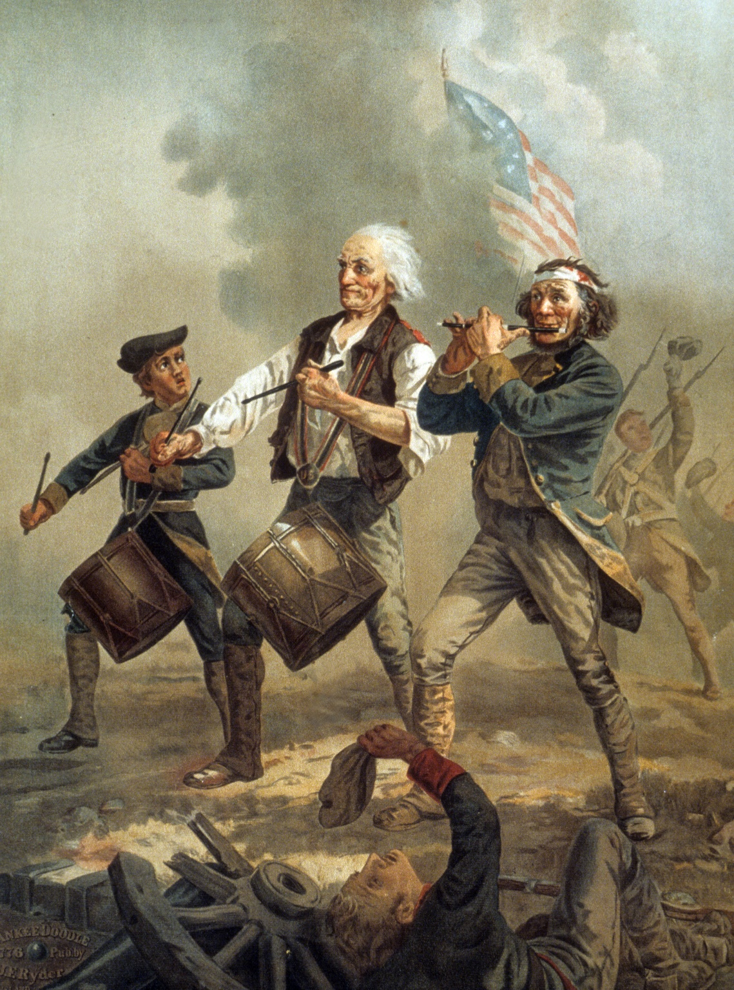
Little money
Few people to serve
Very small, weak navy

Slide 6
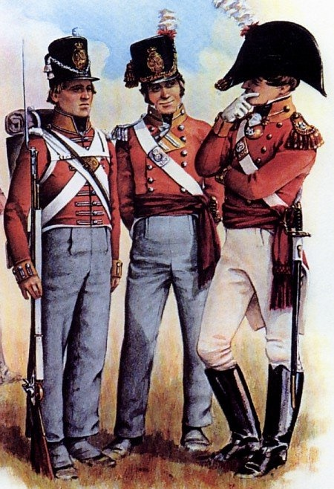
Not as familiar with the land
Older style of fighting with facing the enemy

Slide 7
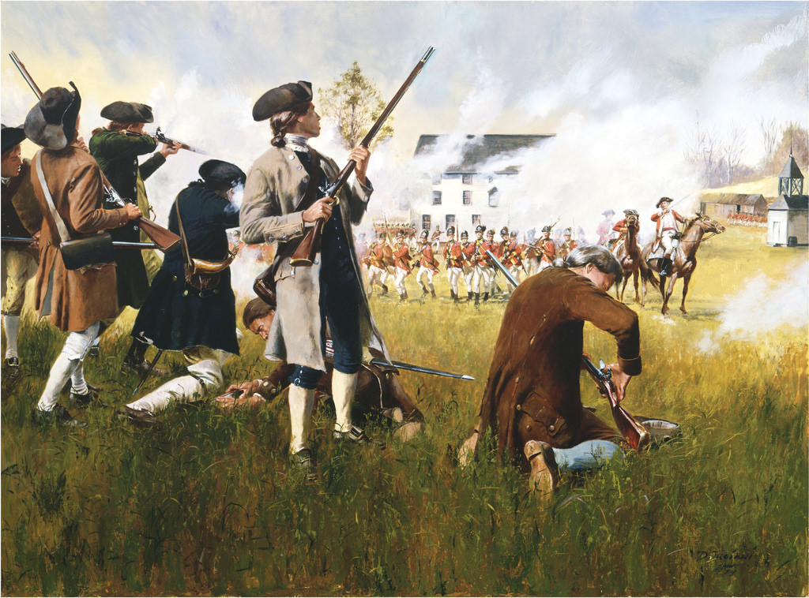
Small towns outside Boston
Minutemen meet Redcoats in a very brief skirmish
Starts the war
Known as the “Shot heard round the world”

Slide 8
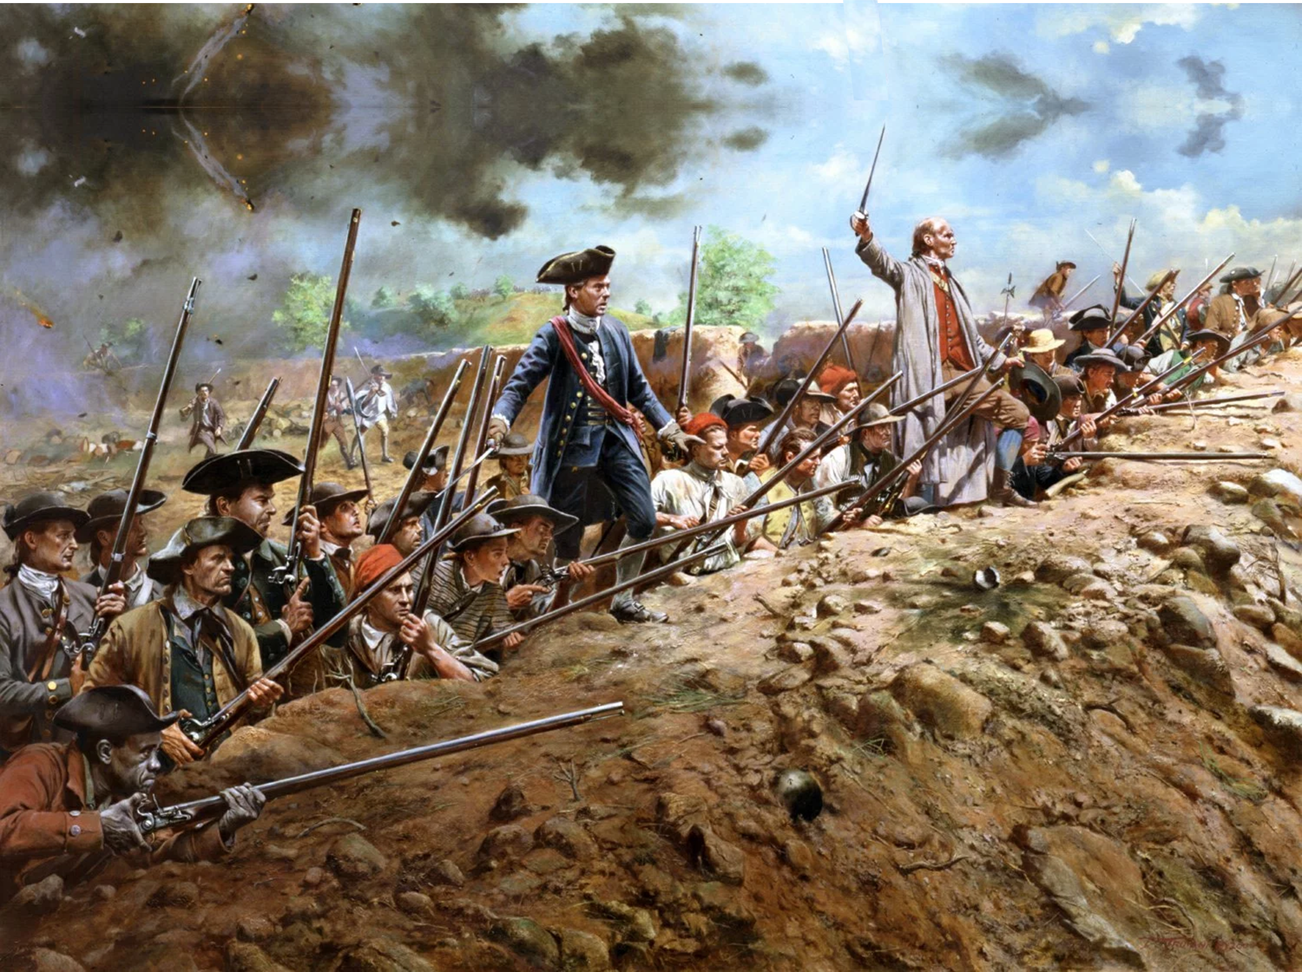
British Victory but costly
Very high casualties for British inspire Americans

Slide 9
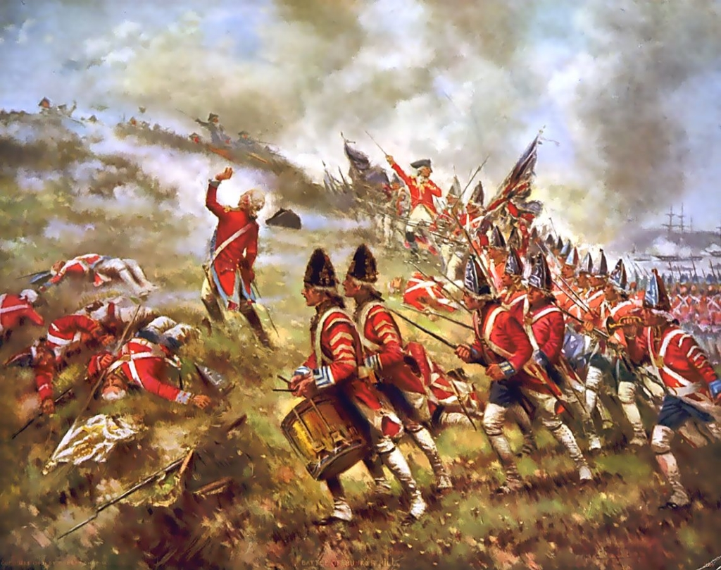
lukerosa@gmail.com

Slide 10
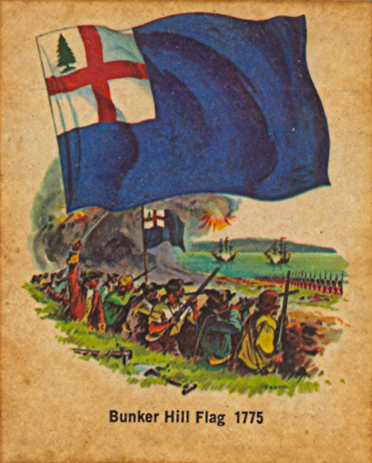
Bunker Hill was the bloodiest battle of the Revolutionary War. More than 1,000 British soldiers and about 400 American patriots were killed or wounded.
The Bunker Hill flag was also one of the first American flags to include the Pine Tree, which would become a lasting symbol of New England and the Colonies.

Slide 11
Surprise Attack on Christmas Night, 1776

Slide 12
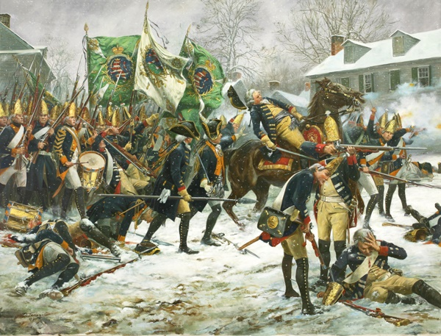
After Washington’s secret crossing from PA into NJ
Surprises Hessians – mercenaries hired by the British
Major, inspirational victory for the Continental Army

Slide 13
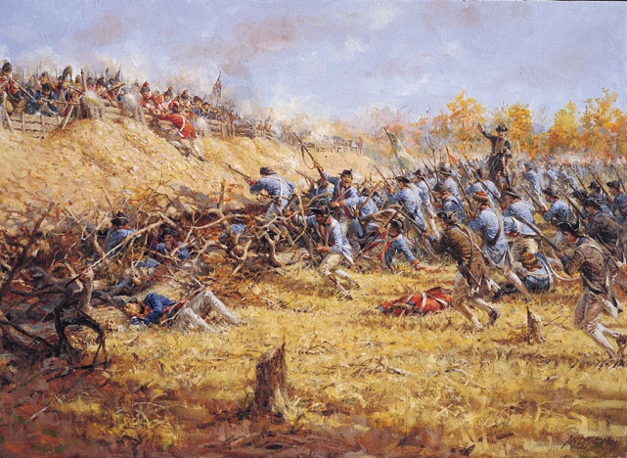
Two battles in NY in Fall of 1777
The 2nd was a decisive American victory
Major turning point in the war
Inspired France to agree to Treaty of Alliance
lukerosa@gmail.com

Slide 14
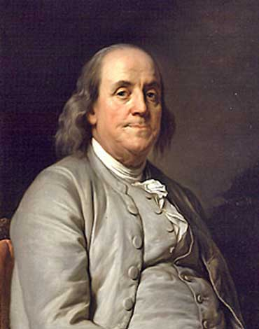
Benjamin Franklin had one of the most important tasks of the Revolution. He was sent to France in 1777 in order to gain a treaty of alliance against the British.
The French & British had long been enemies and Franklin was beloved in France. His popularity helped him secure the Treaty of Alliance in 1778

Slide 15
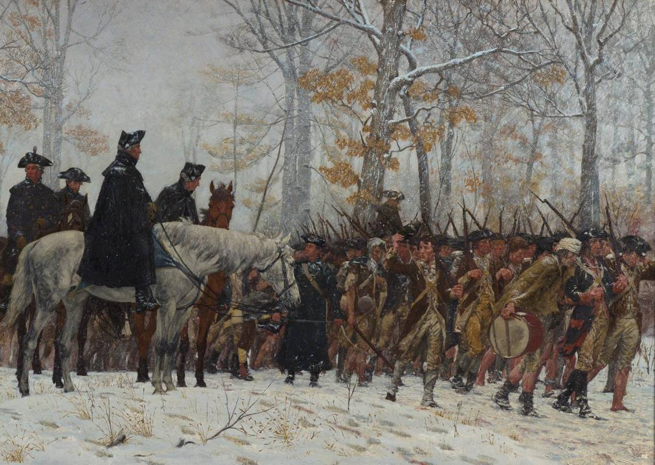
Washington has his army camp in Pennsylvania during winter of 1777
Over 2000 men die during brutal, freezing winter
Surviving soldiers emerge in spring newly inspired

Slide 16
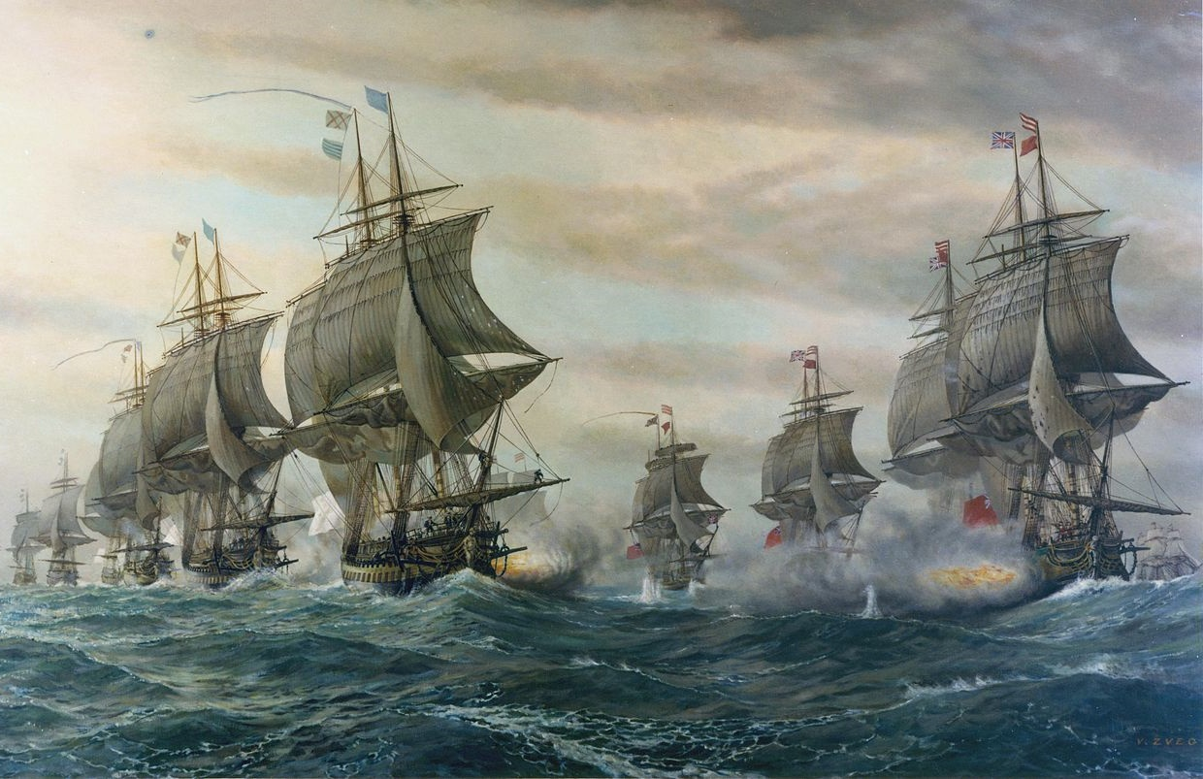
French navy arrives for support in September of 1781

Slide 17
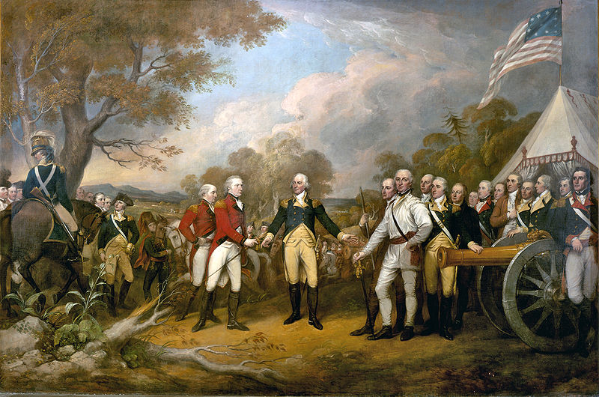
October, 1781
Lord Cornwallis surrenders to the Continental Army
America wins the war

Slide 18
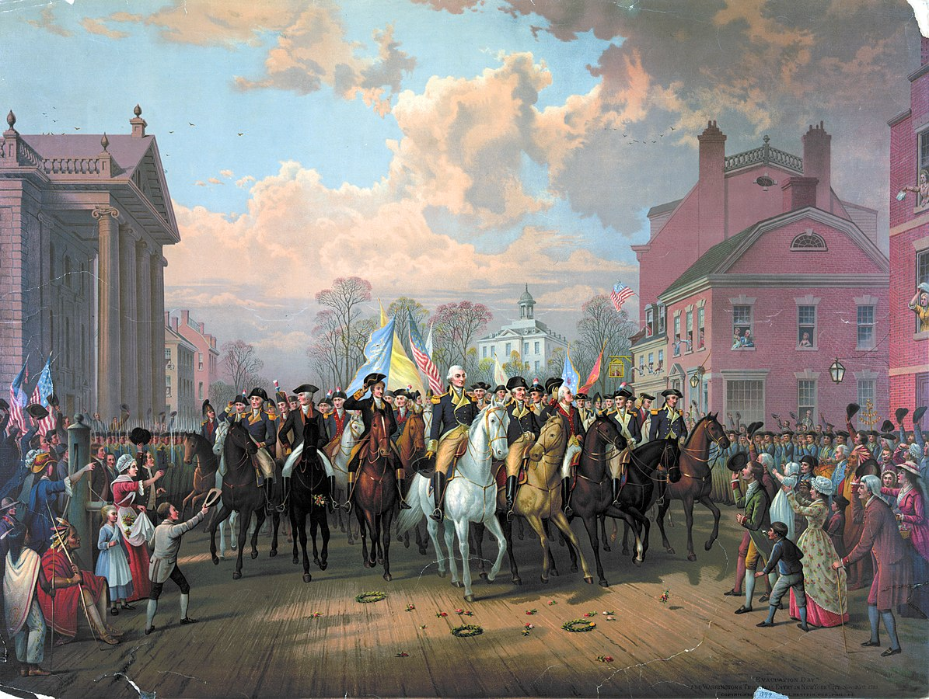
Notes:
The United States wins and becomes an independent nation!!!! But now what? Will the US survive?? Stay tuned to find out!!

