Slide 1
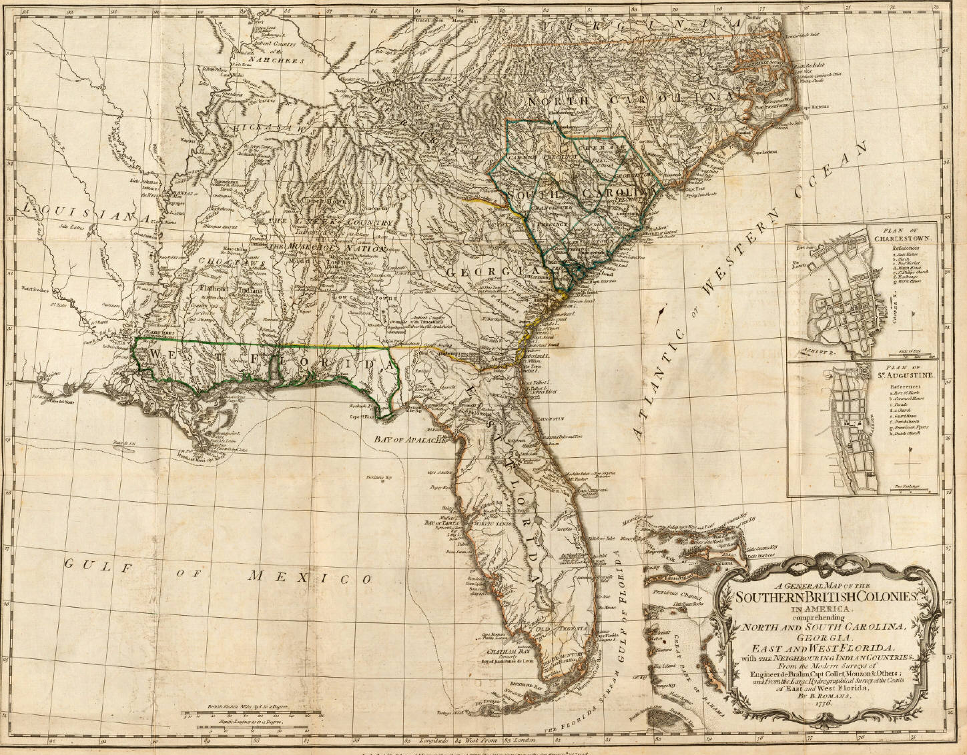

Slide 2
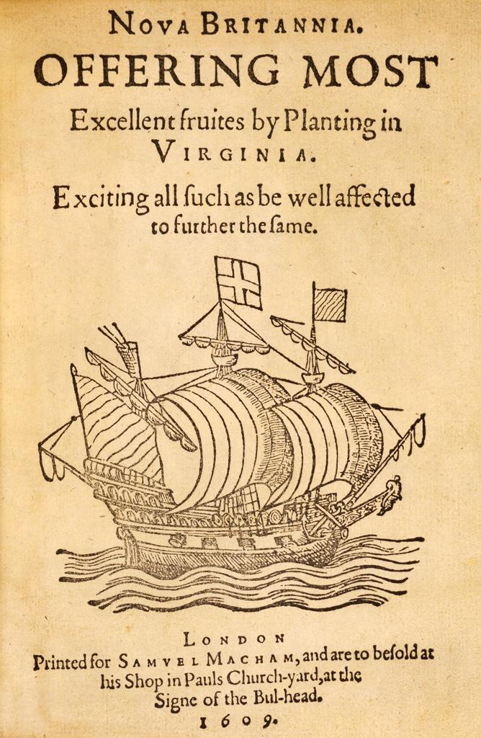
1606: James I granted a charter creating 2 branches of the Virginia Company of London:
The Plymouth Company
London Company
Motives for settlement:
Gold
Passage to Asia
Converting Indians to Christianity
April 1607: London Company settles Jamestown
Selected the peninsula on the James River for defense
Area was ridden with malaria

Slide 3
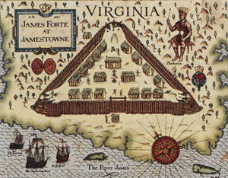
Initial poor leadership
John Smith eventually provides effective leadership
John Rolfe establishes tobacco crops
Tobacco
1616: 2500 lbs produced
1618: 30,000 lbs produced
1627: 500,000 lbs produced
Tobacco profits off-set the fruitless search for gold
Colonies spreads outward through Virginia

Slide 4
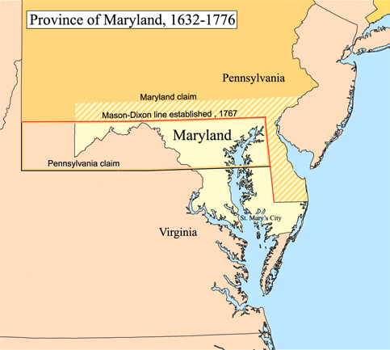
Lord Baltimore (Sir George Calvert) wanted his own colony
Promoted to be a refuge for English Catholics
Selected St. Mary’s City as the first settlement
Representative government (like Virginia)

Slide 5
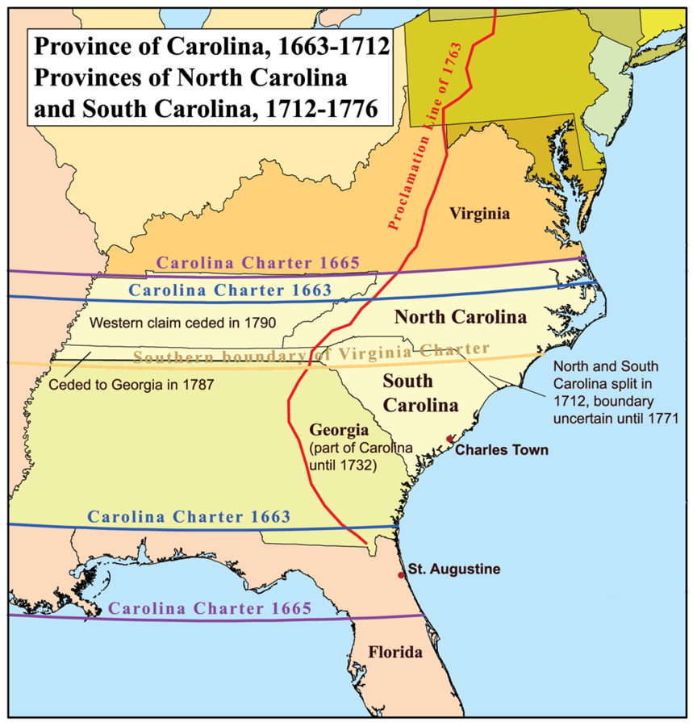
Chartered in 1663
Representative assembly
Largely Protestant
Settled by some French Huguenots
Also settled by some West Indian planters (who brought slavery to the region)
Economy based on cash crops

Slide 6
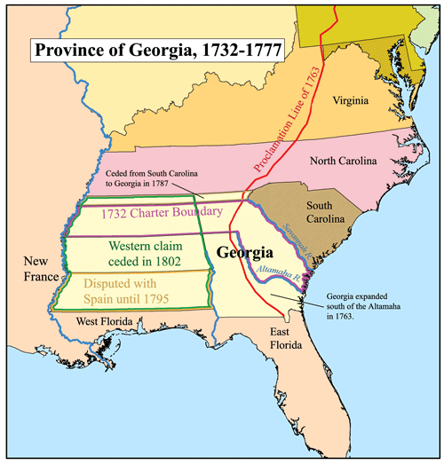
Granted a charter in 1732
Founded by Gen. James Oglethorpe
Created as a buffer between the British and Spanish Florida
Also used as a debtor’s colony (criminals and convicts from England)

Slide 7
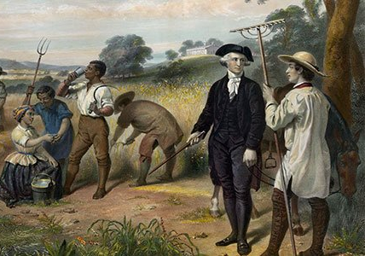
Outbreaks of malaria & yellow fever keep life expectancies low
Difficult to start families and create solid settlements
Climate & Soil create a Tobacco Economy

Slide 8
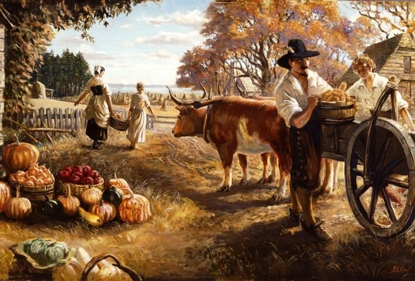
Headright System
To encourage the importation of workers
Land grants of about 50 acres per person were given to the “head” of a family
Could receive up to 1,000 acres

Slide 9
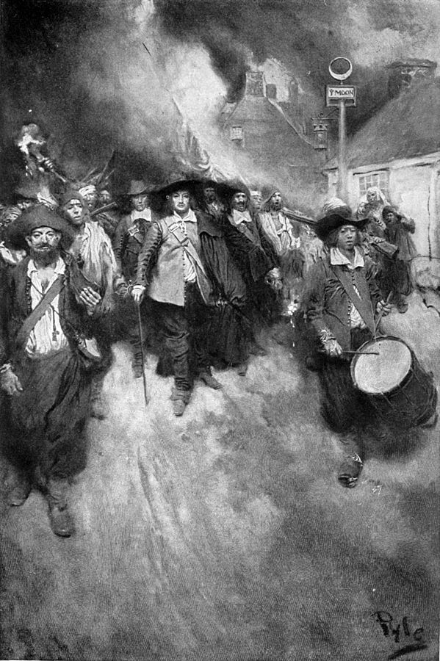
Increasing number of poor freemen in the Chesapeake
Frustrated by lack of good land & Indian attacks on the frontier
In 1676, Nathaniel Bacon and former indentured servants led a rain on Jamestown and burned it
Governor Berkeley crushed the rebellion
Landowners begin to distrust indentured servants and import more slave labor

Slide 10
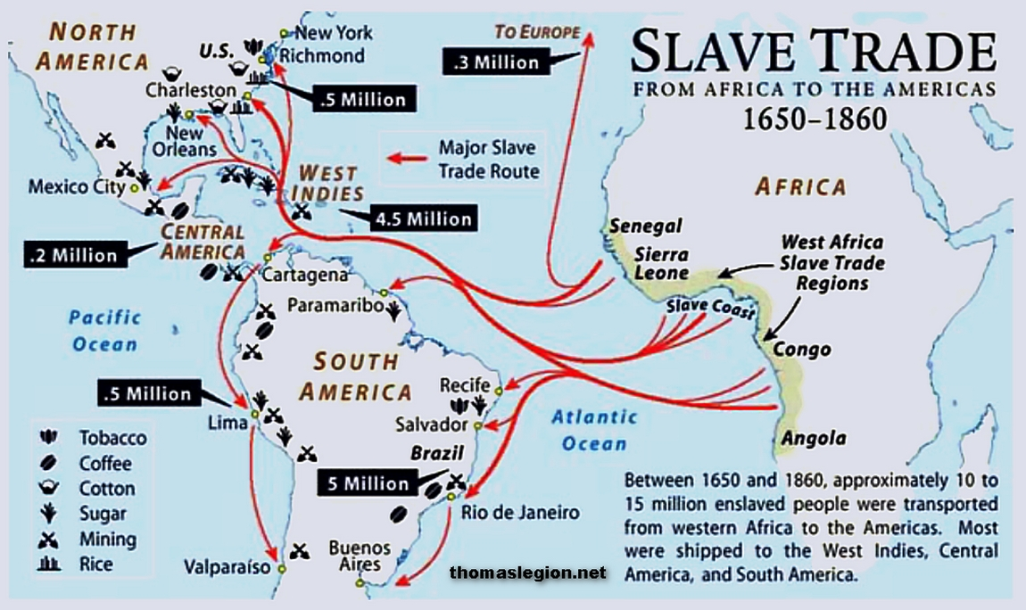

Slide 11
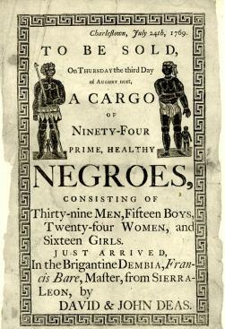
The Royal African Company lost its charter in 1698
enterprising colonists rushed to cash in on the lucrative slave trade
By the 1660s, “slave codes” were drawn up by the colonial governments to delineate between servants’ and slaves’ rights

Slide 12
About 10 million Africans were forced over the course of 3 centuries
First Africans came to Jamestown in 1619 (about 2,000)
Slaves were too expensive for poorer colonists
By the 1680s, rising wages in England shrank the pool of servants coming over

