Slide 1
Thank you!
Supplemental Materials for Download:
Paste any of these links into your web browser to access the supplemental resources for the lesson.
Thank you so much for purchasing this product for your classroom! I very much appreciate your support and business. Please, however, do not post this resource to any webpage, blog, Weebly page or Youtube.
Interactive Foldable & Guided Notes:
https://s3.amazonaws.com/americancolonies/03+-+New+England+Colonies+Notes+Page.docx
Guided Notes:
https://docs.google.com/document/d/1ZdA8NzoSznSMuLRRtcyMZv3jBFhZGbjvq47LyxBRgQo/copy
Cornell Style Notes:
https://docs.google.com/document/d/1yQFAuvuRTzhtPAWr5Pl9ciLI65zwx6c48RHMHM_8SVY/copy
Google Slides Presentation:
https://docs.google.com/presentation/d/1cMgu1as7RxMNd0-Y_dwYFXuCvOPSVVE6ApTyOQAIV5k/copy
Flipped Classroom Video:
https://youtu.be/AIgPLnQ_5VA
Notes:
© Students of History - http://www.teacherspayteachers.com/Store/Students-Of-History

Slide 2
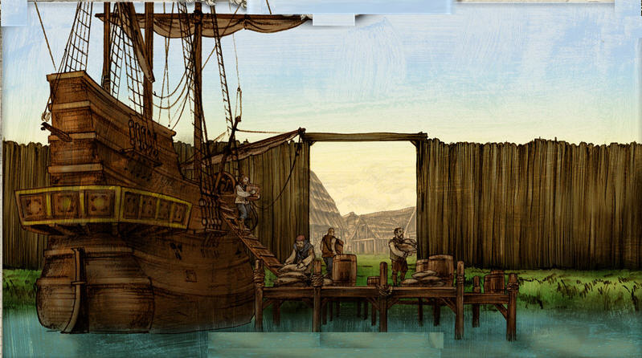
Warm Up
Push factors are reasons for moving out of a place and pull factors are things that attract immigrants.
Identify 3 push or pull factors that brought immigrants to the New World and 3 that attract immigrants to the US today.

Slide 3
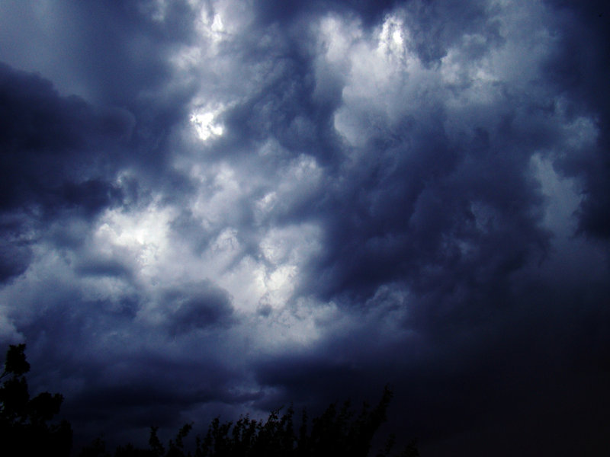
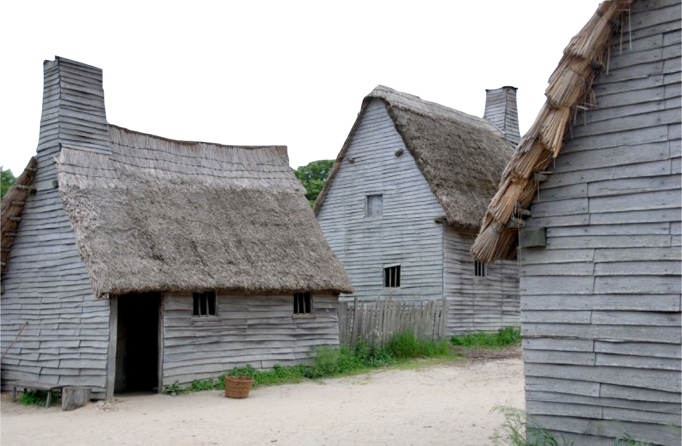
witches!

Slide 4
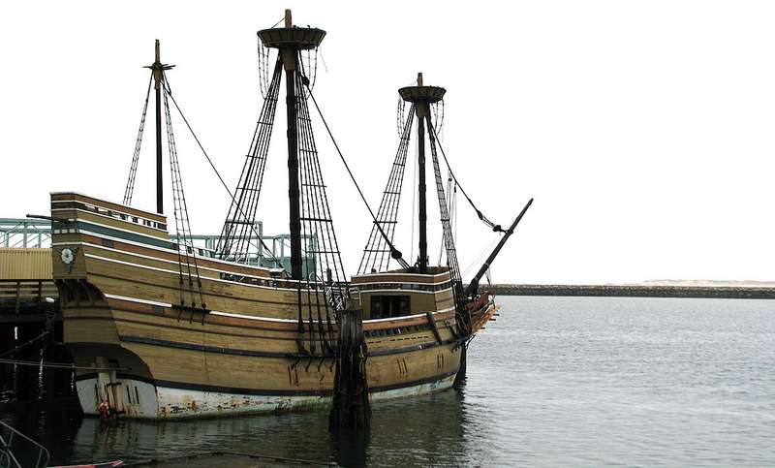
Strict religious separatists first leave England for Holland
Secure funding in 1620 for a voyage to America

Slide 5
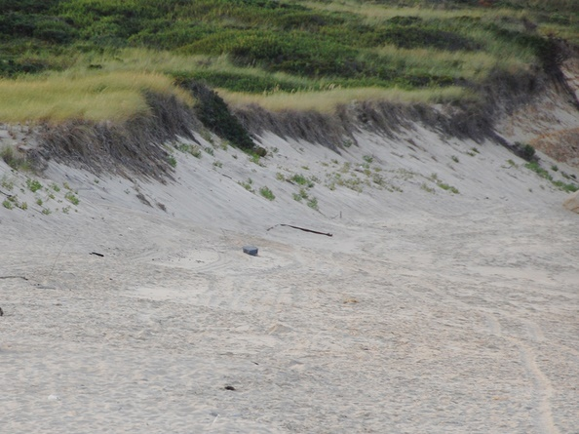
Thin, rocky soil not great for farming
Short growing season & cold winters
More mountainous inland than Southern America

Slide 6
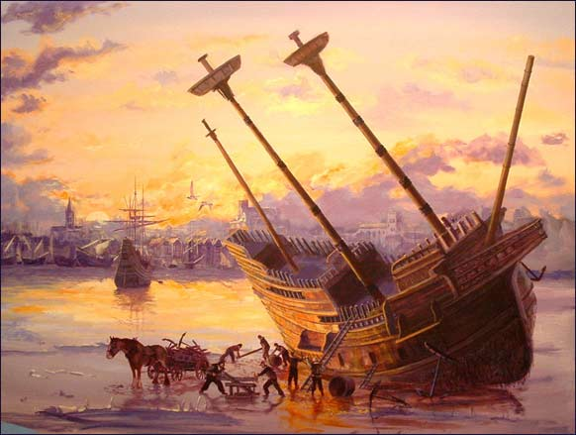
66 Day voyage to America
Land in Plymouth
Sign the Mayflower Compact
Helps establish America’s ideas on self-government and majority rule

Slide 7
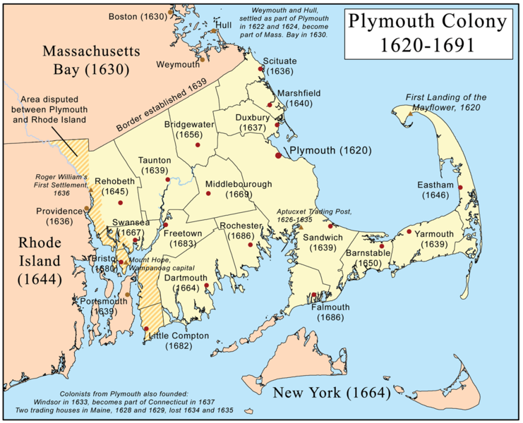

Slide 8
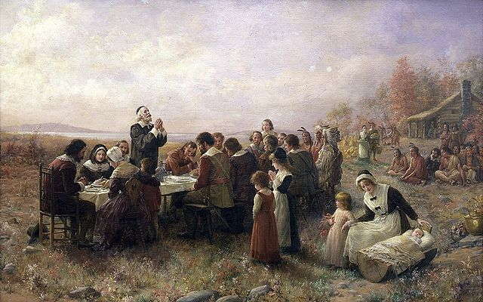
A Wampanoag named Squanto taught the pilgrims to fish & grow corn
In 1621, Pilgrims & Native Americans supposedly held the 1st Thanksgiving Feast

Slide 10
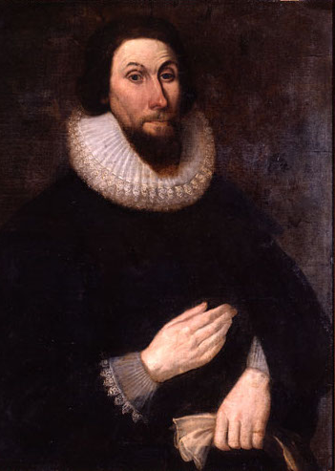
In 1628, he becomes Governor of the larger Massachusetts Bay Colony
Wished to create a “City Upon a Hill”
This was his Puritan vision of a Christian society

Slide 11
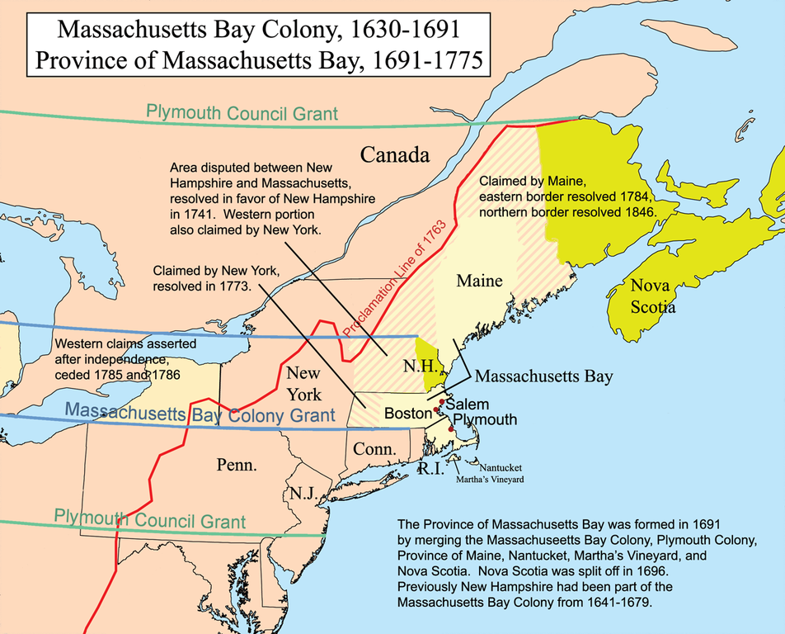

Slide 12
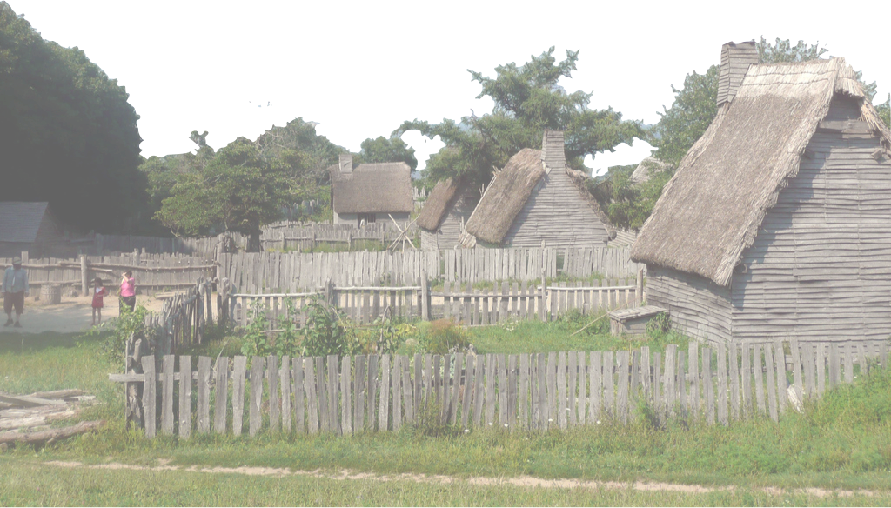
Create a “covenant community”
Practice Athenian-style direct democracy in town meetings
Lays the foundation of majority rule in America

Slide 13
Religious leaders do not accept any dissent
Roger Williams - banished for giving his opinions in church, founds Rhode Island
Anne Hutchinson - banished for holding bible meetings for women, moves to Rhode Island

Slide 14
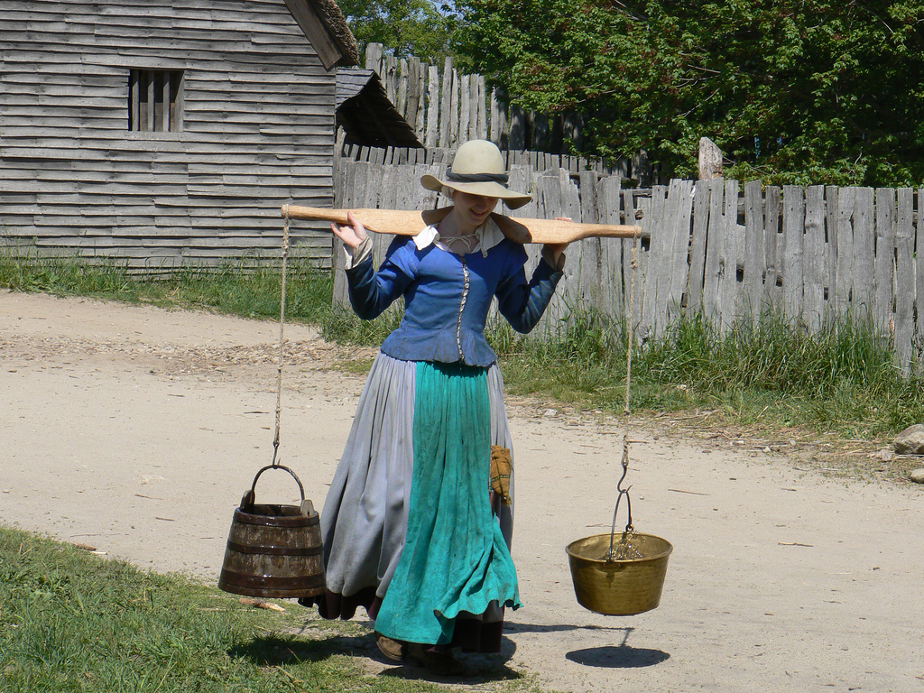
Very patriarchal society with men in charge
Women were supposed to be subservient to men

Slide 15
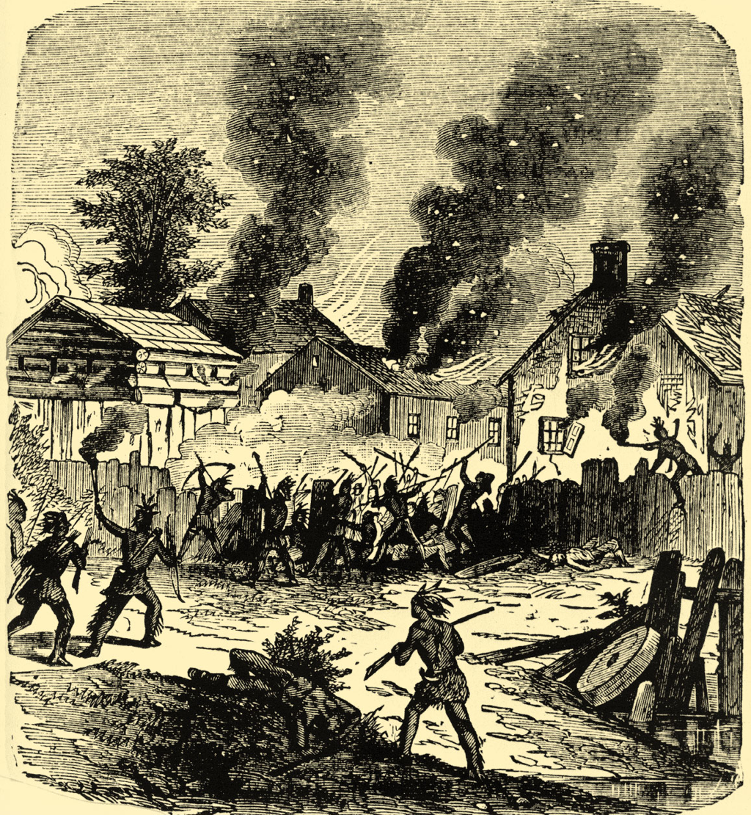
Conflict with Native American groups grows over land ownership
Wampanoag Chief Metacom unites tribes against colonists in 1675
War kills 7 of 8 natives, & 6/13 whites
Colonists win after Metacom’s death

Slide 16
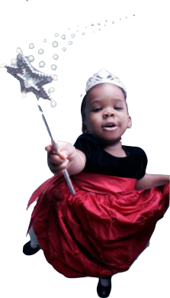
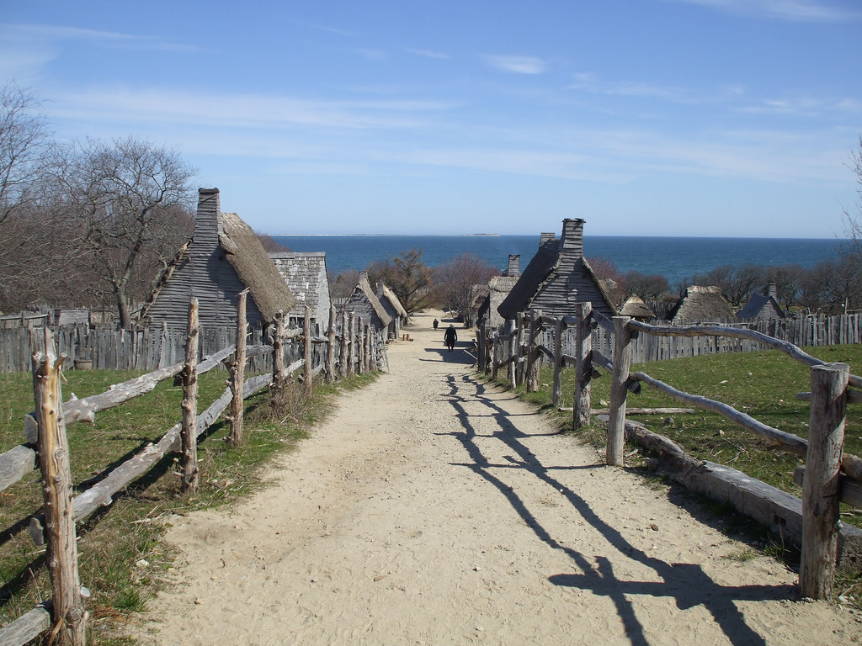
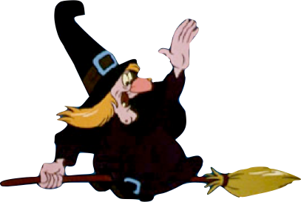
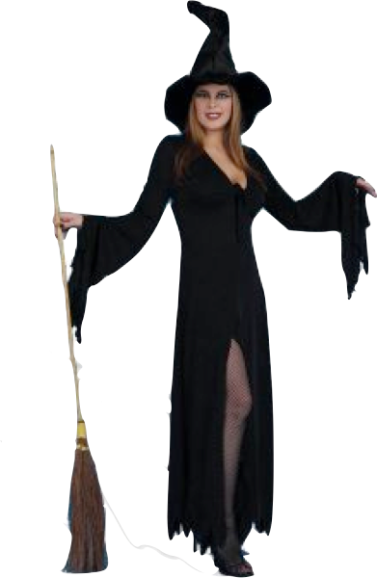
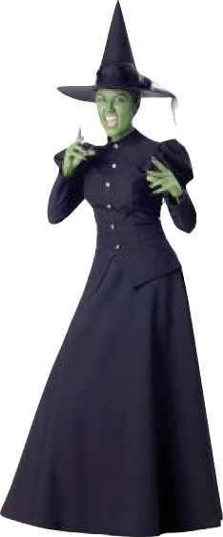
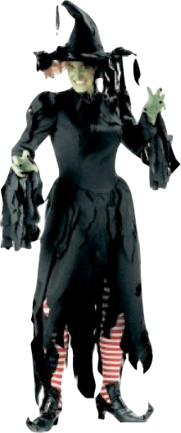
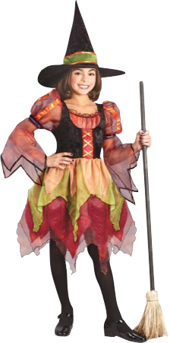
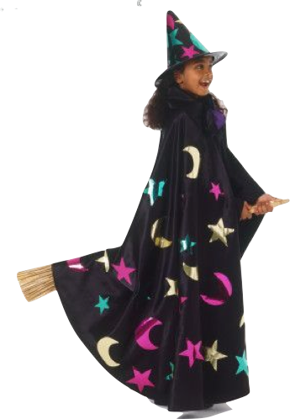
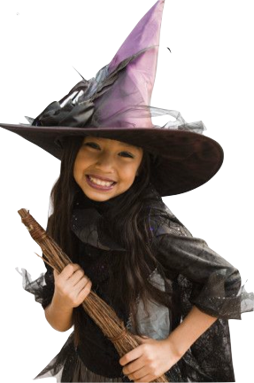
Notes:
I use this as a fun intro on stereotypes and clichés on “witches” and how they compare to what the people of Salem believed. It’s kind of silly now but was deadly serious to them back then.

Slide 17
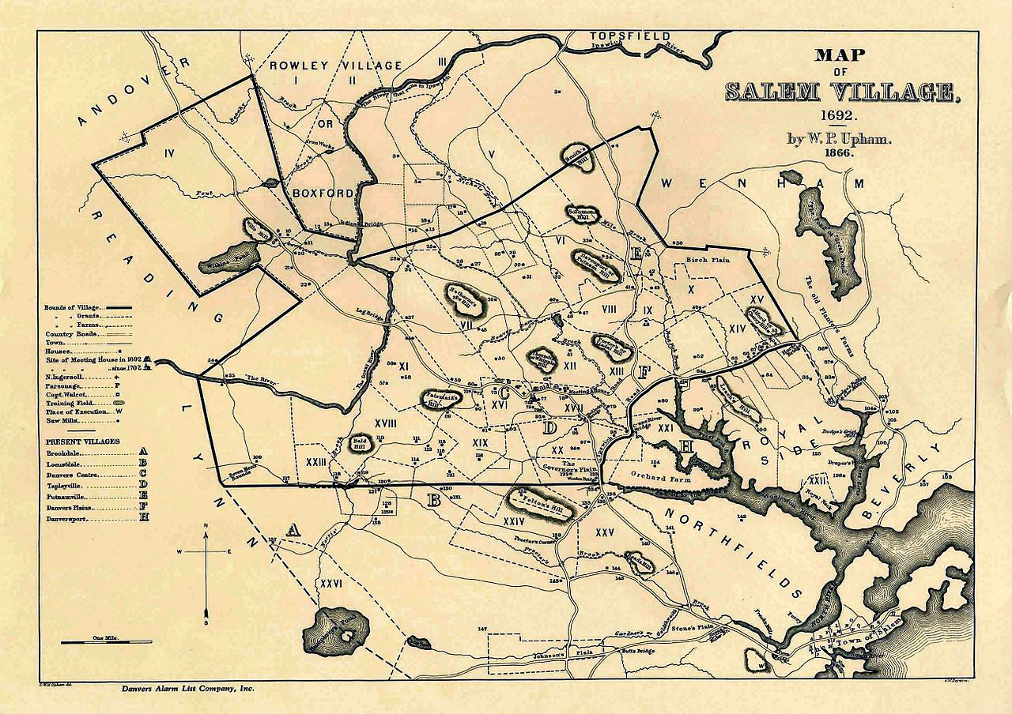

Slide 18
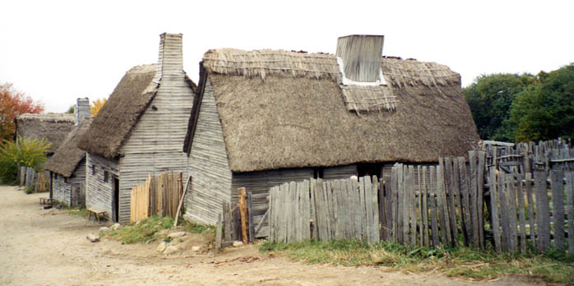
In 1692, several young Puritan girls seem bewitched
Over 100 people (mostly women) are arrested and tried for witchcraft
20 are executed for witchcraft, most by hanging

Slide 19
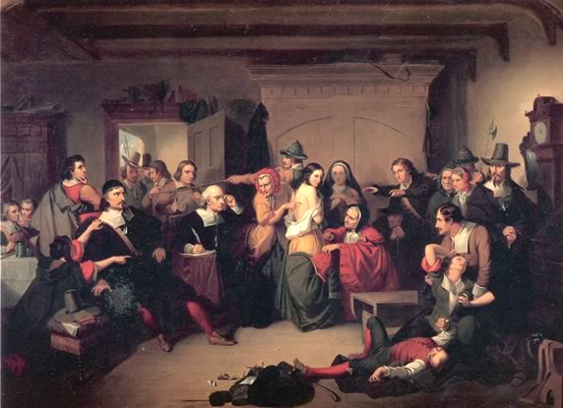
Examination of a Witch – the court looked for birthmarks which were thought to be made by the Devil

Slide 20
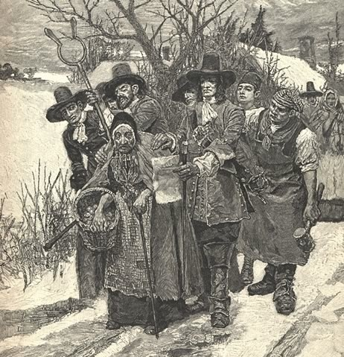
Many of those accused are single, independent women who go against Patriarchal Puritan society

Slide 21
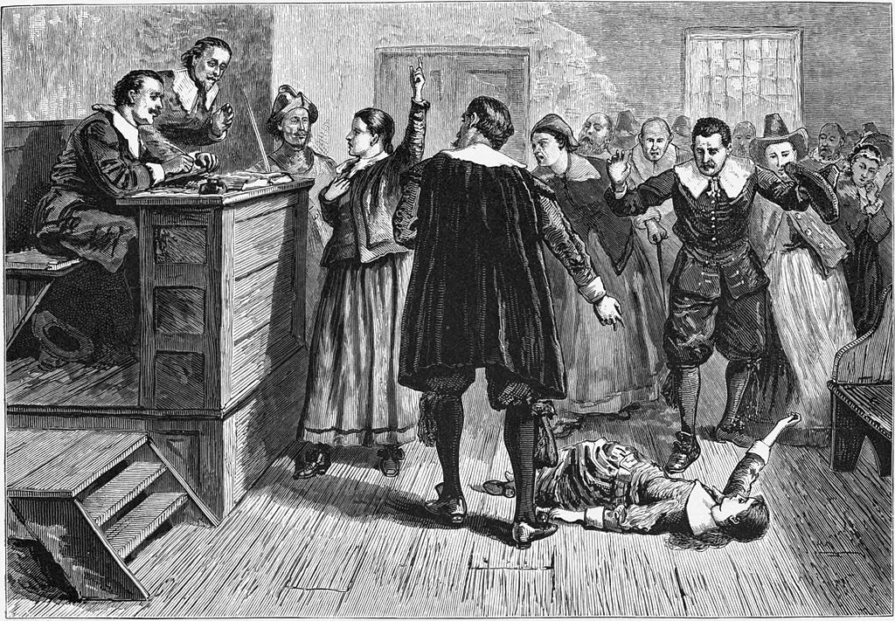

Slide 22
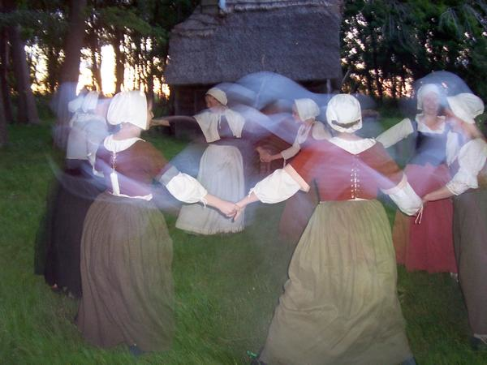
Fear of independent women
Challenges to Puritan authority
Rigid structured society

Slide 23
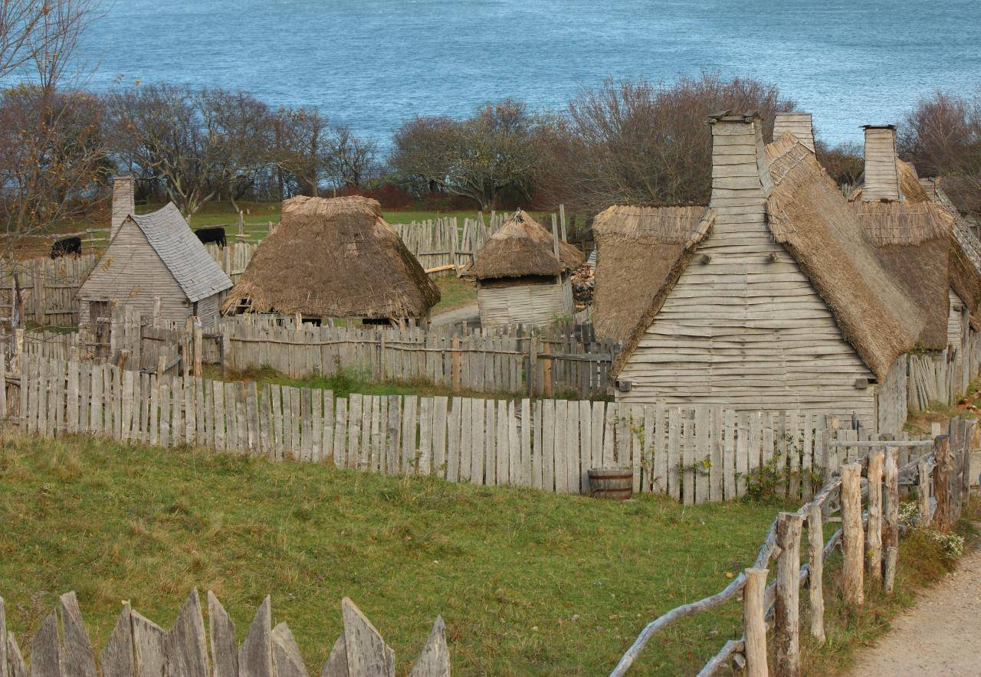
Economy grows based on shipbuilding, fishing, & trade
Colonies spread to the Connecticut River & New Hampshire

