Slide 1
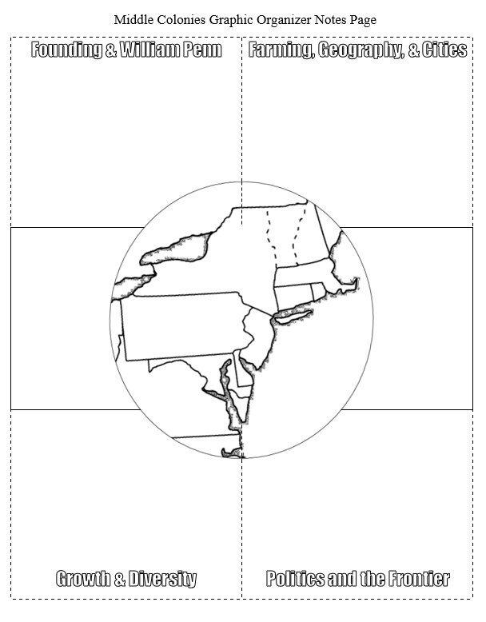
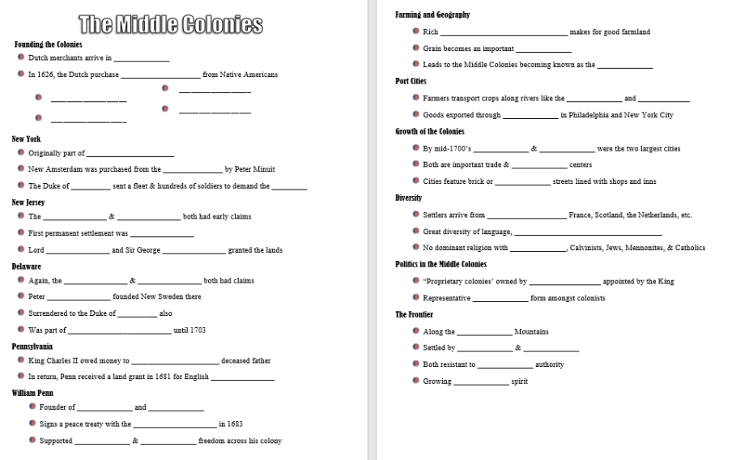

Thank you!
Included are 2 options for guided notes plus “flipped” Youtube & Google Slides versions:
Thank you so much for purchasing this product for your classroom! I very much appreciate your support and business. Please, however, do not post this resource to any webpage, blog, Weebly page or Youtube.
Interactive Foldable Style & Guided Outline Notes:
https://www.dropbox.com/s/oo8wx9tdkynqr3j/Middle%20Colonies%20Notes%20Page.docx?dl=0
Flipped Classroom Youtube Video of this presentation:
https://youtu.be/o1vjsCbfM5k
Google Slides Version
https://docs.google.com/presentation/d/1AlFbTeBRlKbBJpDkcxzmlQG4_e4JWbyP3fMGfCaJOCQ/copy
Notes:
© Students of History - http://www.teacherspayteachers.com/Store/Students-Of-History

Slide 2
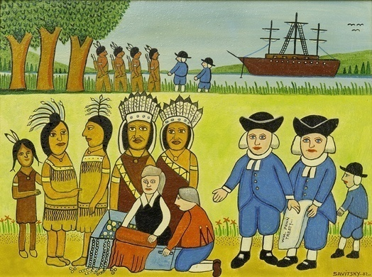
Warm Up
Among the many achievements of William Penn were his just and friendly relations with Native Americans. While some scholars doubt whether a formal treaty was ever signed, legend persists that in late 1682, Penn and the Native Americans signed The Great Treaty. According to belief, the treaty was signed under a large elm tree in a place called Shackamaxon. So the legend goes, the Indians agreed to “live in love with William Penn and his children so long as the sun and moon shall endure.”
Unlike other settlers of his time, Penn respected Native American beliefs and culture. He learned the language and customs of the tribes in his colony, such as the Lenni Lenape, Delaware, Shawnee, and Iroquois. As a result, Penn was respected by these tribes, who called him Onas, an Iroquois word for pen.
Which word best describes Penn’s relationship with Native Americans?
  Disdainful
  Respectful
  Selfish
  Unfriendly
  Explain one example that shows why this word best fits Penn.
  Some Indians had a name for Penn that meant ____
    Fool
    Wise man
    Invader
    None of the above

Slide 3
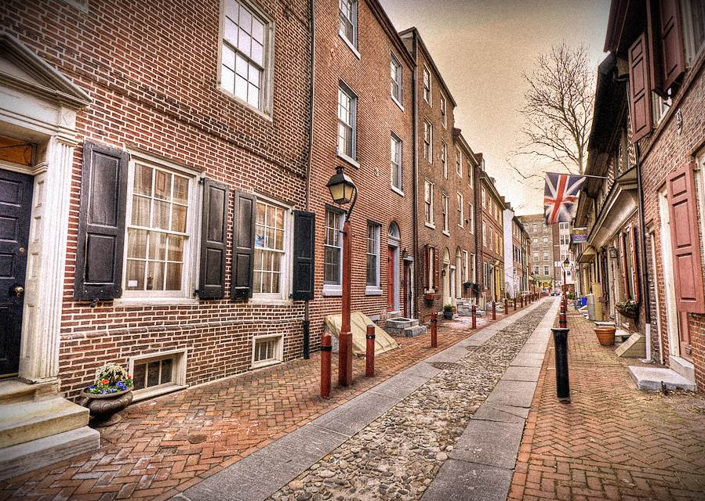

© Students of History - http://www.teacherspayteachers.com/Store/Students-Of-History

Slide 4
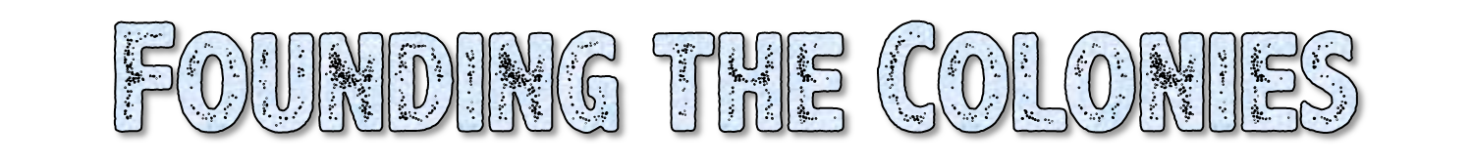
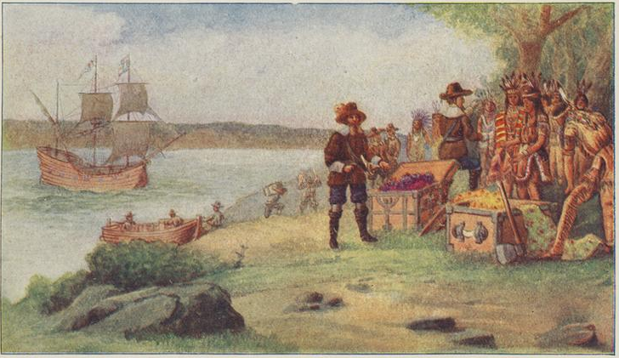
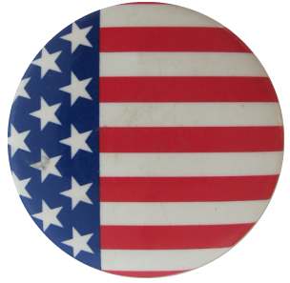
The first Dutch merchants arrive in 1609
In 1626, the Dutch purchase Manhattan
from Native
Americans
© Students of History - http://www.teacherspayteachers.com/Store/Students-Of-History

Slide 5
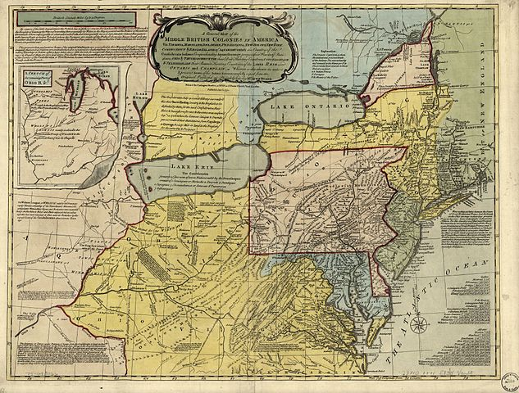
New York
New Jersey
Pennsylvania
Delaware

Slide 6

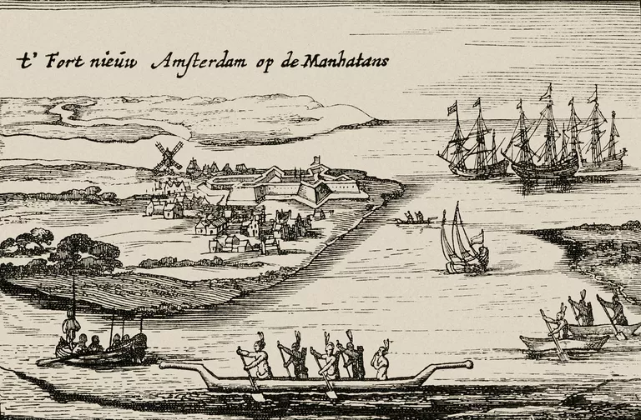
Originally part of New Netherland
New Amsterdam was purchased from the Lenape by Peter Minuit
The Duke of York sent a fleet & hundreds of soldiers to demand the colony
Notes:
A common account states that Minuit purchased Manhattan for $24 worth of trinkets. A letter written by Dutch merchant Peter Schaghen to directors of the Dutch East India Company stated that Manhattan was purchased "for the value of 60 guilders" in goods, an amount worth approximately $1,075 in 2019 dollars.

Slide 7
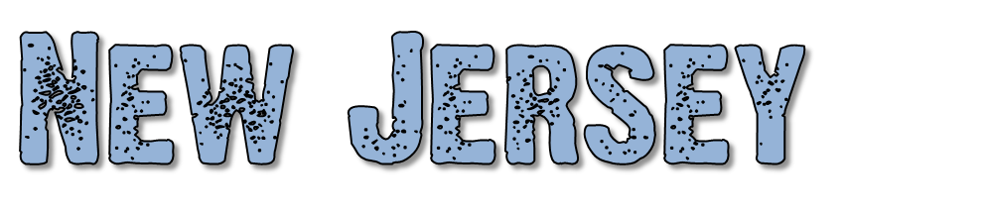
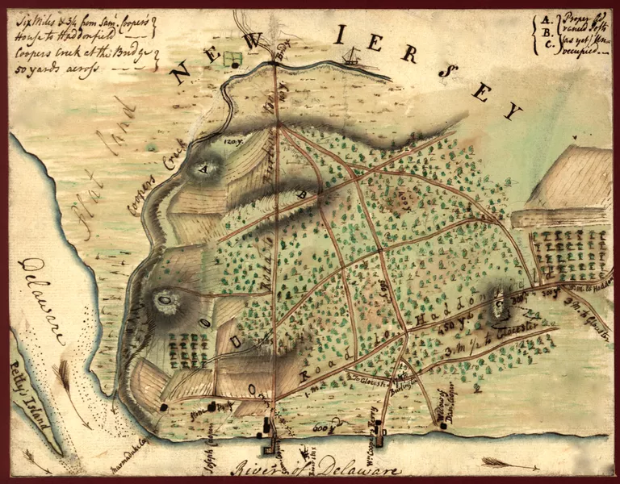
The Dutch & Swedish both had early claims
First permanent settlement was English
Lord Berkeley and Sir George Carteret granted the lands

Slide 8

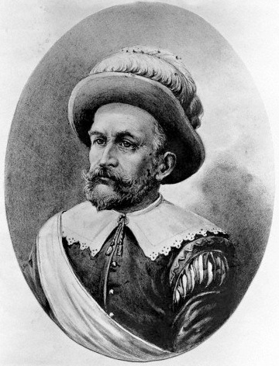
Again, the Dutch & Swedish both had claims
Peter Minuit founded New Sweden there
Surrendered to the Duke of York also
Was part of Pennsylvania until 1703

Slide 9
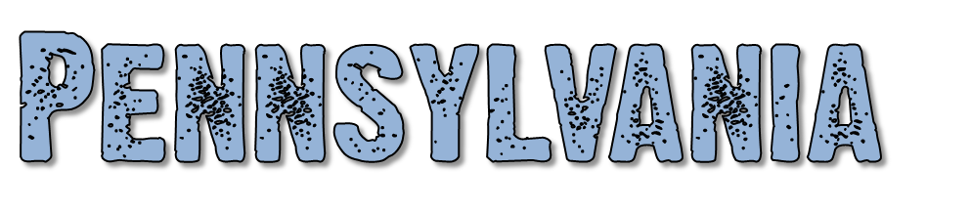
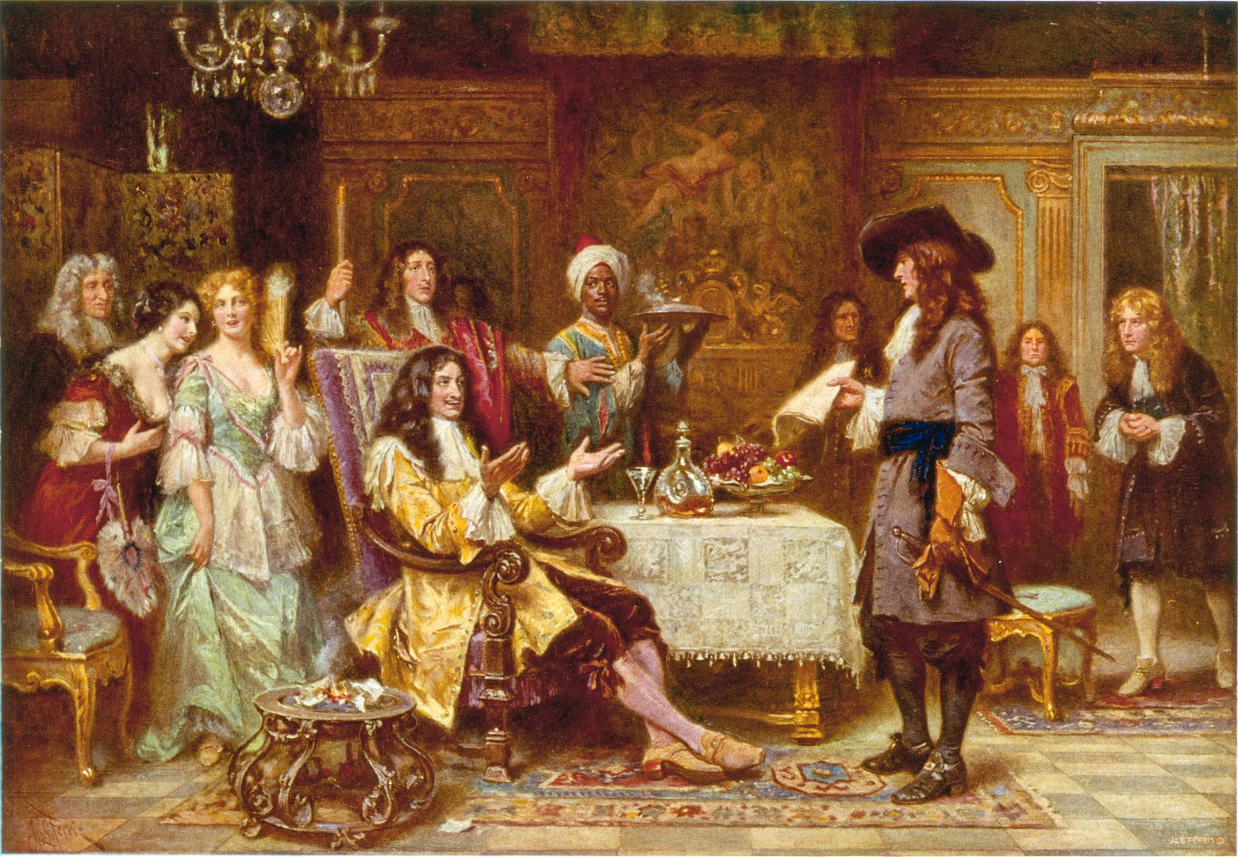
King Charles II owed money to William Penn’s deceased father
In return, Penn received a land grant in 1681 for English Quakers
Notes:
The Birth of Pennsylvania, 1680: William Penn, holding paper, standing and facing King Charles II, in the King's breakfast chamber at Whitehall.

Slide 10
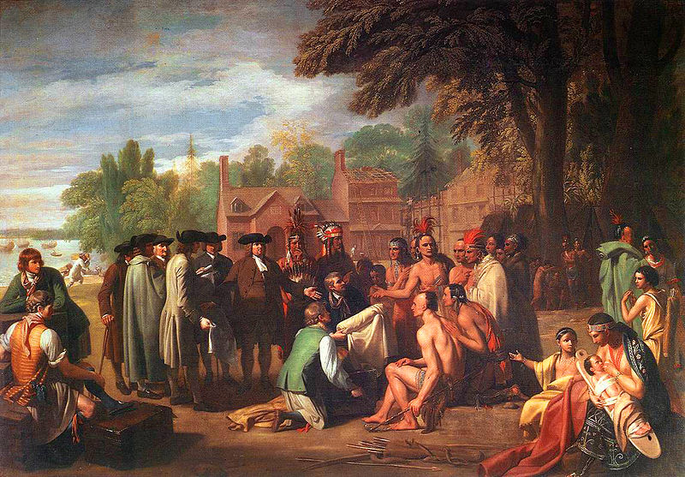

Founder of Pennsylvania and Philadelphia
Signs a peace treaty with the Lenape Indians in 1683
Supported democracy & religious freedom across his colony

Slide 11
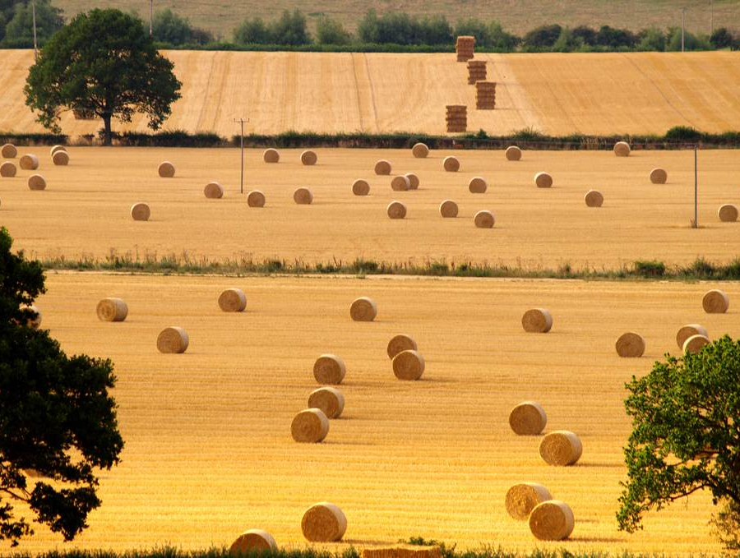
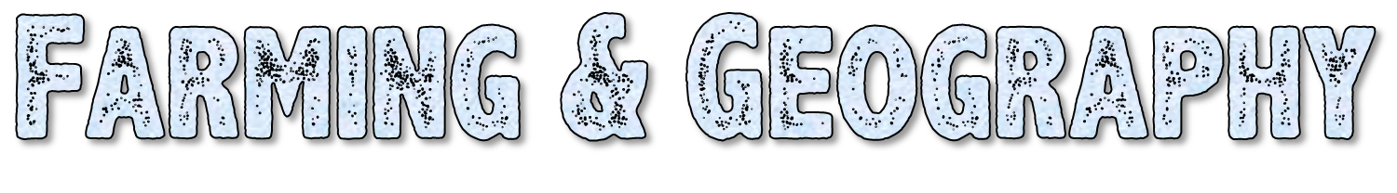
Rich soil and mild climate makes for good farmland
Grain becomes an important Cash Crop
Leads to the Middle Colonies becoming known as the “bread basket”

Slide 12

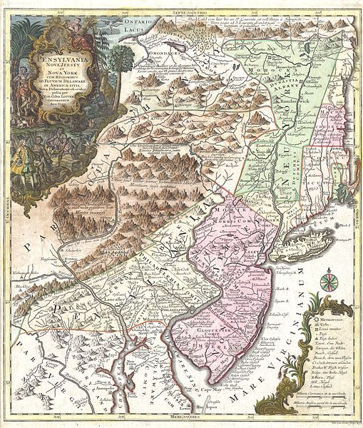
Farmers transport crops along rivers like the Hudson and Delaware
Goods exported through ports in Philadelphia and New York City

Slide 13
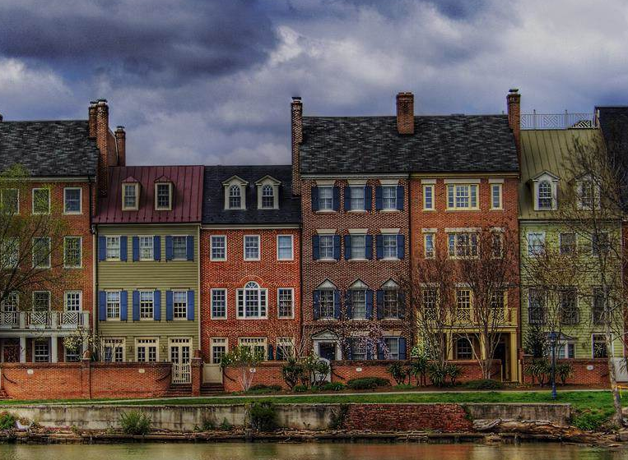
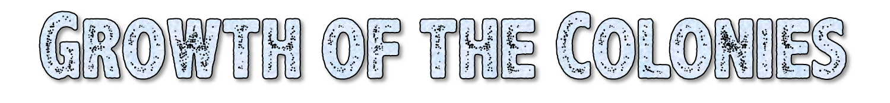
By mid-1700’s Philadelphia & New York were the two largest cities in the colonies
Both are important trade & manufacturing centers
Cities feature brick or cobblestone streets lined with shops and inns

Slide 14

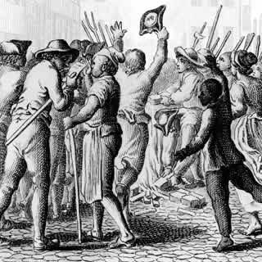
Settlers arrive from Germany, Sweden, France, Scotland, the Netherlands, etc.
Great diversity of
language, culture,
customs, and beliefs
No dominant religion
with Quakers,
Calvinists, Jews,
Mennonites, & Catholics

Slide 15
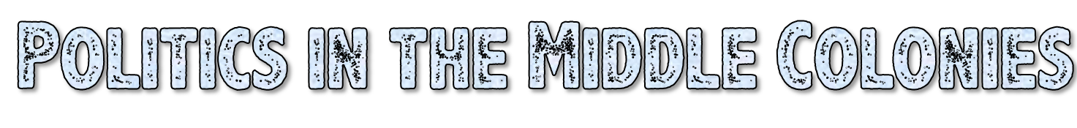
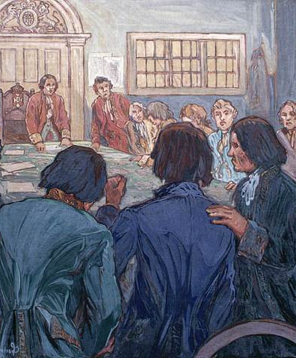
“Proprietary colonies” owned by single individuals appointed by the King
Representative assemblies form amongst colonists

Slide 16
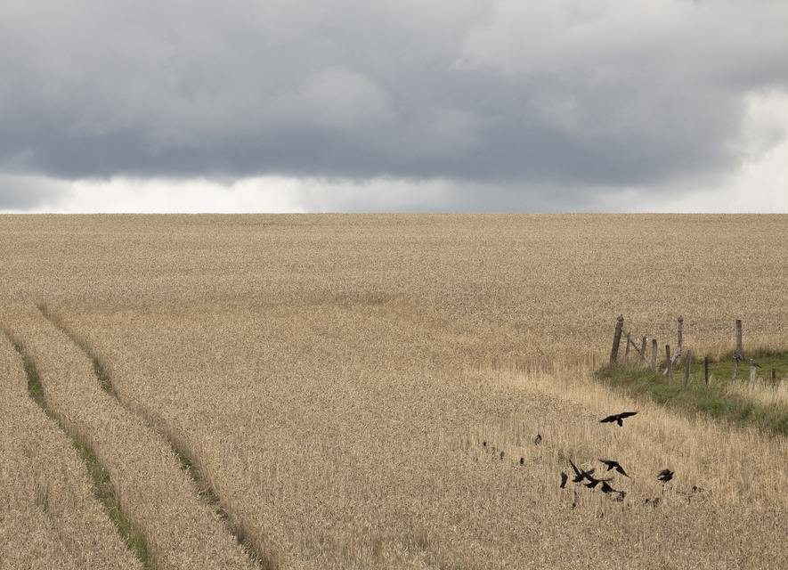
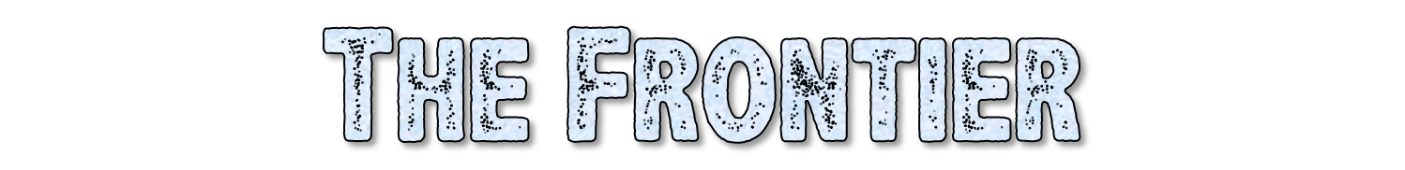
Along the Appalachian Mountains
Settled by Scots-Irish & Germans
Both resistant to English authority
Growing independent spirit
© Students of History - http://www.teacherspayteachers.com/Store/Students-Of-History

Slide 17
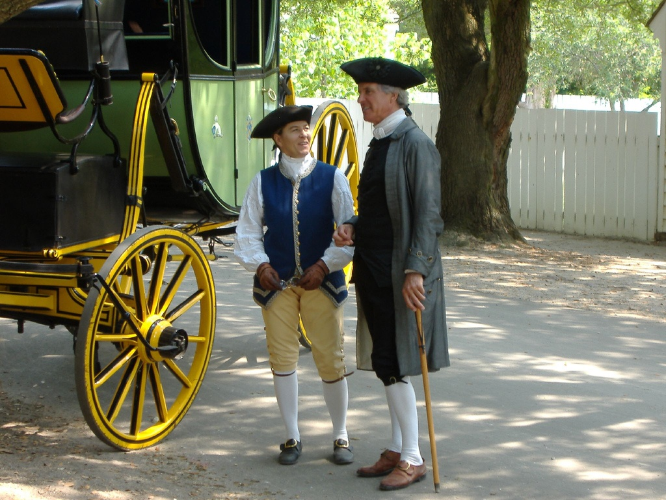

Predict 3 factors that might have lead the people in the Middle Colonies to begin desiring independence from England.

