Slide 1


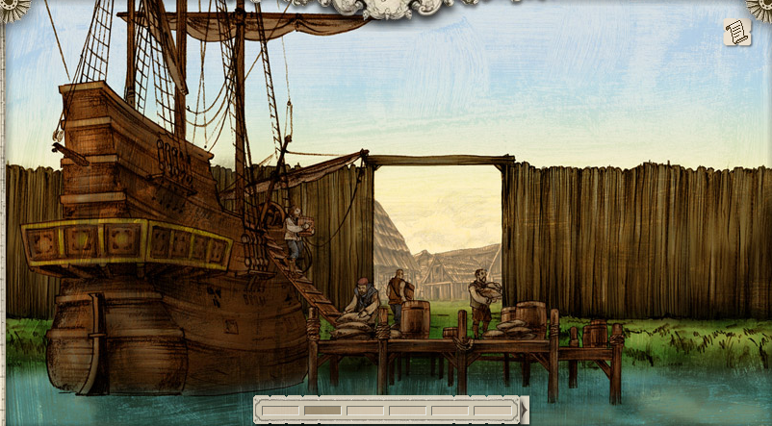
Use your imagination to make a list of 5 important settlers’ jobs that would make Jamestown successful. Explain your reasons for each choice.
lukerosa@gmail.com

Slide 2
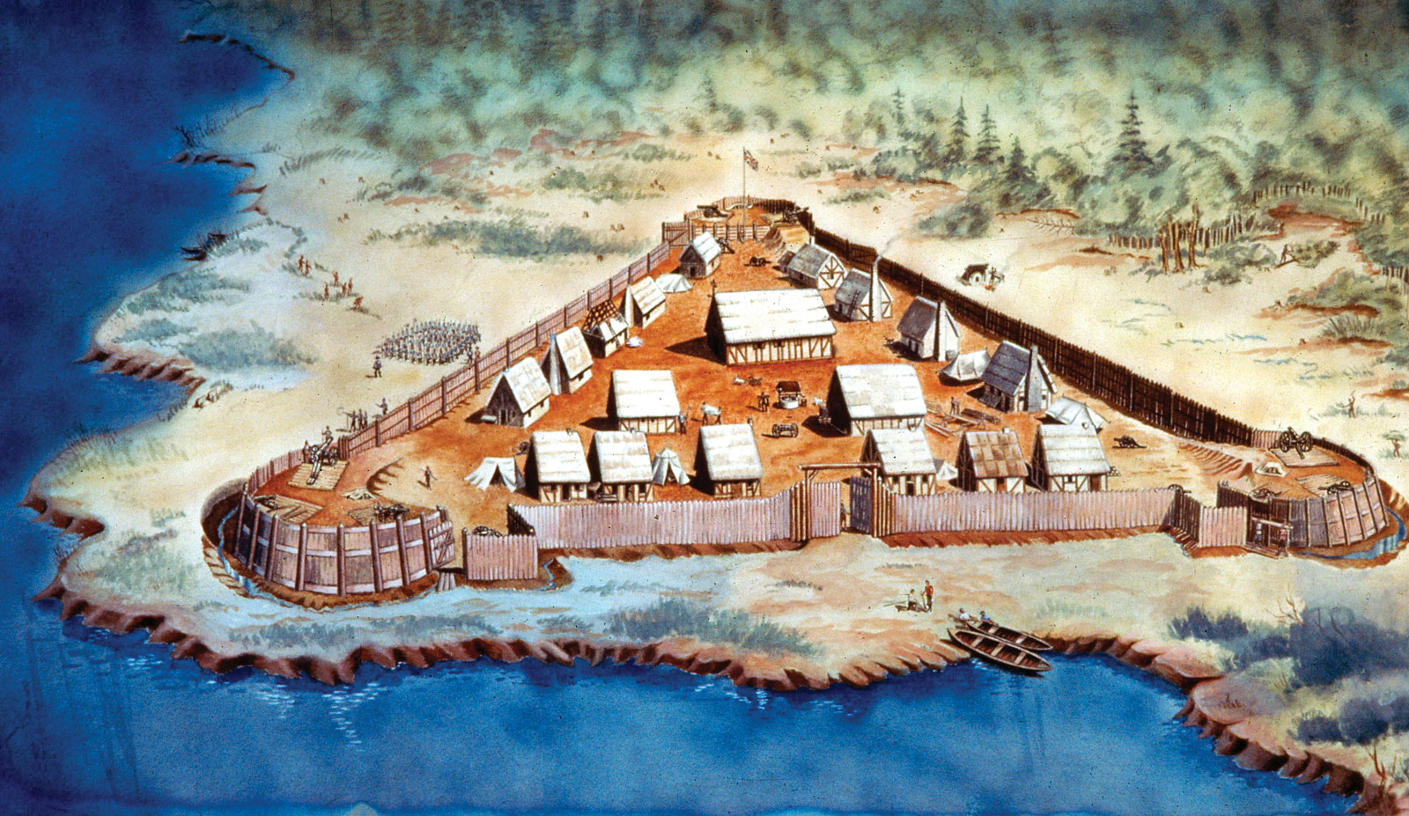
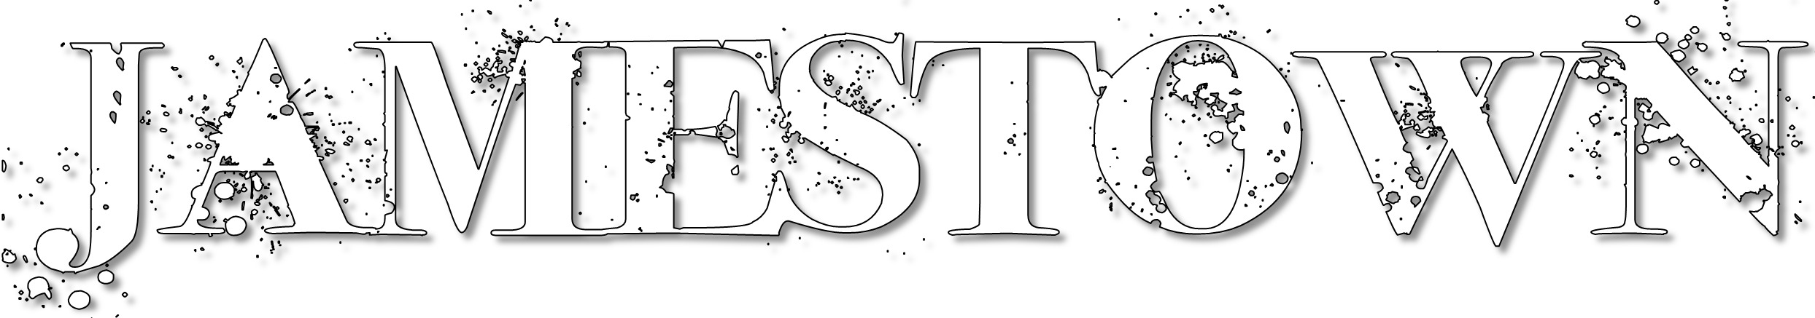

Slide 3
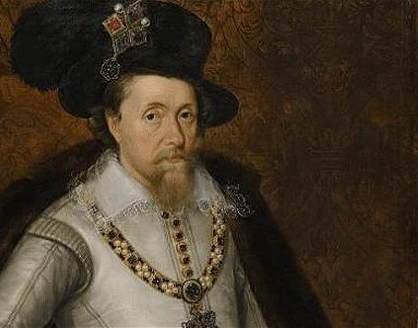

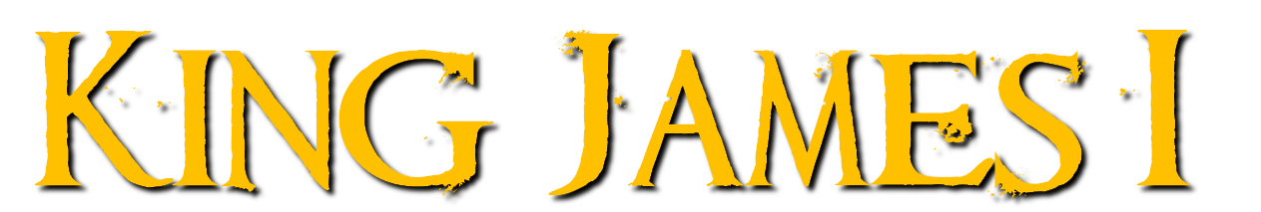

Grants a charter to the Virginia Company in 1606 to settle & civilize America
Wants to prevent Spanish advancements in the New World & find a Northern passage to Asia

Slide 4
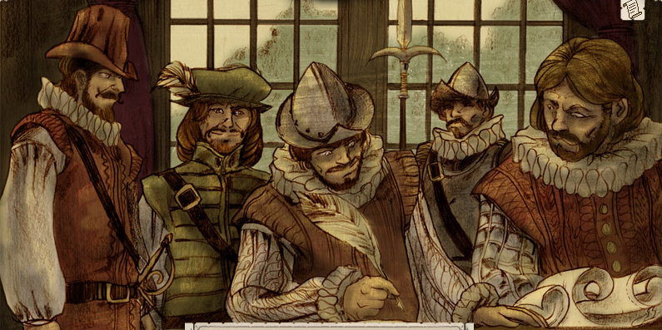
Joint stock company
Group of wealthy investors are shareholders
Plan to establish settlements in America for a profit

Slide 5
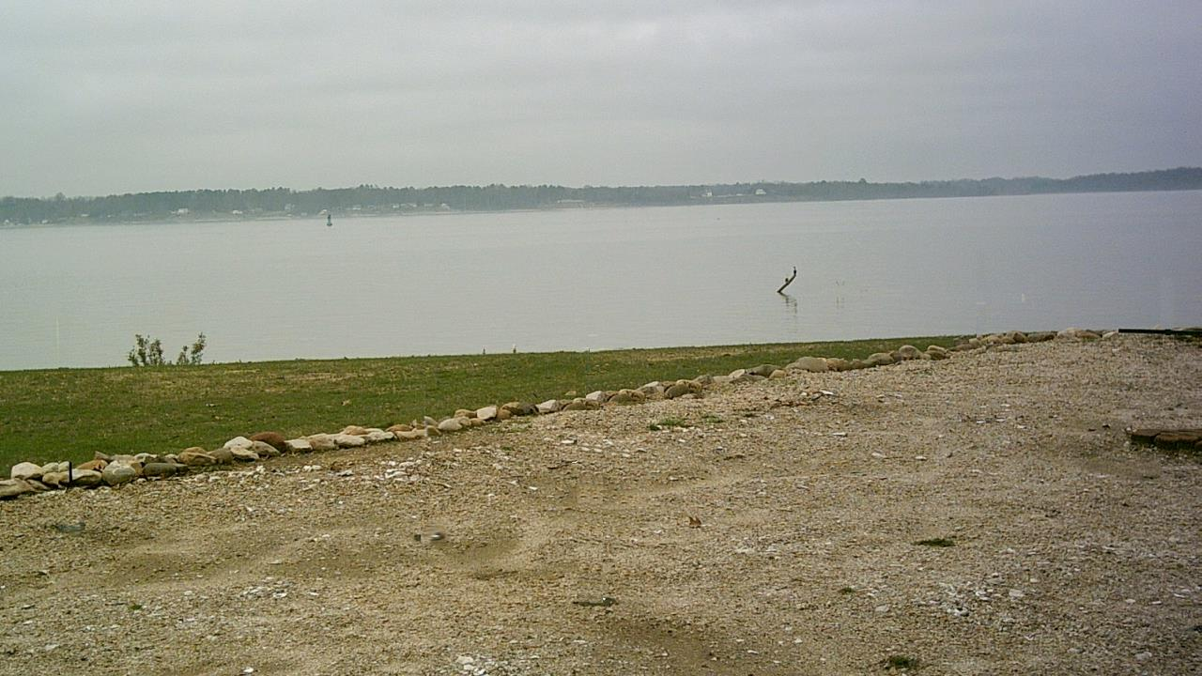

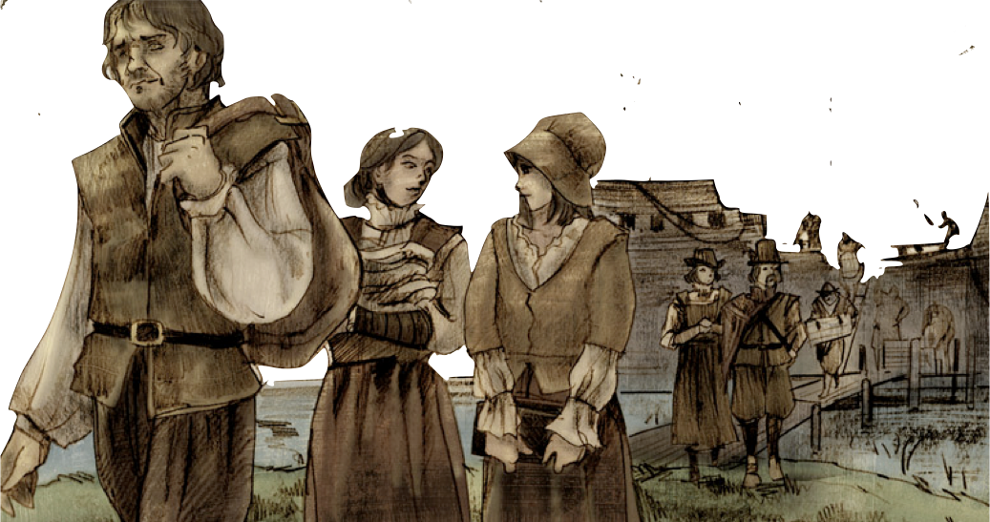
Sought economic opportunities
Expected wealth from gold & minerals

Slide 6
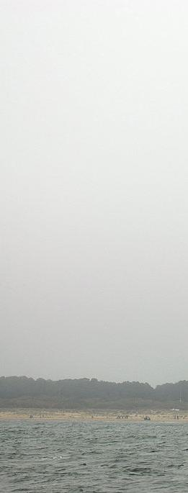
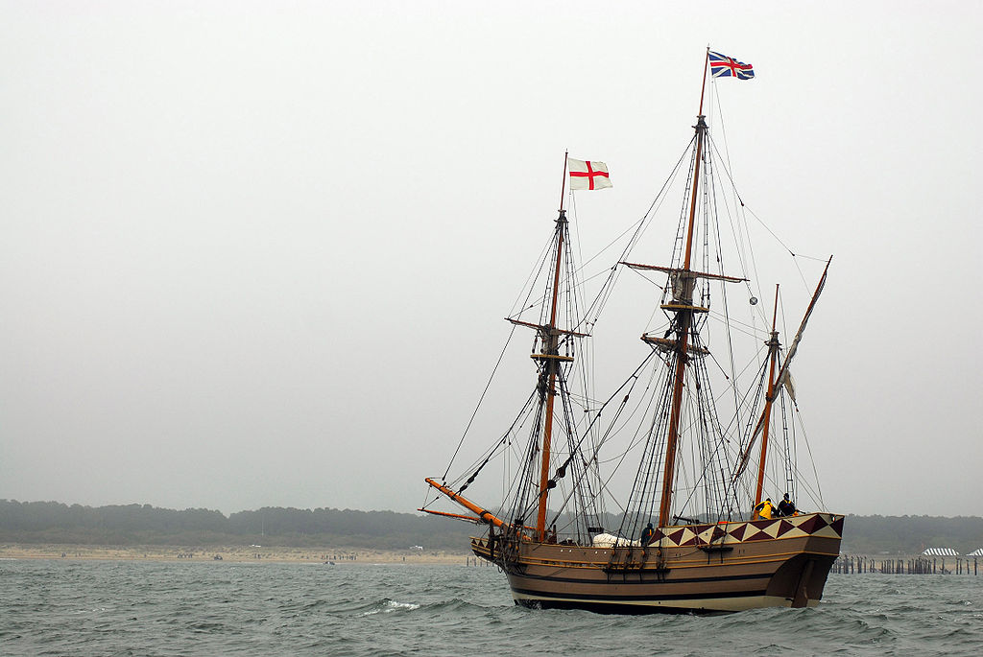
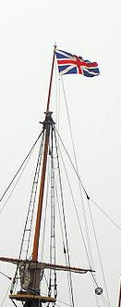
In December 1606, 105 settlers & entrepreneurs set off for America
Arrive in Virginia in April 1607
Edward Maria Wingfield elected president of
governing council &
selects the island location

Slide 7
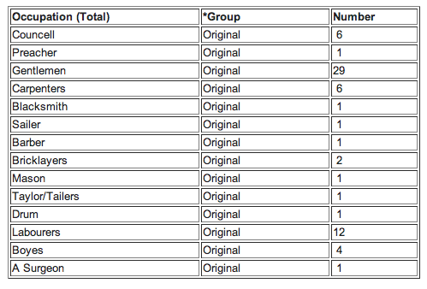
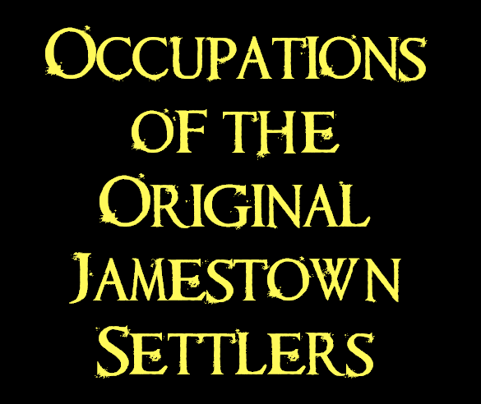

Slide 8
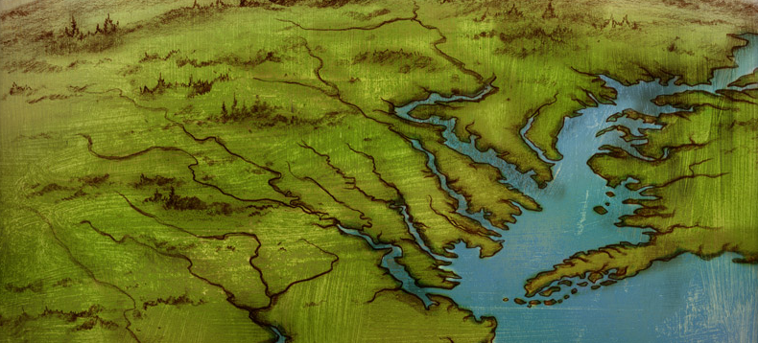
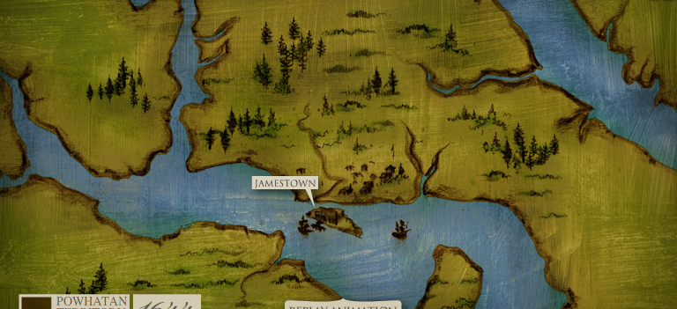
Far enough inland to hide from the Spanish
Deep water anchor for the ships
Swamp and river offers protection from local Native Americans

Slide 9
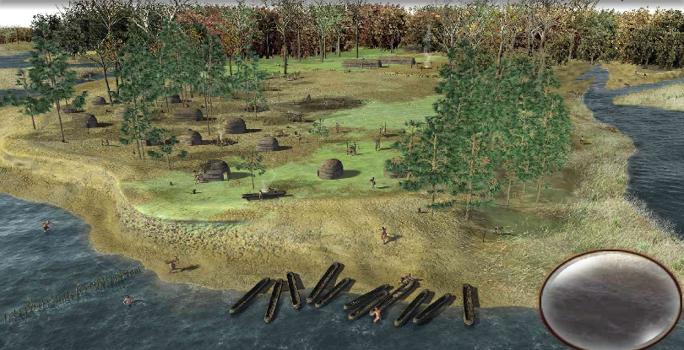
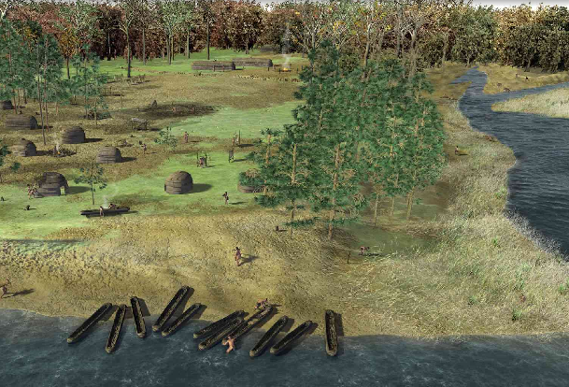

About 14,000 Powhatan Indians lived in the Virginia area
Chief Powhatan’s daughter was the famous Pocahontas

Slide 10
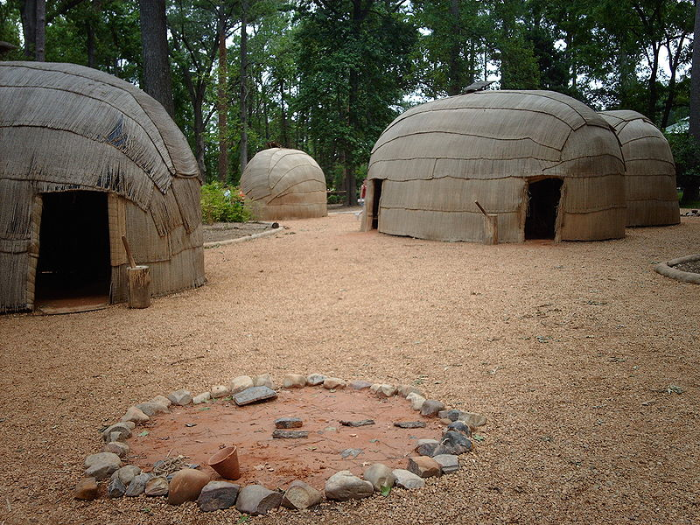


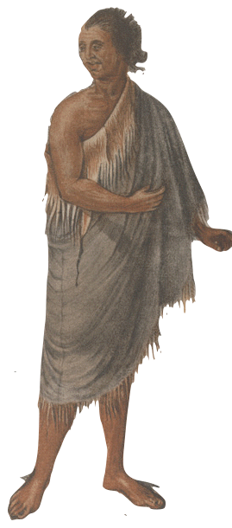
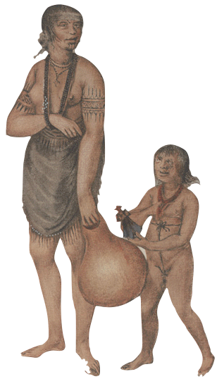

We bathe and shave our faces every day, unlike the English.
We practice communal land ownership. We don’t really believe in “owning” land. We share it as a community.
We worship the great spirits in nature, not in a church of any kind.

Slide 11
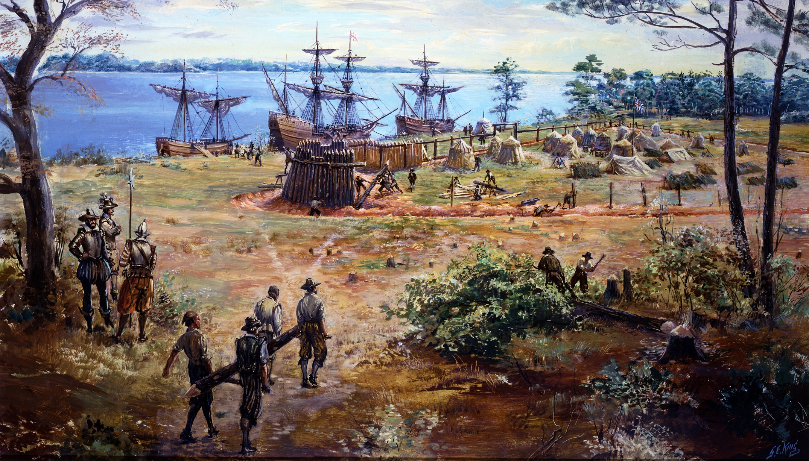
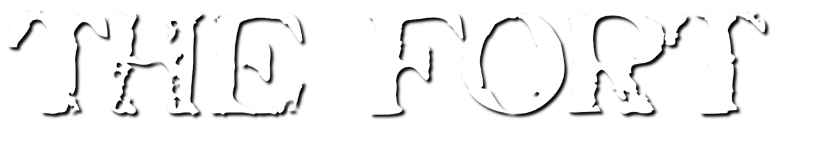

Slide 12

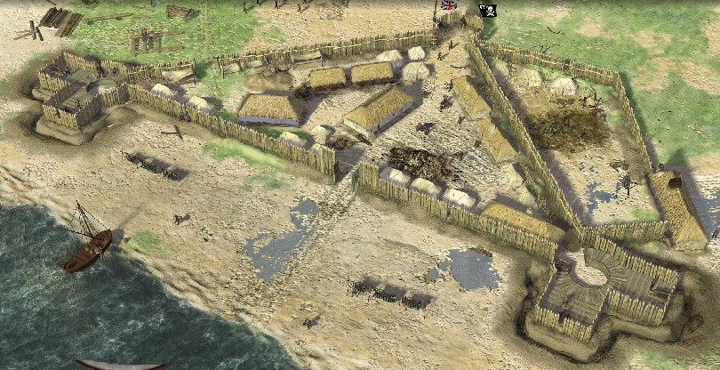

Slide 13
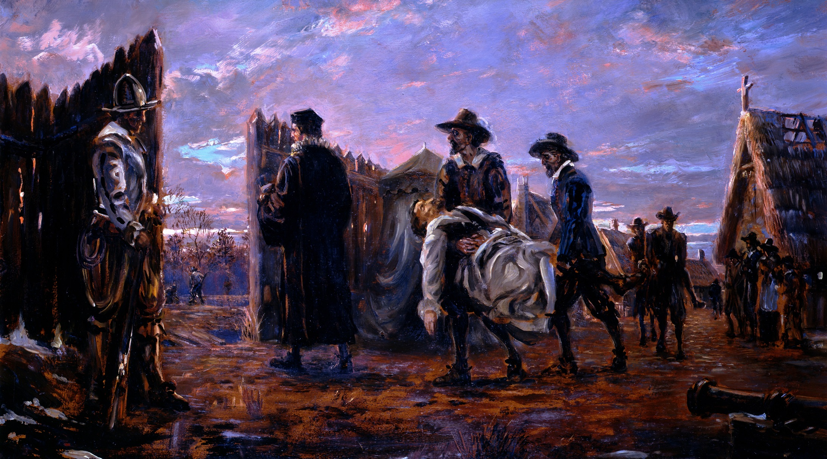

Many of the settlers unaccustomed to work
Didn’t plan for such harsh winters
Too much time spent searching for gold & minerals

Slide 14
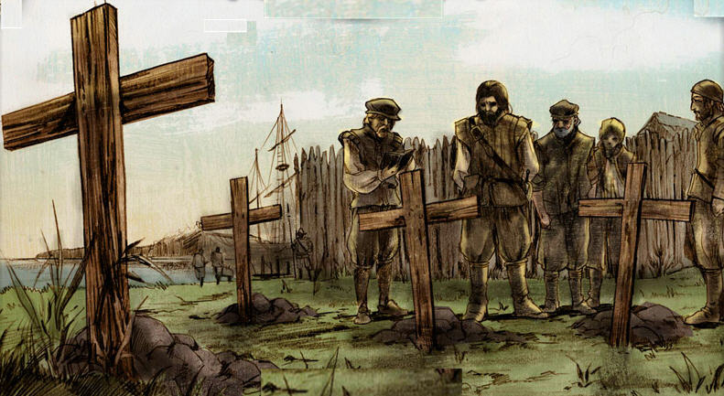
Disease from the infected river
Hunger from not planting crops
Attacks by local Native Americans
lukerosa@gmail.com

Slide 15
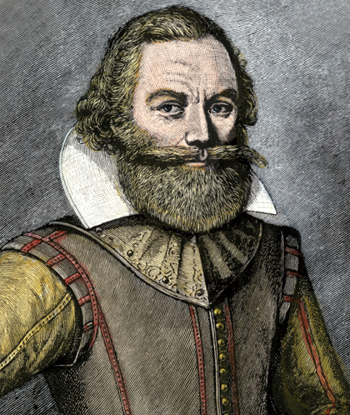
Supposedly saved by Pocahontas
Takes leadership of the colony
“He that will not work, shall not eat.”
lukerosa@gmail.com

Slide 16

Only about 60 colonists left when 2 ships arrive from England with resources and new settlers

Slide 17
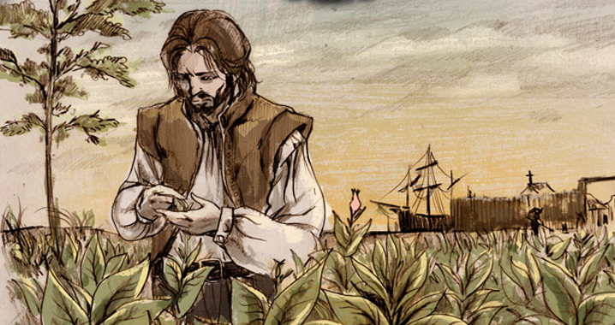
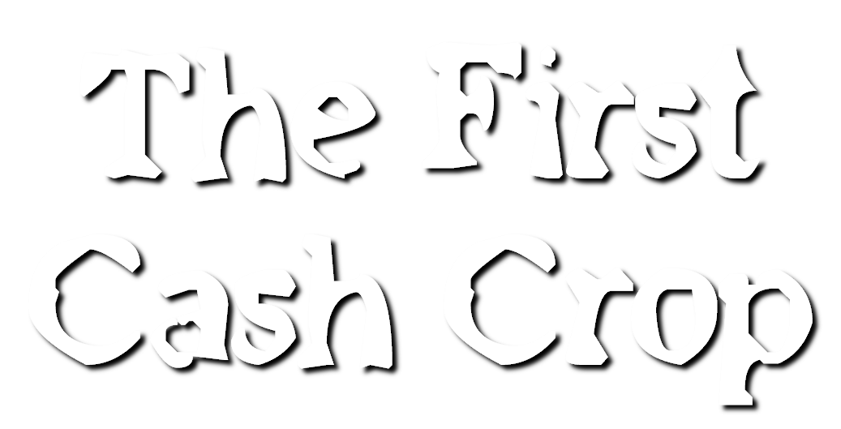
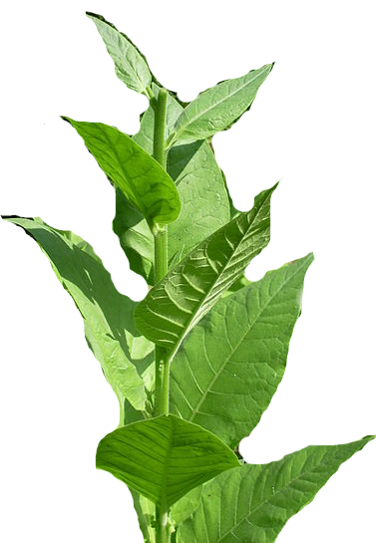
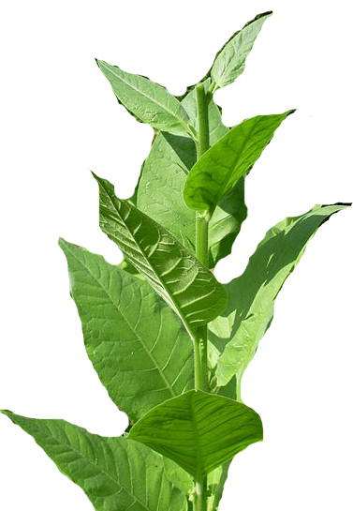

Slide 18

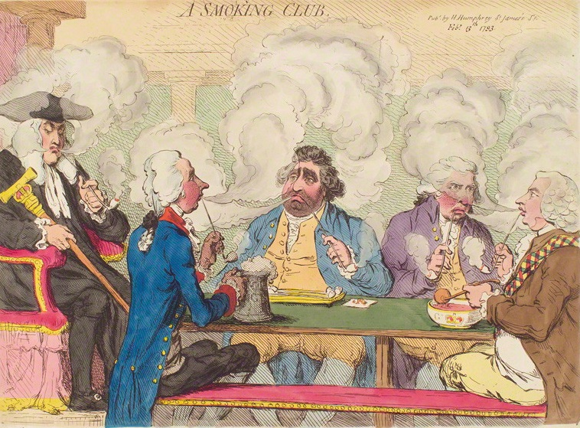
1612 - John Rolfe creates a smoother breed of tobacco
Becomes very popular in England

Slide 19
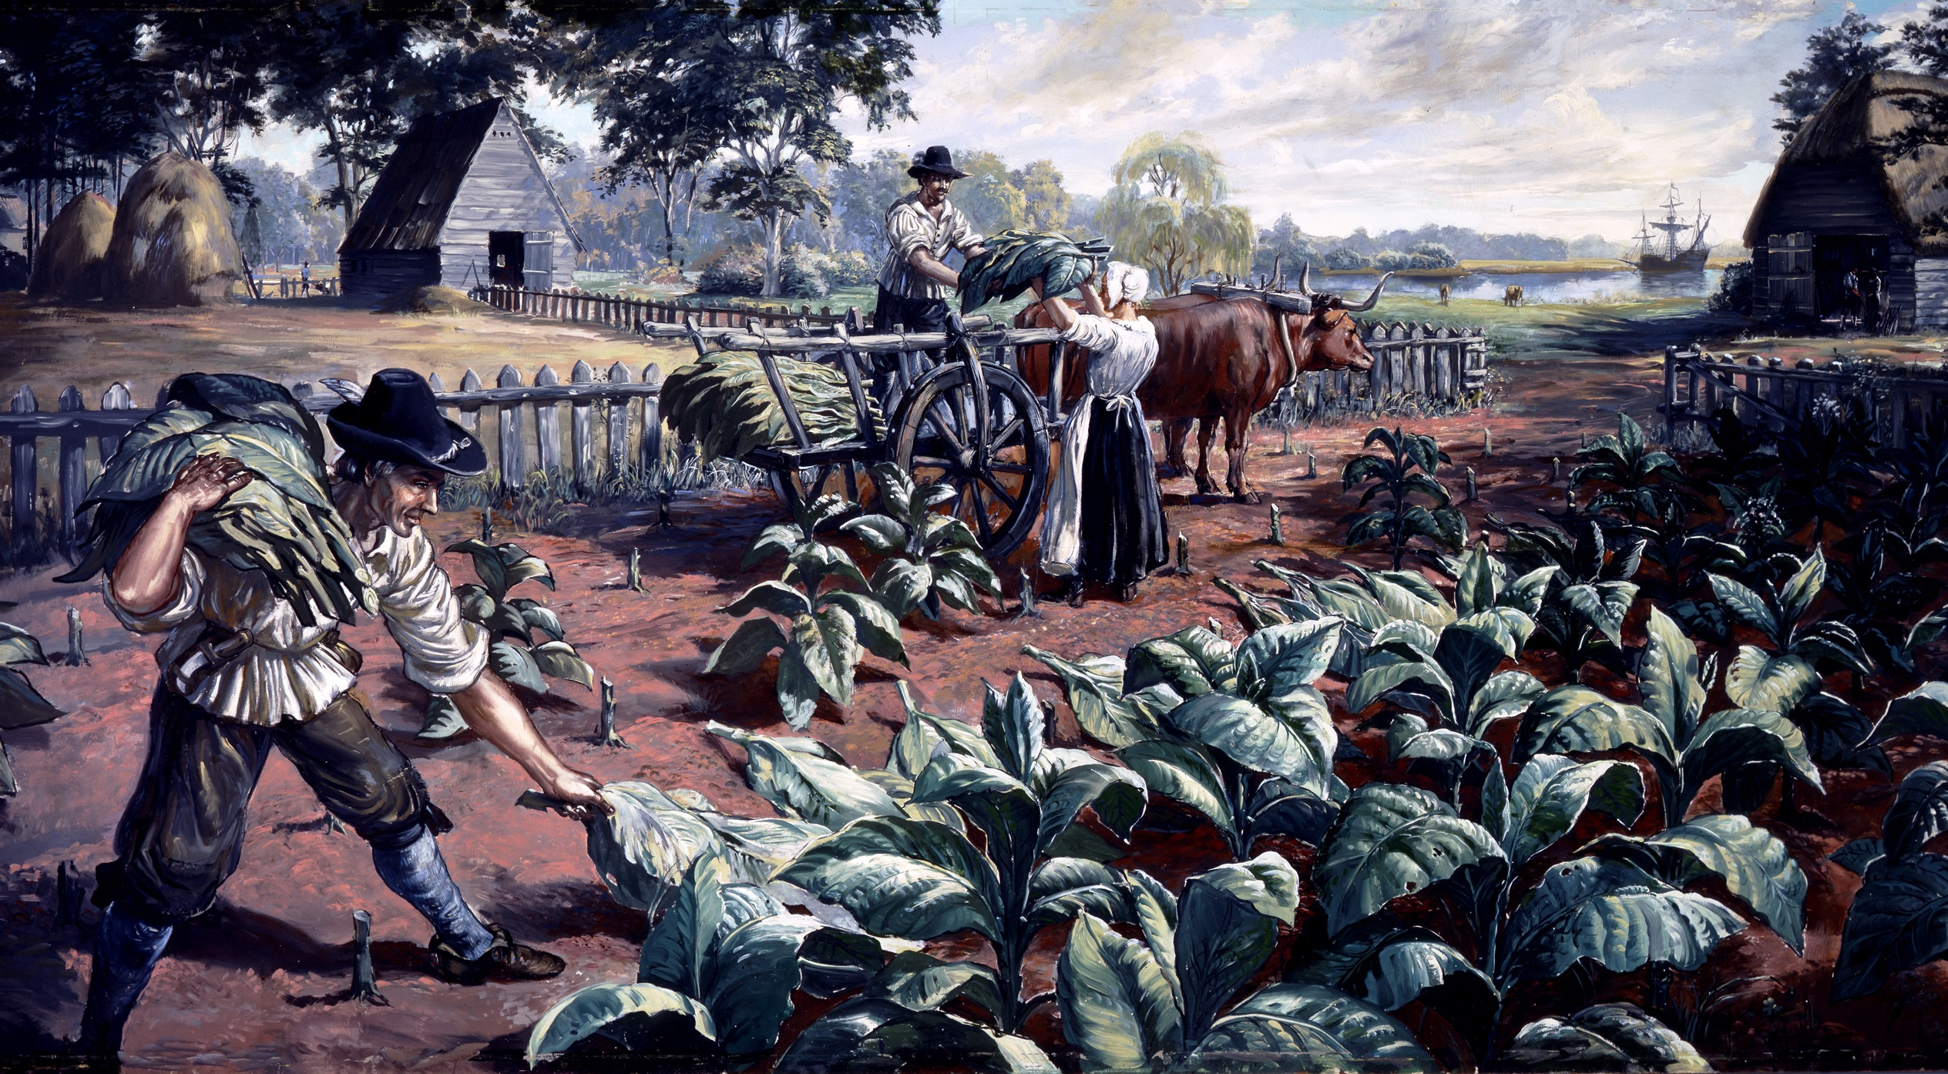
Tobacco becomes a cash crop colonists can sell
John Rolfe marries Pocahontas which helps bring peace to English & Native Americans

Slide 20
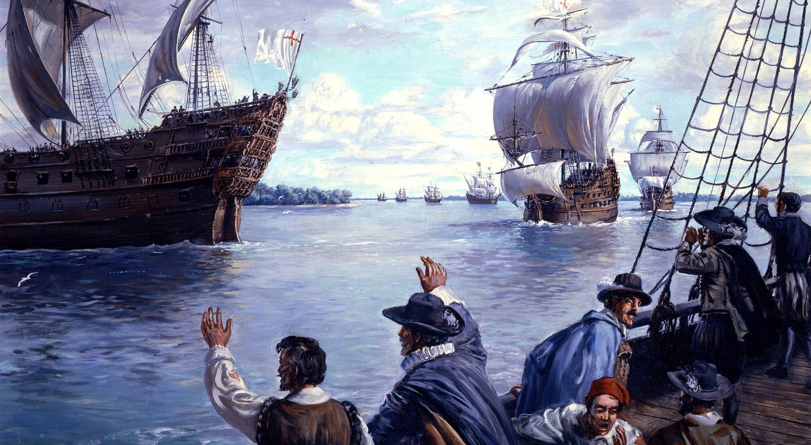

Growing tobacco is very labor-intensive & more colonists are needed to work
Indentured Servants arrive - poor English who agree to work for a number of years in return for their passage

Slide 21
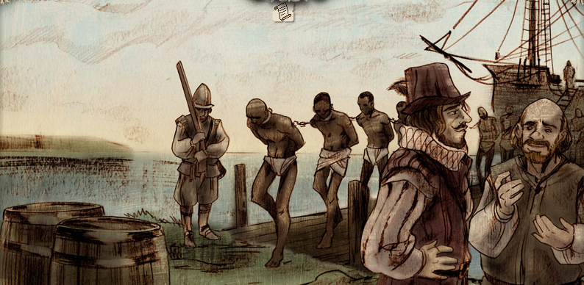
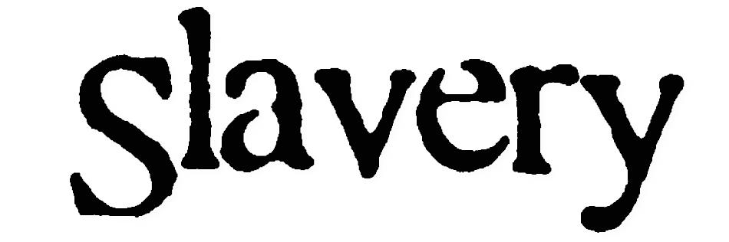
Eventually even more labor is needed to keep up with demand
First Africans brought to Jamestown in 1619 & institution of slavery begins

Slide 22
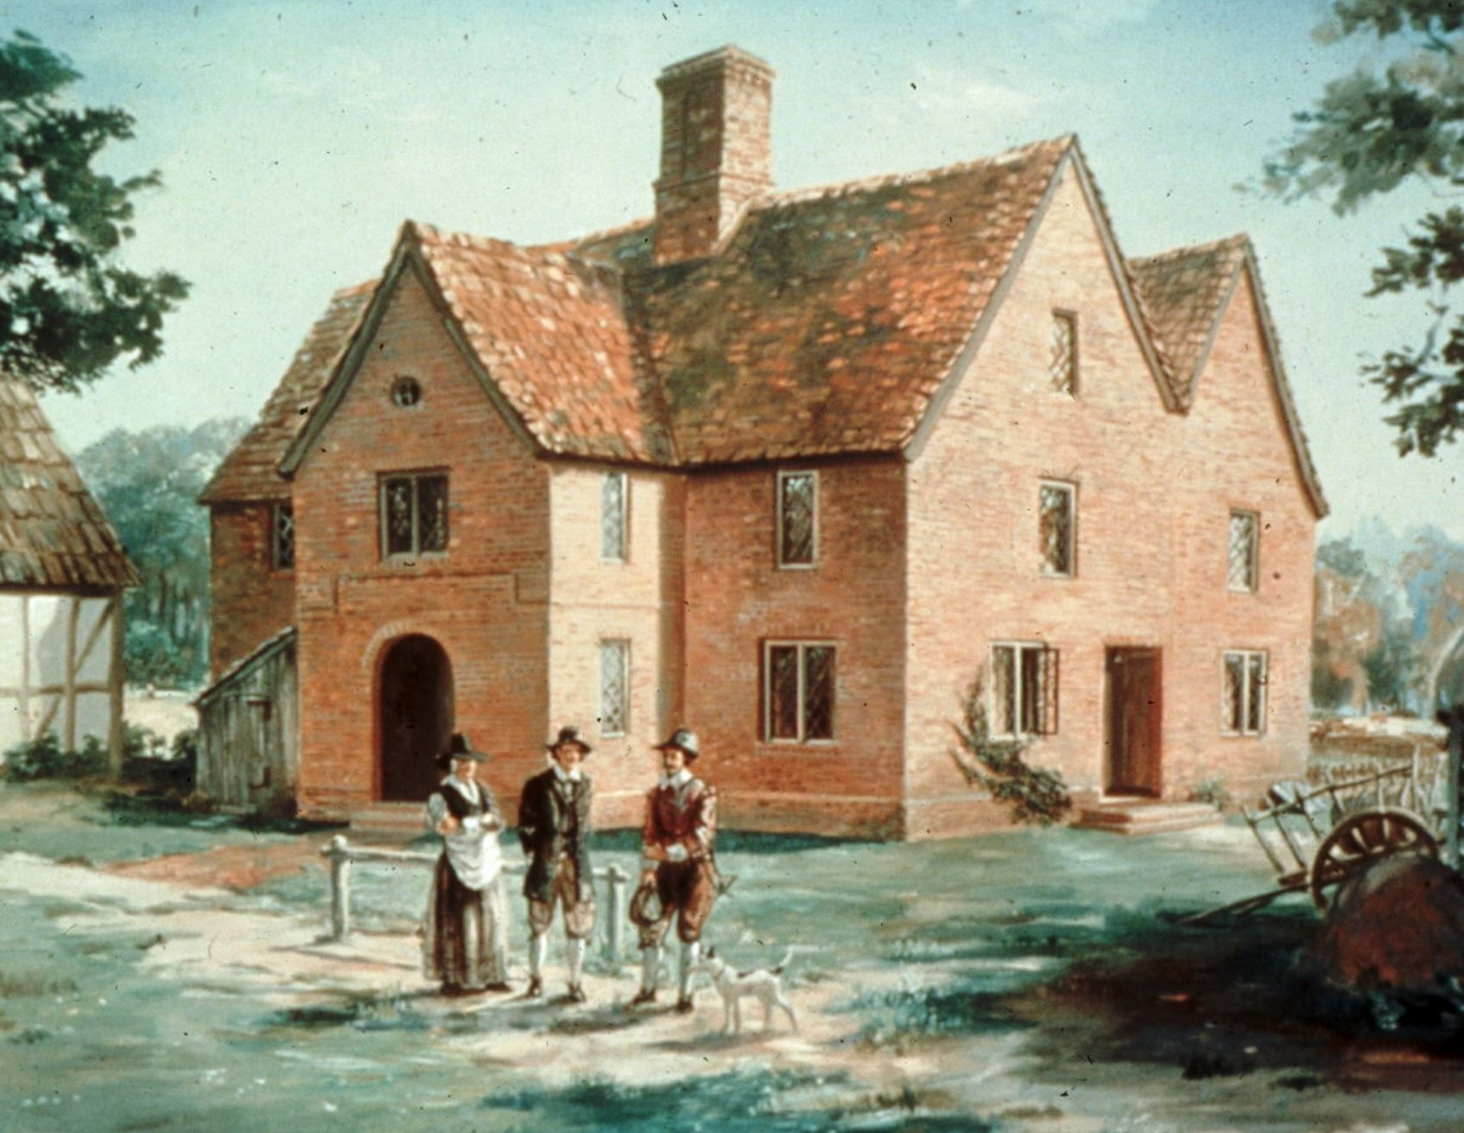
Established in 1619 so colonists could make their own laws
Becomes the first representative government in America
lukerosa@gmail.com

Slide 23
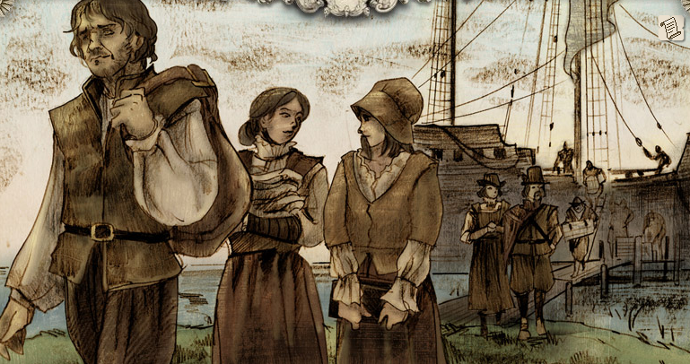
In 1620, about 90 women arrive from England
Allows settlers to establish families & make Jamestown more of a permanent colony

Slide 24
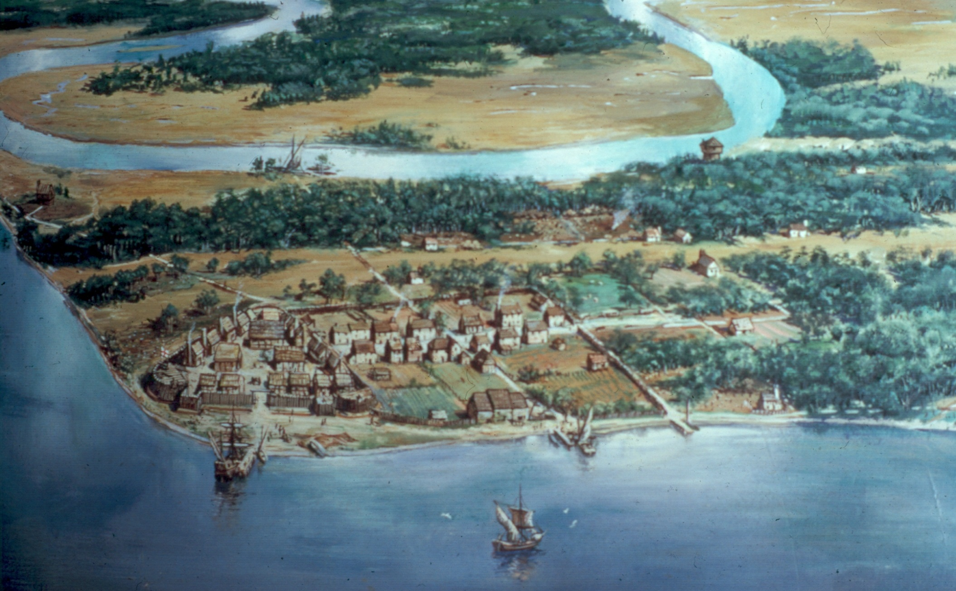

Slide 25
lukerosa@gmail.com
lukerosa@gmail.com

