Slide 1
Psychology Introduction and Careers
Module 01

Slide 2
The Definition of Psychology
Module 1: Introduction and Careers

Slide 3
Psychology
The scientific study of behavior and mental processes.
Uses scientific research methods.
Behavior includes all observable behavior.
Mental processes include thoughts, feelings and dreams.

Slide 4
Careers in Psychology
Module 1: Introduction and Careers

Slide 5
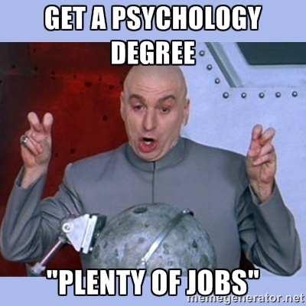
Psychologist
Need a doctorate graduate degree
May take 4-6 years to earn a doctorate in a subfield

Slide 6
Clinical Psychologist
Diagnose and treat patients with psychological problems
Largest number of professional psychologists

Slide 18
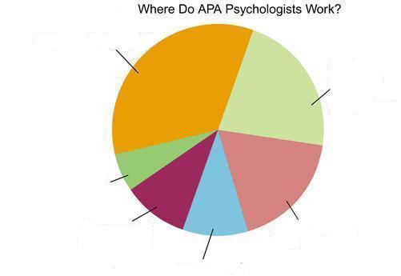

Slide 19
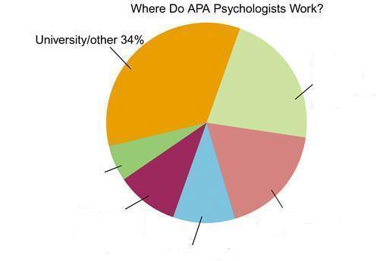

Slide 20
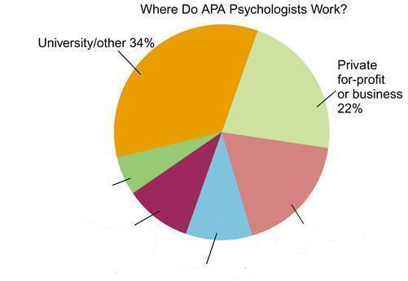

Slide 22
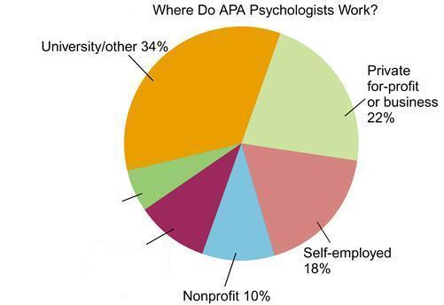

Slide 23
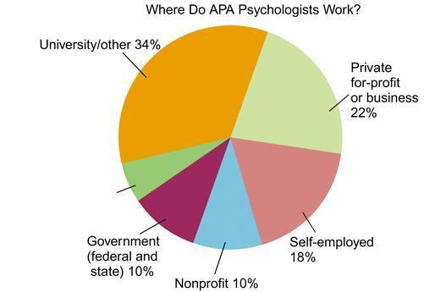

Slide 24
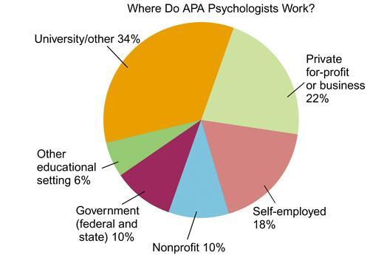

Slide 25
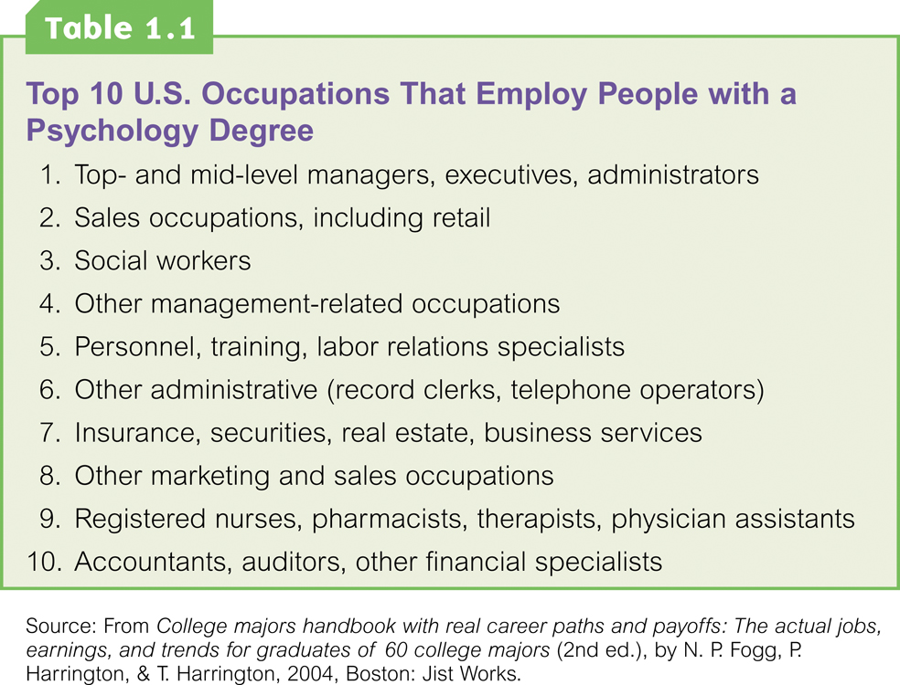

Slide 26
Basic Research
Pure science or research
Research for the sake of finding new information and expanding the knowledge base of psychology

Slide 27
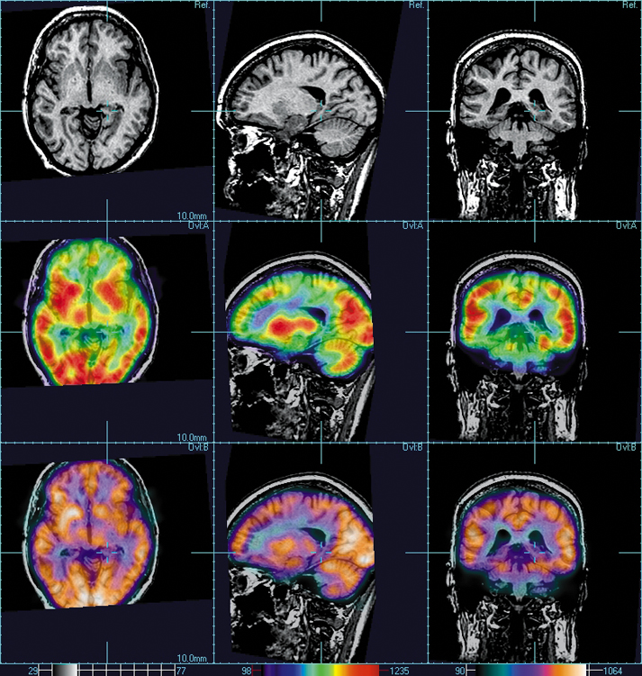
Neuropsychologist
Also called biological psychologists or biopsychologists
Explore how the brain works
Most often work in university/college settings

Slide 28
Social Psychologist
Explore how behaviors, feelings, and beliefs are influenced by others
Study conformity, attitudes, leadership, prejudice, group behavior, etc.
Work in the business setting, government, and universities

Slide 29
Developmental Psychologist
Study the growth or development that takes place from the womb to death
Work in senior centers, hospitals, day-cares or universities

Slide 30
Cognitive Psychologist
Study thought processes including intelligence, problem solving, attention, decision making, language, etc.
Work in educational settings and the business world

Slide 31
Experimental Psychologist
Also called research psychologist
Specialize in doing research in any of the other subfields
Work at universities, for the government, or in a business setting

Slide 32
Applied Research
Research designed to solve specific practical problems

Slide 33
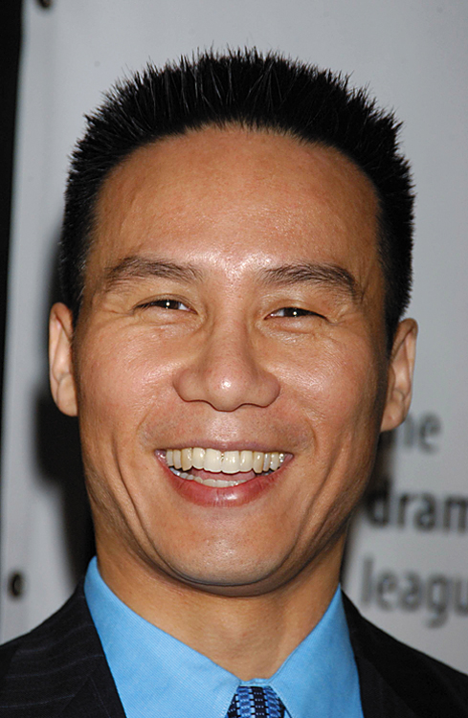
Forensic Psychologist
Apply law and psychology to legal issues
Work in correctional settings, law enforcement, and academic settings

Slide 34
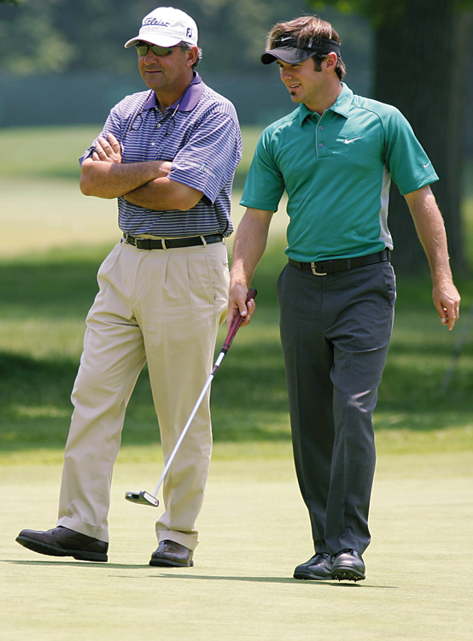
Sports Psychologist
Explore psychological issues in improving athletic performance
Work for sports teams or in private practice

Slide 35
Educational Psychologist
Study how humans learn and how to improve the learning process
Work in school systems, the government, or at universities

Slide 36
Human-factors Psychologist
Study how people and machines interact at home and in the workplace
Try to minimize frustration and increase safety and production
Work in the business world or for the government

Slide 37
Industrial/Organizational (I/O) Psychologist
Try to apply psychology to help business and organizations operate
Work for the government, business or in academic settings

Slide 38
School Psychologist
Use psychology to improve the development of children in the school system
Are involved in assessments (testing)
Work for school systems, the government or universities

Slide 39
Consumer Psychologist
Study why people buy certain products and not others
Work in the business or academic world

Slide 40
Rehabilitation Psychologist
Help those who have been involved in an accident or have been ill
Work in medical rehabilitation centers

Slide 41
Health Psychologist
Find ways to prevent disease and promote good health
Work for health agencies, hospitals, rehabilitation centers, and universities

Slide 42
Social Worker
Only have an undergraduate or masters degree in psychology or social work
Work to improve the lives of others
Work for the government, schools, and residential facilities

Slide 43
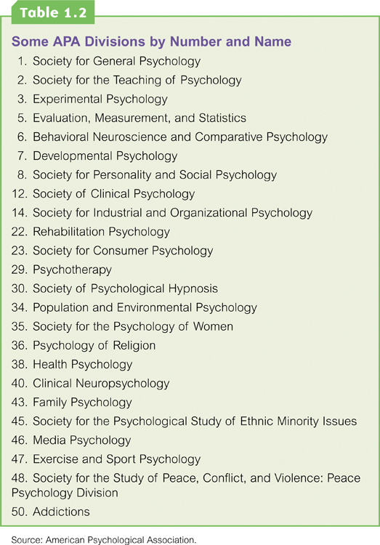

Slide 44
History and Perspectives
Module 02

Slide 45
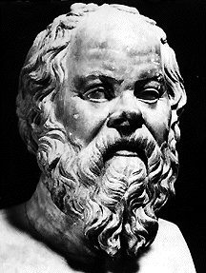
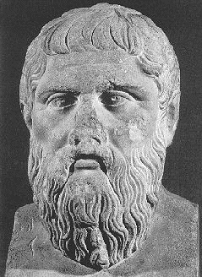
Prescientific Psychology
Socrates (469-399 BCE) and Plato (428-348 BCE)
http://www.law.umkc.edu
http://www.law.umkc.edu
Socrates
Plato
Socrates and his student Plato believed that the mind was separate from the body, that it continued to exist after death, and that ideas were innate.
Notes:
Aristotle believed that the human mind and body are not inseparable. Ideas were born from experience.

Slide 46
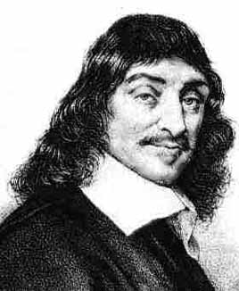
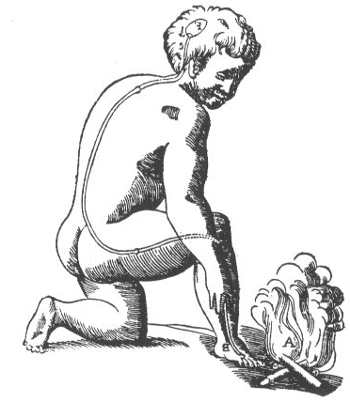
Prescientific Psychology
Rene Descartes (1596-1650)
http://www.spacerad.com
http://ocw.mit.edu
Descartes, like Plato, believed in soul (mind) body separation but speculated on how the immaterial mind and the physical body communicated.

Slide 47
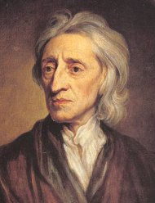
Prescientific Psychology
John Locke (1632-1704)
biografieonline.it/img/bio/John_Locke.jpg
Locke held that the mind is a tabula rasa or blank sheet at birth and experience writes on it.
He would be an advocate of nurture rather than nature

Slide 48
Prescientific Psychology
How are ideas formed?
Some ideas are inborn | The mind is a blank slate
Socrates | Aristotle
Plato | Locke
NATURE
NURTURE

Slide 49
Modern Psychology’s Nineteenth-Century Roots
Module 2: History and Perspectives

Slide 50
Structuralism
Theory that the structure of conscious experience could be understood by analyzing the basic elements of thoughts and sensations.

Slide 51
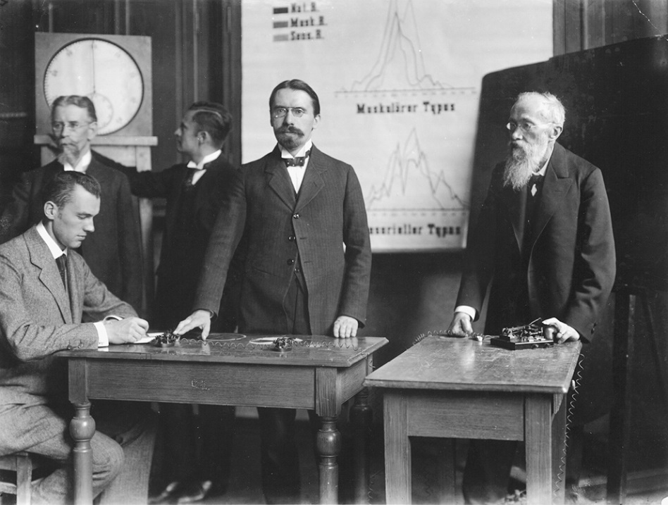
Wilhelm Wundt (1832-1920)
The “father of psychology”
Founder of modern psychology
Opened the first psychology lab in 1879

Slide 52
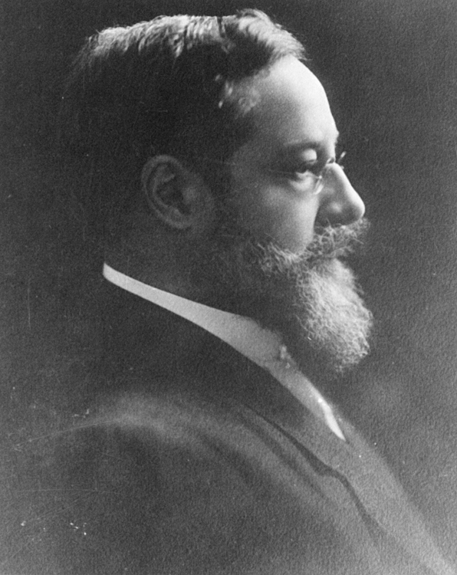
E.B. Titchener (1867-1927)
Analyzed the intensity, clarity and quality of the parts of consciousness
Founder of structuralism

Slide 54
Gestalt Psychology
Psychological perspective that emphasized our tendency to integrate pieces of information into meaningful wholes.
The whole is different from the sum of its parts.

Slide 56
Functionalism
Theory that emphasized the functions of consciousness or the ways consciousness helps people adapt to their environment

Slide 57
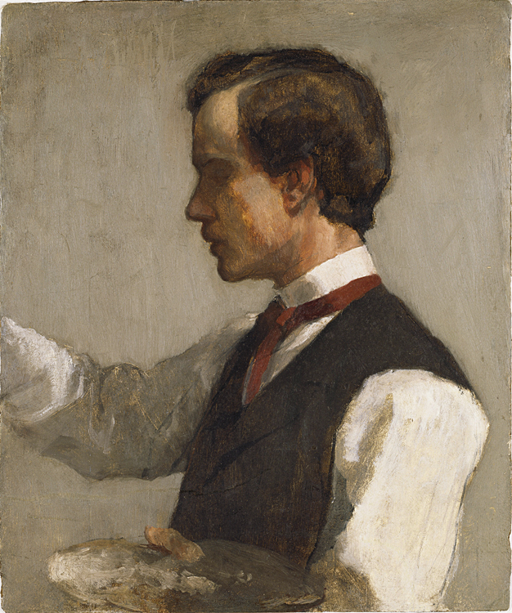
William James (1842-1910)
First American psychologist
Author of the first psychology textbook
The James
Founder of Functionalism

Slide 58
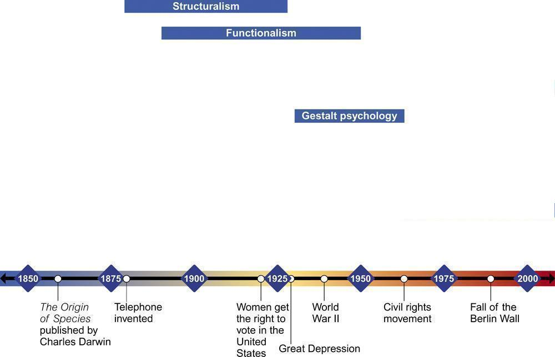

Slide 59
Psychology’s American Groundbreakers
Module 2: History and Perspective

Slide 60
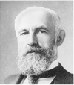
G. Stanley Hall
First American with a doctorate in psychology
Open the first psychology lab in U.S. at John Hopkins University
First president of the APA
Notes:
Developed the field of Educational Psychology and studied with Wundt and Freud.

Slide 61
Mary Whiton Calkins
First woman to complete the requirements for a Ph.D. in psychology
Studied under William James
Harvard refused to award diploma
President of the APA in 1905

Slide 62
Margaret Floy Washburn
First woman to receive a Ph.D. in psychology in the U.S.
2nd woman to serve as APA President
Notable work in animal behavior

Slide 63
Francis Cecil Sumner
First African-American to receive a Ph.D. in psychology
Notable work in refuting racism
Showed eugenics as a faulty science

Slide 64
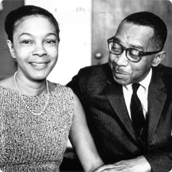
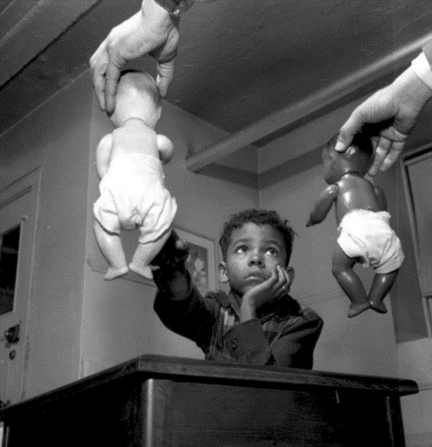
Kenneth Clark/Mamie Philips Clark
Educational psychologists
Studied institutionalized racism and effect on self-perception
The Doll Test
Studies were cited in “Brown v Board of Education”

Slide 65
Inez Beverly Prosser
First African-American woman to receive a Ph.D. in psychology
Looked at the effect on segregation on the education of students.

Slide 66
Contemporary Psychological Perspectives
Module 2: History and Perspectives

Slide 67
Psychology in the Twentieth Century
Module 2: History and Perspectives

Slide 68
Psychological Perspectives
Method of classifying a collection of ideas
Also called “schools of thought”
Also called “psychological approaches”
To view behavior from a particular perspective

Slide 69
Cognitive Perspective
School of thought that focuses on how people think – how we take in, process, store, and retrieve information
Focus: On how people think and process information
Behavior is explained by how a person interprets the situation

Slide 70
Jean Piaget
Developmental and cognitive psychologist known for his studies of children’s thought processes
Interested in how thinking develops

Slide 72
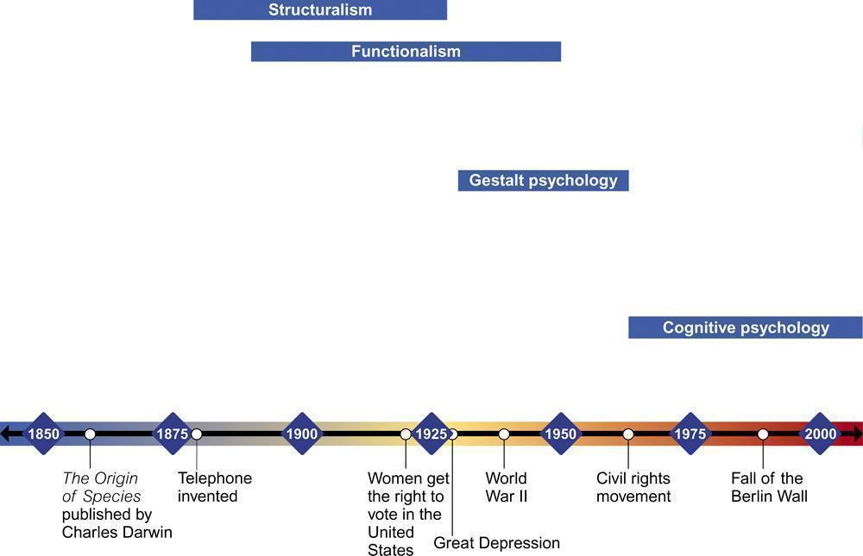

Slide 73
Biological Perspective
School of thought that focuses on the physical structures and substances underlying a particular behavior, thought, or emotion
Focus: How our biological structures and substances underlie a given behavior, thought, or emotion
Behavior is explained by brain chemistry, genetics, glands, etc.

Slide 75
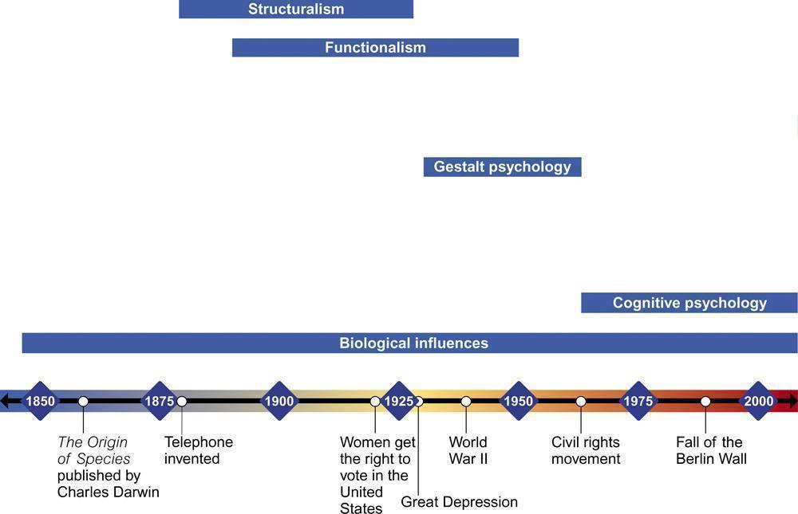

Slide 76
Social-Cultural Perspective
School of thought that focuses on how thinking or behavior changes in different contexts or situations
Focus: How thinking and behavior change depending on the setting or situation
Behavior is explained by the influence of other people present

Slide 78
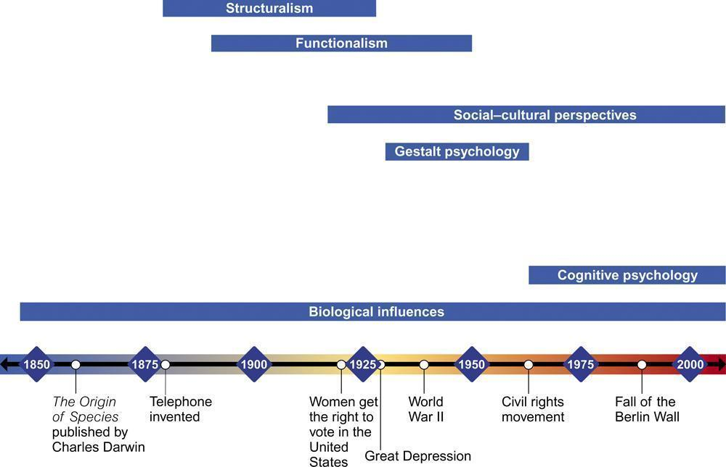

Slide 79
Behavioral Perspective
Focus: How we learn through rewards, punishments, and observation
Behavior is explained by previous learning

Slide 80
Behaviorism
The theory that psychology should only study observable behaviors, not mental processes.

Slide 81
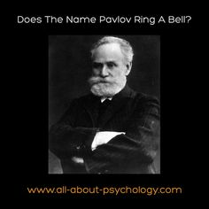
Ivan Pavlov (1849-1936)
Russian Physiologist
Studied learning in animals
Emphasized the study of observable behaviors

Slide 82
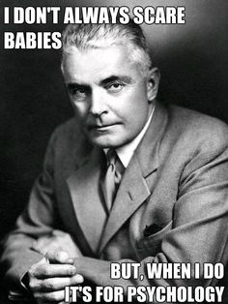
John B. Watson (1878-1958)
Founder of behaviorism
Studied only observable and objectively described acts
Emphasized objective and scientific methodology

Slide 83
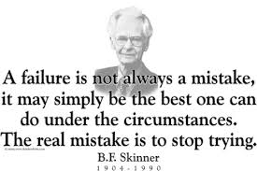
B.F. Skinner (1904-1990)
American psychologist whose brand of behaviorism focused on the role of responses in learning.
Focused on learning through rewards and observation
Behaviorist

Slide 85
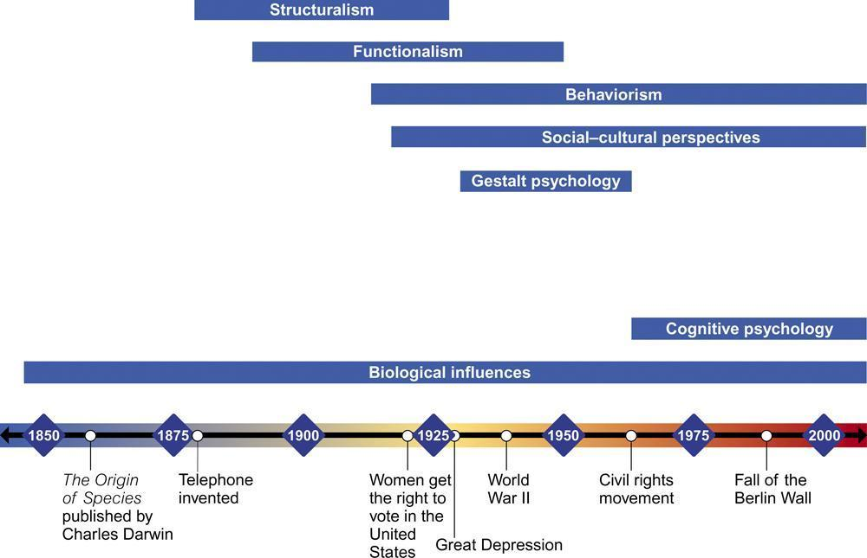

Slide 86
Humanistic Perspective
Focus: How healthy people strive to reach their full potential
Behavior is explained as being motivated by satisfying needs (safety, hunger, thirst, etc.), with the goal of reaching one’s full potential once basic needs are met.

Slide 87
Humanistic Psychology
School of thought that focuses on the study of conscious experience, the individual’s freedom to choose, and the capacity for personal growth
Stressed the study of conscious experience and an individual’s free will
Healthy individuals strive to reach their potential.

Slide 88
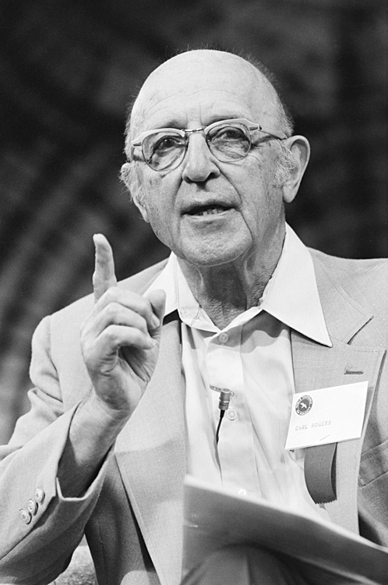
Carl Rogers/Abraham Maslow
Prominent Humanists
Rejected idea that behavior is controlled by rewards and punishments
Stressed free will in decision making
Carl Rogers

Slide 90
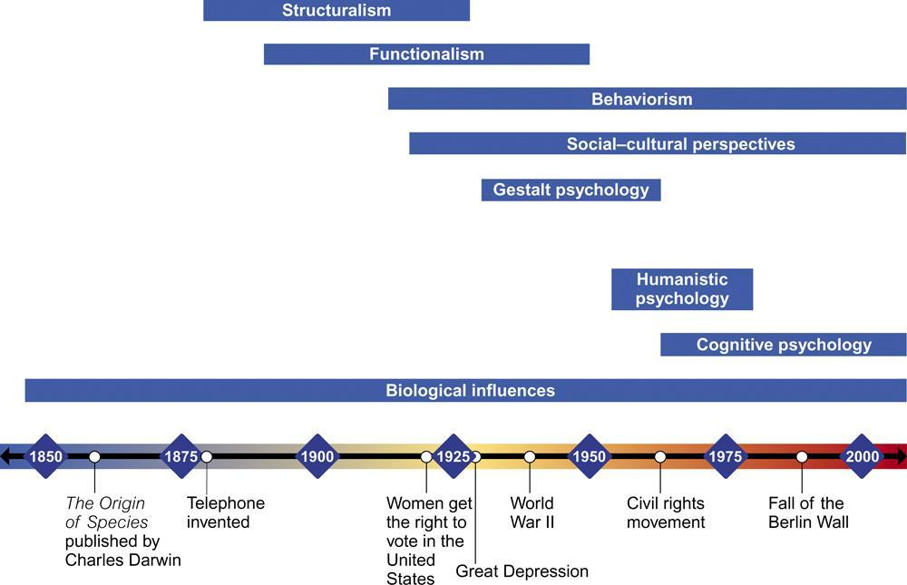

Slide 91
Psychodynamic Perspective
Focus: How behavior is affected by unconscious drives and conflicts
Behavior is explained through unconscious motivation and unresolved inner conflicts from one’s childhood.
Modern version of psychoanalytic perspective.

Slide 92
Psychoanalysis
Theory of personality and therapeutic technique that attributes our thoughts and actions to unconscious motives and conflicts

Slide 93
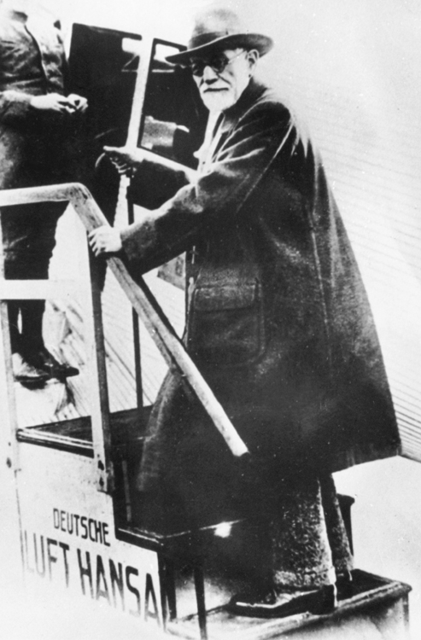
Sigmund Freud (1856-1939)
Founder of the psychoanalytic perspective
Believed that abnormal behavior originated from unconscious drives and conflicts

Slide 94
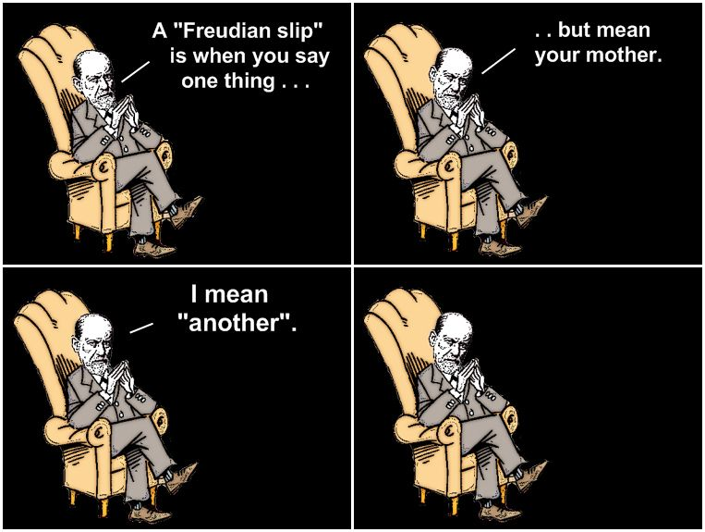
Freud’s Influence
Influence on “pop culture”
Freudian slips
Anal-retentive
Influence on psychology
Psychodynamic theory
Unconscious thoughts
Significance of childhood experiences

Slide 96
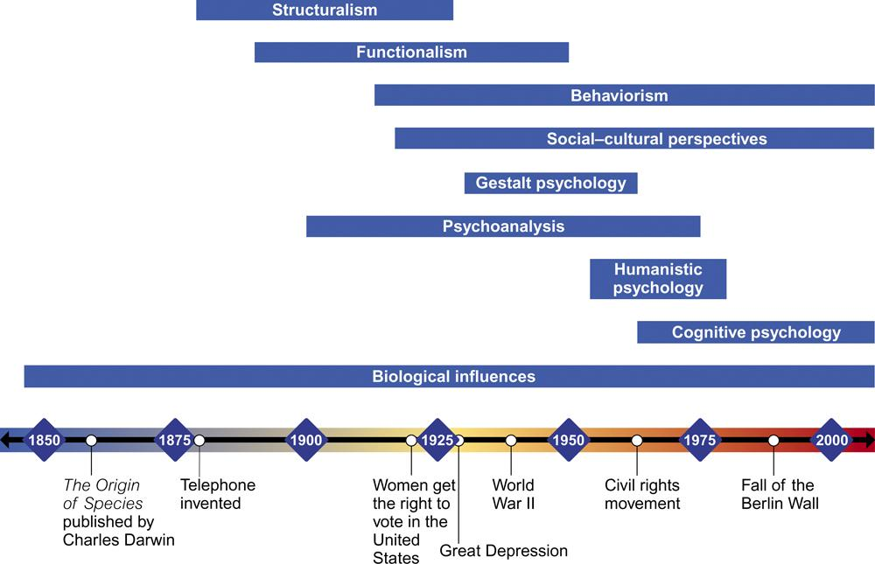

Slide 97
Psychology in the Twenty-First Century
Module 2: History and Perspectives

Slide 98
Behavior Genetics
School of thought that focuses on how much our genes and our environment influence our individual differences
Focus: How behavior is affected by genes and the environment
Combines biology and behaviorism
Emphasis on the importance of both genetic and environmental factors on behavior

Slide 99
Evolutionary Psychology
Combines aspects of biological, psychological, and social perspectives
Behavior is explained by how the behavior may have helped our ancestors survive long enough to reproduce successfully.

Slide 100
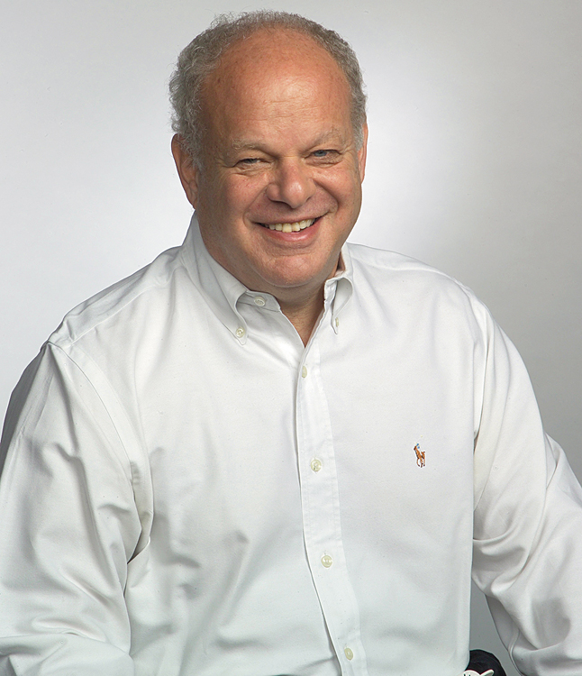
Positive Psychology
Movement that focuses on the study of optimal human functioning and the factors that allow individuals and communities to thrive
Focus: To study and promote optimal human functioning
Martin E.P. Seligman is a major advocate
Should promote building positive qualities of people

Slide 101
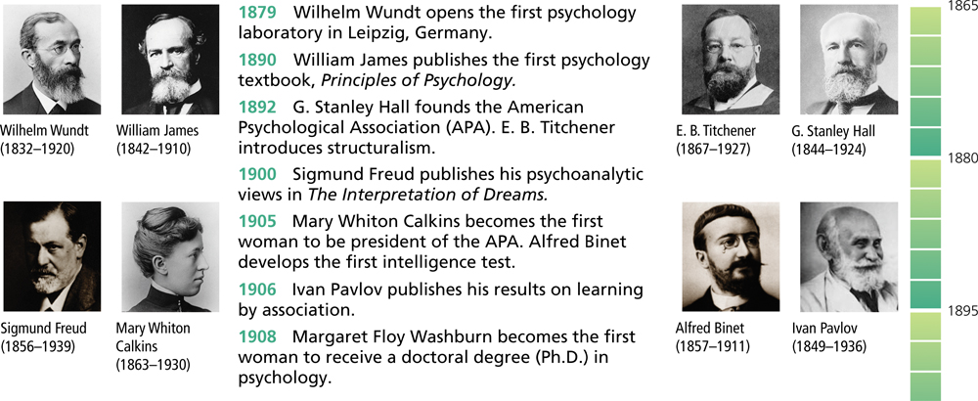
History of Psychology

Slide 102
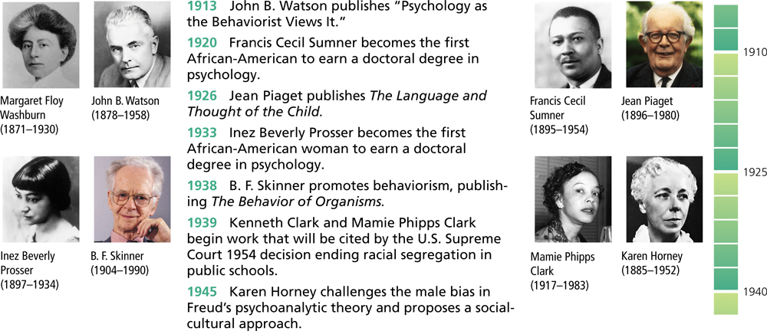
History of Psychology

Slide 103
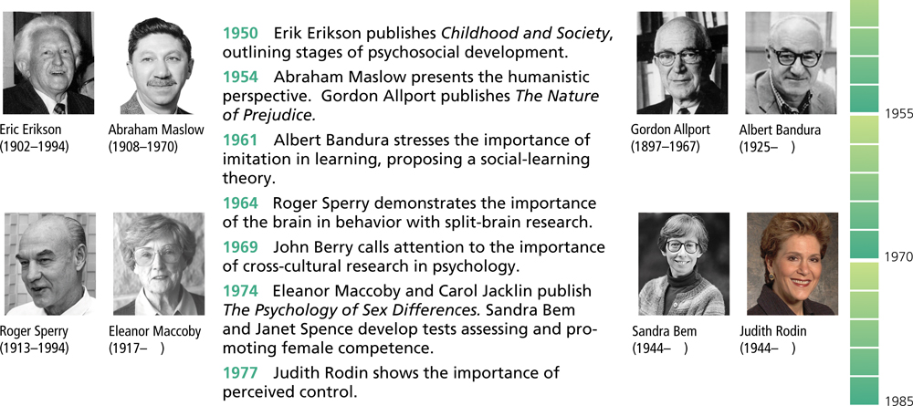
History of Psychology

Slide 104
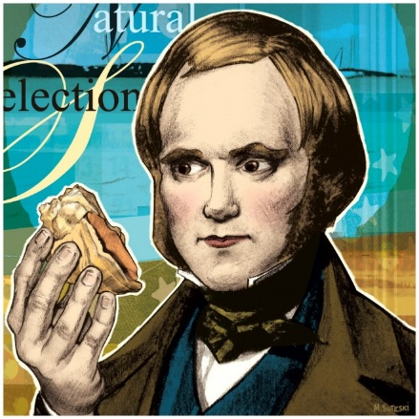
Contemporary Psychology
Psychology’s 1st Big Debate
Nature versus Nurture
How much of our thinking and behavior is due to biological influences (nature) and what role does the environment play (nurture)
Often studies involve identical (monozygotic) twins who were separated at birth. Accounts for nature variables so any differences must be from nurture

Slide 105
Psychology’s 2nd Big Debate Stability versus Change
How much of who we are and how we behave will change over our lifetime?
Baby temperament a predictor of personality?
Likes and dislikes, ways of thinking
Are you going to become your parents???

Slide 106
Psychology’s 3rd Big Debate Continuity versus Stages
Is development a continuous process or does it occur in distinct stages?
We will study stage theorists of social (Erickson), cognitive (Piaget), and moral (Kohlberg) development

Slide 107
Contemporary Psychology
Psychology’s Three Main Level of Analysis
Biological influences
genetic predispositions
genetic mutations
natural selection of adaptive physiology and behaviors
genes responding to environment
Psychological Influences
learned fears and other learnt expectations
emotional responses
cognitive processing and perceptual interpretations
Behavior or mental process
Social-cultural Influences
presence of others
cultural, societal, and family expectations
peer and other group influences
compelling models (such as media)
Notes:
OBJECTIVE 1-6| Identify the three main levels of analysis in the biopsychosocial approach, and explain why psychology’s varied perspectives are complementary. Biopsychosocial approach considers the influence of biological, psychological, and socio-cultural factors on behavior. Each approach provides an incomplete explanation of behaviors.

Slide 108
Psychology’s Current Perspectives
Perspective | Focus | Sample Questions
Neuroscience | How the body and brain enables emotions. | How are messages transmitted in the body? How is blood chemistry linked with moods and motives?
Evolutionary | How the natural selection of traits the promotes the perpetuation of one’s genes. | How does evolution influence behavior tendencies?
Behavior genetics | How much our genes and our environments influence our individual differences. | To what extent are psychological traits such as intelligence, personality, sexual orientation, and vulnerability to depression attributable to our genes? To our environment?
Notes:
Although debates arise among the psychologists working from differing perspectives, each point of view addresses important questions.

Slide 109
Psychology’s Current Perspectives
Perspective | Focus | Sample Questions
Psychodynamic | How behavior springs from unconscious drives and conflicts. | How can someone’s personality traits and disorders be explained in terms of sexual and aggressive drives or as disguised effects of unfulfilled wishes and childhood traumas?
Behavioral | How we learn observable responses. | How do we learn to fear particular objects or situations? What is the most effective way to alter our behavior, say lose weight or quit smoking?

Slide 110
Psychology’s Current Perspectives
Perspective | Focus | Sample Questions
Cognitive | How we encode, process, store and retrieve information. | How do we use information in remembering? Reasoning? Problem solving?
Social-cultural | How behavior and thinking vary across situations and cultures. | How are we --- as Africans, Asians, Australian or North American – alike as members of human family? As products of different environmental contexts, how do we differ?

Slide 111
Right now, which psychological perspective do you think best explains human behavior and thought processes?
In a short essay choose one of the perspectives and argue that it best answers this basic question: What causes thinking and behavior? Identify and explain the perspective you chose and contrast it with at least two other psychological perspectives.

Slide 112
Thinking Critically with Psychological Science
The Need for Psychological Science
The limits of Intuition and Common Sense
The Scientific Attitude
The Scientific Method

Slide 113
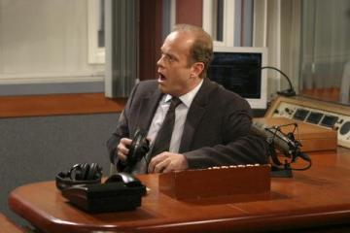
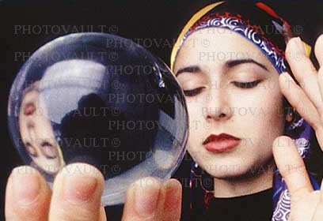
Impression of Psychology
Hoping to satisfy curiosity, many people listen to talk-radio counselors and psychics to know about others and themselves.
http://www.photovault.com
http://www.nbc.com
Dr. Crane (radio-shrink)
Psychic (Ball gazing)

Slide 114
The Need for Psychological Science
Intuition & Common Sense
Many of us believe that intuition and common sense are enough to bring forth answers about human nature.
Although intuition and common sense may aid queries, they are not free of error.

Slide 115
Limits of Intuition
Personal interviewers tend to be overconfident of their “gut feelings” about job applicants.
Taxi/ Getty Images

Slide 116
Errors of Common Sense
Try this !
If you were to fold a piece of paper (0.1 mm thick) 100 times, how large do you think its thickness would be?
800,000,000,000,000 times the distance between the sun and the earth.
Notes:
800 trillion

Slide 117
Or which would you rather have…
A million dollars today
Or
A penny that doubles everyday for a month
Take your time…

Slide 118
.01
.02
.04
.08
.16
.32
.64
By day 8 you have…. $1.28
(ready to reconsider?)

Slide 119
$2.56
$5.12
$10.24
$20.48
$40.96
$81.92
By day 15… $163.84

Slide 120
In the interest of time…
16 $327.68 17 $655.36 18 $1,310.72 19 $2,621.44 20 $5,242.88 21 $10,485.76 22 $20,971.52 23 $41,943.04 24 $83,886.08 25 $167,772.16 26 $335,544.32 27 $671,088.64 28 $1,342,177.28 29 $2,684,354.56 30 $5,368,709.12 Total $10,737,418.23

Slide 121
Hindsight Bias
Hindsight Bias is the “I-knew-it-all-along” phenomenon.
We tend to believe, after learning about an outcome, that we would have foreseen it. We knew that the mortgage bubble would burst, only after it did.
Notes:
OBJECTIVE 2-1| Describe hindsight bias and explain how it can make research findings seem like mere common sense.
“Anything seems commonplace, once explained.” Dr. Watson to Sherlock Holmes.
Two phenomena – hindsight bias and judgmental overconfidence – illustrate why we cannot rely solely on intuition and common sense.

Slide 122
Overconfidence
We tend to think we know more than we actually do.
How long do you think would it take to unscramble these anagrams?
Anagram
WREAT
WATER
ETYRN
ENTRY
People said about 10 seconds. On average they took about 3 minutes (Goranson, 1978).
GRABE
BARGE
Notes:
OBJECTIVE 2-2| Describe how overconfidence contaminates our everyday judgments.

Slide 123
Psychological Science
How can we differentiate between uninformed opinions and examined conclusions?
The science of psychology can help make these examined conclusions, which lead to our understanding what people feel, think, act, as they do!

Slide 124
The Scientific Attitude
The scientific attitude is composed of curiosity (passion for exploration), skepticism (doubting and questioning) and humility (humbleness to accept when wrong).
Notes:
OBJECTIVE 2-3| Explain how the scientific attitude encourages critical thinking.

Slide 125
Critical Thinking
Critical thinking does not blindly accept arguments and conclusions.
It examines assumptions, discerns hidden values, evaluates evidence, assesses conclusions.
The Amazing Randi
Notes:
James Randi is a Canadian-American retired stage magician and scientific skeptic best known for his challenges to paranormal claims and pseudoscience. Randi is the founder of the James Randi Educational Foundation. He began his career as a magician named The Amazing Randi, but after retiring at age 60, he chose to devote most of his time to investigating paranormal, occult, and supernatural claims, which he collectively calls "woo-woo."

Slide 126
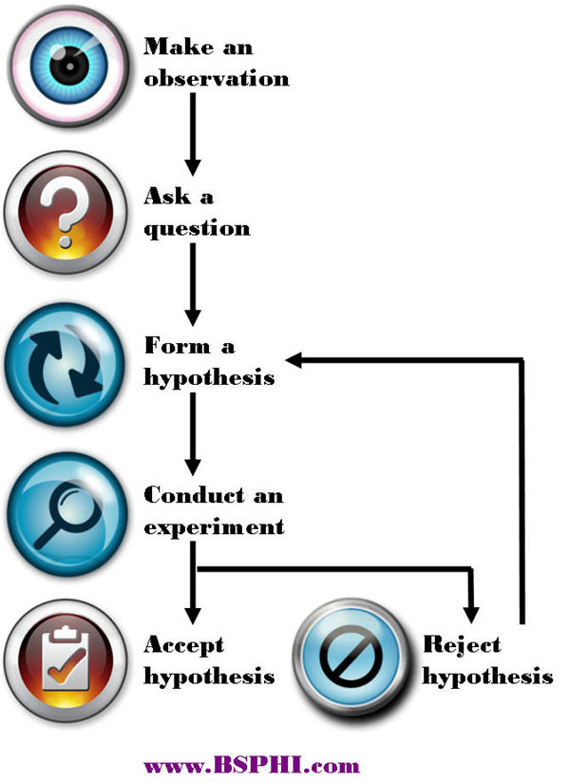
Scientific Method
Psychologists, like all scientists, use the scientific method to construct theories that organize, summarize and simplify observations.
Notes:
OBJECTIVE 2-4| Describe how psychological theories guide scientific research.

Slide 127
Theory
Theory is an explanation that integrates principles, organizes and predicts behaviors or events. General.
For example, low self-esteem contributes to depression.
Notes:
If we were to observe that depressed people talk about their past, present, and future in a gloomy manner, we may theorize that low-self-esteem contributes to depression.

Slide 128
Hypothesis
Hypothesis is a testable prediction, often induced by a theory, to enable us to accept, reject or revise the theory. Specific.
Example: People who score low on a self-esteem assessment are more likely to feel depressed.
Null Hypothesis vs. If, Then Hypothesis
Null is easiest to disprove
A statement that the IV will have NO EFFECT on the DV
“People who score low on a self-esteem assessment will not feel depressed.”
If found false, implication of relationship
(Most data will suggest that the IV will at least have some effect on the DV)

Slide 129
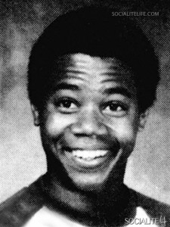
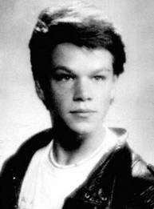
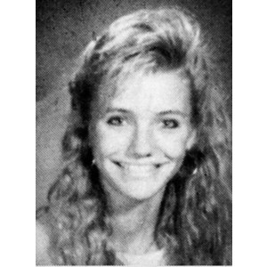
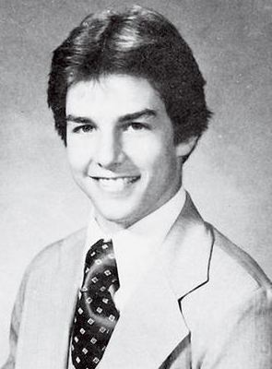
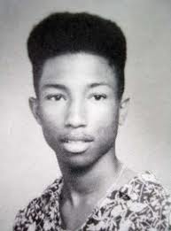
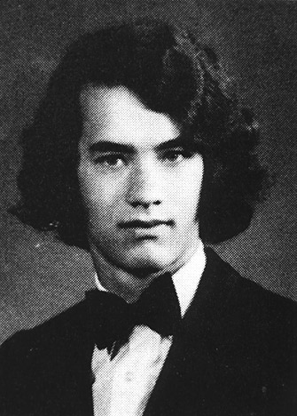
Who is smiling?
Notes:
Must operationalize the hypothesis!

Slide 130
Research Observations
Research refers to the process of testing the hypothesis.
Example: Administer tests of self esteem and depression to people.
Individuals who score low on self-esteem measures and high on depression tests, would confirm our hypothesis.

Slide 131
Some Biases that may affect your Research:
Observer/Experimenter Bias
Mismatched Validity
Confirmation Bias
Extraneous Variables
Placebo Effect
Hawthorne Effect
Belief Perseverance
Notes:
Ob/Ex Bias – inability of humans to be objective. Creation of double blind studies and technology have reduced effects
Mismatched validity - no test works well for all tasks with all people in all situations
Confirm Bias - we tend to seek, recognize, and value information that is consistent with our attitudes, beliefs, and expectations
Ex. Variables – undesirable variables that influence between the IV and DV (add error)
Confounding variables – extraneous that correlates (+or-) with the IV and DV (Ice cream and murder = spurious correlation)
Placebo Effect - The beneficial effect in a patient following a particular treatment that arises from the patient's expectations concerning the treatment rather than from the treatment itself.
Haw. Eff. - some people to work harder and perform better when they are participants in an experiment
Belief per. - tendency to cling to ideas even when confronted with evidence to the contrary

Slide 132
Research on Animals
Justification of the research
Personnel aware of guidelines
Care and housing of animals
Acquisition of animals must be lawful
Experimental procedures

Slide 133
Ethical Considerations for research with humans
Participants must be informed of the general nature of an experiment prior to consenting to participation “informed consent”
The researcher is responsible for all components of the experiment, physical and psychological
Some deception is acceptable, must be necessary for the research
May end participation at any time
Must be “debriefed” after study and follow-up consultation
Must have confidentiality

Slide 134
Methods used in studying Psychology

Slide 135
Description
Case Study
A technique in which one person is studied in depth to reveal underlying behavioral principles.
In-depth information, time consuming, difficult to generalize results for population
Often used to learn about psychological disorders
Notes:
OBJECTIVE 3-1| Identify the advantages and disadvantages of case studies in studying behavior and mental processes.

Slide 136
Activity
Divide the class into two groups
Group 1, put head down while group 2 answers the question on the board.
Group 2, put head down while group 1 answers the question on the board.
Ready?

Slide 137
Group 1 Question
Is the Missouri River longer or shorter than 500 miles?
How long is it?

Slide 138
Group 2 Question
Is the Missouri River longer or shorter than 3000 miles?
How long is it?
Notes:
2,341 miles

Slide 139
Survey
A technique for ascertaining the self-reported attitudes, opinions or behaviors of people usually by questioning a random sample of people.
-usually easy to conduct
-a lot of data very quickly
-beware of wording effect, overgeneralizing,
false consensus effect, bias
-random samples are NOT representative samples
Notes:
OBJECTIVE 3-2| Identify the advantages and disadvantages of surveys in studying behavior and mental processes, and explain the importance of wording effects and random sampling.

Slide 140
Survey
Wording Effect-”Framing”
Wording can change the results of a survey.
Q: Should cigarette ads not be allowed on television? Yes or no.

Slide 141
Survey
False Consensus Effect
A tendency to overestimate the extent to which others share our beliefs and behaviors.

Slide 142
Survey
Blind and Double Blind to reduce bias
Hide or “mask” information that may lead to bias

Slide 143
Survey
Random Sampling
From a population, if each member has an equal chance of inclusion into a sample, we call that a random sample (unbiased).
The fastest way to know about the marble color ratio is to blindly transfer a few into a smaller jar and count them.

Slide 144
Naturalistic Observation
Observing and recording behavior of animals in the wild, to recording self-seating patterns in lunch rooms in a multiracial school constitute
naturalistic observation.
Observe in natural environment
Least amount of researcher interference
May not observe studied behavior at times
More of a way to develop an idea of what to study
in the future
Notes:
OBJECTIVE 3-3| Identify the advantages and disadvantages of naturalistic observation in studying behavior and mental processes.

Slide 145
Descriptive Methods
Summary
Case studies, surveys, and naturalistic observation all describe behaviors.
-Longitudinal studies-same subject over a
long period of time
-Cross-sectional studies-representative sample of different people during a particular time.

Slide 146
Correlation
When one trait or behavior accompanies another, we say the two correlate.
Indicates strength
of relationship
(0.00 to 1.00)
Correlation
coefficient
r =
+
0.37
Correlation Coefficient is a statistical measure of relationship between two variables.
Indicates direction
of relationship
(positive or negative)
Notes:
OBJECTIVE 3-4| Describe positive and negative correlations and explain how correlational measures can aid the process of prediction.

Slide 147
Scatterplots
Perfect positive
correlation (+1.00)
Scatterplot is a graph comprised of points generated by values of two variables. The slope of points depicts the direction, and the amount of scatter the strength of relationship.

Slide 148
Scatterplots
Perfect negative
correlation (-1.00)
No relationship (0.00)
Scatterplot on the left shows a negative correlation, and the one on the right shows no relationship between the two variables.

Slide 149
Patterns of Correlation
The more TV is on, the lower your GPA.
The higher the ice cream consumption, the higher the murder rate.
People who wear hats are more likely to suffer skin cancer.

Slide 150
Correlation and Causation
or
Notes:
OBJECTIVE 3-5| Explain why correlational research fails to provide evidence of cause-effect relationships.

Slide 151
Illusory Correlation
The perception of a relationship where none exists.
“Superstitions”
Notes:
OBJECTIVE 3-6| Describe how people form illusory correlations.

Slide 152
Order in Random Events
Given random data we look for order, for meaningful patterns.
Your chances of being dealt either of these hands is precisely the same: 1 in 2,598,960.

Slide 153
Experimentation
Exploring Cause and Effect
Like other sciences, experimentation forms the backbone of research in psychology. Experiments isolate causes and their effects.
Notes:
OBJECTIVE 3-8| Explain how experiments help researchers isolate cause and effect.

Slide 154
Exploring Cause & Effect
Many factors influence our behavior. Experiments
manipulate factors that interest us while keeping
other factors under (2) control.
Effects generated by manipulated factors isolate cause and effect relationships.

Slide 155
Independent Variable
Independent Variable (cause) is a factor, manipulated by the experimenter, and whose effect is being studied.
Notes:
OBJECTIVE 3-9| Explain the difference between an independent variable and a dependent variable.

Slide 156
Dependent Variable
Dependent Variable (outcome, effect) is a factor that may change in response to independent variable. In psychology it is usually a behavior or a mental process.
The dependent variable depends on what you do to the independent variable

Slide 157
For example
General hypothesis: food effects learning
Specific (operationalized) hypothesis: students who eat an oatmeal raisin cookie before class each day will have higher average scores on the semester final than students who don’t eat a cookie.
**Operationally define your variables to allow for
replication**

Slide 158
Eating cookies before class each day will lead to higher average scores.
Variables:
Independent (IV)
Controlled by experimenter
The “cause” variable
Dependent (DV)
Predicted by experimenter
The “effect” variable

Slide 159
Eating cookies before class each day will lead to higher average scores.
What if kids get cookies and A’s?
Groups (conditions): to establish different levels of the IV
Experimental group
Exposed to IV
Get cookie
Control group
Not exposed to IV
No cookie

Slide 160
Eating cookies before class each day will lead to higher average scores.
Confounding
Variables
IV
DV
Environmental
Expt. Gp.
Cookie
95%
Cntrl. Gp.
No Cookie
82%
Expectations
Individual
differences

Slide 161
Random Sampling
To select participants from population
Allows you to generalize results
All members have the same chance to be chosen
Representative Sample
accurately represents the population, think about
the numbers of students who are seniors,
juniors, etc
Random Assignment (experiments only)
To divide participants into either the experimental
or control group
Controls the confounding variables

Slide 162
Eating cookies before class each day will lead to higher average scores.
IV
DV
Expt. Gp.
Cookie
95%
Cntrl. Gp.
No Cookie
82%
85%
93%

Slide 163
Evaluating Therapies
Double-blind Procedure
In evaluating drug therapies it is important to keep the patients and experimenter’s assistants blind to which patients got real treatment and which placebo.
This can control experimenter bias
Notes:
OBJECTIVE 3-10| Explain why random assignment and double-blind procedure build confidence in research findings.

Slide 164
Comparison
Below is a comparison of different research methods.

Slide 165
Stanford Prison Experiment (Phillip Zimbardo)
What police procedures are used during arrests, and how do these procedures lead people to feel confused, fearful, and dehumanized?
Do you think that kids from an urban working class environment would have broken down emotionally in the same way as did our middle-class prisoners? Why? What about women?
How do the ethical dilemmas is this research compare with the ethical issues raised by Stanley Milgram's obedience experiments? Would it be better if these studies had never been done?
If you were the experimenter in charge, would you have done this study? Would you have terminated it earlier? Would you have conducted a follow-up study?
Notes:
The purpose was to understand the development of norms and the effects of roles, labels, and social expectations in a simulated prison environment
Prisoners and Guards rapidly adapted to their roles, stepping beyond the boundaries of what had been predicted and leading to dangerous and psychologically damaging situations. A 1/3 of the guards were judged to have exhibited " Genuine " sadistic tendencies, while many prisoners were emotionally traumatized and 2 had to be removed from the experiment early. After sensing that everyone had been too absorbed in their roles, including himself, Zimbardo terminated the experiment after 6 days...

Slide 166
Statistical Reasoning
Measures of central tendency
The normal curve and standard deviation
Sampling
Assignment to groups
Variables

Slide 167
Measures of Central Tendency
Mode: The most frequently occurring score in a distribution.
Mean: The arithmetic average of scores in a distribution obtained by adding the scores and then dividing by their number.
Median: The middle score in a rank-ordered distribution.
Notes:
OBJECTIVE 3-13| Describe three measures of central tendency and tell which is most affected by extreme scores.

Slide 168
Statistical Reasoning
A. Describing data
1. Frequency distributions

Slide 169
Statistical Reasoning
A. Describing data
1. Frequency distributions
2. Histograms & frequency polygons

Slide 170
Histogram

Slide 171
Frequency Polygon

Slide 172
V. Statistical Reasoning
A. Describing data
B. Measures of central tendency
Mode=most common=4
Mean=arithmetic average=20/5=4
Median=middle score=4
4
3
5
4
4

Slide 173
Central Tendency 1968 TOPPS Baseball Cards
Nolan Ryan $1500
Billy Williams $8
Luis Aparicio $5
Harmon Killebrew $5
Orlando Cepeda $3.50
Maury Wills $3.50
Jim Bunning $3
Tony Conigliaro $3
Tony Oliva $3
Lou Pinella $3
Mickey Lolich $2.50
Elston Howard $2.25
Jim Bouton $2
Rocky Colavito $2
Boog Powell $2
Luis Tiant $2
Tim McCarver $1.75
Tug McGraw $1.75
Joe Torre $1.5
Rusty Staub $1.25
Curt Flood $1
With Ryan:
Median=$2.50
Mean=$74.14
Without Ryan:
Median=$2.38
Mean=$2.85

Slide 174
Measures of Central Tendency
A Skewed Distribution

Slide 175
Statistical Reasoning
A. Describing data
B. Measures of central tendency
C. Measures of variation
1. Range
2. Variance & standard deviation

Slide 176
Standard Deviation
Punt
Distance
Deviation
from Mean
Deviation
Squared
36
38
41
45
-4
-2
+1
+5
16
4
1
25
std. dev.=
variance=
11.5=3.4 yds
Mean=
160/4=
40 yds
46
46/4=11.5=
variance

Slide 177
Statistical Reasoning
A. Describing data
B. Measures of central tendency
C. Measures of variation
D. Characteristics of the normal curve

Slide 178
Statistical Reasoning
A. Describing data
B. Measures of central tendency
C. Measures of variation
D. Characteristics of the normal curve
E. Inference
1. Does the sample represent the pop.?
a. Non-biased sample-good
b. Low variability-good
c. Larger samples-good

Slide 179
Statistical Reasoning
E. Inference
1. Does the sample represent the pop.?
2. Are differences between groups statistically significant?
a. Big differences-good
b. Low variability-good
c. Big groups-good
3. Statistical significance is the likelihood that your results occurred by chance. The p value (probability) must be lower than .05. Basically want to be at least 95% certain
Notes:
P value is probability of observed results occurring by chance.
Null hypothesis (H0): The coin is fair; Prob(heads) = 0.5
Observation O: 14 heads out of 20 flips; and
p-value of observation O given H0 = Prob(≥ 14 heads or ≥ 14 tails) = 2*(1-Prob(< 14)) = 0.115.
The calculated p-value exceeds 0.05, so the observation is consistent with the null hypothesis, as it falls within the range of what would happen 95% of the time were the coin in fact fair. Hence, we fail to reject the null hypothesis at the 5% level. Although the coin did not fall evenly, the deviation from expected outcome is small enough to be consistent with chance.
However, had one more head been obtained, the resulting p-value (two-tailed) would have been 0.0414 (4.14%). This time the null hypothesis – that the observed result of 15 heads out of 20 flips can be ascribed to chance alone – is rejected when using a 5% cut-off.

Slide 180
Try this for an experiment
Hypothesis: “If students use effortful processing in a cognitive task, their rate of recall will be better”
IV-level of processing
DV-rate of recall
(Think of the “IF”…”THEN” relationship
“IF” you do something (IV, cause) then this will be the outcome (DV, effect)

Slide 181
Group 1
Which of the following items would be of most use to you on a deserted island?

Slide 182
Group 2
How many of the following words have three or more vowels?

Slide 183
Read each word and complete the task you have been instructed to complete

Slide 184
basketball

Slide 185
umbrella

Slide 186
water

Slide 187
window

Slide 188
elevator

Slide 189
radio

Slide 190
batteries

Slide 191
envelope

Slide 192
jackknife

Slide 193
oar

Slide 194
hammer

Slide 195
newspaper

Slide 196
bananas

Slide 197
tent

Slide 198
table

Slide 199
Take a break, and answer these questions…
What is your zip code?
What is your favorite color?
What did you eat for dinner last night?
What is your favorite class?
Now, try to recall as many of the words from the previous slides as you can…NO CHEATING

Slide 200
M&Ms and sampling procedures

Slide 201
Create a table for each color:
Using the observed frequency of your sample, formulate expected percentages of the entire population

Slide 202
Now pool your data with others in your group and revise your hypothesis if necessary
Now consider the entire class

Slide 203
Mars.Inc. reports the actual percentages: For plain M&M’s,
13 percent are brown
13 percent are red,
14 percent are yellow,
24 percent are blue,
20 percent are orange, and
16 percent are green.

Slide 204
Advantages of each:
Survey/interview
Usually anonymous, so answers are more honest
Instant feedback
Quantitative data
Case study (either longitudinal or cross-sectional)
You observe activities/reactions personally and do not rely on others’ reports
For longitudinal, you can see how a treatment/behavior changes over a long period of time
For cross-sectional, you can see if a treatment/behavior is adaptable to different age groups at a given time.

Slide 205
Advantages cont.
Experiment
You decide what you are looking for before you start, and set the experiment up to directly show
your hypothesis as part of the scientific method.
You can focus more on causation, and less on correlation.
By operationally defining your variables you can help replication which leads to reliability

Slide 206
Disadvantages…
Survey/interview
You have to control for different types of bias or leading questions.
You have to make sure you have a representative population and a random sample of that population.
Case study
Your findings may be specific to the particular subject you have chosen. They may be the exception to the norm (though it worked out in Piaget’s case).
Time, time, time … you need a lot of it.

Slide 207
Disadvantages cont…
Experiment
You have to monitor all things closely and make sure to control the environment as to limit stimuli and confounding variables
You have to make sure that you are following all ethical protocols.
Possible issues with placebo effect, employ a double-blind method

Slide 208
 | Pros | Cons
Descriptive Methods:
1. Case Study | - Allows for in-depth study - can study things otherwise impossible to study (brain damage, for example) | - single subject may not be representative; could be a fluke - only describe behavior; do not tell us cause and effect (or “why?”)
2. Survey | - can measure attitudes, motives, and opinions - can get a lot of data easily | - wording of the questions can drastically affect results - relies on honesty and reflection of participants - small rate of return is not likely to be representative - only describe behavior; do not tell us cause and effect (or “why?”)
3. Naturalistic Observation | - results have ecological (real world) significance | - only describe behavior; do not tell us cause and effect (or “why?”)
4. Correlation Studies | - useful for predicting behavior - provides quantitative data about the strength of the relationship | - only describe behavior; do not tell us cause and effect (or “why?”)
Experimentation:
1. Experiment | - Can be used to determine cause and effect relationships | - may lack ecological (real-world) significance - ethical issues may limit possibilities.

Slide 209
Social Psychology (Social Thinking)
Attributing theory and error
Attitudes
Compliance
Role-playing Zimbardo

Slide 210
Focuses in Social Psychology
“We cannot live for ourselves alone.”
Herman Melville
Social psychology scientifically studies how we think about, influence, and relate to one another.
Notes:
OBJECTIVE 55-1| Describe the three main focuses of social psychology.

Slide 211
Attributing Behavior to Persons or to Situations
Attribution Theory: Fritz Heider (1958) suggested that we have a tendency to give causal explanations for someone’s behavior, often by crediting either the situation or the person’s disposition.
http://www.stedwards.edu
Fritz Heider
Notes:
OBJECTIVE 55-2| Contrast dispositional and situational attributions, and explain how the fundamental attribution error can affect our analysis of behavior.

Slide 212
Situational Attribution

Slide 213
Situational Attribution

Slide 214
Situational Attribution

Slide 215
Dispositional Attribution

Slide 216
Dispositional Attribution

Slide 217
Dispositional Attribution

Slide 218
Attribution

Slide 219
Fundamental Attribution Error
Tendency to attribute the behavior of others to internal disposition rather than to situations
People tend to blame or credit the person more than the situation

Slide 220
Attitude
Belief and feeling that predisposes one to respond in a particular way to objects, people and events.
If we believe a person is mean, we may feel dislike for the person and act unfriendly.
Notes:
OBJECTIVE 55-3| Define attitude.
https://www.youtube.com/watch?v=F9Egi8EoQc8 - Embassy Suites commercial

Slide 221
Attitudes Can Affect Action
Our attitudes predict our behaviors imperfectly because other factors including the external situation also influence behavior.
Although Democrat leaders supported Bush’s attack on Iraq, under public pressure, they had their private reservations.
Notes:
OBJECTIVE 55-4| Describe the conditions under which attitudes can affect actions.

Slide 222
Actions Can Affect Attitudes
Not only do people stand for what they believe [attitude] in, but they start believing in what they stand for.
Cooperative actions can lead to mutual liking (beliefs).

Slide 223
Small Request –> Large Request
Compliance
Foot-in-the-Door Phenomenon: tendency for people who have first agreed to a small request, to comply later with a larger request.
“Well, if you are already spending this on a dress, what’s a few more dollars to get this?”

Slide 224
Another method of compliance
Large request --> Small request
Door-in-the-face phenomenon
After disagreeing to a large initial request, a person is more likely to agree to something that seems less expensive, painstaking, etc
“So you can’t afford the luxury model, how about the next level down?”

Slide 225
Actions Can Affect Attitudes
Why do actions affect attitudes? One explanation is that when our attitudes and actions are opposed, we experience tension, called cognitive dissonance.
To relieve us of this tension we bring our attitudes closer to our actions (Festinger, 1957).
Notes:
OBJECTIVE 55-5| Explain how the foot-in-the-door phenomenon, role-playing, and cognitive dissonance illustrate the influence of actions on attitudes.

Slide 226
Cognitive Dissonance

Slide 227
Role Playing Affects Attitudes
Zimbardo (1972) assigned the role of guards and prisoners to random students and found that guards and prisoners developed role appropriate attitudes. Our schemas and perceptions affect our thinking and behaviors when we assume other roles.
Notes:
https://www.youtube.com/watch?v=sZwfNs1pqG0 – 13 minute video on prison study

Slide 228
Social Influence
Conformity- Asch
Obedience- Milgram
Persuasion

Slide 229
Social Influence
The greatest contribution of social psychology is its study of attitudes, beliefs, decisions, and actions and the way they are molded by social influence.

Slide 230
Conformity & Obedience
Behavior is contagious, modeled by one followed by another. We follow the behavior of others to conform (Asch).
Other behaviors may be the expression of compliance (obedience) toward authority.
Conformity Obedience
Notes:
OBJECTIVE 56-1| Describe the chameleon effect, and give an example of it.

Slide 232
Group Pressure & Conformity
Suggestibility is a subtle type of conformity– adjusting our behavior or thinking toward some group standard.
Notes:
OBJECTIVE 56-2| Discuss Asch’s experiments on conformity, and distinguish between normative and informational social influence.

Slide 233
The Chameleon Effect
Conformity: adjusting one’s behavior or thinking to coincide with a group standard (Chartrand & Bargh, 1999).

Slide 234
Group Pressure & Conformity
Influence resulting from one’s willingness to accept others’ opinions about reality.

Slide 235
Asch found that these conditions strengthen conformity
One is made to feel incompetent or insecure.
The group has at least three people.
The group is unanimous.
One admires the group’s status and attractiveness.
One has as open mind.
The group observes one’s behavior.
One’s culture strongly encourages respect for social standard.
An authority figure or respected individual models.

Slide 236
Reasons for Conformity
Normative Social Influence: influence resulting from a person’s desire to gain approval or avoid rejection. Respecting normative behavior, because price may be severe if not followed.
Informational Social Influence: The group may provide valuable information, only stubborn people will never listen to others.
Notes:
Norm – laughing at a joke you don’t get
Inform – maybe they know something I don’t

Slide 238
Obedience
People comply to social pressures. But how would they respond to outright command?
Stanley Milgram designed a study that investigated the effects of authority on obedience.
Stanley Milgram
(1933-1984)
Notes:
OBJECTIVE56- 3| Describe Milgram’s experiments on obedience, and outline the conditions in which obedience was highest.

Slide 239
Milgram’s Study
Notes:
https://www.youtube.com/watch?v=4b7YFtiE5EA

Slide 240
Milgram’s Study: Results

Slide 241
Persuasion
The researcher in the Milgram study used a Central route for persuasion – that is, he focused on facts and logic to attain the desired behavior. What were these?
Group leaders tend to use a Peripheral route for persuasion – one which focuses on emotional appeal, personality and positive regard for the group at hand.

Slide 242
Persuasion
Central Route – Adds in facts, logic and strong arguments
Peripheral Route – Emphasizes emotional appeal, focuses on personal traits and generates positive feelings
Three components – source, message and audience

Slide 243
Source – We are more likely to believe sources that appear honest, trustworthy, have expertise and credibility and are attractive.
Message – messages using a central route are convincing and understandable, however, the peripheral route may appeal to people more. Fear tends to be a good technique.
Audience – audiences who want the facts should be given the central route, others the peripheral. Know your audience and their attitudes

Slide 244
Individual Resistance
A third of individuals in Milgram’s study resisted social coercion.
An unarmed individual single-handedly
Challenged a line of tanks at Tiananmen Square.

Slide 245
Lessons from the Conformity and Obedience Studies
In both Asch's and Milgram's studies participants were pressurized between following their standards and being responsive to others.
In Milgram’s study, a step forward, participants were torn between hearing victims pleas and experimenter’s orders.
Notes:
OBJECTIVE 56-4| Explain how the conformity and obedience studies can help us understand our susceptibility to social influence.

Slide 246
Group Influence
Group behavior

Slide 247
Individual Behavior in the Presence of Others
Social facilitation: Refers to improved performance on a task in the presence of others. Triplett (1898) noticed cyclists’ race time were faster when they competed against others than against a clock. This only occurred, however, if the person already acquired the skill.
Notes:
OBJECTIVE 56-5| Describe conditions in which the presence of others is likely to result in social facilitation, social loafing, or deindividuation.

Slide 248
Social Loafing
Tendency of an individual in a group to exert less effort toward attaining a common goal than when tested individually (Latané, 1981).
Hey, I wore a tie at least.

Slide 249
Deindividuation
Loss of self-awareness and self-restraint in group situations that foster arousal and anonymity.
Mob behavior

Slide 250
Effects of Group Interaction
Group Polarization: enhances group’s prevailing attitudes through discussion. If a group is like-minded, discussion strengthens its prevailing opinions and attitudes.
Notes:
OBJECTIVE 56-6| Discuss how group interaction can facilitate group polarization and groupthink.

Slide 251
Groupthink
Mode of thinking that occurs when the desire for harmony in a decision-making group overrides realistic appraisal of alternatives.
Where were those weapons of
mass destruction????

Slide 252
Antisocial Relations
Prejudice
Group Bias
Aggression
Conflict

Slide 253
Social Relations
Social psychology teaches us how we relate to one another from prejudice, aggression and conflict to attraction, altruism and peacemaking.
Notes:
More than social networking. It’s the creation of relationships and how we behave with one another.

Slide 254
Prejudice
Simply called, “prejudgment,” a prejudice is an unjustifiable (usually negative) attitude toward a group and its members – often of different cultural, ethnic or gender groups.
Components of Prejudice
Beliefs (stereotypes)
Emotions (hostility, envy, fear)
Predisposition to act (to discriminate)
Notes:
OBJECTIVE 57-1| Identify three components of prejudice.
Discrimination is the acting upon a prejudice – may focus on gender, race, age, religion, body size, or other characteristics

Slide 255
Reign of Prejudice
Prejudice works at the conscious and [more so] the unconscious level. Thus prejudice is more like a knee-jerk response than a conscious decision.
Implicit racial associations – trouble identifying pleasant words
Unconscious patronization – lower expectations
Race-influenced perceptions – perceived to have weapon more frequently
Notes:
As overt prejudice wanes, subtle prejudice lingers.
Increased support for interracial marriage but the Cheerios commercial was pulled in some markets.
Gender prejudice and discrimination – women seen as less intelligent, paid less, more likely to live in poverty, worldwide – lower literacy rate, valued less. According to “natural” male to female ratio of births, there are 101 million missing women. Female shortage in China. 40 million bachelors with unavailable mates.

Slide 256
Divide into 2 groups
Create list of characteristics that your group shares
Create list of characteristics that defines the other group

Slide 257
Social Roots of Prejudice
Why does prejudice arise?
Social Inequalities
Social Divisions
Emotional Scapegoating
Notes:
OBJECTIVE 57-3| Discuss the social factors that contribute to prejudice.

Slide 258
Social Inequality
When people have money, power and prestige, and others do not, prejudice develops. Social inequality increases prejudice.
Notes:
Discrimination also increases prejudice through the reactions it provokes in its victims. Allport (1954) – self-blame or anger (creates the “blame the victim” dynamic) Ex: poverty breeds high crime, high crime rate is used to justify discrimination against those in poverty

Slide 259
Ethnocentrism
The tendency to think that your nation or culture is superior to others
Judge other cultures based on your own rather than on its own merits
Notes:
Ancestral need to belong – we are group-bound species. We cheer for our groups, kill for them, and die for them.

Slide 260
In and Out Groups
Ingroup: People with whom one shares a common identity. Outgroup: Those perceived as different from one’s ingroup. Ingroup Bias: The tendency to favor one’s own group.
Scotland’s famed “Tartan Army” fans.
Notes:
When we define who we are – we define who we are NOT. Us versus them. Cliques act as in-groups

Slide 261
Emotional Roots of Prejudice
Prejudice provides an outlet for anger [emotion] by providing someone to blame. After 9/11 many people lashed out against innocent Arab-Americans.
Notes:
OBJECTIVE 57-4| Explain how Scapegoating illustrates the emotional component of prejudice.

Slide 262
Cognitive Roots of Prejudice
One way we simplify our world is to categorize. We categorize people into groups by stereotyping them.
Foreign sunbathers may think Balinese look alike.
Notes:
OBJECTIVE 57-5| Cite four ways that cognitive processes help create and maintain prejudice.
Categorize, vivid cases, just world, hindsight bias.

Slide 263
Cognitive Roots of Prejudice
The tendency of people to believe the world is just and people get what they deserve and deserve what they get (the just-world phenomenon).

Slide 264
Aggression
Aggression can be any physical or verbal behavior intended to hurt or destroy whether done reactively out of hostility or proactively as a calculated means to an end.
Research shows that aggressive behavior emerges from the interaction of biology and experience.
Notes:
OBJECTIVE 57-6| Explain how psychology’s definition of aggression differs from everyday usage.

Slide 265
The Biology of Aggression
Three levels of biological influences on aggressive behavior are:
Genetic Influences
Neural Influences
Biochemical Influences
Notes:
Genetic Influences: Animals have been bred for aggressiveness – for sport and at times for research. Twin studies show aggression may be genetic. In men, aggression is possibly linked to Y chromosome.
Neural Influences: Some centers in the brain, especially the limbic system (amygdala) and the frontal lobe are intimately involved with aggression.
Biochemical Influences: Animals with diminished amounts of testosterone (castration) become docile, and if injected with testosterone aggression increases. Prenatal exposure to testosterone also increases aggression in female hyenas.
OBJECTIVE 57-7| Describe three levels of biological influences on aggression, and cite evidence for each level.

Slide 266
Influences
Genetic Influences: Animals have been bred for aggressiveness – for sport and at times for research. Twin studies show aggression may be genetic. In men, aggression is possibly linked to Y chromosome.
Neural Influences: Some centers in the brain, especially the limbic system (amygdala) and the frontal lobe are intimately involved with aggression.
Notes:
Violent people tend to have lower than average activity in frontal lobes.

Slide 267
Influences
Biochemical Influences: Animals with diminished amounts of testosterone (castration) become docile, and if injected with testosterone aggression increases. Prenatal exposure to testosterone also increases aggression in female hyenas.
Notes:
Violent criminals tend to be young, muscular, lower than average intelligence, low levels of serotonin, high levels of testosterone. Alcohol helps to speed up aggressive responses.

Slide 268
The Psychology of Aggression
Four psychological factors that influence aggressive behavior are:
Aversive Events
Learning Aggression is Rewarding
Observing Models of Aggression
Acquiring Social Scripts
Notes:
OBJECTIVE 57-8| Outline four psychological triggers of aggression.

Slide 269
Aversive Events
Studies in which animals and humans experience unpleasant events reveal that those made miserable often make others miserable.
Ron Artest (Pacers) attack on Detroit Pistons.
Notes:
Pacers were winning – testosterone
They were young males
Artest was shoved by a frustrated Piston player
Deindividuated fan (who was consuming alcohol) threw a cup of beer at Artest.

Slide 270
Frustration-Aggression Principle
A principle in which frustration (caused by blocking to achieve some goal) creates anger, which can generate aggression.

Slide 271
Learning that Aggression is Rewarding
When aggression leads to desired outcomes, one learns to be aggressive. This is shown in animals and humans alike.
Cultures that favor violence breed violence. Scotch-Irish settlers in the South had more violent tendencies than their Quaker, Dutch counterparts in the Northeast of the US.
Notes:
Death Penalty
Parent modeling – parents who scream and hit kids model aggression as a form of communication.

Slide 272
Acquiring Social Scripts
The media portrays social scripts and generates mental tapes in the minds of the viewers. When confronted with new situations individuals may rely on such social scripts. If social scripts are violent in nature, people may act them out.

Slide 273
Do Video Games Teach or Release Violence?
The general consensus on violent video games is that to some extent it breeds violence. Adolescents view the world as hostile, get into arguments, and get bad grades after playing such games.
Notes:
OBJECTIVE 57-9| Discuss the effects of violent video games on social attitudes and behavior.
http://www.youtube.com/watch?v=bzzC9qf8ODc - 13 minute video on gaming

Slide 274
Summary

Slide 275
Jim Jones
“Dissent was unthinkable… Offenders sweltered in "The Box," a 6-by-4-foot (1.8-by-1.2-meter) underground enclosure. Misbehaving children were dangled head-first into the well late at night. Loudspeakers broadcast Jones' voice at all hours.
Deborah Layton – escaped from Jonestown

Slide 276
Brainwashed????
Brainwashing is a forced attitude change that requires a captive audience
POW’s often subjected to brainwashing techniques
Patricia Hearst
Notes:
Stockholm Syndrome

Slide 277
Physical and psychological aspects of brainwashing:
Physical abuse
Lack of sleep
Humiliation
Isolation
Giving hope
Fear

Slide 278
Cults
Cults often look for people who socially isolate themselves from friends and family
They then work to further isolate them and make them initially feel like the cult is their family
Jim Jones used sedatives to calm people and armed guards to keep people in line

Slide 279
People who join cults often do so because of the personality of the leader, not necessarily what they believe in
Often see leader as infallible

Slide 280
They often follow leader without question
Often used guilt, manipulation, deception, fear, and high-pressure indoctrination

Slide 281
Group behavior
Group cohesion – when groups bond strongly together due to common attitudes
Group norms – unwritten rules that may be spoken or simply understood about behavior of the group

Slide 282
How do we form groups?
Maslow cites the need for love and belongingness
Schacter cites the need for affiliation
Festinger cites the social comparison theory – which states that humans are compelled to compare themselves to others in group to determine correct beh.

Slide 283
Mullen & Copper cite the fact that people like to join task-oriented groups – where every member has specific tasks to complete. Makes people feel needed
People are more willing to work hard if there is a group cohesion
Others cite the fact that people join groups that are socially oriented
Notes:
https://www.youtube.com/watch?v=IzWpfq103q4 – Heavens Gate Remembered from CNN (5 minutes)

Slide 284
Prosocial Relations
Attraction
Love
Altruism
Bystanders
Social Norms
Peacemaking

Slide 285
“No Man is an Island”
No man lives in isolation
All people are interconnected
People need social relationships

Slide 286
Social Perception
Nonverbal Communication – unspoken communication and the distance we keep from one another
Haptic – physical contact
Waitresses get larger tips, mood increases
Must be appropriate, depends on the person
Eye Contact
Gazing – steady, intent look (Sign of friendship)
Staring – looking fixedly with wide-open eyes (Sign of anger)
Paralinguistic – tone, volume, …
Proxemics, Body language, Facial expression, Gestures, and Appearance

Slide 287
Attraction and Relationships
Relatively new to social psychology
Psychologists generally only focus on individuals
Romance and attraction isn’t a ‘scholarly’ thing to study
Halo Affect
Relationships have a number of important health benefits.
Notes:
What are some of the benefits? Several studies report fewer colds, lower blood pressure and lower heart rates in participants with strong social ties. Statistics show that marriage, perhaps the strongest tie, adds years to life expectancy. And suicide, mental illness and alcoholism rates are much lower when people feel a sense of belonging. Plus reduces stress.

Slide 288
Ideal Qualities in a Romantic Partner
1 | 2 | 3
Less than me | About the same as me | More than me
1 | Extraversion
2 | Conscientiousness
3 | Agreeableness
4 | Openness
5 | Neuroticism
6 | Age
7 | Height
8 | Education
9 | Intelligence
10 | Good Looks
11 | Social Status
12 | Spirituality
13 | Dominance
Notes:
Have students get out a piece of paper and rank order the importance of all of the traits. After they have ranked them, have students write down if they would like their partner to have more, the same or less of the following 13 traits. After several minutes, please get into your small groups to discuss. (Give students several minutes to complete the activity before they get into their small groups).
Have them discuss in small groups why they made the ratings they did.
(note: This might be a good opportunity to use the interactive clickers to see how the class as a whole responded.)
Do we always want similarity or are there some traits we would like our partners to differ?
When we desire differences is it because we either lack those qualities our selves or fear that too much of the same trait will clash and cause problems.
Which traits are the most important that our partners are similar?

Slide 289
Overview
What leads to attraction?
Proximity
Mere exposure
Physical attractiveness
Similarity (Chameleon Effect)
Matching
Mimicry

Slide 290
Psychology of Attraction
Proximity: Geographic nearness is a powerful predictor of friendship. Repeated exposure to stimuli increases their attraction
(mere exposure effect).
Ever like a song the more times you hear it?
This is why long-distance relationships don’t work out (sorry) ☹
Notes:
We prefer the mirror image of our self versus reality.
In a classic study done at MIT in the 1950’s, Festinger, Schachter, & Back, 1950) examined the friendship patterns among couples living in two student housing complexes. They found that those couples who lived closer to one another were more likely to become friends than the couples who lived in apartments located further apart. That is, when asked to name their friends, 65% of the people mentioned lived in the same apartment building. In addition, 41% of next-door neighbors said that they were close friends, 22% of those who lived two doors apart said that they were close friends, and only 10% of those who lived on opposite ends of the halls indicated the same. Thus the closer people live to each other, the more likely they are to become friends. Among these students, proximity was a better predictor of friendships than were any conventional wisdom factors.
Segal (1974) examined Maryland state police trainees grouped together alphabetically. The closer the two trainees last names were in the alphabet the more likely they were to name each other as friends.
Proximity in alphabet was more predictive of friendship than similarity of race religion, age etc.

Slide 291
Attraction
Mere exposure
Moreland & Beach (1992): women coming into class; the more they came to class, the more other students liked her
Notes:
Mere Exposure—the more exposure that we have to a stimulus, the more positively we evaluate that stimulus
For example, Brooks-Gunn & Lewis (1981) found that infants smiled more at faces that were repeatedly exposed to them than to faces with which they were less familiar.
Two researchers, Moreland & Beach (1992), conducted a study to test the effects of simple repeated exposure. They selected four women to play the part of their research assistants. They had 3 of the women come into the class at varying times throughout the semester. The fourth woman simply had her picture taken. Of the 3 women who came to class during the semester, one of them came 5 times, another came 10 times, and the third one came 15 times. Now none of the women had any direct contact with the students; they simply came into the classroom and sat down.
At the end of the semester, the students were shown photographs of all 4 women and were asked to rate them on a number of different traits (e.g., popularity, honesty, intelligence, and physical attractiveness). They were also asked to record their beliefs about how much they would like her, enjoy spending time with her, and want to work on a mutual project with her.
What did the researchers find? The more the research assistant came to class, the more attracted the students were to her.

Slide 292
Preferred Qualities in Partners (Buss et al., 1986)
Women | Men
1) Kind/understanding | Kind/understanding
2) Exciting Personality | Exciting Personality
3) Intelligent | Intelligent
4) Healthy | Physically Attractive
5) Easy Going | Healthy
6) Physically Attractive | Easy Going

Slide 293
Psychology of Attraction
2. Physical Attractiveness: Once proximity affords contact the next most important thing in attraction is physical appearance.
Notes:
Physical appearance – opinions vary
Universals of beauty
Smiles
Large eyes, high cheekbones, and narrow jaw for women
Body shape preferences varied greatly
Women believe the ideal is lighter than their shape
Men believe the ideal is their shape

Slide 294
Physical Attraction
“What Is Beautiful Is Good” stereotype
People tend to attribute desirable characteristics such as sociable, friendly, poised, warm, competent, and well adjusted to those who are good looking
Attractive children and adults are judged and treated more favorably
Implications for career & salary

Slide 295
Physical Attraction
Physical attractiveness:
Walster, Hatfield, Berscheid (1966):
Computer Dance
Randomly matched 752 incoming students as blind dates for an orientation dance
What was the MOST IMPORTANT determinant in future dating???

Slide 296
Walster et al. Computer Dating Study
Freshman “Welcome Week” dance
I.V.s
Attractiveness rated
Personality tests (social skills; introversion-extroversion; masculinity-femininity; MMPI)
IQ
Subjects matched for date (randomly)
D.V.s
Rated date at intermission
Contacted several months later about further dates

Slide 297
Computer Dating Study
Physical attractiveness the most important factor
Intelligence and personality were not related to future dating

Slide 298
Card activity
Don’t look at your card.
Match with the person with the highest card who will also agree to match with you.
Notes:
You will get a set of 60, 3X5 notecards each with a number ranging from 2-10 on it. Make sure they are shuffled so that students randomly get different numbers. Give one card to each student. Instruct them not to look at their card. The activity is to hold the card face out on their forehead so that others can see it but they cannot. The goal of the activity is to find a partner with the highest number who is willing to hook up with you. Tell the class they can play hard to get to some degree and that they should not automatically accept their first offer, unless of course you are propositioned by someone with a high number.
Initially people will gravitate to those with 9s and 10s. As people find that they are either accepted or rejected based on their number they should eventually settle with others who have similar numbers on their forehead.
This is basically how assortative mating occurs in terms of physical attractiveness but it is well known that assortative mating likely occurs for a number of valuable traits such as intelligence, athleticism, political and religious views etc.

Slide 299
Symmetry
Notes:
Recall that when we talked about evolutionary psychology, we talked about the importance of symmetry for physical attraction. People tend to find symmetrical faces more attractive. In fact, according to numerous studies by Gangestead and colleagues, women seem to think that symmetrical men even smell better, but only when their ovulating. To test this, the researchers had men and women wear the same shirt to bed for two nights. Then they had men and women of the opposite sex smell the shirts and rate how attractive they thought the owner was. Women who were most fertile rated the shirts of the men with the most symmetry faces the best. Women who were not ovulating or who were on hormonal contraceptive did not show this pattern. Men did not seem to be able to pick up symmetry by scent.

Slide 300
Psychology of Attraction
3. Similarity: Having similar views between individuals causes the bond of attraction to strengthen.
Similarity breeds content!
Notes:
Ask students. Refer back to the original rating activity.
Matching Hypothesis
Tend to choose partners who are similar to us
More likely to have similar interactions
Similar attitudes and values

Slide 301
Similarity
Couples tend to be similar in age, race, religion, social class, personality, education, intelligence, physical attractiveness, and attitudes
Personality similarity related to marital happiness.
Perceived similarity more strongly associated with marital satisfaction than actual similarity
Notes:
there is a great deal of evidence that shows that we will be more attracted to someone we believe has attitudes similar to our own than to someone we believe is attitudinally dissimilar.
Couples tend to be similar in age, race, religion, social class, personality, education, intelligence, physical attractiveness, and attitudes
Personality similarity related to marital happiness.
Perceived similarity more strongly associated with marital satisfaction than actual similarity

Slide 302
What personality traits are important to match on?
Malouff, et al. (2010) meta-analysis
Connection between personality traits and relationship satisfaction.
Low neuroticism,
Higher agreeableness, conscientiousness and extraversion.
Matching on Individual Big 5 traits does not predict satisfaction but matching on overall profile does.
Notes:
A partner higher in neuroticism might be more critical, contemptuous and defensive with their partner decreasing satisfaction.

Slide 303
Similarity
Why do we like people like us?
Why does similarity increase relationship satisfaction?

Slide 304
Mimicry-Similarity in Behavior
When we want to belong to a group or want others to like us, we mimic their behavior.
Mirror Neuron
We like people who mimic our behavior.
But don’t be too obvious!!!
Notes:
Insert ABC video http://www.youtube.com/watch?v=7BKwBsPlR04 – 5 minute video with Alan Alda

Slide 305
People get more similar over time
Zajonc et al. (1987)
Dissimilar looking couples at marriage look more similar 25 years later.
Happier couple look more similar
Decades of shared emotions?
Notes:
Zajonc proposes that people, often unconsciously, mimic the facial expressions of their spouses in a silent empathy and that, over the years, sharing the same expressions shapes the face similarly.
''Facial mimicry allows a truer empathy because it triggers the same inner state,'' Dr. Zajonc said. ''Couples can understand each other much better when this happens.''
''Common life experiences over years and years can alter facial musculature and wrinkle patterns, leading to an increased resemblance, '' said Paul Ekman,
Like other muscles of the body, facial muscles grow or atrophy according to the amount of use; facial muscle activity, in turn, stimulates growth in facial bones. People who maintain a particular emotional stance toward life - such as fear, disdain or joy - may tend to hold the facial muscles involved in those feelings slightly tensed in a readiness to respond, according to Dr. Ekman. Over several decades, that tension can come to give the face a distinctive cast by altering wrinkle patterns, changing the relative size of different muscles and even bones, and so altering the contours of the face.
Such a process is likely to occur in a married couple, according to Dr. Ekman. ''There is no question that we unwittingly use our facial muscles in the same way as the person we are looking at,'' he said.

Slide 306
Similarity to Pets
Notes:
We are basically in love with ourselves so people may choose pets that resemble themselves
Or people and their pets appearance converge over time
Roy and Christenfeld (2004) People with purebred dogs look more alike due to selection and deliberation
No correlation with length of time owned and similarity.

Slide 307
Romantic Love
Passionate Love: An aroused state of intense positive absorption in another usually present at the beginning of a love relationship.
Two-factor theory of emotion
Physical arousal
Perceptions of that arousal
Attraction can be attributed to the event/feeling versus the actual person
Notes:
OBJECTIVE 58-2| Describe the effect of physical arousal on passionate love, and identify two predictors of enduring companionate love.
Friendship – people for whom one has affection, respect, and trust. Concern for one another. Frequent contact

Slide 308
Romantic Love
Companionate Love: Deep affectionate attachment we feel for those with whom our lives are intertwined.
Equity: A condition in which people receive from a relationship in proportion to what they give to it.
Self-Disclosure: Revealing intimate aspects of oneself to others.
Notes:
Passionate love fades… and so will the relationship unless a deeper connection is made.
Equity – mutually sharing self and possessions, emotions,…
Self-Disclosure – intimacy

Slide 309
Commensurate Love
Triangular Model of Love
Intimacy – closeness
Passion – attraction
Commitment - recognition

Slide 310
When all else fails…
Misattribution of arousal
Notes:
Ok, so if all else fails—you’ve moved closer to your crush, you keep inexplicably keep running into them (mere exposure), you try to look as physically attractive as possible, you mimic their behavior—if you’ve done all these tricks, there’s still one more you can try. Remember our discussion in emotion on the misattribution of arousal? Remember how the men who crossed the high scary bridge were more likely to call the researcher and somehow saw more sex themes when looking at an ambiguous picture. Try that! Take your date somewhere exciting, somewhere sure to get the adrenaline pumping. Why do you think they always do this kind of date on the bachelor?
Show from the Bachelor. http://www.corriehunt.com/uploads/5/0/6/4/5064667/the_bachelor_.wmv

Slide 311
Conclusions-Summary
Many factors contribute to attraction
Proximity
Physical attractiveness (matching)
Similarity
Importance of personality similarities
Mimicry → increased liking
We become more similar to our partners over time

Slide 312
Altruism
Unselfish regard for the welfare of others.
Notes:
OBJECTIVE 58-3| Define altruism, and give an example.

Slide 313
Bystander Effect
Tendency for any given bystander to be less likely to give aid if other bystanders are present.
Kitty Genovese
Notes:
OBJECTIVE 58-4| Describe the steps in the decision-making process involved in bystander intervention.
Chances of getting help increase as the number of people available to help you decrease
Kitty Genovese

Slide 314
Bystander Intervention
The decision-making process for bystander intervention.

Slide 315
The Social Norms for Helping
Unselfish regard for the welfare of others.
Social Exchange Theory: Our social behavior is an exchange process, the aim of which is to maximize benefits and minimize costs.
Reciprocity Norm: The expectation that we should return help, not harm, to those who have helped us.
Social–Responsibility Norm: Tells us to help others when they need us even though they may not repay us in kind.
Social Trap: A situation in which a person acts to obtain short-term individual gains, which in the long run leads to a loss for the group as a whole.
Notes:
OBJECTIVE 58-3| Define altruism, and give an example.

Slide 316
Peacemaking
Superordinate Goals are shared goals that override differences among people and require their cooperation.
Communication and understanding is developed through talking to one another. Sometimes mediated with a third party.
Notes:
OBJECTIVE 58-6| Discuss effective ways of encouraging peaceful cooperation and reducing social conflict.

Slide 317
Peacemaking
Graduated & Reciprocated Initiatives in Tension-Reduction (GRIT) A strategy designed to decrease international tensions. One side recognizes mutual interests and initiates a small conciliatory act that opens the door for reciprocation by the other party.

Slide 318
AP info…
Know attitudes, prejudice, stereotypes
Know Asch (conformity), Milgram (obedience), and Zimbardo (role-playing)
3 factors of attraction (proximity, physical, similarity)
Group think (harmony), group polarization
Bystander Effect
Social traps

Slide 319
More AP info…
Central and Peripheral routes to persuasion
Just-world phenomenon
Fundamental attribution error (Heider)
Normative vs Informative social influence
Compliance (foot-in-the-door, door-in-the-face)
Cognitive dissonance (Festinger)
Relative deprivation

Slide 320
The Psychology of Culture
System of subtle and obvious rules (shared beliefs, attitudes, and behaviors) established to ensure a group’s survival
The rules are passed from one generation to the next.
The “software of our minds”
Different from nationality, race, and ethnicity

Slide 321
Factors Influencing Culture
Four factors influence culture
Population density
Climate
Resources
Technology
Notes:
Societies with higher population densities require more rules for maintaining social order.
Climate has profound influence on life-styles.
Abundance or lack of resources has an influence on how the people of the culture behave.
Inventions influence the interactions of people.

Slide 322
Individualism and Collectivism

Slide 323
Individualism
Cultural style that places personal goals or needs ahead of group goals or needs
Collectivism
Cultural style that places group goals or needs ahead of personal goals or needs

Slide 324
Self-Concept
One’s sense of self
Individualist cultures have an independent understanding of self
Are separate from others
Collectivist cultures have an interdependent understanding of self
Are connected with others

Slide 325
Motivation and Culture
Individualist cultures view motivation as an internal push and achievement as an individual triumph.
Collectivist cultures view the desire to achieve as emerging from a sense of indebtedness or obligation to the group.
Notes:
The desire to excel
A product of one’s culture and cultural influences

Slide 326
Cross-Cultural Research: Culture and Personality
Notes:
Research that tests hypotheses on many groups of people to understand whether principles apply across cultures
Culture-Specific - Principles that are true only for people of a certain culture
Called culture-bound
Opposite of universal principles which are true of people of all cultures

Slide 327
Locus of Control
Person’s perception of the source of control over fate or what happens in life
Two types:
Internal locus of control
External locus of control
Notes:
INT - Person’s perception that they control their fate through their behavior
Western cultures tend to have an internal locus of control.
EXT - Person’s perception that their fate is controlled by external circumstances
Non-Western cultures tend to have an external locus of control.

Slide 328
Cross-Cultural Research: Attachment

Slide 329
Secure Attachment
Parents in the United States value secure attachment with their children.
Some other cultures consider such attachment as spoiling the child.

Slide 330
Cross-Cultural Research: Developmental Psychology

Slide 331
Socialization
Learning to become a member of a culture including behaviors the individual expects, and what is expected of the individual

Slide 332
Personality Development
Heredity
Aptitude – capacity to learn a particular skill
Limits on what is possible
Birth Order
Siblings, birth order influence behavior
1st born – achievement oriented, cautious, cooperative
Later-born – more affectionate, friendly, creative
Parental Characteristics
Age of parents, level of education, religious orientation, cultural heritage,…
Cultural Environment
U.S. – competitiveness, assertiveness
Ik – children out of home by age three
Male or female, region of country

Slide 333
Personality Development
Isolation in Childhood
Few human characteristics
No reasoning, no ability to move like human beings,…
Institutionalization
Show similar characteristics of isolated children
Feral Children
Raised by animals

Slide 334
The Development of the Self
Tabula Rasa
John Locke
Each of us is born without a personality
The Looking Glass Self
3 step process of developing sense of self
Perceptions of how others judge us to develop feelings about ourselves
Role-Taking
Learn how to see ourselves and allows us to anticipate what others expect of us
Notes:
Imagine how we appear to others
Determine whether others view us the way we do
Interpret expectations
“Me” gradually dominates the “I”
“I” is unsocialized, spontaneous
“Me” is our socialized self

Slide 335
Agents of Socialization
Specific forces and situations that shape socialization experiences
The Family
The Peer Group
The School
The Mass Media
Religion
Sports
Other Agents
Notes:
Clubs, Boy Scouts, 4-H, Jobs,…
Total Institutions

