Slide 1
Treatment and Therapy
-History of treatment
-Types of therapy
-Psychoanalytic/Psychodynamic therapy and
techniques

Slide 2
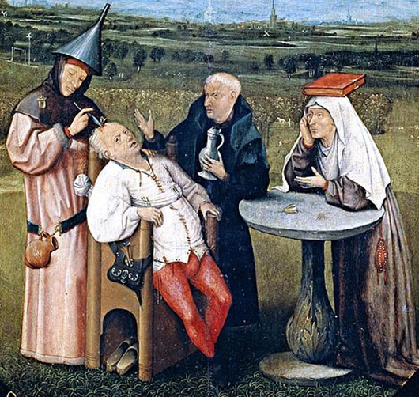
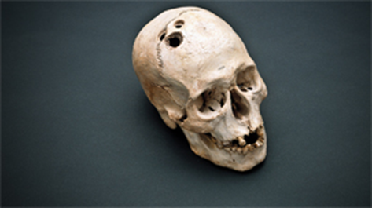
History of Treatment
Maltreatment of people with disorders throughout the ages was based on irrational views. Many patients were subjected to strange, debilitating and downright dangerous treatments.

Slide 3
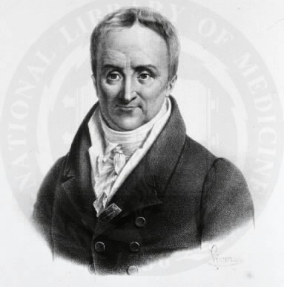
History of Insane Treatment
Pinel in France and Dix in America founded humane movements to care for the mentally sick.
http://wwwihm.nlm.nih.gov
Culver Pictures
Philippe Pinel (1745-1826)
Dorthea Dix (1745-1826)
Notes:
Discovered many mentally ill people were in prison with hardened criminals. A recent movement (1950s) has shut down many mental hospitals and left the mentally ill on their own or in the care of communities.

Slide 4
Through the 20th century
Early 1900s Freud and talking therapy
1930-1950s Institutionalization
1950s Advent of neuroleptics and deinstitutionalization
1960s Humanistic approach
1970-1980s, increase in homelessness, crime, and incarceration
1990s to present Cognitive, Behavioral, biomedical, alternative therapies

Slide 5
Types of Therapies
1. Psychotherapy involves an emotionally charged, confiding interaction between a trained therapist and a mental patient. Sometimes referred to as “insight therapy”
Notes:
OBJECTIVE 52-1| Discuss some ways that psychotherapy and an eclectic approach to therapy differ.

Slide 6
Psychological Therapies
We will look at four major forms of psychotherapy based on different theories on human nature:
Psychoanalytical theory
Humanistic theory
Behavioral theory
Cognitive theory
Notes:
OBJECTIVE 52-2| Define psychoanalysis, and discuss the aims of this form of therapy.

Slide 7
2. Biomedical therapy uses drugs or other procedures that act on the patient’s nervous system curing him of psychological disorders.
3. An Eclectic approach uses various forms of healing techniques depending on the client’s unique problems. Used by about half of therapists today

Slide 8
Psychoanalysis
The first formal psychotherapy to emerge was psychoanalysis developed by Sigmund Freud.
Edmund Engleman
Sigmund Freud's famous couch
Notes:
Therapist has to be out of view so patient may let down guard. If there is hesitation, then the patient is resisting treatment.

Slide 9
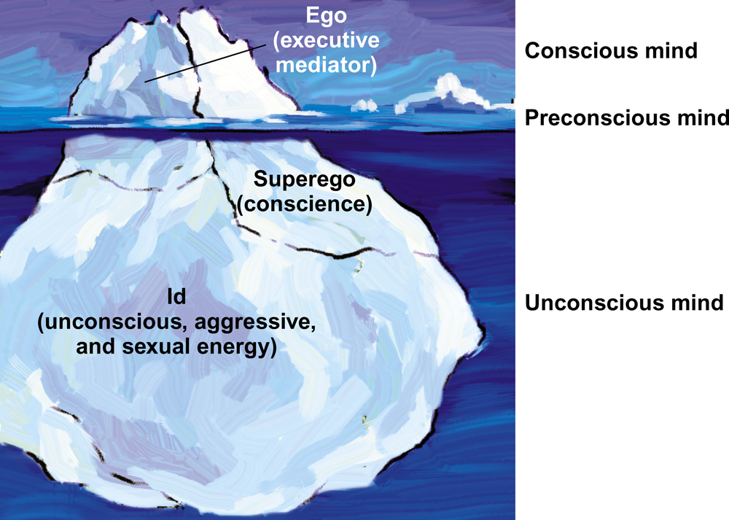
Psychoanalysis: Aims
The aim of psychoanalysis is to bring repressed feelings into conscious awareness where the patient can deal with them. “Know-thyself”.
When energy devoted
to id-ego-superego
conflict is released,
the patient’s
anxiety lessens.
Notes:
Freud assumed many problems fueled by childhood conflicts:
Oral Stage – Early weaning = overeating or smoking
Anal Stage – Early training = Anal Retentive
Phallic Stage (until school starts) – Oedipus Complex
Latency Stage (elementary age) – gender roles
Genital Stage – Repressed sexuality leads to problems.

Slide 10
Psychoanalysis: Methods
Dissatisfied with hypnosis, Freud developed the method of free association to unravel the unconscious mind and its conflicts.
The patient lies on a couch and speaks whatever comes to his mind.
http://www.english.upenn.edu
Notes:
OBJECTIVE 52-3| Describe some of the methods used in psychoanalysis, and list some criticisms of this form of therapy.

Slide 11
Psychoanalysis: Methods
During free association, the patient edits his thoughts to resist his feelings and to express his emotions. Such resistance becomes important in the analysis of conflict-driven anxiety.
Eventually the patient opens up and reveals his innermost private thoughts to the therapist, developing positive or negative feelings (transference) towards him.
Notes:
Analyst notes times and topics of resistance – then offers insight to what that could mean. Ex: If you don’t want to talk about mother = avoidance
These “transferred” feelings are of our own feelings towards family or other important people.

Slide 12
Dream Interpretation
Freud spent a great deal of time analyzing dreams
Manifest (what happened) content and
latent (what is means) content

Slide 13
Psychoanalysis: Criticisms
Psychoanalysis is hard to refute because it cannot be proven or disproven.
Confirmation Bias
False Memories – Elizabeth Loftus
Psychoanalysis takes a long time and is very expensive.

Slide 14
Three psychodynamic approaches: (focus more on society and our relationships with others)
Adler- relationships in the family (birth order and feelings of inferiority)
Jung-what we show the world (persona vs. shadow)
Horney-pressure according to gender norms

Slide 15
Psychodynamic Therapies
Interpersonal psychotherapy, a variation of psychodynamic therapy is effective in treating depression. It focuses on symptom relief here and now, not overall personality change.
Notes:
Looks for patterns in behavior to address current problems, not focus on childhood conflicts.
https://www.youtube.com/watch?v=QV6DpJKW6a0 - 3 minute video from Big Bang theory on psychodynamic approach

Slide 16
Psychodynamic Therapies
Influenced by Freud, in a face-to-face setting, psychodynamic therapists understand symptoms and themes across important relationships in a patient’s life.
Notes:
OBJECTIVE 52-4| Contrast psychodynamic therapy and interpersonal therapy with traditional psychoanalysis.
Sit face to face, meet only once a week for a couple weeks/months instead of years.

Slide 17
More therapy…
-Humanistic therapy and techniques
-Behavioral therapy and techniques

Slide 18
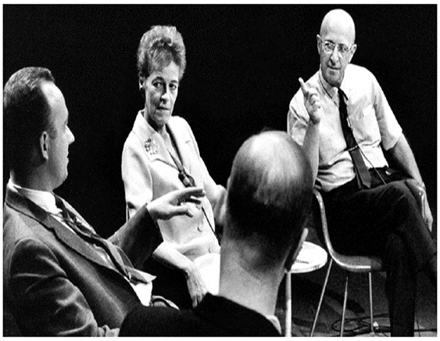
Humanistic Therapies
Humanistic therapists aims to boost self-fulfillment by helping people grow in self-awareness and self-acceptance.
Notes:
OBJECTIVE 52-5| Identify the basic characteristics of the humanistic therapies, and describe the specific goals and techniques of Carl Rogers’ client-centered therapy.
Focus on present and future rather than past
Conscious rather than unconscious
Taking responsibility instead of finding blame
Promotes growth instead of “curing” an individual

Slide 19
Person-Centered Therapy
Developed by Carl Rogers, person-centered therapy is a form of humanistic therapy.
Unconditional Positive Regard: The therapist listens to the needs of the “client” in an accepting and non-judgmental way, addressing his problems in a productive way and building his or her self-esteem.
Felt the “clients” must come to understand their “ideal self” and improve their “real self”.
Notes:
Belief that all people possess ability to grow – therapists need to listen. The therapist is merely there for support. We have two ears and one mouth so that we may listen more than we talk.

Slide 20
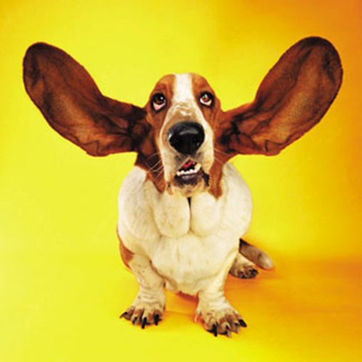
Humanistic Therapy
The therapist engages in active listening and echoes, restates, and clarifies patient’s thinking, acknowledging expressed feelings.
Active listening entails:
Paraphrasing: uses the words of the client to summarize the conversation
Clarifying: encouraging the
client to say more by asking
leading questions
Reflecting feelings: mirrors
the feelings of the client
Notes:
Similar to Maslow’s Hierarchy of needs – behavior is defined by a variety of needs.
Would too much unconditional positive regard be a bad thing? How could it lead to unwarranted self-esteem? Why would people in therapy benefit most from unconditional positive regard?

Slide 21
Behavior Therapy
Therapy that applies classical and operant conditioning (learning) principles to the elimination of unwanted behaviors.
Example: To treat anxiety disorders therapists do not delve deeply below the surface looking for inner causes.
Notes:
OBJECTIVE 52-6| Explain how the basic assumption of behavior therapy differs from those of traditional psychoanalytic and humanistic therapies.

Slide 22
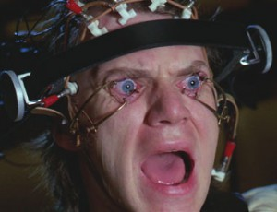
Classical Conditioning Techniques
Counterconditioning: a procedure that conditions new responses to stimuli that trigger unwanted behaviors.
It is based on classical conditioning and includes exposure therapy and aversive conditioning.
Notes:
OBJECTIVE 52-7| Define counterconditioning, and describe the techniques used in exposure therapies and aversive conditioning.

Slide 23
Exposure Therapy
Exposes patients to things they fear and avoid. Through repeated exposures anxiety lessens because they habituate to the things feared.
The Far Side © 1986 FARWORKS. Reprinted with Permission. All Rights Reserved.
Notes:
https://www.youtube.com/watch?v=GVNgmJ4tIpo – 4 minute video on overcoming fears
https://www.youtube.com/watch?v=doxxfXqpKYA - 4 minute video on overcoming fears

Slide 24
Systematic Desensitization
A type of exposure therapy that associates a pleasant, relaxed state with gradually increasing anxiety-triggering stimuli commonly used to treat phobias.

Slide 25
Aversive Conditioning--Garcia
Type of counterconditioning that associates an unpleasant state (such as nausea) with an unwanted behavior (such as alcohol)
The person is replacing a positive but harmful response with a negative response
Example with alcoholism: Add a med to a drink that makes the person becomes sick
A Clockwork Orange
Notes:
Can be harmful – some believe that electroshock can “cure” homosexuality. Relapse is high.
https://www.youtube.com/watch?v=A-irAT0viF0- video on Sissy Boy Experiment (9 minutes)

Slide 26
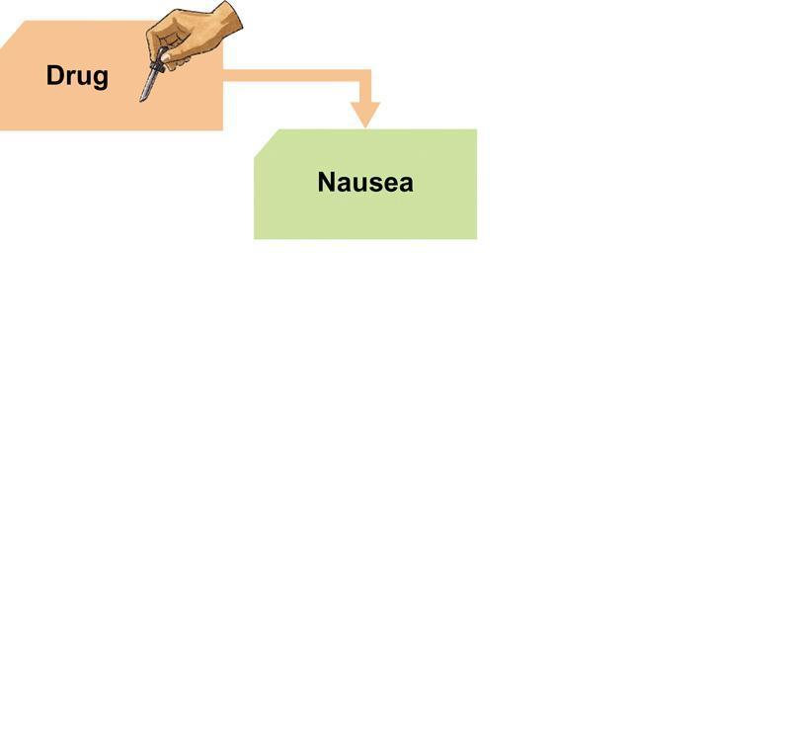
Aversive Conditioning

Slide 27
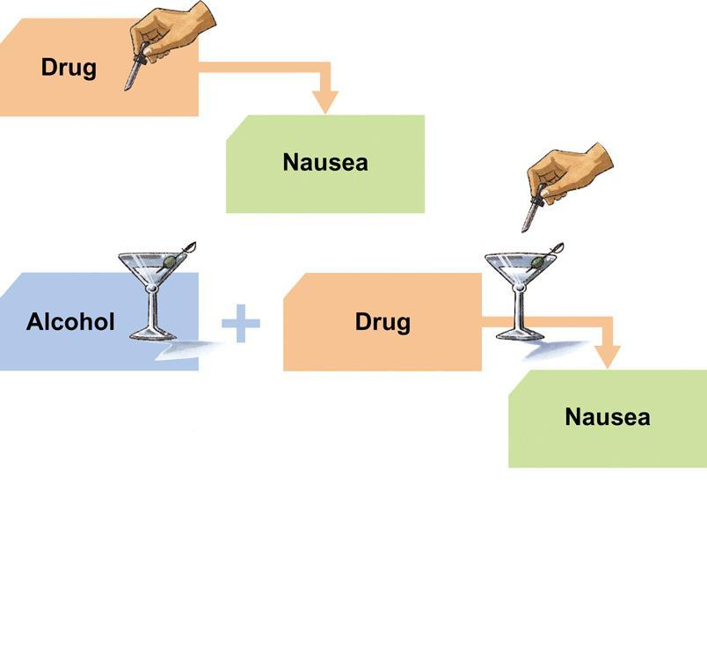
Aversive Conditioning

Slide 28
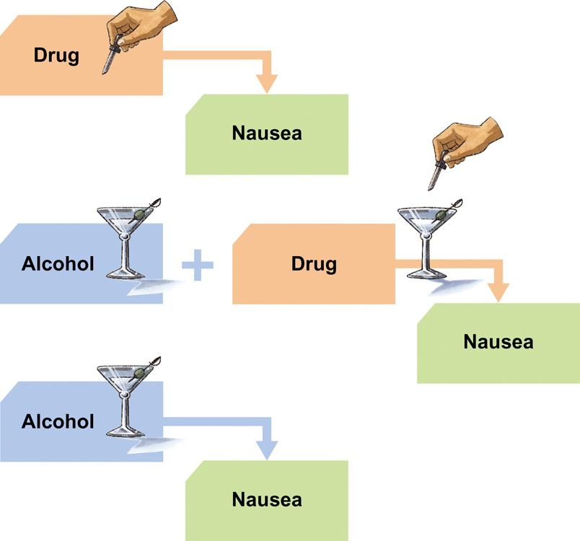
Aversive Conditioning

Slide 29
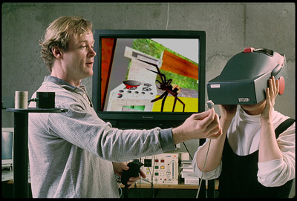
Virtual reality
Behaviorists have turned to VR therapy as a way to place the patient in the situation (in the virtual sense) so that they may experience the anxiety or fear in a controlled environment
This allows the patient
to approach the
situation with more
relaxed feelings
Notes:
Used with PTSD patients

Slide 30
Some evasive types of counterconditioning
Implosive therapy
Patient is guided to visualize the situation or the object that causes the stress response, try to gain control of their reaction
Flooding
A patient is forced to confront their fears through full-intensity exposure to the stimuli
Forced to cope
Kind of like “sink or swim”
Pretty unethical
Notes:
Careful not to re-traumatize the patient.

Slide 31
Operant Conditioning
Operant conditioning procedures enable therapists to use behavior modification in which desired behavior is rewarded and undesired behaviors are not or are punished.
A number of withdrawn, uncommunicative
3 year-old autistic children have been successfully trained by giving and withdrawing reinforcements for desired and undesired behaviors.
Notes:
OBJECTIVE 52-8| State the main premise of therapy based on operant conditioning principles, and describe the views of proponents and critics of behavior modification.

Slide 32
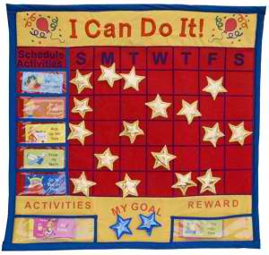
Token Economy
In institutional settings therapists may create a token economy, where a patient exchanges a token of some sort, earned for exhibiting the desired behavior, for various privileges or treats.
Kind of like the behavior modification charts in Sociology or elementary schools.
Notes:
https://www.youtube.com/watch?v=A-irAT0viF0- video on Sissy Boy Experiment (9 minutes)

Slide 33
Therapy continued…
Cognitive therapy and techniques
Group and family therapy
Prevalence of approaches
Alternative therapies

Slide 34
Cognitive Therapy
Teaches people adaptive ways of thinking and acting based on the assumption that thoughts intervene between events and our emotional reactions.

Slide 35
Some Cognitivists…Remember these guys?
Martin Seligman
Referred to explanatory styles to explain why people think the way they think
Optimistic vs. Pessimistic
Learned helplessness
Julian Rotter
Locus of control
Internal vs. External

Slide 36
Case Study
Tina, who worked in publishing, met her boss in the elevator and said 'good morning', but her boss didn't reply.
In no time Tina was thinking thoughts like:
my boss doesn't like me
no-one likes me
I'm going to lose my job
life is hell.
Notes:
These thoughts were responsible for Tina plunging into a low mood.
Tina didn't for one minute consider that her boss may not have heard her or that her boss might have been pre-occupied with her own thoughts.
Tina realized she was always getting upset about such situations, and she started therapy to try to sort things out.
In a few weeks, she came to understand how negative thoughts were causing her to be unhappy. Tina also learned how to spot when she was jumping to conclusions in this way.
Then, with help, she was able to challenge these negative thoughts by looking for evidence to see if they were really true.
They were rarely true, so Tina was only upsetting herself by thinking in such a way. This is what many of us do.
Cognitive therapy teaches us to stop thinking so negatively, to challenge untrue thoughts and to replace them with more rational and healthy ones that are based in reality.

Slide 37
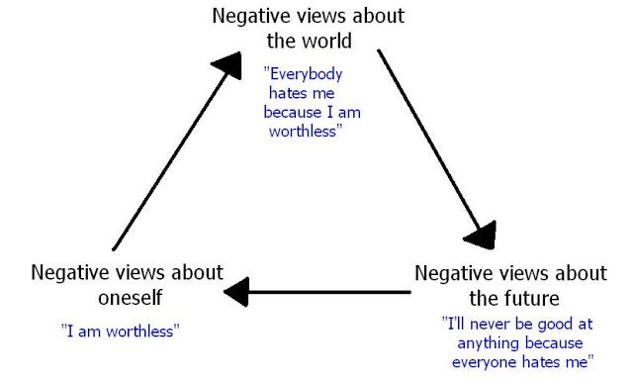
Cognitive Therapy for Depression
Aaron Beck (Cognitive Triad) suggests that depressed patients have:
Beck believes that cognitions such as “can never be happy,” need to change in order for depressed patients to recover. This change is brought into patients by gentle questioning.
Notes:
OBJECTIVE 52-9| Contrast cognitive therapy and cognitive-behavior therapy, and give some examples of cognitive therapy for depression.

Slide 38
Cognitive Therapy for Depression
Albert Ellis and Rational Emotive Therapy (RET)
People are not disturbed by things but rather by their view of things.
Therapists boldly challenges the irrational thoughts and fears of the patient
Forces the patient to confront their own way of thinking
Highly charged
Goal is to help the patient more accurately see themselves within the world – Use ABC Model

Slide 39
The ABC Model
A – Activating Event: Something happens in the environment around you.
Identifying the underlying irrational thought patterns and beliefs.
B – Beliefs: You hold a belief about the event or situation.
Challenging the irrational beliefs
C – Consequence: You have an emotional response to your belief.
Gaining insight and recognizing irrational thought patterns

Slide 40
Cognitive Therapy Stress Inoculation Training
Meichenbaum (1977, 1985) trained people to restructure their thinking in stressful situations.
“Relax, the exam may be hard, but it will be hard for everyone else too. I studied harder than most people. Besides, I don’t need a perfect score to get a good grade.”
Notes:
Relaxation techniques are taught to individuals and then they learn to apply them to everyday situations

Slide 41
Cognitive-Behavior Therapy
Cognitive therapists often combine the reversal of self-defeating thinking with efforts to modify behavior.
Richard Lazarus’ concept of appraisal and how we view stress affecting our emotional experience was a pioneer in the use of c-b therapy
Cognitive-behavior therapy aims to alter the way people act (behavior therapy) and alter the way they think (cognitive therapy).
Notes:
Primary Appraisal – “is this harmful to me?”
Secondary Appraisal – “what resources do I have to cope?”
Reappraisal – “do I still think this is harmful?”

Slide 42
Group Therapy
Group therapy normally consists of 6-9 people and a 90-minute session which can help more people and cost less. Clients benefit from knowing others have similar problems.
© Mary Kate Denny/ PhotoEdit, Inc.
Notes:
OBJECTIVE 52-10| Discuss the rationale and benefits of group therapy, including family therapy.
Instillation of hope, universality, imparting information, altruism, catharsis, creation of family bond, interpersonal learning, role models, safe haven.

Slide 43
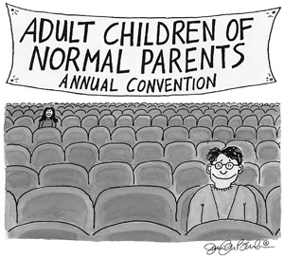
Family Therapy
Family therapy treats the family as a system. Therapy guides family members toward positive relationships and improved communication.

Slide 44
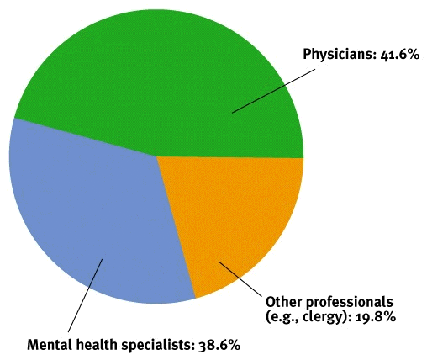
Evaluating Therapies
To whom do people turn for help with psychological difficulties? Community mental health specialists provide the largest outpatient psychotherapy.

Slide 45
Evaluating Psychotherapies
Within psychotherapies cognitive therapies are most widely used, followed by psychoanalytic and family/group therapies.

Slide 46
Is Psychotherapy Effective?
It is difficult to gauge the effectiveness of psychotherapy because there are different levels on which its effectiveness can be measured.
Does the patients sense improvement?
Does the therapist feel the patient has improved?
How do friends and family feel about patient’s improvement?

Slide 47
Client’s Perceptions
If you ask clients about their experiences of getting into therapy, they always overestimate its effectiveness. Critics however remain skeptical.
Clients enter therapy in crisis and crisis may subside over the natural course of time (regression to normalcy/mean).
Clients may need to believe the therapy was worth the effort.
Clients generally speak kindly of their therapists.
Notes:
OBJECTIVE 53-2| Explain why clients tend to overestimate the effectiveness of psychotherapy.

Slide 48
Clinician’s Perceptions
Like clients, clinicians believe in the therapy’s success. They believe that the client is better off after receiving therapy than not.
Clinicians are aware of failures, but those of other therapists.
If a client seeks another clinician, the former therapist is more likely to argue that the client has developed another psychological problem.
Clinicians are likely to testify to the efficacy of their therapy regardless of the outcome of treatment.
Notes:
OBJECTIVE 53-3| Give some reasons why clinicians tend to overestimate the effectiveness of psychotherapy, and describe the phenomena that contribute to clients’ and clinicians’ misperceptions of this area.

Slide 49
The Relative Effectiveness of Different Therapies
Which psychotherapy will be most effective for treating a particular problem?
Disorder | Therapy
Depression | Behavior, Cognition, interpersonal
Anxiety | Cognition, Exposure, Stress Inoculation
Bulimia | Cognitive-behavior
Phobia | Behavior
Bed Wetting | Behavior Modification
Notes:
OBJECTIVE 53-5| Summarize the findings on which psychotherapies are most effective for specific disorders.

Slide 50
Evaluating Alternative Therapies
Lilienfeld (1998) suggests comparing scientific versus popular therapies through electronic means. The results of such a search are below:
Notes:
OBJECTIVE 53-6| Evaluate the effectiveness of eye movements desensitization and reprocessing (EMDR) and light exposure therapies.

Slide 51
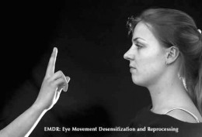
Eye Movement Desensitization and Reprocessing (EMDR)
In EMDR therapy the therapist attempts to unlock and reprocess previously frozen traumatic memories by waving a finger in front of the eyes of a client.
EMDR has not held up under scientific testing.
Notes:
8 Step process that entails relaxation techniques and rewiring memories.

Slide 52
Light Exposure Therapy
Seasonal Affective Disorder (SAD), a form of depression has been effectively treated by light exposure therapy. This form of therapy has been scientifically validated.
may be linked to the fact that light therapy makes up for lost sunlight exposure and resets the body's internal clock
Courtesy of Christine Brune
Notes:
Concern about negative effects – retinal damage, insomnia or hyperactivity

Slide 53
Commonalities Among Psychotherapies
Three commonalities shared by all forms of psychotherapies are:
Hope for demoralized people.
A new perspective.
An empathic, trusting and a caring relationship.
© Mary Kate Denny/ PhotoEdit, Inc.
Notes:
OBJECTIVE 53-7| Describe the three benefits attributed to all psychotherapies.

Slide 54
Therapists & Their Training
Clinical psychologists: Mostly PhDs. Expert in research, assessment, and therapy, supplemented by a supervised internship.
Clinical or Psychiatric Social Worker: Master of Social Work plus postgraduate supervision prepares some social workers to offer psychotherapy, mostly to people with everyday personal and family problems.

Slide 55
Therapists & Their Training
Counselors: Pastoral counselors, abuse counselors work with a problems arising from family relations and substance abuse and with spouse and child abusers and their victims.
Psychiatrists: Physicians who specialize in the treatment of psychological disorders. Not all psychiatrists have had extensive training in psychotherapy, but as MDs they can prescribe medications.

Slide 56
Psychological Therapies and Treatments are Biopsychosocial in Nature

Slide 57
The Biomedical/Somatic Therapies
Psychopharmacology
Physical treatment techniques
Psychosurgery

Slide 58
The Biomedical Therapies
Include physical, medicinal and other forms of biological therapies. Sometimes referred to as “somatic approach”
Drug Treatments (psychopharmacology)
ECT, TMS, insulin
Psychosurgery

Slide 59
Drug Therapies
Psychopharmacology is the study of drug effects on mind and behavior.
With the advent of drugs, hospitalization in mental institutions has rapidly declined.
Notes:
OBJECTIVE 54-1| Define psychopharmacology, and explain how double-blind studies help researchers evaluate a drug’s effectiveness.

Slide 60
Drug Therapies
However, many patients are left homeless on the streets due to their ill-preparedness to cope independently outside in society.

Slide 61
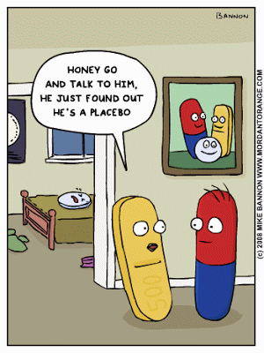
Double-Blind Procedures
To test the effectiveness of a drug patients are tested with the drug and a placebo, in which two groups of patients and medical health professionals are kept blind to who got the drug and who got the placebo.

Slide 62
Antipsychotic Drugs
Classical antipsychotics [Chlorpromazine (Thorazine)]: Remove a number of positive symptoms associated with schizophrenia, like agitation, delusions and hallucination.
Atypical antipsychotics [Clozapine (Clozaril)]: Remove negative symptoms associated with schizophrenia, like apathy, jumbled thoughts, concentration difficulties, difficulty in interacting with others.
A side effect of neuroleptics is “tardive dyskinesia”
-involuntary twitching of muscles of the face, etc.
Notes:
OBJECTIVE 54-2| Describe the characteristics of antipsychotic drugs, and discuss their use in treating specific disorders.
Tardive Dyskinesia – involuntary movement of mouth (jaw, lips, tongue). Sometimes affects limbs. Gets worse when you try to relax. Disappears when asleep.

Slide 63
Atypical Antipsychotic
Clozapine (Clozaril) blocks receptors for dopamine and serotonin to remove the negative symptoms of schizophrenia.

Slide 64
Antianxiety Drugs
Antianxiety drugs (Xanax and Ativan) depress central nervous system and reduce anxiety and tension by elevating the levels of the Gamma-aminobutyric acid (GABA) neurotransmitter.
Notes:
OBJECTIVE 54-3| Describe the characteristics of antianxiety drugs, and discuss their use in treating specific disorders.

Slide 65
Antidepressant Drugs
Antidepressant drugs like Prozac, Zoloft, and Paxil are Selective Serotonin Reuptake Inhibitors (SSRIs) and improve mood by elevating the levels of serotonin by inhibiting reuptake.
Notes:
OBJECTIVE 54-4| Describe the characteristics of antidepressant drugs, and discuss their use in treating specific disorders.
serotonin helps to relay messages from one area of the brain to another. Because of the widespread distribution of its cells, it is believed to influence a variety of psychological and other body functions. Of the approximately 40 million brain cells, most are influenced either directly or indirectly by serotonin. This includes brain cells related to mood, sexual desire and function, appetite, sleep, memory and learning, temperature regulation, and some social behavior.

Slide 66
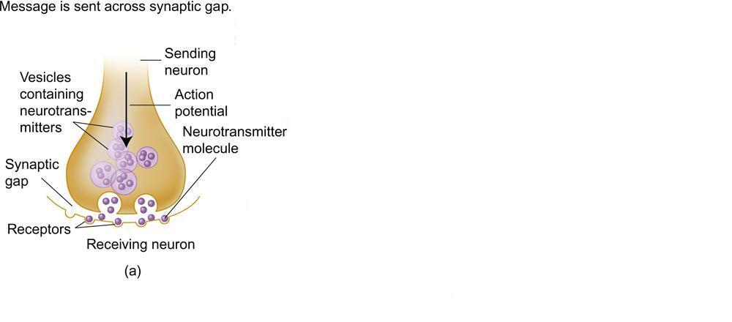
Prozac and the Brain

Slide 67
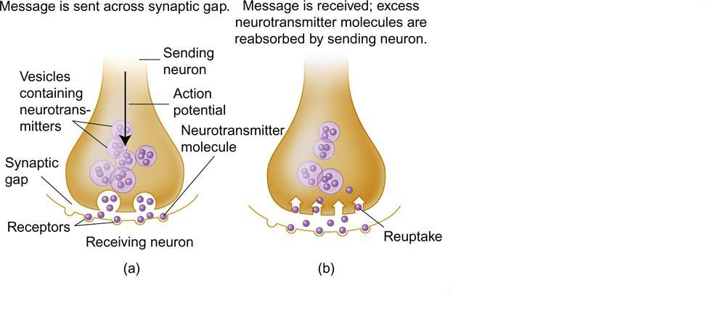
Prozac and the Brain

Slide 68
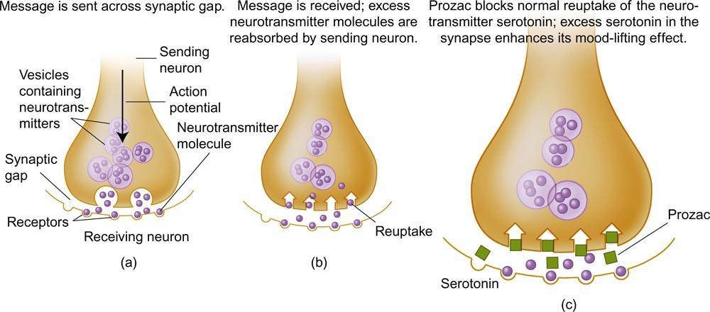
Prozac and the Brain

Slide 69
Mood-Stabilizing Medications
Lithium Carbonate a common salt has been used to stabilize manic episodes in bipolar disorders. It moderates the levels of norepinephrine and glutamate neurotransmitters.
Notes:
OBJECTIVE 54-5| Describe the use and effects of mood-stabilizing medications.

Slide 70
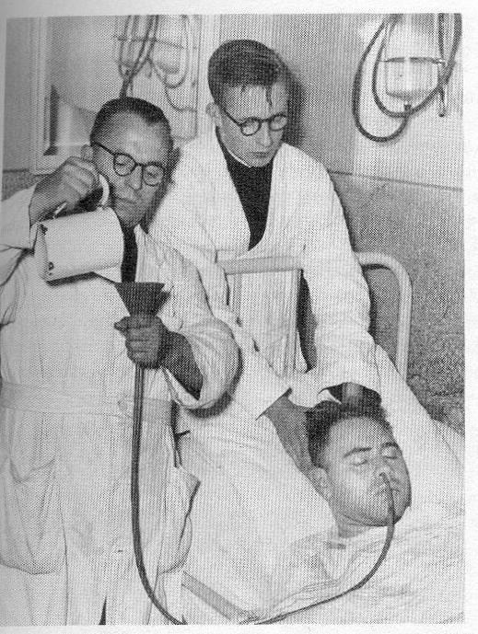
Insulin shock therapy
Patient given a near lethal overdose of insulin
Would cause a coma
Glucose used to bring patient out
Used over several weeks
1930’s and 1940’s treatment
of schizophrenia, replaced by
neuroleptics (thorazine) in the
later 1950’s and 1960’s

Slide 71
Brain Stimulation
Electroconvulsive Therapy (ECT)
ECT is delivered to severely depressed patients who do not respond to drugs. The patient is anesthetized and is given a muscle relaxant. Patients usually get a 100 volt shock that relieves them of depression.
-Causes a change in blood flow patterns to help symptoms
-Also causes memory loss
Notes:
OBJECTIVE 54-6| Describe the use of electroconvulsive therapy (ECT) in treating severe depression, and describe some possible alternatives to ECT

Slide 72
Alternatives to ECT
Transcranial Magnetic Stimulation (TMS)
In TMS, a pulsating magnetic coil is placed over prefrontal regions of the brain to treat depression, with minimal side effects.

Slide 73
Psychosurgery
Psychosurgery was popular even in Neolithic times. Although used sparingly today, about
200 such operations do take place in the US alone.
http://www.epub.org.br
Notes:
OBJECTIVE 54-7| Summarize the history of the psychosurgical procedure known as lobotomy, and discuss the use of psychosurgery today.
https://www.youtube.com/watch?v=_0aNILW6ILk - 5 minute video on lobotomies

Slide 74
Psychosurgery
Psychosurgery is used as a last resort in alleviating psychological disturbances. Psychosurgery is irreversible. Removal of brain tissue changes the mind.

Slide 75
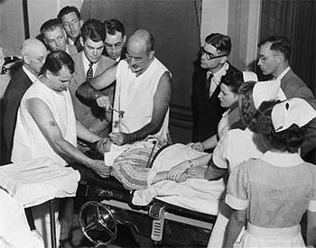
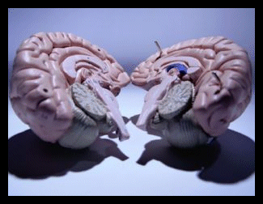
Psychosurgery
Modern methods use stereotactic neurosurgery and radiosurgery (Laksell, 1951) that refine older methods of psychosurgery.
Lobotomies (Moniz, Freeman) and split-brain (Sperry, Gazannaga)

Slide 76
AP info…
Know the history of treatment
Pinel and the medical model
Majority use some form of cognitive (50%)
Know the schools
Psychoanalytic/psychodynamic approach
Unconscious mind, relationships, talking therapy
Freud, Adler, Jung, Horney
Humanistic approach
Unconditional positive regard , active listening
Maslow, ROGERS
Notes:
https://www.youtube.com/watch?v=mbbMLOZjUYI Ted Talks – What’s so funny about mental illness?

Slide 77
More AP info…
Behavioral approach
Counter conditioning, token economy, systematic desensitization (Skinner, Garcia)
Cognitive approach
Perceptions and thinking (Bandura, Seligman, Rotter), rational-emotive (Ellis), triad (Beck)
Biomedical approach
Thorazine/clozaril-schizophrenia, SSRI-depression, GABA-anxiety, Lithium-mania
Psychosurgery, split-brain, lobotomy, ECT, rTMS, insulin
Rosenhan hospital study (labeling, unethical)

