Slide 1
Classical Conditioning
Classical conditioning formula and theorists
  Acquisition
  Extinction
  Spontaneous Recovery
Stimulus discrimination, generalization, habituation
Applications of classical conditioning
Notes:
Classical Conditioning = association of things naturally occurring.
Operant Conditioning = associated with outcomes that have desired reinforcers or avoidable punishers
Observational Learning = learning by watching others

Slide 2
How Do We Learn?
Learning (Conditioning) is a relatively permanent change in an organism’s behavior due to experience.
We learn by association. Classical conditioning is based on making these associations. Our minds naturally connect events that occur in sequence.
Aristotle, 2000 years ago, suggested this law of association. Then 200 years ago Locke and Hume reiterated this law.
Notes:
OBJECTIVE 21-1| Define learning, and identify two forms of learning.
Classical Conditioning = association of things naturally occurring.
Operant Conditioning = associated with outcomes that have desired reinforcers or avoidable punishers
Observational Learning = learning by watching others

Slide 3
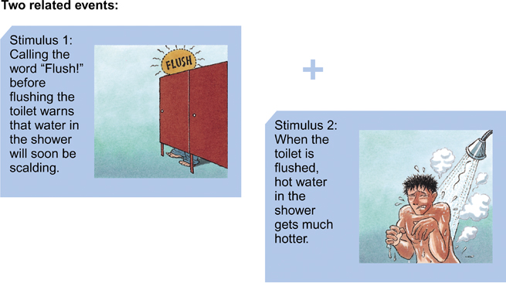
Stimulus-Response Relationship

Slide 4
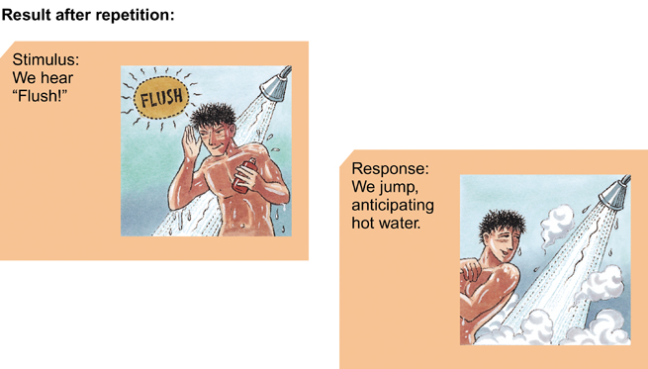
Stimulus-Response Relationship
Notes:
Response = behavior (example – jumping away from hot water)

Slide 5
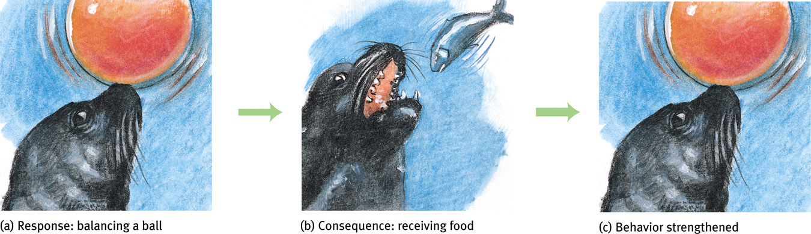
Response-Consequence Learning
Learning to associate a response
with a consequence.
Notes:
Response = behavior (example – balancing ball on nose in order to receive a consequence)

Slide 6
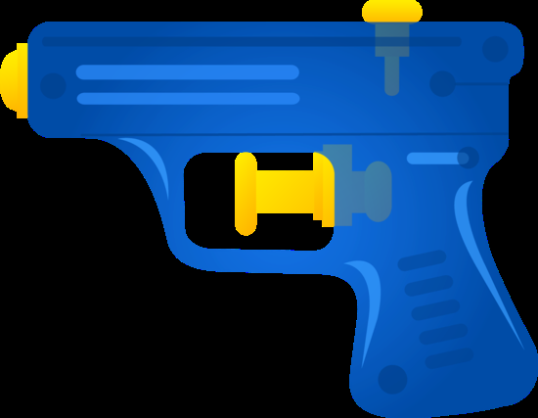
Water Gun Activity
Pay attention to volunteers and describe behaviors.
Identify any other conditioning items you noticed.
Notes:
Identify:
UCS
UCR
NS/CS
CR

Slide 7
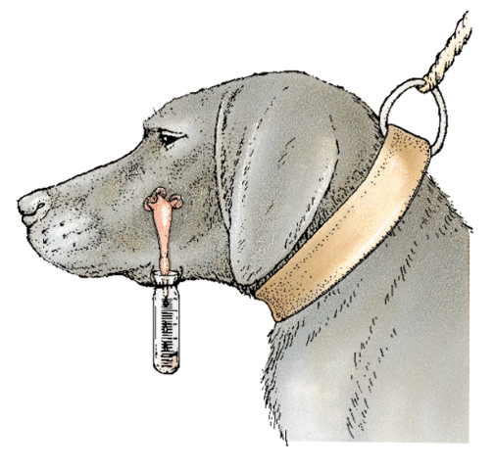
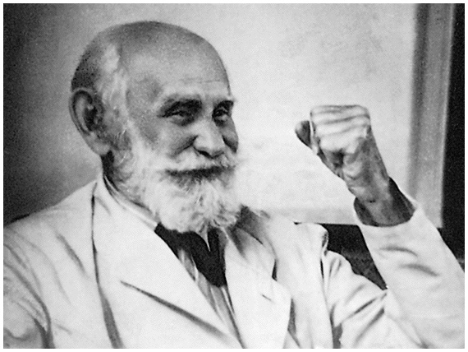
Classical Conditioning
Ideas of classical conditioning originate from old philosophical theories, however it was a Russian physiologist Ivan Pavlov who first described classical conditioning. His work became seminal for later behaviorists like John Watson and B. F. Skinner.
Sovfoto
Ivan Pavlov (1849-1936)
Notes:
Simple form of learning
Learning achieved through experience
Anything born knowing how to do is not learning
Stimulus – something that produces a reaction or response
Associations of new information with existing information – Plato
Two stimuli associated with each other → Classical Conditioning

Slide 8
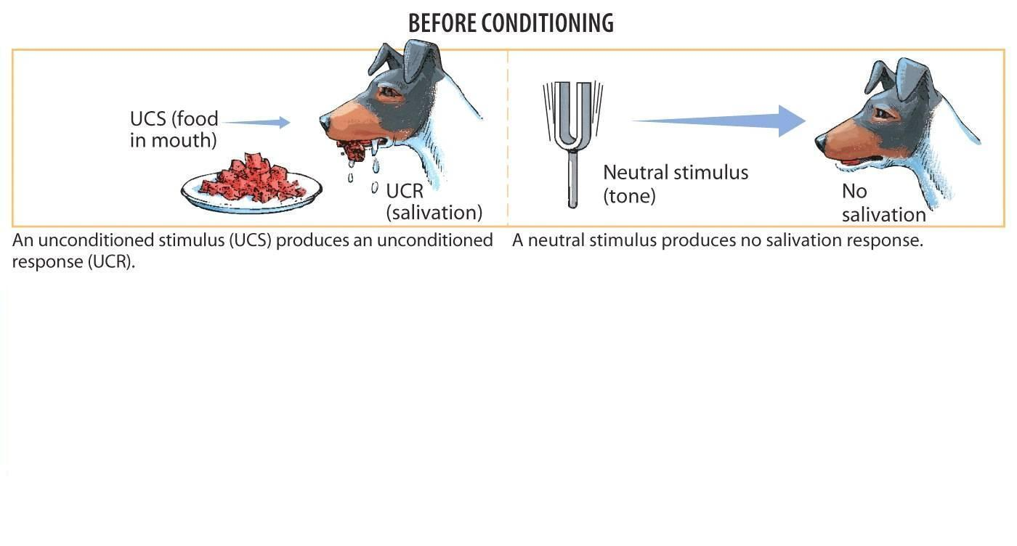
Pavlov’s Experiment

Slide 9
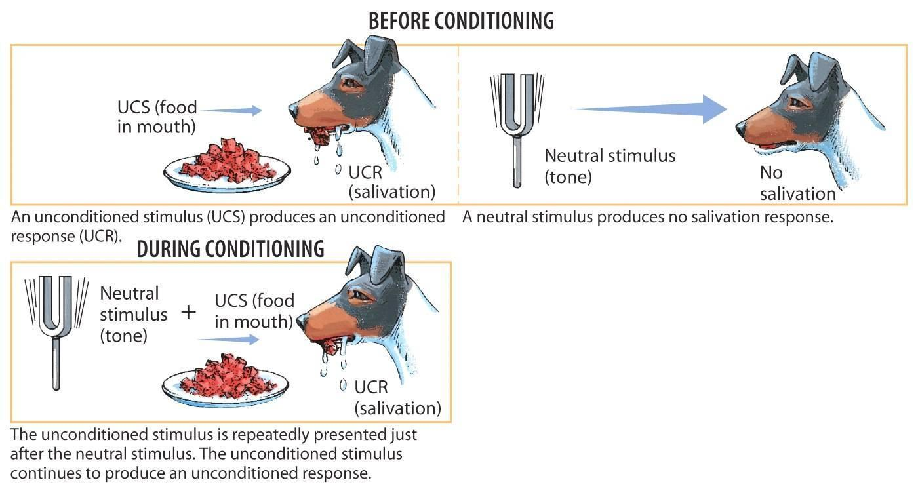
Pavlov’s Experiment

Slide 10
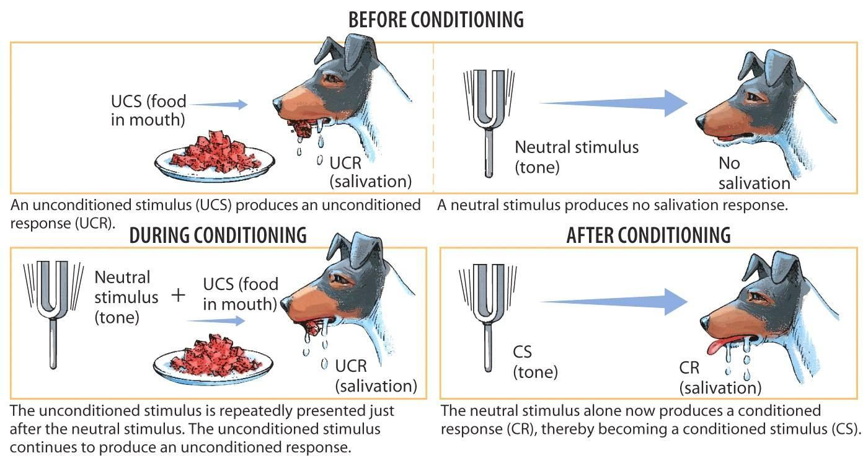
Pavlov’s Experiment
Notes:
Unconditioned Stimulus (UCS): A stimulus that automatically and naturally triggers a response. Unconditioned Response (UCR): A unlearned, naturally occurring response to the unconditioned stimulus, like salivation in the dog when food is in the mouth. Conditioned Stimulus (CS): Originally a neutral stimulus that, after association with an unconditioned stimulus, comes to trigger a conditioned response. Conditioned Response (CR): A learned response to a previously neutral conditioned stimulus.

Slide 11
THE FORMULA
  UCS→UCR
  NS + UCS→ UCR
  CS → CR

Slide 12
A BMW commercial has lots of pretty people in it. People who watch the commercial find the people pleasing to look at. With repeated viewing, they begin to associate the car with the pleasant feeling.
UCS? Pretty people
UCR? Feeling good
CS? Sight of BMW
CR? Feeling good

Slide 13
You get in a car accident and hurt your neck. Now you find you are afraid to get in a car.
UCS? Pain of the accident
UCR? Fear
CS? Presence of car
CR? Fear

Slide 14

You go to a fancy restaurant and decide to try an appetizer you’ve never tried before – escargot. After dinner, you go to a concert and get violently ill (from a stomach virus that’s been going around). From then on, you can’t even look at snails without feeling sick.
  UCS? Stomach virus
  UCR? Feeling sick
  CS? Sight of snails
  CR? Feeling sick

Slide 15
You are cruising on 270 at 75 mph when you see flashing police lights behind you. You pull over and the policeman gives you a ticket. You get in insane amounts of trouble from your parents. The next time you see flashing police lights, your heart rate speeds up.
  UCS? Getting in trouble from parents
  UCR? Increased heart rate
  CS? Flashing lights
  CR? Increased heart rate

Slide 16
Acquisition
The initial stage in classical conditioning when an association between a neutral stimulus and a UCS takes place.
Neutral stimulus needs to come before the UCS for conditioning to occur.
Ideally the time between the two stimuli should be about half a second. No more than a couple seconds
It must be reliably predicted by the subject in order to make the connection, thus the CS (NS) must reliably predict the presentation of the UCS
Notes:
OBJECTIVE 21-3| Describe the timing requirements for the initial learning of a stimulus-response relationship.

Slide 17
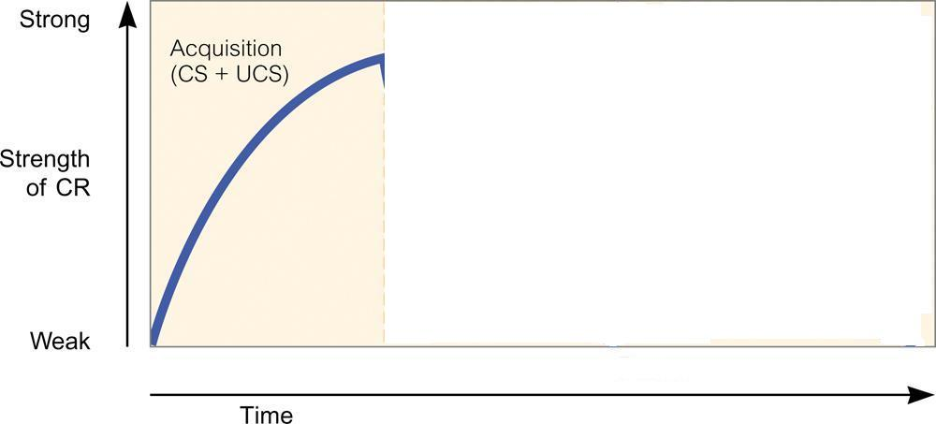
Acquisition
Notes:
The initial stage in classical conditioning when an association between a neutral stimulus and a US takes place.
Neutral stimulus needs to come before the UCS for conditioning to occur.
The time between the two stimuli should be about half a second.
It must be reliably predicted by the subject in order to make the connection, thus the CS (NS) must reliably predict the presentation of the UCS

Slide 18
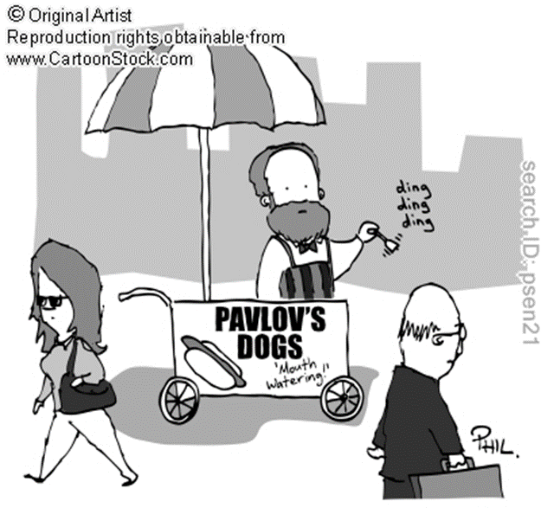
Extinction
When a UCS (food) does not follow a CS (tone) the CR (salivation) starts to decrease and at some point goes extinct.
Notes:
OBJECTIVE 21-4| Summarize the processes of extinction, spontaneous recovery, generalization, and discrimination.

Slide 19
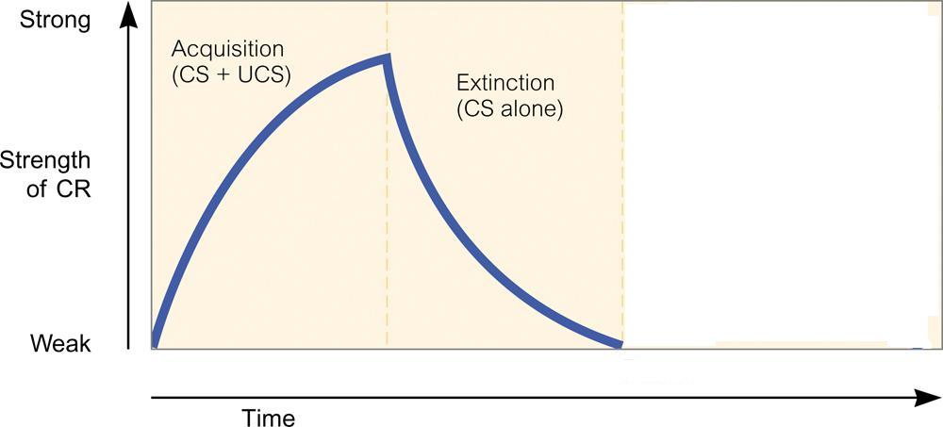
Extinction

Slide 20
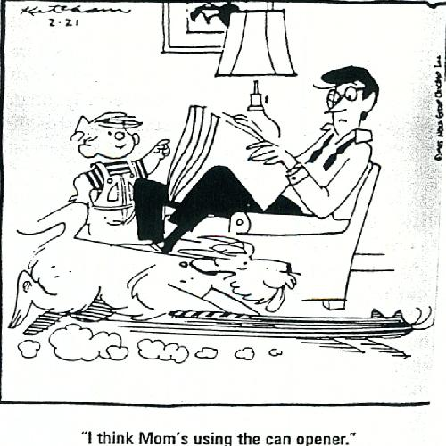
Spontaneous Recovery
After a rest period an extinguished CR (salivation) spontaneously recovers and if CS (tone) persists alone becomes extinct again.

Slide 21
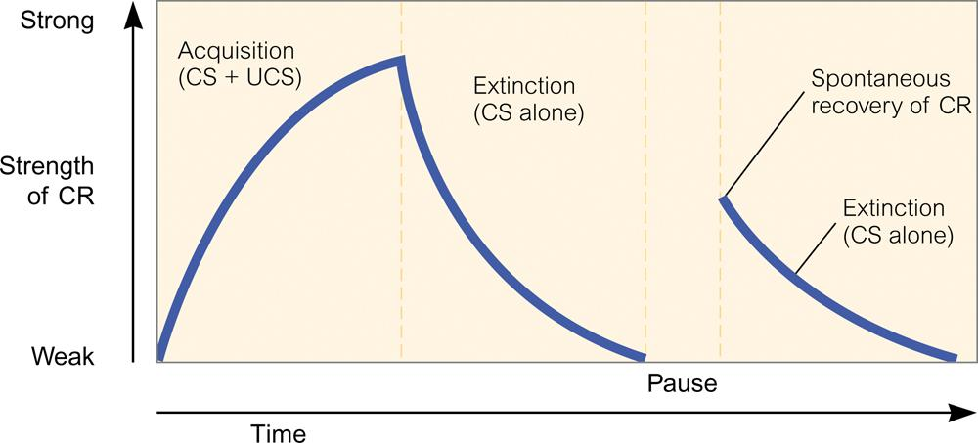
Spontaneous Recovery

Slide 22
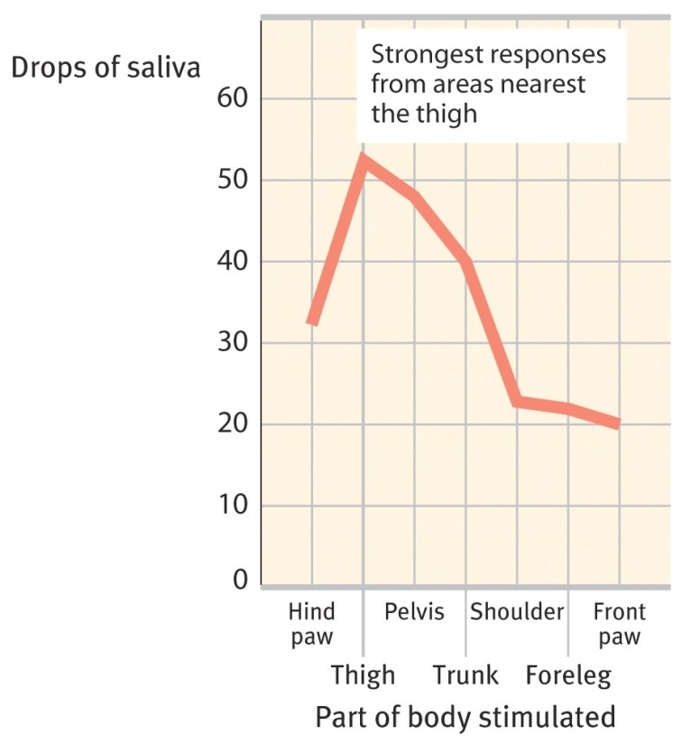
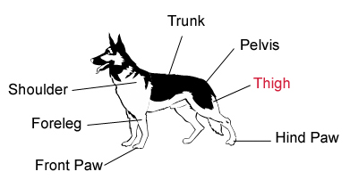
Stimulus Generalization
Tendency to respond to stimuli similar to CS is called generalization.
The more similar the substitute stimulus is to the original used in conditioning, the stronger the generalized response
Notes:
Generalization and discrimination
Generalization – react the same to similar stimuli
Discrimination – respond differently to stimuli that are not similar to each other

Slide 23
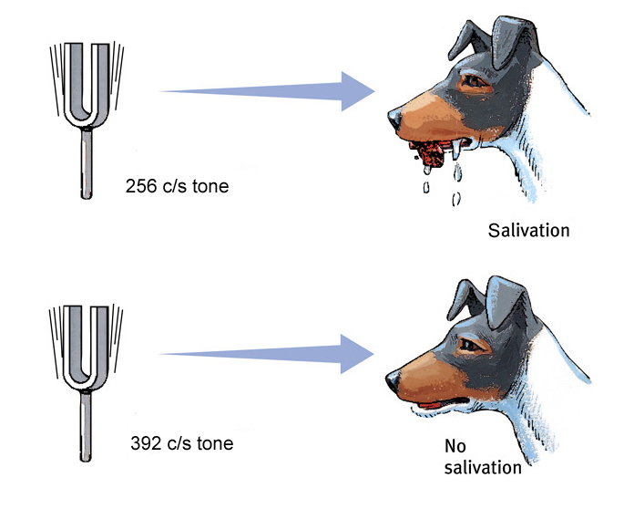
Stimulus Discrimination
Discrimination is the learned ability to distinguish between a CS and other stimuli that do not signal a US.
Notes:
OBJECTIVE 21-5| Discuss the survival value of extinction, spontaneous recovery, generalization and discrimination.
Pavlov conditioned the dog’s salivation (CR) by using miniature vibrators (CS) to the thigh. When he subsequently stimulated other parts of the dog’s body, salivation dropped.

Slide 24
Extending Pavlov’s Understanding
Pavlov and Watson considered consciousness or the mind not fit for scientific study of psychology. However, they underestimated the importance cognitive processes and biological constraints.

Slide 25
Cognitive Processes
Early behaviorists believed that learned behaviors of various animals could be reduced to mindless mechanisms.
However, later behaviorists suggested that animals learn predictability of a stimulus, thus learn expectancy or awareness of a stimulus (Rescorla, 1988).
Notes:
OBJECTIVE 21-6| Discuss the importance of cognitive processes in classical conditioning.

Slide 26
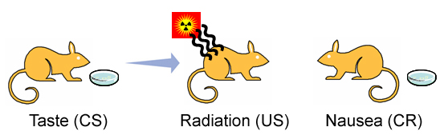
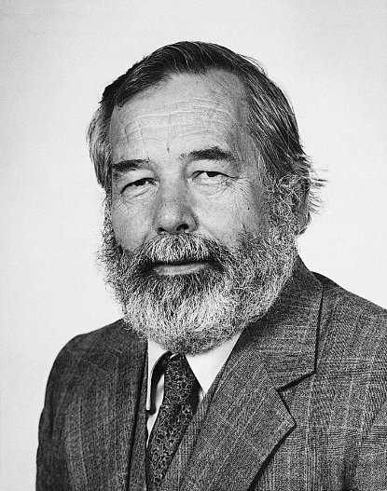
Biological Predispositions
Garcia showed that duration between CS and US can be long (hours) and yet result in conditioning. Biologically adaptive CS (taste) led to conditioning and not others (light or sound).
Courtesy of John Garcia
John Garcia

Slide 27
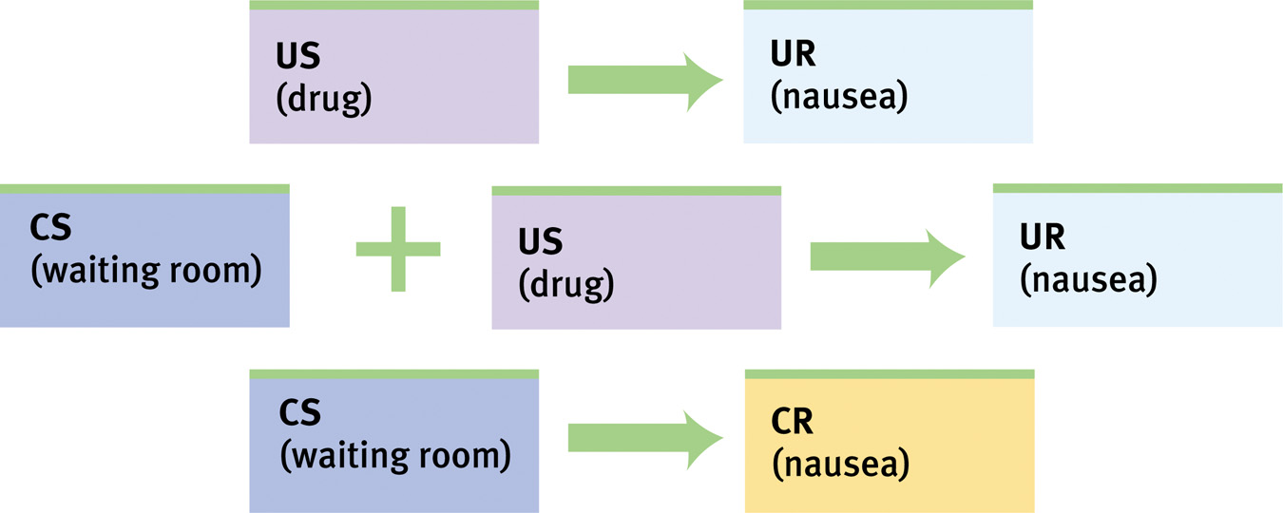
Biological Predispositions
Even humans develop classically conditioned nausea.

Slide 28
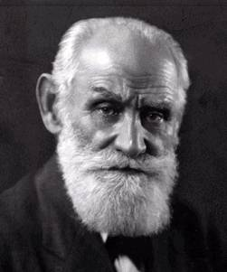
Pavlov’s Legacy
Pavlov’s greatest contribution to psychology is isolating elementary behaviors from more complex ones through objective scientific procedures.
Ivan Pavlov
(1849-1936)
Notes:
OBJECTIVE 21-8| Summarize Pavlov’s contribution to our understanding of learning.

Slide 29
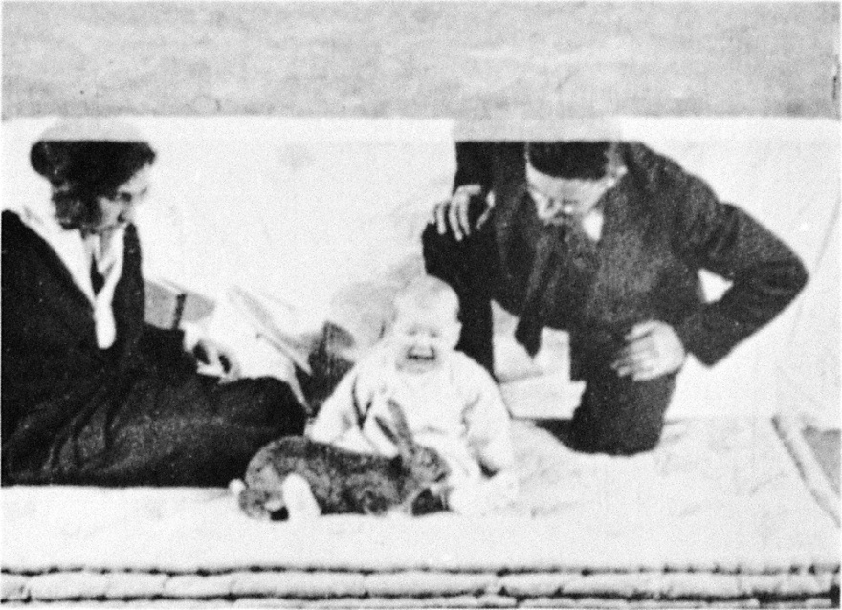
Classically conditioning emotions (Watson and Raynor)
This doesn’t end well

Slide 30
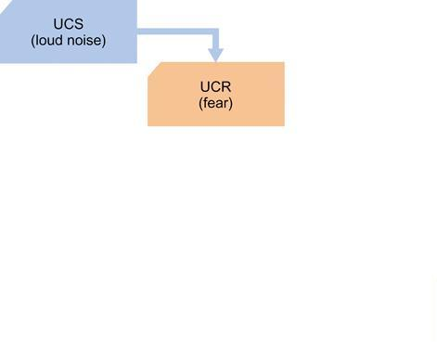
Little Albert – Before Conditioning

Slide 31
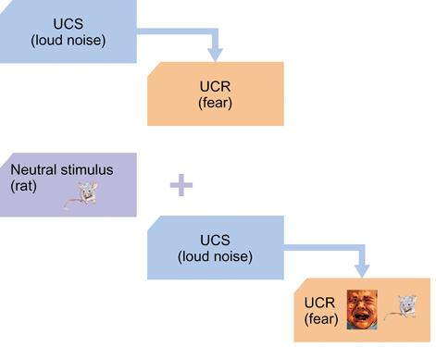
Little Albert – During Conditioning

Slide 32
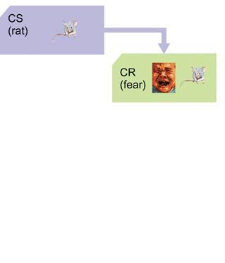
Little Albert – After Conditioning

Slide 33
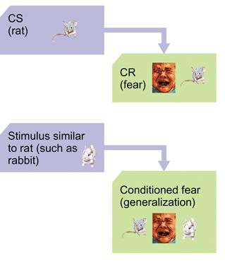
Little Albert - Generalization

Slide 34
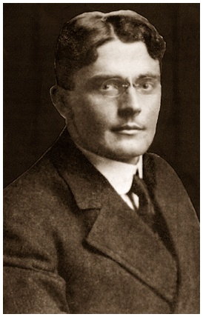
Applications of Classical Conditioning
Watson used classical conditioning procedures to develop advertising campaigns for a number of organizations including Maxwell House, making “coffee break” an American custom. He also explored the conditioning of emotions
Brown Brothers
Leads to “Behaviorism”
John B. Watson
Notes:
OBJECTIVE 21-9| Describe some uses of classical conditioning to improve human health and well-being.
Wheaties cereal associated with athletes.

Slide 35
Applications of Classical Conditioning
Alcoholics can be conditioned (aversively) partly reversing their positive-associations with alcohol.
A drug (plus its taste) that affects the immune response, can lead the taste to invoke the immune response through classical conditioning.
Phobias or simple fears can be eased through flooding and systematic desensitization or counterconditioning.
Children can be conditioned to not wet the bed at night through the bell-and-pad method
Notes:
Taste aversions
Learned avoidance of a particular food
Flooding and systematic desensitization
Flooding – exposed to stimuli until fear responses are gone
Systematic desensitization – relaxation techniques, gradual exposure
Counterconditioning
Pleasant stimulus paired with fearful one
The bell-and-pad method
Teaches children to wake up in response to bladder tension

Slide 36
AP Info
Know the components of classical conditioning, which ones are the same?
  UCS→UCR
  NS + UCS→ UCR
  CS → CR
What is important about the timing of the stimuli?
Know the intensity of the conditioned response after extinction and spontaneous recovery
Stimulus discrimination and generalization
Garcia and taste aversion (we will see in Therapy)

Slide 37
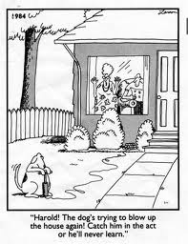
Operant Conditioning
Operant Conditioning and people
Reinforcement/Punishment
  Positive/Negative
  Primary/Secondary
  Premack Principle
Law of Effect
Reinforcement Schedules
Motivation
Latent Learning
Applications of Operant Conditioning

Slide 38
Operant & Classical Conditioning
Classical conditioning involves respondent behavior that occurs as an automatic response to some stimulus.
Operant conditioning involves operant behavior, a behavior that operates on the environment producing rewarding or punishing stimuli.
Notes:
A type of learning in which the frequency of a behavior depends on the consequence that follows that behavior
The frequency will increase if the consequence is reinforcing to the subject.
The frequency will decrease if the consequence is not reinforcing to the subject.

Slide 39
Operant Conditioning
A type of learning in which the frequency of a behavior depends on the consequence that follows that behavior
The frequency will increase if the consequence is reinforcing to the subject.
The frequency will decrease if the consequence is not reinforcing to the subject.

Slide 40
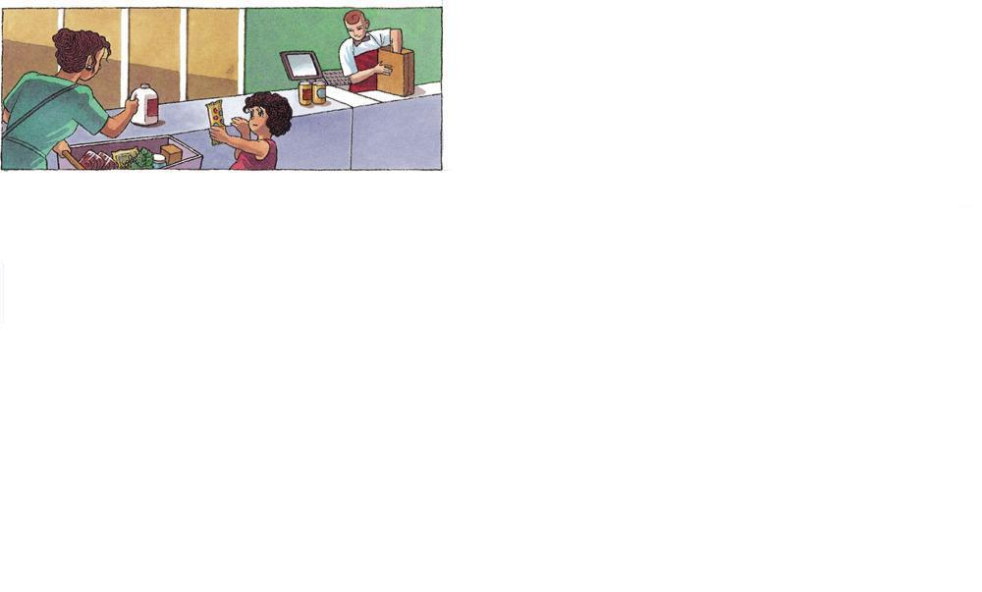
Operant Conditioning

Slide 41
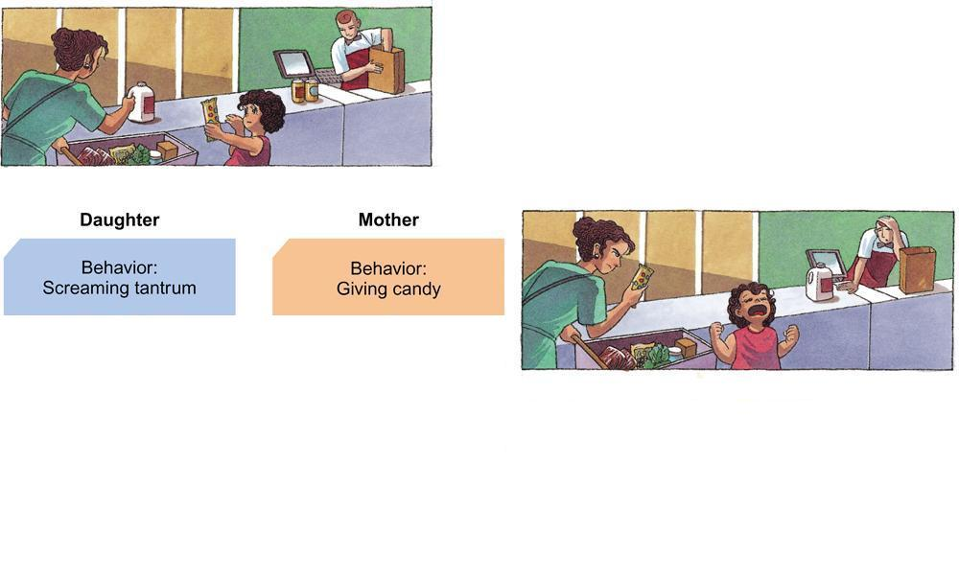
Operant Conditioning

Slide 42
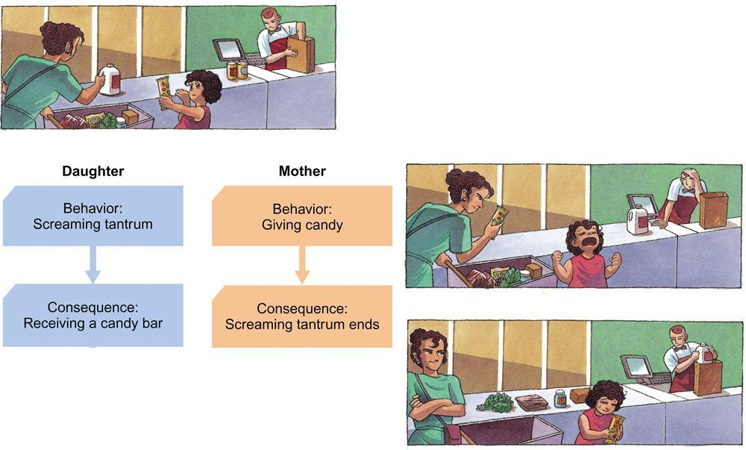
Operant Conditioning

Slide 43
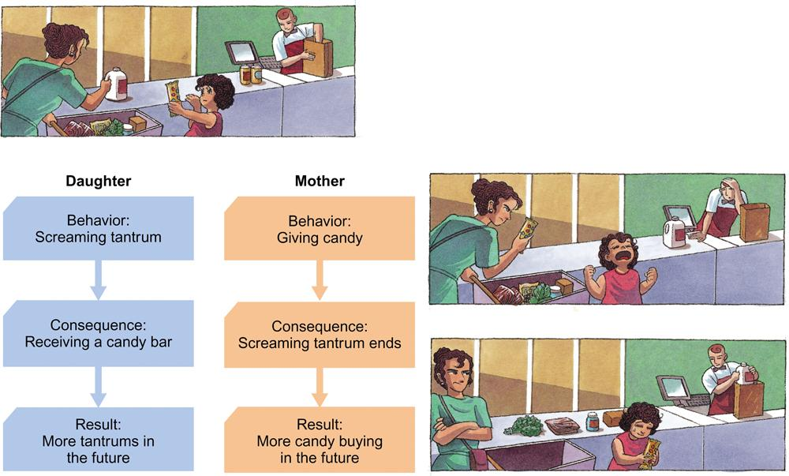
Operant Conditioning

Slide 44
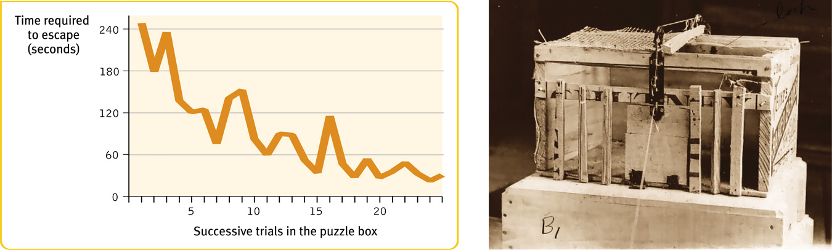
Skinner’s Experiments
Skinner’s experiments extend Thorndike’s thinking especially his law of effect which states that rewarded behavior is likely to recur.
Notes:
OBJECTIVE 22-2| State Thorndike’s law of effect, and explain its connection to Skinner’s research on operant conditioning.

Slide 45
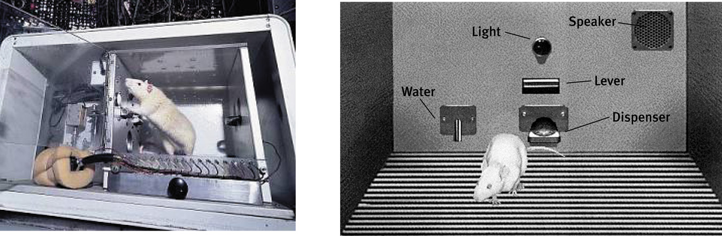
Operant Chamber
Using Thorndike's law of effect as a starting point Skinner developed the operant chamber or the Skinner box to study operant conditioning.
From The Essentials of Conditioning and Learning, 3rd
Edition by Michael P. Domjan, 2005. Used with permission
by Thomson Learning, Wadsworth Division
Walter Dawn/ Photo Researchers, Inc.

Slide 46
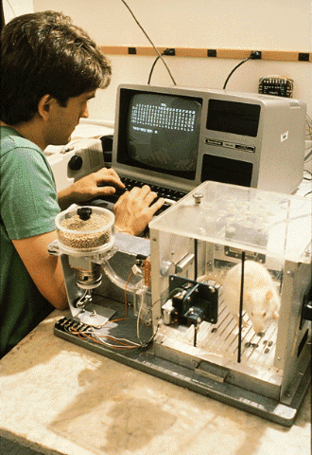
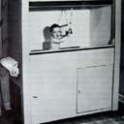
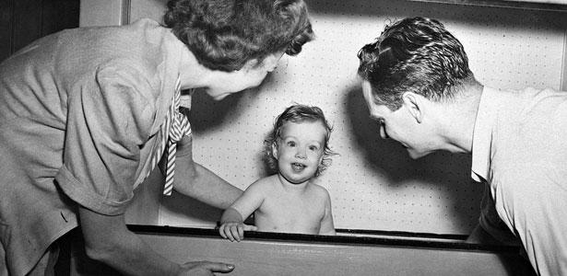
Operant Chamber
Operant chamber or Skinner box comes with a bar or key that an animal manipulates to obtain a food or water reinforcer. It is connected to devices that record the animal’s responses.
Air cribs were designed for human babies.

Slide 47
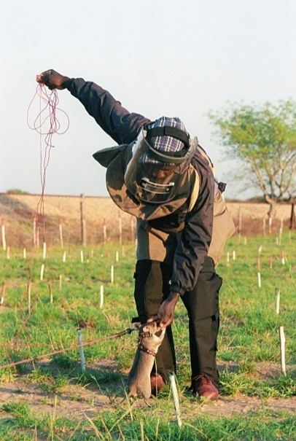
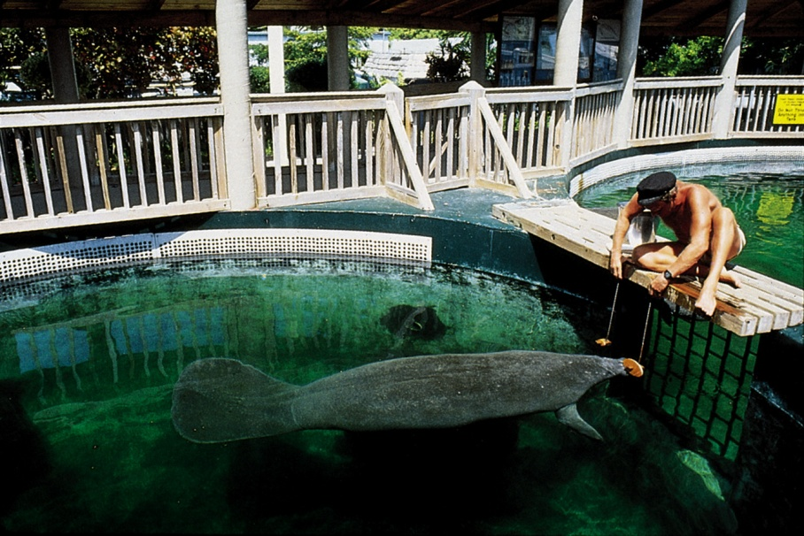
Shaping
Operant conditioning procedure in which reinforcers guide behavior closer towards target behavior through successive approximations. Too complex to happen spontaneously.
Khamis Ramadhan/ Panapress/ Getty Images
Fred Bavendam/ Peter Arnold, Inc.
A rat shaped to sniff mines. A manatee shaped to discriminate
objects with different shapes, colors and sizes.
Notes:
OBJECTIVE 22-3| Describe the shaping procedure, and how it can increase our understanding of what animals and babies can discriminate.

Slide 48
Reinforcement/Punishment
Reinforcement - Any consequence that increases the future likelihood of a behavior
Punishment - Any consequence that decreases the future likelihood of a behavior
The subject determines if a consequence is reinforcing or punishing

Slide 49
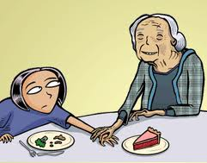
The Premack Principle
Reinforcer must be desired by the subject in order for it to be considered a reinforcer
If it is not desirable to that person, it will not strengthen that behavior
Grandma’s Rule – Eat your veggies before dessert

Slide 50
Positive Reinforcement
In operant conditioning, anything that increases the likelihood of a behavior by following it with a desirable event or state
The subject receives something they want
Will strengthen the behavior

Slide 51
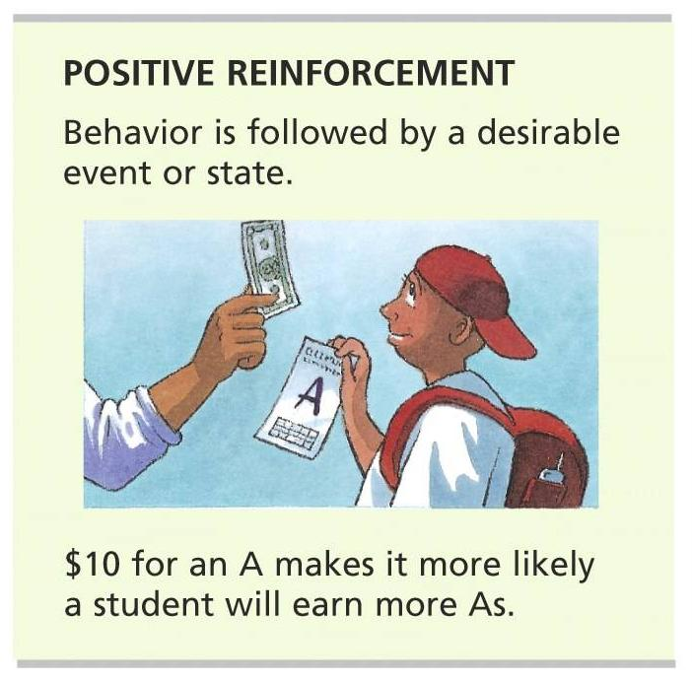
Positive Reinforcement

Slide 52
Negative Reinforcement
In operant conditioning, anything that increases the likelihood of a behavior by following it with the removal of an undesirable event or state
Something the subject doesn’t like is removed
Will strengthen the behavior

Slide 53
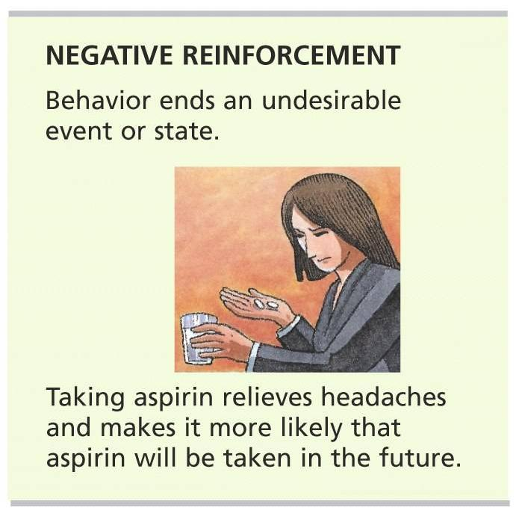
Negative Reinforcement

Slide 54
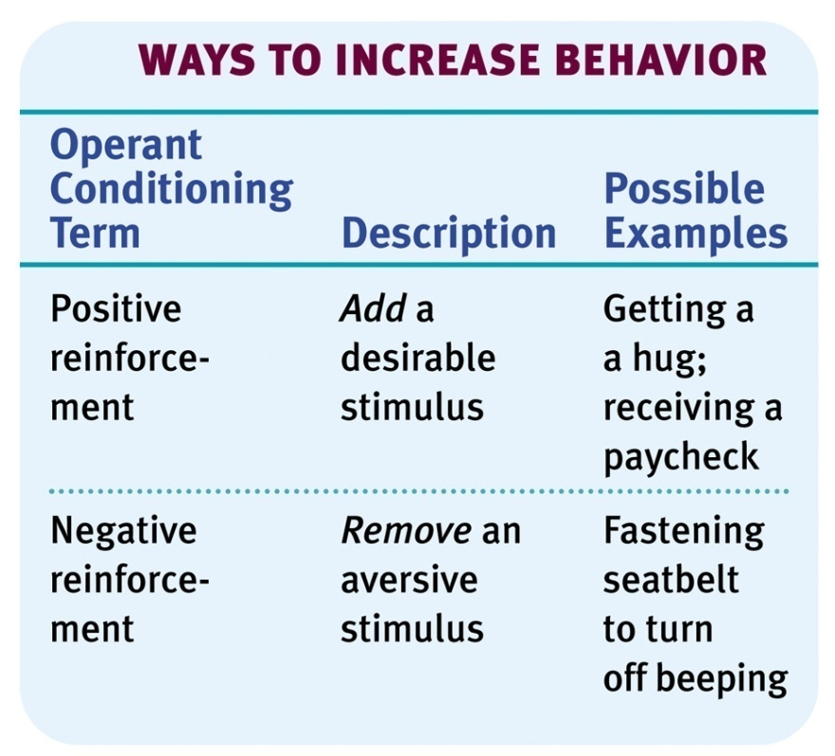
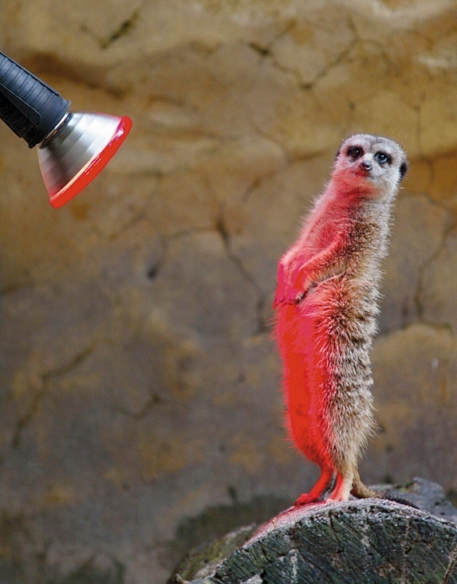
Types of Reinforcers
Any event that strengthens the behavior it follows. A heat lamp positively reinforces a meerkat’s behavior in cold.
Reuters/ Corbis
Notes:
OBJECTIVE 22-4| Compare positive and negative reinforcement, and give one example each of a primary reinforcer, a conditioned, an immediate, and a delayed reinforcer.

Slide 55
Primary & Secondary Reinforcers
Primary Reinforcer: Innately reinforcing stimulus like food or water.
Conditioned (secondary) Reinforcer: Is a learned reinforcer. It gets its reinforcing power through its association with primary reinforcer. It is a “learned” reinforcer
Money is a great example

Slide 56
Immediate & Delayed Reinforcers
Immediate Reinforcer: A reinforcer that occurs closely to a behavior in time. Rat gets a food pellet for a bar press.
Delayed Reinforcer: A reinforcer that is delayed in time for a certain behavior. A paycheck that comes at the end of a week.
We may be more inclined to engage in small immediate reinforcers (buying something with a credit card) than large delayed reinforcers (paying cash) which requires consistent saving of money.

Slide 57
Reinforcement Schedules
Continuous Reinforcement: Reinforcing the desired response each time it occurs.
Partial (intermittent) Reinforcement: Reinforcing a response only part of the time. Though results in slower acquisition in the beginning, shows greater resistance to extinction later on.
BF Skinner conducted a great deal of
research on this stuff.
Partial reinforcements can be… (this is important)…
Notes:
OBJECTIVE 22-5| Discuss the strengths and weaknesses of continuous and partial reinforcement schedules, and identify four schedules of partial reinforcements.

Slide 58
Ratio Schedules
Fixed-ratio schedule: Reinforces a response only after a specified number of responses e.g., like piecework pay. (5 apples=$1.00)
Variable-ratio schedule: Reinforces a response after an unpredictable number of responses. Hard to extinguish because of unpredictability. (fishing, gambling)

Slide 59
Interval Schedules
Fixed-interval schedule: Reinforces a response only after a specified time has elapsed. (paycheck every two weeks)
2. Variable-interval schedule: Reinforces a response at unpredictable time intervals. produces slow steady responding.
(pop quiz)

Slide 60
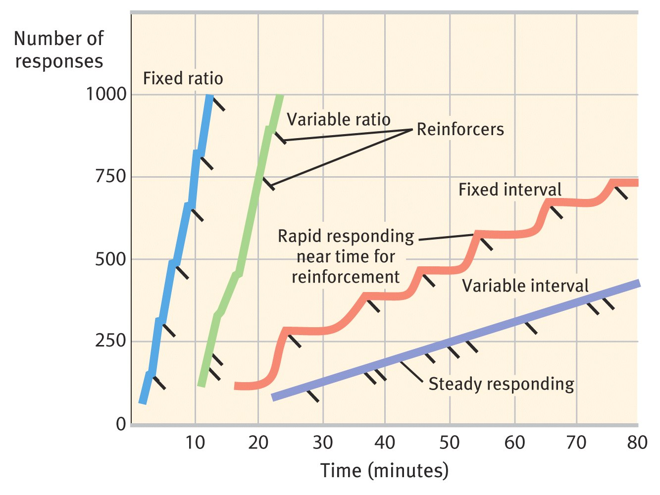
Schedules of Reinforcement

Slide 61
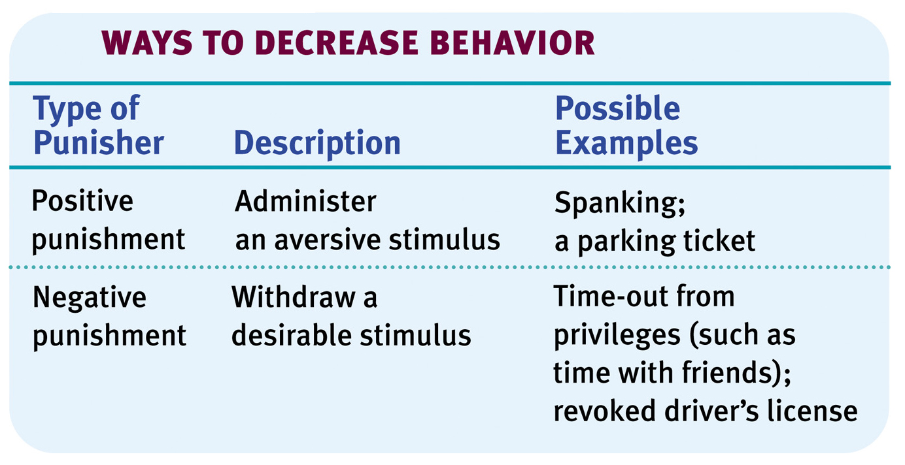
Punishment
An aversive event that decreases the behavior that it follows.
Notes:
OBJECTIVE 22-6| Discuss the ways negative punishment, positive punishment, and negative reinforcement differ, and list some drawbacks of punishment as a behavior-control technique.

Slide 62
Punishment
Although there may be some justification for occasional punishment (Larzelaere & Baumrind, 2002), it usually leads to negative effects.
Punishment can result in unwanted fears.
Conveys no information to the organism.
Justifies pain to others.
Unwanted behaviors reappear in its absence.
Aggression towards the agent.
One unwanted behavior appears in place of another.

Slide 63
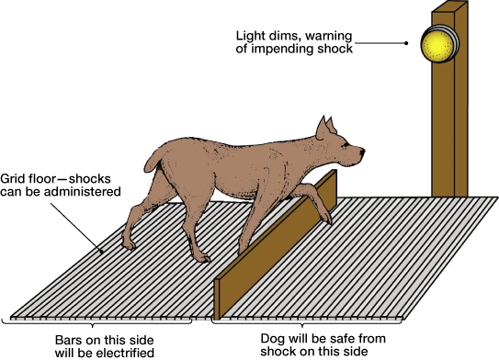
Impact of Punishment
When punishment is given haphazardly, learned helplessness can result.
  Learned Helplessness occurs when NO MATTER WHAT THE ORGANISM DOES, it cannot change the consequences of behavior.
  Martin Seligman’s experiment with dogs showed that dogs given a series of inescapable shocks stopped trying to escape the shocks even when given the opportunity to escape later.
  Another example would be finding that whether or not you study for your calculus tests, you fail, so you stop trying altogether.

Slide 64
Effective Punishment?
Effective punishment must be
  SWIFT
    Should occur as soon as possible after the behavior
  CERTAIN
    Should occur every time the behavior does
  SUFFICIENT
    Should be strong enough to be a deterrent
  CONSISTENT
    Should apply to all individuals the same way

Slide 65
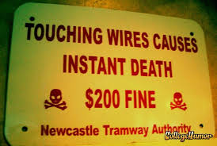
Alternatives to Punishment
An alternative to punishment if known as AVOIDANCE TRAINING
  the organism is given a “warning” before punishment occurs so it may change its behavior in order to avoid an unpleasant consequence like a punishment.
  ex/”Counting to three” before punishment is delivered to provoke a child to stop misbehaving.

Slide 66
Behavior Modification
Stimulus
 | Appetitive ☺ | Aversive ☹
Continue behavior | Positive Reinforcement (Like a reward) | Negative Reinforcement (Escape and avoidance)
End behavior | Negative Punishment (Loss of something wanted) | Positive Punishment (Receive something unwanted)
Consequence

Slide 67



Motivation
Intrinsic Motivation: The desire to perform a behavior for its own sake.
Extrinsic Motivation: The desire to perform a behavior due to promised rewards or threats of punishments.
Overjustification Effect: When intrinsic motivation is rewarded extrinsically. The behavior will decrease after the reward is taken away.
Notes:
Overjustification is related to cognitive dissonance. Subjects were asked to pretend they liked a boring task and then were paid $1. Others were paid $20. Those who were paid less said they liked the task afterward because they had no other incentive.

Slide 68
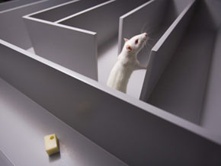
Cognition & Operant Conditioning
Evidence of cognitive processes during operant learning comes from rats during maze exploration, where they navigate it without an obvious reward. Rats seem to develop cognitive maps (Tolman) or mental representation of the layout of the maze (environment).
Notes:
OBJECTIVE 22-7| Explain how latent learning and the effect of external rewards demonstrate that cognitive processing is an important part of learning

Slide 69
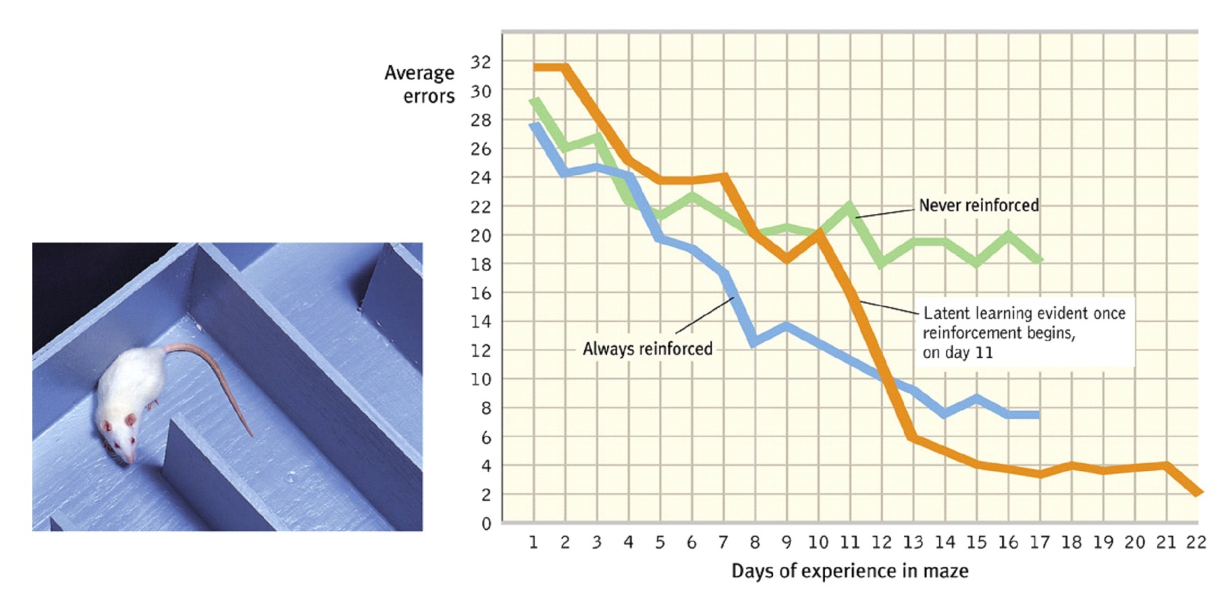

Latent Learning
Such cognitive maps are based on latent learning which becomes apparent when incentive is given (Tolman & Honzik, 1930).

Slide 70

Skinner’s Legacy
Skinner argued that behaviors were shaped by external influences and not inner thoughts and feelings. Critics argued that Skinner dehumanized people by neglecting their free will.
Falk/ Photo Researchers, Inc.
Notes:
OBJECTIVE 22-9| Describe the controversy over Skinner’s views of human behavior.

Slide 71

Applications of Operant Conditioning
Skinner introduced the concept of teaching machines that would shape learning in small steps and provide reinforcements for correct responses.
LWA-JDL/ Corbis
In School
Notes:
OBJECTIVE 22-10| Describe some ways to apply operant conditioning principles at school, at work and at home.

Slide 72

Applications of Operant Conditioning
Reinforcement principles can enhance athletic performance.
In Sports

Slide 73

Applications of Operant Conditioning
Reinforcers affect productivity. Many companies now enable employees to share profits and participate in company ownership.
At work

Slide 74
Applications of Operant Conditioning
In children reinforcing (good) behaviors increase their occurrence. Ignoring unwanted behaviors decrease their occurrence.
This is tricky for teachers and the students who tend to be behavioral problems. What may seem to be a punishment (scolding the student) may actually be a reinforcement (paying attention to the student)

Slide 75

Operant vs. Classical Conditioning
Notes:
OBJECTIVE 22-11| Identify the major similarities and differences between classical and operant conditioning.

Slide 76
AP Info…
Law of Effect-Thorndike, Skinner applied it
Overjustification effect
Think in terms of MATH (positive-we add to it) (negative-we take something away)
Learned Helplessness---make a connection to something coming up
Schedules of reinforcement-Skinner
Latent learning (Tolman)-don’t realize you know it until there is an incentive to show that you do

Slide 77
Observational Learning
Observational Learning and people
Vicarious Learning
Modeling Requirements
Antisocial/Prosocial behaviors

Slide 78

Mirror Neurons
Neuroscientist have discovered (mirror) neurons in the brain of animals and humans that activate during observational learning.
Reprinted with permission from the American
Association for the Advancement of Science,
Subiaul et al., Science 305: 407-410 (2004)
© 2004 AAAS.

Slide 79



Imitation Onset
Learning by observation comes about early in life.

Slide 80

Bandura's Experiments
Bandura's Bobo doll study (1961) indicated that individuals (children) learn through imitating others who receive reward and punishments.
Coined phrase “social learning theory”
Courtesy of Albert Bandura, Stanford University
Notes:
OBJECTIVE 23-2| Describe Bandura's findings on what determines whether we will imitate a model.

Slide 81




Bobo Doll Experiments

Slide 82




Bobo Doll Experiments

Slide 83
Vicarious Learning
Learning by seeing the consequences of another person’s behavior
The other person “models” the behavior, and the learner will watch to see if the model is reinforced or punished

Slide 84
Modeling Requirements
Bandura suggests four requirements for effective modeling to occur:
  Attention
  Retention
  Ability to reproduce the behavior
  Motivation
Learner must believe they can successfully carry out the behavior and control the outcome---Self-efficacy
Notes:
Self-efficacy is a person’s belief in his or her ability to succeed in a particular situation. Bandura described these beliefs as determinants of how people think, behave, and feel (perceptual/expectancy set???)

Slide 85
Antisocial/Prosocial Behavior
Antisocial behavior - negative, destructive unhelpful behavior
Prosocial behavior – positive, constructive, helpful behavior
Both types of behavior can be modeled effectively.

Slide 86

Positive Observational Learning
The good news is that prosocial (positive, helpful) models can have prosocial effects.
Bob Daemmrich/ The Image Works
Notes:
OBJECTIVE 22-3| Discuss the impact of prosocial modeling.

Slide 87


Applications of Observational Learning
Bad news from Bandura’s studies is that antisocial models (family, neighborhood or TV) may have antisocial effects.

Slide 88

Modeling Violence
Research has shown that viewing media violence does lead to increased expression of aggression.
Bob Daemmrich/ The Image Works
Glassman/ The Image Works
Children modeling after pro wrestlers

Slide 89

Television and Observational Learning
Gentile et al., (2004) showed that elementary school going children who were exposed to violent television, videos and video games expressed increased aggression.
Does this lead to desensitization?
Ron Chapple/ Taxi/ Getty Images
Notes:
https://www.youtube.com/watch?v=bzzC9qf8ODc – 13 minute video

Slide 90
AP Info…
Social learning
  Attention, retention, motivation, can reproduce behavior
Role of reinforcement, self-efficacy
Bandura and “Bobo Doll”
Mirror neurons
Possible essay themes: similarities and differences between classical and operant conditioning
This whole unit is about BEHAVIORISM

Slide 91

Thinking
Notes:
https://www.youtube.com/watch?v=ygemiMFfpi4
Situation: You are driving your car on a stormy night. You stop near a bus stop, and there you see three people waiting for the bus:
An older woman who looks as if she needs medical attention.
A trusted old friend who once saved your life.
The perfect man or woman of your dreams.
Knowing that all three could use the ride and there could only be one passenger in your car, how would you handle the situation?

Slide 92
Thinking
Thinking or “cognition” refers to a process that involves knowing, understanding, remembering and communicating.
Notes:
OBJECTIVE 29-1| Define cognition.

Slide 93
Components of Thinking Booklet
Foldable outlining the vocabulary from Module 24. (p. 427 – 437)
Include for each term:
  Definition
  Example (personal or from the book)
  Visual representation
Cognitive Abilities
Concept
Prototype
Algorithm
Heuristic
Insight
Mental Set
Fixation
Functional Fixedness
Confirmation Bias
Availability Heuristic
Overconfidence
Framing

Slide 94
Cognitive Psychologists
Thinking involves a number of mental activities listed below, and cognitive psychologists study them with great detail.
Concepts
Problem solving
Decision making
Judgment formation

Slide 95
Some famous cognitive scientists you will need to know:
Albert Bandura (social learning theory, Bobo Doll, modeling)
Julian Rotter (locus of control)
Martin Seligman (learned helplessness, positive psychology)
Aaron Beck (cognitive triad)
  Depression stems from a negative view of the world in general, of oneself and of the future.
Albert Ellis (rational emotive therapy)
  Focus not the event, but how we view them
Notes:
Locus of Control - Refers to causation as perceived by individuals in response to personal outcomes or other events
Learned helplessness - When people feel that they have no control over their situation, they may also begin to behave in a helpless manner. This inaction can lead people to overlook opportunities for relief or change.
The triad involves negative thoughts about:
The self (i.e., the self is worthless)
The world/environment (i.e., the world is unfair), and
The future (i.e., the future is hopeless).
REBT - Based on the premise that whenever we become upset, it is not the events taking place in our lives that upset us; it is the beliefs that we hold that cause us to become depressed, anxious, enraged, etc. A (action) does not cause C (consequence); B (behavior/what we think) causes C

Slide 96





Concepts
Mental grouping of similar objects, events, ideas, or people. There are a variety of chairs but their common features define the concept of chair.
Notes:
OBJECTIVE 29-2| Describe the roles of categories, hierarchies, definitions, and prototypes in concept formation.

Slide 97

Development of Concepts
We form some concepts by definitions, e.g., triangle has three side.
But mostly we form concepts by a mental image or a best example (prototype), e.g., robin is a prototype of a bird but penguin is not.
J. Messerschmidt/ The Picture Cube
Daniel J. Cox/ Getty Images
Triangle (definition)
Bird (mental image)

Slide 98
Different types of categories
SUPERORDINATE CATEGORY
  Basic Category
    subordinate category
For example:
MUSICAL INSTRUMENTS
  Guitars
    electric guitars

Slide 99

Category Hierarchies
We organize concepts into category hierarchies.

Slide 100
How do Categories affect our Schemas (the way we see the world)?
Once we place an item in a category our memory shifts toward the category’s prototype.
We are more likely to think of the characteristics of the prototype rather than the individual characteristics of that particular object (this is why sometimes we don’t notice the details)

Slide 101
Problem Solving
There are two ways to solve problems:
Algorithms: Methodical, logical rule or procedure that guarantees solving a particular problem.
Notes:
OBJECTIVE 29-3| Compare algorithms and heuristics as problem-solving strategies, and explain how insight differs from both of them.

Slide 102
Algorithms
Algorithms exhaust all possibilities before arriving at a solution. They take a long time. Computers use algorithms.
S P L O Y O C H Y G
If we were to unscramble these letters to form a word,
using an algorithm approach would
take 907,208 possibilities.
Notes:
Perfect games – tic tac toe, connect four,… 8 and 11 game in class

Slide 103


For example, Lets say I want to buy some soft tortillas…
If I start at aisle one and look up and down each shelf of every aisle, eventually I will find the tortillas
What is the advantage?
What is the disadvantage?

Slide 104

Heuristics
Simple thinking strategies that often allows us to make judgments and solve problems efficiently. Speedier but more error-prone than algorithms.
Needs a cart

Slide 105
Heuristics
Heuristics make it easy for us to use simple principles to arrive at solutions to problems.
S P L O Y O C H Y G
S P L O Y O C H G Y
P S L O Y O C H G Y
P S Y C H O L O G Y
Try putting Y at the end and see if the word
starts to make sense.

Slide 106




Now, to find my tortillas
What are some heuristics I could use?
  Look in the ethnic foods section
  Look at the signs above the aisles
  Think about where they are in another store
  Ask someone

Slide 107

Insight
Insight involves sudden novel realization of a solution to a problem. Insight is in humans and animals.
Grande using boxes to
obtain food

Slide 108

Insight
Brain imaging and EEG studies suggest that when an insight strikes
(“Aha experience”)
it activates the right temporal cortex (Jung-Beeman, 2004). The time between not knowing the solution to knowing it is 0.3 seconds.
Notes:
Rebus puzzles

Slide 109

Creativity
Difficult to define
Convergent (one answer) and divergent (many answers) thinking
Little correlation to intelligence
Notes:
http://www.dailymotion.com/video/x1gn21d_bbc-documentary-horizon-the-creative-brain-how-insight-works_lifestyle

Slide 110

Obstacles in Solving Problems
Confirmation Bias: A tendency to search for information that confirms a personal bias.
A reporter who is writing an article on an important issue may only interview experts that support her or his views on the issue.
Notes:
OBJECTIVE 29-4| Contrast confirmation bias and fixation, and explain how they can interfere with effective problem solving.
A student who is going to write a research paper may primarily search for information that would confirm his or her beliefs. The student may fail to search for or fully consider information that is inconsistent with his or her beliefs.

Slide 111

Fixation
Inability to see a problem from a fresh perspective. Impediment to problem solving. Two examples are mental set and functional fixedness.
The Matchstick Problem: How would you arrange six matches to form four equilateral triangles?
Notes:
Horse rider activity

Slide 112

The Matchstick Problem: Solution
From “Problem Solving” by M. Scheerer. Copyright © 1963 by
Scientific American, Inc. All Rights Reserved.

Slide 113
Can you connect the nine dots with 4 straights lines without taking your pencil off of your paper?

Slide 114

Mental Set
A tendency to approach a problem in a particular way especially a way that has been successful in the past.

Slide 115

Candle-Mounting Problem
Using these materials, how would you mount the candle on a bulletin board?
From “Problem Solving” by M. Scheerer. Copyright © 1963 by
Scientific American, Inc. All Rights Reserved.

Slide 116

Candle-Mounting Problem: Solution

Slide 117

Functional Fixedness

Slide 118
Functional Fixedness
A tendency to think of the only familiar functions for objects.
If you don’t have a screwdriver, a dime may work
If the back of your earring falls off, you could use a pencil eraser

Slide 119
Making Decision & Forming Judgments
Each day we make hundreds of judgments and decisions based on our intuition seldom using systematic reasoning.

Slide 120
Using and Misusing Heuristics
Two kinds of heuristics have been identified by cognitive psychologists. Representative and availability heuristics.
Notes:
OBJECTIVE 29-5| Contrast the representative and availability heuristics, and explain how they can cause us to underestimate or ignore important information.

Slide 121
Representativeness Heuristic
Judging the likelihood of things or objects in terms of how well they seem to represent, or match a particular prototype.
“it reminds me of…”
Probability that that person is a truck driver is far greater than an ivy league professor just because there are more truck drivers than such professors.
If you were to meet a man, slim, short, wears glasses and likes poetry. What do you think would his profession would be?
An Ivy league professor or a truck driver?
Notes:
The representativeness heuristic is the tendency to judge the frequency or likelihood of an event by the extent to which it resembles the typical case. For example, in a series of 10 coin tosses, most people judge the series HHTTHTHTTH to be more likely that the series HHHHHHHHHH (where H is heads and T is tails), even though both series are equality likely. The reason is that the first series looks more random than the second series. It "represents" our idea of what a random series should look like.

Slide 122
Availability Heuristic
Why does our availability heuristic lead us astray?
Whatever increases the ease of retrieving information increases its perceived availability.
“what comes to mind easiest”
How is retrieval facilitated?
How recently we have heard about the event.
How distinct it is.
How correct it is.
Notes:
After seeing several television programs on shark attacks, you start to think that such incidences are relatively common. When you go on vacation, you refuse to swim in the ocean because you believe the probability of a shark attack is high.

Slide 123

Overconfidence
It is a tendency to overestimate the accuracy of one’s beliefs and judgments.
Notes:
OBJECTIVE 29-6| Describe the drawbacks and advantages of overconfidence in decision making.
Intuitive heuristics, confirmation of beliefs, and knack of explaining failures increases our overconfidence.

Slide 124

Exaggerated Fear
Opposed to overconfidence is our tendency for exaggerated fear about how things may happen. Such fears may be ill-founded.
9/11 crashes led to decline in air travel due to fear.
AP/ Wide World Photos

Slide 125
Framing Decisions
How an issue is framed can significantly affect decisions and judgments.
Example: What is the best way to market ground beef — as 25% fat or 75% lean?
This has a 90% survival rate or a 10% death rate…
Notes:
OBJECTIVE 29-7| Describe how others can use framing to elicit from us the answers they want.

Slide 126
Belief Bias
The tendency for one’s preexisting beliefs to distort logical reasoning sometimes by making invalid conclusions.
God is love.
Love is blind
Ray Charles is blind.
Ray Charles is God.
Anonymous graffiti
Notes:
OBJECTIVE 29-8| Explain how our preexisting beliefs can distort our logic.

Slide 127


Belief Perseverance
Our tendency to cling to our beliefs in the face of contrary evidence.
Ex: Once someone has let you down, it is difficult to believe that they will come through when you need them, even if they have “totally redeemed themselves”.
Notes:
OBJECTIVE 9| Describe the remedy for belief perseverance phenomenon.

Slide 128
AP Info…
Functional fixedness
Concepts influenced by our schemas
  Hierarchies, categories, prototype
Algorithms and Heuristics
Availability vs representative heuristics
Convergent and Divergent thinking
Remember the biases
  Confirmation, belief, hindsight, self-serving

Slide 129
More AP info…
Kohler and the chimps (insight learning)
Self fulfilling prophecy
  Expectations influence performance
Mental set
  Use experience to solve a problem

Slide 130
Language and Thought
Language and structure
Grammar
Stages of language development
Theories of language development
Linguistic determination, schemas
Parts of the brain with language
Animal communication

Slide 131
Language
Is there another word for synonym?
Whose cruel idea was it for the word “lisp” to have an “s” in it?
What if there were no hypothetical questions?
Notes:
What is half of 13? 1 or 3; thir or teen?

Slide 132

Language
Our spoken, written, or gestured word, it is the way we communicate meaning to ourselves and others.
M. & E. Bernheim/ Woodfin Camp & Associates
Language transmits culture.
Notes:
Most complex body of knowledge

Slide 133
Language Structure
Phonemes: The smallest distinctive sound unit in a spoken language. For example:
bat, has three phonemes b · a · t
chat, has three phonemes ch · a · t
Notes:
OBJECTIVE 30-1| Describe the basic structural units of language.
Smallest unit in language (English has 40)

Slide 134
Language Structure
Morpheme: The smallest unit that carries meaning may be a word or a part of a word. For example:
Milk = milk
Pumpkin = pump . kin
Unforgettable = un · for · get · table
Notes:
(100,000 in English)

Slide 135

Structure of Language

Slide 136
Grammar
A system of rules in a language that enables us to communicate with and understand others.
Grammar
Semantics
Syntax

Slide 137
Semantics
Set of rules by which we derive meaning from morphemes, words, and sentences. For example:
Semantic rule tells us that adding –ed to the word laugh means that it happened in the past.
Notes:
Rules to derive meaning

Slide 138

Syntax
The rules for combining words into grammatically sensible sentences. For example:
In English syntactical rule is that adjectives come before nouns; white house. In Spanish it is reversed; casa blanca.
Notes:
Rules to order words

Slide 139

Grammar - Context
The artist painted me on the porch.
The artist painted me on the porch.
The artist painted me on the porch.

Slide 140
Overgeneralization
Child will generalize grammar rules so they apply the rules too broadly.
Example: “I dugged in the sandbox” rather than “I dug in the sandbox”

Slide 141

Overgeneralization

Slide 142

Language Development
Children learn their native languages much before learning to add 2+2.
We learn on average (after age 1) 3,500 words a year, amassing 60,000 words by the time we graduate high school.
Time Life Pictures/ Getty Images

Slide 143

When do we learn language?
Babbling Stage: beginning at 4 months the infant spontaneously utters various sounds, like ah-goo. Babbling is not imitation of adult speech.
Notes:
OBJECTIVE 30-2| Trace the course of language acquisition from the babbling stage through two-word stage.

Slide 144
When do we learn language?
One-Word Stage: Beginning at or around the first birthday, a child starts to speak one-word and makes family adults understand him.
The word “doggy” may mean “look at the dog out there”.

Slide 145
When do we learn language?
Two-Word Stage: Before the 2nd year a child starts to speak in two-word sentences. This form of speech is called telegraphic speech in which the child speaks like a telegram —
“go car,” means, “I would like to go for a ride in the car”.

Slide 146
When do we learn language?
Longer phrases: After telegraphic speech children start uttering longer phrases (Mommy get ball), with syntactical sense and by early elementary school they are enjoying humor.
You never starve in the desert because of all the sand-which-is there.

Slide 147

When do we learn language?

Slide 148
Theories of Language Development
Operant Learning/Social Learning: Skinner (1957, 1985) believed that language development can be explained on the basis of learning principles, such as association, imitation and reinforcement.
NURTURE
-If they are reinforced they will continue to say the word, opposite if punished
Notes:
OBJECTIVE 30-3| Discuss Skinner’s and Chomsky’s contributions to the nature-nurture debate over how children acquire language, and explain why statistical learning and critical periods are important concepts in children’s language learning.

Slide 149
Theories of Language Development
Inborn Universal Grammar: Chomsky (1959, 1987) opposed Skinners ideas and suggested that rate of language acquisition is so fast that it cannot be explained through learning principles, and thus most of it was inborn. Chomsky’s theory is that language learning is facilitated by a predisposition that our brains have for certain structures of language. NATURE
--Inborn Language Acquisition Device (LAD)
--Referred to as nativist theory

Slide 150


Slide 151

Theories of Language Development
Statistical Learning and Critical periods: We learn to recognize breaks in words before our first birthday. These statistical analysis are learned during critical periods of child development and if go unstimulated, will lose ability to fully master language
---Lenneberg (1967) believed human
language acquisition is an example of
biologically constrained learning, governed
by a critical period of development, must
occur before puberty b/c of brain
maturation (GENIE study)

Slide 152

Genes, Brain & Language
Genes design the mechanisms for a language, and experience modifies the brain.
Michael Newman/ Photo Edit, Inc.
David Hume Kennerly/ Getty Images
Eye of Science/ Photo Researchers, Inc.

Slide 153

Language & Age
New language learning gets harder with age.

Slide 154

Language & Thinking
Thinking and language intricately intertwine.
Rubber Ball/ Almay

Slide 155
Language influences Thinking
Linguistic Determinism: Whorf’s (1956) suggested that language determines the way we think, sometimes referred to linguistic relativity
-Hopi, he noted, did not have past tense for verbs therefore Hopis could not think readily about the past.
-Indigenous peoples near the Arctic Circle (not eskimos) have 50 words for “snow”
Notes:
OBJECTIVE 30-4| Summarize Whorf’s linguistic determinism hypothesis, and comment on its standing in contemporary psychology.
language and its structures limit and determine human knowledge or thought

Slide 156

Language influences Thinking
When a language provides words for objects or events we can think about these objects more clearly and retain them. It is easier to think about two colors with two different names
“Can you give me the blue crayon?”

Slide 157
Whorf observed…
On inspecting a chemical plant he once observed that the plant had two storage rooms for gasoline barrels, one for the full barrels and one for the empty ones. He further noticed that while no employees smoked cigarettes in the room for full barrels no-one minded smoking in the room with empty barrels, although this was potentially much more dangerous due to the highly flammable vapors that still existed in the barrels. He concluded that the use of the word empty in connection to the barrels had led the workers to unconsciously regard them as harmless, although consciously they were probably aware of the risk of explosion from the vapors.

Slide 158
Thinking in Images
To a large extent thinking is language based. Like when alone we talk to ourselves. However, we also think in images. That is, the words we possess determine the things that we can know. If we have an experience, we are confined not just in our communication of it, but also in our knowledge of it, by the words we possess.
We don’t think in words, when:
1. When we open the hot water tap.
2. When we are riding our bicycle.
Notes:
OBJECTIVE 30-5| Discuss the value of thinking in images.

Slide 159

Images and Brain
Imagining a physical activity activates the same brain regions as when actually performing the activity.
Jean Duffy Decety, September 2003
Notes:
Imagining yourself studying effectively only 5 minutes a day will improve your overall test performance.

Slide 160

Animals & Language
Do animals have a language?
Honey bees communicate by dancing. The dance
moves clearly indicate the direction of the nectar.

Slide 161

Do animals think?
Common cognitive skills in humans and apes.
Concept formation.
Insight
Problem Solving
Culture
Mind?
William Munoz
African grey parrot sorts red
blocks from green balls.
Notes:
OBJECTIVE 30-6| List five cognitive skills shared by the great apes and humans.

Slide 162

Insight
Chimpanzees show insightful behaviors when solving problems.
Sultan uses sticks to get food.

Slide 163

Do Animals Exhibit Language?
There is no doubt that animals communicate.
Vervet monkeys, whales and even honey bees communicate with members of their specie and other species.
Copyright Baus/ Kreslowski
Rico (collie) has a
200-word vocabulary
Notes:
OBJECTIVE 30-7| Outline the arguments for and against the idea that animals and humans share the capacity for language.

Slide 164

The Case of Apes
Chimps do not have vocal apparatus for human-like speech (Hayes & Hayes,1951). Gardner and Gardner (1969) therefore used American Sign Language (ASL) to train Washoe (a chimp), who learned 182 signs by age 32.
This is the sign for baby

Slide 165


Gestured Communication
Animals show communication through gestures as do humans. It is possible that vocal speech developed from gestures during evolution.

Slide 166
AP info…
Critical periods of language development
Grammar-semantics-syntax
Phonemes (basic), Morphemes (meaning)
Genie
Skinner-operant learning of language (nurture)
Chomsky-universal language (nature)
Whorf-linguistic determinism/relativity
Broca’s area-speaking, Wernicke’s -listening, Angular Gyrus-seeing

Slide 167
Introduction to Memory
Stages of Memory
Information Processing model
Working memory/Short term

Slide 168
Memory
Memory is the basis of knowing your friends, your neighbors, the English language, the national anthem, and yourself.
Memory is any indication that learning has persisted over time. It is our ability to store and retrieve information.
If there was no memory every one would be a stranger to you, every language foreign, every task new, and even you yourself would be a stranger.
Notes:
An event is such a little piece of time and space, leaving only a mindglow behind like the tail of a shooting star. Far a lack of a better word, we call that scintillation memory. Diane Ackerman, An Alchemy of Mind, 2004

Slide 169
How does Memory fit in with what we have already studied?
Nurture—how can you learn from experiences without being able to remember??
Encoding memories in the brain (Hippocampus-explicit, Cerebellum-implicit)
Sensory stimuli transduced and compared to what you already know
Classical conditioning and extinction
Thinking and heuristics (problem solving)

Slide 170



Stages of Memory
Keyboard
(Encoding)
Disk
(Storage)
Monitor
(Retrieval)
Sequential Process

Slide 171

Information Processing Model
Atkinson-Schiffrin (1968) three-stage model of memory includes a) sensory memory, b) short-term memory and c) long-term memory.
Bob Daemmrich/ The Image Works
Bob Daemmrich/ The Image Works
Frank Wartenberg/ Picture Press/
Corbis
Notes:
OBJECTIVE 24-2| Describe Atkinson-Schiffrin’s classic three-stage model of memory and explain how contemporary model of working memory differs.

Slide 172
Problems with the Model
Some information skips the first two stages and enters long-term memory automatically.
The model is linear and doesn’t account for all memory stores (some people whose memories do not seem to decay may have more memory stores than others)
Some rare cases people have damage to STM and LTM is not affected (how possible?)
The nature of short-term memory is more complex---gives rise to “working memory” model by Baddeley

Slide 173

Working Memory
Alan Baddeley (2002) proposes working memory to contain auditory and visual processing areas controlled by central executive through an episodic buffer.

Slide 174

AP info…
What is the difference between the “information processing model” (Atkinson-Schiffrin) and the “working memory” (Baddeley)?
Role of schemas and
attention

Slide 175
Encoding: Getting Info. in
Types of processing
Memory effects
Ways we encode
Mnemonic devices

Slide 176
Encoding: Getting Information In
How We Encode
Some information (route to your school) is automatically processed.
However novel information (friend’s new cell-phone number) requires attention and effort.

Slide 177
Automatic Processing
Enormous amount of information is processed effortlessly (parallel processing) by us, like:
Space: While reading a textbook you automatically encode place of a picture on a page.
Time: We unintentionally note the events that take place in a day.
Frequency: You effortlessly keep track of things that happened to you.
Notes:
OBJECTIVE 25-1| Describe the types of information we encode automatically.

Slide 178

Effortful Processing
Novel information committed to memory requires effort, like learning a concept from a text. Such processing leads to durable and accessible memories.
Leads to LONG TERM POTENTIATION (LTP)
Notes:
OBJECTIVE 25-2| Contrast effortful processing with automatic processing, and discuss the next-in-line effect, the spacing effect and the serial position effect.

Slide 179

Rehearsal
Effortful learning usually requires rehearsal or conscious repetition.
Ebbinghaus studied rehearsal by using nonsense syllables: TUV YOF GEK XOZ
He also came up with the “forgetting curve”
http://www.isbn3-540-21358-9.de
Hermann Ebbinghaus
(1850-1909)

Slide 180

Rehearsal
The more times the nonsense syllables were practiced on Day 1,
the fewer repetitions were required to relearn them on Day 2.

Slide 181
Memory Effects
Next-in-line-Effect: that a person in a group has diminished recall for the words of others who spoke immediately before or after this person, because we are concentrating on what we are going to say
Spacing Effect: We retain information better when our
rehearsal is distributed over time.
Serial Position Effect: When your recall is better for first and last items, but poor for middle items on a list.

Slide 182
Spacing Effect
Distributed rehearsal (spacing effect) is better than massed practice.
DON’T CRAM FOR TESTS
… …

Slide 183

Serial Position Effect
TUV
ZOF
GEK
WAV
XOZ
TIK
FUT
WIB
SAR
POZ
REY
GIJ
Better recall
Poor recall
Better recall

Slide 184
Ways We Encode
Encoding by meaning
Encoding by images (mnemonics)
Encoding by organization
Read the directions on your page to yourself
No peeking

Slide 185
Encoding “Meaning”
--Semantic encoding is a specific type of encoding in which the meaning of something (a word, phrase, picture, event, whatever) is encoded as opposed to the sound or vision of it.
--We have better recall for things that we semantically encode and make meaningful to ourselves (“self-reference effect”)
Notes:
OBJECTIVE 25-3| Compare the benefits of visual, acoustic, and semantic encoding in remembering verbal information, and describe a memory-enhancing strategy related to the self-referent effect.

Slide 186

Results
So, how did you do on the recall of the 20 phrases?

Slide 187

Encoding Imagery
Visual images easily encode
Especially extremely positive or negative images

Slide 188
Mnemonics
Imagery is at the heart of many memory aids. Mnemonic techniques that use vivid imagery in aiding memory.
Method of Loci
Link Method

Slide 189
1. Method of Loci (Location method)
--this method involves matching items to be memorized with a well known location
--Essentially, you would imagine yourself walking through a very familiar area (the road to the store, the various rooms of your house, etc) and place the items to be remembered in each location
--The strength of this method is that our brains are better organized to store locations than random facts

Slide 190
1. Method of Loci (Location method)
Using the method of loci, remember these words
Cap
Rubber band
Mouse
Soap
Fan
Flag
Towel

Slide 191
2. Link Method
Involves forming a mental image of items to be remembered in a way that links them together.
6 Red Apples
Large Loaf of Bread
Carton of Milk
Bar of Foamy Soap
Pair of Yellow Socks
Packet of Chocolate Biscuits

Slide 192


1st Link: Apples smashed on a shopping cart
2nd Link: Apples raining down on a large loaf of bread

Slide 193


3rd Link: Giant milk carton kicking a loaf of bread
4th Link: Milk pouring out of a carton turns into white foamy soap!

Slide 194


5th Link: Soap Man puts on his fuzzy yellow socks
6th Link: I'm putting chocolate biscuits in my socks

Slide 195
Organizing Information for Encoding
Complex information broken down into broad concepts and further subdivided into categories and subcategories.
Chunking
Hierarchy
Notes:
OBJECTIVE 25-5| Discuss the use of chunking and hierarchies in effortful processing.

Slide 196
Chunking
Organizing items into familiar, manageable unit. Try to remember the number below.
1-7-7-6-1-4-9-2-1-8-1-2-1-9-4-1
If you are well versed with American history, chunk the number and see if you can recall it easier. 1776 1492 1812 1941.

Slide 197
Chunking
Acronyms are another way to chunk information and remember it.
HOMES = Huron, Ontario, Michigan, Erie, Superior
PEMDAS = Parentheses, Exponent, Multiply, Divide, Add, Subtract
ROY G. BIV = Red, Orange, Yellow, Green, Blue, Indigo, Violet

Slide 198

Hierarchy
Complex information broken down into broad concepts and further subdivided into categories and subcategories.

Slide 199

Encoding Summarized in a Hierarchy

Slide 200


Slide 201

AP info…
What types of mnemonic devices work for you?
Effortful vs automatic processing
Who remembered more???

Slide 202
Storage: Retaining Information
Sensory memory
  Echoic
  Iconic
  Haptic
Working Memory (Short Term)
Long term memory
LTP
Retrospective Memory
  Explicit memories
  Implicit memories
Prospective Memory
Amnesia

Slide 203

Take out a piece of paper and name as many presidents as you can

Slide 204
Storage: Retaining Information
At the heart of memory is storage. Three stores of memory are shown below:
Sensory
Memory
Working
Memory
Long-term
Memory
Encoding
Events
Encoding
Retrieval
Retrieval

Slide 205
Sensory Memory
Sensory
Memory
Working
Memory
Long-term
Memory
Encoding
Events
Encoding
Retrieval
Retrieval
Notes:
OBJECTIVE 26-1| Contrast two types of sensory memory.

Slide 206
Types of Sensory Memory
Echoic memories are memory of brief auditory stimuli
Iconic memories are memory of brief visual stimuli
Haptic memories are memory for tactile sense of touch
Typically, echoic memories are stored for slightly longer periods of time than iconic memories (visual memories)
All are sensory memories, not types of long-term memory, and thus are very temporary and fade quickly

Slide 207
Sensory Memories
Duration of sensory memory differs for different senses.
Iconic
0.5 sec. long
Echoic
3-4 sec. long
Haptic
< 1 sec. long

Slide 208
Working Memory
Sensory
Memory
Working
Memory
Long-term
Memory
Encoding
Events
Encoding
Retrieval
Retrieval
Notes:
OBJECTIVE 26-2| Describe the duration and working capacity of short-term memory.

Slide 209
Listen to these numbers
When I say “recall”, write them down on your paper

Slide 210
Working Memory
Working memory, a new name for short-term memory, has limited capacity (7±2) and short duration (20 seconds).
M U T G I K T L R S Y P
You should be able to
recall 7±2 letters.
M U T G I K T L R S Y P

Slide 211
Chunking
Capacity of working memory may be increased by “Chunking.”
F-B-I-T-W-A-C-I-A-I-B-M
FBI TWA CIA IBM
4 chunks

Slide 212

Working Memory Duration
Notes:
How can we improve working memory?
Doodle
De-clutter
Get creative
Exercise outdoors

Slide 213
Long-Term Memory
Sensory
Memory
Working
Memory
Long-term
Memory
Encoding
Events
Encoding
Retrieval
Retrieval
Notes:
OBJECTIVE 26-3| Describe the capacity and duration of long-term memory.

Slide 214

Long-Term Memory
Unlimited capacity store. Estimates on capacity range from 1000 billion to 1,000,000 billion bits of information (Landauer, 1986).
R.J. Erwin/ Photo Researchers
The Clark’s nutcracker can locate 6,000 caches of
buried pine seeds during winter and spring.
Notes:
Estimates on capacity are similar to 2.5 petabytes (million gigabytes). If your brain worked like a digital recorder, you could hold 3 million hours of TV shows
The human brain consists of about one billion neurons. Each neuron forms about 1,000 connections to other neurons, amounting to more than a trillion connections. If each neuron could only help store a single memory, running out of space would be a problem. You might have only a few gigabytes of storage space, similar to the space in an iPod or a USB flash drive. Yet neurons combine so that each one helps with many memories at a time, exponentially increasing the brain’s memory storage capacity to something closer to around 2.5 petabytes (or a million gigabytes). For comparison, if your brain worked like a digital video recorder in a television, 2.5 petabytes would be enough to hold three million hours of TV shows. You would have to leave the TV running continuously for more than 300 years to use up all that storage

Slide 215

Memory Feats
Notes:
Eidetic Memory vs. Superior Autobiographical Memory

Slide 216

Synaptic Changes
Long-Term Potentiation (LTP) refers to synaptic enhancement after learning (lynch, 2002). Increase in neurotransmitter release or receptors on the receiving neuron indicates strengthening of synapses.
They learn to fire
the action potential
more efficiently
(potentiation)

Slide 217

Stress Hormones & Memory
Heightened emotions (stress related or otherwise) make for stronger memories. Continued stress can disrupt memory. Cortisol is the stress hormone.
Scott Barbour/ Getty Images
Notes:
OBJECTIVE 26-5| Discuss some ways stress hormones can affect memory.

Slide 218





Flashbulb Memory
An unique and highly emotional moment can give rise to clear, strong, and persistent memory called flashbulb memory. Though this memory is not free from errors.
Where were you when this happened?
Notes:
Episodic Memory
Memory of a specific event
“Flashbulb Memory”
Great detail
Makes impression on us
Emotional connection
Examples:
9/11, wedding day, birth of a child

Slide 219

Storing Retrospective Memories
Explicit Memory refers to facts and experiences that one can consciously know and declare. Implicit memory involves learning an action, and the individual does not know or declare what she knows.
Notes:
OBJECTIVE 26-6| Distinguish between implicit and explicit memory, and identify the main brain structure associated with each.

Slide 220


Explicit Memory
Refers to memories that you can explain how you know them, or declare. Facts, experiences, life events. They are processed in the hippocampus

Slide 221


Implicit Memory
These memories are procedural and allow you
to do something or carry out some task.
They are processed using the cerebellum
(they involvement movement and coordination)

Slide 222
Prospective memory
The ability to remember to do something in the future
  For example; remembering to take medicine at night before going to bed,
At least half of everyday forgetting is due to prospective memory failures
“Remembering to remember”, often triggered by a cue. Pass a mailbox and remember you need to mail something

Slide 223
Two types of Amnesia
After losing his hippocampus in surgery, a man remembers everything before the operation but cannot make new memories. We call this anterograde amnesia
However, if the damage occurred somewhere in the cerebral cortex, he may not be able to access old memories which were formed before the accident due to retrograde amnesia

Slide 224
AP info…
Role of cortisol in memory formation
  Mood-congruent memories
Episodic vs procedural memory
Eidetic memory…Dr. Reid (photographic)
Superior Autobiographical Memory
Types of sensory memory (iconic, echoic, haptic)
Role of the hippocampus and the cerebellum
Explicit memories you can explain,
Implicit memories need to be primed

Slide 225
Retrieval: Getting Info Out
Measures of Memory
  Recognition
  Recall
  Relearning
Cues
Context
“Stroop” Effect
Mood

Slide 226
Measures of Memory
In recognition the person has to identify an item amongst others e.g., a multiple-choice test requires recognition.
Name the capital of France
  Brussels
  Rome
  London
  Paris

Slide 227
Measures of Memory
In recall the person must retrieve information using effort, e.g., a fill-in-the blank test requires recall.
The capital of France is ______.

Slide 228
Measures of Memory
In relearning the individual shows how much time (or effort) is saved when learning material a second time.
List
Jet
Dagger
Tree
Kite
…
Silk
Frog
Ring
List
Jet
Dagger
Tree
Kite
…
Silk
Frog
Ring
Original
Trials
Relearning
Trials
1 day later
Saving
X 100
Relearning
Trials
10
5
X 100
10
It took 10 trials
to learn this list
It took 5 trials
to learn the list
50%

Slide 229
Retrieval Cues
Memories are held in storage by a web of associations. These associations are like anchors that help retrieve memory.
water
smell
hose
Fire Truck
fire
smoke
truck
heat
red
Try these remote associations…
Notes:
OBJECTIVE 27-2| Explain how retrieval cues help us access stored memories, and describe the process of priming.
Remote Associations Test

Slide 230

Priming
To retrieve a specific memory from the web of associations, you first need to activate one of the strands that lead to it, a process called priming.

Slide 231


Context Effects
Scuba divers recalled more words underwater if they learned the list underwater, and recalled more words on land if they learned the list on land (Godden & Baddeley, 1975).
Fred McConnaughey/ Photo Researchers

Slide 232

Read the words below as fast as you can.

Slide 233
Name the COLOR in which the words below are PRINTED as fast as you can.

Slide 234
The Stroop Effect
When we look at a word, we automatically recall information about that word's meaning.
When asked to name the colors of the print in which the words appeared, the meanings of those words interfered with our task, and you found yourself having difficulty completing the task.
This is a good example of the capacity of your “working memory”. Similar to when you used your fingers to count the number of words in the sentence

Slide 235

Déja Vu
Déja Vu means “"I've experienced this before.” Cues from the current situation may unconsciously trigger retrieval of an earlier similar experience.
© The New Yorker Collection, 1990. Leo Cullum from
cartoonbank.com. All Rights Reserved

Slide 236

Moods and Memories
Tendency to recall experiences that are consistent with one’s current mood. Emotions, or moods serve as retrieval cues. “Mood congruent memories”
Jorgen Schytte/ Still Pictures
Notes:
OBJECTIVE 27-4| Describe the effects of internal states on retrieval.

Slide 237

AP info…
Recall vs recognition
Priming (James)
Stroop Effect
Mood congruent
  memories

Slide 238
Forgetting
Forgetting
  Failure
  Storage Decay
  Interference
  Motivated
False Memories
  Misinformation Effect
  Memory Construction
  Source Amnesia

Slide 239
Forgetting
Inability to retrieve information, due to poor:
-encoding
-storage or
-retrieval.
Notes:
OBJECTIVE 28-1| Explain why we should value our ability to forget, and distinguish three general ways our memory fails us.

Slide 240

Encoding Failure
We cannot remember what we did not encode.
Notes:
OBJECTIVE 28-2| Discuss the role of encoding failure in forgetting.

Slide 241


Which penny is real?

Slide 242

Retrieval Failure
Although the information is retained in the memory store it cannot be accessed.
Tip-of-the-tongue (TOT) is a retrieval failure phenomenon. Given a cue (What makes the blood cells red?) the subject says the word begins with an H (hemoglobin). Priming can help overcome this…
Write down as many of the remote associates from earlier…

Slide 243

Storage Decay
Poor durability of stored memories leads to their decay. Ebbinghaus showed this with his forgetting curve.
Notes:
OBJECTIVE 28-3| Discuss the concept of storage decay, and describe Ebbinghaus’ forgetting curve.

Slide 244


Interference
Learning some info. may disrupt retrieval of other info.
Proactive (can’t get the new info.) and
Retroactive (can’t get the old info.)
Notes:
OBJECTIVE 28-4| Contrast proactive and retroactive interference, and explain how they can cause retrieval failure.

Slide 245

Retroactive Interference
Sleeping helps avoid retroactive interference thus
leading to better recall.

Slide 246

Motivated Forgetting
Motivated Forgetting: People unknowingly revise their memories.
Repression: Defense mechanism that banishes anxiety-arousing thoughts, feelings, and memories from consciousness. Freud believed this was at the heart of all defense mechanisms
Culver Pictures
Sigmund Freud
Notes:
OBJECTIVE 28-5| Summarize Freud's concept of repression, and state whether this view is reflected in current memory research.

Slide 247

Why do we forget?
Forgetting can occur at any memory stage; we filter, alter, or lose much information during these stages.

Slide 248
False Memories
While tapping our memories, we filter or fill in missing pieces of information to make our recall more coherent.
Misinformation Effect: Incorporating misleading information into one's memory of an event. Leads to memory construction
False Memory Syndrome
A condition in which a person’s identity and relationships center around a false but strongly believed memory of traumatic experience sometimes induced by well-meaning therapists.

Slide 249

Misinformation and Imagination Effects
Eyewitnesses reconstruct memories when questioned about the event.
Depiction of the actual accident.
Notes:
OBJECTIVE 28-6| Explain how misinformation and imagination can distort our memory of an event.

Slide 250
Misinformation
Group A: How fast were the cars going when they hit each other?
Group B: How fast were the cars speeding when they smashed into each other?

Slide 251

Memory Construction
A week later they were asked; Was there any broken glass? Group B (smashed into) reported more broken glass than Group A (hit).

Slide 252

Constructed Memories
Loftus’ research in eyewitness testimony has shown that if false memories are implanted in individuals, they construct (fabricate) their memories. Your brain will create a story to fill in the gaps.
Don Shrubshell

Slide 253
Source Amnesia
Source Amnesia: Attributing an event to the wrong source we have experienced, heard, read, or imagined (misattribution).
Notes:
OBJECTIVE 28-7| Describe source amnesia’s contributions to false memories.

Slide 254

Accuracy of Memories

Slide 255
Improving Memory
Study repeatedly to boost recall long-term recall.
Spend more time rehearsing or actively thinking about the material.
Make material personally meaningful.
Use mnemonic devices:
  associate with peg words — something already stored
  make up story
  chunk — acronyms
Notes:
OBJECTIVE 28-11| Explain how an understanding of memory can contribute to effective study techniques.

Slide 256

Improving Memory
Activate retrieval cues — mentally recreate situation and mood.
Recall events while they are fresh — before you encounter misinformation.
Minimize interference:
  Test your own knowledge
  Rehearse and determine what you do not yet know
© LWA-Dann Tardiff/ Corbis

Slide 257

AP info…
“retro”-we can’t get to the old stuff (both interference and amnesia)
Serial position effect
Tip of the tongue phenomenon
Ebbinghaus’ forgetting curve
Motivated forgetting—Freud
Loftus and eyewitness
  Influence of framing

Slide 258

Introduction to Intelligence
Crystallized and Fluid
Intelligence
General intelligence
Multiple intelligences
Sternberg’s Triarchic
Theory
Emotional intelligence

Slide 259
Intelligence
Do we have an inborn general mental capacity (intelligence) and can we quantify this capacity as a meaningful number?

Slide 260
What is Intelligence?
Intelligence (in all cultures) is the ability to learn from experience, solve problems, and use knowledge to adapt to new situations.
Crystallized Intelligence represents facts and past experiences (does not decline with age)
Fluid intelligence represents the ability to learn new procedures, behaviors (does decline with age)
In research studies, intelligence is whatever the intelligence tests measure …
which tends to be school smarts.
Notes:
OBJECTIVE 31-1| Discuss the difficulty of defining intelligence, and explain what it means to “reify intelligence.”.

Slide 261
Conceptual Difficulties
Psychologists believe that intelligence is a concept and not a “thing.”
When we think of intelligence as a trait (thing) we commit to an error called reification — viewing an abstract immaterial concept as if it were a concrete thing.
For example: the mind vs the brain
Notes:
Intelligence should be referred to as a “construct”

Slide 262
Controversies about Intelligence
Despite general agreement among psychologists about the nature of intelligence, there are two controversies that remain:
Is intelligence a single overall ability or several specific abilities?
With modern neuroscience techniques can we locate and measure intelligence within the brain?

Slide 263
Intelligence: Ability or Abilities?
Have you ever thought that since people’s mental abilities are too diverse — labeling them with one word intelligence may not be justified?
So you may speculate that diverse abilities may represent different kinds of intelligences. How can you test this idea?

Slide 264
General Intelligence
Spearman proposed that general intelligence (g), is linked to many clusters that can be analyzed by factor analysis.
“G FACTOR”
For example, people who do well on vocabulary do well on paragraph comprehension, a cluster that helps define verbal intelligence.

Slide 265
General Intelligence
L. L. Thurstone, a critic of Spearman, analyzed his subjects NOT on a single scale of general intelligence, but on seven clusters of primary mental abilities including:
Word Fluency
Verbal Comprehension
Spatial Ability
Perceptual Speed
Numerical Ability
Inductive Reasoning
Memory

Slide 266
General Intelligence
Later psychologists analyzed Thurstone’s data and found a weak relationship between these clusters, suggesting some evidence of a g factor.

Slide 267

Contemporary Intelligence Theories
Howard Gardner (1983, 1999) supports Thurstone’s idea that intelligence comes in multiple forms. Gardner notes that brain damage may diminish one type of ability but not others.
People with savant syndrome excel in abilities
not related to general intelligence.
Notes:
OBJECTIVE 31-3| Compare Gardner’s and Sternberg's theories of intelligence.

Slide 268

Howard Gardner
Gardner proposes eight types of intelligences
(“Multiple Intelligences”)and speculates about a ninth one — existential intelligence — the ability to ponder about question of life, death and existence.

Slide 269
Robert Sternberg
Sternberg (1985, 1999, 2003) also agrees with Gardner, but suggests three intelligences rather than eight. This is the most widely accepted theory of intelligence today.
“Triarchic theory of Intelligence”
Practical Intelligence: Intelligence required for everyday tasks (e.g. street smarts).
Analytical Intelligence: Assessed by intelligence tests.
Creative Intelligence: Intelligence that makes us adapt to novel situations, generating novel ideas.

Slide 270

Sternberg’s Types of Intelligence

Slide 271
Intelligence and Creativity
Creativity is the ability to produce ideas that are both novel and valuable. It correlates somewhat with intelligence.
Expertise: A well developed knowledge base.
Imaginative Thinking: The ability to see things in novel ways.
Adventuresome Personality: Seeks new experiences rather than following the pack.
Intrinsic Motivation: Motivated to be creative from within.
A Creative Environment: Creativity blooms in creative and supportive environment.
Notes:
OBJECTIVE 31-5| Identify the factors associated with creativity, and describe the relationship between creativity and intelligence.

Slide 272

Theories: Comparison

Slide 273
Emotional Intelligence
Emotional intelligence is the ability to perceive, understand and use emotions (Salovey and colleagues, 2005). The test of emotional intelligence measures overall emotional intelligence and its four components.
Notes:
OBJECTIVE 31-4| Describe the four aspects of emotional intelligence, and discuss criticisms of this concept.

Slide 274
Emotional Intelligence: Components
Component | Description
Perceive emotion | Recognize emotions in faces, music and stories
Understand emotion | Predict emotions, how they change and blend
Manage emotion | Express emotions in different situations
Use emotion | Utilize emotions to adapt or be creative

Slide 275
Emotional Intelligence: Criticism
Gardner and others criticize the idea of emotional intelligence and question whether we stretch this idea of intelligence too far when we apply it to emotions.

Slide 276

Is Intelligence Neurologically Measurable?
Recent Studies indicate some correlation (about +.40) between brain size and intelligence. As brain size decreases with age, scores on verbal intelligence also decrease.
Gray matter concentration in people with high intelligence.
Notes:
OBJECTIVE 31-6| Describe the relationship between intelligence and brain anatomy.

Slide 277
Brain Function
Studies of brain functioning show that people who score high on intelligence tests perceive stimuli faster, retrieve information from memory quickly, and show faster brain response times.
Higher functioning brains are more efficient than others. They use less glucose.
Notes:
OBJECTIVE 31-7| Discuss the findings on the correlations between perceptual speed, neural processing speed, and intelligence.

Slide 278
Assessing Intelligence
-Assessing intelligence
(know the people and the types of tests)
-Achievement vs. Aptitude
-Standardization and the Normal curve
-Reliability
-Validity

Slide 279
Assessing Intelligence
Psychologists define intelligence testing as a method for assessing an individual’s mental aptitudes and comparing them with others using numerical scores.
Notes:
OBJECTIVE 32-1| Define intelligence tests and discuss the history of intelligence testing.

Slide 280

Alfred Binet
Alfred Binet and his colleague started modern intelligence testing by developing questions that would predict children’s future progress in the Paris school system.

Slide 281

Lewis Terman
Lewis Terman, in the US, adapted Binet’s test for American school children and named the test the Stanford-Binet Test
He later did research and applied these IQ tests but his samples were not representative. Validity is tied to how close you match the norming ethnic/racial group

Slide 282

Intelligence Quotient
The formula of Intelligence Quotient (IQ) introduced by William Stern is
Chronological age of the child and the mental age which corresponds to the difficulty of the questions a child can answer

Slide 283
An average 8-year-old child should have the mental age of 8 years. 8/8=1*100=100 IQ (the mean)
An 8 year old with a mental age of 10 years is 10/8=1.25*100=125 IQ
Imagine a child who is 5 years old and had an IQ of 165. What is their mental age?
X/5=1.65*100=165
About 8 years, 3 months

Slide 284

Aptitude and Achievement Tests
Aptitude tests are intended to predict your ability to learn a new skill and achievement tests are intended to reflect what you have already learned.
Notes:
OBJECTIVE 32-2| Distinguish between aptitude and achievement tests, and describe the modern test of mental abilities, such as the WAIS.

Slide 285

David Wechsler
Wechsler developed the Wechsler Adult Intelligence Scale (WAIS) and later the Wechsler Intelligence Scale for Children (WISC), an intelligence test for preschoolers.

Slide 286

WAIS
WAIS measures overall intelligence, and in addition 11 other aspects related to intelligence designed to assess clinical and educational problems.

Slide 287
Basics of Intelligence Test Components
Short term memory
  Can you replicate this model?
Long term memory
  Vocabulary is a good indicator
Association
  A cat is to feline as a dog is to
Evaluation
  If you could have any one tool on an island, what would it be
Reasoning
  Convergent (one answer) and Divergent thinking (many answers)

Slide 288
Principles of Test Construction
For a psychological test to be acceptable it must fulfill three criteria:
Standardization
Reliability
Validity

Slide 289
Standardization
Standardizing a test involves administering the test to a representative sample of future test takers in order to establish a basis for meaningful comparison.
Notes:
OBJECTIVE 32-3| Discuss the importance of standardizing psychological tests, and describe the distribution of scores in a normal curve.

Slide 290

Normal Curve
Standardized tests establish a normal distribution of scores on a tested population — a bell-shaped pattern called the normal curve.
34-14-2
Each standard deviation is 15

Slide 291


Slide 292

Flynn Effect
In the past 60 years intelligence scores have steadily risen by an average of 27 points — a phenomenon known as the Flynn effect.

Slide 293
Reliability
A test is reliable when it yields consistent results. To establish reliability researchers establish different procedures:
Split-half Reliability: Dividing the test into two equal halves and assessing how consistent the scores are.
Reliability using different tests: Using different forms of the test to measure consistency between them.
Test-Retest Reliability: Using the same test on two occasions to measure consistency.
Notes:
OBJECTIVE 32-4| Explain what it means to say that a test is reliable.

Slide 294
Validity
Reliability of a test does not insure validity. Validity of a test refers to what the test is supposed to measure or predict.
Content Validity: Refers to the extent a test measures a particular behavior or trait. (Achievement tests)
Predictive Validity: Refers to the function of a test in predicting a particular behavior or trait. (Aptitude tests)
Criterion Validity: Do the results correlate with the results of other measures designed to assess similar things
Notes:
OBJECTIVE 32-5| Explain what it means to say that a test is valid, and describe two types of validity.

Slide 295
Limitations of Intelligence Tests
Intelligence can’t be measured directly
  Can we even define it?
Tests only measure a sampling of factors
  Doesn’t measure street smarts
Scores can change with experience and training
  Why people take ACT prep classes
  What kinds of life experiences have you had?

Slide 296
The Dynamics of Intelligence
Does intelligence stay stable over a lifetime or change? Are individuals on the two extremes of the intelligence scale really different?

Slide 297

Stability or Change?
Intelligence scores become stable after about seven years of age. In numerous studies such stability of intelligence scores have been ascertained (Angoff, 1988; Deary et al., 2004).
Notes:
OBJECTIVE 36-6| Describe the stability of intelligence scores over the life span.

Slide 298

Extremes of Intelligence
A valid intelligence test divides two groups of people into two extremes. The mentally retarded (IQ 70) and individuals with high intelligence (IQ 135) are significantly different.
Notes:
OBJECTIVE 36-7| Discuss the two extremes of the normal distribution of intelligence.

Slide 299

Intellectually Disabled
Intellectually disabled individuals required constant supervision a few decades ago, but with supportive family environment and special education can now care for themselves.

Slide 300

High Intelligence
High-scoring people on intelligence tests—contrary to popular beliefs—tend to be healthy, well adjusted, and unusually successful academically.

Slide 301

Influences on Intelligence
Genetic Influences
  Kinship Studies
    Heritability – extent to which variations in a trait are genetic
    40% - 60%
  Adoptee Studies
    Scores more similar to biological parents than adoptive
Environmental Studies
  Home and Parenting
    Emotionally and verbally responsive
    Educational toys
    Involved in activities
    Varied experiences
    Well-organized home
  Pre-school Programs
    Enriched early experiences
    Head Start
    Increased IQ scores, positive long-term effects
Adults and Intelligence
  Drop-off in intelligence
    Timed tests
  Biological changes
  Environment is strong factor - Seattle Study

Slide 302
AP info…
G factor (Spearman) general intelligence
Multiple Intelligences (8-Gardner)
Emotional Intelligence (Mayer, Salvoley)
Triarchic theory of intelligence (Sternberg)
  creative, practical, analytical
Flynn Effect—IQ increases
Alfred Binet dev first skill sets which were adapted into IQ tests
  Adapted into Stanford-Binet by Terman

Slide 303
More AP info…
KNOW THE NORMAL CURVE for WAIS
Can you calculate an IQ (MA/CA)*100
Crystallized and fluid intelligence
Content validity (achievement), predictive validity
(aptitude)

