Slide 1
Introduction to Motivation
Instinct Theory
Drive-Reduction Theory
Incentive Theory
Arousal Theory
Cognitive Theory
Hierarchy of Motives

Slide 2
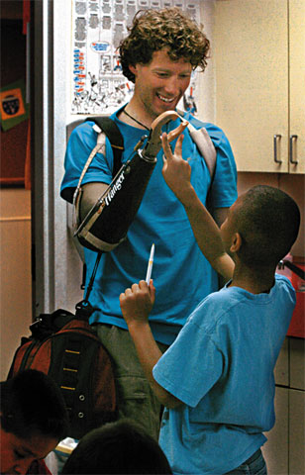
Motivation
Motivation is a need or desire that energizes behavior and directs it towards a goal.
Aron Ralston was motivated to cut his arm to free himself from a rock that pinned him down.
AP Photo/ Rocky Mountain News, Judy Walgren
Aron Ralston
Notes:
127 Hours – story of a hiker trapped and forced to sever arm to survive.

Slide 3

Instincts & Evolutionary Psychology
Motivated by our inborn automated behaviors. The need to survive.
But instincts only explain why we do a small fraction of our behaviors.
Tony Brandenburg/ Bruce Coleman, Inc.
© Ariel Skelley/ Masterfile
Where the woman can build different kinds of houses
the bird builds only one kind of nest.
Notes:
OBJECTIVE 34-2| Discuss the similarities and differences between instinct theory and evolutionary perspective.

Slide 4
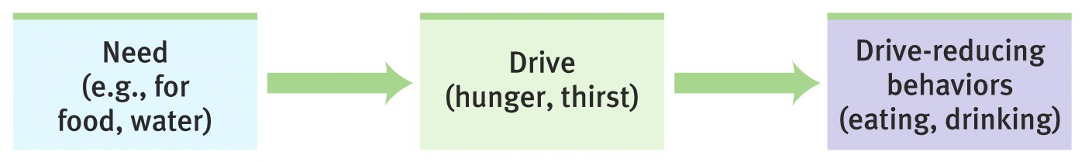
Drive-Reduction Theory
When the instinct theory of motivation failed it was replaced by drive-reduction theory.
Physiological need creates an aroused tension state (a drive) that motivates an organism to satisfy the need (Hull, 1951).
Physiological aim of drive reduction is homeostasis – maintenance of steady internal state, e.g., maintenance of steady body temperature.
Notes:
OBJECTIVE 34-3| Explain how drive-reduction theory views human motivation.

Slide 5

Incentive Theory
Where our needs (drives) push, incentives (positive or negative stimuli) pull us in reducing our drives.
A food-deprived person who smells baking bread
(incentive) feels strong hunger drive.
Incentives can also be negative, we may behave in a certain way in order to avoid an unpleasant outcome
You should see the connection between this theory and Behaviorist principles of learning (conditioning, Law of Effect, and the Premack Principle)
Notes:
Extrinsic vs. Intrinsic motivation
This does not mean that it will always motivate behavior, only that it can.

Slide 6
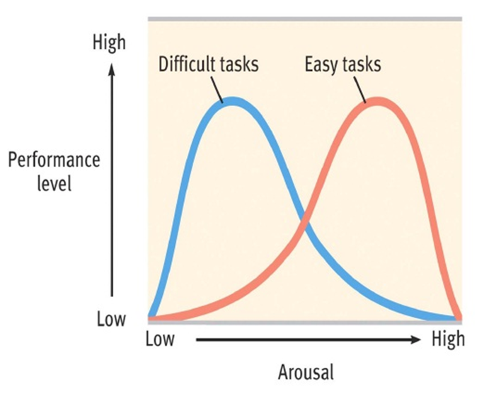
Arousal Theory
Sometimes we do not seek homeostasis. Sometimes we seek arousal or excitement.
We each have our own sense of appropriate arousal and we act in ways to remain at a comfortable level.
Yerkes-Dodson Law predicts that there is a relationship between the difficulty of a task, our level of arousal, and the eventual outcome
  For easy tasks=higher levels of arousal
  For difficult tasks= moderate levels work best
Notes:
OBJECTIVE 34-4| Discuss the contribution of arousal theory to the study of motivation.
People with high optimum levels of arousal will be drawn to high excitement behaviors, like bungee jumping. While the rest of us are satisfied with less exciting and less risky activities. In general, most perform best with an optimum level of arousal, although this varies with different activities. We might perform well at an easy task with a high level of arousal, but the same high level of arousal would prevent us from performing well on a difficult task. In general we perform better perform best at moderate levels of arousal. This concept is called the Yerkes-Dodson law. Think about getting ready for the SATs. If you are too pumped up, your sympathetic nervous system kicks in and it is hard to concentrate. If you are not aroused at all, you just won't put your all in and still will not perform well. The Yerkes-Dodson law basically states that their is a middle, or moderate, level or arousal in which we all perform best.

Slide 7
Cognitive Theory
Combination of incentive and arousal theories.
Motivation results from individuals attempting to maintain order or balance and an understanding of the world.
  Believes that individual behavior is influenced by the way people perceive themselves and their environment.
  Takes into account effort needed to achieve goal.
  Students are motivated to engage in learning tasks to the extent that they expect to succeed and the degree to which they value the achievement of the task.
Notes:
Combination of incentive theory and arousal theory.
Connection to intrinsic and extrinsic motivation. External and internal locus of control. Learned helplessness.

Slide 8
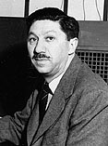
Hierarchy of Motives
Abraham Maslow suggested some needs have priority over others. Physiological needs like breathing, thirst and hunger come before psychological needs like achievement, self-esteem and need for recognition.
(1908-1970)
Notes:
OBJECTIVE 34-5| Describe Maslow’s hierarchy of needs.
Important to remember, that Maslow’s definition of a Self actualized person:
Has no mental illness
Satisfied in basic needs
Fully exploited talents
Motivated by values

Slide 9
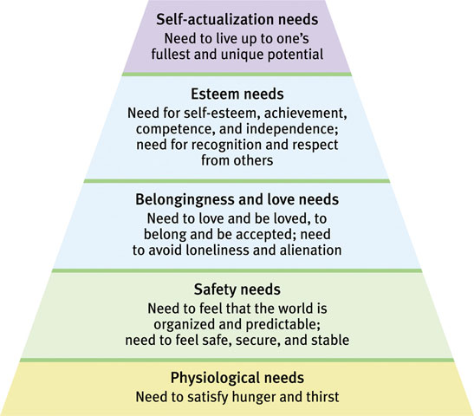
Hierarchy of Needs
Psychological
Needs
Physical
Needs

Slide 10
Hunger
Physiology of hunger
Parts of the hypothalamus
Set Point theory
Eating Disorders

Slide 11
Hunger
When do we eat?
When we are hungry.
When are we hungry?
When there is no food in our stomach.
How do we know when our stomach is empty?
Stomach growls. Also called hunger pangs.

Slide 12
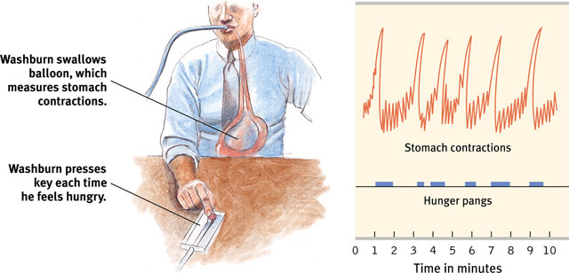
The Physiology of Hunger
Stomach contractions or pangs send signals to the brain making us aware of our hunger. Studies show only partial relation.
Those with their stomachs removed still feel hunger.
Notes:
OBJECTIVE 35-1| Describe the physiological determinants of hunger.

Slide 13
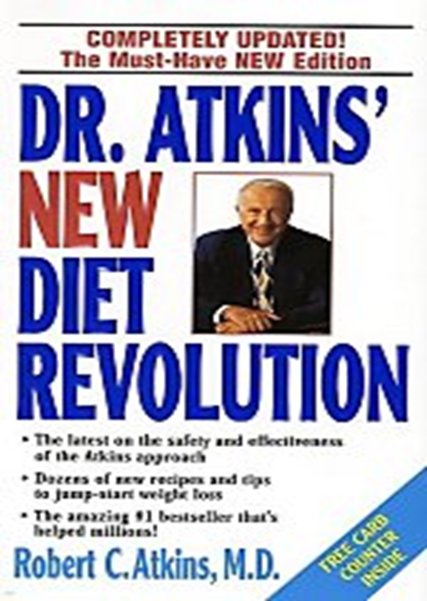
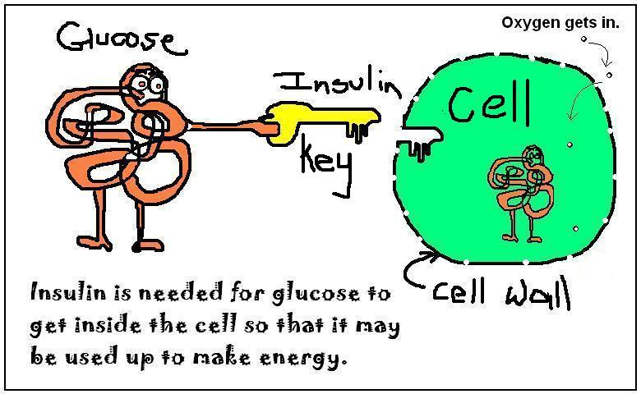
Body Chemistry: Glucose
Glucose level in the blood is maintained. The hormone insulin converts glucose to fat. This decreases the level of glucose in blood - makes us feel hungry.

Slide 14
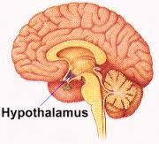
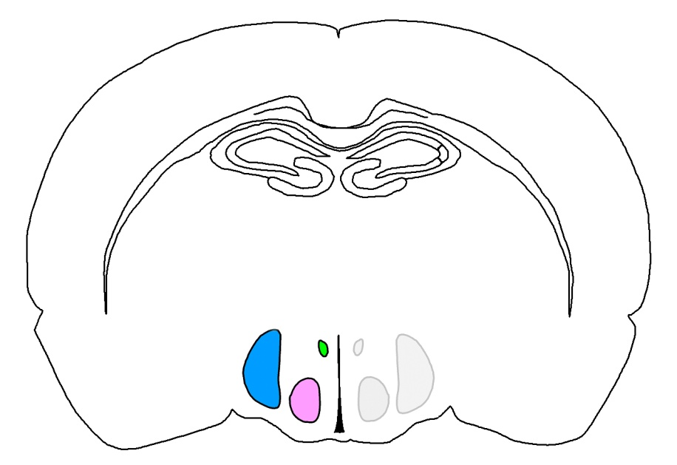
The Brain: Glucose
Levels of glucose in the blood are monitored by receptors (neurons) in the stomach, liver, intestines, they send signals to the hypothalamus in the brain.
Rat Hypothalamus

Slide 15
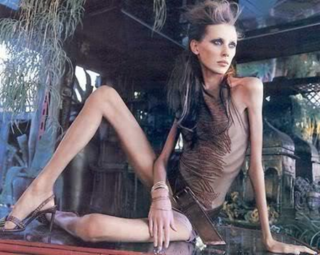
Hypothalamic Centers
Lateral hypothalamus (LH) brings on hunger (stimulation). Destroy it and the animal has no interest in eating.
Reduction of blood glucose stimulates orexin in LH which leads to ravenous eating in rats.
Lat = Fat

Slide 16
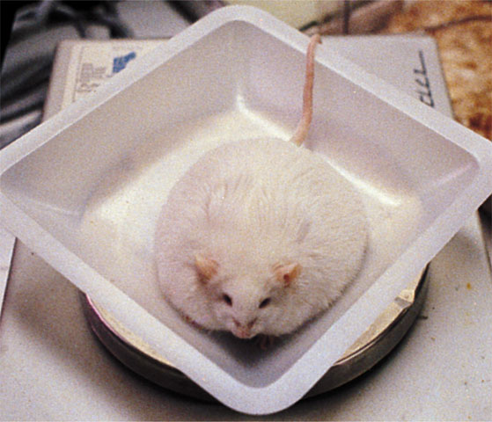
Hypothalamic Centers
Ventromedial hypothalamus (VMH)
depresses hunger
(stimulation).
Destroy it and the animal eats excessively.
Ven = Thin

Slide 17
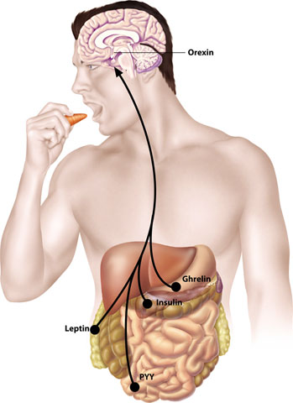
Hypothalamus & Hormones
Hormone | Tissue | Response
Orexin increase | Hypothalamus | Increases hunger
Ghrelin increase | Stomach | Increases hunger
Insulin increase | Pancreas | Increases hunger
Leptin increase | Fat cells | Decreases hunger
PYY increase | Digestive tract | Decreases hunger
Hypothalamus monitors a number of hormones that
are related to hunger.

Slide 18
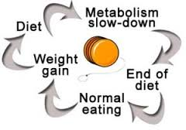
Hypothalamus: Set-Point Theory
We are meant to be in a certain weight range.
Manipulating lateral and ventromedial hypothalamus alters the body’s “weight thermostat.” (Homeostasis)
When we fall below weight our body will increase hunger and decrease energy expenditure (Basic Metabolic Rate).
What happens if we go above?

Slide 19

The Psychology of Hunger
What psychological and cultural factors influence hunger?
Externals: people whose eating is triggered more by the presence of food than internal factors.
Notes:
OBJECTIVE 35-2| Discuss psychological and cultural influences on hunger.

Slide 20
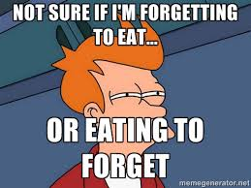
Memory and Hunger
Memory plays an important role in hunger.
Due to difficulties with retention, amnesia patients eat frequently, if given food (Rozin et al., 1998).
On the other hand, Alzheimer’s patients may forget to eat.

Slide 21
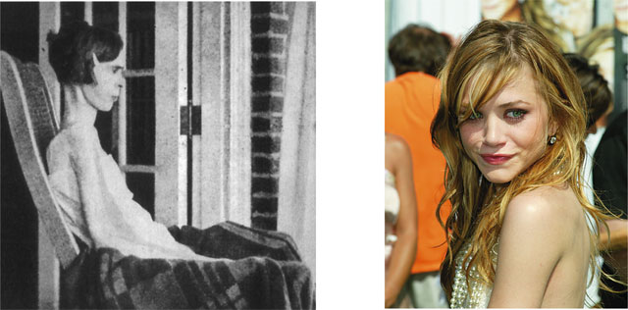
Eating Disorders
Anorexia Nervosa: Characterized by a normal-weight person (usually adolescent women) losing weight continuously and yet feeling overweight.
Reprinted by permission of The New England
Journal of Medicine, 207, (Oct 5, 1932), 613-617.
Lisa O’Connor/ Zuma/ Corbis
Notes:
OBJECTIVE 35-3| Explain how the eating disorders anorexia nervosa and bulimia nervosa demonstrate the influence of psychological forces on physiologically motivated behaviors.

Slide 22
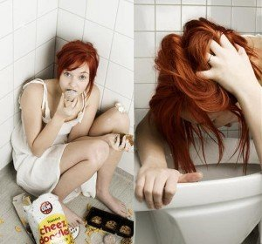
Eating Disorders
Bulimia Nervosa: A disorder characterized by episodes of overeating, usually of high-calorie foods, followed by vomiting, laxative use, fasting, or excessive exercise.

Slide 23
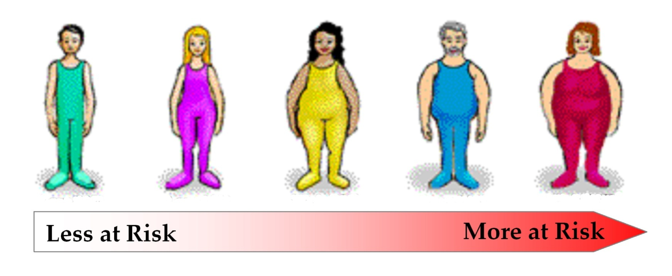
Obesity
A disorder characterized by excessive overweight. Obesity increases risk and health issues like cardiovascular diseases, diabetes hypertension, arthritis, and back problems.
http://www.cyberdiet.com

Slide 24
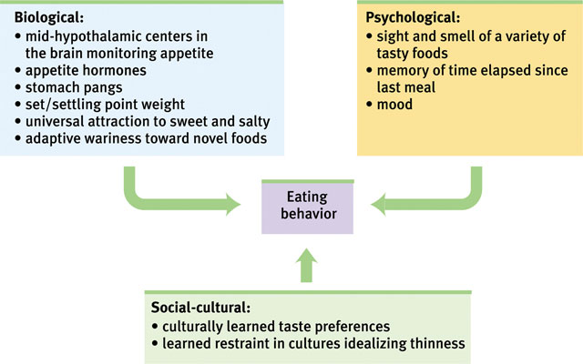
Summary

Slide 25

The Benefits of Belonging
Enhanced survival
How belonging influences our thoughts and emotions
Attachment
  Anxious
  attachment
  Insecure
  avoidant attachment

Slide 26
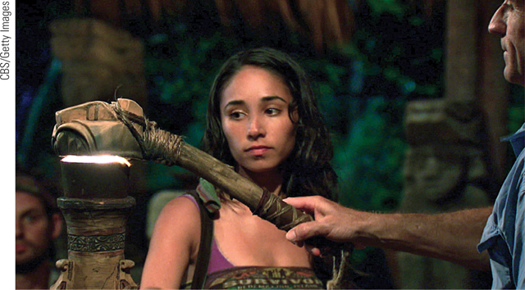
The Pain of Being Shut Out
Ostracism
Cyberostracism
Anterior cingulate cortex
Influences on behavior

Slide 27
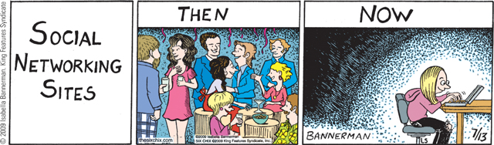
Connecting and Social Networking
Mobile Networks and Social Media
Cell phones
Texting and email
Facebook and twitter

Slide 28
Connecting and Social Networking
The Social Effects of Social Networking
Have social networking sites made us more, or less, socially isolated?
Does electronic communication stimulate healthy self-disclosure?
Do social networking profiles and posts reflect people’s actual personalities?
  Does social networking promote narcissism?

Slide 29
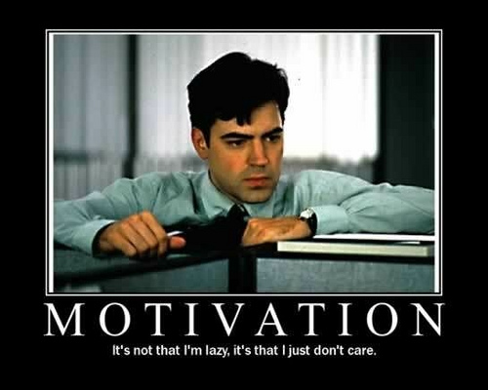
Motivation at Work
The healthy life, said Sigmund Freud, is filled by love and work.
Notes:
OBJECTIVE 37-1| Discuss the importance of flow, and identify the two subfields of industrial-organizational psychology.

Slide 30
Attitudes Towards Work
People have different attitudes towards work. Some take it as a:
Job: Necessary way to make money.
Career: Opportunity to advance from one position to another.
Calling: fulfilling a socially useful activity.

Slide 31
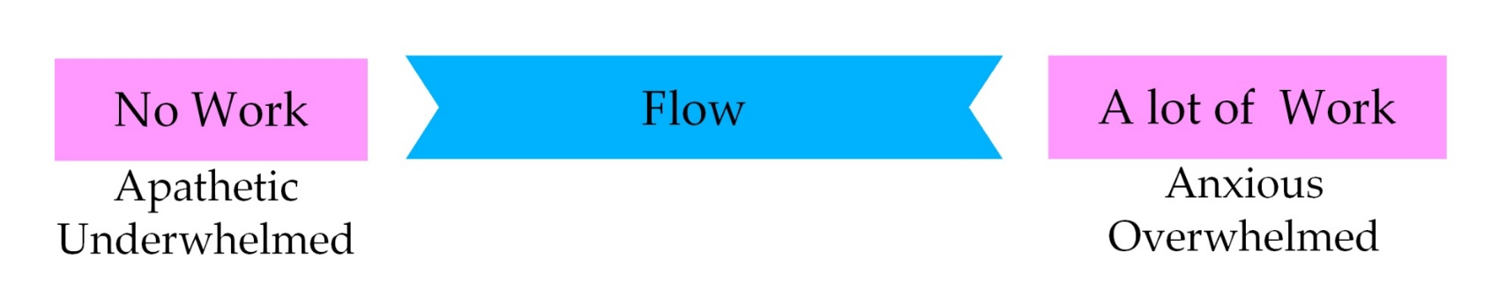
What Motivates Us?
Achievement - need for success or the attainment of excellence. Grit. Extrinsic or Intrinsic rewards
Flow marks immersion into one’s work. Experience between no work and a lot of work.
People who “flow” in their work (artists, dancers, composers etc.) are driven less by extrinsic rewards and more by intrinsic rewards.
Notes:
RSA Animate – cartoon on motivation

Slide 32
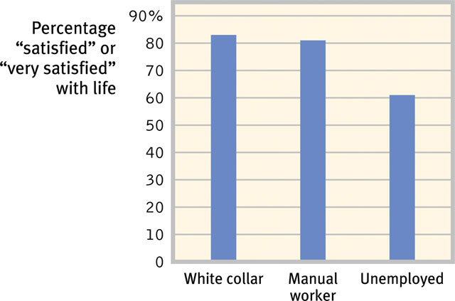
Work and Satisfaction
In industrialized countries work and satisfaction go hand-in-hand.

Slide 33
Industrial-Organizational (I/O) Psychology
Applies psychological principles to workplace.
Personnel Psychology: Principles of selecting and evaluating workers.
Organizational Psychology: Studies how work environments and management styles influence worker motivation, satisfaction, and productivity.

Slide 34
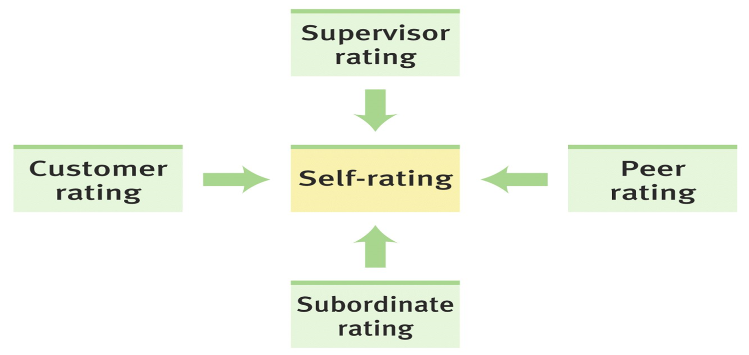
Harnessing Strengths
Identifying people’s strengths (analytical, disciplined, eager to learn etc.) and matching them to work is the first step toward workplace effectiveness.
How to do it successfully:
Appraisal of Performance: 360 Degree Feedback
Notes:
Task leadership (best for reaching specific goal) vs. social leadership (best for morale) Terry Tate

Slide 35


Motivation through Leadership
Task Leadership
  goal-oriented leadership that sets standards, organizes work, and focuses attention on goals
Social Leadership
  group-oriented leadership that builds teamwork, mediates conflict, and offers support
Notes:
Task leadership (best for reaching specific goal) vs. social leadership (best for morale) Terry Tate

Slide 36
Theories of Management X, Y, Z
Theory X states that people are lazy and must be monitored at all times, offered extrinsic motivation.
Theory Y states that people are intrinsically motivated, and want to do well in their work. More hands-off type of management.
Theory Z states that employers who invest in the employees and provide opportunities for self-fulfillment, will reap the benefits of happy employees (productivity and job satisfaction)

Slide 37

Satisfaction & Engagement
Harter et al., (2002) observed that employee engagement meant that the worker knows:
What is expected of him.
Feels the need to work.
Feels fulfilled at work.
Gets opportunities to do the best.
Thinks himself to be a part of something significant.
Has opportunities to learn and develop.
Contributes to the workplace for the common good.
Capital-Journal/ David Eulitt/ AP/ Wide World Photos
Engaged workers are more productive
than non-engaged at different stores
of the same chain.
Notes:
Picture of Dwight

Slide 38
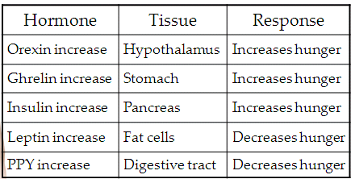
AP Info
Drive-reduction theory (give an example)
Which part of the hypothalamus does what?
Know your hormones (where does the signal come from…before that…?)

Slide 39
More AP info…
Maslow-hierarchy of needs
Drive-reduction theory of motivation
Instinct theory
LH starts feeding, VMH stops feeding
Feel good-do good phenomenon
Intrinsic vs extrinsic motivation, remember the overjustification effect?

Slide 40
Introduction to Emotion
James Lange Theory
Cannon-Bard Theory
Schacter-Singer Theory (2 factor)
Autonomic Nervous System

Slide 41
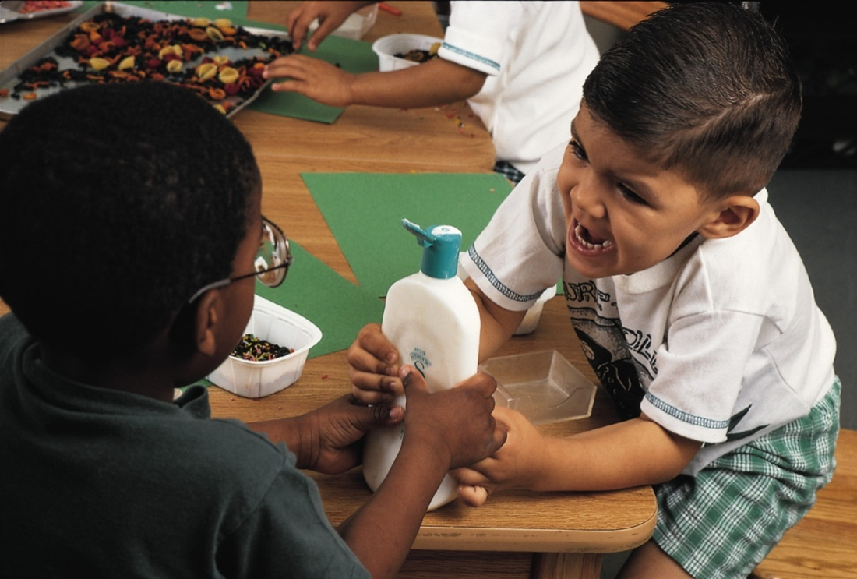
Theories of Emotion
Emotions are our body’s adaptive response.
Emotions are a mix of 1) physiological arousal, 2) expressive behaviors, 3) conscious experience
Notes:
OBJECTIVE 38-1| Identify three components of emotions, and contrast James-Lange, Canon-Bard and two factor theories of emotion.
Do you feel before you are aroused? Do you have a conscious experience so then you have expressive behaviors? How does thinking and feeling interact?

Slide 42
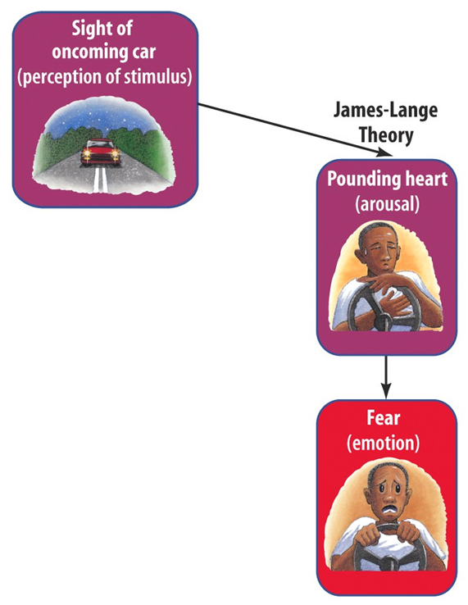

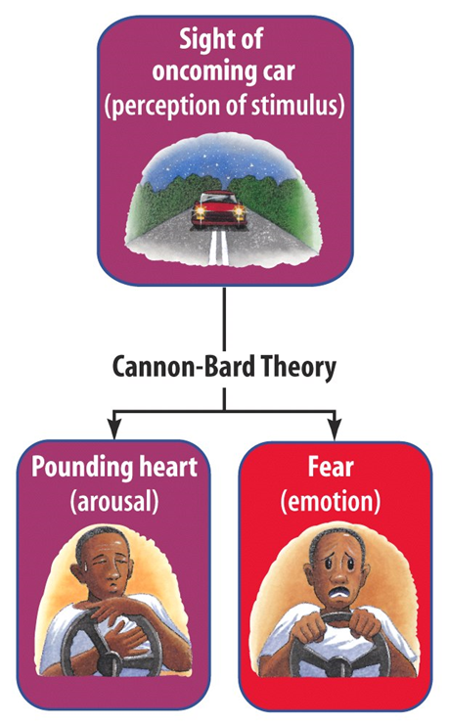
Historical Emotion Theories
Common Sense theory
  We perceive an emotion which causes a physical response
James-Lange Theory
  physiological activity precedes the emotional experience. (We react to the changes in our body that we feel)
Cannon-Bard Theory
  emotion-triggering stimulus and body's arousal take place simultaneously. (Lower spine injuries vs. High spinal cord injury)
Notes:
J-L = We do not run from a tiger because we are afraid. We are afraid because we ran from the tiger.
C-B = We run from a tiger AS we are afraid of the tiger Low spine didn’t feel a change in emotion but higher spine did feel change in anger (lower) and sadness (higher)

Slide 43
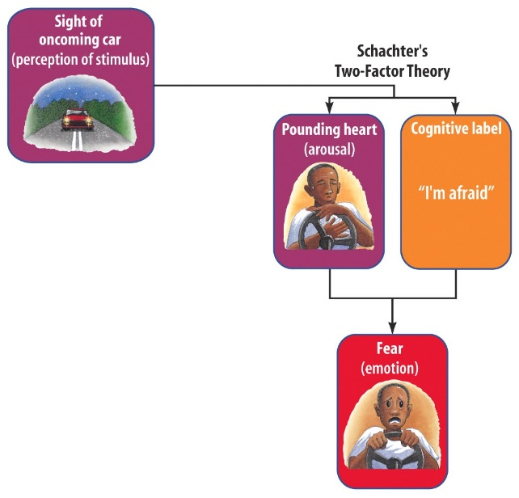
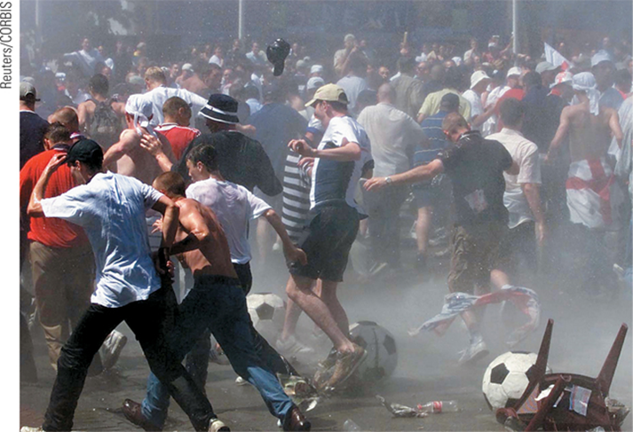
Two-Factor Theory
Schachter – Singer
Emotions have two factors – physical arousal and cognitive label.
Spillover Effect – tendency of one person's emotion to affect how other people around them feel.
Notes:
Perception and thought about a stimulus influence the type of emotion felt
Degree of bodily arousal influences the intensity of emotion felt

Slide 44
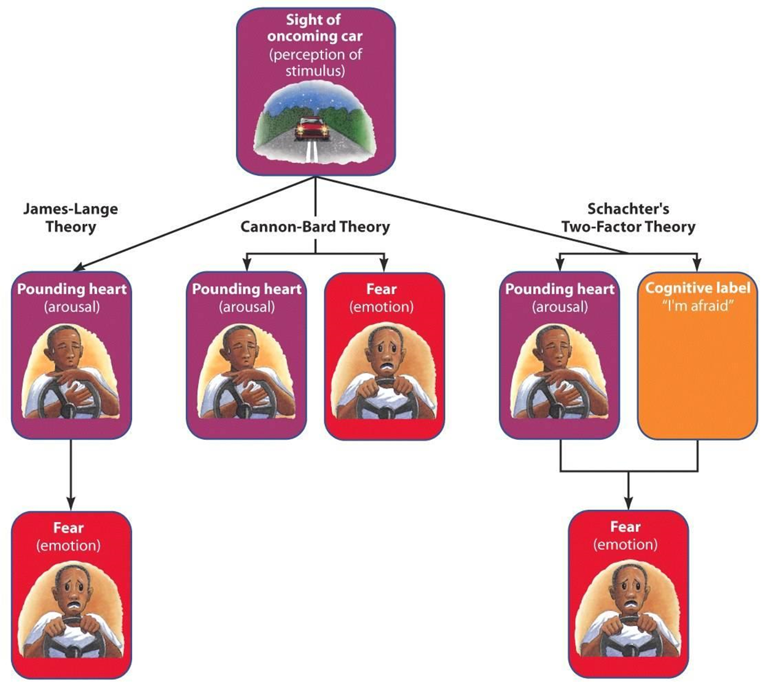

Slide 45
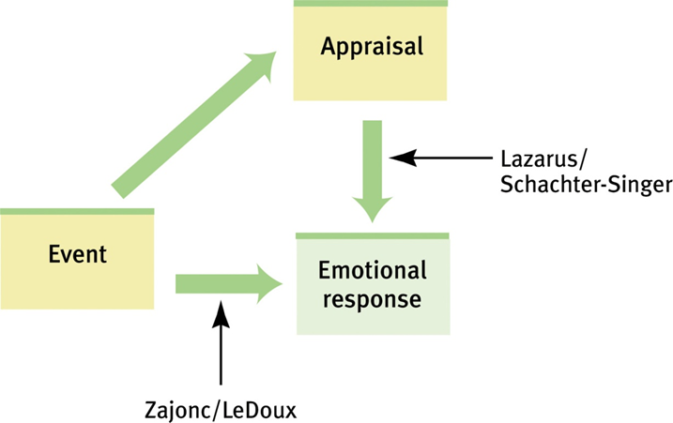
Cognition and Emotion
What is the connection between how we think (cognition) and how we feel (emotion)?
Can we change our emotions by changing our thinking?
Zajonc and LeDoux (1984) - some emotions are immediate without conscious appraisal.
Lazarus, Schachter and Singer (1998) emphasize that appraisal also determines emotions.

Slide 46
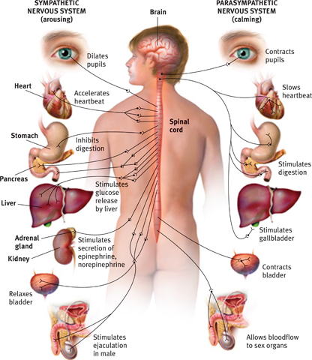
Embodied Emotion
Emotions and the Autonomic Nervous System
Autonomic nervous system
  Sympathetic nervous system
    arousing
  Parasympathetic nervous system
    Calming
  Yerkes Dodson Law
  Fight or flight

Slide 47
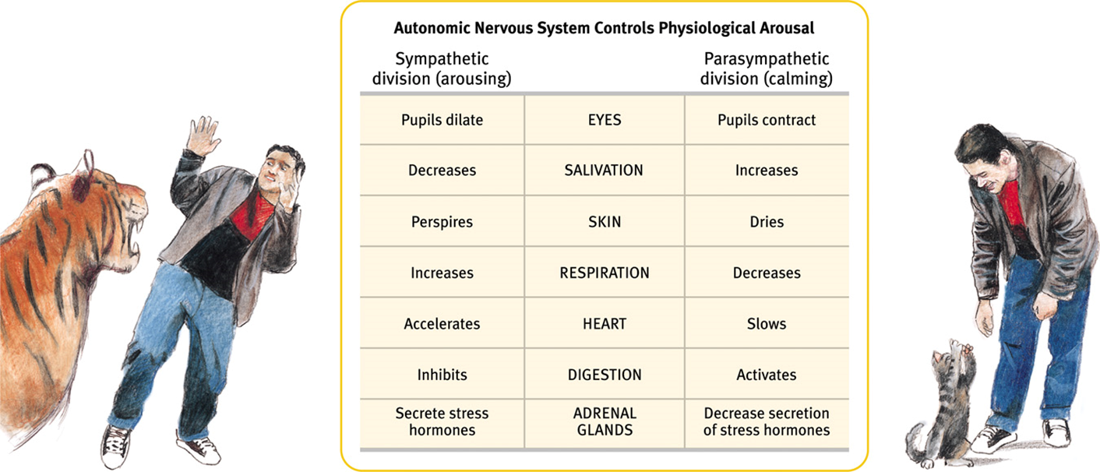
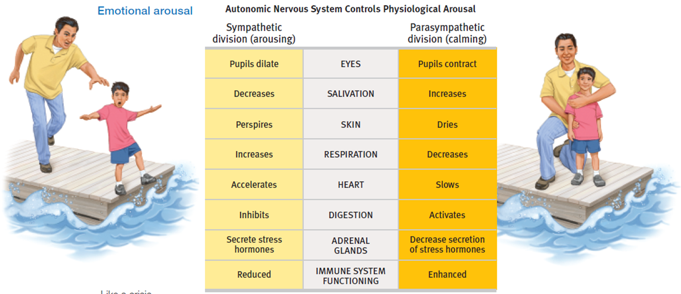
Embodied Emotion
We know that emotions involve bodily response. Some of these response are easy to notice (butterflies in stomach when fear arises) but others are more difficult discern (neurons activated in the brain).
Notes:
During an emotional experience our autonomic nervous system mobilizes energy in the body and arouses us.

Slide 48
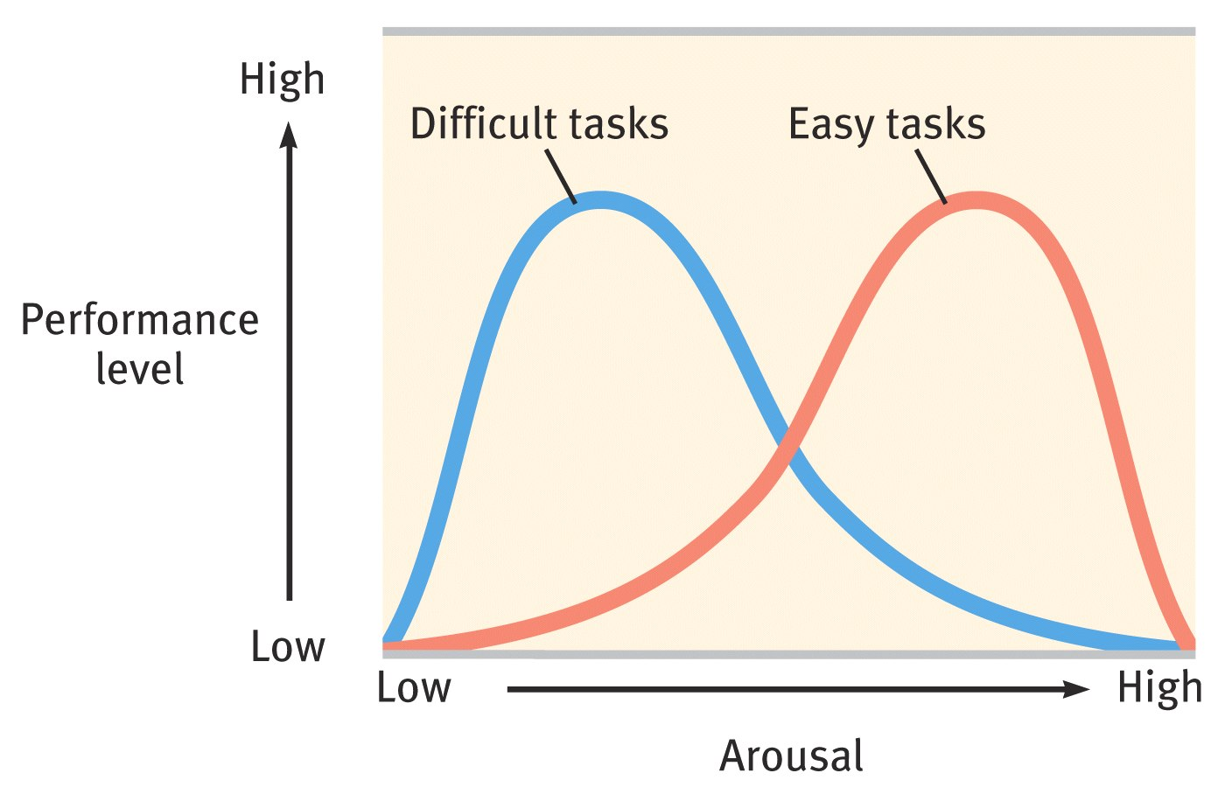
Arousal and Performance
(remember Yerkes-Dodson??)
Arousal in short spurts is adaptive. We perform better under moderate arousal, however optimal performance varies with task difficulty.
Notes:
OBJECTIVE 38-3| Discuss the relationship between arousal and performance.

Slide 49
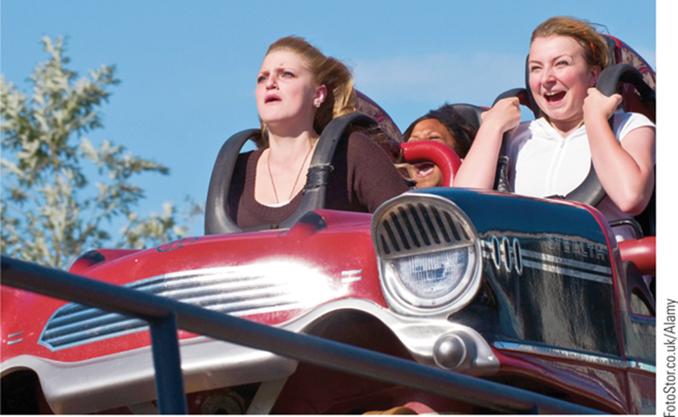
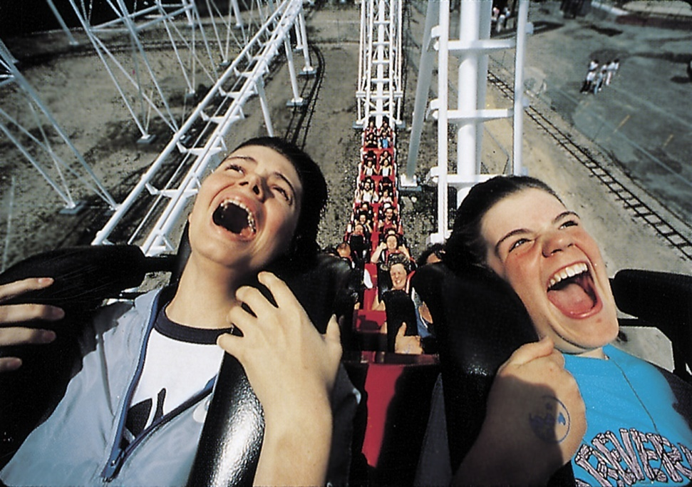
Physiological Similarities
Physiological responses are pretty much similar across the emotions of fear, anger, joy, and love.
Your body only has one response to stress and it involves activating your sympathetic nervous system. This is not always healthy
Excitement and fear involve similar
physiological arousal.
Notes:
OBJECTIVE 38-4| Name three emotions that involve similar physiological arousal.

Slide 50
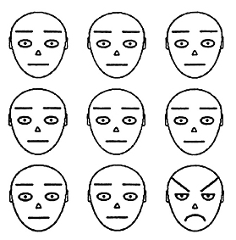
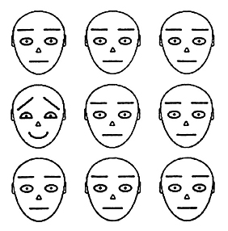
The Expression of Emotion:
Nonverbal Communication
Nonverbal Communication: Most of us are good at deciphering emotions thorough non-verbal communication. In a crowd of faces a single angry face will “pop out” faster than a single happy face (Fox et al. 2000).
Notes:
OBJECTIVE 39-1| Describe some of the factors that affect our ability to decipher non-verbal cues.

Slide 51
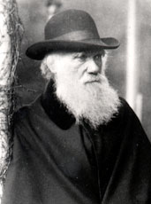
Emotions are Adaptive
Darwin speculated that our ancestors communicated with facial expression in the absence of language. Nonverbal facial expression led to their survival.
Charles Darwin (1809-1882)

Slide 52
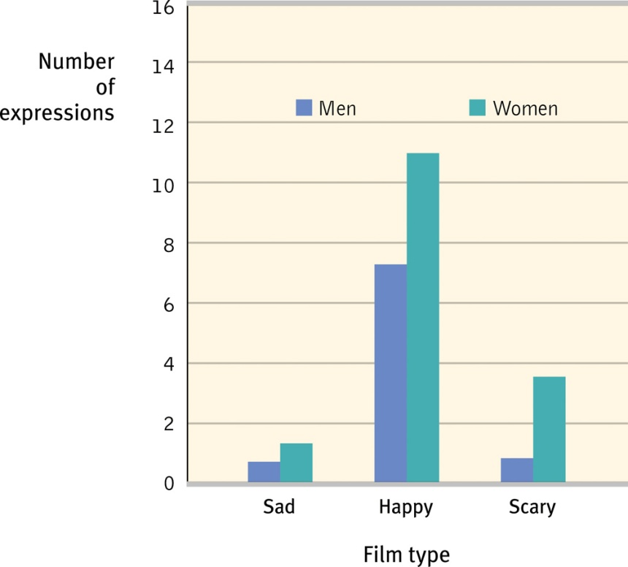
Gender, Emotion, and Nonverbal Behavior
Women are much better at discerning nonverbal emotions then men. When shown sad, happy and scary film clips women expressed emotions more than men.
Notes:
OBJECTIVE 39-2| Describe some gender differences in perceiving and communicating emotions.

Slide 53
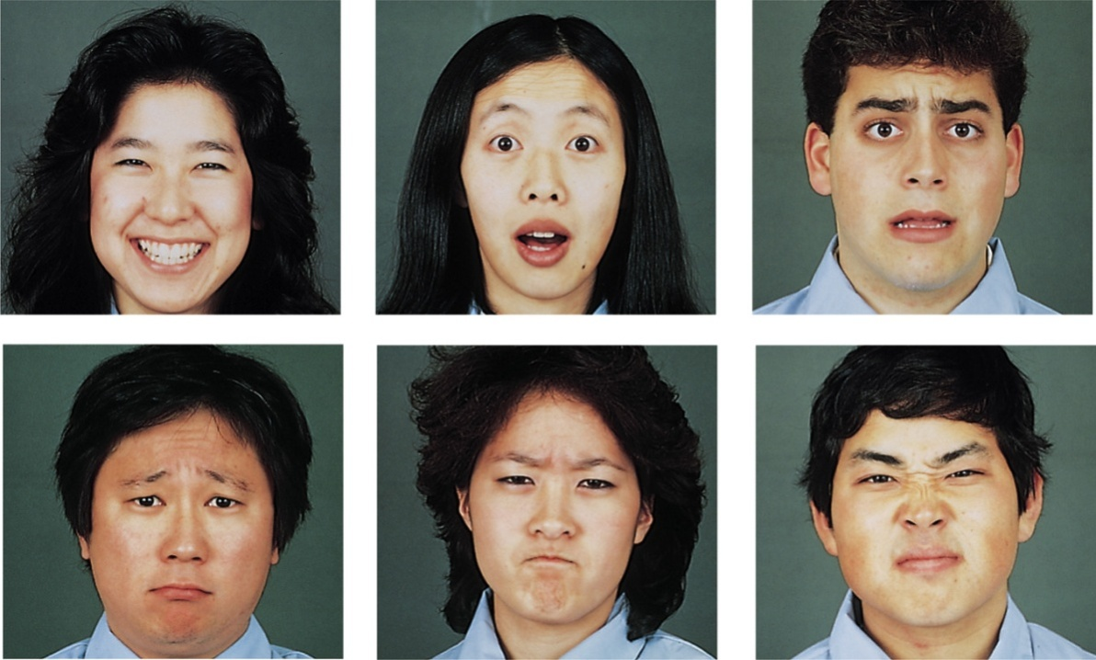
Culture and Emotional Expression
When culturally diverse people were shown basic facial expressions, they did pretty well at recognizing them (Ekman & Matsumoto, 1989).
Elkman & Matsumoto, Japanese and
Caucasian Facial Expression of Emotion
Ekman’s Facial Feedback Theory - Each basic emotion is associated with a unique facial expression. Sensory feedback from the expression contributes to the emotional feeling.
Example: Smile if you want to feel happy. ☺
Notes:
OBJECTIVE 39-4| Discuss the culture-specific and culturally universal aspects of emotional expression, and explain how emotional expressions can enhance survival.

Slide 54
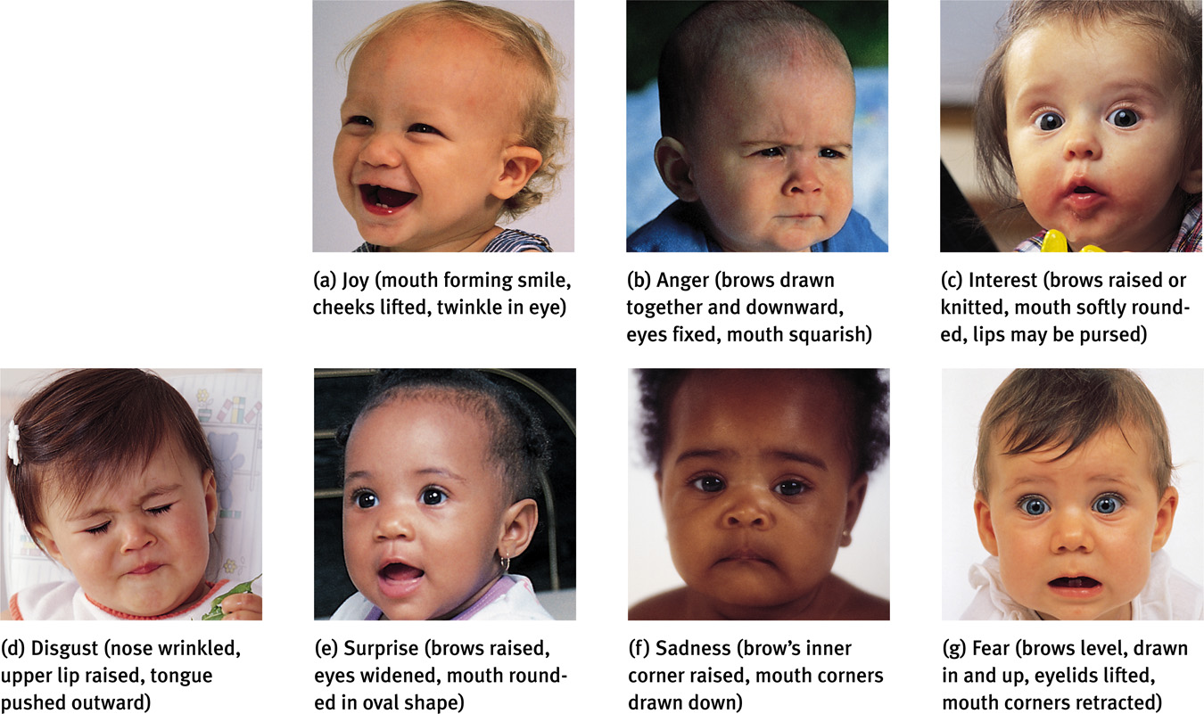
Izard (1977) has isolated 10 emotions. And most of
them are present in infancy, excluding contempt,
shame and guilt.
Tom McCarthy/ Rainbow
Nancy Brown/ The Image Bank
Notes:
OBJECTIVE 40-1| Name the 10 basic emotions, and describe two dimensions psychologists use to differentiate emotions.

Slide 55
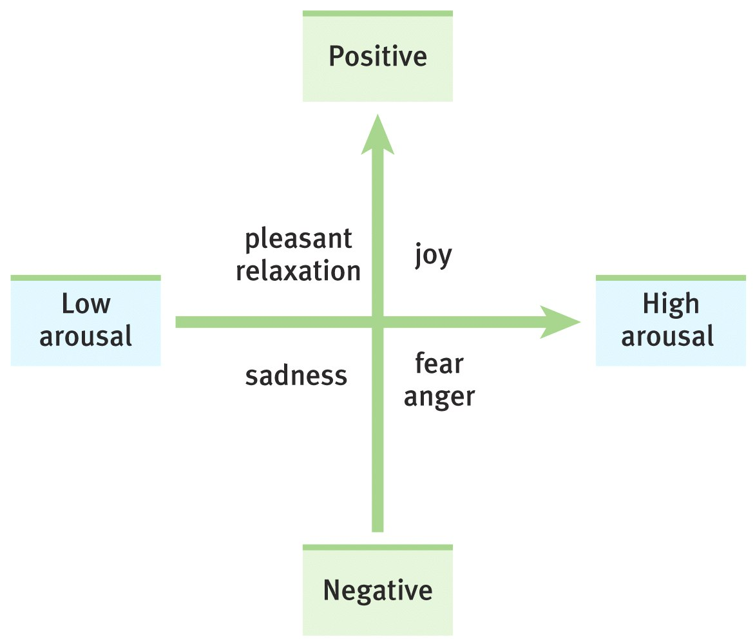
Dimensions of Emotion
People generally divide emotions into
two dimensions

Slide 56

Fear
Fear can torment us, rob us of sleep and preoccupy our thinking.
But fear can be adaptive – it makes us run away from danger, brings us closer as groups, protects us from injury and harm.
We learn fear in two ways through conditioning (Watson – Little Albert) and/or through observation (Bandura – Bobo Doll).
Some fears are easier to learn than others. The amygdala in the brain associates emotions like fear with certain situations and its proximity to the hippocampus allows for the easy encoding of these memories.

Slide 57
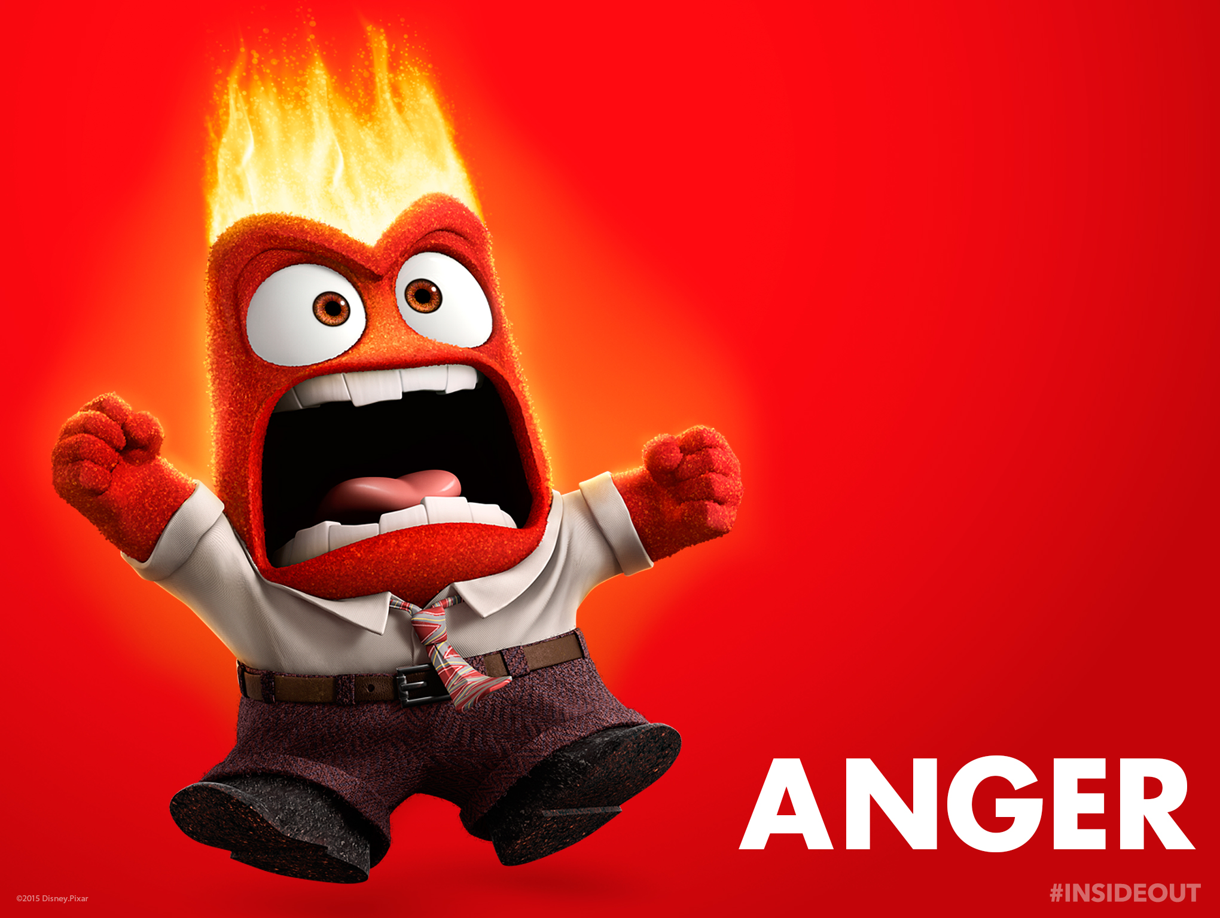
Anger
People generally get angry with friends and loved ones about misdeeds, especially if they are willful, unjustified, and avoidable.
People also get angry about foul odors, high temperatures, traffic jams, aches and pains.

Slide 58
Catharsis Hypothesis
Venting anger through action or fantasy achieves emotional release or “catharsis.”
Some believe that we are drawn to displays of violence (football, etc) because it is cathartic and allows us an outlet for aggression.
Expressing anger breeds more anger, and through reinforcement, is habit forming.

Slide 59
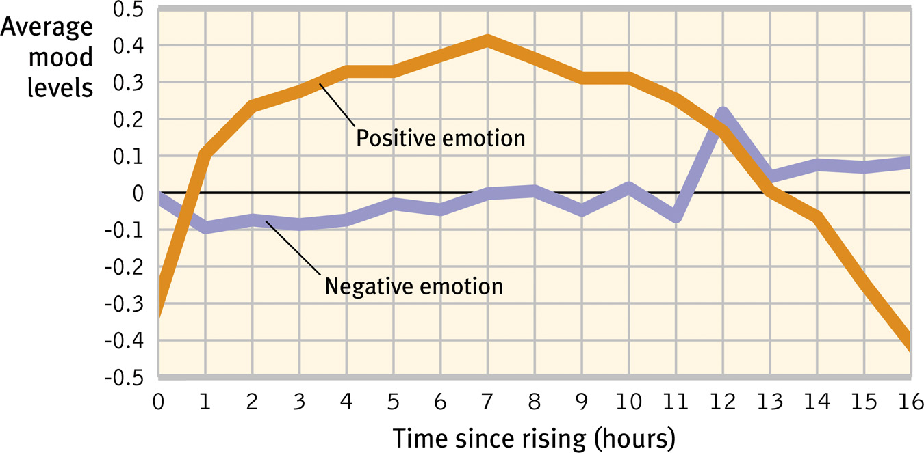
Emotional Ups and Downs
Our positive moods rise to a maximum within 6-7 hours after waking up. Negative moods stay more or less the same over the day.
Notes:
OBJECTIVE 40-6| Discuss some of the daily and longer-term variations in the duration of emotions.

Slide 60

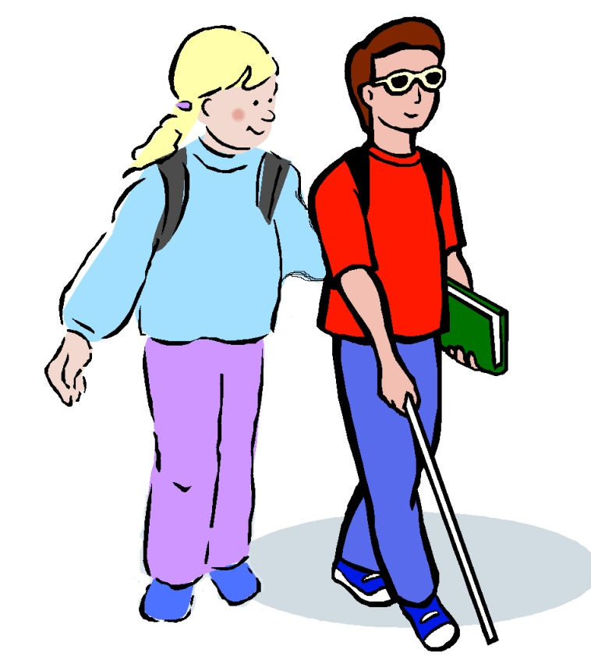
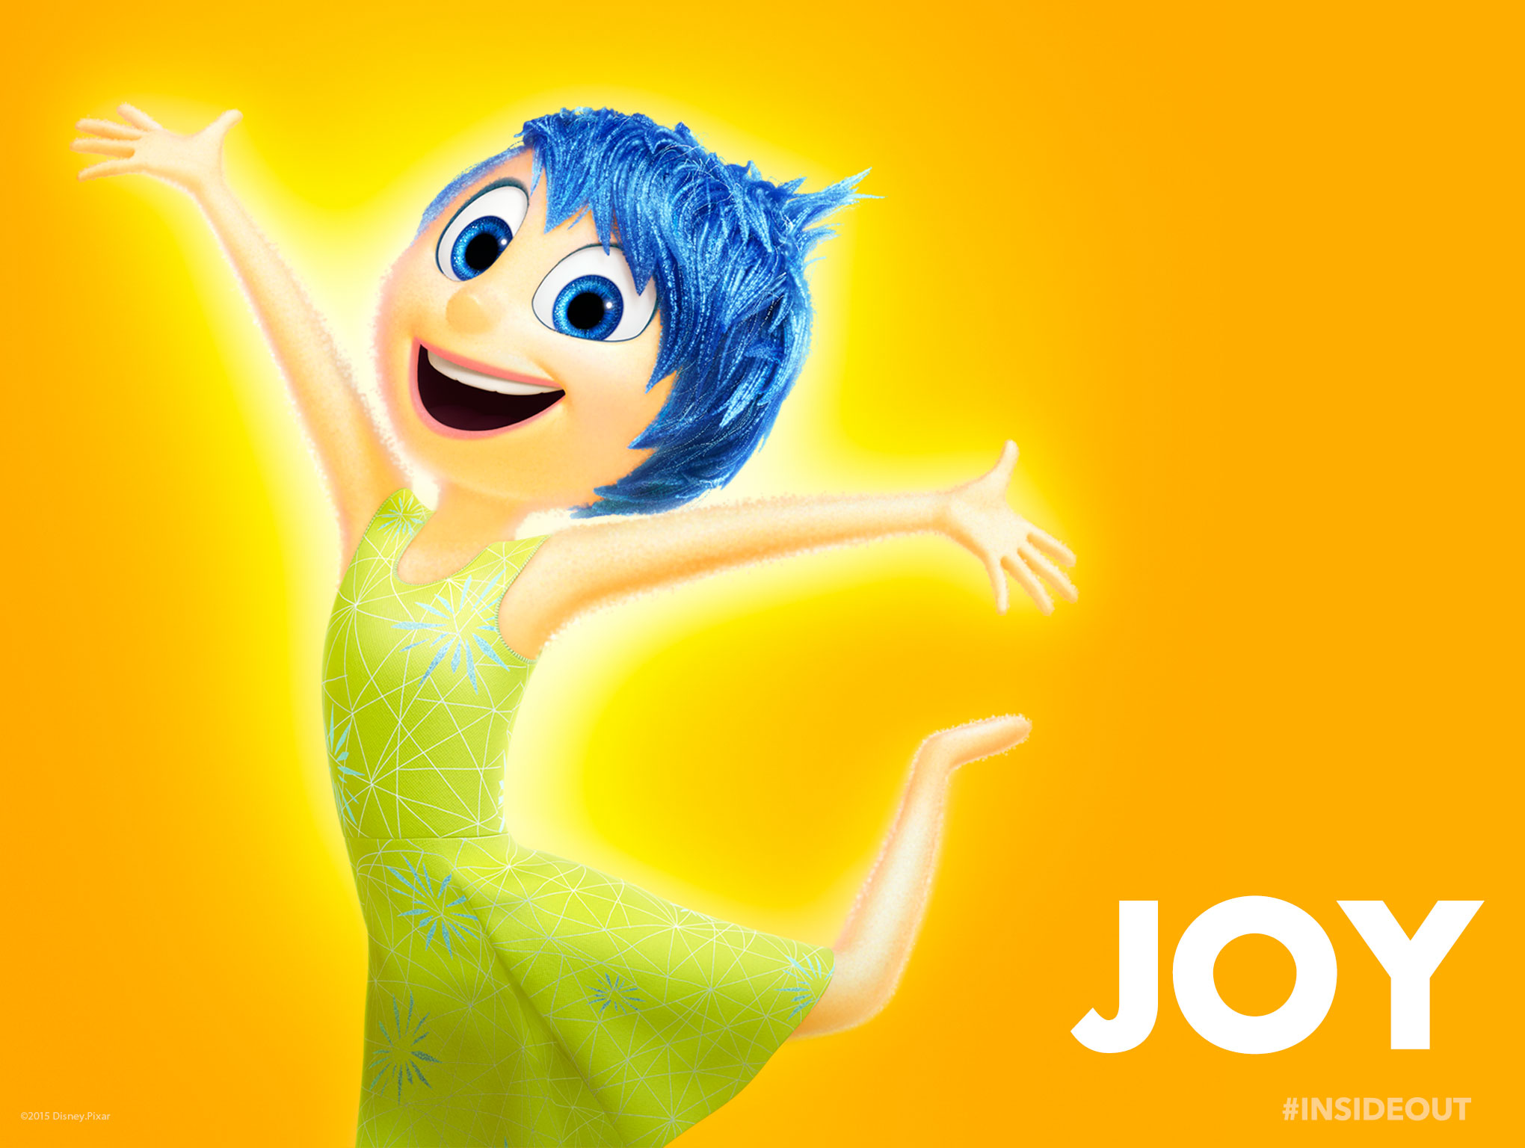
Happiness
Feel-Good, Do-Good phenomenon - When we feel happy we are more willing to help others. This is a good example of the “spill over effect”

Slide 61

Happiness & Satisfaction
Subjective well-being (happiness + satisfaction) measured in 82 countries show Puerto Rico and Mexico (poorer countries) at the top of the list.

Slide 62
Happiness & Prior Experience
Adaptation-Level Phenomenon: Like sensory adaptation to brightness, volume, and touch, people adapt to new situations until that situation becomes the “norm”. Then people need a new experience.
This constantly raises the level for what is considered new and exciting
In baseball, the Cardinals are used to being a successful team, and we are used to rooting for a winner. What would happen if they started having really bad seasons?
Notes:
OBJECTIVE 40-8| Contrast the effects on happiness of the adaptation-level and the relative-deprivation principles.

Slide 63





Slide 64
Happiness & Others’ Attainments
Happiness is not relative to our past but also to our comparisons with others. Relative Deprivation is the perception that one is worse off relative to those with whom one compares oneself with.
They realize that they have less of what they believe themselves to be entitled than those around them.
Can lead to social movements, deviance, rioting, civil wars, etc

Slide 65

Analyzing Emotion
Analysis of emotions is carried out on different levels.

Slide 66
AP Info…
Know the theories of how we experience emotion. Which one involves a cognitive label?
What role does conditioning play in our emotions? Schemas?
Yerkes-Dodson-optimum level of arousal

Slide 67
More AP info…
James-Lange (arousal leads to emotion)
Cannon-Bard (simultaneous experience)
Schacter-Singer (2 factor, cognitive label)
Sternberg triangle theory of love (passion-commitment-intimacy)

Slide 68
Stress
Stress and stressors
Stress response system

Slide 69
Stress
The process by which we perceive and respond to certain events, called stressors, that we appraise as threatening or challenging
Is a process of perceiving and responding
The response is called a stress reaction.

Slide 70

Stress: Some Basic Concepts
Stress
  Stress appraisal

Slide 71




What are your sources of stress?

Slide 72

Stress in Gender: Is there a difference?

Slide 73
Measures of Stressors - SRRS
Social Readjustment Rating Scale (SRRS)
  Assesses impact of major life changes
  A total of 150 or less is good, suggesting a low level of stress in your life and a low probability of developing a stress-related disorder.
  If your score is 300 or more, statistically you stand an almost 80% chance of getting sick in the near future.
  If your score is 150 to 299, the chances are about 50%. At less than 150, about 30%.
  This scale seems to suggest that change in ones life requires an effort to adapt and then an effort to regain stability.

Slide 74
SRRS
Life Event | Value
Death of Spouse | 100
Divorce | 73
Marital separation | 65
Jail term | 63
Death of close family member | 63
Personal injury or illness | 53
Marriage | 50
Fired at work | 47
Marital reconciliation | 45
Retirement | 45
Change in health of family member | 44
Pregnancy | 40
Sex difficulties | 39
Gain of new family member | 39
Business readjustment | 39
Change in financial state | 38
Death of close friend | 37
Change to a different line of work | 36
Change in number of arguments with spouse | 35
Home Mortgage over $100,000* | 31
Foreclosure or mortgage or loan | 30
Change in responsibilities at work | 29
Son or daughter leaving home | 29
Trouble with in-laws | 29
Outstanding personal achievement | 28
Spouse begins or stops work | 26
Begin or end school | 26
Change in living conditions | 25
Revision of personal habits | 24
Trouble with boss | 23
Change in work hours or conditions | 20
Change in residence | 20
Change in schools | 20
Change in recreation | 19
Change in church activities | 19
Change in social activities | 18
Mortgage or loan of less than $100,000* | 17
Change in sleeping habits | 16
Change in number of family get-togethers | 15
Change in eating habits | 15
Single person living alone | **
Other- describe | **
Total:

Slide 75

College Undergraduate Stress Scale (CUSS)
The average score is 1247 with scores ranging from 182 to 2571. The normal range is from 800 to 1700.
The average college student experiences 15 to 20 stressful events a year.

Slide 76

Stress in Age: Is there a difference?
Remember – PERCEPTION of stress. As we age, our emotional responses tend to be less extreme.

Slide 77

Stress and Stressors
Stress is a slippery concept. At times it is the stimulus (missing an appointment) and at other times it is a response (sweating while taking a test).
Notes:
OBJECTIVE 41-2| Discus the importance of appraisal in the way we respond to stressful events.

Slide 78

Stress categories
Biogenic Stressors:
  Stimulants - cause stress by virtue of the biochemical actions they exert on the human body
  Coffee, Nicotine, Amphetamine, Chocolate.

Slide 79

Stress categories
Psychosocial Stressors:
  Combination of an individuals thought processes as well as social circumstances imposed on him or her, e.g. meeting a deadline, being assigned to a new mission.
  Each person handles stress in different ways depending on their perception

Slide 80
Stressful Life Events
Catastrophic Events: earthquakes, combat stress, floods lead individuals becoming depressed, sleepless, and anxious.
Significant Changes: Death of a loved one, divorce, loss of job, promotion.
This can lead to “acute” stress - may leave individual vulnerable to death or illness in the weeks following the event.
Notes:
OBJECTIVE 41-4| Discuss the health consequences of catastrophes, significant life changes, and daily hassles.

Slide 81

Daily Hassles
Rush hour traffic, long lines, job stress, burnout are most significant sources of stress and can damage health
This can lead to “chronic” stress – depression, decreased performance, and cynicism
Also leads to hypertension, depressed immune system, increased risk of heart attack, and weight gain.

Slide 82

Uplifts
Opposed to daily hassles, we experience uplifts
  Pleasant, satisfying experiences
  May serve as buffers against hassles
According to Lazarus, Stress neither resides in the person nor the situation; it depends on the transaction between the two.

Slide 83

Types of Internal Conflicts by Lewin
Approach-approach: choice must be made between two attractive choices.
Avoidance-avoidance: choice must be made between two unattractive choices.
Approach-avoidance: a choice must be made about whether or not to pursue a single goal that has both attractive and unattractive aspects. (Multiple Approach-avoidance)

Slide 84

Stress and Illness
Stress can be adaptive – in a fearful (stress causing) situation we can run away and save our lives. Stress can be maladaptive – if it is prolonged (chronic stress) it increases the risk of illness and health problems.
Eustress vs. Distress

Slide 85


Stress and Causes of Death
Prolonged stress – together with unhealthy behaviors – can increase our risk for today's four leading diseases.

Slide 86
Behavioral Medicine
Centers for Disease Control (CDC) proclaim that half of the deaths in the US are due to people’s behaviors (smoking, alcoholism, unprotected sex, insufficient exercise, drugs and poor nutrition).
Psychologists and physicians have thus developed an interdisciplinary field of behavioral medicine that integrates behavioral and medical knowledge.

Slide 87
Health Psychology
Health psychology is a field of psychology that contributes to behavioral medicine. The field studies stress-related aspects of disease and asks:
How do emotions and personality factors influence risk of disease?
What attitudes and behaviors prevent illness and promote health and well-being?
How our perceptions determine stress?
How can we reduce or control stress?

Slide 88

The Stress Response System
Short term stress:
Fight-or-flight (Walter Cannon)
Basic instinct for survival. Sympathetic nervous system engaged. Production of epinephrine and norepinephrine from inner adrenal glands. Increase heart and respiration rates, mobilize sugar and fat and dull pain.
Notes:
OBJECTIVE 41-3| Identify and describe the dual-track system by which our body responds to stress, and give the three phases of the general adaptation syndrome.
There are two types of instinctive stress response that are important to how we understand stress and stress management: the short-term “Fight-or-Flight” response and the long-term “General Adaptation Syndrome”. The first is a basic survival instinct, while the second is a long-term effect of exposure to stress.
A third mechanism comes from the way that we think and interpret the situations in which we find ourselves.

Slide 89


The Stress Response System
Long term stress:
Extended exposure to stress. (Hans Selye) The hypothalamus and the pituitary gland also respond to stress by triggering outer adrenal glands to secrete glucocorticoids (cortisol).

Slide 90

General Adaptation Syndrome
(GAS)
Selye researched recurring responses to stress. Long term stress.
Concept of the body’s adaptive response to stress in three stages
  Alarm
  Resistance
  Exhaustion

Slide 91
General Adaptation Syndrome
Selye found human body to cope well with temporary stress – not long-term
  Stress ages the body – telomeres
Found adaptive behaviors to help
  Tend and Befriend (more likely female)
  Conserve energy – “Deer in Headlights”

Slide 92


Stress and health
Stress and the heart
Stress and the immune system
Stress and the brain

Slide 93

Stress and the Heart
Stress that leads to elevated blood pressure results in Coronary Heart Diseases clogging of the vessels that nourish the heart muscle.
Plaque in
coronary artery
Artery
clogged
Notes:
OBJECTIVE 41-5| Discuss the role of stress in causing coronary heart disease, and contrast Type A and Type B personalities.

Slide 94
Personality Types
Type A a term used for competitive, hard-driving, impatient, verbally aggressive, and anger-prone people. Type B easygoing, relaxed people (Friedman and Rosenman, 1974).
Type A are more likely to develop
coronary heart disease.

Slide 95

Pessimism and Heart Disease
Pessimistic adult men are twice as likely to develop heart disease over a 10 year period (Kubzansky et al., 2001).

Slide 96

Stress and Anger
When the stress is too much and is no longer a motivator, there is an anger outburst.
You can think of this as when there is a combination of stressors and things just keep piling up.

Slide 97


Stress and the Immune System
B lymphocytes fight bacterial infections,
T lymphocytes attack cancer cells, viruses, and
microphages ingest foreign substances. During stress
energy is mobilized away from the immune system
making it vulnerable.
Lennart Nilsson/ Boehringer Ingelhein International GmbH
Notes:
OBJECTIVE 41-7| Describe the effect of stress on immune system functioning.
Wounds heal faster when not stressed. (40% slower)

Slide 98

Stress and Colds
People with highest life stress scores were also most vulnerable when experimentally exposed to a cold virus.

Slide 99

Stress & Susceptibility to Disease
Psychophysical illness is any stress-related physical illness, such as hypertension or headaches. Hypochondriasis – misinterpreting normal physical sensations as symptoms of disease.
Notes:
OBJECTIVE 41-6| Distinguish between a psychophysical illness and hypochondriasis.

Slide 100

Stress and AIDS
Stress and negative emotions may accelerate the progression from human immunodeficiency virus (HIV) to acquired immune deficiency syndrome (AIDS).
UNAIDS/ G. Pirozzi
Notes:
OBJECTIVE 41-8| Discuss the findings on the link between stress and AIDS.

Slide 101

Stress and Cancer
Stress does not create cancer cells. Researchers disagree on whether stress influences cancer progression. They do agree that avoiding stress and a hopeful attitude cannot reverse advanced cancer.
Notes:
OBJECTIVE 41-9| Discuss the findings on the link between stress and cancer.

Slide 102
Stress and the Brain
Stress affects reward pathways (dopamine) and the way we experience pleasure
Stress also affects the limbic system, in particular the hippocampus (memory)
  It can kill the neurons responsible for relaying messages and building neural networks
  Your brain has difficulty encoding information during periods of prolonged stress (Selye’s exhaustion phase)
  Why you shouldn’t cram the night before the AP exam.

Slide 103

Health-Related Consequences
Stress can have a variety of health-related consequences.
Kathleen Finlay/ Masterfile

Slide 104
Coping With Stress
Types of coping
Control and explanatory styles (Rotter, Seligman)
Managing and relieving stress

Slide 105

Managing Stress
Having a sense of control, optimistic explanatory style, social support can reduce stress and improve health.
Notes:
Sometimes we cannot alleviate our stress so we must manage it.

Slide 106
Strategies For Alleviating Stress
Reducing stress by changing events that cause stress or by changing how we react to stress is called problem-focused coping.
When we cannot change a stressful situation, and respond by attending to our own emotional needs it is called emotion-focused coping.
Notes:
OBJECTIVE 42-1| Explain what it means to cope with stress, and contrast problem-focused coping and emotion-focused coping.
Distress vs. Eustress - This section looks at Distress

Slide 107

Sense of Control (Rotter)
The sense of control or influence one has over stressful events in one’s life (Internal vs. External L of C)
Most studies suggest the lower the perceived control the larger the potential for health-related problems
Lower perceived control leads to a lowered immunity to disease.
Notes:
Longevity associated with economic status and control over environment (Low unemployment and no overcrowding)
Why? Losing control provokes an outpouring of stress hormones – Captive animals experience more stress than wild, overcrowding in prisons and high-density neighborhoods also produce stress, work environments with little control

Slide 108

Explanatory Style (Seligman)
People with optimistic (compared to pessimistic) explanatory style tend to have more control over stressors, cope better with stressful events, have better moods and have a stronger immune system.
Notes:
OBJECTIVE 42-3| Discuss the links among explanatory style, stress and health.
Optimistic vs. Pessimistic – Is laughter the best medicine? Some studies are pointing that way.

Slide 109


Social Support
Supportive family members, marriage partners, and close friends help people cope with stress.
Tend and Befriend – Dominant response for females under stress
Bob Daemmrich/ Stock, Boston
Notes:
OBJECTIVE 42-4| Describe some of the ways that social support acts as a stress buffer.
Married people live longer, healthier lives. Less pain from headaches and backaches, suffer less stress, drink and smoke less, a little heavier but healthier. – ONLY happy marriages.
Close relationships allow people to confide feelings – Talking about a stressful event may cause arousal, but will be calming in the end.

Slide 110

Aerobic Exercise
Studies suggest that aerobic exercise can elevate mood and well-being.
Aerobic exercise raises energy, increases self-confidence, lowers tension, depression and anxiety.
Notes:
OBJECTIVE 42-5| Discuss the advantages of aerobic exercise as a technique for managing stress and fostering well-being.

Slide 111

Biofeedback, Relaxation and Meditation
Biofeedback: Electronic device that informs people about their physiological responses. Gives them the chance to bring their response into a healthier range.
Relaxation and meditation have similar effects in reducing tension and anxiety.
Notes:
OBJECTIVE 42-6| Compare the benefits of biofeedback and relaxation training as stress-management techniques, and discuss meditation as a relaxation technique.

Slide 112

Life-Style
Modifying Type A life-style can reduce recurrence of heart attacks.
Ghislain and Marie David De Lossy/ Getty Images

Slide 113


Spirituality & Faith Communities
Regular religious attendance has been a reliable predictor of a longer life span with a reduced risk of dying.
Notes:
OBJECTIVE 42-7| Discuss the correlation between religiosity and longevity, and offer some possible explanations for this link.

Slide 114

Intervening Factors
Investigators suggest three factors that intervene between religious involvement and better health.

Slide 115
Flow
A state of optimal experience that involves
  A challenge
  Requires skill
  Has clear goals and
  Provides feedback
People do the activity for its own sake.

Slide 116





Managing Stress: Summary
How can stress be managed?
Notes:
http://www.youtube.com/watch?v=RcGyVTAoXEU – 14 minute video from TED Talks

Slide 117
Stress
Modifying Illness Related Behaviors
  Smoking
  Obesity

Slide 118

Modifying Illness-Related Behaviors
Eliminating smoking would increase life expectancy more than any other preventive measure.
Notes:
OBJECTIVE 43-1| Explain why people smoke.
Smoking trends are on the decline in the US and the rest of the Western World. Skyrocketing in China and other parts of the developing world.
Smoking is targeted towards adolescents. More common among lower socioeconomic classes, uneducated. More likely to smoke if parents or close friends smoke. Most people (97%) believe that smoking is bad and will lead to lung disease or other respiratory problems.

Slide 119


Why People Smoke
People smoke because it is socially rewarding.
Smoking also results because of genetic factors.

Slide 120

Why People Smoke
Nicotine takes away unpleasant cravings (negative reinforcement) by triggering epinephrine, norepinephrine, dopamine and endorphins.
Nicotine is itself rewarding (positive reinforcement).
Notes:
Just as addictive as heroin or cocaine. Harder to quit and more accessible. High delivered in just seven seconds. Build up a tolerance rather quickly. Those who are dizzy or nauseous when they first smoke, more likely to develop addiction.

Slide 121

Biopsychosocial Factors: Smoking

Slide 122

Helping Smokers Quit
Smoking has decreased in western countries, especially in higher socioeconomic and educational level groups.
Notes:
OBJECTIVE 43-2| Discuss ways of helping smokers to quit smoking – or preventing young people from ever starting. Ban on television ads or selling to minors. St. Louis county is a non-smoking county. CVS is to stop selling cigarettes as well.

Slide 123
Ways to Quit Smoking
A few pointers to quit smoking are:
Set a quit date.
Inform family and friends.
Remove all cigarettes.
Review successful strategies.
Use nicotine patch or gum.
Abstain from alcohol.
Exercise.
Notes:
Withdrawal symptoms include insomnia, irritability, mood swings. First six months will be difficult.

Slide 124

Smoking Abstinence Programs
Smoking abstinence programs for teens:
Information about the effects of smoking
Information about peer, parent & media influence
Training in refusal skills
Notes:
Ideal way to prevent an increase in smoking - abstinence

Slide 125


Do Programs Work?
Prevention programs do have an effect on smoking.
Paul J. Milette/ Palm Beach Post

Slide 126

Trading Risks
Though cigarette smoking over the years has declined in the Americas, obesity is on the rise.

Slide 127

Obesity and Weight Control
Fat is an ideal form of stored energy and is readily available. In times of famine overweight bodies signaled affluence.
Notes:
OBJECTIVE 43-3| Discuss the adaptive advantage of a body that stores fat. Cultures where there is a shortage of food (developing nations or experiencing famine) there is no such thing as eating disorders.
http://www.youtube.com/watch?v=N0WdRhau_No - 7:30 minute video on obesity and stress

Slide 128

Body Mass Index (BMI)
Obesity in children increases the risk of diabetes, high blood pressure, heart disease, gallstones, arthritis, certain types of cancer, thus shortening life-expectancy.
Notes:
BMI is highly criticized. Created by mathematician in early 19th century. Does not take into account things like waist size, bone density, lean muscle,…

Slide 129

Obesity and Mortality
The death rate is high among very overweight men.
Notes:
Weight carried in mid section more dangerous than around hips/thighs

Slide 130

Social Effects of Obesity
When women applicants were made to look overweight, subjects were less willing to hire them.
Notes:
OBJECTIVE 43-4| Describe some of the social effects of obesity. A great deal of discrimination. Overweight people are paid less, given fewer promotions, and generally have a less successful career. Also tend to be alone.

Slide 131

Physiology of Obesity
Fat Cells: There are 30-40 million fat cells in the body. These cells can increase in size or increase in number (75 million) in an obese individual (Sjöstrum, 1980).
Notes:
OBJECTIVE 43-5| Give arguments for and against the idea that genes determine body weight. Once fat cells are created, they never go away.

Slide 132

Set Points and Metabolism
When reduced from 3,500 to 450 calories weight loss was a minimal 6% and the metabolic rate a mere 15%.
Obese defend their weight by conserving energy.
Notes:
Our bodies have “settling points” regarding our weight. It’s our natural state. If we don’t restrict ourselves and consume an average diet. Average body burns 1500 calories a day at rest – depends on male or female and genetics. With exercise, the human body burns add’l 2000 calories a day.

Slide 133

The Genetic Factor
Identical twin studies reveal that body weight has genetic bases.
Courtesy of John Soltis, The Rockefeller University, New York, NY
Obese mouse at left has defective gene for hormone leptin,
When injected with leptin the mouse on the right
sheds 40 % of its weight.
Notes:
Leptin is made in fat tissue and sends message to brain that we have enough energy in our fat reserves.

Slide 134

Activity
Lack of exercise is a major contributor to obesity. Just watching TV for two hours resulted in 23% of weight increase, when other factors were controlled (Hu et al., 2003).

Slide 135

Food Consumption
Over the past 40 years average weight gain has increased. Health professionals are cajoling US citizens to limit their food intake.
Notes:
We have grown one inch and gained about 23 pounds. Freshman 15 is also increasing. In the 60s there was one food line in the cafeteria but now it’s an all you can eat bonanza.

Slide 136

Losing Weight
In US, two-thirds of women and half of men say that they want to lose weight. The majority of them lose money on diet programs.
Notes:
OBJECTIVE 43-6| Discuss the chances of success for an overweight person to lose weight.

Slide 137

Plan to Lose Weight
To lose weight begin a weight-loss program when motivated, minimize exposure to tempting food cues, exercise a small amount every day, forgive yourself for lapses.
Joe R. Liuzzo
Notes:
Lifestyle change that has to be achieved slowly. Rapid weight loss without a change in mind set will result in gaining the weight back.

Slide 138

Alternative Medicine
Other medicinal ways of achieving health.

Slide 139
AP info…
What is appraisal?
Coping (problem focused, emotion focused)
Influence of locus of control (Rotter) and explanatory style (Seligman)…
Hans Selye has G.A.S. (a.r.e.)
Martin Seligman (from “learned helplessness” to Positive Psychology)
Role of symp, parasymp nervous system, glucocorticoids (cortisol)

Slide 140
More AP info…
Type A and type B, Roseman/Freedman
Immune system (b lymphocytes (bone marrow)-bacteria, t lymphocytes (white blood cells)-cancer, microphages-engulf)
Page 564 and perceived control (this elaborates on Rotter and internal/external)
Types of conflict from “What About Bob?”
  approach-approach, etc (Lewin)

