Slide 1
Psychological Disorders
Defining disorders
Medical Model
DSM 5

Slide 2
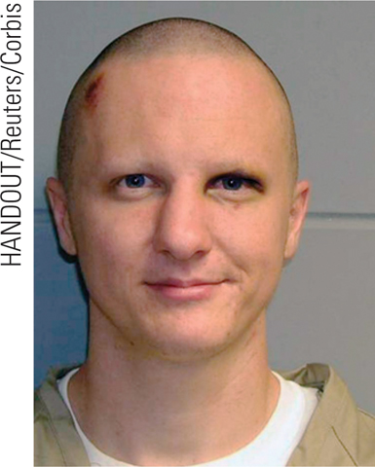
Introduction
How should we define psychological disorders?
How should we understand disorders?
How should we classify psychological disorders?

Slide 3
Defining Psychological Disorders
How do you define psychological disorders? What criteria must be met?
Mental health workers view psychological disorders as persistently harmful thoughts, feelings and action.
When behavior is deviant, distressful, and dysfunctional psychiatrists and psychologists label it as disordered (Comer, 2004).
Notes:
OBJECTIVE 47-1| Identify criteria for judging whether behavior is psychologically disordered.
The first problem is that psychologists must first decide exactly how to define disorder. How do you determine if there is something psychologically wrong or unhealthy about a person? How do you decide what's normal and what's abnormal?
If you were to define disorder as something that lies outside of the statistical norm, then people who are considered exceptionally talented or gifted in a particular area would be regarded as abnormal. So rather than focus on actions that are considered outside of the normal statistically speaking, psychologists tend to concentrate on the results of those behaviors. Behaviors that are considered maladaptive and cause significant personal distress and interrupt daily functioning are more likely to be labeled as abnormal.

Slide 4
Who’s Normal?
Your neighbor has physical complaints and sees several doctors weekly.
A 22 year-old college student smokes 4-5 marijuana joints per day, has a 3.8 GPA, has a part-time job and a solid long term relationship.
Rachel has been caught several times urinating in the corner.
A 35 year-old very happily married man enjoys wearing women’s clothes and underwear on the weekends when he and his wife go out on the town.

Slide 5
Deviant, Distressful & Dysfunctional
1. Deviant behavior (going naked) in one culture may be considered normal while in others leads to arrest.
2. Deviant behavior must accompany distress.
3. If a behavior is dysfunctional it is clearly a disorder.

Slide 6
Psychological Disorder
A “harmful dysfunction” in which behaviors are maladaptive, unjustifiable, disturbing, and atypical

Slide 7
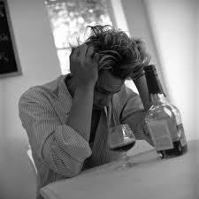
Maladaptive
An exaggeration of normal, acceptable behaviors
Destructive to oneself or others
Notes:
The behavior impairs an individual’s ability to function adequately in everyday life
Can be hazardous to oneself or others
Alcohol abuse

Slide 8
Unjustifiable
A behavior which does not have a rational basis

Slide 9
Disturbing
A behavior which is troublesome. Can cause a feeling of hopelessness and guilt.
Notes:
Can cause a feeling of anxiety and depression, hopelessness and guilt among the sufferer.

Slide 10
Atypical
A behavior so different from other people’s behavior that it violates a norm
Norms vary from culture to culture
Notes:
Normality of a behavior is determined by the degree to which it is average or typical
Cultural context or expectations must be taken into account
Culture Bound Syndromes – clusters of symptoms that define an illness
Koro is a psychological disorder characterized by delusions of penis shrinkage and retraction into the body, accompanied by panic and fear of dying.
Gururumba is a “wild man” episode in which the suffer (typically a married male) begins by burglarizing neighboring homes – taking objects that he thinks are valuable but which seldom are. He then runs to the forest for a number of days returning without the objects and with a case of amnesia. The sufferer appears hyperactive and clumsy with slurred speech. This disorder is specific to New Guinea.

Slide 11
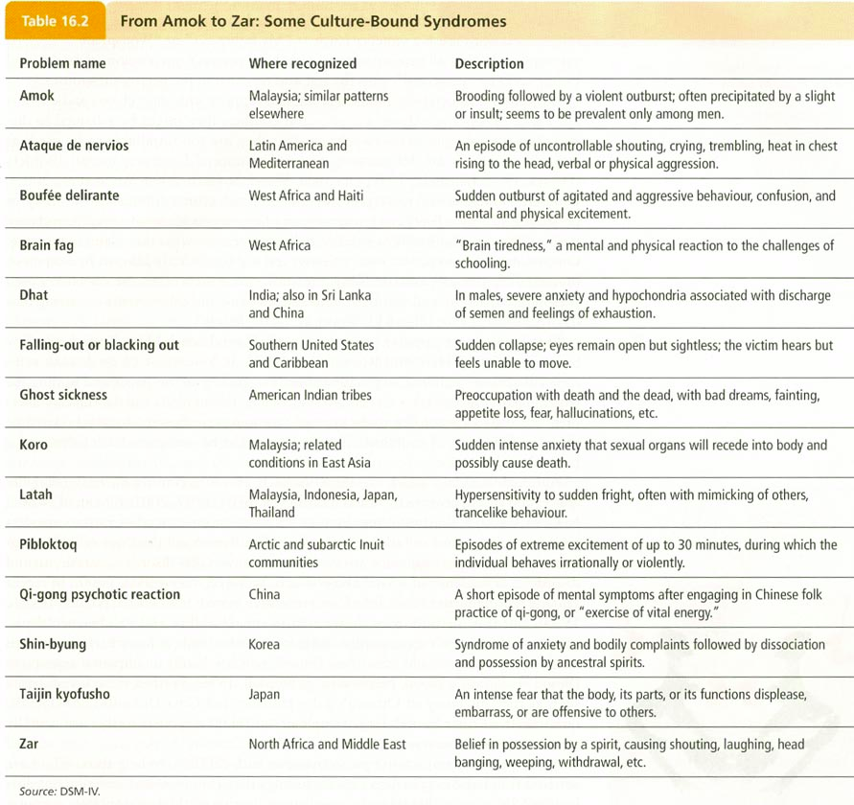

Slide 12
MUDA
A mnemonic device used to remember the four attributes of a psychological disorder
Maladaptive
Unjustifiable
Disturbing
Atypical

Slide 13
Understanding Psychological Disorders
Ancient Treatments of psychological disorders include trephination, exorcism, being caged like animals, beaten, burned, castrated, mutilated, and transfused with animal’s blood.
John W. Verano
Trephination (boring holes in the skull to remove evil forces)
Notes:
OBJECTIVE 47-2| Contrast the medical model of psychological disorders with the biopsychosocial perspective on disordered behavior.

Slide 14
Medical Perspective
Philippe Pinel (1745-1826) from France, insisted that madness was not due to demonic possession but an ailment of the mind. (Psychopathology)
George Wesley Bellows, Dancer in a Madhouse, 1907. © 1997 The Art Institute of Chicago
Dance in the madhouse.

Slide 15
The Medical Model
Concept that mental illnesses have physical causes that can be diagnosed, treated, and in most cases, cured.
Psychological disorders can be diagnosed based on their symptoms and treated or cured through therapy.
Psychological disorders are similar to a physical illness.

Slide 16
Medical Model
When physicians discovered that syphilis led to mental disorders, the medical model started looking at physical causes of these disorders.
Etiology: Causation and development of the disorder.
Diagnosis: Identifying (symptoms) and distinguishing one disease from another.
Treatment: Treating a disorder in a psychiatric hospital.
Prognosis: Forecast about the disorder.

Slide 17
Biopsychosocial Perspective
Assumes that biological, socio-cultural, and psychological factors combine and interact to produce psychological disorders.

Slide 18
Causes of Abnormal Behavior Different Perspectives:
Behavior: maladaptive responses learned through reinforcement of the wrong kinds of behaviors.
Psychoanalytic: results from internal conflicts in the unconscious stemming from early childhood traumas.
Humanist: results from conditions society places on the individual
Evolutionary: harmful evolutionary dysfunctions that occur when evolved psychological mechanisms do not perform their naturally selected functions effectively
Biological: neurochemical or hormonal imbalances, genetic predispositions, damage to brain.
Cognitive: irrational and illogical perceptions

Slide 19
Classifying Psychological Disorders
American Psychiatric Association rendered a Diagnostic and Statistical Manual of Mental Disorders (DSM) to describe psychological disorders.
DSM 5 was released in May, 2013
Nearly 300 psychological disorders compared to 60 in the 1950s
*Textbook references the
DSM-IV-TR (Text Revision, 2000)
400 psychological disorders
Notes:
OBJECTIVE 47-3| Describe the goals and content of the DSM-IV-TR.

Slide 20
DSM Classification of Mental Disorders
The original DSM
Introduced in 1952
Moved from a subjective to operational definition. More reliable system
Diagnosis is based on signs and symptoms
Signs- objective observations of a patients physical or mental disorder by a diagnostician.
Symptoms- patient’s subjective description of a physical or mental disorder.
Monitor the prevalence of disorders
Notes:
Disorders outlined by DSM 5 are reliable thus diagnosis by different professional are similar.

Slide 21
Criticism of DSM
Criticism of the DSM 5 includes “putting any kind of behavior within the compass of psychiatry.”
Concern over cultural bias, political opinions, and pharmaceutical influence as well.
The changes within the DSM 5 also brought up specific criticisms:
Loosen many requirements for variety of diagnoses – fear over “over-medicating” children and adults.
Tighten requirements for Autism – many will lose their educational support
Notes:
Although fewer than 6 percent of American adults will have a severe mental illness in a given year, according to a 2005 study, many more—more than a quarter each year—will have some diagnosable mental disorder. That’s a lot of people. Almost 50 percent of Americans (46.4 percent to be exact) will have a diagnosable mental illness in their lifetimes, based on the previous edition, the DSM-IV. And the new manual will likely make it even "easier" to get a diagnosis.

Slide 22
Categories of Psychological Disorders (According to the DSM 5)
Neurodevelopmental Disorders
Schizophrenia Spectrum
Bipolar and Related Dis.
Depressive Disorders
Anxiety Disorders
Obsessive-Compulsive and Related Disorders
Trauma & Stressor Related Disorders
Dissociative Disorders
Somatic Symptom and Related Disorders
Feeding and Eating Disorders
Elimination Disorders
Sleep-Wake Disorders
Sexual Dysfunctions
Gender Dysphoria
Disruptive, Impulse-Control, and Conduct Dis.
Substance-Related and Addictive Disorders
Neurocognitive Disorders
Personality Disorders
Paraphilic Disorders
Other Mental Disorders
Conditions for Further Study

Slide 23
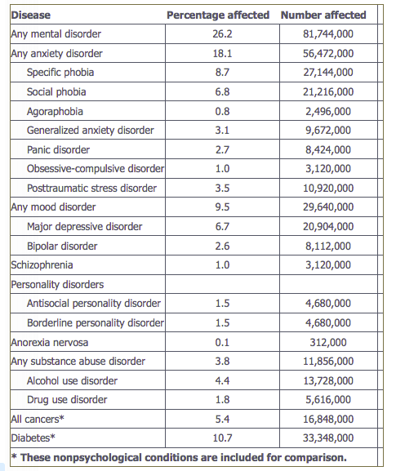
Rates of Psychological Disorders
Chart does not include:
Autism or Aspergers
ADHD
Many others
½ of all Americans will meet criteria at least once in their life
Peak is ages 25 to 34.
Depends on disorder

Slide 24
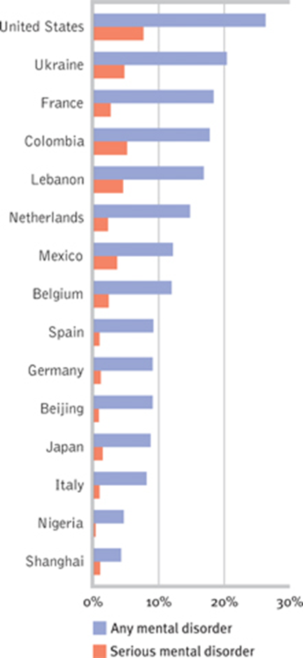
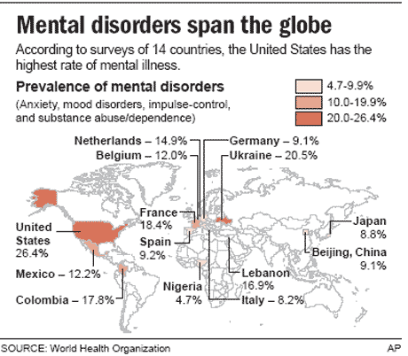

Slide 25
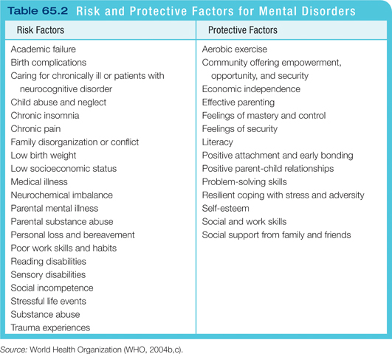

Slide 26
Labeling Psychological Disorders
Critics of the DSM 5 argue that labels can stigmatize individuals.
Asylum baseball team (labeling)
Notes:
OBJECTIVE 47-4| Discuss the potential dangers and benefits of using diagnostic labels.

Slide 27
Labeling Psychological Disorders
2. Hospital Study (1978) – David Rosenhan
- He and a number of his colleagues had themselves committed to mental institutions by complaining of “hearing voices”
After being admitted, they all returned to normal behavior and never complained of symptoms
They were kept in the hospitals for an average of 3 weeks
The doctors never caught on, but the other patients did

Slide 28
Labeling Psychological Disorders
3. Labels can be helpful for health care professionals, communicating with one another and establishing therapy.

Slide 29
Labeling: Positive and Negative
Communication
Social Label
May limit Inquiry Once Applied
Self-fulfilling Prophecy
Have Pejorative and Stigmatizing Implications
Second-Class Citizens
Devastate Self-Esteem and Morale

Slide 30
Somatic Disorders
Conversion Disorder
Somatic Symptom Disorder
Illness Anxiety Disorder (Hypochondriasis)
Notes:
https://www.youtube.com/watch?v=NV40bc6yA7c

Slide 31
What are they?
Person manifests a psychological problem through a physiological symptom
Disorders with physical symptoms, but no physical cause
The causes seem to be “psychological”, but the symptoms are REAL
Notes:
Ricky Bobby from Talladega Nights clip

Slide 32
Conversion Disorder
Person is converting psychological stress into physical symptoms
Person becomes “paralyzed” in a stressful situation (deer in the headlights)
Perhaps the mind is trying to protect the body (best not to do anything)
Sometimes referred to as “hysteria”
Notes:
https://www.youtube.com/watch?v=NV40bc6yA7c
http://thechart.blogs.cnn.com/2012/02/04/taking-the-mystery-out-of-conversion-disorder/ - 3 minute video

Slide 33
Somatic Symptom Disorder (SSD)
A preoccupation with the persistent and irrational fear that one has an illness.
Chronic
One or more bodily symptoms
May seek several medical opinions and still believe they are ill
Notes:
one or more persistent bodily symptoms, e.g. aches or pains, that either distress or cause significant disruption to one's daily life. A patient is often given this label after they have seen their physician who then realizes that the patient is excessively preoccupied with their symptoms. Patients given this label are also likely to be disproportionately anxious about their symptoms.

Slide 34
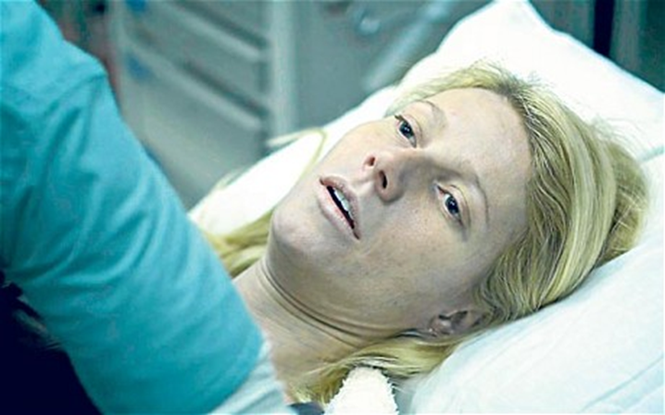
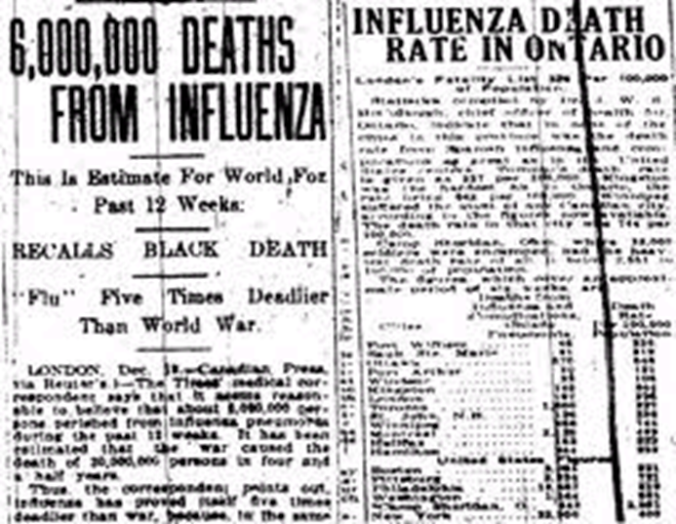
Illness Anxiety Disorder
Less severe form of SSD. Interprets normal physical sensations as symptoms of the disease.
Formerly called Hypochondriasis
Similar to OCD – preoccupied with thoughts of health
Headaches are brain cancer or scratchy throats are throat cancer
Can you think of some things that may play into this….
Notes:
Either repeatedly check to ensure that they don't get a serious medical problem, e.g. excessive checking for breast lumps or skin cancers, or they may avoid checking or seeing doctors because of their excessive fears.
http://www.youtube.com/watch?v=8VzhqKj28IY – 9 minutes of video clips from tv and movies

Slide 35
Factitious Disorder
Umbrella category that covers a group of mental disturbances in which patients intentionally act physically or mentally ill without obvious benefits.
Münchausen syndrome
Münchausen syndrome by proxy
Notes:
People with Factitious Disorder deliberately create or exaggerate symptoms of an illness in several ways. They may lie about or mimic symptoms, hurt themselves to bring on symptoms, or alter diagnostic tests (such as contaminating a urine sample).Those with Factitious Disorders have an inner need to be seen as ill or injured, but not to achieve a concrete benefit, such as a financial gain. Individuals with Factitious Disorder are even willing to undergo painful or risky tests and operations in order to obtain the sympathy and special attention given to people who are truly ill. Factitious Disorder is considered a mental illness because it is associated with severe emotional difficulties.

Slide 36
Some explanations
Psychoanalytic explanations of conversion disorder emphasize unconscious drives, including sexuality, aggression or dependency, and the internalized prohibition against their expression
Behaviorists would say that these are maladaptive behaviors that act on the environment to produce reinforcing consequences
Sociocultural would say in some cultures the direct expression of intense emotions is prohibited, represent non-verbal communication of a forbidden idea or feelings

Slide 37
Anxiety Disorders
Anxiety Disorders
Obsessive-Compulsive Disorder (OCD)
Trauma or Stressor Related Disorder (PTSD)
Notes:
https://www.youtube.com/watch?v=44DCWslbsNM – clip from as good as it gets (ocd) 1 minute

Slide 38
Anxiety Disorders

Slide 39
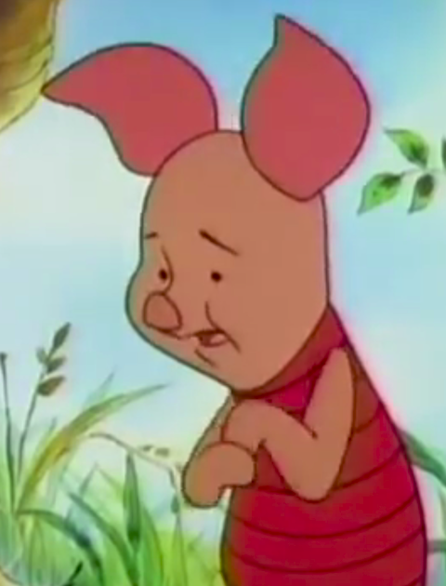
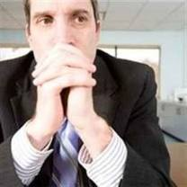
Generalized Anxiety Disorder
An anxiety disorder characterized by disruptive levels of persistent, unexplained feelings of apprehension and tenseness
2/3 women
Usually constant, low level anxiety
No specific trigger or stimulus
Freud referred to this as “free floating” anxiety
Notes:
Worry involves thoughts about negative events that might happen in the future. It usually begins as a "what if" question:
What if I'm caught in traffic and late for work? My boss might be angry with me, and he might even fire me! What if I can't find another job and my friends and family think that I'm a failure?
I have to buy new curtains for the kitchen; what if I buy some curtains and then I find better ones or cheaper ones later on? What if I buy new furniture at some point and the curtains I bought don't match the furniture anymore?

Slide 40
Symptoms of Generalized Anxiety
Must have displayed some of the following:
Autonomic Arousal
Restlessness
Feeling on edge
Difficulty concentrating/mind going blank
Irritability
Muscle Tension
Sleep Disturbance
Notes:
Many adults with GAD are perfectionists. They can spend hours on a simple task, in an attempt to make sure that they have completed it perfectly. This might involve re-reading a school or work assignment repeatedly, or agonizing over small details at work or in the home (e.g., what kind of font to use in an e-mail, whether to try a new cleaning product at home).
People with GAD seem to be allergic to uncertainty. That is, they don't like it when they are not 100% sure of themselves, others, their actions and decisions, or the future. Because of this, they will often engage in tiring and time-consuming behaviors designed to make them feel more certain

Slide 41
Panic Disorder
An anxiety disorder characterized by sudden bouts of intense, unexplained anxiety, fear, or discomfort
Often associated with physical symptoms like choking sensations or shortness of breath
Panic “attacks” may happen several times a day – start quickly, reach peak within 10 minutes. Peak may last 5 – 10 minutes.
Often suffer additional anxiety due to anticipating the attacks
Notes:
Panic attacks tend to start quickly and reach a peak within 10 minutes. The peak generally lasts for about 5 to 10 minutes before the symptoms start to settle. However, it can take quite some time for all the symptoms to subside.
racing or pounding heart
sweating
shaking or trembling
shortness of breath or feelings of being smothered
feeling of choking
chest pain or discomfort
chills or hot flashes
nausea or upset stomach
dizziness or lightheadedness
a sense of things being unreal or feeling detached from oneself
numbness or tingling sensations
fear of losing control or "going crazy"
fear of dying

Slide 42
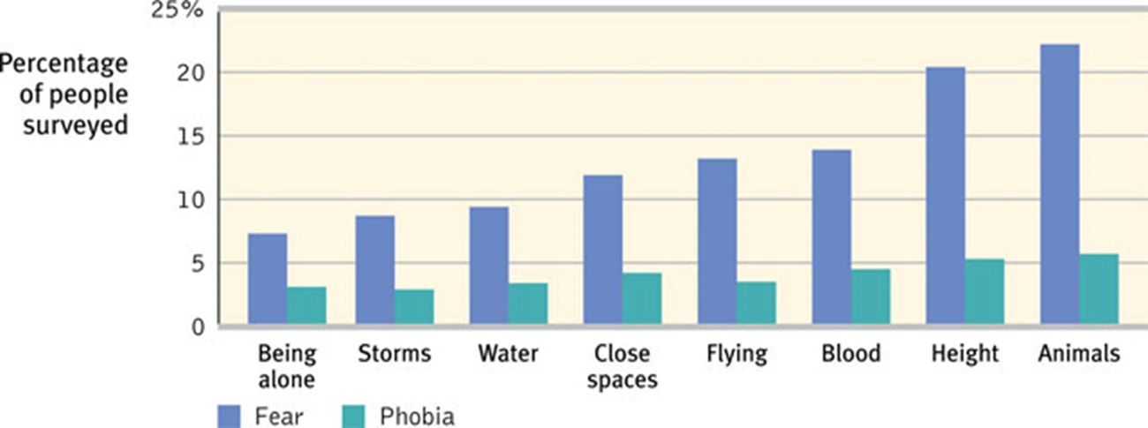
Specific Phobias
An anxiety disorder characterized by disruptive, persistent, and irrational fears of specific objects or situations
The fear must be both irrational and disruptive.

Slide 43
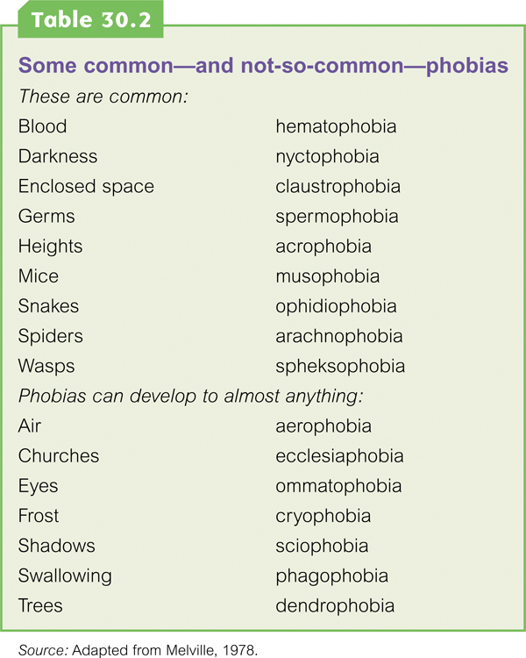

Slide 44
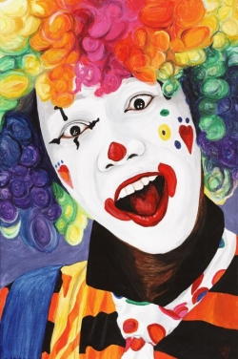
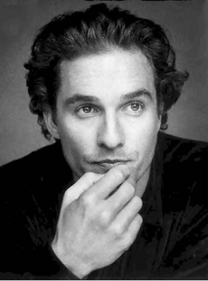
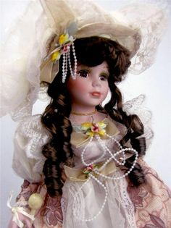
Notes:
Billy Bob is afraid of antique furniture (pre-1950)
Johnny Depp is afraid of clowns
Matthew McCouneghey is afraid of revolving doors and tunnels
Nicole Kidman is afraid of butterflies

Slide 45
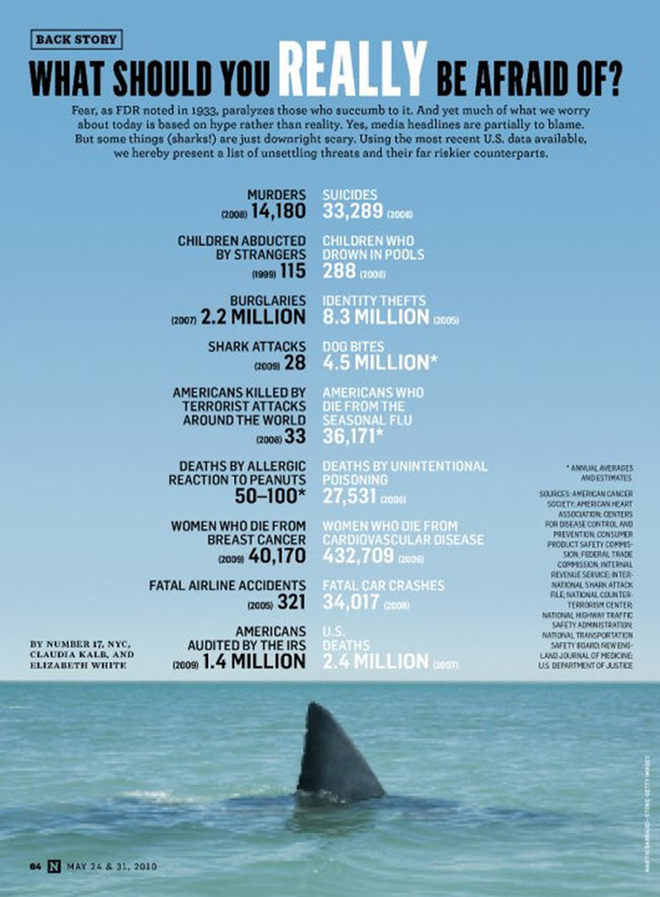

Slide 46
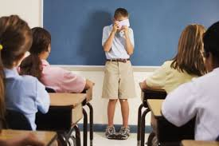
Social Anxiety Disorder (Social Phobia)
Phobias which produce fear in social situations
Fear of speaking in public
Notes:
http://www.webmd.com/balance/video/too-scared-social-anxiety-disorder – 2 minute WebMD video

Slide 47
Agoraphobia
Condition which develops when a person begins to avoid spaces or situations associated with anxiety
Individual fears going anywhere or doing anything where these feelings of panic have repeatedly occurred before
Notes:
Kim Basinger

Slide 48
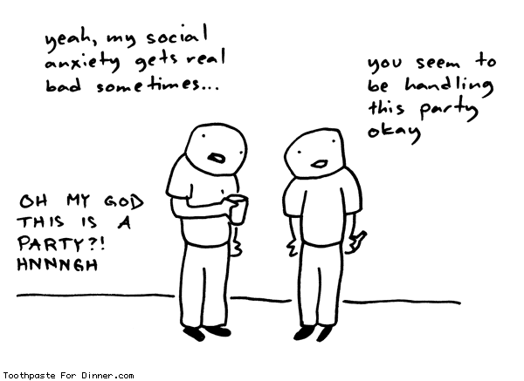
Explaining Anxiety Disorders
Freud suggested that we repress our painful intolerable, ideas, feelings and thoughts resulting in anxiety.
Notes:
OBJECTIVE 48-6| Discuss the contributions of the learning and biological perspectives to our understanding of the development of anxiety disorders.

Slide 49
The Learning Perspective
Behaviorists suggest that fear conditioning leads to anxiety. This anxiety then gets associated with other objects or events (stimulus generalization) and gets reinforced.
Fear responses can also be learned through observational learning.
John Coletti/ Stock, Boston
Notes:
Conditioning is why some people fear dogs as if they were fire-breathing monsters, while others consider them part of the family.
People also may develop phobias through observational learning. For example, children may learn to be afraid of certain objects or situations by observing their parents’ behavior in the face of those objects or situations.

Slide 50
The Biological Perspective
Natural Selection has led our ancestors to learn to fear snakes, spiders, and other animals. So fear preserves the species.
Twins studies suggest that our genes may be partly responsible for developing fears and anxiety. Twins are more likely to share phobias.

Slide 51
The Biological Perspective
Generalized anxiety, panic attacks, and even OCD is linked with brain circuits like the anterior cingulate cortex.
Person does not produce enough GABA (major inhibitory neurotransmitter)
S. Ursu, V.A. Stenger, M.K. Shear, M.R. Jones, & C.S. Carter (2003). Overactive action
monitoring in obsessive-compulsive disorder. Psychological Science, 14, 347-353.
Anterior Cingulate Cortex
of an OCD patient.
Notes:
It appears to play a role in a wide variety of autonomic functions, such as regulating blood pressure and heart rate.
It is also involved in rational cognitive functions, such as reward anticipation, decision-making, empathy, impulse control, and emotion

Slide 52
Cognitive scientists would say…
Dysfunctional ways of thinking
Anxiety could stem from unrealistic expectations about ourselves and others
External locus of control
Learned helplessness

Slide 53
Obsessive-Compulsive Disorder
An anxiety disorder characterized by unwanted, repetitive thoughts followed by actions
Obsessions – repetitive thoughts
Compulsions – repetitive actions
The obsessions/compulsions begin to take control of the person’s life, the person wants to stop-but can’t
High levels of serotonin, low levels of GABA
Notes:
http://www.youtube.com/watch?v=dSZNnz9SM4g – Howie Mandel (9 minute video)

Slide 54
Obsessive-Compulsive and Related Disorders
Hoarding Disorder
Excoriation Disorder (skin picking)
Substance-medication induced obsessive-compulsive and related disorder
Obsessive-compulsive and related disorder due to another medical condition
Body Dysmorphic Disorder and Trichotillomania now fall under Obsessive-Compulsive and Related Disorder

Slide 55
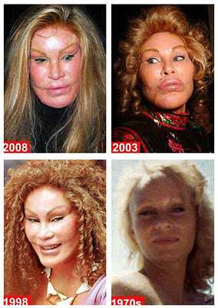
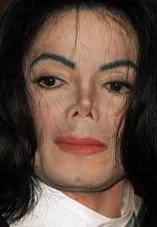
Body Dysmorphic Disorder
Intense anxiety about a perceived physical deformity or defect
Does Western culture contribute to this? (think models, what is considered attractive?)
Notes:
http://abcnews.go.com/GMA/video/americans-struggle-body-dysmorphic-disorder-14526036 - 5 minute video from Good Morning America

Slide 56
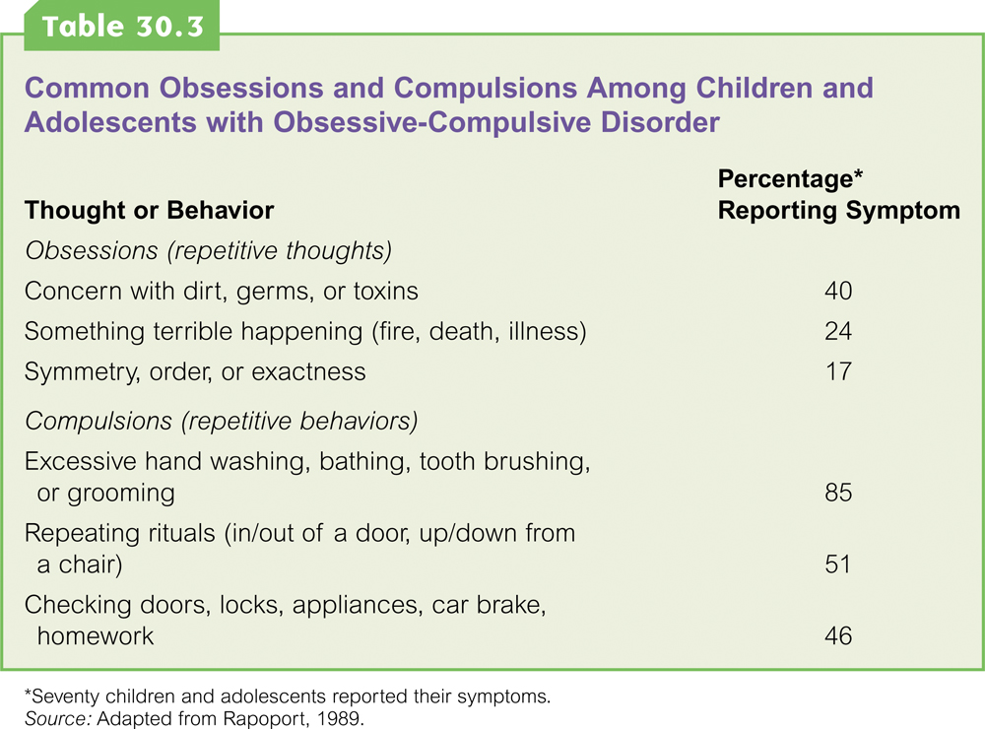

Slide 57
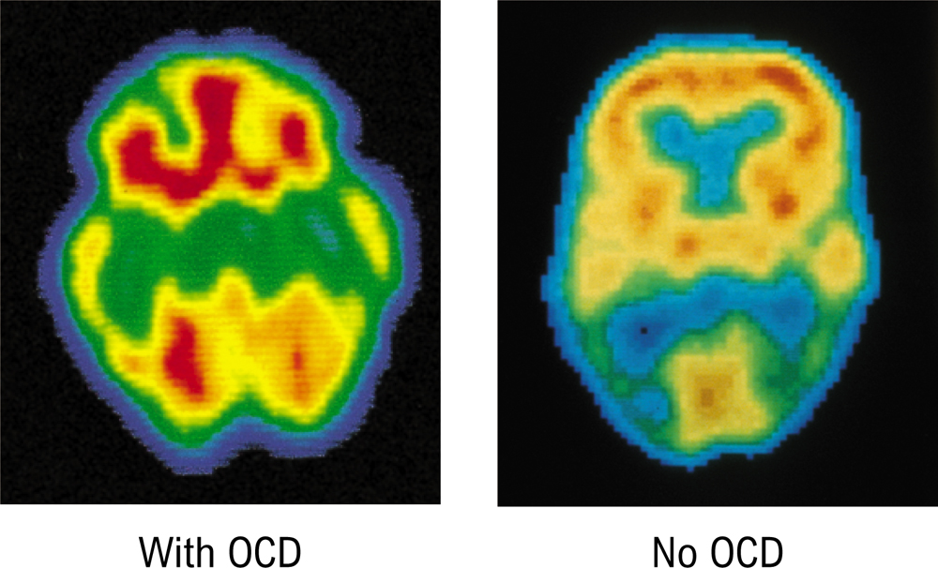
Brain Imaging
PET Scan of brain of person with Obsessive- Compulsive Disorder (OCD). High metabolic activity (red) in frontal lobe areas involved with directing attention.

Slide 58
Notes:
http://www.youtube.com/watch?v=dSZNnz9SM4g – 8 minute interview with Howie Mandel

Slide 59
Trauma and Stressor related disorders
Post traumatic stress disorder (PTSD):
Four or more weeks of the following symptoms constitute post-traumatic stress disorder (PTSD).
Haunting memories.
Nightmares.
Social withdrawal.
Jumpy anxiety.
Sleep problems.
Reactive attachment disorder
No healthy attachment with parents or caregivers
Notes:
https://www.youtube.com/watch?v=_O9HIQyUtx8 - PTSD clip (4 minutes)
http://www.cbsnews.com/news/the-war-within-treating-ptsd/ - 13 minute video from 60 minutes
Reactive attachment disorder is a rare but serious condition in which an infant or young child doesn't establish healthy attachments with parents or caregivers. Reactive attachment disorder may develop if the child's basic needs for comfort, affection and nurturing aren't met and loving, caring, stable attachments with others are not established.

Slide 60
Dissociative Disorders
Dissociative Amnesia
Depersonalization Disorder
Dissociative Identity Disorder

Slide 61
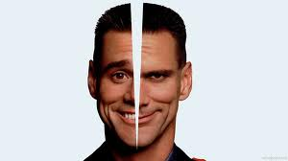
Dissociative Disorders
What is dissociation?
literally a “dis-association” of memory
a “disconnection” between the mind and body
person suddenly becomes unaware of some aspect of their identity or history
unable to recall except under special circumstances (e.g., hypnosis)
Three types are recognized
dissociative amnesia
depersonalization
dissociative identity disorder
Notes:
Keywords: definition of dissociation
https://www.youtube.com/watch?v=0tITzDjPf4g - 5 minute video from “Inside” – scene of dissociative disorder.
http://www.youtube.com/watch?v=HknGXOhyrLo - 5 minute video of movie clips
Some psychologists use the term repression for dissociative amnesia
A problem is that we need to distinguish between normal forgetting and the extreme case of dissociative amnesia. Just because you can’t remember something from your past very well doesn’t mean you are dissociating.
Amnesia can also be caused by a head injury or by drugs. This isn’t considered dissociative amnesia
How can we tell other kinds of forgetting from dissociation?
Sudden onset, related to emotional trauma
absence of brain injury, drugs

Slide 62
Dissociative Amnesia
Margie and her brother were recently victims of a robbery. Margie was not injured, but her brother was killed when he resisted the robbers. Margie was unable to recall any details from the time of the accident until four days later.
Notes:
Keywords: dissociative amnesia example

Slide 63
Dissociative Amnesia
Also known as psychogenic amnesia
Memory loss the only symptom
Often selective loss surrounding traumatic events
person still knows identity and most of their past
Can also be global
loss of identity without replacement with a new one
Notes:
Keywords: dissociative amnesia
Dissociative amnesia is not the same as simple amnesia, which involves a loss of information from the memory, usually as the result of disease or injury to the brain. With dissociative amnesia, the memories still exist but are deeply buried within the person’s mind and cannot be recalled. However, the memories might resurface on their own or after being triggered by something in the person’s surroundings.
More common in women than men

Slide 64
Depersonalization Disorder
Angie, age 23, has been feeling detached for the past 4 years. She says she feels “fuzzy all the time, like I lost touch with reality 4 years ago and really miss it.” She complains of “confused thinking,” excessive tiredness and weakness, depression, and anxiety. She says, “It feels like I’m watching my life on television; I don’t feel any emotions.” These symptoms began immediately after a college party, which the police stopped because of underage drinking. She says, “I don’t know why, but that party set it off, and it feels like I am in a dream all the time.”

Slide 65
Depersonalization Disorder
Also known as depersonalization-derealization syndrome
Common descriptions of symptoms
feeling disconnected from one's body
feeling detached from one's own thoughts/emotions
feeling as if one is disconnected from self
sense of feeling as if one is dreaming or in a dreamlike state.
Thought to be caused by severe traumatic lifetime events, including childhood abuse, accidents, natural disasters, war, torture, and bad drug experiences.
Notes:
Can result in depression, self-harm, low self-esteem, anxiety attacks, panic attacks, extreme phobias (especially of losing their mind), etc. It can also cause a variety of physical symptoms, including chest pain, blurry vision, nausea, and pins and needles.

Slide 66
Dissociative Identity Disorder (DID)
Norma has frequent memory gaps and cannot account for her whereabouts during certain periods of time. While being interviewed by a clinical psychologist, she began speaking in a childlike voice. She claimed that her name was Donna and that she was only six years old. Moments later, she seemed to revert to her adult voice and had no recollection of speaking in a childlike voice or claiming that her name was Donna.
Notes:
keywords: dissociative identity disorder example

Slide 67
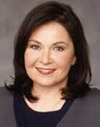
Dissociative Identity Disorder (DID)
Originally known as “multiple personality disorder”
2 or more distinct personalities manifested by the same person at different times
VERY rare and controversial disorder
Examples include Sybil, Truddi Chase, Chris Sizemore (“Three Faces of Eve”)
Has been used as a criminal defense
Notes:
Keywords: dissociative identity disorder, symptoms
Herschel Walker and Rosanne Barr plus Adam Duritz of the Counting Crows

Slide 68
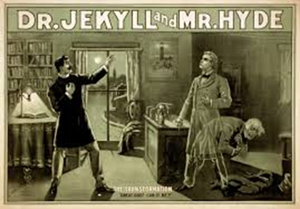
The DID Controversy
Some curious statistics
1930–60: 2 cases per decade in USA
1980s: 20,000 cases reported
many more cases in US than elsewhere
varies by therapist—some see none, others see a lot
Is DID the result of suggestion by therapist and acting by patient?
“Is there a part of you that feels…”
Could be similar to false memory syndrome
Notes:
keywords: dissociative identity disorder, controversy over
Spanos asked college students to pretend they were accused murderers being examined by a psychiatrist. When given hypnotic therapy the students often expressed a second personality which claimed to be the murderer.
This raises the question of whether DID might arise in some cases as a strategy or ploy by the patient, not just to avoid prosecution for crimes but perhaps to avoid other negative situations.
It is not suggested that all DID cases arise in this way, but perhaps the large increase in diagnosis can be accounted for in this way.
The increase in incidence in the 1980s was preceded by heightened awareness of the stories of THE THREE FACES OF EVE and SYBIL which became known in the 1960’s
http://www.youtube.com/watch?v=nGSxaP1XCbc - 7 minute video over Sybil

Slide 69
Causes of Dissociative Disorders?
Biological--Traumatic head injury with memory loss, family member increases risk (organic cause)
Behaviorists-actions are reinforced, attention
Psychoanalytic--Repeated, severe sexual or physical abuse may cause the development of alternates to cope with the past (psychogenic cause, defense mechanisms in play)
However, many abused people do not develop DID
Notes:
keywords: causal theories of dissociative disorders
While the causes of dissociative identity disorder are still vague, research indicates that a combination of environmental and biological factors work together to cause it. As many as 98% to 99% of individuals who develop dissociative disorders have recognized personal histories of recurring, overpowering, and often life-threatening disturbances at a sensitive developmental stage of childhood (usually before age 9). Dissociation may also happen when there has been insistent neglect or emotional abuse, even when there has been no overt physical or sexual abuse. Findings show that in families where parents are frightening and unpredictable, the children may become dissociative.

Slide 70
Personality Disorders
Related to Odd or Eccentric Behaviors
Related to Dramatic or Impulsive Behaviors
Related to Anxiety

Slide 71
Personality Disorders
Characterized by inflexible and enduring behavior patterns that impair social functioning. Usually without anxiety, depression, or delusions.
Divided into three clusters:
-With odd and eccentric behaviors
-With dramatic or impulsive behaviors
-Related to anxiety
Notes:
OBJECTIVE 49-2| Contrast the three clusters of personality disorders, and describe the behaviors and brain activity associated with antisocial personality disorders.
http://www.youtube.com/watch?v=ZXa_YreEFEs - 3 minute video on the BTK killer, Dennis Radar
https://www.youtube.com/watch?v=J68DzrL6oTs – 2 minute video from Cable Guy. In this clip from the film The Cable Guy, Jim Carrey plays basketball according to “prison rules” by being physically and verbally aggressive. He elbows, pushes, and trips others to benefit his team. Throughout the film, Carrey’s character fails to conform to social norms, uses aliases, and disregards the safety of himself and others. Of the disorders in Cluster B (dramatic, emotional, or erratic), which does Carrey exemplify best? How is this personality disorder predictive of criminality?

Slide 72
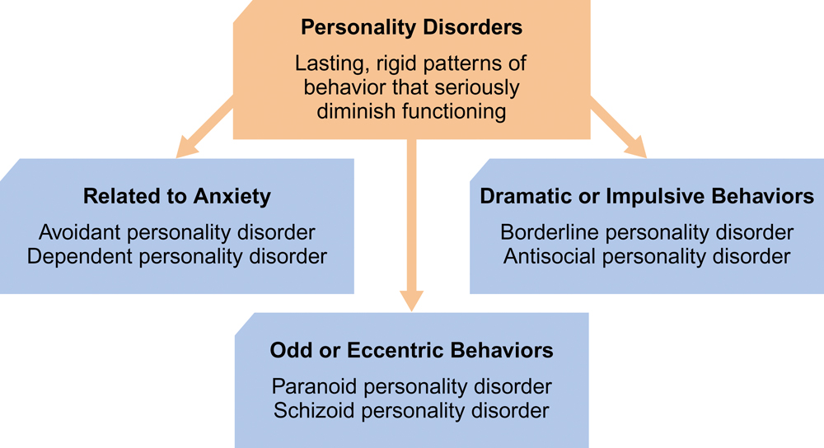
Personality Disorders
Notes:
Furthermore, the ten different personality disorders can be grouped into three clusters based on descriptive similarities within each cluster. These clusters are:
Cluster A (the "odd, eccentric" cluster);
Cluster B (the "dramatic, emotional, erratic" cluster); and,
Cluster C (the "anxious, fearful" cluster).
Oftentimes, a person can be diagnosed with more than just one personality disorder. Research has shown that there is a tendency for personality disorders within the same cluster to co-occur (Skodol, 2005). The alternative model of personality disorder, proposed for further study in DSM-5 (APA, 2013), hopes to reduce this overlap by using a dimensional approach versus the present categorical one.

Slide 73
Cluster A: Personality Disorders with Odd or Eccentric Behaviors
Notes:
Cluster A is called the odd, eccentric cluster. It includes Paranoid Personality Disorder, Schizoid Personality Disorder, and Schizotypal Personality Disorders. The common features of the personality disorders in this cluster are social awkwardness and social withdrawal. These disorders are dominated by distorted thinking.

Slide 74
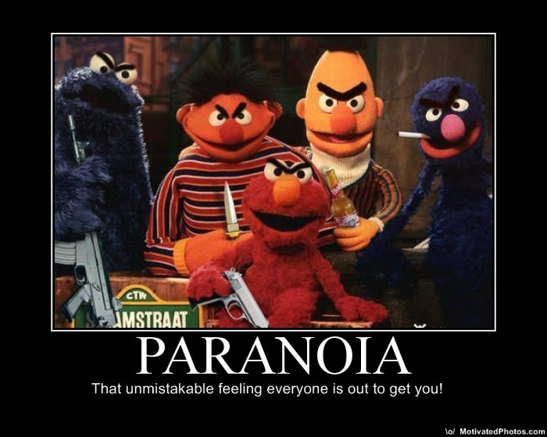
Paranoid Personality Disorder
Chronic sense of being observed and persecuted
Shows deep distrust of other people, which gets in the way of personal relationships
Different than paranoid schizophrenia
Notes:
Individuals with Paranoid Personality Disorder are generally difficult to get along with and often have problems with close relationships. Their excessive suspiciousness and hostility may be expressed in overt argumentativeness, in recurrent complaining, or by quiet, apparently hostile aloofness. Because they are hypervigilant for potential threats, they may act in a guarded, secretive, or devious manner and appear to be “cold” and lacking in tender feelings. Although they may appear to be objective, rational, and unemotional, they more often display a labile range of affect, with hostile, stubborn, and sarcastic expressions predominating. Their combative and suspicious nature may elicit a hostile response in others, which then serves to confirm their original expectations.

Slide 75
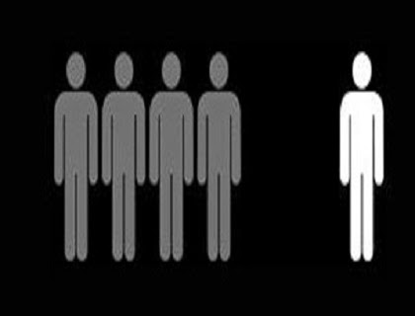
Schizoid Personality Disorder
Is detached from social relationships
Are true hermits, preferring life alone and avoiding intimate interactions at all costs
Loners
Notes:
Individuals with Schizoid Personality Disorder may have particular difficulty expressing anger, even in response to direct provocation, which contributes to the impression that they lack emotion. Their lives sometimes seem directionless, and they may appear to “drift” in their goals. Such individuals often react passively to adverse circumstances and have difficulty responding appropriately to important life events.
Because of their lack of social skills and lack of desire for sexual experiences, individuals with this disorder have few friendships, date infrequently, and often do not marry. Employment or work functioning may be impaired, particularly if interpersonal involvement is required, but individuals with this disorder may do well when they work under conditions of social isolation.

Slide 76
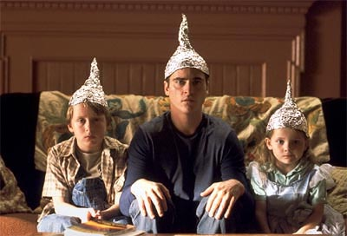
Schizotypal Personality Disorder
Characterized by a need for social isolation, odd behavior and thinking, and often unconventional beliefs such as being convinced of having extra sensory abilities.
Some people believe that schizotypal personality disorder is a mild form of schizophrenia.
Sometimes called “Latent Schizophrenia”
Notes:
Persons with Schizotypal Personality Disorder* are characterized by a pervasive pattern of social and interpersonal limitations. They experience acute discomfort in social settings and have a reduced capacity for close relationships. For these reasons they tend to be socially isolated, reserved, and distant. Unlike the Schizoid Personality Disorder, they also experience perceptual and cognitive distortions and/or eccentric behavior. These perceptual abnormalities may include noticing flashes of light no one else can see, or seeing objects or shadows in the corner of their eyes and then realizing that nothing is there. People with Schizotypal Personality Disorder have odd beliefs, for instance, they may believe they can read other people's thoughts, or that that their own thoughts have been stolen from their heads. These odd or superstitious beliefs and fantasies are inconsistent with cultural norms. Schizotypal Personality Disorder tends to be found more frequently in families where someone has been diagnosed with Schizophrenia; a severe mental disorder with the defining feature of psychosis (the loss of reality testing). There is some indication that these two distinct disorders share genetic commonalities (Coccaro & Siever, 2005).

Slide 77
Cluster B: Personality Disorders with Dramatic or Impulsive Behaviors
Notes:
Cluster B is called the dramatic, emotional, and erratic cluster. It includes Borderline Personality Disorder, Narcissistic Personality Disorder, Histrionic Personality Disorder, and Antisocial Personality Disorder. Disorders in this cluster share problems with impulse control and emotional regulation.
Cable Guy

Slide 78
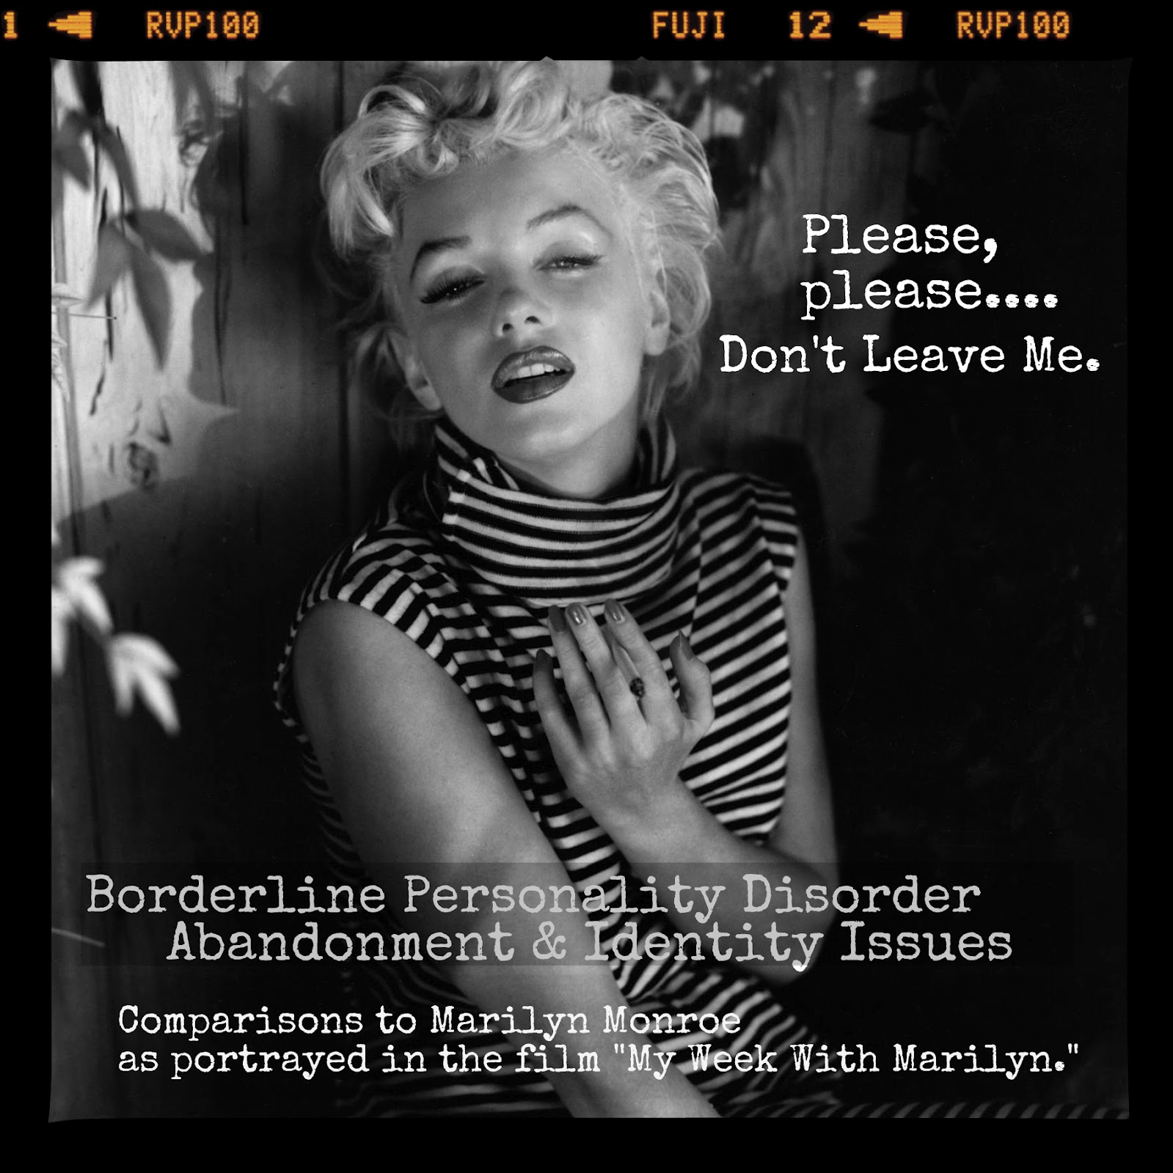
Borderline Personality Disorder
Exhibit instability of emotions, self-image, behavior, and relationships
Sudden intense rages, deep insecurity
Notes:
A person with this disorder will also often exhibit impulsive behaviors and have a majority of the following symptoms:
Frantic efforts to avoid real or imagined abandonment
A pattern of unstable and intense interpersonal relationships characterized by alternating between extremes of idealization and devaluation
Identity disturbance, such as a significant and persistent unstable self-image or sense of self
Impulsivity in at least two areas that are potentially self-damaging (e.g., spending, sex, substance abuse, reckless driving, binge eating)
Recurrent suicidal behavior, gestures, or threats, or self-mutilating behavior
Emotional instability due to significant reactivity of mood (e.g., intense episodic dysphoria, irritability, or anxiety usually lasting a few hours and only rarely more than a few days)
Chronic feelings of emptiness
Inappropriate, intense anger or difficulty controlling anger (e.g., frequent displays of temper, constant anger, recurrent physical fights)
Transient, stress-related paranoid thoughts or severe dissociative symptoms

Slide 79
Histrionic Personality Disorder
Excessive emotionality and attempt to get attention
Bizarre appearance
Bizarre speech
Rapidly shifting and shallow emotions
Need to be the center of attention
Notes:
A pervasive pattern of excessive emotionality and attention seeking, beginning by early adulthood and present in a variety of contexts, as indicated by five (or more) of the following:
Is uncomfortable in situations in which he or she is not the center of attention
Interaction with others is often characterized by inappropriate sexually seductive or provocative behavior
Displays rapidly shifting and shallow expression of emotions
Consistently uses physical appearance to draw attention to themself
Has a style of speech that is excessively impressionistic and lacking in detail
Shows self-dramatization, theatricality, and exaggerated expression of emotion
Is highly suggestible, i.e., easily influenced by others or circumstances
Considers relationships to be more intimate than they actually are

Slide 80
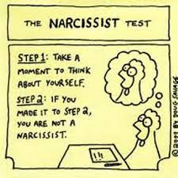
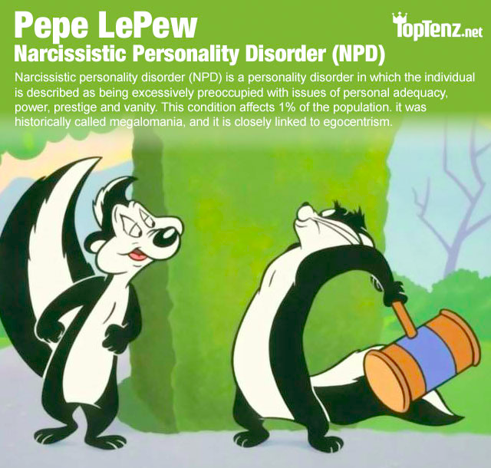
Narcissistic Personality Disorder
Grandiosity, need for admiration
Extremely self-absorbed
Intolerant of others
Indifferent to the effect of their own behavior
Notes:
In order for a person to be diagnosed with narcissistic personality disorder (NPD) they must meet five or more of the following symptoms:
Has a grandiose sense of self-importance (e.g., exaggerates achievements and talents, expects to be recognized as superior without commensurate achievements)
Is preoccupied with fantasies of unlimited success, power, brilliance, beauty, or ideal love
Believes that he or she is “special” and unique and can only be understood by, or should associate with, other special or high-status people (or institutions)
Requires excessive admiration
Has a very strong sense of entitlement, e.g., unreasonable expectations of especially favorable treatment or automatic compliance with his or her expectations
Is exploitative of others, e.g., takes advantage of others to achieve his or her own ends
Lacks empathy, e.g., is unwilling to recognize or identify with the feelings and needs of others
Is often envious of others or believes that others are envious of him or her
Regularly shows arrogant, haughty behaviors or attitudes

Slide 81
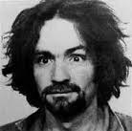
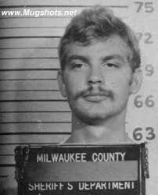
Antisocial Personality Disorder
Not a person who is “shy”
Personality disorder in which the person shows a lack of conscience for wrongdoing
Shows no respect for the rights others
Usually male
Also known as psychopathic or sociopathic personality disorder
Notes:
Individuals with Antisocial Personality Disorder frequently lack empathy and tend to be callous, cynical, and contemptuous of the feelings, rights, and sufferings of others. They may have an inflated and arrogant self-appraisal (e.g., feel that ordinary work is beneath them or lack a realistic concern about their current problems or their future) and may be excessively opinionated, self-assured, or cocky. They may display a glib, superficial charm and can be quite voluble and verbally facile (e.g., using technical terms or jargon that might impress someone who is unfamiliar with the topic).

Slide 82
Understanding Antisocial Personality Disorder
Like mood disorders and schizophrenia, antisocial personality disorder has biological and psychological reasons. Youngsters before committing crime respond with lower levels of stress hormones than do others their age.

Slide 83
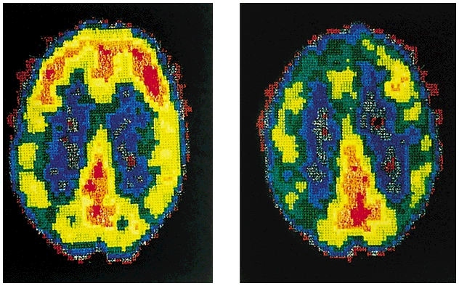
Understanding Antisocial Personality Disorder
PET scans of 41 murderers revealed reduced activity in the frontal lobes. In a follow-up study repeat offenders had 11% less frontal lobe compared to normals (Raine et al., 1999; 2000).
Courtesy of Adrian Raine,
University of Southern California
Normal
Murderer

Slide 84
Understanding Antisocial Personality Disorder
Probability of crime increases twice as much when childhood poverty is compounded with obstetrical complications (Raine et al., 1999; 2000).

Slide 85
Cluster C: Personality Disorders Related to Anxiety
Notes:
Cluster C is called the anxious, fearful cluster. It includes the Avoidant, Dependent, and Obsessive-Compulsive Personality Disorders. These three personality disorders share a high level of anxiety.

Slide 86
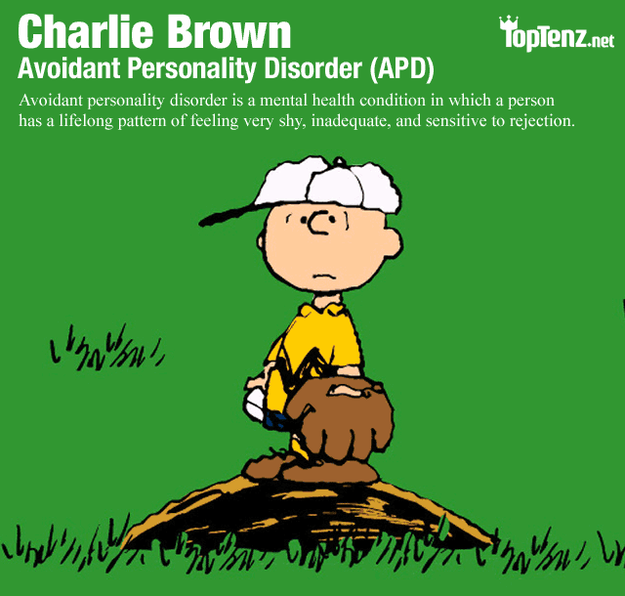
Avoidant Personality Disorder
So sensitive about being rejected that personal relationships become difficult
Notes:
characterized by a pervasive pattern of social inhibition, feelings of inadequacy, and a hypersensitivity to negative evaluation. People with this disorder are intensely afraid that others will ridicule them, reject them, or criticize them. This leads them to avoid social situations and to avoid interactions with others. This further limits their ability to develop social skills. People with Avoidant Personality Disorders often have a very limited social world with a small circle of confidants. Their social life is otherwise rather limited..
Their way of thinking about and interpreting the world revolves around the thought that they are not good enough, and that others don't like them. They think of themselves as unappealing and socially inept. These types of thoughts create feelings of intense anxiety in social situations, along with a fear of being ridiculed, criticized, and rejected. The intensity of this fearful anxiety, and the discomfort it creates, compels them to avoid interpersonal situations. They might avoid parties or social events, and may have difficulty giving presentations at work or speaking up in meetings. Others might perceive them as distant or shy. They likely come across as stiff and restricted. All this will likely interfere with their ability to make friends, or to move ahead professionally.

Slide 87
Dependent Personality Disorder
Behave in clingy, submissive ways and displays a strong need to have others take care of them
Rely too much on the attention and help of others.
Notes:
The core feature of the Dependent Personality Disorder* is a strong need to be taken care of by other people. This need to be taken care of, and the associated fear of losing the support of others, often leads people with Dependent Personality Disorder to behave in a "clingy" manner; to submit to the desires of other people. In order to avoid conflict, they may have great difficulty standing up for themselves. The intense fear of losing a relationship makes them vulnerable to manipulation and abuse. They find it difficult to express disagreement or make independent decisions, and are challenged to begin a task when nobody is available to assist them. Being alone is extremely hard for them. When someone with Dependent Personality Disorder finds that a relationship they depend on has ended, they will immediately seek another source of support.

Slide 88
Obsessive-Compulsive Personality Disorder
Characterized by a general psychological inflexibility, rigid conformity to rules and procedures, perfectionism, and excessive orderliness.
Tend to stress perfectionism above all else, and feel anxious when they perceive that things aren't "right".
Notes:
Persons with Obsessive-Compulsive Personality Disorder* are preoccupied with rules, regulations, and orderliness. This preoccupation with perfectionism and control is at the expense of flexibility, openness, and efficiency. They are great makers of lists and schedules, and are often devoted to work to such an extent that they often neglect social relationships. They have perfectionist tendencies, and are so driven in their work to "get it right" that they become unable to complete projects or specific tasks because they get lost in the details, and fail to see the "forest for the trees." Persons with Obsessive-Compulsive Personality Disorder tend to be rigid and inflexible in their approach to things. It simply isn't an option for them to do a "sub-standard" job just to get something done. Often, they are unable to delegate tasks for fear that another person will not "get it right." Sometimes people with this disorder adopt a miserly style with both themselves and others. Money is regarded as something that must be rigidly controlled in order to ward off future catastrophe. People with this disorder are often experienced as rigid, controlling, and stubborn.

Slide 89
Etiology of personality disorders
Physiological differences in brain activity (most notably antisocial with regard to arousal levels)
Behaviorists and socioculturalists would want to examine the home environment, were inappropriate behaviors reinforced, etc

Slide 90
Depressive and Bipolar Disorders
Major Depressive Disorder
Bipolar Disorder
Notes:
http://www.youtube.com/watch?v=F5YubjEqbZ8 - Depression Documentary from BBC
http://www.youtube.com/watch?v=J3L6Nwr8fp8 - Depression Documentary
https://www.youtube.com/watch?v=j4ryGoxRBRU – Bipolar clips from movies

Slide 91
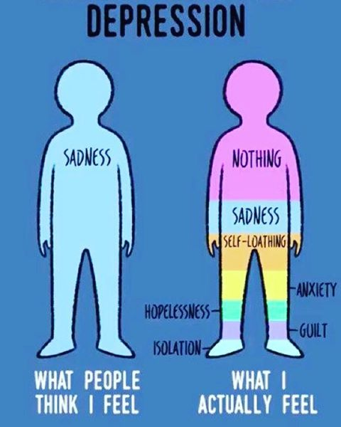
Depressive and Bipolar Disorders
Emotional extremes of depressive and bipolar disorders come in a few principal forms. These are not the same as feeling “down” or being in a bad mood. These extremes are pervasive and damage healthy functioning.
Notes:
OBJECTIVE 50-1| Define mood disorders, and contrast major depressive disorder and bipolar disorder.

Slide 92
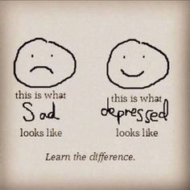
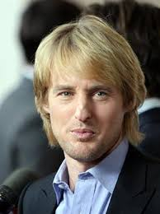
Major Depressive Disorder
Sometimes called unipolar or clinical depression. Occurs when signs of depression last two weeks or more and are not caused by drugs or medical conditions and cannot be explained by a single stimulus. DSM 5 removed bereavement exclusion (this is not “normal” grief)
Signs include:
Lethargy and tiredness
Feelings of worthlessness
Loss of interest in family & friends
Loss of interest in activities
Suicidal thoughts
Notes:
People with dysthymia generally experience little or no joy in their lives. Instead things are rather gloomy most of the time. If you have dysthymia you may be unable to remember a time when you felt happy, excited, or inspired. It may seem as if you have been depressed all your life. You probably have a hard time enjoying things and having fun. Rather, you might tend to be inactive and withdrawn , you worry frequently, and criticize yourself as being a failure. You may also feel guilty, irritable, sluggish, and have difficulty sleeping regularly.

Slide 93
Why the removal of the bereavement exclusion??
In normal bereavement, emotional connection with significant others is preserved, self-esteem is preserved, suicidal ideation is uncommon, grief is mixed with positive feelings, the person is consolable, and the dysphoria is often experienced in waves triggered by memories of the deceased person.
Depression is intensely self-focused, whereas bereavement tends to involve focus on the deceased.
Important to receive treatment asap

Slide 94
Persistent Depressive Disorder (Dysthymia)
The symptoms of dysthymia are the same as those of major depression but fewer in number and not as intense.
This low, dark mood -- sometimes described as a "veil of sadness" -- occurs nearly every day and can sometimes persist for many years.
Some people may have this mood disorder for 10 to 20 years or even more before seeking treatment.
Notes:
People with dysthymia generally experience little or no joy in their lives. Instead things are rather gloomy most of the time. If you have dysthymia you may be unable to remember a time when you felt happy, excited, or inspired. It may seem as if you have been depressed all your life. You probably have a hard time enjoying things and having fun. Rather, you might tend to be inactive and withdrawn , you worry frequently, and criticize yourself as being a failure. You may also feel guilty, irritable, sluggish, and have difficulty sleeping regularly.

Slide 95
Disruptive Mood Dysregulation Disorder
Severe and frequent temper tantrums that interfere with an ability to function at home, in school or with their friends.
Notes:
The defining characteristic of disruptive mood dysregulation disorder (DMDD) in children is a chronic, severe and persistent irritability. This irritability is often displayed by the child as a temper tantrum, or temper outburst, that occur frequently (3 or more times per week). When the child isn’t having a temper outburst, they appear to be in a persistently irritable or angry mood, present most of the day, nearly every day. As the DSM-5 Fact Sheet says, “Far beyond temper tantrums, DMDD is characterized by severe and recurrent temper outbursts that are grossly out of proportion in intensity or duration to the situation.”

Slide 96
Seasonal Affective Disorder
Characteristics
Similar to major depression
Triggered by changes in the season
Reduced levels of light seem to be main cause

Slide 97
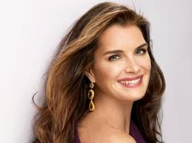
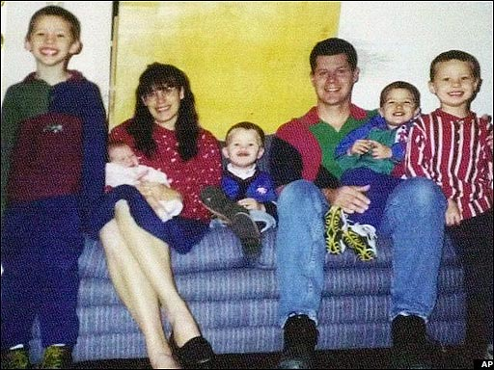
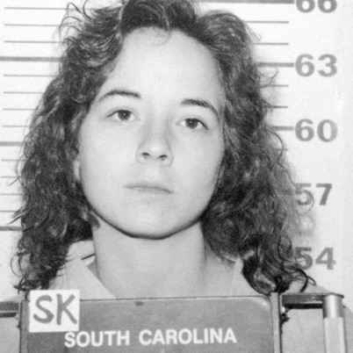
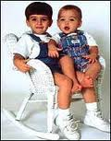
Postpartum Depression
Not just the “Baby Blues”
Postpartum Psychosis
Rare, severe, and dangerous form of postpartum depression
Occurs within the first 3 weeks following childbirth.
Feel detached from her baby and other people.
Hallucinations involving smell, touch, sight, or hearing.
She may have thoughts not based in reality (delusions), display bizarre behavior, or have urges to kill herself and her child or children.
Notes:
Postpartum depression is the most common problem associated with childbirth. It has been described as afflicting prominent historical figures like author/suffragist Charlotte Perkins Gilman in the 19th century. This illness is characterized by depression that a woman experiences within four weeks of childbirth, affecting about 13% of women who give birth. Postpartum depression occurs after one out of every eight deliveries in the United States, affecting about half a million women every year. Postpartum depression is also called major depression with postpartum onset. Delusional thinking after childbirth, called postpartum psychosis, affects about one in every thousand women.
Notably, postpartum depression is not an illness that is exclusive to mothers. Fathers can experience it as well. In fact, it can affect as many as 10% of new fathers. As with women, symptoms in men can result in fathers having difficulty caring for themselves and for their children when suffering from postpartum depression.
Unfortunately, up to 50% of individuals with postpartum depression or postpartum psychosis are never detected. That can result in devastating outcomes for the patient and family. For example, postpartum psychosis is thought to have been a potential factor in Andrea Yates drowning her five children in 2001 and was explored as a factor in Susan Smith drowning her two sons.
http://www.youtube.com/watch?v=ps5fbErITQs – 5 minute video on Postpartum Depression
http://www.youtube.com/watch?v=IWXxAcnBxW8 - 5 minute video on Postpartum Depression in Men
Andrea Yates and Susan Smith

Slide 98
Bipolar Disorder
Formerly called manic-depressive disorder, alteration between depression and mania signals bipolar disorder. (Bipolar I is more psychotic than Bipolar II)
Depressive Symptoms
Manic Symptoms
Gloomy
Elation
Withdrawn
Euphoria
Inability to make decisions
Desire for action
Tired
Hyperactive
Slowness of thought
Multiple ideas
Notes:
The main difference between mania and hypomania is a matter of severity. In the hypomania of bipolar 2, a person has a sustained mood that is elevated (heightened), expansive (grand, superior) or irritable. This mood has to be noticeably different from his or her normal mood when not depressed. In mania, that mood is extremely abnormal, and is also combined with increased activity or energy that is also abnormal.
For example, Hank, when he has hypomanic episodes, is exceptionally cheerful, needs only three hours sleep instead of his usual seven, spends more money than he safely should and speaks far more rapidly than usual, along with other symptoms of hypomania.
This behavior is noticeably different from his own stable mood, yet there are cheerful people who need little sleep, spend a lot and talk fast who don't have bipolar disorder, so while it's abnormal for him, it's not outside the range of possible behavior in general.
On the other hand, Hank's friend Robert, who has manic episodes, is out-of-control happy, even during serious events (he burst out laughing disruptively during a funeral).
He ran around outside at midnight shouting how much he loved all his neighbors (along with other symptoms of mania). This is abnormal behavior for anyone

Slide 99
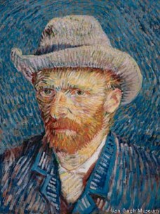
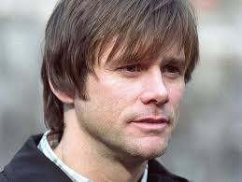
Bipolar Disorder
Many great writers, poets, composers suffered from bipolar disorder. During their manic phases, their creativity surged and dropped off during their depressive phases.
Notes:
Cyclothymia symptoms alternate between emotional highs and lows. The highs of cyclothymia are characterized by symptoms of an elevated mood (hypomanic symptoms), which resemble those of mania but are less severe. The lows consist of mild or moderate depressive symptoms.
Cyclothymia symptoms are similar to those of bipolar disorder I or II, but they're less severe. When you have cyclothymia, you can typically function in your daily life, though not always well. The unpredictable nature of your mood shifts may significantly disrupt your life because you never know how you're going to feel.

Slide 100
Cyclothymic Disorder
This is a less intense but often longer lasting version of bipolar disorder.
Both high and low mood, but never as severe as either mania or major depression.
To make this diagnosis, the person usually has symptoms that last for at least two years.
Notes:
Cyclothymia symptoms alternate between emotional highs and lows. The highs of cyclothymia are characterized by symptoms of an elevated mood (hypomanic symptoms), which resemble those of mania but are less severe. The lows consist of mild or moderate depressive symptoms.

Slide 101
Explaining Depressive and Bipolar Disorders
Since depression is so prevalent worldwide, investigators want to develop a theory of depression that will suggest ways to treat it.
Lewinsohn et al., (1985, 1995) note that a theory of depression should explain:
Behavioral and cognitive changes
Common causes of depression
Notes:
OBJECTIVE 50-2| Discuss the facts that an acceptable theory of depression must explain.

Slide 102
The Depressed Brain
PET scans show that brain energy consumption rises and falls with manic and depressive episodes.
Courtesy of Lewis Baxter an Michael E.
Phelps, UCLA School of Medicine

Slide 103
Cycle of Depression
The negative stressful events.
Pessimistic explanatory style.
Hopeless depressed state.
Hampers the way the individual thinks and acts, and thus fuels personal rejection.

Slide 104
Etiology of Mood Disorders
Biomedical- focus on brain chemistry, underproduction of serotonin and norepinephrine, linked to cortisol (stress hormone). Tend to run in families (genetic)
Psychoanalytic- unresolved unconscious anger that is internalized, repressed
Cognitive-pessimistic explanatory style, self defeating beliefs
Behaviorist- symptoms have been reinforced
Sociocultural- more prevalent in females, examine society, roles, etc
Notes:
http://www.youtube.com/watch?v=ps5fbErITQs – 5 minute video on Postpartum Depression
http://www.youtube.com/watch?v=IWXxAcnBxW8 - 5 minute video on Postpartum Depression in Men

Slide 105
Schizophrenia
Notes:
http://www.youtube.com/watch?v=Rv0b1unxUpM - 50 minute video

Slide 106
Schizophrenia
If depression is the common cold of psychological disorders schizophrenia is the cancer.
Nearly 1 in a 100 suffer from schizophrenia and world over 24 million people suffer from this disease (WHO, 2002).
Strikes young people as they mature into adults. Affects men and women equally, but men suffer from it more severely than women.
Notes:
Conditions that can look like schizophrenia
The medical and psychological conditions the doctor must rule out before diagnosing schizophrenia include:
Other psychotic disorders – Schizophrenia is a type of psychotic disorder, meaning it involves a significant loss of contact with reality. But there are other psychotic disorders that cause similar symptoms of psychosis, including schizoaffective disorder, schizophreniform disorder, and brief psychotic disorder. Because of the difficulty in differentiating between the psychotic disorders, it may take six months or longer to arrive at a correct diagnosis.
Substance abuse – Psychotic symptoms can be triggered by many drugs, including alcohol, PCP, heroin, amphetamines, and cocaine. Some over-the-counter and prescription drugs can also trigger psychotic reactions. A toxicology screen can rule out drug-induced psychosis. If substance abuse is involved, the physician will determine whether the drug is the source of the symptoms or merely an aggravating factor.
Medical conditions – Schizophrenia-like symptoms can also result from certain neurological disorders (such as epilepsy, brain tumors, and encephalitis), endocrine and metabolic disturbances, and autoimmune conditions involving the central nervous system.
Mood disorders – Schizophrenia often involves changes in mood, including mania and depression. While these mood changes are typically less severe than those seen in bipolar disorder and major depressive disorder, they can make diagnosis tricky. Schizophrenia is particularly difficult to distinguish from bipolar disorder. The positive symptoms of schizophrenia (delusions, hallucinations, and disorganized speech) can look like a manic episode of bipolar disorder, while the negative symptoms of schizophrenia (apathy, social withdrawal, and low energy) can look like a depressive episode.
Post-traumatic stress disorder (PTSD) – PTSD is an anxiety disorder that can develop after exposure to a traumatic event, such as military combat, an accident, or a violent assault. People with PTSD experience symptoms that are similar to schizophrenia. The images, sounds, and smells of PTSD flashbacks can look like psychotic hallucinations. The PTSD symptoms of emotional numbness and avoidance can look like the negative symptoms of schizophrenia.

Slide 107
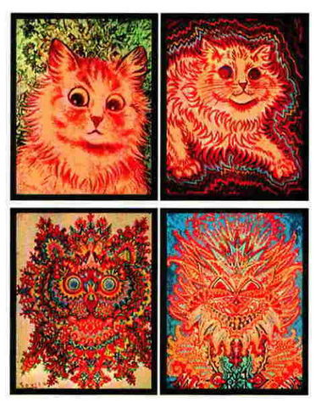
General Symptoms of Schizophrenia
Literal translation “split mind”. A group of severe disorders characterized by:
Disorganized and delusional thinking.
Disturbed perceptions.
Inappropriate emotions and actions.
Cat images painted by artist Louis Wain during the period when he became schizophrenic.
Notes:
OBJECTIVE 51-1| Describe the symptoms of schizophrenia, and differentiate delusion and hallucinations.
Conditions that can look like schizophrenia
The medical and psychological conditions the doctor must rule out before diagnosing schizophrenia include:
Other psychotic disorders – Schizophrenia is a type of psychotic disorder, meaning it involves a significant loss of contact with reality. But there are other psychotic disorders that cause similar symptoms of psychosis, including schizoaffective disorder, schizophreniform disorder, and brief psychotic disorder. Because of the difficulty in differentiating between the psychotic disorders, it may take six months or longer to arrive at a correct diagnosis.
Substance abuse – Psychotic symptoms can be triggered by many drugs, including alcohol, PCP, heroin, amphetamines, and cocaine. Some over-the-counter and prescription drugs can also trigger psychotic reactions. A toxicology screen can rule out drug-induced psychosis. If substance abuse is involved, the physician will determine whether the drug is the source of the symptoms or merely an aggravating factor.
Medical conditions – Schizophrenia-like symptoms can also result from certain neurological disorders (such as epilepsy, brain tumors, and encephalitis), endocrine and metabolic disturbances, and autoimmune conditions involving the central nervous system.
Mood disorders – Schizophrenia often involves changes in mood, including mania and depression. While these mood changes are typically less severe than those seen in bipolar disorder and major depressive disorder, they can make diagnosis tricky. Schizophrenia is particularly difficult to distinguish from bipolar disorder. The positive symptoms of schizophrenia (delusions, hallucinations, and disorganized speech) can look like a manic episode of bipolar disorder, while the negative symptoms of schizophrenia (apathy, social withdrawal, and low energy) can look like a depressive episode.
Post-traumatic stress disorder (PTSD) – PTSD is an anxiety disorder that can develop after exposure to a traumatic event, such as military combat, an accident, or a violent assault. People with PTSD experience symptoms that are similar to schizophrenia. The images, sounds, and smells of PTSD flashbacks can look like psychotic hallucinations. The PTSD symptoms of emotional numbness and avoidance can look like the negative symptoms of schizophrenia.

Slide 108
Daniel’s story
Daniel is 21 years old. Six months ago, he was doing well in college and holding down a part-time job in the stockroom of a local electronics store. But then he began to change, becoming increasingly paranoid and acting out in bizarre ways. First, he became convinced that his professors were “out to get him” since they didn’t appreciate his confusing, off-topic classroom rants. Then he told his roommate that the other students were “in on the conspiracy.” Soon after, he dropped out of school.
From there, things just got worse. Daniel stopped bathing, shaving, and washing his clothes. At work, he became convinced that his boss was watching him through surveillance bugs planted in the store’s television sets. Then he started hearing voices telling him to find the bugs and deactivate them. Things came to a head when he acted on the voices, smashing several TVs and screaming that he wasn’t going to put up with the “illegal spying” any more. His frightened boss called the police, and Daniel was hospitalized.
Notes:
The most common early warning signs of schizophrenia include:
Social withdrawal
Hostility or suspiciousness
Deterioration of personal hygiene
Flat, expressionless gaze
Inability to cry or express joy
Inappropriate laughter or crying
Depression
Oversleeping or insomnia
Odd or irrational statements
Forgetful; unable to concentrate
Extreme reaction to criticism
Strange use of words or way of speaking

Slide 109
Disorganized & Delusional Thinking
Many psychologists believe disorganized thoughts occur because of selective attention failure (fragmented and bizarre thoughts).
Patient’s speech may be loosely connected and words thrown together causing nonsense
(word salad)
Often patients experience delusions of grandeur or persecution
Notes:
Disorganized speech
Fragmented thinking is characteristic of schizophrenia. Externally, it can be observed in the way a person speaks. People with schizophrenia tend to have trouble concentrating and maintaining a train of thought. They may respond to queries with an unrelated answer, start sentences with one topic and end somewhere completely different, speak incoherently, or say illogical things.
Common signs of disorganized speech in schizophrenia include:
Loose associations – Rapidly shifting from topic to topic, with no connection between one thought and the next.
Neologisms – Made-up words or phrases that only have meaning to the patient.
Perseveration – Repetition of words and statements; saying the same thing over and over.
Clang – Meaningless use of rhyming words (“I said the bread and read the shed and fed Ned at the head").

Slide 110
Disturbed Perceptions
A schizophrenic person may perceive things that are not there (hallucinations). Frequently such hallucinations are auditory, and less often visual, somatosensory, olfactory or gustatory.
Photos of paintings by Krannert Museum, University of Illinois at Urbana-Champaign
August Natter, Witches Head. The Prinzhorn Collection, University of Heidelberg
L. Berthold, Untitled. The Prinzhorn Collection, University of Heidelberg

Slide 111
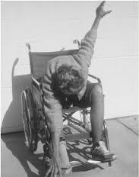
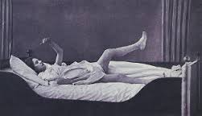
Inappropriate Emotions & Actions
A schizophrenic person may laugh at the news of someone dying, or show no emotion at all (apathy).
Patients with schizophrenia can continually rub an arm or rock a chair or remain motionless for hours (catatonia).

Slide 112
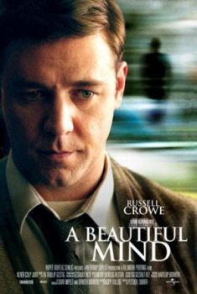
Subtypes of Schizophrenia
Schizophrenia is a cluster of disorders. These subtypes share some features but there are other symptoms that differentiate these subtypes.
Notes:
OBJECTIVE 51-2| Distinguish the five subtypes of schizophrenia, and contrast chronic and reactive schizophrenia.

Slide 113
Subtypes

Slide 114
Positive and Negative Symptoms
Schizophrenics have inappropriate symptoms (hallucinations, disorganized thinking, deluded ways) not present in normal individuals
(positive symptoms).
Schizophrenics also have absence of appropriate symptoms (apathy, expressionless faces, rigid bodies) present in normal individuals
(negative symptoms).

Slide 115
Chronic and Acute Schizophrenia
When schizophrenia is slow to develop (chronic/process) recovery is doubtful. Such schizophrenics usually displays negative symptoms.
When schizophrenia rapidly develops (acute/reactive) recovery is better. Such schizophrenics usually shows positive symptoms.

Slide 116
The differences
Acute schizophrenia | Chronic schizophrenia
“Reactive” | “Process”
Positive symptoms | Negative symptoms
Prognosis better | Prognosis worse
Treat with classic antipsychotics (Thorazine) | Treat with atypical antipsychotics (Clozaril)

Slide 117
Understanding Schizophrenia
Schizophrenia is a disease of the brain exhibited in the symptoms of the mind.
Brain Abnormalities
Dopamine Overactivity: Researchers have found that schizophrenic patients express higher levels of dopamine D4 receptors in the brain.
Notes:
OBJECTIVE 51-3| Outline some abnormal brain functions and structures associated with schizophrenia, and discuss the possible link between prenatal viral infections and schizophrenia.

Slide 118
Abnormal Brain Activity
Brain scans show abnormal activity in frontal cortex, thalamus and amygdala of schizophrenic patients. Also adolescent schizophrenic patients show brain lesions.
Paul Thompson and Arthur W. Toga, UCLA Laboratory of Neuro
Imaging and Judith L. Rapport, National Institute of Mental Health

Slide 119
Abnormal Brain Morphology
Schizophrenia patients may express morphological changes in the brain like enlargement of fluid filled ventricles.
Both Photos: Courtesy of Daniel R. Weinberger, M.D., NIH-NIMH/ NSC

Slide 120
Viral Infection
Schizophrenia has also been observed in individuals who contracted a viral infection (flu) during the middle of their fetal development.
Notes:
Schizophrenia has long been blamed on bad genes or even bad parents. Wrong, says a growing group of psychiatrists. The real culprit, they claim, is a virus that lives entwined in every person’s DNA.
Schizophrenia is usually diagnosed between the ages of 15 and 25, but the person who becomes schizophrenic is sometimes recalled to have been different as a child or a toddler—more forgetful or shy or clumsy. Even more puzzling is the so-called birth-month effect: People born in winter or early spring are more likely than others to become schizophrenic later in life. It is a small increase, just 5 to 8 percent, but it is remarkably consistent, showing up in 250 studies. That same pattern is seen in people with bipolar disorder or multiple sclerosis.
“The birth-month effect is one of the most clearly established facts about schizophrenia,” says Fuller Torrey, director of the Stanley Medical Research Institute in Chevy Chase, Maryland. “It’s difficult to explain by genes, and it’s certainly difficult to explain by bad mothers.”

Slide 121
Genetic Factors
Prevalence of schizophrenia in identical twins as seen in different countries.

Slide 122
Psychological Factors
Psychological and environmental factors can trigger schizophrenia if the individual was genetically predisposed (Nicols & Gottesman, 1983).
Genetically identical Genain
sisters suffer from schizophrenia. Twice as many as statistically likely due to genetics, thus there are contributing environmental factors.
Courtesy of Genain Family
Genain Sisters
Notes:
OBJECTIVE 51-5| Describe some psychological factors that may be early signs of schizophrenia in children.

Slide 123
Neurodevelopmental Disorders
Autism Spectrum Disorder
ADHD
Communication Disorders
Intellectual Disabilities
Motor Disorders
Specific Learning Disorder
Notes:
https://www.youtube.com/watch?v=KmDGvquzn2k – Carly’s Cafe

Slide 124
Neurodevelopmental Disorders
Each group will be researching a category of disorders under Neurodevelopmental Disorders classification to share with the class.
Please include:
General Definition/Overview
Specific disorders within the category
Etiology (Biopsychosocial)
Treatment
New to DSM 5

Slide 125
Neurodevelopmental Disorders
Usually diagnosed in infancy or early childhood
“maladaptive” is important, must be chronic
Etiology:
Roots of autism
poorly understood
Biomedical therapy for ADHD

Slide 126
Autism Spectrum Disorder
Persistent deficits in social communication and social interaction across multiple contexts
Pervasive developmental disorder
Lack of appropriate social responsiveness and highly impaired communication
Wide range of symptoms
and levels of functioning
More common among
boys (genetic??)
Notes:
http://www.youtube.com/watch?v=FuWWie1DlJY – 4 minute video
https://www.youtube.com/watch?v=rSVhXOFtoYY – Asperger’s in Sheldon from the Big Bang Theory.
No longer in the DSM 5 - Asperger's disorder was marked by difficulties interacting with others, along with abnormal behaviors and abnormally intense interests in topics such as baseball statistics or trains. These characteristics can give people with the disorder a savant-like quality portrayed in pop culture

Slide 127
Attention Deficit/Hyperactivity Disorder
Referred to as a neurodevelopmental disorder
More common among boys, may be diagnosed later in adulthood
Impulsivity
Sustained inattention
Limited ability to focus on tasks
ADHD
Notes:
http://www.youtube.com/watch?v=u82nzTzL7To - 4minute video

Slide 128
Tourette’s Disorder
Referred to as a neurodevelopmental disorder
Consistent vocal or motor “tics” (sudden, rapid, recurrent, non-rhythmic, stereotyped movement or vocalization)
Somewhat like OCD
Notes:
http://www.youtube.com/watch?v=dtCUYUBOnzk - 7 minute video

Slide 129
Intellectual Disabilities
Formerly referred to as mental retardation
4 levels; mild, moderate, severe, profound

Slide 130
Feeding and Eating Disorders
Anorexia Nervosa – Restriction of food, exercise, view themselves as overweight
Bulimia Nervosa – Binge and purge, laxatives, vomiting
Binge Eating – Binge eating followed by remorse.
Pica – Consumption of non-edible substances.

Slide 131
Other Disorders
Paraphilic Disorders (pedophilia, zoophilia, hybristophilia)
Gender Dysphoria
Disruptive, Impulsive-Control, and Conduct Disorders
Substance-Related and Addicitve Disorders
Notes:
Hybristophilia - Bonnie and Clyde Syndrome

Slide 132
Conduct Disorder
Frequent lying
Stealing
Manipulation
Cruelty and lack of remorse, empathy
Some call it a childhood form of antisocial personality disorder
Notes:
Aggression to people and animals
bullies, threatens or intimidates others
often initiates physical fights
has used a weapon that could cause serious physical harm to others (e.g. a bat, brick, broken bottle, knife or gun)
is physically cruel to people or animals
steals from a victim while confronting them (e.g. assault)
forces someone into sexual activity
Destruction of Property
deliberately engaged in fire setting with the intention to cause damage
deliberately destroys other's property
Deceitfulness, lying, or stealing
has broken into someone else's building, house, or car
lies to obtain goods, or favors or to avoid obligations
steals items without confronting a victim (e.g. shoplifting, but without breaking and entering)
Serious violations of rules
often stays out at night despite parental objections
runs away from home
often truant from school

Slide 133
AP info…
Perspective Psychoanalytic/ psychodynamic Humanistic Behavioral Cognitive Sociocultural Biomedical | Cause of disorder Internal, unconscious conflicts Failure to strive toward one’s potential or being out of touch with one’s feelings Reinforcement history, the environment Irrational, dysfunctional thoughts or ways of thinking Dysfunctional society Organic problems, biochemical imbalances genetic predispositions

Slide 134
More AP info…
Medical Model (Pinel)
Somatoform (conversion, hypochondriasis, body dysmorphic)
Personality (anti-social, narcissistic, histrionic, borderline, paranoid)
Anxiety (GAD, phobias, panic, PTSD, OCD)
Not enough GABA to control CNS

Slide 135
And more AP info.
Developmental (autism, ADHD, Tourette’s, conduct, mental retardation)
Schizophrenia (paranoid, catatonic, disorganized, undifferentiated, residual,)
Too high levels of dopamine
Dissociative disorder (D. amnesia, D. fugue,
D. identity disorder (MPD)
Mood/Affective disorder (major depressive, bipolar, SAD)
Lower levels of serotonin (need SSRI)

