Slide 1
Electromagnetic
Induction
Prepared by
Chris Chiaverina

Slide 2
Chapter Contents
Electricity from Magnetism
Electric Generators and Motors
AC Circuits and Transformers

Slide 3
Electricity from Magnetism
When Hans Oersted observed that an electric current produces a magnetic field, it was pure serendipity. In contrast, Michael Faraday (1791–1867), an English chemist and physicist, was aware of Oersted's results, and purposely set out to see if a magnetic field could produce an electric field. His ingenious experiments showed that such a connection does exist.
Faraday found that a changing magnetic field produces an electric current, but a magnetic field that doesn't change has no such effect. Faraday set out to study this type of behavior.

Slide 4
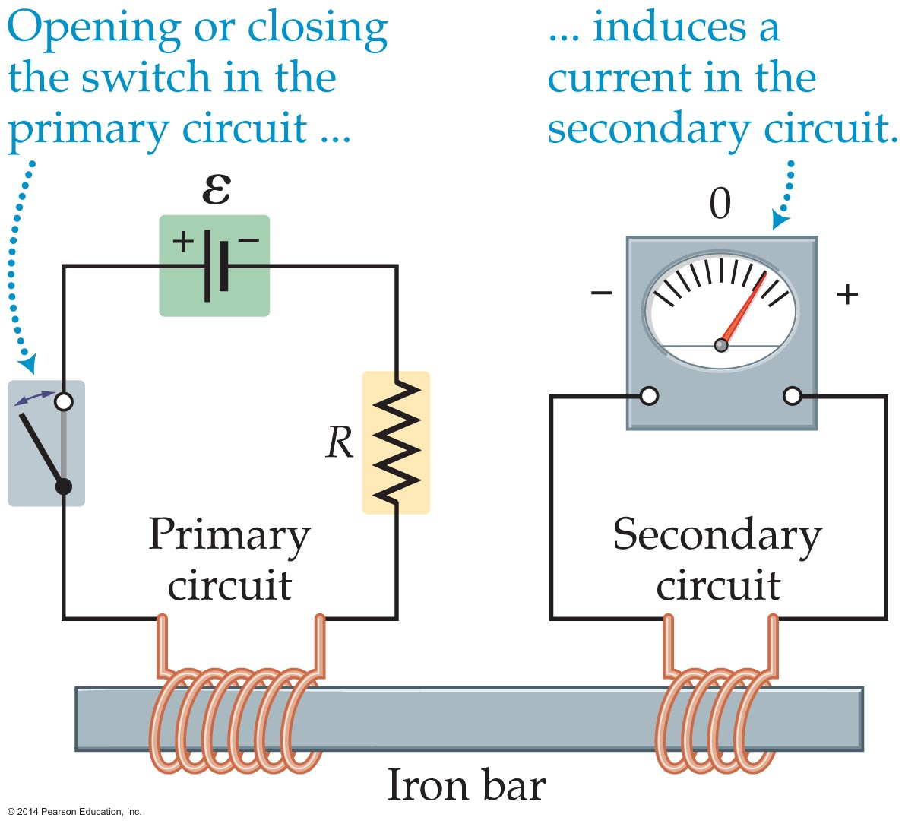
Electricity from Magnetism
The following figure shows a simplified version of Faraday's experiment.
As the figure indicates, two electric circuits are involved. The first, called the primary circuit, consists of a battery, a switch, a resistor, and a wire coil wrapped around an iron bar.

Slide 5
Electricity from Magnetism
When the switch is closed on the primary circuit, a current flows through the coil, producing a strong magnetic field in the iron bar.
The secondary circuit also has a wire coil wrapped around the same iron bar, and this coil is connected to an ammeter that detects any current in the circuit. There is no battery in the circuit, and no direct physical contact between the two circuits. What does link the circuits, instead, is the magnetic field in the iron bar.

Slide 6
Electricity from Magnetism
When the switch is closed on the primary circuit, the magnetic field in the iron bar rises from zero to some finite amount, and the ammeter in the secondary coil deflects to one side briefly and then returns to zero. As long as the current in the primary circuit is maintained at a constant value, the ammeter in the secondary circuit gives a zero reading.
If the switch on the primary circuit is then opened, so the magnetic field drops again to zero, the ammeter in the secondary circuit deflects briefly in the opposite direction and then returns to zero.

Slide 7
Electricity from Magnetism
These observations can be summarized as follows:
  The current in the secondary circuit is zero as long as the magnetic field in the iron bar is constant. It does not matter whether the constant value of the magnetic field is zero or nonzero.
  When the magnetic field in the secondary coil increases, a current is observed to flow in one direction in the secondary coil. When the magnetic field in the secondary coil decreases, a current is observed to flow in the opposite direction.

Slide 8
Electricity from Magnetism
It is important to note that the current in the secondary coil appears without any physical contact between the primary and secondary coils.
For this reason, the current in the secondary coil is referred to as an induced current. The process of inducing an electric current in a circuit by using a changing magnetic field is known as electromagnetic induction.

Slide 9
Electricity from Magnetism
Because an induced current behaves the same as a current produced by an electromotive force (emf) supplied by a battery, we say that the changing magnetic field creates an induced emf in the secondary circuit.
As far as the circuit is concerned, the changing magnetic field has the same effect as a battery.
Faraday observed that the magnitude of the induced emf is proportional to the rate of change of the magnetic field—the more rapidly the magnetic field changes, the greater the induced emf.

Slide 10
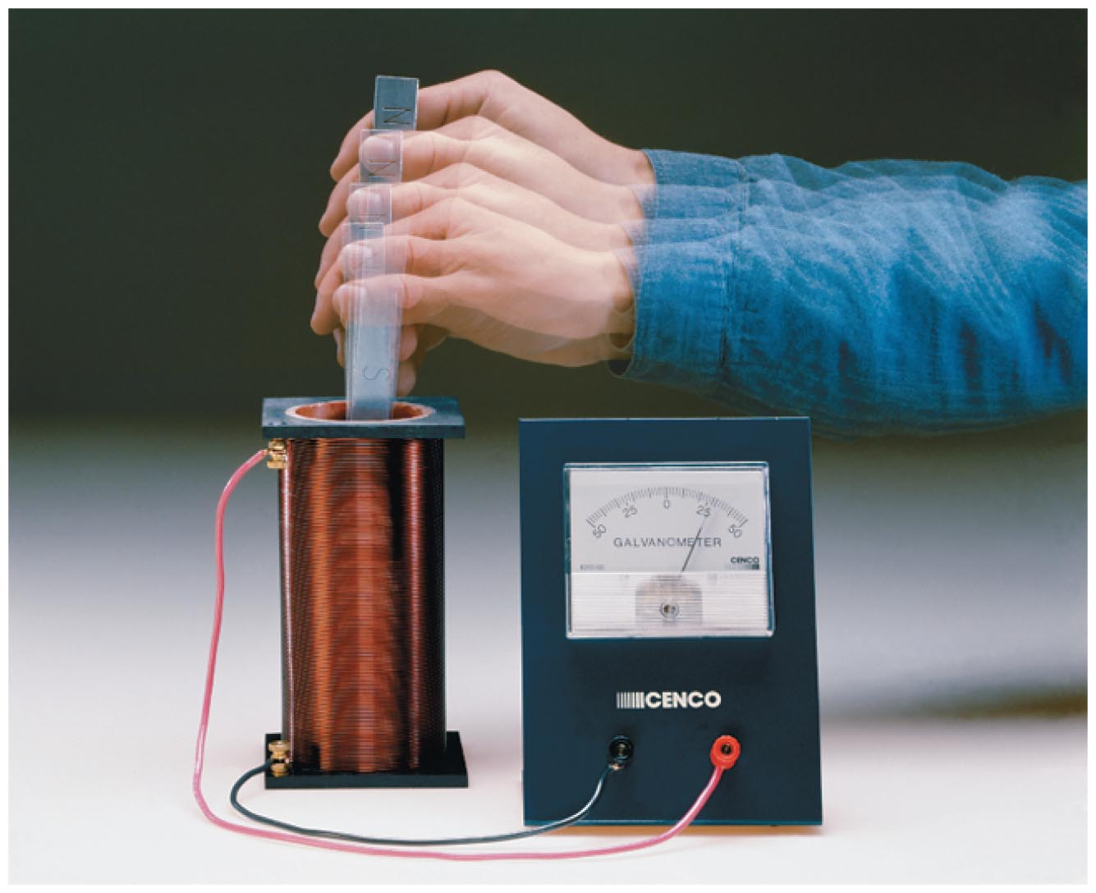
Electricity from Magnetism
Any means of changing the magnetic field is as effective as changing the current in the primary.
The figure below shows a common classroom demonstration of induced emf.
In this case, there is no primary circuit; instead, the magnetic field is changed by simply moving a bar magnet toward or away from a coil connected to an ammeter.

Slide 11
Electricity from Magnetism
When the magnet is moved toward the coil, the meter deflects in one direction; when it is pulled away from the coil, the meter deflects in the opposite direction. There is no deflection when the magnet is held still.
Understanding electromagnetic induction requires a new concept—magnetic flux. The word flux basically means "flow." For example, the flux, or flow, of air through a window is directly related to the direction of the wind and the cross-sectional area of the window.

Slide 12
Electricity from Magnetism
Similarly, magnetic flux is a measure of the number of magnetic field lines that pass through a given area.
A magnetic field perpendicular to a surface gives a high flux, and the larger the surface area, the greater the flux. A magnetic field parallel to a surface gives zero flux.
Figure (a) on the next slide shows a magnetic field B crossing a surface area, A, at right angles.

Slide 13
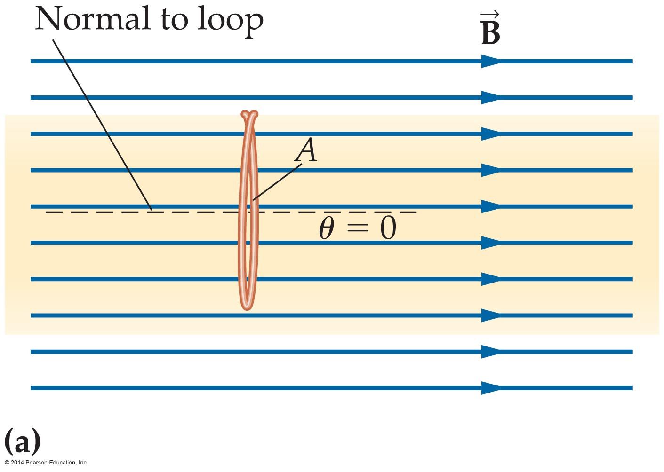
Electricity from Magnetism
The magnetic flux, Ф, in this case is simply the magnitude of the magnetic field times the area:
Ф = BA
If the magnetic field is parallel to the surface—like wind blowing parallel to an open window—then no field lines cross through the surface. As figure (b) on the next slide shows, the magnetic flux in this case is zero: Ф = 0.

Slide 14
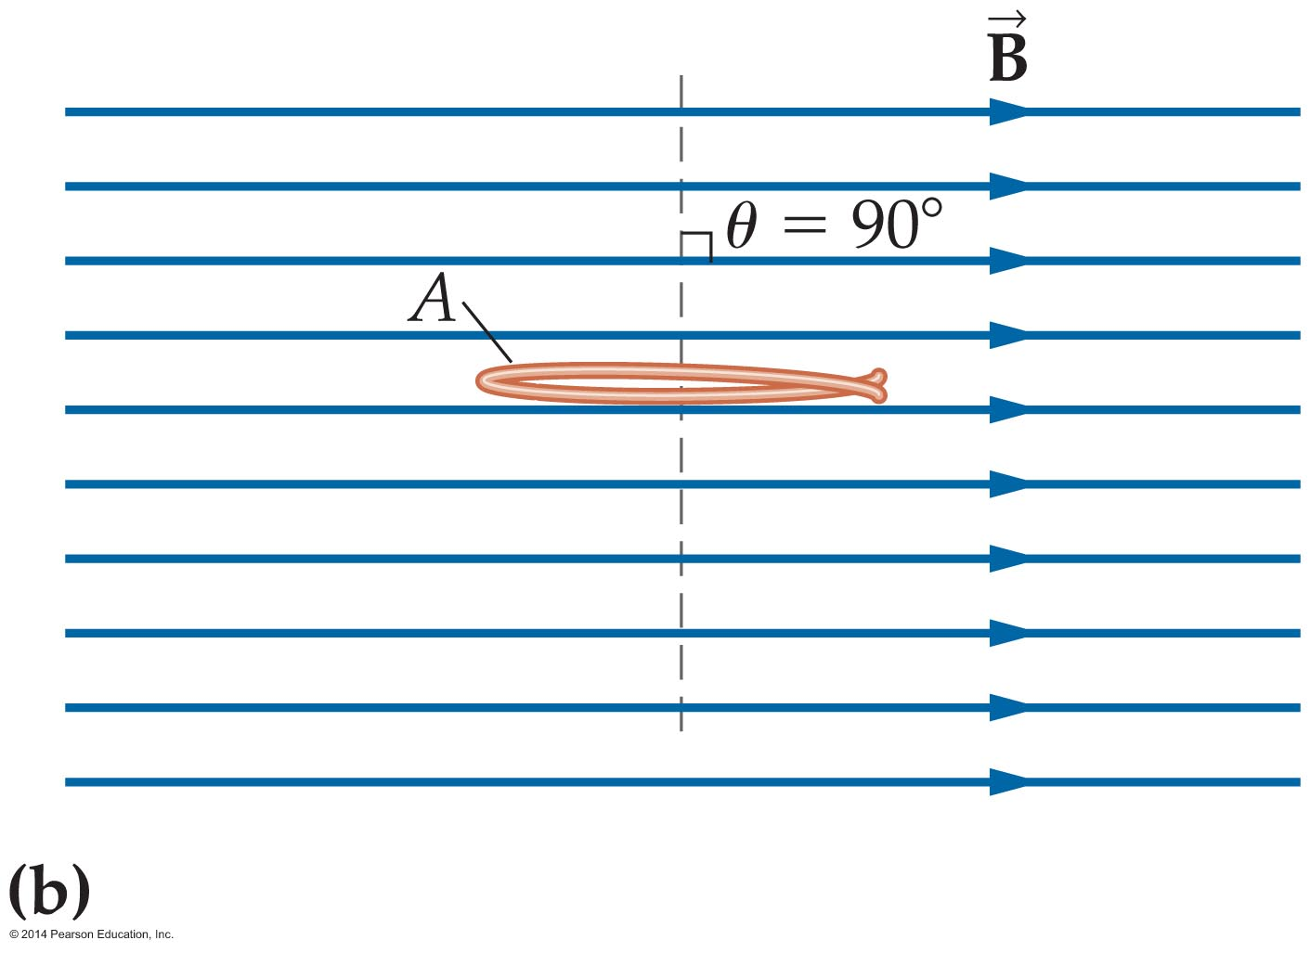
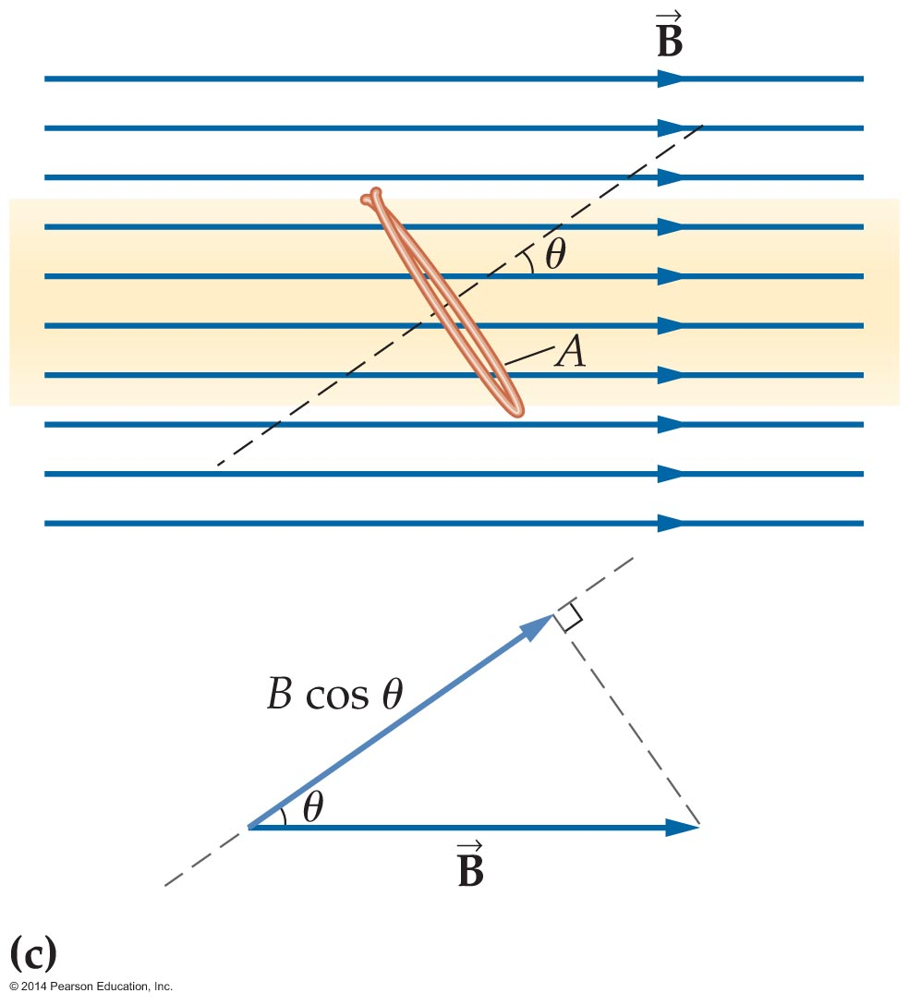
Electricity from Magnetism
In general, only the component of B that is perpendicular to a surface contributes to the magnetic flux. The magnetic field in figure (c) crosses the surface at an angle θ relative to the normal.

Slide 15
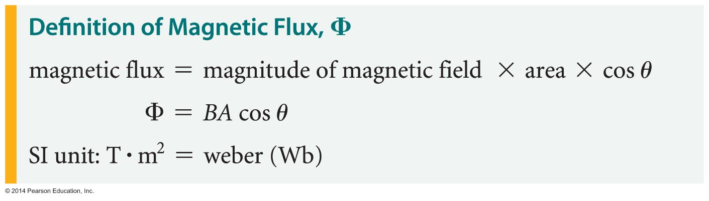
Electricity from Magnetism
Therefore, the magnetic field's perpendicular component is B cos θ. The magnetic flux, then, is simply B cos θ times the area, A:
The SI unit of magnetic flux is the weber (Wb), named after physicist Wilhelm Weber (1804–1891). It is defined as follows: 1 Wb = 1 T·m².

Slide 16
Electricity from Magnetism
Magnetic flux depends on the magnitude of the magnetic field B, its orientation with respect to the surface, θ, and the area of the surface, A. A change in any of these variable results in a change in flux.
The following example illustrates the effect of changing the orientation of a wire loop in a region of constant magnetic flux.

Slide 17
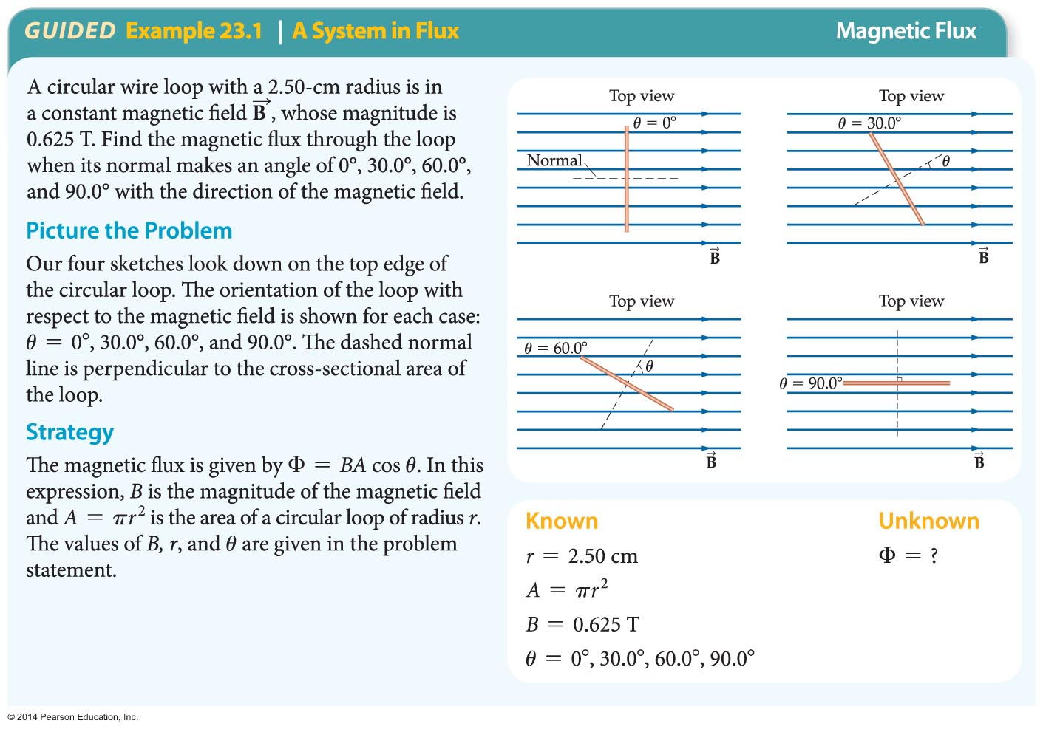
Electricity from Magnetism

Slide 18
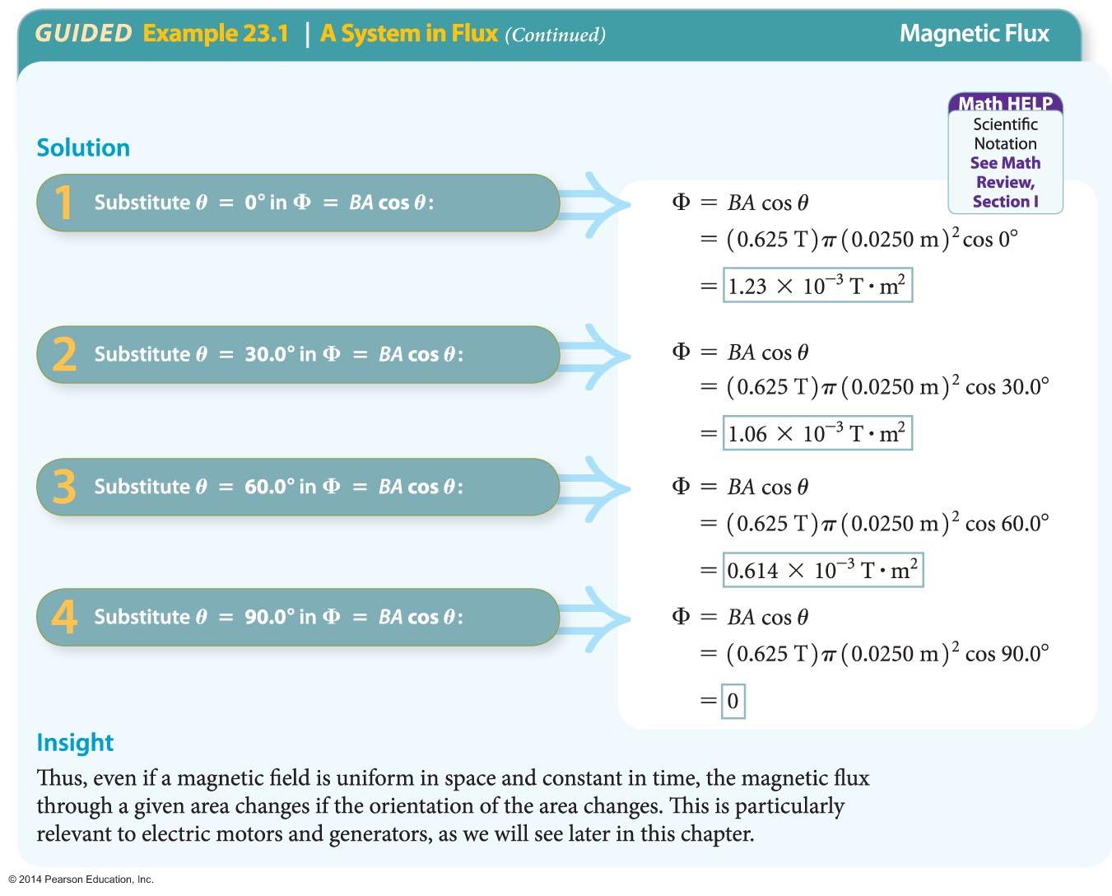
Electricity from Magnetism

Slide 19
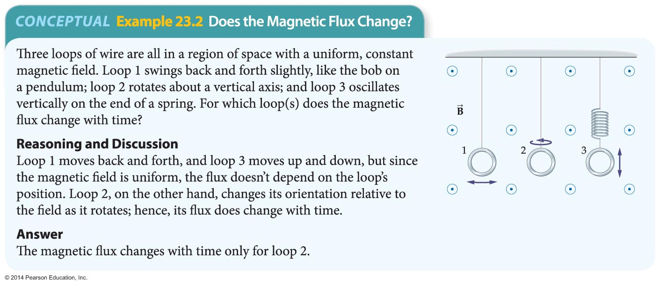
Electricity from Magnetism
The next example illustrates motions of a wire loop that produce a change in flux.

Slide 20
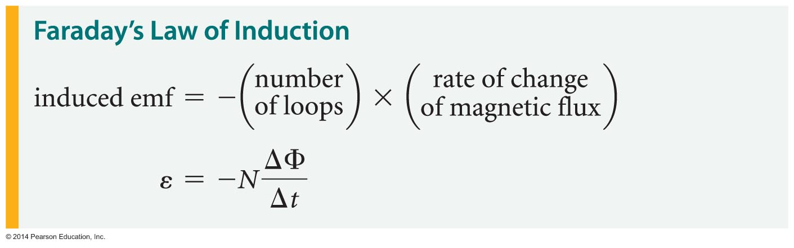
Electricity from Magnetism
Faraday found that the secondary coil experiences an induced emf only when the magnetic flux changes with time. In general, the rate at which the magnetic flux changes is defined as follows:
rate of change of magnetic flux =
change in magnetic flux/change in time = ΔФ/Δt
If there are N loops in a coil, the induced emf is given by Faraday's law of induction:

Slide 21
Electricity from Magnetism
The negative sign in Faraday's law indicates that the induced emf opposes the change in magnetic flux.
If only the magnitude of the emf is of concern, then the following equation may be used:
|ε| = |ΔФ|/|Δt|
Notice that Faraday's law gives the emf that is induced in a coil or loop of wire. The current that is induced as a result of the emf depends on the resistance of the circuit—just as in the case of a battery connected to a resistor. This is shown in the following example.

Slide 22
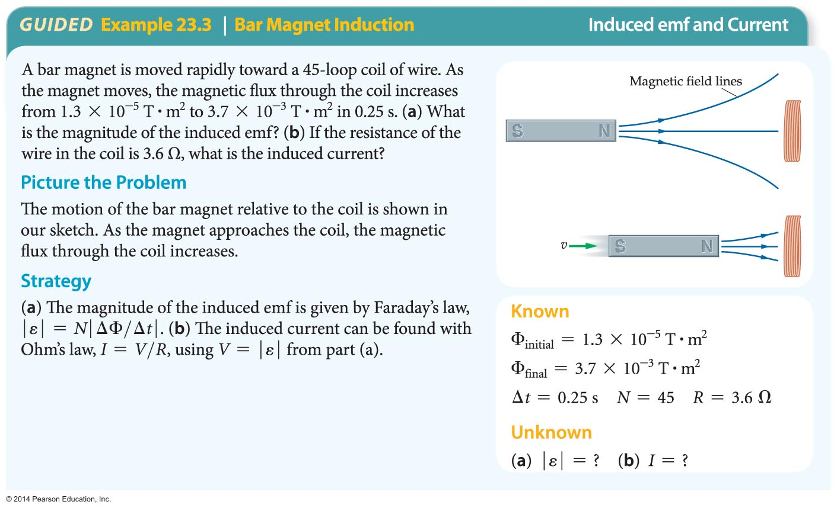
Electricity from Magnetism

Slide 23
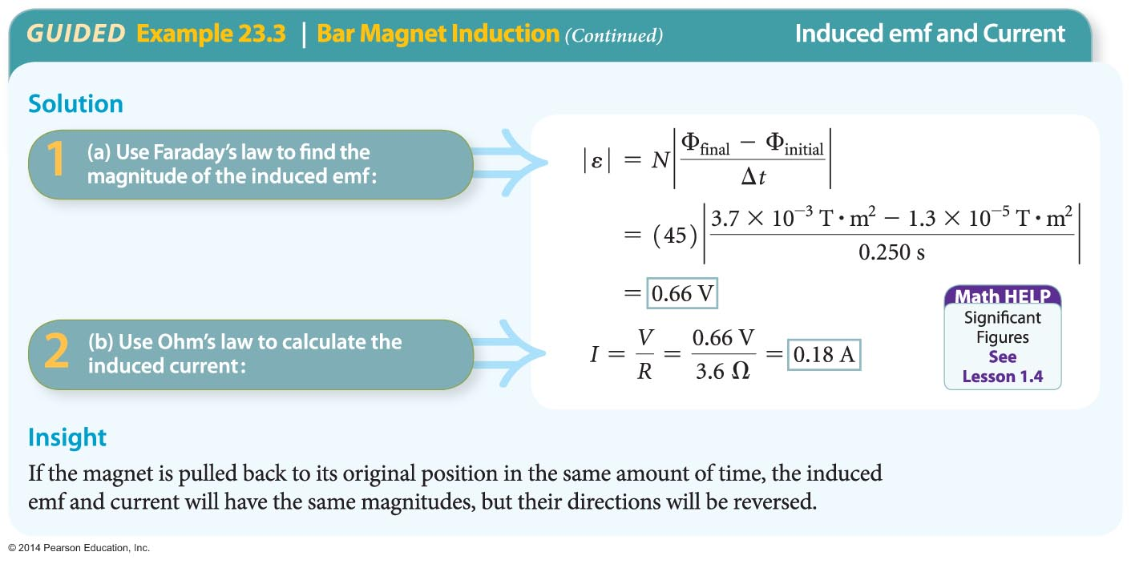
Electricity from Magnetism

Slide 24
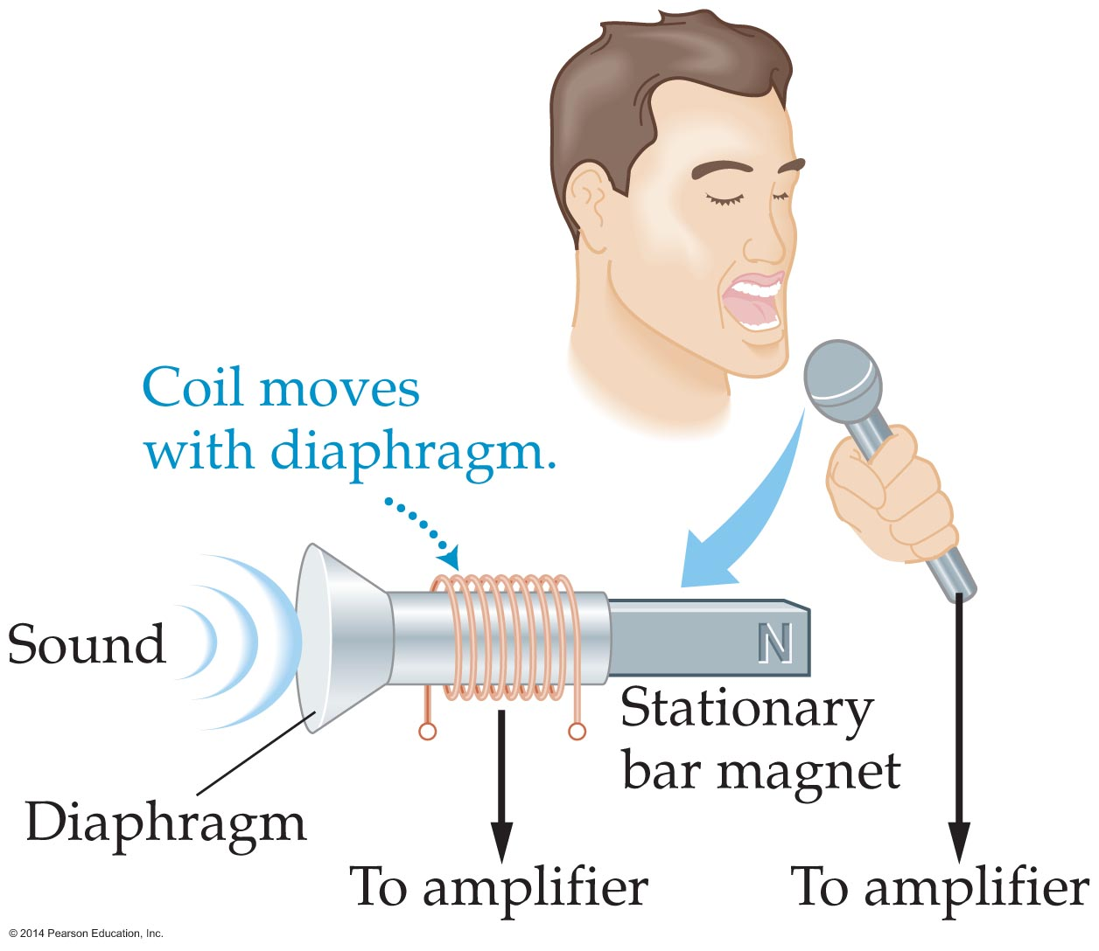
Electricity from Magnetism
A familiar example of Faraday's law in action is the dynamic microphone. This type of microphone uses a stationary magnet and a wire coil attached to a movable diaphragm, as illustrated in the figure below.
Sound waves move a coil of wire in a microphone, changing the magnetic flux through the coil. The result is an induced emf that is amplified and sent to speakers.

Slide 25
Electricity from Magnetism
Nature often reacts in a way that opposes change. For example, if you compress a gas, the pressure of the gas increases—and opposes the compression.
A similar principle applies to induced electric currents. It is known as Lenz's law, and was first stated by Estonian physicist Heinrich Lenz (1804–1865).
Lenz's law states that an induced current always flows in a direction that opposes the change that caused it.
Lenz's law is the reason for the negative sign in Faraday's law. It indicates that the induced current opposes the change in magnetic flux.

Slide 26
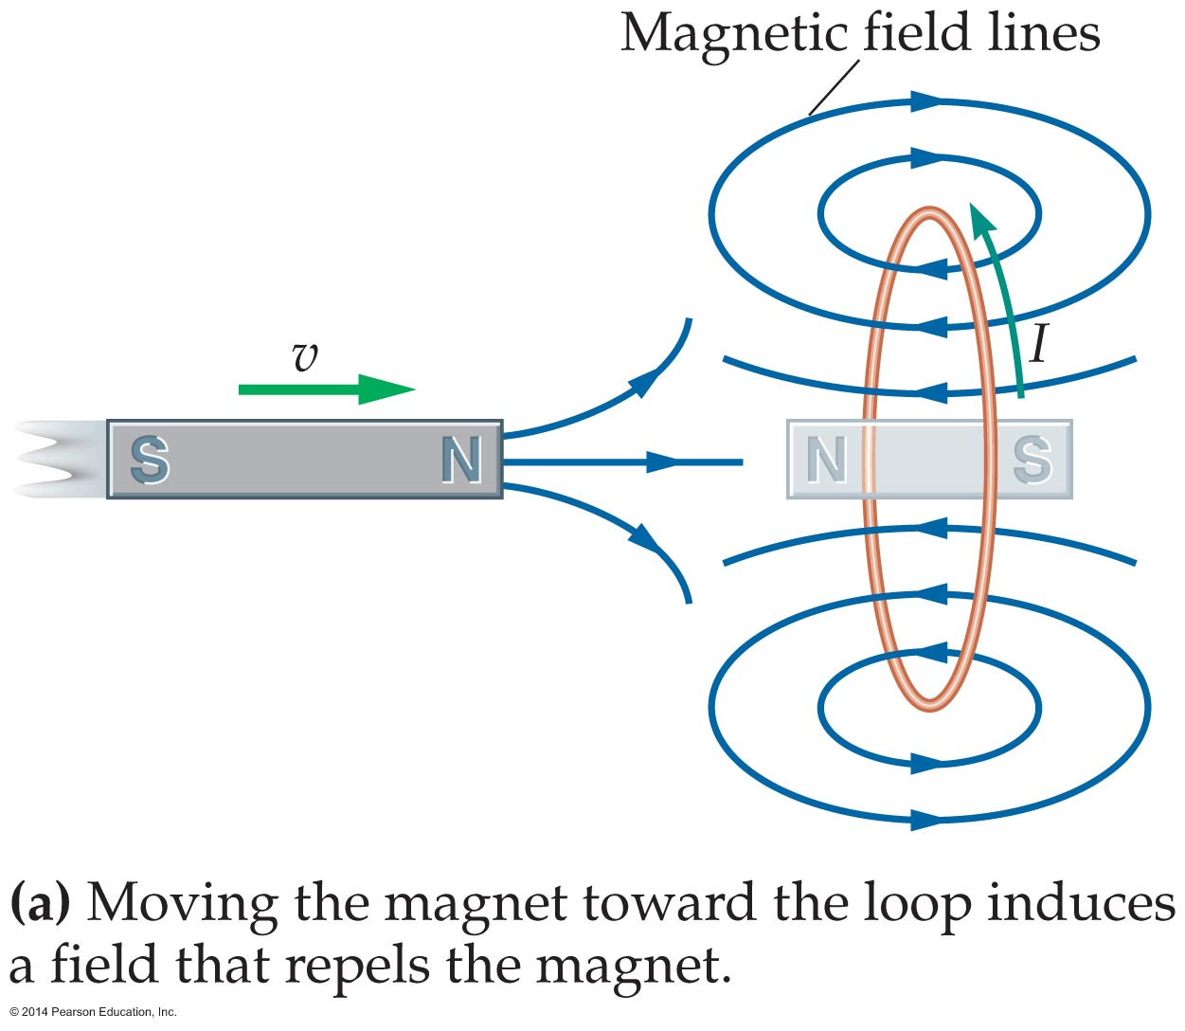
Electricity from Magnetism
To see how Lenz's law works, consider a bar magnet that is moved toward a conducting loop, as in figure (a) below.

Slide 27
Electricity from Magnetism
If the north pole of the magnet approaches the loop, a current is induced that tends to oppose the motion of the magnet. To be specific, the current in the loop creates a north pole of a magnet. This produces a repulsive force acting on the magnet, opposing the motion.
On the other hand, suppose the magnet is pulled away from the loop, as in figure (b) on the next slide. The induced current is in the opposite direction, creating a south pole and a corresponding attractive force—which again opposes the motion.

Slide 28
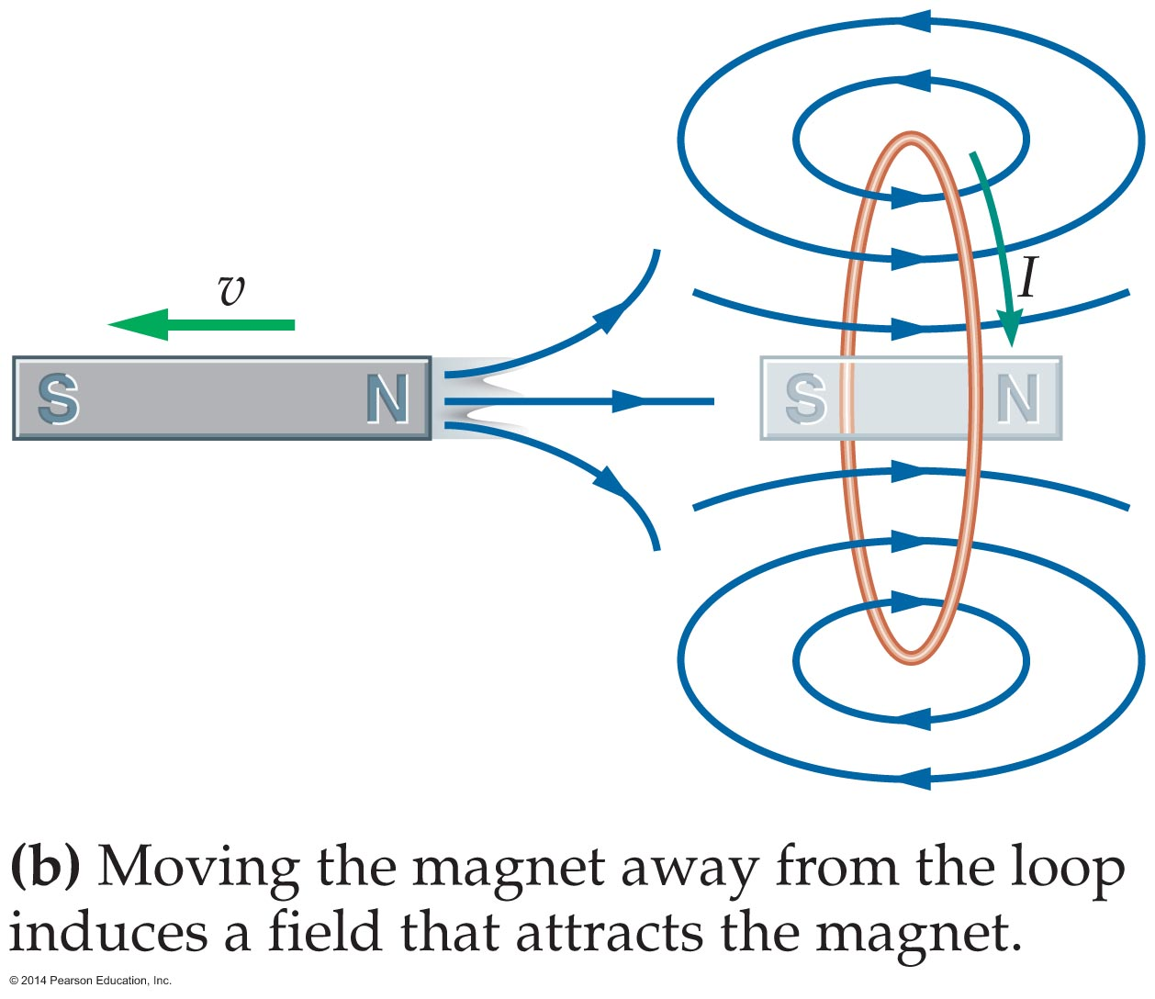
Electricity from Magnetism
The following example serves to illustrate Lenz's law.

Slide 29
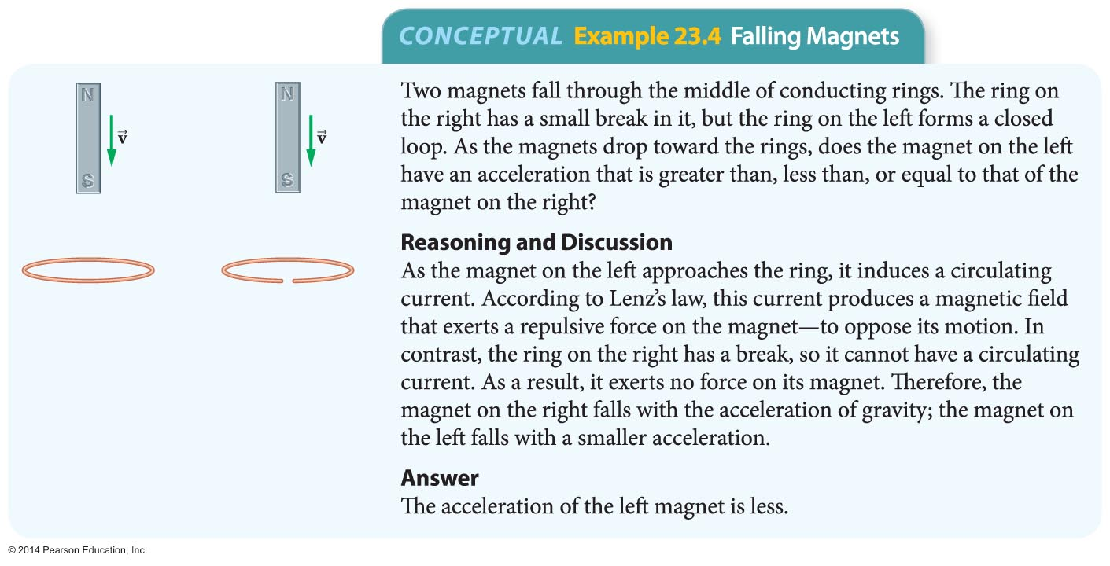
Electricity from Magnetism

Slide 30
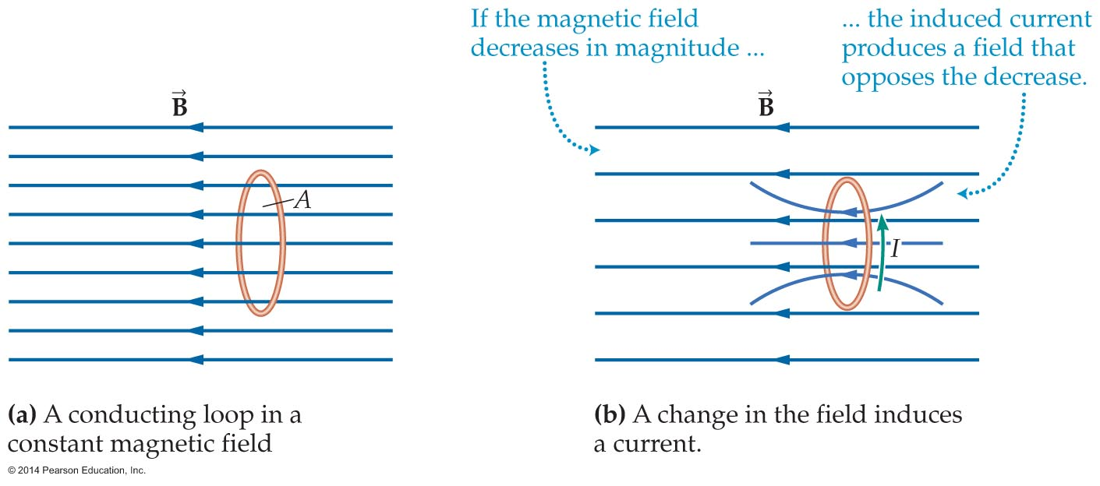
Electricity from Magnetism
Lenz's law also applies to a decreasing magnetic field. Figure (a) below shows a conducting loop in a constant magnetic field. If the magnetic field decreases in magnitude, as is shown in figure (b), the induced current produces a magnetic field that acts to maintain the original magnetic strength in the loop.

Slide 31
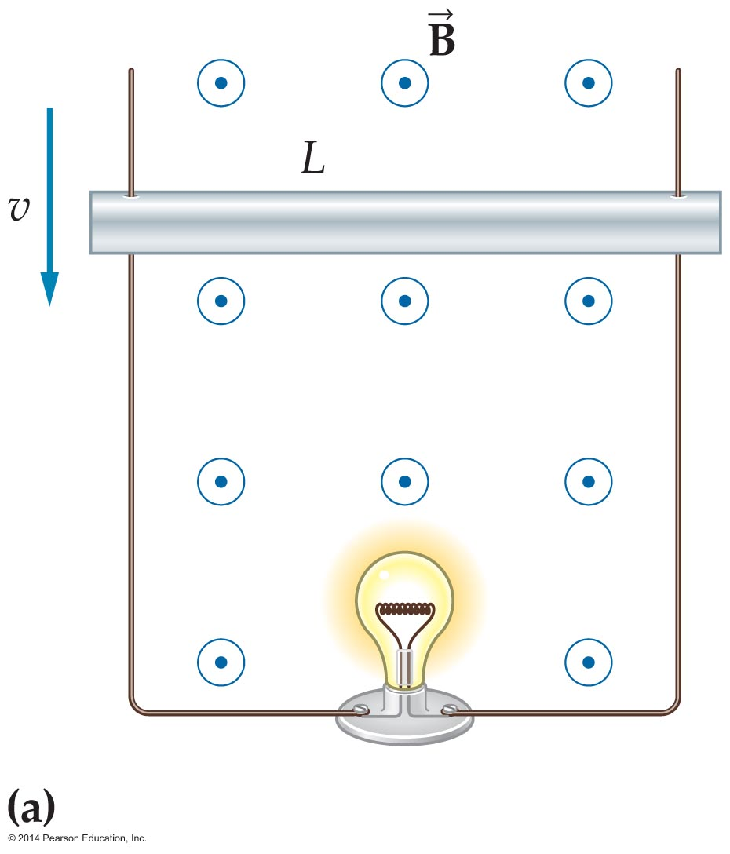
Electricity from Magnetism
An object moving through a magnetic field may experience an induced current. As an example, consider the situation shown in figure (a) below.
A metal rod of length L is shown moving in the vertical direction with a speed v through a region with a constant magnetic field B. The rod is in frictionless contact with two vertical wires, which allows a current to flow in a loop through the rod, the wires, and the lightbulb.

Slide 32
Electricity from Magnetism
The magnetic field is constant in this system, but the magnetic flux through the loop still changes with time. A decrease in the area enclosed by the loop, caused by the downward motion of the rod, causes the magnetic flux to decrease.
The motion of the rod produces an emf, called a motional emf. The magnitude of the motional emf is
ε = vBL
Notice that the emf depends directly on the speed of the rod, its length, and the strength of the magnitude field through which it moves.

Slide 33
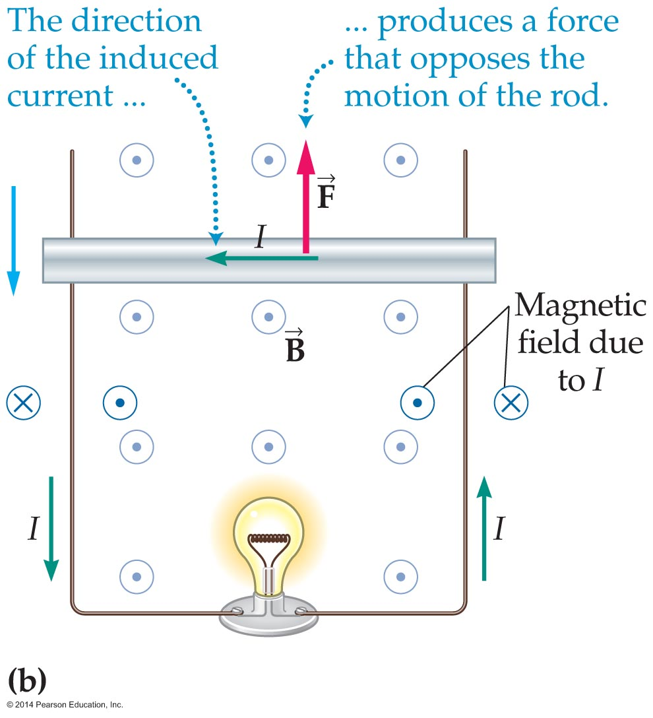
Electricity from Magnetism
According to Lenz's law, the direction of the motional
emf—and thus the direction of the induced current—must oppose changes caused by the motion of the rod. To see how this works, consider figure (b) below.
The direction of the current induced by the rod's downward motion is counterclockwise, because this direction produces an upward force on the rod, opposing its downward motion.

Slide 34
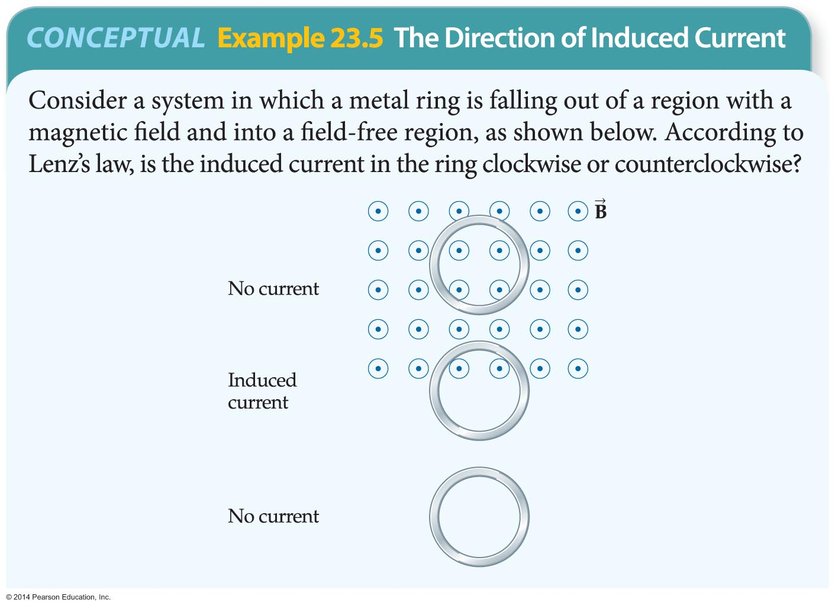
Electricity from Magnetism
The following example illustrates how the direction of the induced current in a ring first falling through, and then falling out of, a region with a magnetic field is determined.

Slide 35
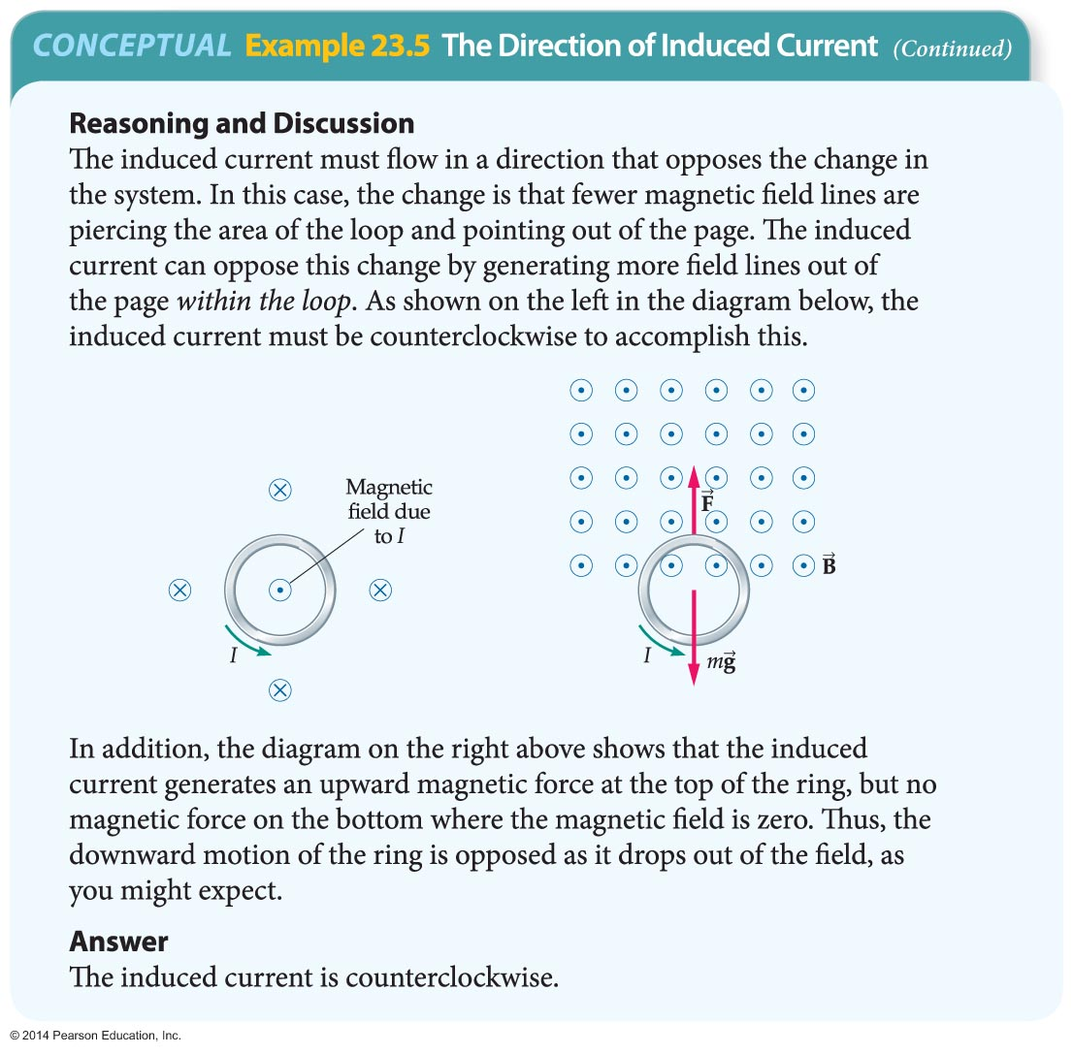
Electricity from Magnetism

Slide 36
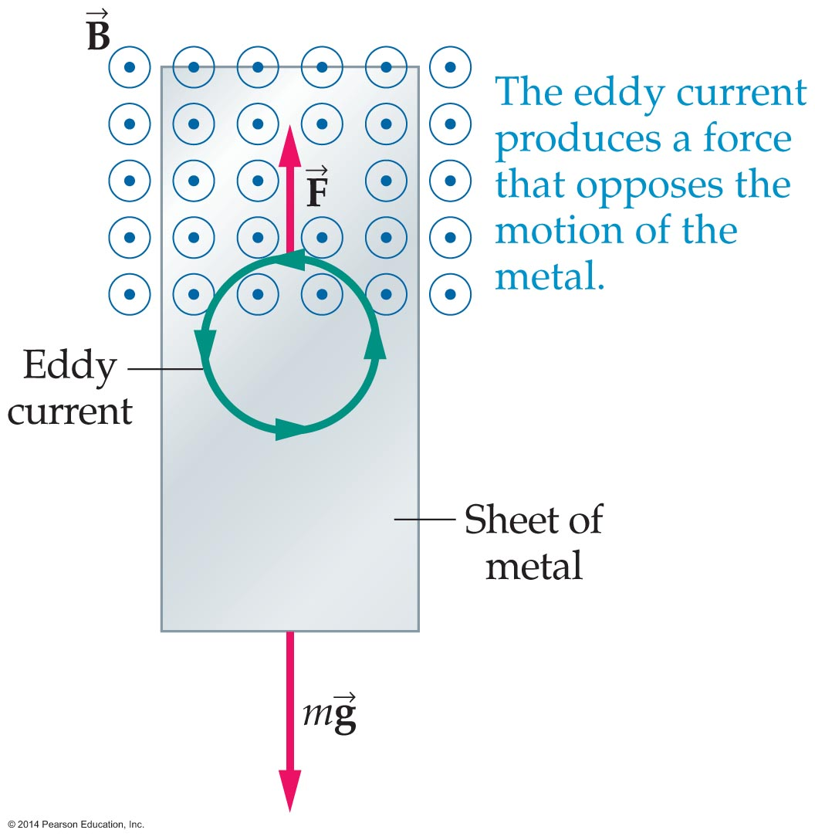
Electricity from Magnetism
The figure below shows a sheet of metal falling from a region with a magnetic field to a region with no field.
In the portion of the sheet that is just leaving the field, a localized circulating current known as an eddy current is induced in the metal. This current retards the motion of the metal sheet, having an effect much like a frictional force.
The friction-like effect of eddy currents is the basis for magnetic braking. Magnetic braking is used in everything from exercise bicycles to roller coasters.

Slide 37
Electric Generators and Motors
An electric generator is a device designed to convert mechanical energy to electrical energy.
The mechanical energy used to drive a generator can come from many different sources. Examples include falling water in a hydroelectric dam, expanding steam in a coal-fired power plant, and a gasoline-powered motor in a portable generator.
All generators use the same basic operating principle—mechanical energy moves a conductor through a magnetic field to produce a motional emf.

Slide 38
Electric Generators and Motors
Rotating a wire loop or coil in a magnetic field to change the magnetic flux allows the electromagnetic induction process to continue indefinitely.
Thus, rotating a coil of wire through a magnetic field is a way to transfer energy from mechanical motion to an electric emf and current.
To see how this works, imagine a wire coil of area A located in the magnetic field between the poles of a magnet, as illustrated in the figure on the next slide.

Slide 39
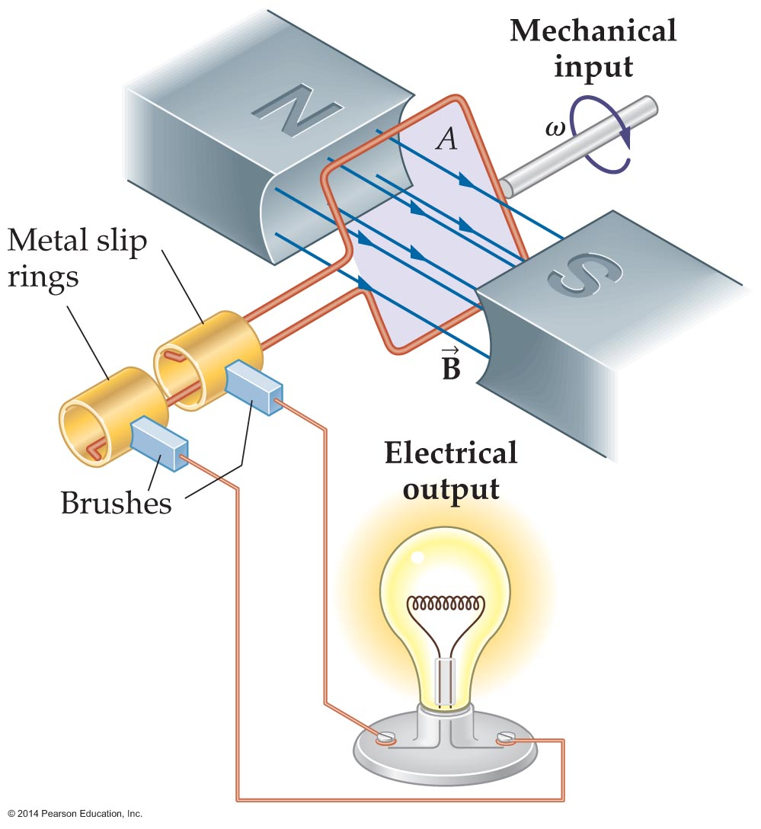
Electric Generators and Motors
As mechanical work rotates the coil with an angular speed ω, the emf produced in it is given by Faraday's law. In the case of a rotating coil, it can be shown that Faraday's law gives the following result:
ε = NBA sinωt

Slide 40
Electric Generators and Motors
This result is plotted in the figure below. Notice that the induced emf in the coil alternates in sign, which means that the current in the coil alternates in direction. For this reason, this type of generator is referred to as an alternating current generator or, simply, an AC generator.
The maximum emf occurs when sin ωt = 1. Thus,
ε_{max} = NBAω

Slide 41
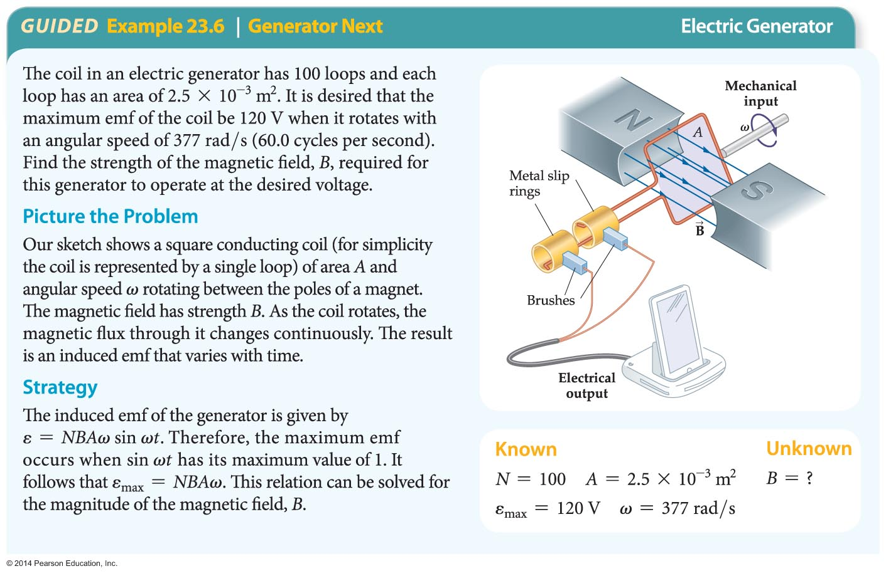
Electric Generators and Motors
This result is applied in the next example.

Slide 42
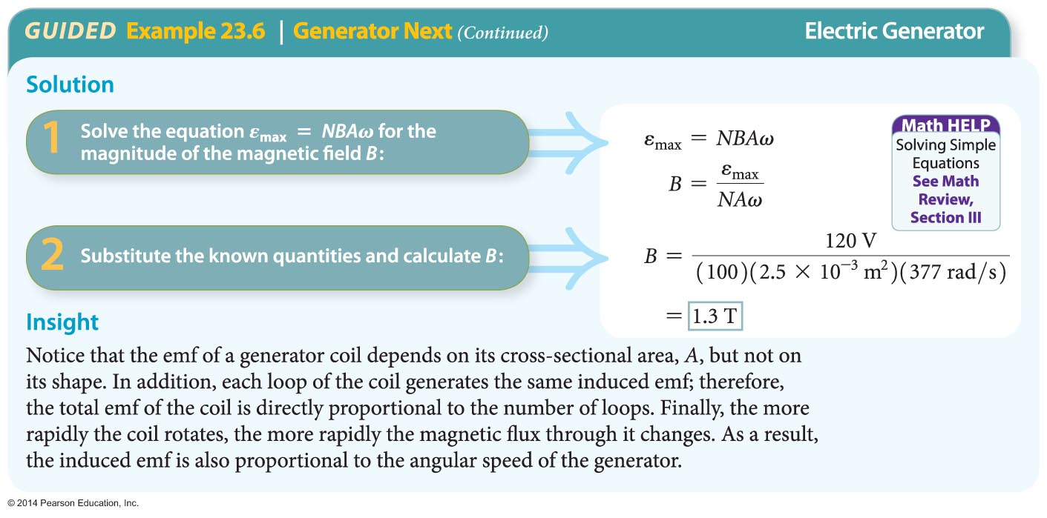
Electric Generators and Motors

Slide 43
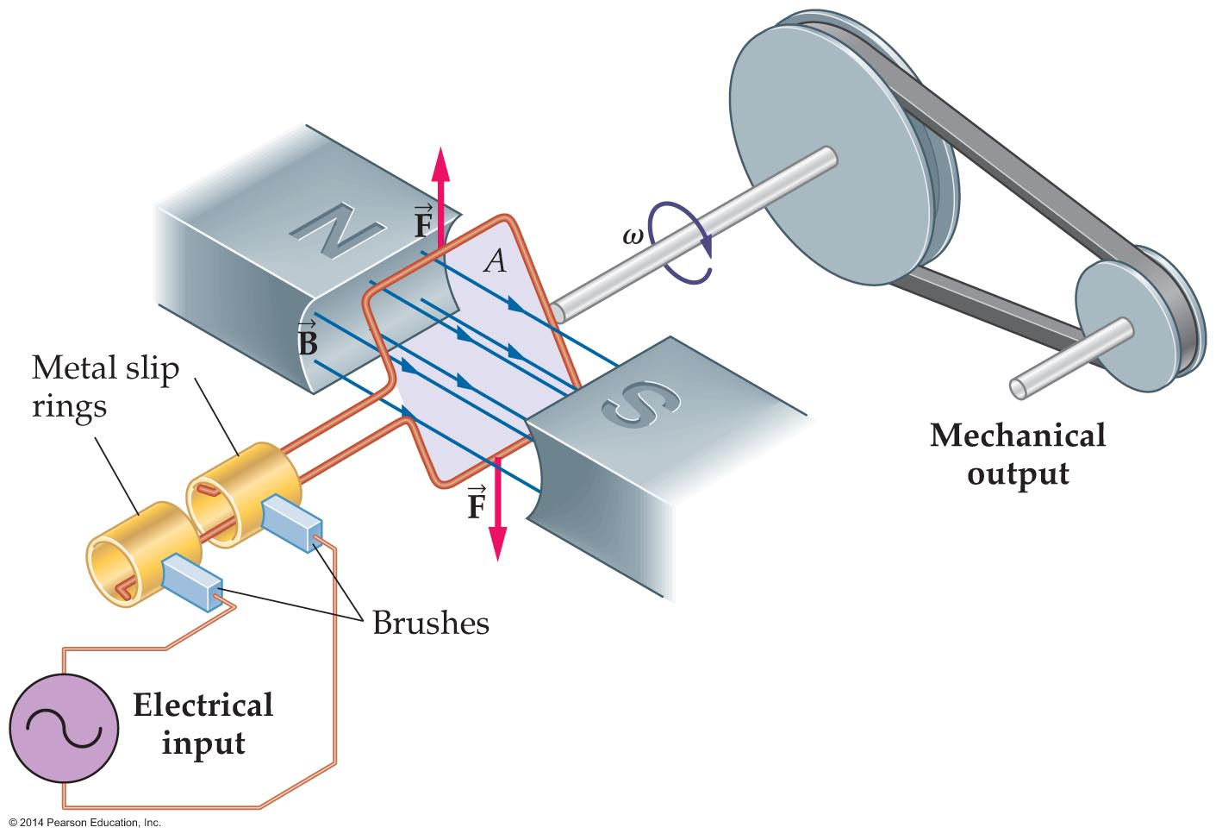
Electric Generators and Motors
A current-carrying loop in a magnetic field experiences a torque that tends to make it rotate. If such a loop is mounted on an axle, as shown in the figure below, the magnetic torque can be used to operate machinery.
This device converts electric energy to mechanical work. A device that converts electric energy into mechanical energy is called an electric motor.

Slide 44
Electric Generators and Motors
Instead of doing work to turn a coil and produce an electric current, as in a generator, an electric motor uses an electric current to produce rotation of a loop or coil, which then does work.
An electric motor transforms energy from electric emf and current into mechanical motion. It follows that an electric motor is basically an electric generator run in reverse.

Slide 45
AC Circuits and Transformers
Electricity comes in two types—direct current and alternating current. Each has benefits and drawbacks. Alternating current is particularly useful in the home, in part because it works so well with devices called transformers that change the voltage.
A simplified AC circuit diagram for a lamp is shown in the figure on the next slide. The bulb is represented by a resistor with equivalent resistance R and the wall socket is shown as an AC generator, represented by a circle enclosing one cycle of a sine wave.

Slide 46
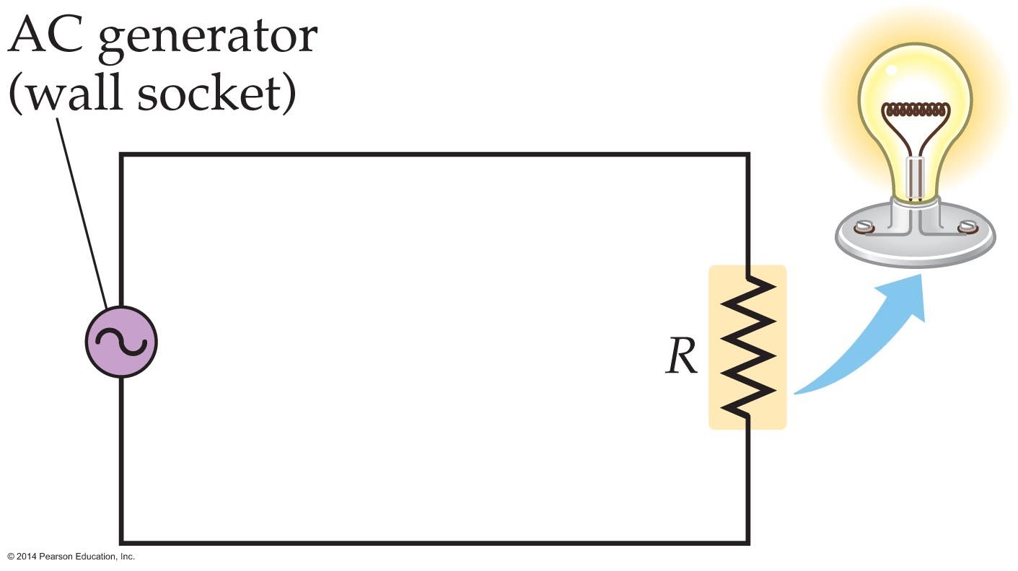
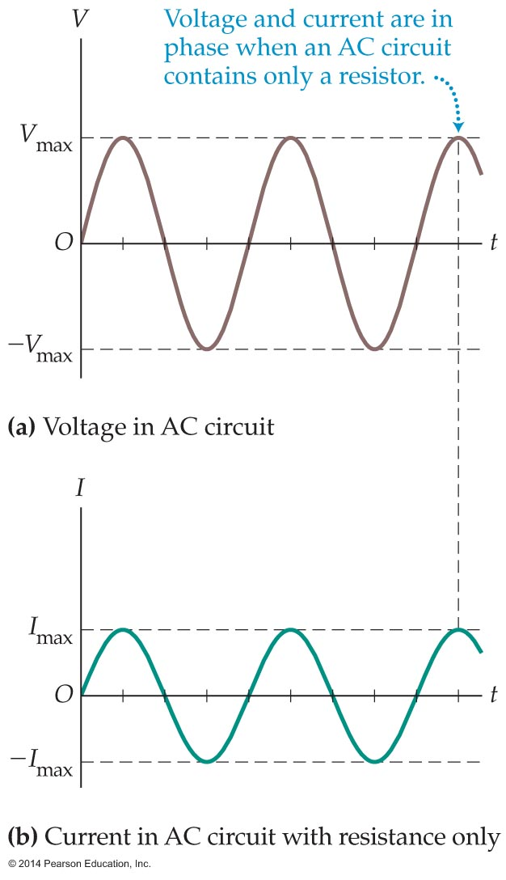
AC Circuits and Transformers
The voltage delivered by an AC generator is plotted in figure (a) below.
Notice that the graph has the shape of a sine curve. In fact, the mathematical equation for the voltage is
V = V_{max} sin ωt

Slide 47
AC Circuits and Transformers
In household circuits, the angular frequency is
ω = 2πf, with f = 60 Hz. The maximum voltage, V_{max}, is the largest value of the voltage during a cycle.
Because the voltage in an AC circuit depends on the sine function, we say that it has a sinusoidal dependence.
The current in a resistor in an AC circuit is
I = I_{max} sinωt
The value of the maximum current is given by Ohm's law:
I_{max} = V_{max}/R

Slide 48
AC Circuits and Transformers
Thus, the current in an AC circuit also has a sinusoidal dependence. This result is plotted on the graph in the figure below.
The voltage and current for a resistor reach their maximum values at the same times. This means that the voltage and current are in phase with one another. Other circuit elements, like capacitors and inductors, have different phase relationships between the current and voltage.

Slide 49
AC Circuits and Transformers
Notice that both the voltage and the current in the previous two figures have average values of zero. Thus, the average values of AC quantities give very little information. A more useful type of average, or mean, is the root mean square, or rms for short.
To see the significance of a root mean square, start by taking the square of the AC current:
I ² = I ²_{max} sin²ωt

Slide 50
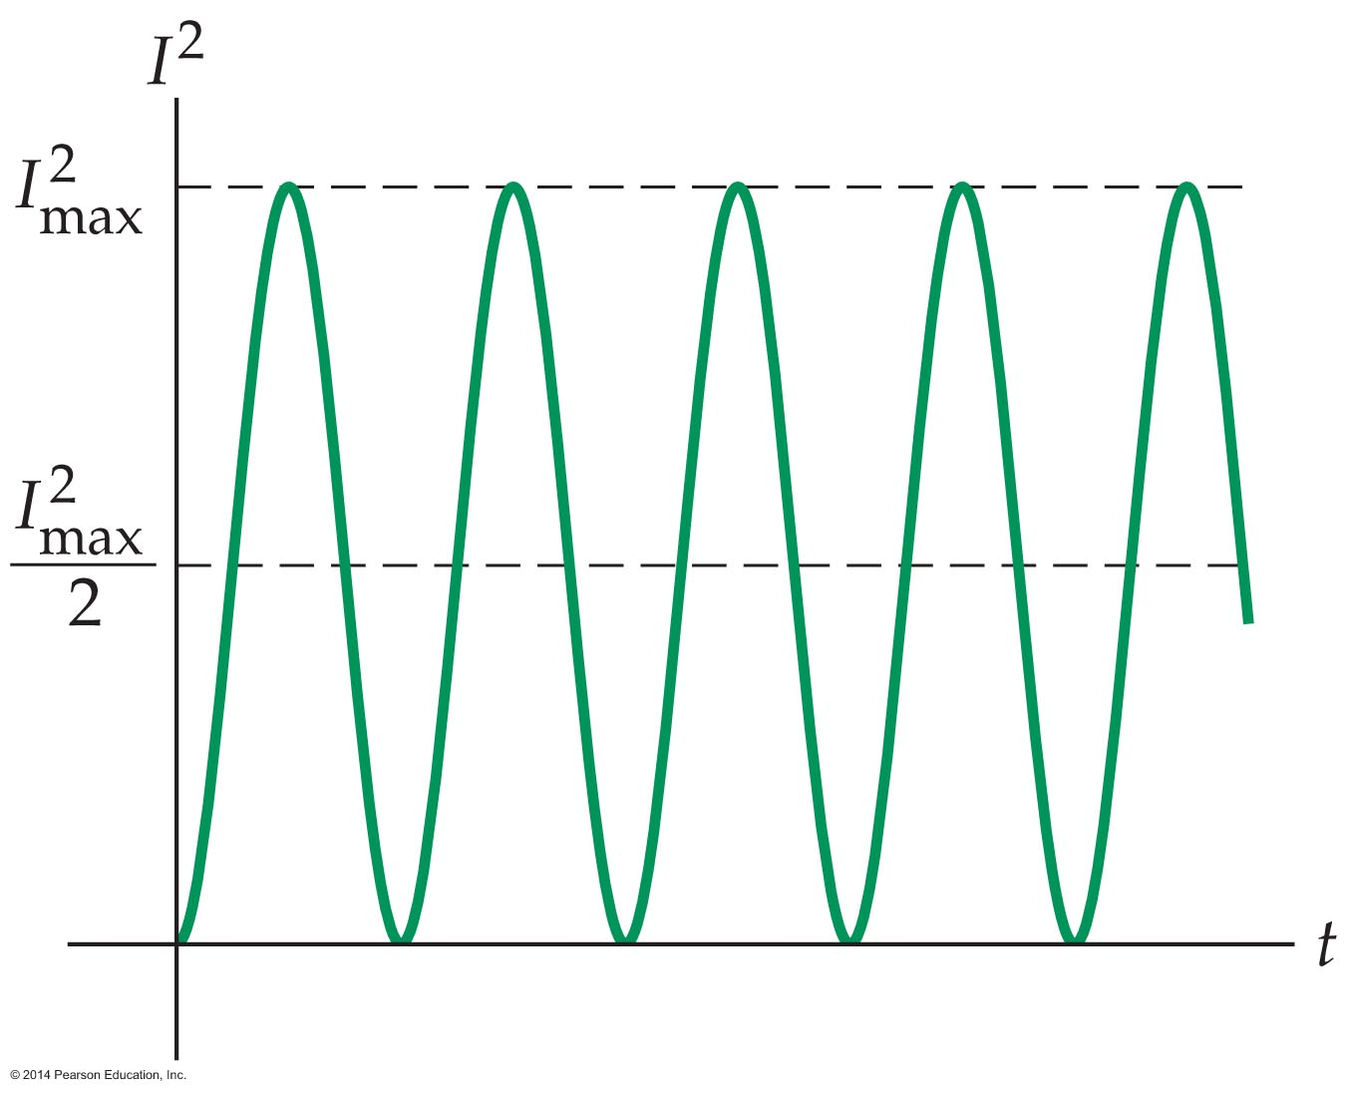
AC Circuits and Transformers
This result is plotted in the figure below.

Slide 51
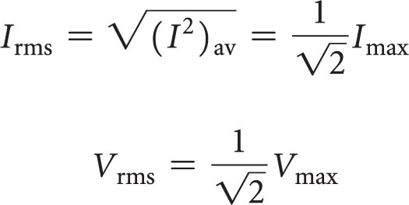
AC Circuits and Transformers
As the graph indicates, the current squared is always positive and varies symmetrically between 0 and I ²_{max}.
Now, we take the square root of the average so that the final result is a current rather than a current squared. This yields the rms value of the current:
The same reasoning applies to the rms value of the voltage in an AC circuit. Therefore,

Slide 52
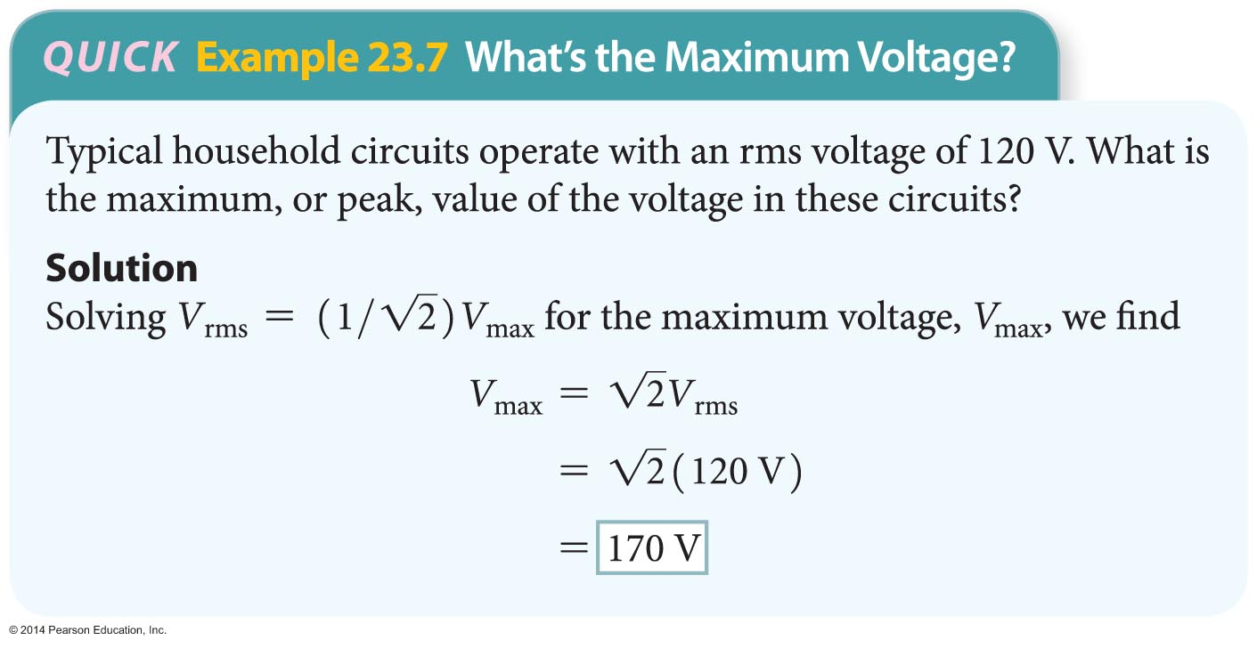
AC Circuits and Transformers
These results are applied in the following example.

Slide 53
AC Circuits and Transformers
The average power in an AC circuit depends on the root mean square values of the voltage and current.
Recall that the power dissipated in a resistor is
P = I ²R

Slide 54
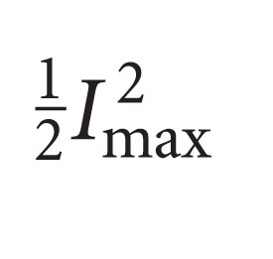
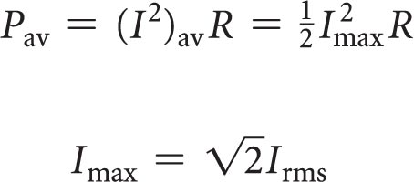
AC Circuits and Transformers
The current in an AC circuit is changing constantly with time, and therefore the power is also changing with time. So what is the average power in the circuit?
To find the average power dissipated in a resistor, we recall the average of the current squared is . Using this result, we find
We've also seen that the maximum current is related to the rms current by the relation

Slide 55
AC Circuits and Transformers
Therefore, the average power in an AC circuit can be written as follows:
P_{av} = I ²_{rms}R
Similar conclusions apply to the other power formulas as well. For example, recall that the power dissipated in a DC circuit can be written as P = V ²/R or as P = IV. To find the average power in an AC circuit, we take those equations and simply change the current to the rms current and the voltage to the rms voltage:
P_{av} = V²_{rms} /R
P_{av} = I_{rms}V_{rms}

Slide 56
AC Circuits and Transformers
Thus, the average power in an AC circuit is given by the same equations used in DC circuits—we just replace the DC current and voltage with the corresponding rms values.
The example on the next slide illustrates how the rms voltage, rms current, and average power are calculated in an AC circuit.

Slide 57
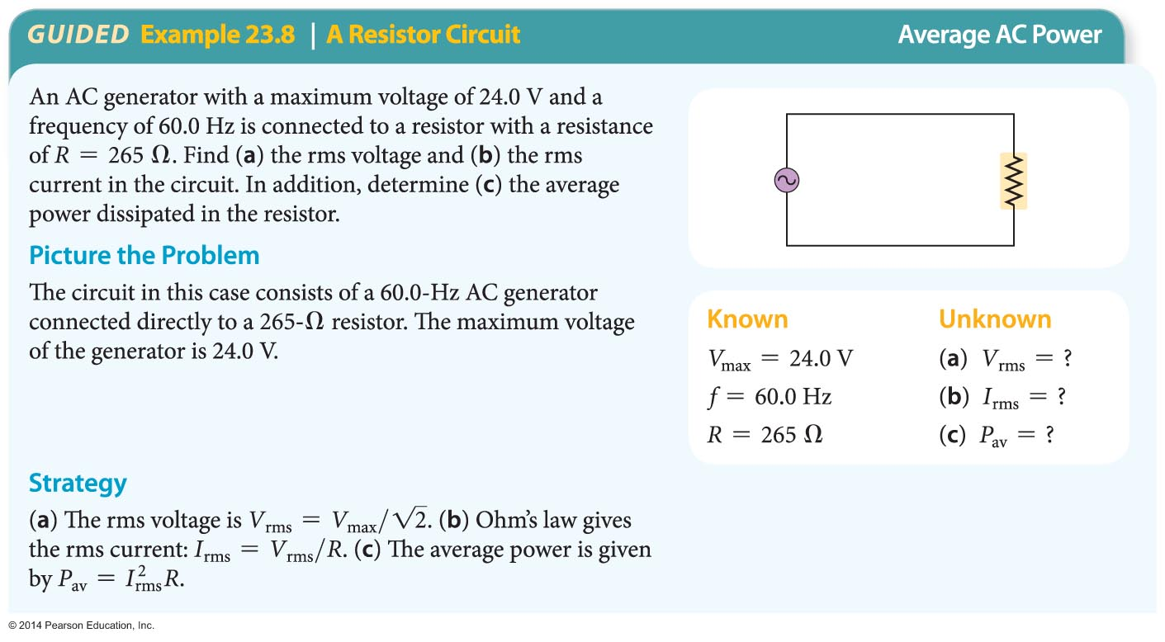
AC Circuits and Transformers

Slide 58
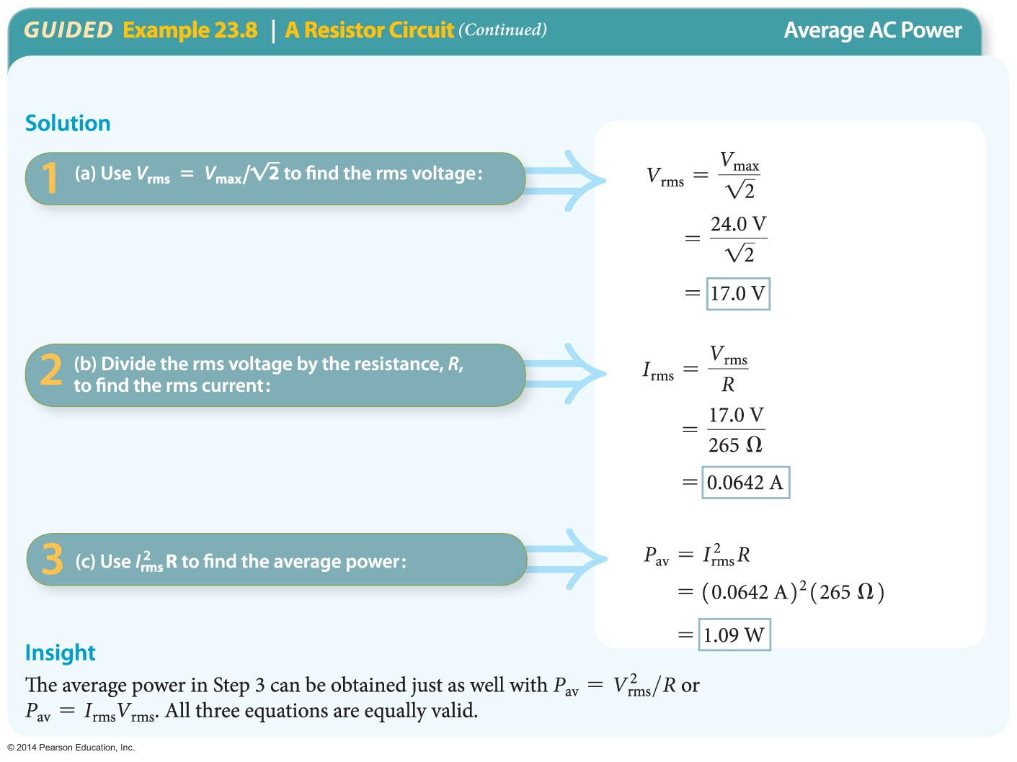
AC Circuits and Transformers

Slide 59
AC Circuits and Transformers
It is easy to forget that household electrical circuits pose potential dangers to homes and their occupants. Fortunately, there are many devices available to ensure electrical safety.
Fuses—In the case of a fuse, the current in a circuit must flow through a thin metal strip enclosed within the fuse. If the current exceeds a predetermined amount (typically 15 A), the metal strip becomes so hot that it melts and breaks the circuit. Thus when a fuse "burns out," it is an indication that too many devices are operating on that circuit.

Slide 60
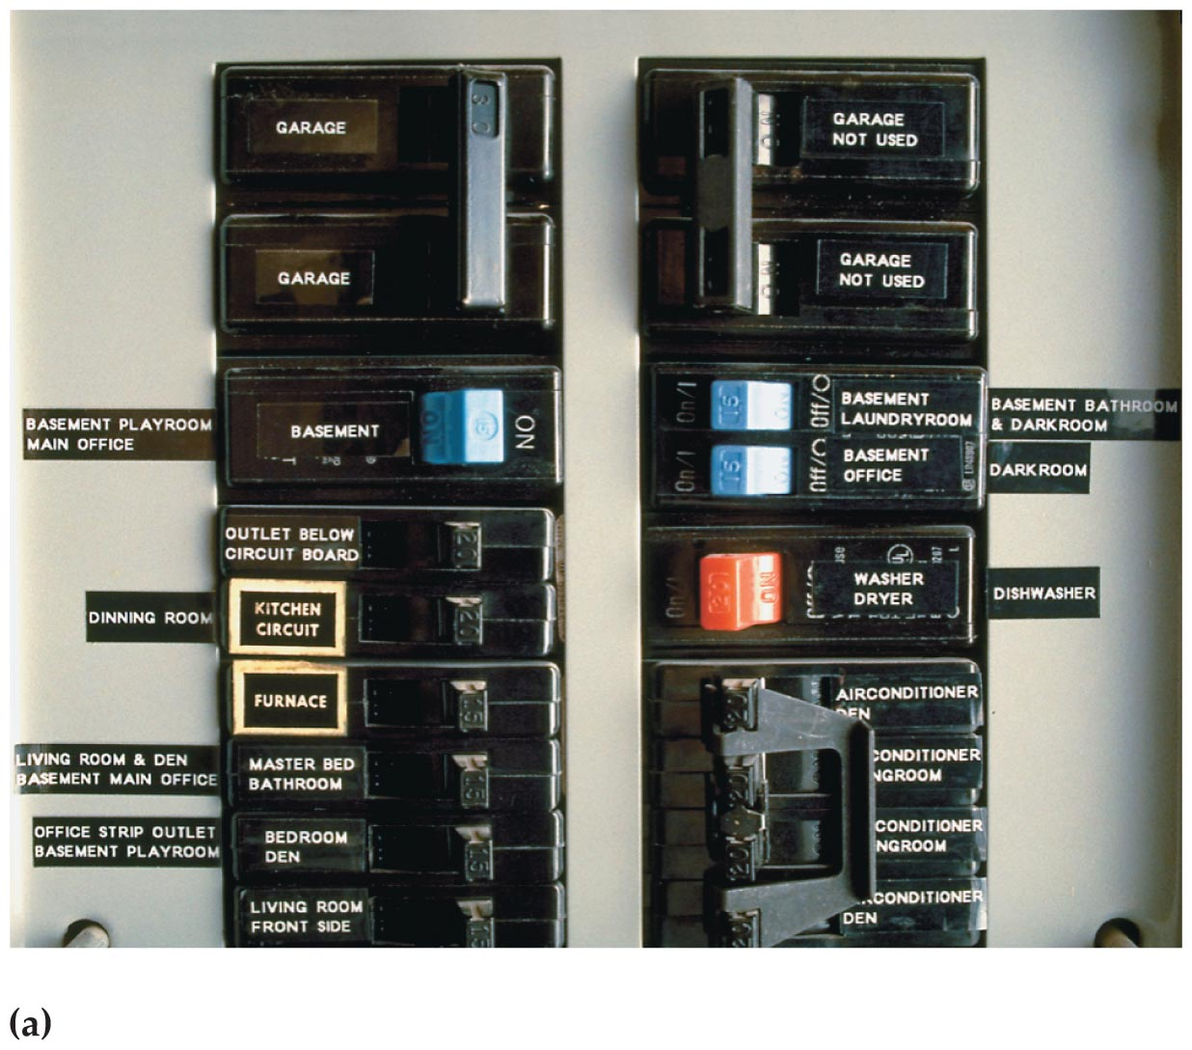
AC Circuits and Transformers
Circuit Breakers—Circuit breakers like the one in figure (a) below provide protection in a way similar to a fuse by means of a switch that incorporates a bimetallic strip.

Slide 61
AC Circuits and Transformers
  When the bimetallic strip is cool, it closes the switch, allowing current to flow. When the strip is heated by a large current, however, it bends enough to open the switch and the stop the current. Unlike a fuse, which cannot be used after it burns out, a circuit breaker can be reset when the bimetallic strip cools and returns to its original shape.

Slide 62
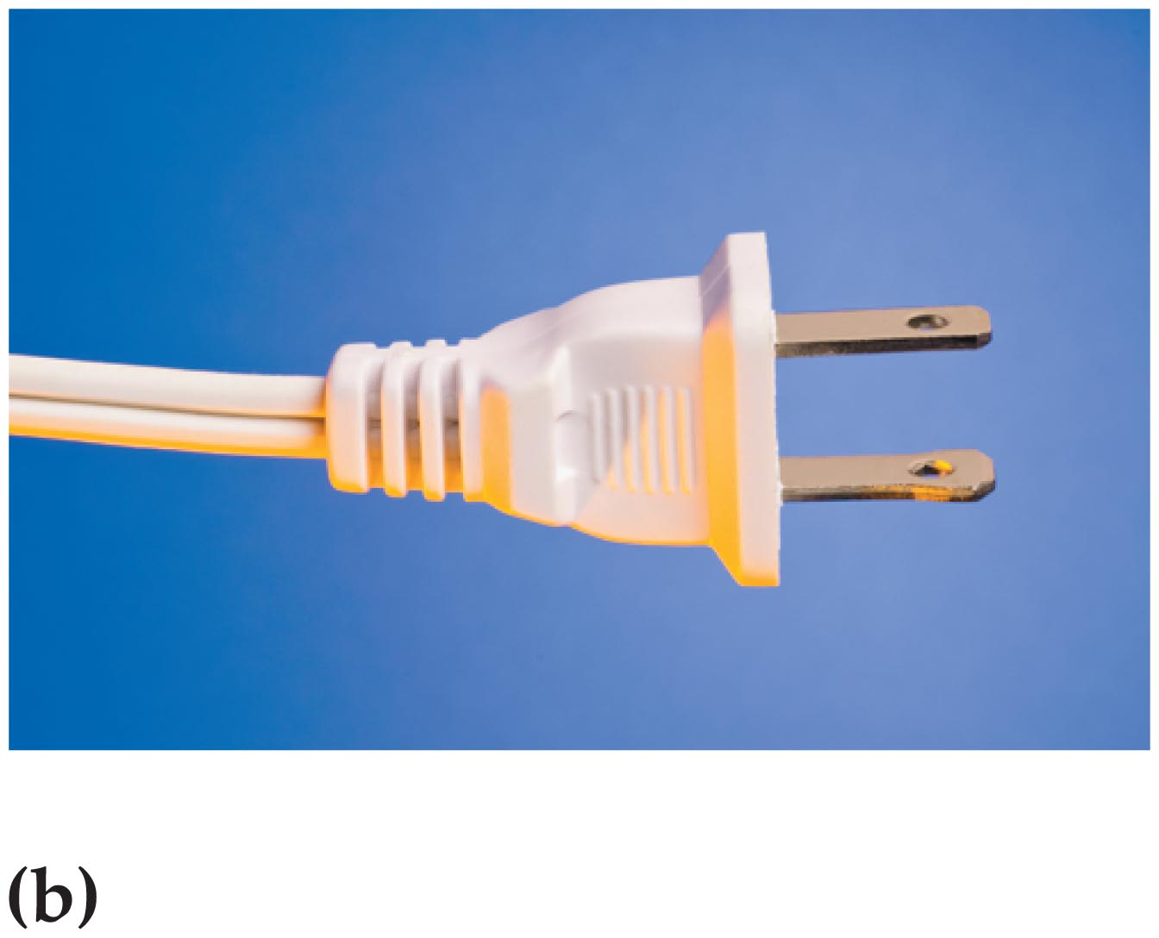
AC Circuits and Transformers
Polarized Plugs—The first line of defense against accidental shock is the polarized plug (see figure (b) below), on which one prong is wider than the other prong.
  The corresponding wall socket will accept the plug in only one orientation, with the wide prong in the wide receptacle. The narrow receptacle of the outlet is wired to the high-potential side of the circuit; the wide receptacle is connected to the low-potential side, which is essentially at ground potential.

Slide 63
AC Circuits and Transformers
  A polarized plug provides protection by ensuring that the case of an electrical appliance, which is connected to the wide prong, is at low potential.
  Furthermore, when an electrical device with a polarized plug is turned off, the high potential extends only from the wall outlet to the switch, leaving the rest of the device at zero potential.

Slide 64
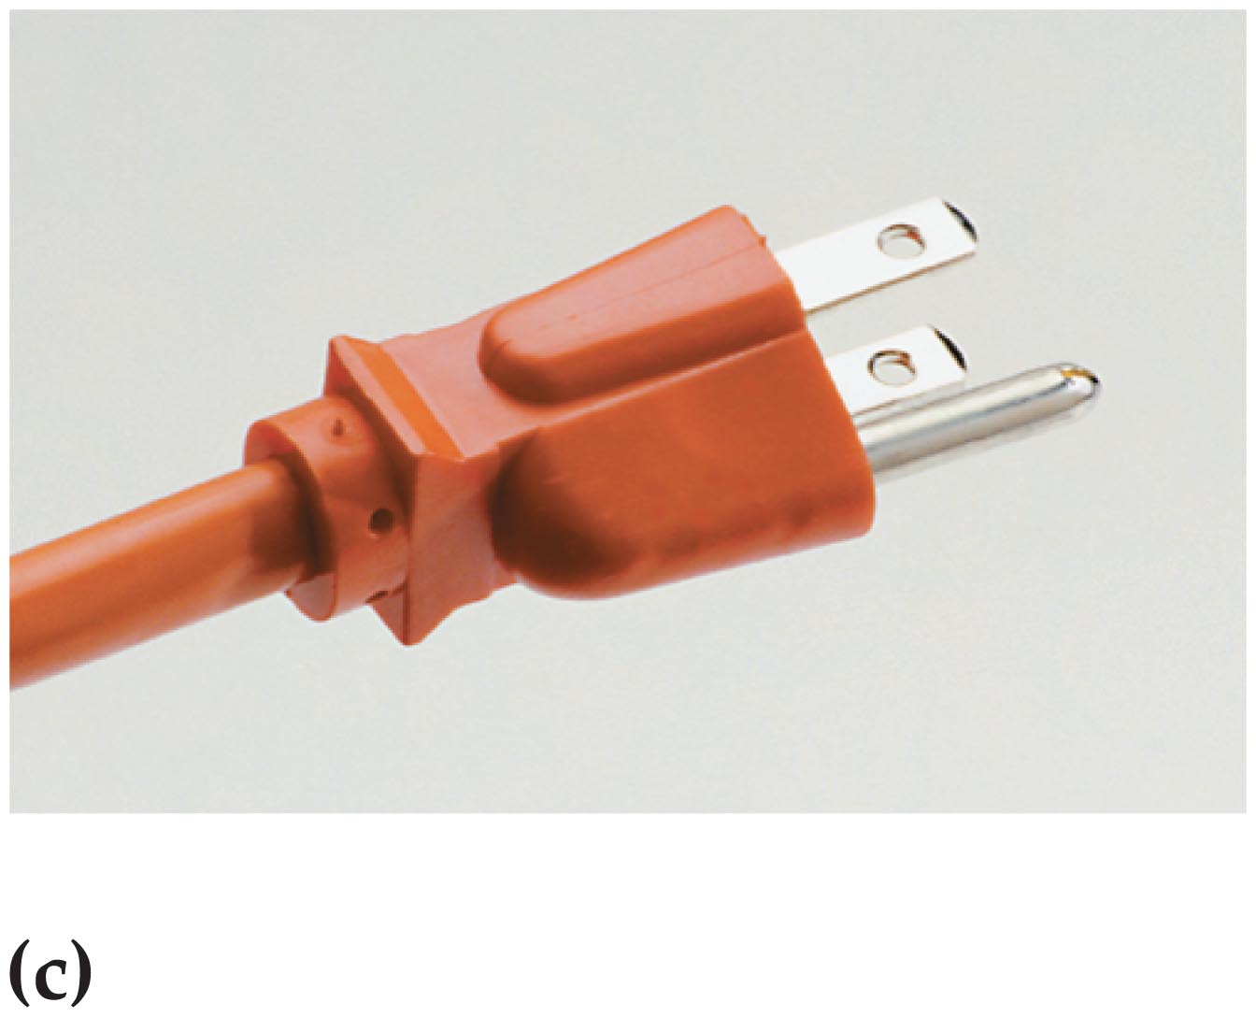
AC Circuits and Transformers
Grounded Plugs—The next line of defense against accidental shock is the three-prong grounded plug shown in figure (c) below.
  In this plug, the rounded third plug is connected directly to ground when plugged into a three-prong receptacle. In addition, the third prong is wired to the case of an electrical appliance.

Slide 65
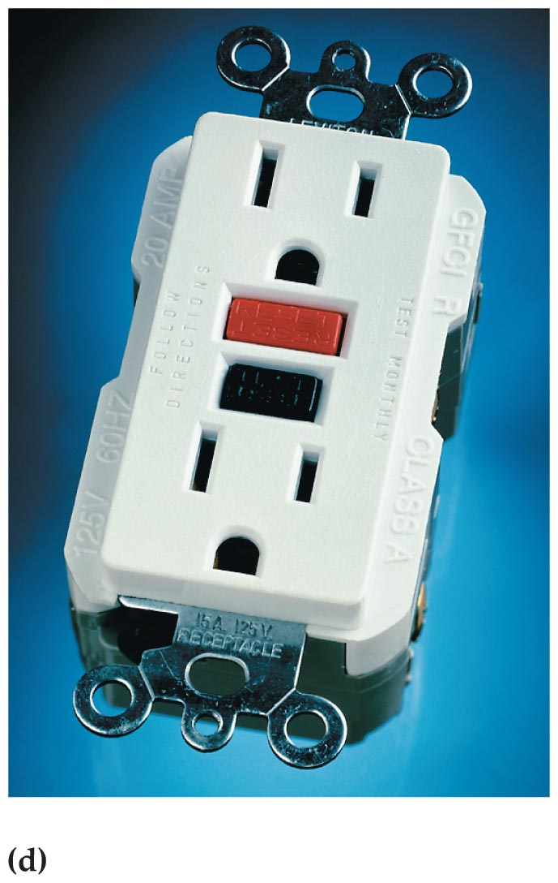
AC Circuits and Transformers
  If something goes wrong within the appliance, and a high-potential wire comes into contact with the case, the resulting current flows through the third prong, rather than through the body of a person who happens to touch the case.
GFCI Devices—A even greater level of protection is provided by a device known as a ground fault circuit
interrupter (GFCI), shown in figure (d) below.

Slide 66
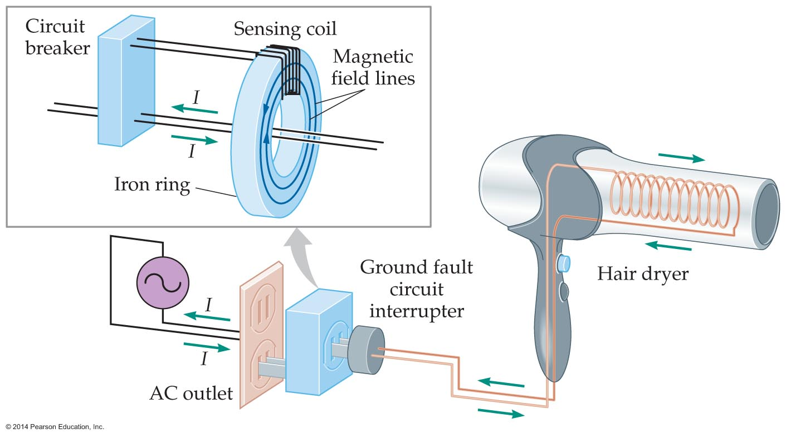
AC Circuits and Transformers
  The basic operating principle of an interrupter is illustrated in the figure below.
  Notice that the wires carrying an AC current to the protected appliance pass through a small iron ring. When the appliance operates normally, the two wires carry equal amounts of current in opposite directions—in one wire the current goes to the appliance, and in the other the current returns from the appliance.

Slide 67
AC Circuits and Transformers
  Each of the wires produces a magnetic field, but because their currents are in opposite directions, the magnetic fields are in opposite directions as well. As a result, the magnetic fields of the two wires cancel.
  If a malfunction occurs in the appliance— say a wire frays and contacts the case—current that would ordinarily return through the power cord may pass through the user's body instead and into the ground.

Slide 68
AC Circuits and Transformers
  In such a situation, the wire carrying current to the appliance immediately produces a net magnetic field within the iron ring that varies with the frequency of the AC generator. The changing magnetic field in the ring induces a current in the sensing coil wrapped around ring, and the induced current triggers a circuit breaker in the interrupter. This cuts the flow of current to the appliance within a millisecond, protecting the user.

Slide 69
AC Circuits and Transformers
It is often useful to change the voltage from one value to another in an electrical system. For example, high-voltage power lines may operate at voltages as high as 750,000 V, but before the electric power can be used in homes it must be stepped down (lowered) to 120 V. In other situations voltages need to be stepped up.
The electrical device that changes the voltage in an AC circuit is called a transformer.

Slide 70
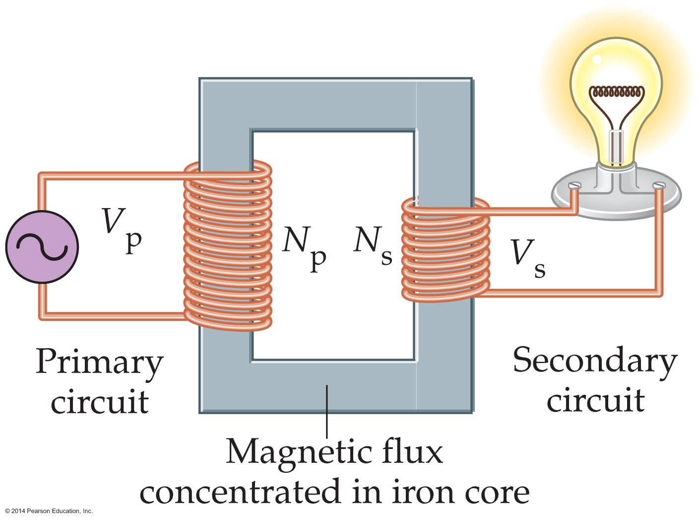
AC Circuits and Transformers
A simple transformer is shown in the figure below.
Here an AC generator produces an alternating current in the primary (p) circuit at the voltage V_{p}. The primary circuit includes a coil with N_{p} loops wrapped around an iron core. The iron core intensifies and concentrates the magnetic flux and ensures, at least to a good approximation, that the secondary (s) coil experiences the same magnetic flux as the primary coil.

Slide 71
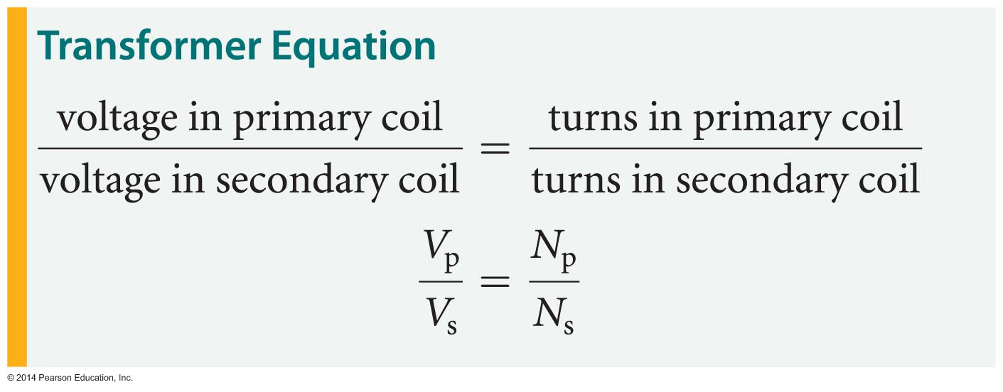
AC Circuits and Transformers
The secondary coil has N_{s} loops around an iron core and is part of a secondary circuit that may operate a CD player, a lightbulb, or some other device.
To relate the voltage of the primary and secondary circuits, we apply Faraday's law of induction to each of the coils. The result, after some straightforward algebra, is the transformer equation:

Slide 72
AC Circuits and Transformers
This equation relates the voltages and the number of loops in the two circuits. Solving the transformer equation for the voltage in the secondary circuit yields
V_{s} = V_{p}(N_{s}/N_{p})
The transformer equation shows that if the number of loops in the secondary coil is less than the number of loops in the primary coil, the voltage is stepped down to a lower value. Similarly, if the number of loops in the secondary coil is higher, the voltage is stepped up to a higher value.

Slide 73
AC Circuits and Transformers
There is a tradeoff between voltage and current in a transformer. This follows from the law of conservation of energy.
Because energy must always be conserved, the average power in the primary circuit must be the same as the average power in the secondary circuit.
Since power can be written as P = IV, it follows that
I_{p}V_{p} = I_{s}P_{s}

Slide 74
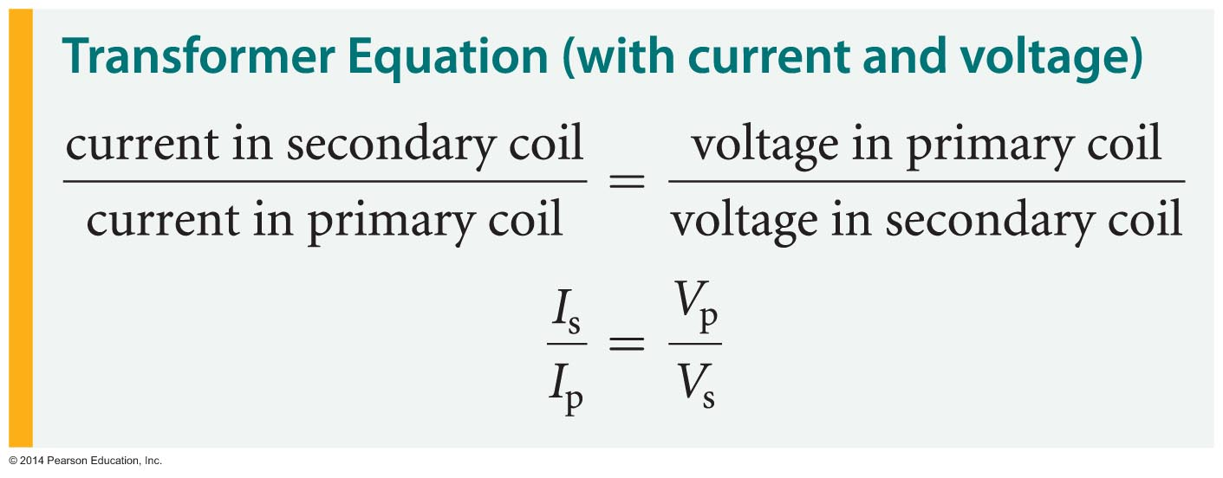
AC Circuits and Transformers
Isolating the currents I_{s} and I_{p} on one side of the equation and the voltages V_{s} and V_{p} on the other side yields the following equation:

Slide 75
AC Circuits and Transformers
This version of the transformer equation shows an important relationship, namely, if a transformer increases the voltage by a given factor, it decreases the current by the same factor. Similarly, if it decreases the voltage, it increases the current.
For example, suppose the number of loops in a secondary coil of a transformer is twice the number of loops in the primary coil. This transformer doubles the voltage in the secondary circuit, V_{s} = 2V_{p}, and at the same time halves the current, I_{s} = I_{p}/2.

Slide 76
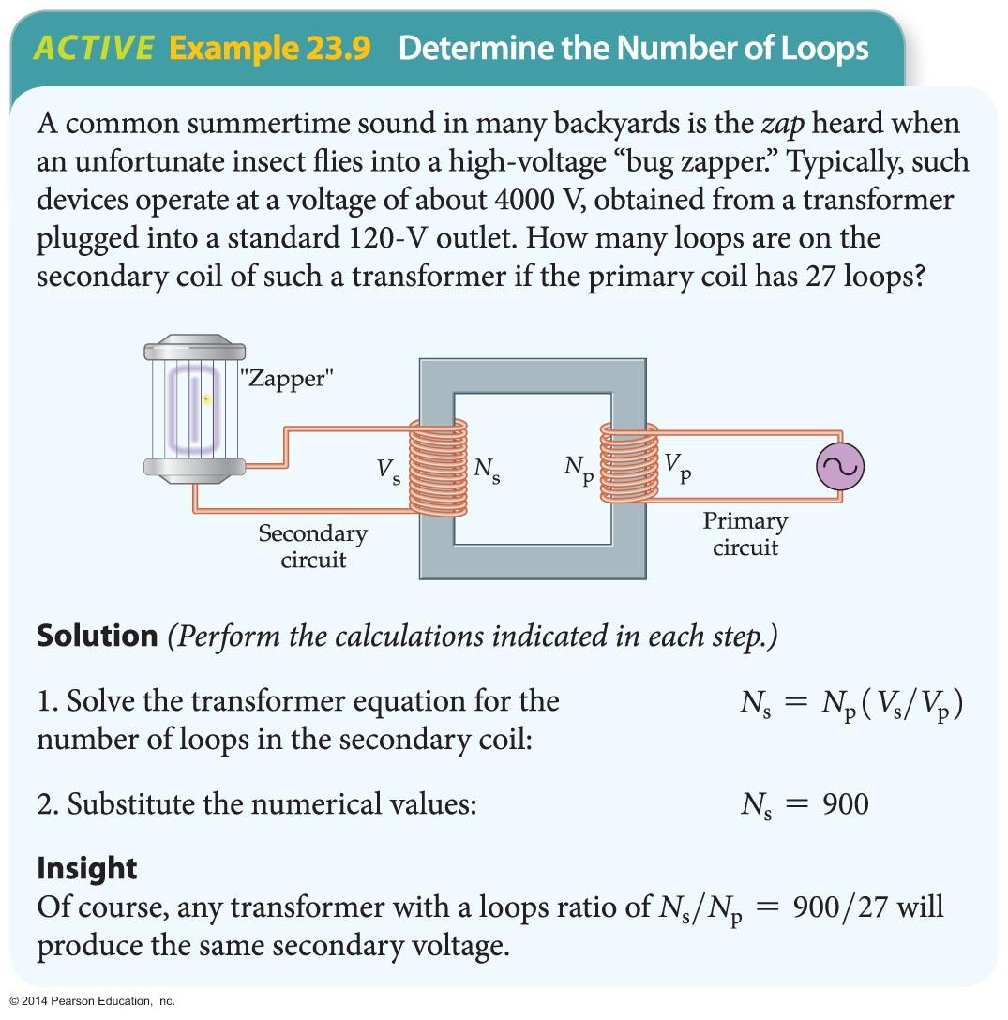
AC Circuits and Transformers
The following example illustrates an application of the transformer equation.

Slide 77
AC Circuits and Transformers
A transformer depends on a changing magnetic flux to create an induced emf in the secondary coil. If the current is constant—as in a DC circuit—there is no induced emf, and the transformer ceases to function.
This is an important advantage that AC circuits have over DC circuits and one reason why most electrical power systems operate with alternating current.
Transformers play an important role in the transmission of electrical energy from the power plants that produce it to the communities and businesses where it is used.

Slide 78
AC Circuits and Transformers
When electrical energy is transmitted over large distances, the resistivity of the wires that carry the current becomes significant. If a wire carries a current I and has a resistance R, the power dissipated as heat is P = I ²R.
One way to reduce this energy loss is to reduce the current. A transformer that steps up the voltage of a power plant by a factor of 20 will at the same time reduce the current by a factor of 20, which reduces the power dissipation by a factor of 20² = 400. When the electricity reaches the location where it is to be used, step-down transformers lower the voltage to a level such as 120 V
or 240 V.

