Slide 1
Electric Current and Electric Circuits
Prepared by
Chris Chiaverina

Slide 2
Chapter Contents
Electric Current, Resistance, and Semiconductors
Electric Circuits
Power and Energy in Electric Circuits

Slide 3
Electric Current, Resistance, and Semiconductors
All electric circuits have one thing in
common—they depend on the flow of electric charge.
When electric charge flows from one place to another, we say it forms an electric current. The more charge that flows, and the faster it flows, the greater the electric current.
In general, electric charge is carried through a circuit by electrons.

Slide 4
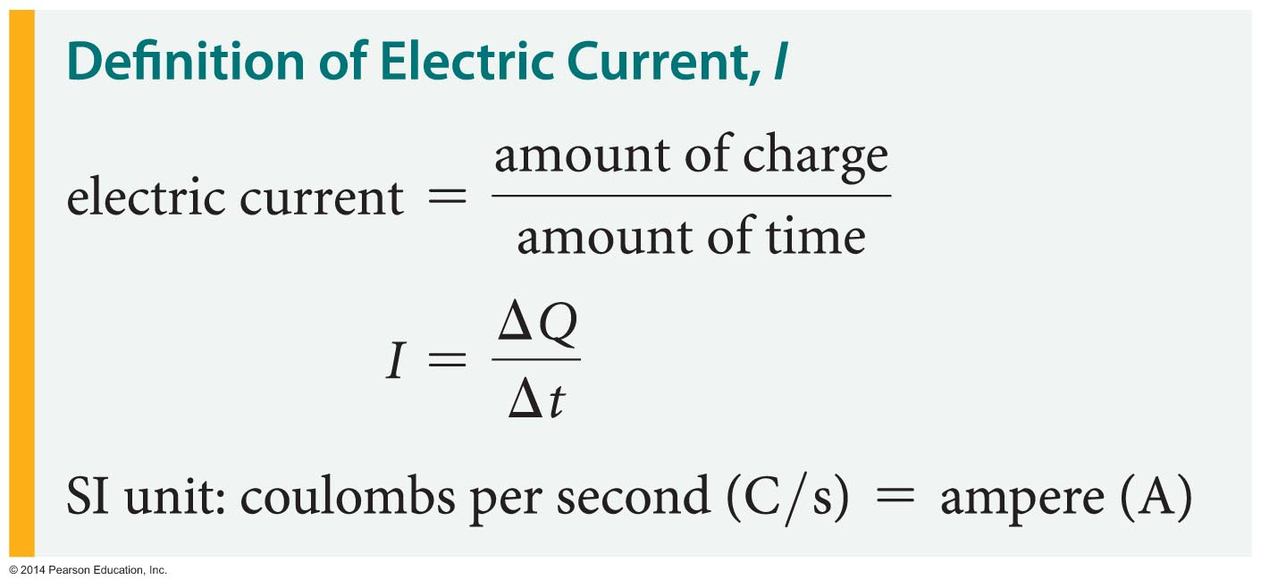
Electric Current, Resistance, and Semiconductors
Suppose an amount of charge ΔQ flows past a given point in a wire in the time Δt. The electric current, I, in the wire is simply defined as the amount of charge divided by the amount of time.
The following equation is used to determine the current flowing in a wire.

Slide 5
Electric Current, Resistance, and Semiconductors
The unit of current is the ampere (A), or amp for short. It is named for the French physicist
André-Marie Ampère (1775–1836).
A current of 1 amp is defined as the flow of
1 coulomb of charge in 1 second:
1 A = 1 C/s
A 1-amp current is fairly strong. Many electronic devices, like cell phones and digital music players, operate on currents that are a fraction of an amp.

Slide 6
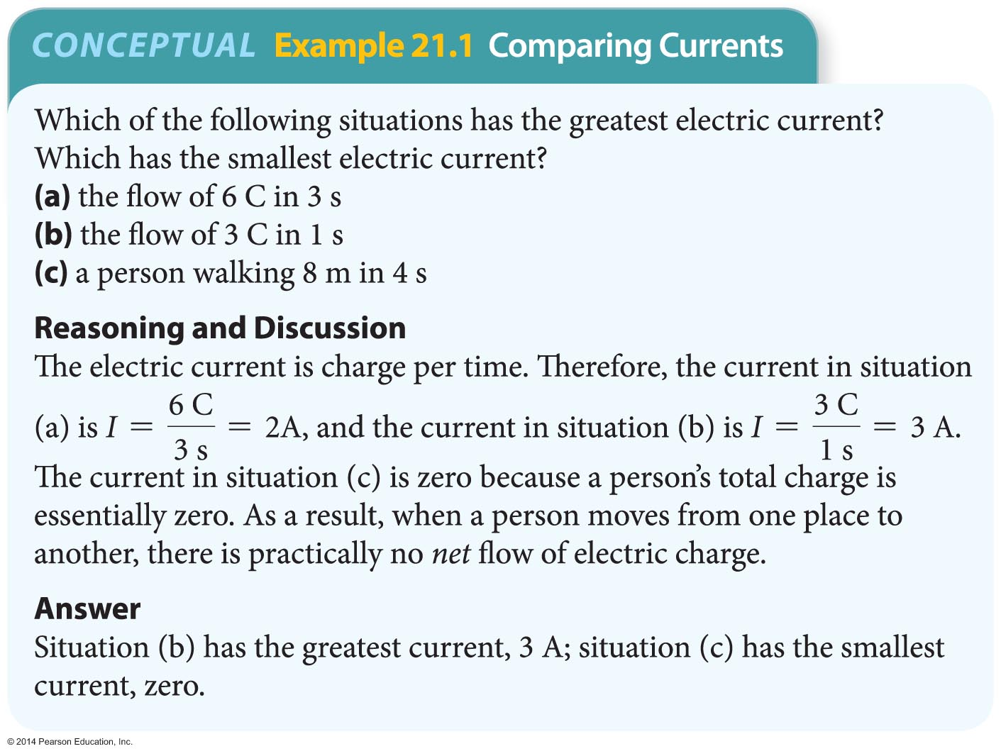
Electric Current, Resistance, and Semiconductors
The following Conceptual Example illustrates how the current depends on both the amount of charge flowing and the amount of time.

Slide 7
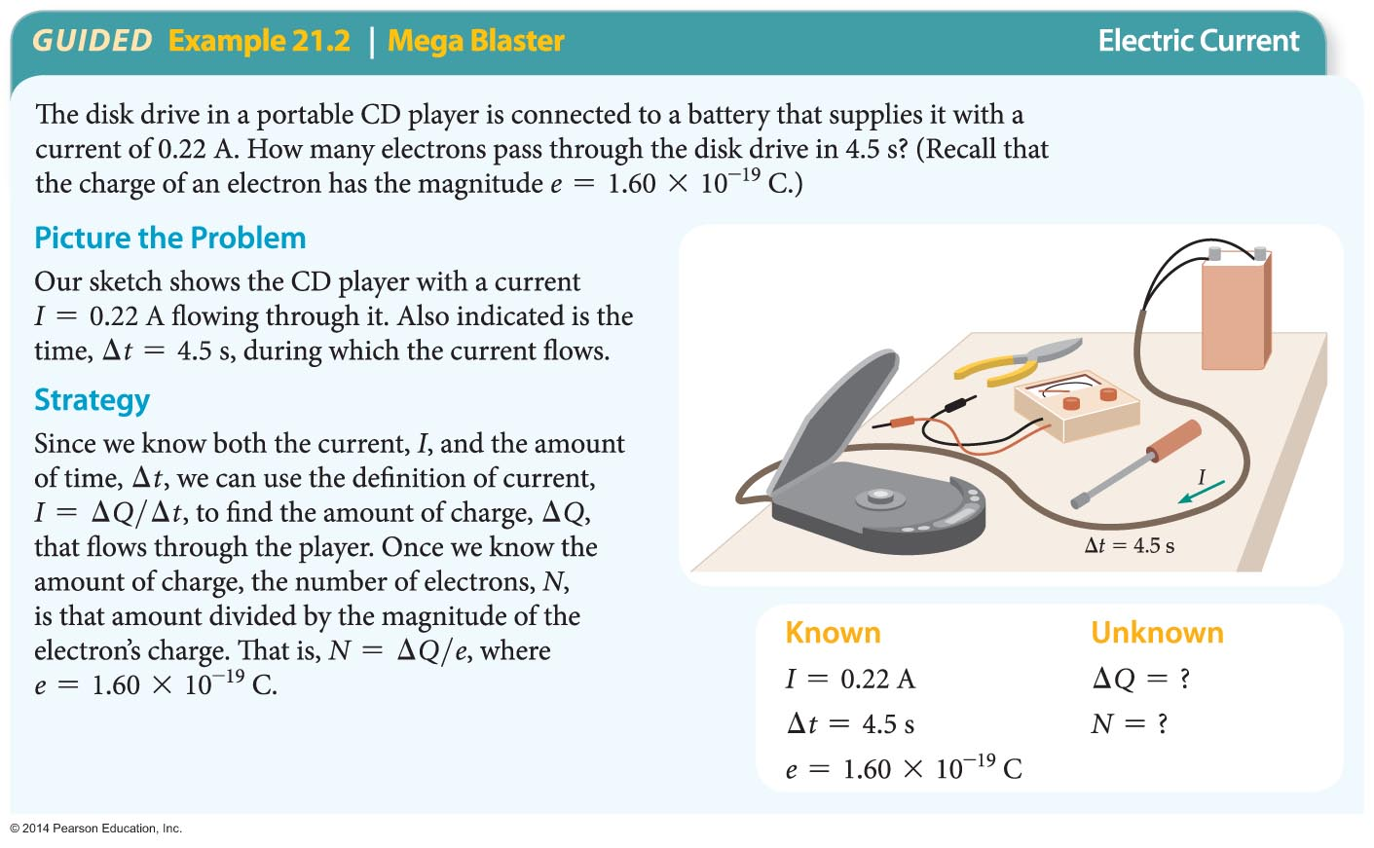
Electric Current, Resistance, and Semiconductors
The following example shows that the number of electrons flowing in a typical circuit is extremely large. The situation is similar to the large number of water molecules flowing through a garden hose.

Slide 8
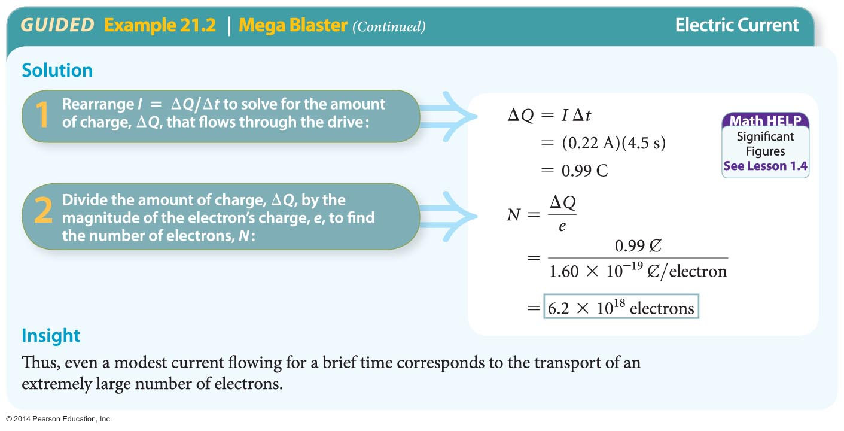
Electric Current, Resistance, and Semiconductors

Slide 9
Electric Current, Resistance, and Semiconductors
When charge flows through a closed path and returns to its starting point, we say that the closed path is an electric circuit.
In a type of circuit known as a direct-current circuit, or DC circuit, the current always flows in the same direction. Circuits that run on batteries are typically DC circuits.
Circuits with currents that periodically reverse their direction are referred to as alternating-current circuits, or AC circuits. The electricity provided by a wall plug in your house is AC.

Slide 10
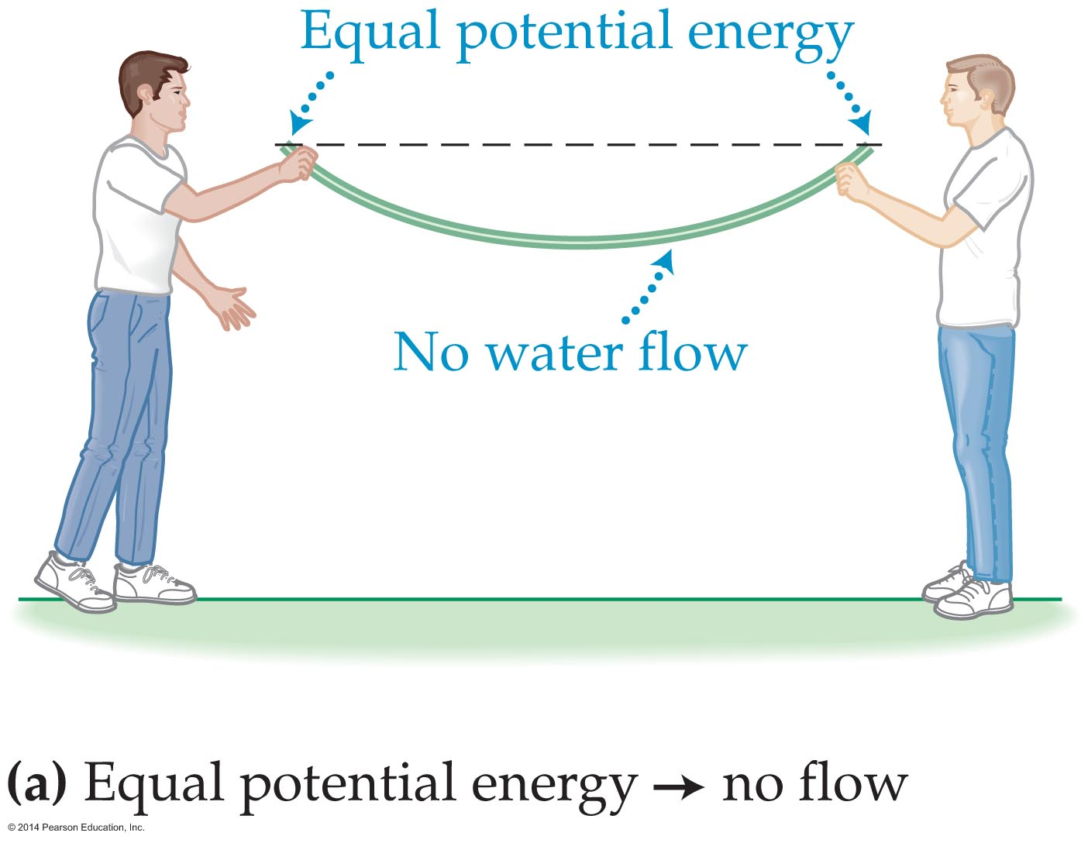
Electric Current, Resistance, and Semiconductors
Although electrons move fairly freely in metal wires, something has to push on them to get them going and keep them going. It's like water in a garden hose; the water flows only when a force pushes on it. Similarly, electrons flow in a circuit only when an electrical force pushes on them.
Figure (a) below shows
that there is no water
flow if both ends of the
garden hose are held
at the same level.

Slide 11
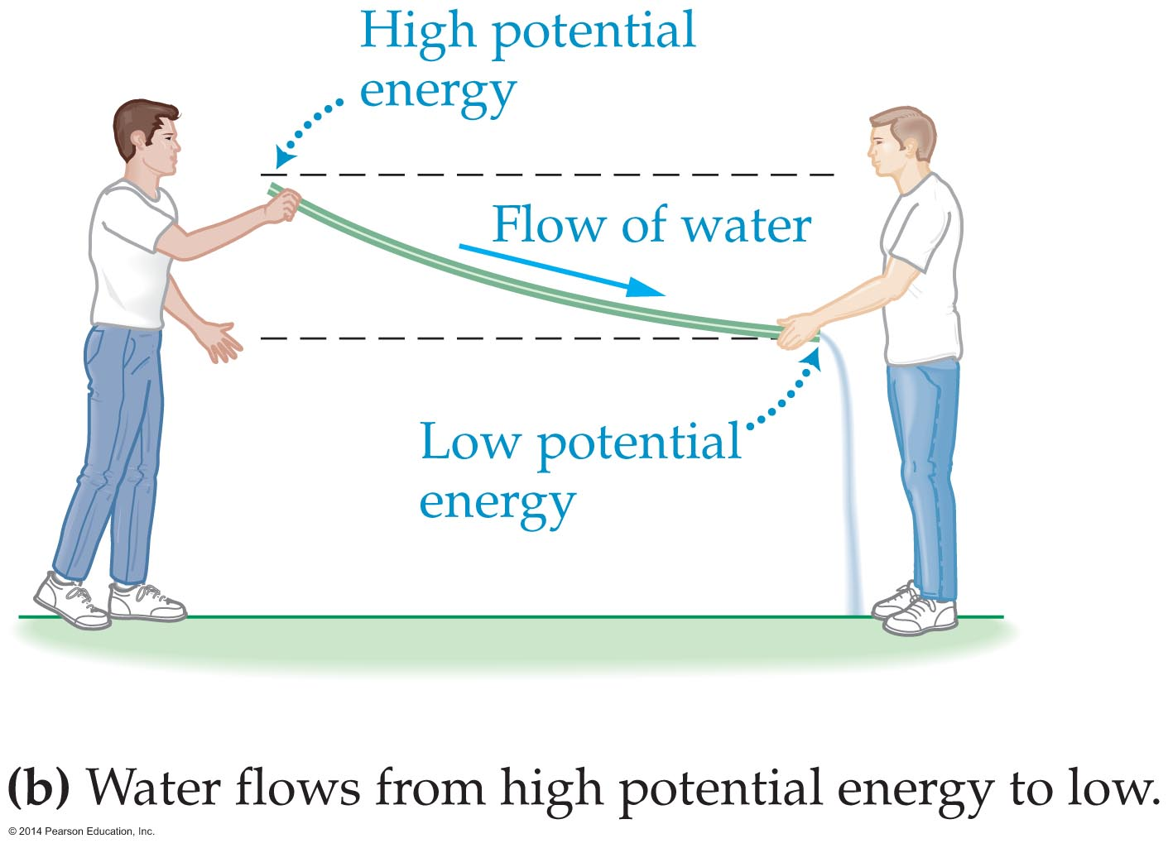
Electric Current, Resistance, and Semiconductors
Figure (b) shows that water flows from the end where the gravitational potential energy is high to the end where it is low. The difference in gravitational potential energy between the two ends of the hose results in a force on the water—which in turn produces a flow. A battery performs a similar function in an electric circuit.

Slide 12

Electric Current, Resistance, and Semiconductors
A battery uses chemical reactions to produce a difference in electric potential between its two ends, which are referred to as the terminals. The symbol for a battery is .
A battery's positive terminal has a high electrical potential and is denoted with a plus (+) sign; the negative terminal has a low electric potential and is denoted with a minus sign (−).

Slide 13
Electric Current, Resistance, and Semiconductors
When a battery is connected to a circuit, electrons move in a closed path from one terminal of the battery through the circuit and back to the other terminal of the battery. The electrons leave from the negative terminal of the battery and return to the positive terminal.
The situation is similar to the flow of blood in your body. Your heart acts like a battery, causing blood to flow through a closed circuit of arteries and veins in your body.

Slide 14
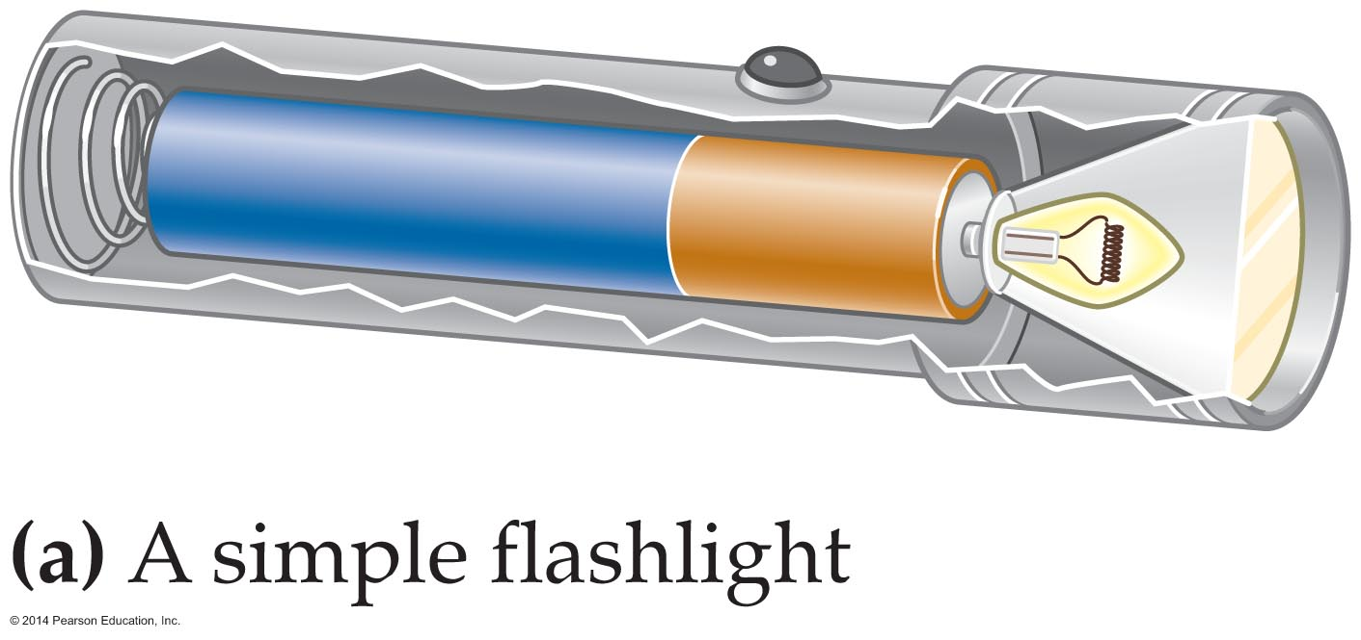
Electric Current, Resistance, and Semiconductors
The figure below shows a simple electrical system consisting of a battery, a switch, and a lightbulb connected together in a flashlight.

Slide 15
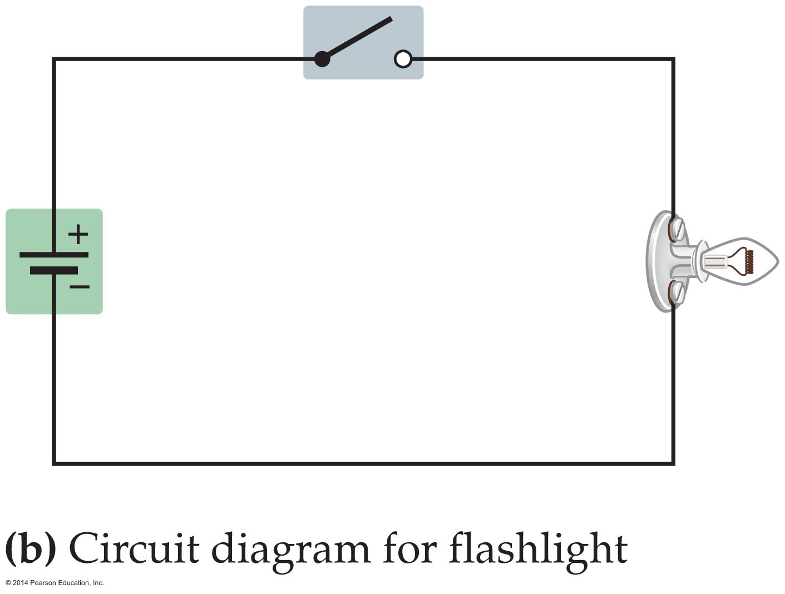
Electric Current, Resistance, and Semiconductors
The circuit diagram in figure (b) below shows that the switch is open—creating an open circuit. When a circuit is open, no charge can flow. When the switch is closed, electrons flow through the circuit and the light glows.

Slide 16
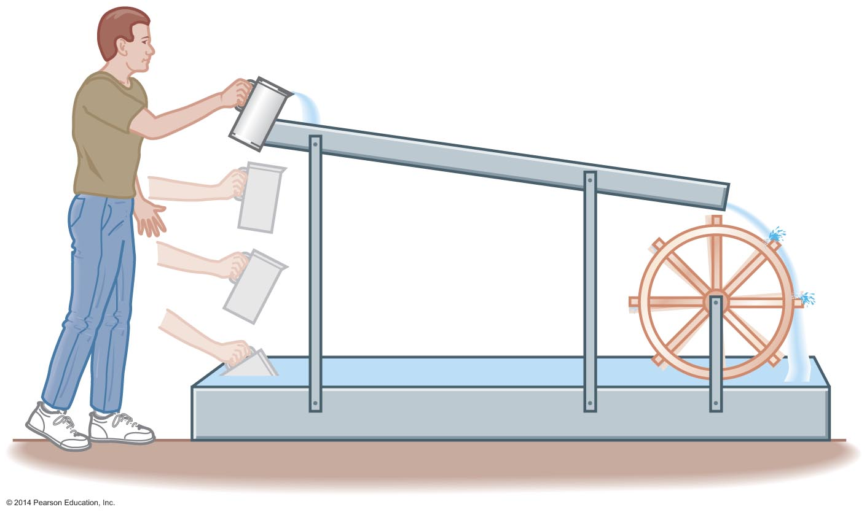
Electric Current, Resistance, and Semiconductors
The figure below shows a mechanical equivalent of the flashlight circuit. The person lifting the water corresponds to the battery, the paddle wheel corresponds to the lightbulb, and the water is like the electric charge.

Slide 17
Electric Current, Resistance, and Semiconductors
The difference in electric potential between the terminals of the battery is the electromotive force, or emf. Symbolically, the electromotive force is represented by the symbol ε (the Greek letter epsilon). The unit of emf is the same as that of electrical potential, namely, the volt.
The electromotive force is not really a force. Instead, the emf determines the amount of work a battery does to move a certain amount of charge around a circuit.

Slide 18
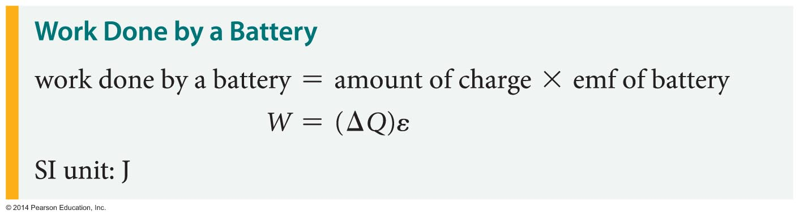
Electric Current, Resistance, and Semiconductors
To be specific, the magnitude of the work done by a battery with the emf ε as charge ΔQ moves from one terminal to the other is

Slide 19
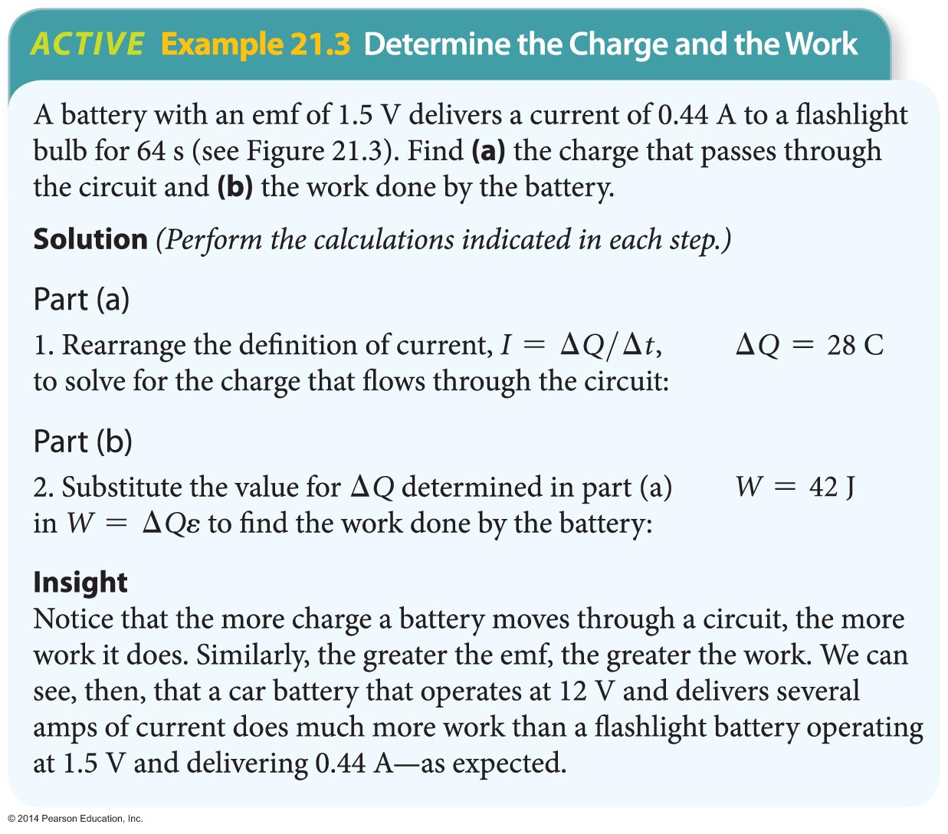
Electric Current, Resistance, and Semiconductors
The following example illustrates how the charge that passes through a circuit and the work done by the battery moving that charge can be determined.

Slide 20
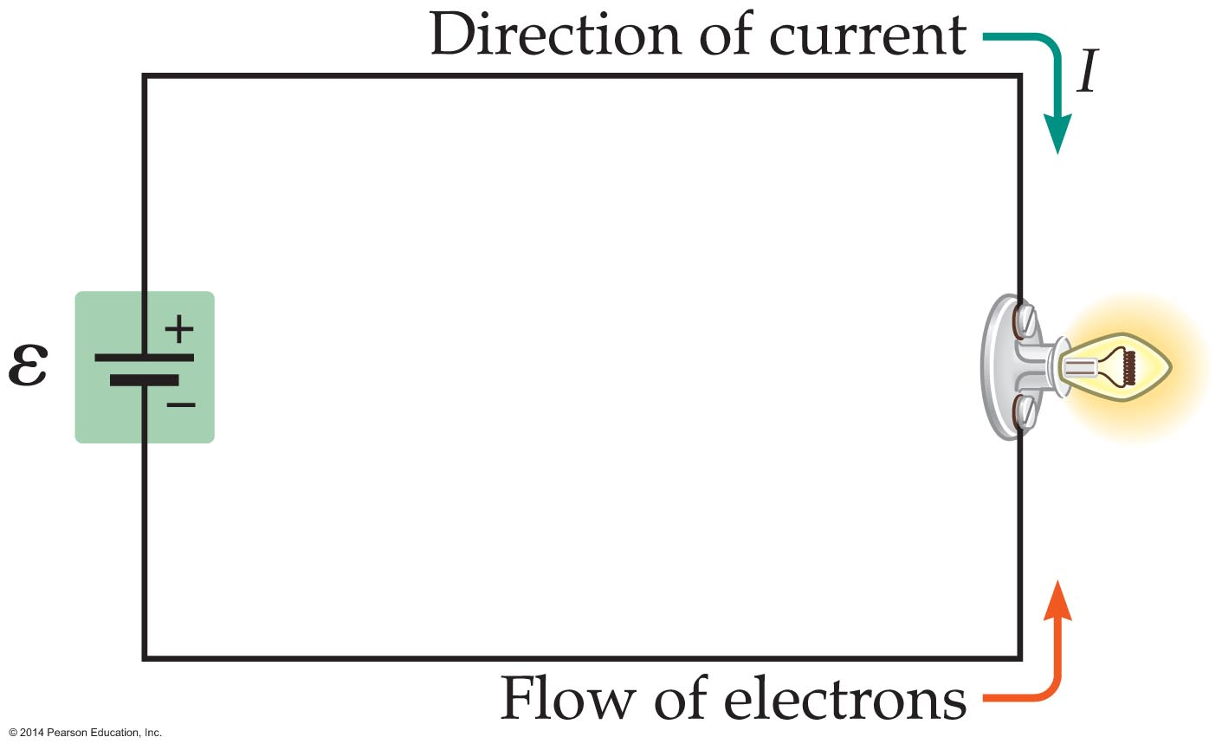
Electric Current, Resistance, and Semiconductors
When drawing an electric circuit, it's helpful to include an arrow to indicate the flow of current. By convention, the direction of the current in an electric circuit is the direction in which a positive test charge would move.
In typical circuits, the charges that flow are actually negatively charged electrons. As a result, the flow of electrons and the current arrow point in opposite directions, as indicated in the figure below.

Slide 21

Electric Current, Resistance, and Semiconductors
As surprising as it may seem, electrons move rather slowly through a wire. Their path is roundabout because they are involved in numerous collisions with the atoms in the wire, as indicated in the figure below.
A electron's average speed, or drift speed, as it is called, is about 10⁻⁴ m/s—that's only about a hundredth of a centimeter per second!

Slide 22
Electric Current, Resistance, and Semiconductors
At this speed, it would take an electron about
3 hours to go from a car's battery to the headlights. However, we know that the lights come on almost immediately. Why the discrepancy?
While the electrons move with a rather slow average speed, the influence they have on one another, due to the electrostatic force, moves through the wire at nearly the speed of light.

Slide 23
Electric Current, Resistance, and Semiconductors
Electrons flow through metal wires with relative ease. In the ideal case, the electrons move with complete freedom. Real wires, however, always affect the electrons to some extent.
Collisions between electrons and atoms in a wire cause a resistance to the electron's motion. This effect is similar to friction resisting the motion of a box sliding across a floor.

Slide 24
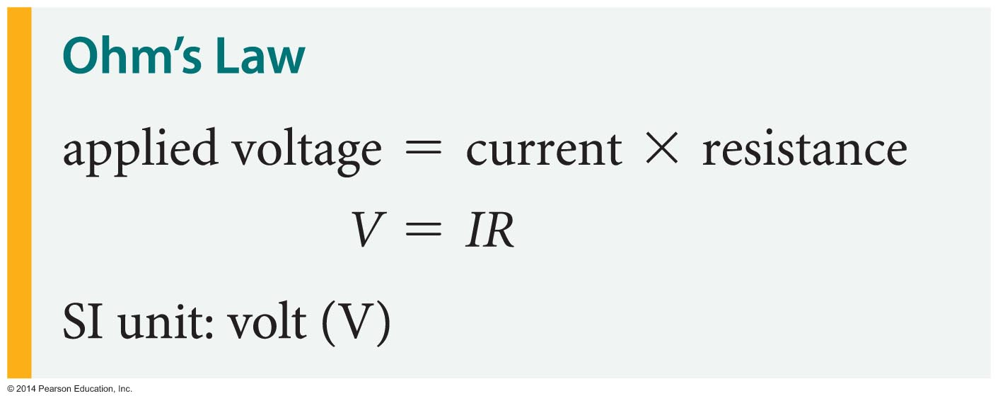
Electric Current, Resistance, and Semiconductors
To move electrons against the resistance of a wire, it is necessary to apply a potential difference between the wire's ends.
Ohm's law relates the applied potential difference to the current produced and the wire's resistance. To be specific, the three quantities are related as follows:

Slide 25
Electric Current, Resistance, and Semiconductors
Ohm's law is named for the German physicist Georg Simon Ohm (1789–1854).
Rearranging Ohm's law to solve for the resistance, we find
R = V/I
From this expression, it is clear that resistance has units of volts per amp. A resistance of 1 volt per amp defines a new unit—the ohm. The Greek letter omega (Ω) is used to designate the ohm. Thus,
1 Ω = 1 V/A
A device for measuring resistance is called an ohmmeter.

Slide 26
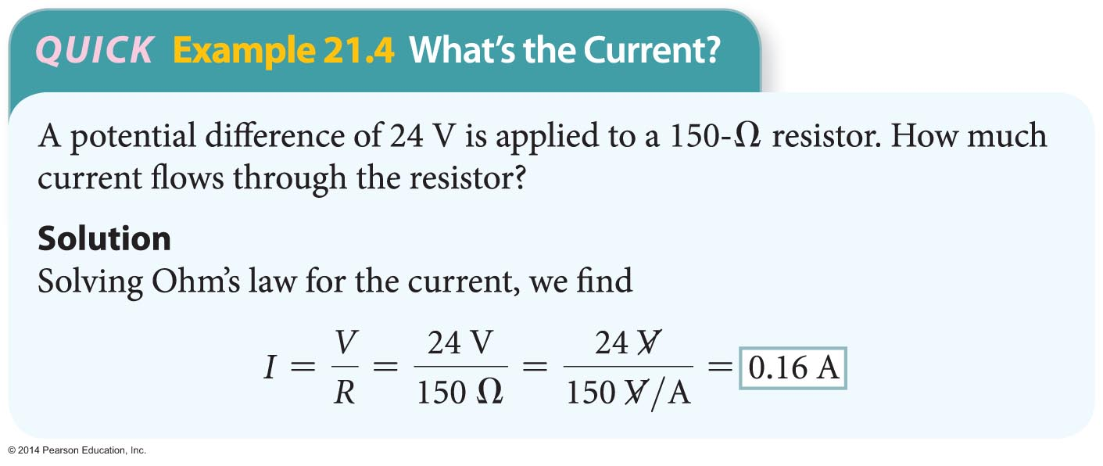

Electric Current, Resistance, and Semiconductors
A resistor is a small device used in electric circuits to provide a particular resistance to current. The resistance of a resistor is given in ohms, as shown in the following Quick Example.
In an electric circuit, a resistor is signified by a zigzag line, 222.. , as a reminder of the zigzag path of the electrons in the resistor.

Slide 27
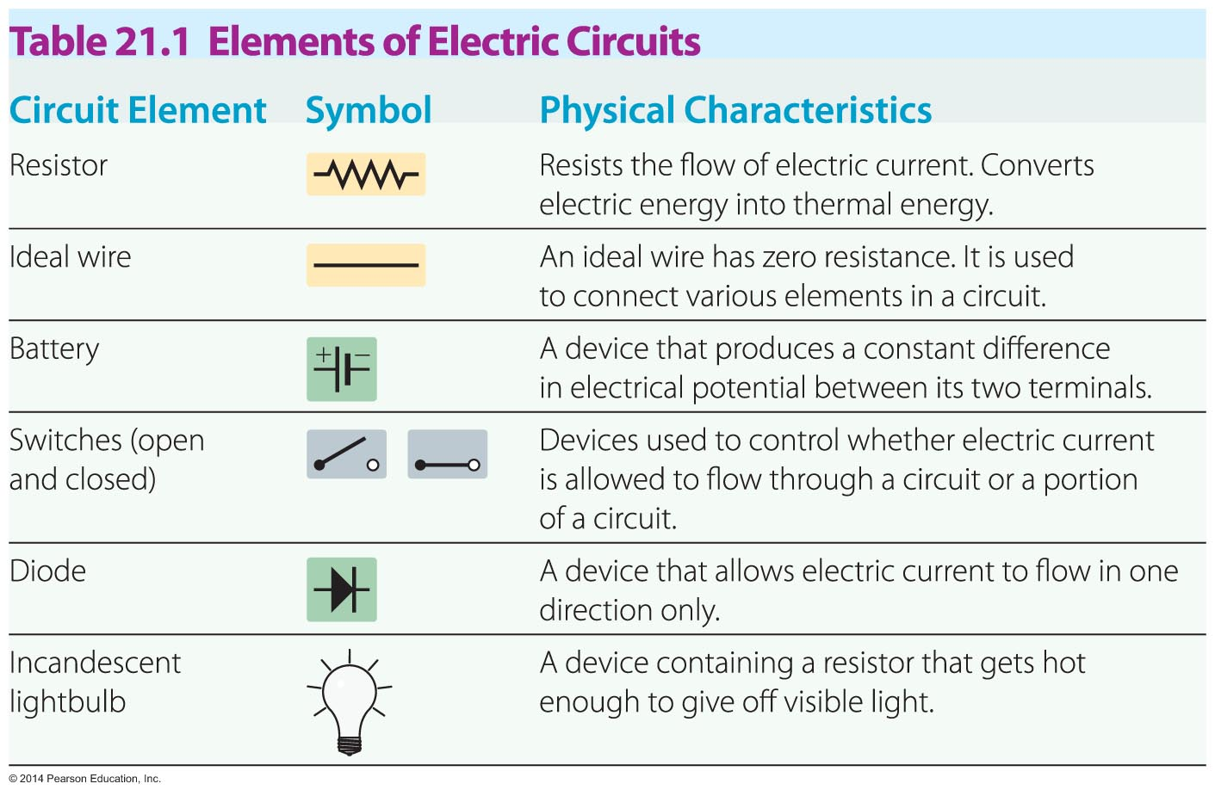
Electric Current, Resistance, and Semiconductors
The following chart summarizes the elements of electric circuits, their symbols, and their physical characteristics.

Slide 28
Electric Current, Resistance, and Semiconductors
A wire's resistance is affected by several factors.
The resistance of a wire depends on the material from which it is made. For example, if a wire is made of copper, its resistance is less than if it is made from iron. The resistance of a given material is described by its resistivity, ρ.
A wire's resistance also depends on it length, L, and its cross-sectional area, A. To understand these factors, let's consider water flowing through a hose. If the hose is very long, its resistance to the water is correspondingly large. On the other hand, a wide hose, with a greater cross-sectional area, offers less resistance to the water.

Slide 29
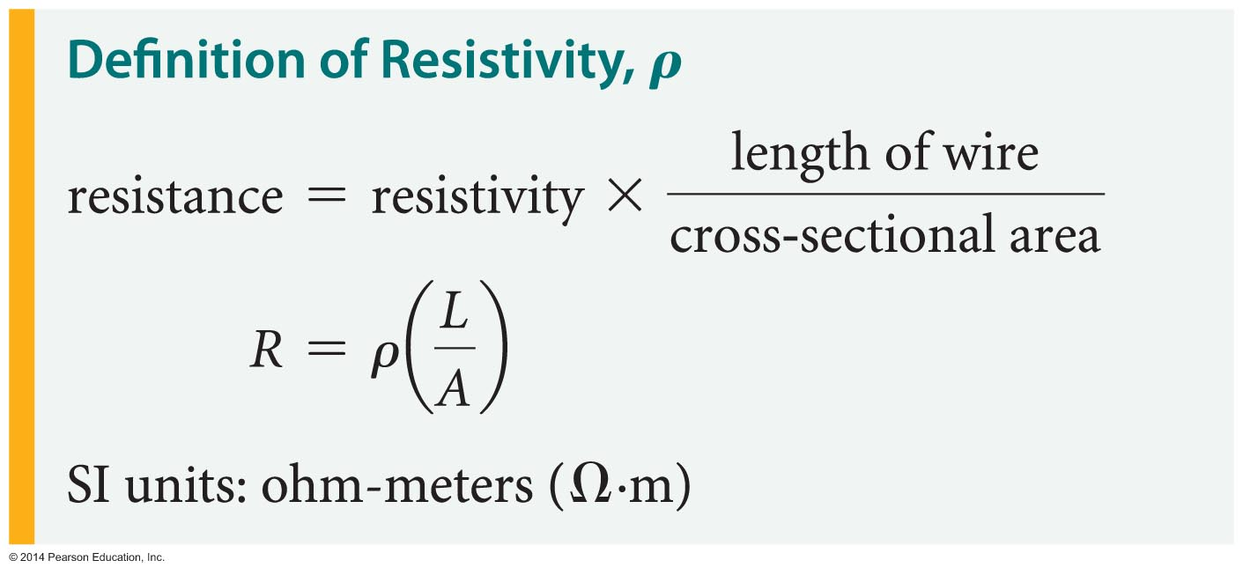
Electric Current, Resistance, and Semiconductors
Combining these observations regarding the factors that affect a wire's resistance, we can write the following relationship:
The units of resistivity are ohm-meters (Ω·m), and its magnitude varies greatly with the type of material. Insulators have large resistivities; conductors have low resistivities.

Slide 30
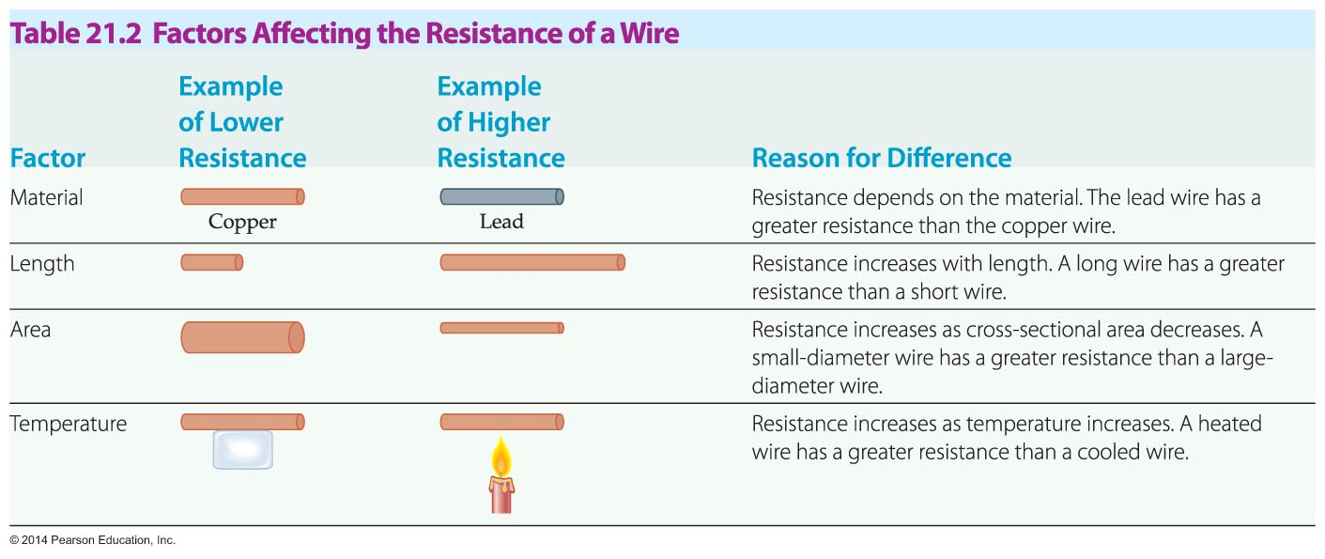
Electric Current, Resistance, and Semiconductors
As a wire is heated, its resistivity tends to increase. This effect occurs because atoms that are jiggling more rapidly are more likely to collide with electrons and slow their progress through the wire.
The following table summarizes the four factors that affect the resistance of a wire.

Slide 31
Electric Current, Resistance, and Semiconductors
Though Ohm's law is an excellent approximation for metal wires and the resistors used in electric circuits, it does not apply to all materials. Materials known as semiconductors are an important exception to Ohm's law.
Elements such as germanium and silicon are insulators in their pure form. However, when impurities are added—which is referred to as doping—these substances can conduct electricity. Doping produces two types of semiconductors.

Slide 32
Electric Current, Resistance, and Semiconductors
If a small amount of arsenic is added to
silicon—say, one arsenic atom per million silicon atoms—the silicon becomes a conductor. The arsenic-doped silicon conducts electricity because electrons break free from the arsenic atoms and move freely through the material.
Silicon doped in this way is referred to as an
n-type semiconductor because current is carried by negative (n) electrons.

Slide 33
Electric Current, Resistance, and Semiconductors
Silicon also becomes a semiconductor when it is doped with gallium instead of arsenic. In this case, however, the gallium atoms take electrons from the silicon atoms, forming positively charged "holes" that can carry current. Because positive (p) holes carry the current, this type of material is referred to as a p-type semiconductor.
Unlike a typical resistor, a semiconductor has a lower resistance when its temperature increases. This is because an increase in temperature makes it easier for electrons to move, and this produces more current. The result is a decrease in resistance.

Slide 34
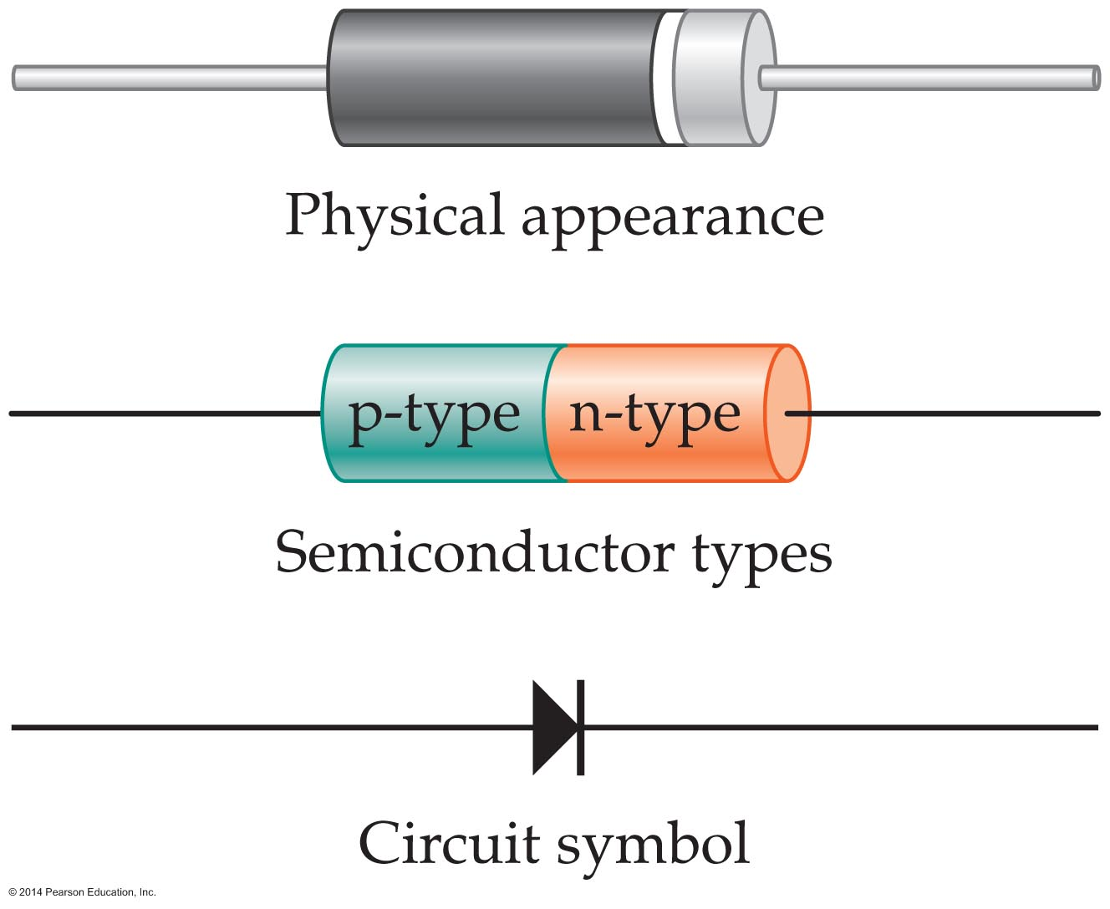
Electric Current, Resistance, and Semiconductors
Semiconductors can be used to make a variety of electronic devices. The simplest semiconducting device, the diode, consists of a p-type semiconductor joined to an n-type semiconductor. A diode is shown in the figure below.
The basic property of a diode is that it allows current to flow in one direction, but not the other.

Slide 35
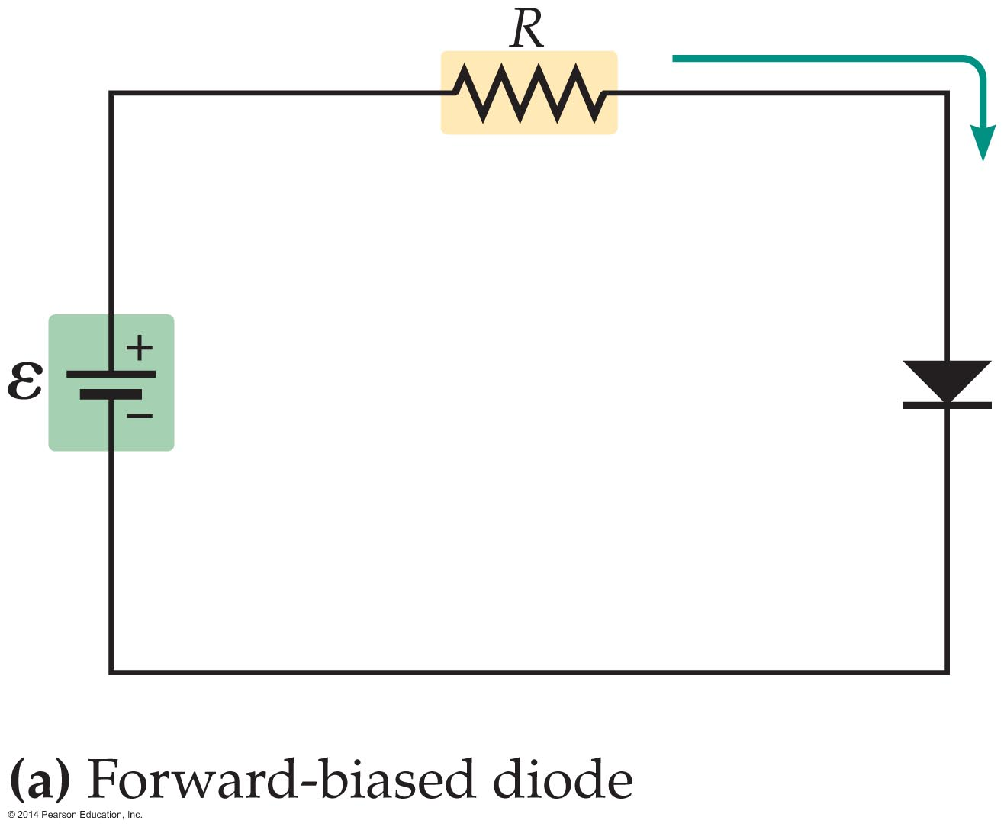
Electric Current, Resistance, and Semiconductors
For example, when the positive terminal of a battery is attached to the p-type semiconductor in an ideal diode, as in the figure below, the current flows with zero resistance. In this case, we say that the diode is forward biased.

Slide 36
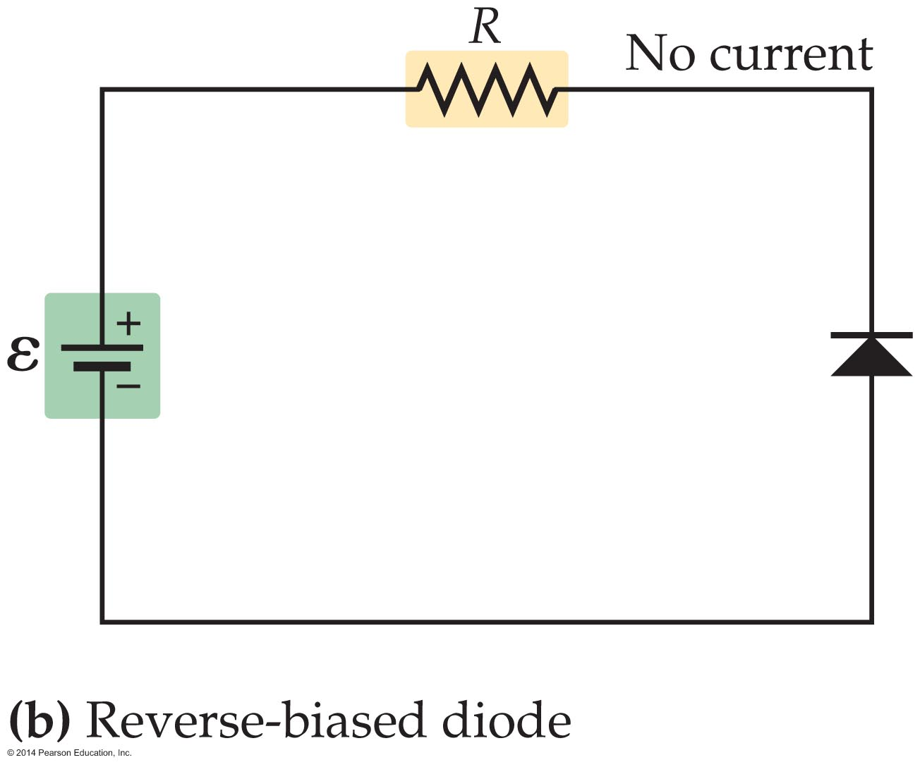
Electric Current, Resistance, and Semiconductors
On the other hand, if the positive terminal of a battery is connected to the n-type semiconductor of an ideal diode, as in the figure below, no current flows at all. In this case, we say that the diode is reverse biased.

Slide 37
Electric Current, Resistance, and Semiconductors
Because of the one-way nature of diodes, they find uses in electric circuits.
One application is the conversion of AC current (which alternates in direction) to DC current (which flows in one direction only).
Another application makes use of the fact that light is emitted when electrons and holes come together in a diode. This is the basic process behind the operation of an LED, light-emitting diode.

Slide 38
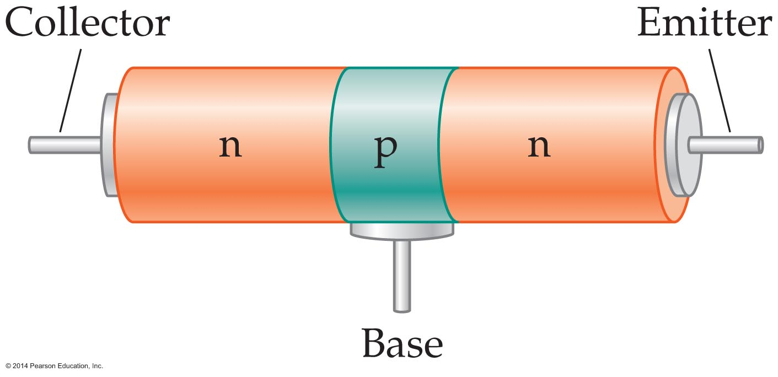
Electric Current, Resistance, and Semiconductors
Another useful semiconductor device is produced by making a "sandwich" of three layers of semiconductors. The most common type of transistor has an n-type semiconductor on either side of the sandwich and a thin p-type semiconductor in the middle, as is shown in the figure below. This is known as an npn transistor.

Slide 39
Electric Current, Resistance, and Semiconductors
Transistors can also be made with the opposite sequence of semiconductors, resulting in a pnp transistor.
The basic function of a transistor is to act as an electronic switch that controls the flow of current in a circuit.
Consider the schematic view of an npn transistor shown in the figure on the next slide. The three electrodes of the transistor are the collector, the base, and the emitter. Of these three electrodes, it is the base that switches on or off the flow of current through the other two electrodes.

Slide 40
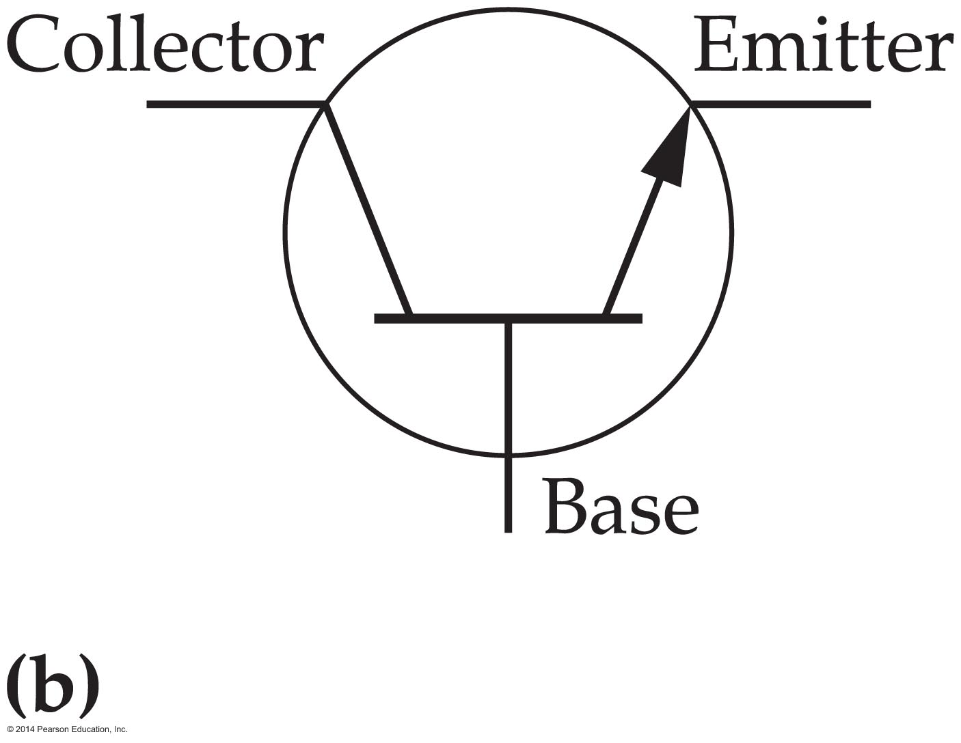
Electric Current, Resistance, and Semiconductors
You might find it helpful to think of the control of current by the base electrode as similar to turning a valve in a large-diameter water pipe. Though it doesn't take much force to turn the valve, once the valve is opened, a large volume of water flows through the pipe. Similarly, a small base current "opens the valve" that allows a large amount of current to flow from the collector to the emitter.

Slide 41

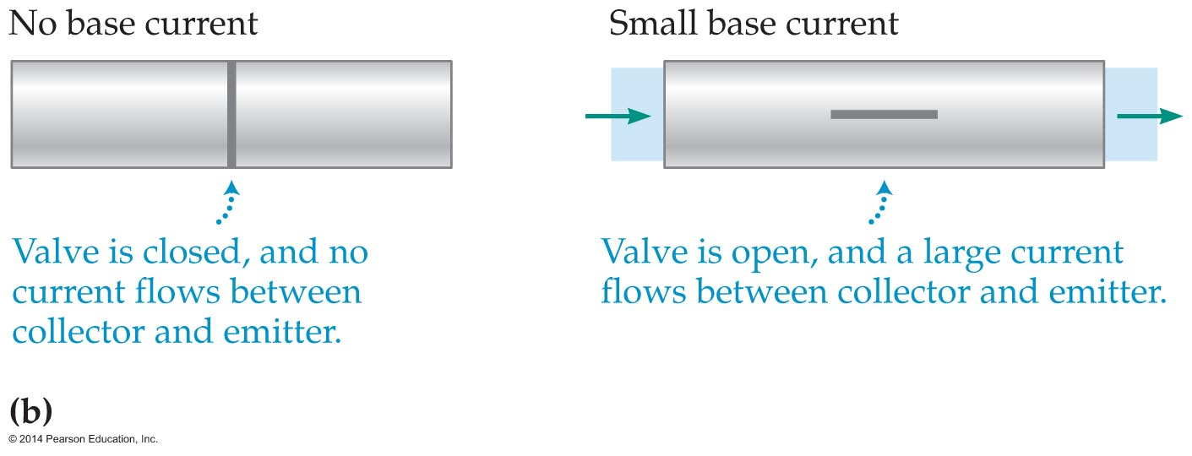
Electric Current, Resistance, and Semiconductors
In a typical transistor, a current I in the base can control the flow of current of up to 300I through the other two electrodes. Therefore, any signal with a changing current that comes into the base electrode is reflected accurately in a corresponding change in current flowing from the collector to the emitter—but amplified 300 times.
The water valve analogy for a transistor is shown in the figure below.

Slide 42
Electric Current, Resistance, and Semiconductors
One of the great advantages of transistors is that a small base current can turn a transistor on, by allowing current to flow through it, or off, by preventing the flow of current.
A device that can switch rapidly is just what's needed in modern digital computers, whose language is based on the binary digit (bit), which takes on the value 1 or 0. Computers represent these two states by a transistor that is either on or off.

Slide 43
Electric Current, Resistance, and Semiconductors
Many transistors are required in a computer. Most electronic devices today rely on silicon wafers, called microchips, that contain thousands of transistors, diodes, and resistors connected in elaborate circuits.
These integrated circuits (ICs) are built up layer by layer on a silicon wafer by depositing specific patterns of silicon, gallium, and arsenic, and so on, to produce the desired arrangement of
n-type and p-type semiconductors.

Slide 44
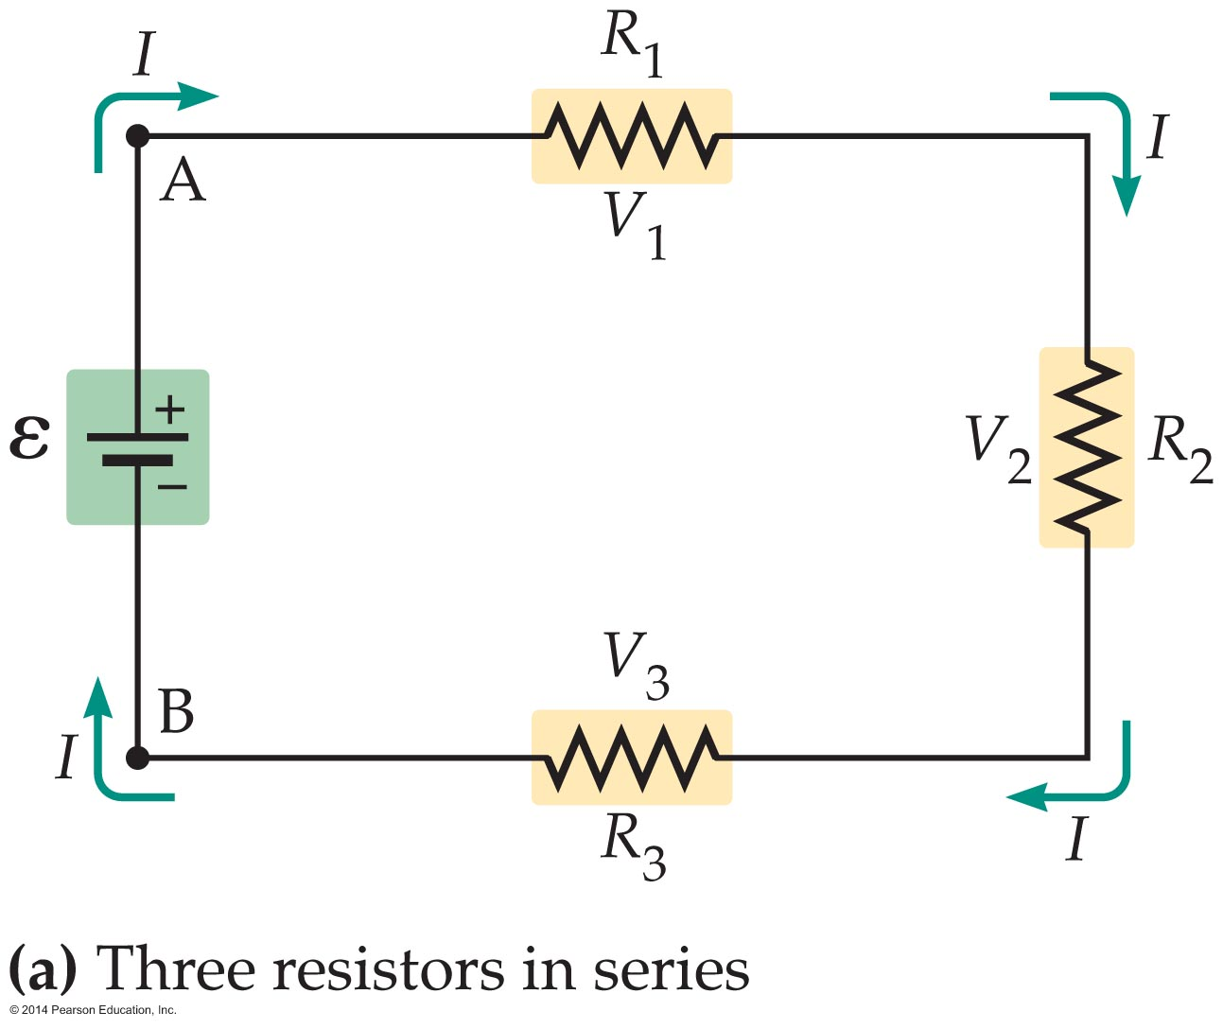
Electric Circuits
Electric circuits often contain a number of resistors connected in various ways.
One way resistors can be connected is end to end. Resistors connected in this way are said to form a series circuit. The figure below shows three resistors R₁, R₂, and R₃, connected in series.

Slide 45
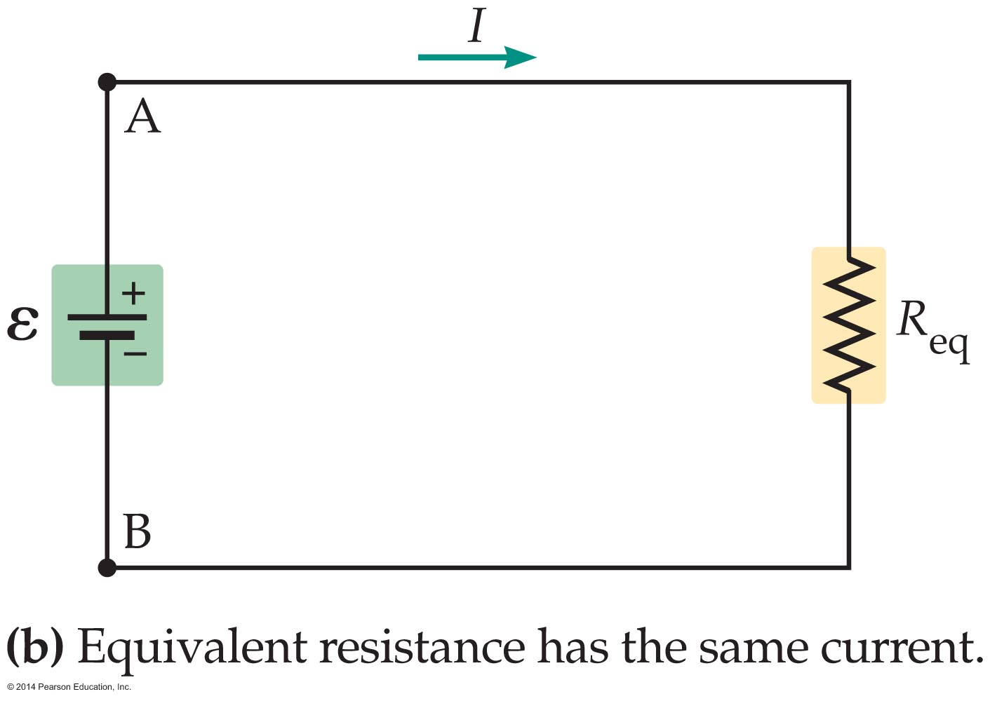
Electric Circuits
The three resistors acting together have the same
effect—that is, they draw the same current—as a single resistor, which is referred to as the equivalent resistor, R_{eq}.
This equivalence is illustrated in the figure below.
The equivalent resistor has the same current, I, flowing through it as each resistor in the original circuit.

Slide 46
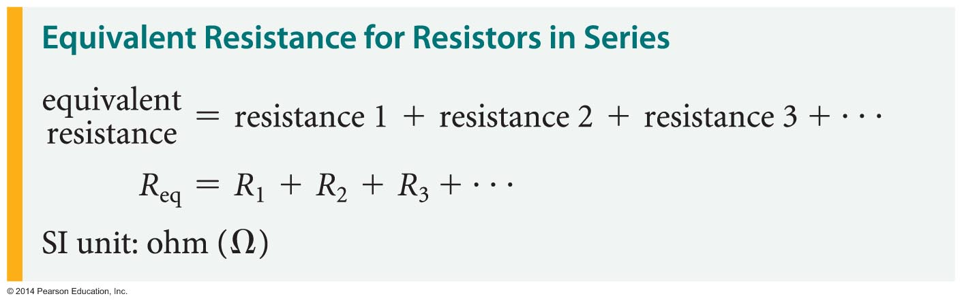
Electric Circuits
When resistors are connected in series, the equivalent resistance is simply the sum of the individual resistances.
In our case, with three resistors, we have
R_{eq} = R₁ + R₂ + R₃
In general, the equivalent resistance of resistors in series is the sum of all the resistances that are connected together:

Slide 47
Electric Circuits
The equivalent resistance is greater than the greatest resistance of any individual resistor.
In general, the more resistors connected in series, the greater the equivalent resistance.
For example, the equivalent resistance of a circuit with two identical resistors, R, connected in series is R_{eq} = R + R = 2R. Thus, connecting two identical resistors in series produces an equivalent resistance that is twice the individual resistances.

Slide 48
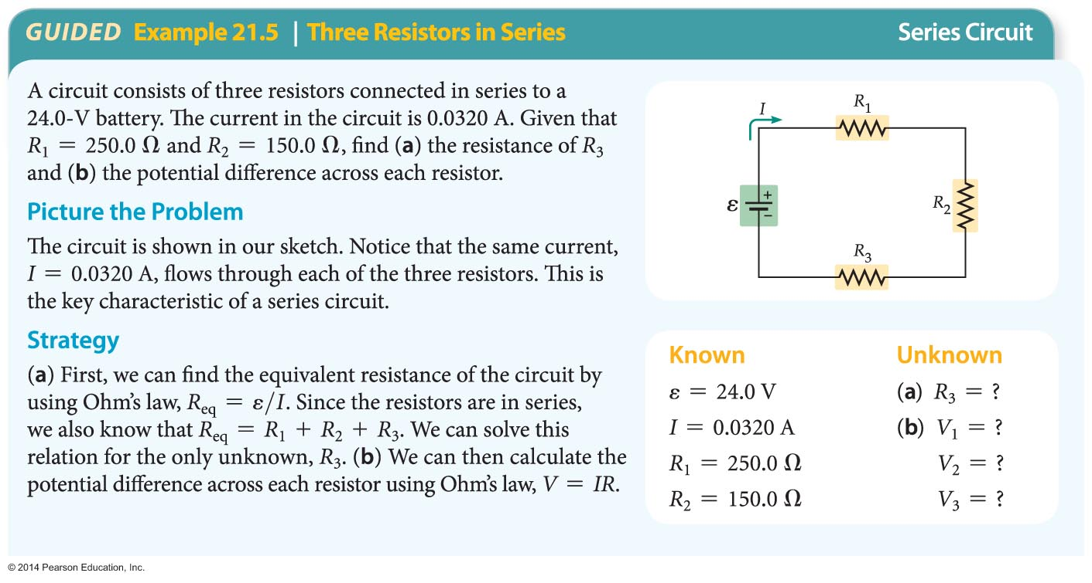
Electric Circuits
The following example illustrates the functioning of a series circuit.

Slide 49
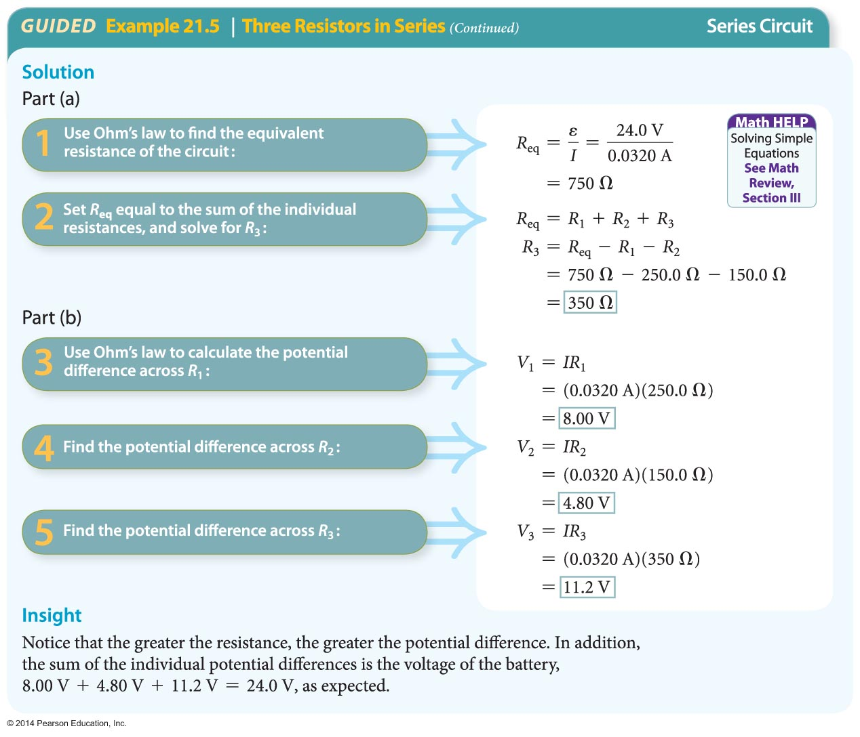
Electric Circuits

Slide 50
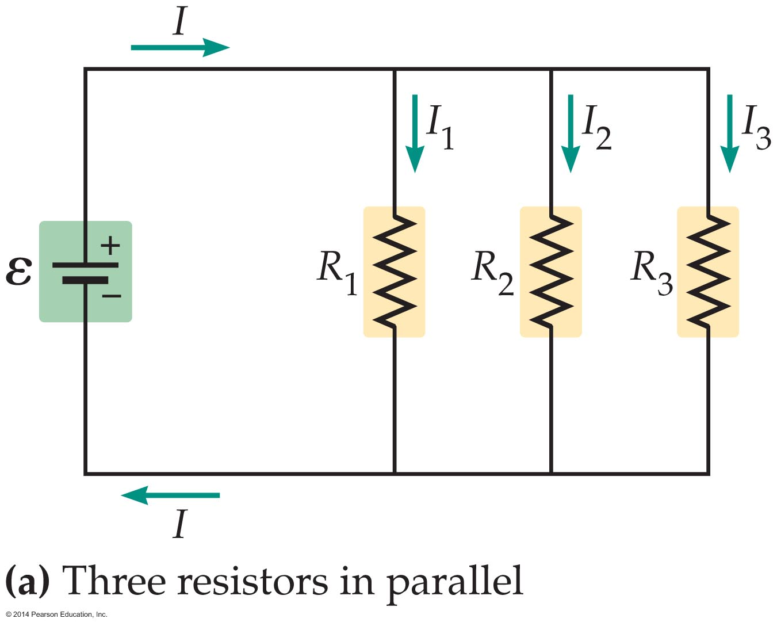
Electric Circuits
Resistors that are connected across the same potential difference are said to form a parallel circuit.
An example of three resistors connected in parallel is shown the figure below.

Slide 51
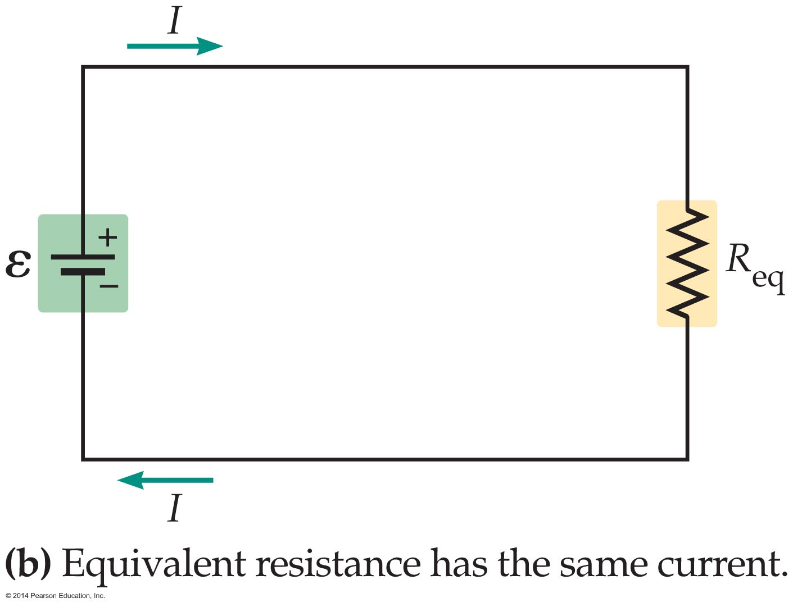
Electric Circuits
In a case like this, the electrons have three parallel paths through which they can flow—like parallel lanes on the highway.
The three resistors acting together draw the same current as a single equivalent resistor, R_{eq}, as indicated in the figure below.

Slide 52
Electric Circuits
When resistors are connected in parallel, the reciprocal of the equivalent resistance is equal to the sum of the reciprocals of the individual resistances. Thus, for our circuit of three resistors, we have
1/R_{eq} = 1/R₁ + 1/R₂ + 1/R₃
In general, the inverse equivalent resistance is equal to the sum of all of the individual inverse resistances:

Slide 53
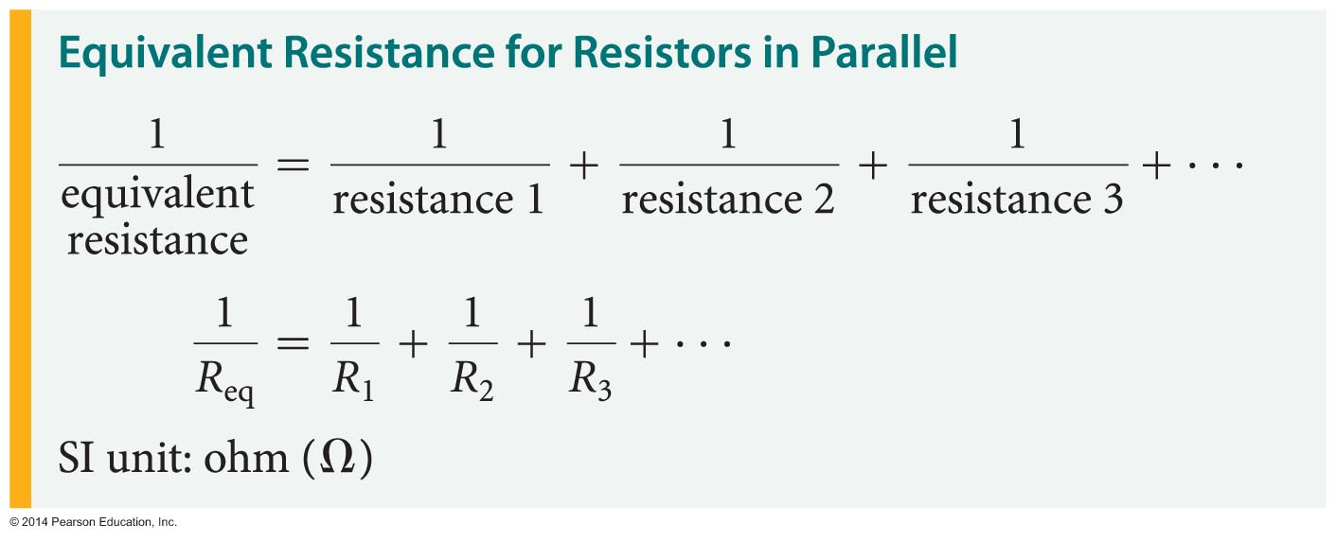
Electric Circuits
As an example of parallel resistors, consider a circuit with two identical resistors, R, connected in parallel. The equivalent resistance in this case is
1/R_{eq} = 1/R + 1/R
1/R_{eq} = 2/R

Slide 54
Electric Circuits
Solving for the equivalent resistance gives
R_{eq} = ½R. Thus, connecting two identical resistors in parallel produces an equivalent resistance that is half of the individual resistances.
A similar calculation shows that three resistors,
R, connected in parallel produces an equivalent that is one-third of the original resistances,
or R_{eq} = ⅓R.
These results show a clear trend, namely, the more resistors connected in parallel, the smaller the equivalent resistance.

Slide 55
Electric Circuits
In general, the equivalent resistance of a parallel circuit is less than or equal to the smallest individual resistance. What happens if one of the individual resistances is zero?
In this case, the equivalent resistance is also zero, because R_{eq} is less than or equal to the smallest individual resistance, and a resistance can't be negative.

Slide 56
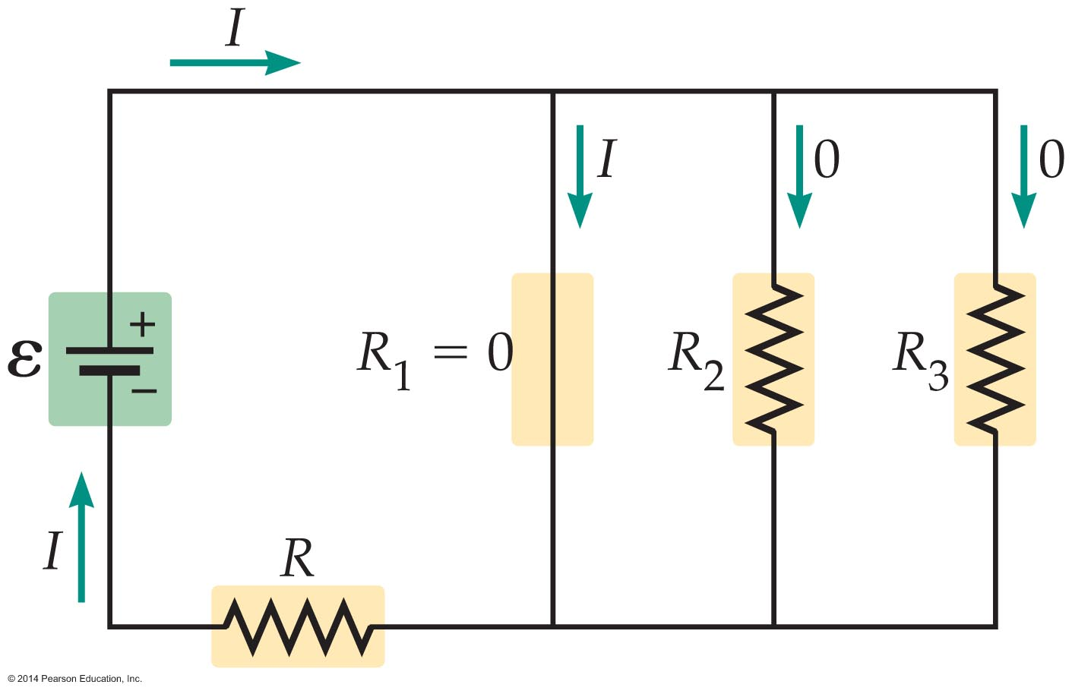
Electric Circuits
This situation, referred to as a short circuit, is illustrated in the figure below. In a short circuit, all the current flows through the path of zero resistance.

Slide 57
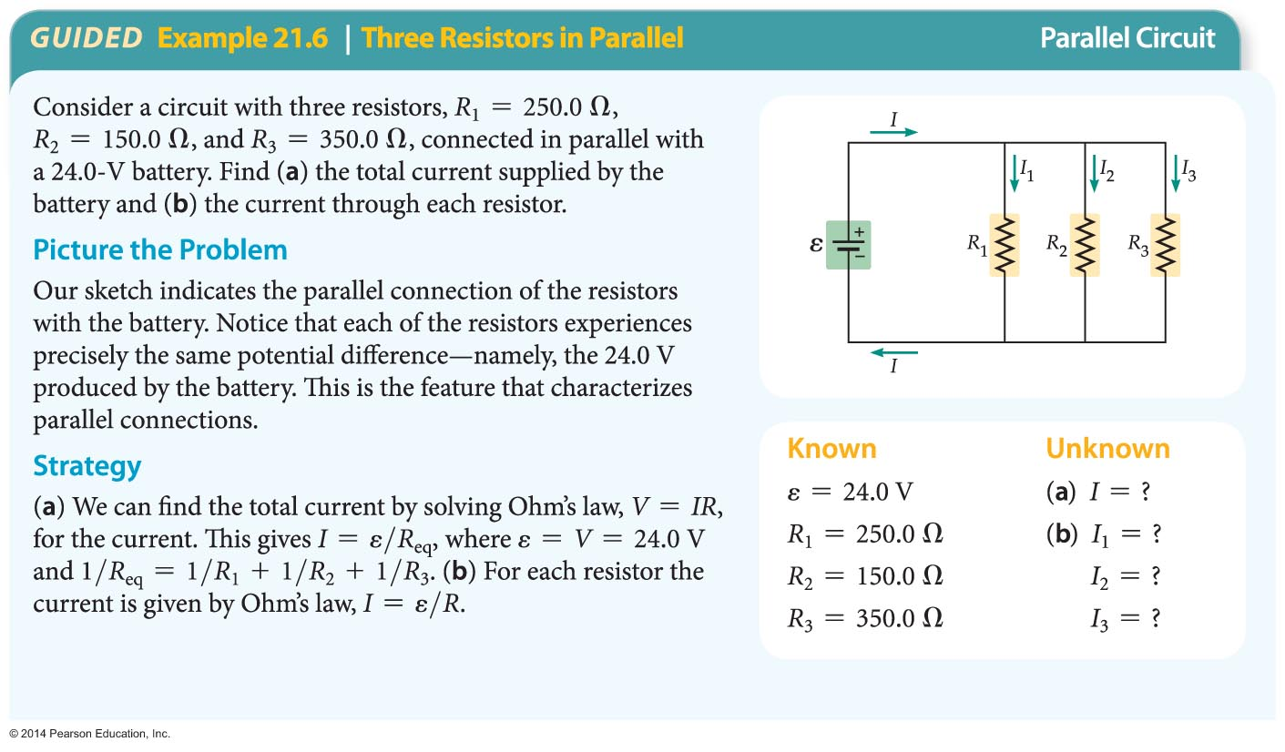
Electric Circuits
The following example illustrates the functioning of a parallel circuit.

Slide 58
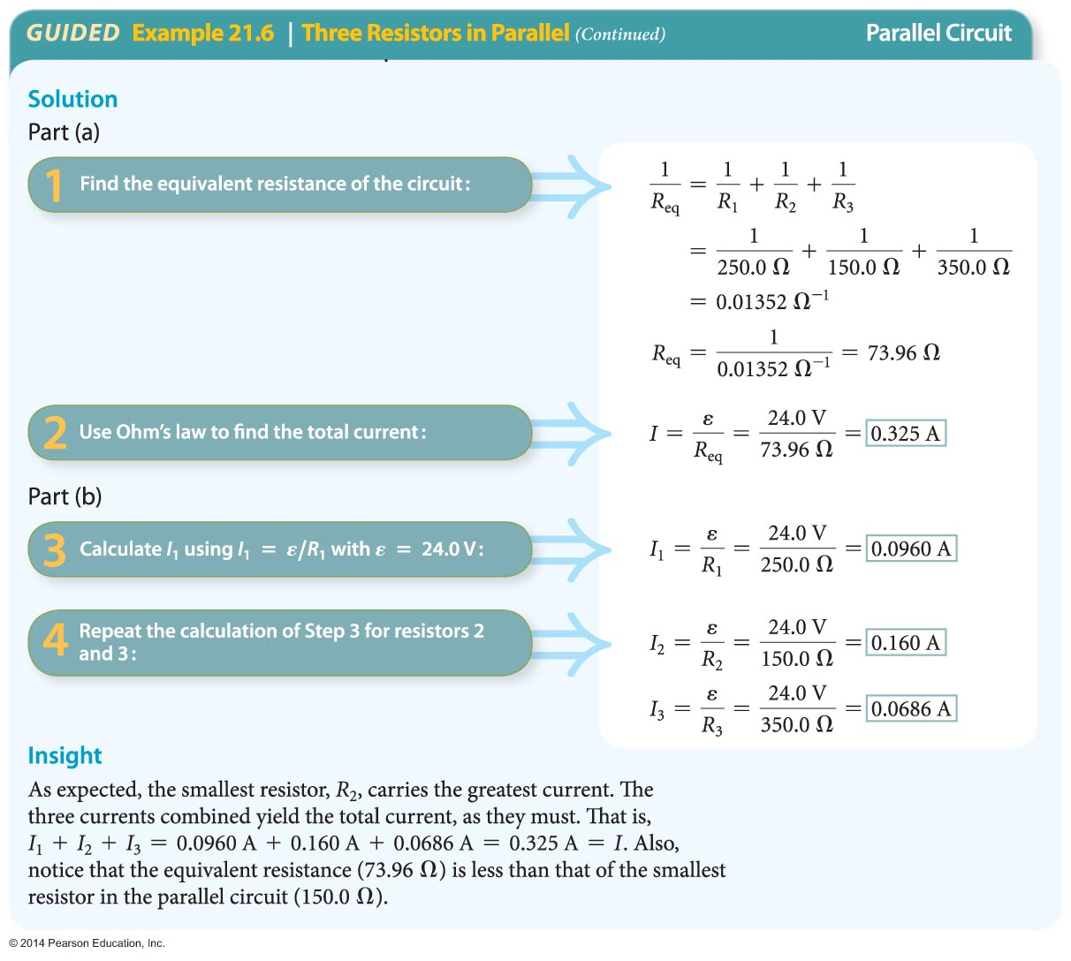
Electric Circuits

Slide 59
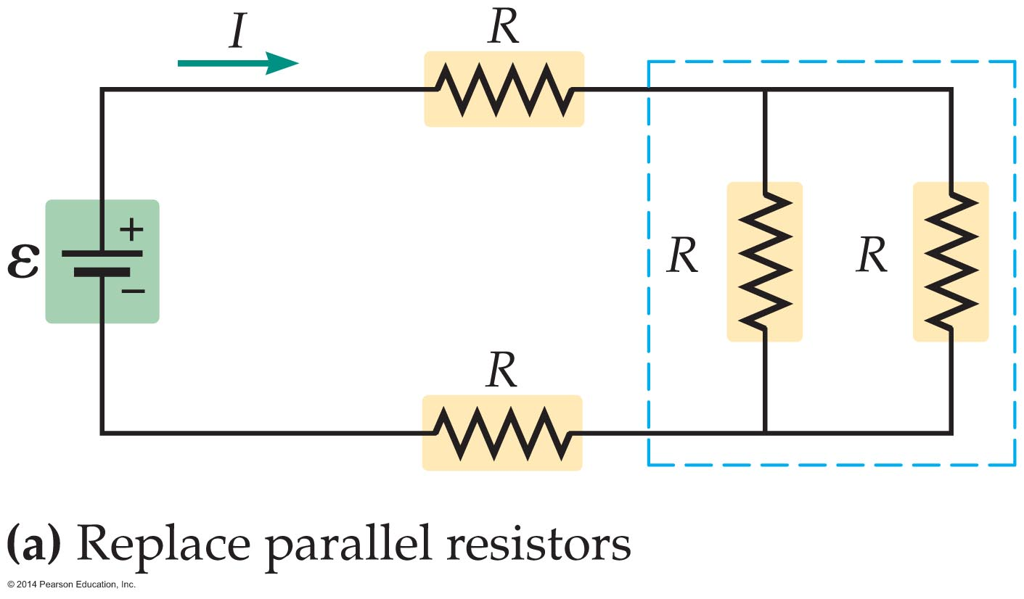
Electric Circuits
The rules that apply for series and parallel resistors can be applied to a variety of interesting circuits that aren't purely series or parallel.
The circuit in the figure below contains a total of four resistors, each with resistance R, connected in a way that combines series and parallel features. Because the circuit is not strictly series or parallel, we can't directly calculate the equivalent resistance.

Slide 60
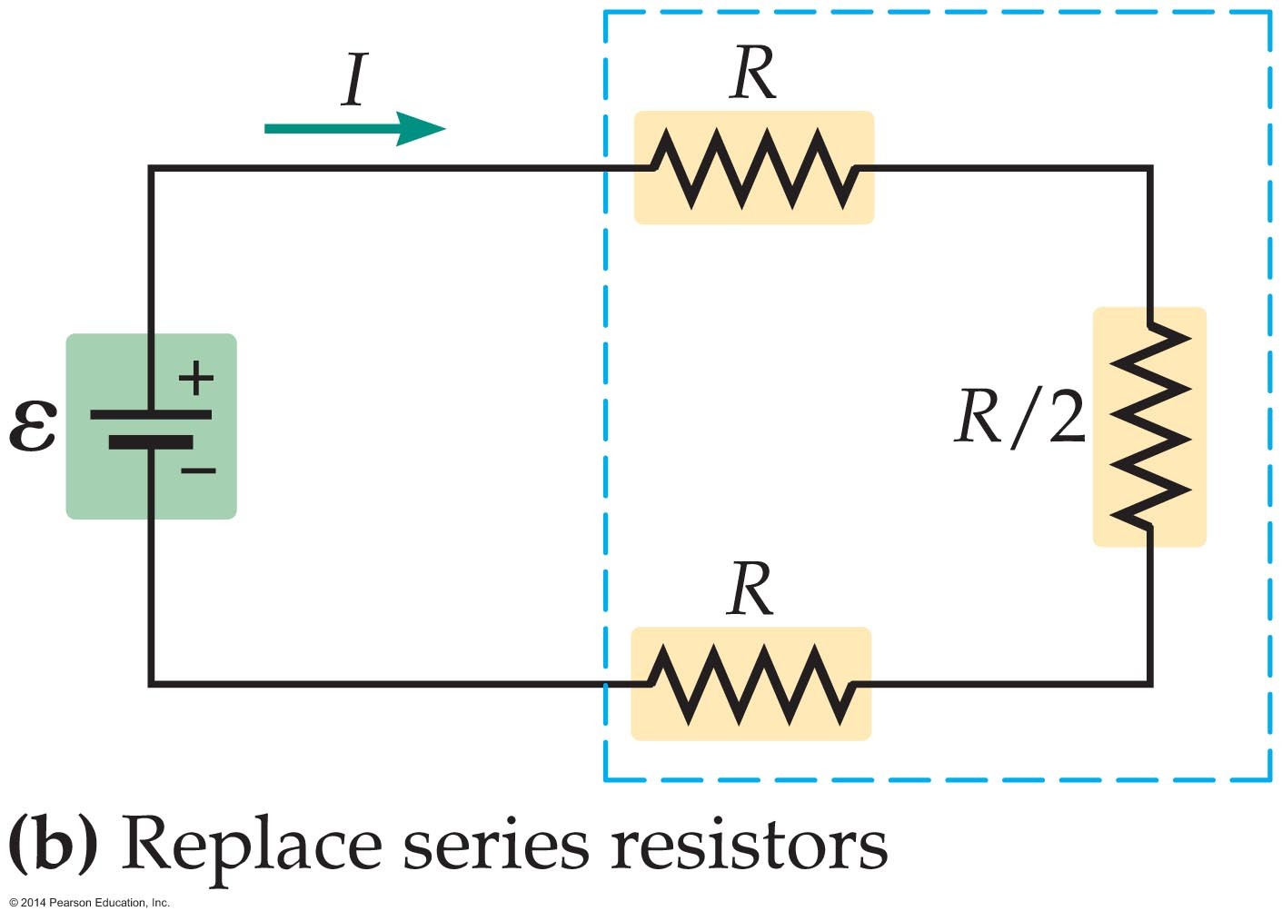
Electric Circuits
What we can do, however, is break the circuit into smaller subcircuits, each of which is purely series or purely parallel. For example, we first note that the two vertically oriented resistors on the right are in parallel with one another; hence they can be replaced with their equivalent resistance R/2.
The next step is to replace these two resistors with R/2. This yields the circuit shown below.

Slide 61
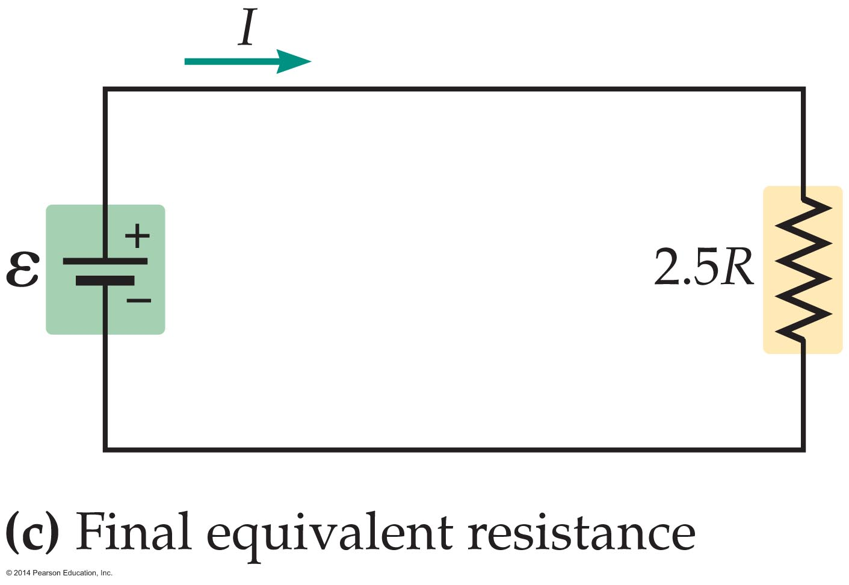
Electric Circuits
Notice that this equivalent circuit consists of three resistors in series, R, ½R, and R. The equivalent resistance of these resistors is equal to their sum, R_{eq} = R₁ + R₂ + R₃ = 2.5R.
Therefore, the equivalent resistance of the original circuit is 2.5R, as indicated in the figure below.

Slide 62
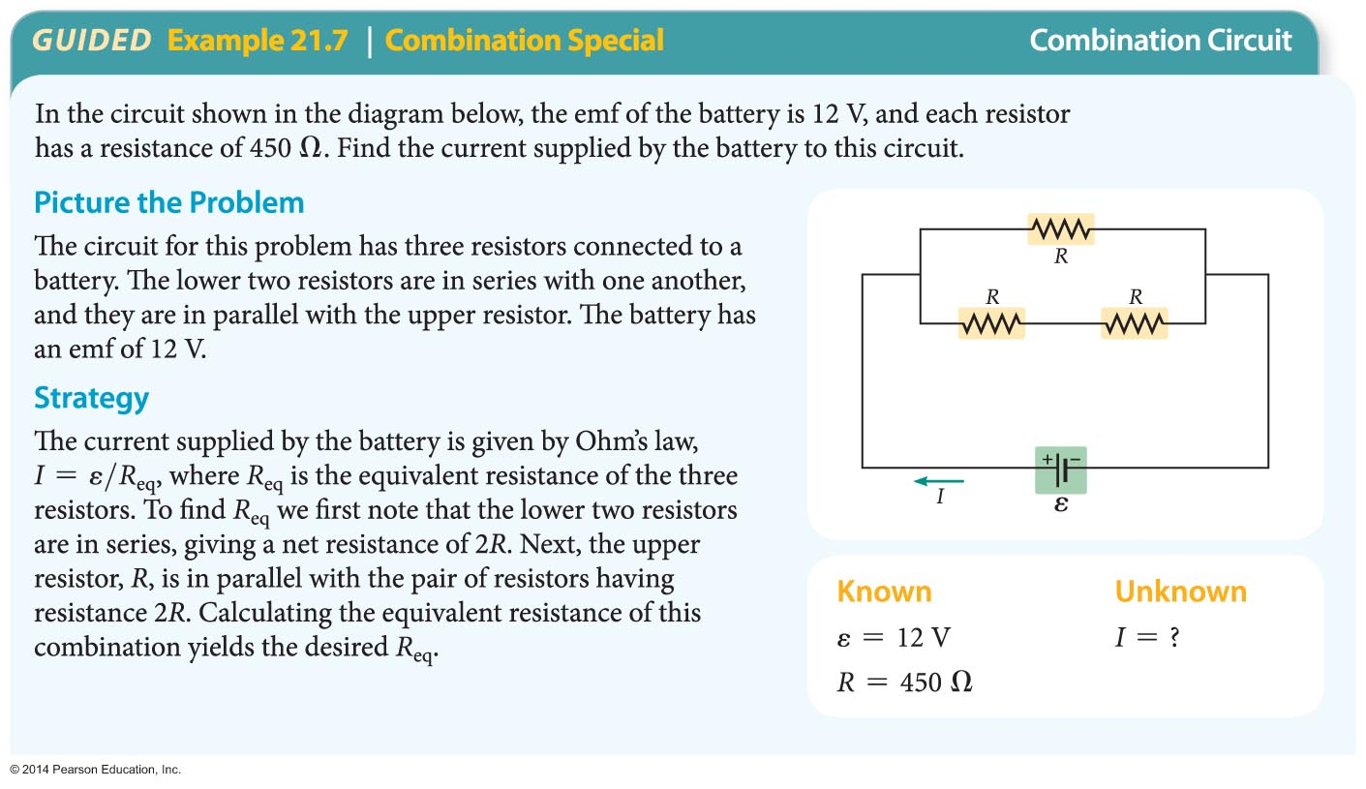
Electric Circuits
By considering the resistors in pairs or groups that are connected in parallel or in series, you can reduce the entire circuit to one equivalent circuit. This method is applied in the following example.

Slide 63
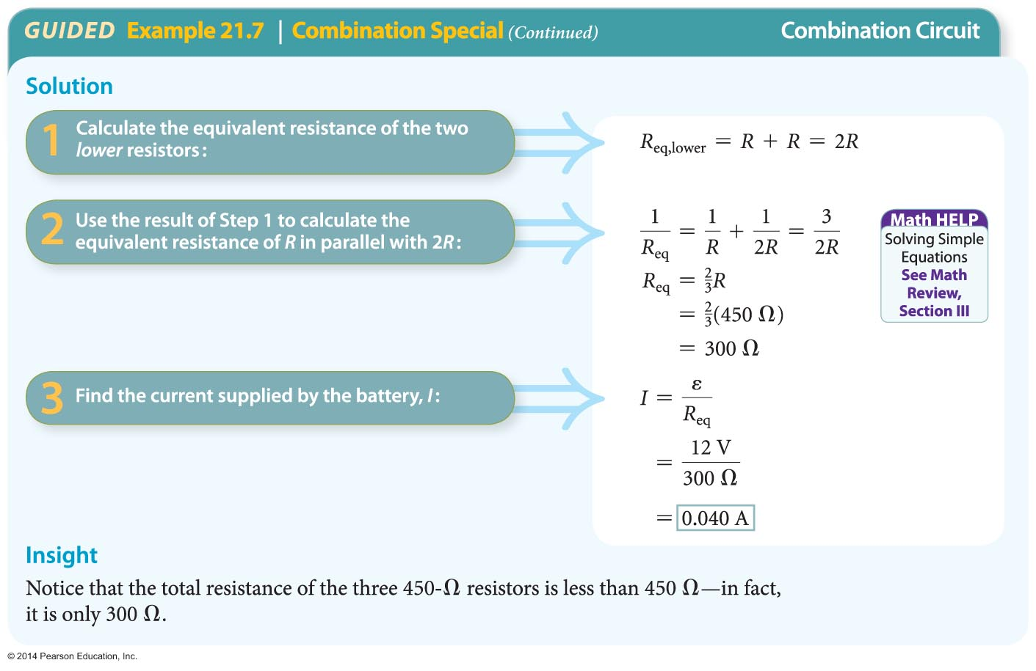
Electric Circuits

Slide 64
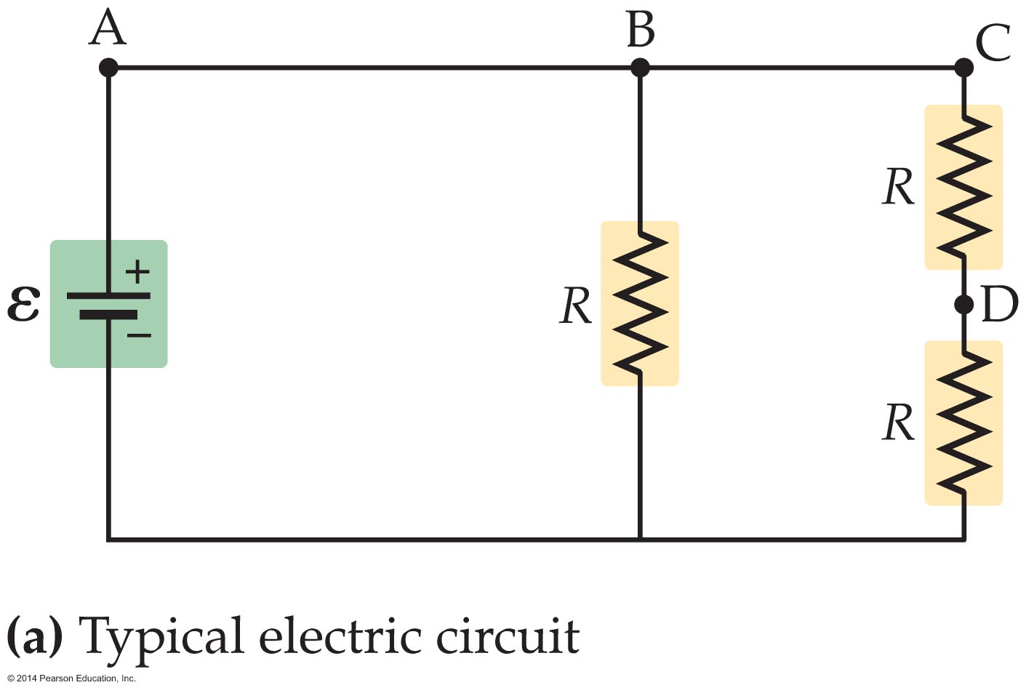
Electric Circuits
The current flowing through a circuit, or the potential difference between two points in a circuit, can be measured directly with a meter.
The device used to measure current is an ammeter. An ammeter is designed to measure the flow of current through a particular portion of a circuit.
For example, you might want to know the current flowing between points A and B in the circuit shown in the figure below.

Slide 65
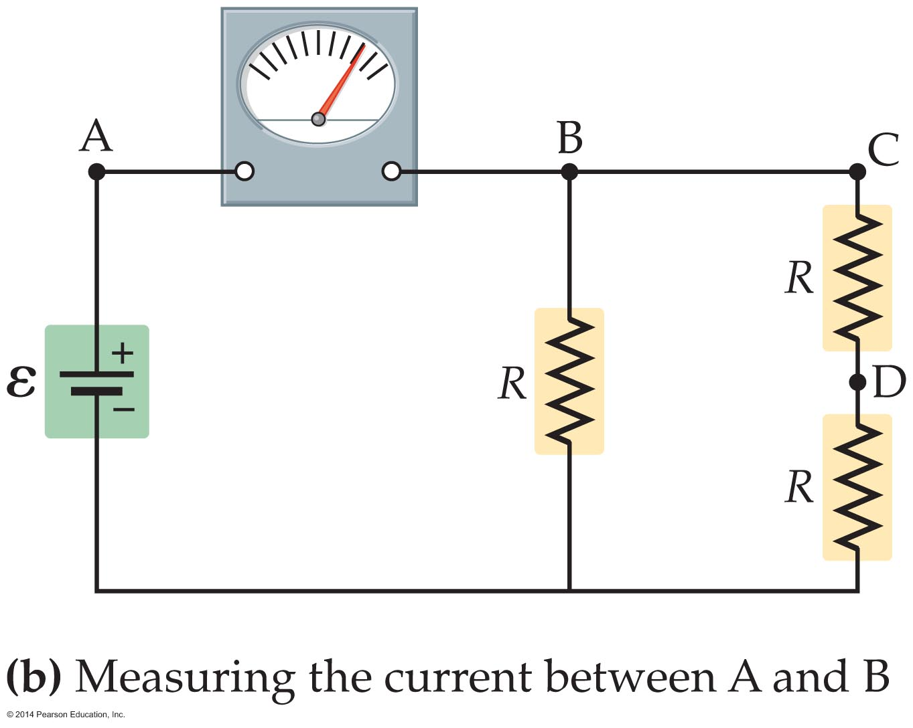
Electric Circuits
To measure this current, the ammeter must be added to the circuit in such a way that all the current flowing from A to B also flows through the meter. This is done by connecting the meter in series with the other circuit elements between A and B, as is shown in the figure below.

Slide 66
Electric Circuits
If the ammeter has a finite resistance—which is the case for any real meter—then its presence in a circuit alters the current it is intended to measure. Thus, an ideal ammeter would have zero resistance. Real ammeters, however, give accurate readings as long as their resistance is much less than the other resistances in the circuit.

Slide 67
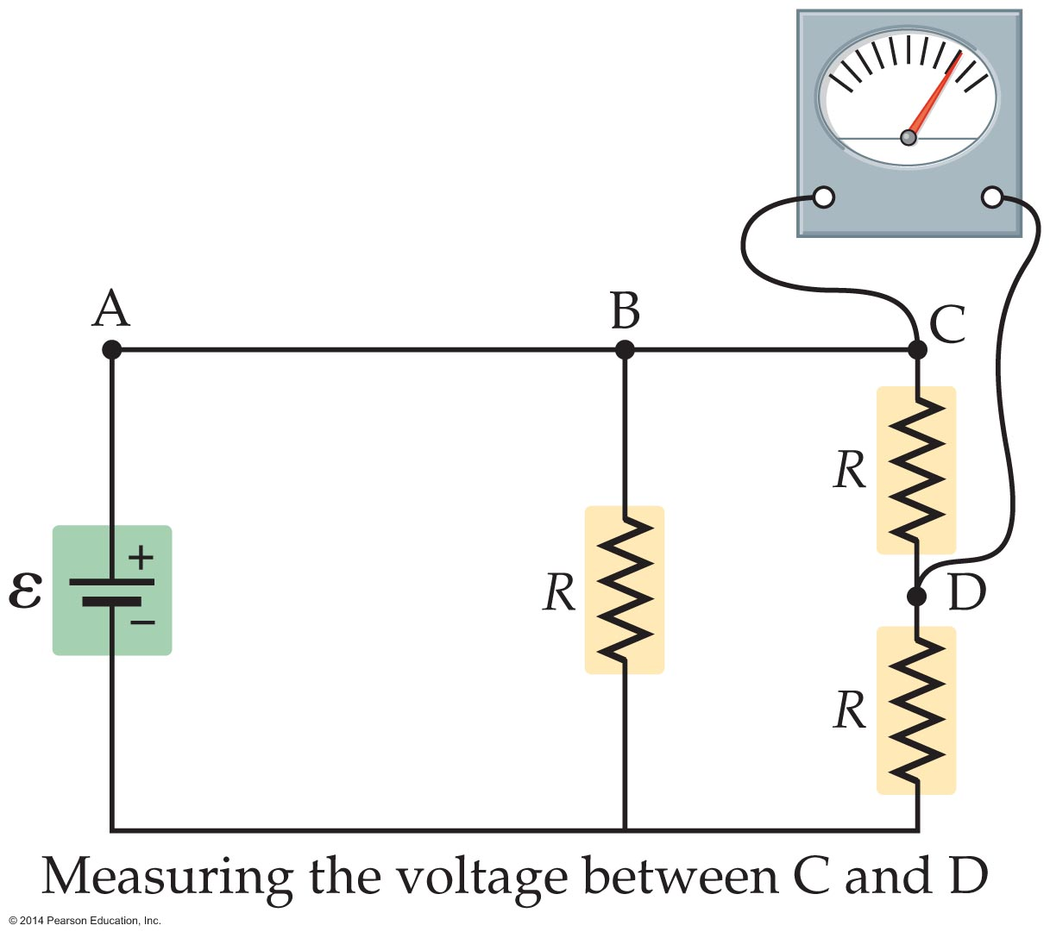
Electric Circuits
A voltmeter is a device used to measure the potential difference between any two points in a circuit. To measure the voltage between two points, for example, points C and D in the figure below, the voltmeter is placed in parallel at the appropriate points.

Slide 68
Electric Circuits
Because a small current must flow through the voltmeter in order for it to work, the meter reduces the current flowing through the circuit. As a result, the measured voltage is altered from its ideal value. Thus, an ideal voltmeter would have infinite resistance.
Real voltmeters give accurate readings as long as their resistance is much greater than other resistances in the circuit.

Slide 69
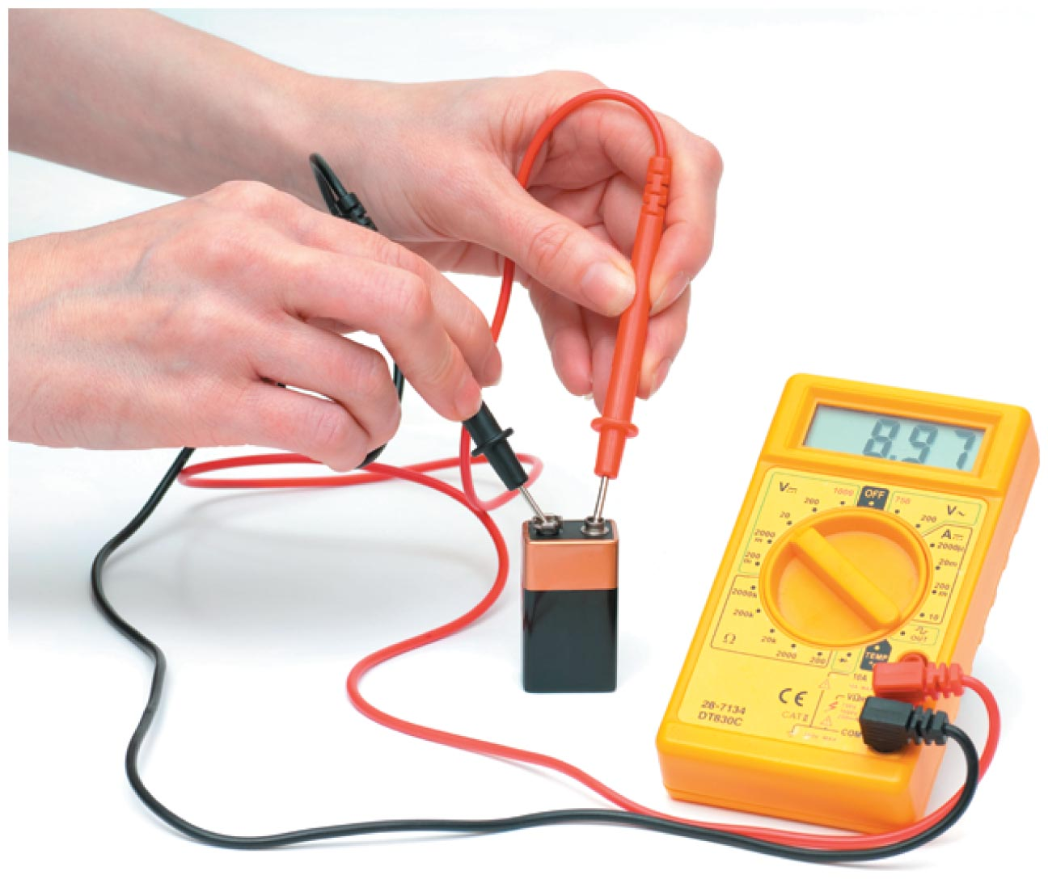
Electric Circuits
Sometimes the functions of an ammeter, a voltmeter, and an ohmmeter (a meter to measure resistance) are combined in a single device called a multimeter. An example of a multimeter is shown in the figure below.
Adjusting the settings on a multimeter's dial allows a variety of circuit properties to be measured.

Slide 70
Power and Energy in Electric Circuits
The power delivered by an electric circuit increases with both the current and the voltage. Increase either, and the power increases.
When a ball falls in a gravitational field, there is a change in gravitational potential energy. Similarly, when an amount of charge, ΔQ, moves across a potential difference, V, there is a change in electrical potential energy, ΔPE, given by
ΔPE = (ΔQ)V

Slide 71
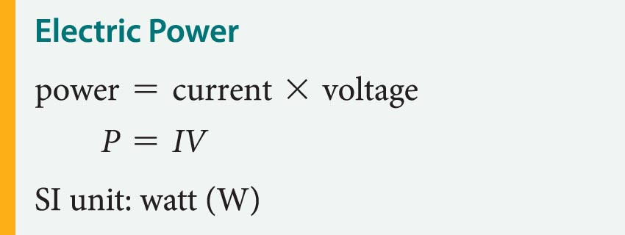
Power and Energy in Electric Circuits
Recalling that power is the rate at which energy changes, P = ΔE/Δt, we can express the electric power as follows:
P = ΔE/Δt = (ΔQ)V/Δt
Knowing that the electric current is given by
I = (ΔQ)/Δt allows us to write an expression for the electric power in terms of the current and voltage.

Slide 72
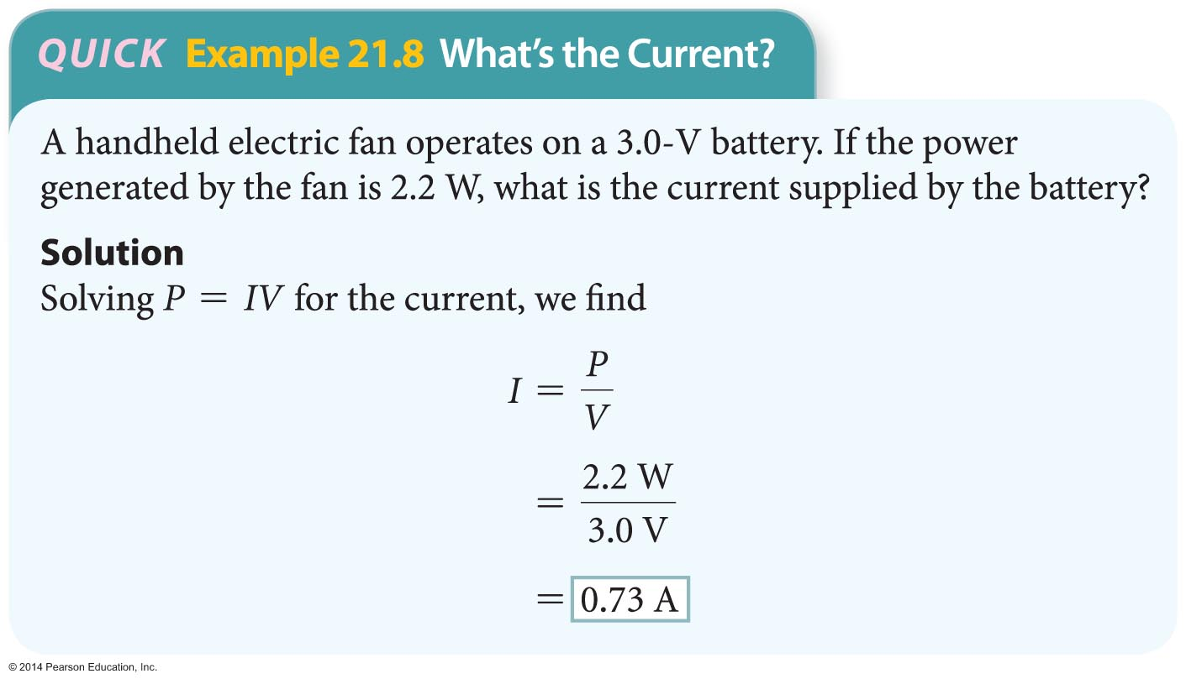
Power and Energy in Electric Circuits
Thus, the electric power used by a device is equal to the current times the voltage. For example, a current of 1 amp flowing across a potential difference of 1 V produces a power of 1 W.
The following example provides another example of how the electric power is calculated.

Slide 73
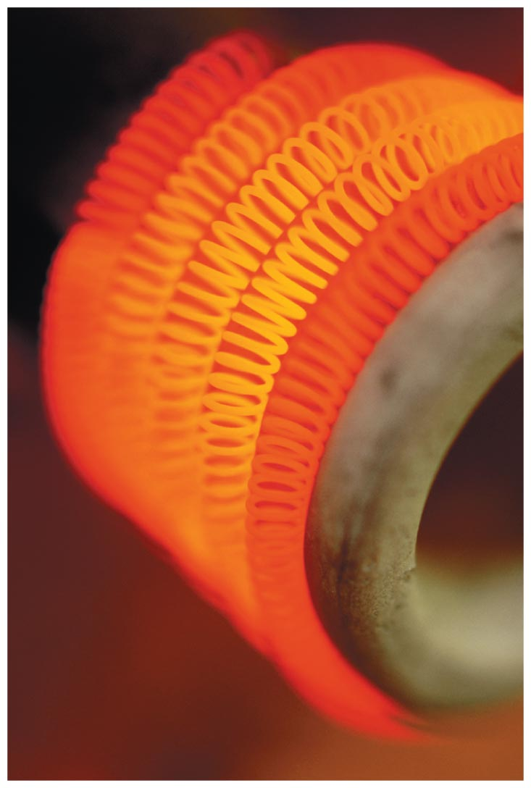
Power and Energy in Electric Circuits
The equation P = IV applies to any electrical system. In the special case of a resistor, the electric power is dissipated in the form of heat and light, as shown in the figure, where the electric power dissipated in an electric space heater.

Slide 74
Power and Energy in Electric Circuits
Applying Ohm's law, V = IR, which deals with resistors, we can express the power dissipated in a resistor as follows:
P = IV = I(IR) = I²R
Similarly, solving Ohm's law for the current, I = V/R, and substituting that result gives an alternative expression for the power dissipated in a resistor:
P = IV = (V/R)V = V²/R
All three equations for power are valid. The first, P = IV, applies to all electrical systems. The other two
(P = I²R and P = V²/R) are specific to resistors, which is why the resistance, R, appears in those equations.

Slide 75
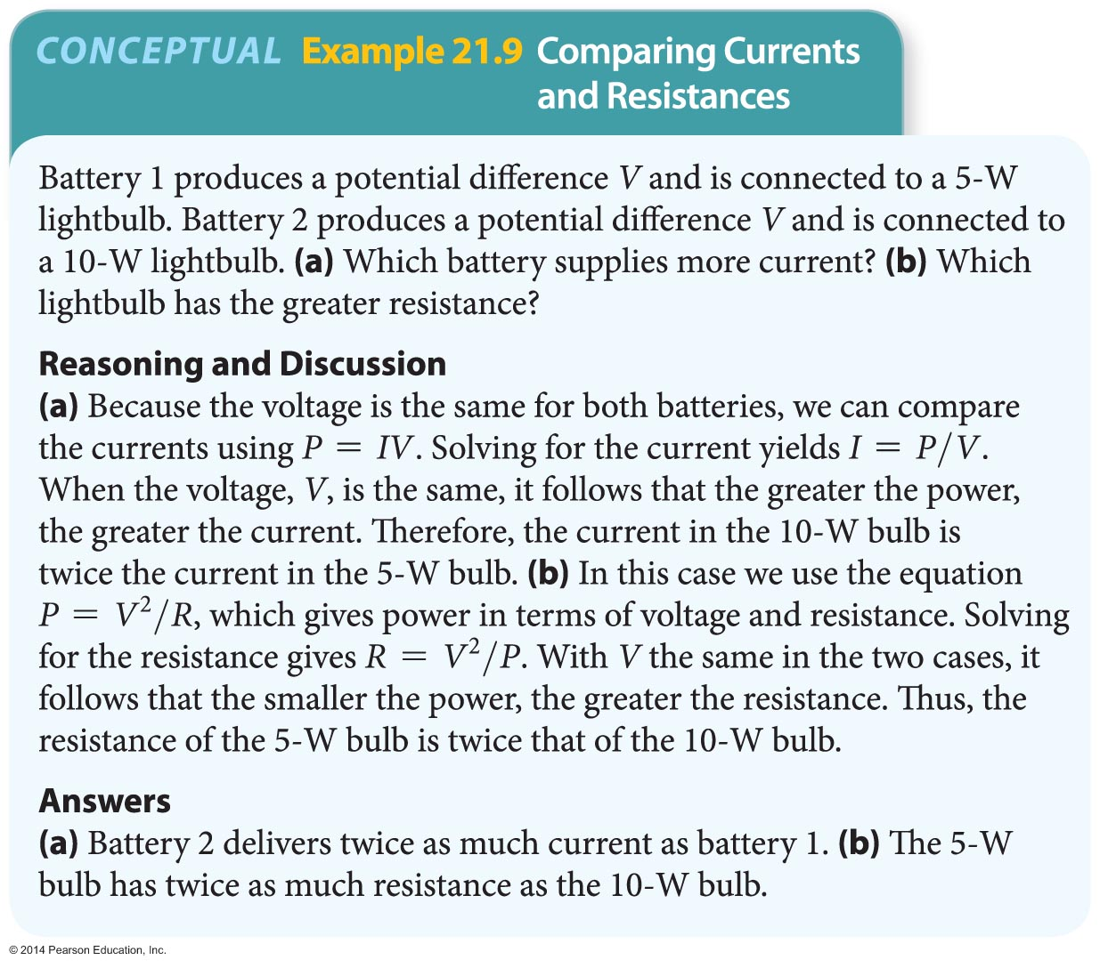
Power and Energy in Electric Circuits
The following example shows how currents and resistances are related.

Slide 76
Power and Energy in Electric Circuits
The power dissipated by a resistor is the result of collisions between electrons moving through the circuit and the atoms making up the resistor.
The potential difference produced by the battery causes conduction electrons to accelerate until they bounce off an atom, causing the atoms to jiggle more rapidly.
The increased kinetic energy of the atoms is reflected as an increased temperature of the resistor. After each collision, the potential difference accelerates the electrons again, and the process repeats. The result is the continuous transfer of energy from the conducting electrons to the atoms.

Slide 77
Power and Energy in Electric Circuits
The filament of an incandescent lightbulb is basically a resistor inside a sealed, evacuated tube. The filament gets so hot that it glows, just like the heating coil on a stove or the coils in a space heater.
The power dissipated in the filament determines the brightness of the lightbulb. The higher the power, the brighter the bulb. This basic concept is applied in the example on the next slide.

Slide 78
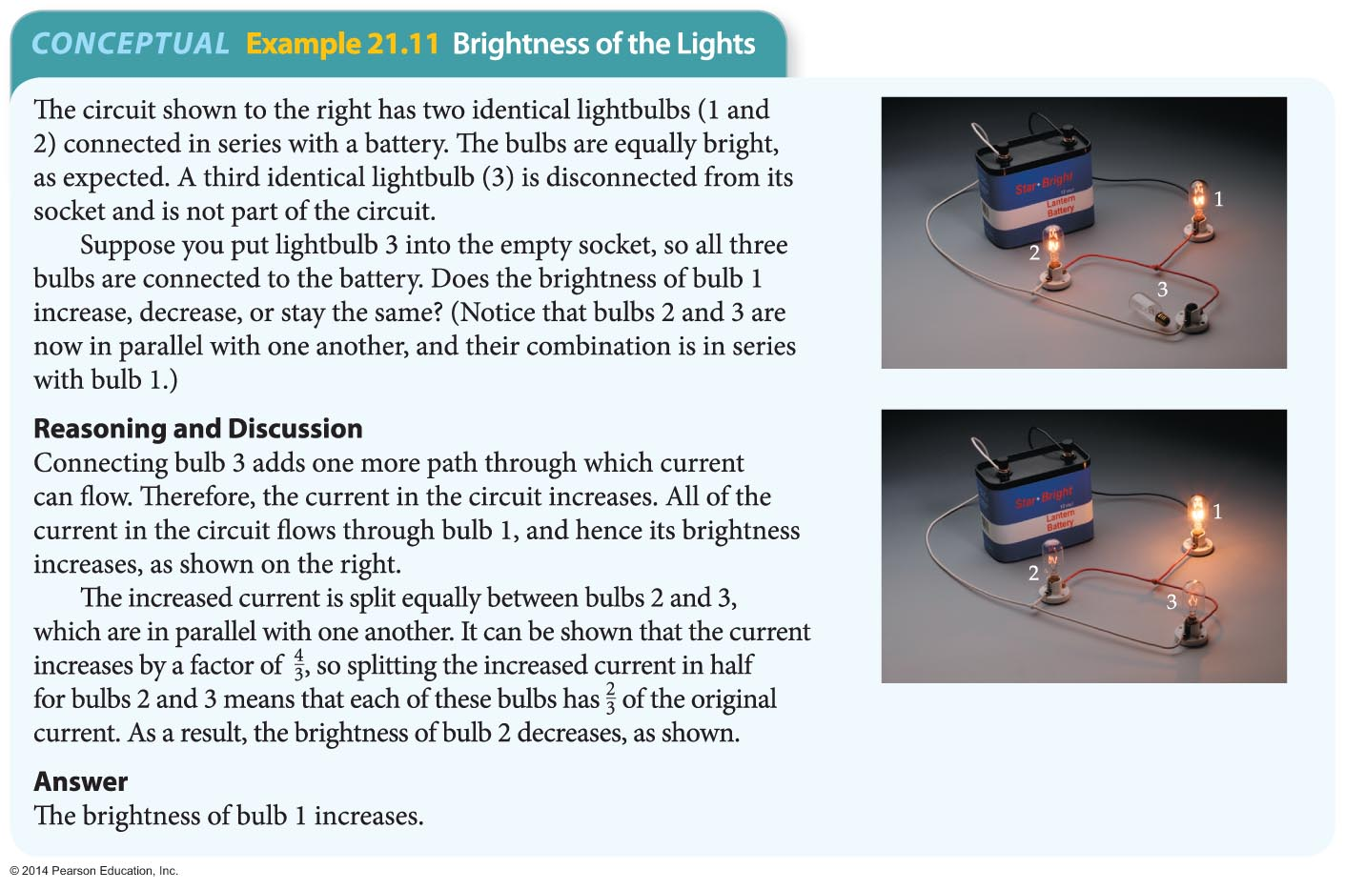
Power and Energy in Electric Circuits

Slide 79
Power and Energy in Electric Circuits
The local electric company bills consumers for the electricity they use each month. To do this, they use a convenient unit for measuring electric energy called the kilowatt-hour.
Recall that a kilowatt is 1000 W, or equivalently, 1000 J/s. Similarly, an hour is 3600 s. Combining these results, we see that a kilowatt-hour is equal to 3.6 million joules of energy:
1 kWh = (1000 J/s)(3600 s) = 3.6 x 10⁶ J

Slide 80
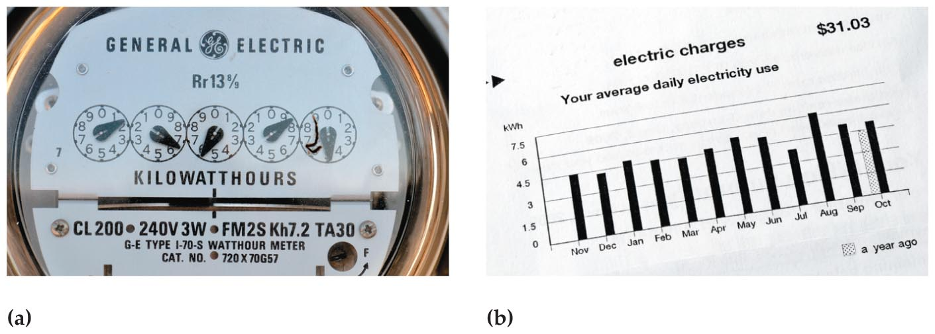
Power and Energy in Electric Circuits
The figure below shows the type of meter used to measure the electrical energy consumption of a household, as well as the typical bill.

Slide 81
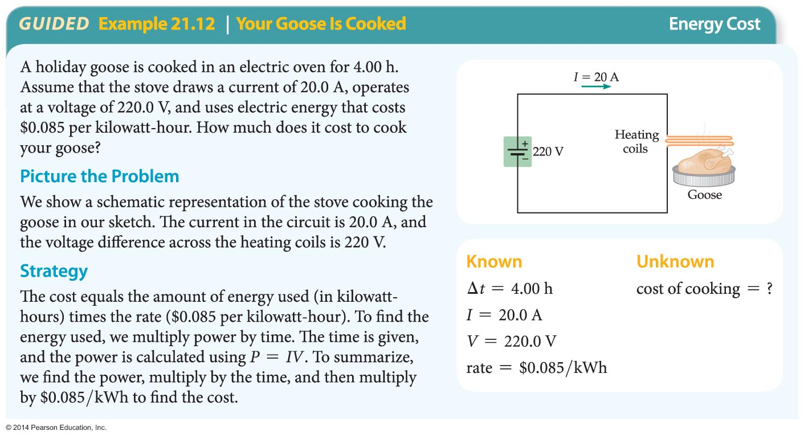
Power and Energy in Electric Circuits
The following example illustrates how the cost of electrical energy is calculated.

Slide 82

Power and Energy in Electric Circuits

