Slide 1
Interference and
Diffraction
Prepared by
Chris Chiaverina

Slide 2
Chapter Contents
Interference
Interference in Thin Films
Diffraction
Diffraction Gratings

Slide 3
Interference
Waves can interfere with one another. Interfering waves can add to produce a larger amplitude, subtract to produce a smaller amplitude, or even cancel one another.
Interference is caused by the superposition of waves.
The principle of superposition states that the displacement of two or more waves is the sum of the displacement of the individual waves.

Slide 4
Interference
When waves combine to cause a larger displacement, they interfere constructively; when they combine to cause a smaller displacement, they interfere destructively.
Interference between light waves results in an increase in brightness for constructive interference and a decrease in brightness for destructive interference.

Slide 5
Interference
Light interference is most noticeable when the light sources are coherent and monochromatic.
Monochromatic light is light of a single color, or frequency.
Coherent light sources maintain a constant phase relative to one another.
Because a laser emits light that is both monochromatic and coherent, it is perfect for showing interference.

Slide 6
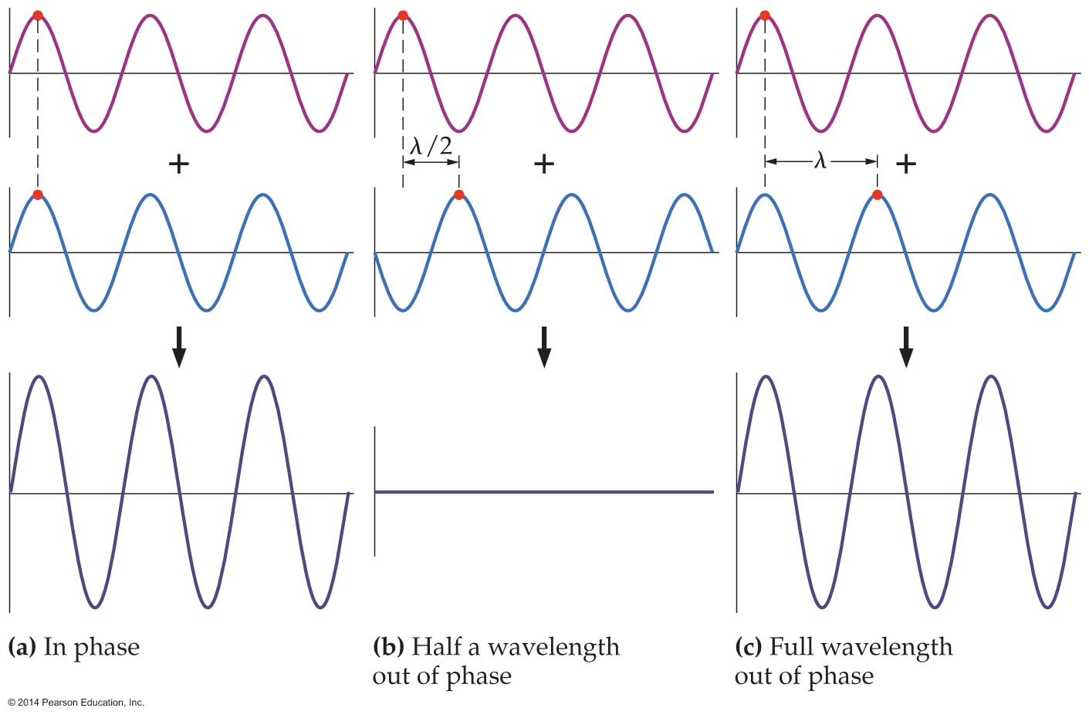
Interference
The phase difference between incoherent light sources varies randomly with time. Incoherent light sources—which include incandescent lightbulbs, fluorescent lights, and the Sun—do not form noticeable interference patterns.
Wave interference depends on the phase difference, as the figure below indicates.

Slide 7
Interference
In figure (a), the waves are in phase and add to give a larger displacement. This is constructive interference.
In figure (b), the waves are half a wavelength out of phase and interfere destructively. If the waves have equal amplitudes, as they do here, their sum will have zero displacement.
In figure (c), the waves are one wavelength out of phase, and the result is again constructive interference, exactly the same as when the waves are in phase.

Slide 8
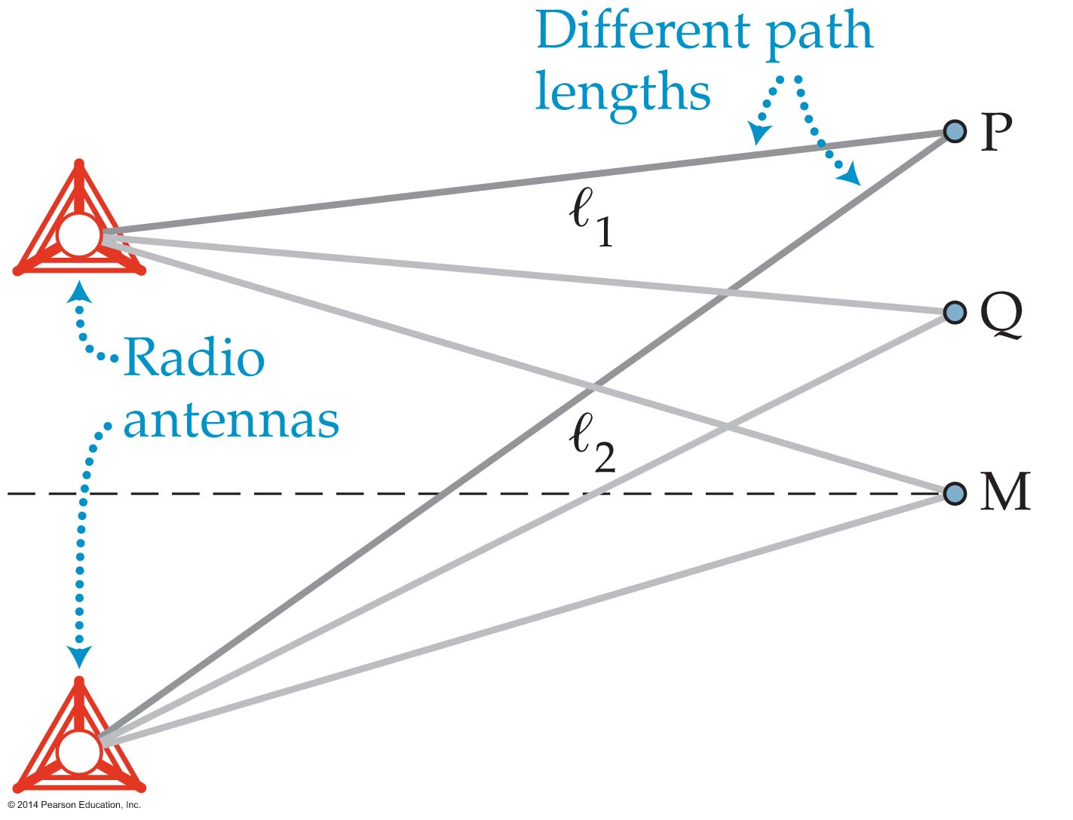
Interference
Consider two radio antennas that send out electromagnetic waves of frequency f and wavelength λ, as is illustrated in the figure below.

Slide 9
Interference
When the waves from the antennas reach point M in the figure, they have traveled the same distance—that is, they have traveled the same number of wavelengths. Therefore, the waves are still in phase at M. As a result, they interfere constructively at that point, and the radio signal is strong.

Slide 10
Interference
Next, consider point P in the figure. To reach P, the waves from the two antennas must travel different distances, ℓ₁ and ℓ₂. Let's assume that the difference between these distances is one wavelength:
ℓ₂ – ℓ₁ = λ
This means that the waves are 360°, that is, one full wavelength out of phase at point P. It follows that they experience constructive interference there.

Slide 11
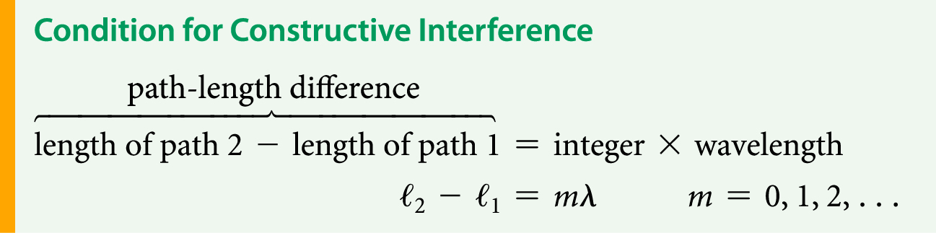
Interference
In general, if the difference in path length at a given point is an integer number of wavelengths (0λ, 1λ, 2λ, 3λ,…), then that point is a location of constructive interference. The condition for constructive interference may also be stated as follows:

Slide 12

Interference
On the other hand, consider the situation at point Q in the figure below.
The difference in path length to point Q is half a wavelength:
Therefore, the waves cancel there.

Slide 13
Interference
Destructive interference also occurs when the difference in path length is one and a half wavelengths, two and a half wavelengths, and so on.
In general, if the difference in path length at a given point is an integer plus one half wavelength …, then that point is a location of destructive interference.

Slide 14
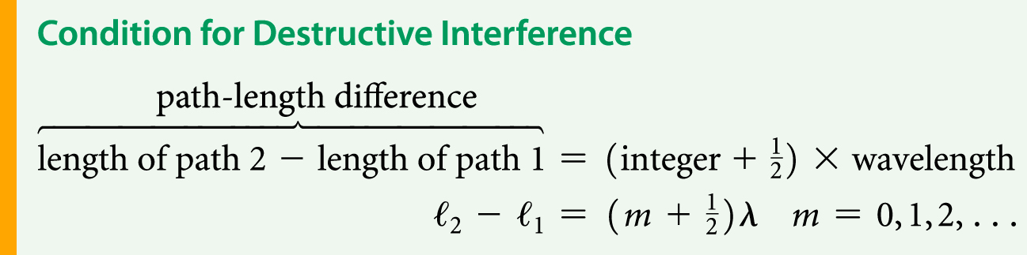
Interference
The condition for destructive interference may also be stated as follows:

Slide 15
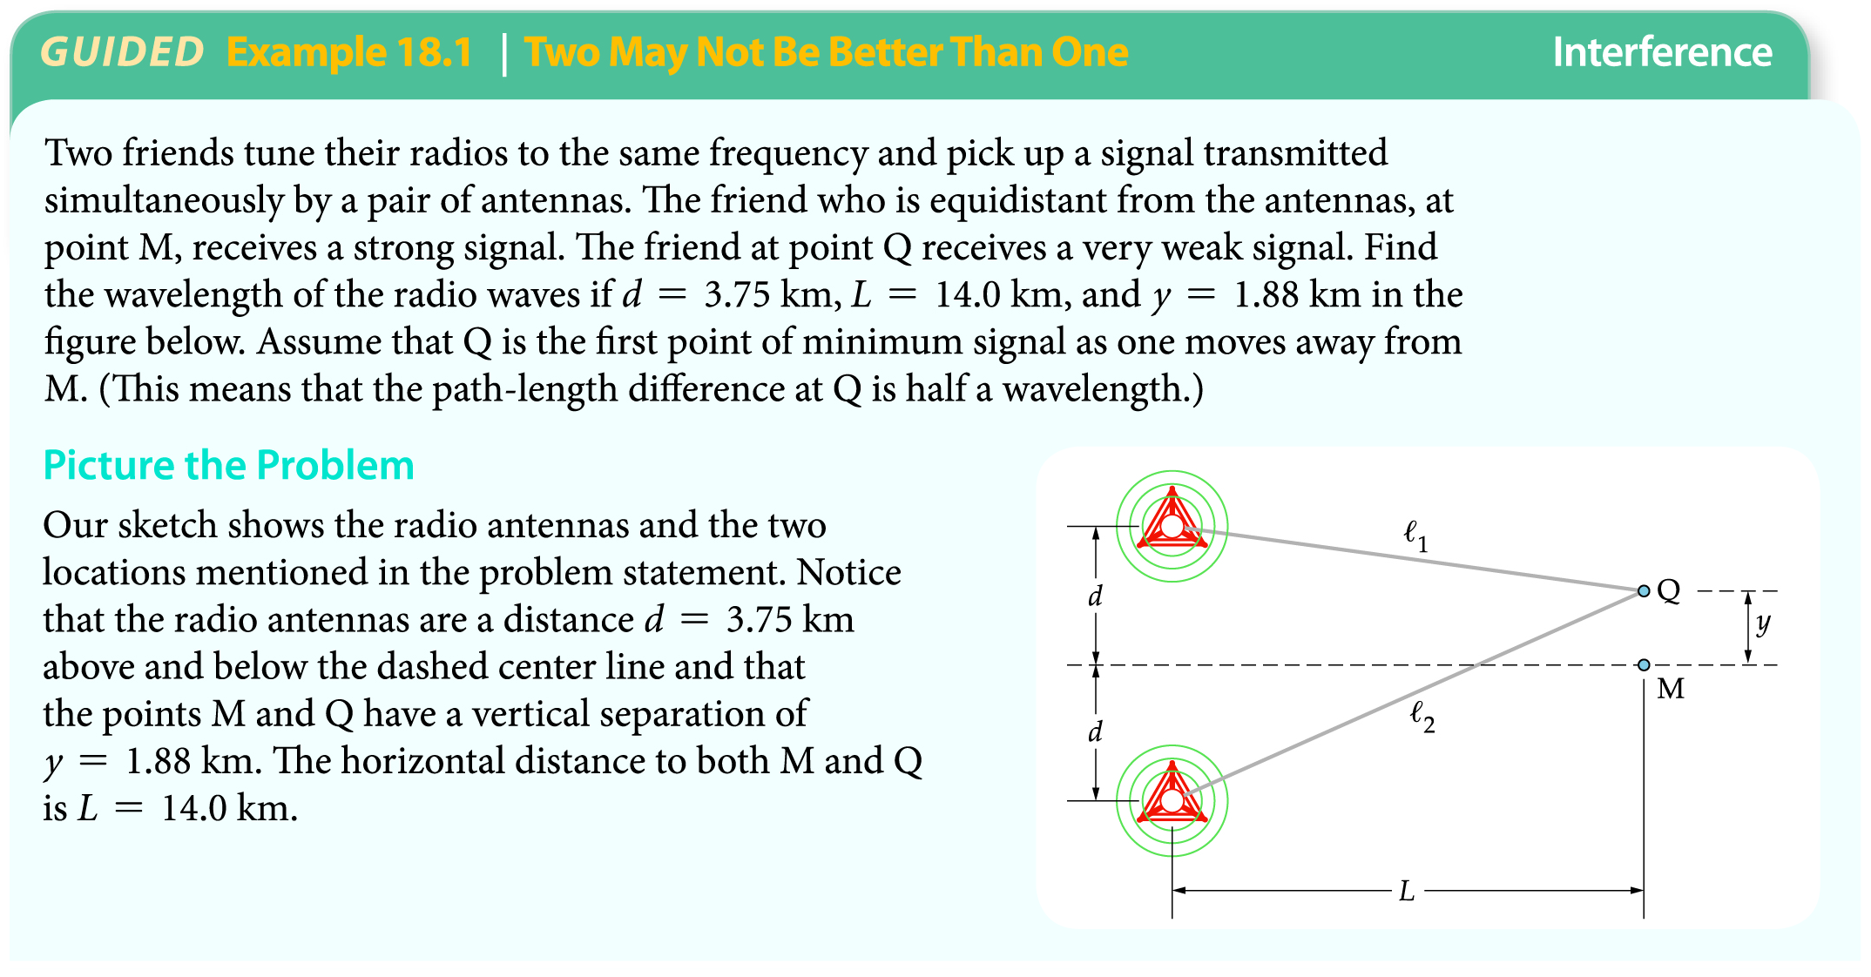
Interference
The following example illustrates how destructive interference may be used to find the wavelength of radio waves.

Slide 16
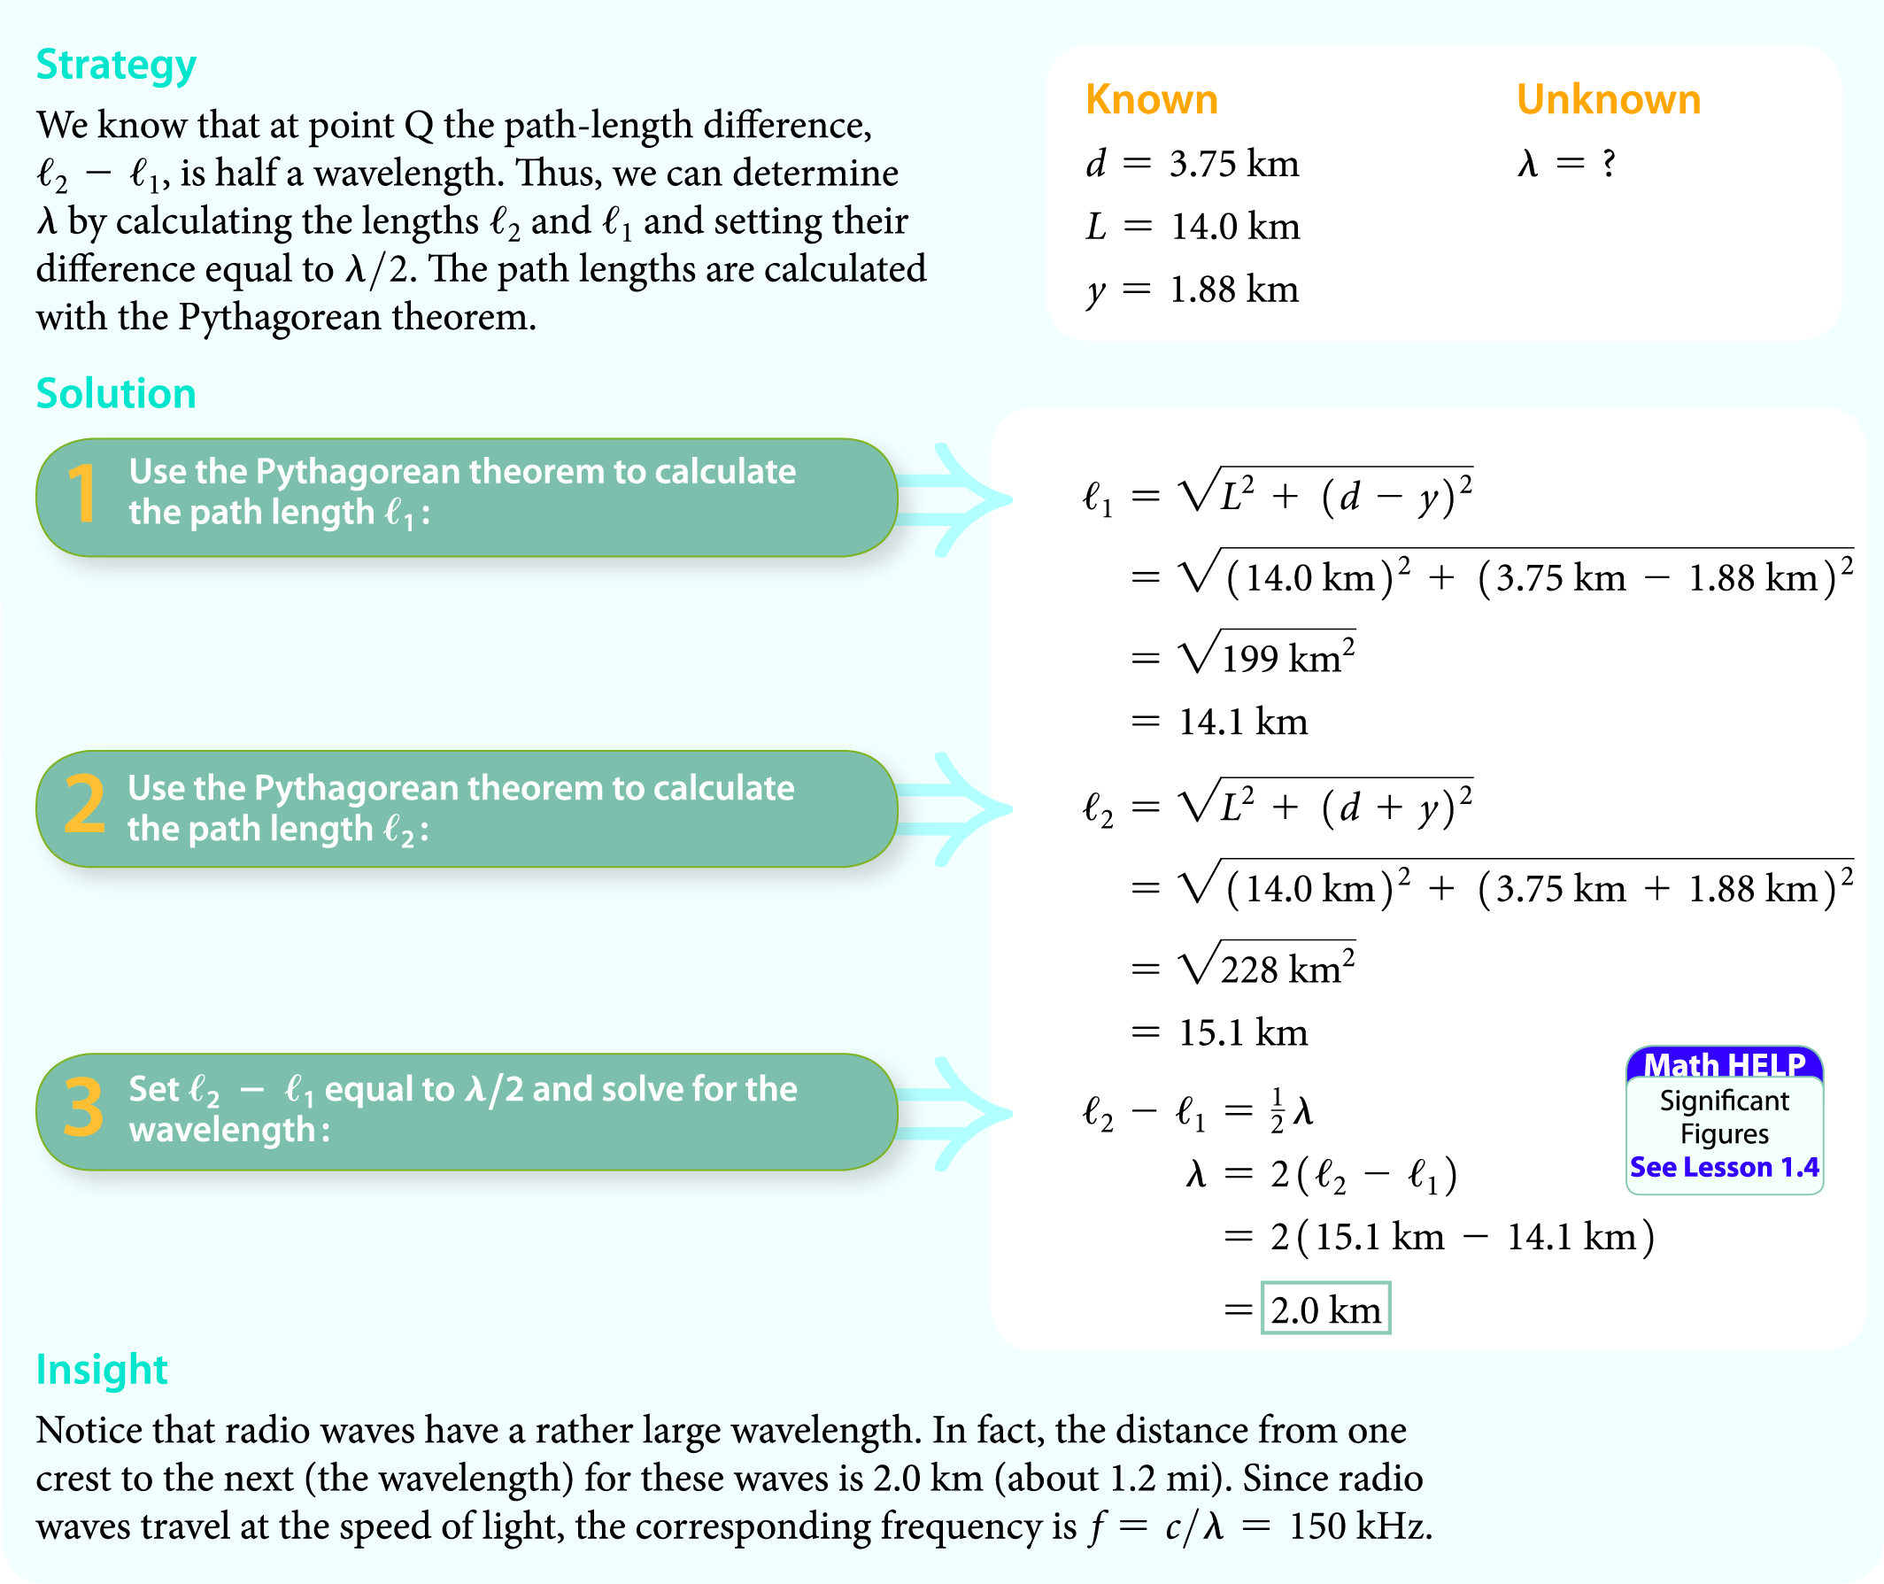
Interference

Slide 17
Interference
A classic physics experiment, known as the
two-slit experiment, clearly demonstrates the wave nature of light.
The experiment, first performed in 1801 by English physicist Thomas Young (1773−1829), consists of a beam of monochromatic (single-color) light that passes through a small slit in a screen and then illuminates two slits, S₁ and S₂, in a second screen.

Slide 18
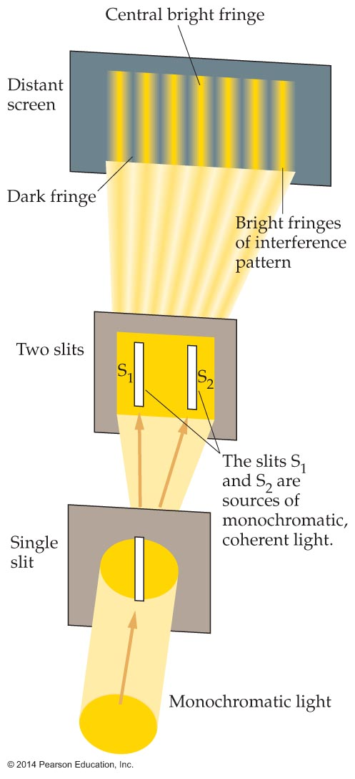
Interference
After the light passes through the two slits, it shines on a distant screen, as shown in the figure below. As the figure indicates, an interference pattern with bright and dark fringes (narrow bands) forms on the distant screen.

Slide 19
Interference
The key elements in the experiment are the two thin slits in the second screen. Since they are equidistant from the single slit, the two slits act as monochromatic, coherent sources of light, just like the two antennas in the Guided Example 18.1.
But why does light spread out as it passes through the slits?

Slide 20
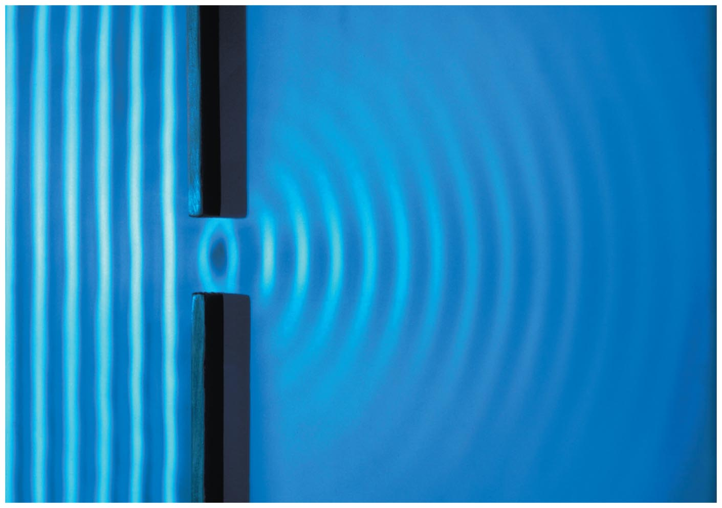
Interference
Perhaps you have noticed that water waves spread out when they pass through a small opening in an obstruction. The following figure shows such a situation.

Slide 21
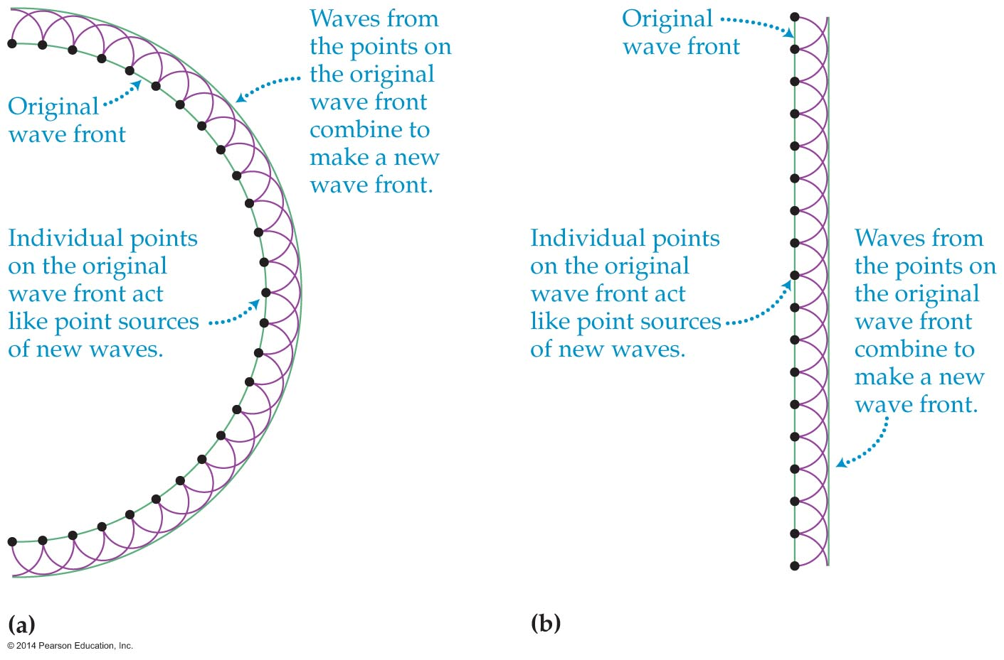
Interference
Huygens's principle explains this behavior.
Huygens's principle states that every point on a wave front acts like a point source for new waves. Examples of how the principle applies to circular and plane wave fronts are shown in the figure below.

Slide 22
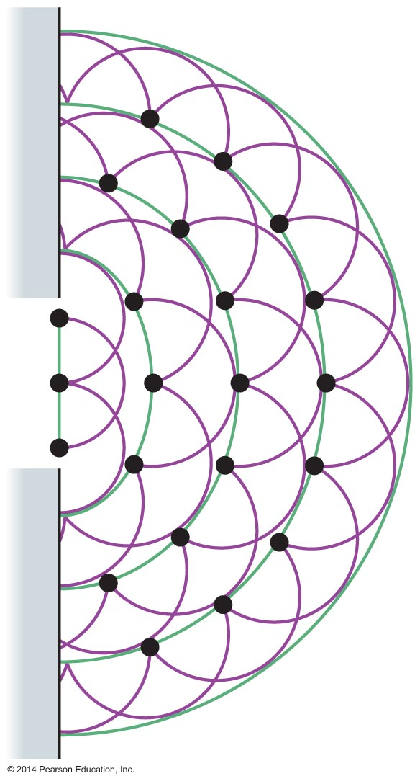
Interference
What happens when a wave passes through a small opening and most of the wave is cut off?
The section of wave that passes through the small opening acts almost like a point source of waves. This is why waves—whether they are water waves or light waves—spread out after they pass through a small opening.
This spreading is seen in the figure below.

Slide 23
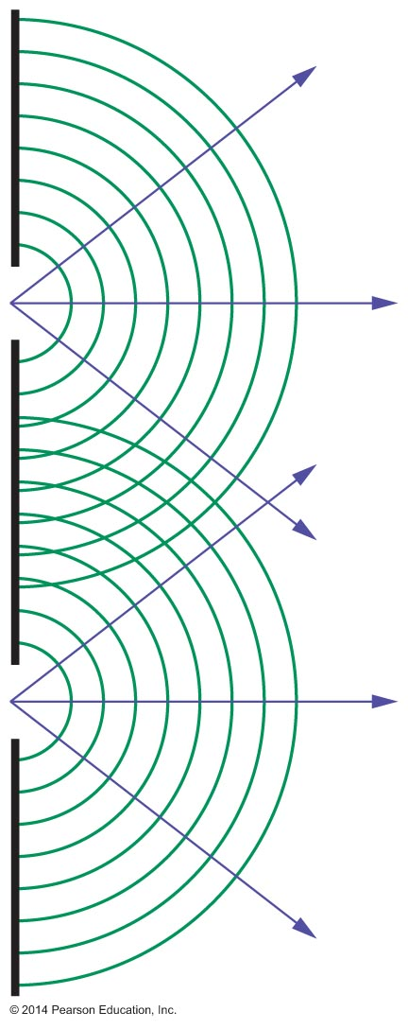
Interference
Huygens's principle is applied to the two slits in Young's experiment in the figure below. Notice that the light radiates away from the slits in all directions—not just in the direction of the incoming light. The result is that light is spread out over a large area on the distant screen.

Slide 24
Interference
As you have seen, the two-slit experiment produces a series of alternating bright and dark fringes. These fringes are the direct result of constructive and destructive interference.
A figure in a previous slide shows that the central bright fringe is midway between the two slits. This is a region where constructive interference occurs. The next bright fringe occurs when the difference in path length from the two slits is equal to one wavelength of light.

Slide 25
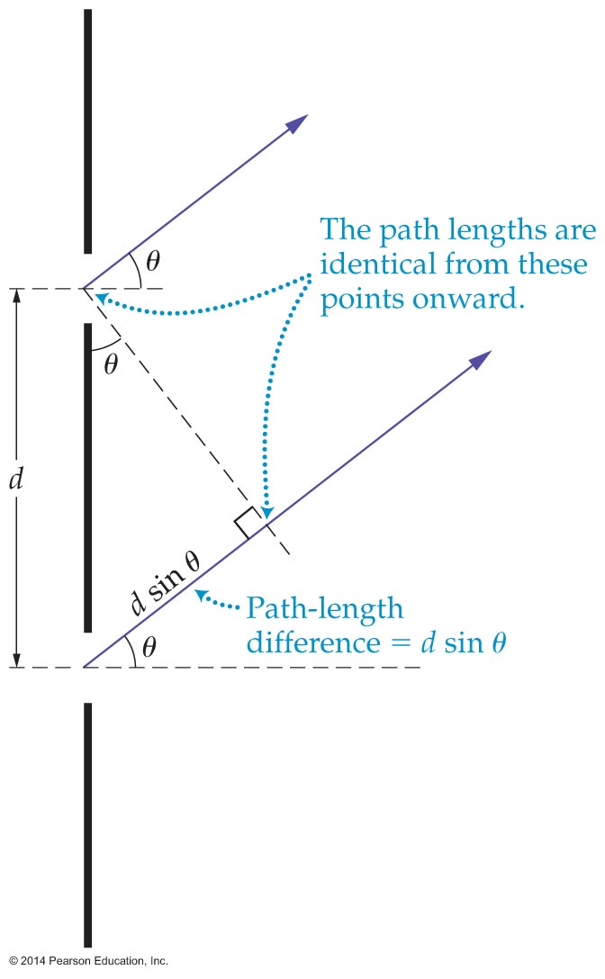
Interference
The figure below shows that the path-length difference for the two rays in a two-slit experiment is
d sin θ
where d is the slit separation.

Slide 26
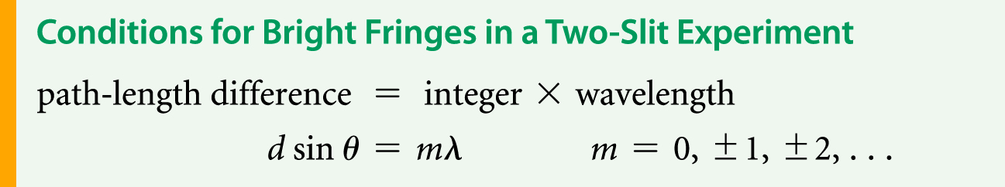
Interference
Thus, the bright fringe closest to the midpoint, with a path-length difference of one wavelength, occurs at the angle θ given by the condition
d sin θ = λ
In general, a bright fringe occurs whenever the path-length difference is equal to an integer number of wavelengths (0λ, 1λ, 2λ, 3λ,…). Therefore, bright fringes satisfy the following conditions:

Slide 27
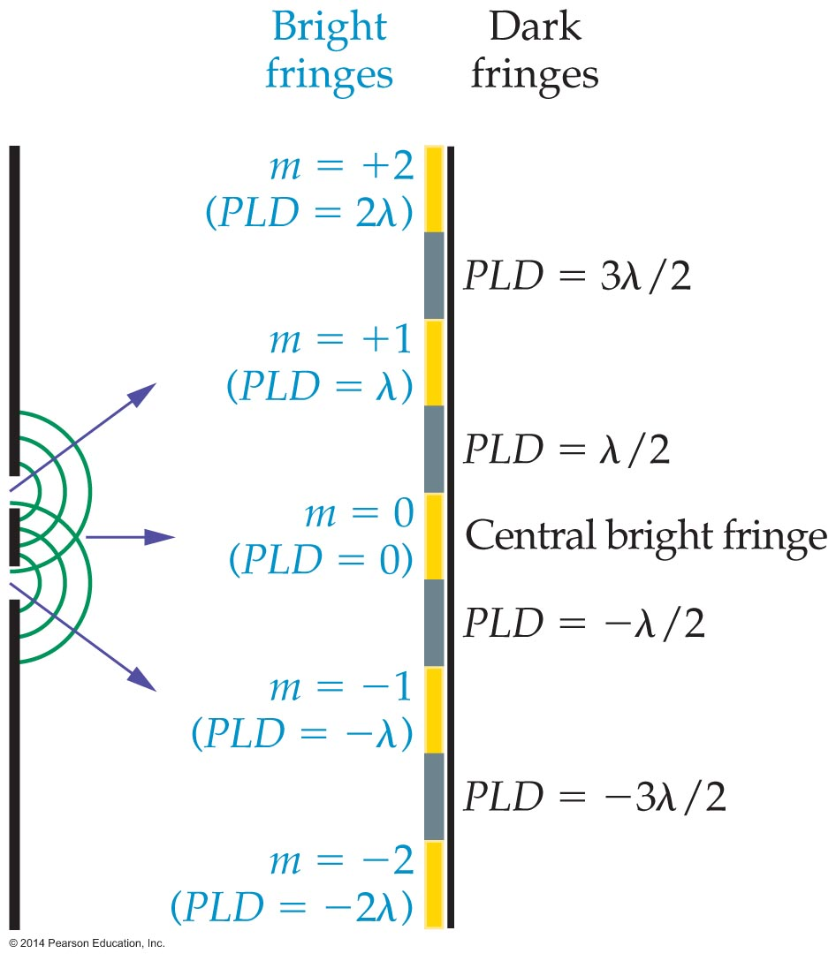
Interference
The figure below shows bright and dark fringes in the two-slit experiment. The path-length difference is indicated in parentheses for each fringe, and the values of m are given for the bright fringes.

Slide 28
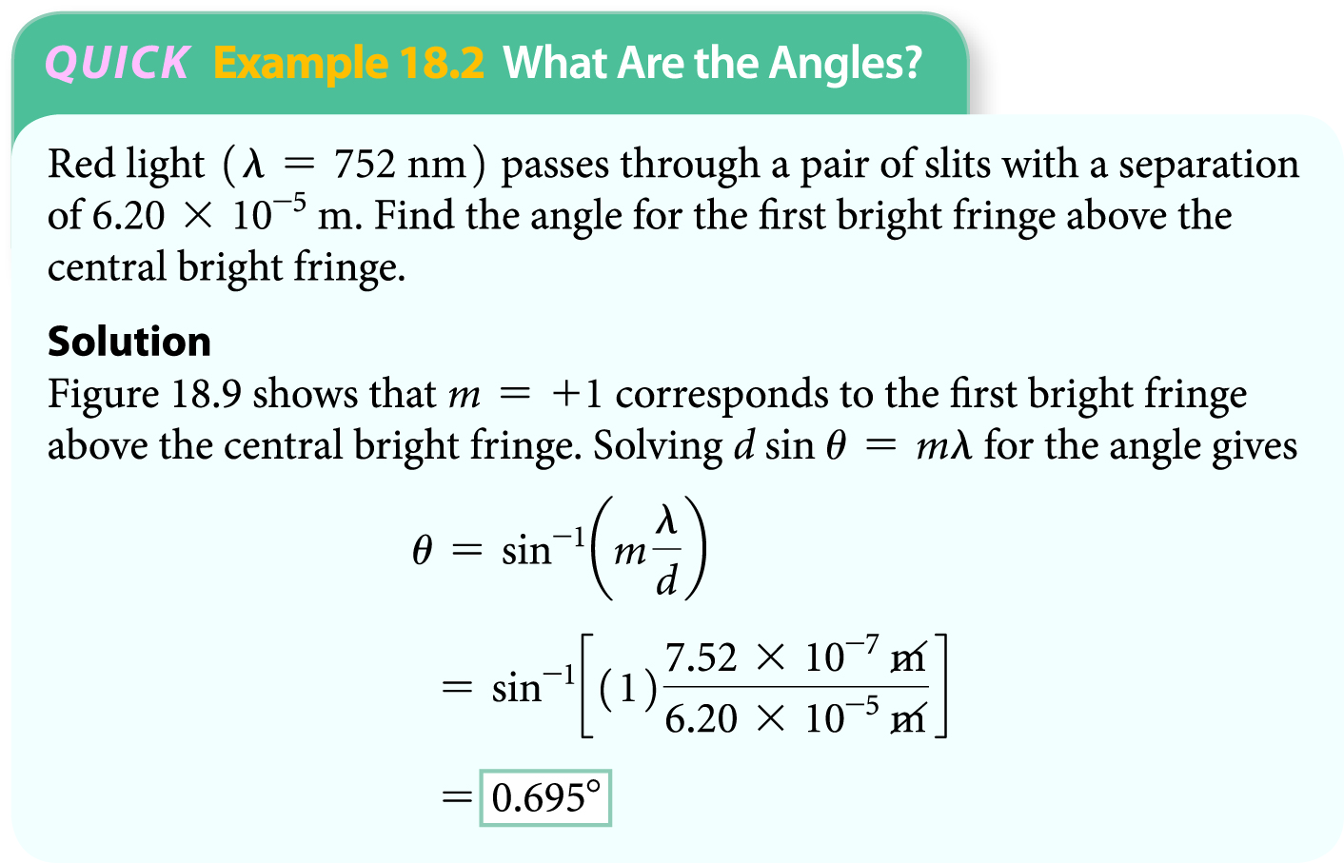
Interference
The preceding figure also indicates that halfway between any two bright fringes is a dark fringe, where destructive interference occurs. The dark fringes correspond to differences in path length of a half a wavelength, one and a half wavelengths, and so on.
The following example demonstrates how the angle for a particular bright or dark fringe may be found.

Slide 29
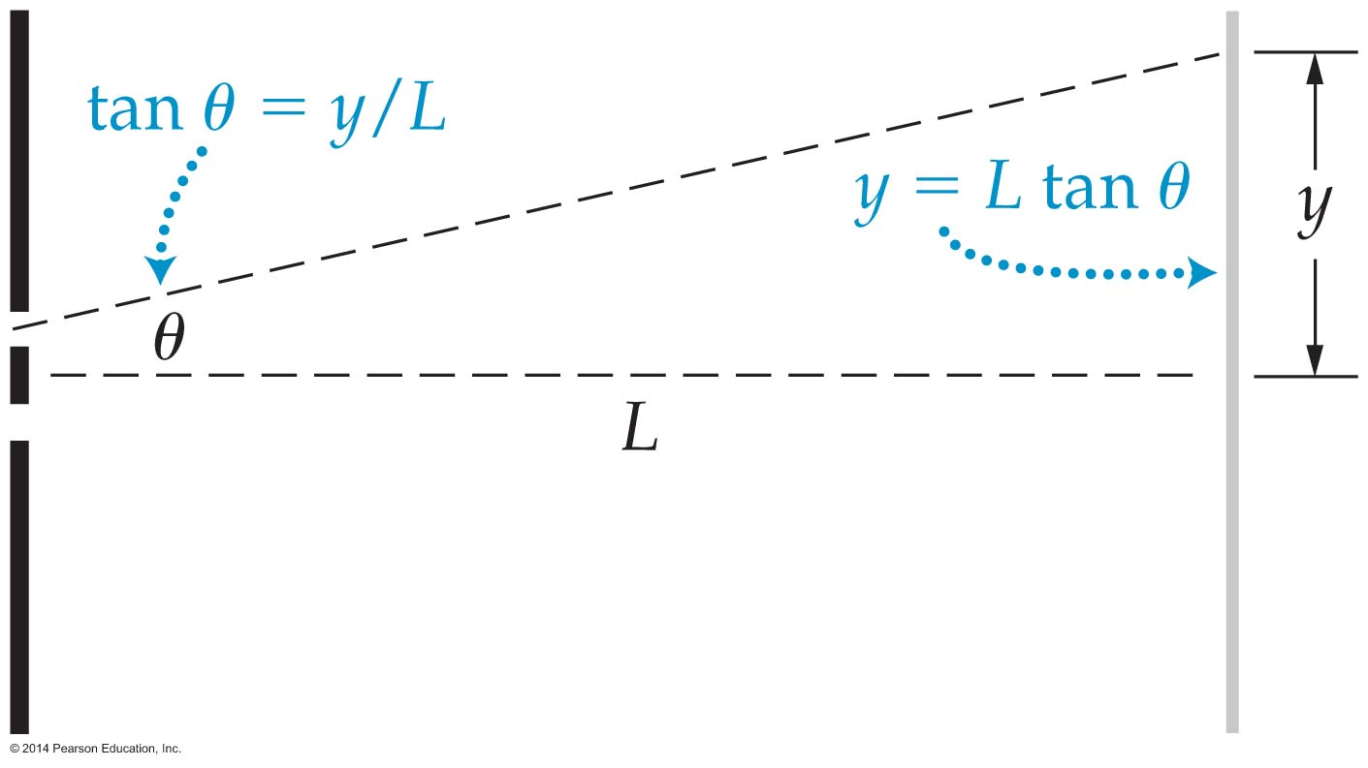
Interference
A convenient way to characterize the location of interference fringes is in terms of their vertical distance from the central bright fringe.
As the figure below indicates, if light travels at an angle θ relative to the normal to the slits, it is displaced by a vertical distance y = L tan θ.

Slide 30
Interference in Thin Films
You've probably seen a film of oil floating on water and noticed all the colors of the rainbow in the film. The beautiful colors are produced by a phenomenon known as thin-film interference.
You have seen how light from two slits can interfere to form bright and dark fringes. Something similar happens when you shine light on a film of oil. In this case, instead of two slits there are two surfaces of the film (top and bottom), each causing a reflection.

Slide 31
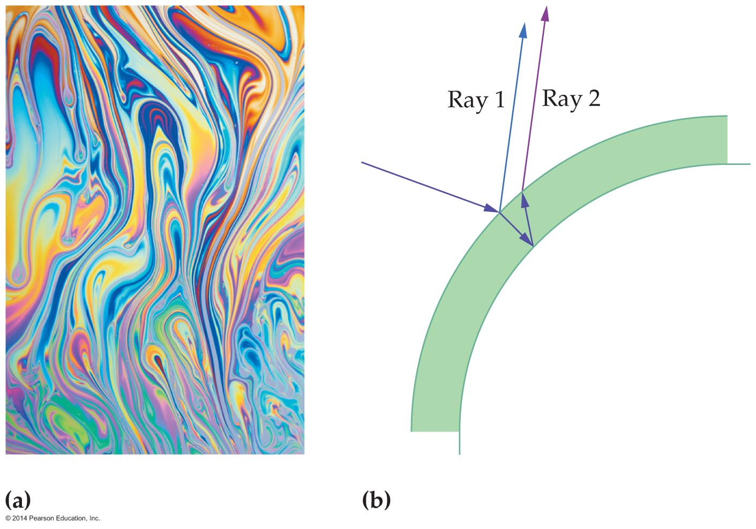
Interference in Thin Films
Figure (a) below shows the colors produced by thin-film interference; figure (b) shows the light reflecting from the top and bottom of a thin film.

Slide 32
Interference in Thin Films
In the two-slit experiment, the light from two sources interferes because it travels different distances, which changes the relative phase of the waves. A change in phase also happens with a thin film.

Slide 33
Interference in Thin Films
In the case of thin-film reflection, the reflection process itself can change the phase.
As you know, a wave on a string reflects differently depending on whether the end of the string is tied to a solid support or is free to move up and down.
  A wave reflected from a loose end is reflected back with no change in phase.
  A wave reflected from a fixed end is flipped upside-down. This is equivalent to a phase change of 180°.

Slide 34
Interference in Thin Films
Since light is a wave, it undergoes a similar phase change when it reflects.
  When light encounters a medium with a lower index of refraction, it is reflected with no phase change.
  In contrast, when light encounters a medium with a higher index of refraction, it is reflected with a phase change of half a wavelength.

Slide 35
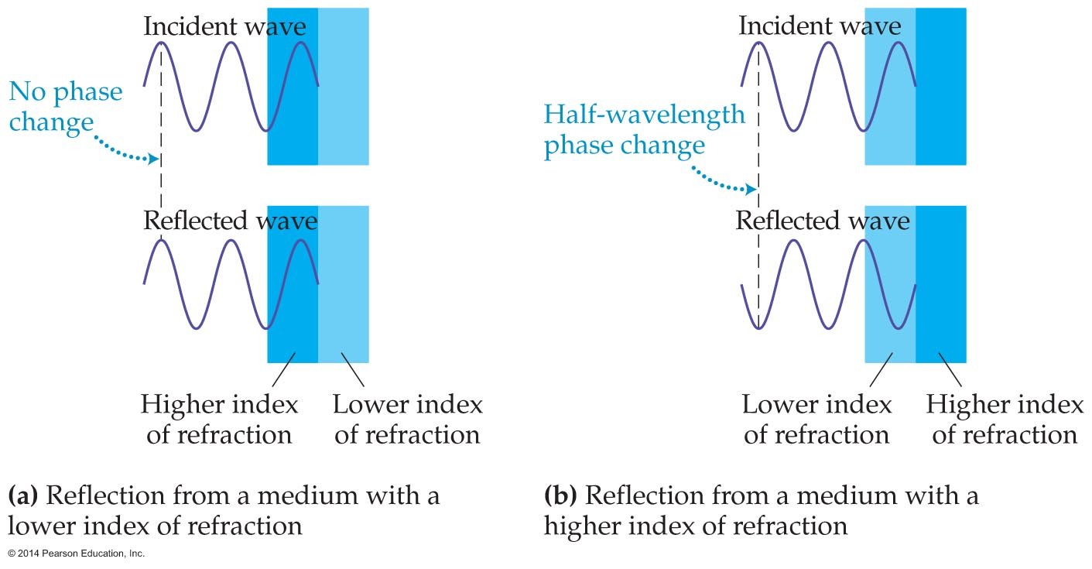
Interference in Thin Films
The figure below illustrates changes in phase that can occur with reflection.

Slide 36
Interference in Thin Films
An interesting example of interference due to reflection is provided by two plates of glass that touch at one end and have a small separation at the other end.

Slide 37
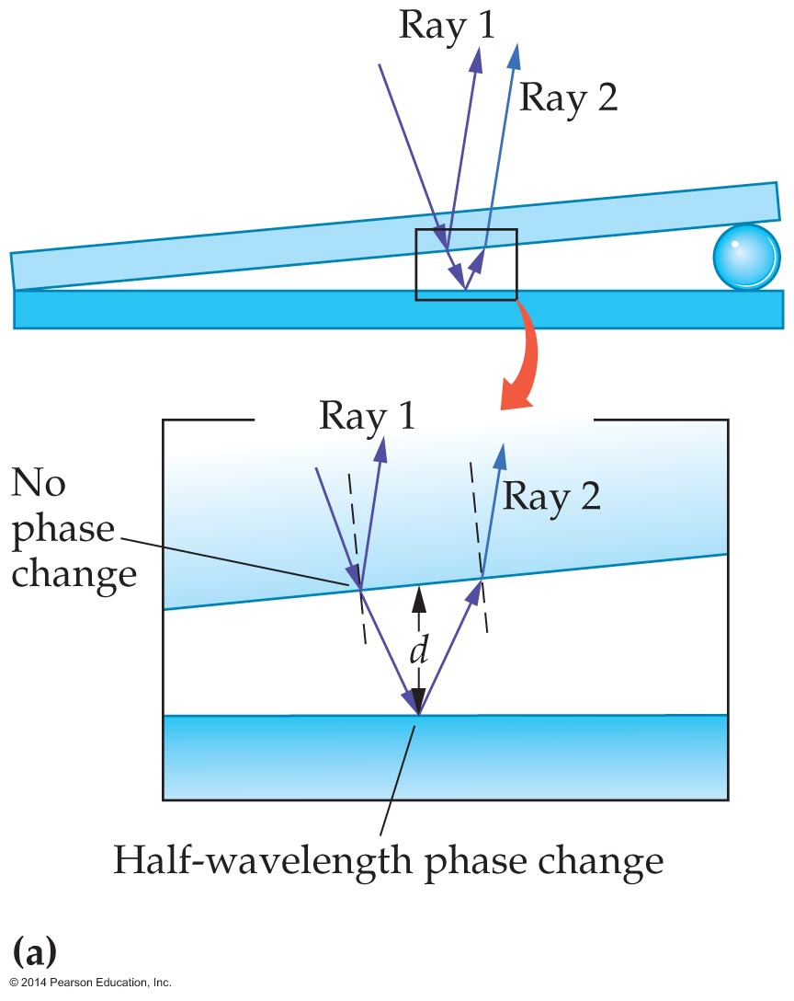
Interference in Thin Films
The two plates of glass form an air wedge such as the one shown in the figure below.

Slide 38
Interference in Thin Films
The air wedge causes interference between light reflected from the bottom surface of the top plate (ray 1) and light reflected from the top surface of the lower plate (ray 2).

Slide 39

Interference in Thin Films
Ray 1 reflects at a glass-to-air boundary. Air has a lower index of refraction than glass, and hence this ray reflects with no phase change.
Ray 2 travels a distance d through the air, reflects from the air-to-glass boundary, and then travels essentially the same distance d in the opposite direction. Since glass has a higher index of refraction than air, this ray reflects with a phase change of 180°—the same as if it had traveled an extra half-wavelength, or
.

Slide 40

Interference in Thin Films
Taking this phase change into account gives the effective path length for ray 2:
effective path length of ray
Because ray 2 has a greater effective path length than ray 1, the rays can interfere constructively when they combine if the path length of ray 2 is greater than the path length of ray 1 by an integer number of wavelengths:

Slide 41
Interference in Thin Films
Rays 1 and 2 interfere destructively when the effective path length of ray 2 is greater than the path length of ray 1 by half a wavelength, one and a half wavelengths, and so on:

Slide 42
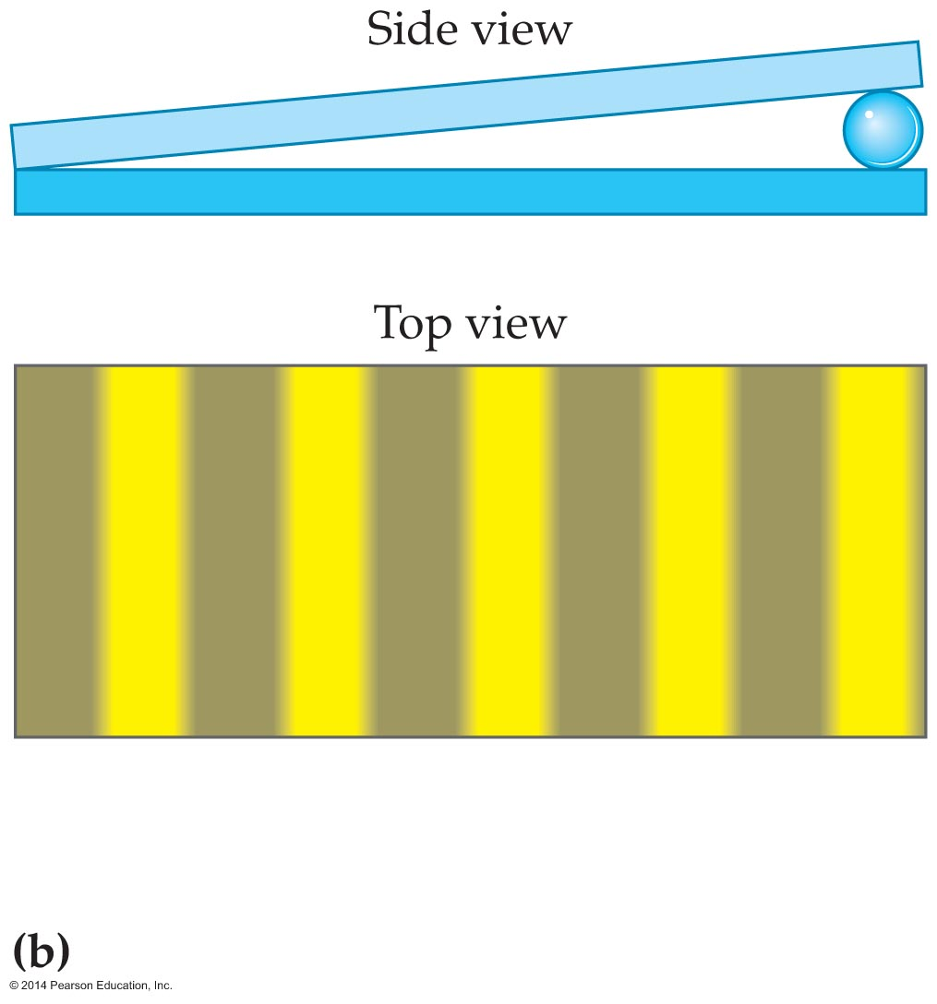
Interference in Thin Films
Since the distance between plates, d, increases steadily in the air wedge, it follows that the dark and bright interference fringes are evenly spaced, as shown in the figure below.

Slide 43
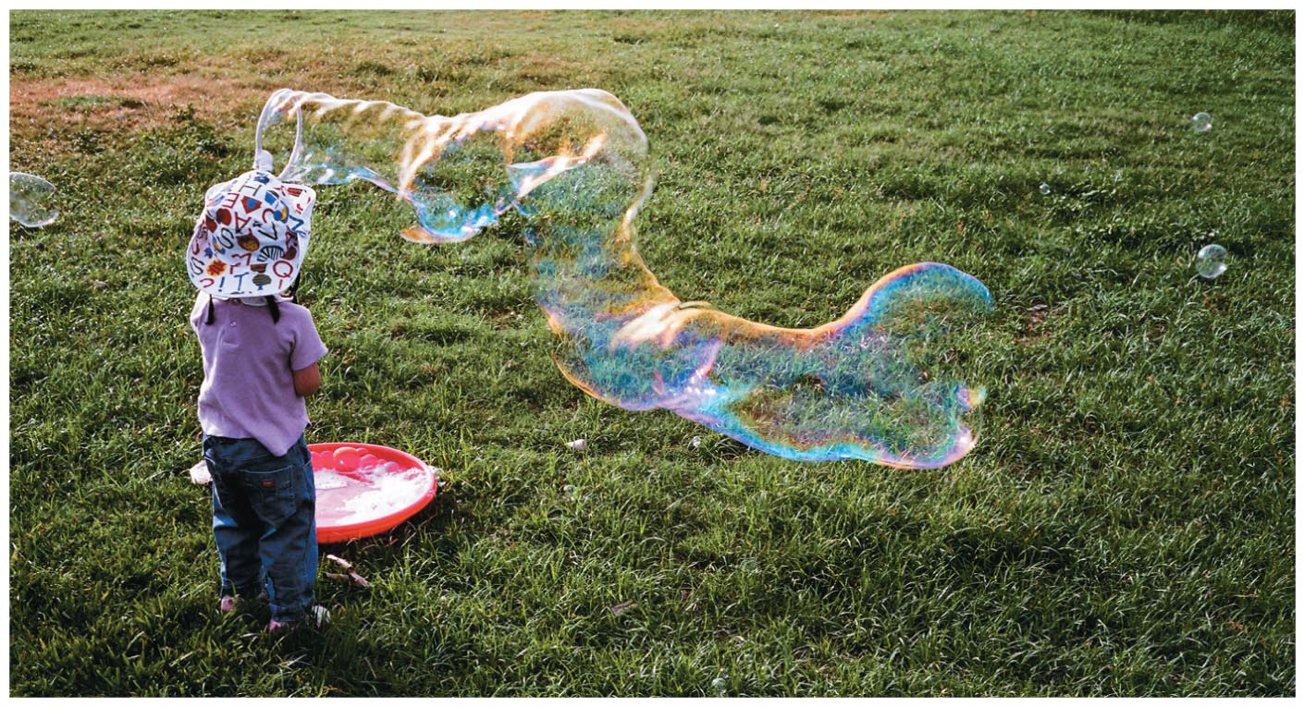
Interference in Thin Films
An example of the beautiful swirling patterns of color on the surface of a bubble is shown in the figure below.
The colors in a thin film are the result of constructive and destructive interference that occurs when white light reflects from the film's top and bottom surfaces.

Slide 44
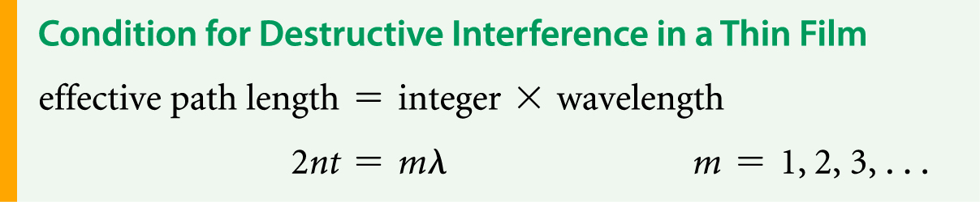
Interference in Thin Films
Some colors experience destructive interference and are eliminated from the reflected light. Other colors are enhanced by constructive interference.
A thin film surrounded by air, like a soap bubble, is analyzed in the same manner as an air wedge.
As a result, the condition for destructive interference is as follows:

Slide 45
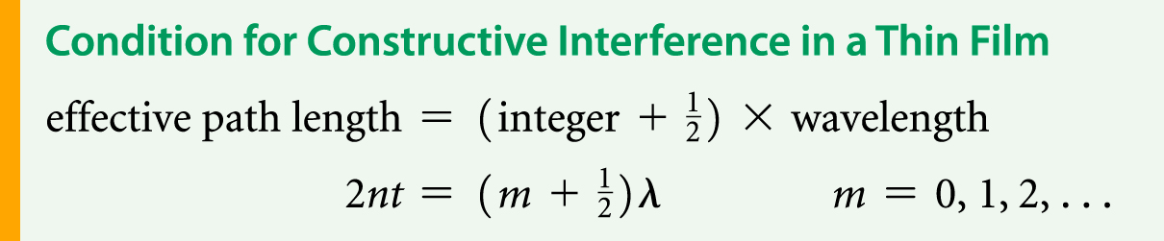
Interference in Thin Films
In this equation, t is the thickness of the film, n is the index of refraction of the soap film, and λ is the wavelength of light.
Since constructive interference requires an extra half-wavelength difference in the path length, it follows that the condition for destructive interference is the following:
These conditions apply to any thin film suspended between materials whose indices of refraction are lower than that of the film.

Slide 46
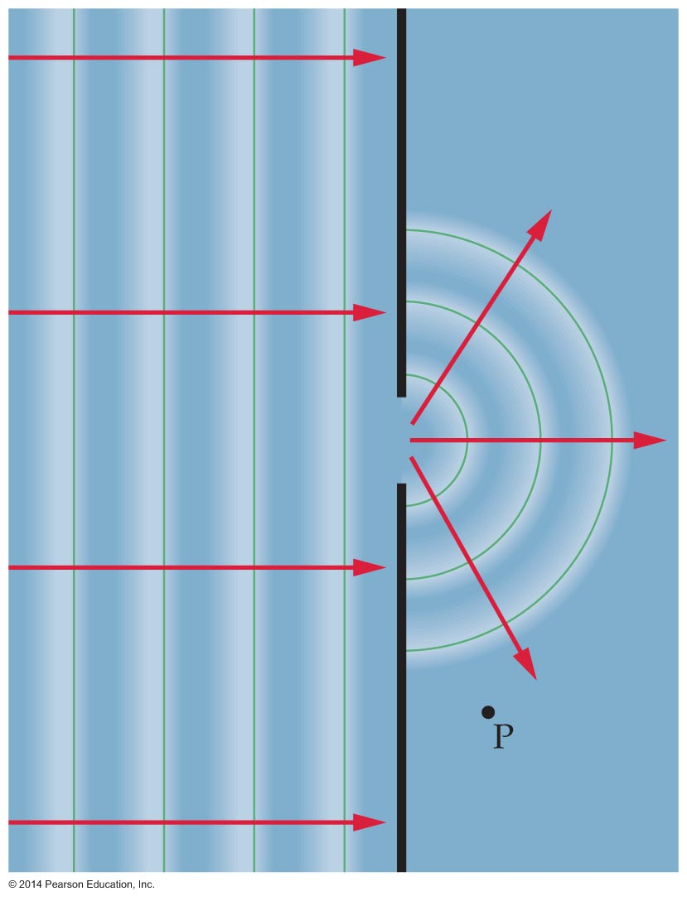
Diffraction
As the figure below shows, water waves spread outward, or diffract, when they pass through an opening. Thus an observer at point P detects waves even though this point is not in line with the original direction of the waves through the opening.
Since light is a wave, it must exhibit behavior similar to that of water.

Slide 47
Diffraction
The bending of a wave around a barrier or through an opening is known as diffraction. A common result of diffraction is the ability to hear a person talking even when the person is out of sight around a corner.
It might seem that light cannot be a wave, since it does not bend around a corner along with the sound. There is a significant difference between sound waves and light waves, however. The wavelength of sound is about a meter, but the wavelength of light waves is about 10⁻⁷ m.

Slide 48
Diffraction
The huge difference in wavelength between sound waves and light waves greatly affects their behavior, because long waves diffract more than short waves. It follows that long-wavelength sound waves diffract much more than short-wavelength light waves.

Slide 49
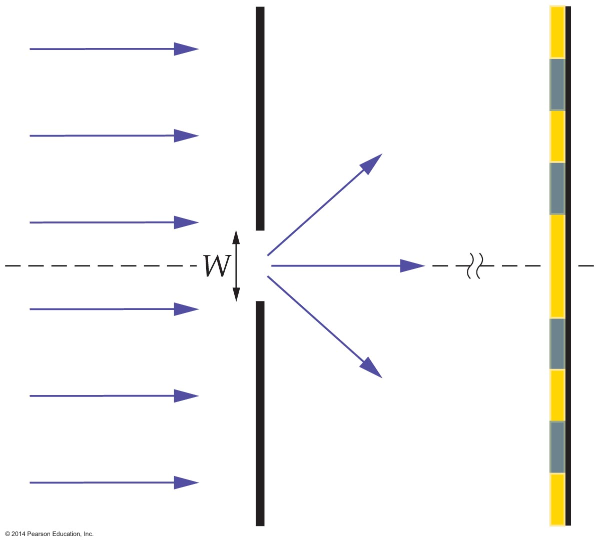
Diffraction
To investigate the diffraction of light, consider monochromatic light of wavelength λ passing
through a slit of width W as shown in the figure below.

Slide 50
Diffraction
After passing through the slit, the light shines on a distant screen.
According to Huygens's principle, each point within the slit can be considered as a source of new waves that travel outward toward the screen. The interference of these waves with one another generates a series of bright and dark fringes referred to as a diffraction pattern.

Slide 51
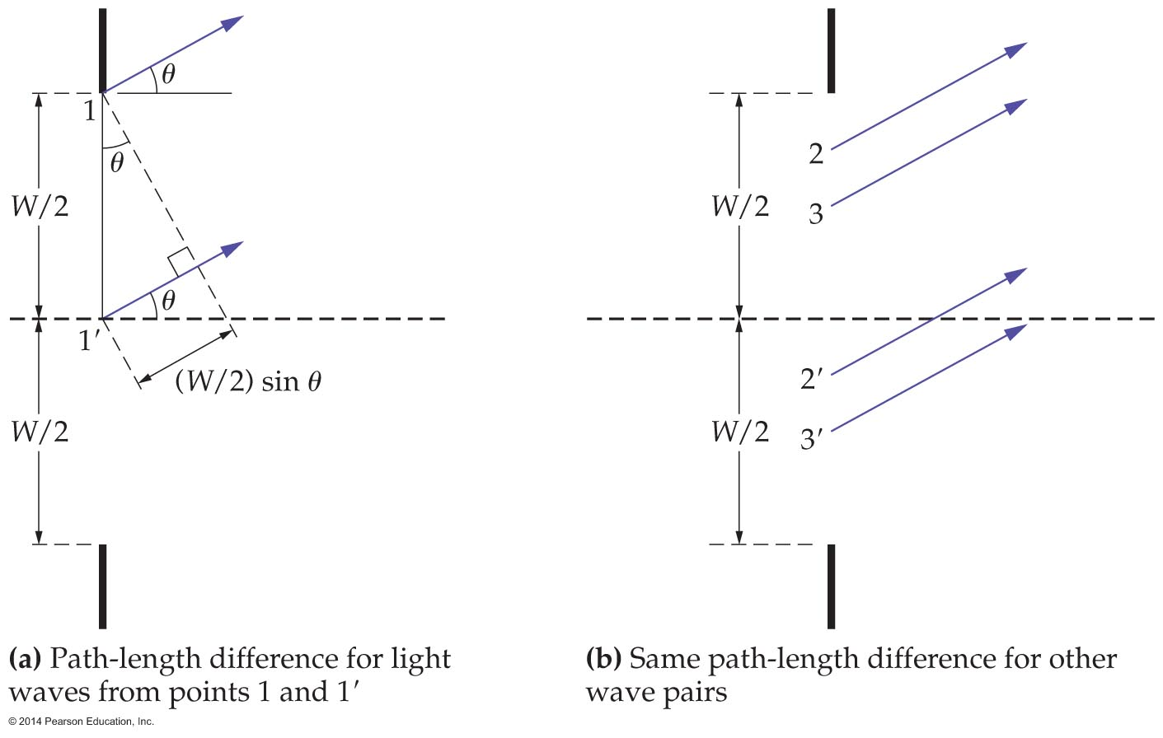
Diffraction
We can understand single-slit diffraction by referring to the figure below.

Slide 52
Diffraction
The figure shows light waves traveling to a screen from various points in a slit. Consider waves from points 1 and 1′ traveling to the screen at an angle θ relative to the initial direction of the light.

Slide 53
Diffraction
The path-length difference for these waves is (W/2) sin θ. This same path-length difference applies to points 2 and 2′, 3 and 3′, and so on for all points in the slit.
Each of these pairs acts like it came from the two slits in a two-slit experiment.
The path-length difference for waves traveling in the forward direction is zero. As a result, all wave pairs interfere constructively, giving maximum intensity at the center of the diffraction pattern.

Slide 54
Diffraction
Things change, however, when the angle θ does not equal zero. If the angle is increased until the path-length difference is half a wavelength, λ, then each pair experiences destructive interference.
Thus, the first dark fringe in the diffraction pattern occurs when (W/2) sin θ = λ or, cancelling the 2's,
W sin θ = λ
Similar analysis shows that the second dark fringe occurs at the angle given by
W sin θ = 2λ

Slide 55
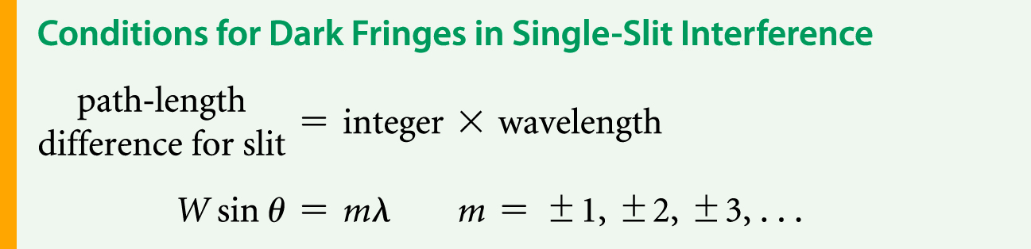
Diffraction
In general, dark fringes satisfy the following conditions:

Slide 56
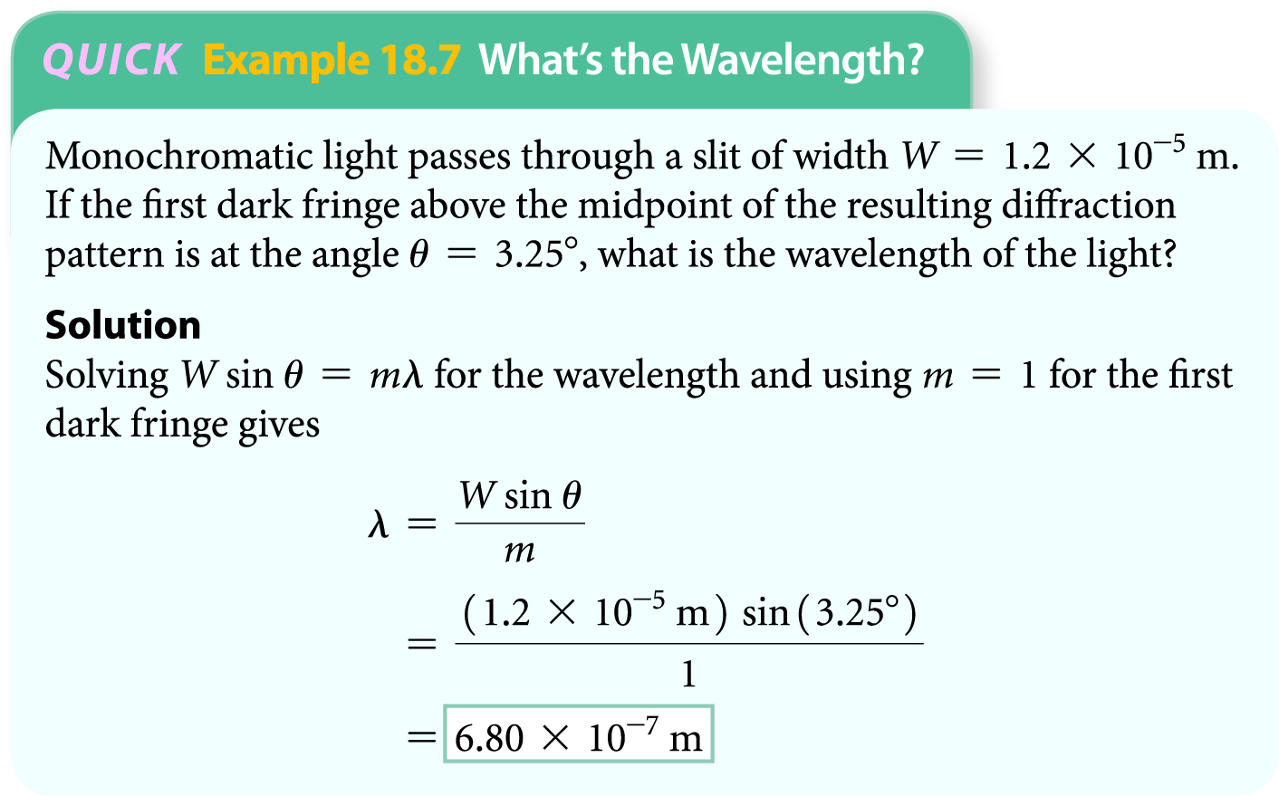
Diffraction
The following example shows how the equation describing the conditions for dark fringes in single-slit interference may be used to determine wavelength.

Slide 57
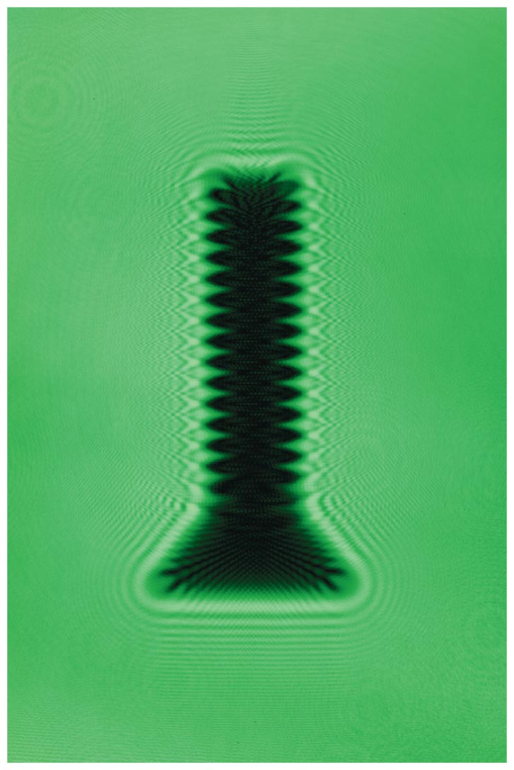
Diffraction
As mentioned earlier, waves diffract when they encounter a barrier or an opening. It follows, then, that the shadow cast by an object is not really as sharp as it might seem. For example, the shadow of the metal screw shown in the figure below actually consists of tightly spaced series of diffraction fringes.

Slide 58
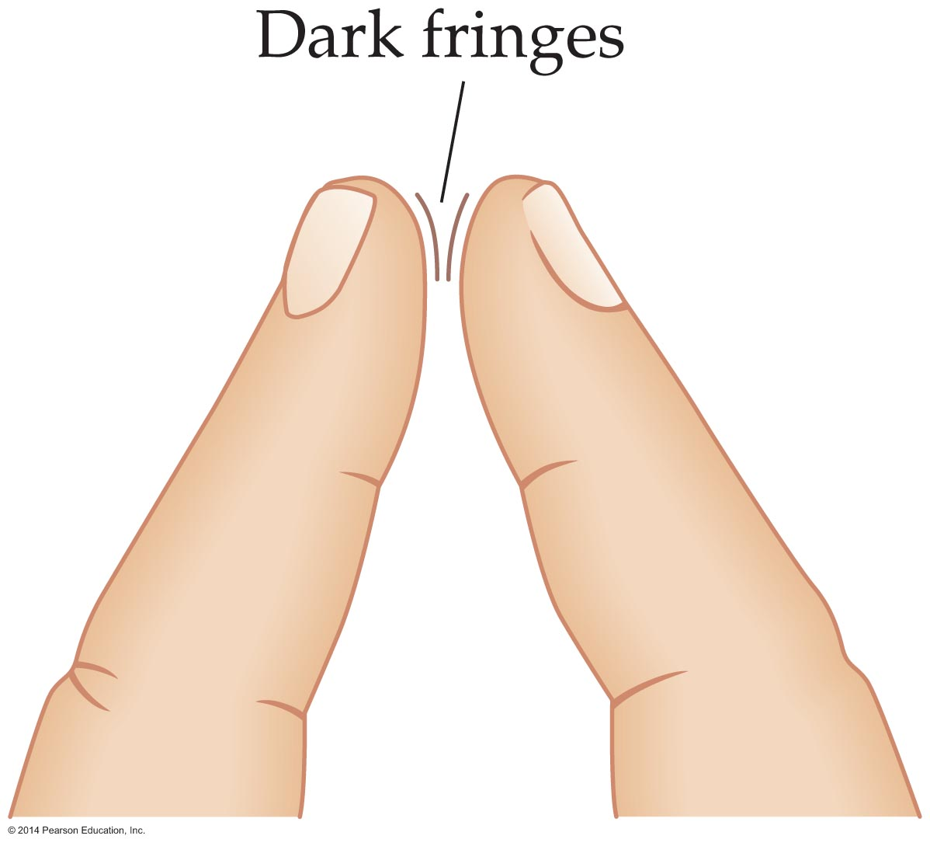
Diffraction
Thus, shadows do not have the sharp boundaries implied by geometrical optics. However, under normal circumstances the diffraction pattern in a shadow may be difficult to see.
That said, a diffraction pattern may be seen by holding two fingers close together in front of your eyes. Don't let the finger tips touch, but look carefully between them toward a smooth, bright background, as is shown in the figure below.

Slide 59
Diffraction
Diffraction limits the way you see the world. How sharply a scene appears to your eyes depends on the size of your pupils. In general, larger pupils produce sharper vision. Let's see why that is so.
Let's take a look at the diffraction pattern created by a circular opening—such as the pupil of your eye.

Slide 60
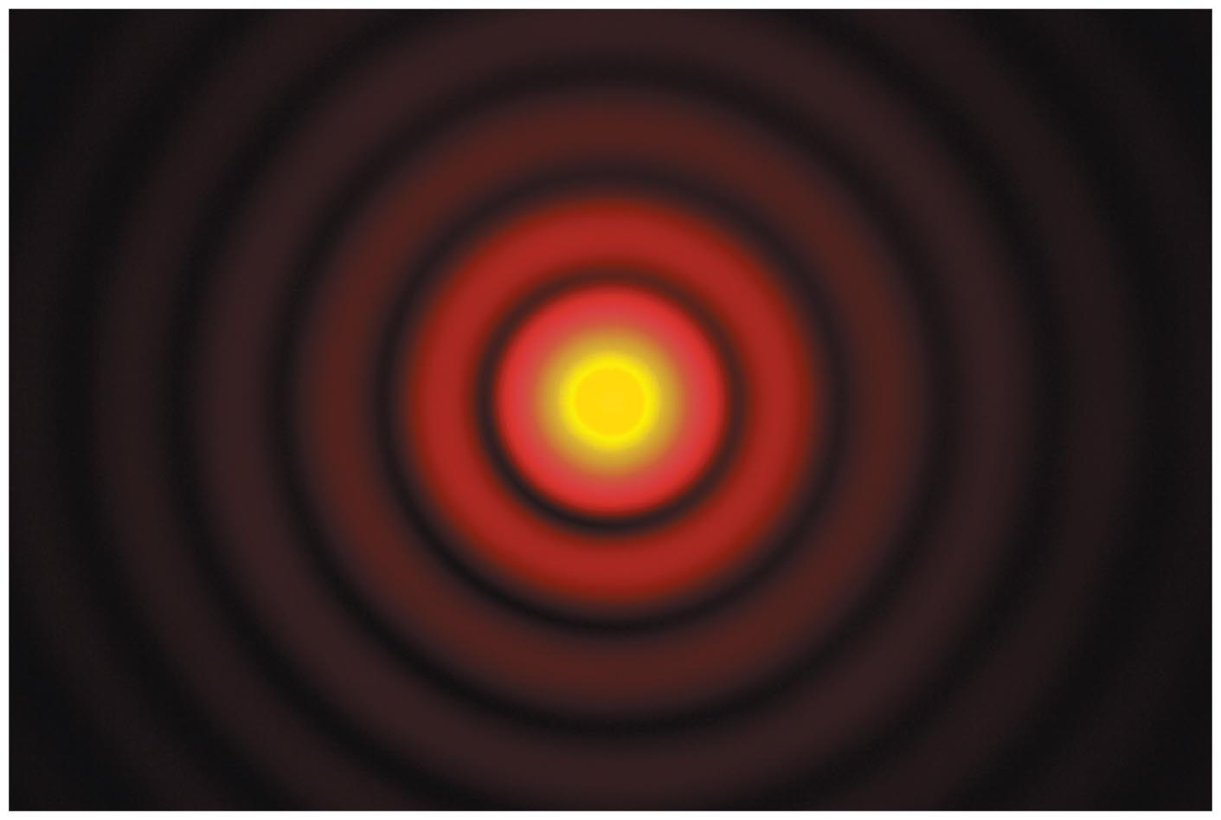
Diffraction
The pattern is slightly different from that produced by the linear slits studied earlier. The circular opening creates a circular diffraction pattern of alternating bright and dark regions such as that shown in the figure below.

Slide 61
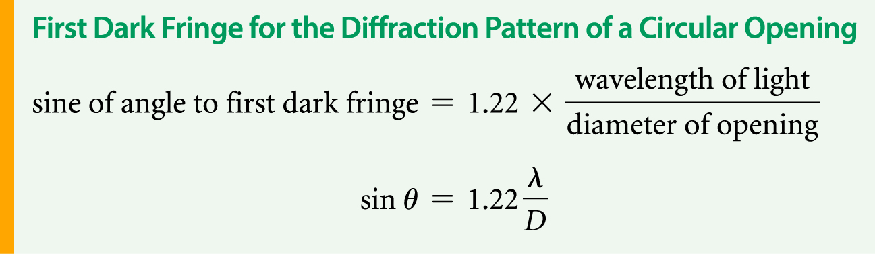
Diffraction
More specifically, a circular opening of diameter D produces a dark fringe at an angle given by the following condition:
The sharpness of vision—in particular, the ability to visually separate closely spaced objects—is referred to as resolution.

Slide 62
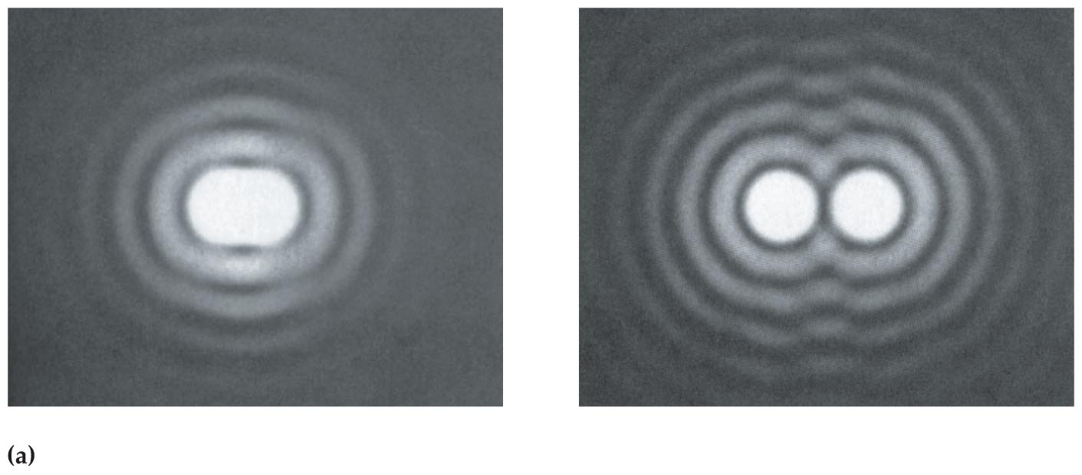
Diffraction
Because diffraction through the pupil blurs images, it can be difficult to visually separate objects that are very close together. In other words, diffraction limits the resolving power of your vision. This is illustrated in the figure below.
Note that if the angular separation between two sources is not great enough (left), their diffraction patterns overlap to the point where they appear as a single elongated source.

Slide 63
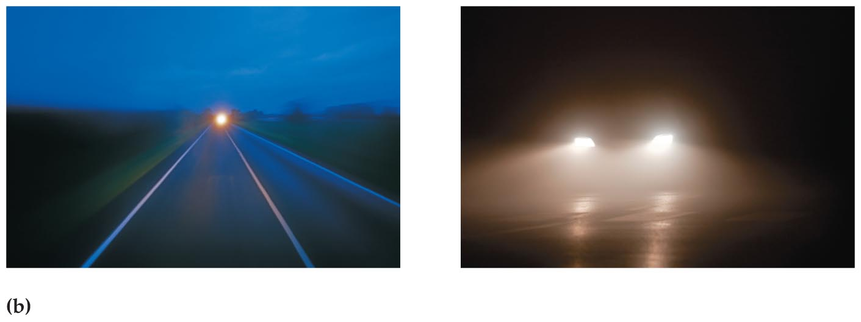
Diffraction
An everyday example of diffraction-limited resolution is shown in the figure below.
In the photograph on the left we see a brilliant light in the distance that may be the single headlight of an approaching motorcycle or the unresolved images of two headlights of a car. When the angular separation exceeds the angle of the first dark fringe, as in the second photograph, we are able to distinguish the two headlights as separate sources of light.

Slide 64
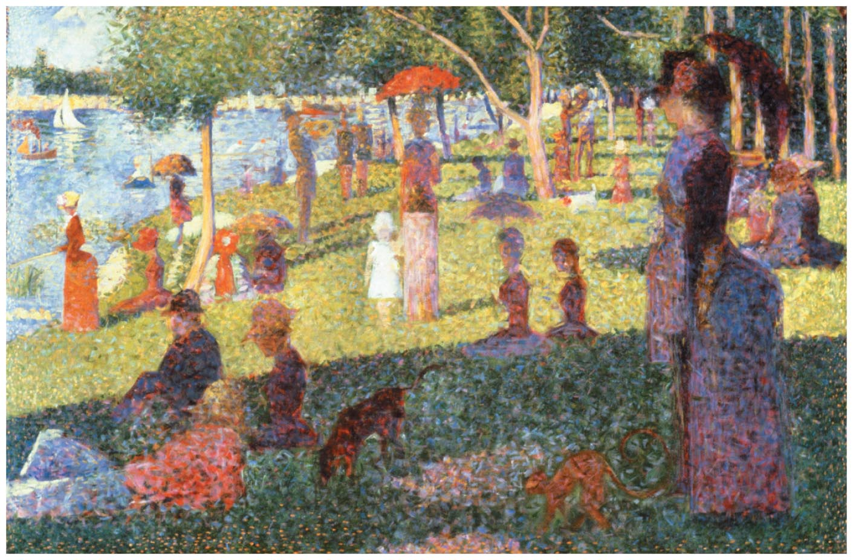
Diffraction
In a style of painting known as pointillism, the artist applies paint to a canvas in the form of small dots of color. When viewed from a distance, the individual dots blur together—due to diffraction—and the painting appears to be painted with continuous colors.
Shown in the figure below is a famous example of a pointillist painting, Georges Seurat's A Sunday Afternoon on the Island of La Grande Jatte (1884).

Slide 65
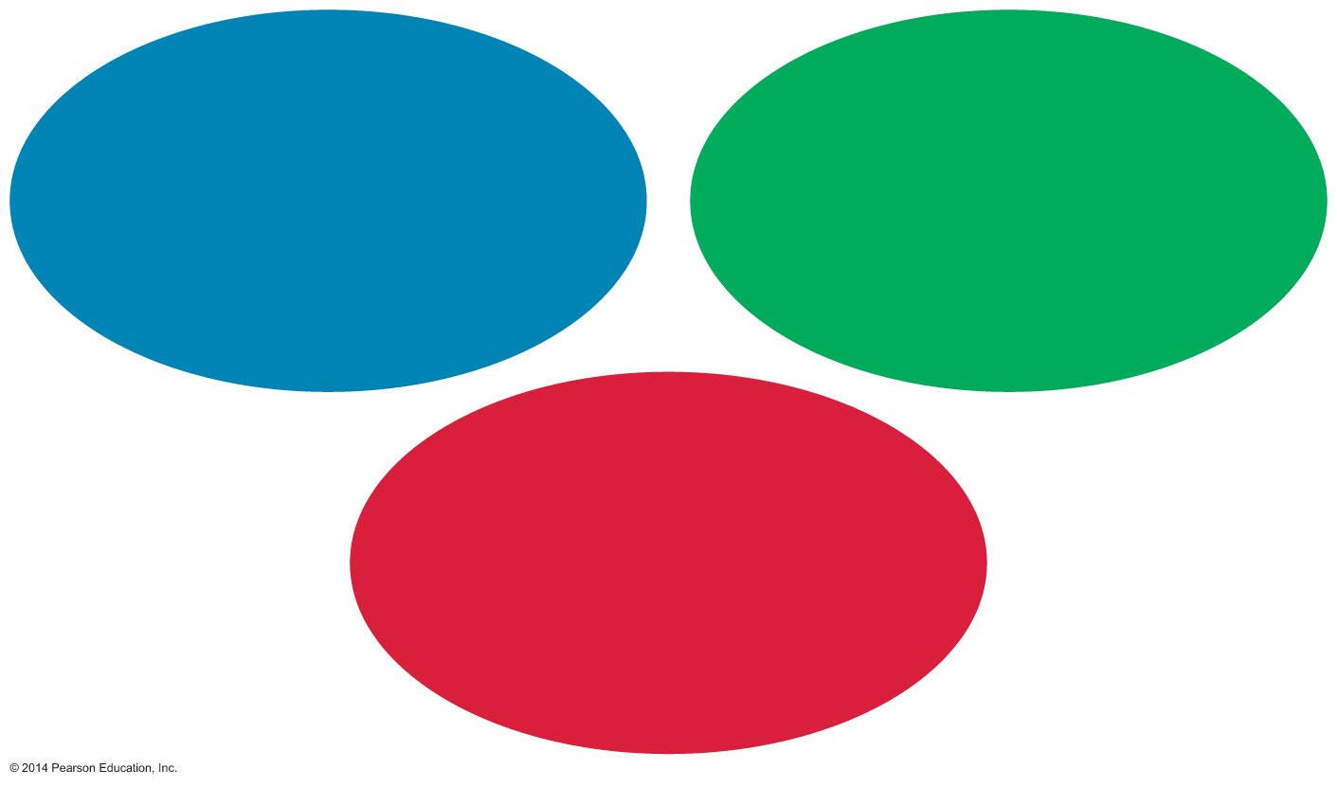
Diffraction
Watching television is a lot like viewing a pointillist painting. Although a TV screen appears to show all the colors of the rainbow, it actually produces only three colors—red, green, and blue—the additive primaries. These three colors are grouped together in small points known as pixels, as shown in the figure below.

Slide 66
Diffraction
From a distance, the three individual color spots blur together, and the eyes see the net effect of the various combinations of the three colors.

Slide 67
Diffraction Gratings
As you know from the previous lessons, a screen with one or two slits produces patterns of interference fringes. It's natural to wonder what happens if the number of slits is increased.
A screen with a large number of slits is referred to as a diffraction grating. In some cases a grating can have as many as 40,000 slits—or lines, as they are called—per centimeter.
The interference pattern formed by a diffraction grating consists of a series of sharp, widely spaced bright fringes called principal maxima, separated by relatively dark regions, which contain a number of weak secondary maxima.

Slide 68
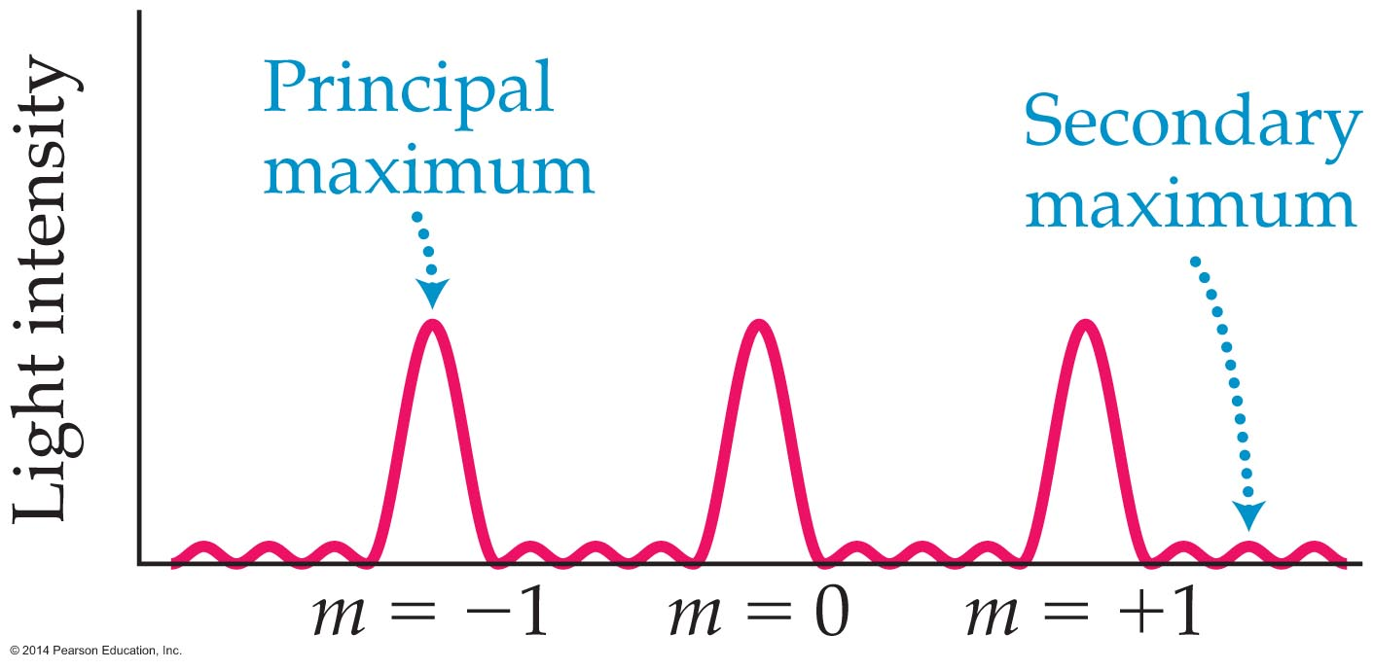
Diffraction Gratings
Such a pattern is shown in the figure below for the case of five slits. As the number of slits becomes larger, the principal maxima become brighter, and the secondary maxima become insignificant.

Slide 69
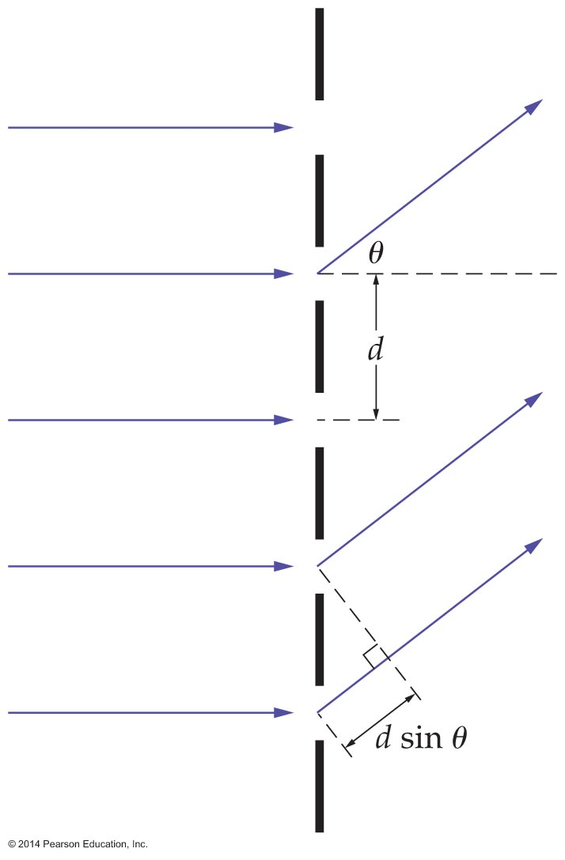
Diffraction Gratings
To see how the angles at which principal maxima are found, consider the grating with a large number of slits and slit separation d shown in the figure below.

Slide 70
Diffraction Gratings
A beam of light with wavelength λ approaches the grating from the left and is diffracted onto a distance screen.

Slide 71
Diffraction Gratings
At an angle θ to the incident direction, the path-length difference between successive slits is d sin θ, as shown in the figure.
As before, constructive interference (and hence principle maxima) occurs when the path-length difference is an integer number of wavelengths, mλ.
That is,
path-length difference = integer x wavelength
d sin θ = mλ m = 0, ±1, ±2,…

Slide 72
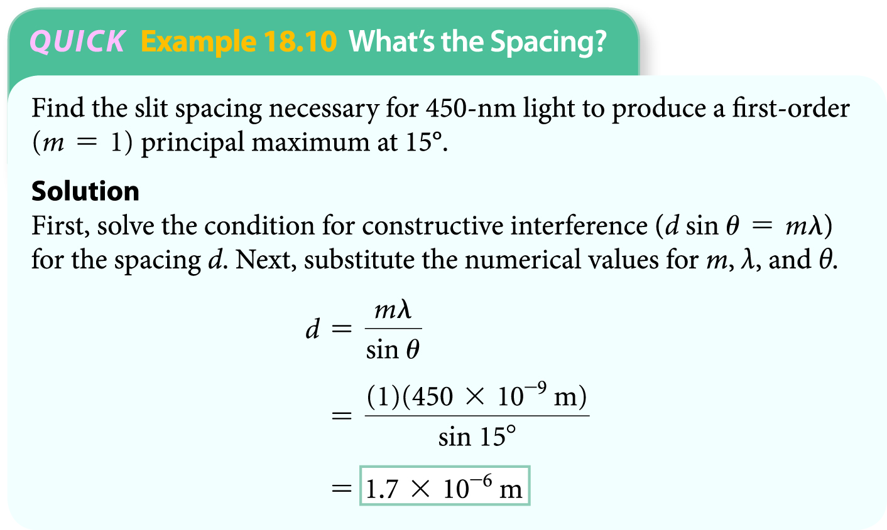
Diffraction Gratings
The following example illustrates how the diffraction grating equation may be applied to find the slit spacing.
The first-order principal maximum for the grating in the above example is at 15°, the second-order principal maximum occurs at 32°, and the third-order maximum is at 53°.

Slide 73
Diffraction Gratings
When you try to solve for the fourth-order maximum, you find that sin θ > 1, which isn't possible.
Therefore, there is no fourth-order principal maximum for this grating, and no maxima higher than that.

Slide 74
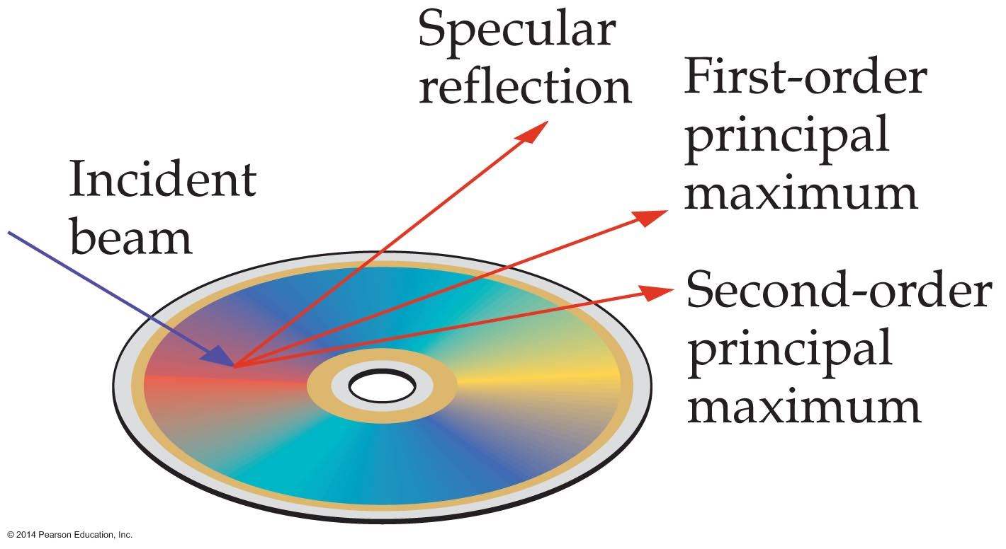
Diffraction Gratings
When a laser beam shines on a CD, a number of reflected beams are observed. The most intense of these is the specular beam, whose angle of reflection is equal to its angle of incidence—the same as if the CD were a mirror.

Slide 75
Diffraction Gratings
In addition, two more beams corresponding to the first-order and second-order principal maxima can be seen.
Therefore, CDs typically produce three reflected beams, two of which wouldn't occur with a mirror—the microscopic lines on the CD's surface produce them.

Slide 76
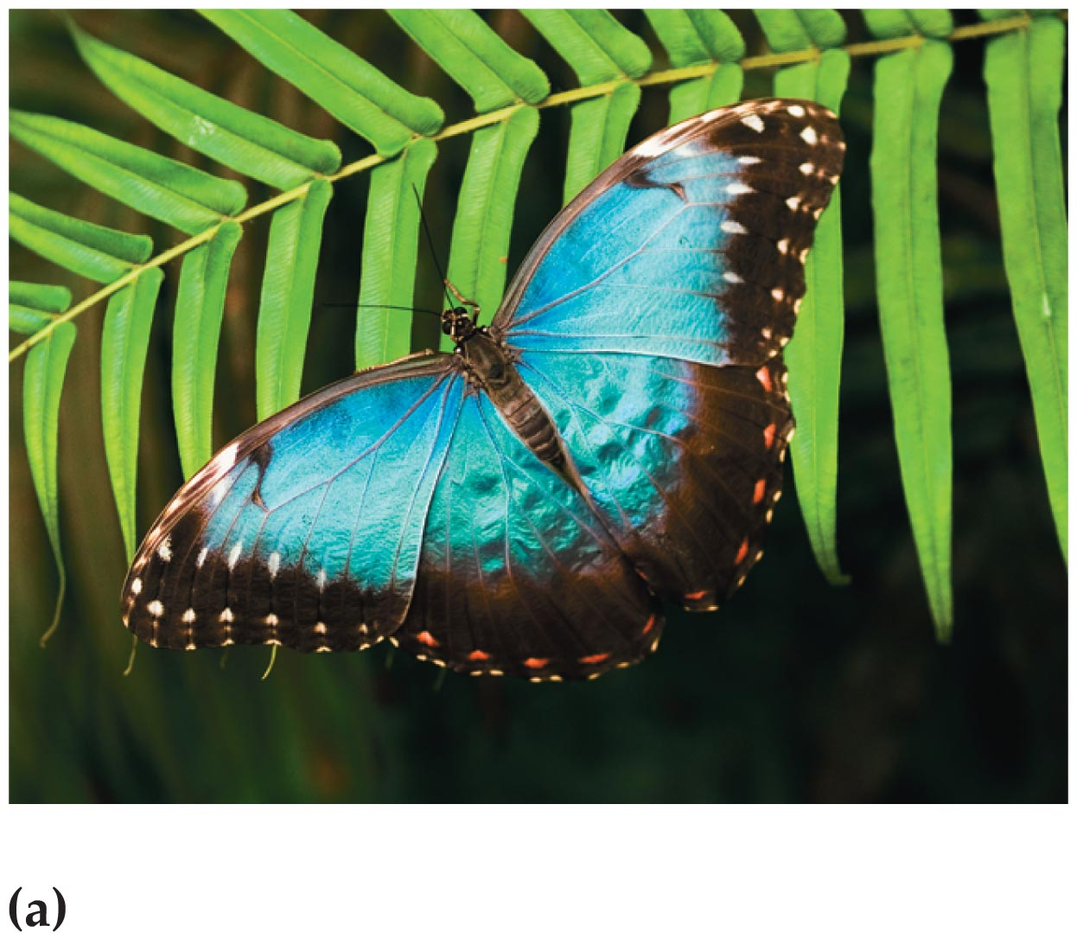
Diffraction Gratings
Diffraction gratings are common in nature. Bird feathers and butterfly wings are examples.
The figure below shows the beautiful wing of a blue morpho butterfly.

Slide 77
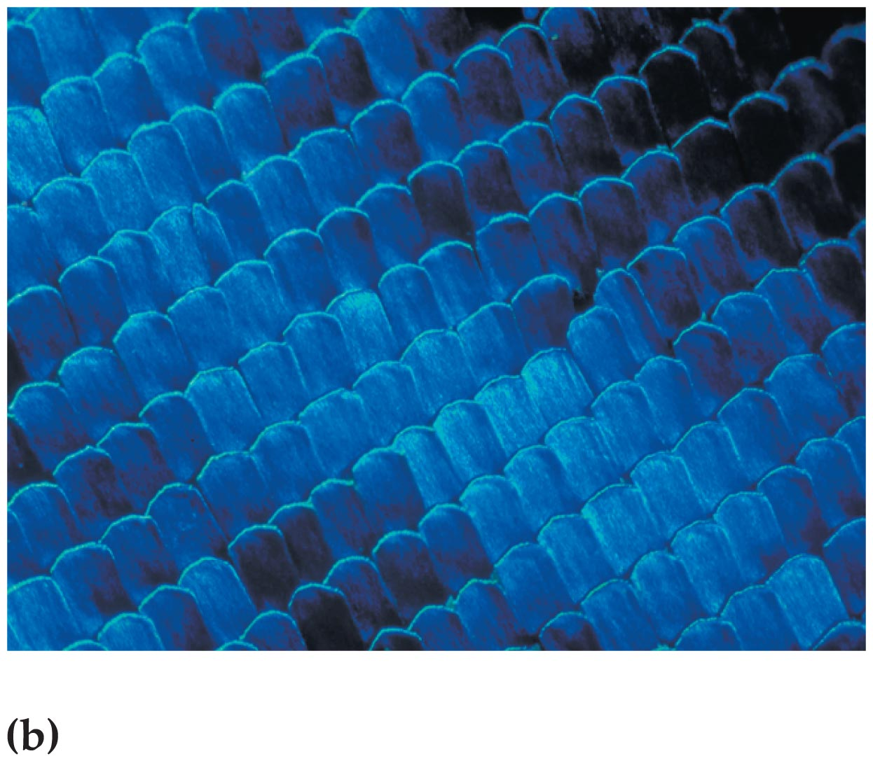
Diffraction Gratings
A microscopic examination of a butterfly wing shows that it is covered by thousands of tiny tiles, like shingles on a roof, as shown in the following figure.
Each of these tiles has a series of closely spaced ridges. These ridges act just like the lines on a CD, producing reflected light of different colors in different directions.

Slide 78
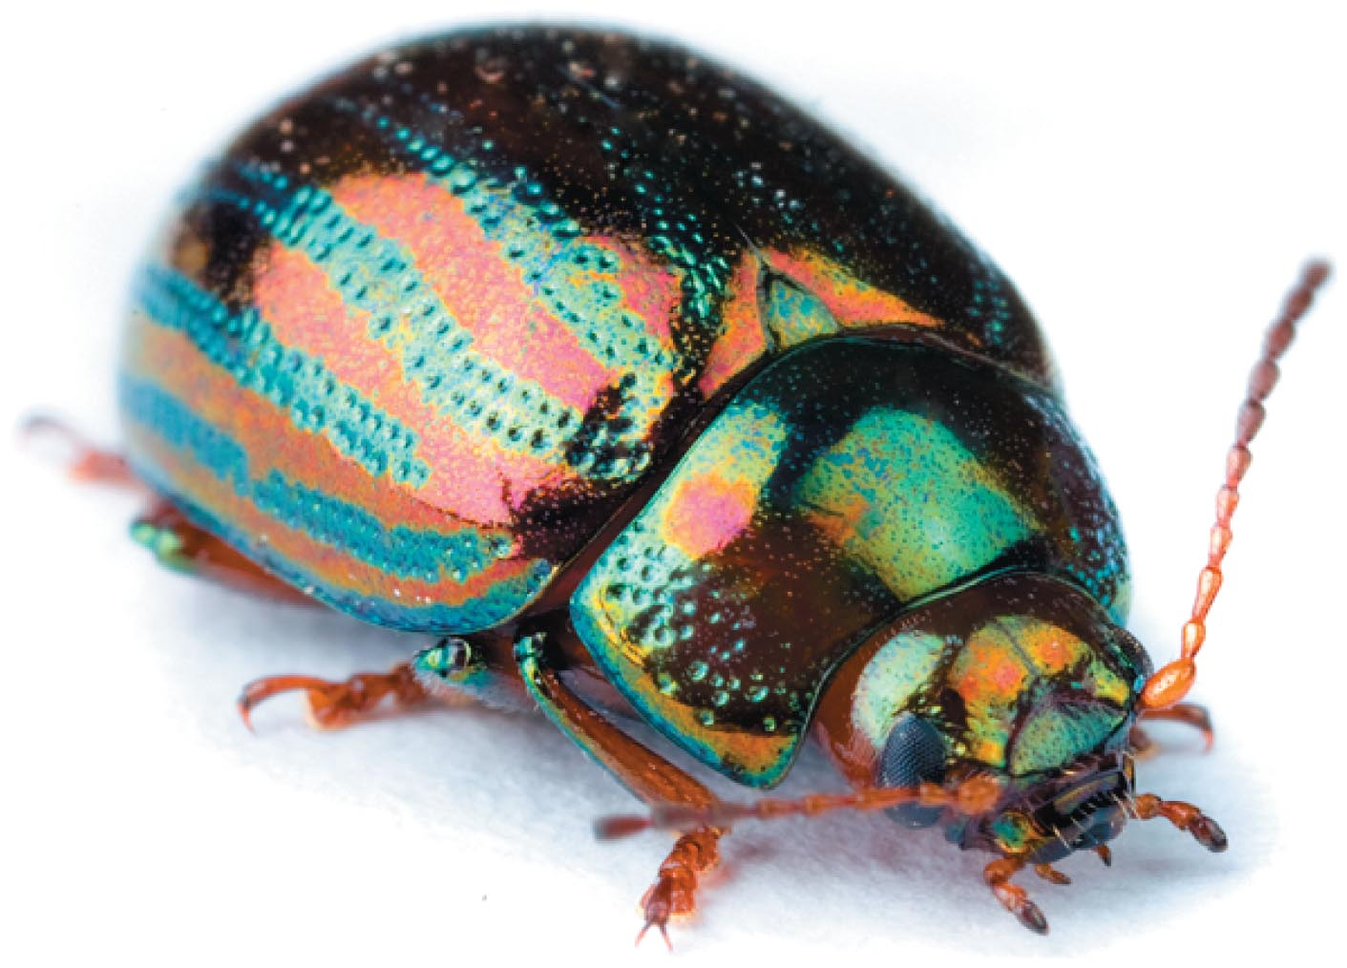
Diffraction Gratings
Coloration that is produced by the interference of light is referred to as iridescence. In fact, many colors seen in nature are produced by iridescence rather than by pigments.
Feathers, seashells, and insects—such as the beetle in shown in the figure below—often exhibit iridescence.
The next time you examine an iridescent object, notice how its color changes as you change your viewing angle. This is a key feature of iridescence.

