Slide 1
Refraction and Lenses
Prepared by
Chris Chiaverina

Slide 2
Chapter Contents
Refraction
Applications of Refraction
Lenses
Applications of Lenses

Slide 3
Refraction
Light travels quickly through some materials and more slowly through others.
The speed of light in a vacuum is c = 3 x 10⁸ m/s. This is as fast as light can go.
When light travels through a dense material like water, however, its speed is reduced.
In fact, the speed of light through any material is slower than its speed in a vacuum.

Slide 4
Refraction
Measurements show that the speed of light in water is smaller than the speed of light in a vacuum by a factor of 1.33:
speed of light in water = c/1.33
The index of refraction of a material is the factor by which it reduces the speed of light. Therefore, the index of refraction of water is 1.33.

Slide 5
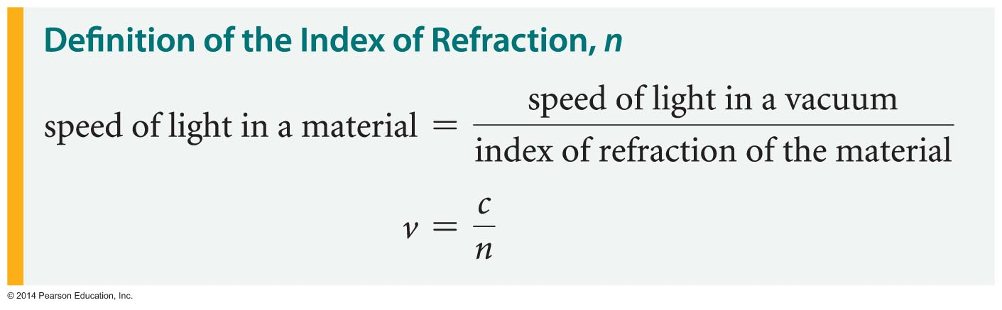
Refraction
In general, if the speed of light in a material is v, its index of refraction n is defined as follows:
Thus, the larger the index of refraction, the smaller the speed of light.

Slide 6
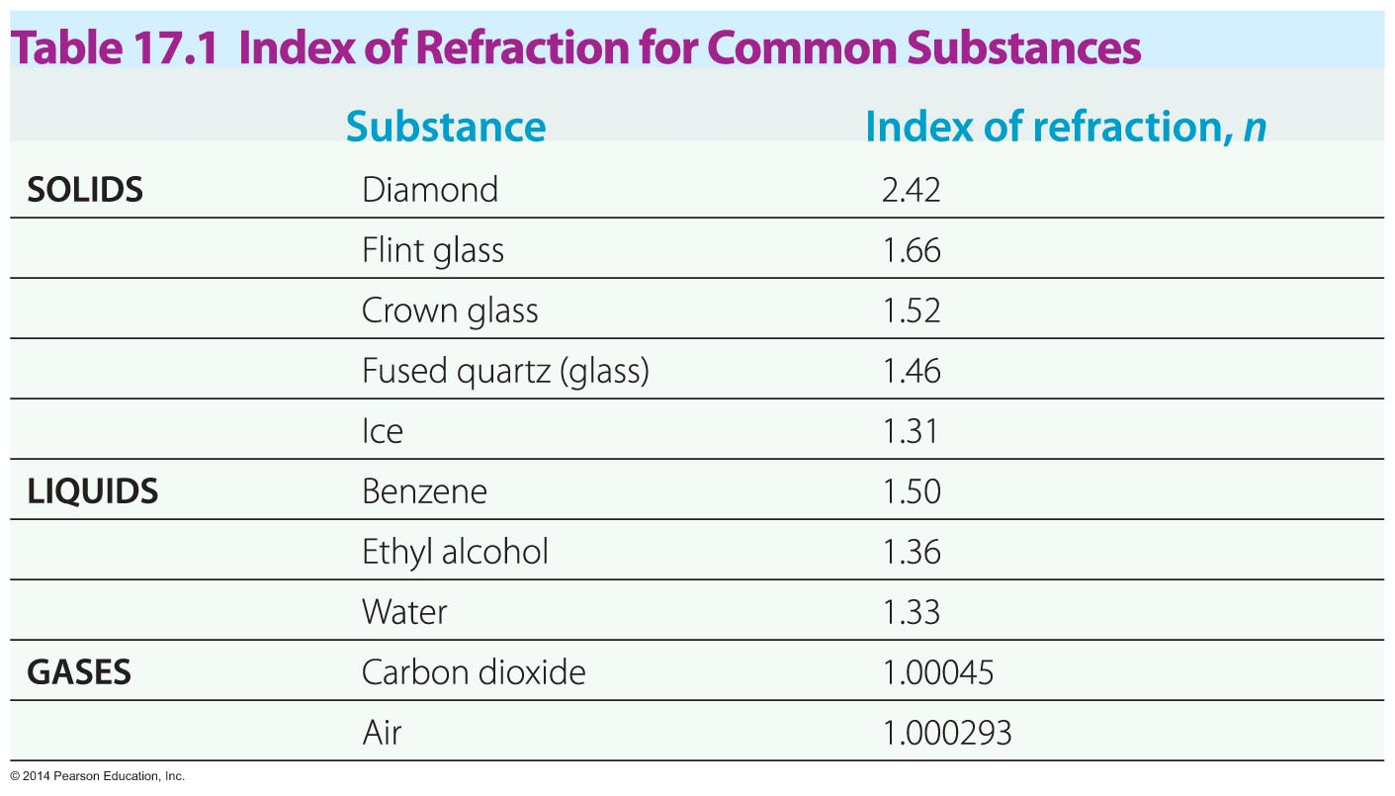
Refraction
The table below lists values of the index of refraction for a variety of materials.

Slide 7
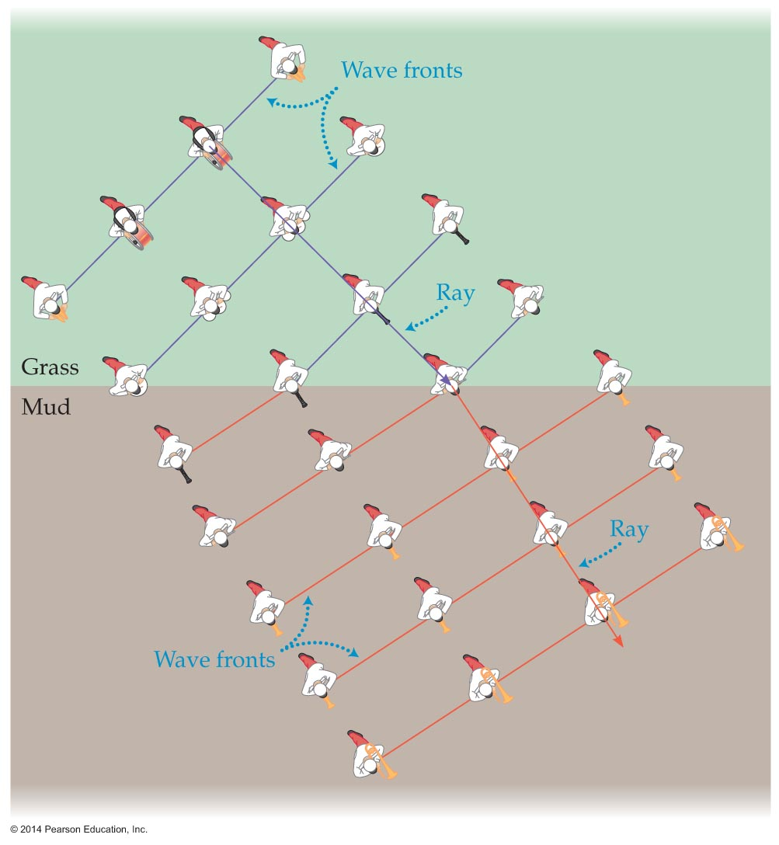
Refraction
Changing the speed of light can change its direction.
To see how this can occur, consider a high-school marching band such as the one shown in the figure below.
The band consists of several rows, each like a wave front in a beam of light. The direction of marching is indicated by a "ray" that is perpendicular to the "wave fronts."

Slide 8
Refraction
Now suppose the band encounters a section of the field that is muddy. As band members on one end of each row encounter the mud, they slow down.
The members still in the grass continue with their usual speed.
This difference in speed causes the "wave fronts" to bend as they enter the muddy area. As a result, the band is traveling in a different direction in the mud.
In general, a change in direction due to a change in speed is referred to as refraction.

Slide 9
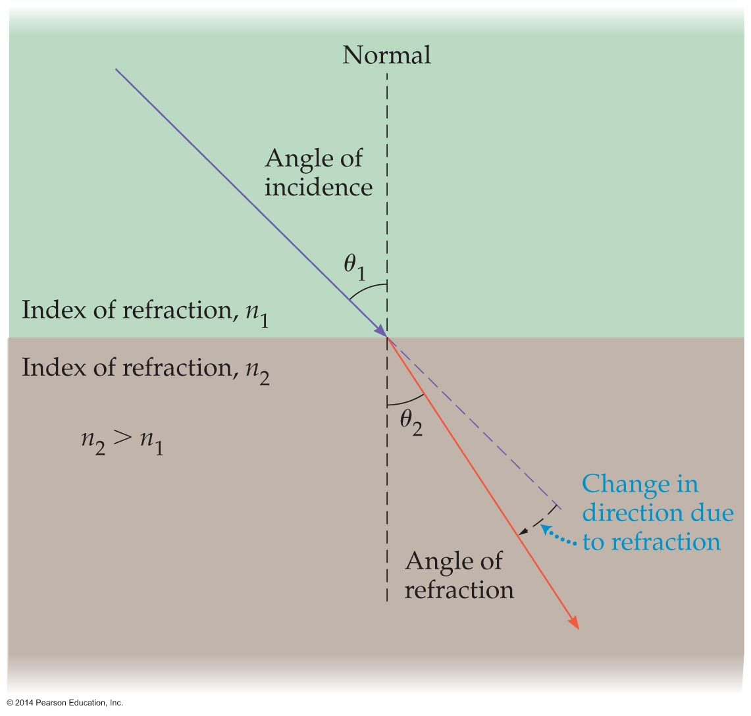
Refraction
For light, refraction generally occurs when it passes from one material to another. The exception is when light is perpendicular to the boundary between two materials.
To describe the new direction of travel, consider the simplified situation shown in the figure below.

Slide 10
Refraction
In the figure, only "rays" for the band in the grass (material 1) and in the mud (material 2) are shown. The normal to the boundary between the grass and the mud is shown with a dashed line.
The ray in material 1 makes an angle θ₁ with the normal. The ray in material 2 makes an angle θ₂ with the normal.
If the index of refraction of material 1 is n₁ and the index of refraction of material 2 is n₂, the angles in these two materials are related by Snell's law:

Slide 11
Refraction
Snell's law is stated as follows:
We refer to θ₁ as the angle of incidence and θ₂ as the angle of refraction.

Slide 12
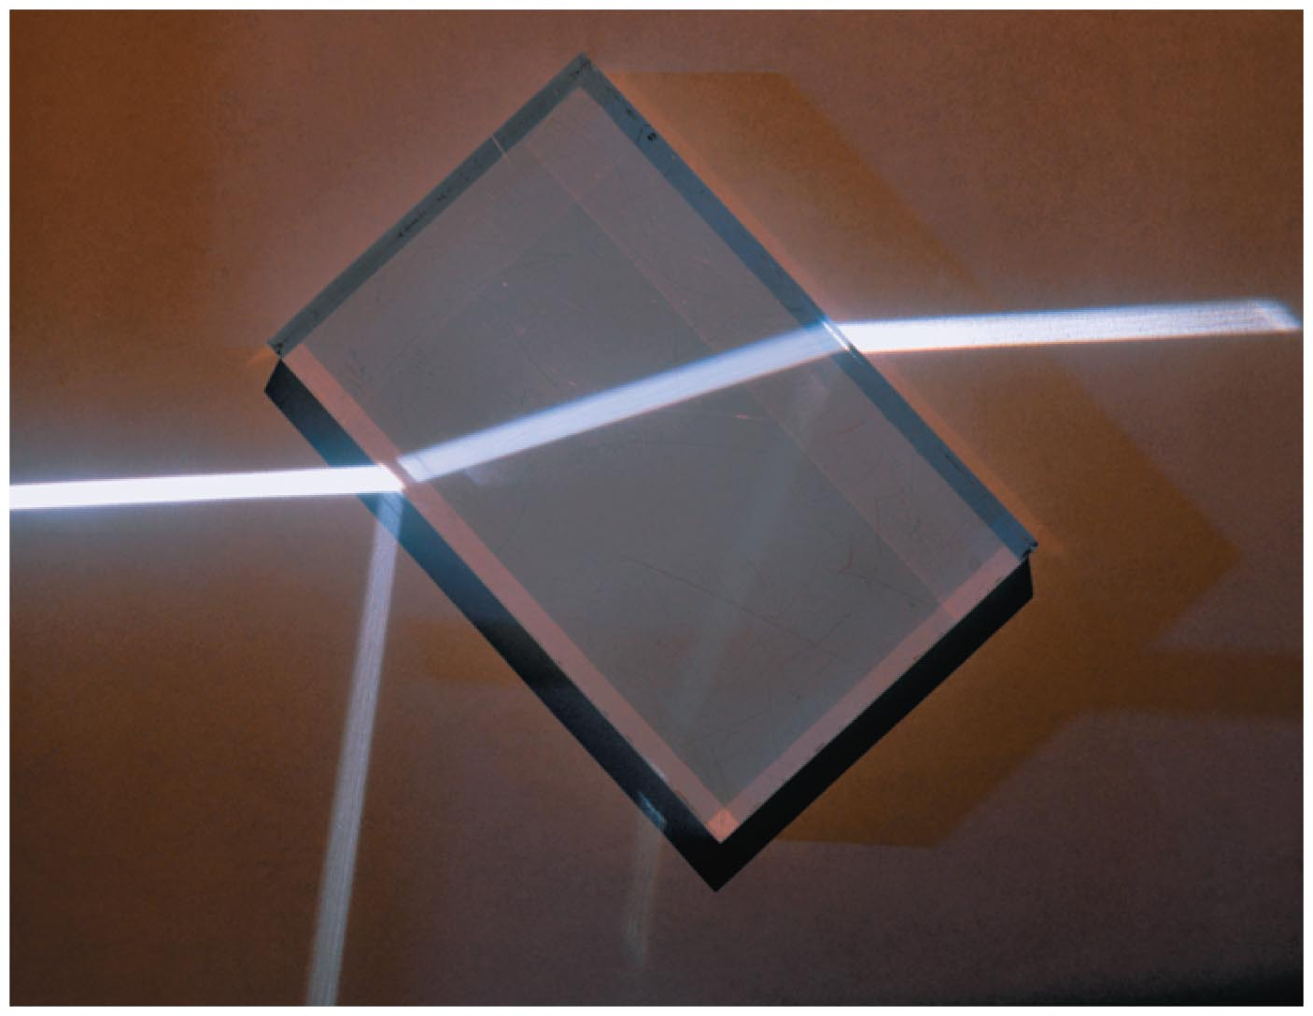
Refraction
In general, whenever light—or any wave—encounters a boundary between two different materials, some of the light is reflected and some is refracted (a small amount may also be absorbed).
The figure below shows light reflecting and refracting as it passes from air to glass. The direction of the reflected ray is given by the law of reflection, and the direction of the refracted ray is given by Snell's law.

Slide 13
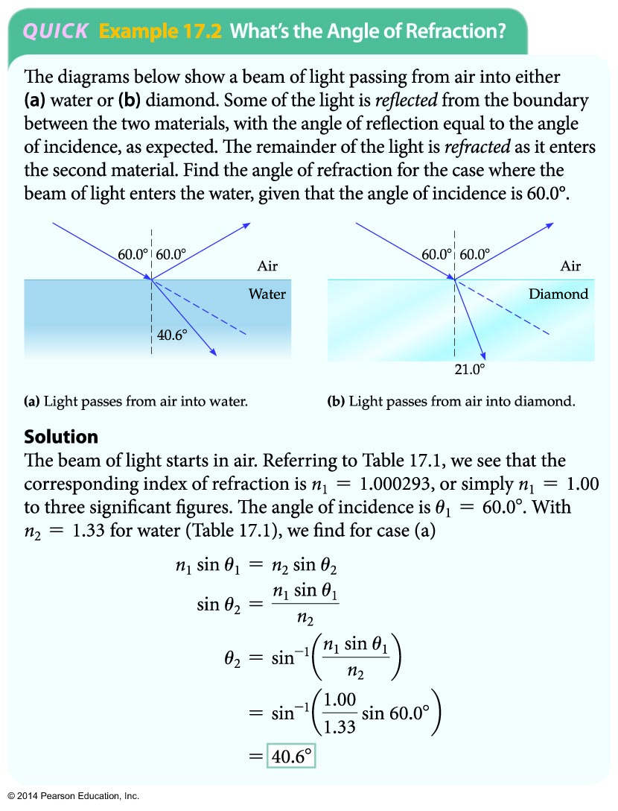
Refraction
The following example illustrates how Snell's law is applied.

Slide 14
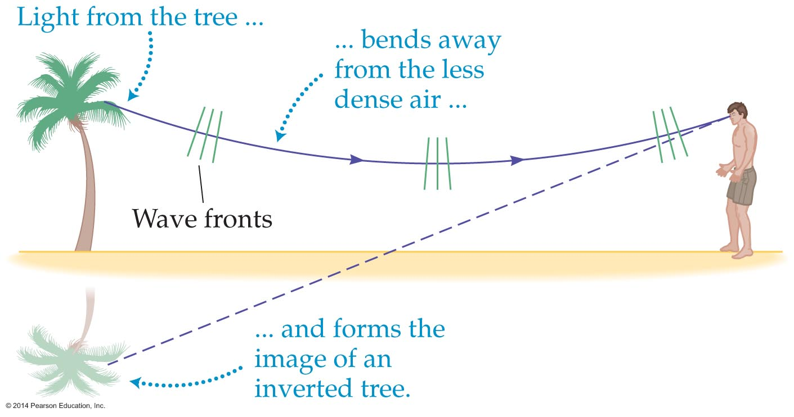
Refraction
A mirage is an optical illusion caused by the refraction of light. To see the connection between refraction and a mirage, consider the figure below.
The mirage illustrated in the figure is produced when light bends upward due to the low index of refraction of heated air near the ground.

Slide 15
Refraction
Because of this low index of refraction, the speed of light is greater near the ground. As a result, the bottom of the wave front moves farther in a given amount of time than the top of the wave front. This causes the wave front to rotate, so much so that the rays of light are heading upward, away from the ground.
As a result, the upward-moving light rays can enter the eye of an observer. To the observer, it looks like the light has come from the ground—exactly as if it had been reflected from a pool of water.

Slide 16
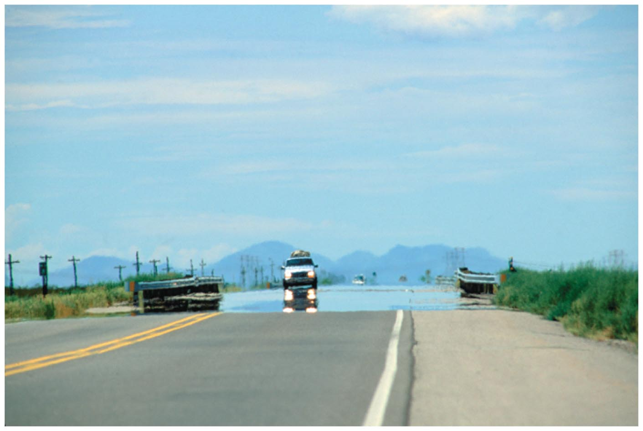
Refraction
The blue color that so resembles water to our eyes is actually an image of the sky, refracted by the hot, low-density air just above the road (see figure below).

Slide 17
Refraction
The basic features of refraction, all of which are consistent with Snell's law, are summarized below.
  Light is bent toward the normal when it slows down because it has entered a material with a higher index of refraction.
  Light is bent away from the normal when it speeds up because it has entered a material with a lower index of refraction.
  The greater the change in the index of refraction, the greater the change in direction of the light.
  If light goes from one material to another along the normal, it does not change direction.

Slide 18
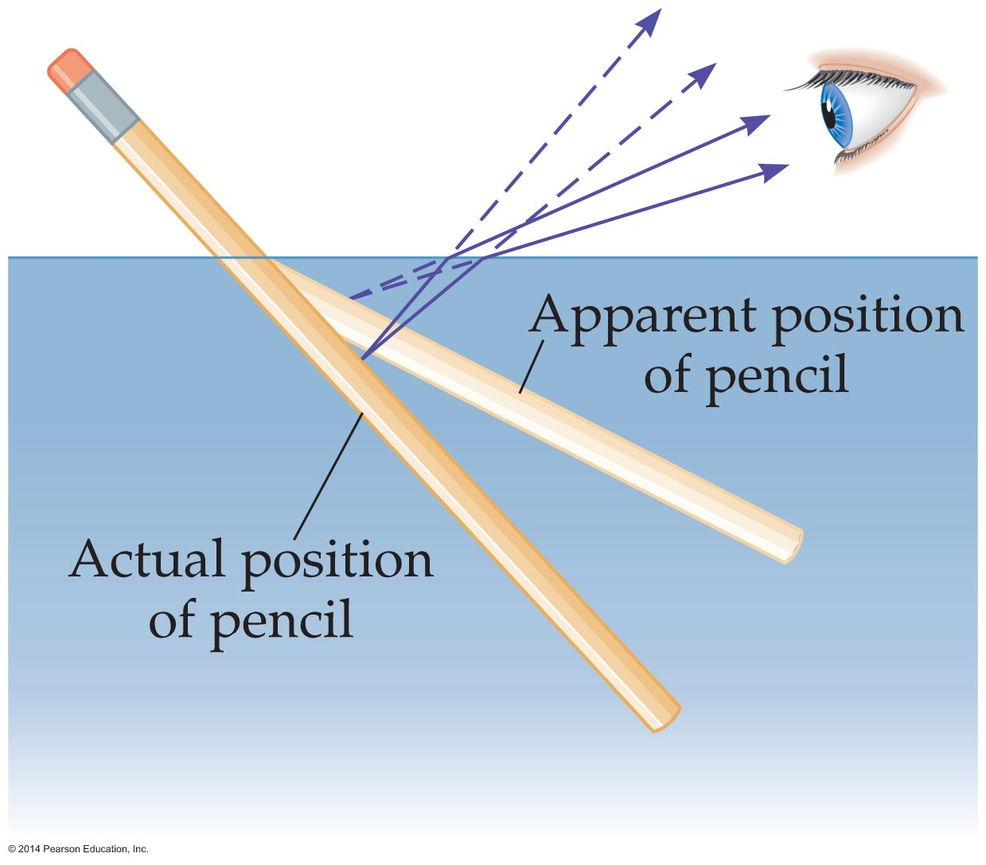
Refraction
The phenomenon shown in the figure below is an example of what is known as apparent depth, in which an object appears to be closer to the water's surface than it really is.
As the figure indicates, rays leaving the water are bent away from the normal and hence extend back to a point that is higher than the actual position of the pencil.

Slide 19
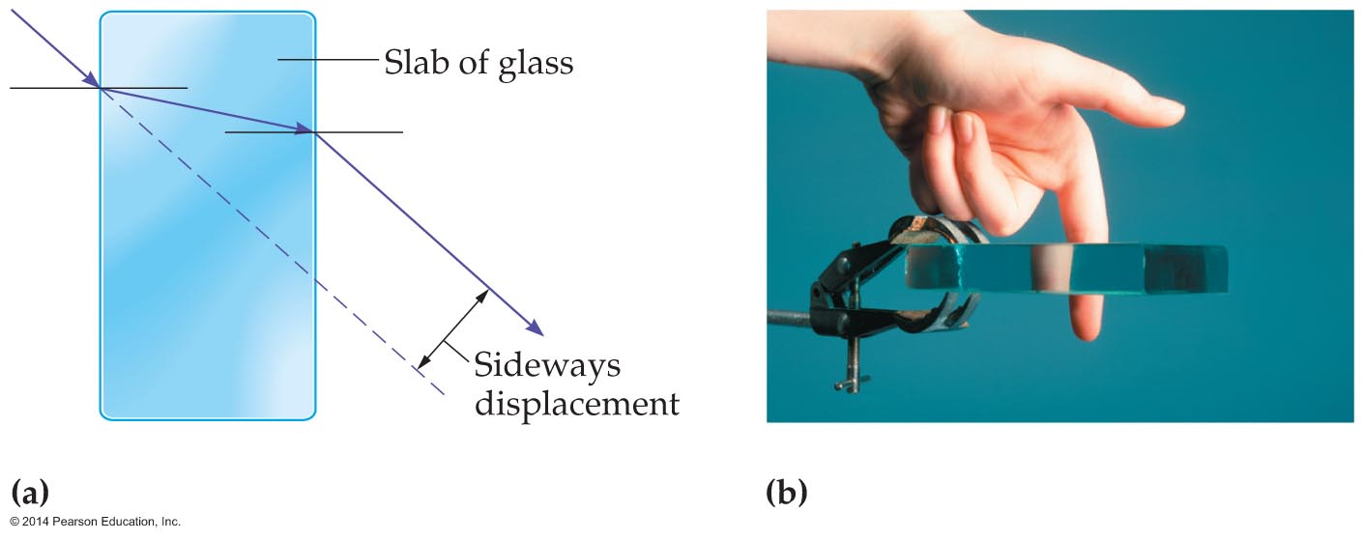
Refraction
Another example of refraction bending light is shown in the figure below.
As figure (a) shows, the light passing through a slab of glass is bent twice. Since the two changes in direction cancel, the final direction of the light is the same as the original.

Slide 20
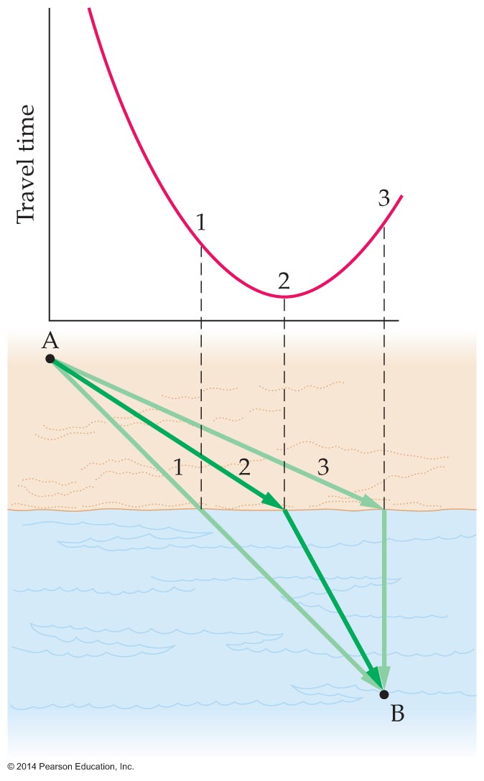
Refraction
Figure (b) shows that the light has been displaced, however, by an amount proportional to the thickness of the slab. The finger behind the slab of glass appears disjointed, because light is refracted as it passes through the slab.
Imagine you're a lifeguard at a beach. You're on the sandy beach at point A as shown in the figure below.

Slide 21
Refraction
You suddenly see a swimmer who needs help in the water at point B. You want to get to the swimmer as quickly as possible, so what route do you take?
As it turns out, a lifeguard, starting out at point A, who runs on the beach and then swims in the water can reach the swimmer at point B in the least time by following path 2. This path obeys Snell's law and is the one that light follows in a similar situation.
This means that refraction obeys the principle of least time, as does reflection.

Slide 22
Applications of Refraction
Refraction plays a key role in many technological applications. It is also responsible for many of the beautiful optical effects found in nature.
If you have ever looked upward from the bottom of a swimming pool, you've probably noticed an interesting effect. Directly overhead you see the ceiling or the sky. As you look farther away from the vertical, however, you can no longer see out of the pool. Instead, you see the bottom of the pool. Why is this so?

Slide 23
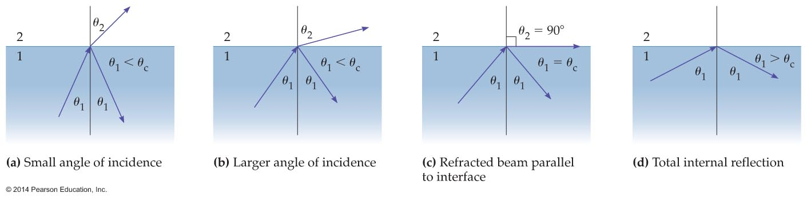
Applications of Refraction
The figure below will help you understand the phenomenon.
Figure (a) shows a ray of light in water encountering a water-air boundary. Part of the light is reflected back into the water at the boundary, as if from the surface of a mirror. The rest of the light emerges into the air.

Slide 24
Applications of Refraction
If the angle of incidence is increased, as in figure (b), the angle of refraction increases as well.
At a critical angle of incidence, θ_{c}, the refracted beam no longer enters the air but instead is parallel to the water-air boundary. This is shown in figure (c). In this case, the angle of refraction is 90°.
For angles of incidence greater than the critical angle, as shown in figure (d), all of the light is reflected back into the water.

Slide 25
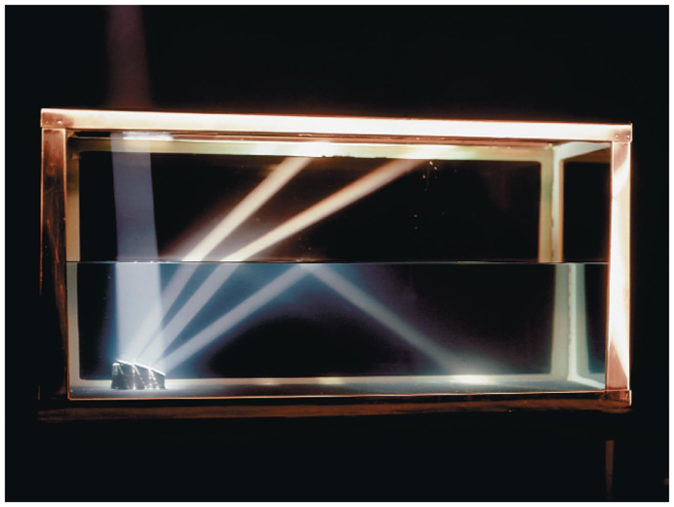
Applications of Refraction
When light is completely reflected back into the original material in which it was traveling, we say that it has undergone total internal reflection.
Total internal reflection can occur only when light is trying to enter a material with a lower index of refraction.
The figure below shows an example of total internal reflection.

Slide 26
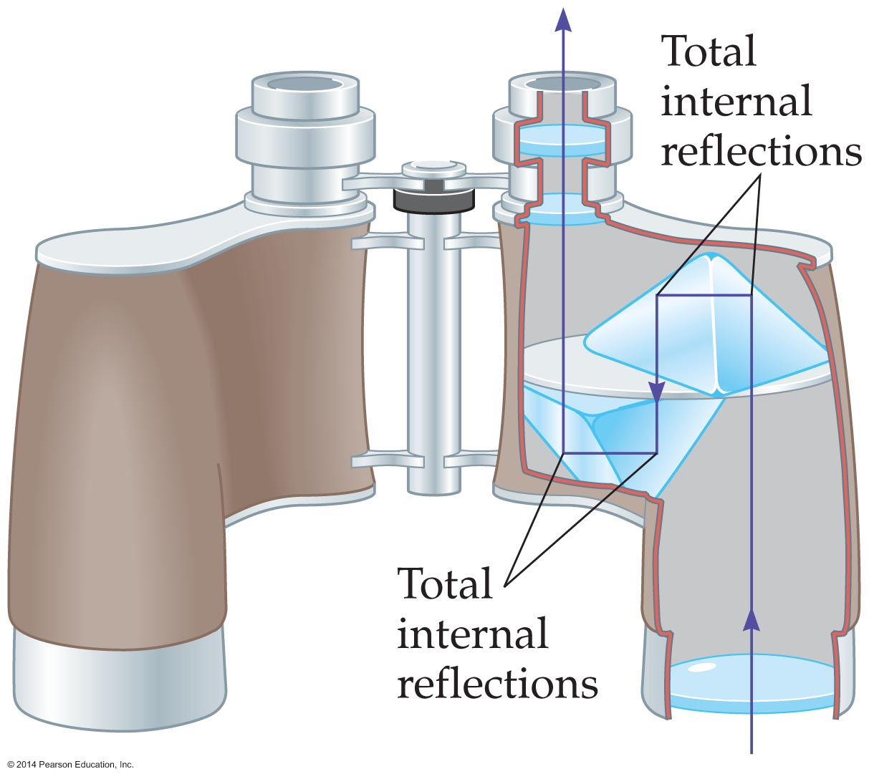
Applications of Refraction
Total internal reflection has many applications.
For example, many binoculars contain a pair of prisms –called Porro prisms—that use total internal reflection to "fold" a relatively long light path into the short length of the binoculars, as is shown in the figure below.

Slide 27
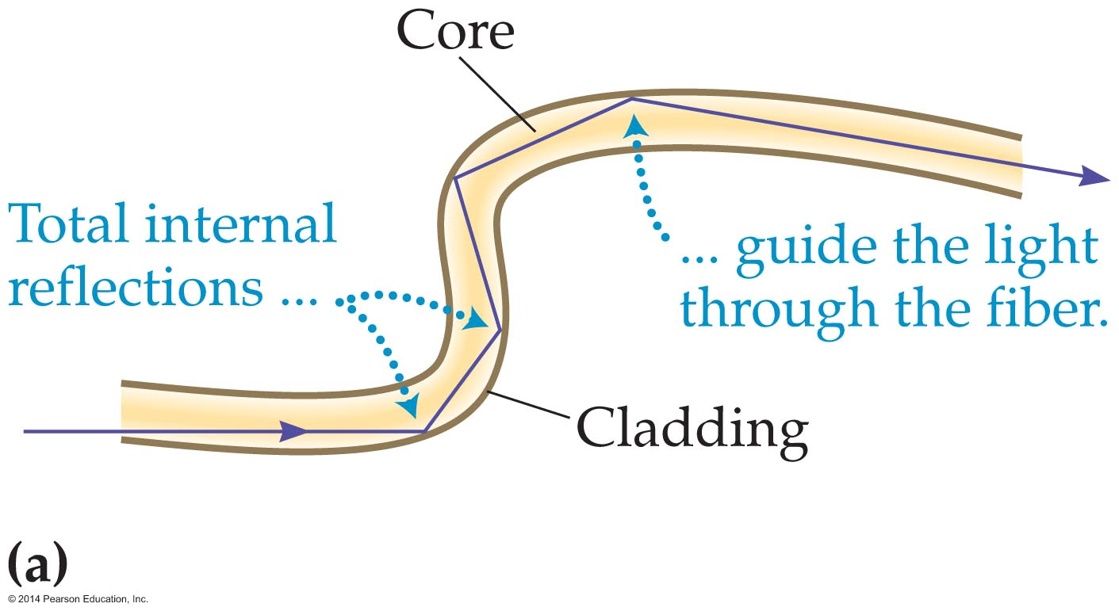
Applications of Refraction
Optical fibers are another important application of total internal reflection. As the figure below shows, an optical fiber channels light along its core by means of a series of total internal reflections between a core and an outer coating called cladding.

Slide 28
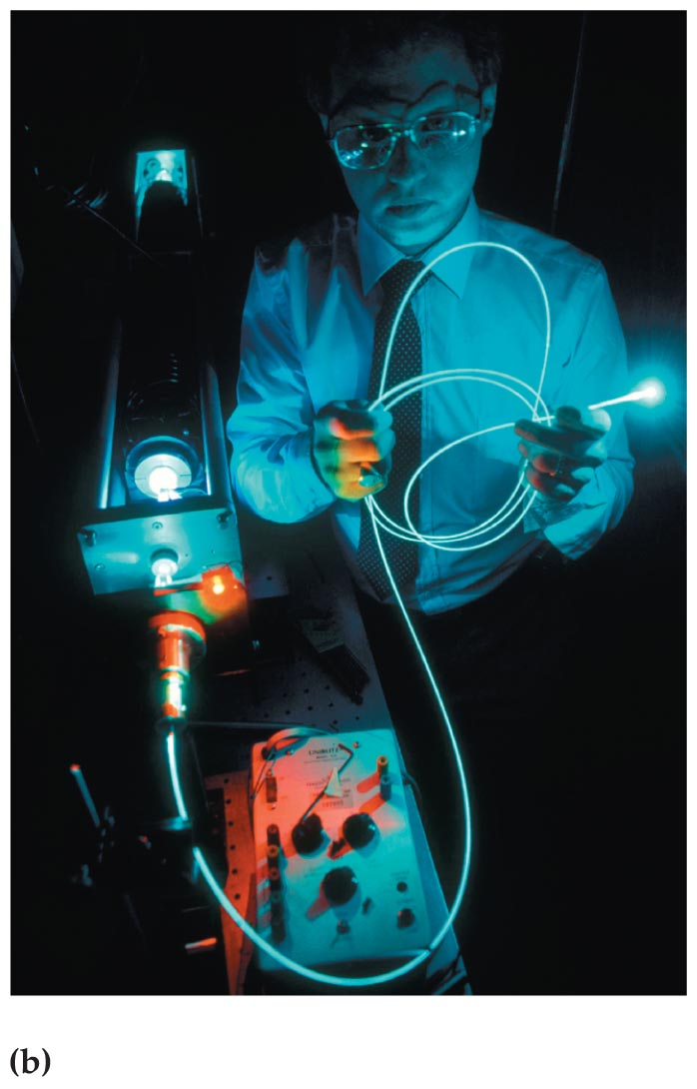
Applications of Refraction
The figure below shows how total internal reflection makes it possible to send light through an optical fiber, as if it were a "light pipe."

Slide 29
Applications of Refraction
Different materials—like air, water, and glass—have different indices of refraction. It turns out that the index of refraction of a given material also depends on the color of the light being refracted.
In general, a material has a higher index of refraction for light toward the blue end of the visible spectrum. This means that blue light bends more when refracted than red light does. This is why different colors of light travel in different directions after passing through a prism.
The spreading out of refracted light according to color is known as dispersion.

Slide 30
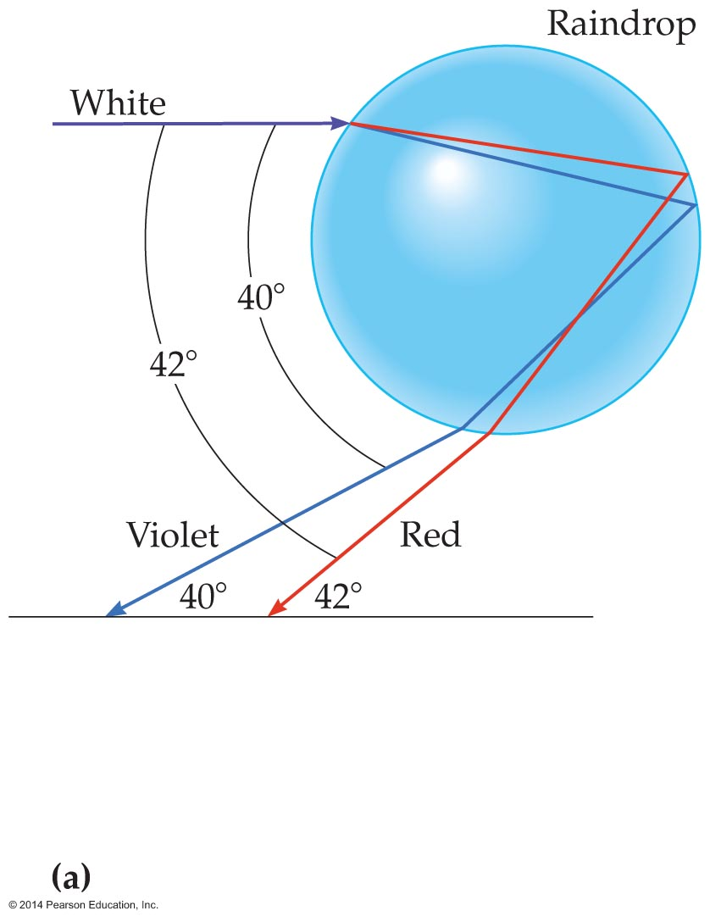
Applications of Refraction
Perhaps the most famous example of dispersion is the rainbow. Rainbows are produced by the dispersion of sunlight in raindrops.
The figure below shows a single drop of rain and incident beam of light. When sunlight enters the drop, it is separated into its red and violet components.

Slide 31
Applications of Refraction
As the figure shows, the light then reflects from the back of the drop, and finally refracts and undergoes additional dispersion as it leaves the drop.
The direction of light as it emerges from the water drop is almost opposite to its incident direction. The difference is only 40° to 42°, depending on the color of the light. To be specific, violet light corresponds to an angle of 40°, and red light corresponds to an angle of 42°.

Slide 32
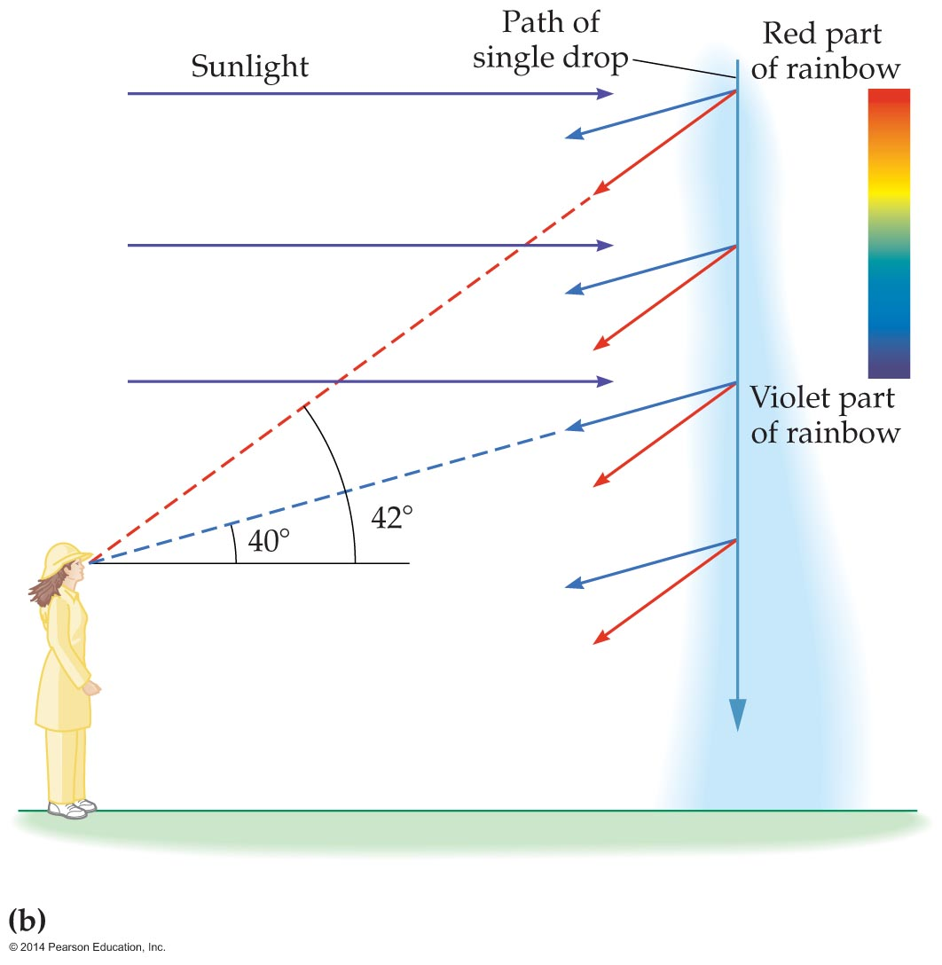
Applications of Refraction
Each drop is sending out light of all colors in different directions. When a drop is 42° above the horizontal, you see red light coming from it.
As the drop continues to fall, its angle above the horizontal decreases. Eventually, it reaches a height where this angle is 40°. At this point the violet light from the drop reaches your eye. In between, the drop sends out all the colors of the rainbow to your eye.

Slide 33
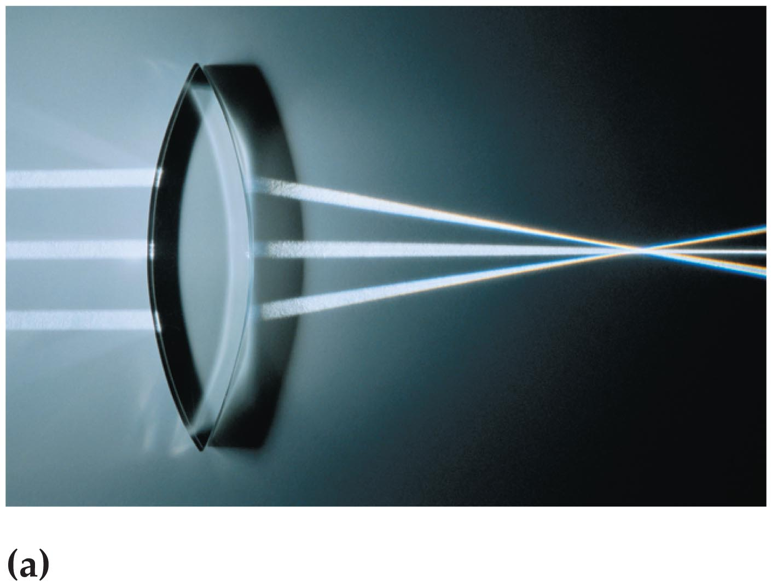
Lenses
A device that takes advantage of refraction and uses it to focus light is referred to as a lens.
Typically, a lens is a thin piece of glass with a curved surface.
Converging lenses take parallel rays of light and bring them together at a focus, as shown in the figure below.

Slide 34
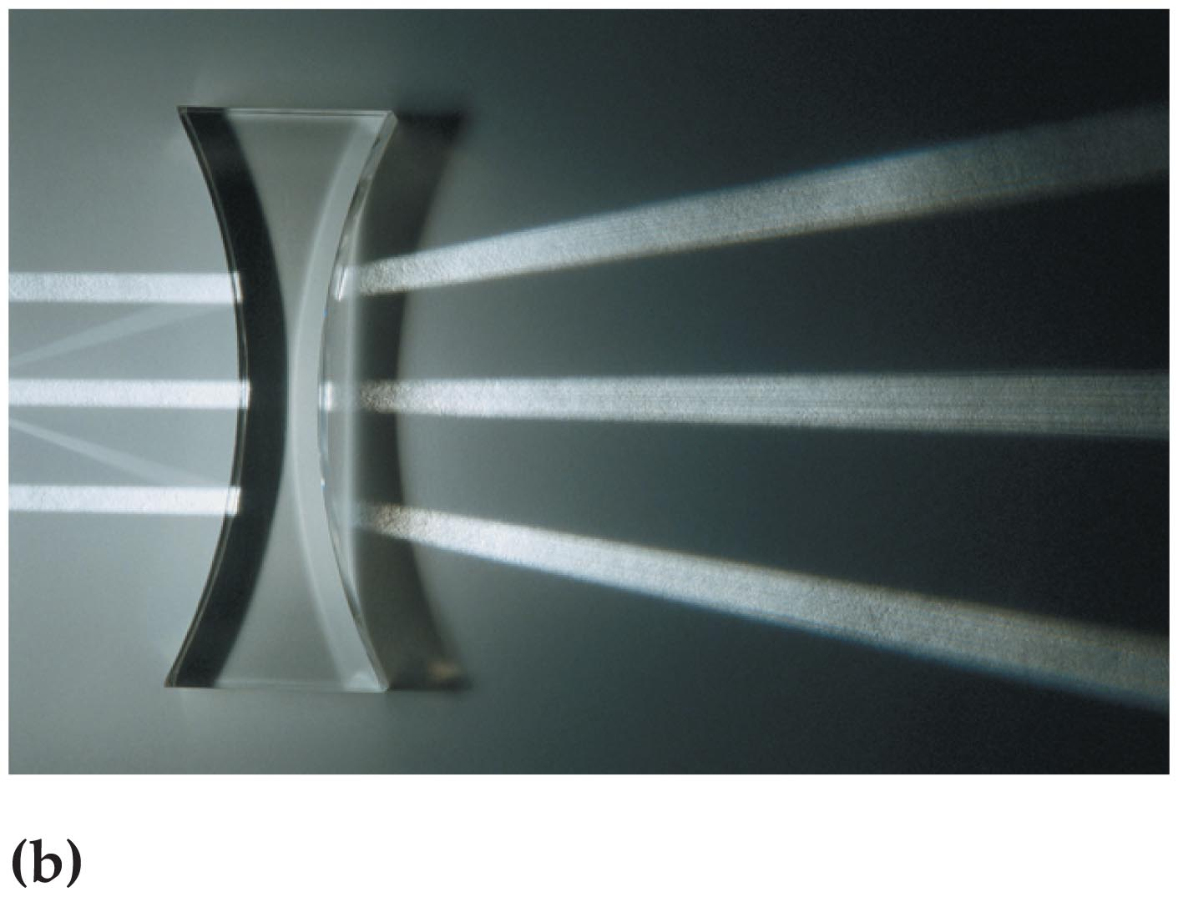
Lenses
Diverging lenses cause parallel rays to spread out as if diverging from a point. A diverging lens is shown in the figure below.
In general, a lens that is thicker in the middle converges light, and a lens that is thinner in the middle diverges light.

Slide 35
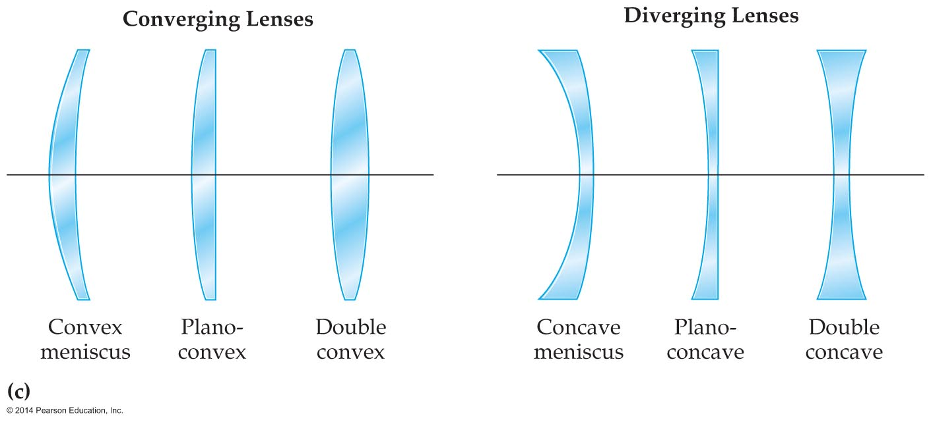
Lenses
A variety of converging and diverging lenses are shown in the figure below.

Slide 36
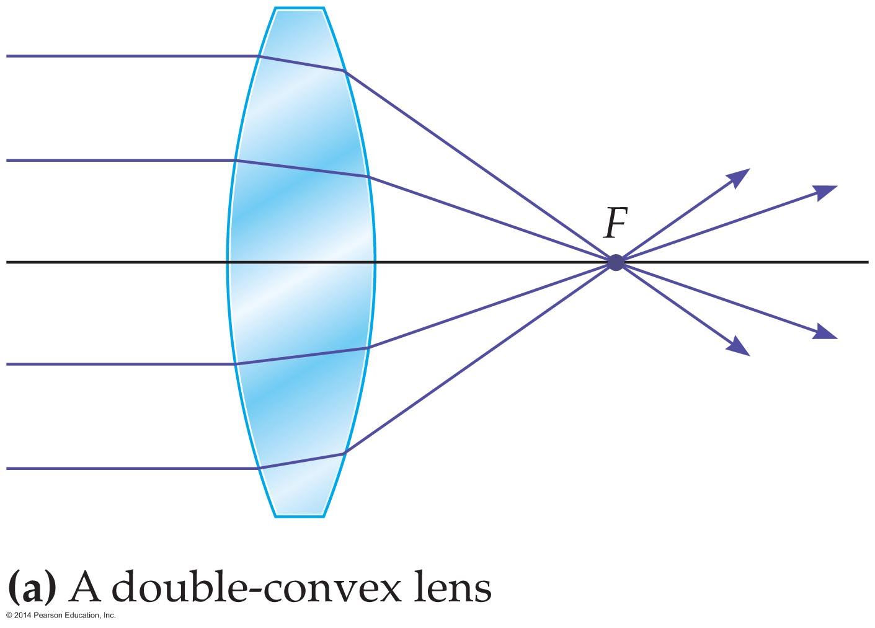
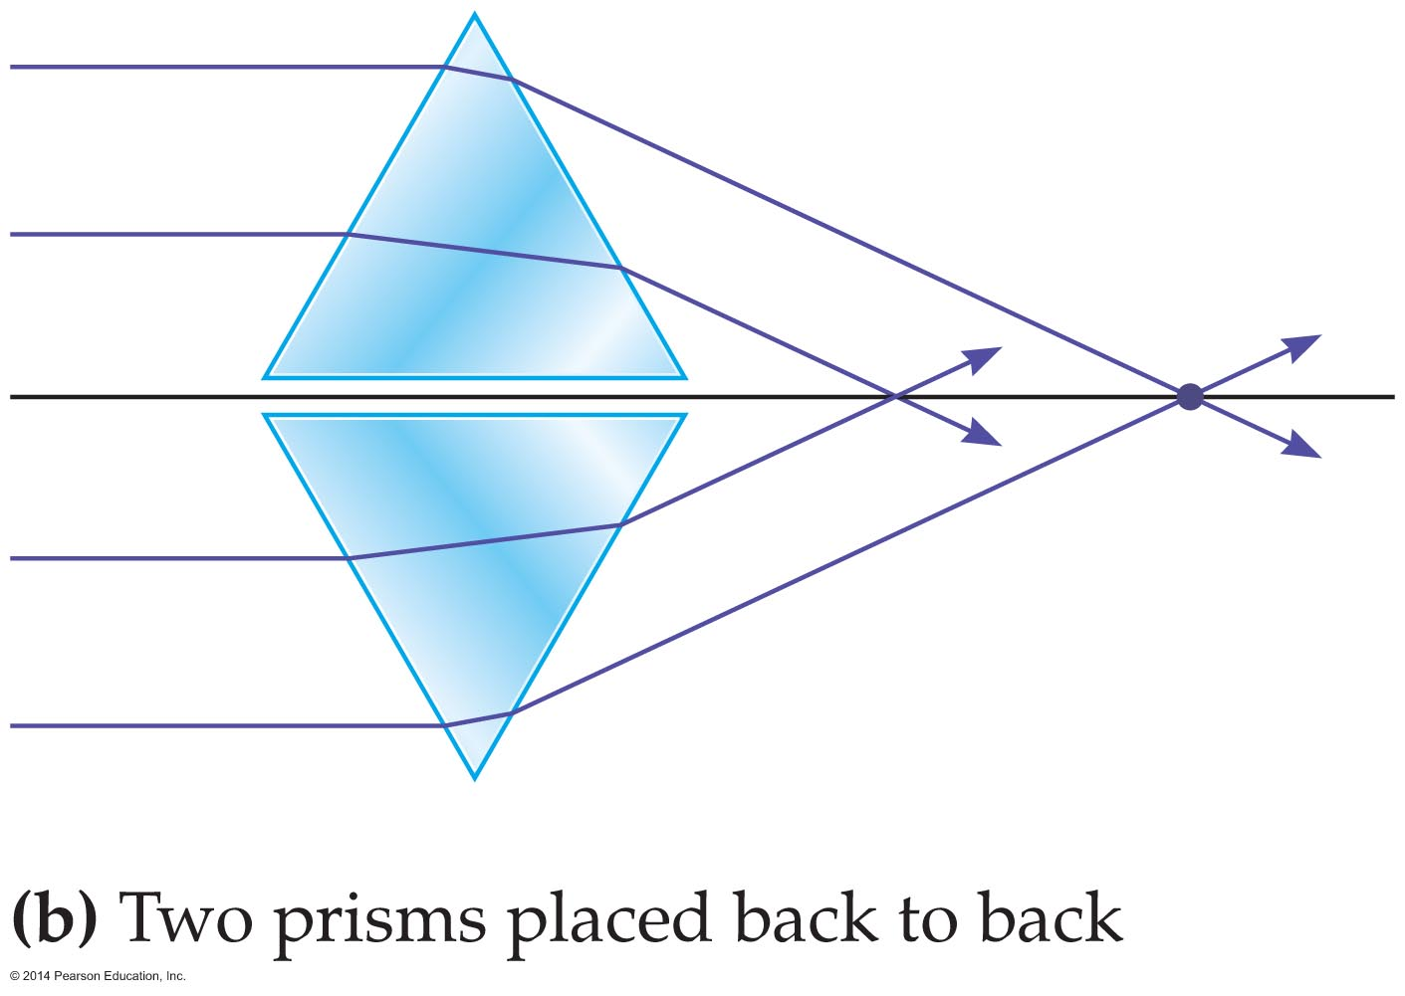
Lenses
The behavior of a convex lens is similar to that of two prisms placed back to back, as is shown below. In both cases light rays parallel to the axis are made to converge. The lens brings light to a focus at the focal point, F.

Slide 37
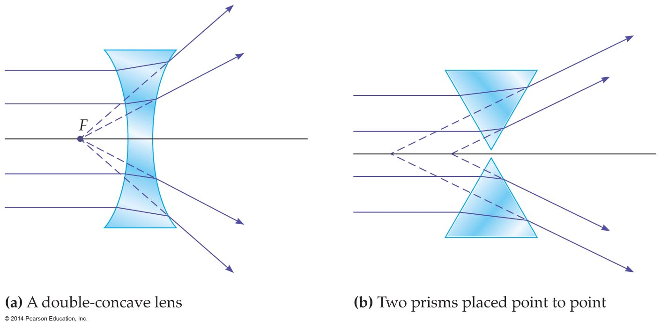
Lenses
A concave lens is similar to two prisms placed point to point (see figure below). In both cases parallel light rays are made to diverge. In the case of a concave lens, the diverging rays appear to originate from the focal point, F.

Slide 38
Lenses
Ray tracing is a simple and useful way to study the behavior of a lens. Ray tracing may be used to find the location, size, and orientation of an image produced by a lens, just as was done previously for mirrors.
There are three principal rays for lenses, and they are very similar to the three principal rays used with mirrors.

Slide 39
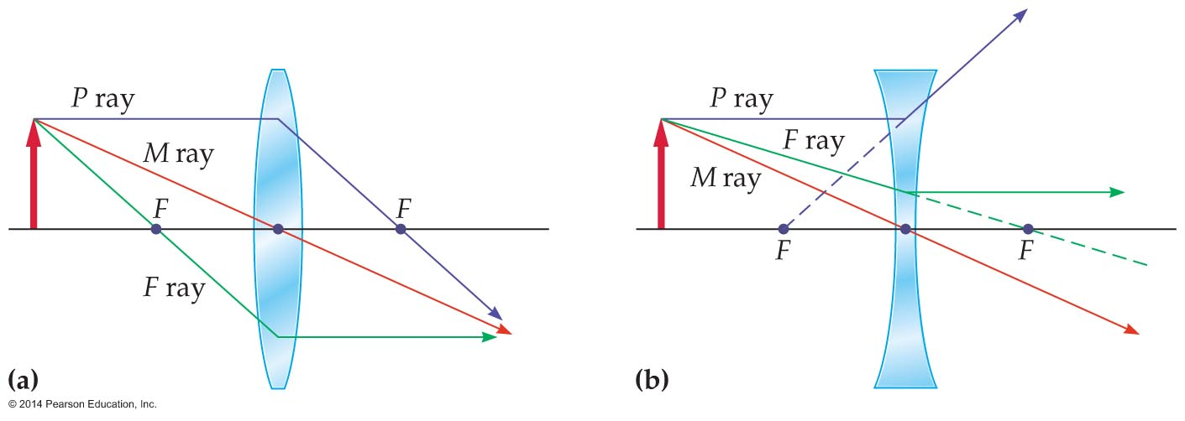
Lenses
The principal rays for a convex lens are shown in figure (a) below. Figure (b) shows the principal rays for a concave lens.

Slide 40
Lenses
The properties of the principal rays are as follows:
  The midpoint ray, or M ray, goes through the middle of the lens. The M ray continues in its original direction straight through the middle of the lens. The midpoint ray is shown in red.
  The parallel ray, or P ray, approaches a lens parallel to its axis. The P ray is bent so that it passes through the focal point, F, of a convex lens. The P ray extends back to the focal point, F, with a concave lens. The parallel ray is shown in purple.

Slide 41
Lenses
  The focal-point ray, or F ray, for a convex lens is drawn through the focal point and then to the lens. For a concave lens the F ray is drawn toward the focal point on the other side of the lens. In both cases, the lens bends the ray so that it is parallel to the lens's axis. The focal-point ray is shown in green.

Slide 42
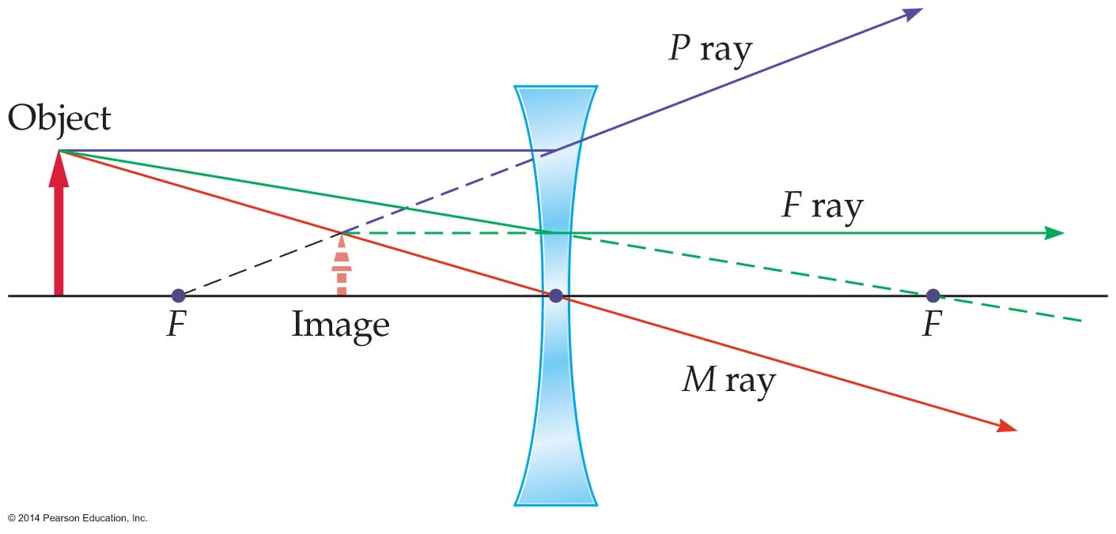
Lenses
To illustrate the use of ray tracing, consider the image formed by the concave lens in the figure below.
The three rays (P, F, and M) extend back to a single point on the left side of the lens. This point is the top of the image.
The image is upright, reduced in size, and virtual, since it is on the same side of the lens as the object. It is not possible to project this image on a screen.

Slide 43
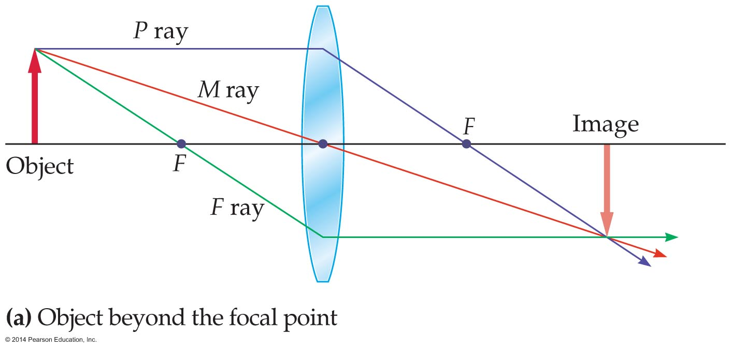
Lenses
The behavior of a convex lens is more interesting than that of a concave lens in that the type of image it forms depends on the location of the object.
In the figure below, the object is placed beyond the focal point. The resulting image is on the opposite side of the lens and upside-down. Light passes through the image, and so it is a real image that can be projected on a screen.

Slide 44
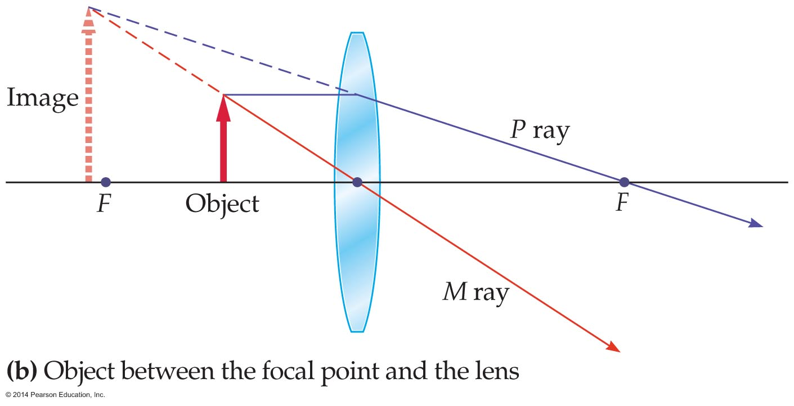
Lenses
The figure below shows the image produced when the object is placed between the lens and the focal point. Notice that the image is virtual (on the same side of the lens as the object), is upright, and cannot be projected on a screen.

Slide 45
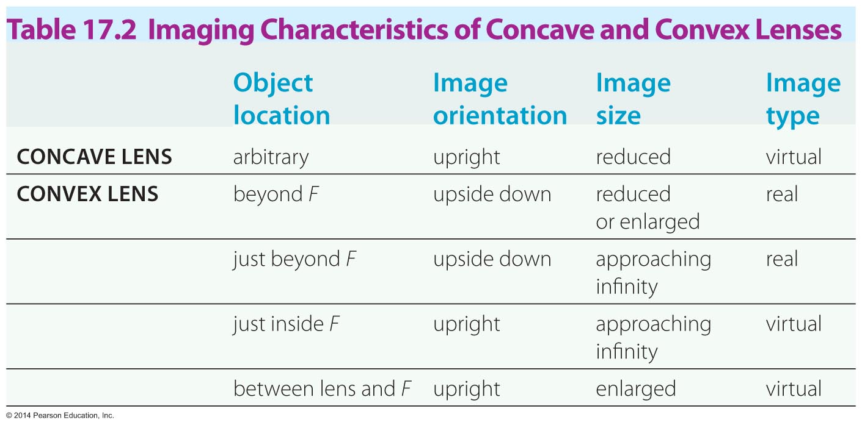
Lenses
The imaging characteristics of concave and convex lenses are summarized in the table below.

Slide 46
Lenses
The location of a lens's focal point depends on the index of refraction of the lens, as well as the index of refraction of the surrounding material.
For example, when a glass lens is placed in water, the light is bent less by the lens. Consequently, the focal length increases when a lens is placed in water.
This is the reason why you can't focus when your eyes are under water. Wearing goggles puts your eyes in contact with air, restoring your vision to normal.

Slide 47
Lenses
While ray tracing is very useful, images can be located more precisely with an equation. The thin-lens equation is a precise mathematical relationship between the object distance, image distance, and the focal length for a given lens.
Therefore, to calculate the precise location and size of an image formed by a lens, we use the thin-lens equation, which is identical in form to the mirror equation.

Slide 48
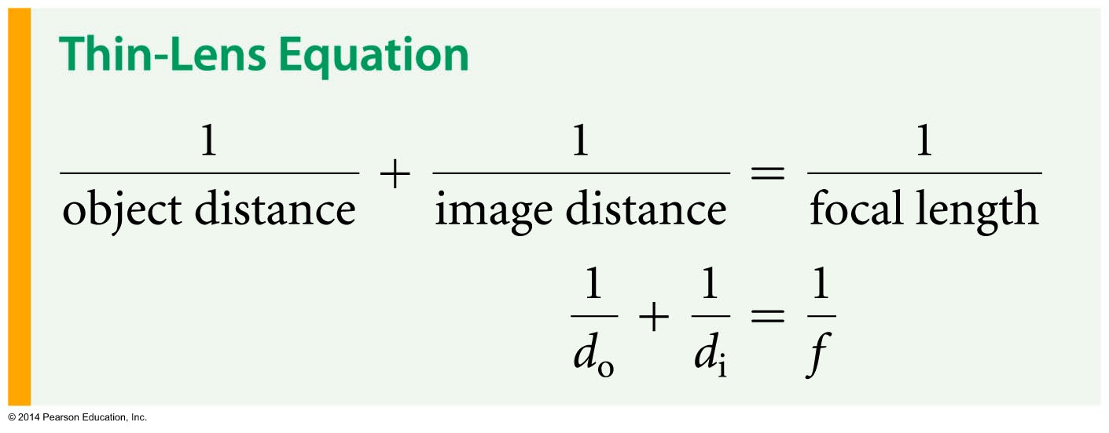
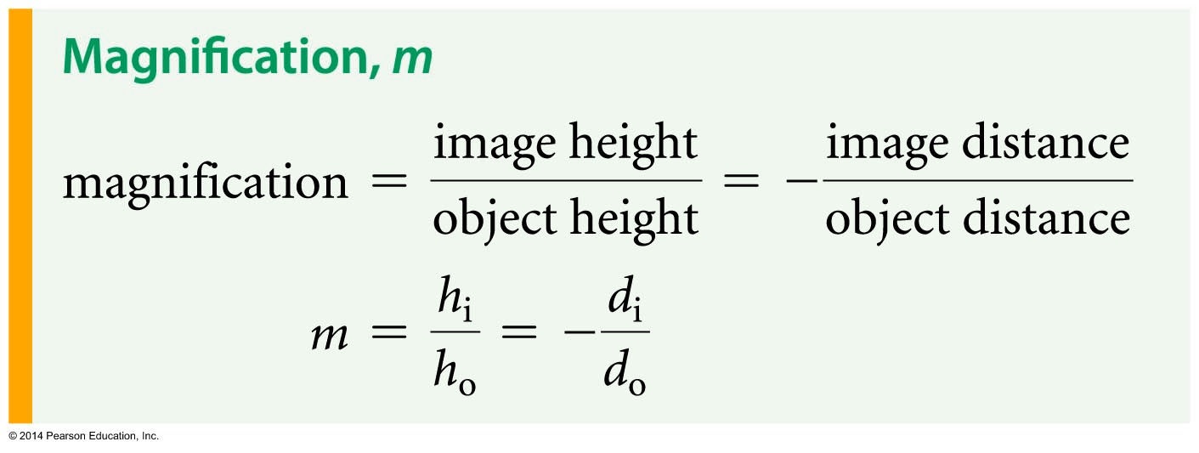
Lenses
The thin-lens equation is as follows:
The magnification, m, of an image is found in exactly the same way as for mirrors:

Slide 49
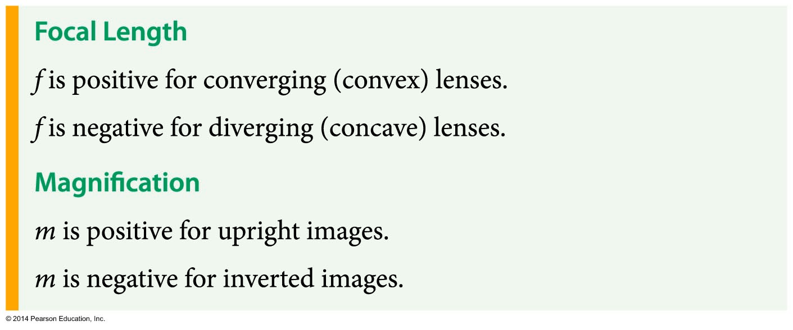
Lenses
As with mirrors, the sign of the magnification indicates the orientation of the image. The magnitude of the magnification gives the amount by which the image is enlarged or reduced compared with the object.
The sign conventions for lenses are summarized below:

Slide 50
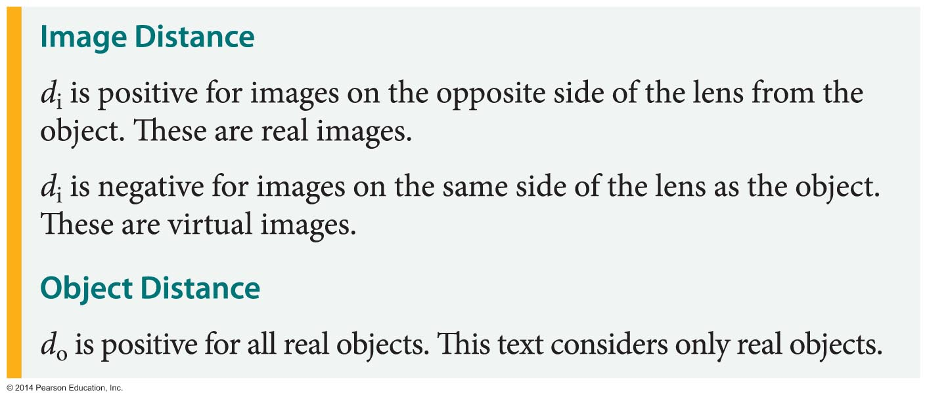
Lenses

Slide 51
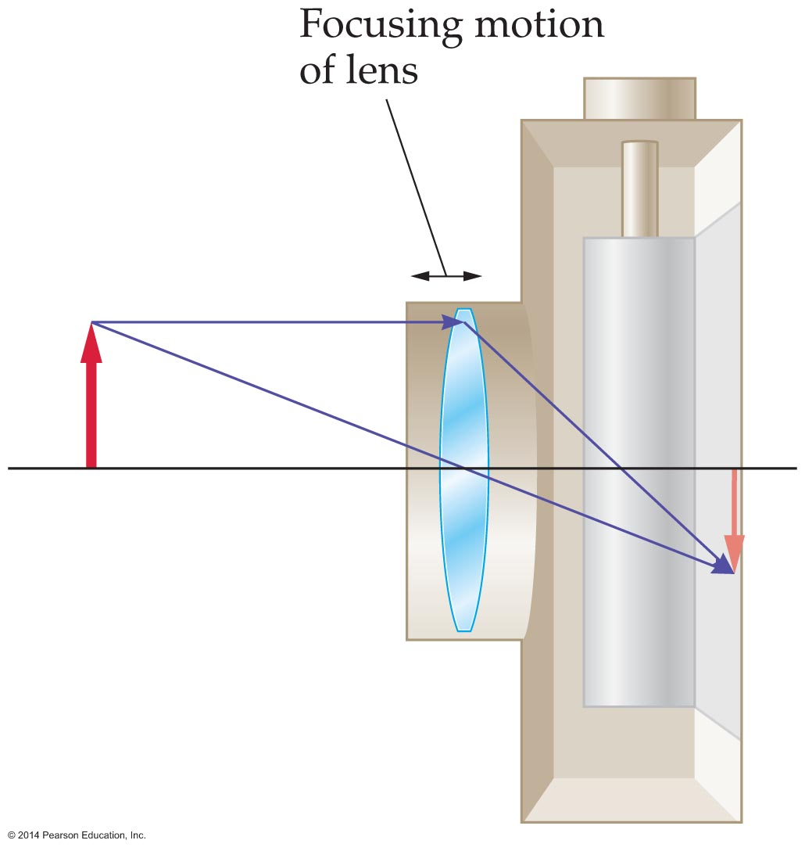
Applications of Lenses
The camera is a simple application of a lens.
The basic elements of a camera are shown in the figure below.
The lens forms a real, upside-down image on photographic film or an electronic sensor. The image is brought into focus by moving the lens back and forth. Unlike the adjustable shape of the human eye, the shape of the camera lens does not change.

Slide 52
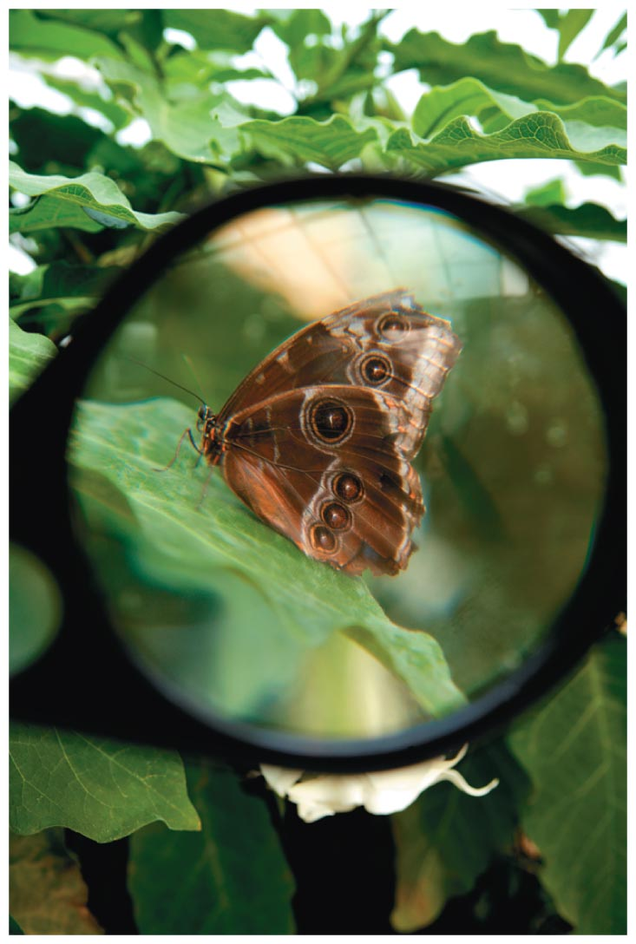
Applications of Lenses
A magnifying glass is nothing more than a simple convex lens. Even so, a magnifier can make objects appear many times larger than their actual size (see image below).
Typically, magnifiers produce images that are upright, enlarged, and virtual.

Slide 53
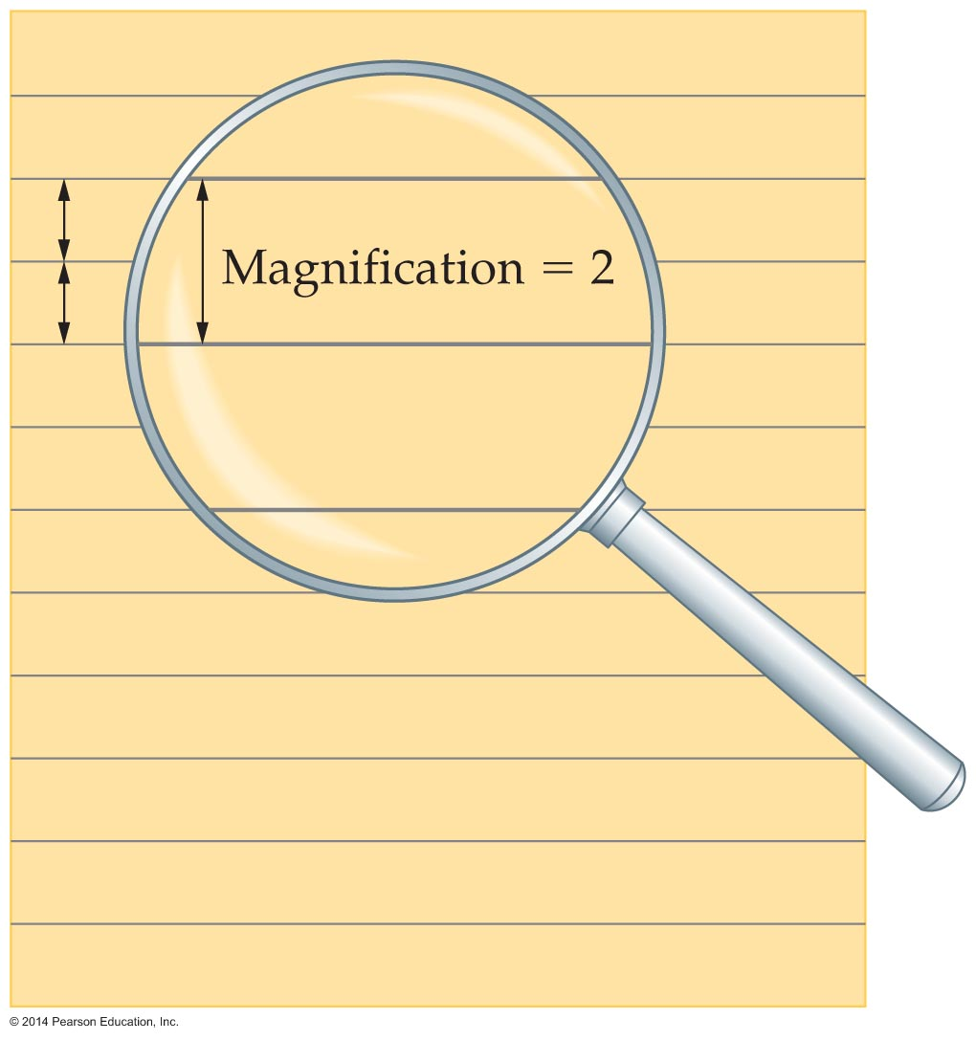
Applications of Lenses
The magnification of a magnifying glass can be determined by holding it over a page of ruled paper, as is indicated in the figure below.
In the figure, the magnified rules have twice as much space between them as the rules on the sheet of paper. It follows that this is a two-power (2x) magnifying glass.

Slide 54
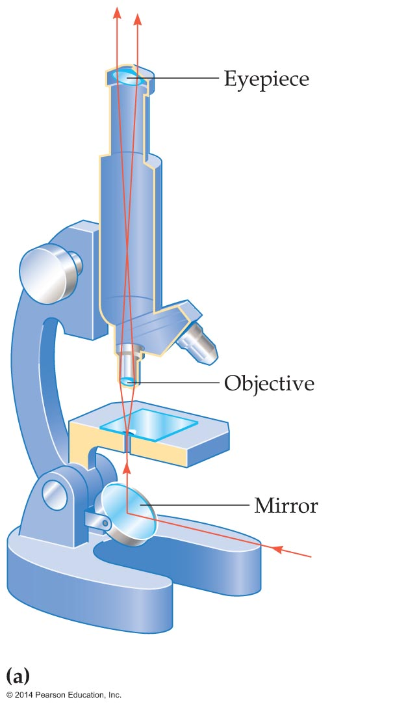
Applications of Lenses
Although the magnifying glass is a useful device, higher magnification and improved optical quality can be obtained with a microscope.
The simplest microscope, referred to as a compound microscope, consists of two converging lenses fixed at either end of a tube. An example of such a microscope is shown in the figure below.

Slide 55
Applications of Lenses
The basic optical elements of a microscope are the objective and the eyepiece.
The objective is a converging lens with a relatively short focal length that is placed near the object to be viewed. It forms a real, upside-down, and enlarged image.
This image serves as the object for the second lens—the eyepiece. In fact, the eyepiece is simply a magnifier that further enlarges the image produced by the objective.

Slide 56
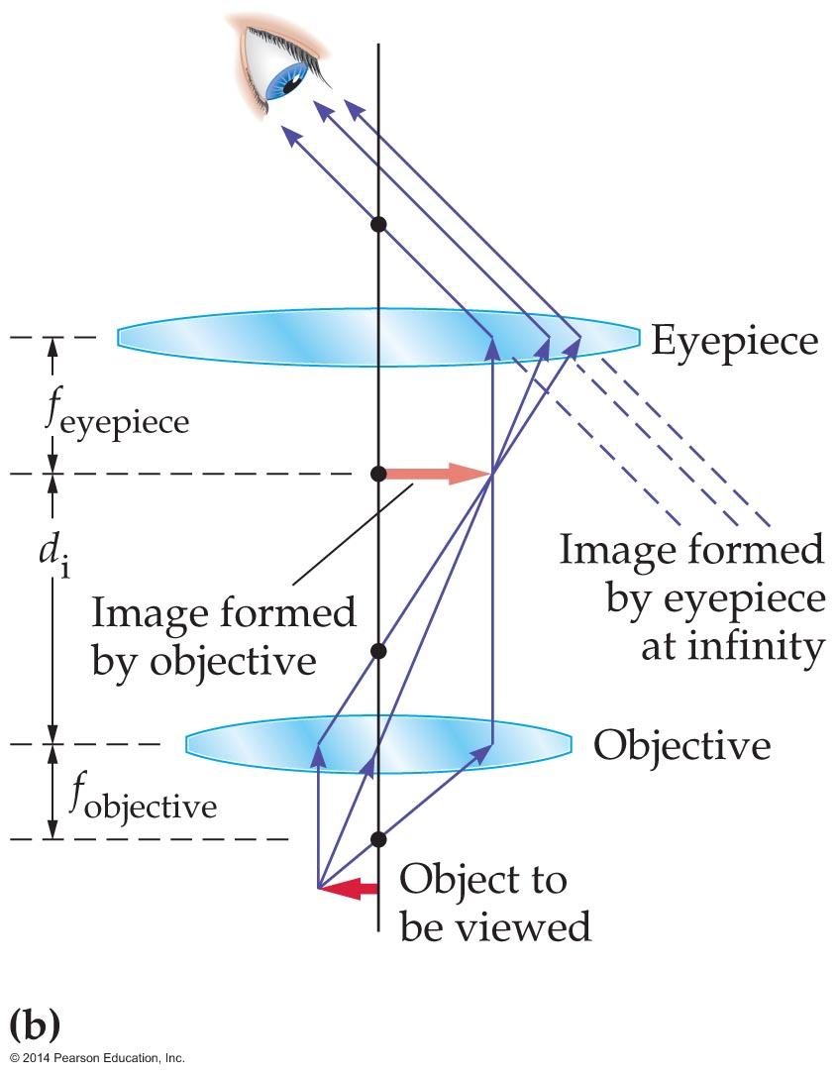
Applications of Lenses
The operation of a compound microscope is shown in the figure below.
The magnification of a microscope, such as the one shown above, is found by multiplying the magnification of the objective and the magnification of the eyepiece.

Slide 57
Applications of Lenses
A telescope is similar in many respects to a microscope. Both instruments use two converging lenses to produce a magnified image of an object.
In the case of a microscope, the object is small and close at hand. In the case of a telescope, the object is large—a planet or galaxy, perhaps—but its apparent size can be very small because of its great distance.
Because the object is essentially at infinity, the light entering the objective of a telescope is focused at the focal point of the objective, as is shown in the following figure.

Slide 58
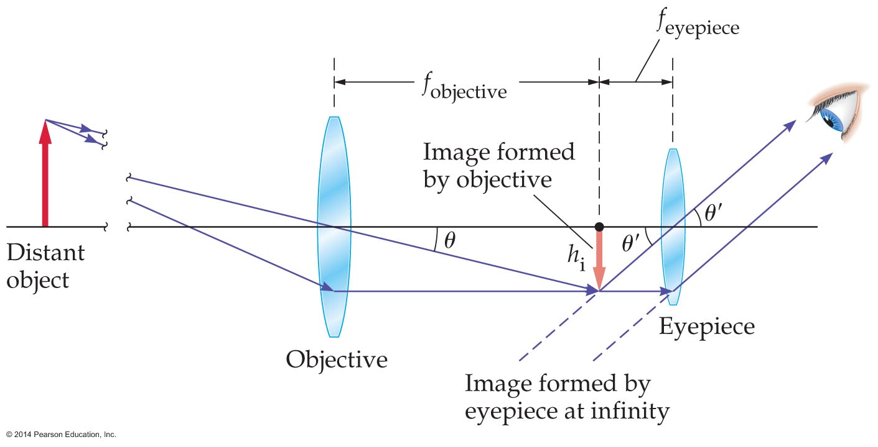
Applications of Lenses
As in a microscope, the image formed by a telescope's objective lens is the object for the eyepiece.
Thus, if the image from the objective is placed at the focal point of the eyepiece, it will form an image that is at infinity. In this configuration the observer can view the final image of the telescope with a completely relaxed eye.

Slide 59
Applications of Lenses
The magnification of a telescope is the ratio of focal lengths of the objective and the eyepiece.
An ideal lens brings all parallel rays of light that strike it together at a single focal point. Real lenses, however, never quite live up to the ideal.
A real lens blurs the focal point into a small but finite region of space. This in turn blurs the image.
The deviation of a lens from ideal behavior is referred to as an aberration.

Slide 60
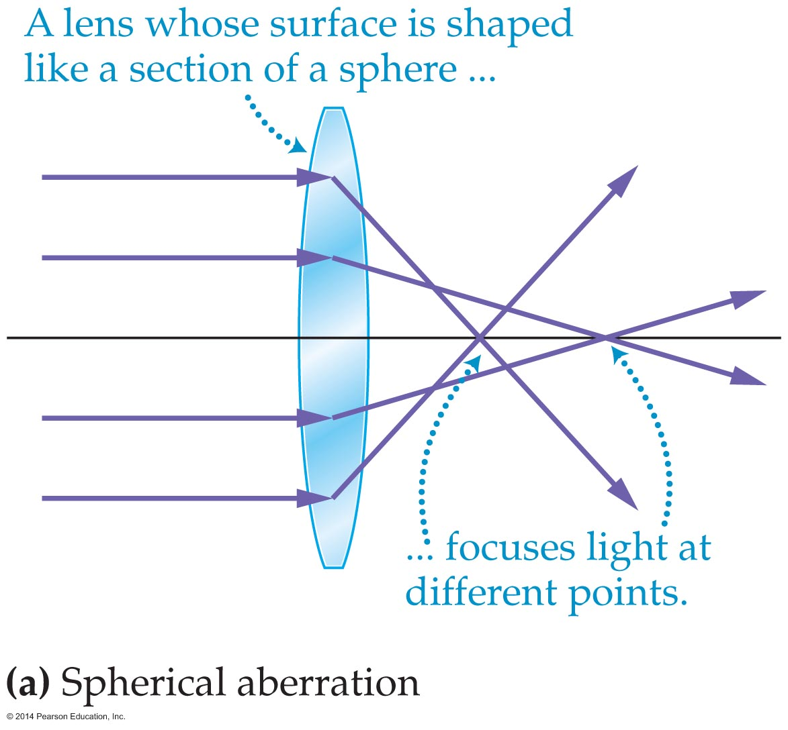
Applications of Lenses
Some lens shapes cause aberration. Spherical aberration occurs when a lens has a surface that is a section of a sphere.
The figure below shows a lens with a spherical shape that fails to focus parallel rays at a single focal point.

Slide 61
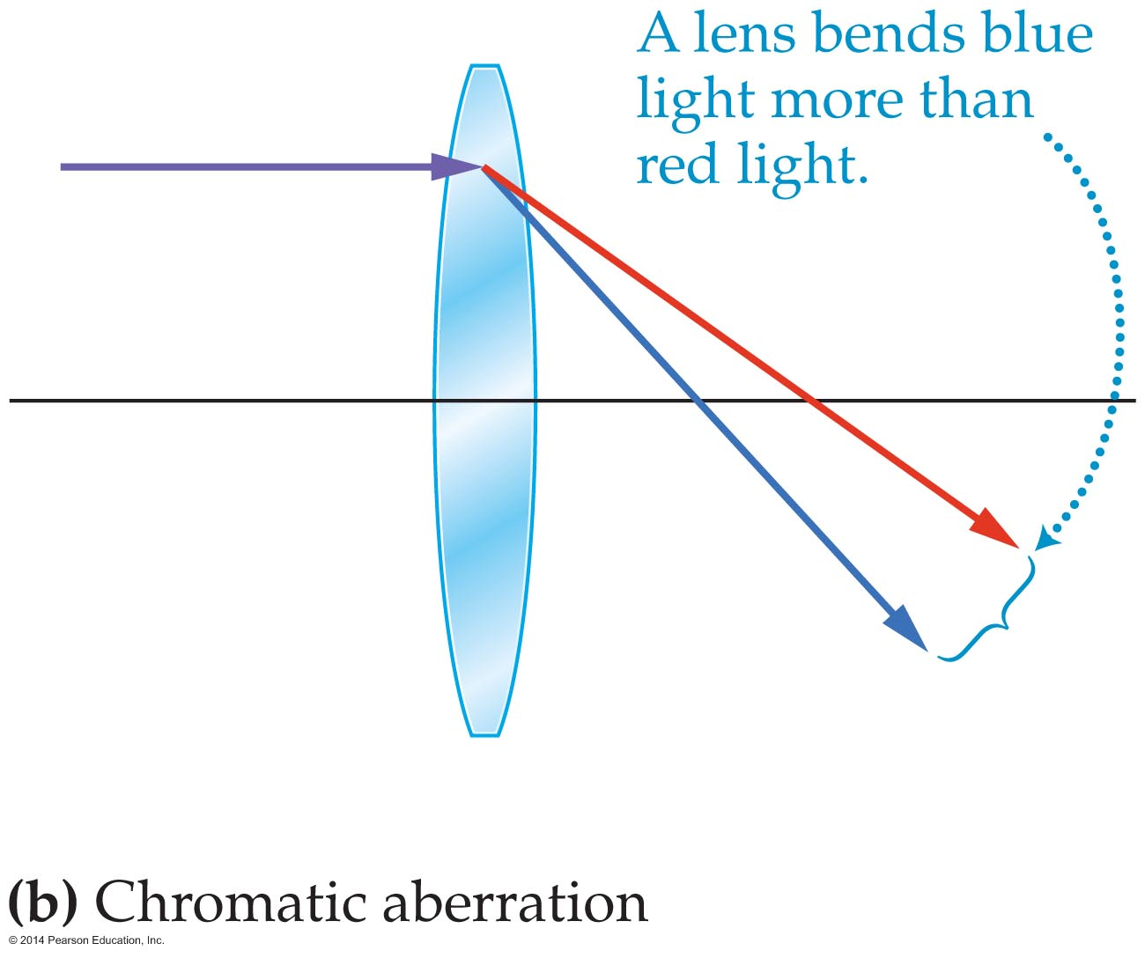
Applications of Lenses
Another common type of aberration is due to the basic properties of refraction. In general, chromatic aberration occurs when a lens bends light of different colors by different amounts. This is shown in the figure below.
As a result of chromatic aberration, white light passing through a lens does not focus at a single point.

Slide 62
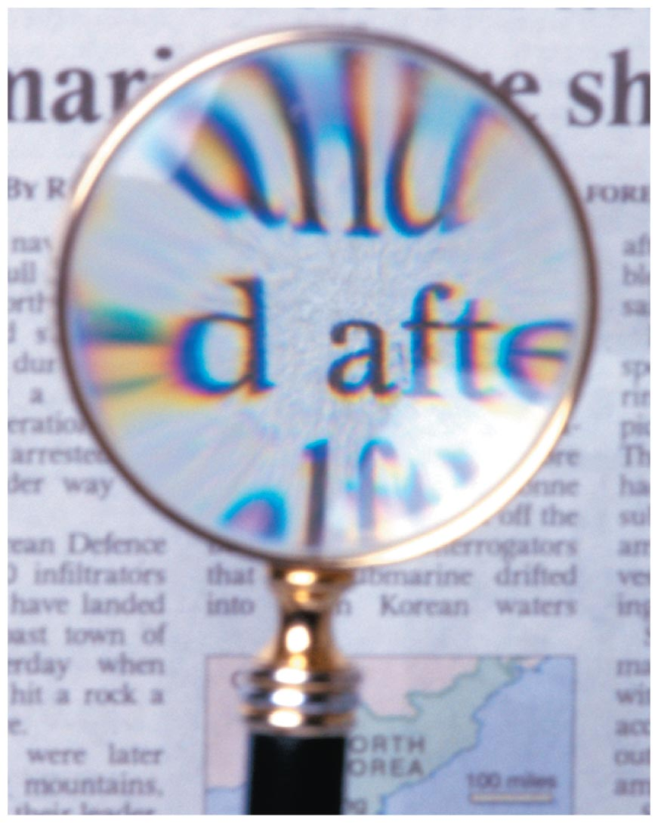
Applications of Lenses
This is why you sometimes see a fringe of color around an image seen through a simple lens, as is shown in the figure below.
Chromatic aberration can be corrected by combining two or more lenses to form a compound lens. This is done in 35-mm cameras, where five or more lenses may be used to correct for chromatic aberration.

Slide 63
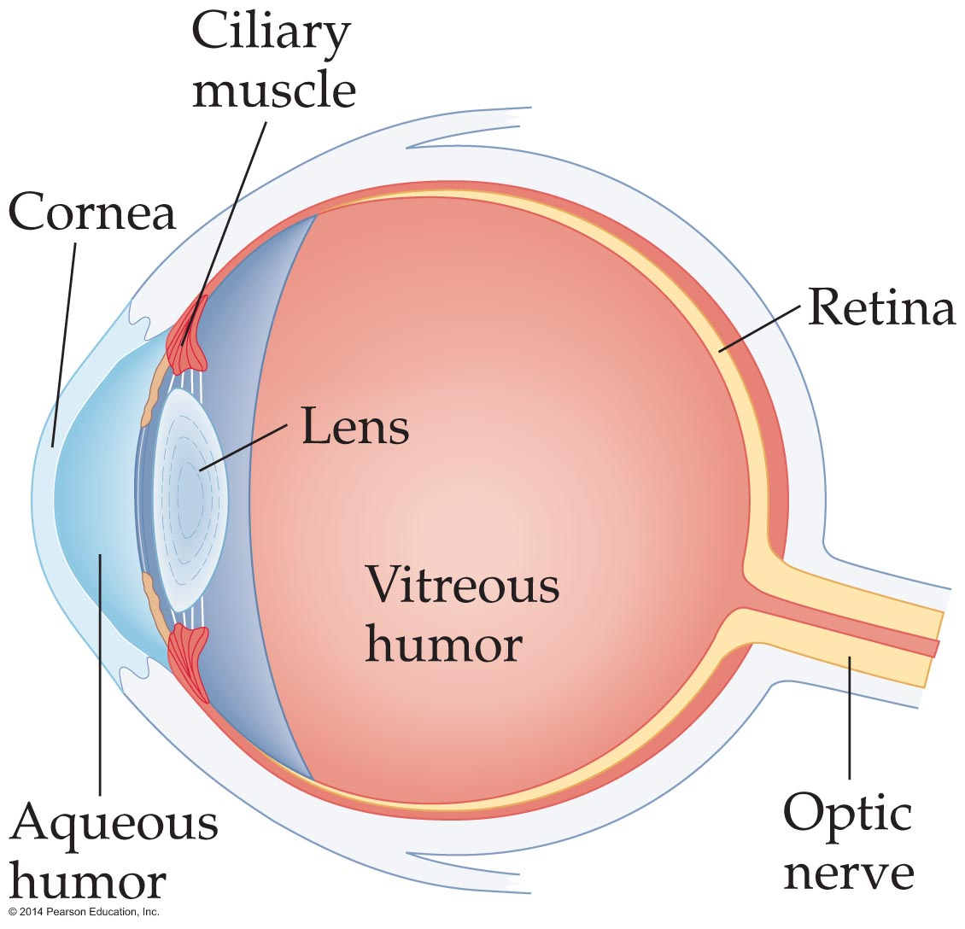
Applications of Lenses
The eye is a marvelously sensitive and versatile optical instrument. It allows us to observe objects as distant as stars and as close as a book in our hands.
The key elements of the eye are shown in the figure below.

Slide 64
Applications of Lenses
Light enters the eye through the transparent outer coating of the eye, the cornea. It then passes through the aqueous humor, the adjustable lens, and the jellylike vitreous humor before reaching the light-sensitive retina.
The retina is covered with millions of small structures known as rods and cones, which, when stimulated by light, send electrical impulses along the optic nerve to the brain.

Slide 65
Applications of Lenses
The human eye focuses by changing the shape of the lens, which changes the focal length, rather than by moving the lens back and forth as in a camera.
However, as in a camera, the lens in an eye produces a real, upside-down image. Fortunately, the brain processes the upside-down images to give us a right-side-up view of the world.
Most of the refraction needed to produce an image occurs at the cornea, as light first enters the eye.

Slide 66
Applications of Lenses
The lens accounts for only about a quarter of the total refraction needed for focusing. That said, the contribution made by the lens is crucial. By altering the shape of the lens, the ciliary muscles are able to change the precise amount of refraction the lens produces.
Figure (a) (following) shows how the ciliary muscles relax when we view a distant object. Figure (b) shows how muscles tense when the eye is focusing on a near object.

Slide 67
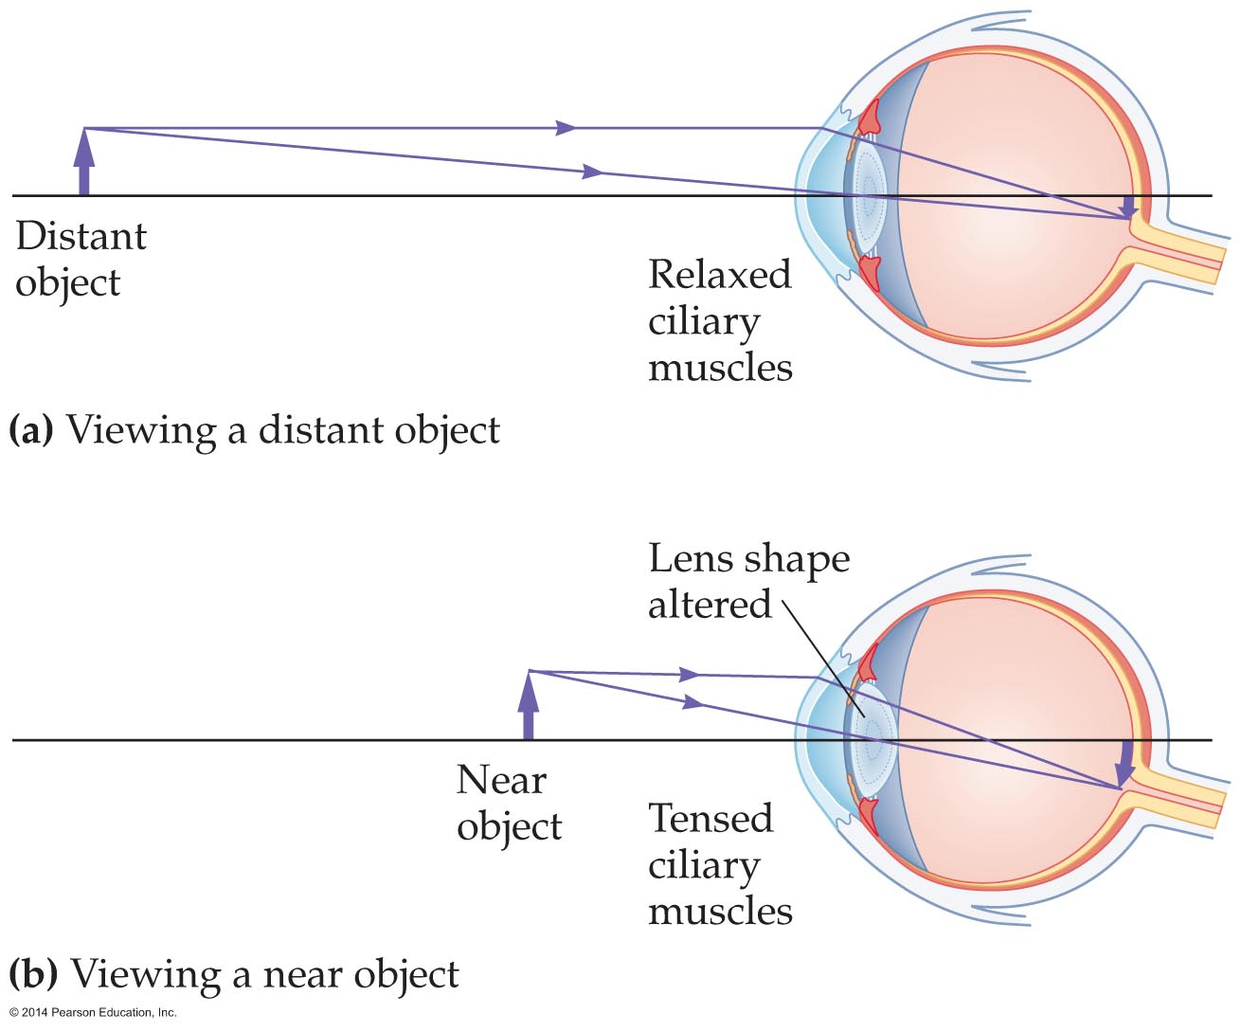
Applications of Lenses
The lenses in our eyes can be distorted only so much. As a result, there is a limit to how close the eyes can focus.
The shortest distance at what a sharp image can be obtained is the near point—anything closer will appear fuzzy.

Slide 68
Applications of Lenses
For a young person, the near point is about 25 cm; it is 40 cm for an older person. In old age, the near point may move to 500 cm or more.
There is also a far point, the greatest distance an object can be from the eyes and still be in focus. The far point is essentially infinity.

Slide 69
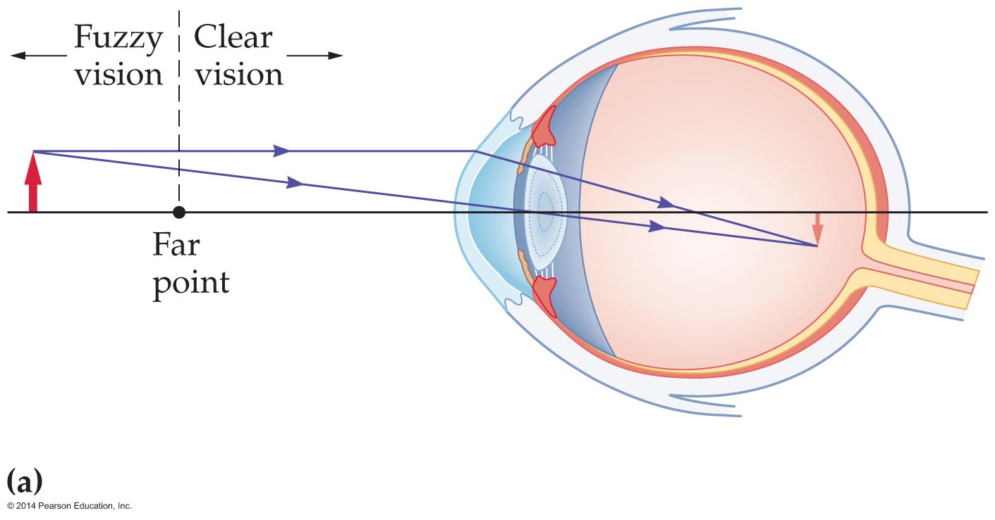
Applications of Lenses
Normally, the ciliary muscles of the eye are relaxed when an object at infinity is in focus. If you are nearsighted (myopic), however, your relaxed eyes do not focus at infinity as they should. Instead, they focus at a finite distance—the far point.
The problem is that a nearsighted eye converges light in too short a distance. As the figure below shows, an object at infinity comes to a focus in front of the retina.

Slide 70
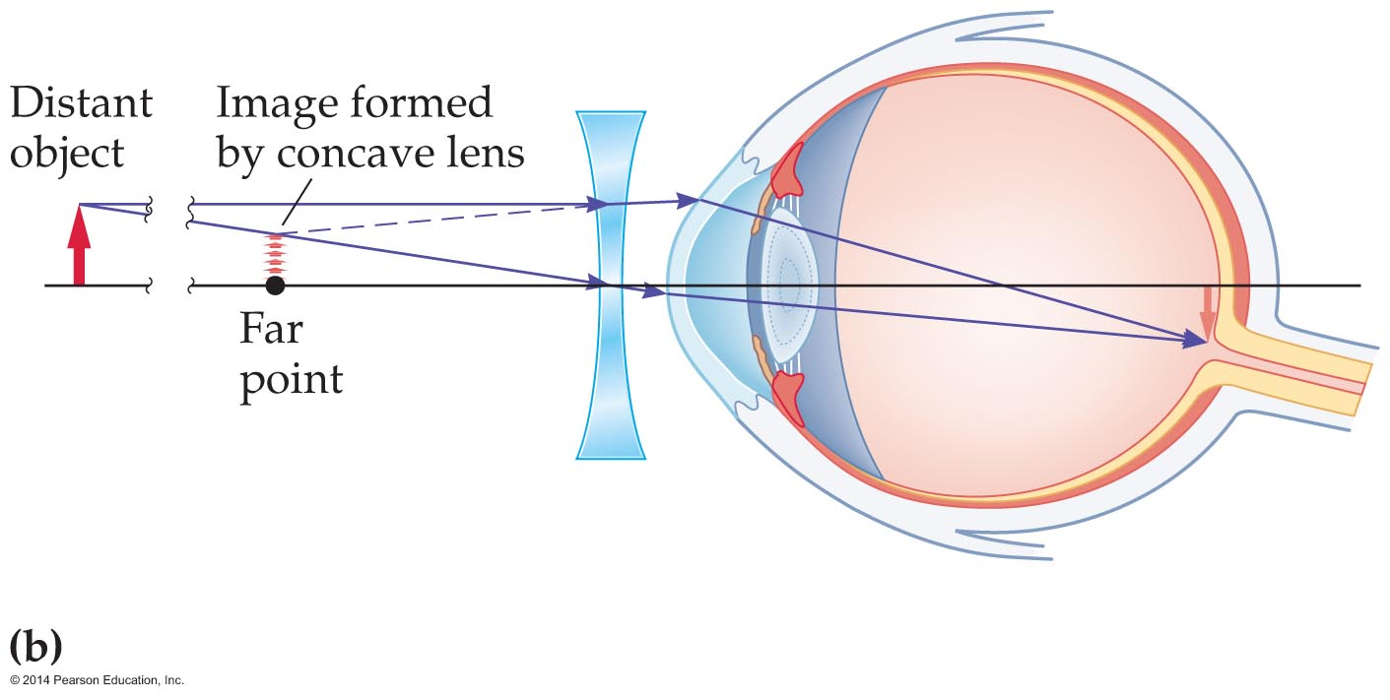
Applications of Lenses
One cause of nearsightedness is an elongation of the eye.
Correcting nearsightedness requires "undoing" some of the excess convergence so that images fall on the retina.
This correction can be achieved by placing a diverging lens in front of the eye, as is shown in the figure below.

Slide 71
Applications of Lenses
A person who is farsighted (hyperopic) can see clearly beyond a certain distance—the near point—but cannot focus on closer objects.
A farsighted eye does not converge light enough to focus it on the retina.
Farsightedness can be caused by an eyeball that is shorter than normal. It can also be caused by a lens that becomes stiff with age.
The problem can be corrected by "preconverging" the light—that is, by using a converging lens in front of the eye.

Slide 72
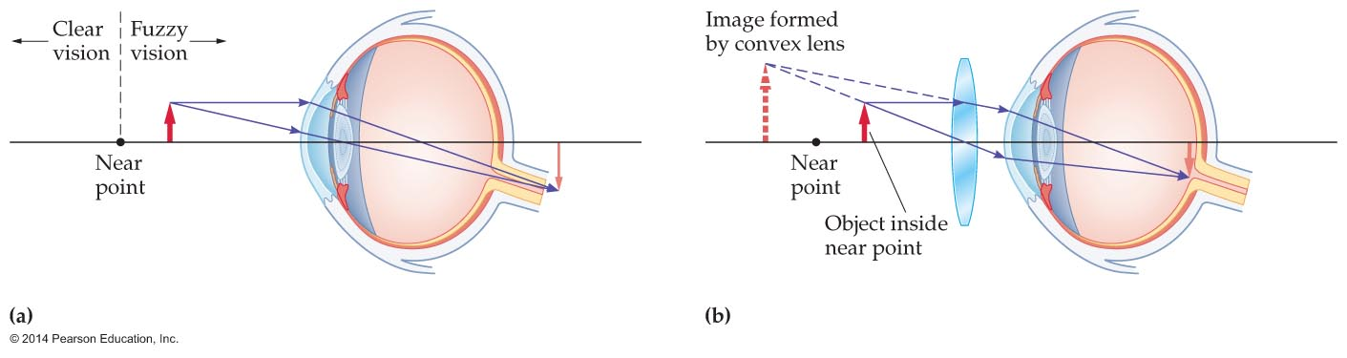
Applications of Lenses
The figures below show farsightedness and its correction.

