Slide 1
Reflection and Mirrors
Prepared by
Chris Chiaverina

Slide 2
Chapter Contents
The Reflection of Light
Plane Mirrors
Curved Mirrors

Slide 3
The Reflection of Light
If you throw a ball at a wall, it bounces back. Sound and light waves also bounce (reflect) off
a wall. That's why you hear echoes from a wall and can see a wall even though it produces no light.
In general, waves are reflected—at least partially—any time they encounter a boundary between two different materials.
In the case of a wall, the two materials are the air in the room and the substance of the wall.

Slide 4
The Reflection of Light
When light hits a boundary between air and glass, for example, some of the light passes into the glass, and some reflects back into the air. The reflected rays stay in the original substance and travel in a different direction.
Mirrors are simply objects that are particularly good at reflecting light waves.

Slide 5
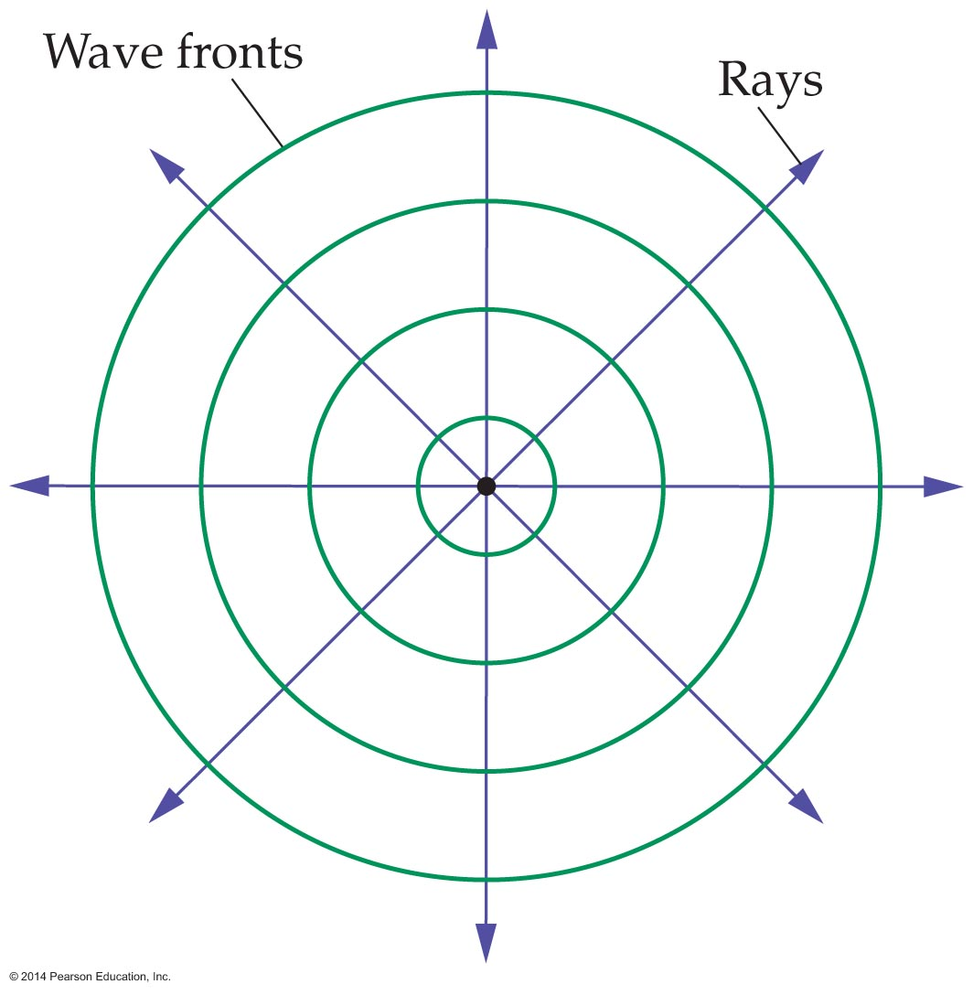
The Reflection of Light
To study the reflection of light, we need a simple way to draw situations we are interested in. A convenient method is to use rays. A ray is an arrow that points in the direction that light travels.
Waves created by a rock dropped into a pool of water form concentric outward-moving circles. The figure below shows a simplified version of this situation.

Slide 6
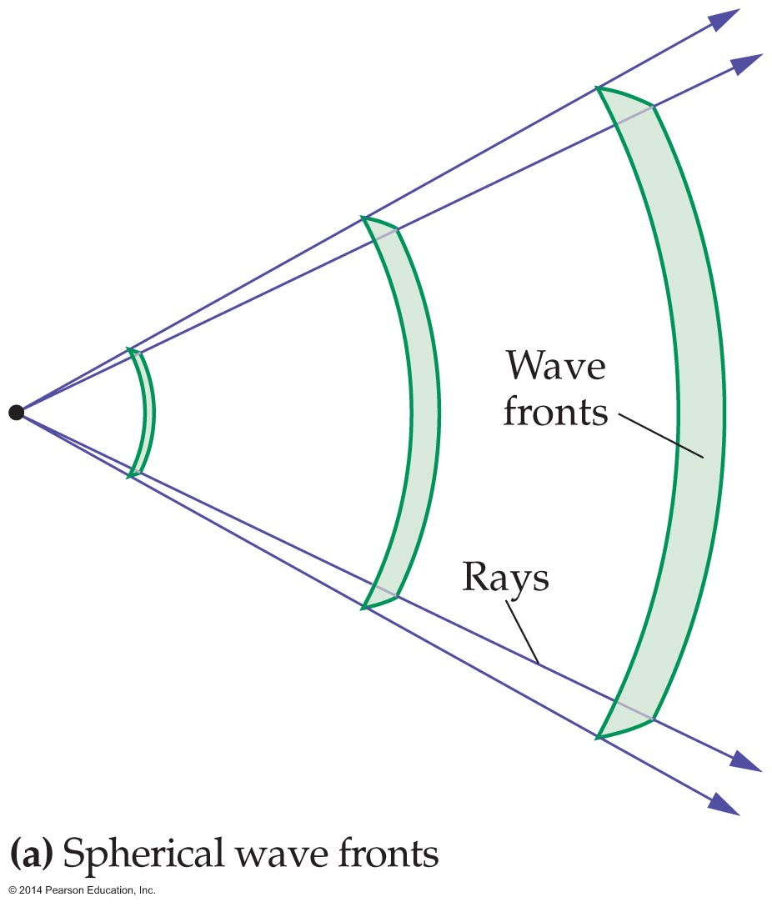
The Reflection of Light
The circles represent crests of the outgoing waves. The outward motion of the waves is indicated by the outward-pointing arrows—the rays.
Rays are always at right angles to the wave fronts.
A similar situation applies to light and other electromagnetic waves, as illustrated in the figure below.

Slide 7
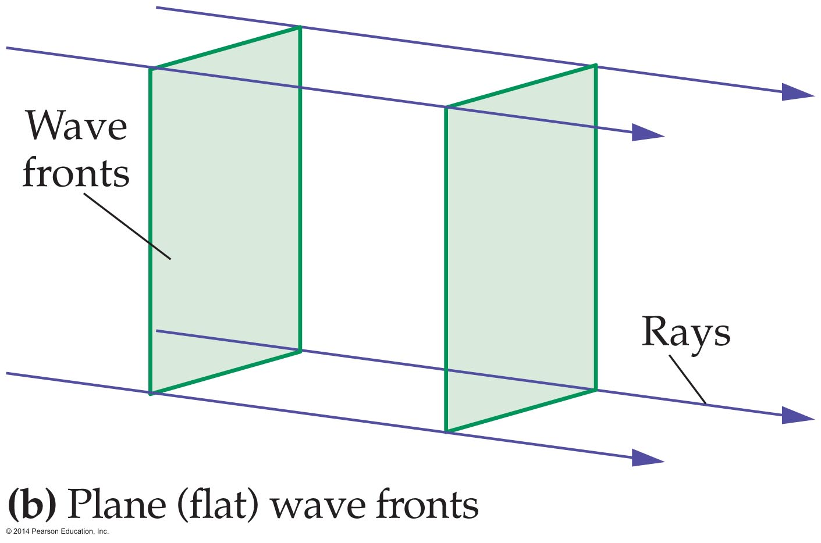
The Reflection of Light
In this case, the waves move out in three dimensions. Spherical waves fronts such as these have rays that point radially outward.
The figure below shows that as waves move farther from a source, spherical wave fronts become flat planes, and the rays become parallel.
In general, plane waves have flat wave fronts and parallel rays all pointing in the same direction.

Slide 8
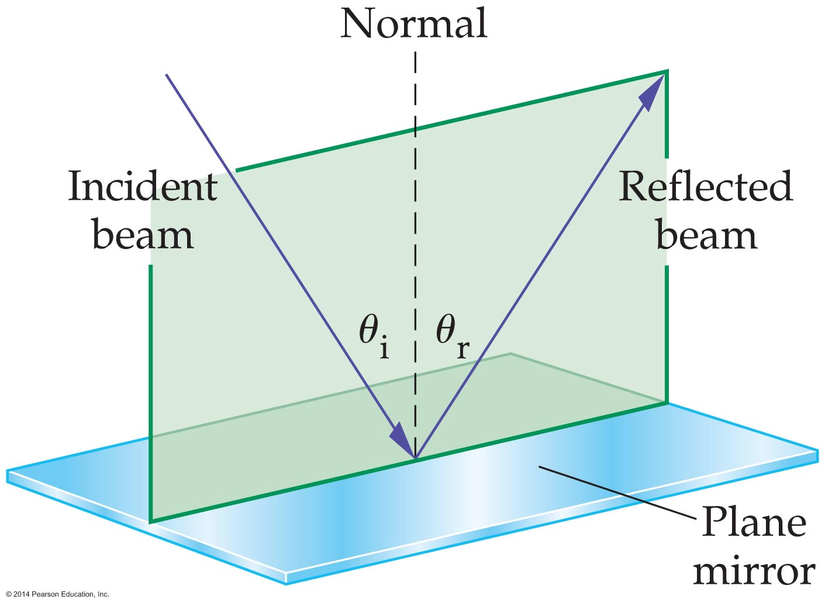
The Reflection of Light
Plane waves and their corresponding rays are useful when investigating the properties of mirrors.
Consider a beam of light that reflects from a mirror. To study this situation, we begin by drawing the normal to the surface of the mirror. The normal to a reflecting surface is a line drawn perpendicular to the surface. An example is shown as a dashed line in the figure below.

Slide 9
The Reflection of Light
The incident and reflected beams of light in the figure are each represented by a single ray. The incident ray hits the surface of the mirror at the angle θ₁ to the normal. The angle θ₁ is called the angle of incidence.
Similarly, the angle of reflection, θ₂, is the angle that the reflected ray makes with the normal.
The relationship between the angle of reflection and the angle of incidence is very simple—they are equal. This relationship is called the law of reflection.

Slide 10
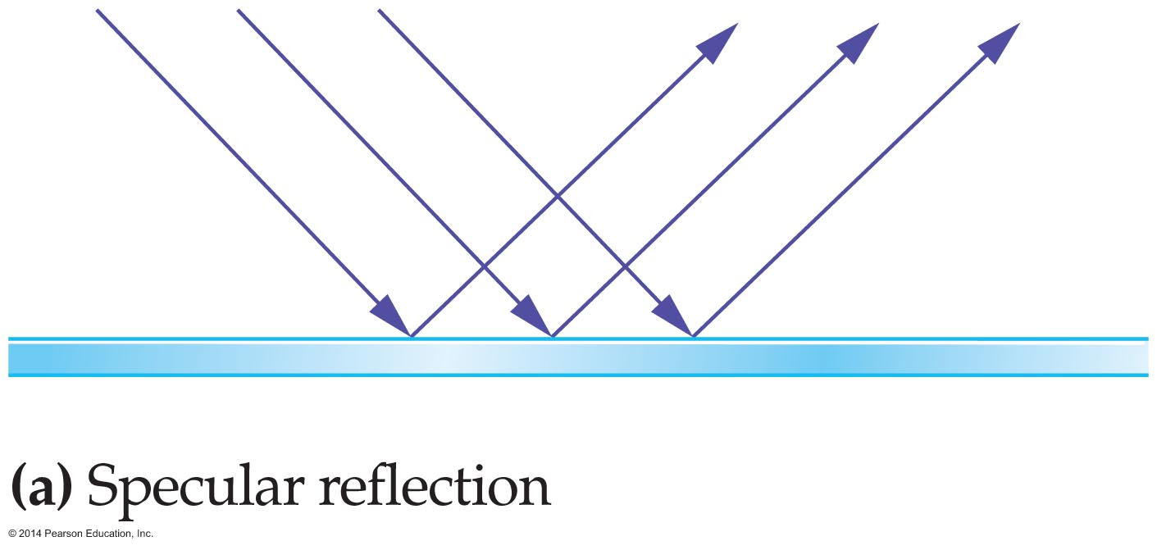
The Reflection of Light
When light reflects from a surface, the texture of the surface determines its appearance. A smooth surface looks shiny because the reflected light is "beamed" in one direction.
Reflection from a smooth surface, with all the reflected light moving in one direction, is referred to as specular reflection. An example of specular reflection is shown in the figure below.

Slide 11
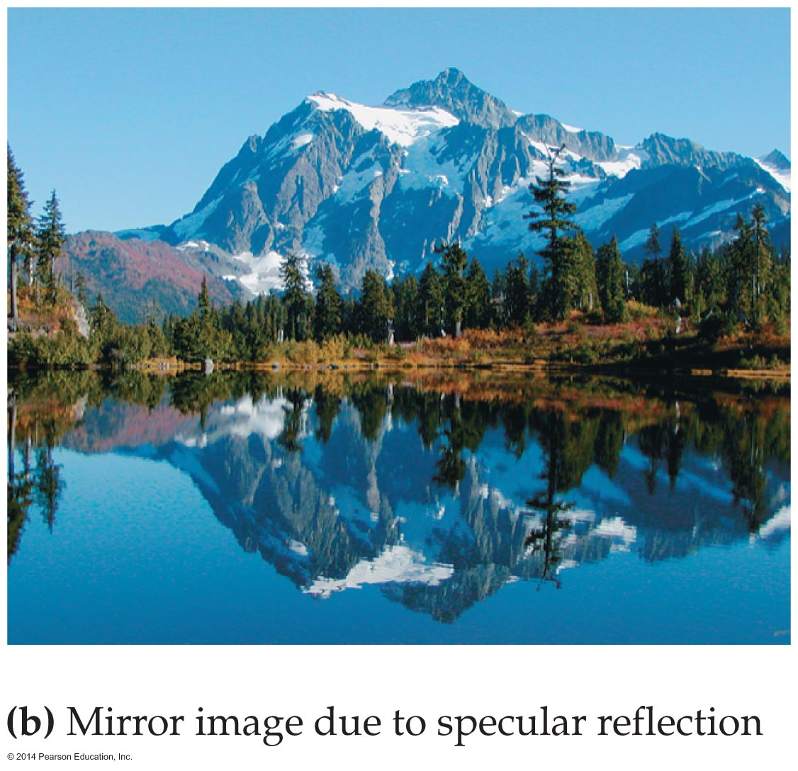
The Reflection of Light
Specular reflection is responsible for the sharp, clear images seen in mirrors. Such an image appears in the mirror-like surface of a lake, as is seen in the figure below.

Slide 12
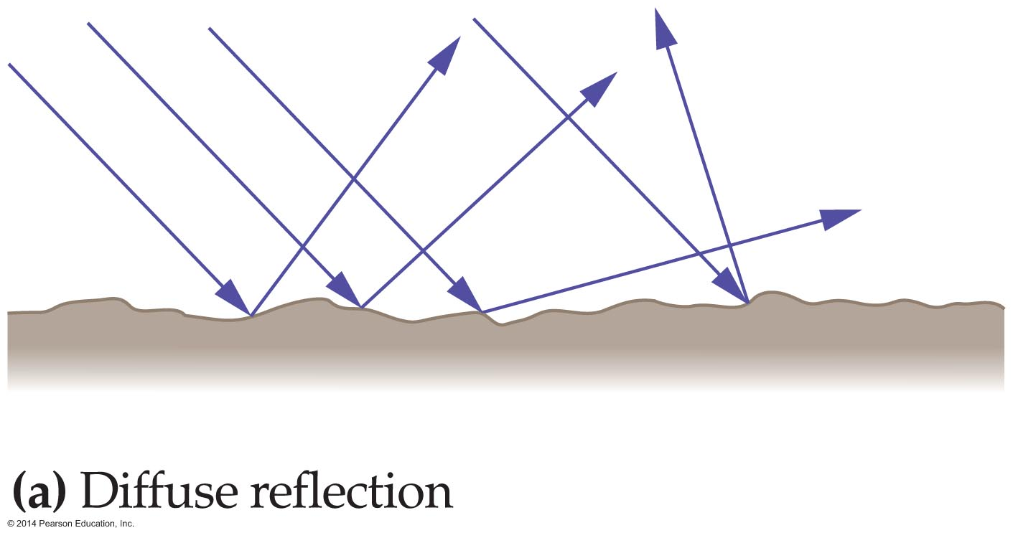
The Reflection of Light
Reflection from rough surfaces is quite different. Consider the rough surface of a bathroom towel. It reflects light in all directions.
Reflection that sends light off in a variety of directions is referred to as diffuse reflection.
An example of diffuse reflection is shown in the figure below.

Slide 13
The Reflection of Light
The surface of a road proves a good illustration of the difference between specular and diffuse reflection.
When the road is wet, the water creates a smooth surface. Headlights reflecting from the wet road undergo specular reflection, producing an intense glare.
When the road is dry, the surface is rough, and the headlights are reflected in many different directions.
The law of reflection is obeyed in both cases, of course—it's the texture of the surface that differs.

Slide 14
The Reflection of Light
A clever application of specular and diffuse reflection occurs in an electronic chip known as a digital micromirror device (DMD). These small devices consist of as many as 1.3 million microscopic plane mirrors.
When all 1.3 million micromirrors are oriented in the same direction, the DMD acts like a small plane mirror. When the micromirrors are oriented randomly, the reflection form the DMD is diffuse.
When a DMD is used to project a movie, each micrometer plays the role of a single pixel in the projected image.

Slide 15
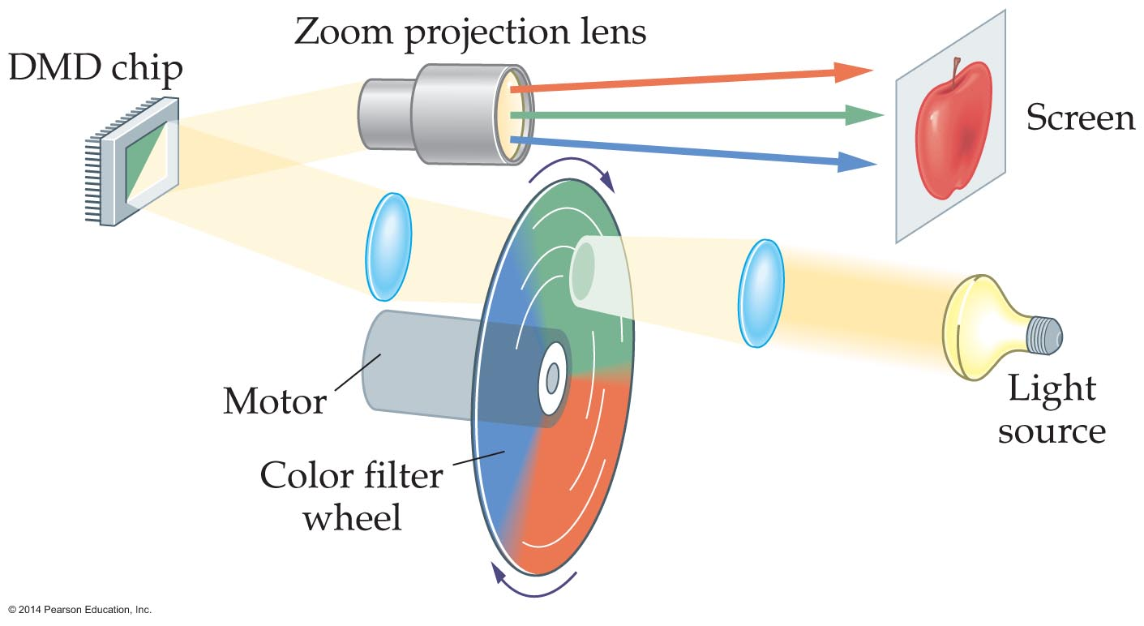
The Reflection of Light
In such a projection system, the light directed onto the DMD cycles rapidly from red to green to blue, and each micromirror reflects only the appropriate colors for that pixel onto the screen.
A digital micromirror projection system is shown in the figure below.

Slide 16
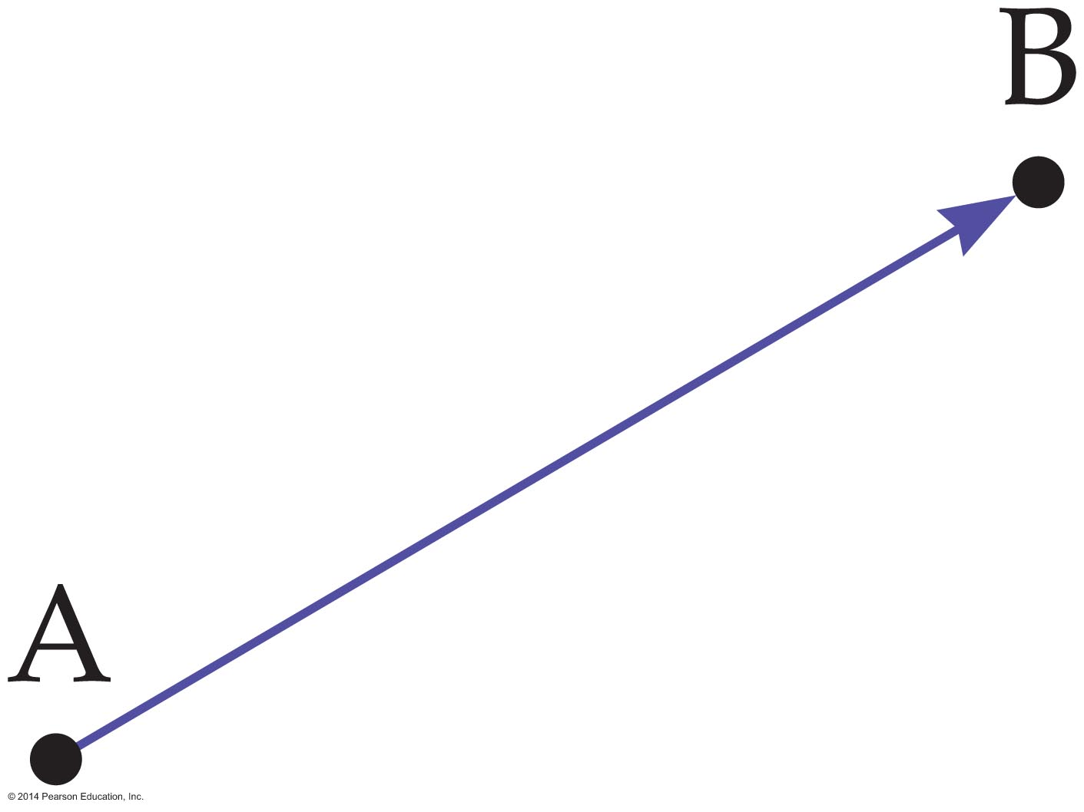
The Reflection of Light
The speed of light is greater than anything else in the universe. It also travels along the path that gives the shortest possible travel time.
As an example, when light travels from point A to point B in the figure below, it travels along a straight line from A to B. As we know, a straight line is the shortest distance between two points, and therefore the path of least time.

Slide 17
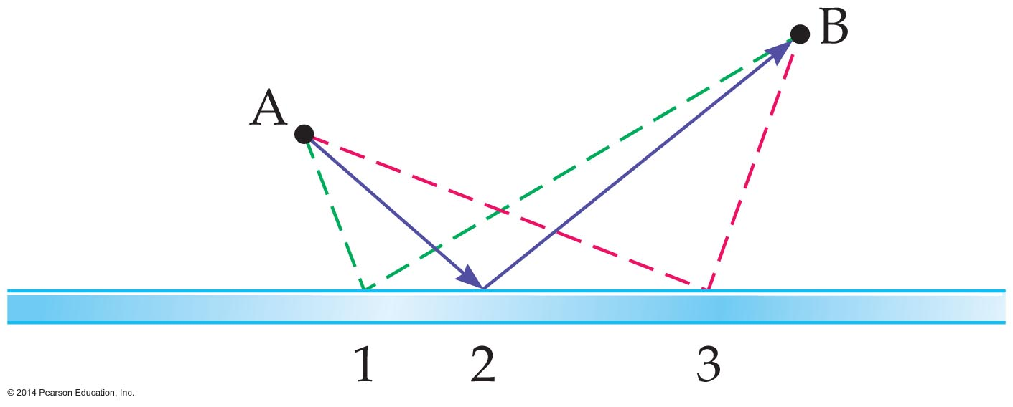
The Reflection of Light
Suppose, instead, that light travels from point A to a mirror, reflects from the mirror, and then continues to point B. This situation is shown in the figure below.
Which path should the light take if it is to get to B in the least time? That is, from which point on the mirror should the light reflect?

Slide 18
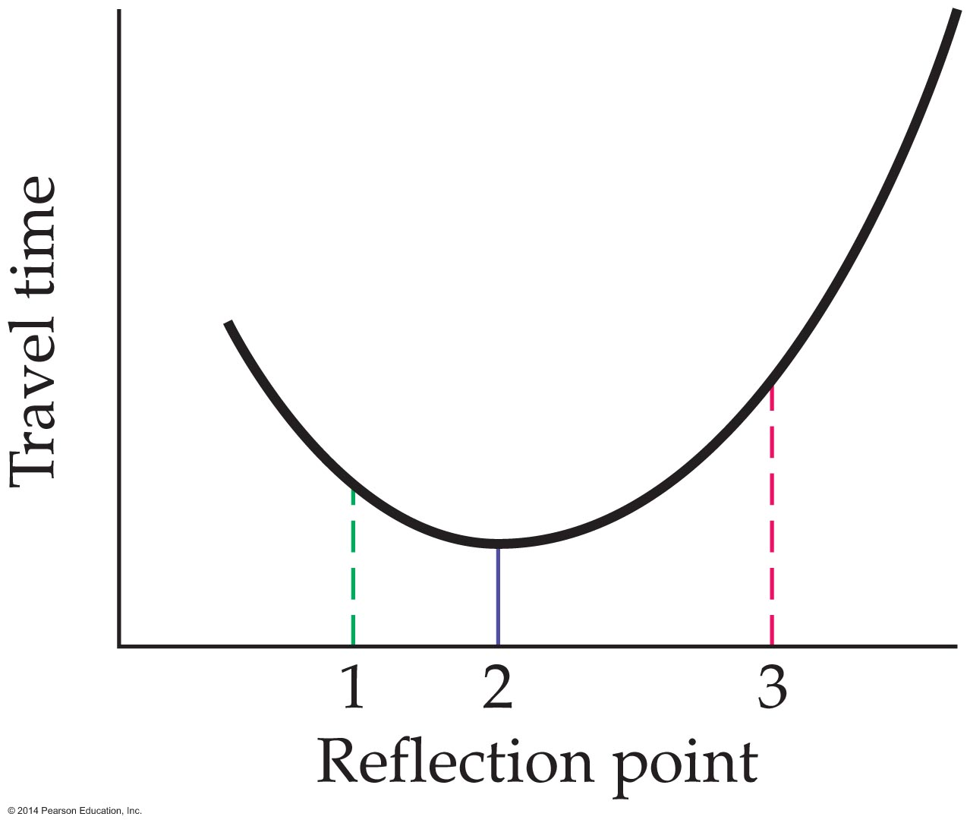
The Reflection of Light
It turns out that the travel time is least when the light follows path 2. This obeys the law of reflection, with the angle of reflection equal to the angle of incidence.
This path is also the shortest possible reflecting path from A to B. The distances (and travel times) along paths 1 and 3 are greater, as is shown in the figure below.

Slide 19
Plane Mirrors
A perfectly flat mirror is called a plane mirror.
Before discussing how mirrors produce images, let's consider how objects produce images in our eyes.
Any nearby object is bathed in light coming at it from all directions. As the object reflects the light back into the room, each point on it acts like a source of light.
When you view the object, the light coming from a point on the object enters your eyes and is focused to a point on the retina. This is the case for every point that you can see on the object.

Slide 20
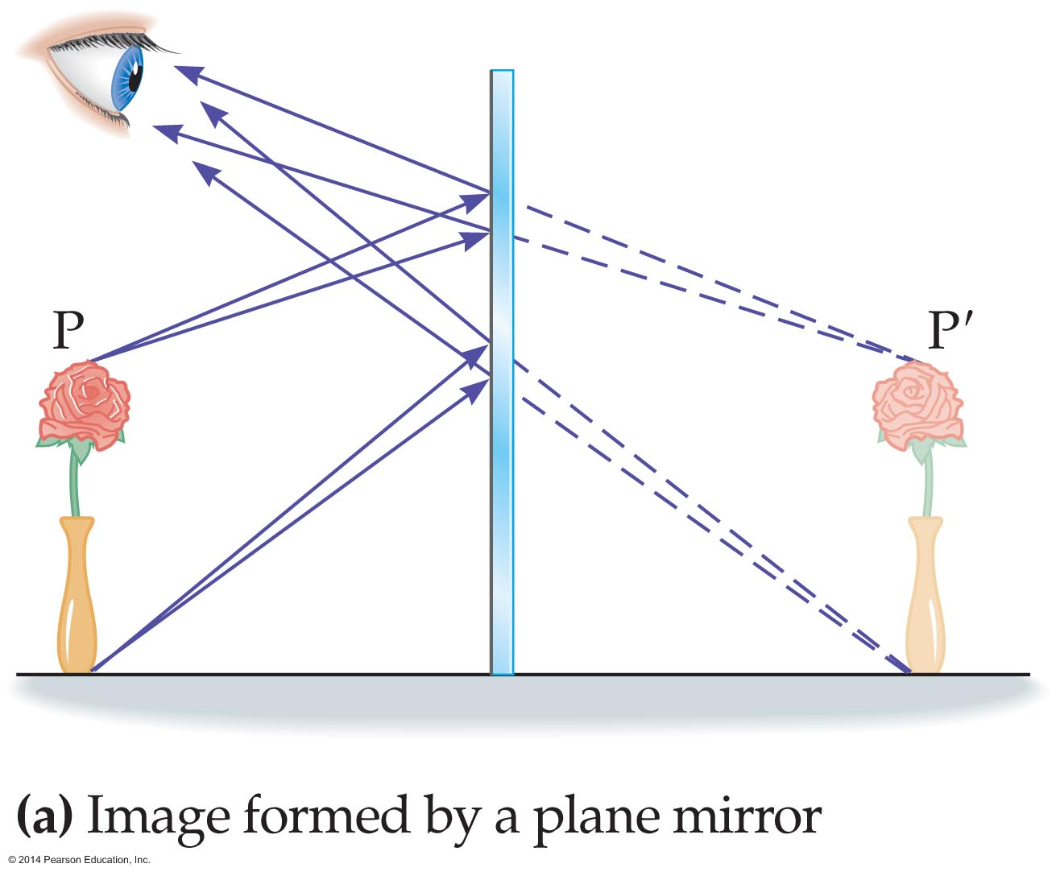
Plane Mirrors
This results in a one-to-one connection between the physical object and the image on the retina.
The formation of a mirror image occurs in the same way, except the light from the object reflects off the mirror before it enters the eyes. This is illustrated in the figure below, in which a small flower in a vase placed before a plane mirror.

Slide 21
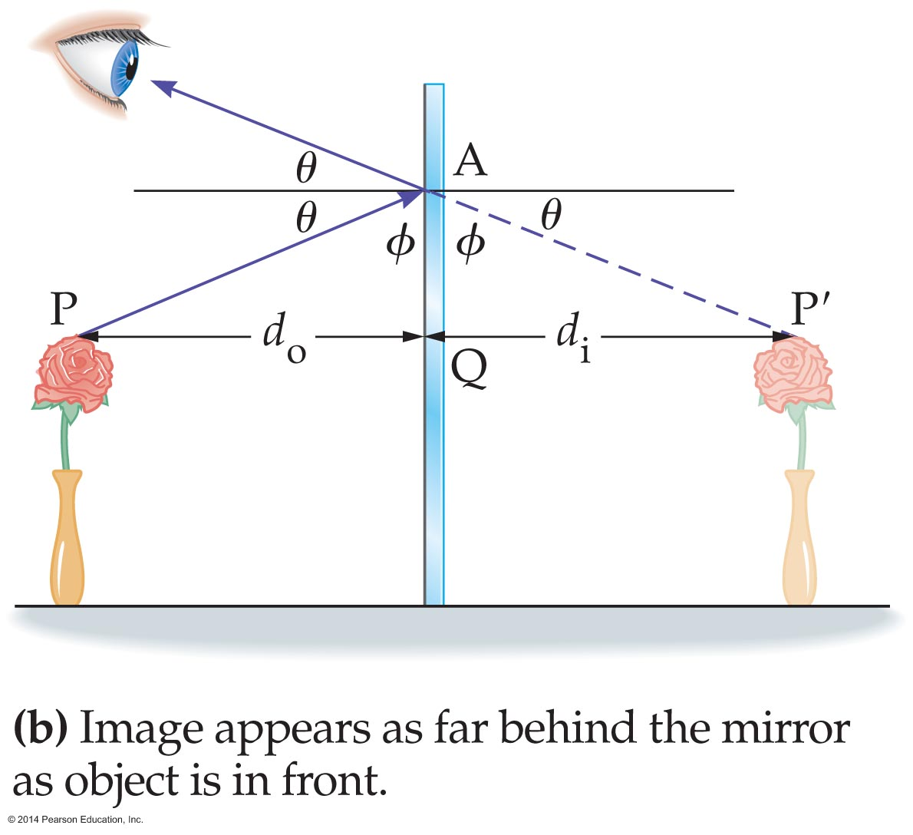
Plane Mirrors
Rays of light leaving the top of the flower at point P reflect from the mirror and enter the eye of an observer. To the observer, it appears that the rays are coming from the point P′ behind the mirror.
Similar remarks apply to rays of light coming from the base of the flower vase.
In the figure below, a ray is drawn from the flower to the mirror—where it reflects—and then to the eye.

Slide 22
Plane Mirrors
The construction shown in the figure indicates that the length of the line PQ (object to mirror) is the same as the length of the line QP′ (mirror to image).
In other words, the image formed by a plane mirror appears as far behind the mirror as the object is in front of the mirror.
We can write this in the form of an equation as follows:
image distance = −(object distance)
d_{i} = −d_{o}
where d_{i} is the image distance and d_{o} is the object
distance.

Slide 23
Plane Mirrors
The negative image distance means that the image is behind the mirror.
In general, an image that is behind a mirror is known as a virtual image. The term virtual is used to indicate that no light passes through the image and that it cannot be projected onto a screen. A virtual image looks just as real to your eye as any physical object, however.

Slide 24
Plane Mirrors
In the previous figure, notice that the height of the image is the same as the height of the object. This is always true for plane mirrors.
If we let h_{i} denote the image height and h_{o} the object height, we can express this result with the following simple equation:
h_{i} = h_{o}
Finally, it should be noted that plane mirrors reverse right and left. This is the reason ambulances and other emergency vehicles have mirror-image labels on the front.

Slide 25
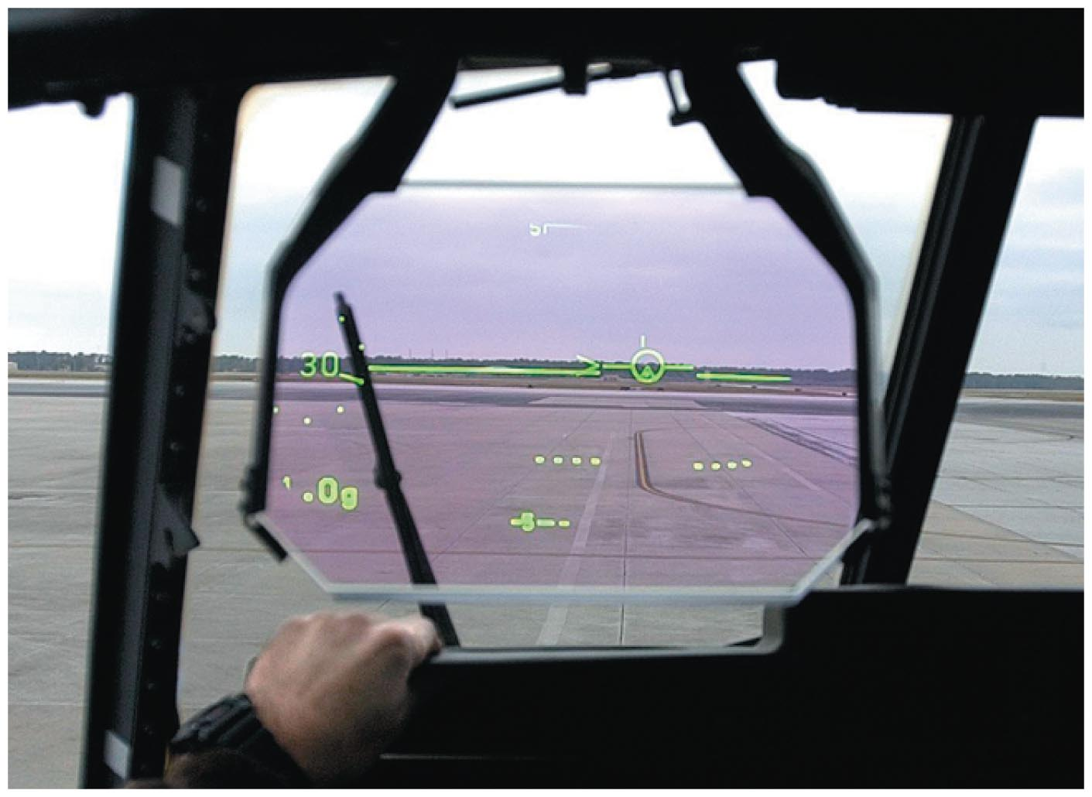
Plane Mirrors
An interesting application of mirror images is the heads-up display. An example from an airplane is shown in the figure below.
The heads-up display in an airplane cockpit displays important flight information by reflecting it on a transparent screen near the windshield. This lets the pilot view the data without looking away from the scene ahead.
Some cars also use heads-up displays.

Slide 26
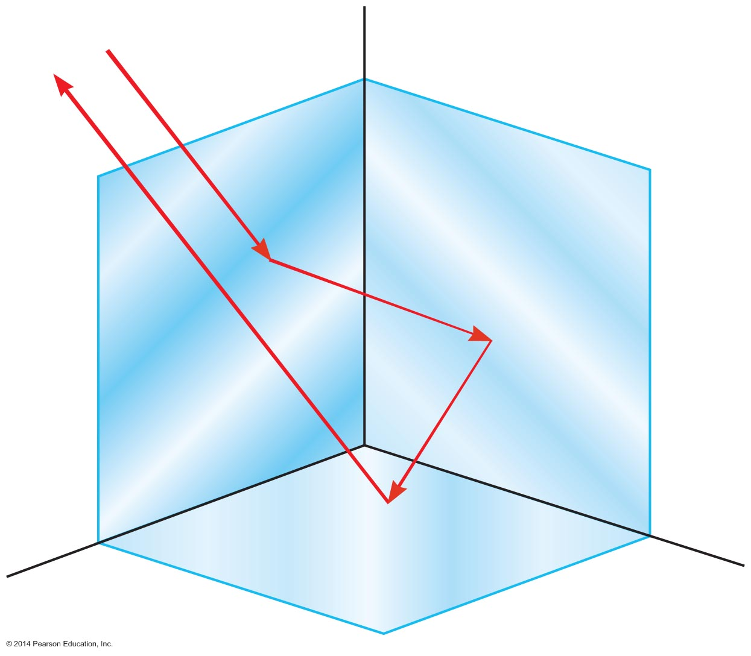
Plane Mirrors
If three plane mirrors are joined at right angles, as shown in the figure below, the result is referred to as a corner reflector.
A light ray incident on a corner reflector is sent back in the same direction from which it came.

Slide 27
Plane Mirrors
Corner reflectors are used on ships, especially on lifeboats, where they reflect radar waves directly back to the source. Often referred to as retroreflectors, corner reflectors are common on cars, on bicycles, and even on the backs of running shoes.

Slide 28
Curved Mirrors
Curved mirrors produce all sorts of interesting effects, like enlarging an object, shrinking an object, or even turning an object upside-down.
There are two basic types of curved mirrors, concave and convex.
A concave mirror is one that curves inward, forming a sort of "cave" within the mirror.
In contrast, a convex mirror has the opposite shape—it bulges outward like the surface of a ball.

Slide 29
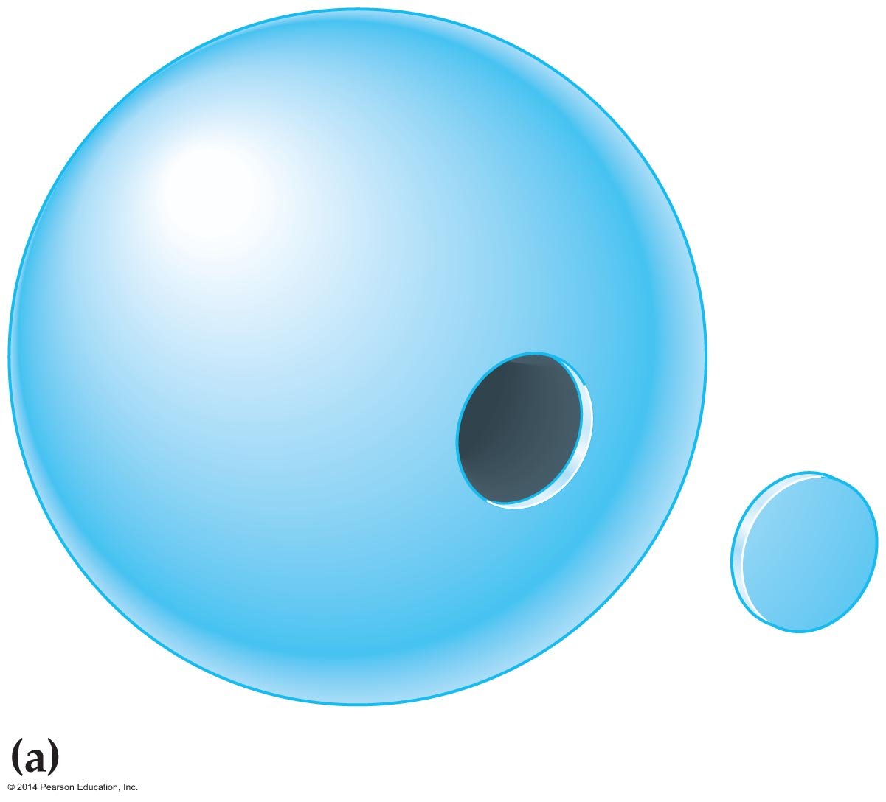
Curved Mirrors
Most curved mirrors have a spherical shape, as indicated in the figure below, and are referred to as spherical mirrors. A typical spherical mirror is just a portion of a spherical shell of radius R.

Slide 30
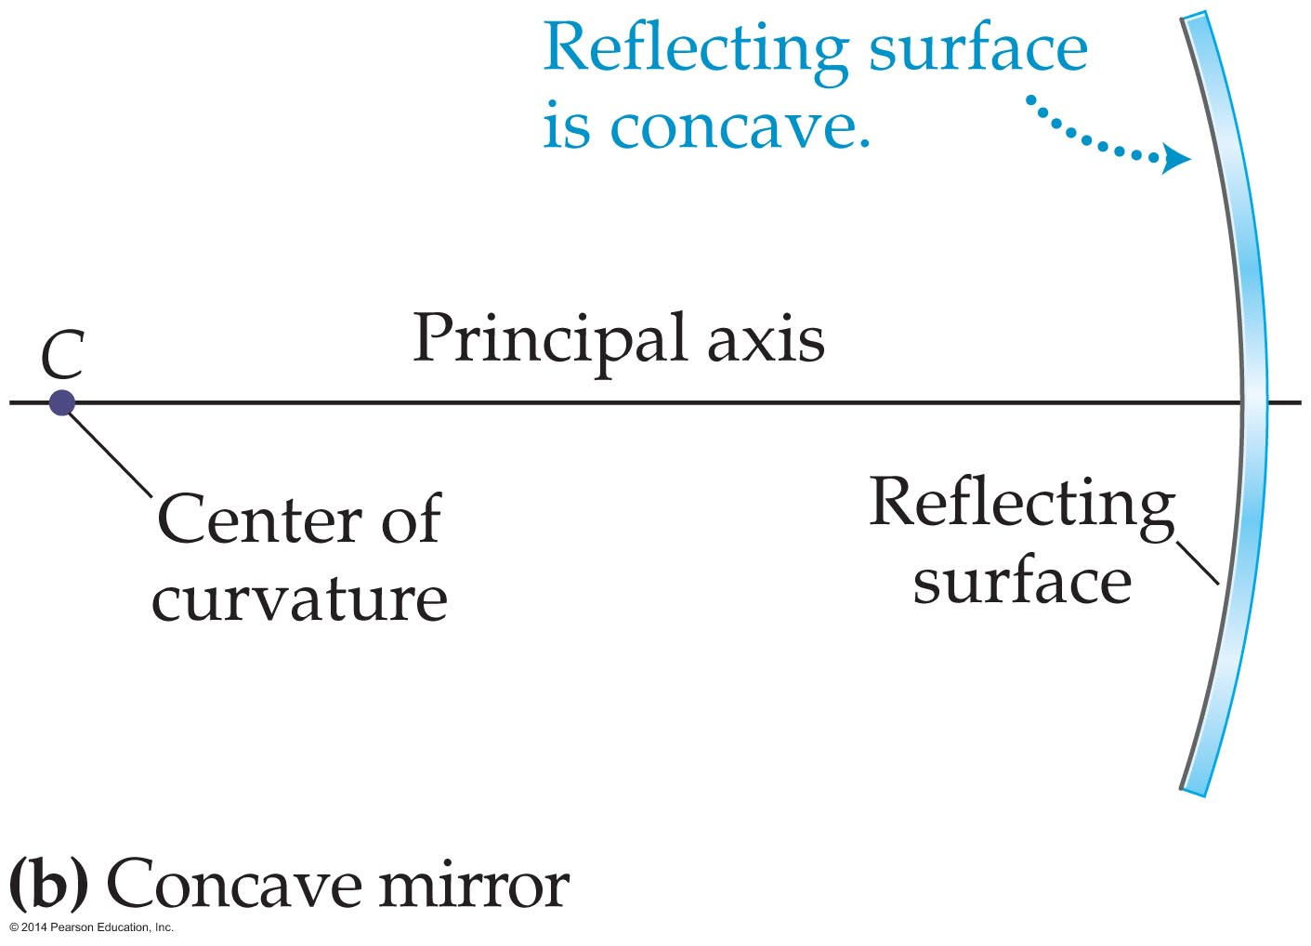
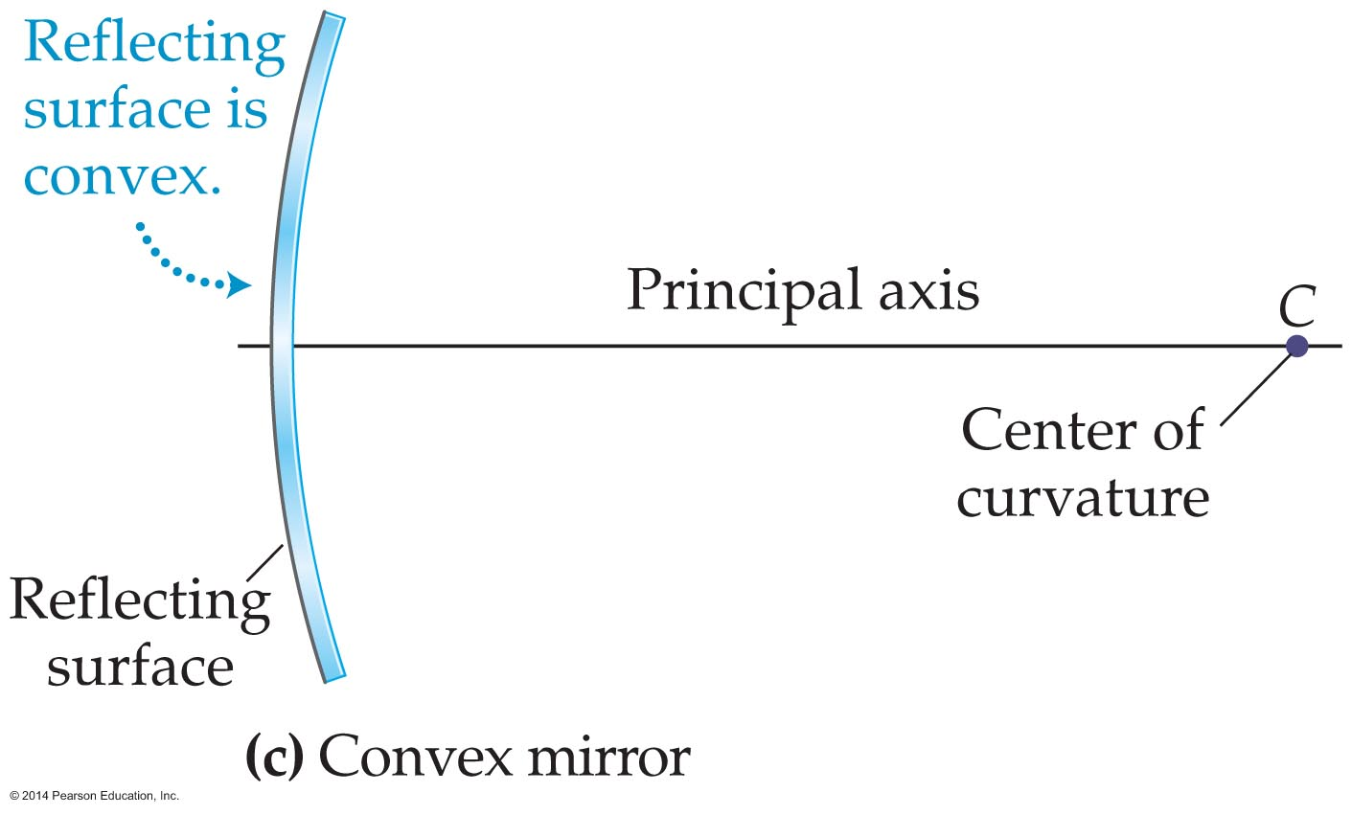
Curved Mirrors
If the inside of this spherical section is a reflecting surface, the result is a concave spherical mirror. If the outside surface is reflecting, the result is a convex spherical mirror. The two situations are illustrated in the figures below.

Slide 31
Curved Mirrors
The figure also shows the center of curvature and the principal axis for each type of mirror.
The center of curvature, C, is the center of the spherical shell with radius R of which the curved mirror is a section.
The principal axis is a straight line drawn through the center of curvature and the midpoint of the mirror. Notice that the principal axis intersects the mirror at right angles.

Slide 32
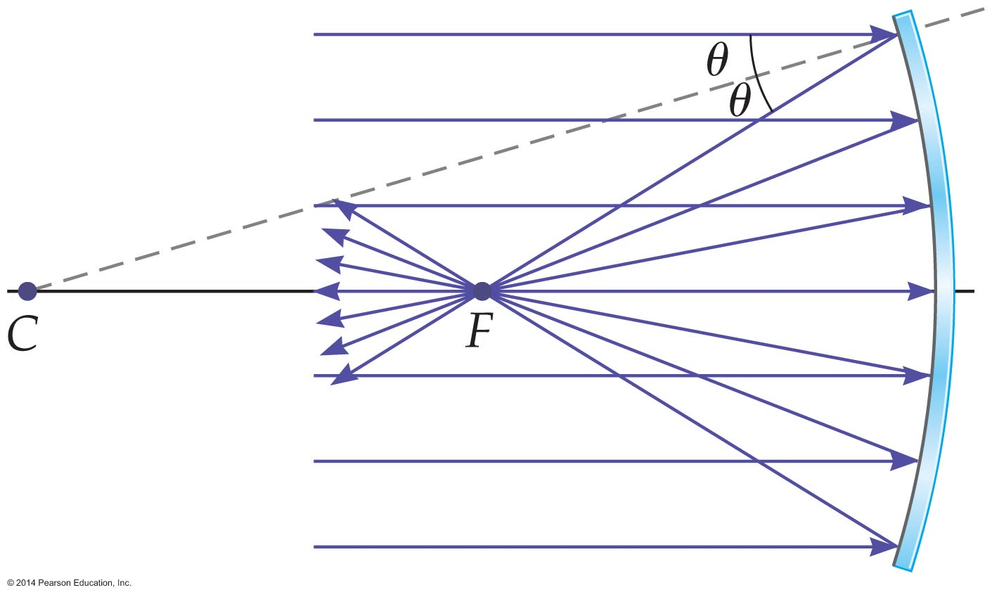
Curved Mirrors
In the figure below, a beam of light is directed toward the mirror along its principal axis. This beam is represented in the figure by several parallel rays.
Notice that the rays reflect from the surface of the mirror and converge—or focus—at the focal point, F.

Slide 33
Curved Mirrors
From the figure we can see that the focal point, F, is halfway between the center of curvature, C, and the surface of the mirror.
Since the center of curvature is a distance R from the surface, it follows that the distance from the mirror to the focal point is R/2. In general, the focal length, f, of a concave mirror is the distance from the surface of the mirror to the focal point. That is,
focal length = ½ (radius of curvature)
f = ½R
With a concave mirror, incoming rays of light that are parallel to the principal axis are reflected through the focal point.

Slide 34
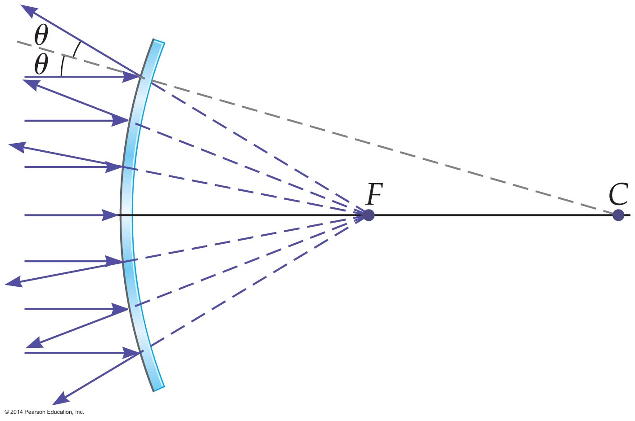
Curved Mirrors
Several parallel rays are shown approaching a convex mirror in the figure below.
Incoming rays of light that are parallel to the principal axis of a convex mirror spread outward when they are reflected—just as if they had started from the focal point behind the mirror. However, no light actually passes through the focal point of a convex mirror.

Slide 35
Curved Mirrors
To distinguish between focal points in front and behind a mirror, we give a sign to the focal length. The sign of the focal length is determined as follows:
  The focal length of a mirror is positive if the focal point is in front of the mirror. All concave mirrors have positive focal lengths.
  The focal point of a mirror is negative if the focal point is behind the mirror. All convex mirrors have negative focal lengths.

Slide 36
Curved Mirrors
The easiest way to find the image formed by a mirror is to draw a few rays and see how they reflect.
In this method, called ray tracing, we draw the paths of rays of light as they reflect from a mirror and use them to find the location of the image.

Slide 37
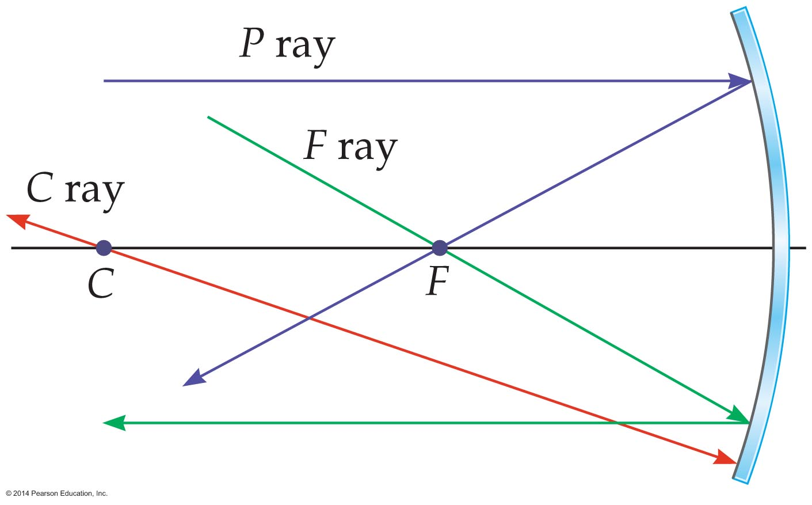
Curved Mirrors
Three rays, known as principal rays, are used in ray tracing with spherical mirrors. These rays are illustrated in the figure below.
As the figure shows, the parallel ray (P ray) reflects through the focal point. The focal-point ray (F ray) reflects parallel to the principal axis, and the center-of-curvature ray (C ray) reflects back along its incoming path.

Slide 38
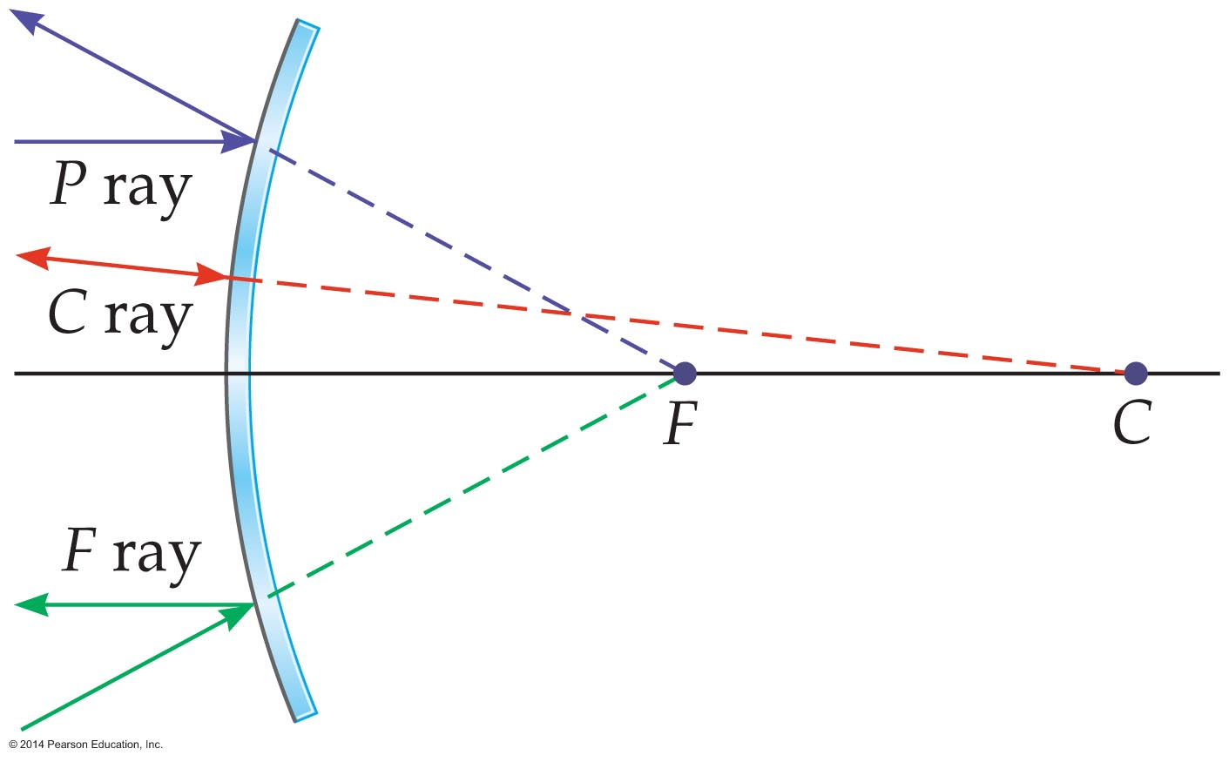
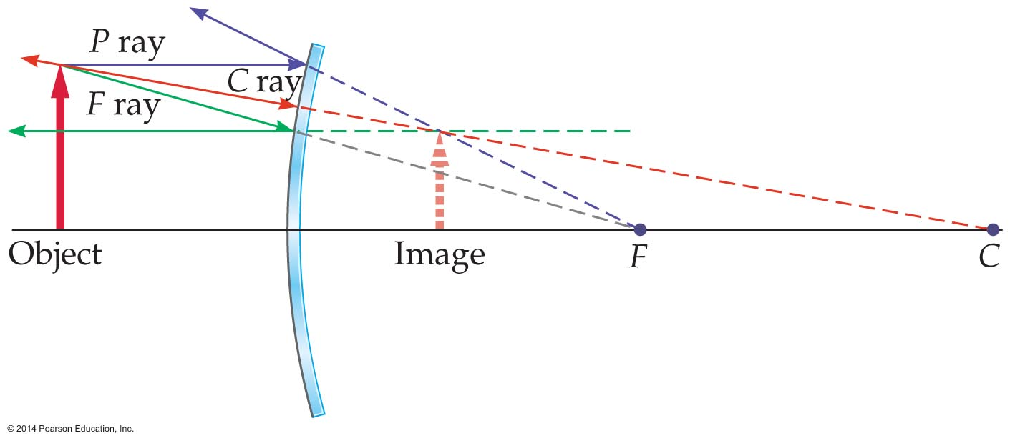
Curved Mirrors
The figure below shows the principal rays used in ray tracing for a convex mirror.
The following figure shows how the principal rays can be used to obtain an image with a convex mirror.

Slide 39
Curved Mirrors
The figure shows that in front of the mirror is an object, represented symbolically by the red arrow. Also indicated in the figure are the principal rays.
Notice that these rays diverge from the mirror as if they had originated from the tip of the dashed orange arrow behind the mirror.
Recall that an image formed behind a mirror (with no light passing through the image) is a virtual image.
It is worth noting that even though three rays were used in the figure, any two would have given an intersection point at the tip of the virtual image.

Slide 40
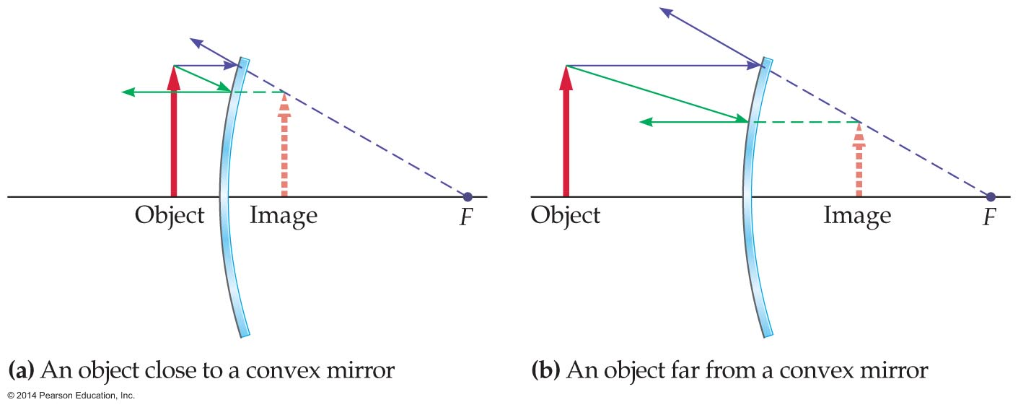
Curved Mirrors
As the figure below illustrates, when an object is close to a convex mirror, the image is practically the same size and distance from the mirror. If the object is far from the mirror, the image is small and close to the focal point.

Slide 41
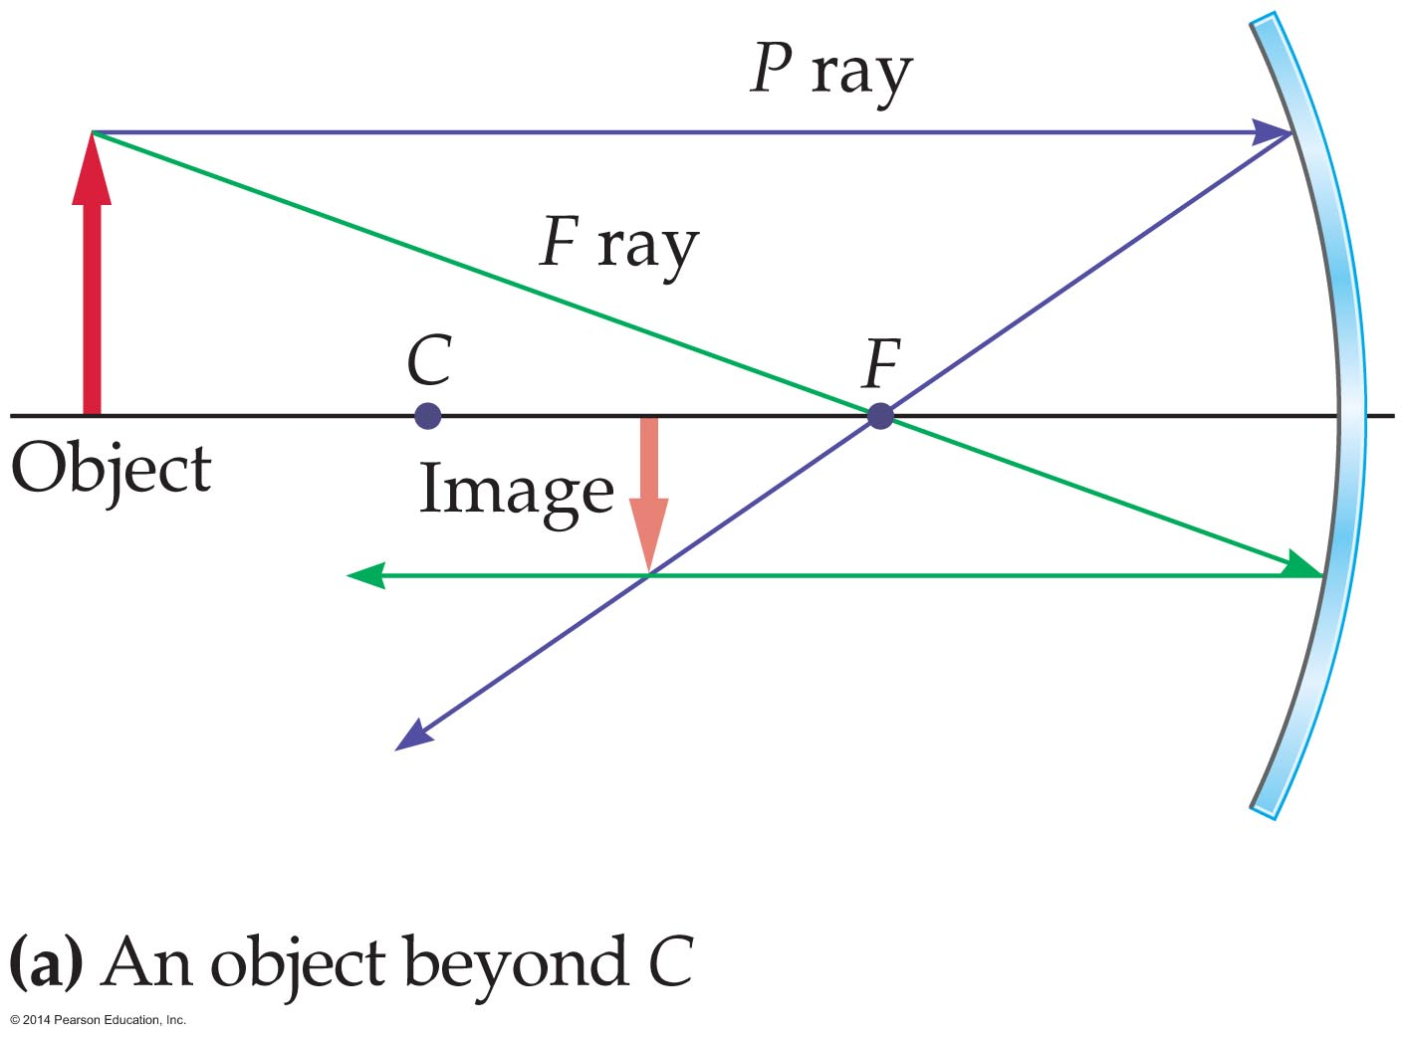
Curved Mirrors
Concave mirrors are capable of producing a variety of images.
The F and P rays for the case where the object is farther from the mirror than the center of curvature are shown in the figure below.
The C ray isn't needed in this case and has been omitted for clarity. Notice that the image is inverted (upside-down), closer to the mirror, and smaller than the object.

Slide 42
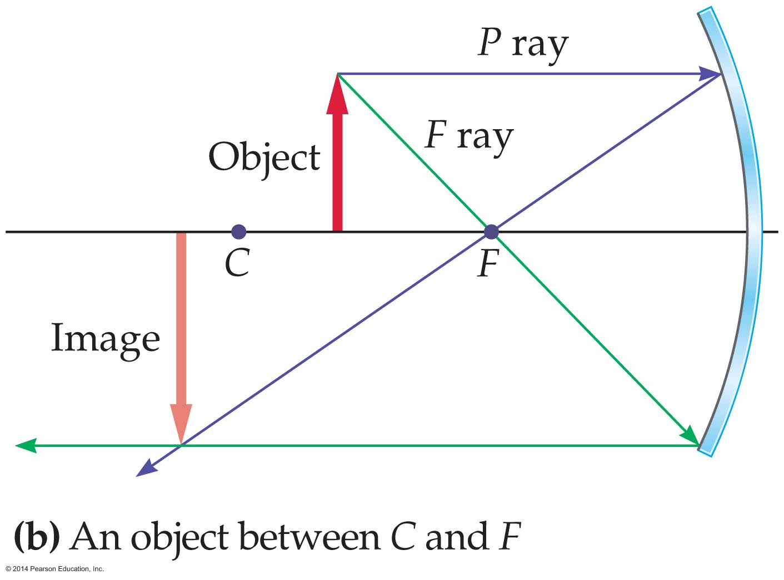
Curved Mirrors
The ray diagram for the case where the object is between the center of curvature and the focal point is shown below. Again, the C ray has been omitted for clarity.
As the figure shows, the image is real and inverted, but it is now farther from the mirror and larger than the object.

Slide 43
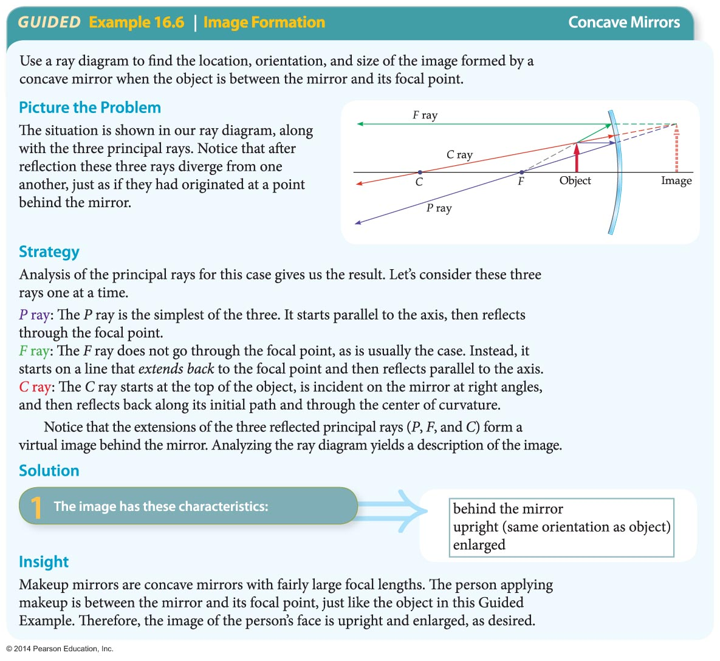
Curved Mirrors
The case in which the object is between the mirror and the focal point is discussed in the following Guided Example.

Slide 44
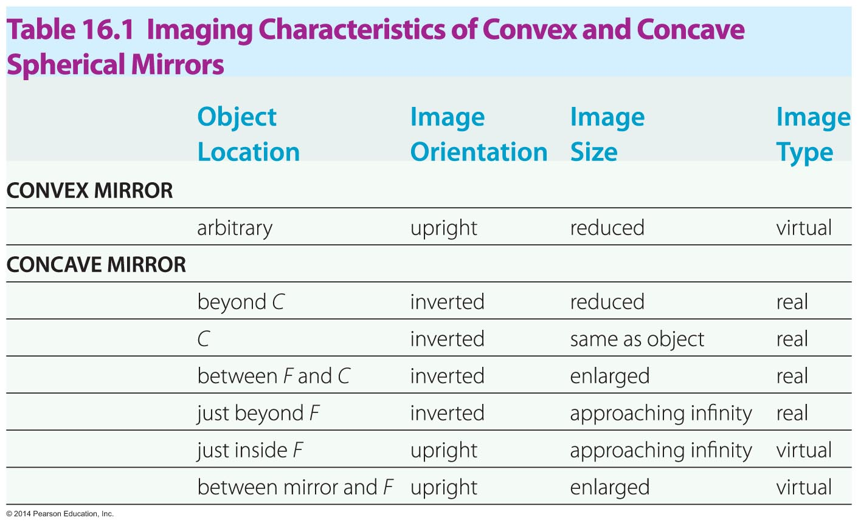
Curved Mirrors
The imaging characteristics of convex and concave mirrors are summarized in the table below.

Slide 45
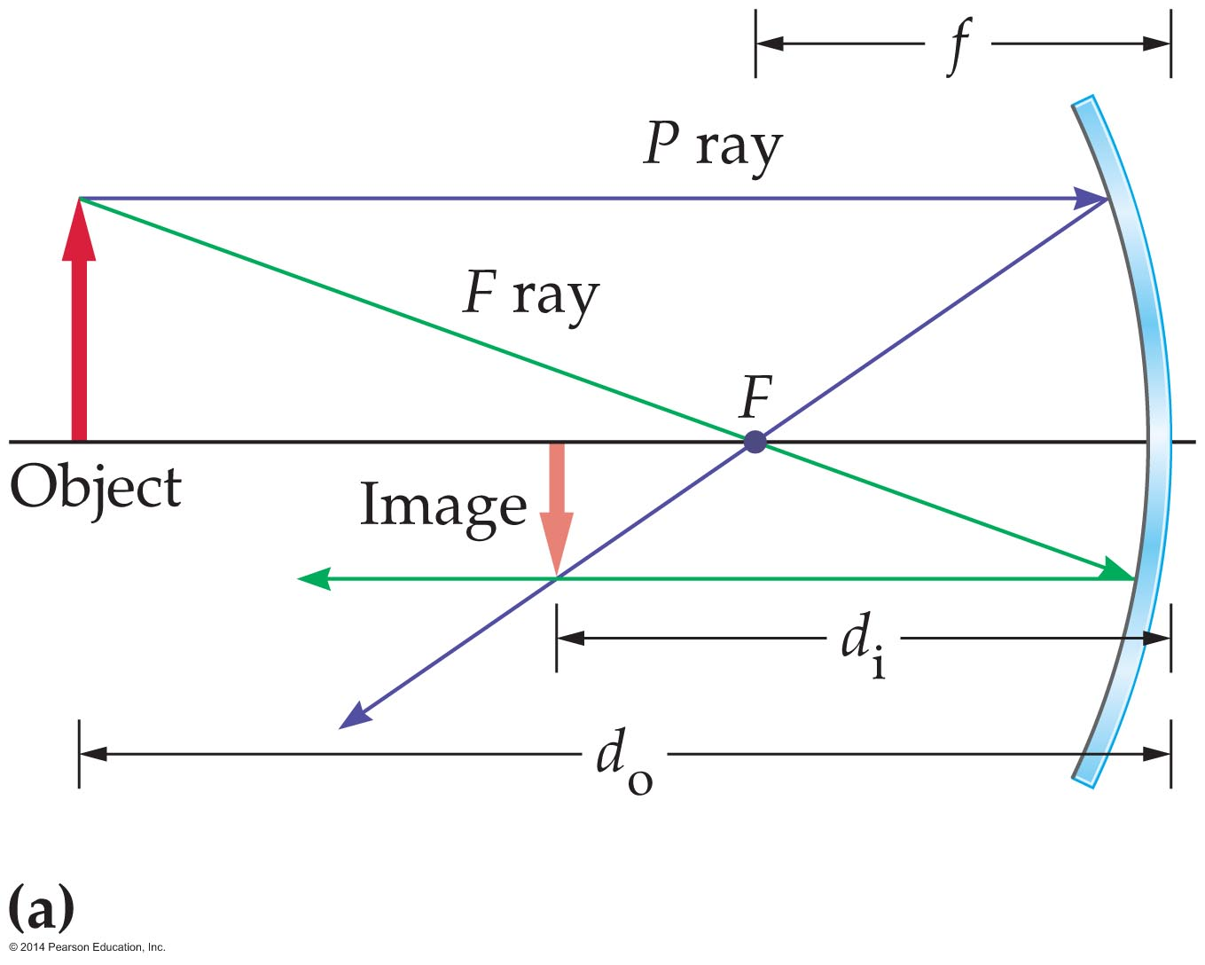
Curved Mirrors
While ray tracing is very useful, images can be located more precisely with an equation. The mirror equation is a precise mathematical relationship between object distance, image distance, and focal length for a given mirror.
In the figure below, an object is at a distance d_{o} from a mirror. The image is a distance d_{i} from the mirror, and the focal point is a distance f from the mirror.

Slide 46
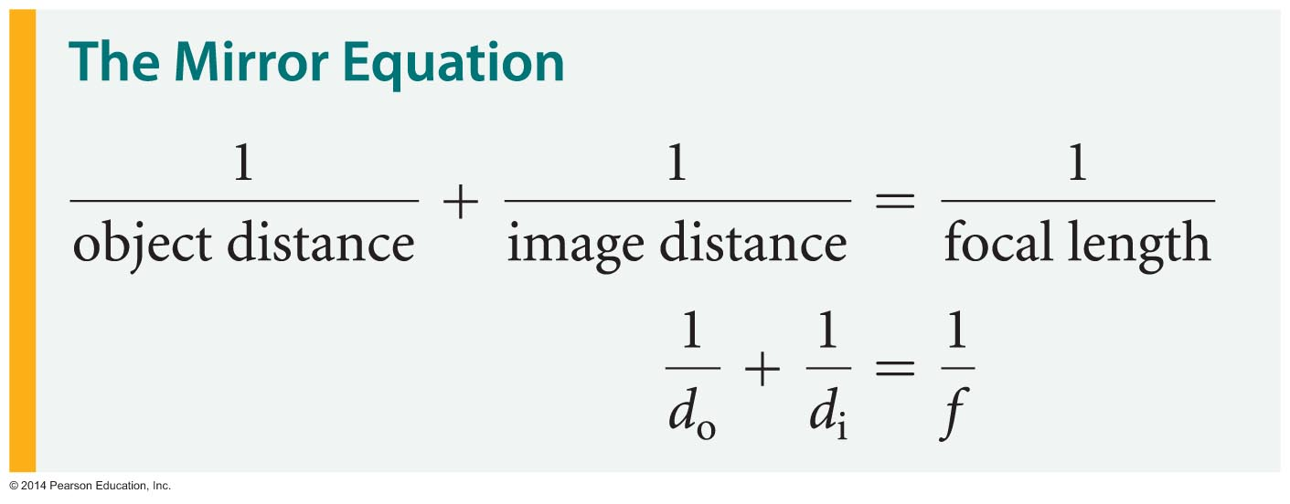
Curved Mirrors
These three distances, d_{o}, d_{i}, and f, are related by the following equation:
If two of these quantities are known, the mirror equation yields the third.

Slide 47
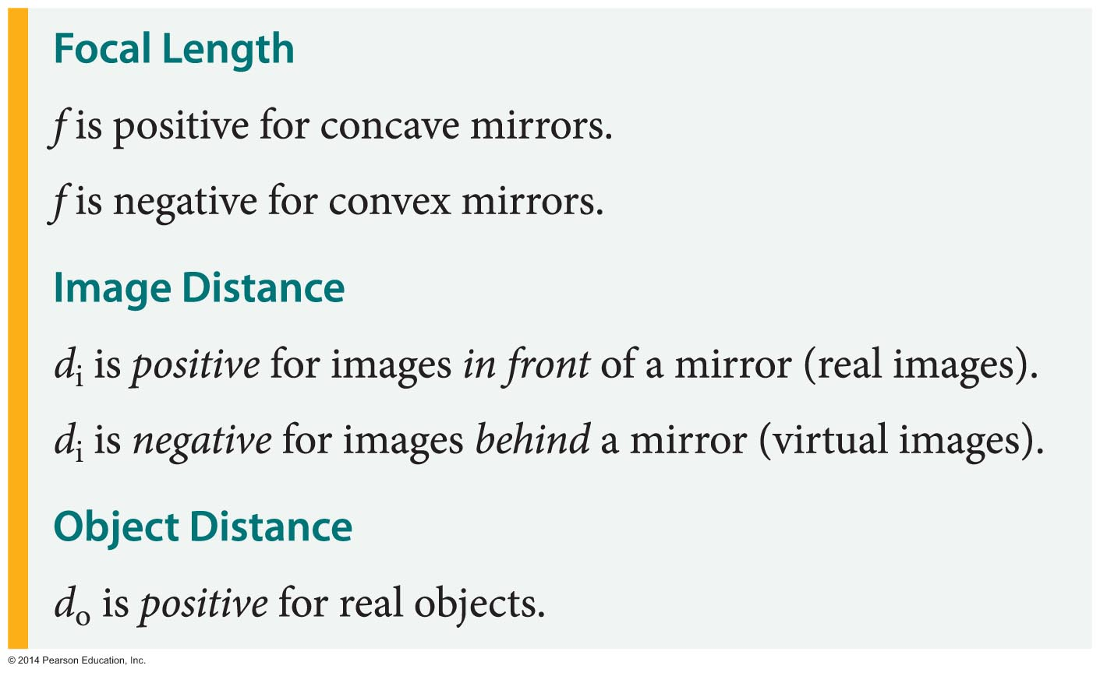
Curved Mirrors
It is important to identify and use the correct sign for each term in the mirror equation. The sign convention for both concave and convex mirrors is summarized in the table below.

Slide 48
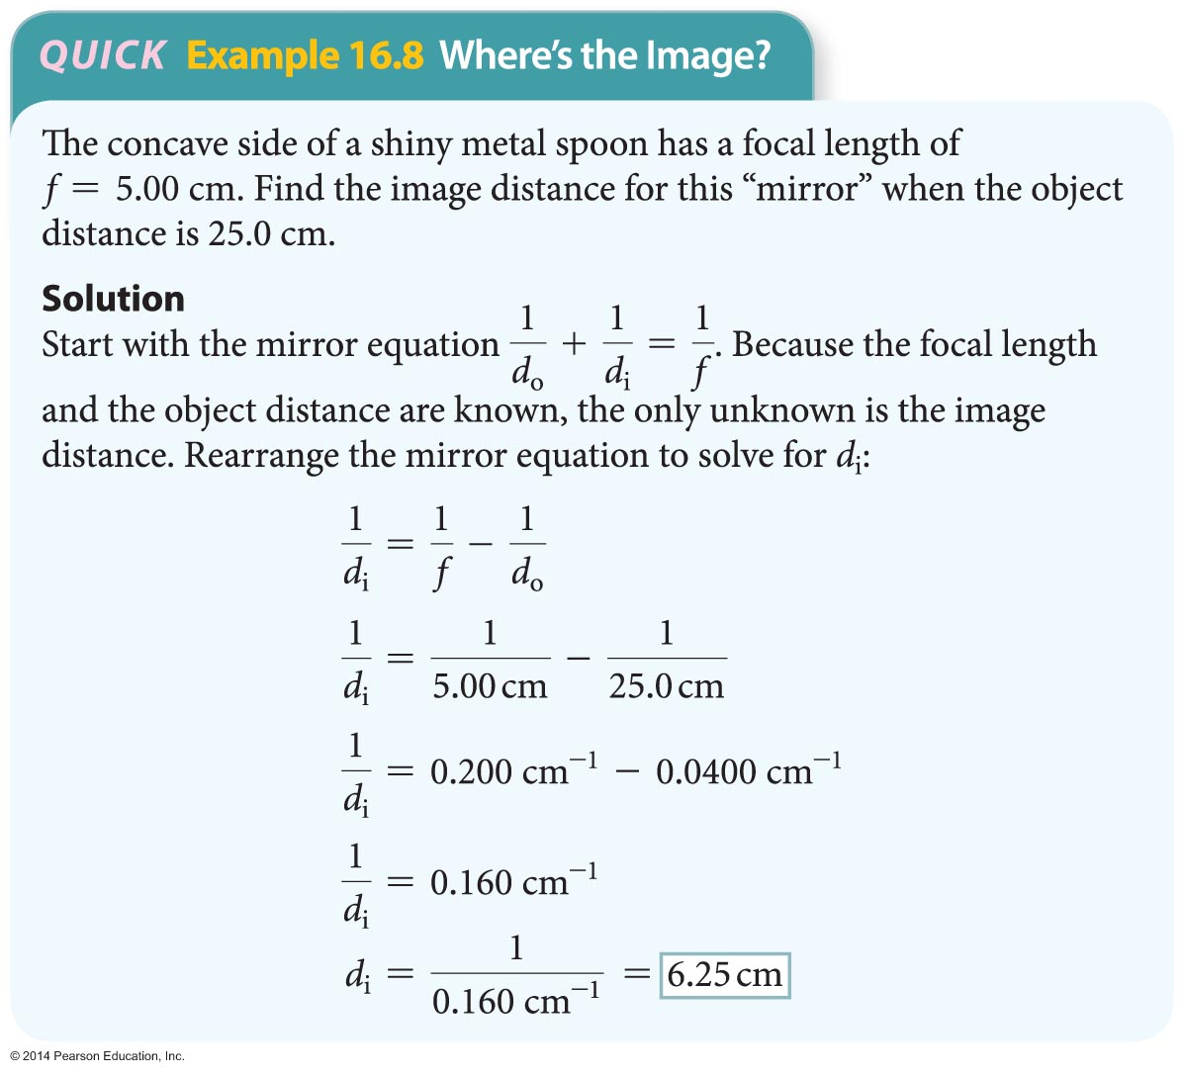
Curved Mirrors
The following example shows how the mirror equation may be used to determine the image distance in the case of a concave mirror.

Slide 49
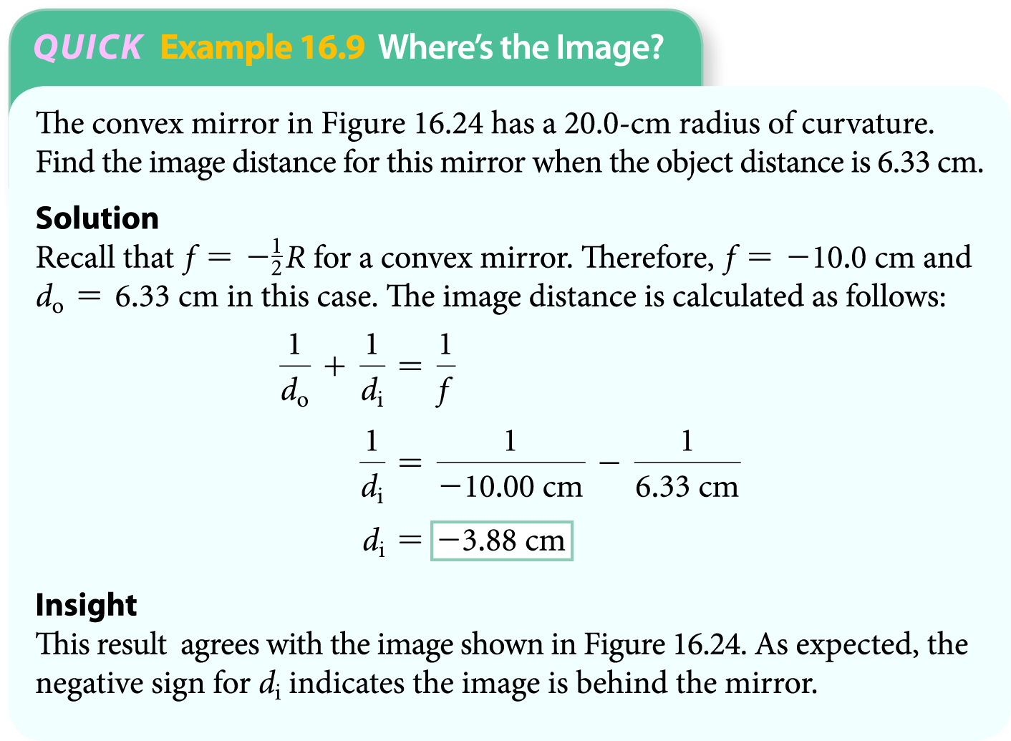
Curved Mirrors
The following example shows how the mirror equation may be used to determine the image distance in the case of a convex mirror.

Slide 50
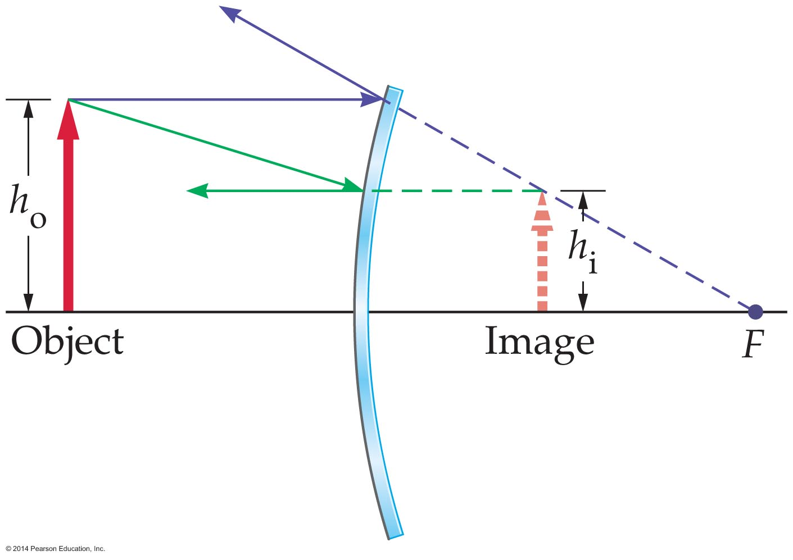
Curved Mirrors
Curved mirrors typically produce images that are either larger or smaller than the object. The figure below shows an image that is reduced in size.
In general, the ratio of the height of the image, h_{i}, to the height of the object, h_{o}, is defined as the magnification, m.

Slide 51
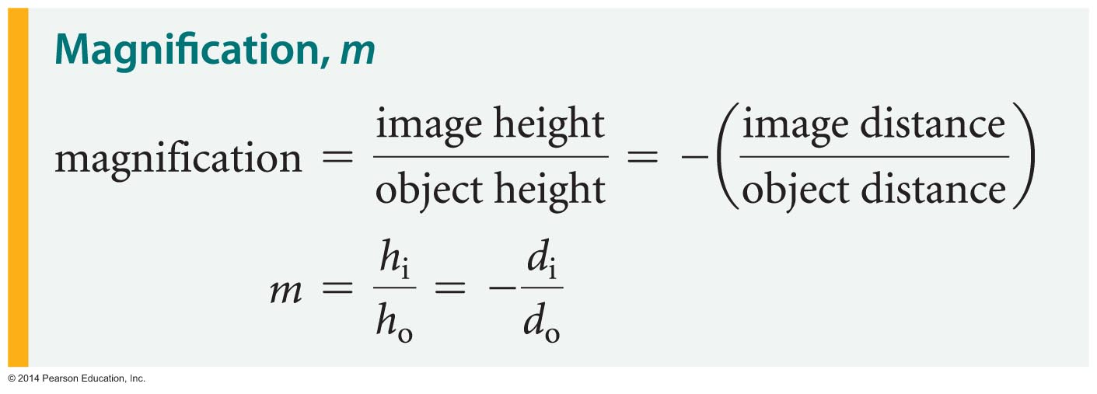
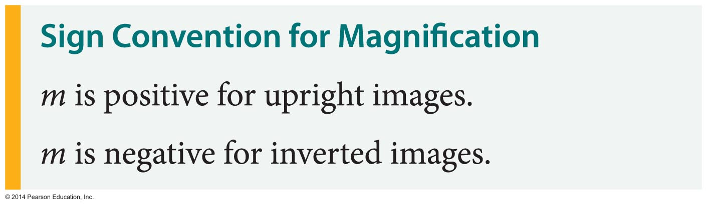
Curved Mirrors
The magnification can also be determined in terms of the object and image distances as follows:
The sign of the magnification tells whether the image is upright or inverted:

