Slide 1
The Properties of Light
Prepared by
Chris Chiaverina

Slide 2
Chapter Contents
The Nature of Light
Color and the Electromagnetic Spectrum
Polarization and Scattering of Light

Slide 3
The Nature of Light
Light is a small but important part of the electromagnetic spectrum. Everything you see either emits or reflects light.
The waves that make up light can travel through a vacuum, unlike mechanical waves of sound.
Nothing can travel faster than light in a vacuum. We use the symbol c, which comes from word celerity, meaning "speed or swiftness," to represent the speed of light.
The approximate speed of light in a vacuum is 3.00 x 10⁸ m/s.

Slide 4
The Nature of Light
Because the speed of light is so large, its value is difficult to determine. The following are some of the important milestones on the road to determining c.
Galileo's Experiment In the first attempt to measure the speed of light, Galileo Galilei (1664–1642) and an assistant used two lanterns. Galileo opened the shutter of one lantern, and an assistant—who was positioned a large distance away—was instructed to open the shutter of second lantern as soon as he saw the light from Galileo's lantern.

Slide 5
The Nature of Light
Galileo then attempted to measure the time that elapsed before he saw the returning light from his assistant's lantern. Seeing no delay, Galileo concluded that the speed of light must be very large—too large to measure with such an experiment.
Romer's Observations The first to give a numerical value to the speed of light was Danish astronomer Ole Romer (1644–1710). While using the eclipses of the moons of Jupiter to solve the problem of determining longitude, Romer found that the time of these eclipses varied during the course of a year.

Slide 6
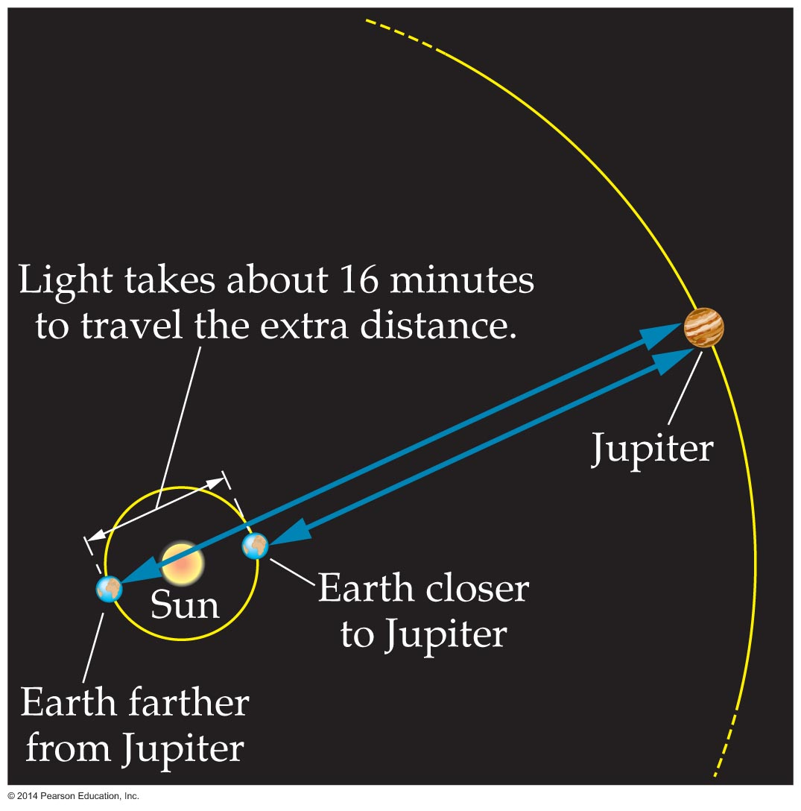
The Nature of Light
He realized that the eclipses occurred earlier when Earth was closer to Jupiter and later when Earth was farther away. The difference is illustrated in the figure below.
Romer observed that light requires about 16 minutes to travel from one side of Earth's orbit to the other. Using this value, he calculated the speed of light to be 2 x 10⁸ m/s, while the modern value is
3 x 10⁸ m/s.

Slide 7
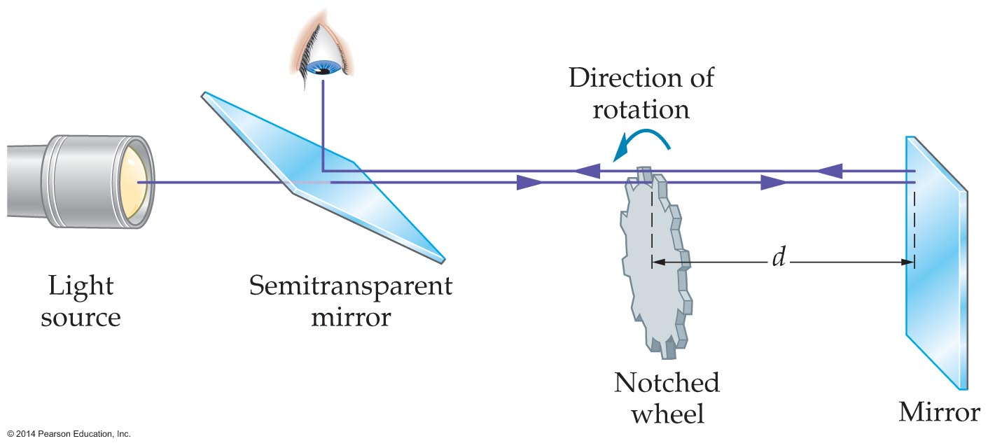
The Nature of Light
Fizeau's Experiment The first laboratory measurement of the speed of light was performed by French scientist Armand Fizeau (1819–1896).
The basic elements of his experiment are shown in the figure below.

Slide 8
The Nature of Light
In the apparatus, light passes through one notch in a rotating wheel and travels to a mirror a considerable distance away. If the time required for the light to travel to the far mirror and back is equal to the time it takes for the wheel to rotate from one notch to the next, light will pass through the wheel and on to the observer.
By measuring the rotational speed of the wheel and the distance from the wheel to the mirror, Fizeau was able to make an accurate measurement of the speed of light. His value was about 3.13 x 10⁸ m/s.

Slide 9
The Nature of Light
The Doppler effect applies to light as well as to sound. It changes the frequency of light waves just as it does for sound wave.
For a source of light with a frequency f_{source} and speed v_{source} relative to an observer, the observed frequency, f_{observed}, is
f_{observed} = f_{source}(1 ± v_{source}/c)
The plus sign (+) is used when the source is approaching the observer.
The minus sign (−) is used when the source is moving away from the observer.

Slide 10
The Nature of Light
The Doppler effect applies to all types of electromagnetic waves, including light waves, radio waves, microwaves, and so on.
The following example illustrates how the Doppler equation can be used to determine the change in frequency of radio waves.

Slide 11
The Nature of Light
American astronomer Edwin Hubble (1889–1953) discovered that light from distant galaxies is Doppler shifted.
In fact, he found that the greater the distance to a galaxy, the greater the Doppler shift. Furthermore, he found that most galaxies are moving away from us and that their speed is directly proportional to their distance.
Hubble's observations gave strong support for the Big Bang theory. According to this theory, the universe started in a hot dense state and then expanded rapidly outward.

Slide 12
The Nature of Light
Light is certainly a wave. Light displays all of the properties that define a wave.
Even so, light also displays some of the properties associated with particles.
To understand this behavior you might say that light "bottles" its energy, rather than delivering it from a "tap."

Slide 13

The Nature of Light
As figure (a) indicates, a wave with energy that can have any value is like water coming from a tap, which can provide any amount.

Slide 14
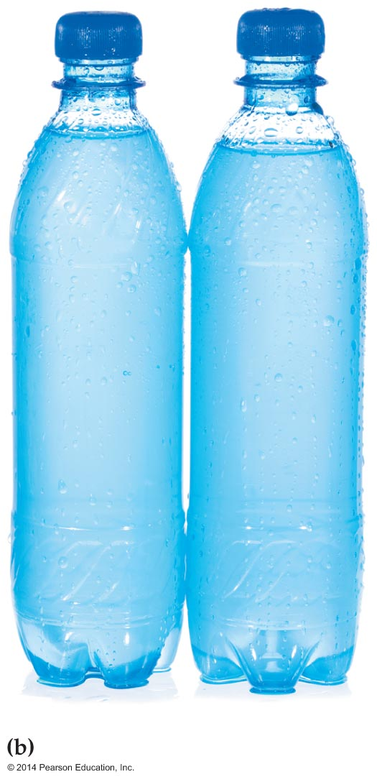
The Nature of Light
In contrast, bottled water comes in discrete packages—the individual bottles. You can get one bottle, two bottles, three bottles, or more. This is like energy carried by a light wave. It doesn't come in any amount at all, but only in bundles of energy of a fixed amount—just like bottled water.

Slide 15
The Nature of Light
The "bottled-up" packets of energy in a beam of light are referred to as photons. You can think of a photon as a "particle" of light that carries energy but has no mass. Photons are what give light its particle-like nature.
One final mystery of light involves its speed as measured by different observers.
Albert Einstein made the following bold prediction in 1905: All observers measure the same speed of light, regardless of their speed relative to one another.

Slide 16
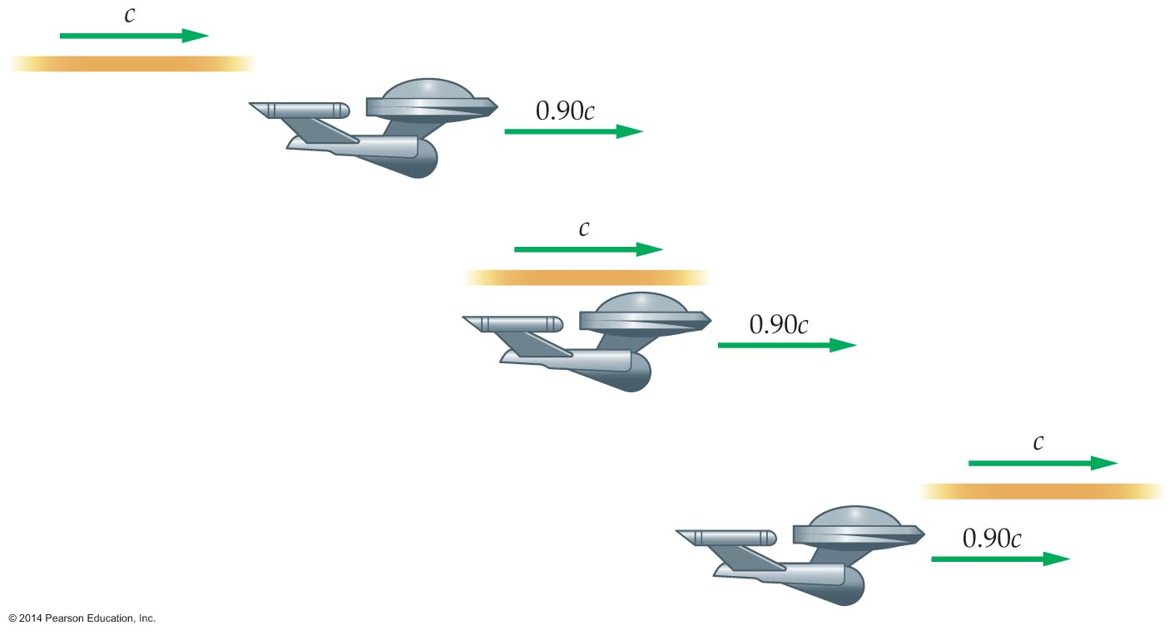
The Nature of Light
To see how remarkable this prediction really is, consider the following example.
Suppose a friend zooms by you in her spaceship at 90% of the speed of light. After she goes by, you shine a beam of light in her direction, as is shown in the figure below.

Slide 17
The Nature of Light
Even though the spaceship moves with a speed of 0.9c, your friend sees the beam of light going past her at 100% of the speed of light! Both you and your friend measure exactly the same speed for the light beam, even though she's moving very fast relative to you.
The fact that all observers measure the same speed of light leads to additional interesting consequences. Among these are the facts that clocks run slow at high speed and metersticks shrink in length.

Slide 18
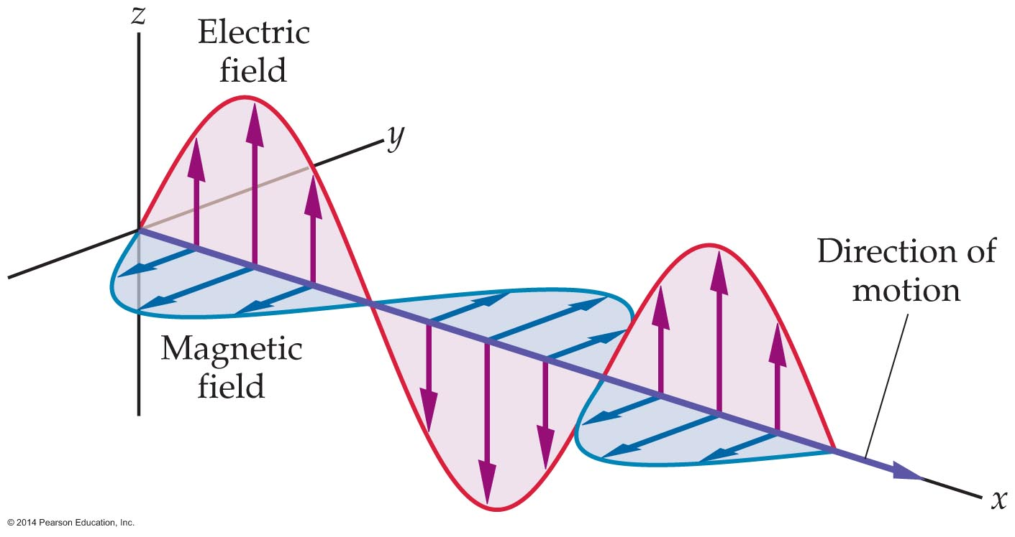
Color and the Electromagnetic Spectrum
A wave on a string causes the string to oscillate back and forth. A sound wave causes air molecules to oscillate back and forth. What oscillates back and forth in a light wave?
Light waves consist of oscillating electric and magnetic fields, as is shown in the figure below. Notice that the electric and magnetic fields are perpendicular to one another.

Slide 19
Color and the Electromagnetic Spectrum
Light waves are just one example of a large group of waves known as electromagnetic waves. The electromagnetic waves that our eyes can detect are known as visible light.
Electromagnetic waves are produced in nature when an electron in an atom oscillates back and forth. This sends out an electromagnetic wave, just like shaking one end of a string sends out a wave.
Electromagnetic waves can also be produced by oscillating electric currents. Even shaking a bar magnet produces an electromagnetic wave.

Slide 20
Color and the Electromagnetic Spectrum
The frequency of an electromagnetic wave is key to its behavior. For example, different colors of visible light are produced by electromagnetic waves of different frequencies. But light isn't the only type of electromagnetic wave.
Visible light corresponds to only a small range of possible frequencies. The full range of frequencies of electromagnetic waves is known as the electromagnetic spectrum.

Slide 21
Color and the Electromagnetic Spectrum
A wave's speed, frequency, and wavelength are related by the equation v = fλ.
All electromagnetic waves in a vacuum have the same speed, c. Therefore, the frequency, f, and the wavelength, λ, of an electromagnetic wave are related as follows:
c = fλ
The product of an electromagnetic wave's frequency and wavelength must equal c. Thus, if the frequency of an electromagnetic wave increases, its wavelength must decrease.

Slide 22
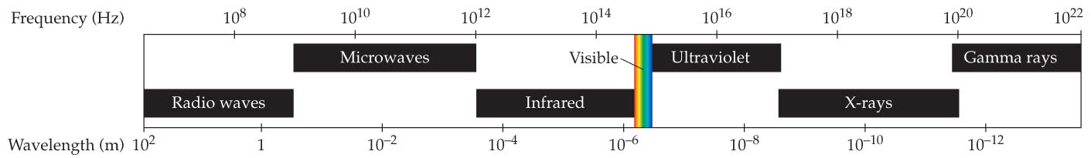
Color and the Electromagnetic Spectrum
In the electromagnetic spectrum certain portions are given special names. This is indicated in the figure below.
The following is a discussion of the most important regions of the electromagnetic spectrum in order of increasing frequency.
Radio Waves The lowest-frequency electromagnetic waves of practical importance are radio waves, in the frequency range 10⁶ Hz to 10⁹ Hz.

Slide 23
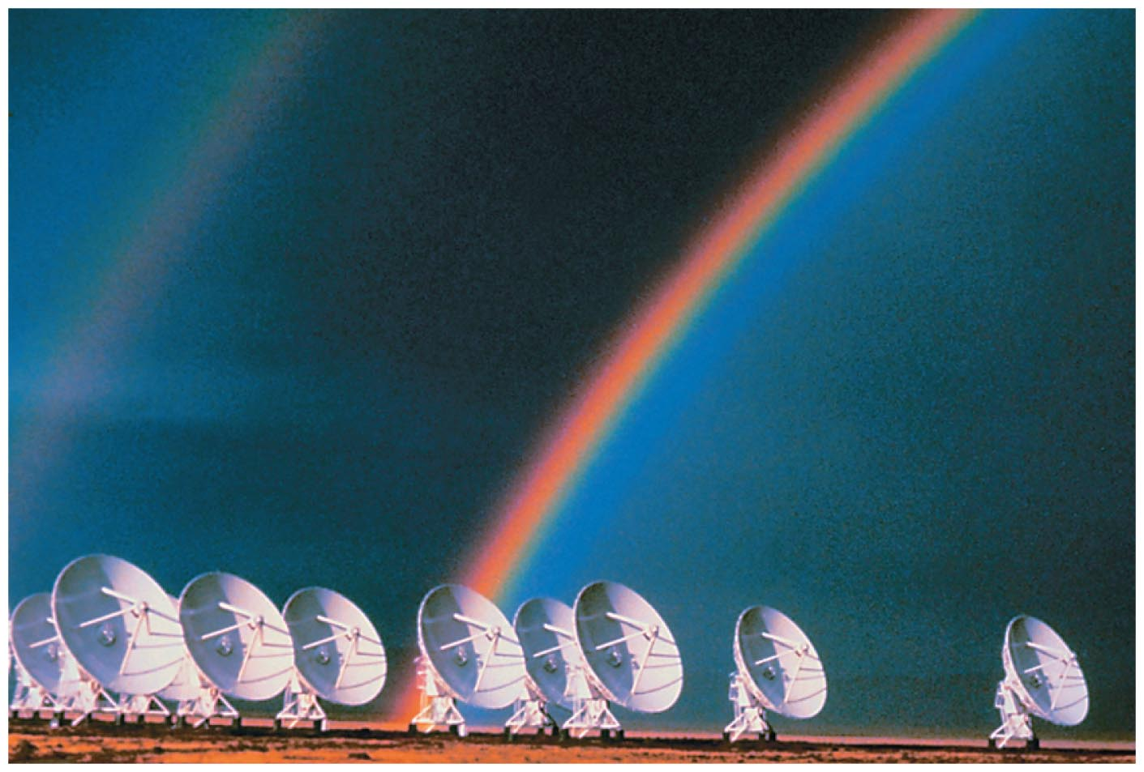
Color and the Electromagnetic Spectrum
These are the waves that are used in both radio and television broadcasting. In addition, molecules and accelerated electrons in space give off radio waves, and radio astronomers can detect these waves with large dish receivers like those shown in the figure below.

Slide 24
Color and the Electromagnetic Spectrum
Microwaves Electromagnetic radiation with frequencies from 10⁹ Hz to about 10¹² Hz are referred to as microwaves. Waves in this frequency range are versatile—they cook your food in microphone ovens and carry your telephone calls by cell phone and through WiFi connections to the Internet.
Infrared Waves Electromagnetic waves with frequencies just below that of red light—roughly 10¹² Hz to 4.3 x 10¹⁴ Hz—are known as infrared (IR) waves. These waves can be felt as heat on our skin but cannot be seen with our eyes. Many animals have infrared receptors that allow them to "see" infrared radiation.

Slide 25
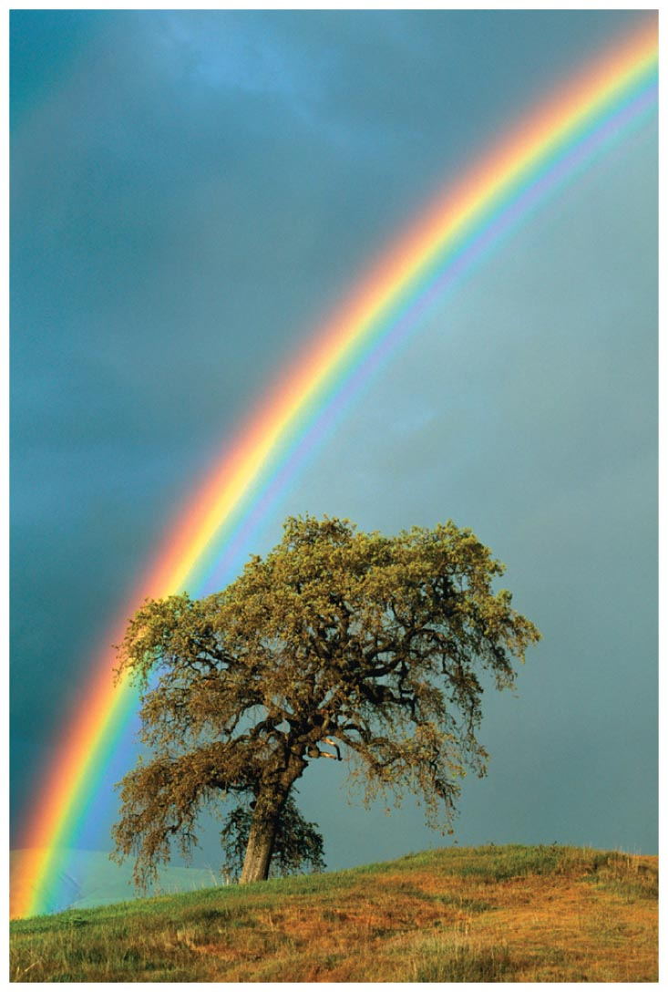
Color and the Electromagnetic Spectrum
Visible Light The spectrum of visible light is represented by the full range of colors seen in the rainbow. Each of the different colors in the figure below is produced by an electromagnetic wave with a different frequency.

Slide 26
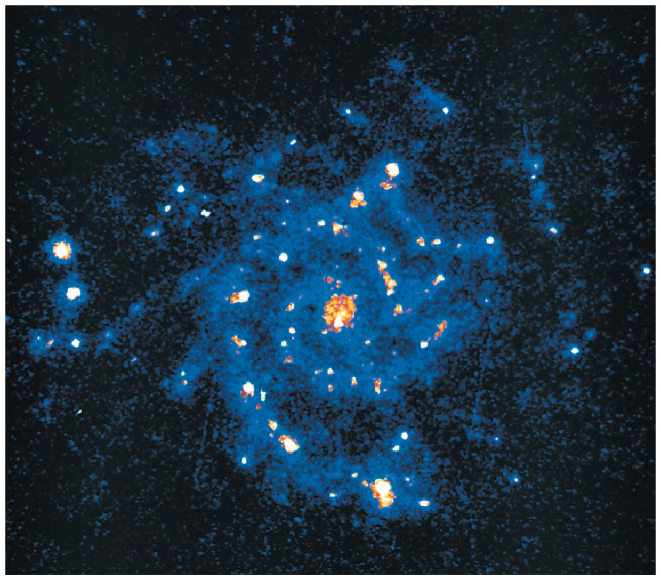
Color and the Electromagnetic Spectrum
Ultraviolet Light When electromagnetic waves have frequencies just above that of violet light—from about 7.5 x 10¹⁴ Hz to 10¹⁷ Hz—they are called ultraviolet (UV) rays.
Although these UV rays are invisible, they often make their presence known by causing suntans. UV light is also given off by galaxies in regions of star formation, as shown in the figure below.

Slide 27
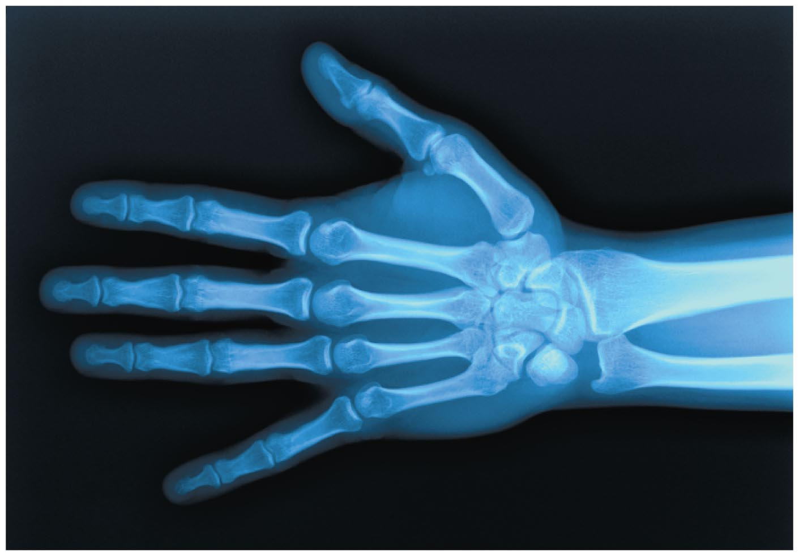
Color and the Electromagnetic Spectrum
X-Rays X-rays are radiation in the range of the electromagnetic spectrum between 10¹⁷ Hz and 10²⁰ Hz. These energetic rays pass through our bodies rather freely, except when they encounter bones, teeth, or other relatively dense material. An X-ray image of a hand is shown in the figure below.

Slide 28
Color and the Electromagnetic Spectrum
X-rays can cause damage to human tissue, and it is desirable to reduce unnecessary exposure to these rays as much as possible.
Gamma Rays Finally, electromagnetic waves with frequencies above 10²⁰ Hz are referred to as gamma rays. Gamma rays are highly energetic and can be destructive to living cells. It is for this reason that they are used to kill cancer cells and, more recently, microorganisms in food.

Slide 29
Color and the Electromagnetic Spectrum
The human eye has three types of light-sensitive cells that detect red, green, and blue light, respectively. Because of this, the colors red, green, and blue are known as primary colors.
All of the colors we see in nature—from red to orange to yellow to green to blue—are produced in our eyes by different amounts of the primary colors.

Slide 30
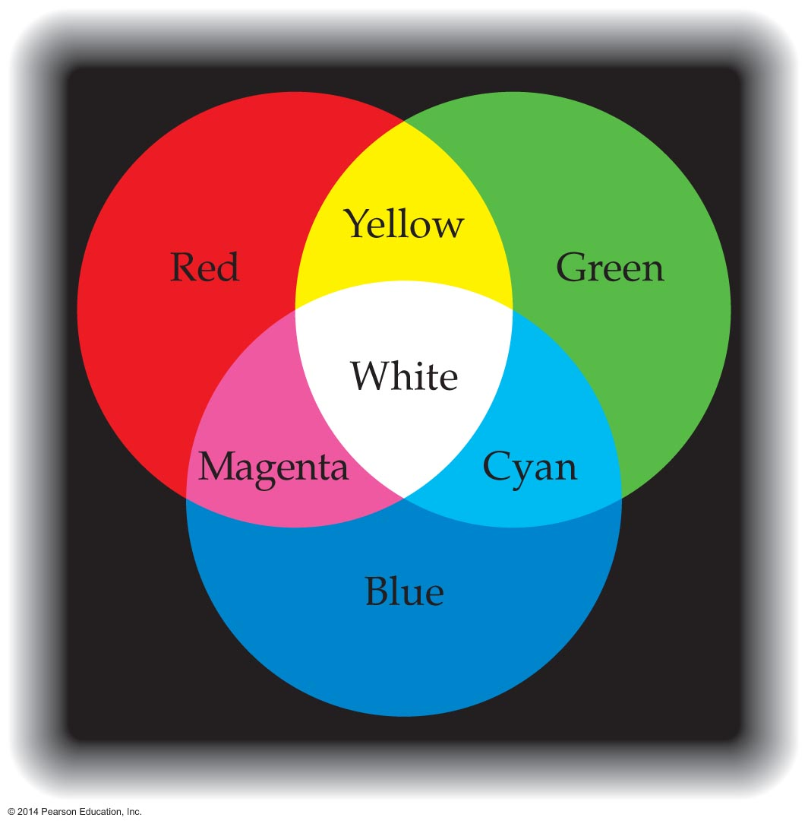
Color and the Electromagnetic Spectrum
The specific way that primary colors combine to form other colors is illustrated in the figure below.
Red, green, and blue are known as the additive primary colors since these colors add together to produce white light. Combining two or more of these primaries results in other colors, including yellow, magenta, cyan, and white.

Slide 31
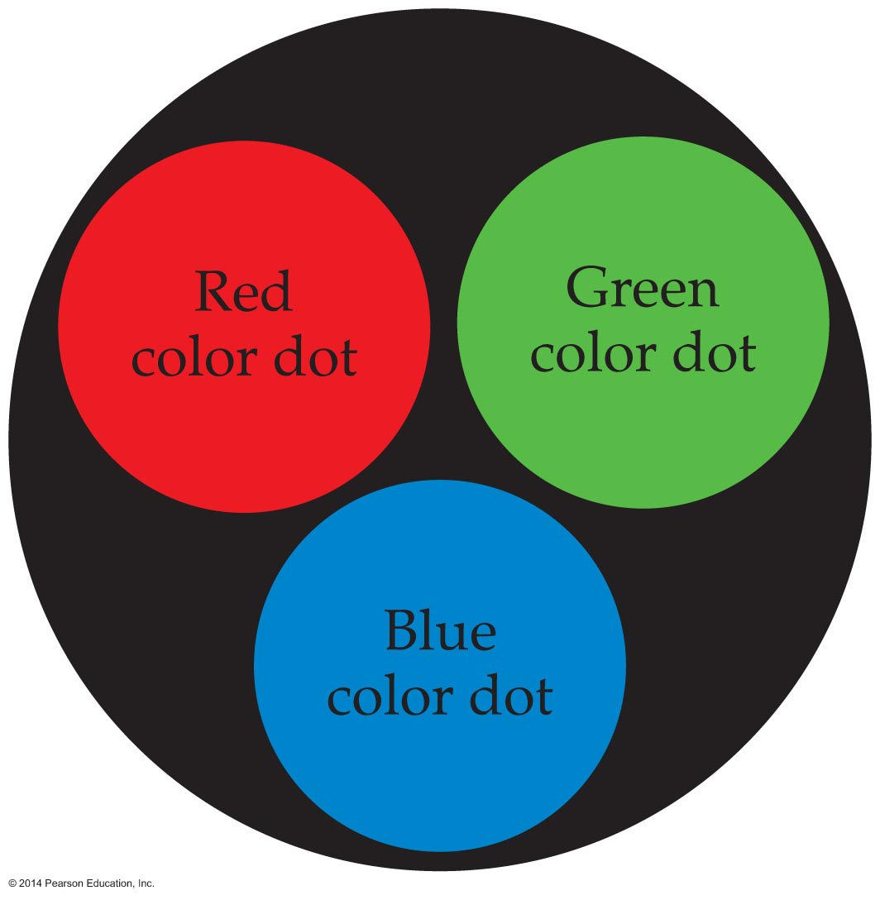
Color and the Electromagnetic Spectrum
Manufacturers of television and computer screens take advantage of the additive primaries. Each picture element—or pixel—on a TV screen consists of three color dots, as shown in the figure below. Lighting combinations of the color dots and varying the brightness allow the screen to display any desired color.

Slide 32
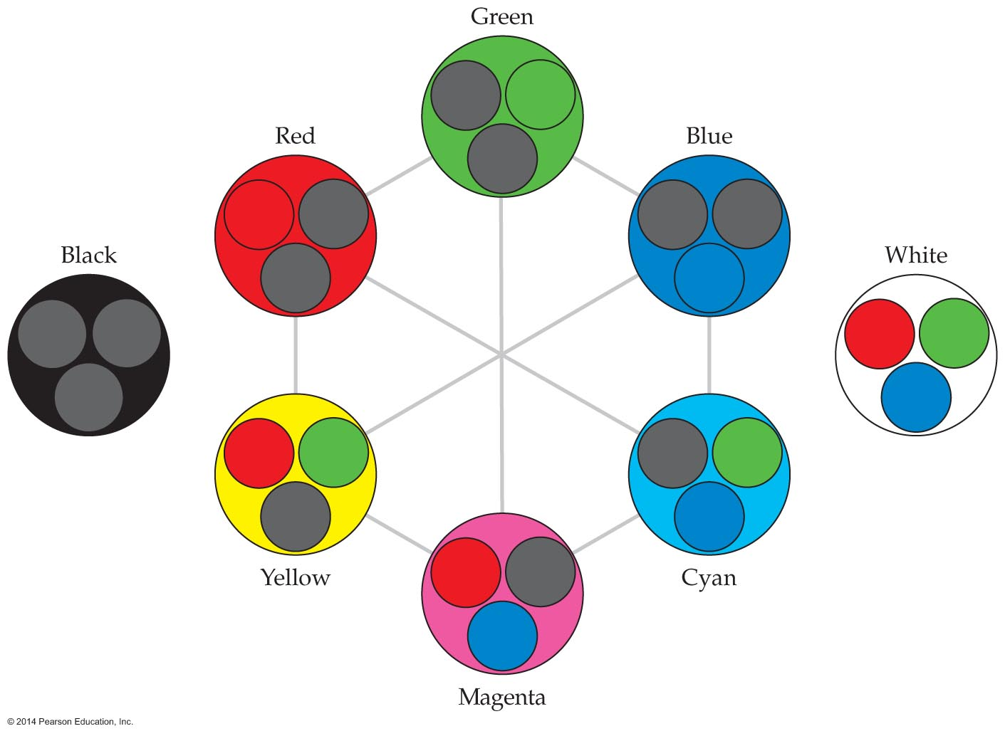
Color and the Electromagnetic Spectrum
The figure below shows what a pixel looks like as it produces various colors. Notice that red and green color dots are lit to produce yellow, the red and blue dots produce magenta, and the blue and green dots produce cyan. Lighting all three dots in a pixel produces white, and lighting none of them produces black.

Slide 33
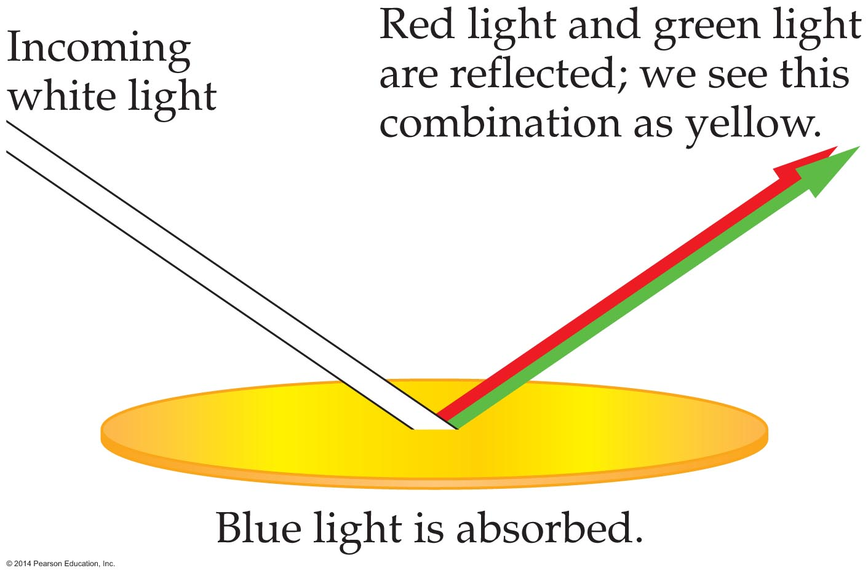
Color and the Electromagnetic Spectrum
Not all colors are produced by sources of light like the color dots on a TV screen. Sometimes color is produced by subtracting, or removing, some of the colors in white light. This is done with pigments, like those used in paints and dyes.
Yellow paint (pigment) looks yellow because it absorbs blue light and reflects red and green light to our eyes. We see the combination of these two colors as "yellow." This is shown in the figure below.

Slide 34
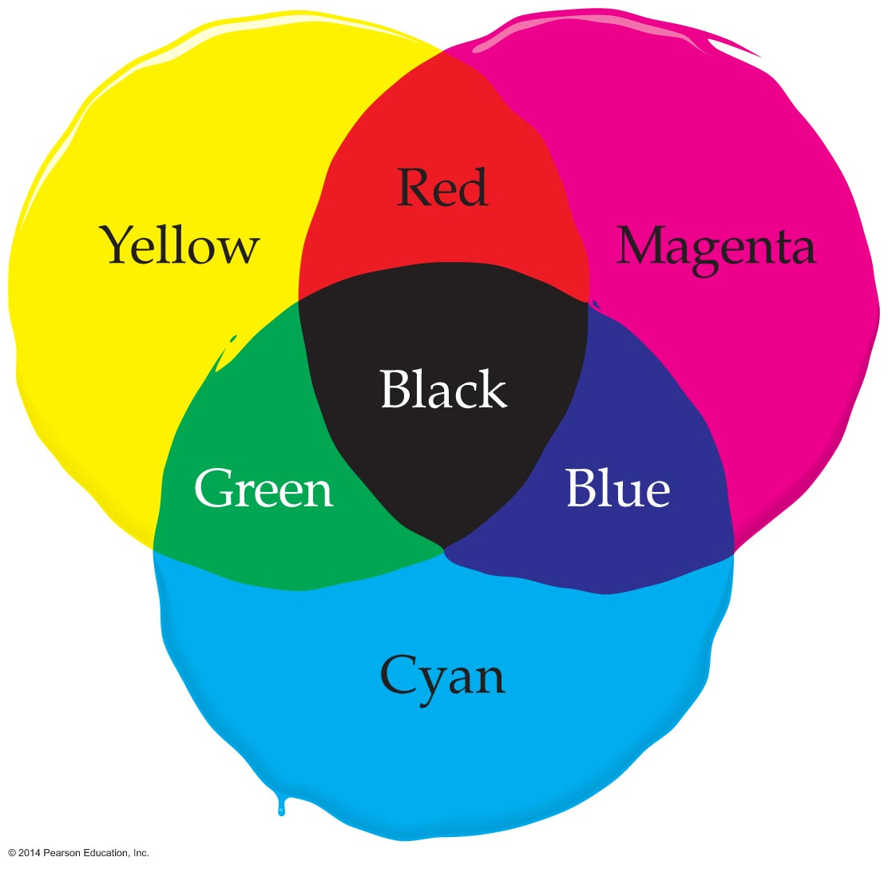
Color and the Electromagnetic Spectrum
Similarly, a cyan pigment absorbs red light and reflects green and blue. A magenta pigment absorbs green light and reflects red and blue light.
Cyan, magenta, and yellow are known as the subtractive primary colors. They are the colors that can combine to produce any desired color by subtracting light (see figure below). If all three subtractive primaries are combined, they subtract all colors from light, leaving black.

Slide 35
Polarization and Scattering of Light
When looking into the blue sky of a crystal-clear day, humans see light that is uniform. However, for some animals, like honeybees and pigeons, the light in the sky is far from uniform. The reason is that these animals are sensitive to the direction of the electric field in a beam of light.
In general, the direction of the electric field in a light wave, or any other electromagnetic wave, is referred to as its polarization.

Slide 36
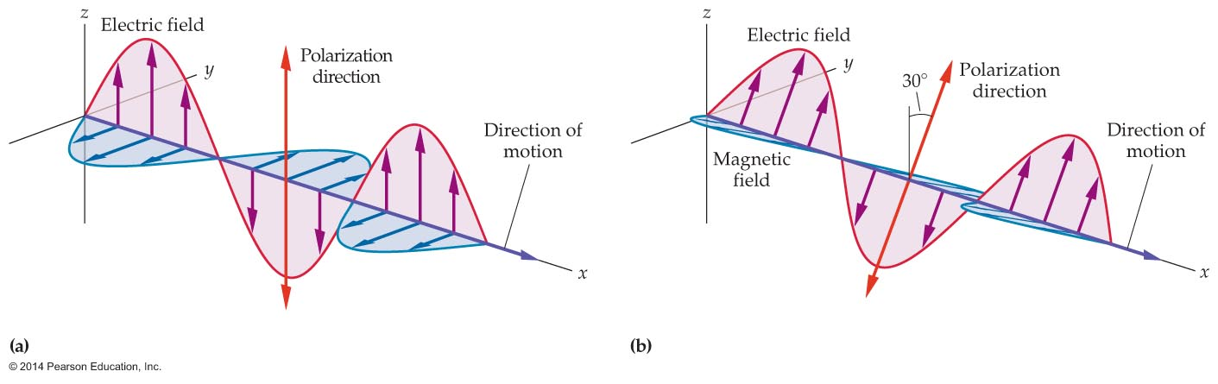
Polarization and Scattering of Light
To understand polarization more clearly, consider the electromagnetic waves pictured in the figure below.
Each of the waves has an electric field that points along a line. For example, the electric field in figure (a) oscillates up and down in the vertical direction. We say that this wave is linearly polarized in the vertical direction.

Slide 37
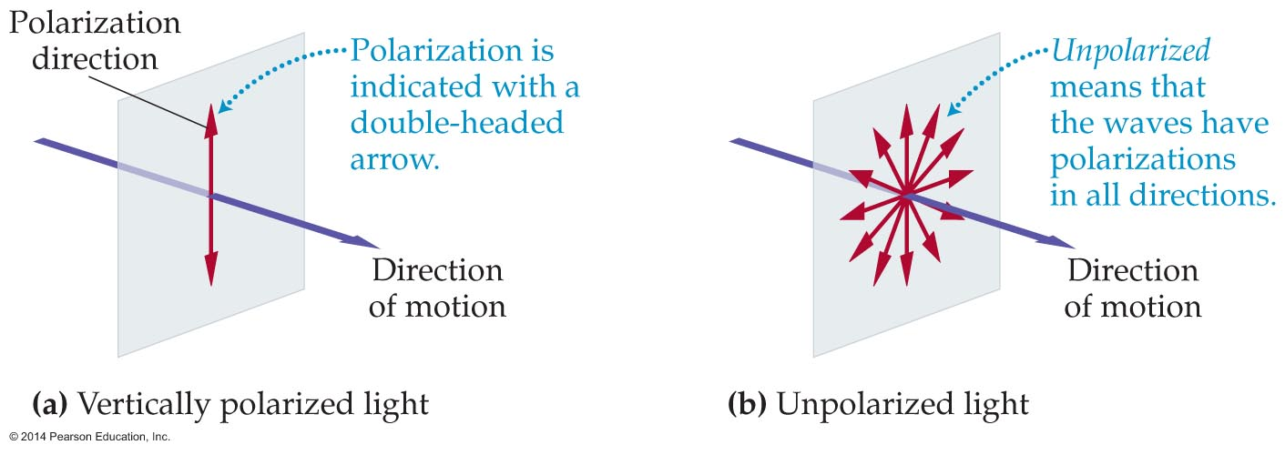
Polarization and Scattering of Light
In figure (a) below, vertically polarized light is indicated with a red double-headed arrow. Figure (b) shows light that is a combination of waves with polarizations in different, random directions. Light with random polarization directions is called unpolarized.
A common incandescent lightbulb and the Sun both produce unpolarized light.

Slide 38
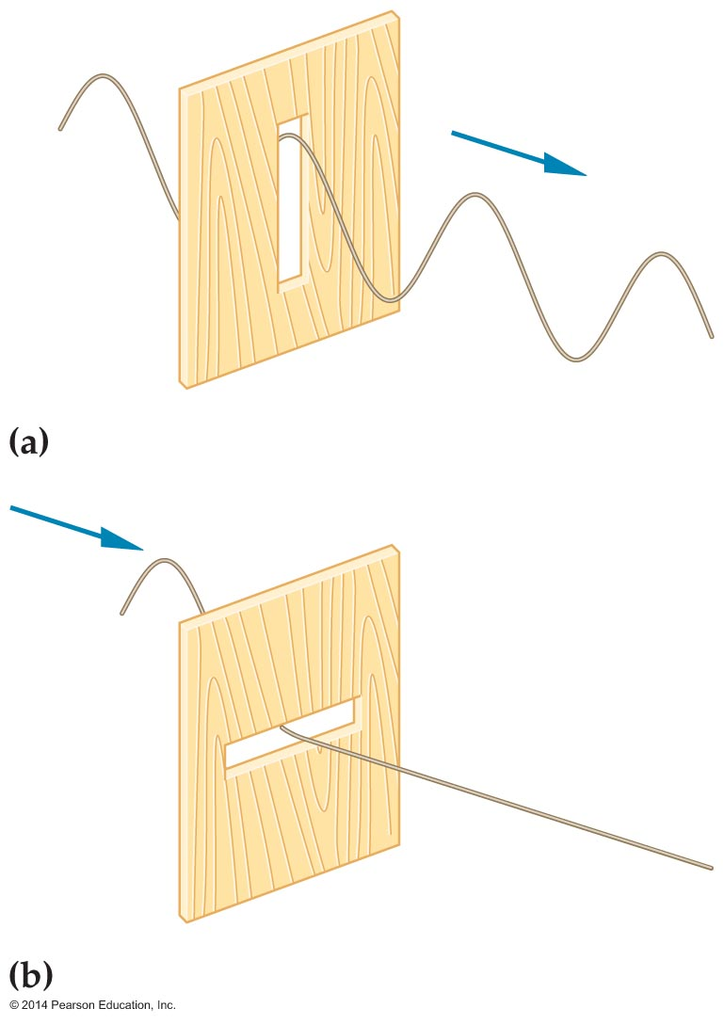
Polarization and Scattering of Light
Unpolarized light can be polarized by passing it through a polarizer, a filter that transmits light waves with only one direction of polarization.
The figure below shows a simple mechanical polarizer. Here a wave displaces a string in the vertical direction as it moves toward a slot cut into a block of wood. If the slot is vertical, the wave passes through unhindered. If the slot is horizontal, it stops the wave.

Slide 39
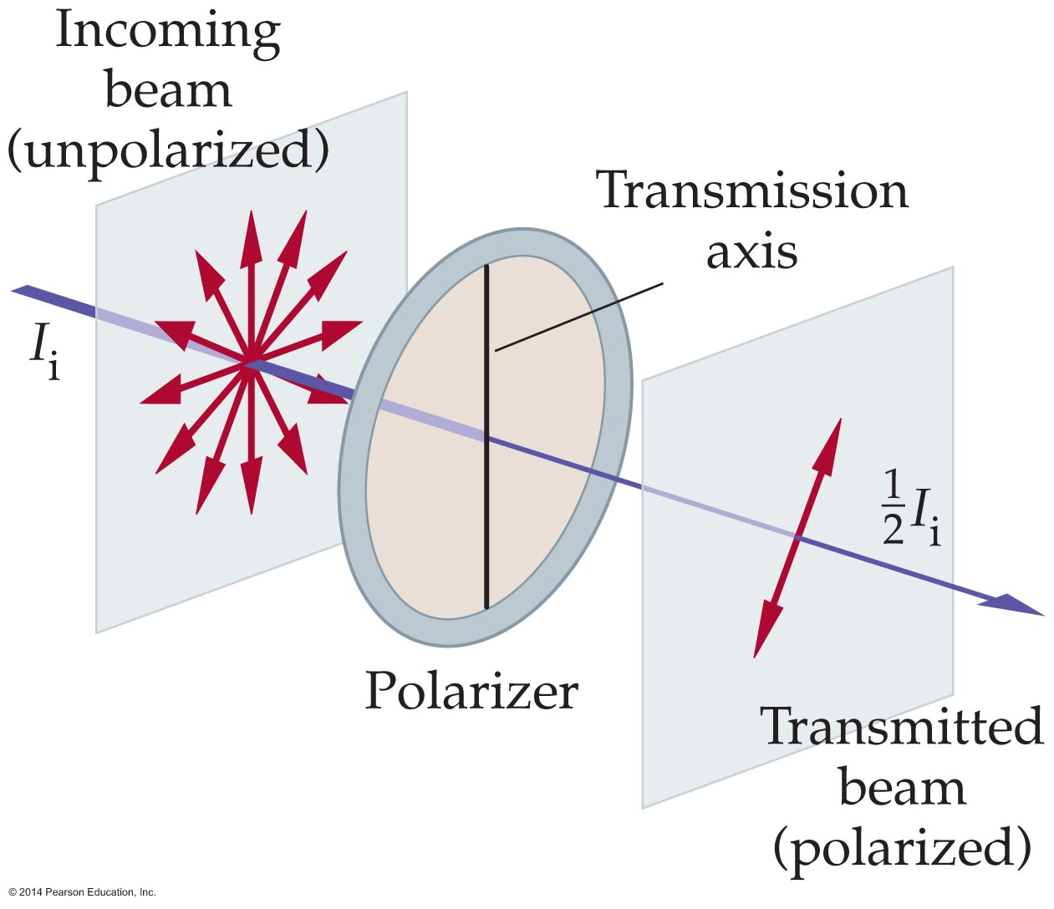
Polarization and Scattering of Light
The figure below shows what happens when unpolarized light encounters a filter. Some of the light in the unpolarized beam has a vertical polarization and passes right through the polarizer. Some of the light has a horizontal polarization and is blocked.

Slide 40
Polarization and Scattering of Light
Averaging over all possible polarization directions, we find that exactly one-half of the light passes through the polarizer. That is, if an unpolarized beam with an initial intensity I_{i} passes through a polarizer, the transmitted, or final, intensity, I_{f}, is one-half the initial intensity:
I_{f} = ½I_{i}
Also, when a beam of light is transmitted through a polarizer, it becomes polarized in a direction of the polarizer's transmission axis.
Thus, a polarizer affects both the intensity and the polarization of a beam of light.

Slide 41
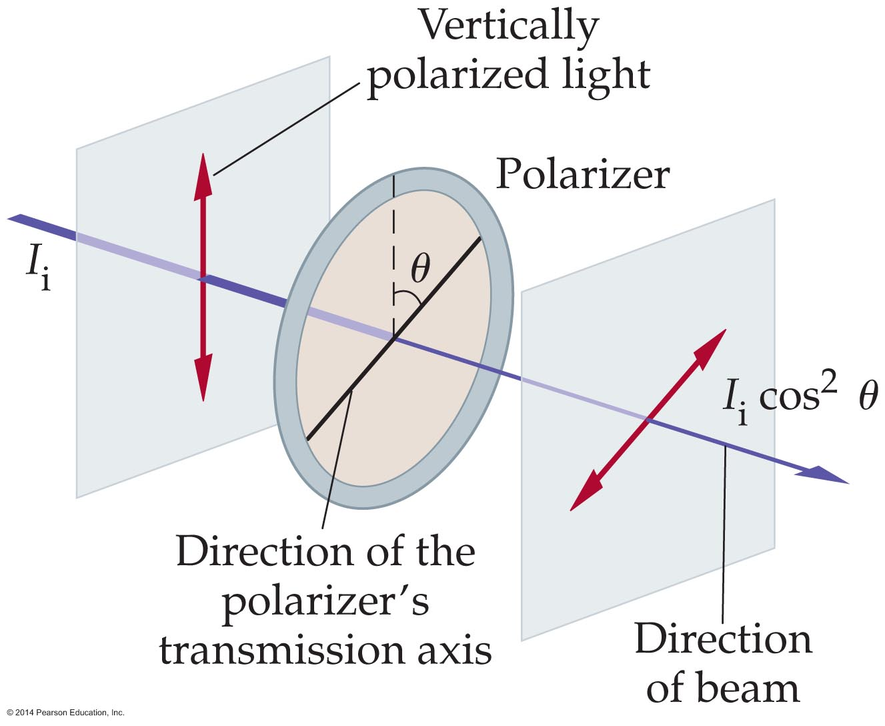
Polarization and Scattering of Light
The transmission of polarized light through a polarizer is illustrated in the figure below.
The light with a vertical polarization and initial intensity I_{i} is seen passing through a polarizer whose transmission axis is at an angle θ to the vertical. In a case like this, the polarizer reduces the intensity of the light that passes through it according to the following law:
I_{f} = I_{i} cos²θ. This is called the Law of Malus.

Slide 42
Polarization and Scattering of Light
The following example shows how the Law of Malus is applied.

Slide 43
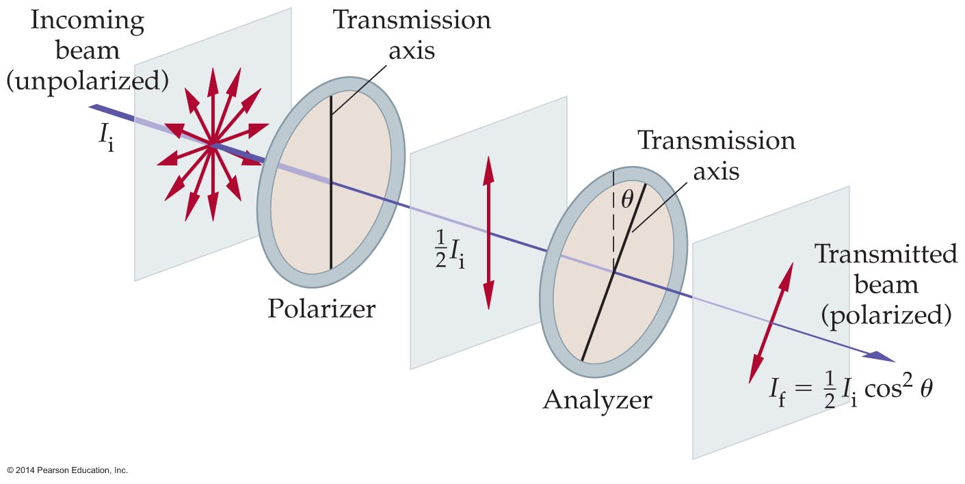
Polarization and Scattering of Light
The figure below shows light passing through two polarizers. The first filter is labeled the polarizer, and the second polarizer is referred to as the analyzer.
After the unpolarized beam passes through a polarizer, it passes through the analyzer, whose transmission axis is at an angle θ relative to that of the first polarizer. The orientation of the analyzer can be adjusted to give a beam of variable intensity and polarization.

Slide 44
Polarization and Scattering of Light
The following example illustrates how light is affected by two polarizers.

Slide 45
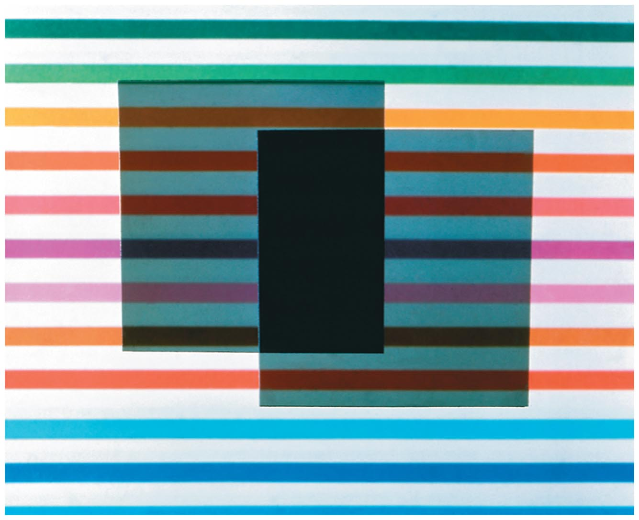
Polarization and Scattering of Light
Polarizers with transmission axes at right angles to one another are referred to crossed polarizers. The transmission through a pair of crossed polarizers is zero according to the Law of Malus, since θ = 90°.
Crossed polarizers are shown in the figure below.

Slide 46
Polarization and Scattering of Light
There are many practical uses for crossed polarizers. For example, engineers often construct a plastic replica of a building, bridge, or similar structure to study the stress in its various parts with a technique known as photoelastic stress analysis. Dentists use the same technique to study stress in teeth, and doctors use it when they design prosthetic joints.

Slide 47
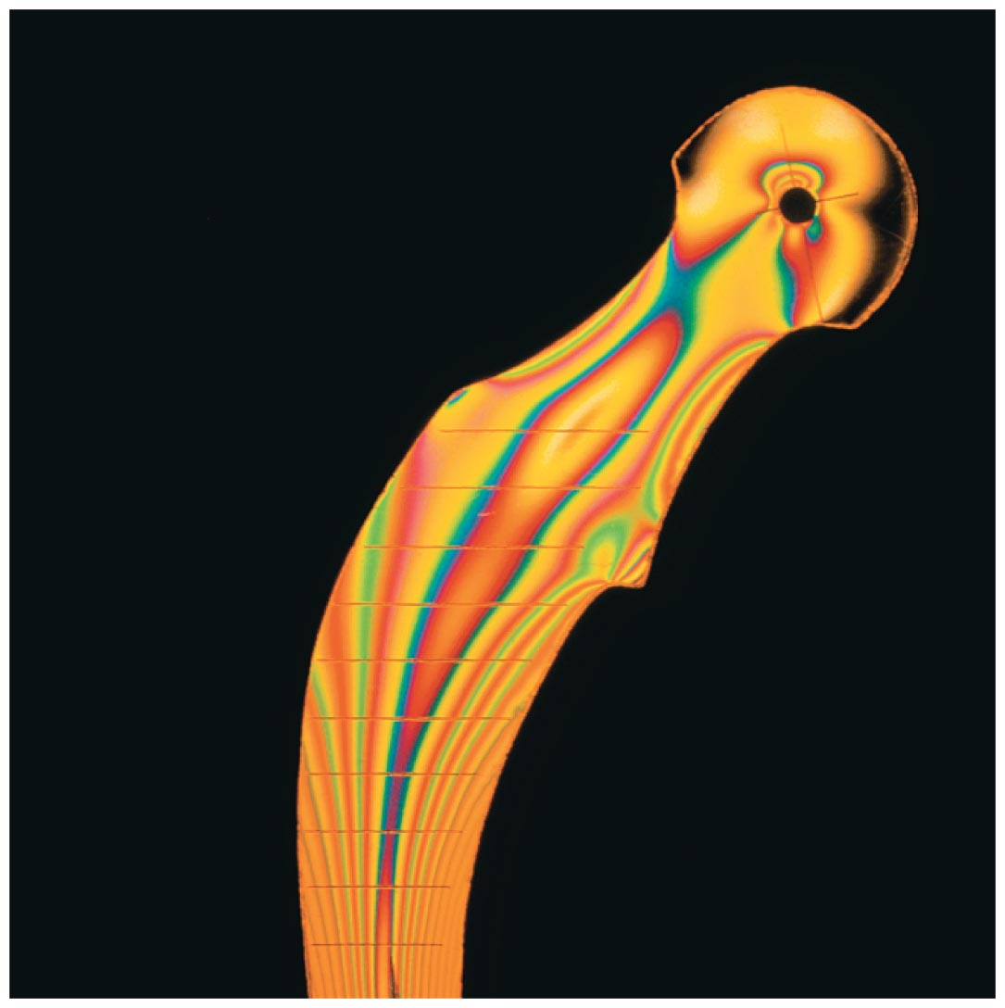
Polarization and Scattering of Light
In the figure below, photoelastic stress analysis is being used to study a plastic model of a prosthetic hip joint. The plastic model is placed between crossed polarizers. If the polarization of the light is unchanged by the plastic, the light will not pass through the second polarizer. In areas where the plastic is stressed, however, it rotates the plane of polarization, allowing some of the light to pass through.

Slide 48
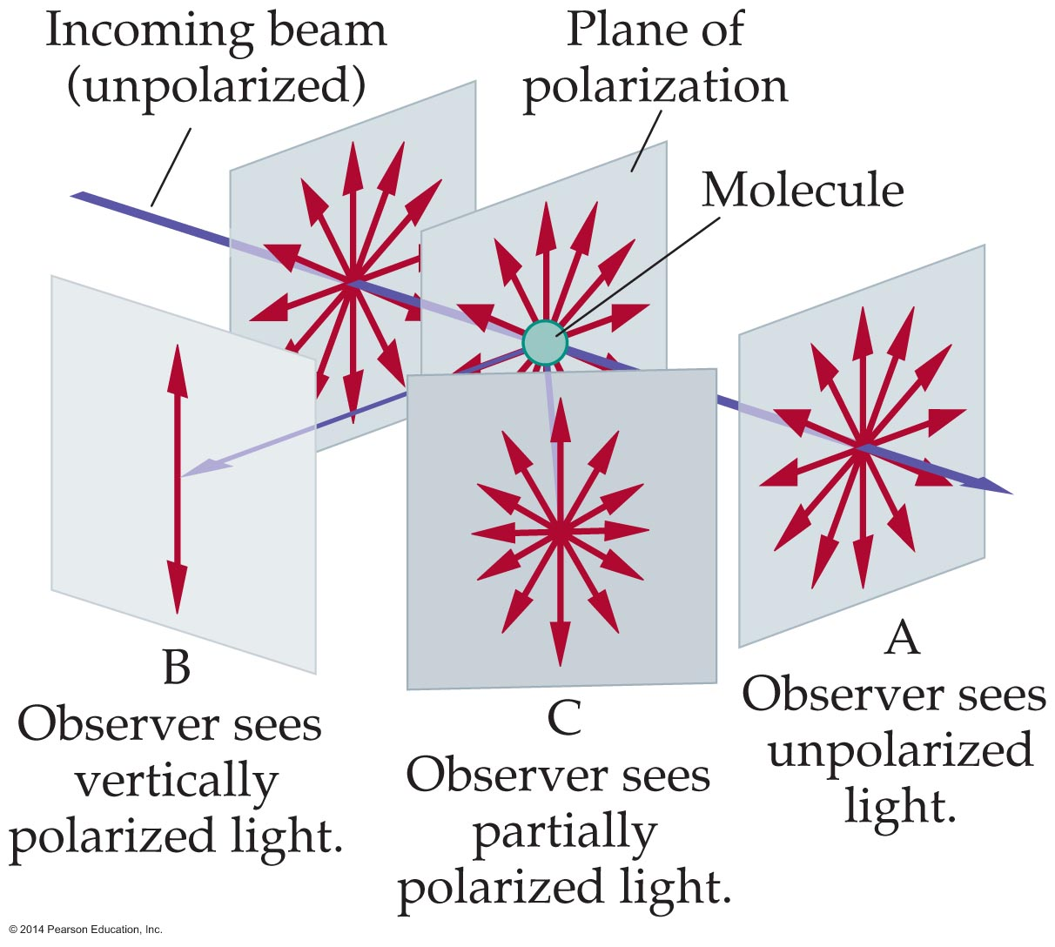
Polarization and Scattering of Light
When unpolarized light is scattered, it can become polarized. This is illustrated in the figure below, where we see an unpolarized beam of light being scattered by a molecule. An observer in the forward position, at point A, sees light of all polarizations. An observer at B, however, sees vertically polarized light.
Thus, the scattering of sunlight by the atmosphere produces polarized light for an observer looking at a right angle to the direction in which the Sun lies.

Slide 49
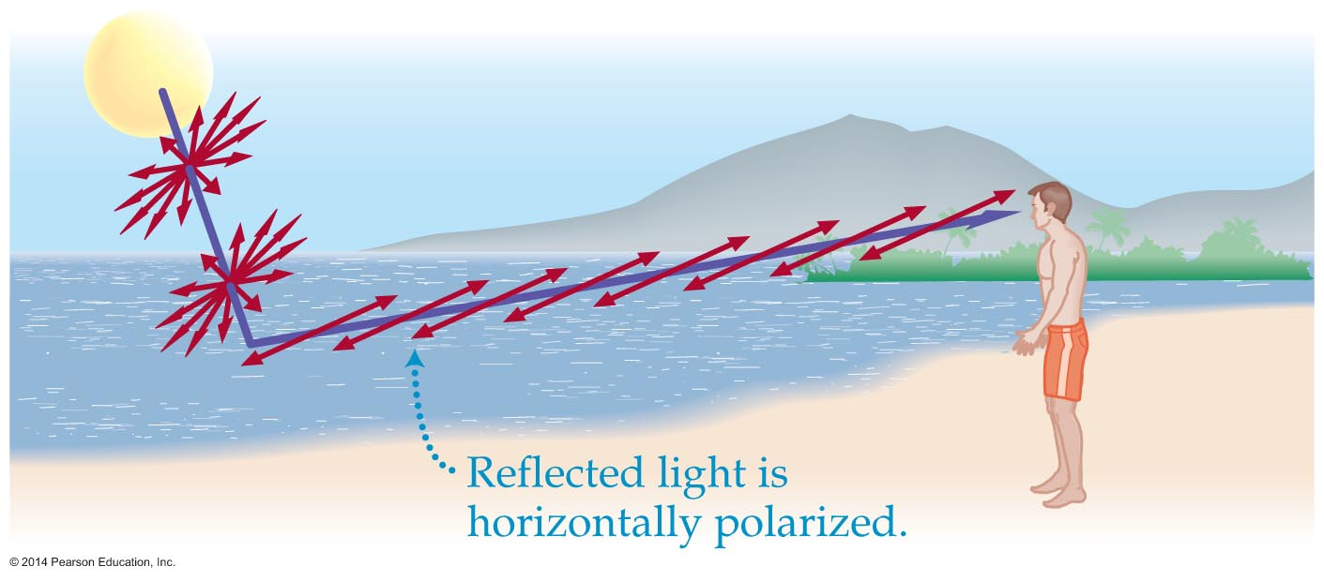
Polarization and Scattering of Light
Light is also polarized when it reflects from a smooth surface, like the top of a table or the surface of a calm lake. The figure below shows a typical situation with unpolarized light from the Sun reflecting from the surface of a lake.
As the figure indicates, the reflected light from the lake is polarized horizontally.

Slide 50
Polarization and Scattering of Light
Polarizing sunglasses take advantage of this effect by using sheets of polarizing material with a vertical transmission axis. With this orientation, the horizontally polarized reflected light—the glare—is not transmitted.

Slide 51
Polarization and Scattering of Light
Why is the sky blue? The answer to this question has to do with the way light scatters.
Light scatters most effectively when its wavelength is comparable to the size of the scatterer.
The molecules in the atmosphere are generally much smaller than the wavelength of visible light. But blue light, with its relatively short wavelength, is scattered more effectively by air molecules than red light, with its longer wavelength.
Similarly, microscopic dust particles in the upper atmosphere also scatter the short-wavelength blue light more effectively. That is why we see a blue sky.

Slide 52
Polarization and Scattering of Light
A sunset appears red because you are looking directly at the Sun through a long expanse of the atmosphere. Most of the Sun's blue light has been scattered off in other directions. This leaves you with red light.

