Slide 1
Sound
Prepared by
Chris Chiaverina

Slide 2
Chapter Contents
Sound Waves and Beats
Standing Sound Waves
The Doppler Effect
Human Perception of Sound

Slide 3
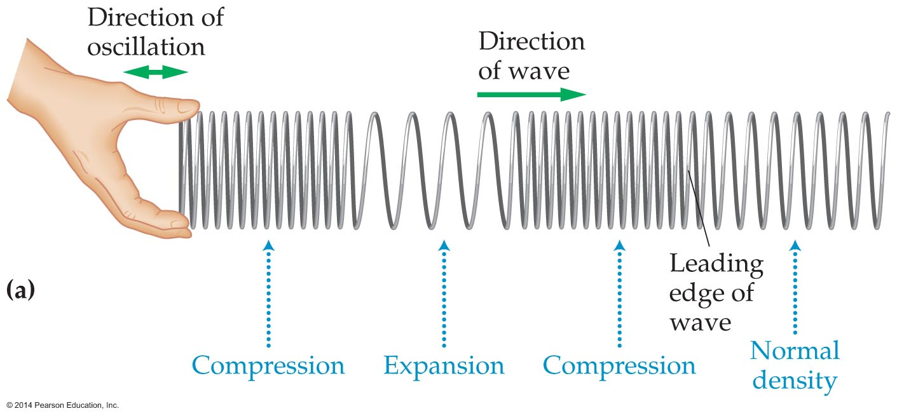
Sound Waves and Beats
Sound is a wave that travels through air and other substances. Sound has the characteristics common to all waves, namely, frequency, period, wavelength, and wave speed.
If you oscillate one end of a coiled spring, such as the one shown in the figure below, back and forth, you will see a longitudinal wave moving away from you.

Slide 4
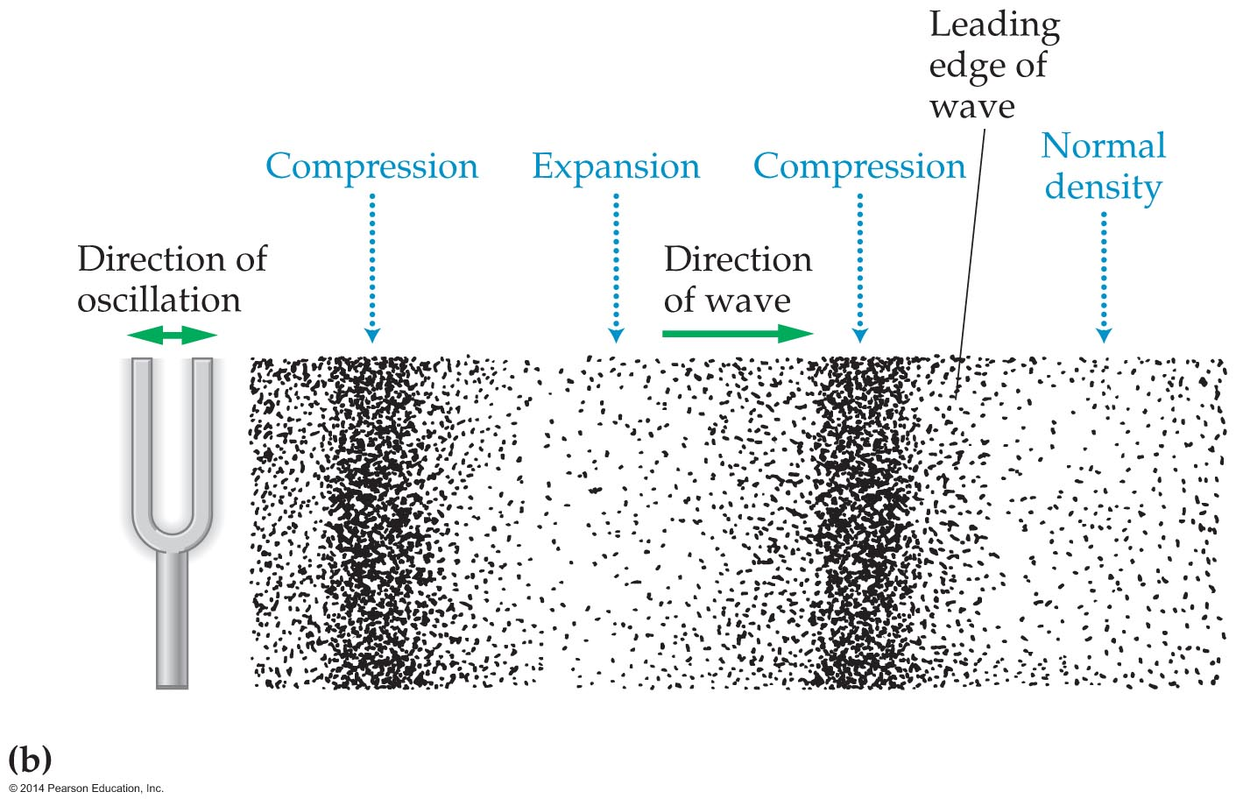
Sound Waves and Beats
Similarly, the figure below shows how a vibrating tuning fork produces sound waves as its tines oscillate back and forth. Just as with a coiled spring, a wave travels away from its vibrating source.

Slide 5
Sound Waves and Beats
In general, a sound wave is formed when an oscillating object creates alternating regions of compressed and expanded air. These alternating regions move away from the source as a longitudinal wave.
A sound wave may seem different from a wave on a string. However, if you plot the appropriate quantities, the classic wave shape emerges.

Slide 6
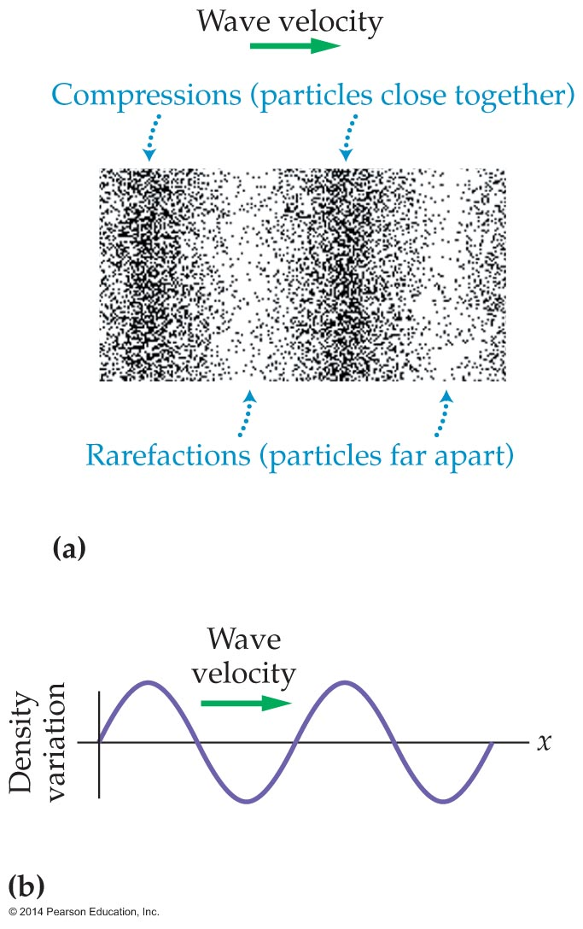
Sound Waves and Beats
Figure (a) below shows the compressions and rarefactions of a typical sound wave. Figure (b) is a plot of the corresponding density of air. Clearly, the density oscillates in a wavelike fashion, just like a wave on a string.

Slide 7
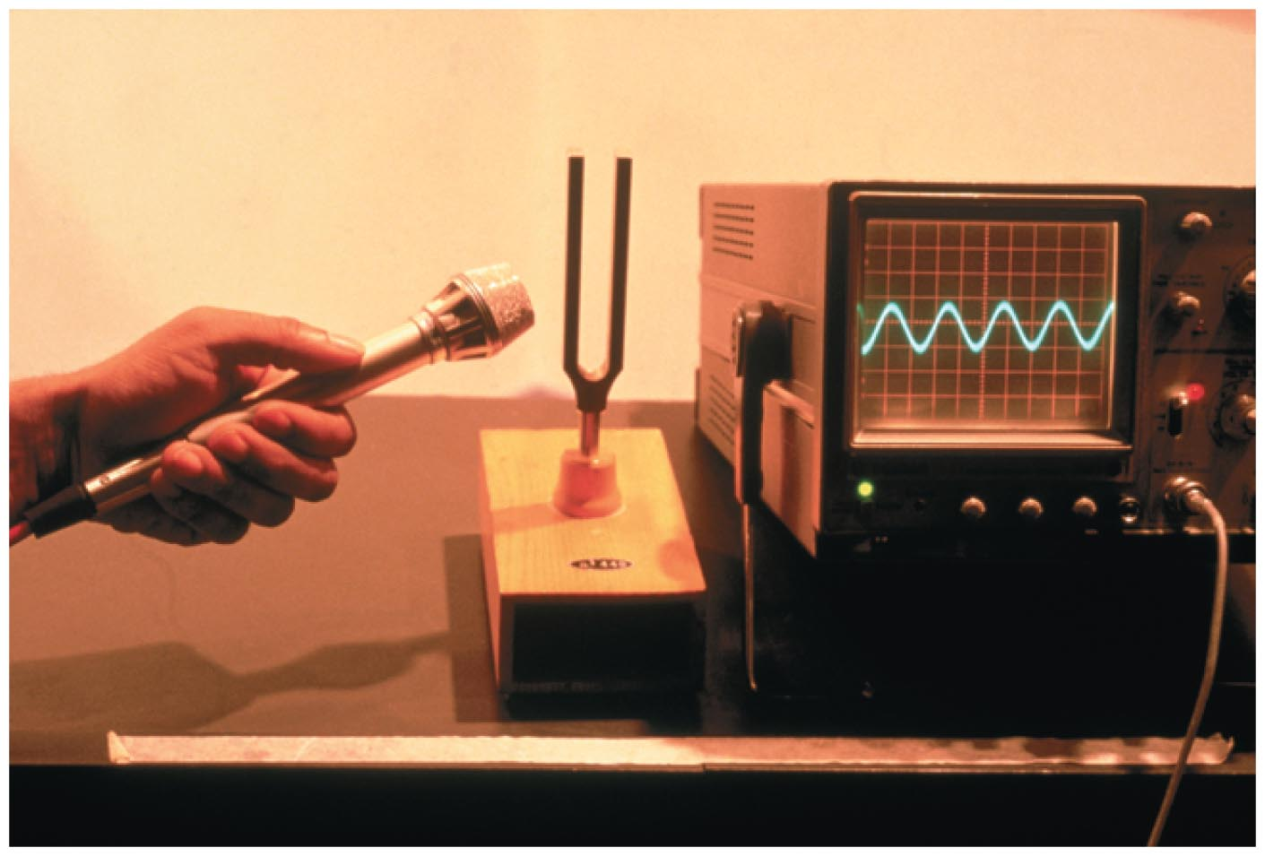
Sound Waves and Beats
The electrical output of a microphone that is picking up the sound from an oscillating tuning fork is shown in the figure below. It also has the typical shape of a sine wave.

Slide 8
Sound Waves and Beats
Like a wave on a sting, the speed of sound is determined by the properties of the medium through which it moves.
Under normal atmospheric pressure and temperature, the speed of sound is 343 m/s, or about 770 mi/h. This high speed is due to the fact that molecules in the air are constantly moving at roughly that speed.
As air is heated, the molecules move faster. As a result, the speed of sound also increases with temperature.

Slide 9
Sound Waves and Beats
The speed of sound depends on the medium through which it is moving. In general, the speed of sound depends on the "stiffness" of a material.
Because air is quite compressible and not very "stiff," the speed of sound is relatively low in air compared to liquids and solids.
Water is not very compressible, and the speed of sound in it is about 4 times greater than in air. Sound travels even faster in solids than in liquids. In fact, the speed of sound in steel is about 17 times greater than in air.

Slide 10
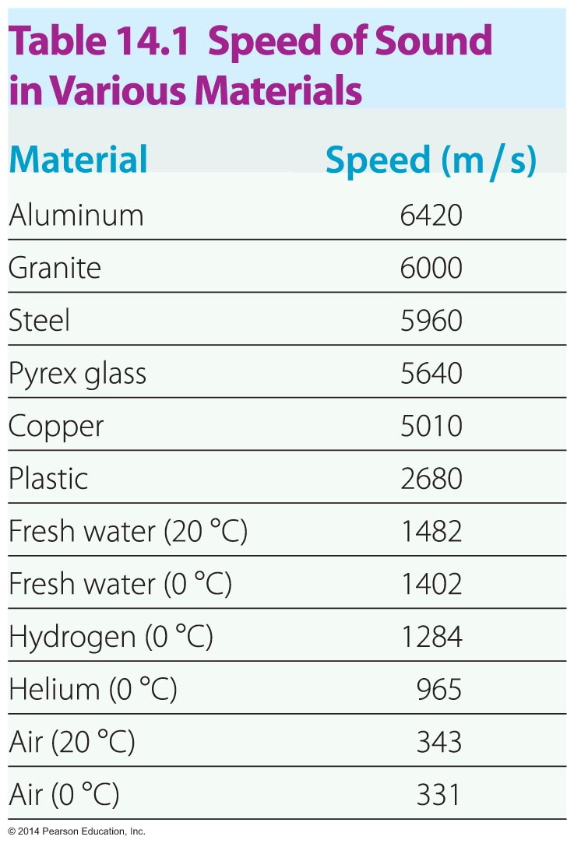
Sound Waves and Beats
The following table gives the speed of sound in a range of materials.

Slide 11
Sound Waves and Beats
The speed of sound is the same in all directions of travel and for all frequencies. Thus, the speed v remains constant in the wave speed equation:
speed = wavelength x frequency
v = fλ
The fact that different frequencies travel with the same speed is evident when you listen to an orchestra in a large room. You hear the different frequencies produced by different instruments at the same time. Otherwise, listening to music from a distance would be quite a strange experience.

Slide 12
Sound Waves and Beats
Humans' sense of hearing detects only a small portion of the sound waves that are created in nature.
As a rule of thumb, humans can hear sounds between 20 Hz on the low-frequency end and 20,000 Hz on the high-frequency end.
Sounds with a frequency of less than 20 Hz are referred to infrasonic.
Sounds with a frequency greater than 20,000 Hz are called ultrasonic.

Slide 13
Sound Waves and Beats
Infrasound and ultrasound frequencies occur commonly in nature.
Bats and dolphins produce ultrasound. They send out ultrasonic waves that reflect back to them from objects in their vicinity. The reflected sound waves—echoes—are used in a process known as echolocation to locate prey and to navigate.
It was also recently learned that elephants communicate with one another using sounds with frequencies as low as 15 Hz.

Slide 14
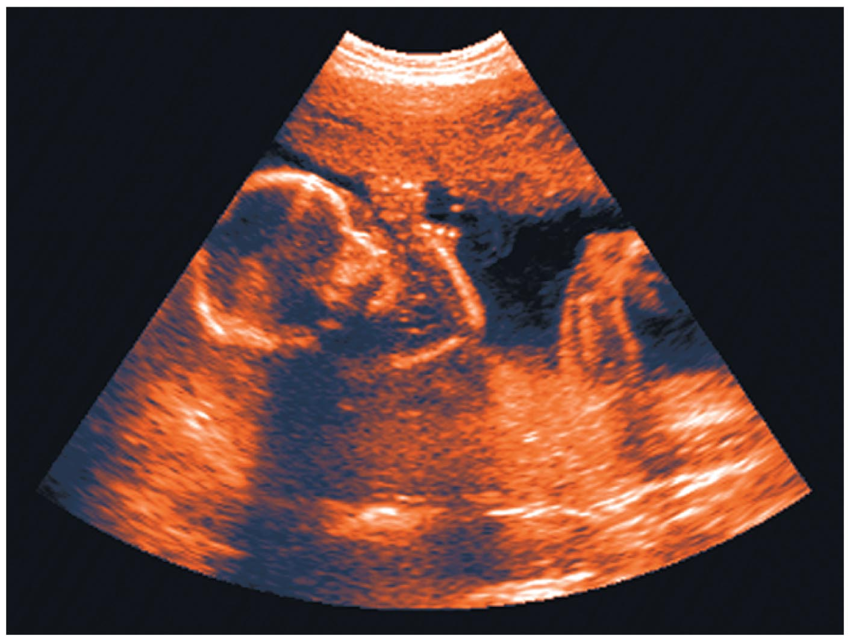
Sound Waves and Beats
Medical applications of ultrasound are common. Perhaps the most familiar is the ultrasound scan that is used to image a fetus in the womb (see figure below).
Sending bursts of ultrasound into the body and measuring the time of delay of the resulting echoes makes it possible to map the structures that lie hidden beneath the skin.

Slide 15
Sound Waves and Beats
If you pluck two guitar strings that have slightly different frequencies, you'll notice that the sound produced by the two strings changes in time. In fact, the loudness increases then decreases, increases then decreases, over and over.
The changes in loudness produced by sounds of different frequency are referred to as beats.

Slide 16
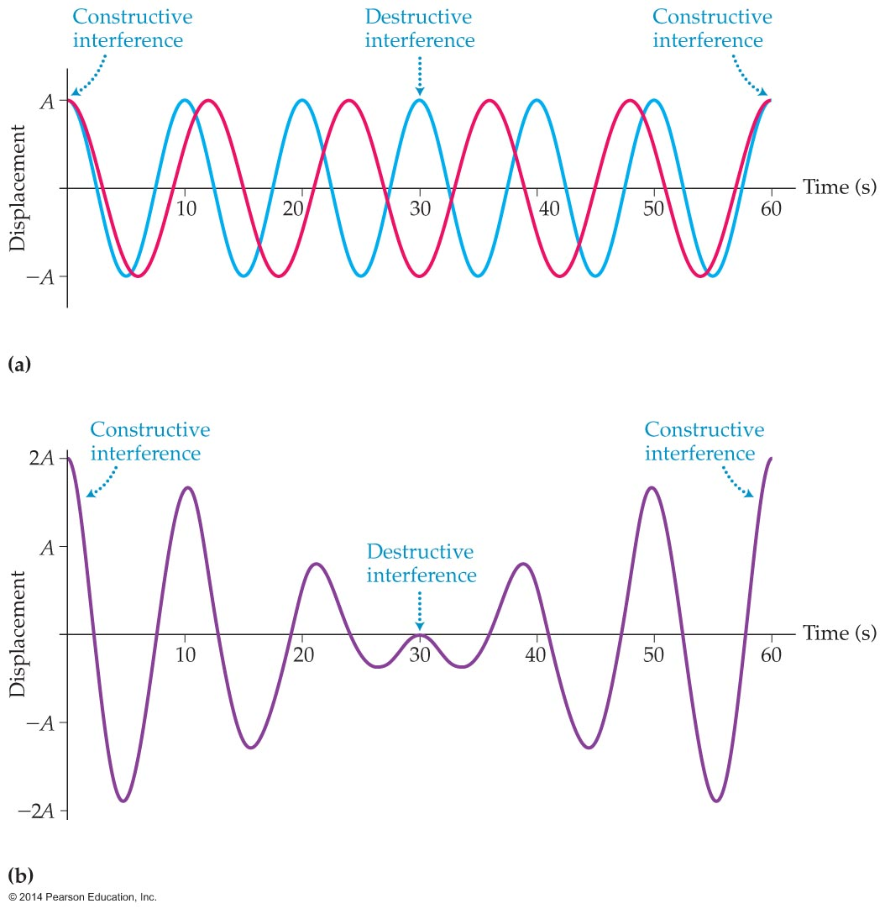
Sound Waves and Beats
Figure (a) below shows how two waves (one red, one blue) combine to produce beats.
Initially, the two waves interfere constructively, giving a large amplitude. The sound we hear at this time is loud, as is indicated in figure (b).

Slide 17
Sound Waves and Beats
A short time later, the two waves interfere destructively, giving zero amplitude and no sound.
A key characteristic of a beat is its repeating pattern of loud and soft sounds. The frequency at which a beat repeats itself is known as the beat frequency.
If one wave has the frequency f₁ and the other has a frequency f₂, the beat frequency is as follows:

Slide 18
Sound Waves and Beats
Taking the absolute value of the difference ensures that the beat frequency is always positive.
As an example, suppose two guitar strings have the frequencies 438 Hz and 442 Hz. If you pluck them at the same time, you hear increasing and decreasing loudness with a beat frequency of 4 Hz.
Beats can be used to tune a musical instrument. For example, to tune a guitar, a musician, listening to beats, increases or decreases the tension in the guitar string until the beat frequency becomes practically zero.

Slide 19
Standing Sound Waves
As has been shown previously, it is possible to make a wave stay in one place. This can be done with a wave on a string by tying the string down at either end, like a guitar string. It can also be done with sound waves by confining them to a pipe or a tube, as in a trumpet or trombone.
A standing wave is produced when a guitar string is plucked or a flute is played. A standing wave is one that oscillates with time but remains fixed in location. In addition, a standing waves always has nodes, where the amplitude is zero, and antinodes, where the amplitude of the wave is a maximum.

Slide 20

Standing Sound Waves
The girl in the figure below is producing a standing sound wave with a bottle. Blowing across the mouth of a bottle sets the air column in the bottle vibrating, producing a tone.

Slide 21
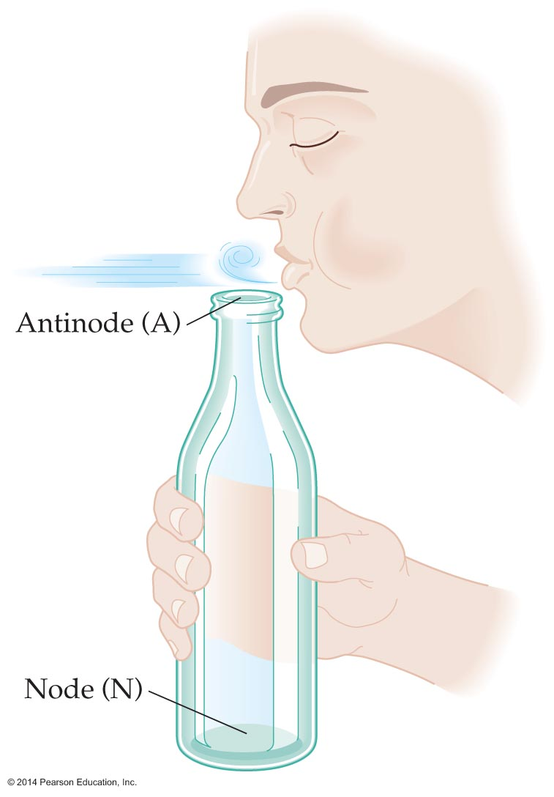
Standing Sound Waves
When air is blown across the open top of a pop bottle, the turbulent air flow can cause an audible standing wave. As the figure below indicates, the standing wave has an antinode, A, at the top (where the air is moving) and a node, N, at the bottom (where the air cannot move).

Slide 22
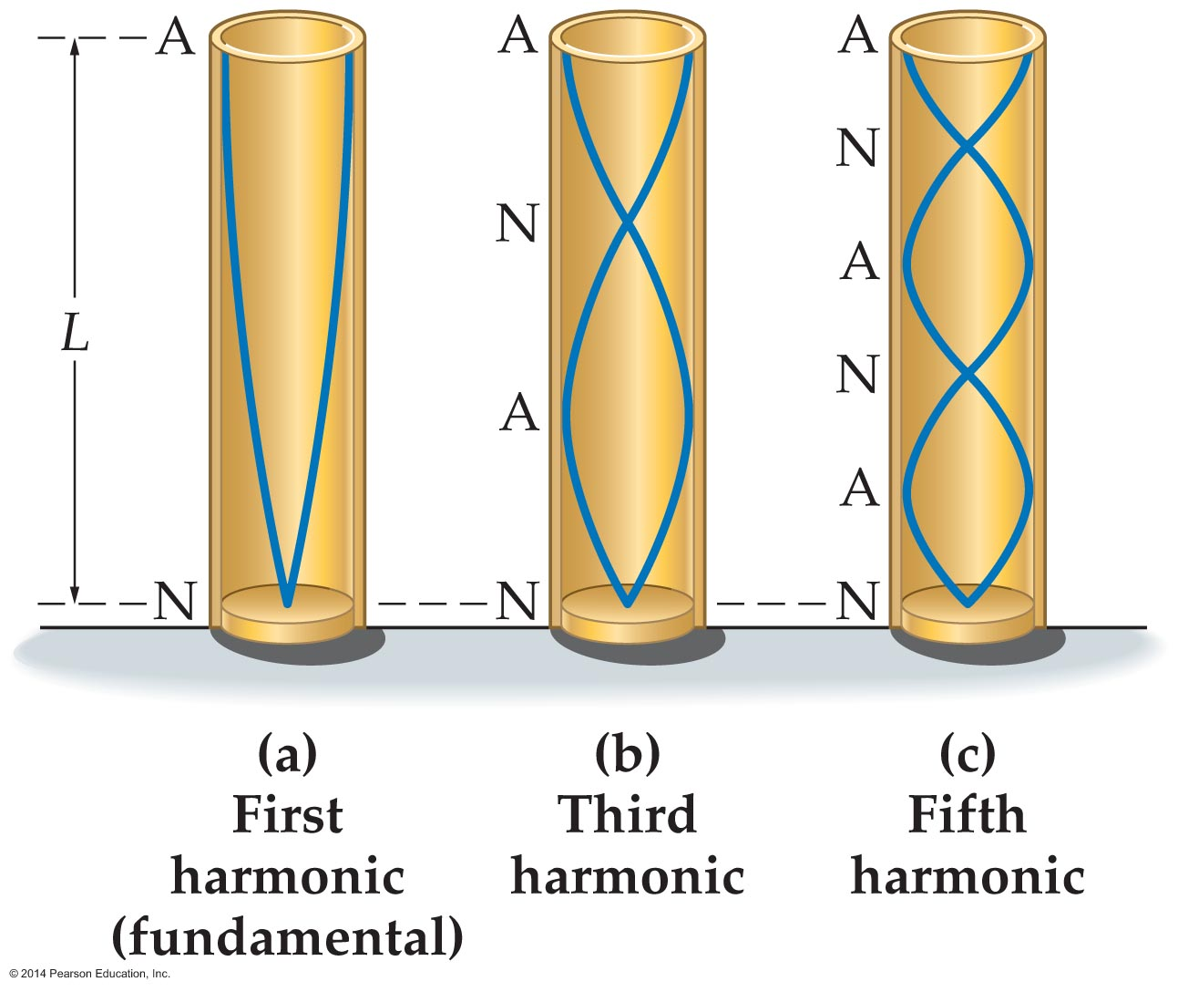
Standing Sound Waves
In general, a standing wave in a bottle or pipe open at one end must have a node at the bottom and an antinode at the top.
The lowest frequency standing wave that meets these conditions for a node and an antinode is shown in figure (a) below. A graph of air density shows that one-quarter of a wavelength fits inside a bottle of length L.

Slide 23
Standing Sound Waves
Thus, the wavelength of the fundamental wave must be four times the length of the bottle; that is, λ = 4L.
Using the formula for the speed of a wave, v = fλ, and letting f₁ stand for the fundamental frequency, we find
This frequency is inversely proportional to the length. Therefore, shortening the air column increases the frequency.

Slide 24
Standing Sound Waves
The next harmonic is produced by adding half a wavelength to the standing wave. Thus, if the first harmonic is represented by N-A, the next harmonic can be written as N-A-N-A.
As figure (b) below shows, three-quarters of a wavelength fits into the bottle for this harmonic. Therefore, 3λ/4 = L and λ = 4/3L.

Slide 25
Standing Sound Waves
As a result, the frequency of the next harmonic is
This is the third harmonic of the pipe.
Similarly, the next higher harmonic is represented by N-A-N-A-N-A. In this case,
This is the fifth harmonic of the pipe.

Slide 26
Standing Sound Waves
Notice that only odd harmonics are present, in contrast to waves on a string, for which all harmonics occur.
To summarize, the progression of harmonics for a column of air that is closed at one end and open at the other is described by the following frequencies and wavelengths:

Slide 27
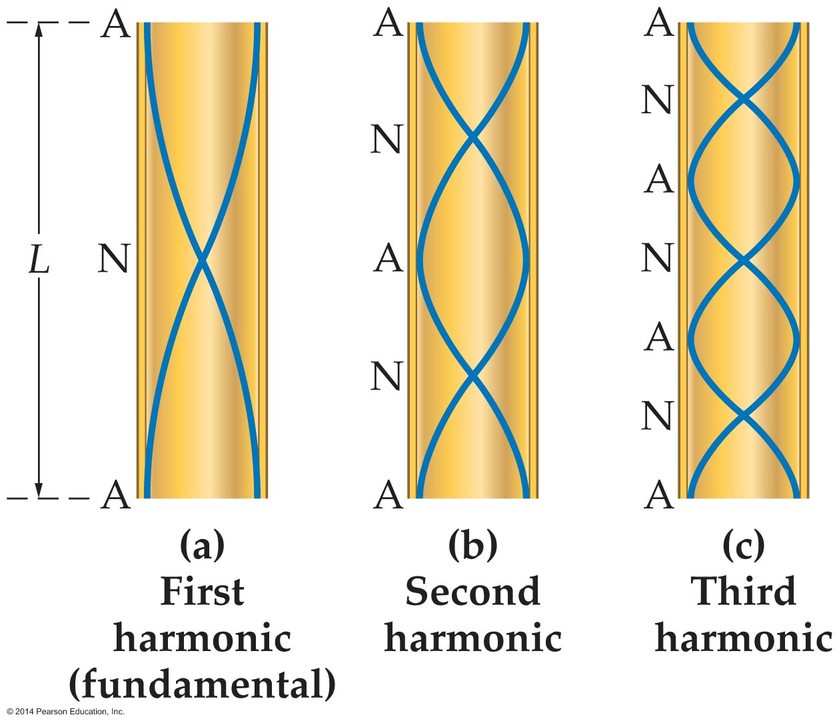
Standing Sound Waves
Standing waves also form in pipes that are open at both ends.
A standing wave in a pipe open at both ends must have an antinode at each end of the pipe. The figure below shows standing waves in a pipe that is open at both ends.

Slide 28
Standing Sound Waves
In figure (a), the first harmonic, or fundamental, is A-N-A. Notice that half a wavelength fits in the pipe; thus,
The next harmonic is A-N-A-N-A, for which a whole wavelength fits in the pipe. This harmonic is shown in figure (b) and has the frequency
This is the second harmonic of the pipe.
Higher harmonics continue in integer steps (3f₁, 4f₁ 5f₁, and so on) just like the harmonics for waves on a string.

Slide 29
Standing Sound Waves
Thus, the frequencies and wavelength in a column of air open at both ends are as follows:

Slide 30
Standing Sound Waves
The following example illustrates the relationship between a pipe's length and its fundamental frequency.

Slide 31
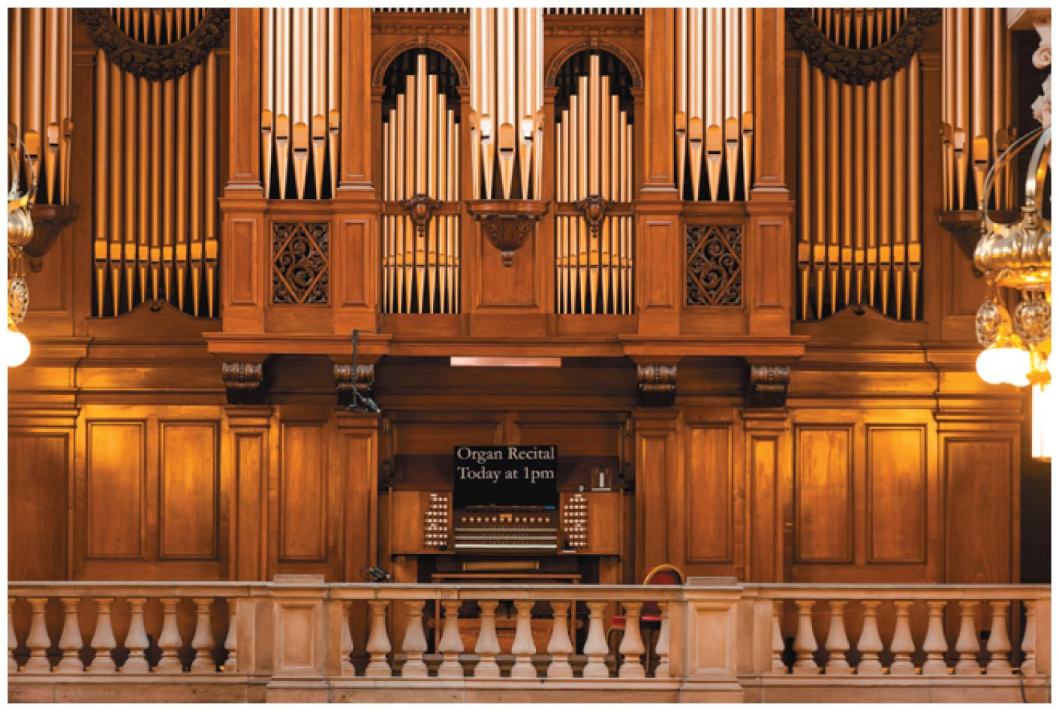
Standing Sound Waves
A pipe organ uses a variety of pipes of different lengths, as shown in the figure below. Some pipes are open at both ends, and some are open at one end only. Pressing a key on the organ forces air through a given pipe, and the length of the pipe determines the pitch of the sound produced.

Slide 32
The Doppler Effect
The change in pitch due to the relative motion between a source of sound and the person hearing the sound is called the Doppler effect.
A common example of the Doppler effect is the change in pitch from high to low as an emergency vehicle, siren blaring, drives by at high speed.
In general, when a source of sound moves toward an observer, the frequency heard is higher than the frequency produced by the source. When a source of sound moves away from the observer, the frequency heard is lower than the frequency produced by the source.

Slide 33
The Doppler Effect
The Doppler effect occurs with all kinds of waves, not just sound waves.
For example, the relative motion between a galaxy (the source of light) and the Earth (the receiver) means that the light astronomers on Earth detect has a different frequency than the light that was emitted by the galaxy. As a result, a galaxy that is moving away from the Earth appears redder than normal, and a galaxy that is moving toward the Earth appears bluer.

Slide 34
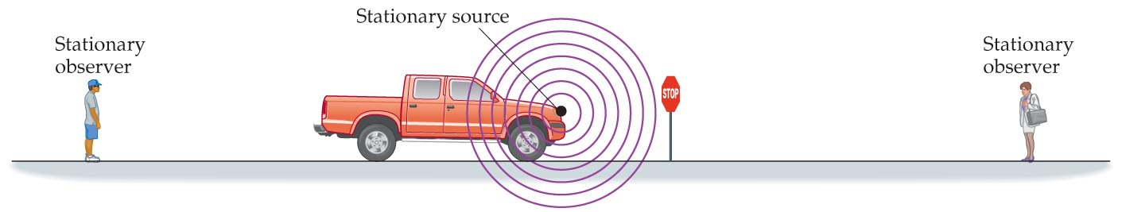
The Doppler Effect
As the figure below illustrates, when the occupant of a parked truck honks the horn, everyone standing nearby hears the same pitch.

Slide 35
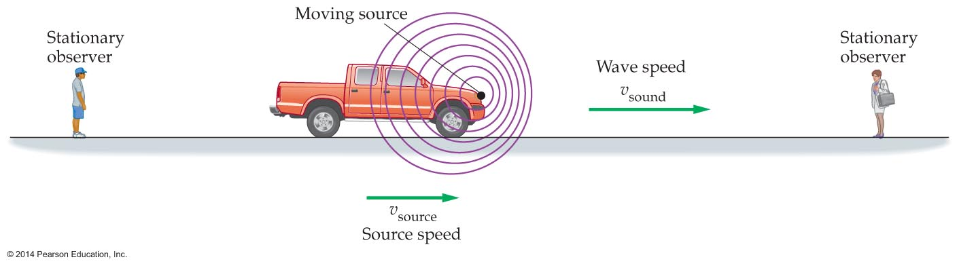
The Doppler Effect
However, when the truck moves toward the right, the wave crests become bunched up close together in the forward direction. This means that the observer ahead of the truck experiences more crests per second and hence a higher-frequency sound (see figure below).
An observer behind the truck experiences wave crests that are spread out, which results in a lower-frequency sound.

Slide 36
The Doppler Effect
The Doppler effect can be modeled by tapping your finger in a pan of water. When your finger is stationary, tapping your finger in the water produces concentric circles centered at your finger.
However, when you move your finger to the right as you tap, the distance between one wave crest and the next will get smaller in the forward direction and spread out in the reverse direction.

Slide 37
The Doppler Effect
To get a precise expression for the change in frequency, suppose a source emits sound with a frequency f_{source} and moves with a speed v_{source}. The speed of sound is v_{sound}. Mathematics shows that the frequency heard by an observer is the following:
The plus sign is used for a source that moves away from the observer. The minus sign is used for a source that moves toward the observer.

Slide 38
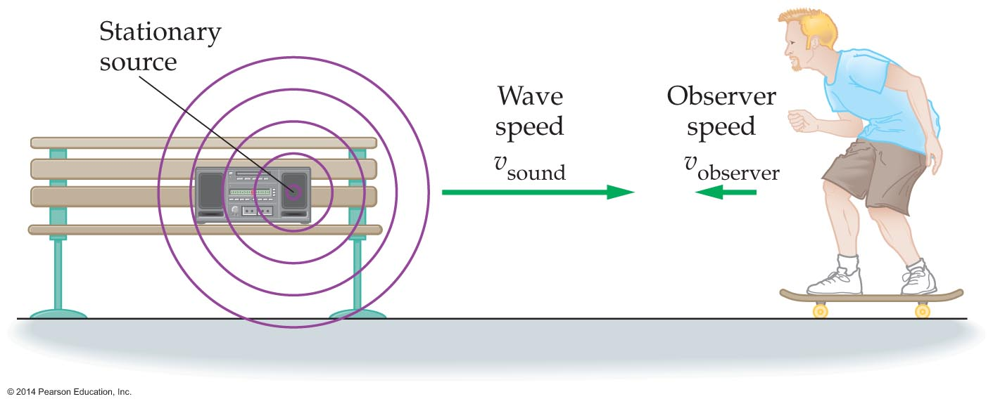
The Doppler Effect
A moving observer also experiences the Doppler effect. The observer hears a higher frequency when approaching the source because he encounters more wave crests per second than if he had been at rest (see figure below).

Slide 39
The Doppler Effect
It turns out that the observed frequency is different when the observer is moving from what it is when the source is moving. The equation for the frequency heard by a moving observer is as follows:
The plus sign is used for an observer that moves toward the source. The minus sign is used for an observer that moves away from the source.

Slide 40
The Doppler Effect
The Doppler effect has many useful applications.
  The Doppler effect is used in radar guns that measure the speed of a car or a pitched baseball. This is accomplished by measuring the Doppler-shifted frequency of waves reflected from a moving object.
  Doppler radar, used in weather forecasting, applies the same principle to tracking the motion of precipitation caused by storm clouds.
  In medicine, the Doppler effect is used to measure the speed of blood flow in an artery.

Slide 41
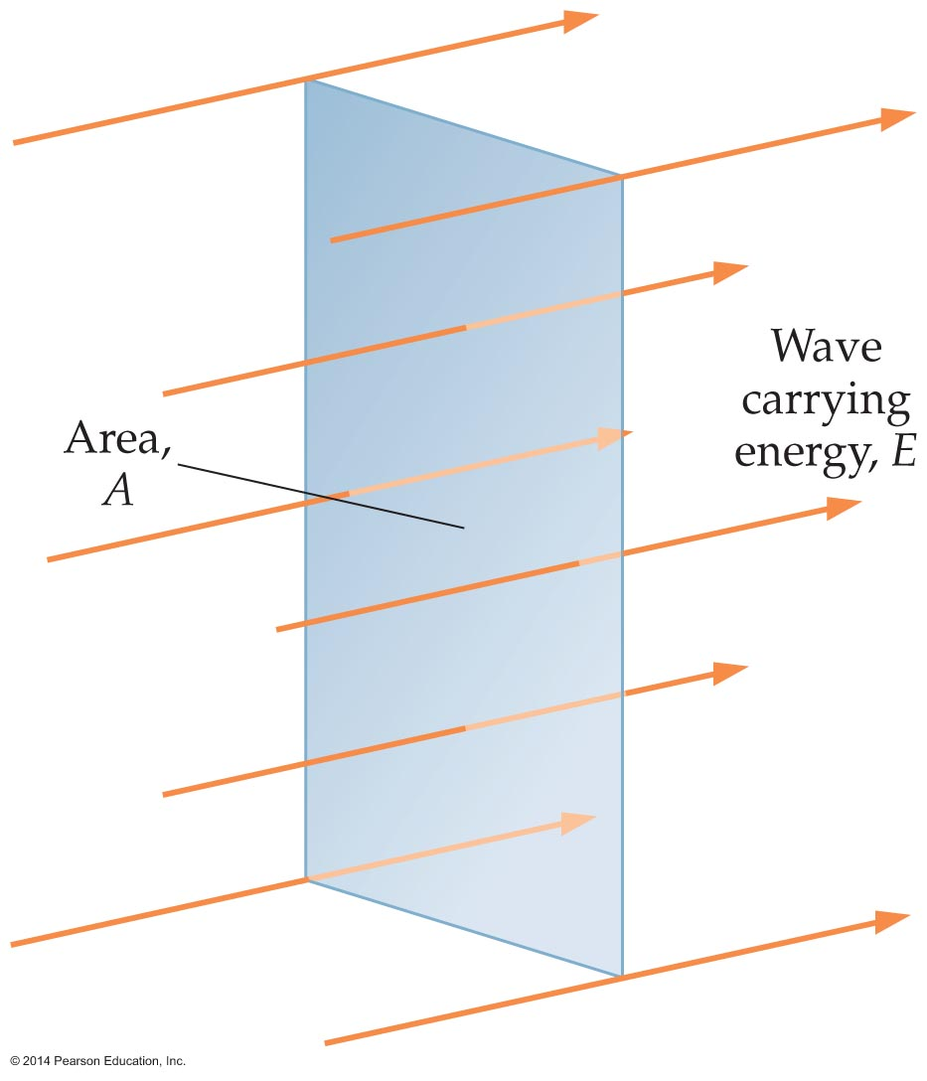
Human Perception of Sound
As you have learned, waves carry energy.
The amount of sound energy passing through a given area in a given time is the loudness, or intensity, I, of a sound wave. This is illustrated in the figure below.

Slide 42
Human Perception of Sound
To be specific, suppose sound energy E passes through area A in time t. In this case, the intensity of the sound wave equals the energy divided by the area and the time:
Recalling that power is energy per time, P = E/t, we can express the intensity as power per area:

Slide 43
Human Perception of Sound
The frequency of a sound wave determines its pitch. So what determines its intensity?
The property of a sound wave that determines the intensity is the amplitude.
In case of a sound wave, the amplitude is the maximum difference in pressure between areas of compression and areas of expansion in the wave.
The greater the difference in pressure, the louder the sound you hear.

Slide 44
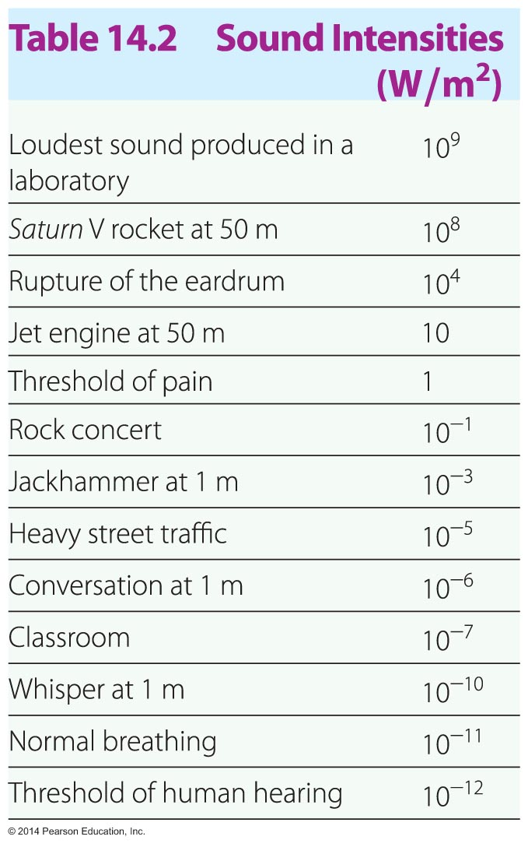
Human Perception of Sound
The following table gives some examples of sound intensities.

Slide 45
Human Perception of Sound
The following example illustrates how sound intensity is calculated.

Slide 46
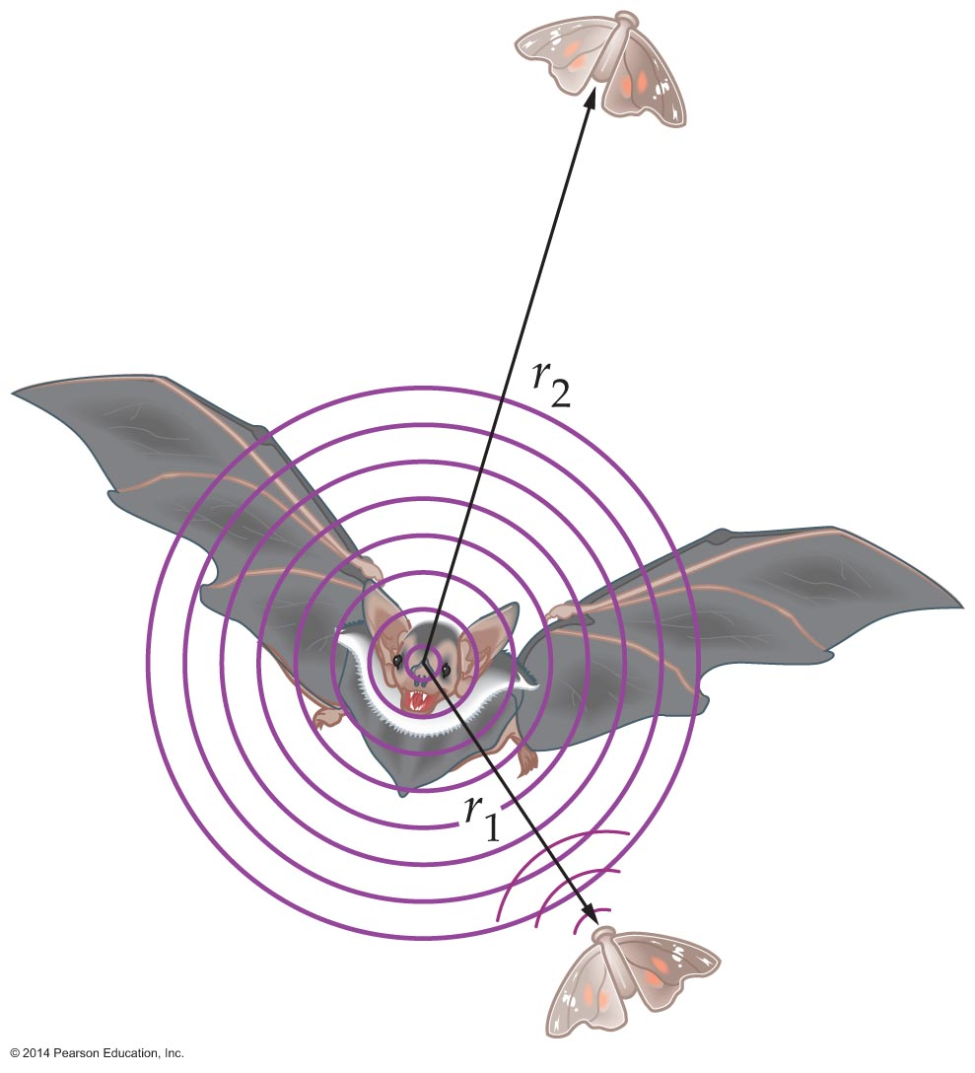
Human Perception of Sound
Sound spreads out over a larger area as it moves away from its source. As a result, the intensity of sound—and its loudness—is reduced.
The figure below shows a source of sound (a bat) and two observers (moths), one listening at a distance r₁, the other at a distance r₂. How do the sound intensities heard by the two moths compare?

Slide 47
Human Perception of Sound
The sound waves from the bat move outward uniformly in all directions, and hence the wave crests are concentric spheres. Since the area of a sphere is 4πr², it follows that the intensities detected by the two moths are and
      , respectively.
If r₂ = 2r₁, then the two intensities are related by
      .
The power is the same in each case; however, the sound is spread out over a larger area for the second moth, and hence the intensity it experiences is less.

Slide 48
Human Perception of Sound
To summarize, the intensity of a sound at a distance r from a point source of power P is as follows:

Slide 49
Human Perception of Sound
Hearing, like most of our senses, is incredibly versatile and sensitive. We can detect sounds that are about a million times fainter than a typical conversation and listen to sounds that are a million times louder than conversations without experiencing pain.
The sensitivity is the human ear is amazing. For example, a faint sound with an intensity of
10⁻¹¹ W/m² causes a displacement of molecules in the air of only 10⁻¹⁰ m. This displacement is roughly the diameter of an atom.

Slide 50
Human Perception of Sound
The ear perceives loudness in an unexpected way.
Our perception of sound is such that doubling the loudness corresponds to increasing the intensity by a factor of 10.
Taking this a step further, how is the intensity of a third sound—twice as loud as the second—related to the intensity of the first sound?
The third sound is 10 times louder than the second, which is 10 times louder than the first sound.
Therefore, the third sound has an intensity 100 times greater than the intensity of the first sound (10 x 10 = 100).

Slide 51
Human Perception of Sound
The loudness of a sound is measured in a unit known as the bel, named after Alexander Graham Bell (1847–1922), inventor of the telephone.
Since the bel is a fairly large unit, it's more common to use a unit that is one-tenth of a bel, the decibel (dB).
On the decibel scale the faintest sound a human ear can hear is zero decibels, 0 dB.
Doubling the loudness of a sound, which increases the intensity by a factor of 10, corresponds to an increase of 10 dB.

Slide 52
Human Perception of Sound
Doubling the intensity of a sound increases the loudness by a factor of 3 dB.
And finally, the smallest increase in loudness that can be detected is about 1 dB.
The loudness of a sound given in decibels is referred to as the intensity level.

Slide 53
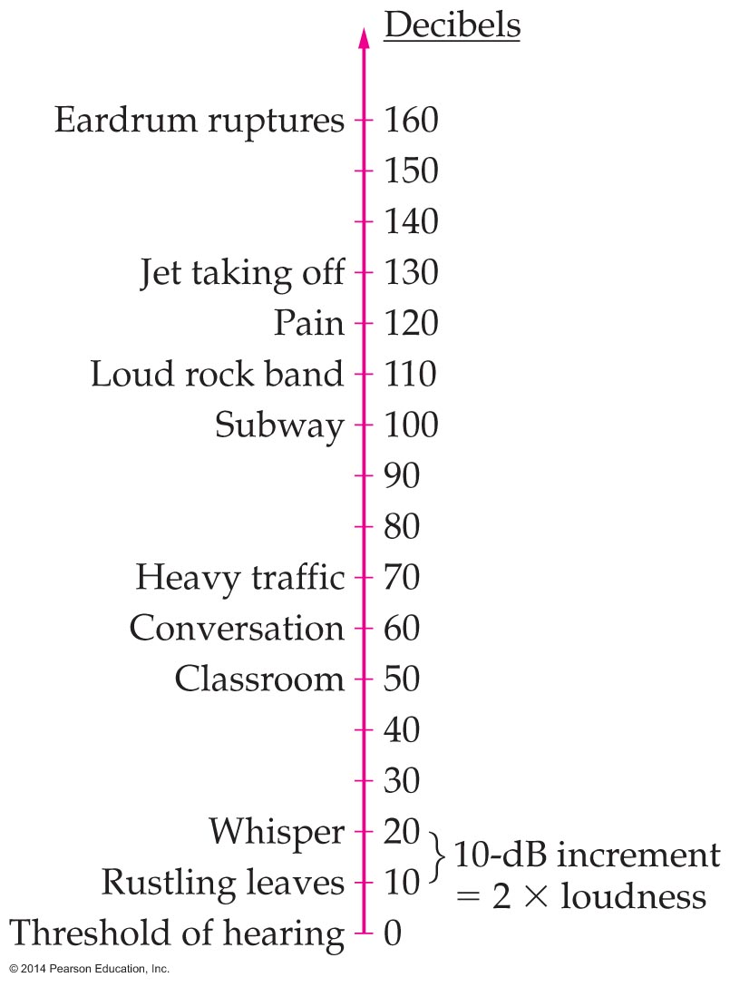
Human Perception of Sound
Decibel levels for a variety of sounds are presented in the table below.

Slide 54
Human Perception of Sound
The following example illustrates how the intensity is determined.
The decibel relationship between loudness and intensity means that a small change in loudness requires a large change in intensity. The following example shows how the intensity changes with a dramatic decrease in number of sound sources.

Slide 55
Human Perception of Sound
The human ear responds to frequency in an unusual way. Frequencies that sound "equally spaced" to our ears—one octave to the next—are actually increasing by a factor of 2. Since there are 12 semitones in one octave of the chromatic scale, the frequency increases from one semitone to the next by a multiplicative factor 2^{1/12}.

Slide 56
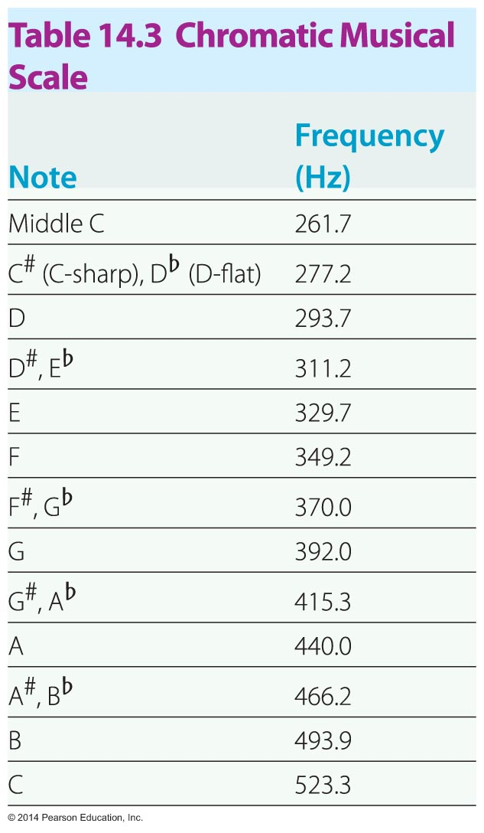
Human Perception of Sound
The frequencies for a full chromatic scale are given in the following table.

Slide 57
Human Perception of Sound
The human ear is particularly sensitive to certain frequencies.
The ear canal is basically a column of air that is closed at one end (at the eardrum) and open at the other.
Standing waves in the ear canal can lead to resonance effects at certain frequencies. At these frequencies the amplitude of the sounds in your ear is enhanced by resonance, and your ability to hear these sounds is increased.

Slide 58
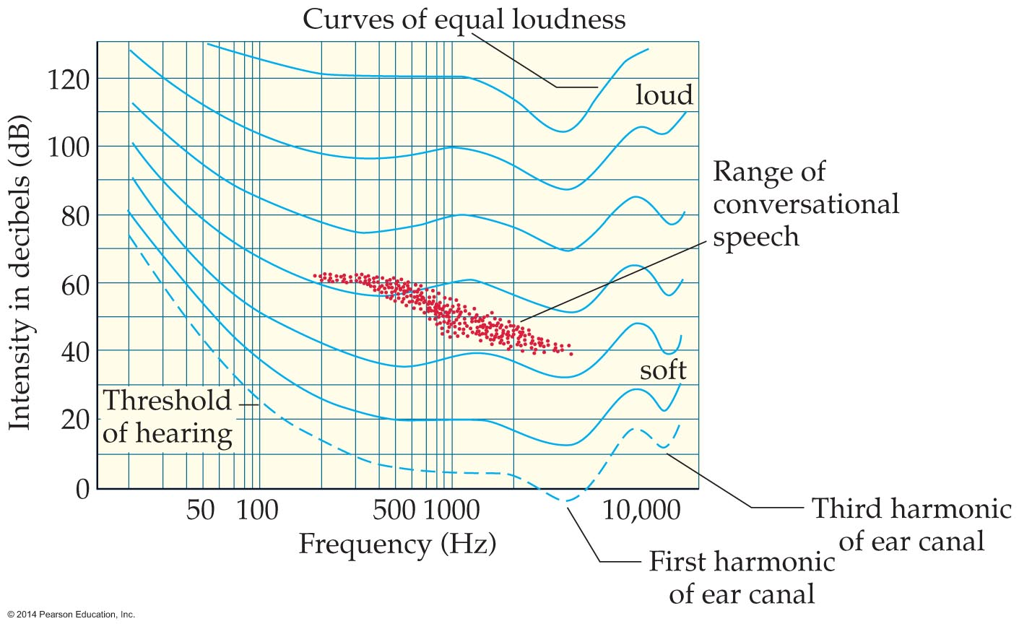
Human Perception of Sound
The figure below shows curves of equal loudness as a function of frequency. At the frequencies where these curves dip downward, sounds of lower intensity seem just as loud as sounds of higher intensity at other frequencies.
The two prominent dips near 3500 Hz and 11,000 Hz are due to standing waves in the ear canal.

