Slide 1
Oscillations and Waves
Prepared by
Chris Chiaverina

Slide 2
Chapter Contents
Oscillations and Periodic Motion
The Pendulum
Waves and Wave Properties
Interacting Waves

Slide 3
Oscillations and Periodic Motion
Back-and-forth motions are referred to as oscillations. Oscillating systems are common and can range from the head on a bobble-head doll to water molecules that oscillate in a microwave oven.
A very familiar example of an oscillating system is a simple pendulum, like the one that keeps time in a grandfather clock.
Any motion that repeats itself over and over, such as the motion of a pendulum, is referred to as periodic motion.

Slide 4

Oscillations and Periodic Motion
Periodic motion has a cycle that repeats. The electrocardiogram in the figure below shows a repeating cycle.

Slide 5
Oscillations and Periodic Motion
One of the key characteristics of periodic motion is its period. The period, T, is the time required to complete one full cycle of motion The SI unit of period is seconds/cycle = s.

Slide 6
Oscillations and Periodic Motion
Closely related to the period is the frequency, f, which is the number of oscillations per unit of time. The higher the frequency, the more rapid the oscillations.
As an example, your heart beats about 60 times per minute, or about once per second. This means that the frequency is 1 cycle (beat) per second.

Slide 7
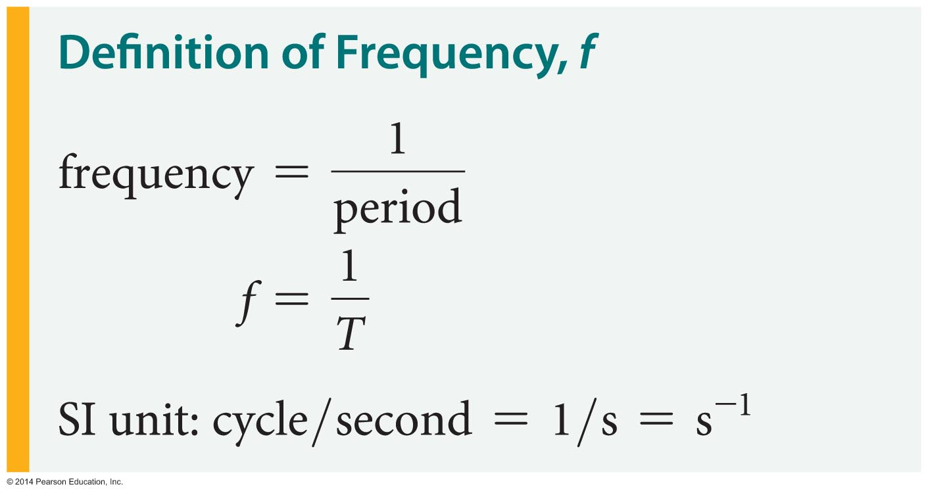
Oscillations and Periodic Motion
The frequency is found by taking the inverse of the period.

Slide 8
Oscillations and Periodic Motion
A special unit called the hertz (Hz) is used to measure frequency. It is named for the German physicist Heinrich Hertz (1857–1894) in honor of his study of radio waves.

Slide 9
Oscillations and Periodic Motion
One hertz equals one cycle per second:
1 Hz = 1 cycle/second
High frequencies are measured in kilohertz (kHz), where 1 kHz = 10³ Hz, or megahertz (MHz), where 1 MHz = 10⁶ Hz.
Since period and frequency are reciprocals of one another, when one is large, the other is small.

Slide 10
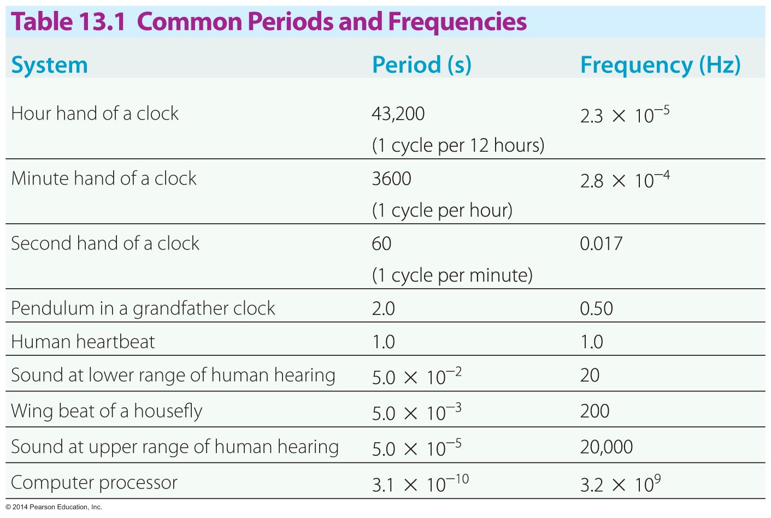
Oscillations and Periodic Motion
The table below shows periods and frequencies for a wide range of periodic motions.

Slide 11
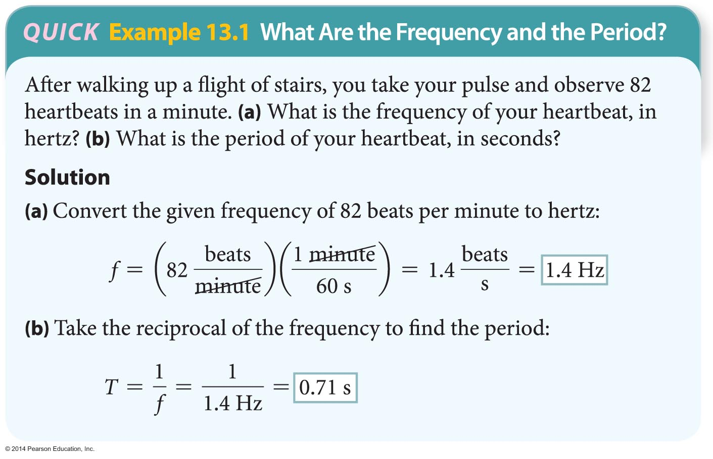
Oscillations and Periodic Motion
The following example illustrates how frequency and period are calculated.

Slide 12
Oscillations and Periodic Motion
One type of periodic motion of particular importance occurs when the force pushing or pulling an object toward equilibrium is proportional to the displacement from equilibrium. This is simple harmonic motion.
A mass attached to a spring, as shown in the figure below, provides a classic example of simple harmonic motion.

Slide 13
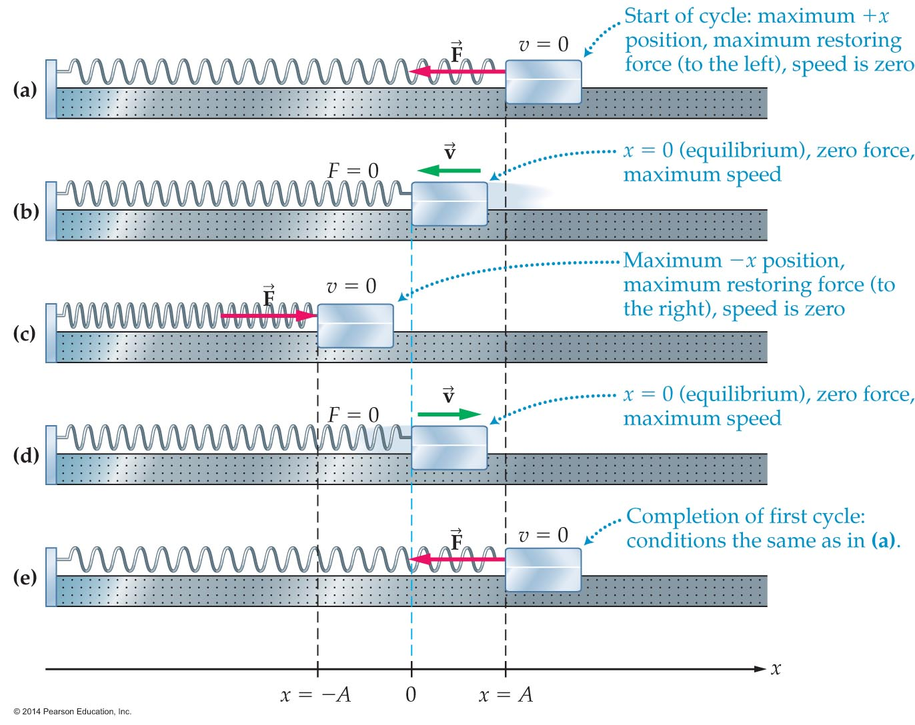
Oscillations and Periodic Motion

Slide 14
Oscillations and Periodic Motion
In the figure, the cart is displaced to x = A and released from rest. When released, the force exerted by the spring accelerates the cart toward the equilibrium position.
When the cart reaches x = 0, the equilibrium position, the force on the cart is zero. The cart doesn't stop, however. Due to its inertia, the cart continues moving to the left.
As the cart moves to the left of equilibrium, it compresses the spring, which produces a restoring force acting to the right.

Slide 15
Oscillations and Periodic Motion
The force decelerates the cart and brings it to rest at x = −A.
Finally the cart begins to move to the right. After passing through x = 0, it comes to rest again at x = A.
At this point the cart has completed one cycle of oscillation of simple harmonic motion. The time required for one oscillation is the period T.

Slide 16
Oscillations and Periodic Motion
The motion of the cart can be divided into four parts, each taking an equal amount of time (one-quarter of the period, or T/4).
  The cart moves from x = A to x = 0 in the time T/4.
  The cart moves from x = 0 to x = −A in the time T/4.
  The cart moves from x = −A to x = 0 in the time T/4.
  The cart moves from x = 0 to x = A in the time T/4.
Thus the cart oscillates back and forth between x = A and x = −A. The maximum displacement from equilibrium is the amplitude of motion. In this case the amplitude is A.

Slide 17
Oscillations and Periodic Motion
Suppose you attach a pen to the cart in the previous figure and let it trace the cart's motion on a strip of paper moving with constant speed. The strip of paper, or strip chart, would record the cart's motion as a function of time. Such a recording is shown in the figure below. Notice that the motion looks like a since or cosine function.

Slide 18
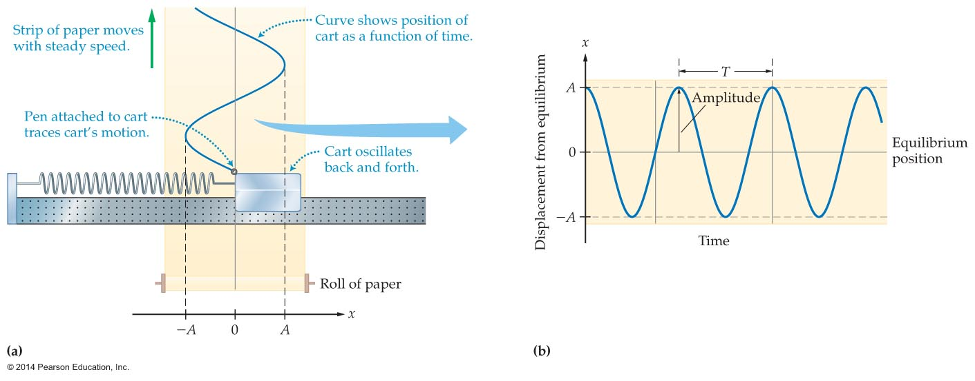
Oscillations and Periodic Motion

Slide 19
Oscillations and Periodic Motion
On the right in the preceding figure, the time from peak to peak is shown to be the period T. In general, whenever the time increases by the amount T, the motion repeats.
In addition, the strip chart shows that the cart's motion is limited to displacements between x = A and x = −A, where A is the amplitude.

Slide 20
Oscillations and Periodic Motion
If a soft spring with a small spring constant k is attached to a mass, then the mass will oscillate slowly. As a result, the period is large—it takes a long time to complete an oscillation.
On the other hand, a mass on a stiff spring (with a large spring constant k) oscillates rapidly.
It follows that the period of a mass on a spring varies inversely with the spring constant.

Slide 21
Oscillations and Periodic Motion
Similarly, the more mass you attach to a given spring, the slower the oscillation. Therefore, the period of a mass on a spring varies directly with the mass.
It can be shown with mathematical analysis or experiment that the period of a mass m on a spring with spring constant k is given by the following equation:

Slide 22
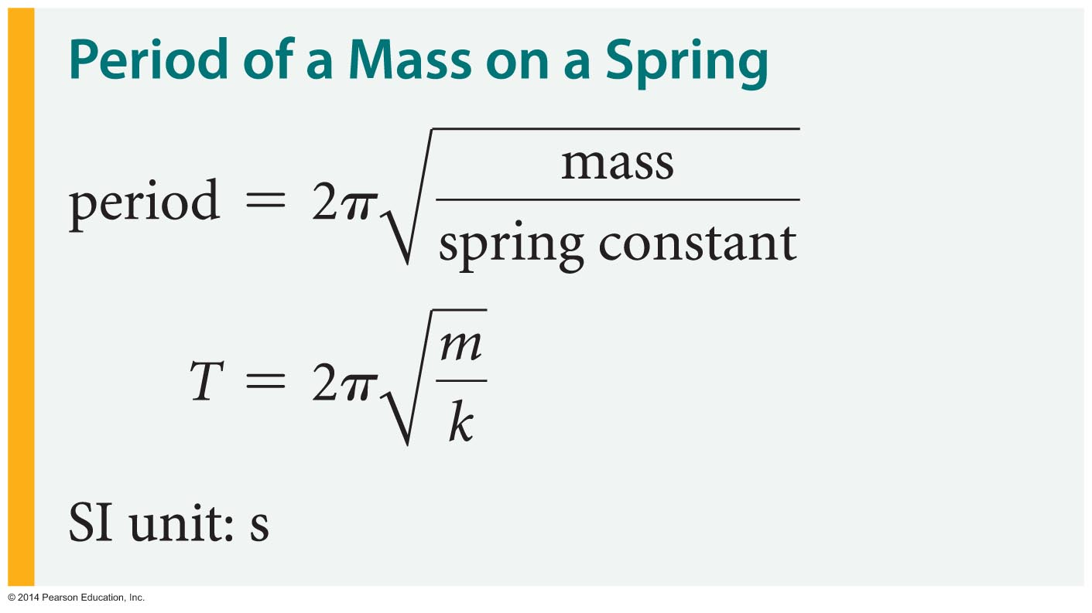
Oscillations and Periodic Motion

Slide 23
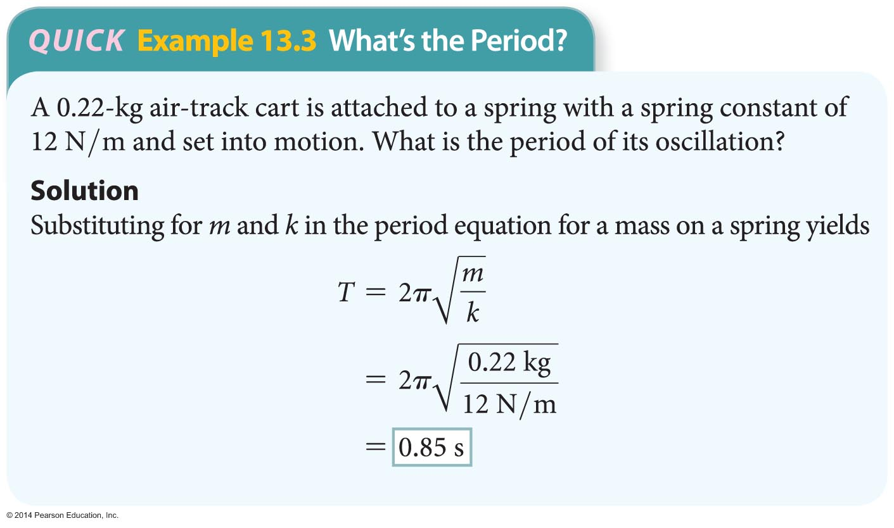
Oscillations and Periodic Motion
The following example illustrates how the period is calculated knowing the mass m and spring constant k.

Slide 24
Oscillations and Periodic Motion
Astronauts floating weightlessly above the Earth can't just jump on a bathroom scale to determine their mass. However, the mass of an astronaut can be measured using a body mass measurement device (BMMD). The device is essentially a chair attached to a spring having a known spring constant k. The mass of the astronaut in the figure below is being determined by measuring the period of oscillations as she rocks back and forth.

Slide 25
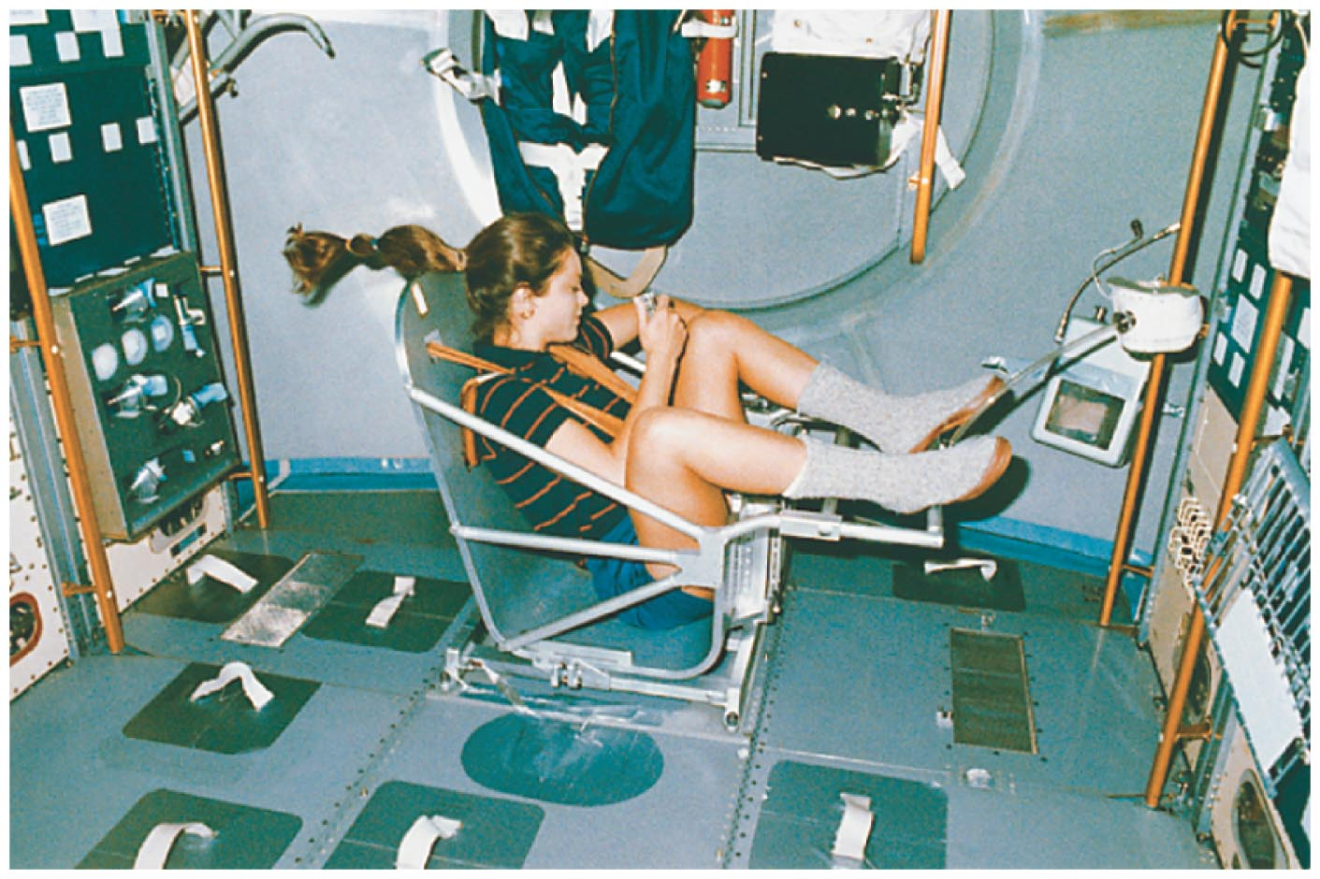
Oscillations and Periodic Motion

Slide 26
Oscillations and Periodic Motion
Suppose you have two identical mass−spring systems. Now suppose you give one mass twice the amplitude of the other. What effect does this have on the period?
Surprisingly, the amplitude has no effect on the period. A larger amplitude causes a larger force to be exerted by the spring. This larger force, in turn, causes the mass to move more rapidly. The speed of the mass increases just enough to make it cover the greater distance in precisely the same time.
This result is predicted by the formula for the period, which does not contain the amplitude, A.

Slide 27
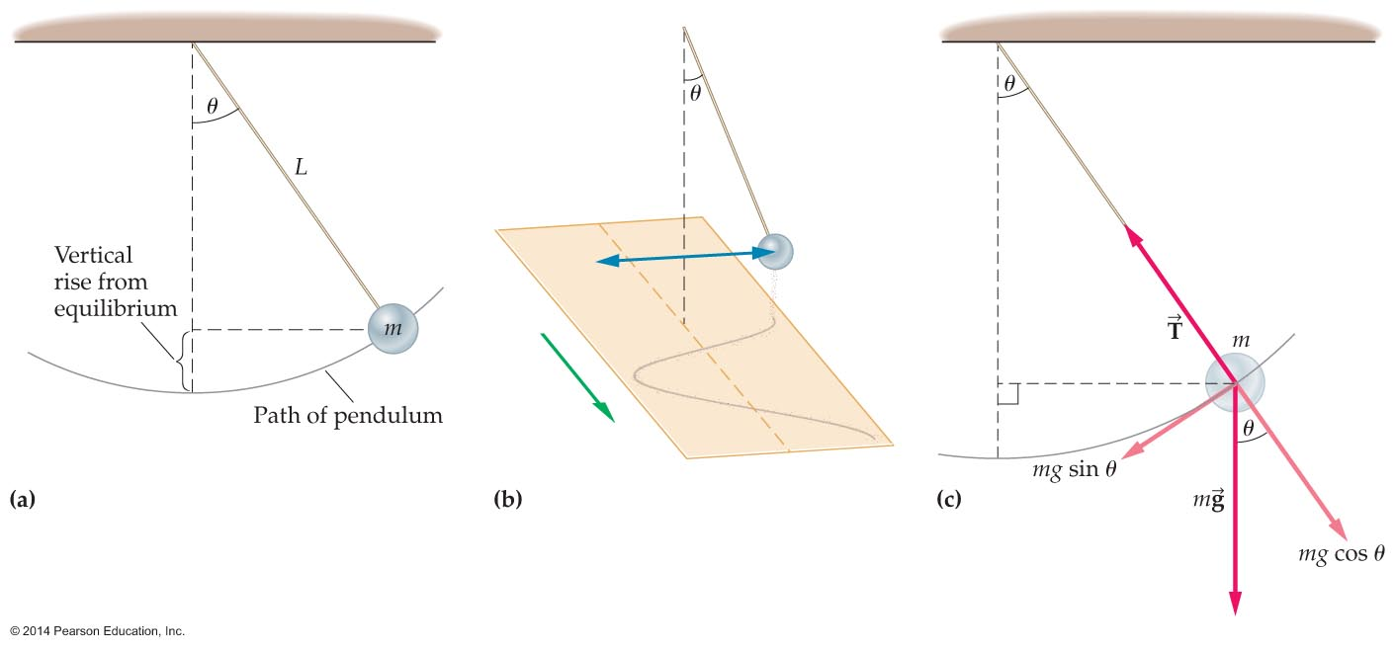
The Pendulum
A pendulum is basically a mass m suspended by a light string or rod of length L. The mass is often called the bob.
An example of a pendulum is shown in the figure below.

Slide 28
The Pendulum
Note that when displaced by a small angle from the vertical and released, the mass oscillates back and forth from one side of the equilibrium position to the other [figure (a)].

Slide 29
The Pendulum
If a stream of sand leaks from the mass onto a moving strip of paper, as in figure (b), it produces a sine wave.
Thus the motion of the pendulum is very similar to that of a mass on a spring.
A pendulum moves with simple harmonic motion because a restoring force acts on it that is approximately proportional to the angle of displacement.
As can be seen in figure (c), a component of the weight (mg sin θ) acts in the direction of the equilibrium position and hence serves as the restoring force.

Slide 30
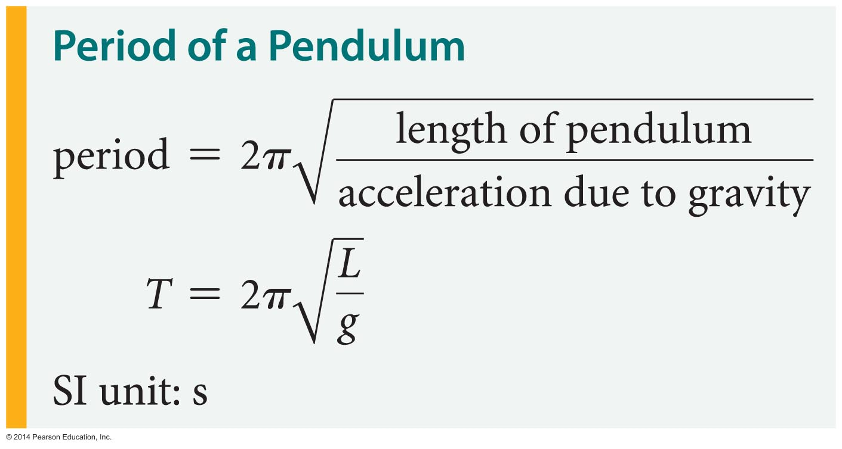
The Pendulum
The period of a pendulum—the time required for one full oscillation—depends on its length and on the acceleration due to gravity.
The formula for the period of a pendulum can be determined mathematically or experimentally. For a pendulum of length L, the period is given by the following formula:

Slide 31
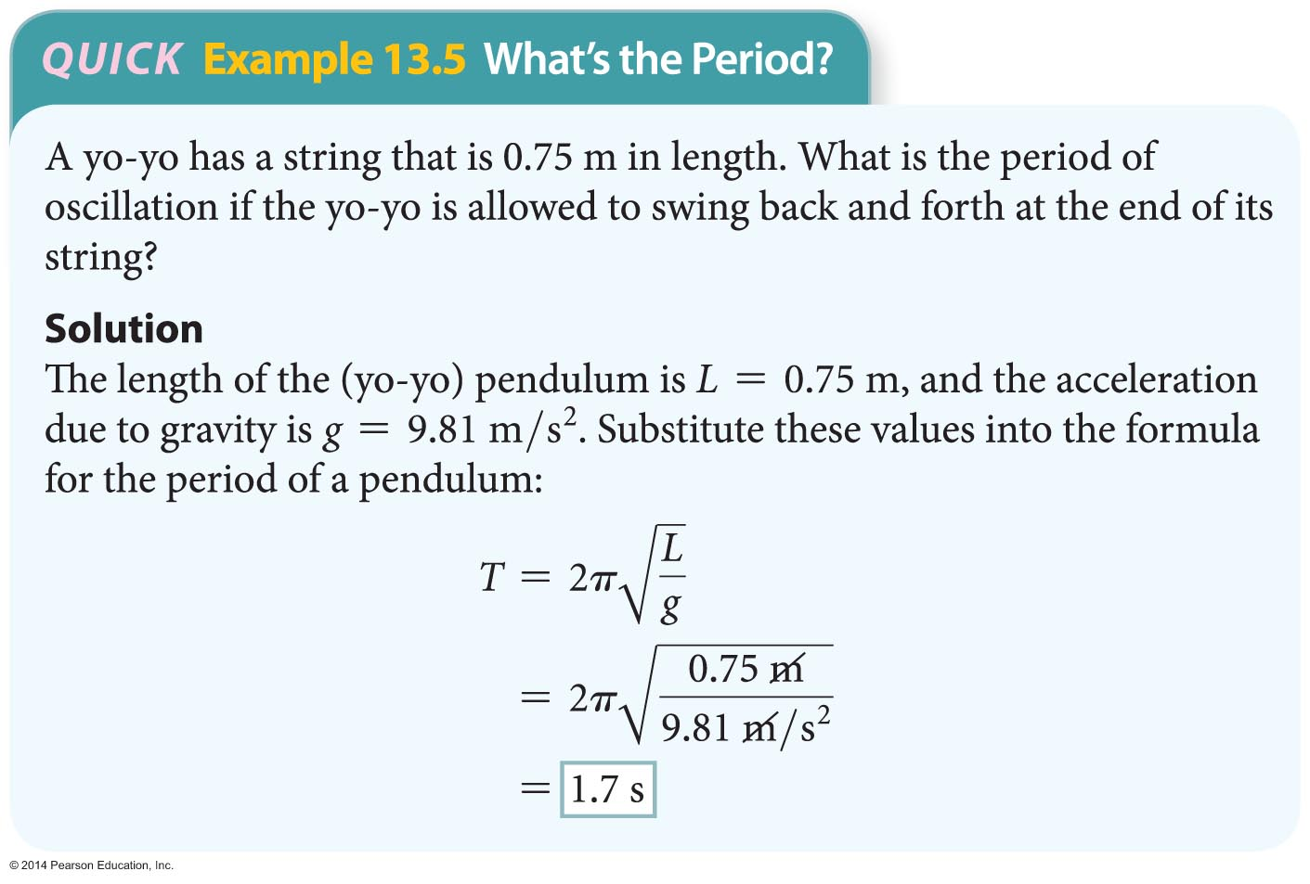
The Pendulum
The following example illustrates how this formula may be applied to find the period of a pendulum.

Slide 32
The Pendulum
The period of a pendulum depends only on the pendulum's length and the acceleration due to gravity, not on the pendulum bob's mass or the pendulum's amplitude.
Why doesn't the period of a pendulum depend on mass? Well, a larger mass tends to move more slowly due to its greater inertia. On the other hand, the gravitational force acting on it is also greater. These two effects cancel exactly, just as in free fall.

Slide 33
The Pendulum
Why doesn't the pendulum's period depend on amplitude? A larger amplitude results in a larger restoring force. This larger force causes the mass to move more rapidly. The speed of the mass increases just enough to make the pendulum cover a greater distance in precisely the same time as a pendulum with a smaller amplitude.

Slide 34
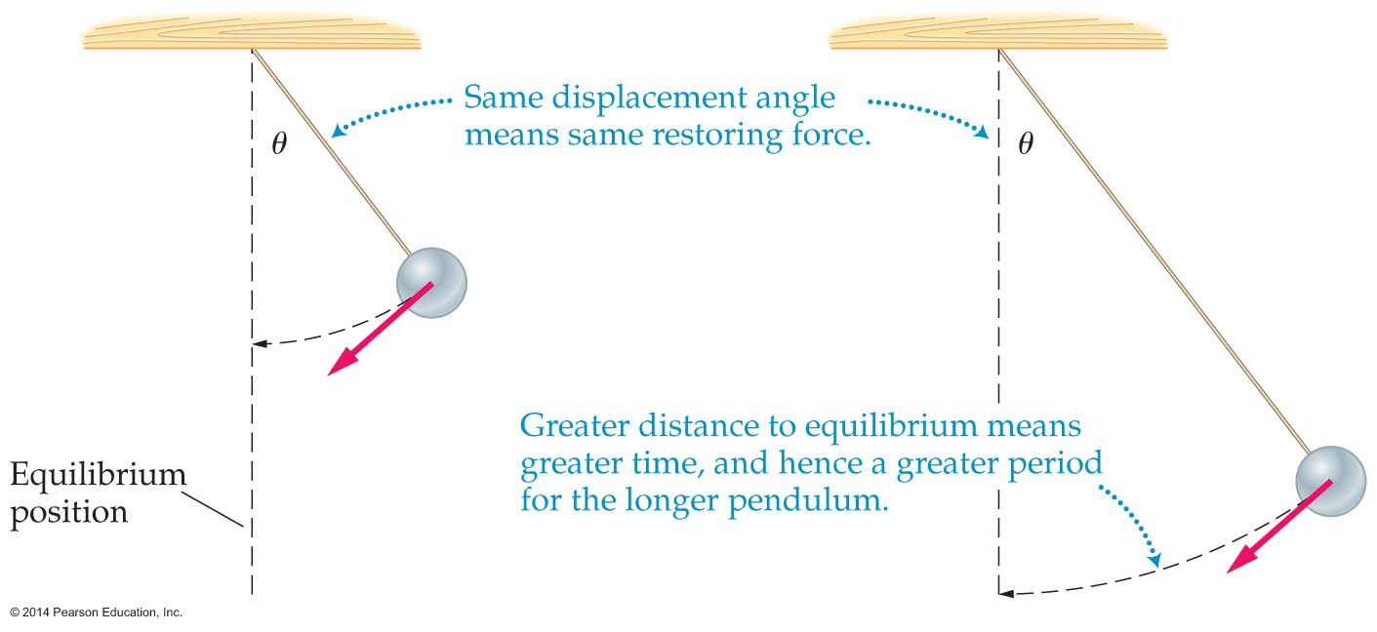
The Pendulum
Why does the length of a pendulum affect its period?
The figure below shows two pendulums of different lengths displaced by the same angle, θ.

Slide 35
The Pendulum
Both masses experience the same force of gravity pulling them back toward the vertical position. Therefore, they will have the same acceleration.

Slide 36
The Pendulum
However, the longer pendulum has farther to travel to reach equilibrium. Therefore, the period of the longer pendulum is greater than the period of the shorter pendulum.
As the formula for the period of a pendulum indicates, a pendulum's period is affected by the value of g. Geologists use very precise pendulums to make gravity maps that show how the Earth's gravitational field varies with location and elevation.

Slide 37
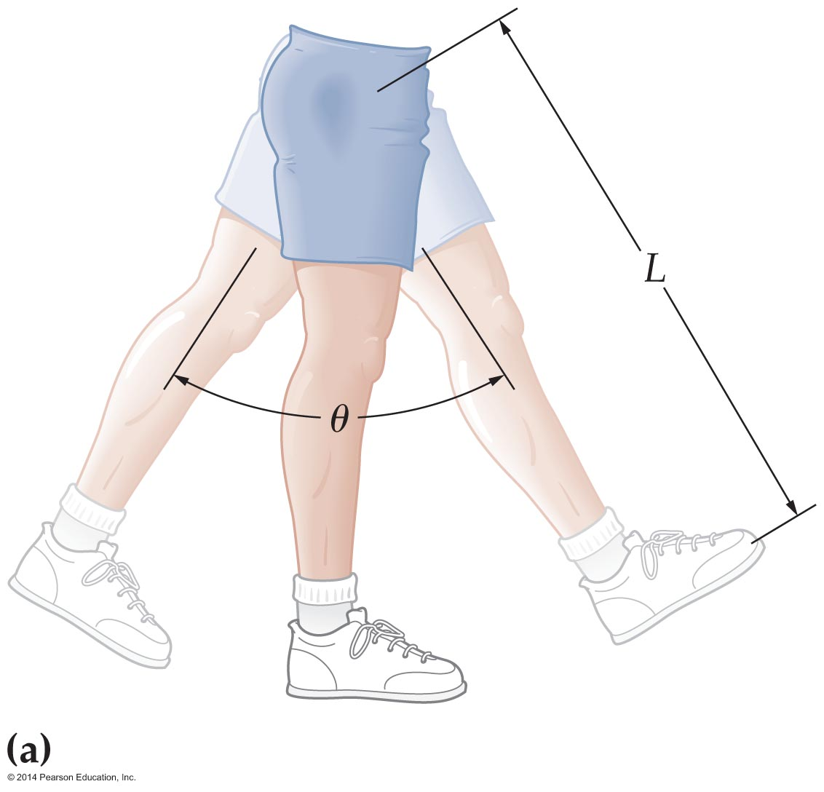
The Pendulum
Your legs act as pendulums when you walk. As you walk, your legs swing back and forth with each step (see the figure below). This is also true for other animals.

Slide 38
The Pendulum
The longer an animal's legs, the more time it takes to complete one step forward. The length of each step is also greater, however. The net effect is that animals with longer legs have greater walking speeds.

Slide 39
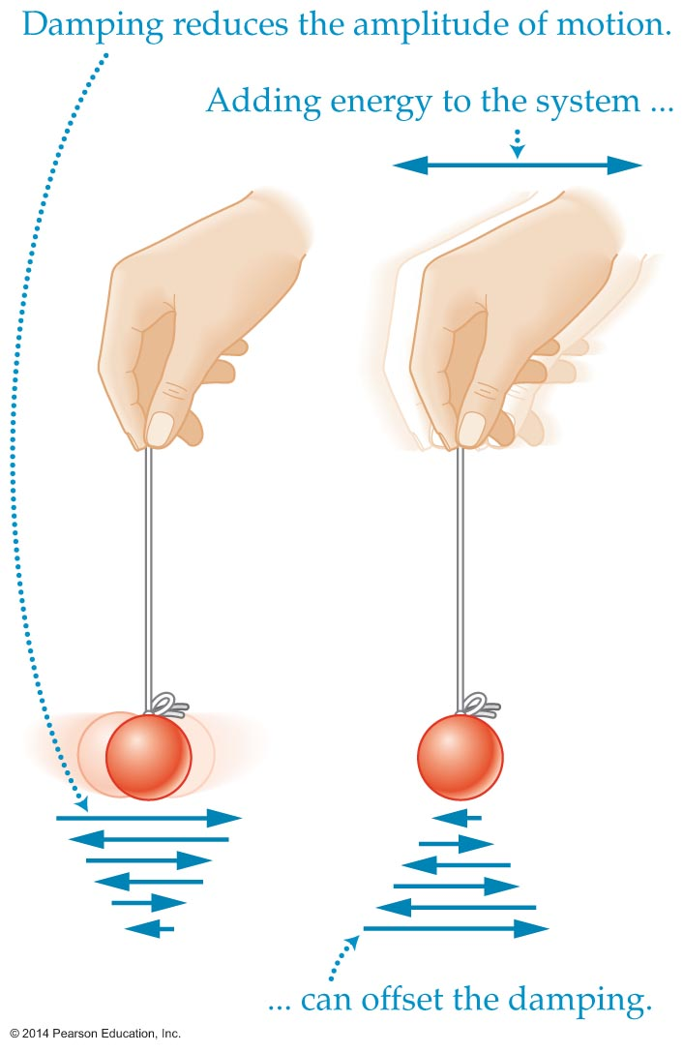
The Pendulum
External forces affect objects all the time, including those that oscillate. When an external force is applied repeatedly at just the right frequency, surprising things can happen.
The figure below shows a small weight suspended on a string.

Slide 40
The Pendulum
If the weight is set in motion and you hold your hand still, it will soon stop oscillating.
If you move your hand back and forth in a horizontal direction, however, you can keep the weight oscillating indefinitely. The motion of your hand drives the motion of the weight. In general, driven oscillations are those caused by an applied force.

Slide 41
The Pendulum
The response of the weight in the figure depends on the frequency of the hand's back-and-forth motion.
If you move your hand slowly, the weight simply tracks the motion of your hand.
If you oscillate your hand rapidly, the weight exhibits only small oscillations.
However, oscillating your hand at an intermediate frequency produces large-scale oscillations.

Slide 42
The Pendulum
It turns out that large oscillations are produced when your hand drives the weight at the frequency at which the object oscillates by itself. This frequency is referred to as the object's natural frequency.
A system driven at its natural frequency is said to be in resonance. Systems in resonance typically have rather large amplitudes.

Slide 43
The Pendulum
Resonance plays a role in a variety of systems. For example, the tuning knob of a radio changes the resonant frequency of the electrical circuit in the tuner. When the tuner's frequency matches the frequency being broadcast by a station, the radio picks up the broadcast.
Buildings and other structures can show resonance effects as well.

Slide 44
The Pendulum
Perhaps the most dramatic and famous example of resonance is the collapse of Washington's Tacoma Narrows Bridge in 1940. During a windstorm the bridge showed a resonance-like effect, and the amplitude of its swaying began to increase. A short time later the swaying motion became so great that the bridge broke apart and fell into the water below (see figure below).

Slide 45
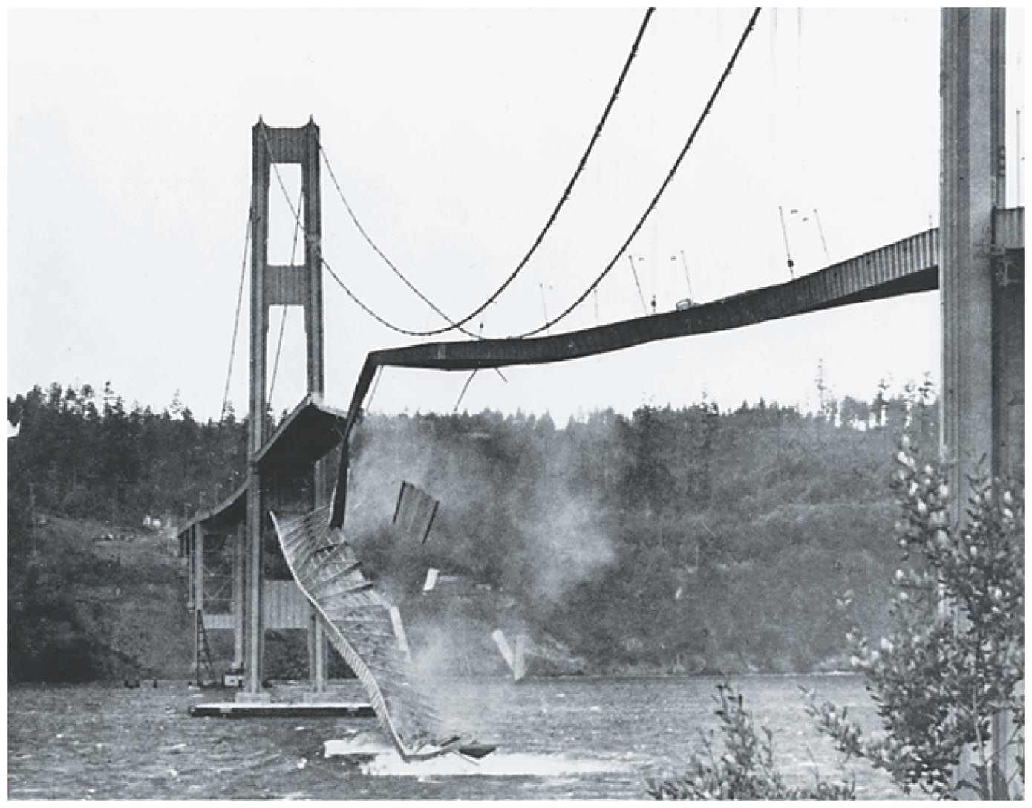
The Pendulum

Slide 46
Waves and Wave Properties
A wave is a disturbance that propagates, or is transmitted, from place to place, carrying energy as it travels.
Examples of waves include ocean waves and light waves.
It is important to distinguish between the motion of the wave and the motion of the individual particles in the wave. In general, waves travel from place to place, but the particles in a wave oscillate back and forth about one location.
For example, a "wave" at a ballgame travels around the stadium, but the individual people making up the wave simply stand up and sit down.

Slide 47
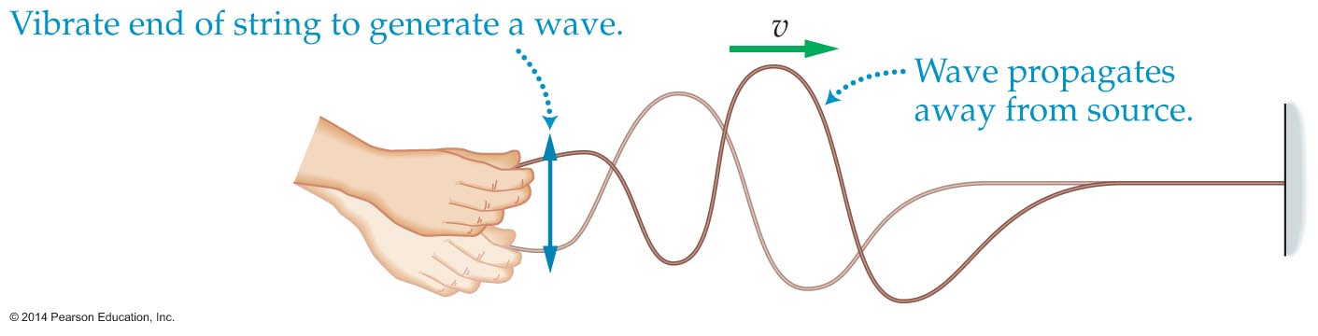
Waves and Wave Properties
Waves can be categorized by the way the particles move. The wave in the figure below is generated by moving a string up and down. This creates a wave that travels along the string toward the wall.

Slide 48
Waves and Wave Properties
Notice that the wave travels in the horizontal direction, even though the hand oscillates vertically. In fact, every point on the string oscillates vertically, with no horizontal motion at all.
The figure below shows that the particles in the string move at right angles to the motion of the wave. Such a wave is called a transverse wave.

Slide 49
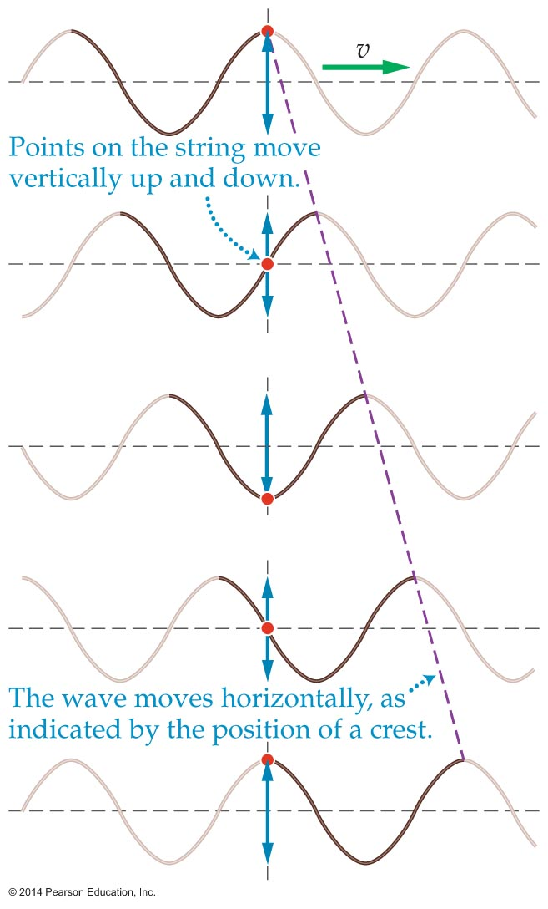
Waves and Wave Properties

Slide 50
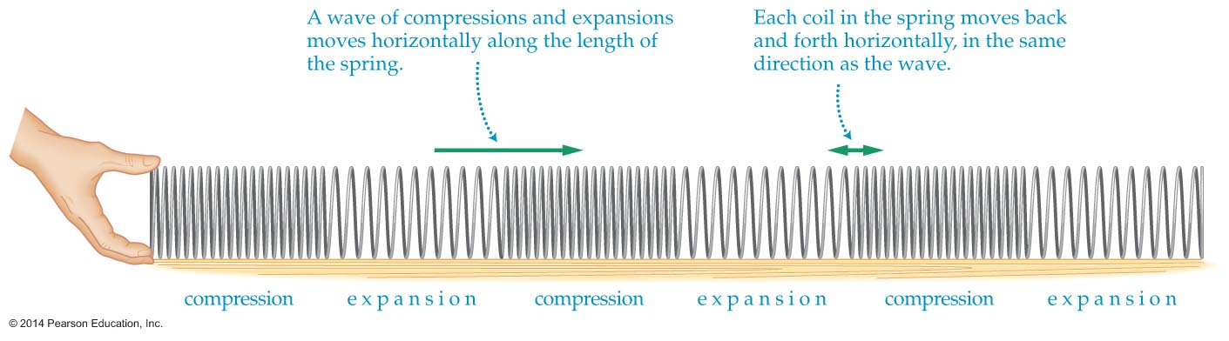
Waves and Wave Properties
Not all waves are transverse. In particular, a wave in which the particles oscillate parallel to the direction of propagation is called a longitudinal wave.
The figure below shows a longitudinal wave traveling through a spring toy.

Slide 51
Waves and Wave Properties
Note that oscillating one end of the spring produces a disturbance consisting of a series of compressions and expansions. Each coil of the spring moves forward and backward horizontally in the same direction as the wave itself.
Disturbing the surface of a pond produces a series of concentric waves that move symmetrically away from the disturbance (see figure below).

Slide 52
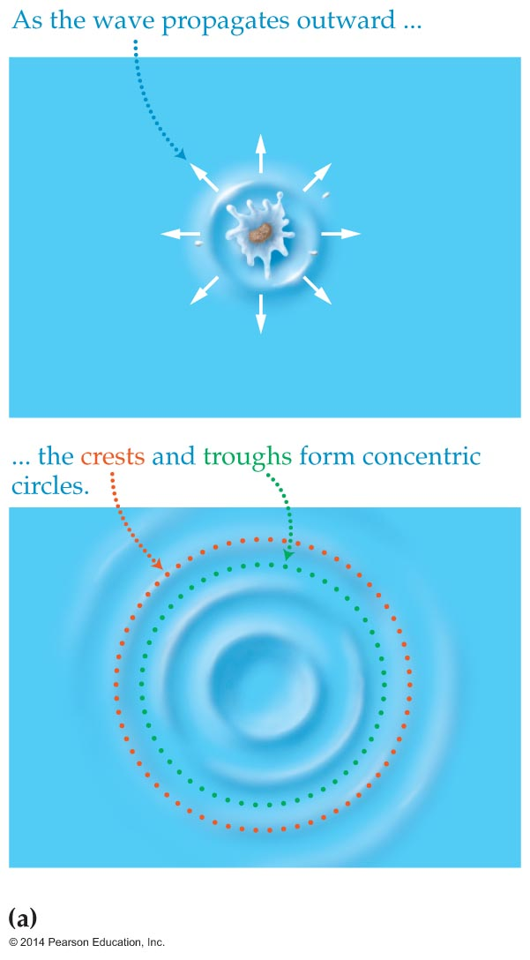
Waves and Wave Properties

Slide 53
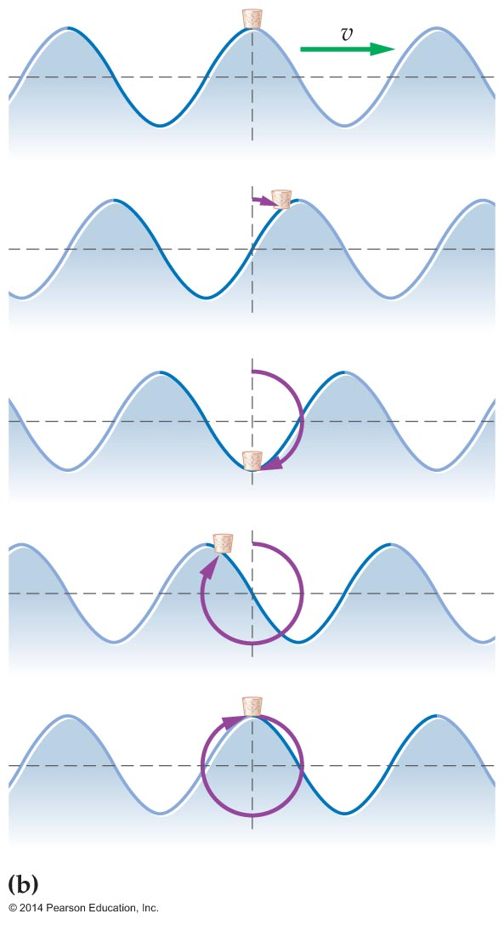
Waves and Wave Properties
A floating piece of cork traces the motion of the water itself as the wave travels outward (see figure below).

Slide 54
Waves and Wave Properties
Notice that the cork moves in a roughly circular path, with each molecule of water moving both vertically and horizontally. Thus the pattern of motion indicates that a water wave is a combination of transverse and longitudinal waves.

Slide 55
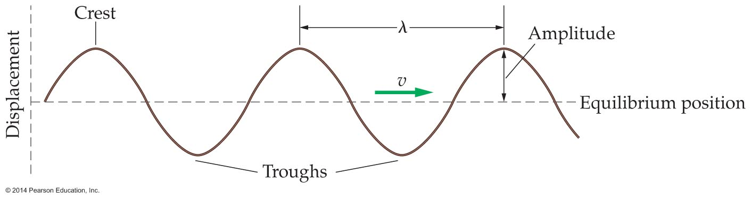
Waves and Wave Properties
A simple wave, like the one shown in the figure below, is a regular, rhythmic disturbance that travels from one location to another.

Slide 56
Waves and Wave Properties
The highest points on the wave are its crests, and the lowest points are its troughs.
The wave repeats itself over a distance equal to the wavelength, λ, the distance between two consecutive crests or troughs.

Slide 57
Waves and Wave Properties
The amplitude of a wave is the distance from the wave's equilibrium position to its maximum displacement, which occurs at a crest or trough.
The time it takes a wave to move one wavelength is equal to its period.
Since the speed is distance divided by time, it follows that the speed of a wave is
speed = wavelength/period
v = λ/T
Since f = 1/T, we can also write v = fλ.
This result applies to all waves, no matter what their type or how they are produced.

Slide 58
Waves and Wave Properties
Waves travel with different speeds in different materials. In fact, the speed of a wave is determined by the properties of the material, or medium, through which it travels. A medium can be any form of matter, such as air, water, or steel.
In general, waves travel faster in a medium that is hard or stiff. For example, sound waves in air have a speed of about 343 m/s. In water, the speed is about four times faster, 1400 m/s. In the solid medium steel, the speed is 5960 m/s.
In addition, wave speed depends on other properties of a medium. For example, sound travels faster in warm air than it does in cool air.

Slide 59
Waves and Wave Properties
In general, waves reflect whenever they hit a barrier. How the reflection occurs depends on the type of barrier.
As the figure below shows, a wave pulse on a string is inverted (turned upside-down) when it reflects from an end that is tied down. A wave pulse on a string whose end is free to move is reflected right-side up.

Slide 60
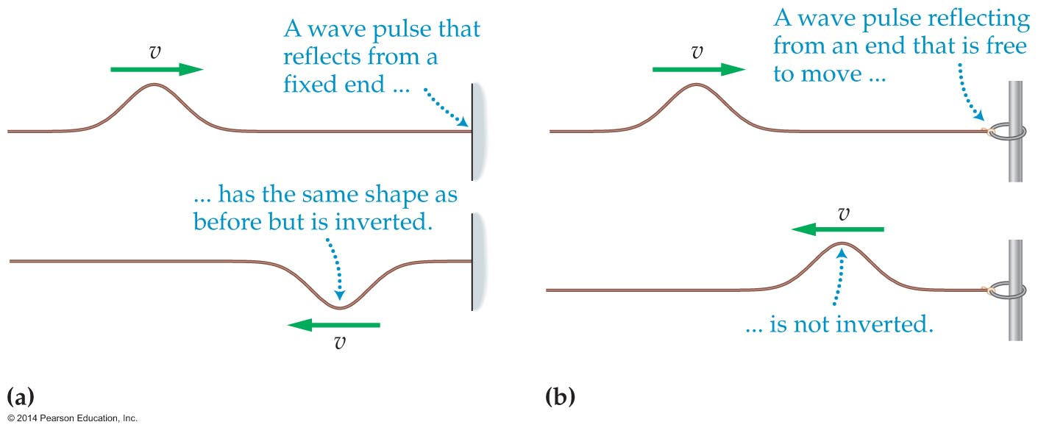
Waves and Wave Properties

Slide 61
Interacting Waves
When two objects collide, they hit and bounce backward. When lumps of clay collide, they "smush" together into a big blob. What about waves?
In some ways, waves are like ghosts—they pass through one another and keep going!
When two or more waves overlap, they combine to form a resultant wave. The principle of superposition states that a resultant wave is simply the sum of the individual waves that make it up.

Slide 62
Interacting Waves
The amazing thing is that a collision between waves doesn't affect the individual waves in any way. The waves pass right through each other and continue on as if nothing had happened.
As simple as the principle of superposition is, it still leads to interesting consequences. For example, consider the wave pulses shown the figure below.

Slide 63
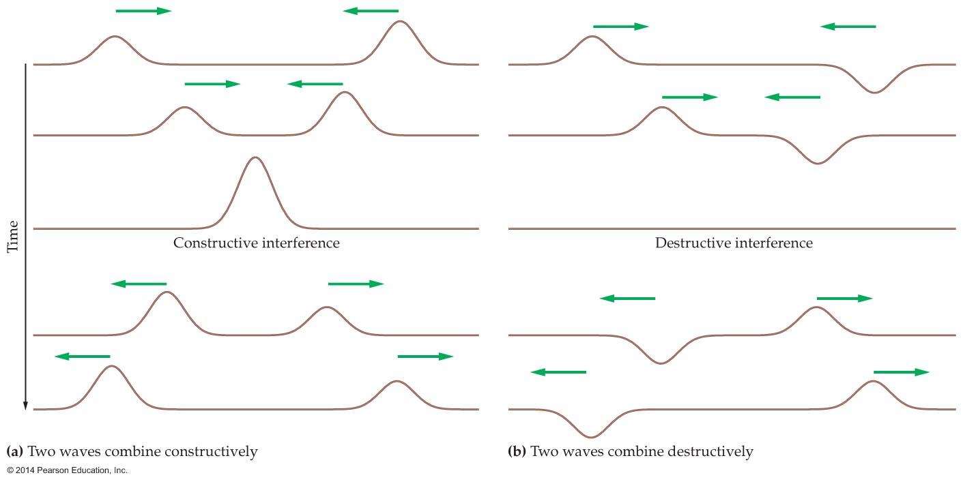
Interacting Waves

Slide 64
Interacting Waves
Figure (a) shows that when two wave pulses combine, the resulting pulse has a larger amplitude, equal to the sum of the amplitudes of the individual pulses.
Whenever waves combine to form a larger wave, the result is referred to as constructive interference.

Slide 65
Interacting Waves
On the other hand, two pulses like those in figure (b) may combine. When this happens, the positive displacement of one wave adds to the negative displacement of the other to crease a net displacement of zero. When waves superpose to form a smaller wave, the result is referred to as destructive interference.
In both constructive and destructive interference, the waves are not changed when they pass through one another. This makes sense from an energy point of view, since energy cannot simply vanish.

Slide 66
Interacting Waves
Interference effects are not limited to waves on a string. In fact, interference is one of the key characteristics that define waves. In general, when waves combine, they form interference patterns that include regions of constructive interference and regions of destructive interference.

Slide 67
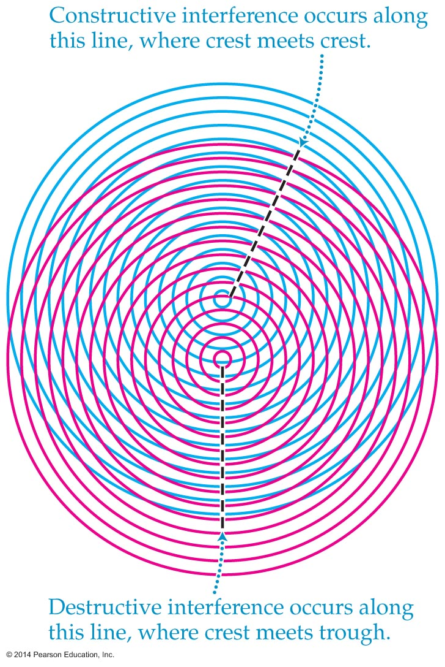
Interacting Waves
The interference pattern produced by the superposition of two circular waves is shown in the figure below.

Slide 68
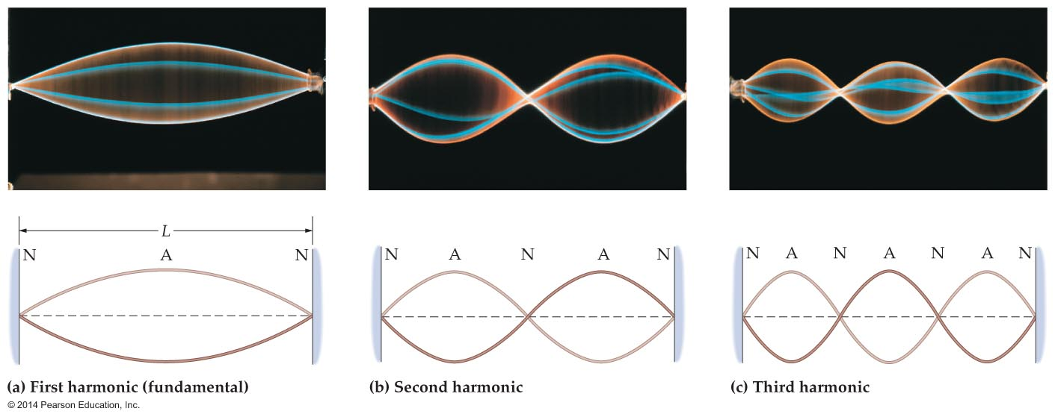
Interacting Waves
A wave that oscillates in a fixed position is called a standing wave.
The figure below contains examples of standing waves. Note that the strings assume a wavelike shape, but the wave stays in the same place.

Slide 69
Interacting Waves
When a string is tied down at both ends and plucked in the middle, a standing wave results [see figure (a)]. This is the string's fundamental mode of vibration, or first harmonic.
The fundamental mode corresponds to a half a wavelength of a usual wave on a string.
Notice that the ends of the plucked string are fixed and do not move. Points that do not move are called nodes.
Halfway between any two nodes is a point of maximum displacement known as an antinode.

Slide 70
Interacting Waves
The first harmonic is formed by a wave that reflects back and forth between the fixed ends of a string. When the frequency is just right, the reflected waves interfere constructively, and the standing wave is formed.
All standing waves are the result of interference. If the frequency differs from the first-harmonic frequency, then the reflections result in destructive interference, and a standing wave does not form.

Slide 71
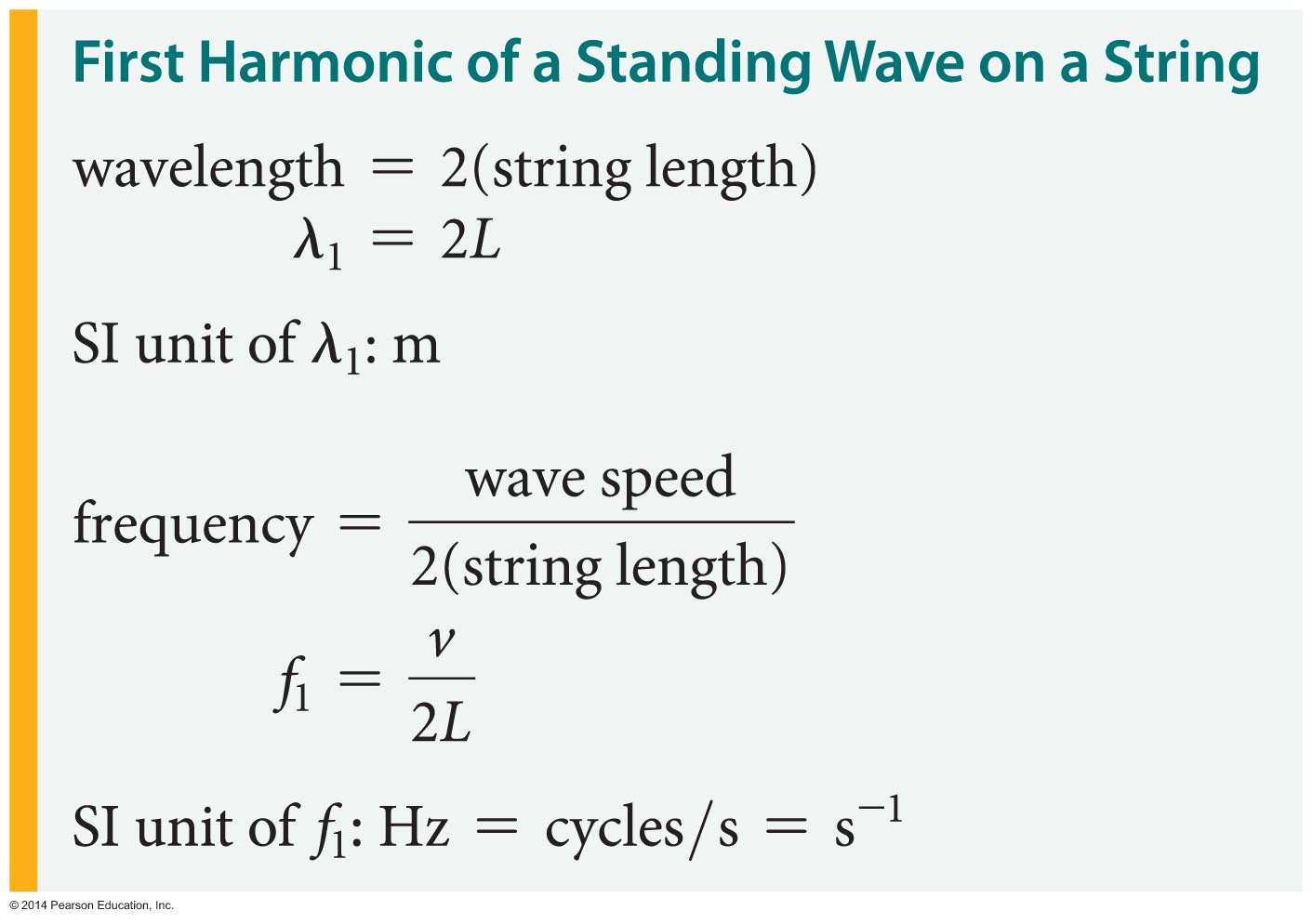
Interacting Waves
The wavelength and frequency of the first harmonic can be calculated from the length of the string, L, and the speed of the wave on the string, v, as follows:

Slide 72
Interacting Waves
However, the fundamental mode, described above, is not the only standing wave that can exist on a string.

Slide 73
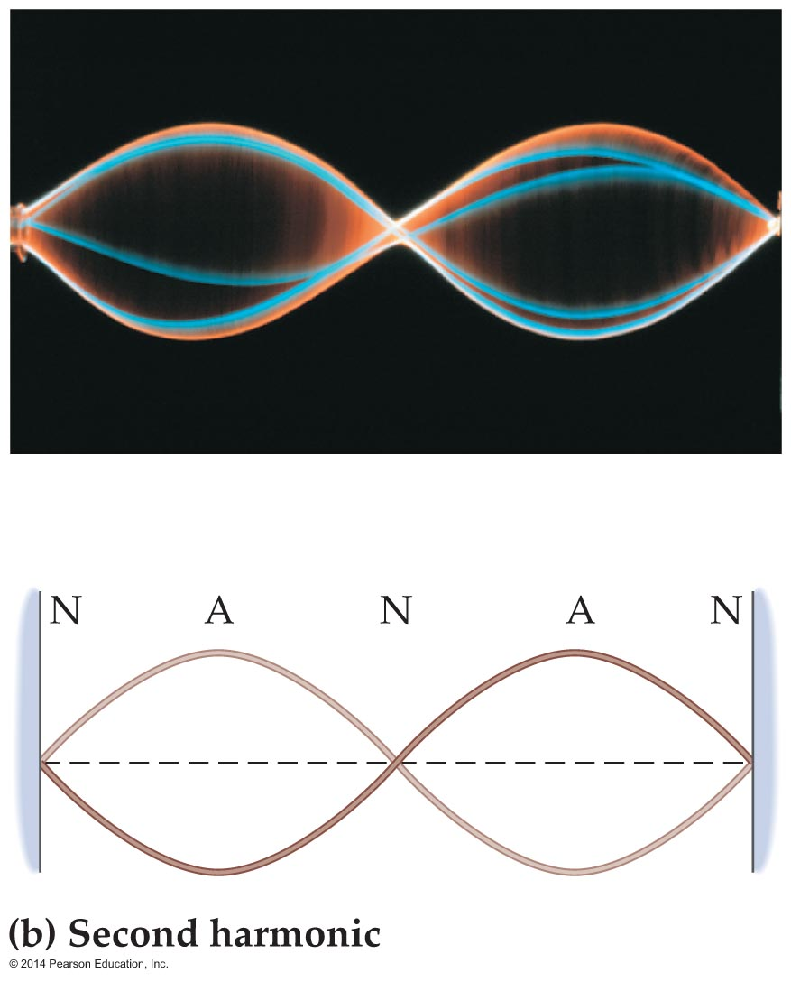
Interacting Waves
A given string has an infinite number of standing wave modes, or harmonics. For example, the second harmonic is shown in the figure below

Slide 74
Interacting Waves
Notice that the sequence of nodes (N) and antinodes (A) is N-A-N-A-N, which has one more antinode (A) and one more node (N) than the first harmonic.

Slide 75
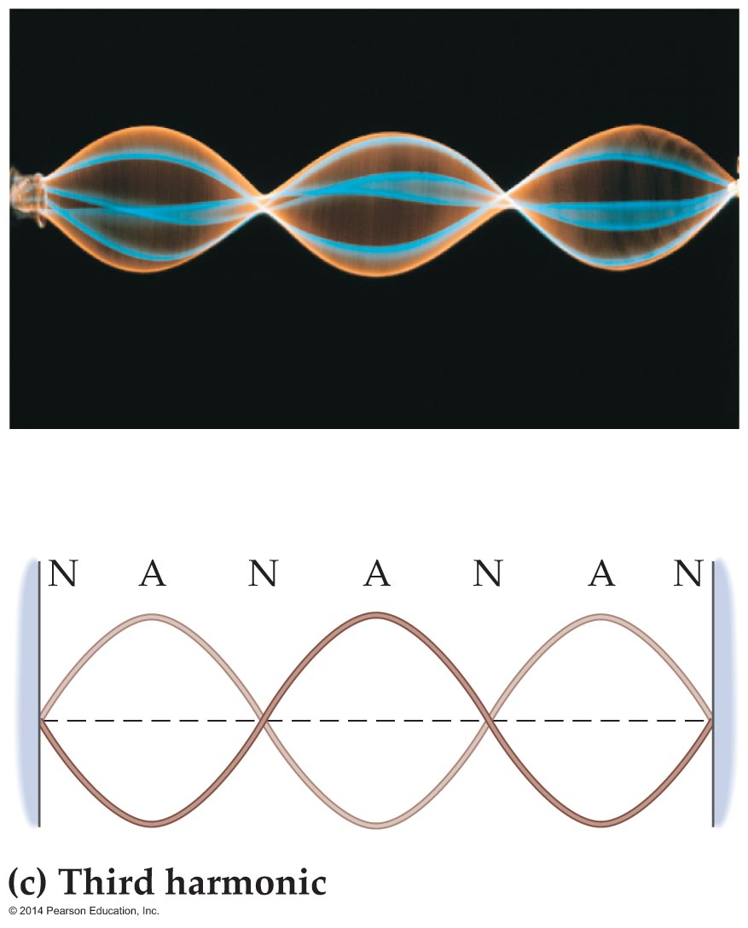
Interacting Waves
Adding one more antinode and node yields the third harmonic, N-A-N-A-N-A-N, as shown in the figure below.

Slide 76
Interacting Waves
The frequency of the second harmonic is twice the frequency of the first harmonic, and the frequency of the third harmonic is three times that of the first. This pattern continues for all higher harmonics.

Slide 77
Interacting Waves
When you pluck a guitar string, it vibrates primarily in its fundamental mode. Higher harmonics make only small contributions to the sound produced. The same is true for strings on a piano, a violin, and other string instruments.
Assuming that all other variables remain the same, longer strings (larger L) produce lower frequencies and shorter strings (smaller L) produce higher frequencies.

Slide 78
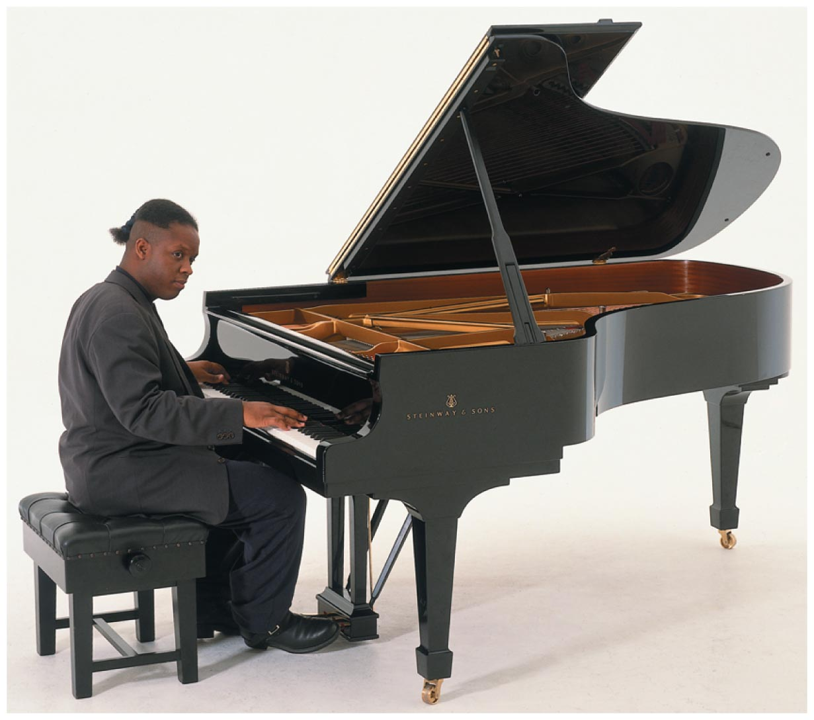
Interacting Waves
This fact accounts for the general shape of a piano, shown in the figure below.

Slide 79
Interacting Waves
The frequency range of an instrument is directly related to the instrument's size. The figure below shows a violin, a cello, and a double bass. The smallest of these string instruments, the violin, has the highest frequency range. The largest instrument, the double bass, produces the lowest frequency range.

Slide 80
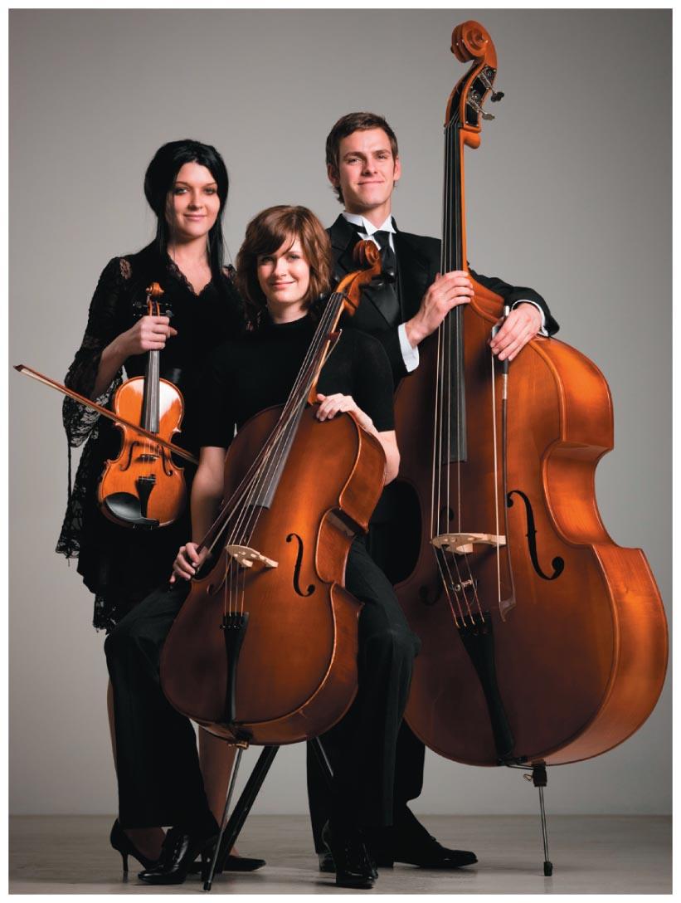
Interacting Waves

