Slide 1
Newton's Laws of Motion
Prepared by Chris Chiaverina

Slide 2
Chapter Contents
Newton's Laws of Motion
Applying Newton's Laws
Friction

Slide 3
Newton's Laws of Motion
Two of the most important quantities in physics are force and acceleration.
As you have learned, acceleration is the rate at which the velocity changes with time.
Force is, quite simply, a push or a pull.
Two quantities characterize a force:
  the strength, or magnitude of the force
  the direction in which the force acts

Slide 4
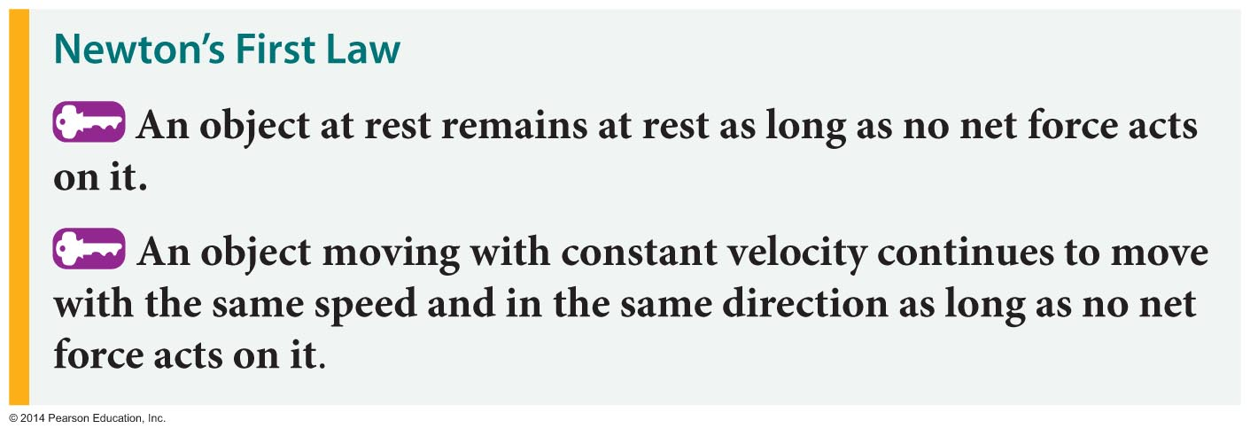
Newton's Laws of Motion
Objects don't start or stop moving on their own.
This observation is the essence of Newton's first law of motion:

Slide 5
Newton's Laws of Motion
Newton's first law of motion contains the phrase "no net force." What does this mean?
The net force is the vector sum of all the individual forces acting on an object.
When you sit in a chair, there are essentially two forces acting on you: the upward push of the chair and the downward pull of gravity. Since you are at rest, the two forces must cancel out. Therefore, the vector sum of the forces, or net force, acting on you is equal to zero.

Slide 6
Newton's Laws of Motion
Our experience tells us that an object, such as a box being pushed across the floor, will stop moving if you stop pushing on it.
This occurs because of the force of friction acting between the box and the floor.
What would happen if the force of friction could be eliminated?

Slide 7
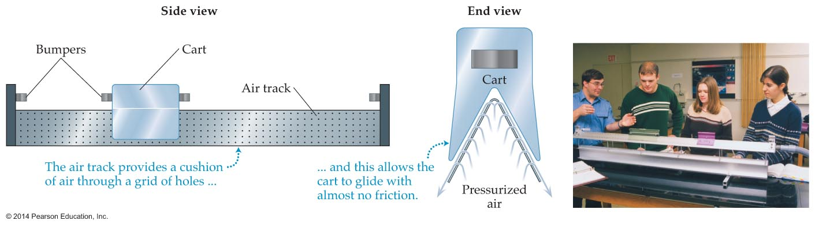
Newton's Laws of Motion
While friction cannot be eliminated completely, it can be greatly reduced.
The figure below shows a device known as an air track. An air track provides a cushion of air on which a cart can ride with virtually no friction.

Slide 8
Newton's Laws of Motion
When placed at rest on a level track, the cart will remain at rest until given a push.
In accordance with Newton's first law, once the cart is in motion, it will remain in motion until acted on by a net force. In theory, if the track could be made infinitely long and perfectly frictionless, the cart would continue moving with a constant velocity forever.

Slide 9
Newton's Laws of Motion
Newton's first law is sometimes referred to as the law of inertia.
Loosely speaking, inertia means laziness. Objects may be thought of as lazy because they don't change their motion unless forced to do so.
The tendency of an object to resist any change in its motion is referred to as its inertia.

Slide 10
Newton's Laws of Motion
Newton's second law of motion tells how a force changes an object's motion.
Throwing a baseball requires less force than pushing a car and giving it the same speed as the baseball. Why?
The car has more a lot more matter than does a baseball.

Slide 11
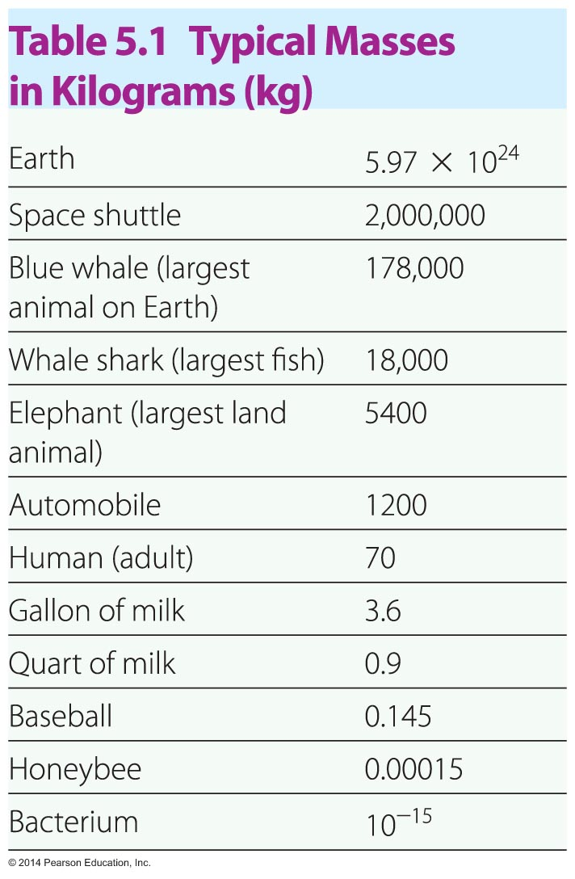
Newton's Laws of Motion
An object's mass is a measure of the amount of matter it contains.
The unit of mass is the kilogram.
The table below provides a list of typical masses.

Slide 12
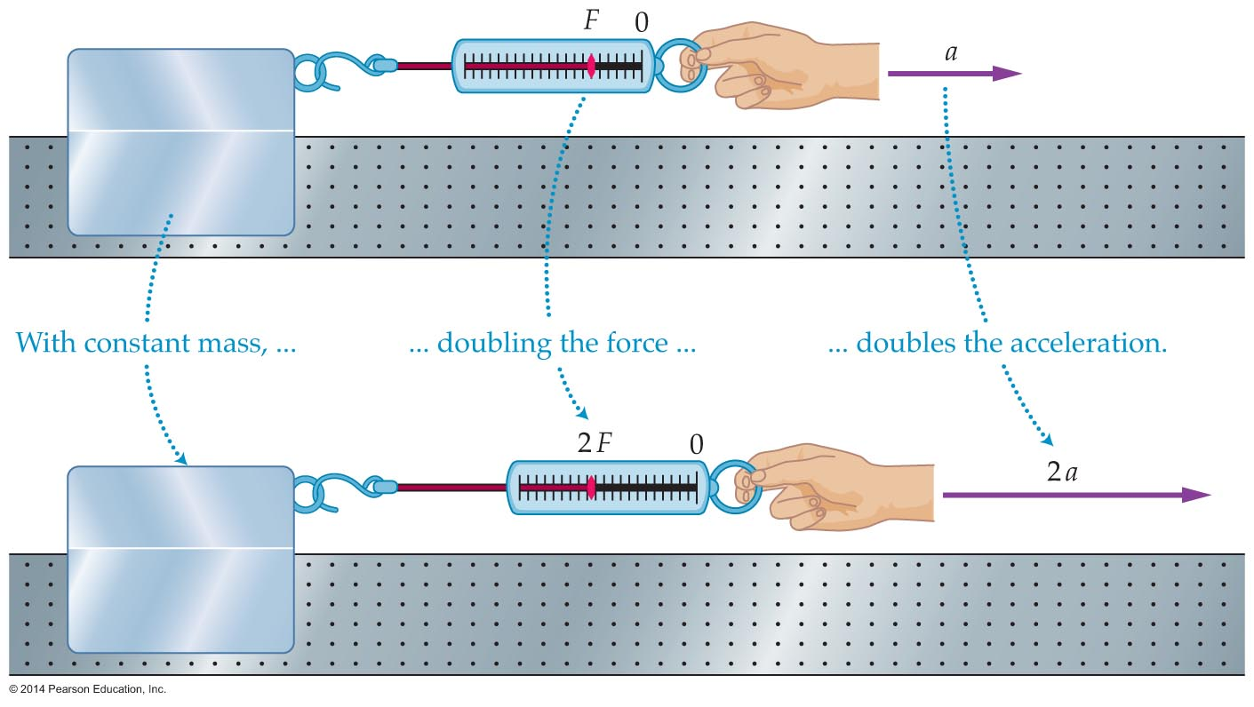
Newton's Laws of Motion
How does an object's acceleration depend on the force?
The experiment illustrated in the following figure shows that the acceleration is doubled when the force acting on a cart on an air track is doubled.

Slide 13
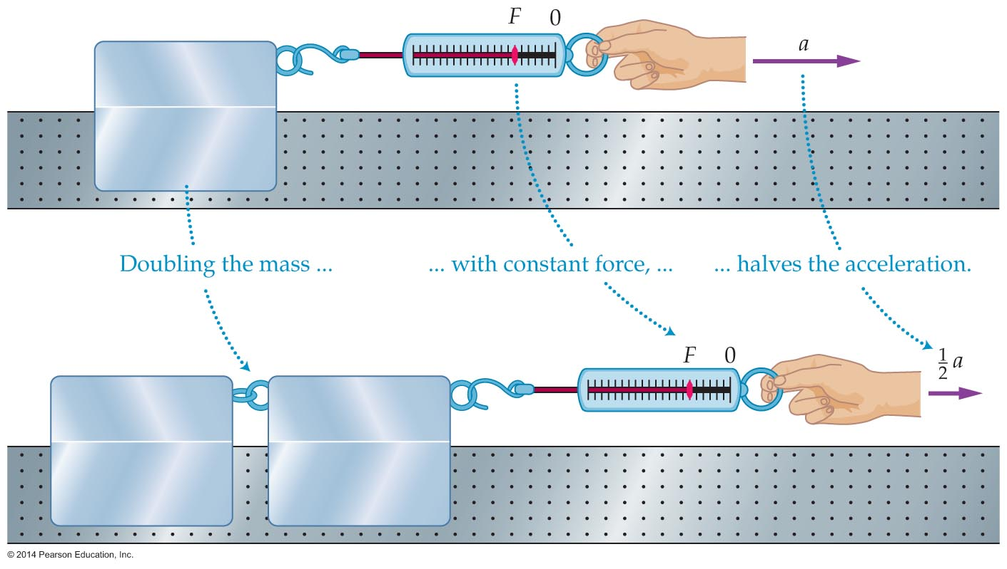
Newton's Laws of Motion
How does an object's acceleration depend on the mass?
The experiment illustrated below shows that the acceleration is halved when the force acting on the cart is doubled.

Slide 14
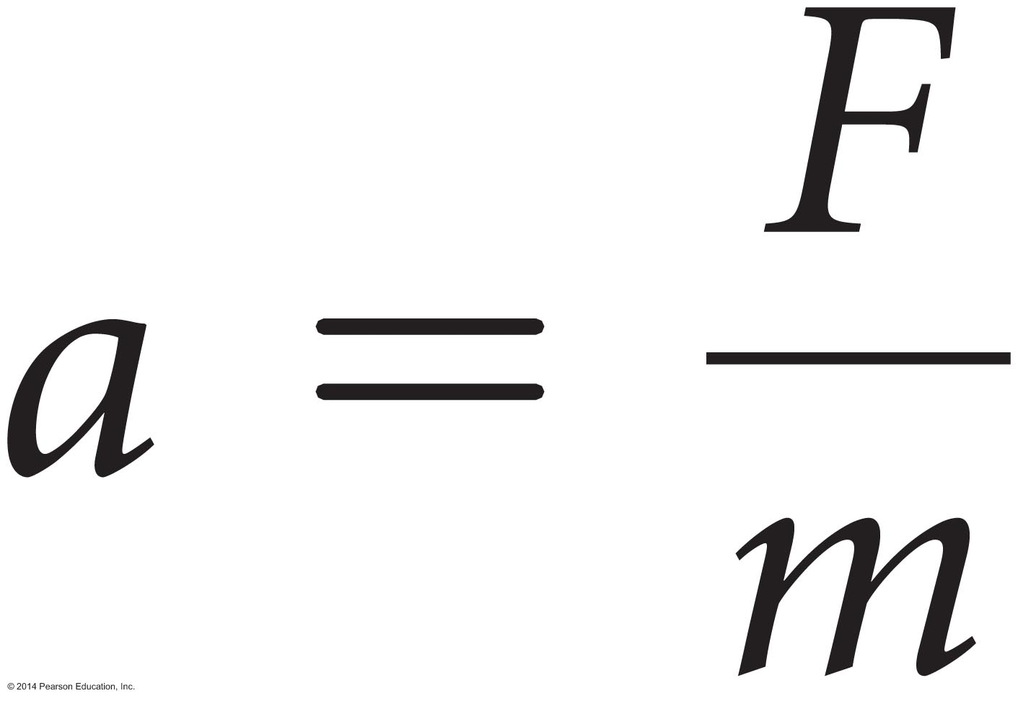
Newton's Laws of Motion
The results of the two experiments can be summarized by saying that an object's acceleration is directly proportional to the force and inversely proportional to the mass. That is,
This is a mathematical statement of Newton's second law of motion.

Slide 15
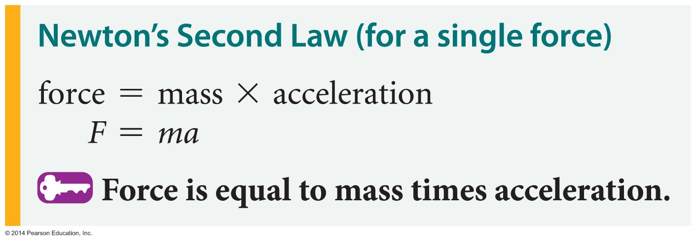
Newton's Laws of Motion
Rearranging the equation yields a form of Newton's second law that is perhaps best known, F equals m times a:

Slide 16
Newton's Laws of Motion
The unit of force used is the newton (N).
A newton is defined as the force required to give a mass of 1 kilogram an acceleration of 1 m/s² .
A newton is roughly equivalent to a quarter of a pound.
The table below gives the magnitudes of some common forces.

Slide 17
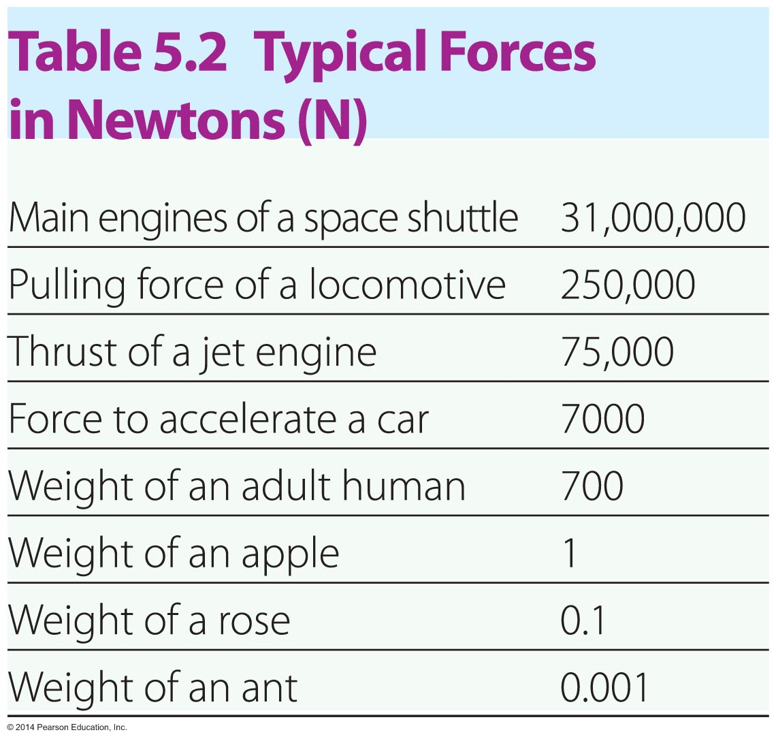
Newton's Laws of Motion

Slide 18
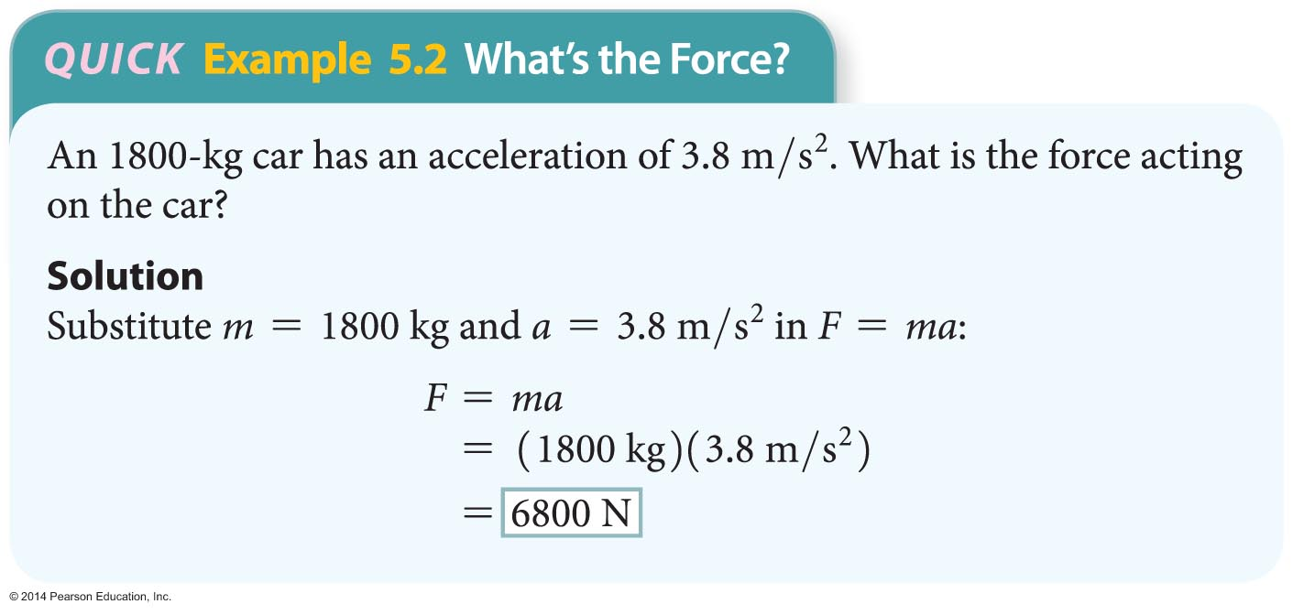
Newton's Laws of Motion
The following example illustrates how Newton's second law is applied to calculate the force when the mass and acceleration are known.

Slide 19
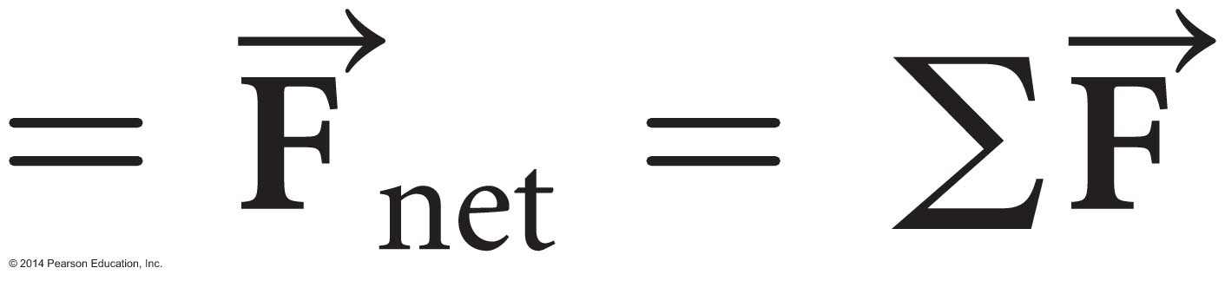

Newton's Laws of Motion
The second law also applies to situations in which several forces are acting on an object.
When several forces act on an object, the F in the equation F = ma is replaced with the sum of the force vectors:
sum of force vectors
The notation is read "sum of the forces."

Slide 20
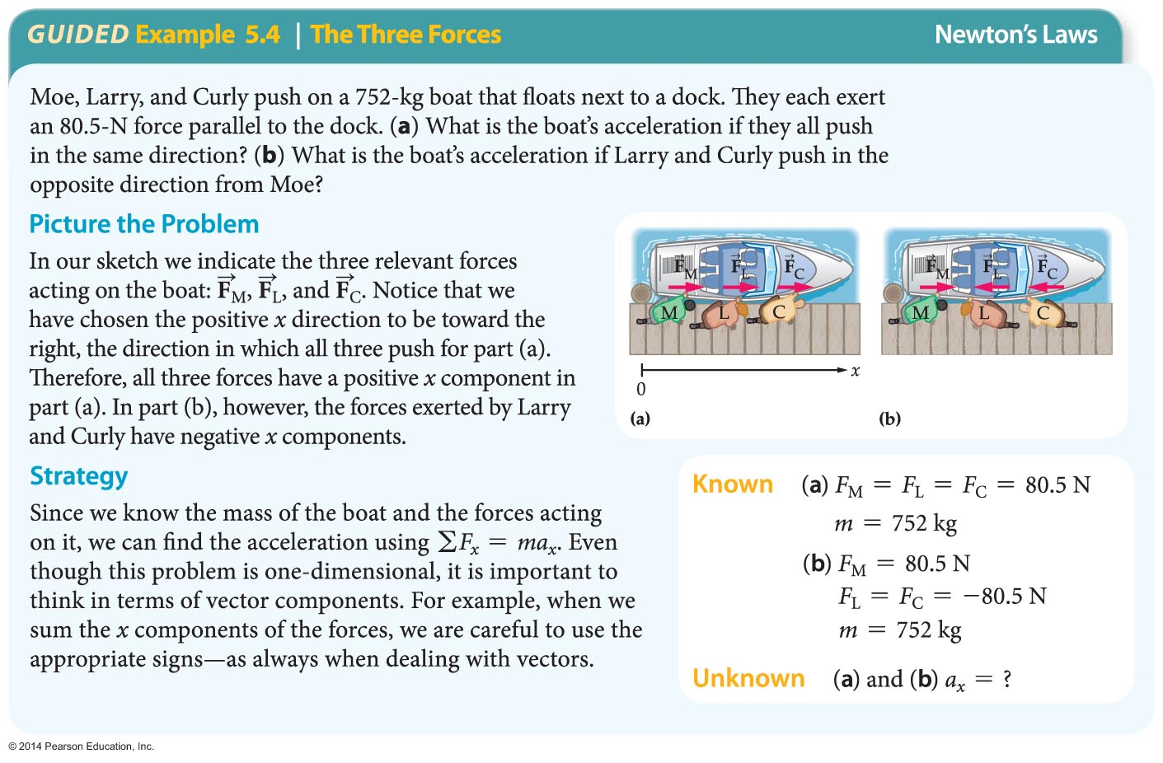
Newton's Laws of Motion

Slide 21
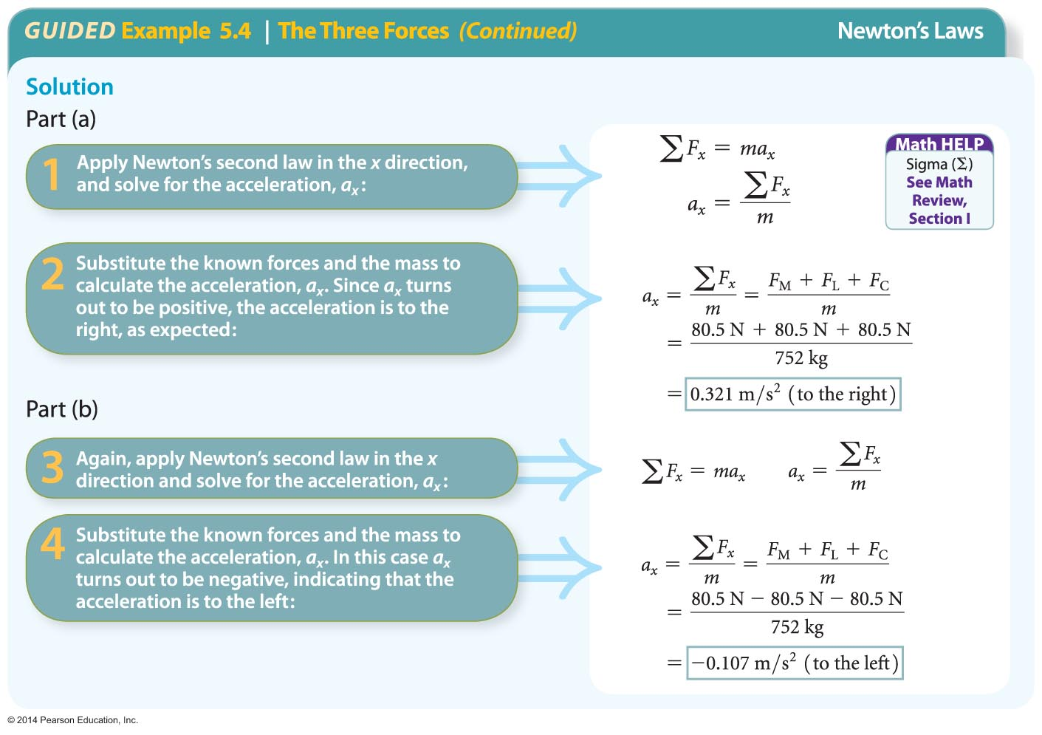
Newton's Laws of Motion (Cont'd)

Slide 22
Newton's Laws of Motion
According to Newton's third law:
  Forces always come in pairs. That is, there are no isolated forces in the universe.
  The forces in a pair are equal in magnitude and opposite in direction.
  The forces in a pair act on different objects.
The third law is commonly stated in an abbreviated form: For every action, there is an equal and opposite reaction.

Slide 23
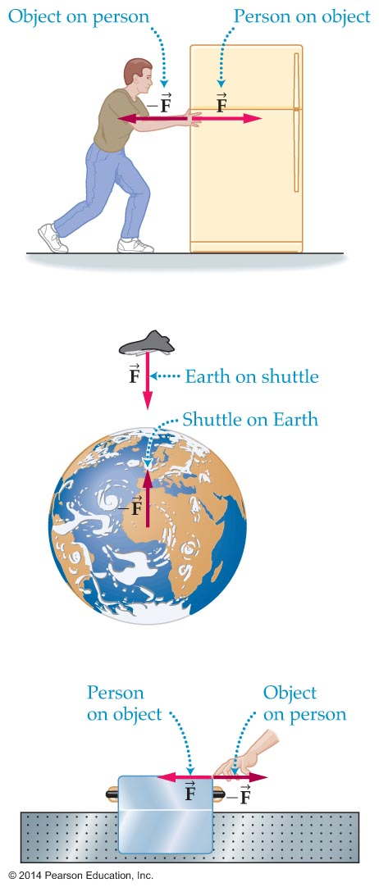
Newton's Laws of Motion
The figure below shows some examples of action-reaction pairs.
Note that in the three examples in the figure, the paired action-reaction forces act on different objects. As a result, the two forces do not cancel.

Slide 24
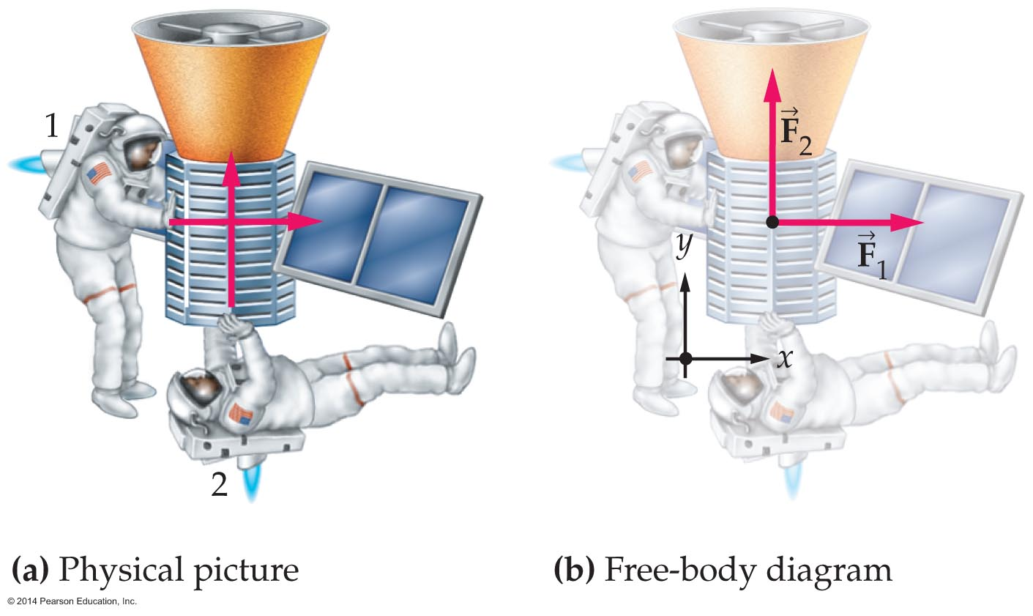
Applying Newton's Laws
Free-body diagrams are useful in applying Newton's laws.
A free-body diagram is a drawing that shows all the forces acting on an object.
To simply a real-life situation, in a free-body diagram the object is often represented as a point.

Slide 25
Applying Newton's Laws
The use of a free-body diagram in the solution of a problem involving Newton's laws may be summarized as follows:
  Once all the forces are drawn on a free-body diagram, a coordinate system is chosen and each force is resolved into components. At this point Newton's second law can be applied to each coordinate direction separately.

Slide 26
Applying Newton's Laws
The following example illustrates how this procedure may be applied to a problem involving two astronauts pushing a satellite, shown in the figure below.

Slide 27
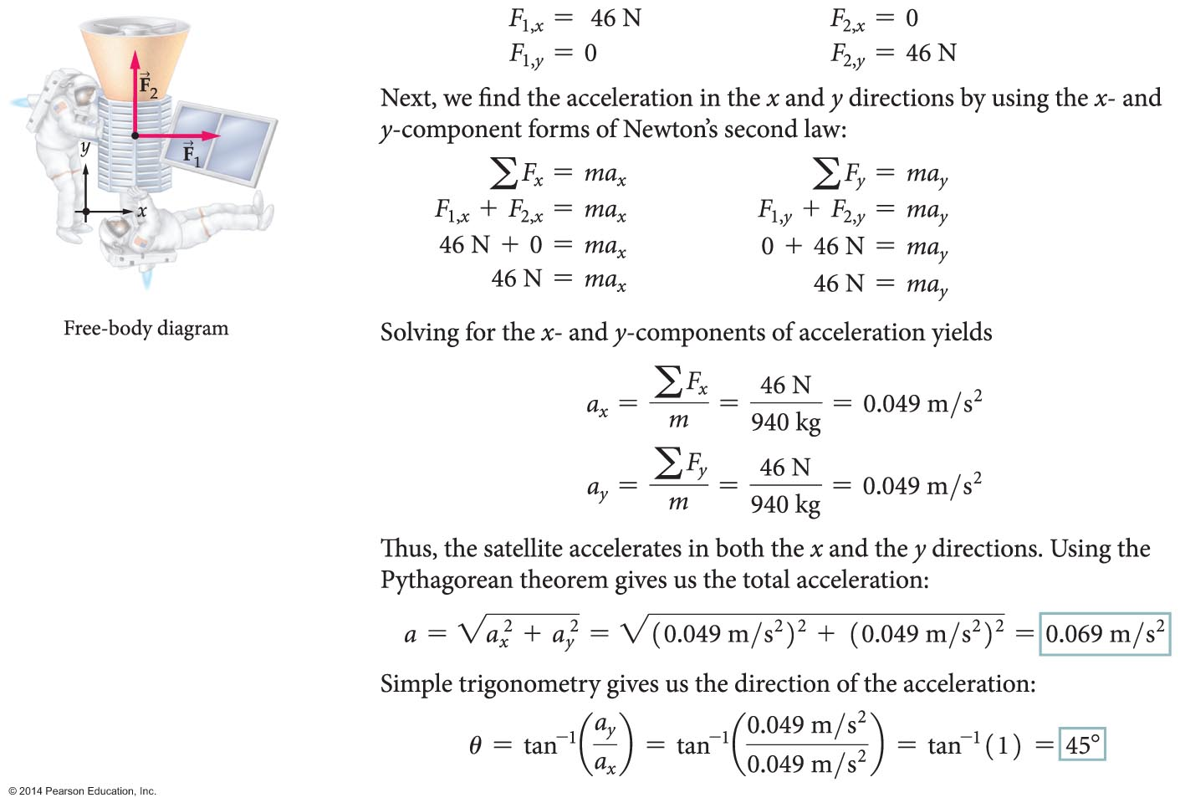
Applying Newton's Laws (Cont’d)

Slide 28
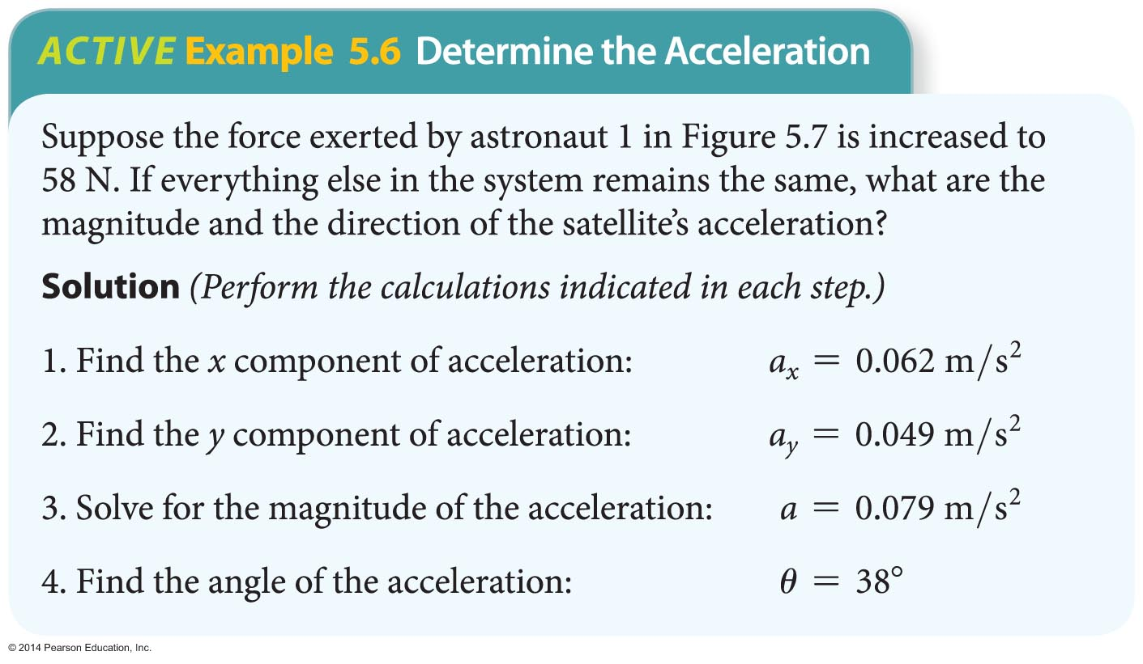
Applying Newton's Laws (Cont’d)

Slide 29
Applying Newton's Laws
There are several types of forces that are encountered in everyday situations.
They include
  normal forces,
  the force exerted by gravity, and
  forces due to stretched or compressed springs.

Slide 30
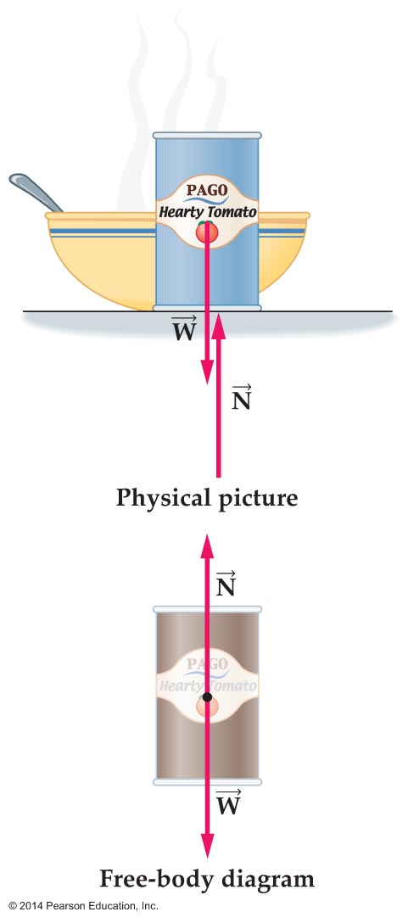

Applying Newton's Laws
When an object sits on a surface, such as a tabletop, it is subject to two forces: the downward force of gravity and the upward force exerted by the table.
The upward force, which is perpendicular to the surface, is called the normal force, .

Slide 31
Applying Newton's Laws (Cont’d)
In general, the force exerted perpendicular to the surface of contact between any two objects is called the normal force.

Slide 32
Applying Newton's Laws
The weight of an object is equal to the force of gravity acting on that object.
A object of mass m in free fall has only one force acting on it—its weight W. The resulting acceleration has a magnitude a = g. From Newton's second law, a = f/m or g = W/m or W = mg.
Therefore, the weight of an object is equal to its mass times the acceleration due to gravity: W = mg, where W is measured in newtons (N).

Slide 33
Applying Newton's Laws
Weight and mass are not the same. Weight is a gravitational force; mass is the measure of an object's inertia. The mass, a measure of the amount of matter in an object, remains the same regardless of location.
The weight is dependent on the gravitational force in a given location.
The gravitational force on the Moon is less than the gravitational force on Earth. As a result, the weight of an 81.0-kg person is 795 N on Earth but only 131 N on the Moon.

Slide 34
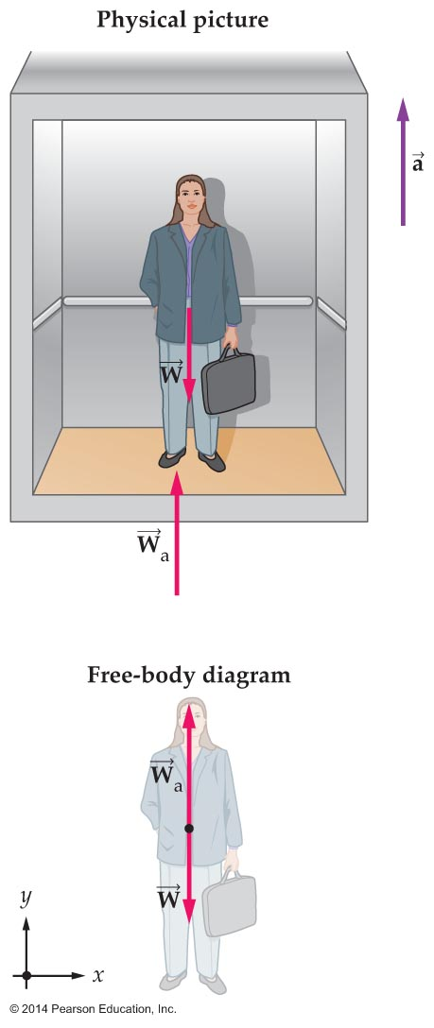
Applying Newton's Laws
Weight can change in accelerating systems. The sensation of having a different weight due to your accelerating environment, such as a moving elevator, is referred to as apparent weight.

Slide 35
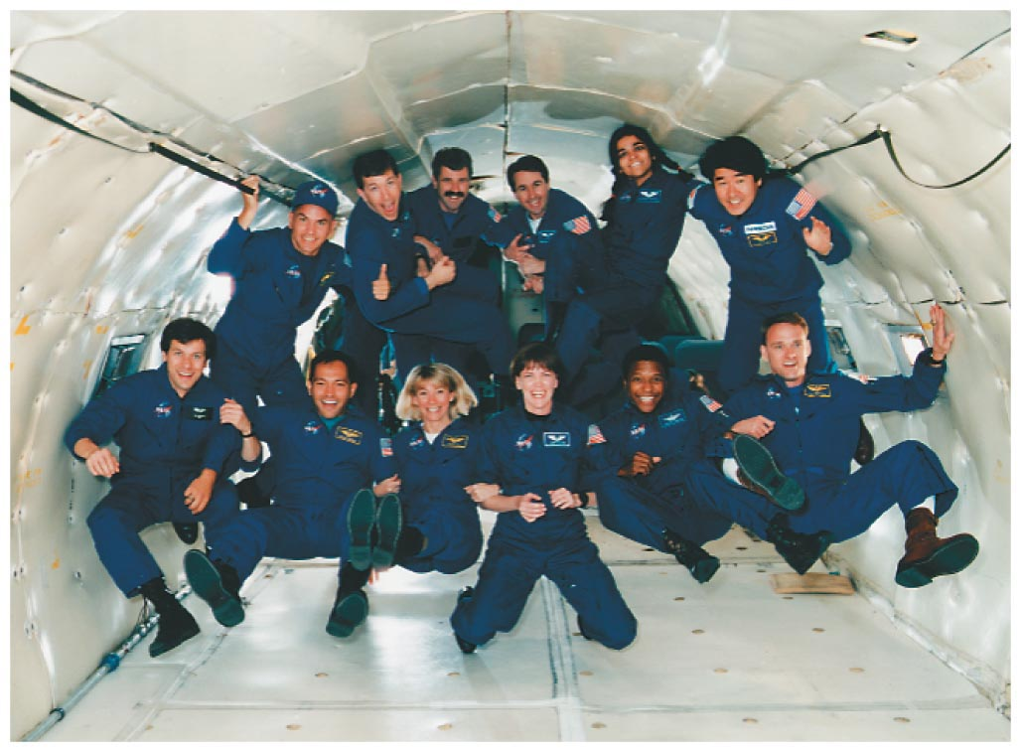
Applying Newton's Laws
If you are in a system that has a downward acceleration of g, then your apparent weight is zero! So in a freely falling elevator or spaceship, you feel weightless. In the photo, astronaut trainees experience weightlessness in an airplane flying along a parabolic path.

Slide 36
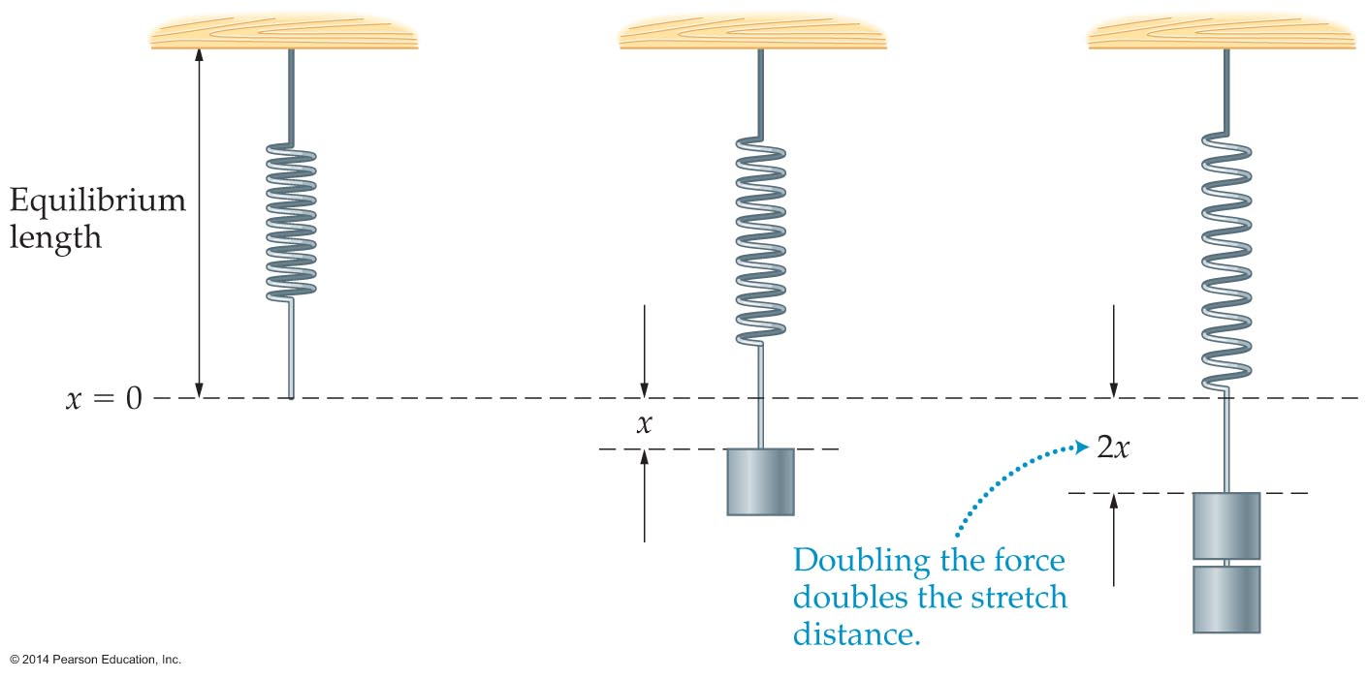
Applying Newton's Laws
Springs exert a force when they are stretched or compressed.
The amount of a spring's stretch or compression varies with the force applied. The greater the force, the greater the stretch or compression of the spring.

Slide 37
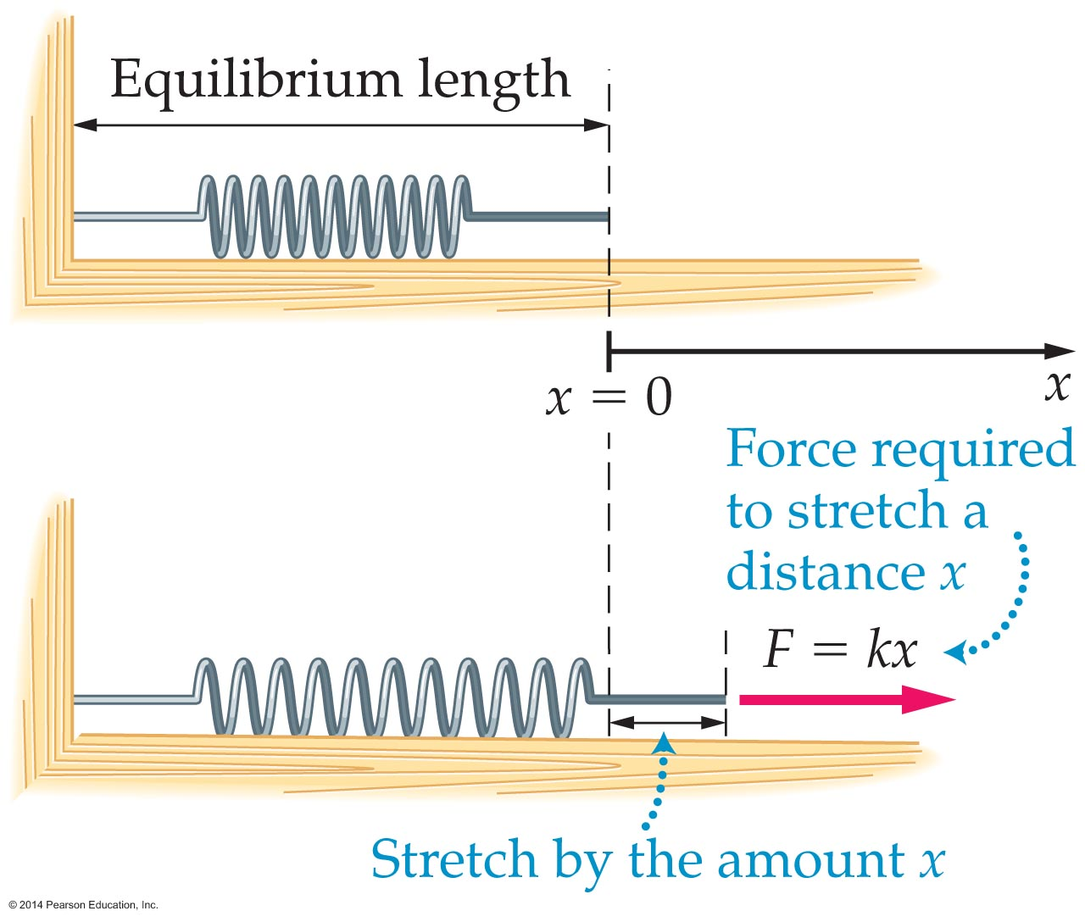
Applying Newton's Laws
In the figure below, the change in length of the spring is represented by the symbol x.

Slide 38
Applying Newton's Laws (Cont’d)
When the spring is relaxed and there is no change in length, x = 0.
When the spring is stretched, x represents the distance from equilibrium.
Hooke's law states that the force exerted by an ideal spring is proportional to the distance of stretch or compression.

Slide 39
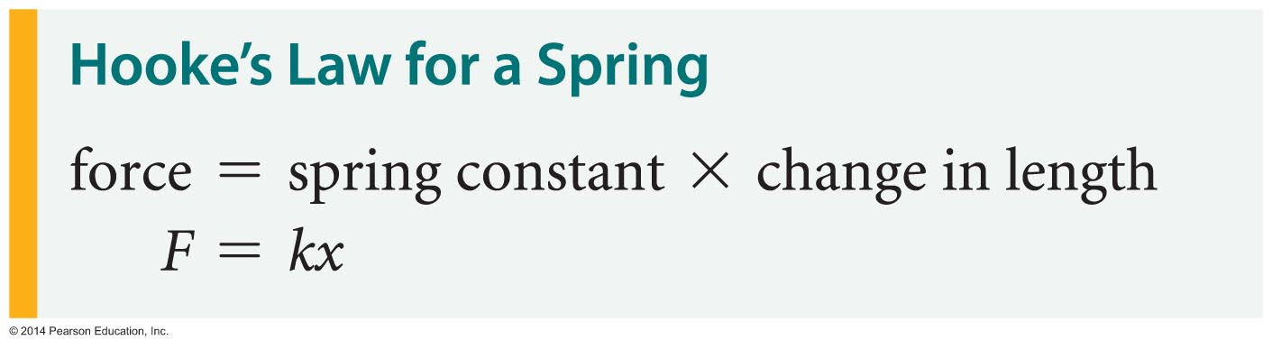
Applying Newton's Laws
Hooke's law may be written as an equation as follows:
The constant k in Hooke's law is called the spring constant. The units associated with k are N/m.
The larger the spring constant, the greater the force exerted by the spring. A large spring constant corresponds to a stiff spring.

Slide 40
Applying Newton's Laws
Objects with zero acceleration are said to be in equilibrium.
According to Newton's second law, the net force must equal zero if an object is not accelerating.
Thus, an object in equilibrium is subject to zero net force: 0.
An object in equilibrium may be either at rest or moving with a constant velocity.

Slide 41
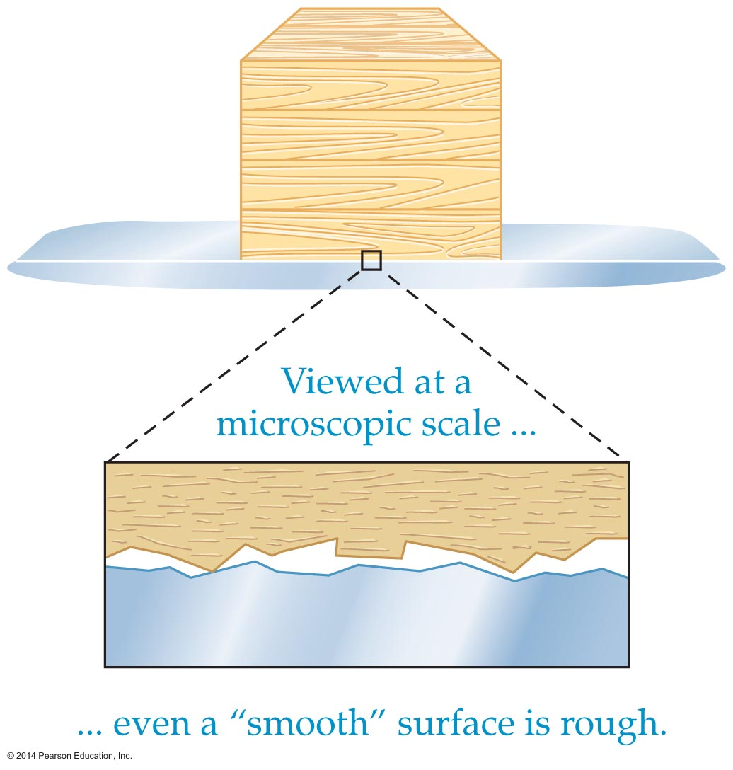
Friction
The force that opposes the motion of one surface over another is called friction.
Sliding one surface over another requires enough force to overcome the resistance caused by microscopic hills and valleys bumping against one another.

Slide 42
Friction
Friction has both negative and positive aspects. Friction reduces the efficiency of machines. On the other hand, we couldn't walk or run without friction.
There are two types of friction: kinetic friction and static friction.
Kinetic friction is the friction encountered when surfaces slide against one another.
The magnitude of the force of kinetic friction depends on the normal force.

Slide 43
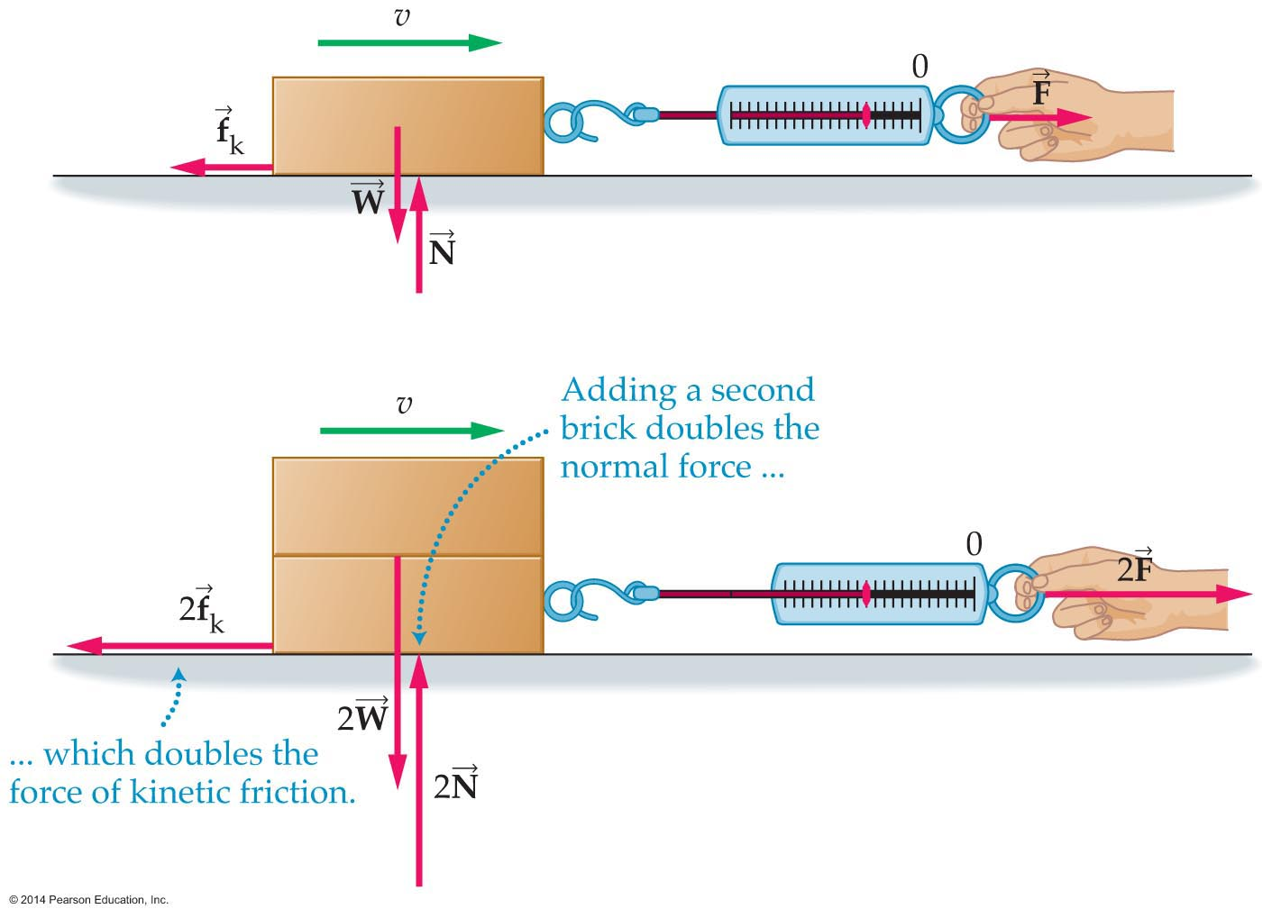
Applying Newton's Laws
As the figure below indicates, the force of kinetic friction is proportional to the normal force: Doubling the normal force doubles the force of kinetic friction.

Slide 44
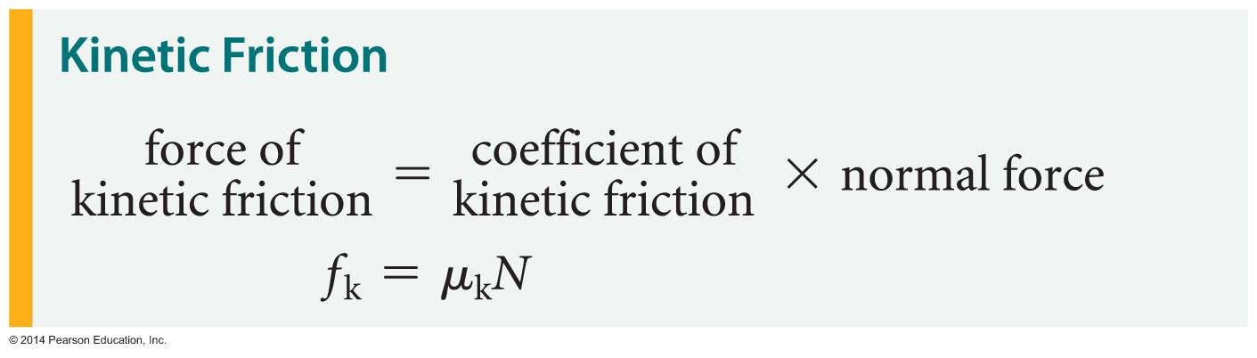
Applying Newton's Laws (Cont’d)
This proportionality may be stated mathematically.

Slide 45
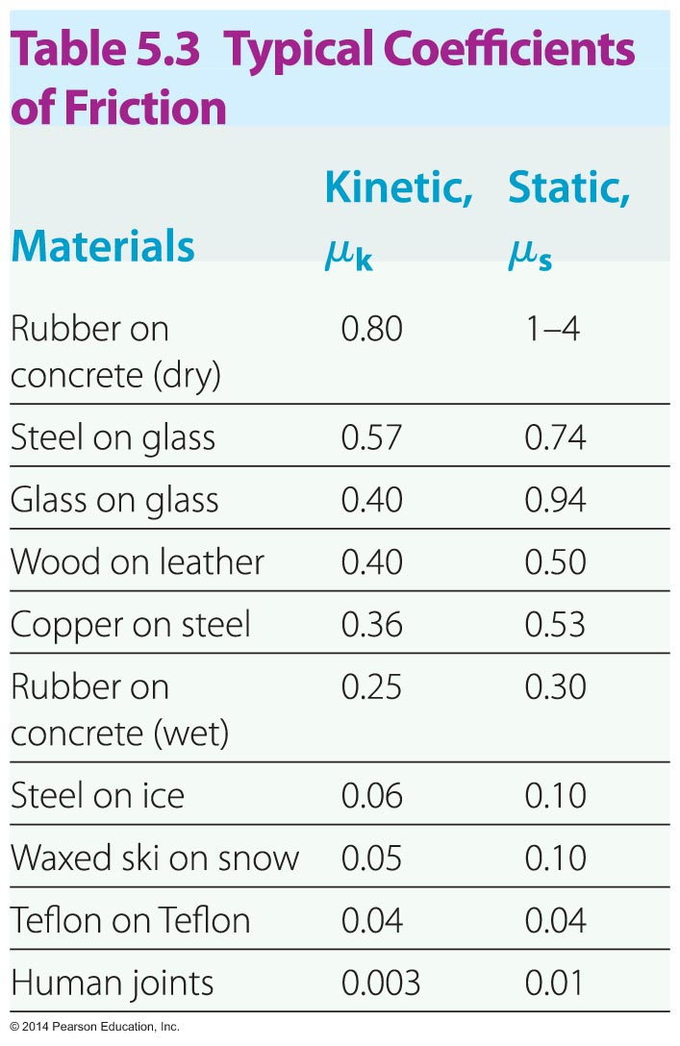
Friction
The constant µ_{k} in the equation is referred to as the coefficient of kinetic friction. The larger the coefficient of friction, the greater the force of friction.
As the table below indicates, µ_{k} depends on the two interacting surfaces.

Slide 46
Friction (Cont’d)
The table also contains values for the coefficient of static friction, which will be discussed later.

Slide 47
Friction
Experiments have shown that the kinetic friction between two sliding surfaces
  is proportional to the normal force between the surfaces,
  is the same regardless of the speed of the surfaces, and
  is the same regardless of the area of contact between the surfaces.

Slide 48
Friction
Static friction is the force that opposes the sliding of one nonmoving surface past another.
Like kinetic friction, static friction is due to microscopic surface irregularities.
As the figure below shows, the force of static friction can have values ranging from zero to some well-defined maximum.

Slide 49
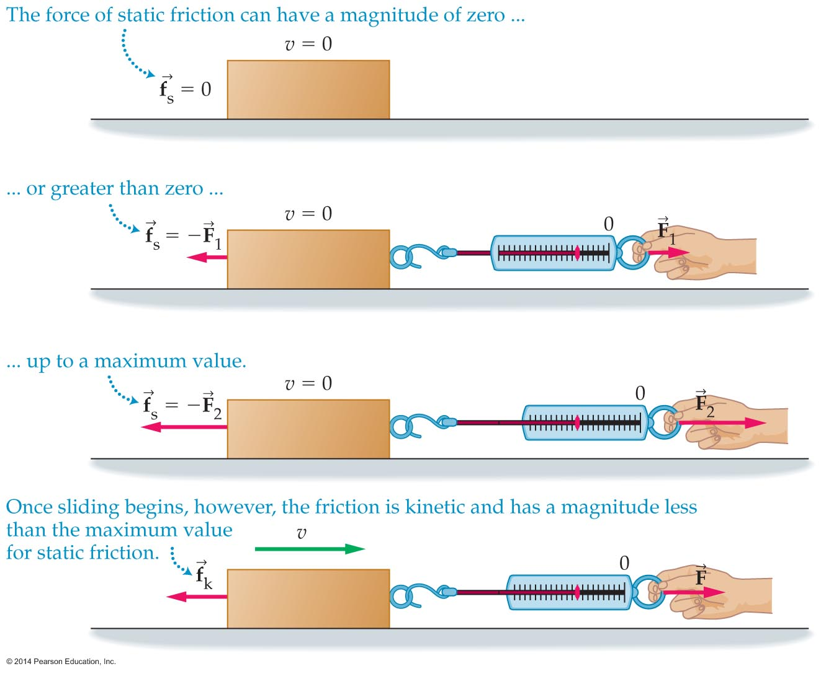
Friction (Cont’d)

Slide 50
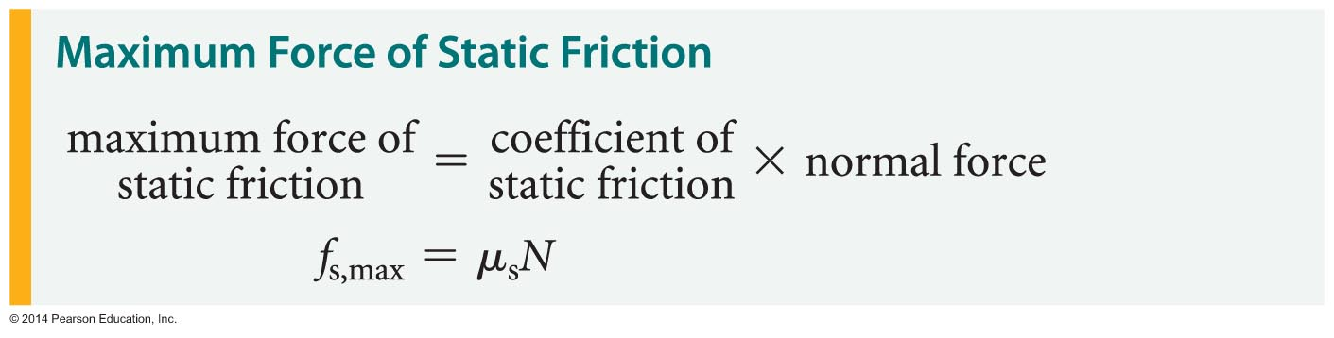
Friction
A stationary object begins to move when the applied force equals the maximum force of static friction. Once an object is moving, kinetic friction comes into play.
The maximum force that static friction can exert is given by the following expression:

Slide 51
Friction
In this equation, µ_{s} is the coefficient of static friction.
In general, µ_{s} is greater than µ_{k}. This means that the force of static friction is usually greater than the force of kinetic friction.
Friction plays an important role in driving safety.
When a car is moving with its tires rolling freely, the friction between the tires and the road is static friction. Why is this so?
Even though the car and tires are moving forward, at any instant the bottom of the tire is at rest with respect to the ground.

Slide 52
Friction
The wheels in older cars often lock during panic braking. This causes the bottom of the tire to slide along the surface of the road.
Sliding means that kinetic friction has taken over, which results in a reduction in the frictional force between the tires and the road.
Antilock braking systems (ABS) use electronic rotation sensors to detect when a wheel is about to skid. A computer then automatically starts pumping the brakes. This pumping allows the wheels to continue rotating, allowing the car to come to rest using static friction rather than kinetic friction.

Slide 53
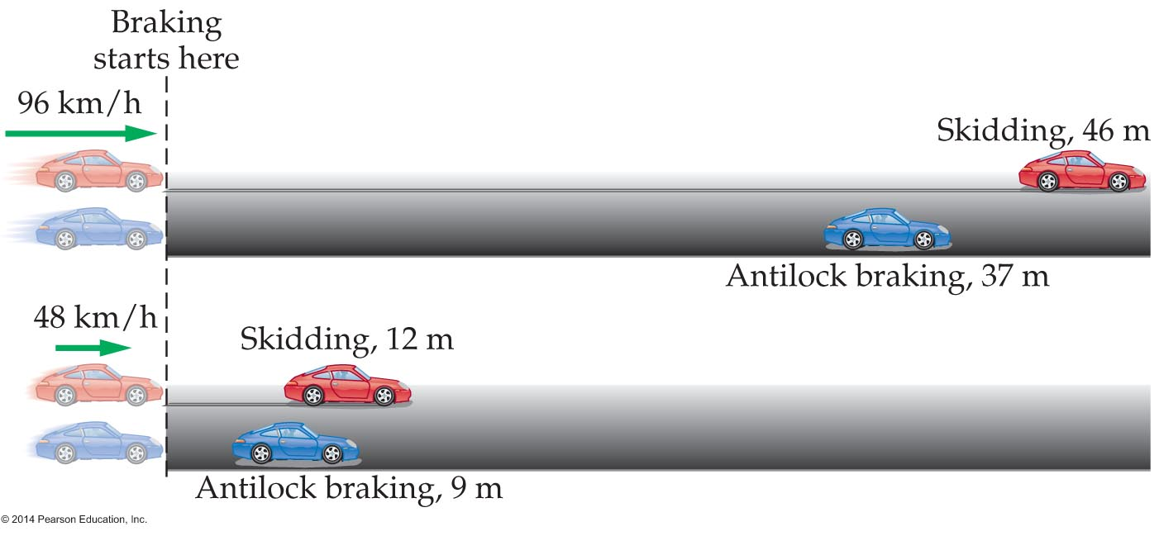
Friction
The figure below shows examples of stopping distances with and without ABS.

