Slide 1
Motion in Two Dimensions
Prepared by Chris Chiaverina

Slide 2
Chapter Contents
Vectors in Physics
Adding and Subtracting Vectors
Relative Motion
Projectile Motion

Slide 3
Vectors in Physics
A quantity that can be expressed by a number alone (plus appropriate units) is called a scalar.
Volume, temperature, and time are examples of scalars.
Sometimes a scalar is isn't enough to adequately describe a physical quantity. There are many cases where a direction is also needed.

Slide 4
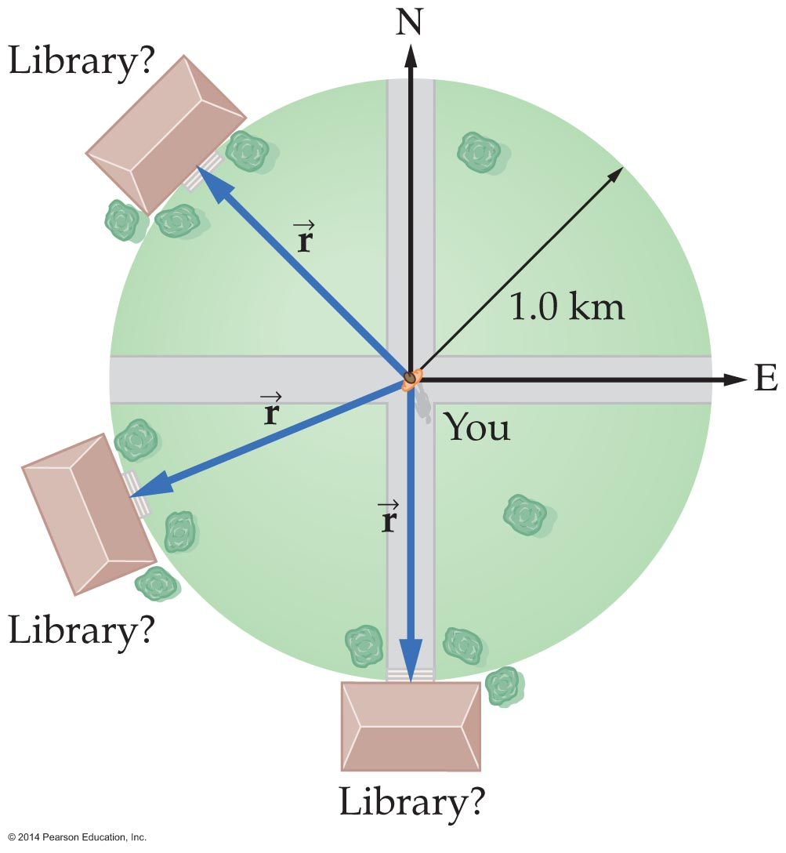
Vectors in Physics
As an example of a situation when a number, units, and direction are needed, suppose that you ask directions to a library and are told that it is 1 kilometer away. As the figure indicates, the library could be anywhere on a circle of radius 1 kilometer.

Slide 5
Vectors in Physics
If a direction of northwest is given in addition to the distance, then the location of the library is completely specified.
A quantity that is specified by both length and direction is called a vector.
The length of a vector is called its magnitude.
Vector quantities are represented on paper by arrows of various lengths. The length is proportional to the magnitude of the vector, and the direction of the arrow represents the direction of the vector's effect.

Slide 6
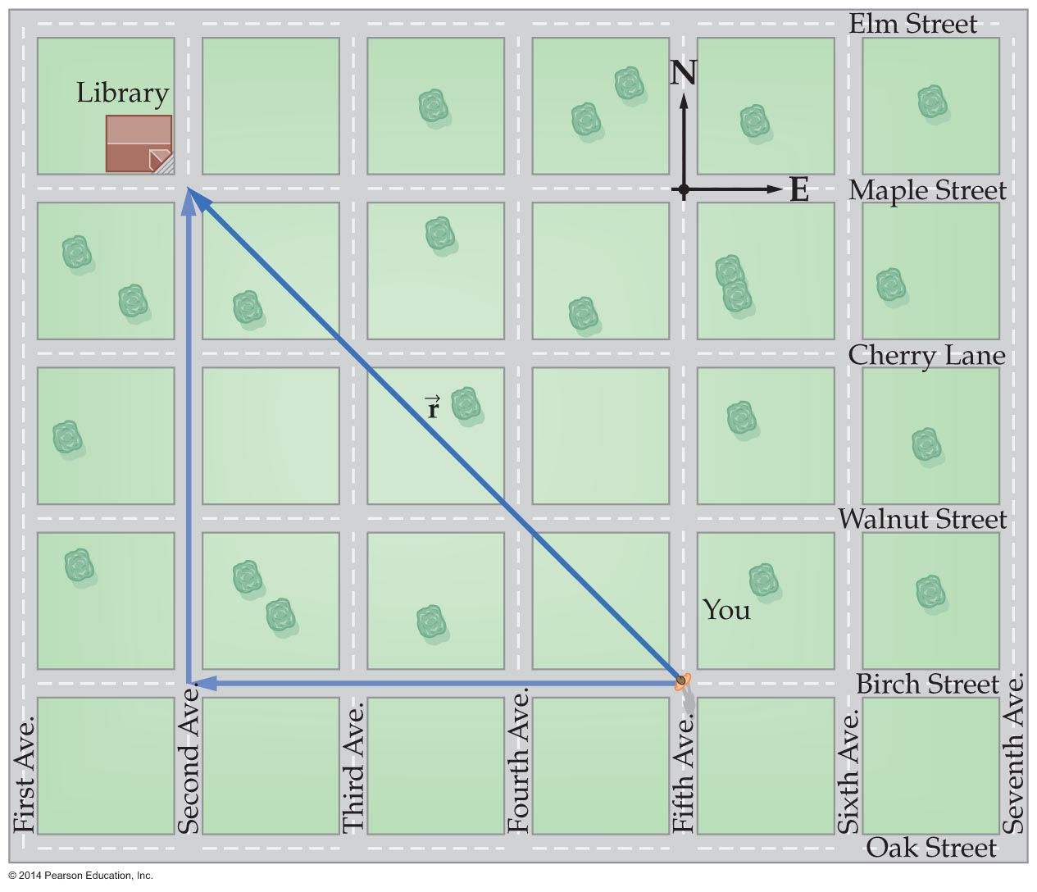
Vectors in Physics
In the previous example, walking northwest 1 kilometer would, in theory, get you to the library. However, this would probably be impossible due to various obstructions. It is more likely that you will walk along city streets, as is shown in the figure below.

Slide 7

Vectors in Physics
If city streets are laid out along north–south and east–west directions, then you might walk west for a certain distance and then proceed north an equal distance. By walking this way, you resolve the displacement vector into its east–west and north–South components.

Slide 8
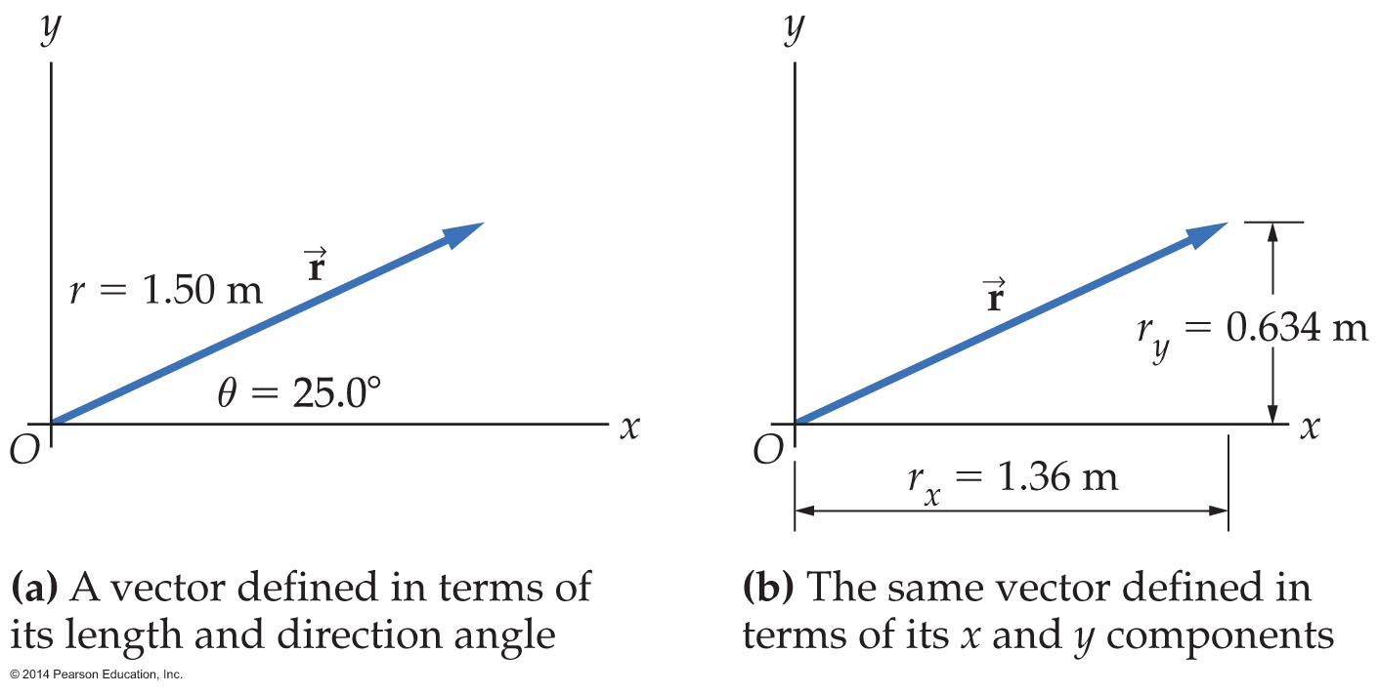
Vectors in Physics
To resolve a vector means to find its components; a vector's components are the lengths of the vector along specified directions.
A vector may be defined by either its length and its direction angle or by its x component and its y component.

Slide 9
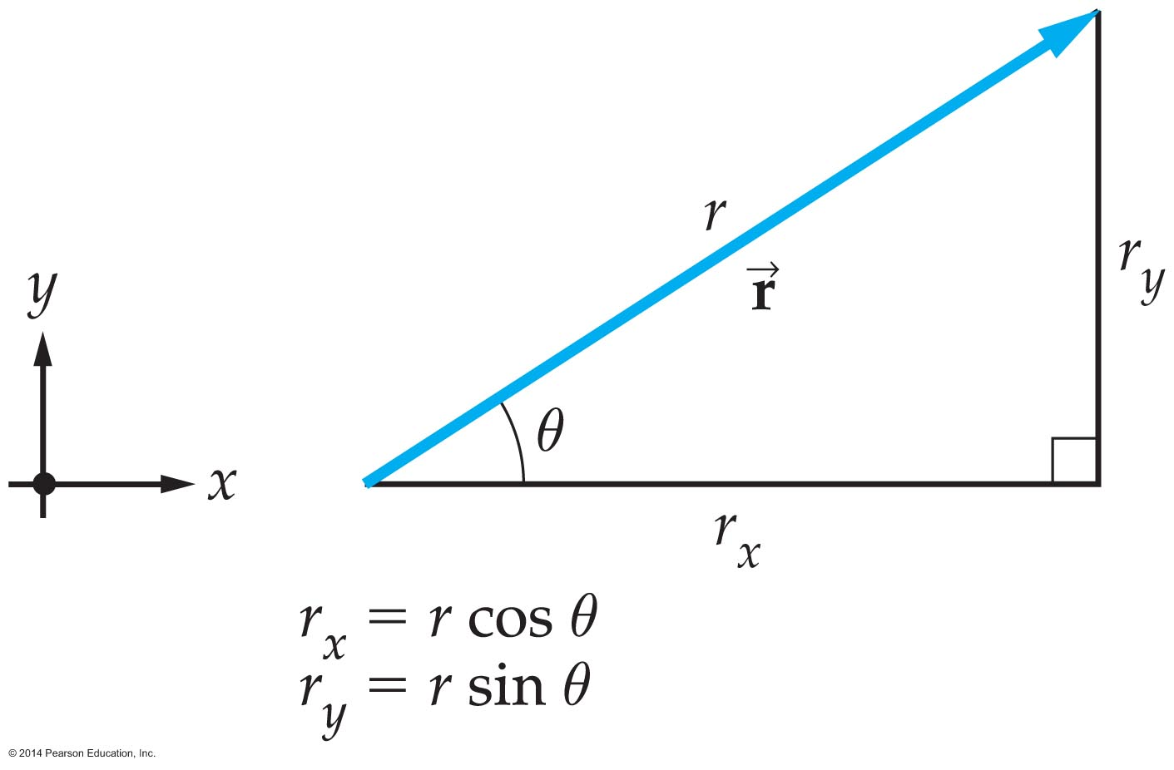
Vectors in Physics
In a right triangle, the cosine of an angle is defined as the length of the adjacent side over the length of the hypotenuse.
The sine of an angle is defined as length of the opposite side over the length of the hypotenuse.
Therefore, in the figure below, r_{x} = r cosθ and
r_{y} = r sinθ.

Slide 10
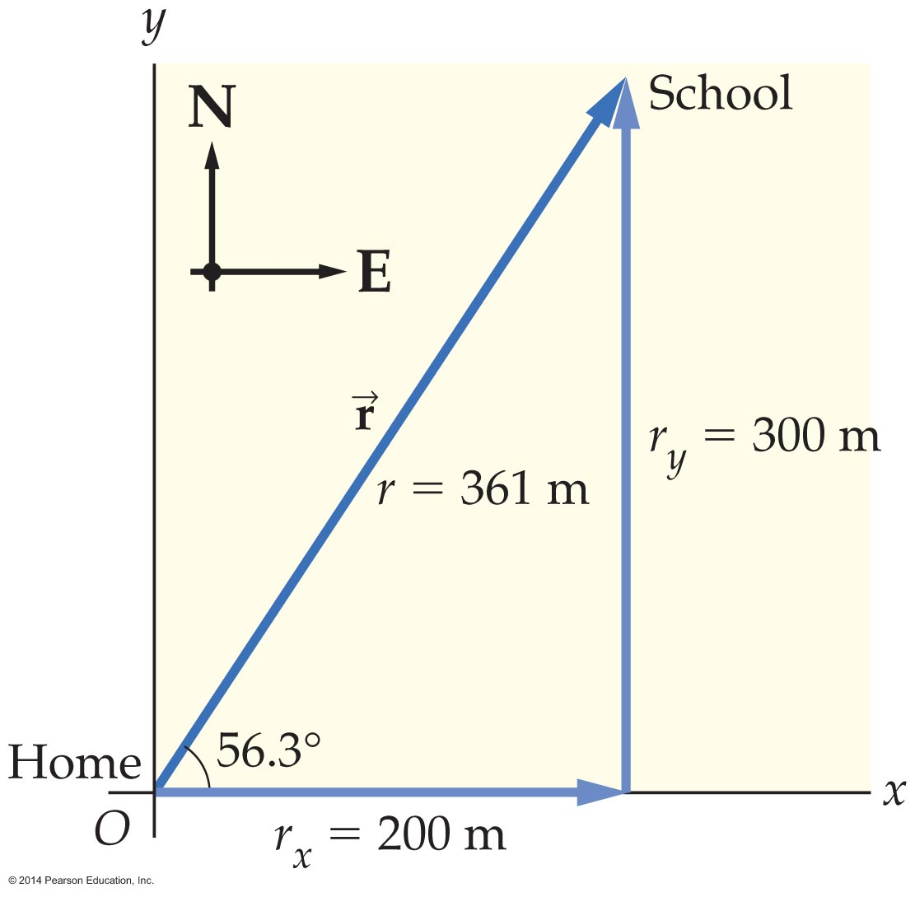
Vectors in Physics
The components of a vector may be converted into the magnitude and direction of the vector.
The magnitude of a vector in the figure below may be found using the Pythagorean theorem:

Slide 11
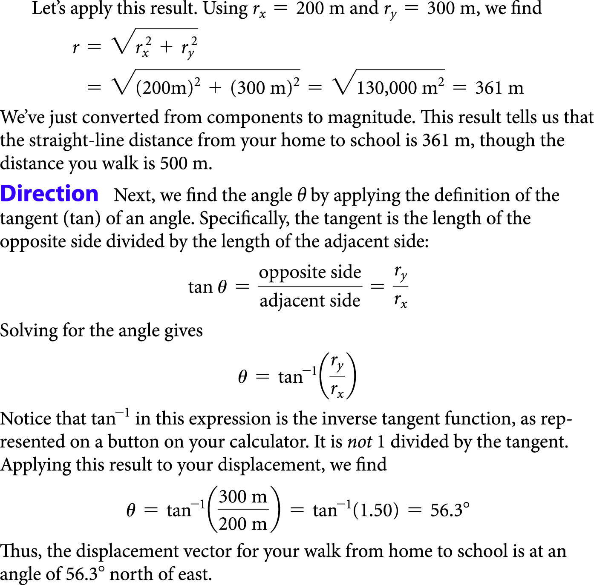
Vectors in Physics

Slide 12
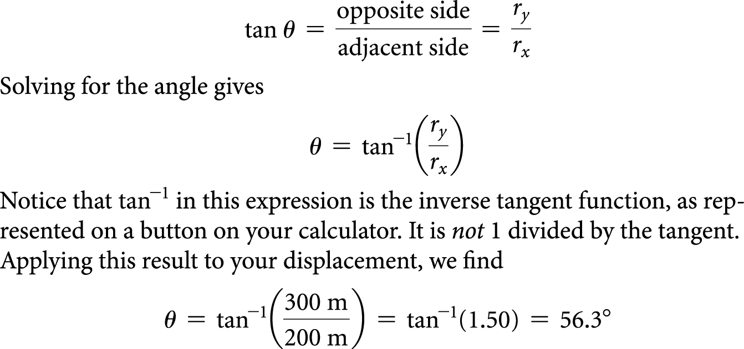
Vectors in Physics
The direction of vector may be found by applying the tangent of an angle. The tangent is the length of the opposite side divided by the length of the adjacent side:

Slide 13
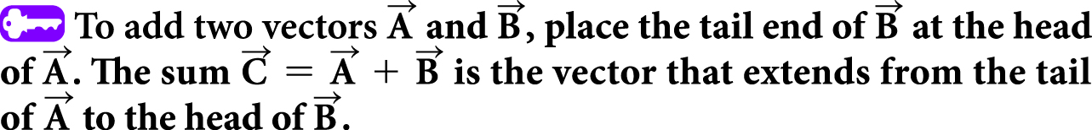
Adding and Subtracting Vectors
Vectors may be added by placing them head to tail.
A resultant vector, or vector sum, is the result of adding two or more vectors.

Slide 14



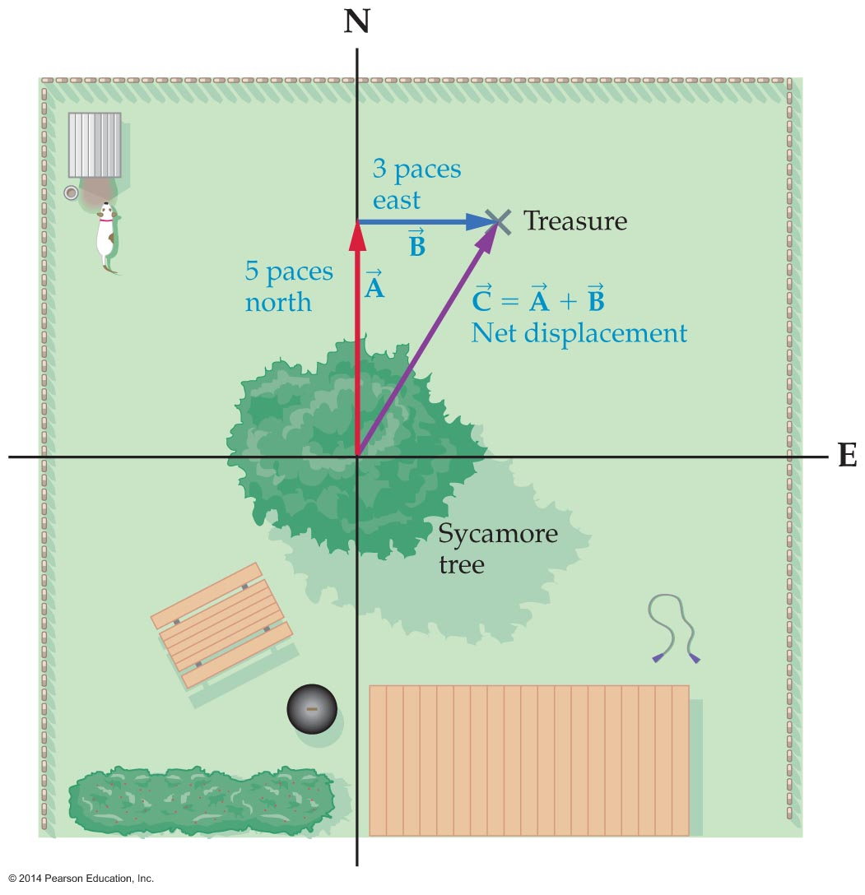
Adding and Subtracting Vectors
In the figure below, two displacement are represented by vectors and . The resultant, or vector sum, is represented by vector .

Slide 15
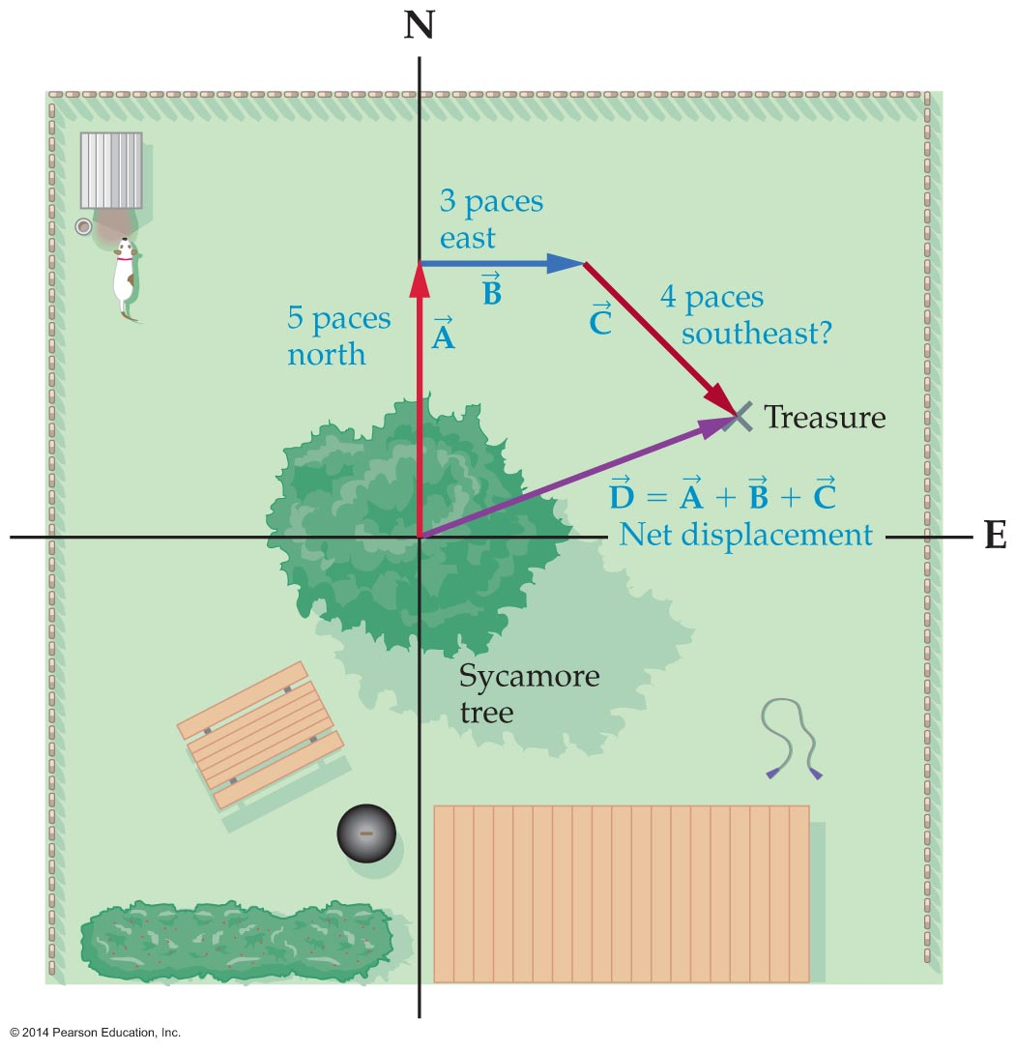
Adding and Subtracting Vectors
To add more than two vectors, first place all the vectors head to tail, head to tail, and so on. Then draw the resultant vector from the tail of the first vector to the head of the last vector. This
process is shown in the figure
below.

Slide 16
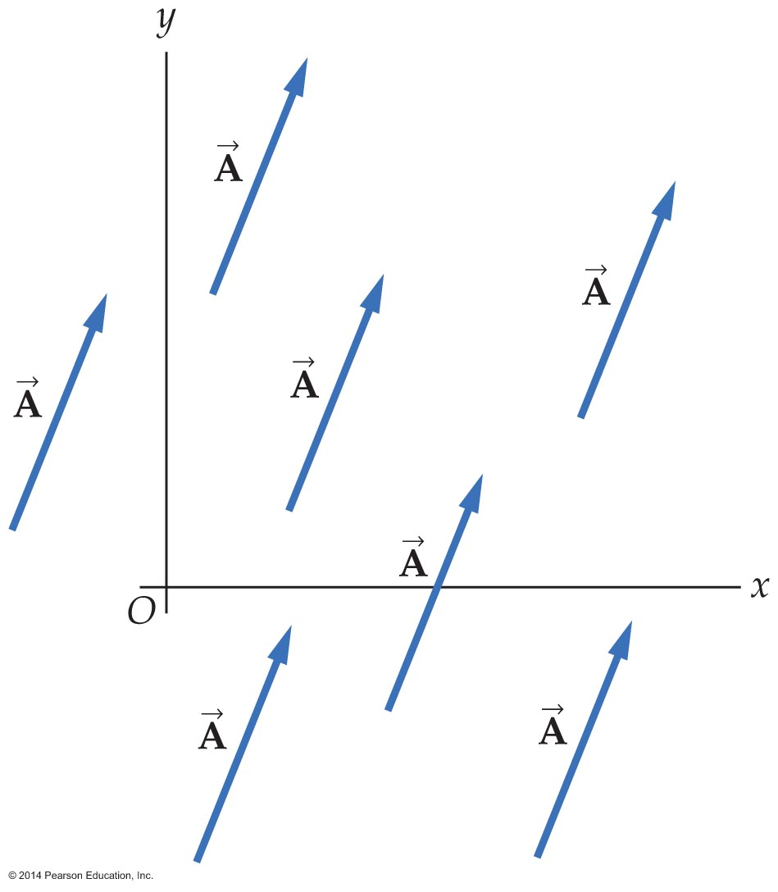
Adding and Subtracting Vectors
Vectors are unchanged if moved to another location as long as their length and direction remain unchanged.
All vectors in the figure below are identical even though they are in different locations.

Slide 17
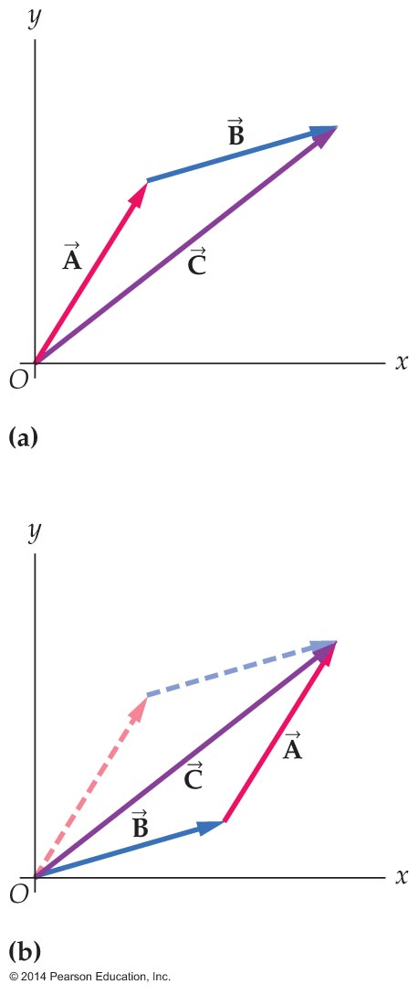


Adding and Subtracting Vectors
In order to place a given pair of vectors head to tail, it may be necessary to move the arrows that represent them.
The figure below indicates that moving the arrows has no effect on the vector sum. That is, vector sums and
produce the same resultant .

Slide 18
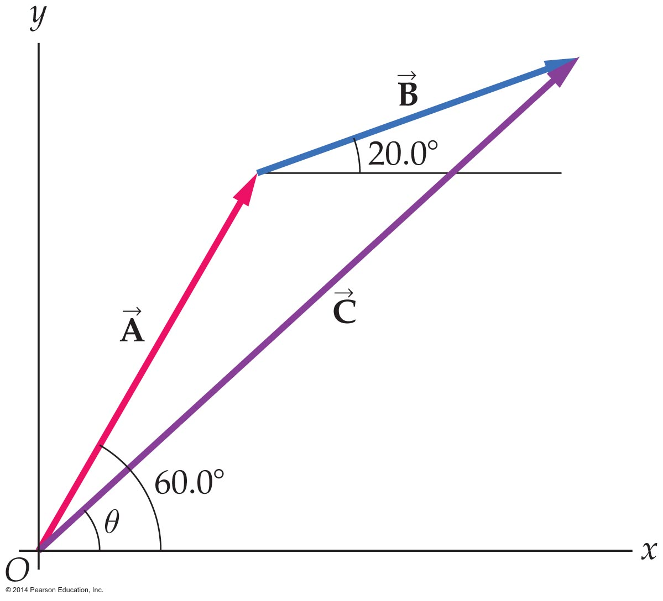
Adding and Subtracting Vectors
Vectors can be added graphically.
Graphical addition of vectors
is limited by how accurately vectors are drawn and measured.
Graphical addition of vectors involves using a ruler and protractor to draw each vector, placed head to tail, to scale.
The magnitude and direction
of the resultant are then determined with ruler and protractor.

Slide 19
Adding and Subtracting Vectors
The most precise method way to add vectors is by using components.
Using this method:
  You first find the components of the vectors to be added.
  You then add the x components of the original
  vectors to find the x component of the sum.
  You repeat the process for the y components.

Slide 20
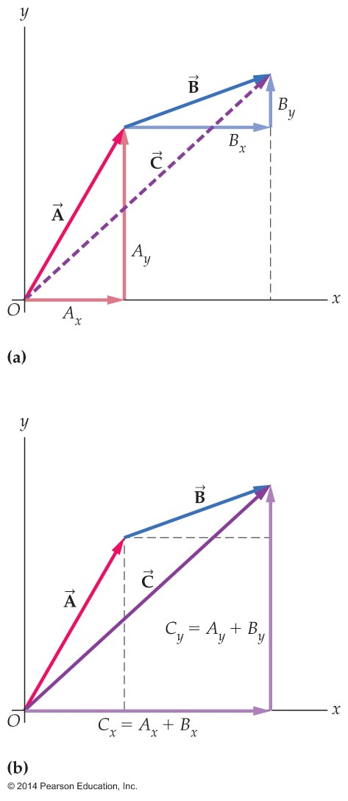
Adding and Subtracting Vectors
In general, the sum of the x components gives the x component of the resultant,
and the sum of the y components gives the y component of the resultant. This is shown in the figure below.

Slide 21
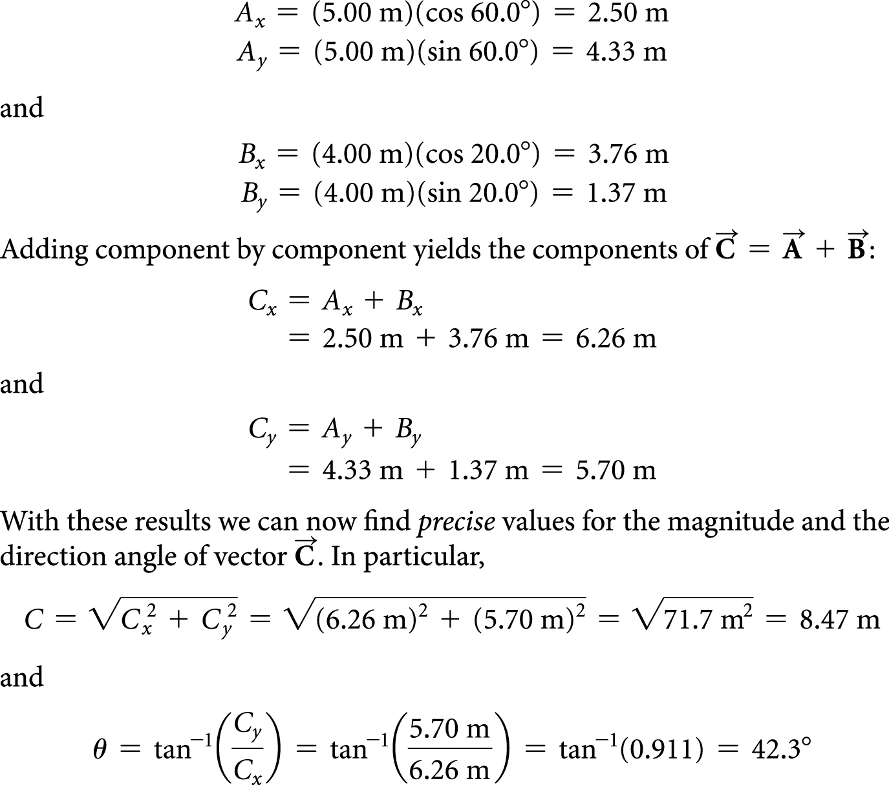
Adding and Subtracting Vectors
In the figure, vector has a magnitude of 5.00 m and a direction angle of 60.0°; the vector has a magnitude of 4.00 m and a direction of 20.0°.
The following illustrates how the resultant of vectors and may be found using the component method.

Slide 22
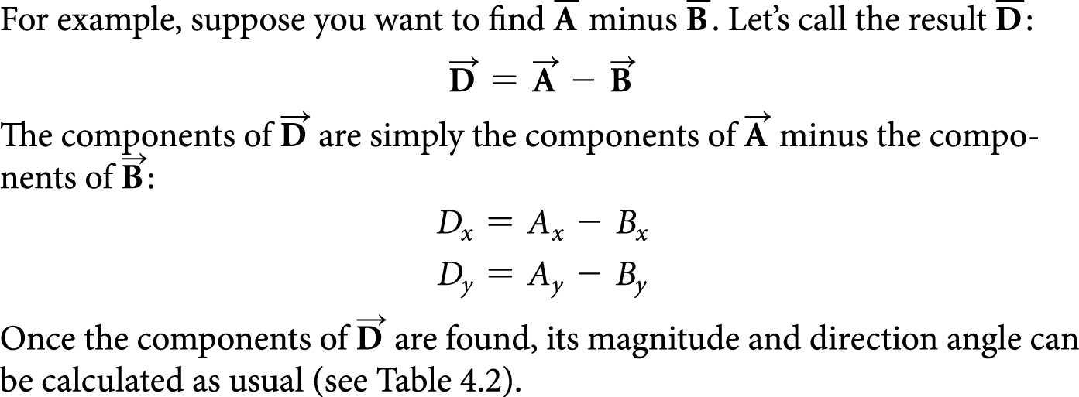
Adding and Subtracting Vectors
Vectors are subtracted by subtracting components.

Slide 23
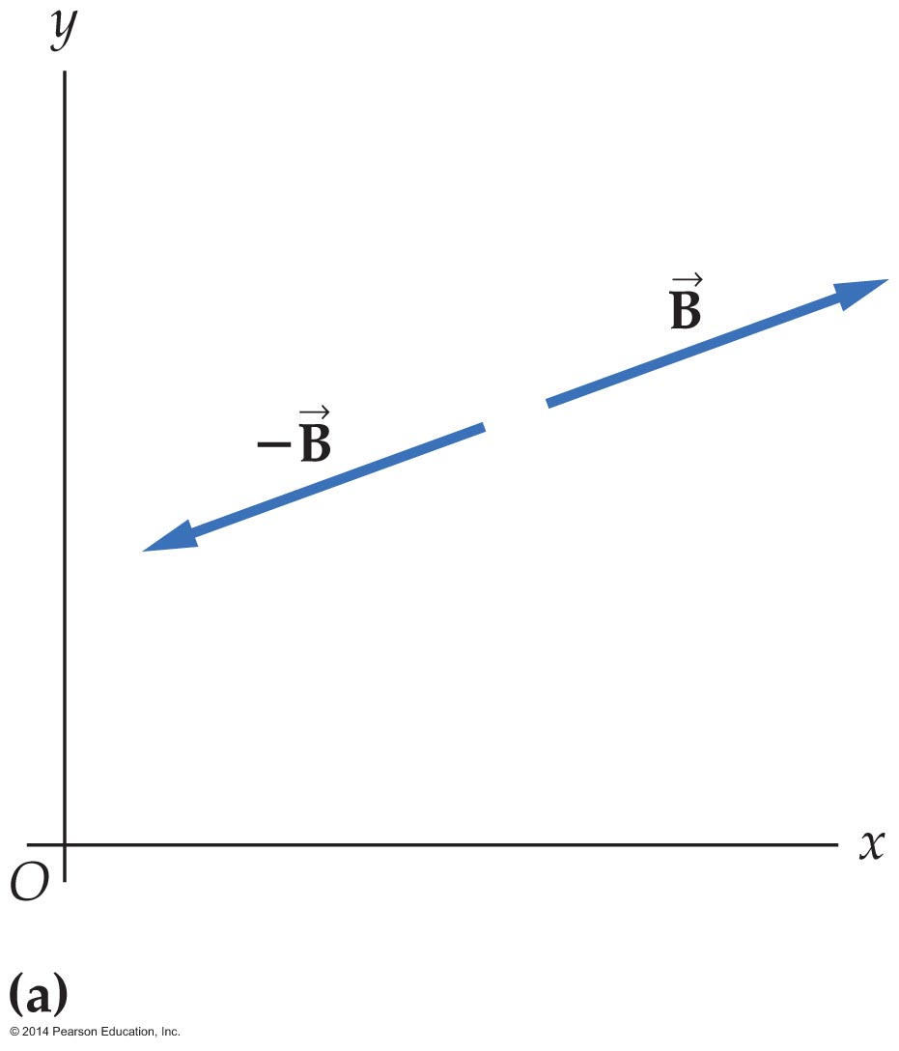
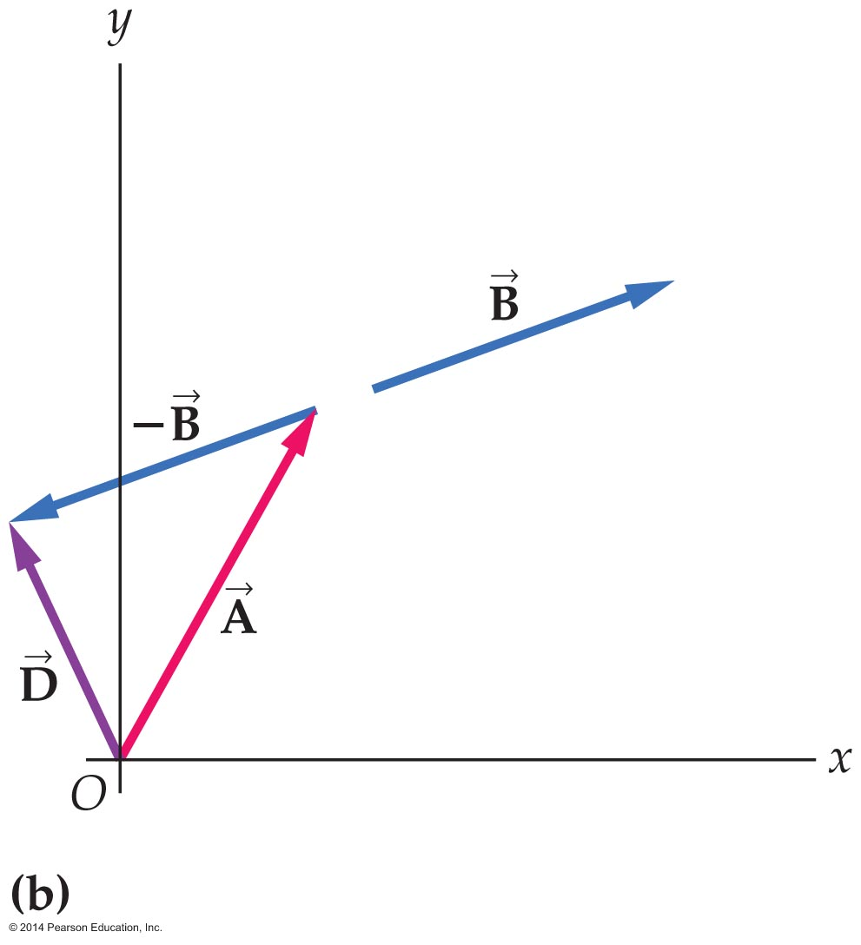
Adding and Subtracting Vectors
Vectors can also be subtracted graphically.
The negative of a vector is represented by a vector of the same length as the original, but pointing in the opposite direction.
To subtract one vector from another, reverse the direction of one vector and add it to the other vector.

Slide 24
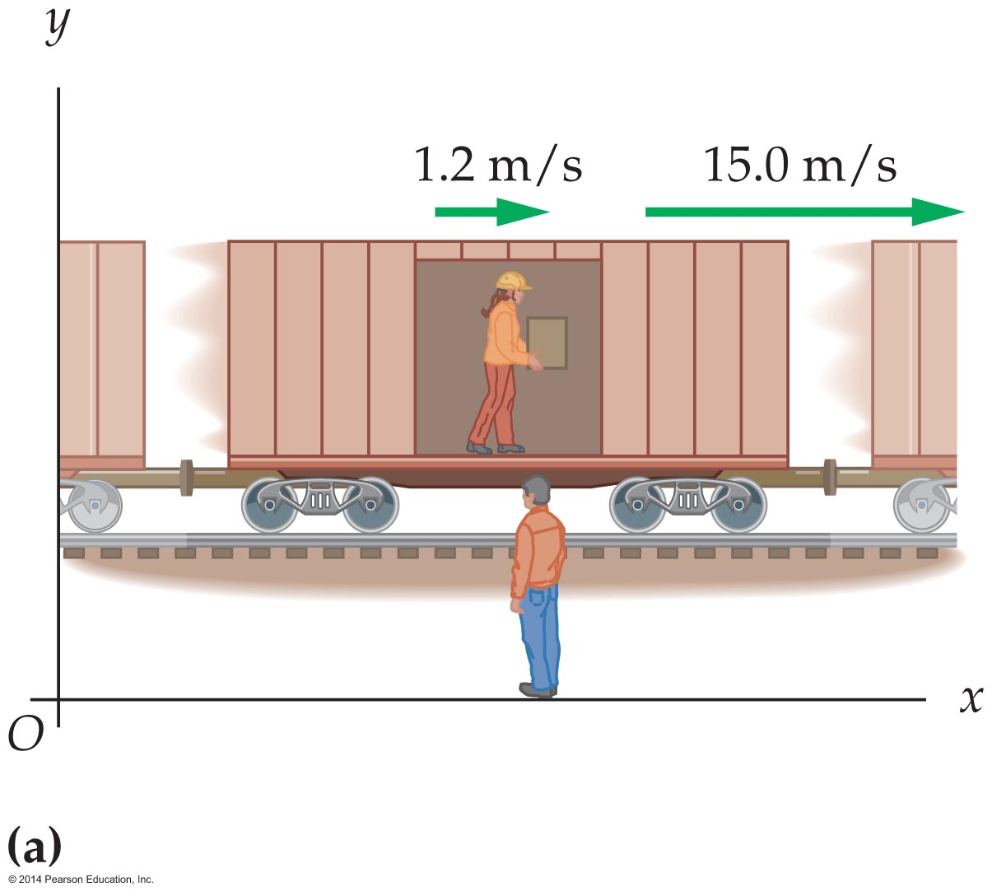
Relative Motion
Relative motion means the motion of one object relative to another object.
If, as is shown in the figure, you observe a railroad worker walking in the forward direction at 1.2 m/s relative to a train moving 15.0 m/s relative to you, then the railroad worker will appear to be moving at 16.2 m/s. The two velocities simply add together:
1.2 m/s + 15.0 m/s = 16.2 m/s

Slide 25
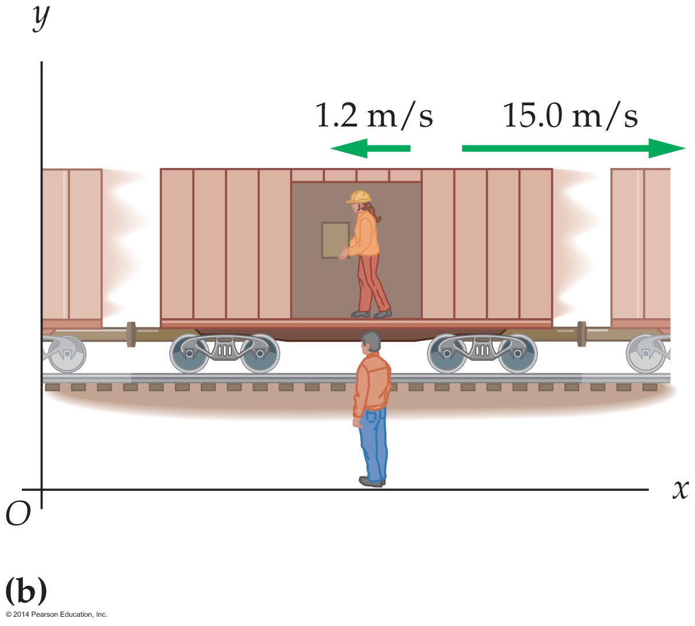
Relative Motion
If the worker is walking with the same speed but toward the back of the train, then the velocity of the worker relative to the ground, and you the observer, is equal to the difference of the original velocities:
–1.2 m/s + 15.0 m/s = 13.8 m/s

Slide 26




Relative Motion
In the previous example, vector addition may be used to find the velocity of the worker with respect to the ground.
If the velocity of the train with respect to the ground is represented by , the velocity of the worker relative to the train by , and the velocity of the worker with respect to the ground by , then the velocity of the worker relative to the grounds is

Slide 27
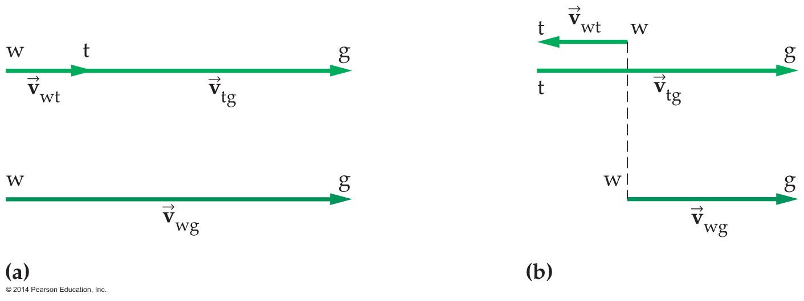
Relative Motion
This vector equation is represented graphically in the figure below.
Using subscripts, as was done with the case of the worker on the train, helps clarify relative motion.

Slide 28
Relative Motion
This vector equation is represented graphically in the figure below.
If two motions do not occur along a straight line, then the approach applied to the worker on the train still applies: The velocity of one object relative to another is found by adding the velocity vectors.

Slide 29
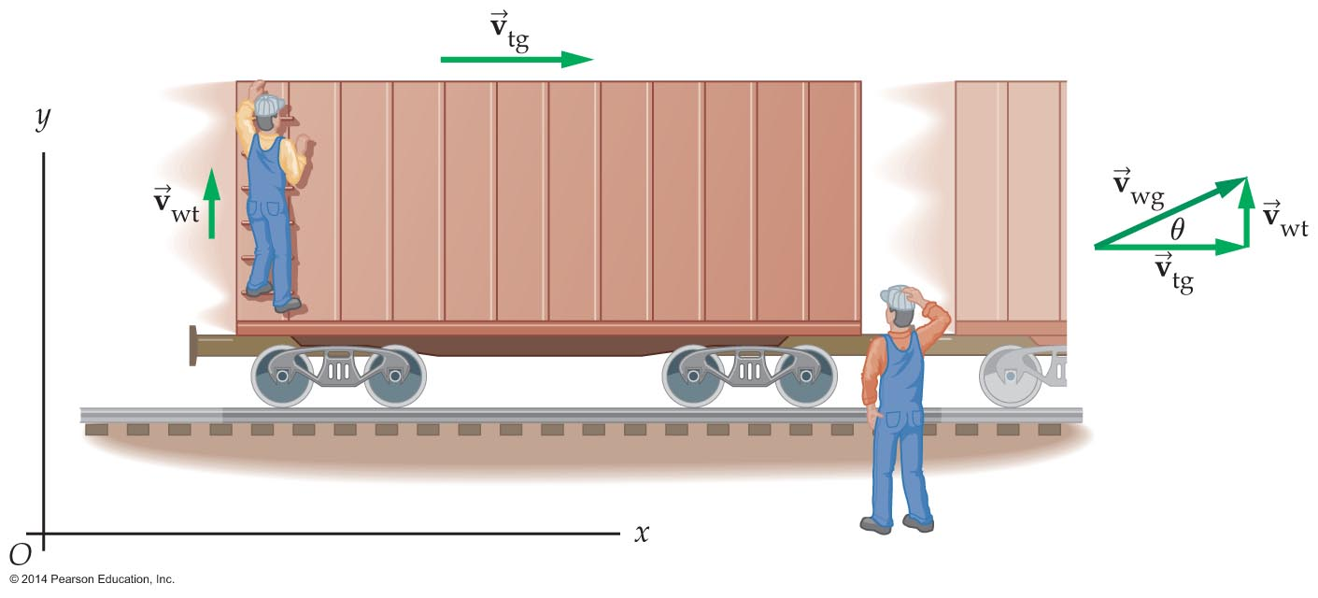
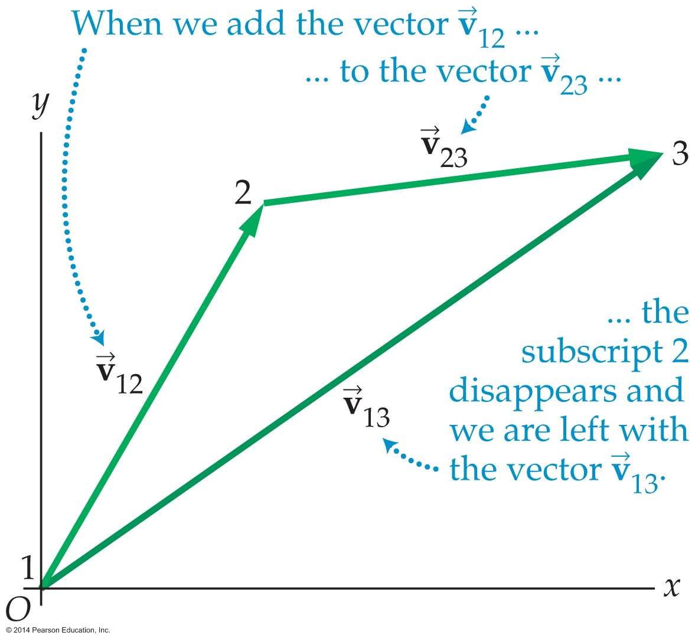
Relative Motion
In the figure below, the worker climbs up a ladder on a moving train. His velocity with respect to the ground is found by adding vectors head to tail.
A general case of determining relative velocities is shown in the
following figure.

Slide 30
Relative Motion
In general you can relate the velocities of two objects to each other if you the velocity of each object relative to a third object.
If the objects are labeled 1, 2, and 3, the velocity of object 1 relative to object 3 is written as follows:

Slide 31
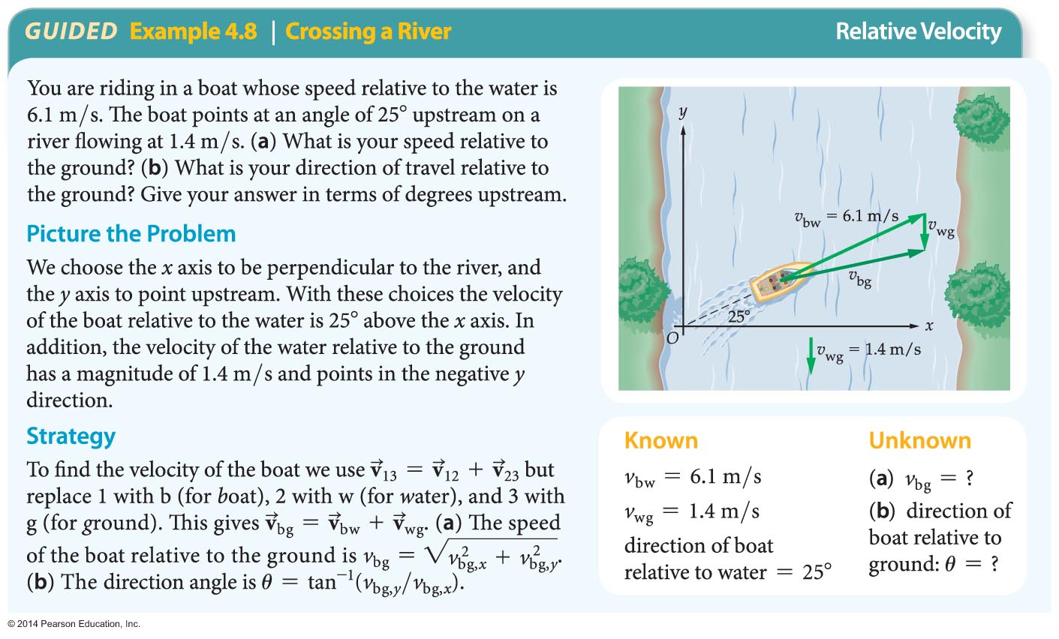
Relative Motion

Slide 32
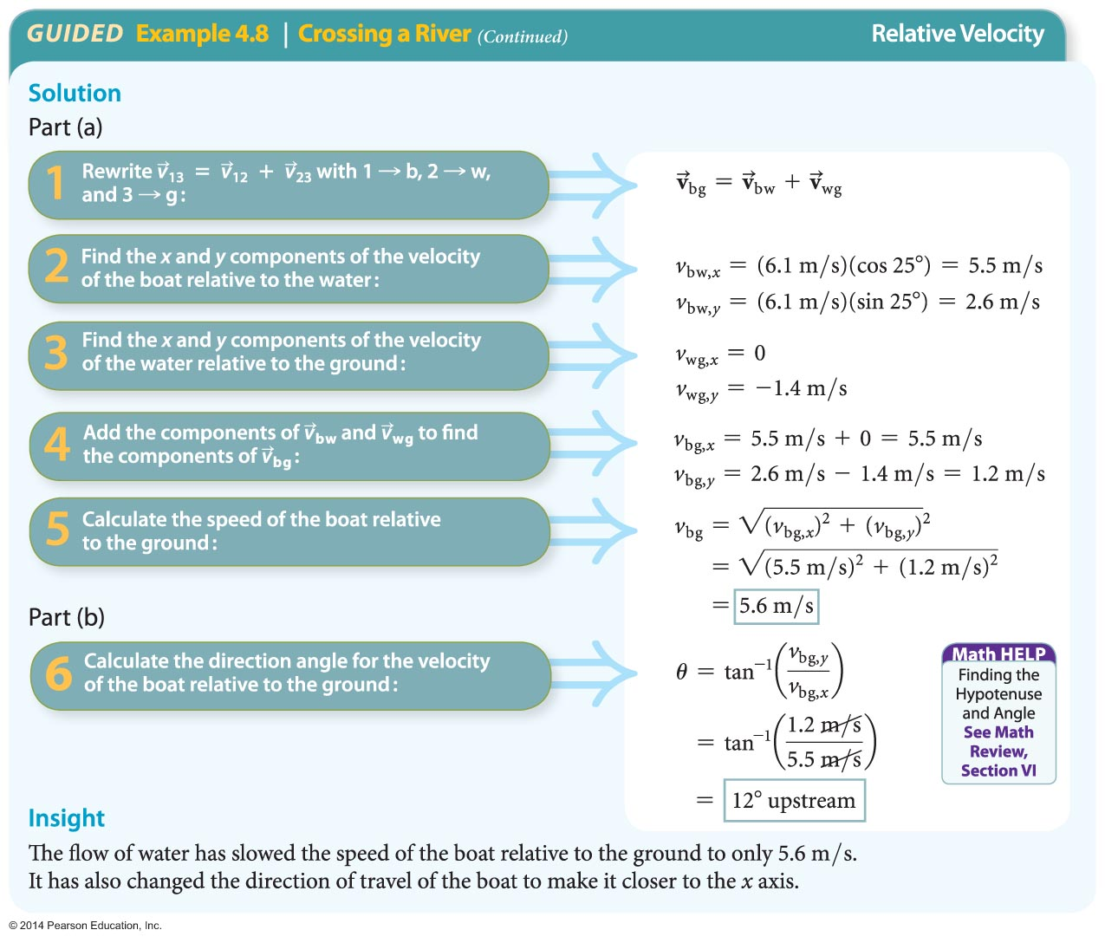
Relative Motion (Cont'd)

Slide 33
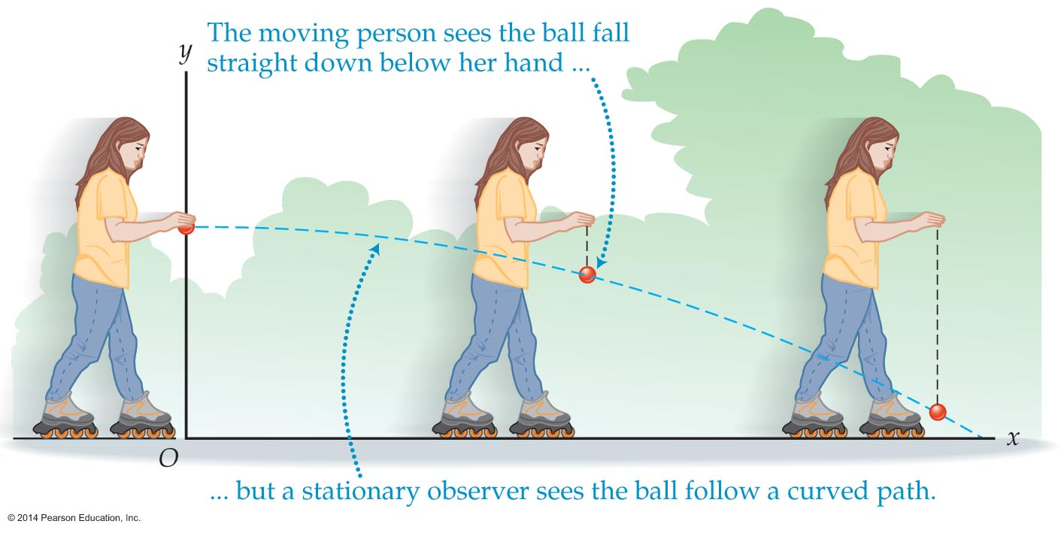
Projectile Motion
When you drop a ball while walking, the ball continues to move horizontally with constant velocity even though it is accelerating downward. This illustrates the independence of horizontal and vertical motions.

Slide 34
Projectile Motion
A projectile is an object that is launched and then allowed to follow a path determined solely by the influence of gravity.
Regardless of how a projectile is launched, its path is a parabola if
  air resistance can be ignored, and
  the acceleration due to gravity is constant and directed downward.
The parabolic path is produced by the combined effects of the horizontal and vertical motions acting independently.

Slide 35
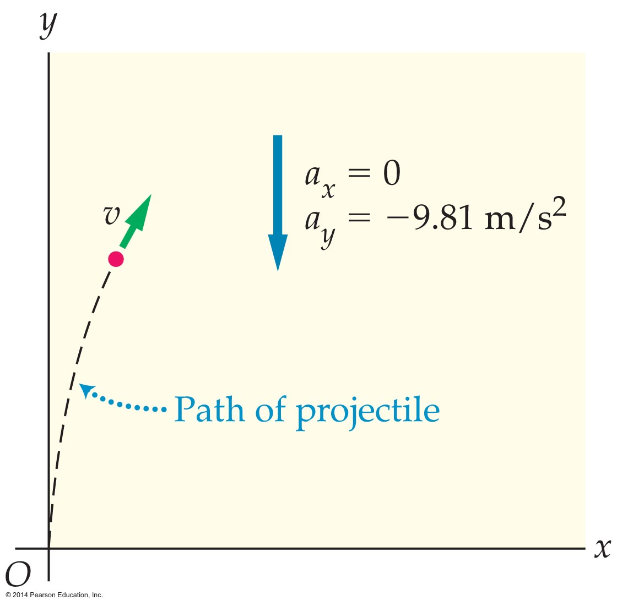
Projectile Motion
Independence of motion means that the position-time equation introduced in Chapter 3 applies to both the x and y motions of a projectile.
When describing projectile motion, a coordinate system is used in which the positive y direction is pointing upward and the positive x direction is pointing to the right. The acceleration of gravity is in the negative y direction.

Slide 36
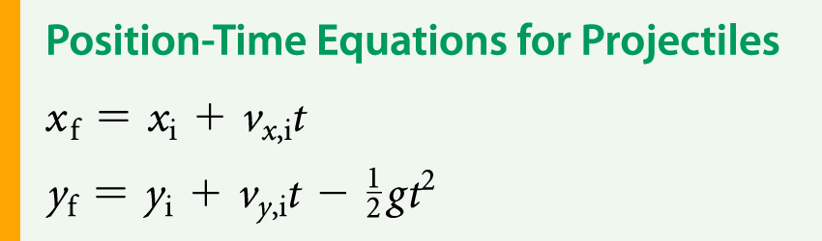
Projectile Motion
The x and y equations governing the motion of a projectile may be stated as follows:
These equations are applied to a specific projectile by identifying the initial position (x_{i}, y_{i}) and initial velocity (v_{x,i},v_{y,i}). Since there is no acceleration in the x direction, a_{x} = 0. The acceleration in the y direction is equal to –g.
The following example will show how the position-time equations may be applied to projective motion.

Slide 37
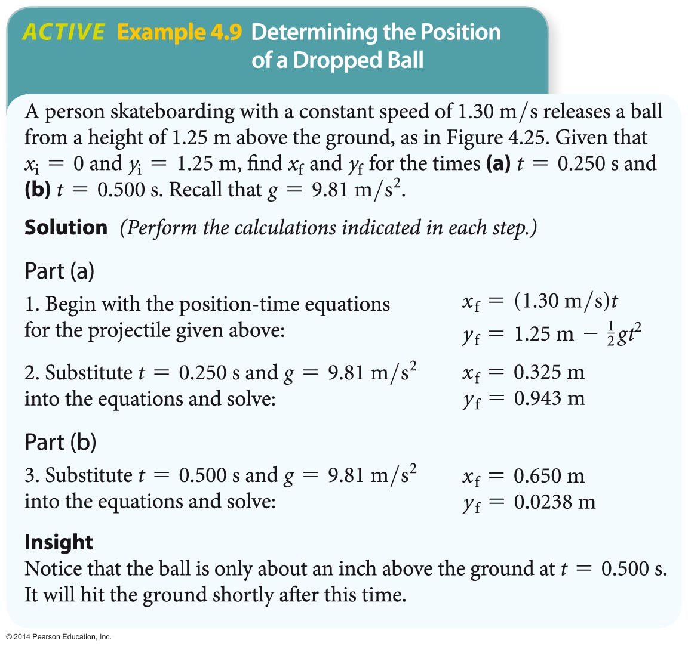
Projectile Motion

Slide 38
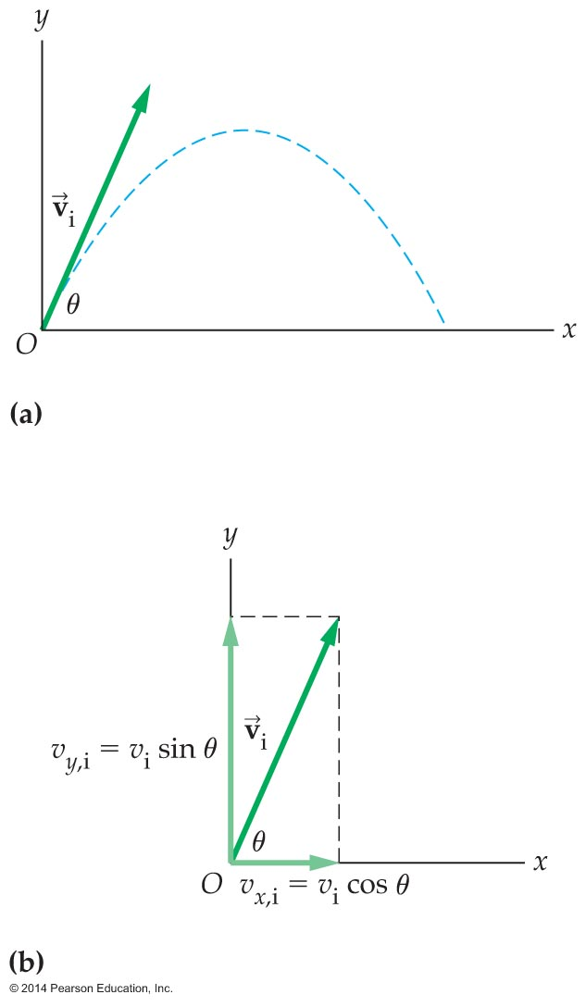
Projectile Motion
A projectile can be launched at any angle.
As the figure below indicates, a projectile launched with an initial speed v_{i} at an angle θ will have initial velocity components
v_{x,i} = v_{i} cosθ and v_{y,i} = v_{i} sinθ

Slide 39
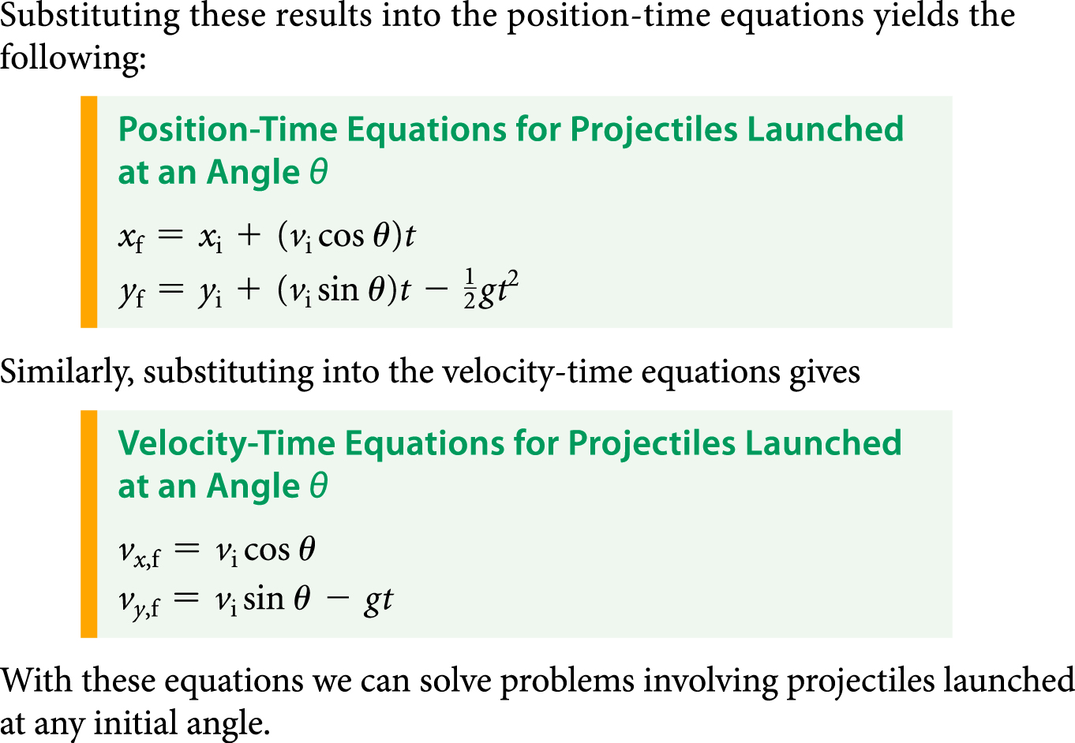
Projectile Motion

Slide 40
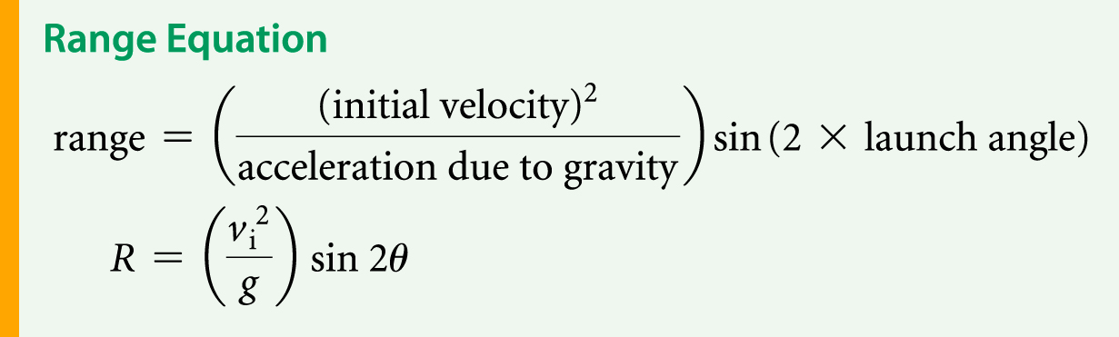
Projectile Motion
The range of a projectile is defined as the horizontal distance it travels before landing.
The range of a projectile can be shown to equal

Slide 41
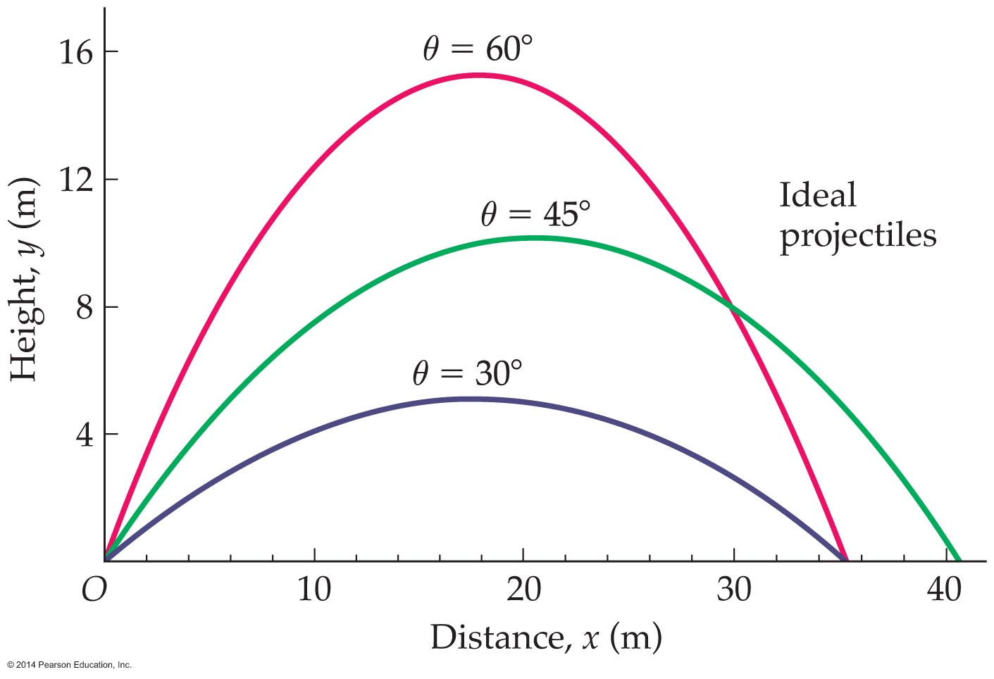
Projectile Motion
Many everyday objects serve as good approximations to ideal projectiles because the air resistance acting on them is negligible.
When air resistance is ignored, the range equation indicates that a projectile's maximum range will be obtained for a launch angle of 45°.

Slide 42
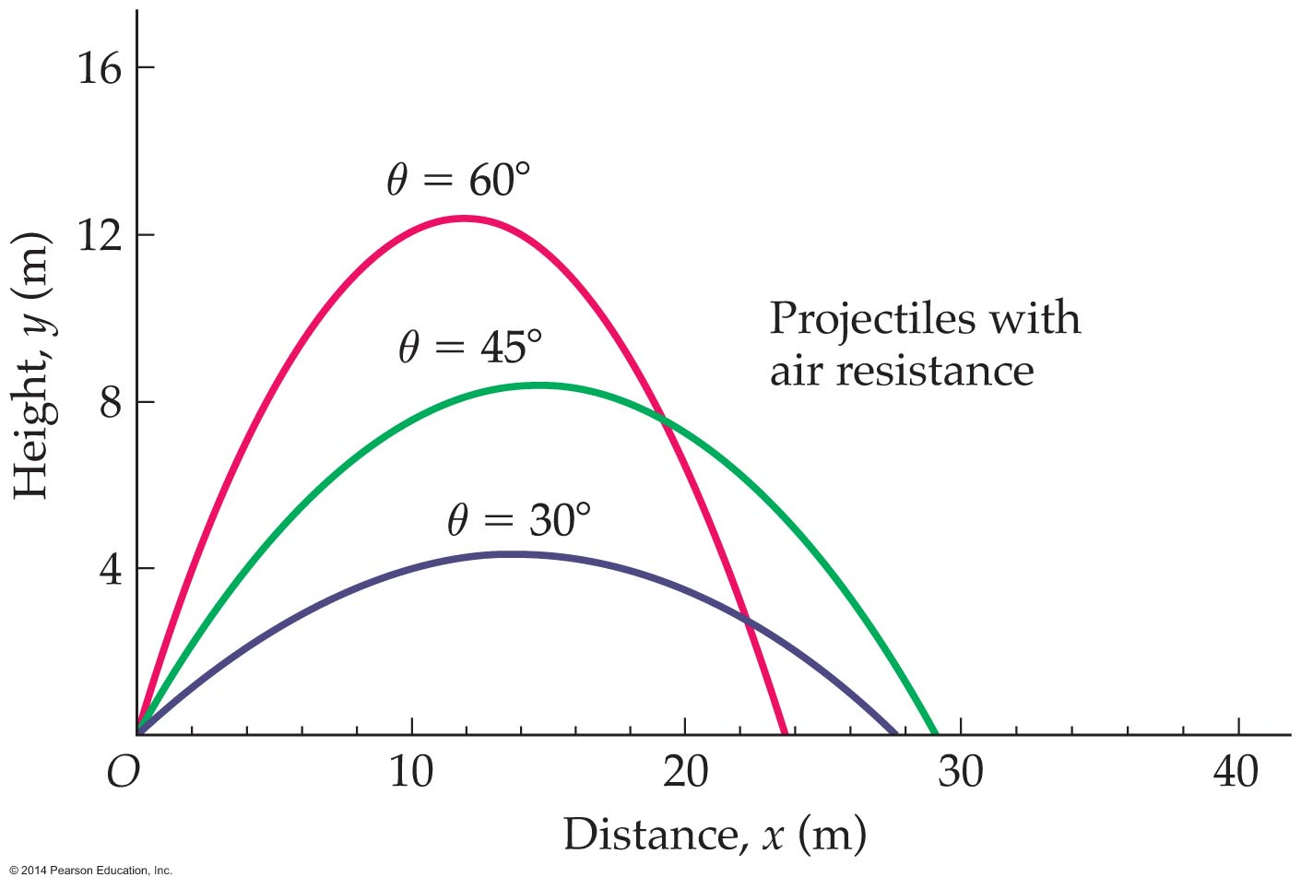
Projectile Motion
Significant air resistance reduces the range and alters the shape of a projectile's trajectory.

