Slide 1
Acceleration and Accelerated Motion
Prepared by Chris Chiaverina

Slide 2
Chapter Contents
Acceleration
Motion with Constant Acceleration
Position-Time Graphs with Constant Acceleration
Free Fall

Slide 3
Acceleration
Acceleration is the rate at which velocity changes with time.
The velocity changes
  when the speed of an object changes.
  when the direction of motion changes.
Therefore, acceleration occurs when there is a change in speed, a change in direction, or a change in both speed and direction.

Slide 4
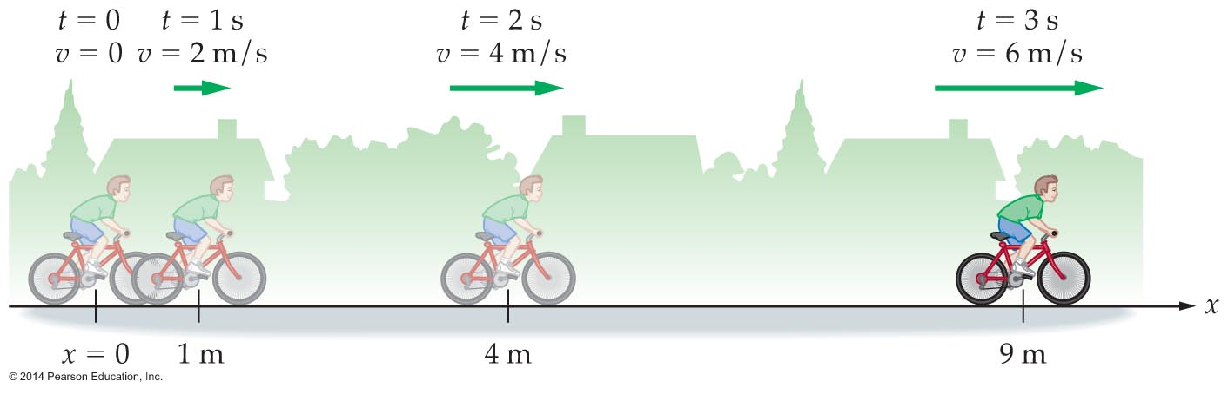
Acceleration
Example: A cyclist accelerates by increasing his speed 2 m/s every second. After 1 second his speed is 2 m/s, after 2 seconds his speed is
4 m/s, and so on.

Slide 5
Acceleration
While the human body cannot detect constant velocity, it can sense acceleration.
Passengers in a car
  feel the seat pushing forward on them when the car speeds up.
  feel the seat belt pushing back on them when the car slows down.
  tend to lend to one side when the car rounds a corner.

Slide 6
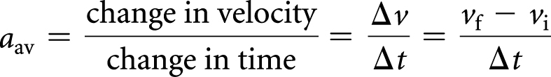
Acceleration
Average acceleration of an object is the change in its velocity divided by the change in time.
Stated mathematically, the definition of average acceleration a_{av} is

Slide 7
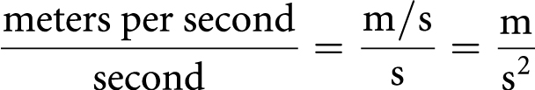
Acceleration
The dimensions of average acceleration are the dimensions of velocity per time or (meters per second) per second. That is,
Written symbolically as m/s², the units of average acceleration are expressed as "meters per second squared."

Slide 8
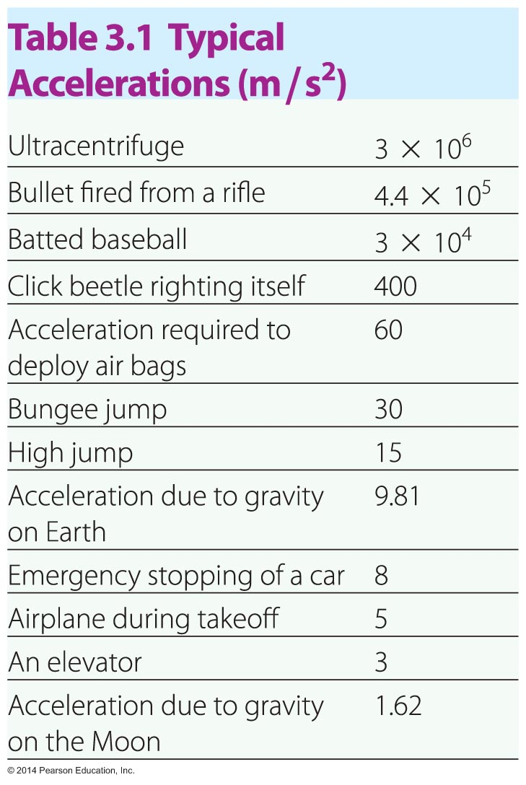
Acceleration
Typical magnitudes of accelerations range from 1.62 m/s² to 3 x 10⁶ m/s².

Slide 9
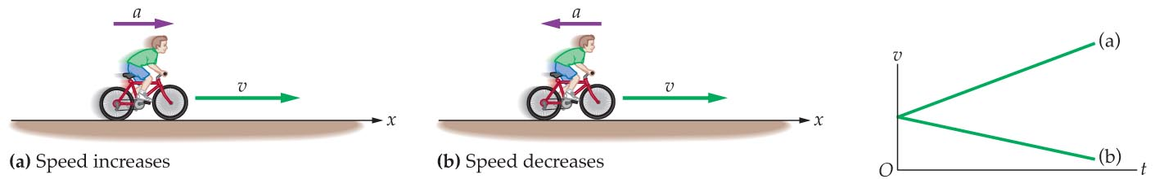
Acceleration
The speed of an object increases when its velocity and acceleration are in the same direction, but decreases when its velocity and acceleration are in opposite directions.

Slide 10
Motion with Constant Acceleration
An object's change in velocity equals the acceleration times the time.
Example: A car having an initial velocity of 10 m/s accelerates at 5 m/s². After 1 second its speed is 15 m/s, after 2 seconds its speed will be 20 m/s, and so on.
Based on this example, it follows that the equation that expresses the relationship between initial velocity, acceleration, and time is
v_{f} = v_{i} + at

Slide 11
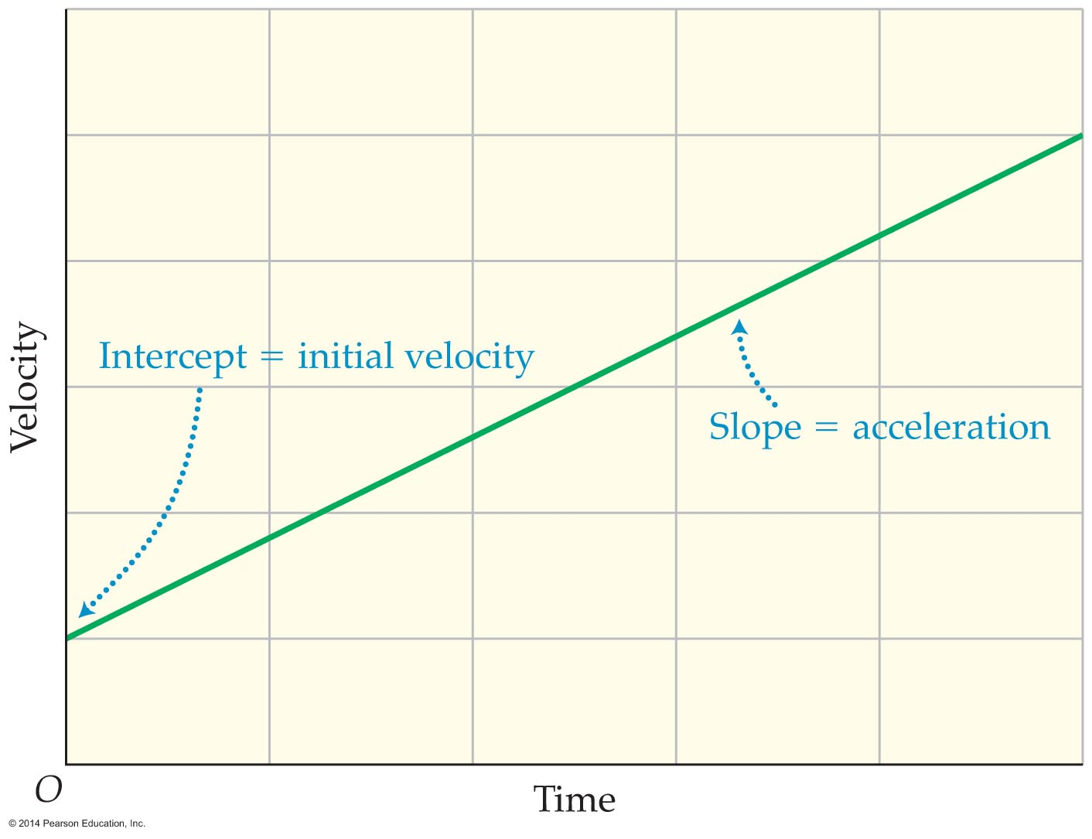
Motion with Constant Acceleration
The graph of the velocity equation v_{f} = v_{i} + at is a straight line. The line crosses the velocity axis at a value equal to the initial velocity and has a slope equal to the acceleration.

Slide 12
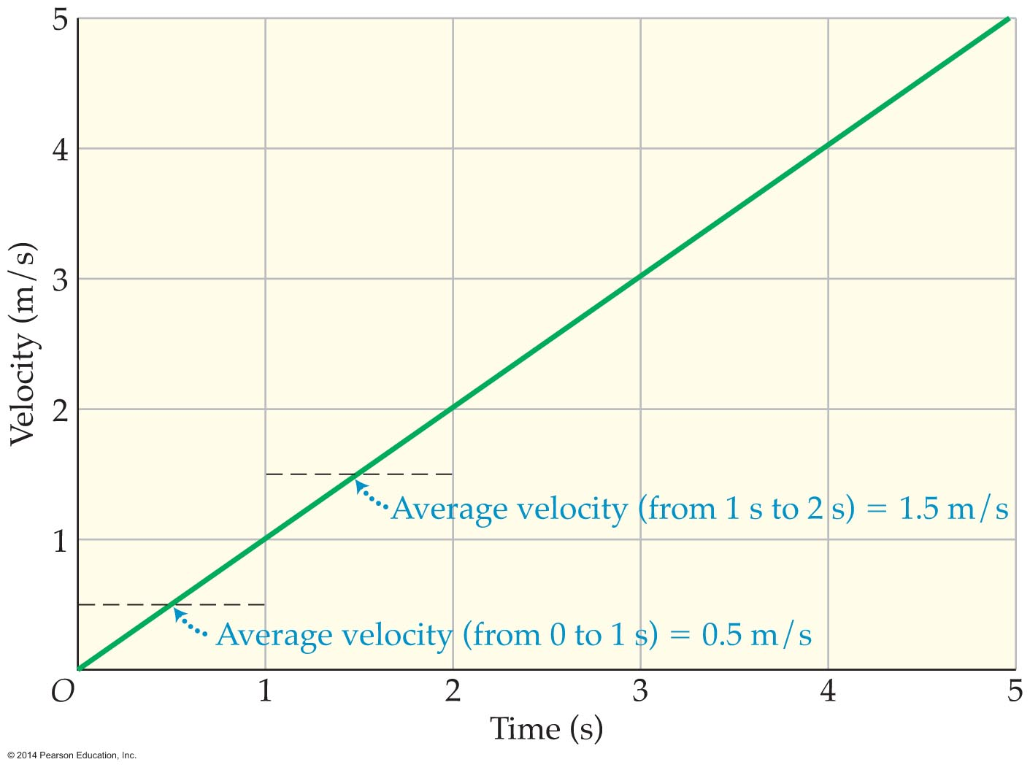
Motion with Constant Acceleration
When the acceleration is constant, the average velocity is equal to the sum of the initial and final velocities divided by 2.
In Figure 3.11, where the velocity is shown to change constantly from 0 m/s to 1 m/s the average velocity is 0.5 m/s.

Slide 13

Motion with Constant Acceleration
The position-time equation for constant velocity x_{f} = x_{i} + vt can be applied to situations in which velocity is changing by replacing the constant velocity with the average velocity v_{av}:
x_{f} = x_{i} + v_{av}t
Expressing average velocity in terms of the initial and final velocities gives the equation to find the position of an accelerating object:

Slide 14
Motion with Constant Acceleration
Example: The equation for determining the position of an accelerating object may be used to find the position of a boat that, having an initial velocity of 1.5 m/s, accelerates with a constant acceleration of 2.4 m/s² for 5.00 s.
Solution: The velocity-time equation for constant acceleration is v_{f} = v_{i} + at. The final velocity is therefore:
v_{f} = v_{i} + at
= 1.5 m/s + (2.4 m/s²)(5.00 s)
= 13.5 m/s

Slide 15
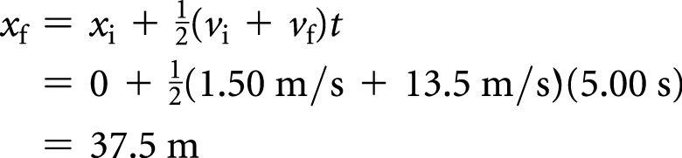
Motion with Constant Acceleration
Solution (cont.): The position-time equation can now be used to find the final position of the boat. To find the final position, substitute the given values for the initial velocity (v_{i} = 1.5 m/s), final velocity (v_{f} = 13.5 m/s, and time (t = 5.00 s). Assuming for convenience that the boat's initial position to be x_{i} = 0, the final position is

Slide 16
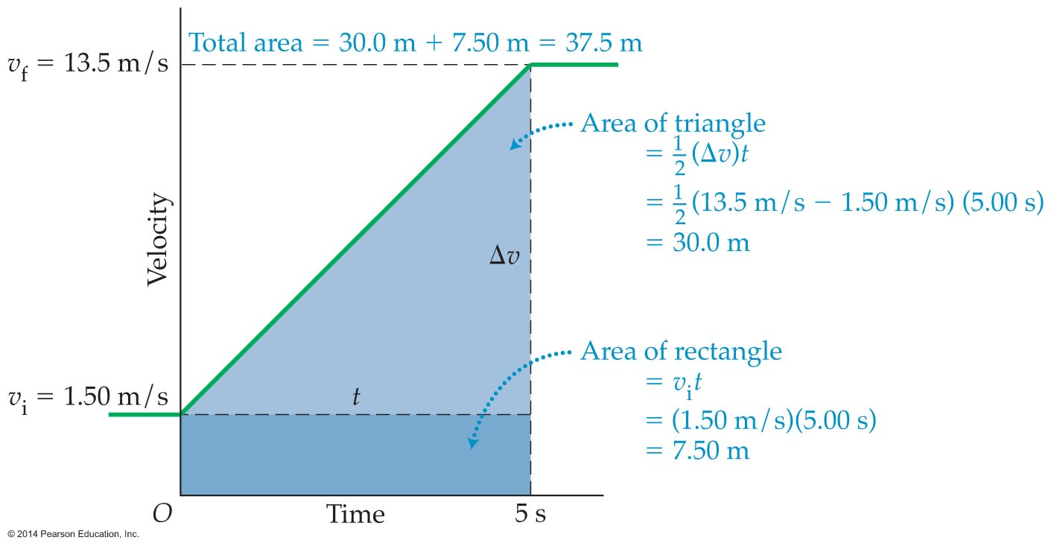
Motion with Constant Acceleration
The area beneath the velocity-time curve for the motion of a boat may be separated into two parts: a rectangle and a triangle.

Slide 17
Motion with Constant Acceleration
The area of the rectangle is the base times the height. The base is 5.00 s and the height is 1.5 m/s; thus the area is 7.5 m.
The area of the rectangle is one-half the base times the height, or 5.00 s times 12.0 m/s; thus the area is 30.0 m.
The total area is therefore 37.5 m.
Since this is in agreement with the result found using the position-time equation of an accelerating object, it can be said that the distance traveled by an object is equal to the area under the velocity-time curve.

Slide 18


Motion with Constant Acceleration
Combing the position-time equation and the velocity-time equation yields an expression that relates position to acceleration and time:
Acceleration results in a change in velocity with position. The following equation relates initial and final velocities, change in position, and acceleration:

Slide 19
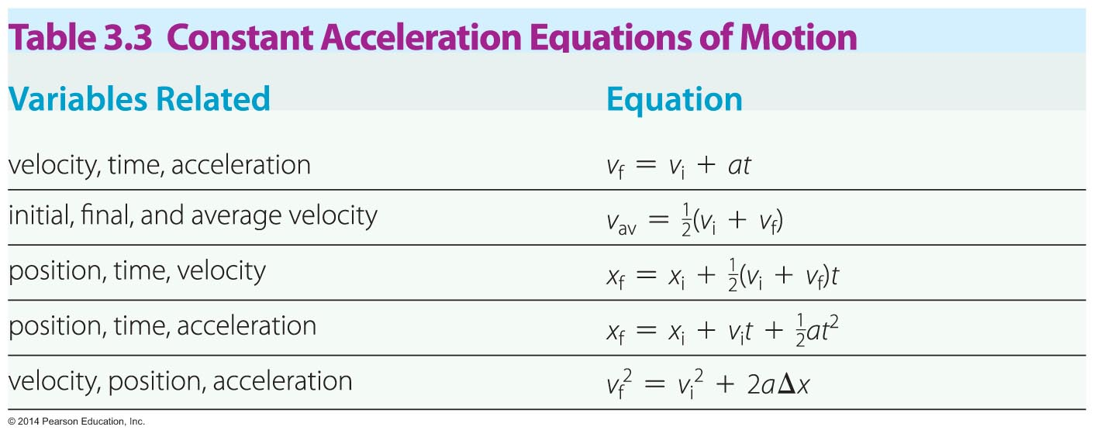
Motion with Constant Acceleration
In all, there are five constant acceleration equations of motion.

Slide 20
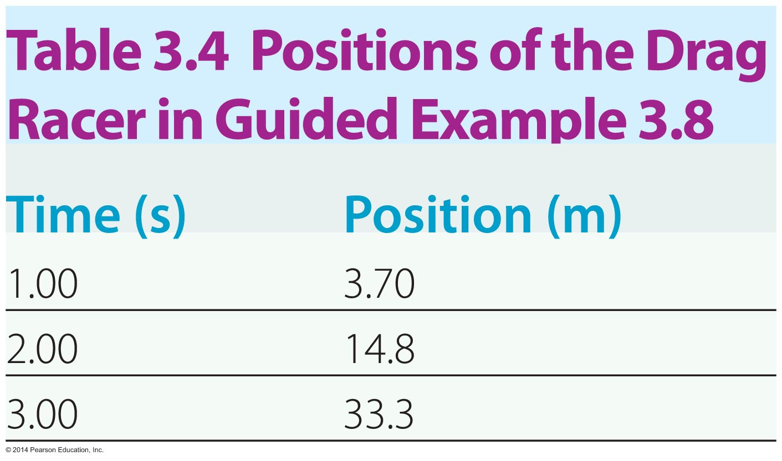
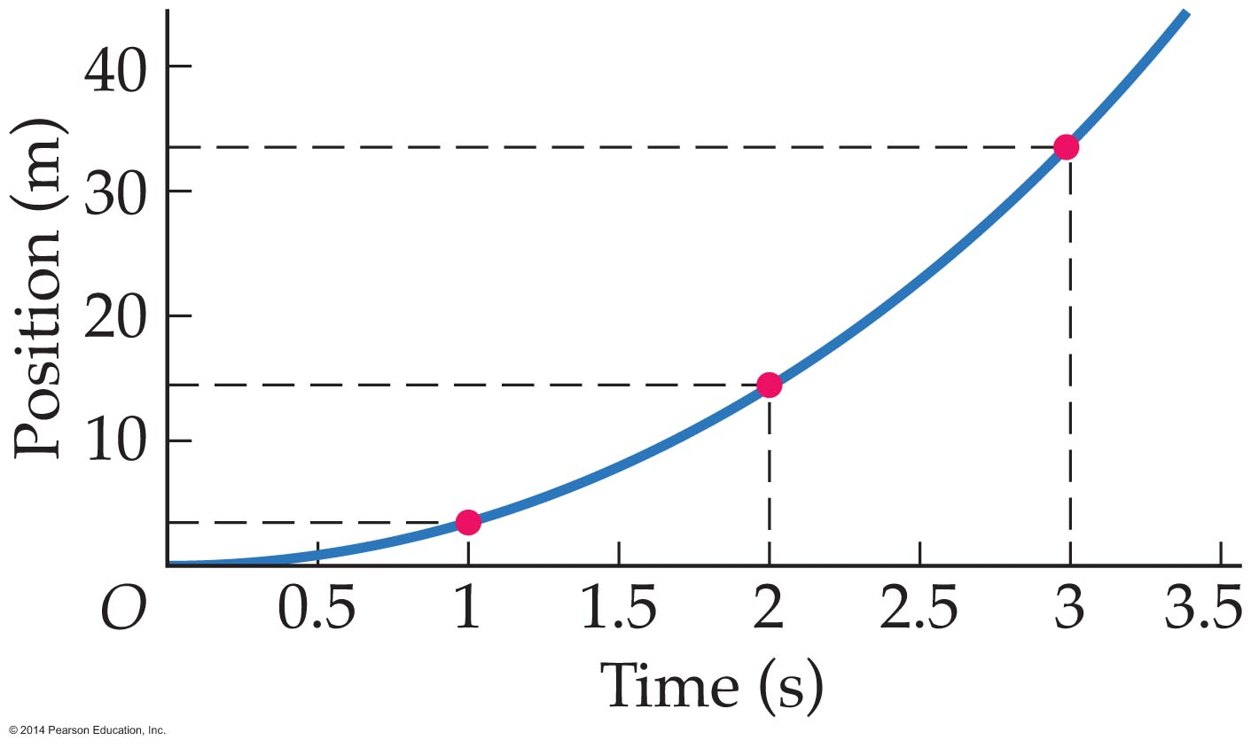
Position-Time Graphs for Constant Acceleration
The shape of a position-time graph contains information about motion whether the motion has constant velocity or constant acceleration.
While a table is useful in conveying information regarding motion, a graph offers a better way to visualize the motion.

Slide 21
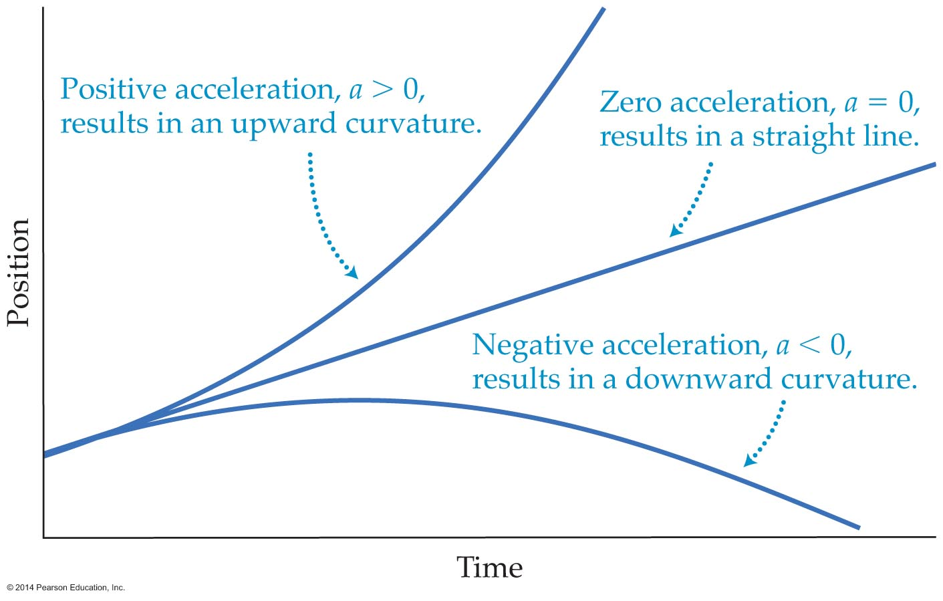
Position-Time Graphs for Constant Acceleration
Constant acceleration produces a parabolic position-time graph.
The sign of the acceleration determines whether the parabola has an upward or downward curvature.

Slide 22
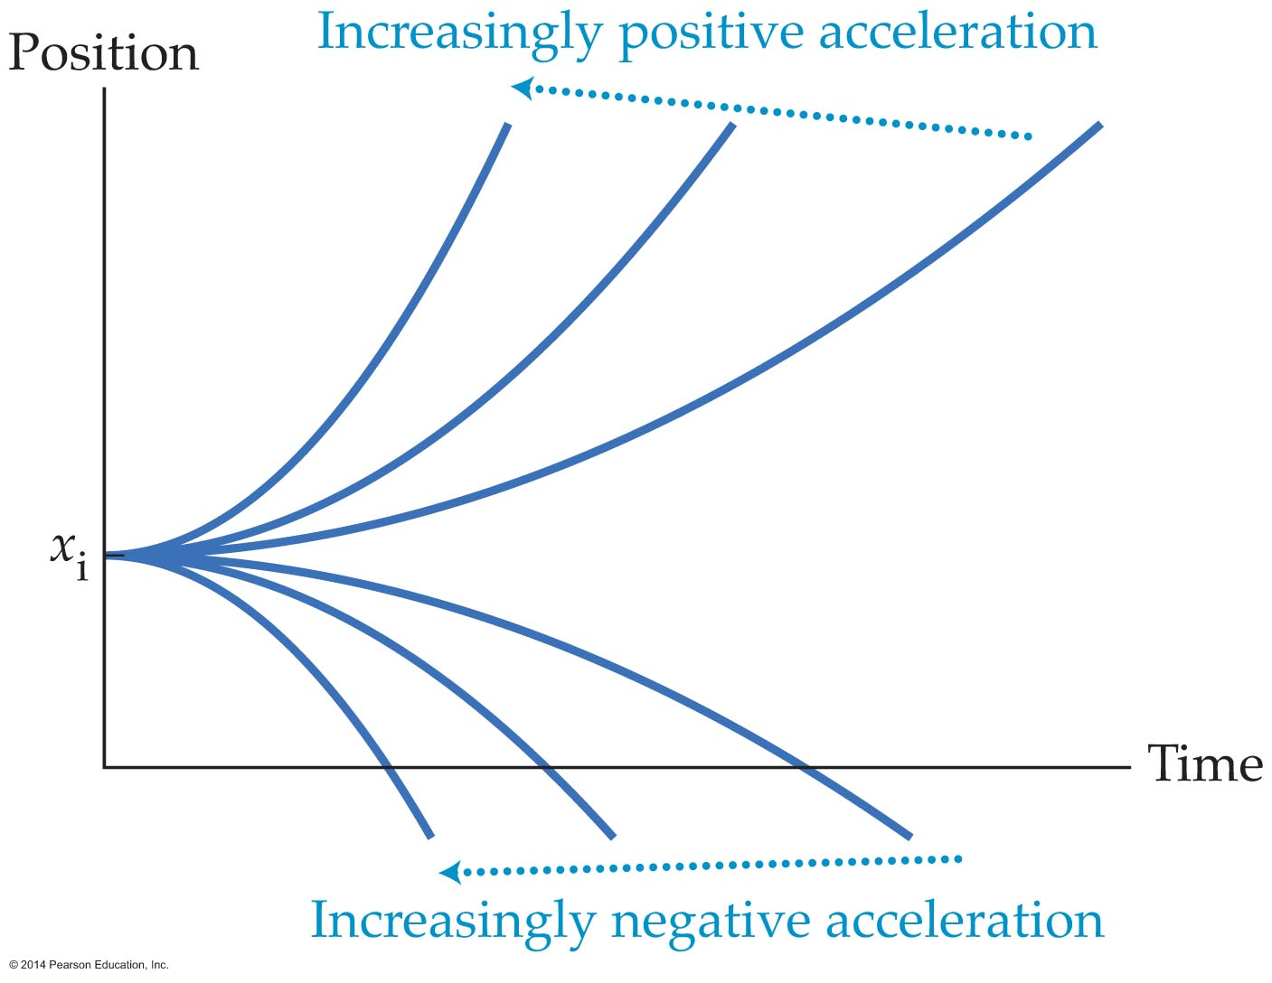
Position-Time Graphs for Constant Acceleration
The magnitude of the acceleration is related to how sharply a position-time graph curves. In general, the greater the curvature of the parabola, the greater the magnitude of the acceleration.

Slide 23

Position-Time Graphs for Constant Acceleration
Each term in the equation has graphical meaning.
  The vertical intercept is equal to the initial position x_{i}.
  The initial slope is equal to the initial velocity.
  The sharpness of the curvature indicates the magnitude of the acceleration.

Slide 24
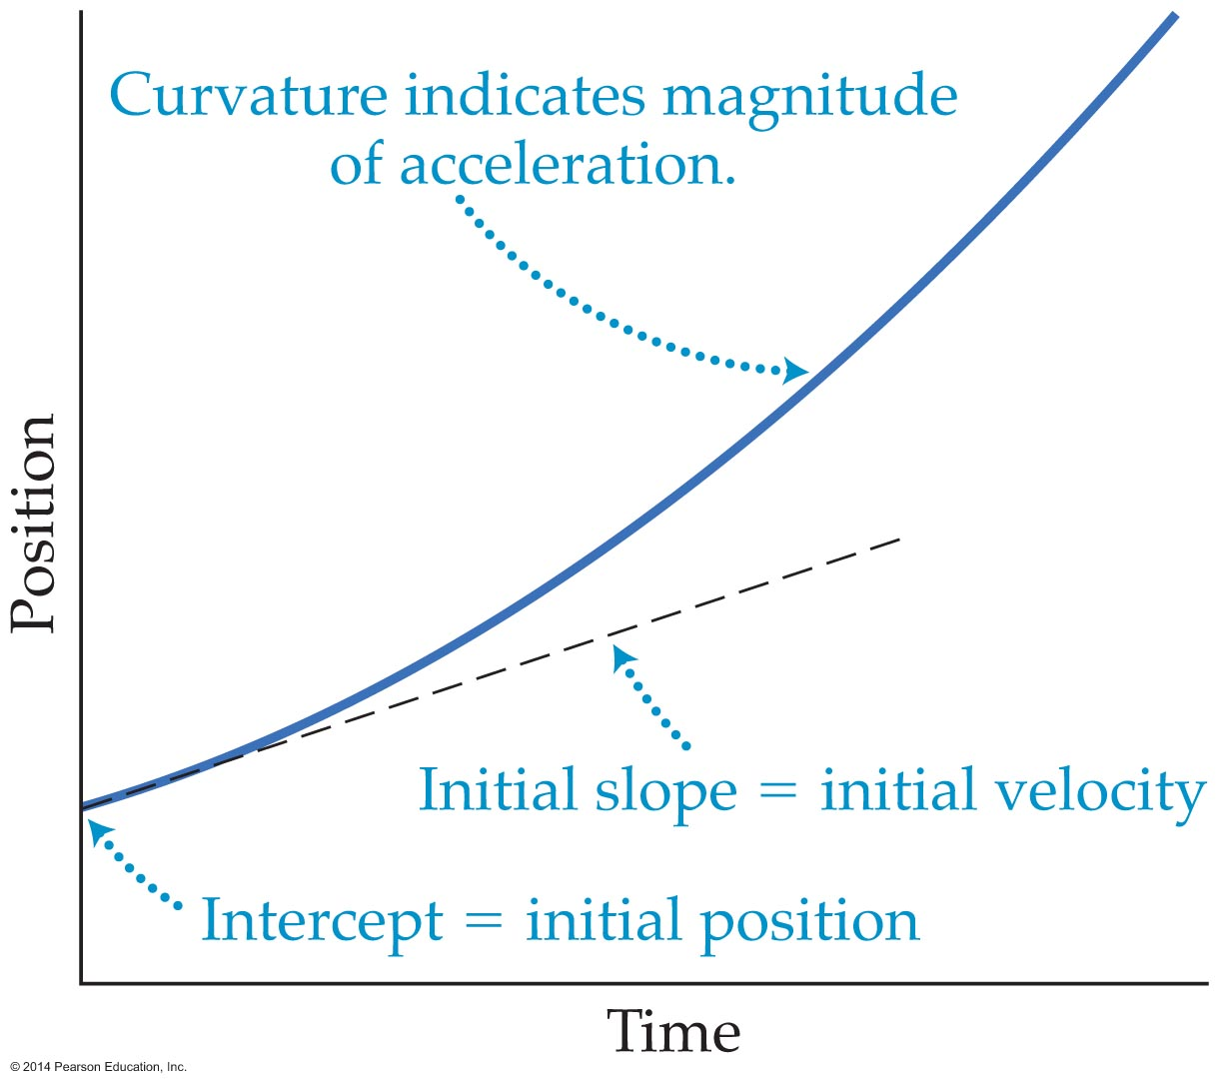
Position-Time Graphs for Constant Acceleration
Thus, considerable information can be obtained from a position-time graph.

Slide 25
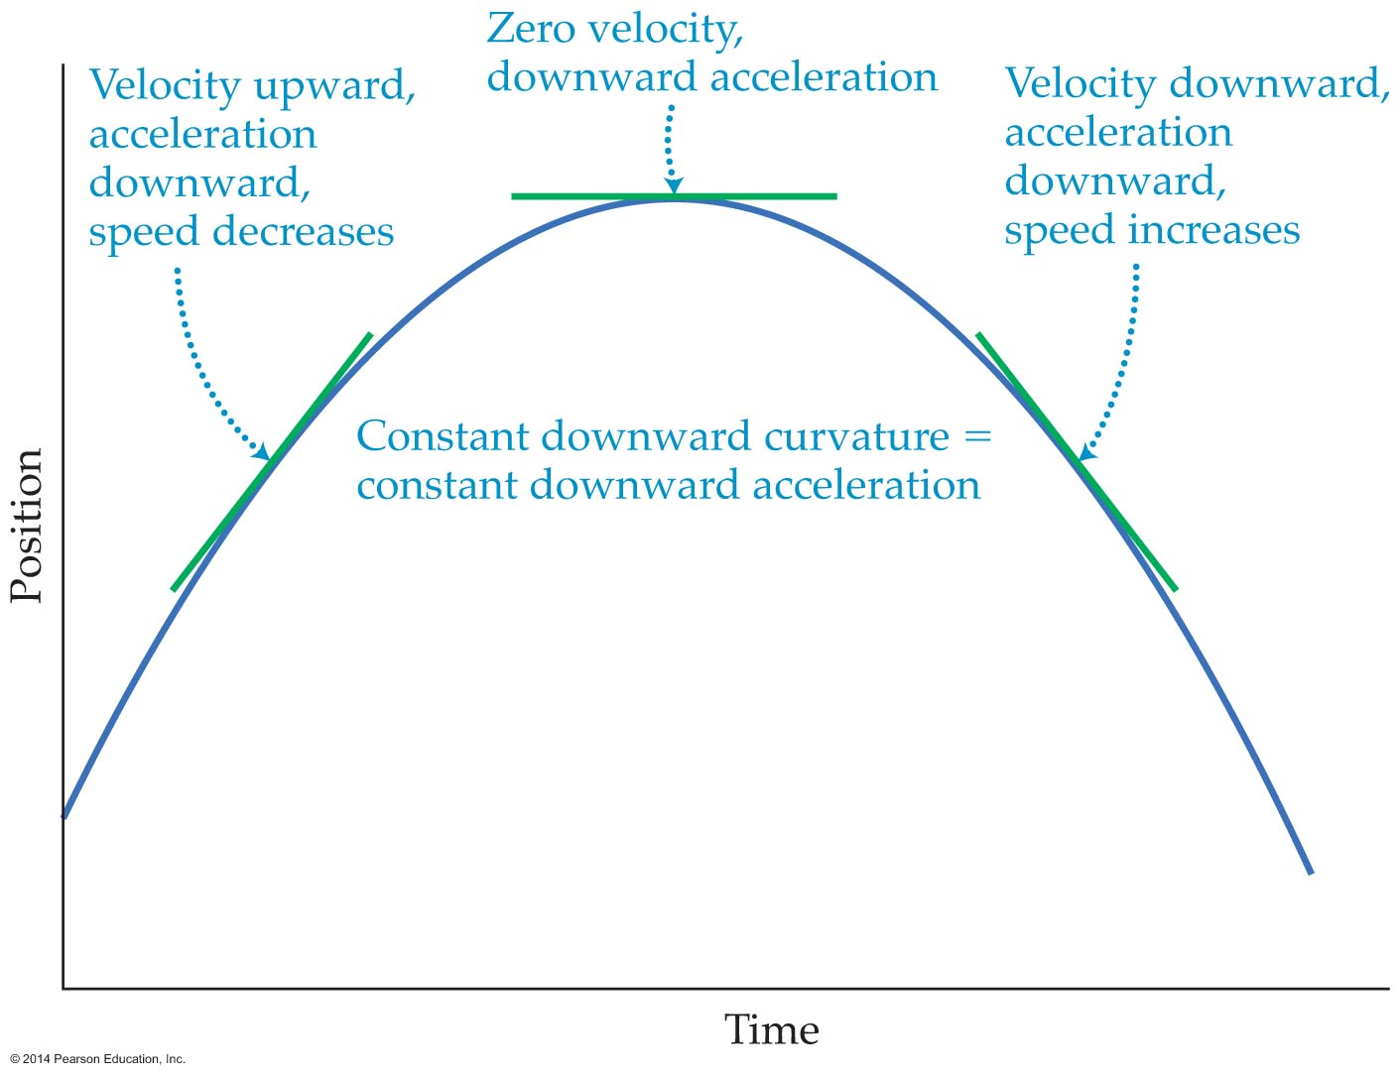
Position-Time Graphs for Constant Acceleration
A single parabola in a position-time graph can show both deceleration and acceleration. A constant curvature indicates a constant acceleration. A ball thrown upward is an example of motion with constant acceleration.

Slide 26
Free Fall
Free fall refers to motion determined solely by gravity, free from all other influences.
Galileo concluded that if the effects of air resistance can be neglected, then all objects have the same constant downward acceleration.

Slide 27
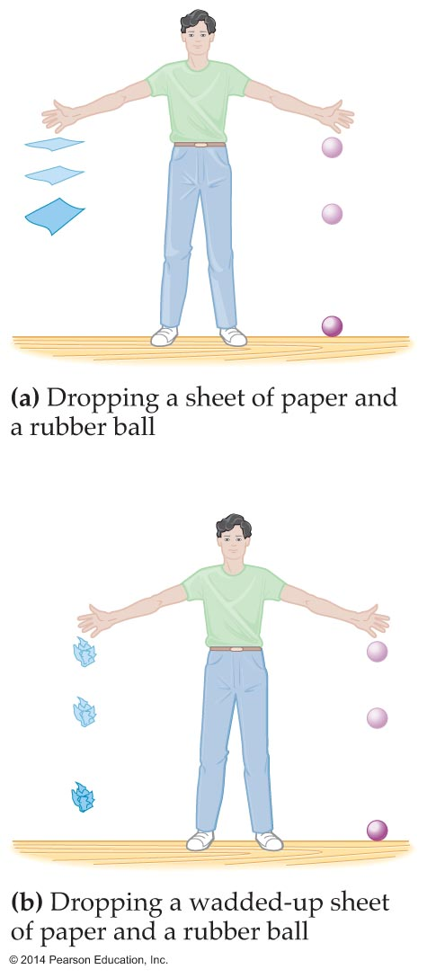
Free Fall
The motion of many falling objects approximate free fall. A wadded-up sheet of paper approximates free-fall motion since the effects of air resistance are small enough to ignore.

Slide 28
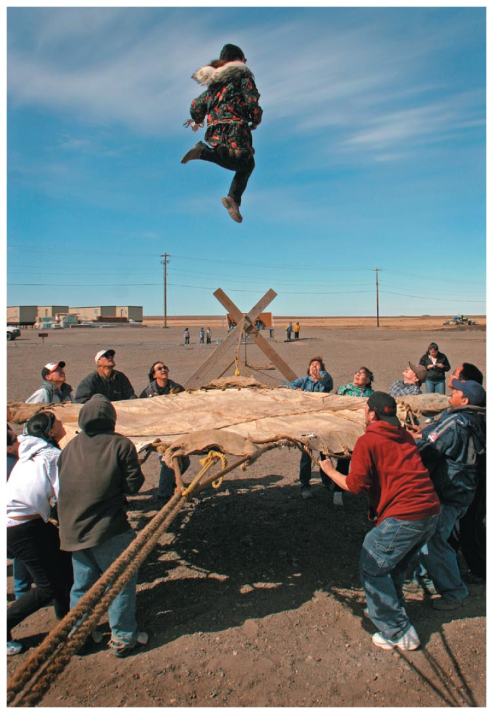
Free Fall
Freely falling objects are always accelerating.
For an object tossed into the air, the acceleration is the same on the way up, at the top of the flight, and on the way down, regardless of whether the object is thrown upward or downward or just dropped.

Slide 29
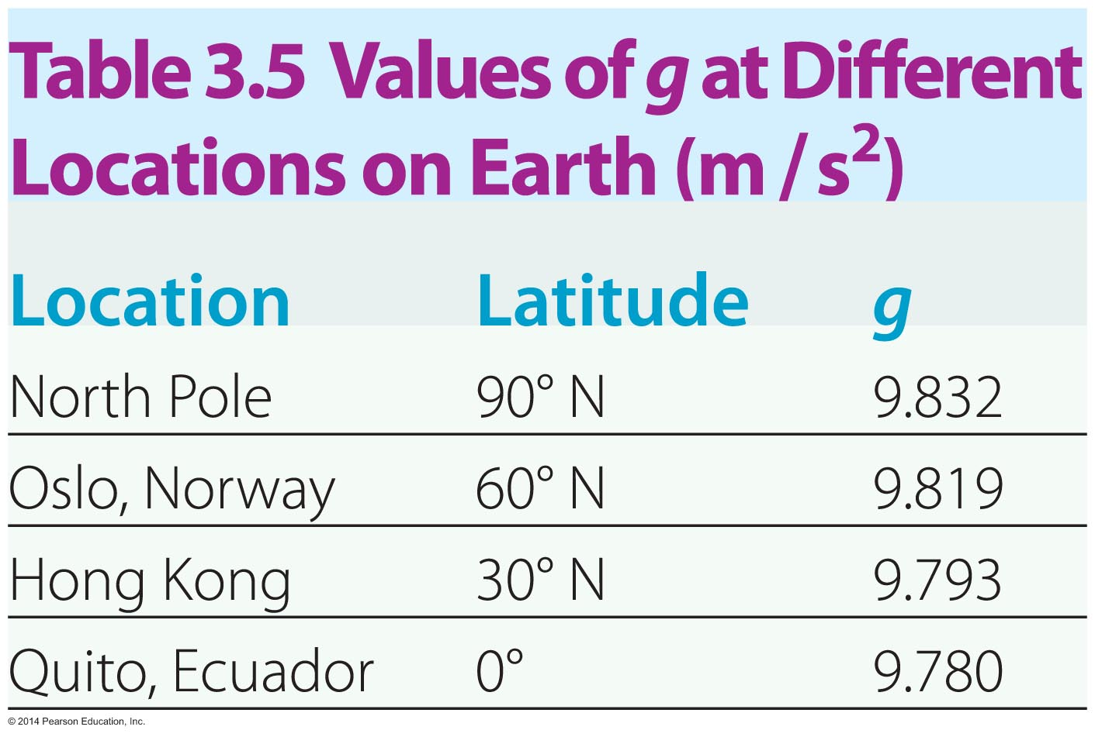
Free Fall
The acceleration produced by gravity at the Earth's surface is denoted with the symbol g.
In our calculations we will use g = 9.8 m/s²; however, the acceleration of gravity varies slightly from location to location on the Earth.

Slide 30
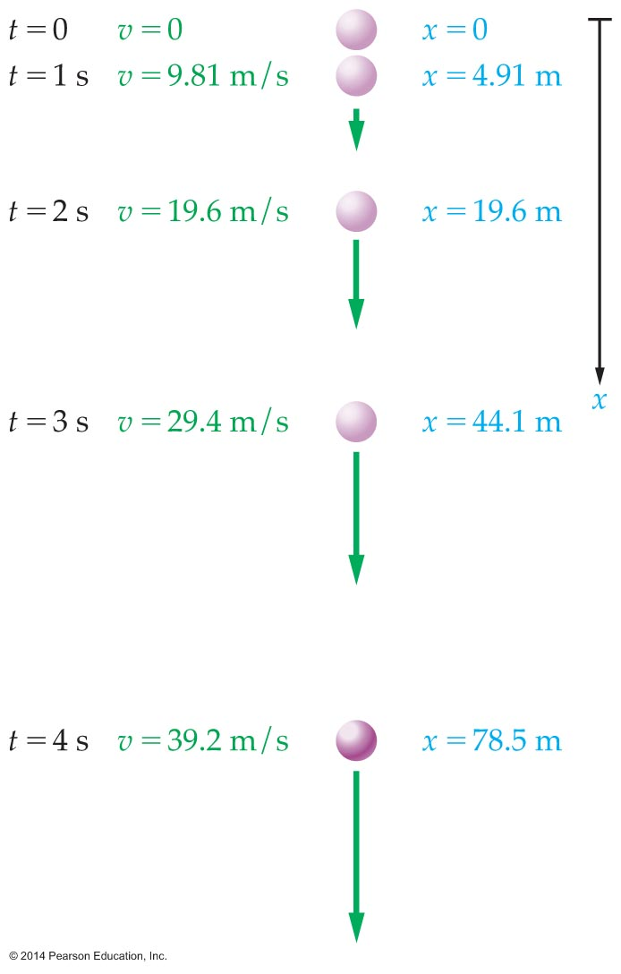
Free Fall
The five constant acceleration equations of motion can be used to determine the position and velocity of a freely falling object by substituting g for a.
The velocity of an object in free fall increases linearly with time. The distance increases with time squared.

Slide 31
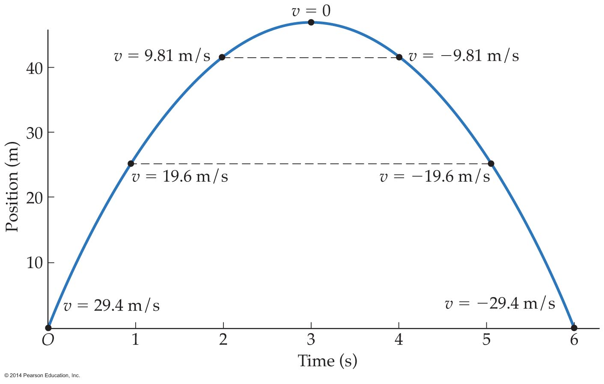
Free Fall
The motion of objects in free fall is symmetrical.
A position-time graph of free-fall motion reveals this symmetry.

