Slide 1
Introduction to Motion
Prepared by Chris Chiaverina

Slide 2
Chapter Contents
Describing Motion
Speed and Velocity
Position-Time Graphs
Equation of Motion

Slide 3
Describing Motion
A frame of reference is referred to as a coordinate system.
A coordinate system in one dimension is represented by an x axis with the origin located at x = 0.
Once an origin and a positive direction are chosen, they must be used consistently.

Slide 4
Describing Motion
The letter x is used to label position.
An arrow drawn from the origin of a coordinate system to an object is referred to as the object's position vector.
Whenever an object is in motion, its position is changing.

Slide 5
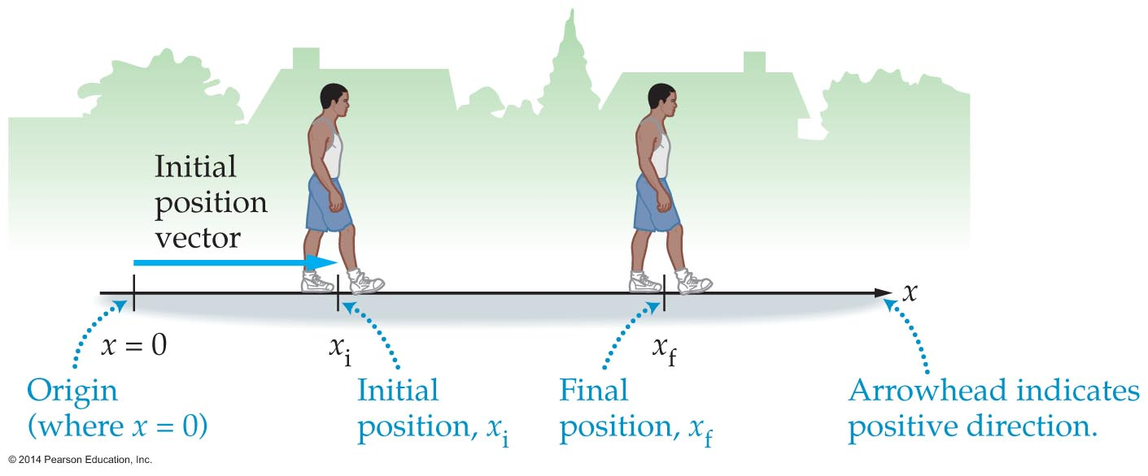
Describing Motion
Initial and final positions are indicated with x_{i} and x_{f}, respectively.

Slide 6
Describing Motion
Distance is the total length of the path taken on a trip.
  No direction is associated with distance. It is a scalar quantity.
  The SI unit of distance is the meter (m).
  When walking, distance is measured with a pedometer.
  In a car, the distance is measured using an odometer.

Slide 7
Describing Motion
Displacement is defined as an object's change in position.
  Displacement is a vector having both magnitude and direction.
  The SI unit of displacement is the meter (m).
  The sign of the displacement vector indicates the direction of motion. Motion in the positive direction has a positive displacement. Motion in the negative direction produces a negative displacement.

Slide 8
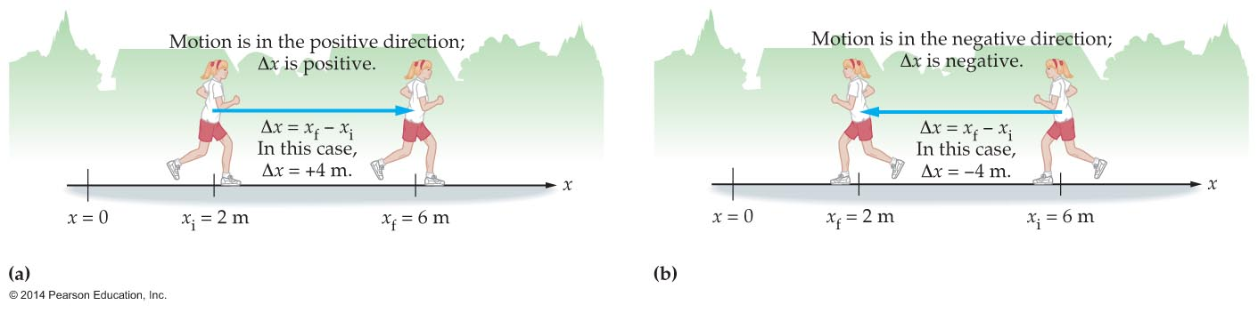
Describing Motion
Displacement is represented by the symbol Δx.
Δx is shorthand for x_{f} – x_{i}. It does not mean Δ times x.
Δx is positive when the change in position is in the positive direction and negative when the change in position is in the negative direction.

Slide 9
Describing Motion
Distance is the total length traveled; displacement is the net change in position.
An object's displacement is zero when it returns to its starting point, even though it may have traveled a considerable distance.

Slide 10
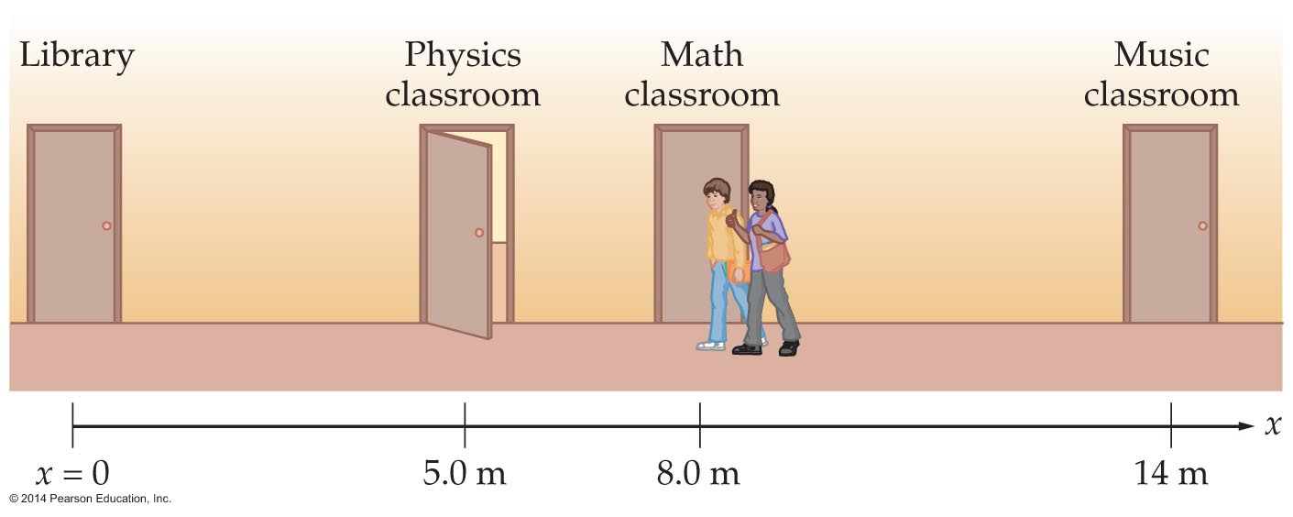
Describing Motion
Example: The total length traveled in going from the math classroom to the library and then to the physics room is 13.0 m, whereas the displacement is −3.0 m.

Slide 11
Speed and Velocity
The rate of motion is referred to as speed.
Speed describes how fast or slow something moves.
The average speed is defined as the distance traveled divided by the elapsed time:
average speed = distance/elapsed time
The SI units of average speed are meters per second (m/s).
Like distance, average speed is always positive.

Slide 12
Speed and Velocity
An object's average velocity is defined as its displacement per unit time:
average velocity = displacement/elapsed time
The SI units of average velocity are meters per second (m/s).
The average velocity describes, on average, how fast something is moving as well as the average direction in which the object is moving.
An object moving in the positive direction has a positive average velocity. An object moving in the negative direction has a negative average velocity.

Slide 13
Position-Time Graphs
A position-time graph is an alternative way of representing data in a table.
On a position-time graph, position data are plotted on the y axis; time data are plotted on the x axis.

Slide 14
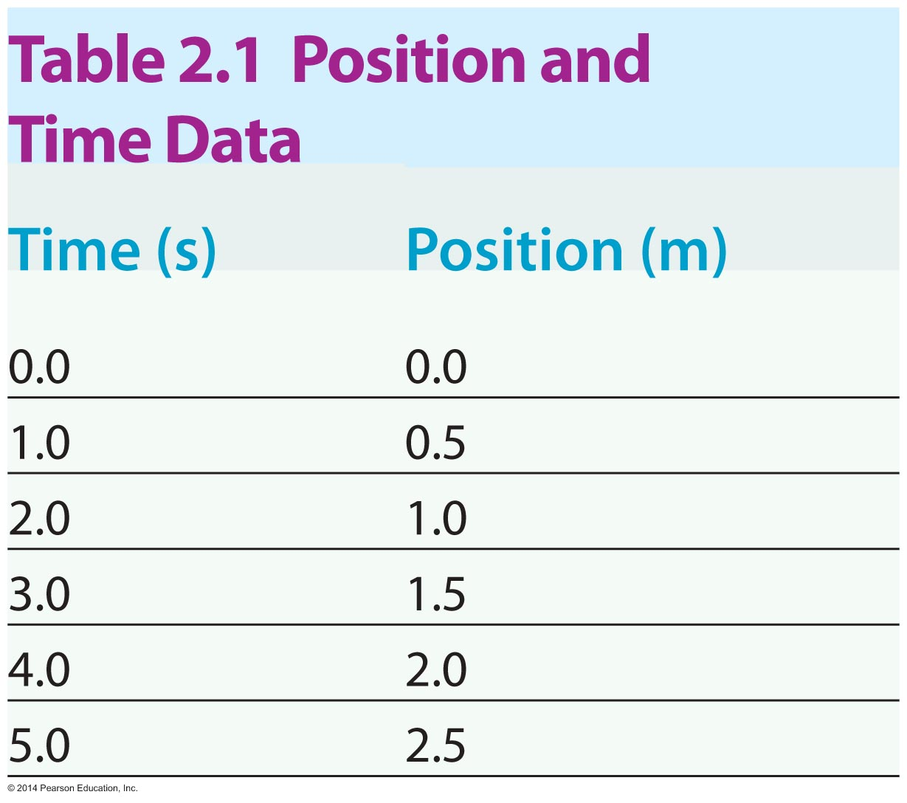
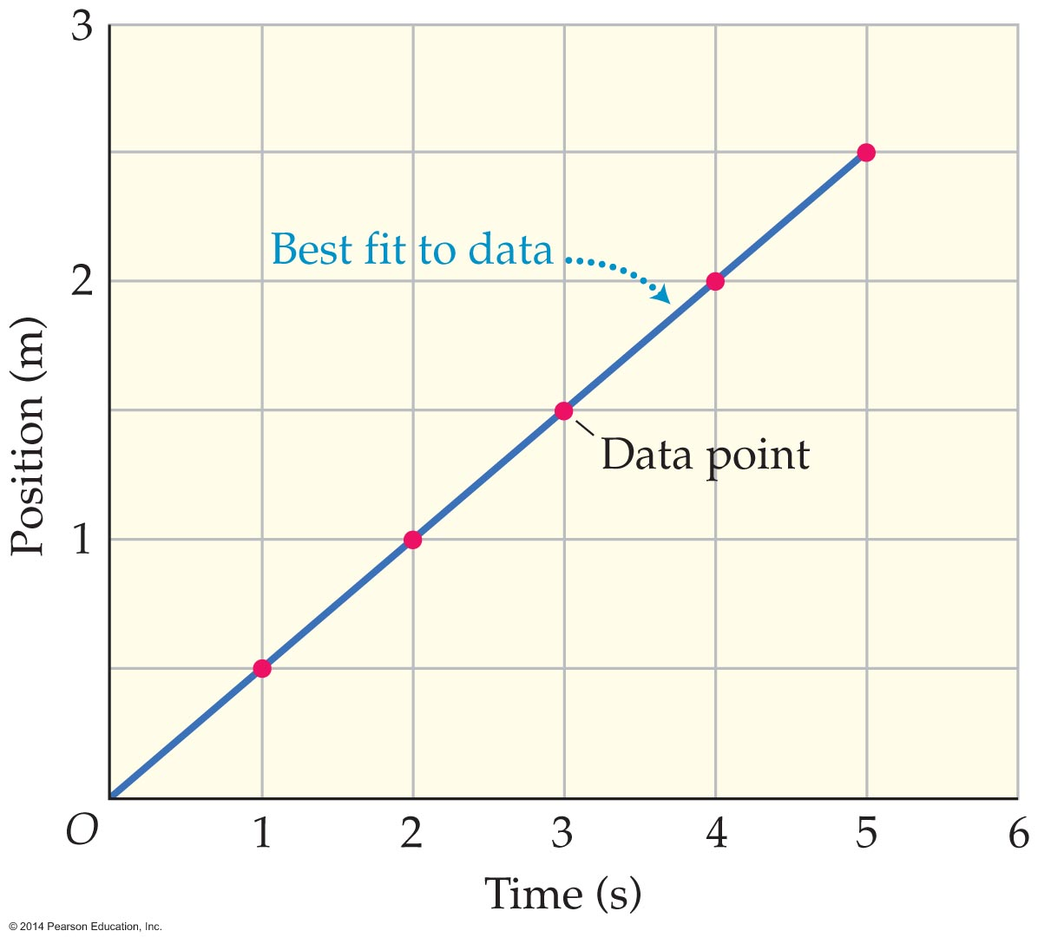
Position-Time Graphs
Example: Plotting the position and time contained in a table results in a position-time graph.

Slide 15
Position-Time Graphs
A best-fit line drawn through data points can be used to learn additional information about an object's motion.

Slide 16
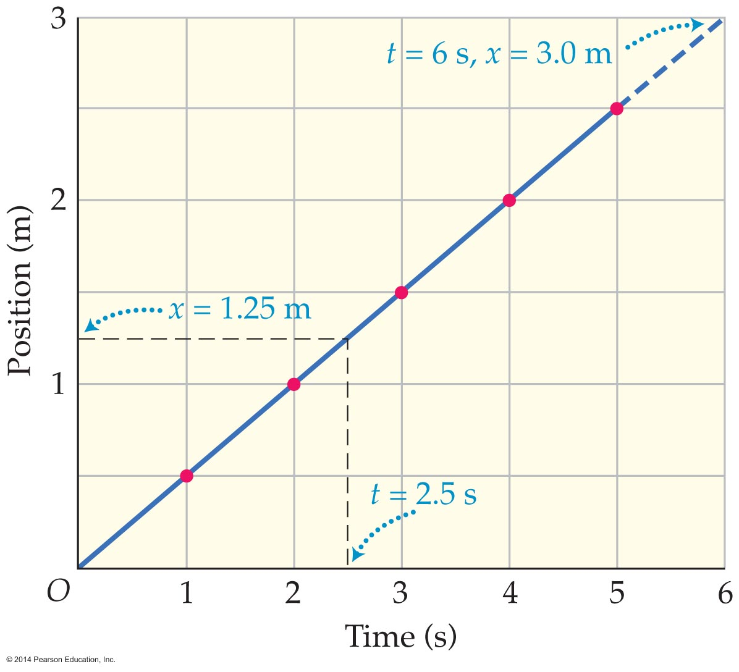
Position-Time Graphs
To find position at a time not in original data,
  trace vertically from a given point on time axis to the straight line, then
  trace sideways until you reach the position axis.

Slide 17
Position-Time Graphs
The slope of a straight line is equal to its rise over its run.
Any two points may be used to calculate the slope of a straight line.
On a position-time graph the rise corresponds to the an object's position and the run to the elapsed time.

Slide 18
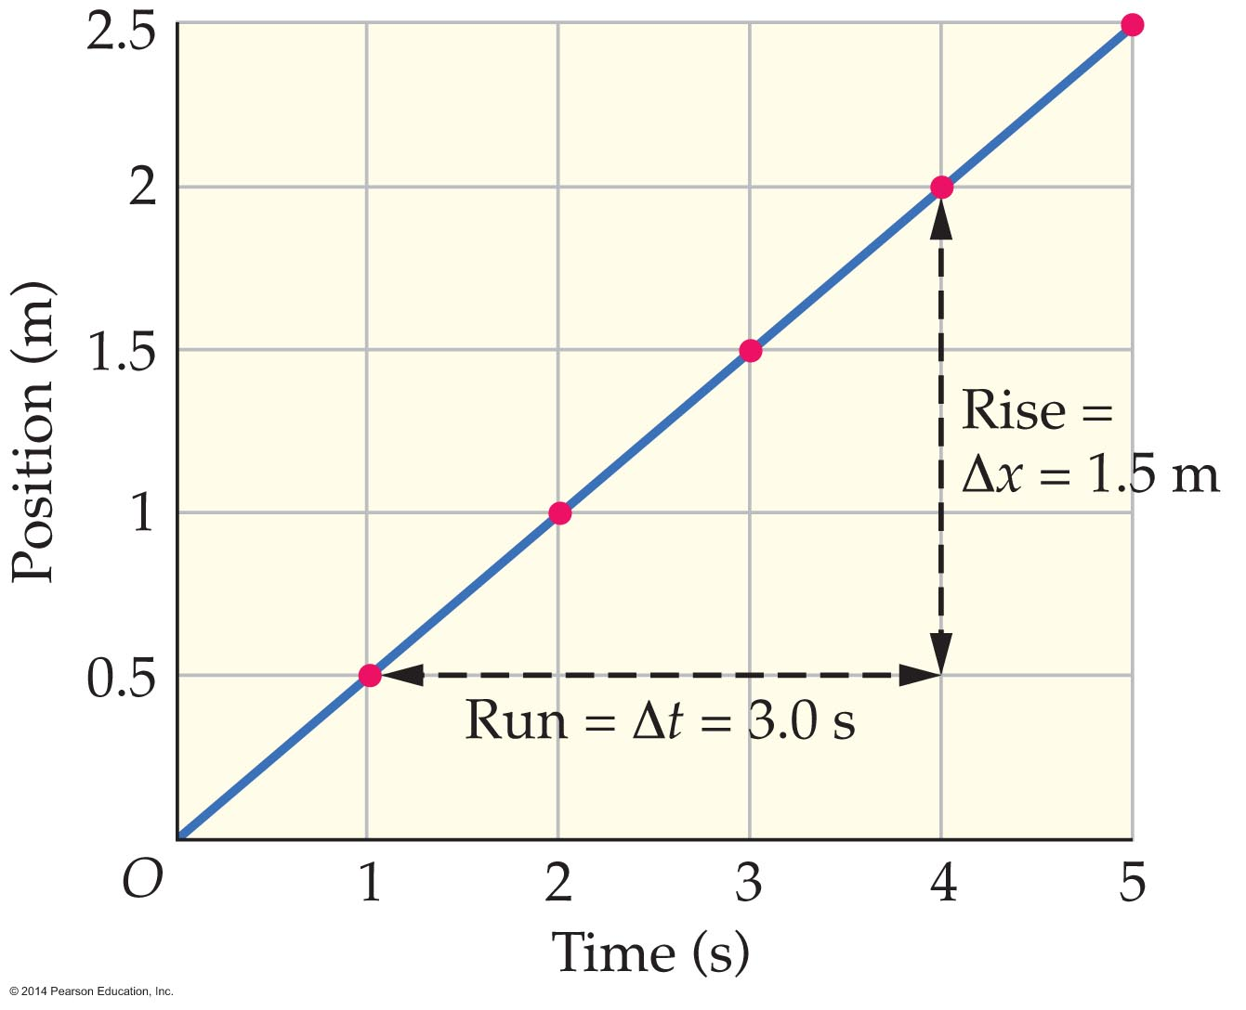
Position-Time Graphs
The slope of a position-time graph equals average velocity.
A straight line on a position-time graph represents motion with constant velocity.

Slide 19
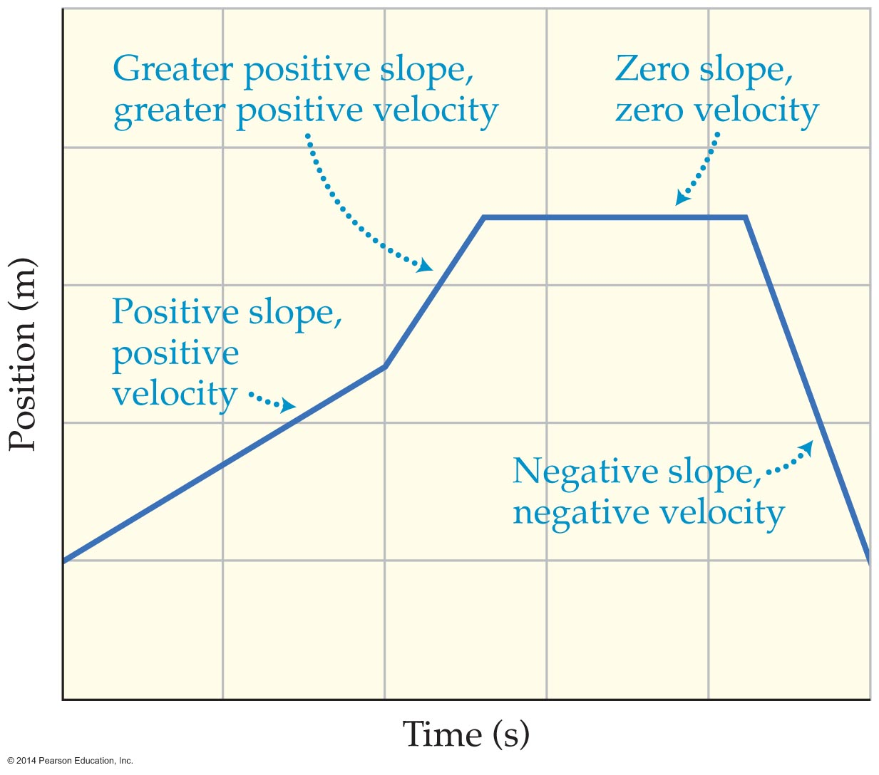
Position-Time Graphs
A straight line on a position-time graph can have a positive, negative, or zero slope.
  A positive slope means a positive velocity.
  A negative slope means a negative velocity.
  Zero slope means zero velocity.

Slide 20
Position-Time Graphs
The greater the slope of a position-time graph, the greater the velocity.
The slope of a tangent line to a position-time graph at a given instant equals the instantaneous velocity.

Slide 21
Equation of Motion
The position-time equation of motion gives an object's position x at any time t if its initial position and constant velocity are known.
The position-time equation states that final position = initial position + (velocity)(elapsed time), or x_{f} = x_{i} + vt.

Slide 22
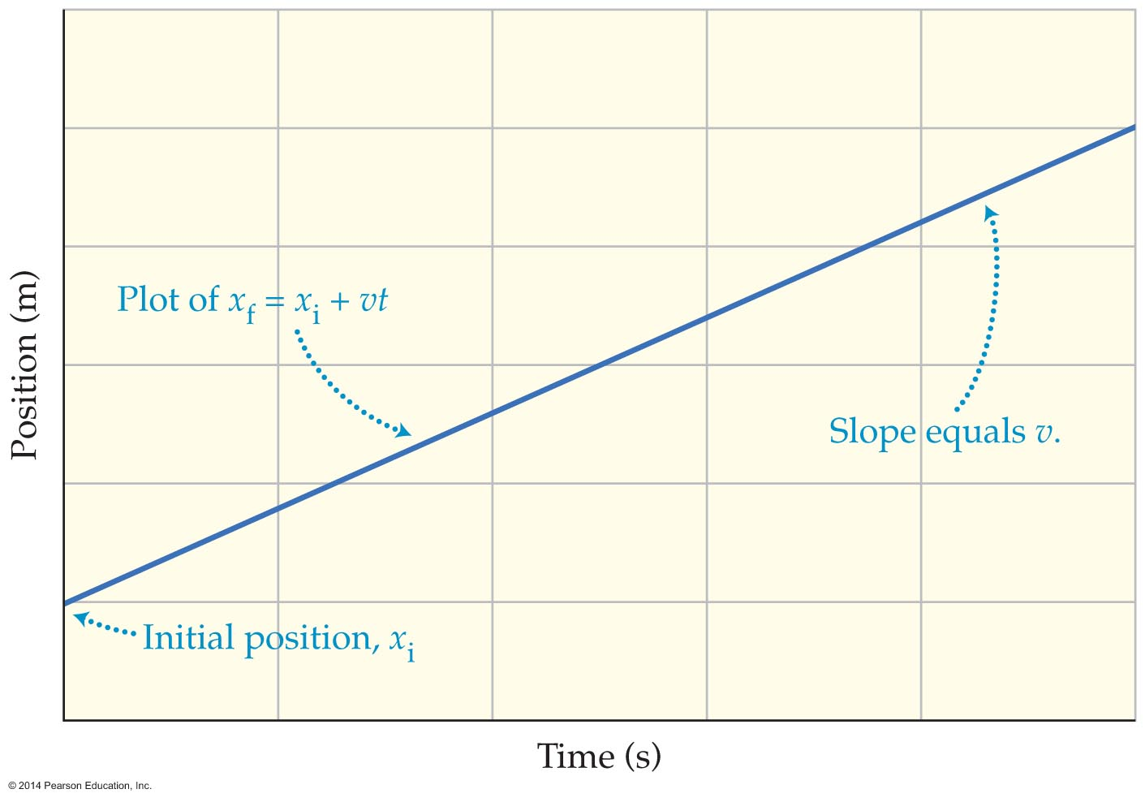
Equation of Motion
The position-time equation of motion gives a straight line for motion with constant velocity.
The intercept of the straight line is the initial position, and its slope is the velocity.

Slide 23
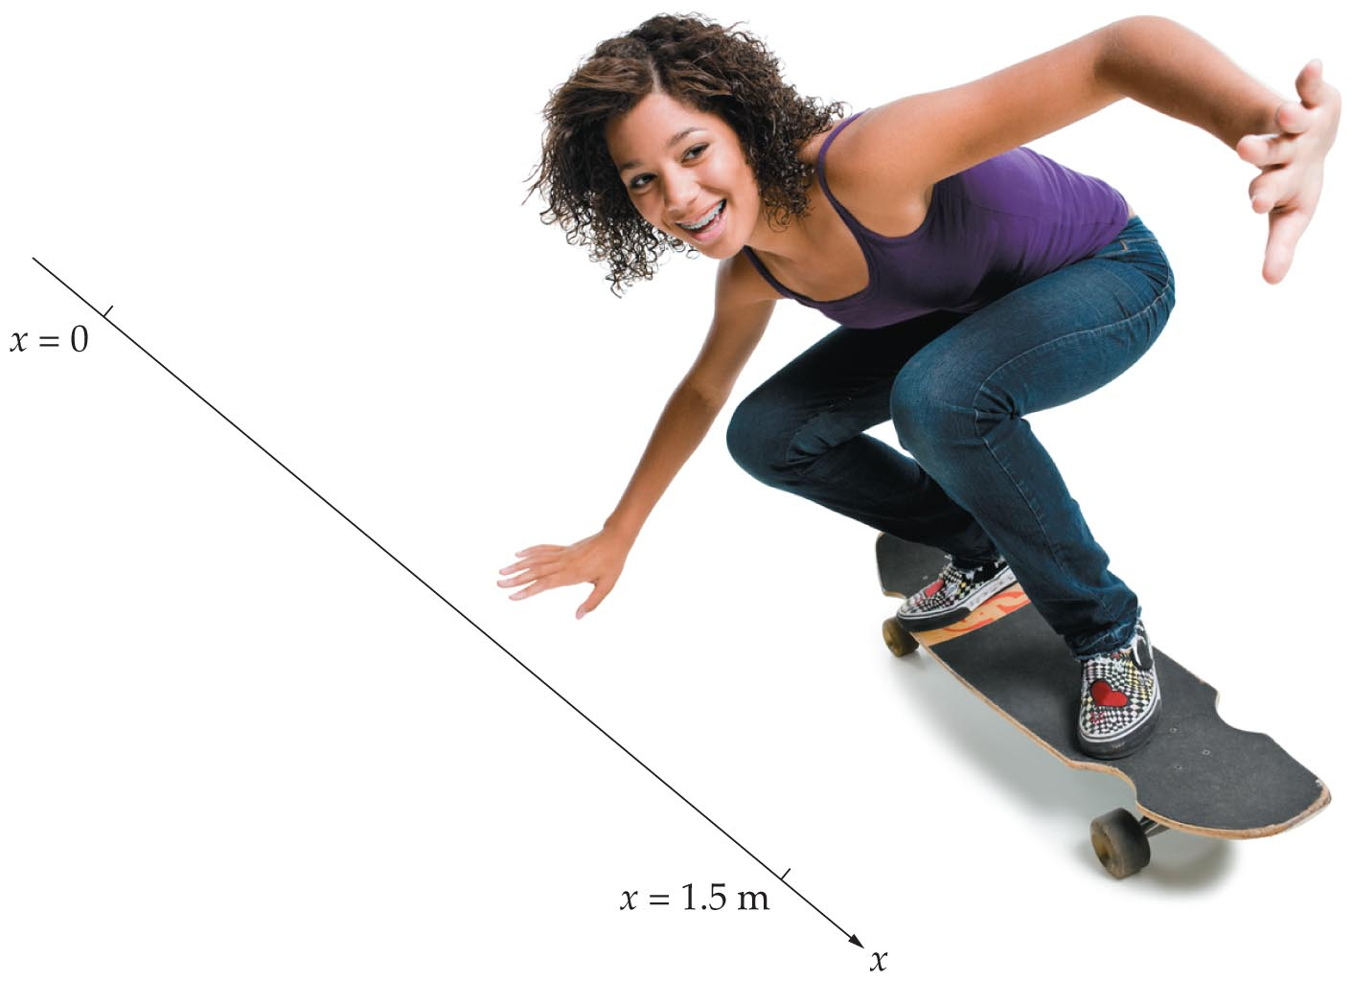
Equation of Motion
Example: A skateboarder with an initial position of 1.5 m moves with a constant velocity of
3.0 m/s. What is the position of the skateboarder?

Slide 24
Equation of Motion
Solution: Substituting 1.5 m for the initial position and 3.0 m/s for the constant velocity in the equation of motion gives the following:
x_{f} = 1.5 m + (3.0 m/s)(2.5 s) = 9.0 m

Slide 25
Equation of Motion
The equation for a straight line is often written as y = mx + b, where m is the slope and b is the y intercept.
This equation may be also written y = b + mx.

Slide 26
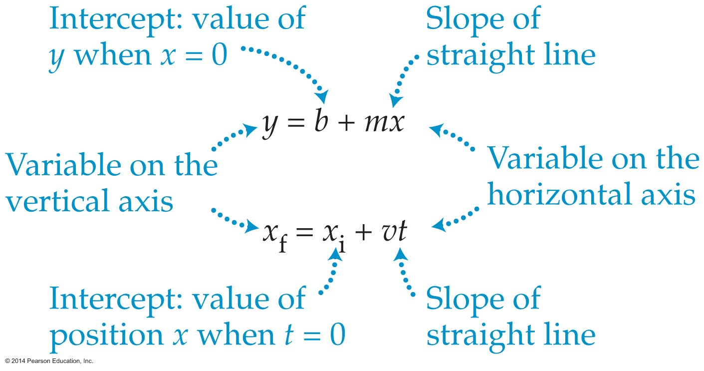
Equation of Motion
Except for the labels, y = b + mx is the same equation as the position-time equation of motion, x_{f} = x_{i} + vt.

Slide 27
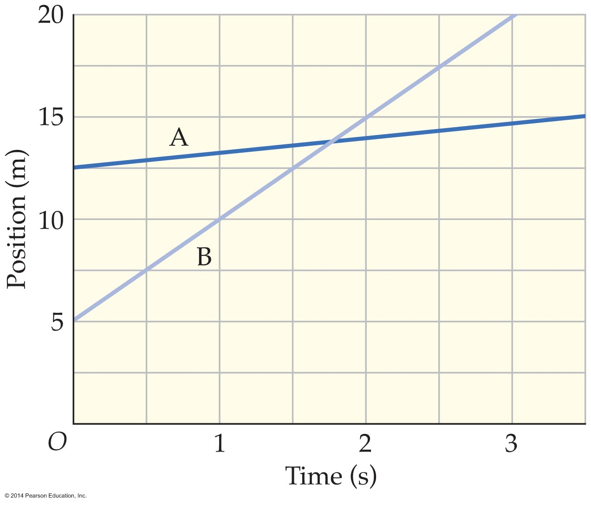
Equation of Motion
Position-time graphs intersect when objects have the same location.

