Slide 1
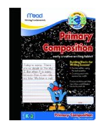
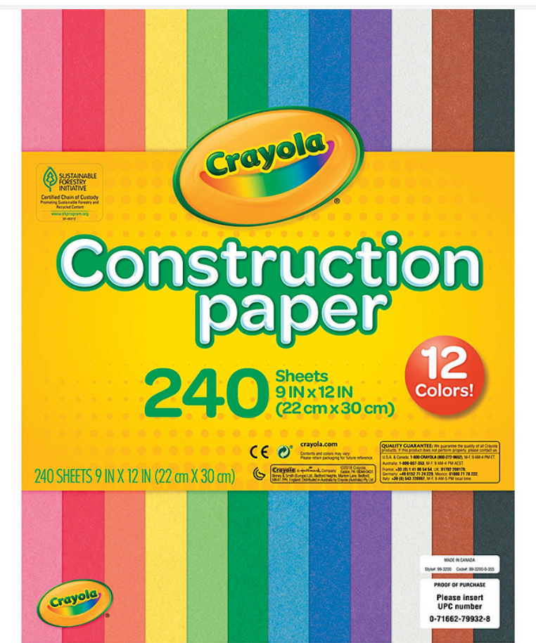
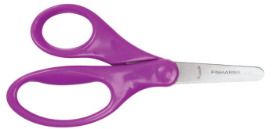
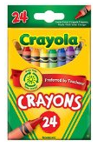
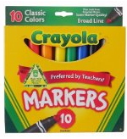
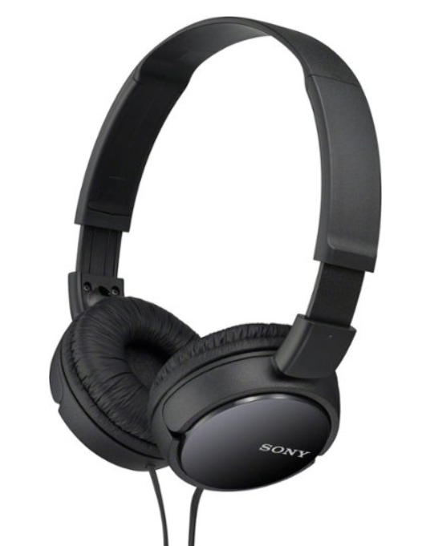
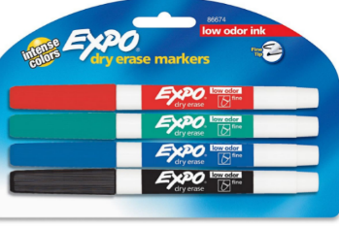
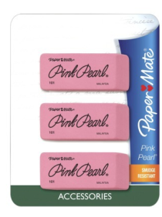
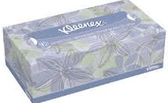
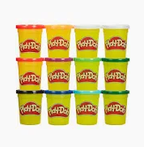
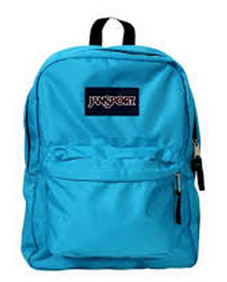
2024-25 Kindergarten Supply List
Our classroom is a community! Please do not label any supplies as they will be community supplies, shared by all students. Thank you!
Blunt-tip Scissors
Need: (1)
Crayons 24 count
Need: (3) box
Broad Line Markers
Need: (2) box
Primary
Composition Book
Each page has space for drawing at the top and is lined at the bottom.
Need: (1)
Glue sticks
Need: (6) glue sticks
Over the ear headphones.
No earbuds!
Construction
paper
Over the
ear headpohes
Tissues
Need: (2) boxes
Dry Erase Markers (fine tip) 3pks
Each student will use one set of black/colors for math and reading activities.
Erasers
Need: (1) pkg of 3
#2 Pencils
Need: (2) pkgs
Disinfecting Wipes
Need: (1)
Playdough
Backpack
(No rolling backpacks please)
Notes:
Right click on any photo and choose “change picture” to swap out a photo of another supply.

