Slide 1
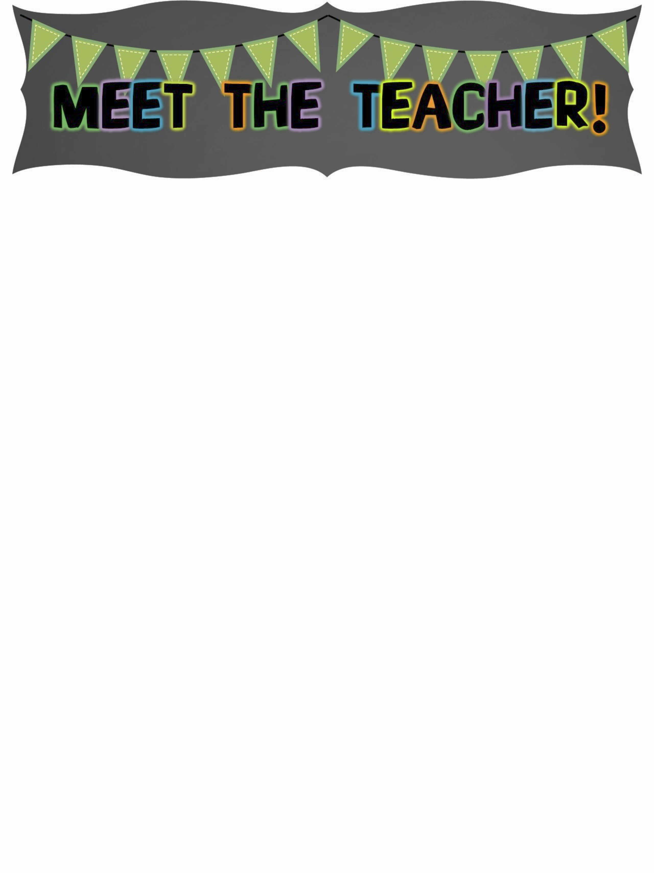
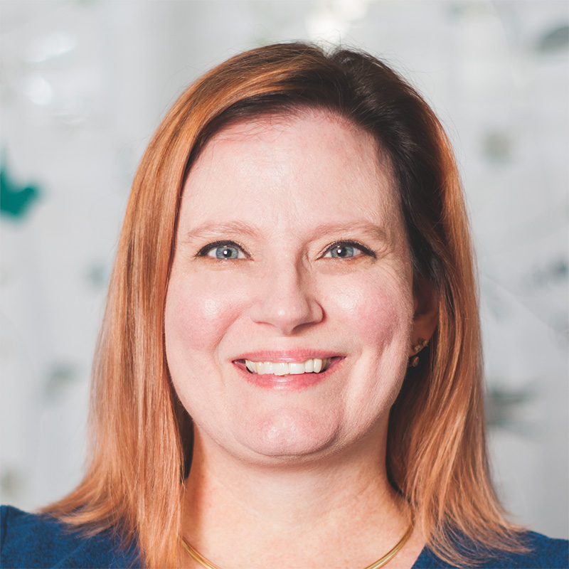
The Basics
Hello! My name is Mrs. Rita Vasquez. I am the Media Specialist at Barton Chapel Elementary and I am excited to be here!
A Little About Me
I grew up in Augusta, Georgia where I met and married my wonderful husband, Roberto. We have two sweet sons, Enrique and Manny. We also have Gus the Westie, Pippi the Rat Terrier and Buffy the black cat. We have moved back to the area. We are so happy to be home!
My Favorites
My Education
Food: Pizza
Movie: Cinderella
Book: Charlotte’s Web
Color: Blue
Animal: flamingo
Drink: Pepsi Max
Season: Spring
Sports: Math
Fast Food: Chick-fil-A
Hobby: Crafting
Subject: Reading
Store: Target
Dessert: Red Velvet Cupcakes
Candy: Chocolate
Restaurant: Chicken Salad Chick
Flower: Sunflower
In May of 2009, I graduated Summa Cum Laude with a Bachelors of Science in Early Childhood Education from Augusta State University. This year, I will finish my Masters of Instructional Technology through Georgia Southern University.
Contact Me
Email: VasquRi@boe.richmond..k12.ga.us
School Phone Number: (706) 796-4955

