Slide 1
The RCSS Success Center
Parent Presentation
Kimberly Mungo
Program Administrator

Slide 2
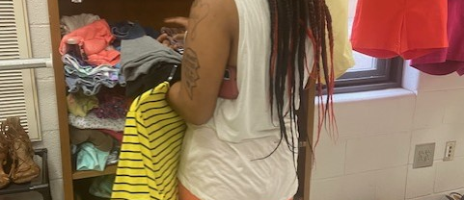
Mission:​
The Richmond County Success Center seeks to remove barriers that can impede students from succeeding. Through a culture of collaboration and respect, our hope is to give students a clear voice and provide relevant services and programs that are equitable and easily accessible. ​
​
Vision: ​
Equipping students and families with tools and resources that promote self-sufficiency. ​

Slide 3
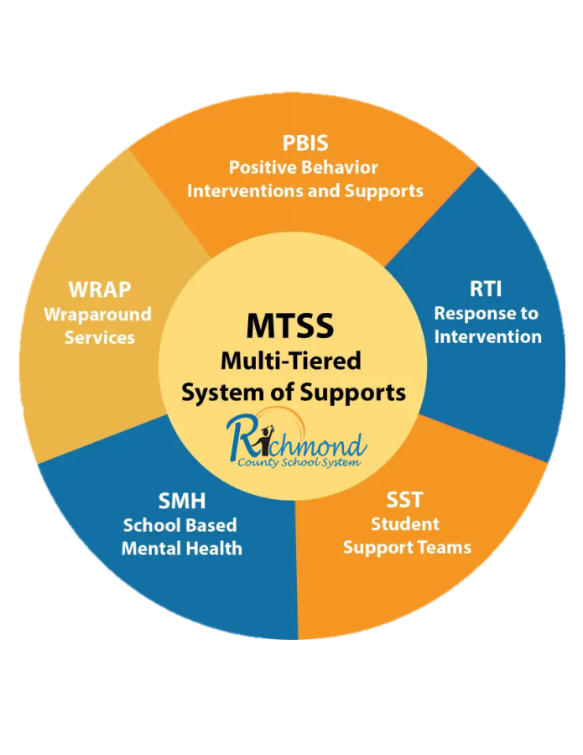
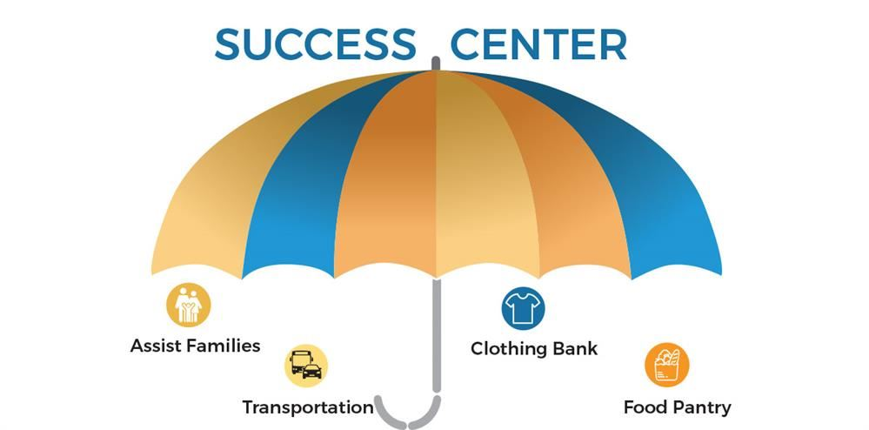
Wraparound Services Support

Slide 4



The Success Center​ provides​
​WRAPAROUND SERVICES
Kimberly Mungo, Ed.S​.​
Program Administrator
Assists families by referring them to agencies for housing, shelter, utility/rent assistance, furniture, and healthcare. Other duties includes addressing SWARM referrals, bus transportation, Stuff the Bus, Toys for Tots for Mckinney-
Vento students and assisting with food distributions.
Le'Troia Parker​
Administrative Assistant
Set up bus transportation, Mckinney-Vento van transportation routing, assists with food distribution, corresponds with parents, and assist with Stuff the Bus distribution.
Tubman Education Center 3rd floor

Slide 5


The Success Center​ provides​
​WRAPAROUND SERVICES
Thelma Lewis​​
Administrative Assistant
Food Pantry​
Food distribution for families who are in need once a month and as needed upon request.
Clothing Boutique
Opened by appointment only and clothing/personal hygiene products can be gathered as needed upon request.
Tubman Learning Center 1st Floor

Slide 6
The Success Center​ provides​
​McKinney-Vento Services
Crystal Palmer, MSW​​
Homeless and Foster Care Liaison
Homeless verification, bus and cab transportation, gas cards, referrals to agencies, address SWARM referrals, summer camp registration, and assist with students who are in foster care.
Kiara Frails, MSW​​
Outreach Social Worker
Parent Resource Fairs, homeless verification, van transportations, gas cards, referrals to community agencies, address SWARM referrals, and FASFA for homeless seniors.
Tubman Education Center 3rd floor

Slide 7
Some Community Partners
United Way​
Economic Opportunity Authority​
Salvation Army​
Golden Harvest Food Bank​
Kabs for Kidz​
Druid Park Health Center​
Safe Homes​
Family Y​
ReStart Augusta​
Richmond County Marshal’s Office
Toys for Tots

Slide 8
Contact Information
Tubman Education Center
1740 Walton Way
Augusta, GA 30904
Phone number 706-826-1000
Kimberly Mungo ext.5719
Thelma Lewis ext.4983
Crystal Palmer ext.5496
Kiara Frails ext.4988
Le’Troia Parker ext.5508

Slide 9

Questions

Slide 10
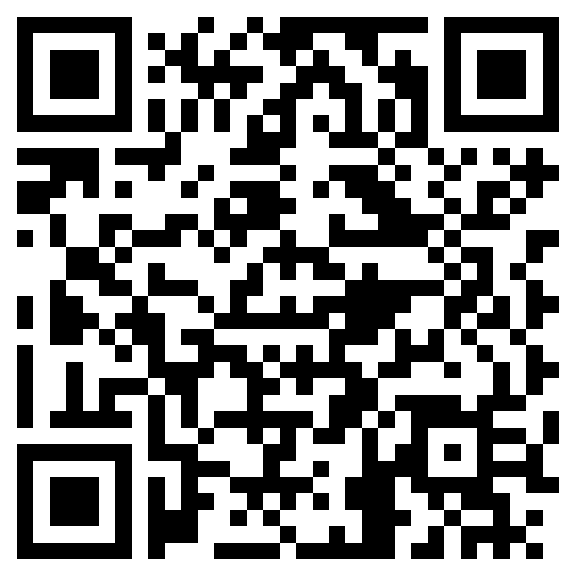
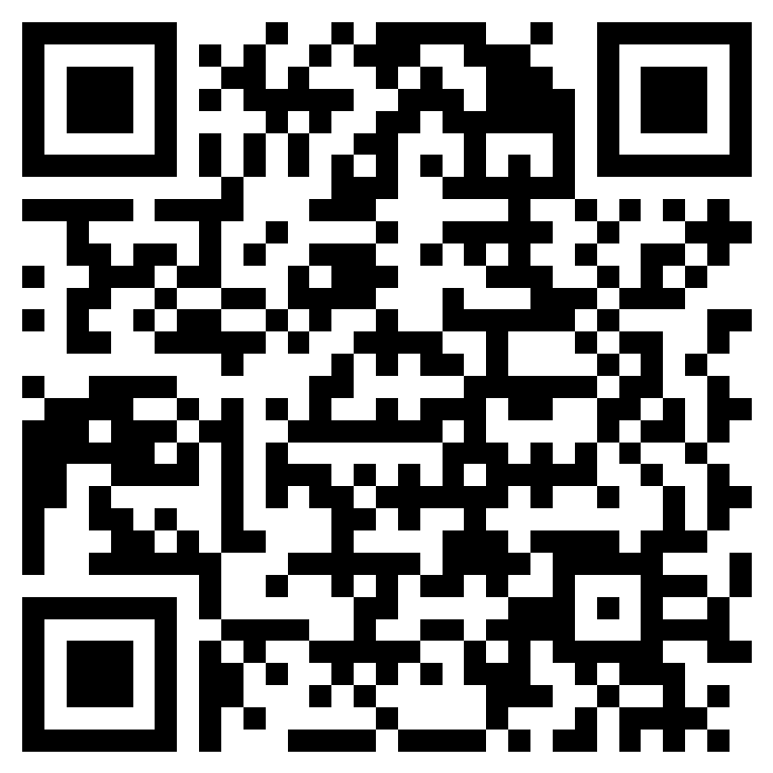
Please use this code to record your viewing of the power point.
Please use this code to provide feedback.

