Slide 1
I Can Join In
Using My Device to Talk

Slide 2
Sometimes, I Talk at School
Everyone LOVES when I talk.
It makes them so happy.
At school, my teachers, therapists, and friends talk to me because they like me so much.
They want to hear what I have to say!

Slide 3
I Can Talk First
I don’t have to wait for people to talk to me.
...
Hey
How are you?

Slide 4
I Can Take My Turn First
In conversations, people take turns talking.
Sometimes, I can go first.
I like this song.
Me too.
INSERT STUDENT PHOTO HERE

Slide 5
I Can Say Hi or Bye
INSERT PHOTO OF STUDENT WAVING HERE
or
When I see my friends or teachers, I can say, “Hi.”
If they’re about to leave, I
can say, “Bye.”

Slide 6
I Can Ask Questions
I can ask lots of different questions if I want to know things.
When is it
break-time?
Are we playing again?
What is that?

Slide 7
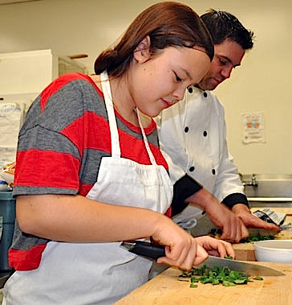
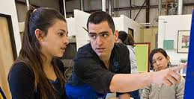
I Can Say What I Need
Excuse me,
I need the bowl.
If I want something I can tell someone.
I can say if I need help.
Mr. ____,
I need help.
Excuse me,
I want candy too.
Notes:
I used the student photos, so you can keep these stock photos or change them out if you can.

Slide 8
I Can Answer Questions
I can raise my hand in class to answer questions.
Who would like to go next?
How much money do we need?
Me
5 dollars

Slide 9
I Can Make Comments
I can talk about what I see
I can talk about what I’m thinking
It’s snowing.
I’m excited! It’s my birthday.

Slide 10
I Can Have Conversations
I can tell about things I like and don’t like. I can tell about things I’ve done. I can ask people questions.
I like Frozen too.
I like Chinese food.
How about you?
I watched football this weekend

Slide 11
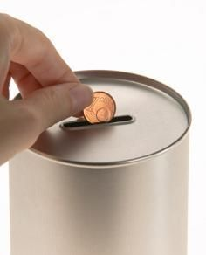
I Can Earn For Joining In!
Every time I choose to talk or join in a conversation in the classroom, I can put a coin in the jar. When the jar is filled up to the line, I earn a prize!
Notes:
Obviously, delete this page if not planning to follow through.

Slide 12
When I Join In, Everyone Is Proud of Me
Everyone wants to know what I have to say! They love it when I talk!
When I join in, it makes my teachers, therapists, and my family is so proud of me!
Awesome, __________!

